Slide 1

LR Distributions and Error Rates
Cybergenetics Webinar
User Group Meeting
January, 2025
Pittsburgh, PA
Mark W Perlin, PhD, MD, PhD
Cybergenetics, Pittsburgh, PA
Cybergenetics © 2003-2025

Slide 2
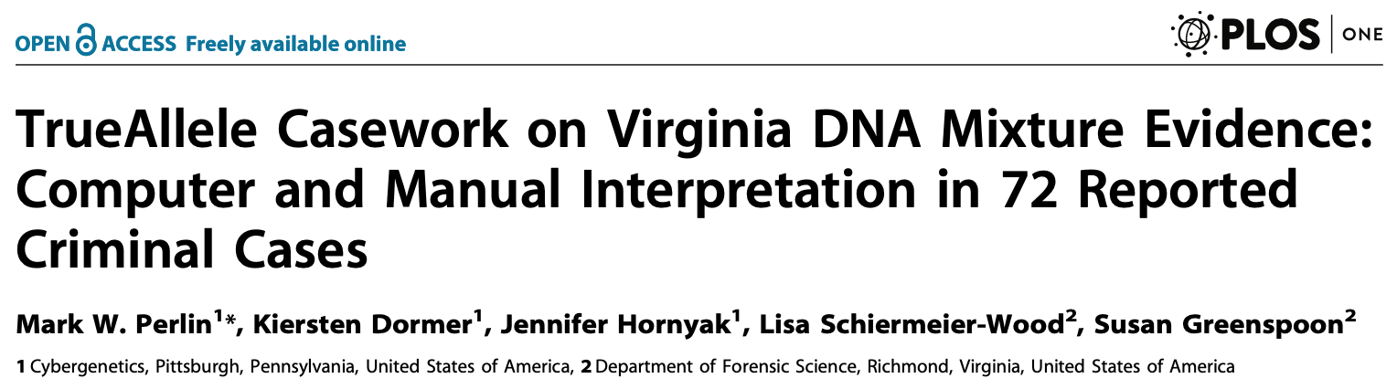
Noncontributor Distribution
What is this?
How was it made?
How is it used?

Slide 3
Questions
What about individual evidence genotypes?
How do we construct LR distributions?
How do we get error rates from them?
How do we report a LR’s error rate?

Slide 4
US v Curtis Johnson
In 2013, men robbed an armored truck outside a New Orleans bank, killing the truck guard in a shootout.
A bandana was collected from the crime scene
A 70 pg sample was a three-person mixture
TrueAllele separated out bandana genotypes
Comparing a 27% contributor with Johnson, LR = 200
2021 – Daubert hearing, TrueAllele admitted, first trial
2022 – Second trial, guilty verdict, 50-year sentence

Slide 5
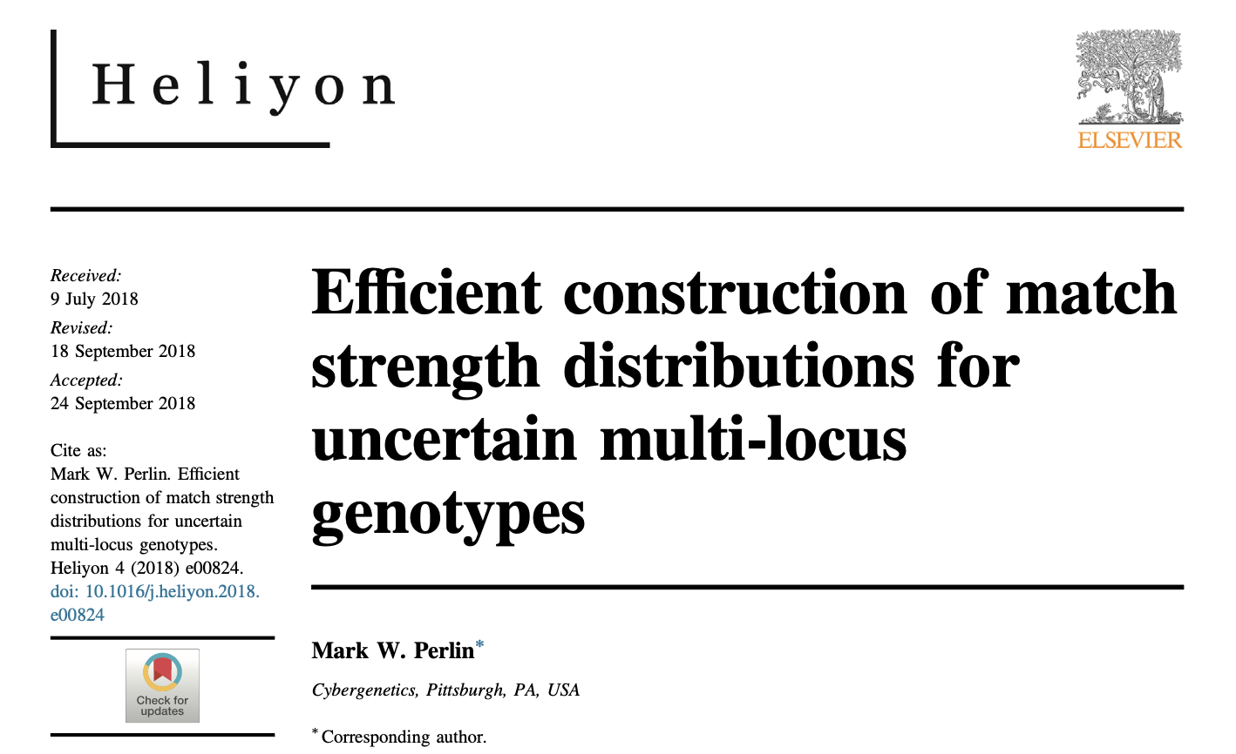
How to form LR distributions
Complete, fast, easy, accurate
TrueAllele® VUIer™ Distribution View

Slide 6
Reporting LR error rate
A match between the bandana and Johnson is 200 times more probable than coincidence.
For a match strength of 200, only 1 in 4.1 thousand people would match as strongly.
ER ≤ 1/LR
1/4100 ≤ 1/200

Slide 7
Question
What about exclusionary error rates?

Slide 8
GA v Kerry Robinson
17-year-old Robinson was wrongfully convicted of rape in 2002 and sentenced to 20 years in prison.
GBI analyzed the vaginal swabs and developed STR data from the three-person mixture.
Cybergenetics’ TrueAllele: exclusionary LR = 1/103.
Based on this new exculpatory DNA evidence, court vacated Robinson's conviction and he was released.

Slide 9
Reporting LR error rate
A match between the vaginal swabs and Robinson is 103 times less probable than coincidence.
For an exclusionary statistic of one over 103, only 1 in 3,730 people would be excluded as strongly.
ER ≤ LR
1/3730 ≤ 1/103

Slide 10
Question
What about validation studies?
Sets of genotypes from a laboratory.

Slide 11
Noncontributor Distribution
Error rate?
Speed?
Exclusion?

Slide 12
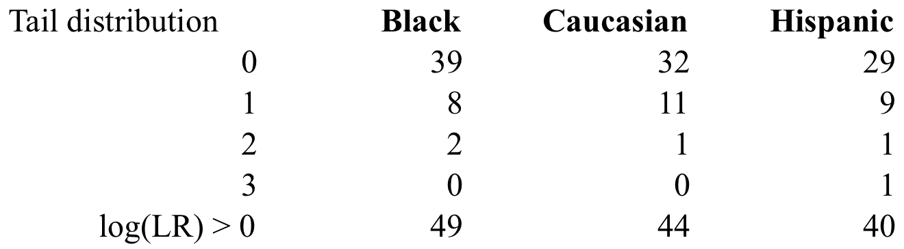
False Positive Rate
in over 1,000,000 comparisons per group
For LR > 0, FPR is under 1 in 20,000 (0.005%)
For LR > 100, FPR is 1 in 1,000,000 (0.0001)%
For any reported LR value, look up FP error rate

Slide 13
Questions
Why can we validate using casework data?
Why is “ground truth” not needed?

Slide 14
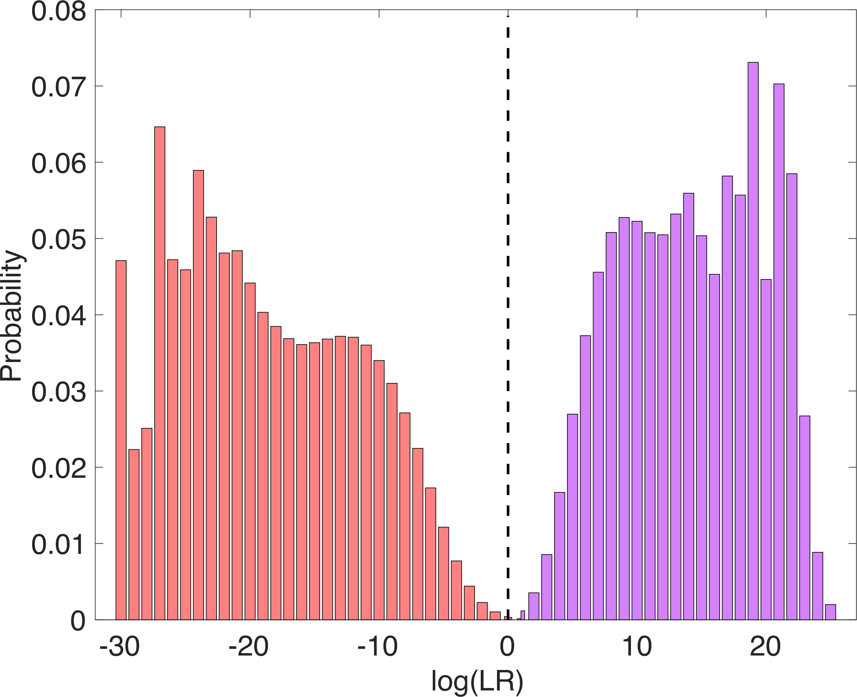
Low ER of sister LR distributions
Noncontributor
Contributor

Slide 15
Question
Why doesn’t TrueAllele need or use analytical thresholds (AT)?

Slide 16
Answer
Bayesian modeling accounts for baseline.
Bayesian computing uses all the data.
TrueAllele explains the STR data pattern. It doesn’t try to classify the data peaks.

Slide 17
Question
How do (other software’s) analytical data thresholds affect LR information?

Slide 18
US v Alejandro Sandoval
Police collected a baggie containing methamphetamine
Defense tested baggie, found a DNA mixture
Two different PG software programs used
STRmix™
  AT = 90 rfu, 11 peaks, log(LR) = -0.53 ban
  AT = 40 rfu, 24 peaks, log(LR) = -1.38 ban (lab report)
  AT = 20 rfu, 38 peaks, log(LR) = -7.48 ban
TrueAllele®
  AT = none, 210 peaks, log(LR) = -6.08 ban (Cybergenetics)
Unsuccessful Daubert attempt to challenge STRmix
Plea agreement dropped the more serious charge
JFS published a “Case Report” that speculated on TrueAllele v. STRmix
Can LR distributions explain what happened?

Slide 19
Question
Why aren’t LR reporting thresholds (RT) needed?

Slide 20
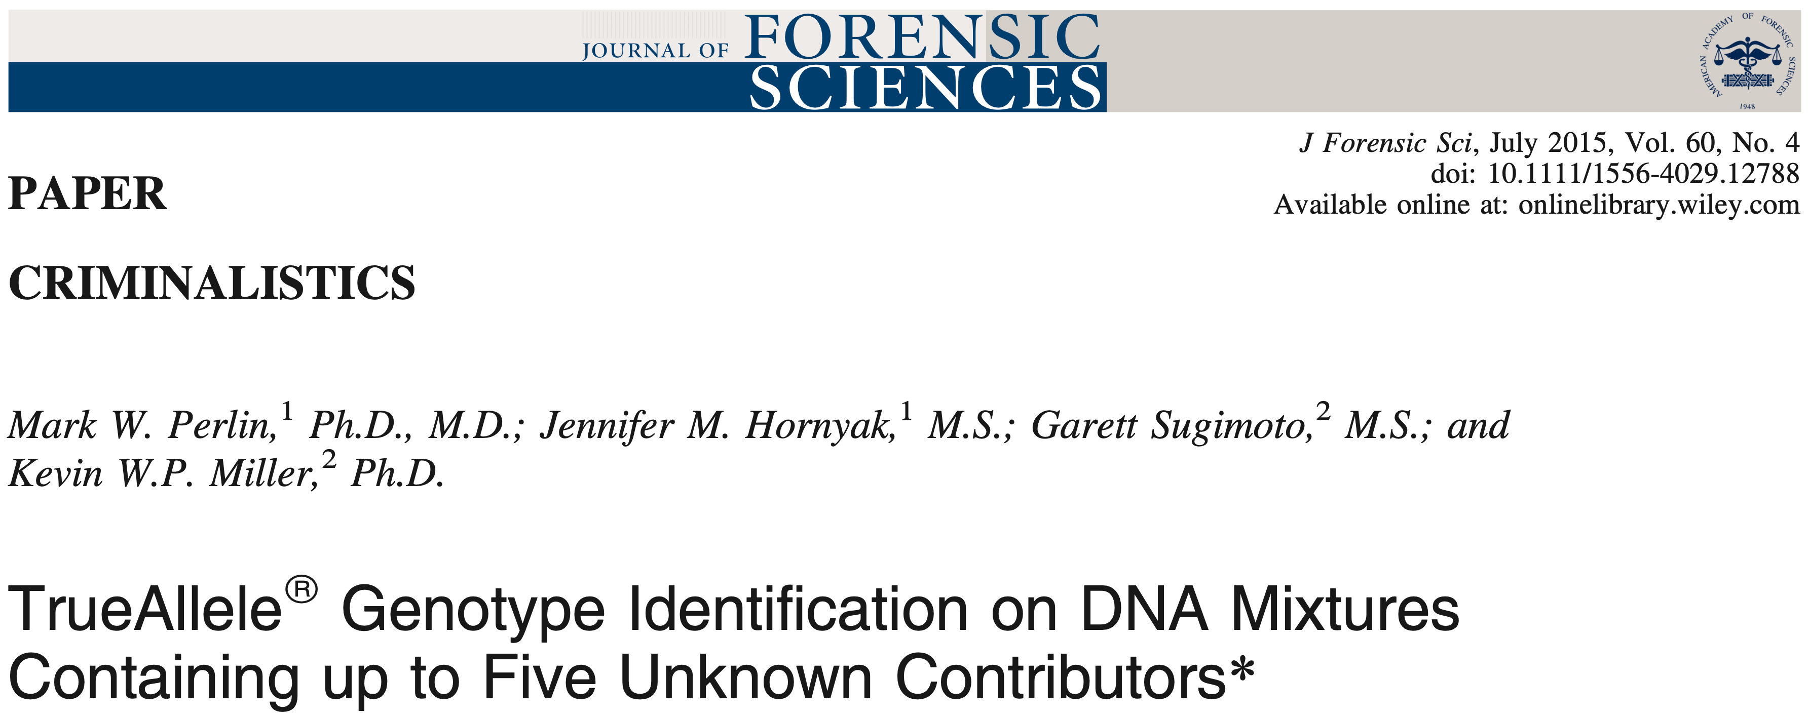
JFS 2015
evidence: 10 x 5-person mixtures = 50 genotypes
reference: R = 10, 100, …, 100,000 references

Slide 21
Unattainable “zero error”
Sampling issue
R | N | positive | maximum | mean | %positive
10 | 500 | 29 | 2.5669 | -7.5297 | 5.800
100 | 5,000 | 63 | 2.5669 | -7.7570 | 1.260
1,000 | 50,000 | 440 | 3.1531 | -8.1047 | 0.880
10,000 | 500,000 | 2,865 | 4.5458 | -8.2003 | 0.573
100,000 | 5,000,000 | 28,614 | 4.5843 | -8.1973 | 0.572
exact |  |  |  | -8.1747 | 0.638
Greater sampling (greater N)
More outliers (more positives)
Larger max LR (larger maximum)
Forcing higher reporting threshold
Just report all LRs and provide ER context

Slide 22
Question
How to rebut “fake science” attacks?

Slide 23
US v Ravel Mills
2020 shooting-related homicide in Washington, D.C.
Gun and magazine recovered as evidence
Gun: 6% component of a three-person mixture
  log(LR)= -7.86, log(ER)= -11.18
Magazine: 2% component of a four-person mixture
  log(LR)= -11.21, log(ER)= -14.54
Federal prosecutor requested Daubert hearing
Typical defense expert attack: old-style binary logic
TrueAllele won “on the papers”, no hearing needed

Slide 24
Take JFS 2015 out of context
Binary error rate (LR <> 1)
in the case software version
N= | Mixture Range % | count for LR<1 | % for LR<1
20 | 1­–5 | 7 | 35%
17 | 5–10 | 0 | 0%
Binary error rates are simplistic and irrelevant
The likelihood ratio is quantitative
Error rate depends on LR magnitude

Slide 25

Error rate depends on LR
Source | Mixture Weight % |  | log(LR) |  | log(ER)
Gun | 5.89 |  | -7.86 |  | -11.18
Magazine | 2.40 |  | -11.21 |  | -14.54
Validation | 1.63 |  | -3.49 |  | -6.08
 | 1.08 |  | -2.61 |  | -3.84
 | 1.70 |  | -2.47 |  | -4.37
 | 1.32 |  | -1.40 |  | -3.14
 | 2.26 |  | -0.60 |  | -2.69
 | 1.65 |  | -0.54 |  | -2.37
 | 1.40 |  | -0.15 |  | -2.53

Slide 26
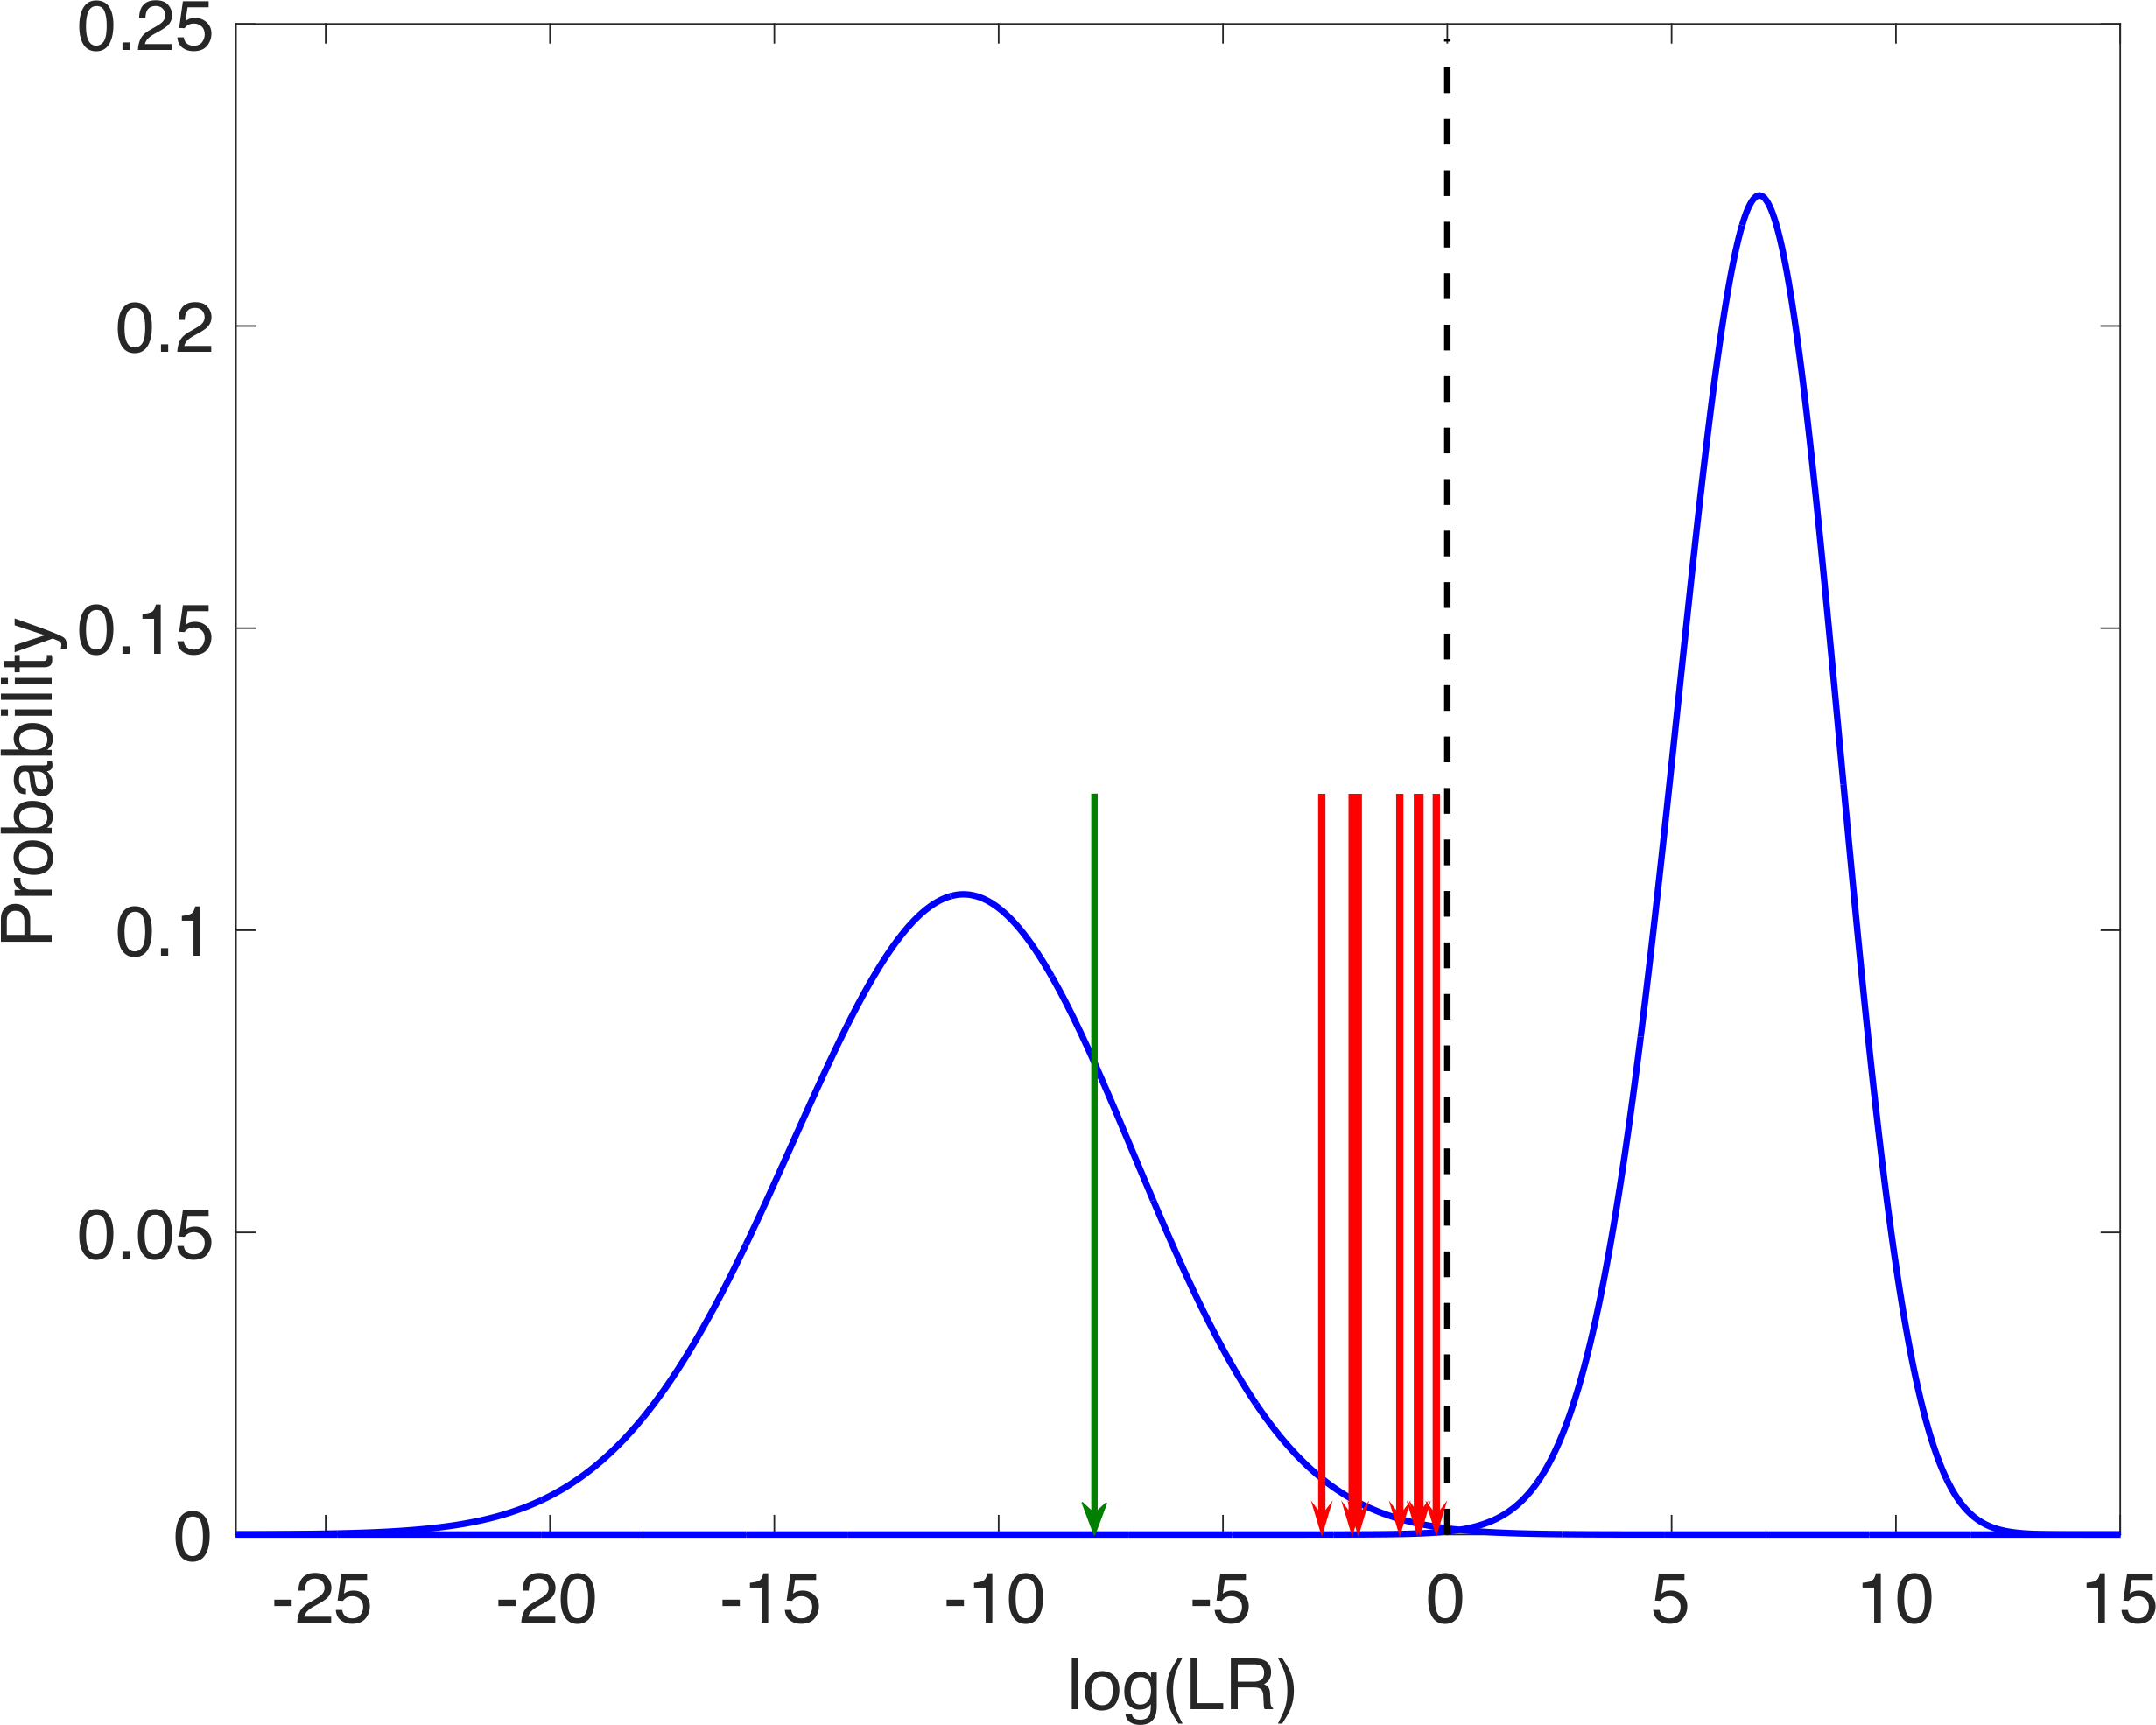
Gun Distributions
Noncontributor
Contributor

Slide 27
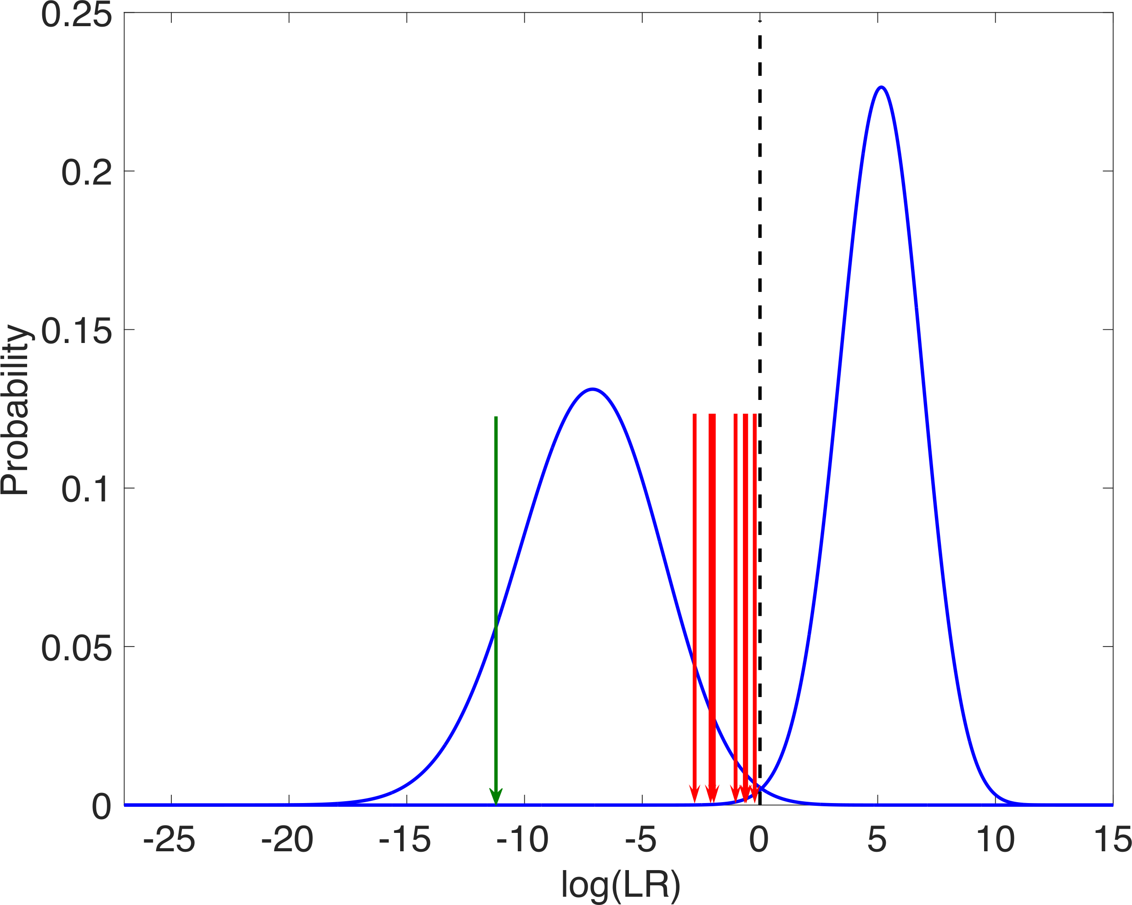
Magazine Distributions
Noncontributor
Contributor

Slide 28
Conclusions
How to always report
the true information from DNA evidence?
1. Use a fully Bayesian model on all the STR data (no AT)
2. Have TrueAllele separate mixtures into contributor genotypes
3. Report all LRs, both inclusionary and exclusionary (no RT)
4. Use Distribution to report ER (frequency context) for every LR

