Slide 1

Pumping a 7-person murder mixture for TrueAllele® information
Cybergenetics Webinar
User Group Meeting
August, 2025
Pittsburgh, PA
Matthew Legler
Cybergenetics, Pittsburgh, PA
Cybergenetics © 2003-2025

Slide 2
Crime
On April 7, 2014, a person killed gas station clerk Babul Kumer Saha before subsequently robbing the store.
“Per video, the suspect wore gloves but the suspect's bare arms may have come in contact with the register and/or the lottery slots when taking the money. Additionally, the video showed that the suspect may have brought a white plastic bag to the scene.”

Slide 3
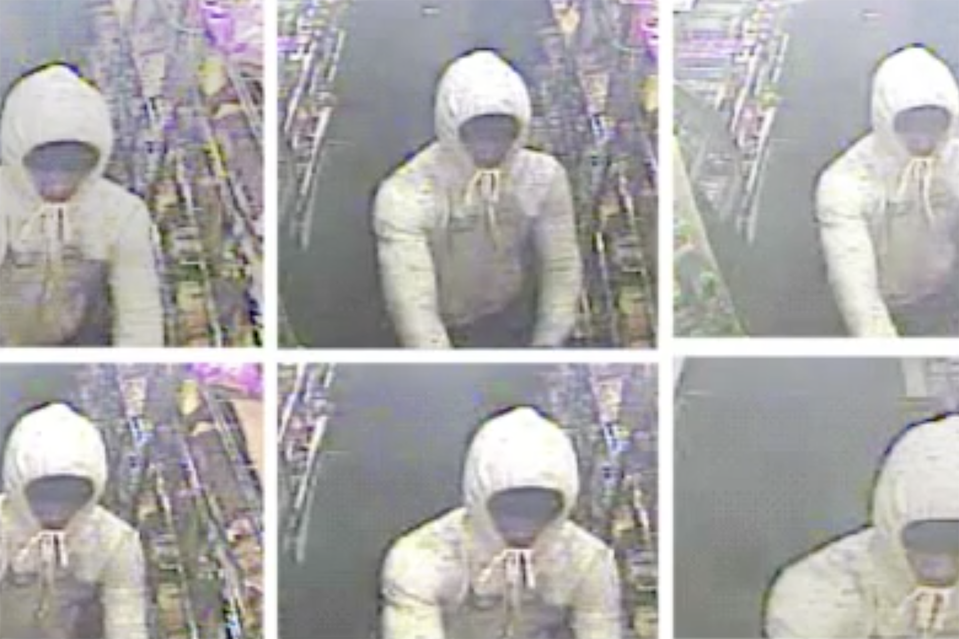
Crime Scene
Video surveillance photos of the man who killed Babul Kumer Saha
released by Maple Heights Police.

Slide 4
Evidence
DNA samples were collected from several items around the gas station, including:
gas pump button (10)
a lottery cash register slot (14)
a plastic bag (17.1)

Slide 5
Previous Analysis
Prior to Cuyahoga County deploying TrueAllele
Lab performed a manual analysis

Slide 6
Previous Results
“The DNA profile obtained from item 14 [cash register] is a mixture of two or more individuals. Babul Kumer Saha cannot be excluded as a possible contributor to this mixture. The probability of selecting an unrelated individual at random from the population as a possible contributor to this mixture is approximately 1 in 35 million in Caucasians, 1 in 133 million in African Americans, and 1 in 19 million in Hispanics. The genetic loci Penta E, CSF1PO, Penta D, and TPOX were not used in the statistical calculations.”
“The DNA profiles obtained from items 10 [gas pump] and 17.1 [bag] are mixtures and are inconclusive due to too many contributors.”
Only match statistic was to victim

Slide 7
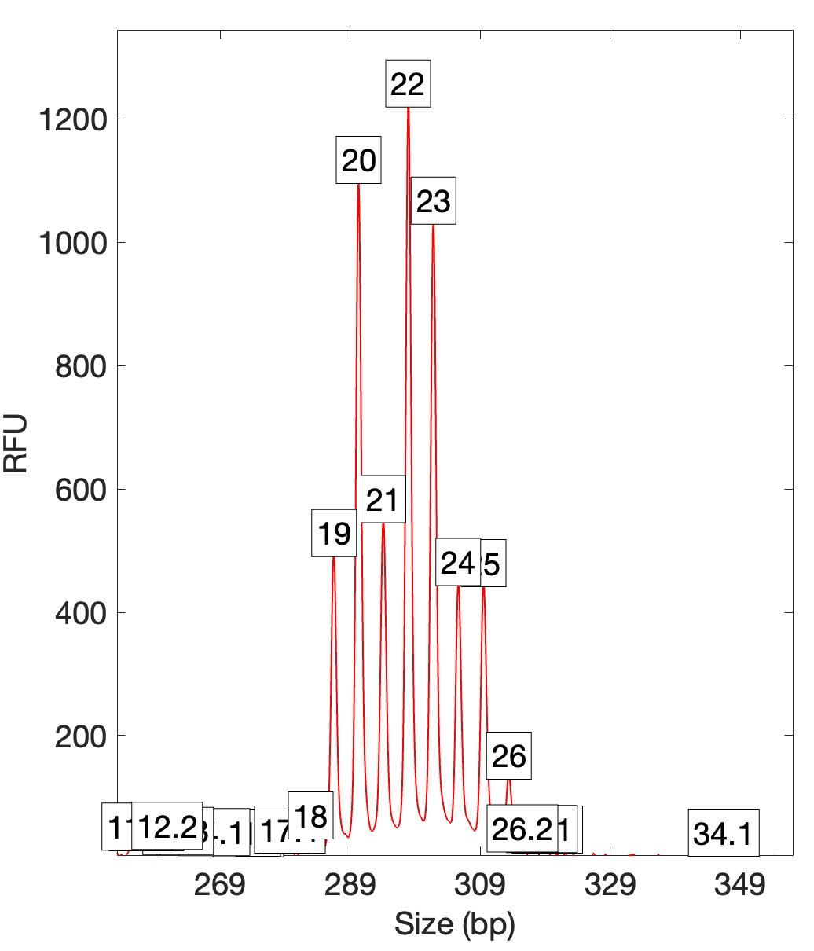
Data (Item 17.1 – plastic bag)
FGA
Consistent with at least 4 (D12, FGA),
5 (D2S1338, PentaE), 6 (D1, D18), or more contributors.

Slide 8
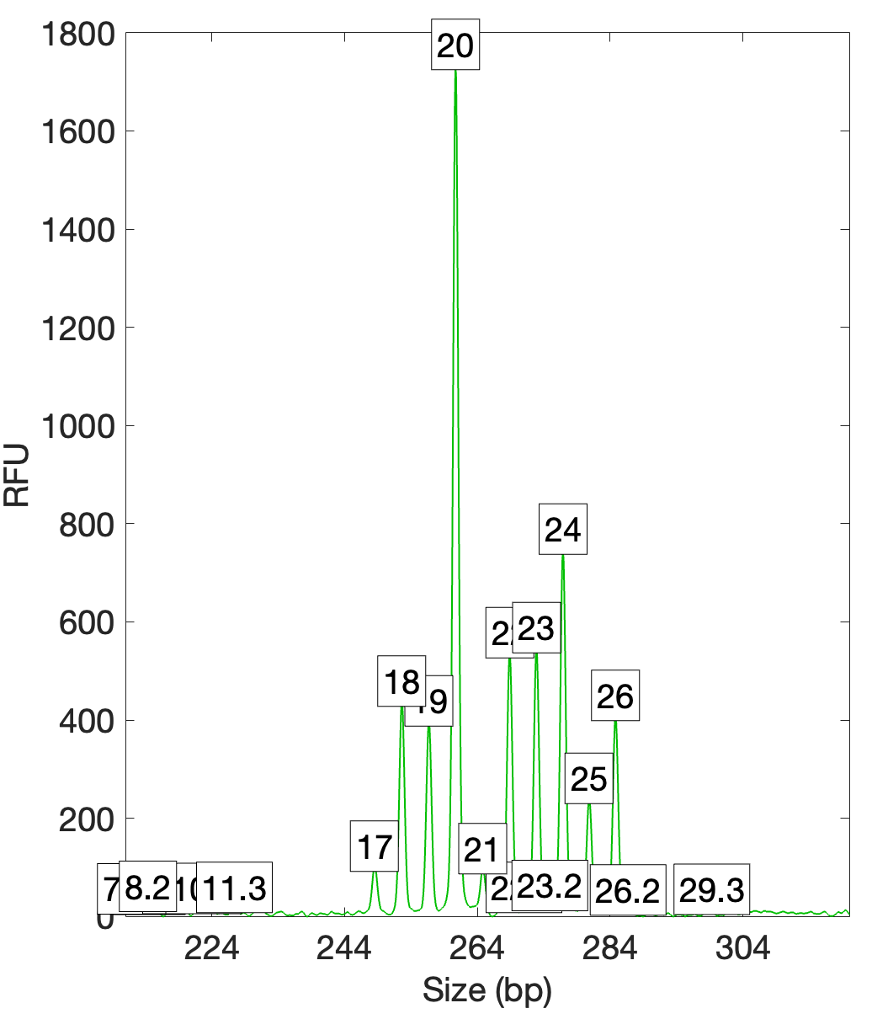
Data (Item 17.1 – plastic bag)
D2S1338
Consistent with at least 4 (D12, FGA),
5 (D2S1338, PentaE), 6 (D1, D18), or more contributors.

Slide 9
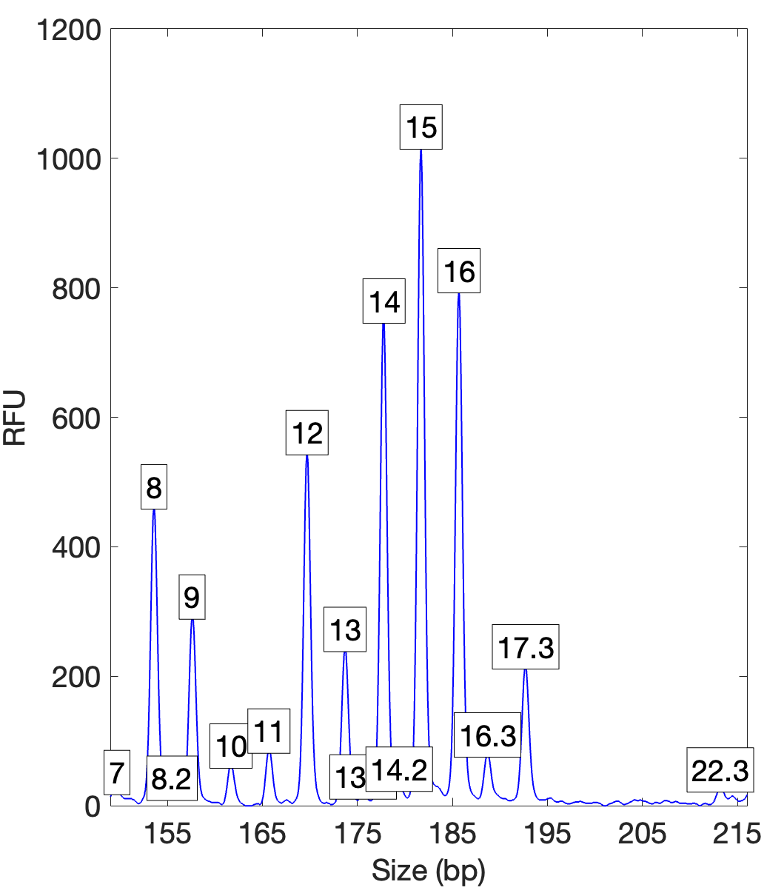
Data (Item 17.1 – plastic bag)
D1S1656
Consistent with at least 4 (D12, FGA),
5 (D2S1338, PentaE), 6 (D1, D18), or more contributors.

Slide 10
TrueAllele Analysis
4 to 8 contributors
100K and 200K cycles
Degraded DNA option on

Slide 11
Genotype Concordance (ncon7)
4 requests x 7 genotypes = 28 genotypes
How do we review efficiently?
  Focus on one matching reference at a time
  Use the filter
Shown in VUIer™

Slide 12
Impact of different contributor assumptions
Ncon | Avg. log(LR)
4 | 2.77
5 | 2.48
6 | 4.12
7 | 4.92
8 | 4.76
Matches to Reference 20

Slide 13
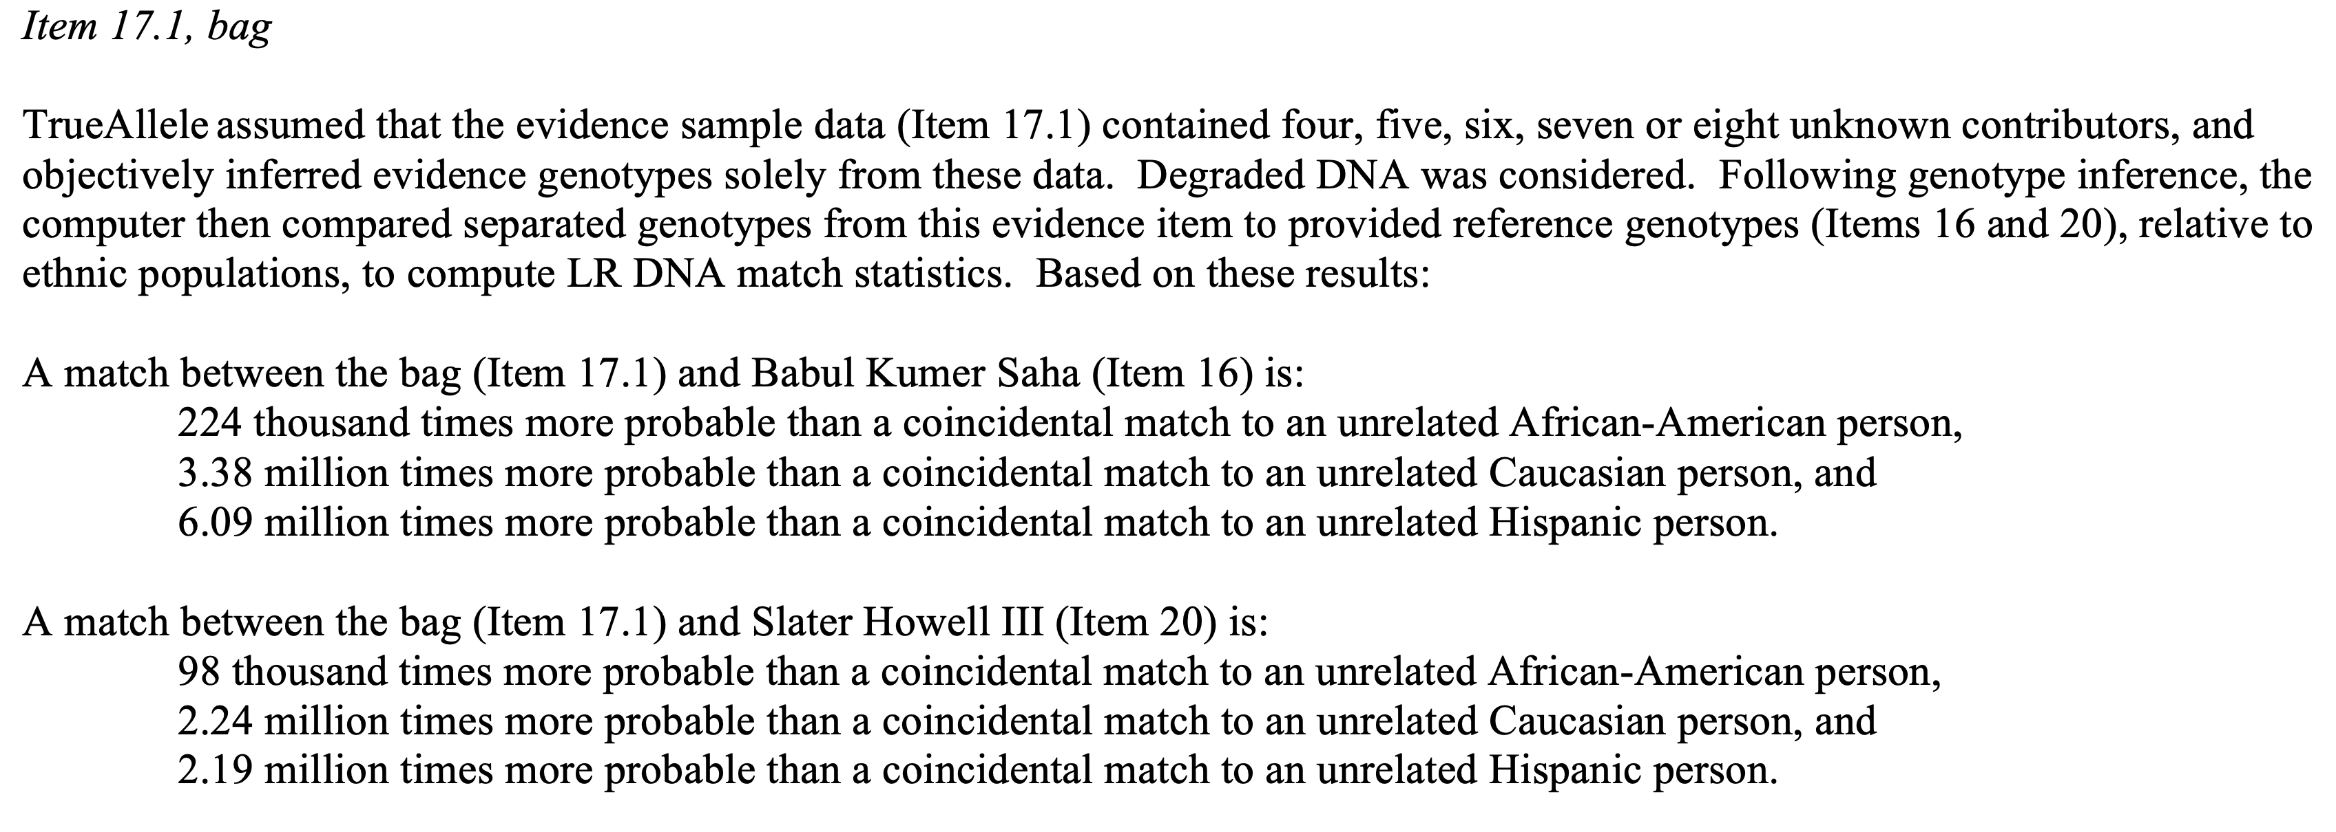
TrueAllele Reporting
Matches to victim and suspect on same item

Slide 14
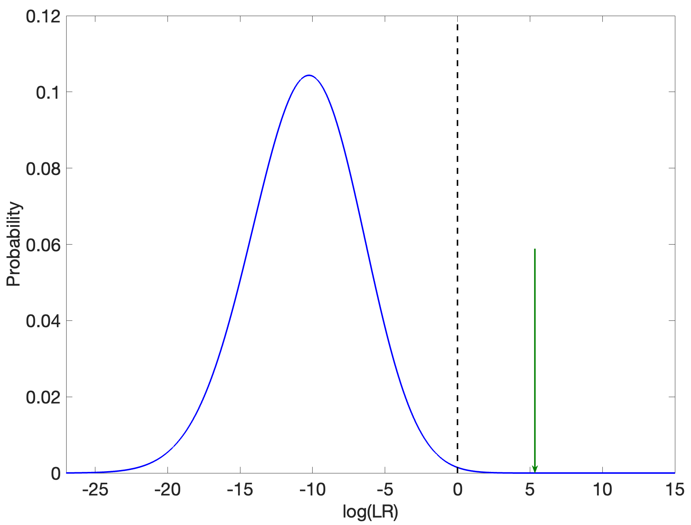
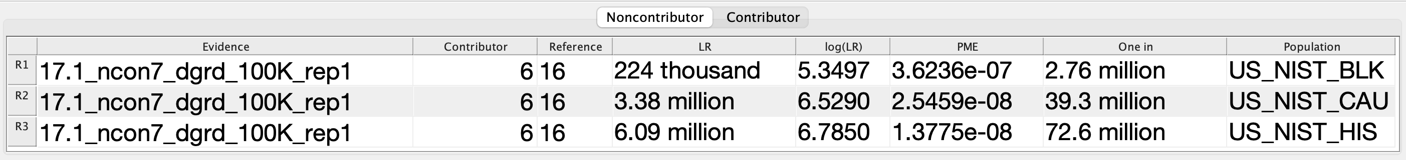
Error Rate (Victim Match)
1 in 2.76 million

Slide 15
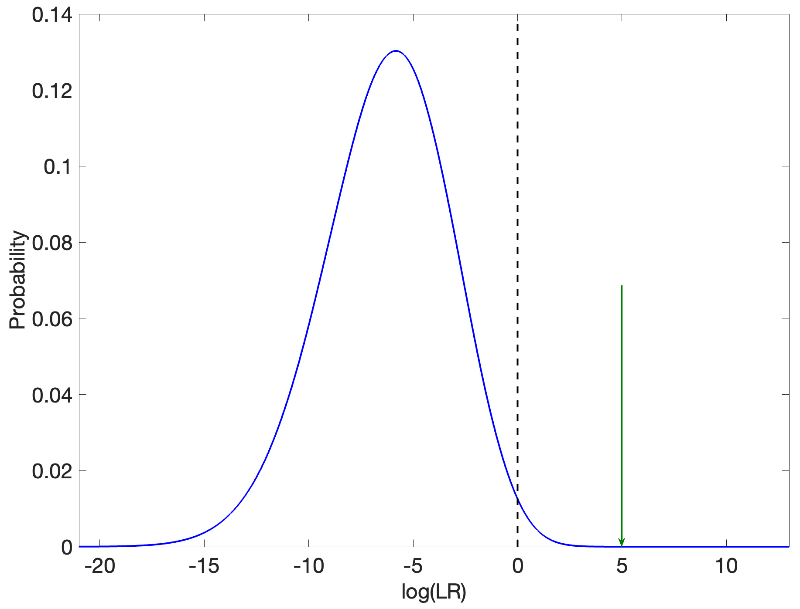
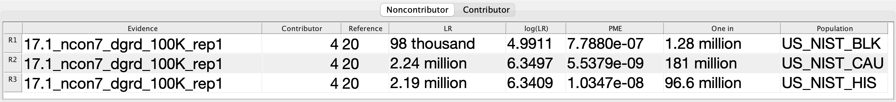
Error Rate (Suspect Match)
1 in 1.28 million

Slide 16
Validation
Question: How can we report on mixtures with >5 contributors?
Answer: We’ve validated the system on up to 10 contributors.

Slide 17
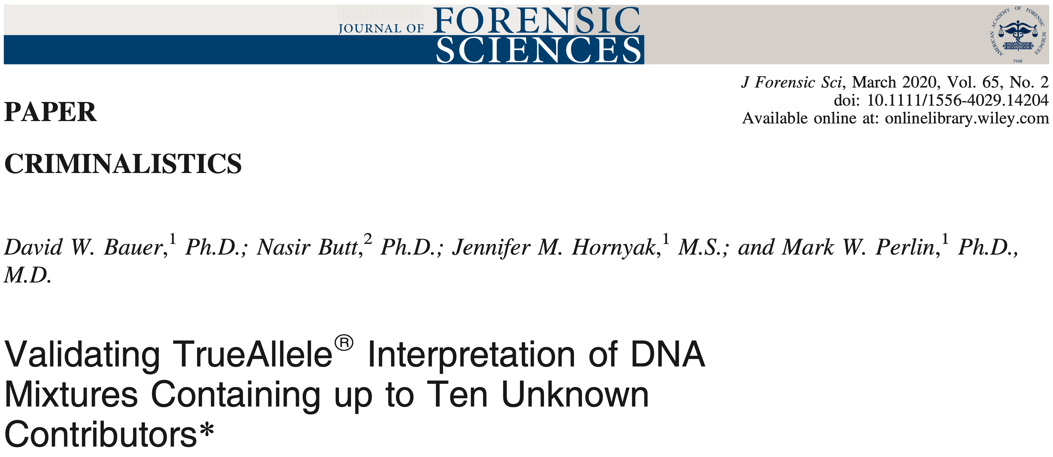
Validation

Slide 18
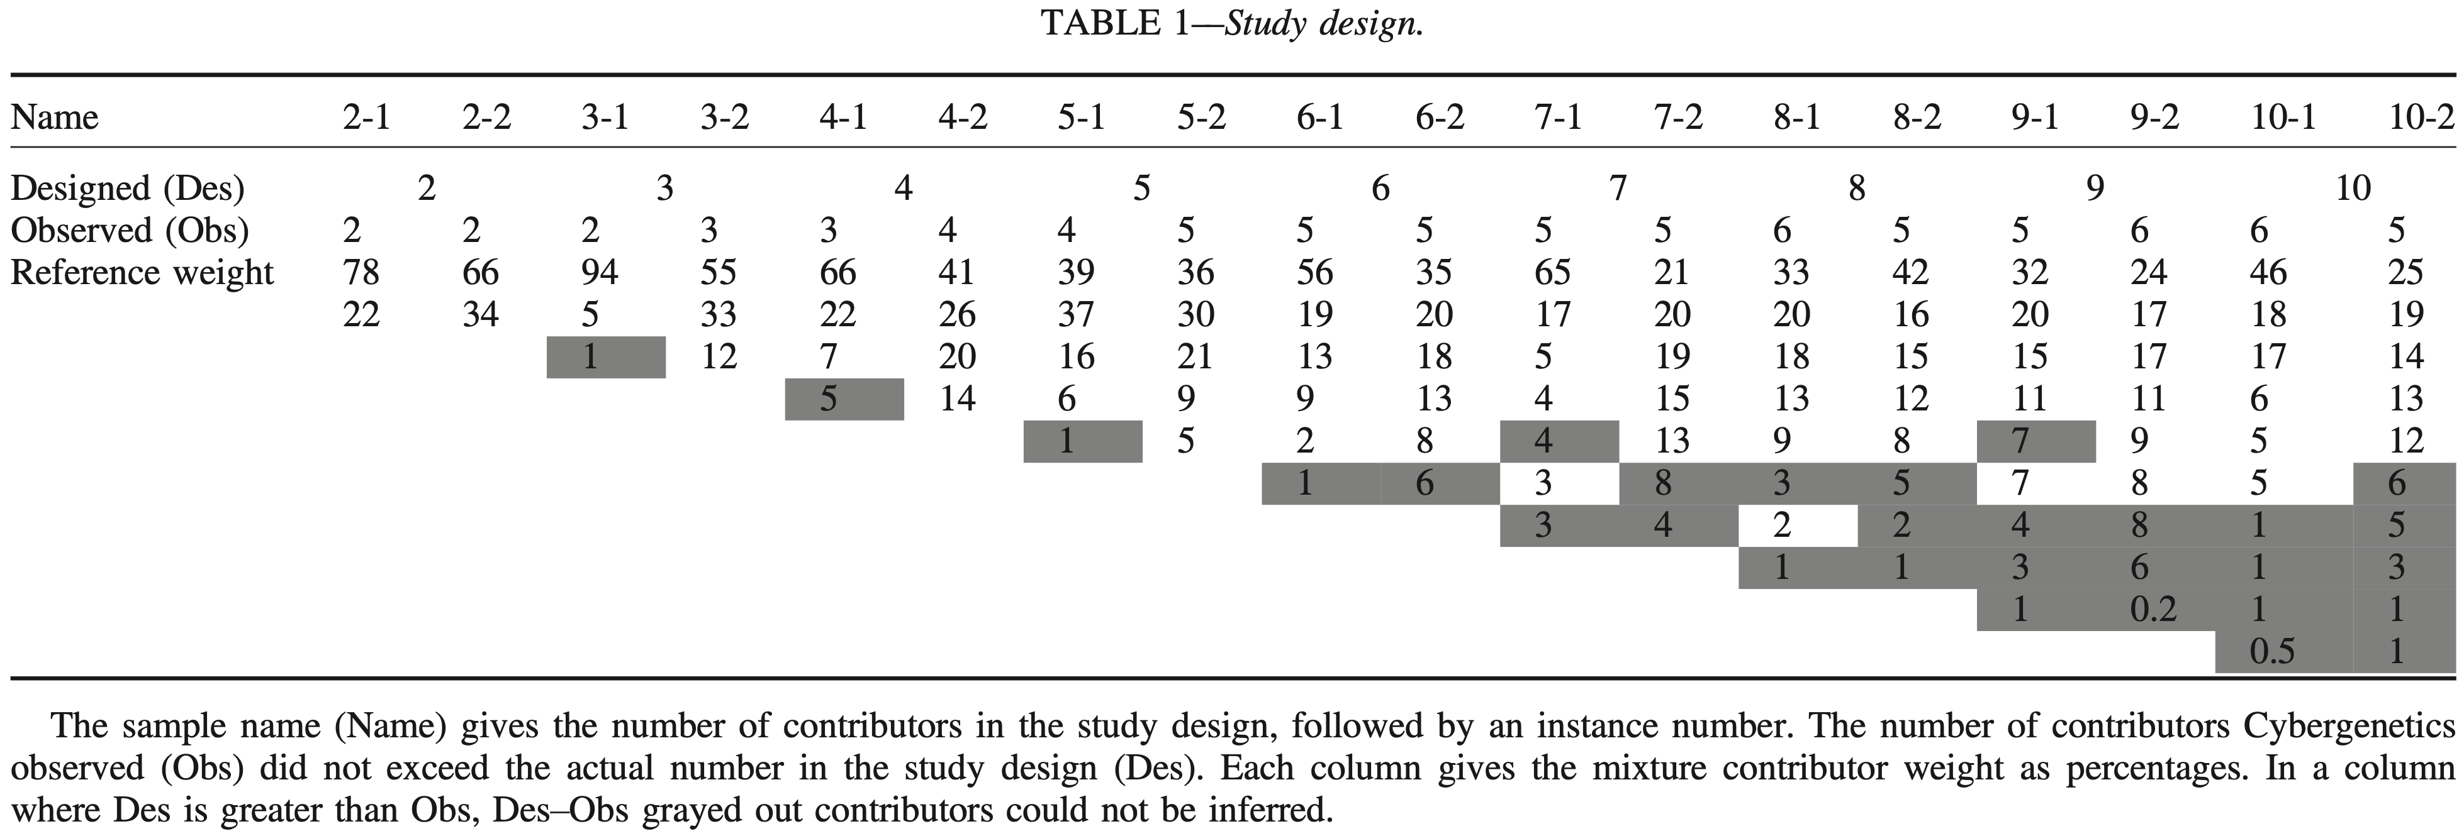
Validation Design
Random design (replicates casework)
Observed vs. Expected

Slide 19
Sensitivity
0
two contributors, more match information
six contributors, less match information

Slide 20
Specificity
0
two contributors, more match discrimination
six contributors, less match discrimination

Slide 21
Reproducibility
two contributors
more DNA
less match variation
six contributors
less DNA
more match variation

Slide 22
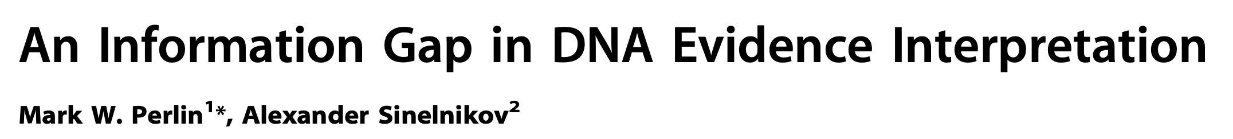

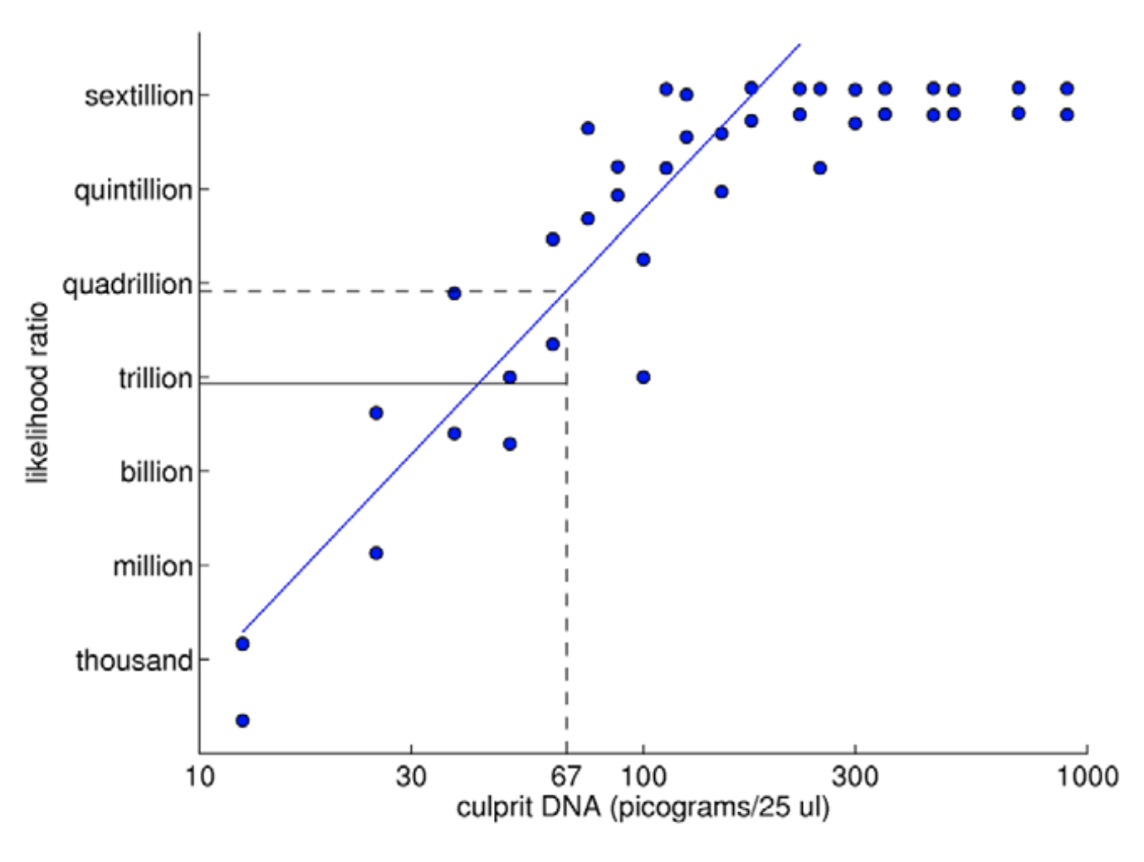
TrueAllele predictability
2009

Slide 23
DNA amount
two contributors:
same linear relation to
DNA contributor quantity
six contributors:
same linear relation to
DNA contributor quantity

Slide 24
Contributor number
0
designed number of contributors,
less specific information
observed number of contributors,
more specific information

Slide 25
Peeling genotypes
 | Peeling Round
 | 0 | 1 | 2 | 3 | 4 | 5 | 6
% DNA | log(LR)
13 | 7.1 | K | K | K | K | K | K
22 | 5.7 | 7.4 | K | K | K | K | K
12 | 5.1 | 4.3 | 5.5 | K | K | K | K
16 | 3.9 | 3.8 | 5.2 | 6.3 | K | K | K
13 | 3.5 | 2.8 | 2.5 | 1.3 | 6.1 | K | K
15 | 3.2 | 3.2 | 4.0 | 1.1 | 5.6 | 8.4 | K
2 | 1.4 | 0.9 | 1.3 | 1.1 | 2.8 | 2.9 | 4.1
2 | 0.2 | 2.3 | 1.8 | 2.7 | 2.3 | 2.5 | 3.6
4 | 0.1 | 1.0 | 0.6 | 1.3 | 2.5 | 0.4 | 1.8
1 | -0.2 | 0.1 | 0.1 | -0.3 | -1.0 | -0.7 | -0.1

Slide 26
MCMC sampling
Five contributors (observed in the EPG data)
Longer sampling, better metrics
major
to
minor
25,000 cycles
sufficient

Slide 27
Independent testing
Cuyahoga
Cybergenetics

Slide 28
Testimony
On September 7, 2017, DNA analyst Jennifer Bracamontes (Née Hornyak) testified about the computer’s results before a Cuyahoga County jury.

Slide 29
Match statistics
Item | Description | 16 Babul Kumer Saha | 20 Slater Howell III
10 | Gas pump button
14 | Cash register lottery slot | 11.1 trillion
17.1 | Bag | 224 thousand | 98 thousand

Slide 30
Match statistics
Item | Description | 16 Babul Kumer Saha | 20 Slater Howell III
10 | Gas pump button
14 | Cash register lottery slot | 13.04
17.1 | Bag | 5.35 | 4.99

Slide 31
Case Outcome
On September 12, 2017, the jury found Slater Howell III guilty of all charges. On November 14, 2017, Howell was sentenced to life in prison for Saha's homicide and the murder of a Cleveland firefighter, a charge to which he plead guilty.
Source: Man convicted of killing Maple Heights store clerk to 'earn bones' for Heartless Felons - cleveland.com

Slide 32
Conclusions
Next month
We’ll hear from Dr. Nasir Butt of Cuyahoga County Regional Forensic Science Laboratory (CCRFSL) who will discuss their workflow and how they are making full use of TrueAllele.

