Slide 1
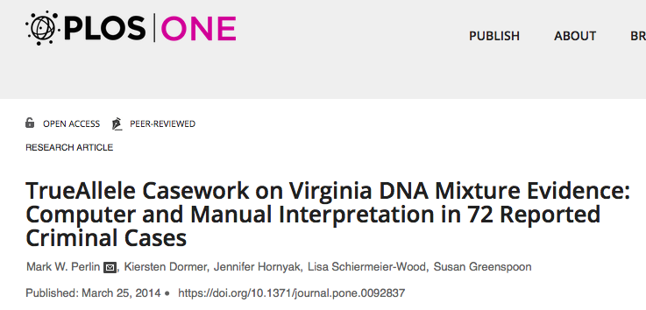
“There were 5 genotype comparisons where CPI indicated a match, but the computer found no statistical support (Table 11, TrueAllele <0, CPI >0). Laboratory reexamination of these items agreed with the computer’s conclusions.”

Slide 2
Notes:
Invited Presentation to the American Society of Crime Laboratory Directors, Laboratory Accreditation Board (ASCLD/LAB) January 8, 2015 – Raleigh, NCDNA Mixture Interpretation: State-of-the-Art, Michael D. Coble, PhD., John M. Butler, PhD National Institute of Standards and Technology, http://www.cstl.nist.gov/strbase/pub_pres/ASCLD-LAB-Jan2015-CobleButler.pdf

Slide 3
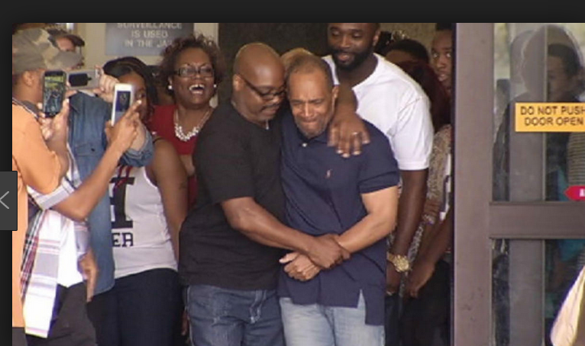
Cellmark’s lab’s DNA data had laid dormant for 15 years. The machine’s capability surpassed human review .

Slide 4
TrueAllele® Pinkins findings
1. compared evidence with evidence
2. calculated exclusionary match statistics
3. revealed 5% minor mixture contributor
4. jointly analyzed DNA mixture data
5. showed three perpetrators were brothers
Found five unidentified genotypes
Defendants not linked to the crime
Computer transcended human analysis

Slide 5
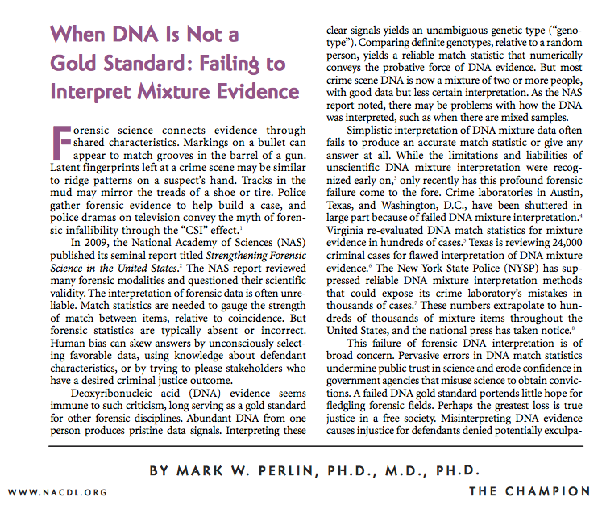

Slide 6
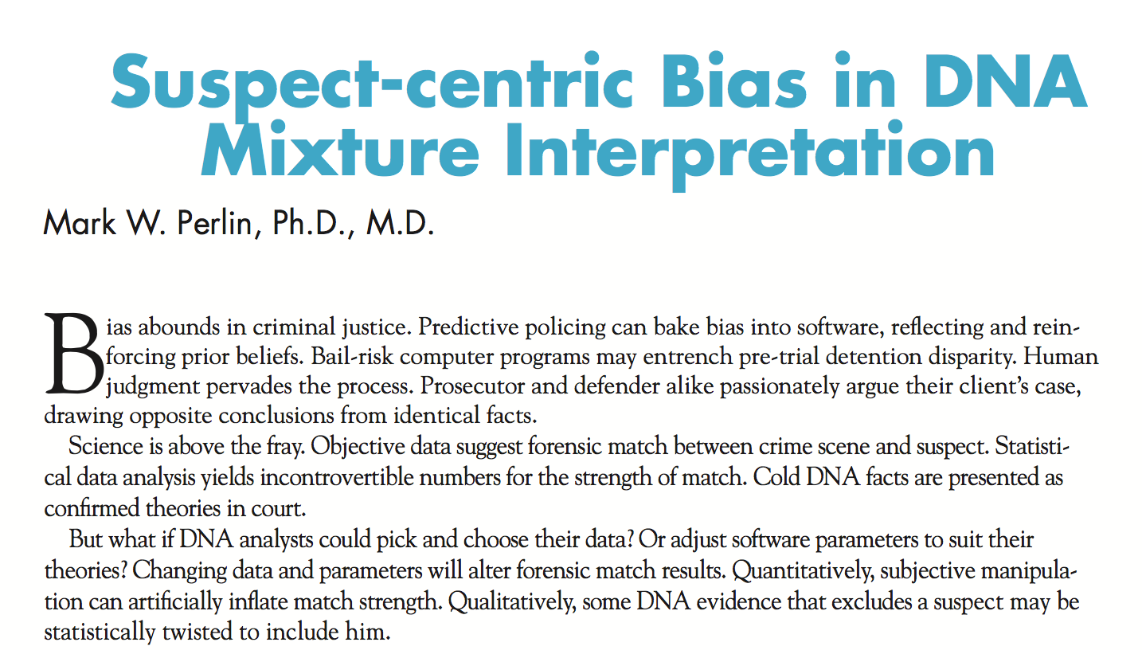

Slide 7
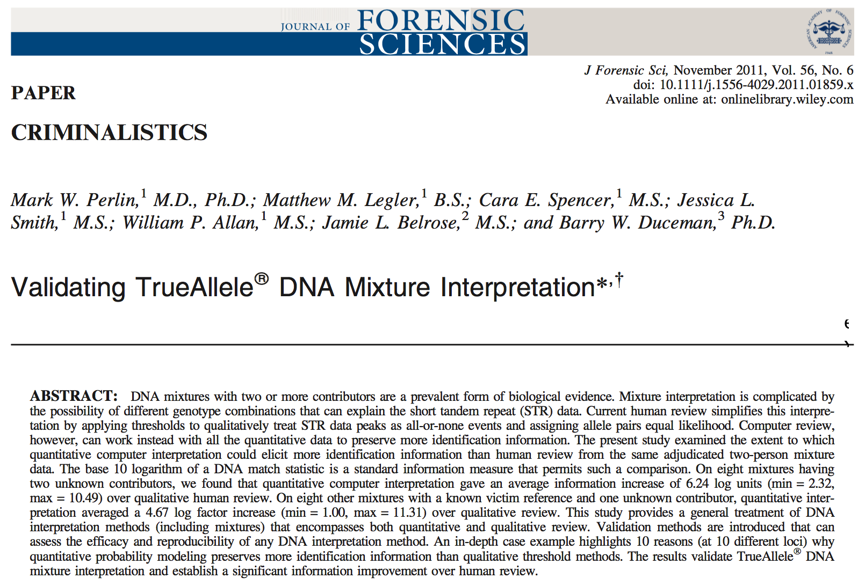

Slide 8
Moving forward
Computer reanalysis of DNA data proved Pinkins innocence
• Exculpatory DNA evidence was available fifteen years ago
• Old 20th century human review couldn’t deliver information
• New 21st century computer analysis overcame limitations
• Failed interpretation cost Pinkins 15 extra years in prison
• Thousands of cases with misinterpreted or “inconclusive” DNA
• Other innocents wrongfully imprisoned by old DNA methods
• Revisit “inconclusive” cases with new computer interpretation
• Re-examine old forensic data for new exculpatory evidence
Get pro bono DNA help – better science for better justice

Slide 9
Case 2 Gregory Hobbs, convicted of manslaughter, New Mexico Innocence Project
Defense claimed a struggle for the gun preceeded the shooting. Lab tested the ejection port area. Included victim in DNA mixture (match=1 in 14)
The DNA analysts testified about her findings at an evidentiary hearing on March 1, 2017. During her testimony, the Court asked her if she could specify that there was more than a 50% probability that the victim’s DNA was present in the mixtures. The analysts told the Court that she could not.
The Court denied Mr. Hobbs a new trial noting the DNA “…was from non-biological touch DNA and there was less than a 50% possibility that the DNA was from [the victim]”

Slide 10
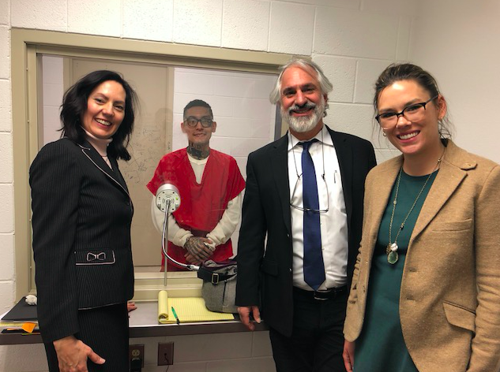
TrueAllele Results
Gun ejection port match to victim was 10,000,000 greater that a random match
Barbara Creel (left) Director of the New Mexico Innocence and Justice Project, Gregory Hobbs, Greg Hampikian, Alex Volner (left) New Mexico Innocence and Justice Project student, Barbara Creel, Director, NM IJP

Slide 11
Conviction Overturned May 24, 2018
“The NM lab analyst and Dr. Hampikian testified to the statistical representation provided in the TrueAllele report.
Judge Romero granted a new trial for Mr. Hobbs. He is currently out on release pending the state's appeal. The photo show's the team celebrating after the hearing and successful testimony (but not yet knowing the results).” -B. Creel
Alex Volner (left) New Mexico Innocence and Justice Project student, Barbara Creel, Director, NM IJP, Sara Escobedo, (right) former NM IJP paralegal.

Slide 12
Case 3: Montana Innocence Project 2018: Fred Lawrence and Paul Jenkins
1994 Murder, two men accused.
One admits the crime. Wife and father in-law testify against the other. Jailhouse “snitch” testifies against them. 2014 Montana Innocence Project, and Boise State join post conviction investigation (US Department of Justice grant).

Slide 13
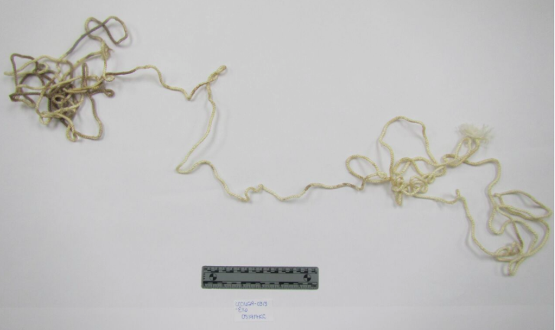
Ligature from scene

Slide 14
DNA Hit

Slide 15
Nephew had told authorities three times since 1999.

Slide 16
On Friday, April 13th, 2018 Lawrence’s and Jenkins Freed

Slide 17
Case 4: 1977, Johnnie Lee Gates admits to murder, and is convicted, sentenced to death.
2016 GA Innocence Project, and Boise State lab with DOJ grant, start working on post conviction.

Slide 18
Post conviction Issues in Gates
Mental deficiency
Brought to crime scene for confession, touched items
Prosecutor struck all black jurors in several capital cases
DNA never tested (two ligatures)

Slide 20
Probabilistic Genotyping: DNA on both ligatures exclude Gates, produce a common major profile

Slide 21
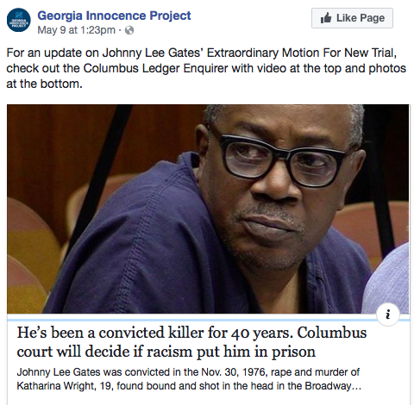
Georgia Innocence Project, Co-Council Southern Center for Human Rights
May 6, 2018 Dr. Mark Perlin Testifies at hearing.
From Inconclusive to EXCLUSION with probabilistic genotyping

Slide 22
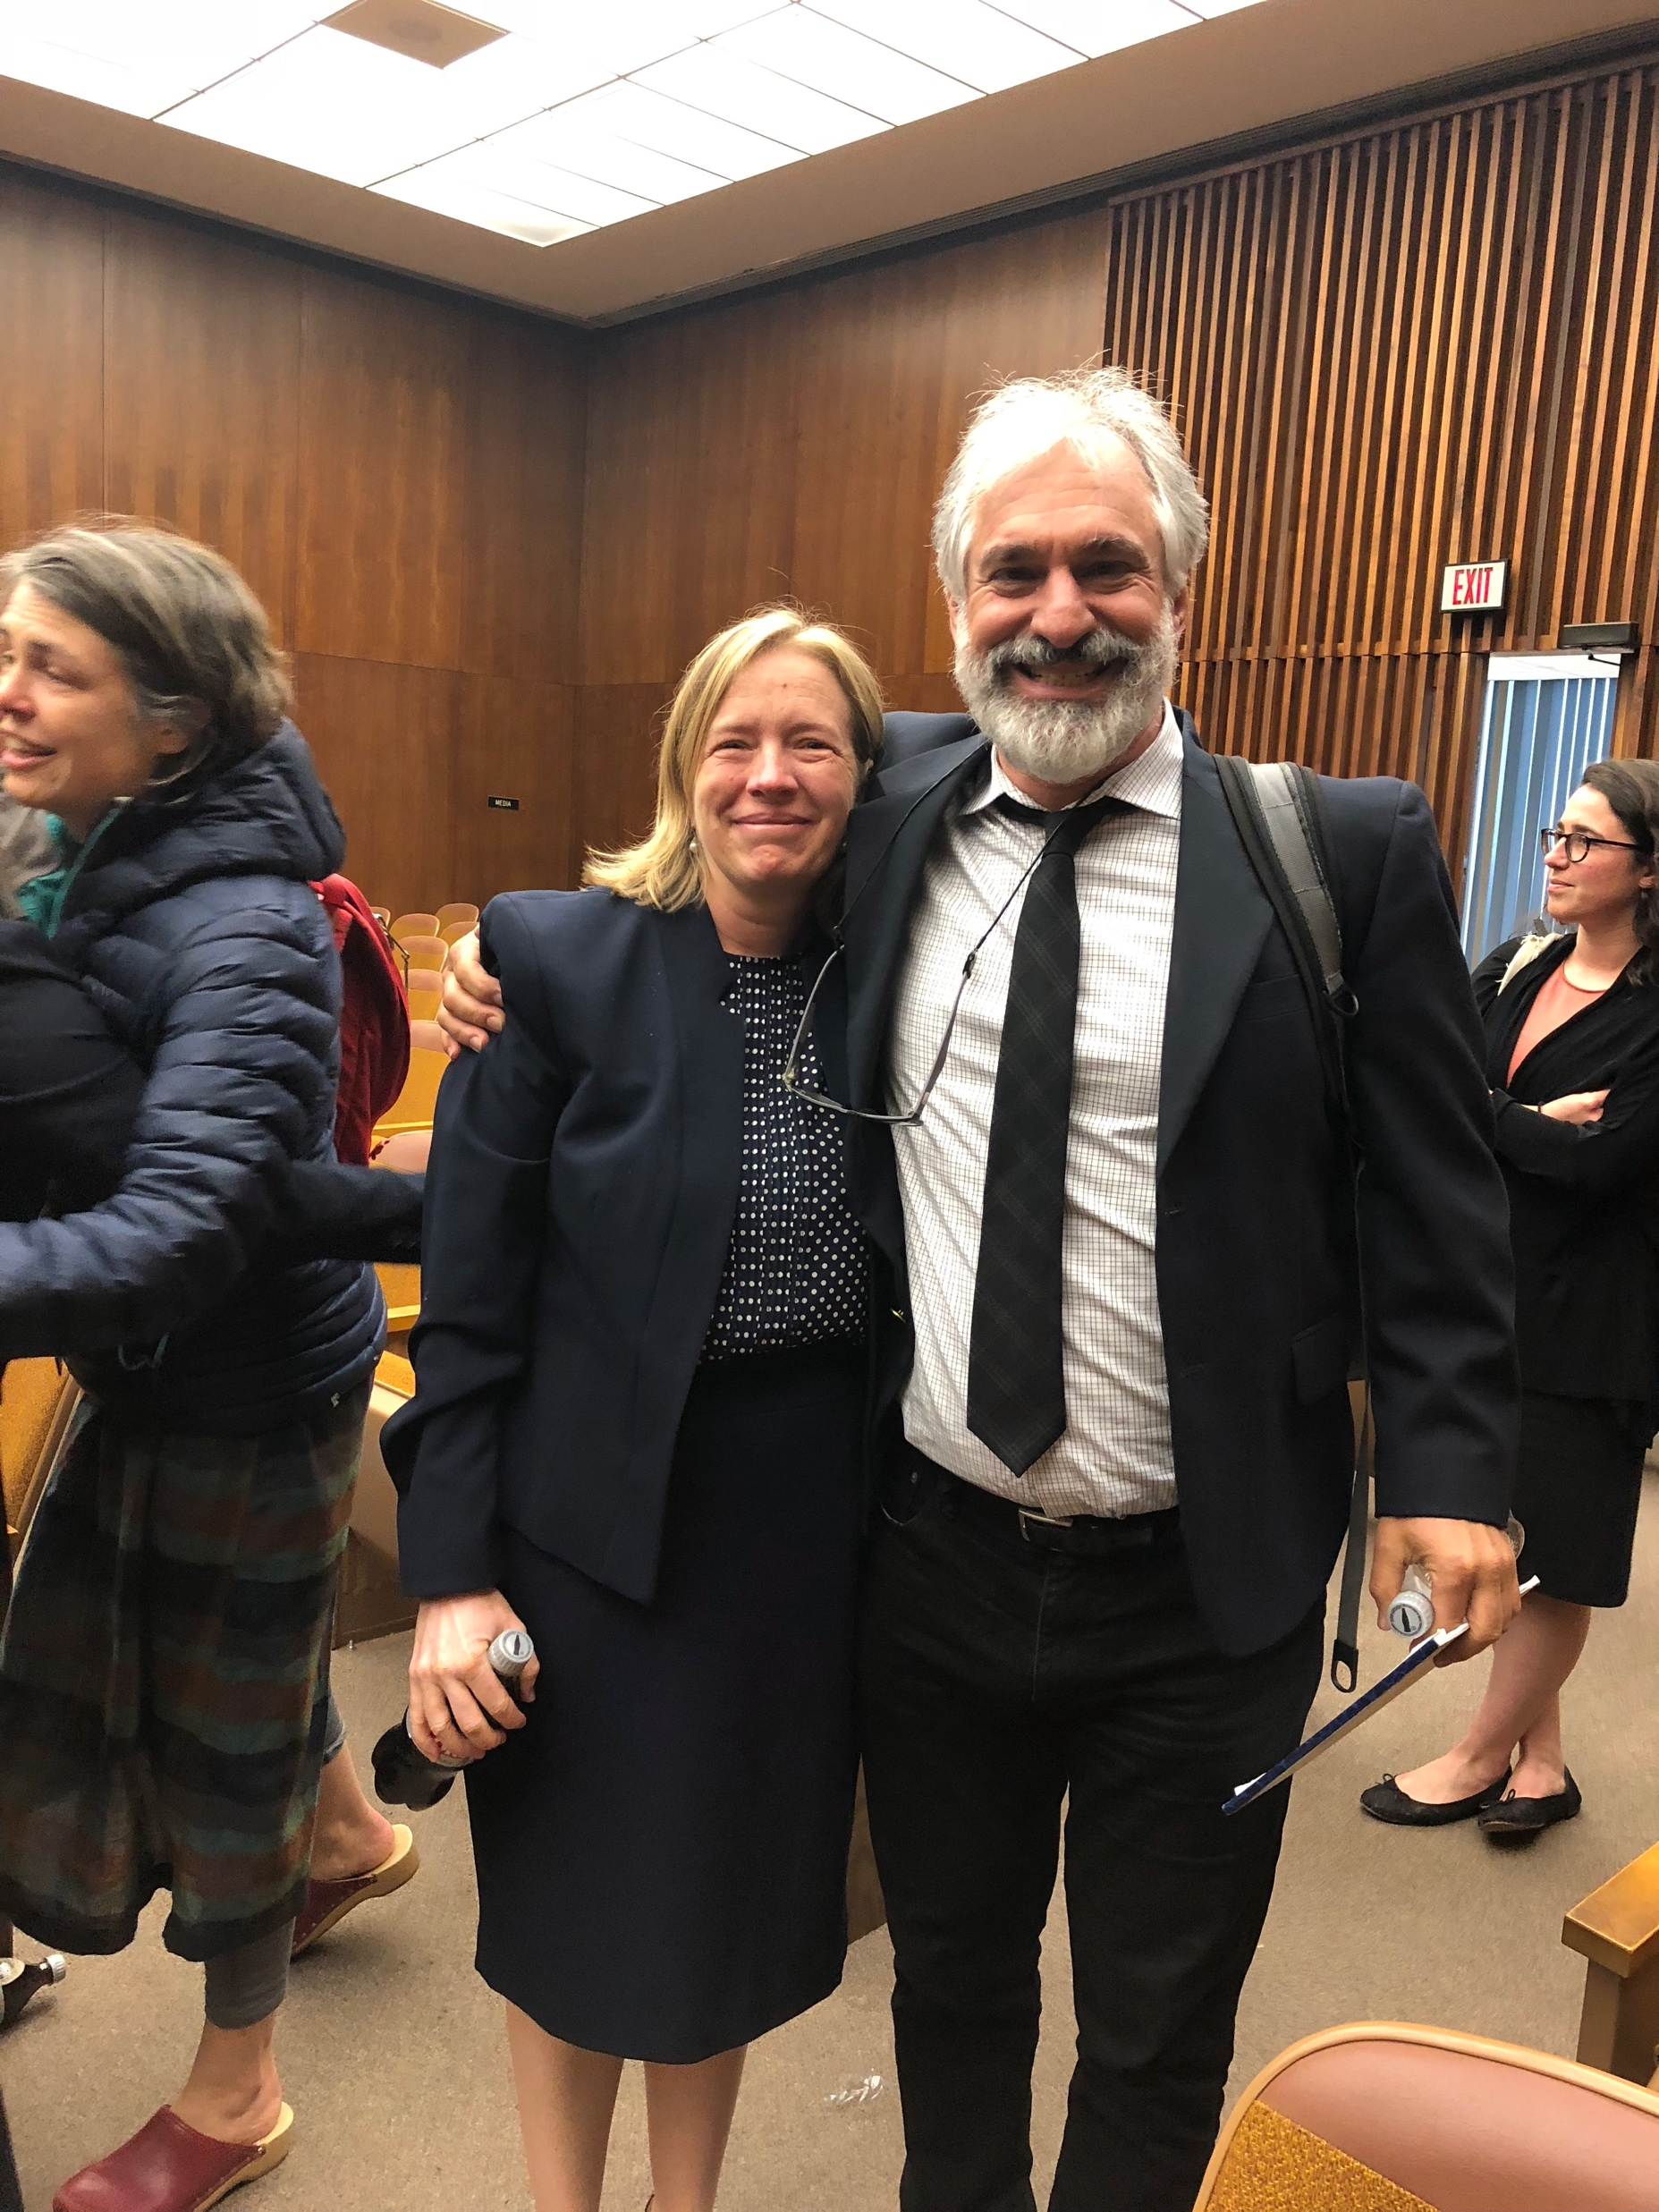
“N” beside potential black jurors
Claire Gilbert, GA Innocence Project

Slide 23
Diligence, Dedication, and Devotion
Do we have an ethical duty to perform analyses that could produce new results that might free the wrongfully convicted?
Does your lab have procedures to reexamine old cases with probabilistic genotyping?
To what are we devoted?

Slide 24
Thank you!
Comments? hampikian@yahoo.com
Gianluca Peri, Karen Rudolph, The Idaho Innocence Project volunteer lawyers
The GA Innocence Project, The Southern Center for Human Rights, The Montana Innocence Project, Frances Watson and The Indiana University Wrongful Conviction Clinic, The New Mexico Innocence Project The Georgia Bureau of Investigation, The New Mexico Department of Public Safety Forensic Laboratories, The Montana Forensic Science Division Lab
Mark Perlin and Cybergentics,
This project was supported by Grant No. (2016-DY-BX-0006) awarded by the Bureau of Justice Assistance. The Bureau of Justice Assistance is a component of the U.S. Department of Justice's Office of Justice Programs, which also includes the Bureau of Justice Statistics, the National Institute of Justice, the Office of Juvenile Justice and Delinquency Prevention, the Office for Victims of Crime, and the SMART Office. Points of view or opinions in this document are those of the author and do not necessarily represent the official position or policies of the U.S. Department of Justice.

