Slide 1
Use of a Database Feature in the TrueAllele® Casework System to Cross Compare DNA Cases
Dr. Nasir Butt, Ph.D.* and Jeffrey Oblock, B.S.,

Slide 2
The History
Spike in auto thefts in multiple westside suburbs of Cleveland, Ohio in the summer and fall of 2015
Believed to be committed by the same gang of juveniles
Most vehicles stolen over night from driveways or from the street
Vehicles were unlocked or windows smashed
Steering columns “peeled” or keys left inside vehicle

Slide 3
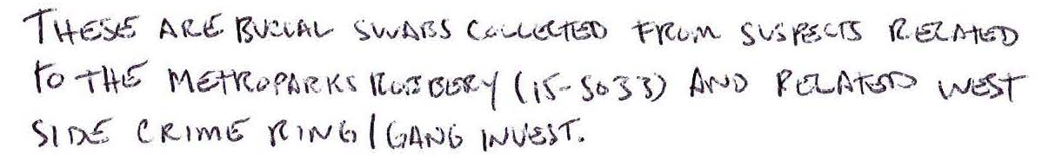
The Numbers
37 separate incidents/cases submitted for testing
6 different jurisdictions
161 total evidence samples
  Swabs from various areas of recovered autos
  Personal property left behind
38 suspect reference samples collected during gang “round up” (72 total references)

Slide 4
The Challenge
Efficiently cross-compare 38 suspect references to each of the 37 cases/100+ evidence samples
  Manual interpretation done using in-house protocols with RMP/CPI
    Many man hours of desk work
    Ignoring profiles/data

Slide 5
Manual Interpretation
Threshold – 200RFU cutoff
Profiles reported as single source and major/minor or indistinguishable mixtures up to 3 contributors
  >3 is inconclusive due to too many contributors
Statistical calculations
  RMP for single source and major profiles
  CPI for indistinguishable mixtures
General rules
  >50% data (alleles) needed for inclusions
  <50% data inconclusive due to insufficient information

Slide 6
Manual Interpretation
~2 months from initial testing to release of 37 reports
~1 additional month for release of 26 supplemental reports for additional suspect submissions
11 of the 38 suspects were associated to at least one case (RMP/CPI)
4 of the 11 positively associated suspects were connected to more than one case
30 evidence samples contained no or insufficient amount of DNA
30 profiles were reported as inconclusive due to too many contributors or insufficient information (some minor components also)

Slide 7
TrueAllele® Interpretation/Database
Cuyahoga County Prosecutor’s Office made aware of TA Databasing capabilities
Probabilistic Genotyping using TrueAllele® Technology’s Databasing Feature was done by Cybergenetics.
.hid data files sent to Cybergenetics for TA analysis
All profiles run through TA including those manually deemed inconclusive
  Low data/3+ contributors
Database Match Rules: EVI-EVI, EVI-REF, REF-REF

Slide 8
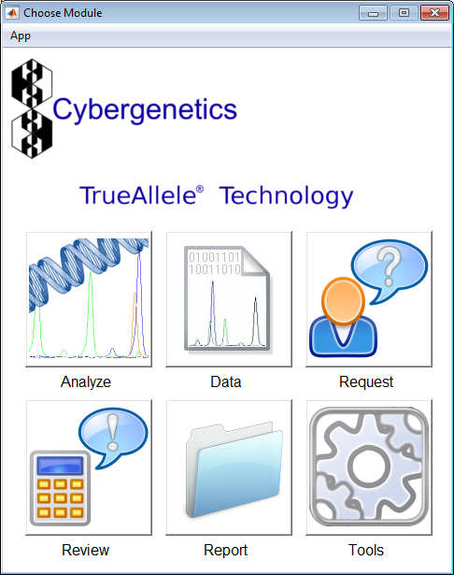
TrueAllele® Interpretation/Database

Slide 9
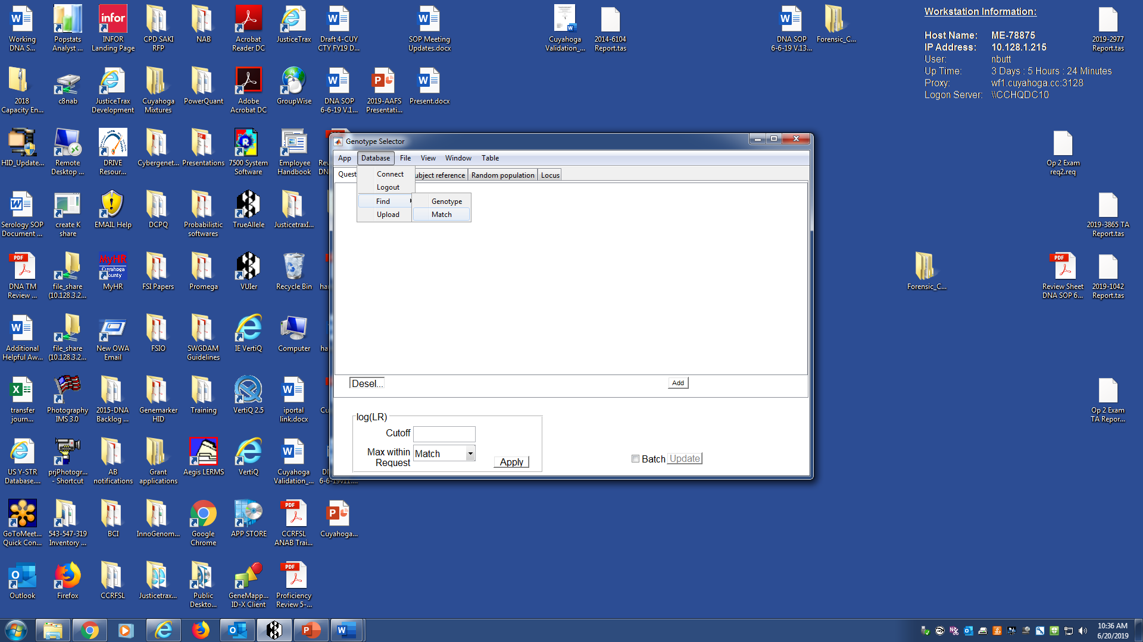

Slide 10
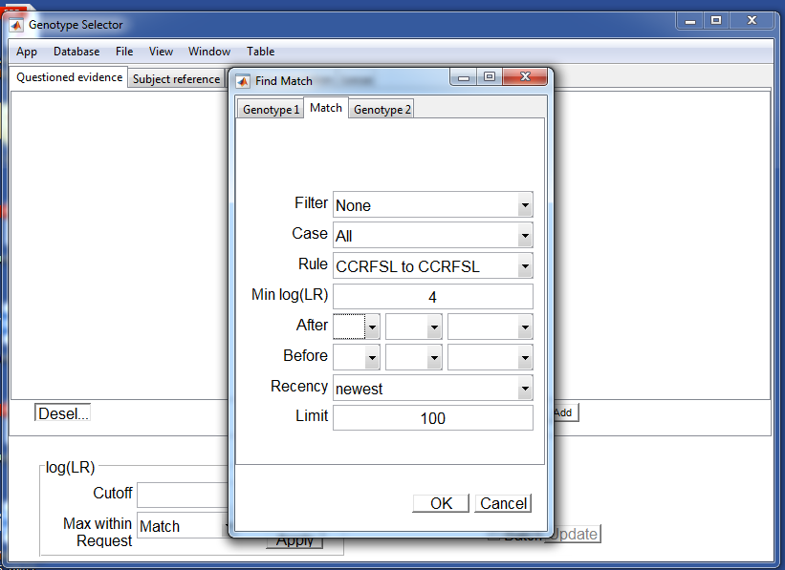

Slide 11
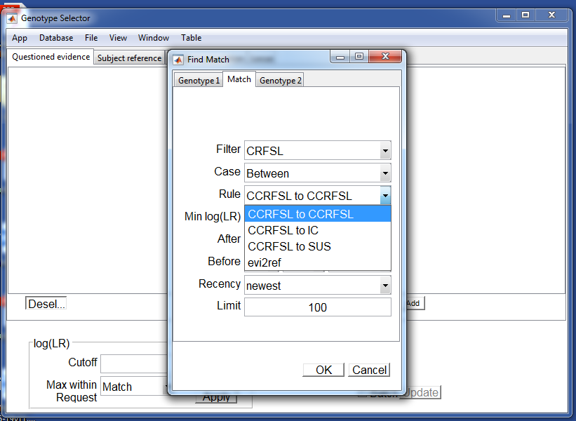

Slide 12
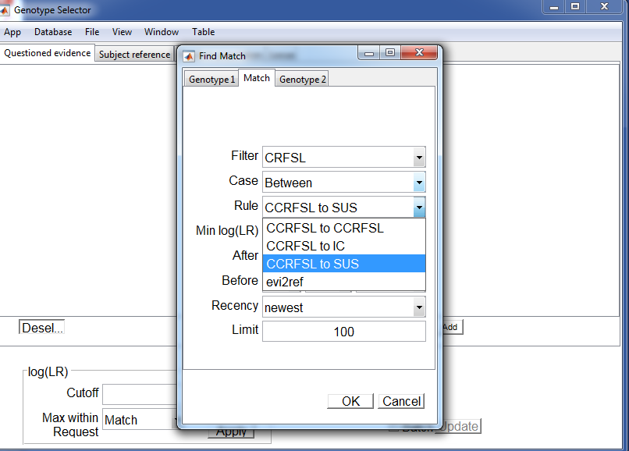

Slide 13
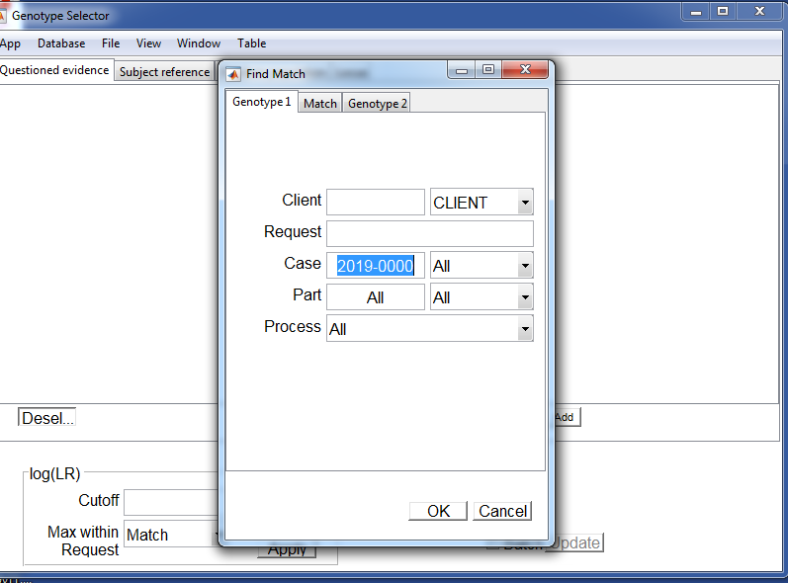

Slide 14
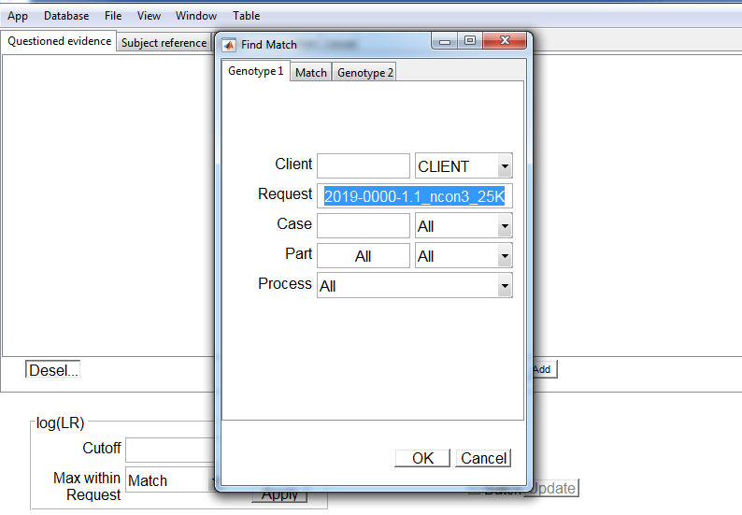

Slide 15
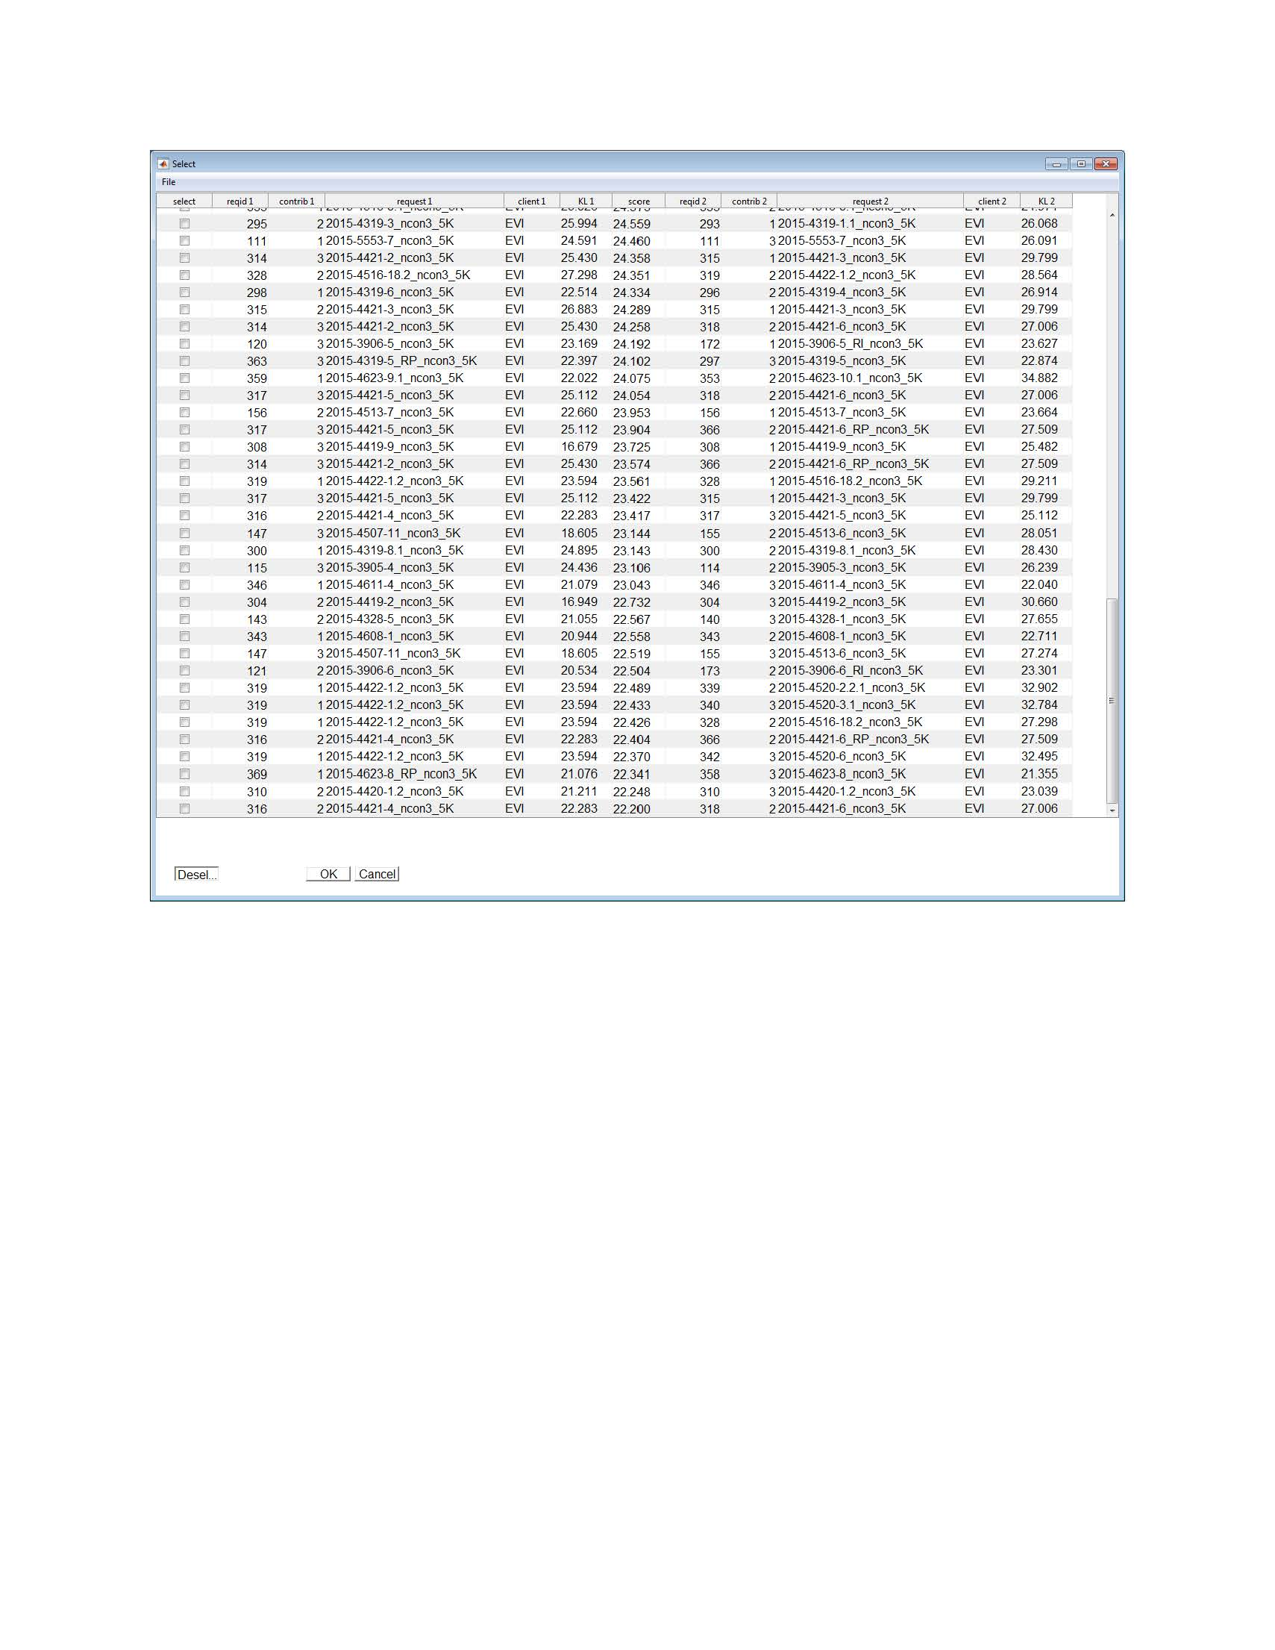
TrueAllele® Interpretation/Database
EVI-EVI Match Rule

Slide 16
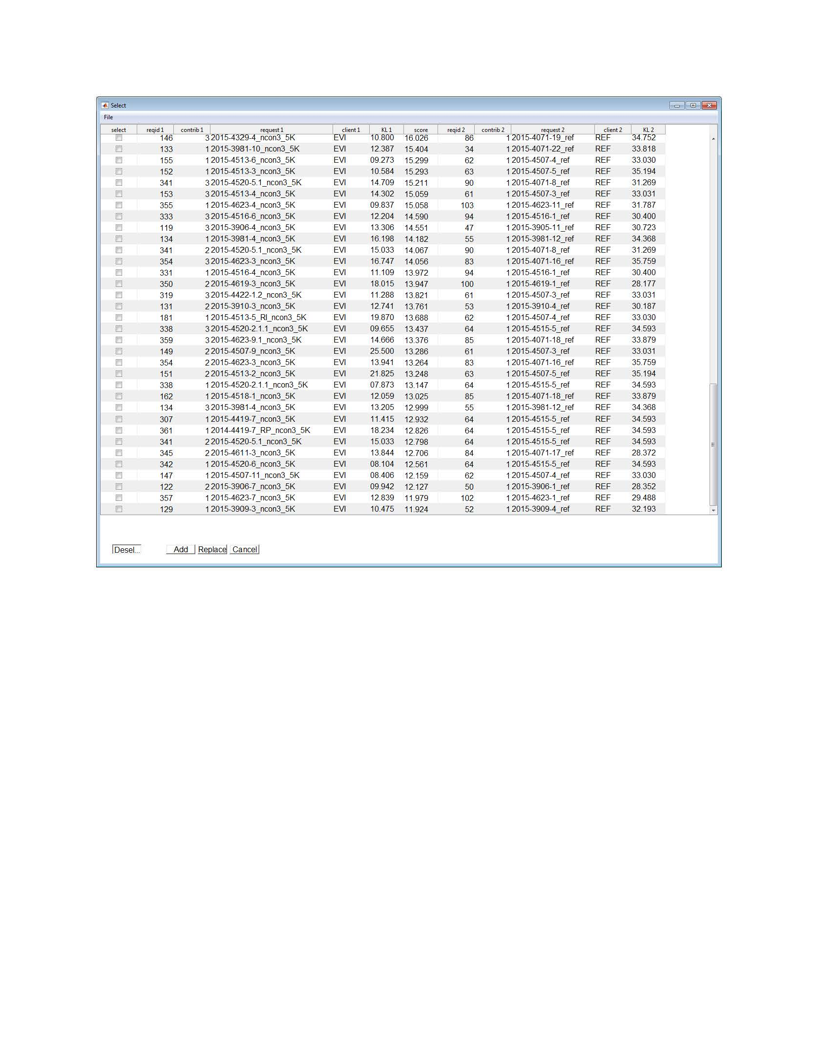
TrueAllele® Interpretation/Database
EVI-REF Match Rule

Slide 17
TrueAllele® Interpretation/Database
EVI-REF Match Rule
Link suspects to multiple cases
Avoid direct comparison between reference and evidence profiles
One suspect linked to eight cases
Case | Item | Log(LR)
1 | Steering Wheel | 12.45
2 | Steering Wheel | 6.44
3 | Steering Wheel | 2.28
4 | Flashlight | 4.02
 | Steering Wheel | 16.04
 | Steering Wheel | 5.21
5 | Cigar | 6.36
 | Steering Wheel | 9.54
6 | Ignition Key | 2.33
 | Gear Shift | 5.99
7 | Gear Shift | 4.22
 | Driver Door Handle | 3.00
 | Pass. Door Handle | 4.55
8 | Cigar | 13.52
 | Cigarette Butt | 14.84
 | Ziploc Package | 10.32

Slide 18
TrueAllele® Interpretation/Database
EVI-REF Match Rule
Profiles not considered previously provide match information
Manually interpreted profile was inconclusive due to >3 contributors
Three linked suspects identified in the TA database
Three linked suspects to above profile
Suspect | Item | Log(LR)
1 | Gear Shift | 9.37
2 | Gear Shift | 8.00
3 | Gear Shift | 14.46

Slide 19
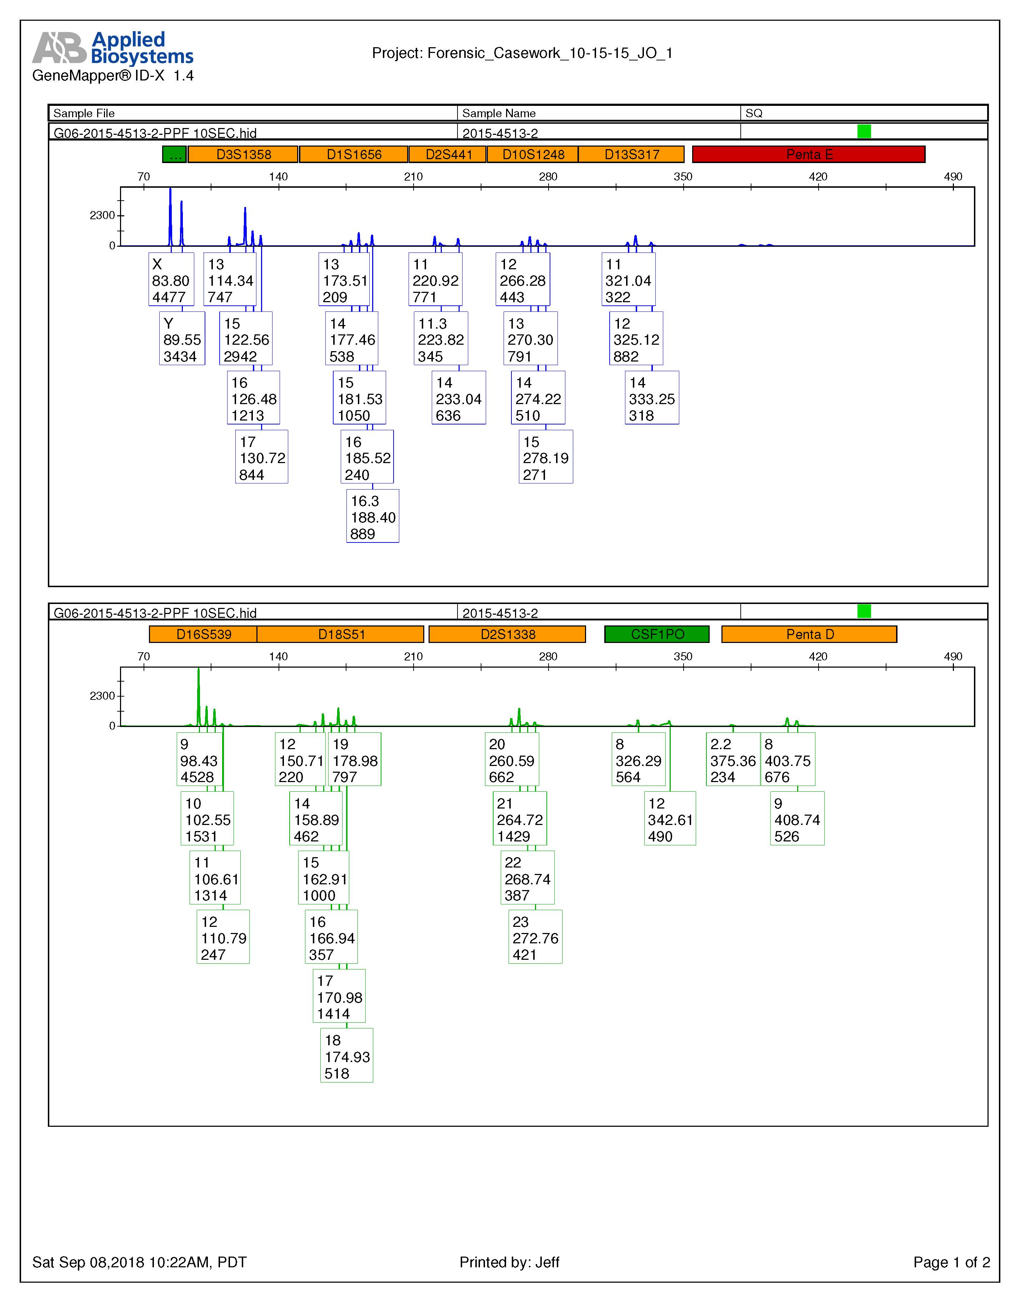
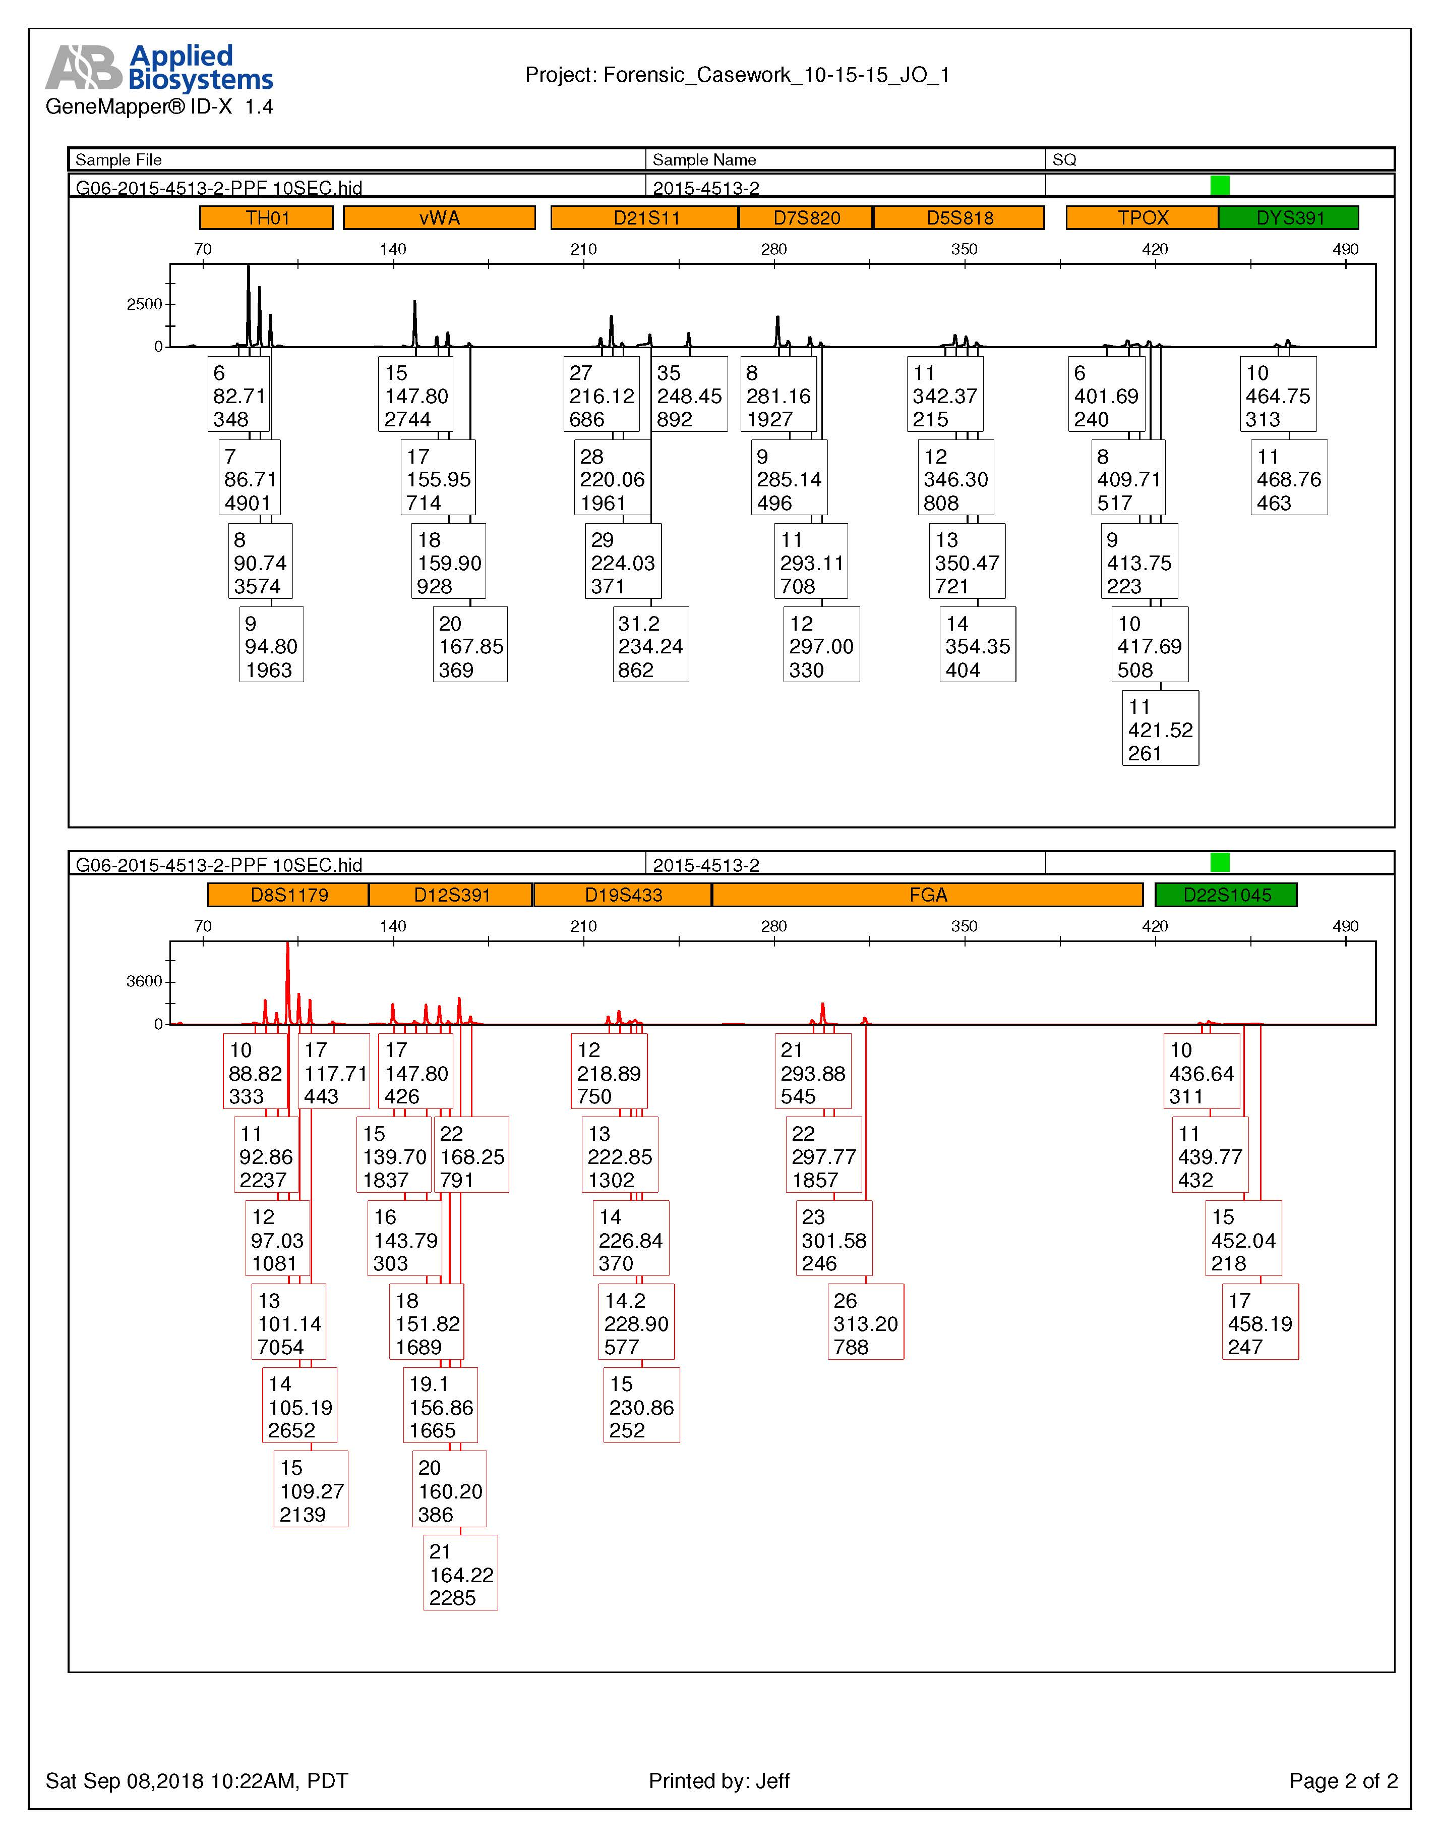
TrueAllele® Interpretation/Database

Slide 20
The Summary
Manual
TrueAllele
~2 month from testing to report release, additional month to release supplemental reports
11 of 38 suspects associated to at least one case
4 of the 11 suspects connected to multiple cases
30 profiles reported as inconclusive
12 samples reported as exclusions
~1 month from data upload/request to preliminary results
16 of 38 suspects associated to at least one case
8 of the 16 suspects connected to multiple cases
All 30 profiles with at least one positive association
Positive match scores for the 12 manual exclusions

Slide 21
Acknowledgements
Work would not have been possible without the help and support of the members of the Cybergenetics team:
Bill P. Allen, MS
Jennifer M. Hornyak, MS
Dr. Mark W. Perlin, PhD, MD, PhD
Matthew Legler

Slide 22
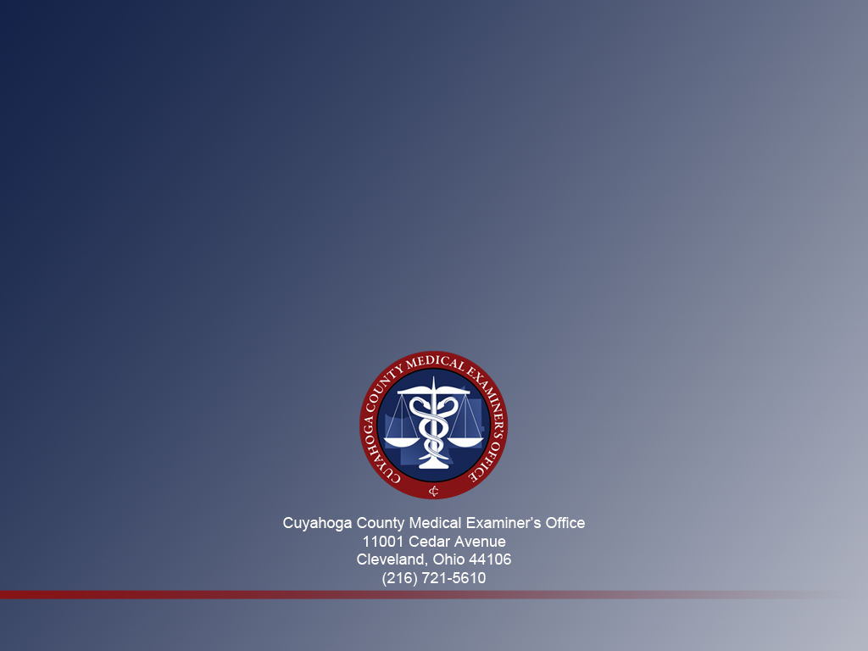
Thank You!
Use of a Database Feature in the TrueAllele® Casework System to Cross Compare DNA Cases
Dr. Nasir Butt, Ph.D. and Jeffrey Oblock, B.S.

