Slide 1
“Using Computer Technology to Overcome Bottlenecks in the Forensic DNA Testing Process and Improve Data Recovery from Complex Samples”

Slide 2
Goals of DNA Testing
Help identify perpetrators of crimes
Eliminate the wrongfully accused
Help prevent future crimes

Slide 3
Reducing DNA Testing Time
Hire more staff
Automate
Humans for tasks requiring intelligence
Machines for repetitive processes

Slide 4
Typical Laboratory Automation Setup
Identify Material | Human
DNA Extraction | Automated, ~15 years
DNA Quantification | Automated, ~15 years
DNA Amplification | Automated, ~10-15 years
Instrumental Analysis | Automated, ~20 years
DNA Profile Interpretation | Human

Slide 5
How Many DNA Profiles?
96-well plate
4 to 8 allelic ladders
At least two PCR controls
Several DNA extraction blanks
Typical plate could contain 80 to 90 DNA profiles

Slide 6
Interpretation Guidelines
2017 SWGDAM Guidelines for human interpretation
To avoid confirmation bias, evidence samples should be interpreted before comparison to known samples

Slide 7
To Avoid Confirmation Bias
Look at your evidence profile first
Infer DNA types from the evidence without knowledge of known types
Compare inferred DNA types to knowns
Determine if match exists

Slide 8
Human Interpretation
Eight hour workday
8 hours x 60 minutes = 480 minutes
480 minutes / 84 DNA profiles =
5 minutes, 42 seconds per DNA profile

Slide 9
Interpretation Bottleneck
Volume of data
Complexity
Thresholds
Data declared “Inconclusive” or “Too Complex for Interpretation”

Slide 10
So Throwing Out Data is the Only Way?

Slide 11
Alternate Approach - Automate
Automate DNA interpretation using computers
Use humans for tasks requiring intelligence, use machines for repetitive processes
DNA interpretation can be automated with the TrueAllele® technology

Slide 12
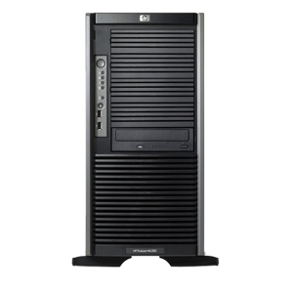
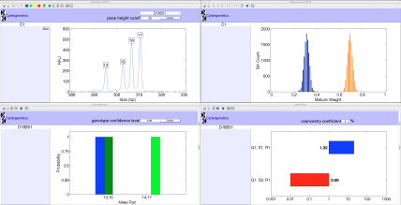
TrueAllele® Processing
ViewStation
User Client
Database
Server
Interpret/Match
Expansion
Visual User Interface
VUIer™ Software
Parallel Processing Computers

Slide 13
Automated Process
Upload entire plate to server
Computer interprets the data
Check results and compare:
To other data files on the same plate
To known profiles
To previous runs
Perform detailed processing on potential matches

Slide 14
Benefits of Automated DNA Interpretation
All data examined, nothing discarded
Speed
One plate in ~6 – 7 hours
No confirmation bias
Computer infers genotypes
No prior knowledge

Slide 15
Benefits of Automated DNA Interpretation
All data compared:
Evidence, references, lab staff, crime scene investigators, controls
Identify more case-to-case matches and potential contamination
CODIS specimen and candidate match assessment

Slide 16
Database Matching
TrueAllele implemented in January 2016
Server expansion modules installed May 2017
20 processors (casework and database screening)
8 (original) processors dedicated to database screening

Slide 17
TrueAllele Workflows
Casework
Traditional sample-by-sample analysis
Database
Process everything, look for matches
Confirm matches in Casework process

Slide 18
Database Matching
Uploaded all 7 years of data to BCSO TrueAllele database
>7,500 DNA profiles
>15,000 inferred genotypes
Batched request run conditions:
5K/5K
3 unknown contributors

Slide 19
Database Matching
~30,000 potential matches returned
Most were “within case”
To date, ~80 previously unknown EVI-REF case-to-case matches

Slide 20
Match Evaluation
Five samples from five different cases matched to each other
EVI – EVI; no reference matches
No matches to any other genotypes

Slide 21
Sample | Contributor | N Con | KL | 2016 Case (log LR)
2014 Case | 2 | 3 | 19.9574 | 12.5962
2015 Case | 1 | 3 | 19.675 | 14.7183
2017 Case | 3 | 3 | 14.6881 | 6.2815
2015 Case 2 | 1 | 3 | 17.401 | 8.0723

Slide 22
Case Evaluation
2014 Home Invasion (unknown suspect)
2015 Attempted Murder (known suspect)
2015 Burglary (two known suspects)
2016 Murder (known suspect)
2017 B&E Auto (three known suspects)

Slide 23
Case Evaluation
No suspects in common
2015 Attempted Murder & 2016 Murder: identity was not in dispute
2017 B&E Auto: suspects were witnessed and caught soon after

Slide 24
Possible Causes
Wrongfully accused?
An accomplice that we don’t know about?
Contamination?
Aliens?

Slide 25
Investigation
Worked in lab at different times
Worked in lab by three different examiners
Genotypes did not match lab staff
Genotypes did not match any case reference samples

Slide 26
Investigation
All cases worked by same agency
All items were touch DNA
All evidence was collected or handled by same investigator
Investigator was the only common link between all five cases

Slide 27
Sample | Contributor | N Con | KL | Reference (log LR)
2014 Home Invasion | 2 | 3 | 19.9574 | 13.4844
2015 Burglary | 1 | 3 | 19.675 | 15.4627
2016 Murder | 1 | 3 | 23.3979 | 17.798
2017 B&E Auto | 3 | 3 | 14.6881 | 11.0779
2015 Attempted Murder | 1 | 3 | 17.401 | 4.0144

Slide 28
Run Conditions
Batched request:
5K/5K
3 unknown contributors

Slide 29
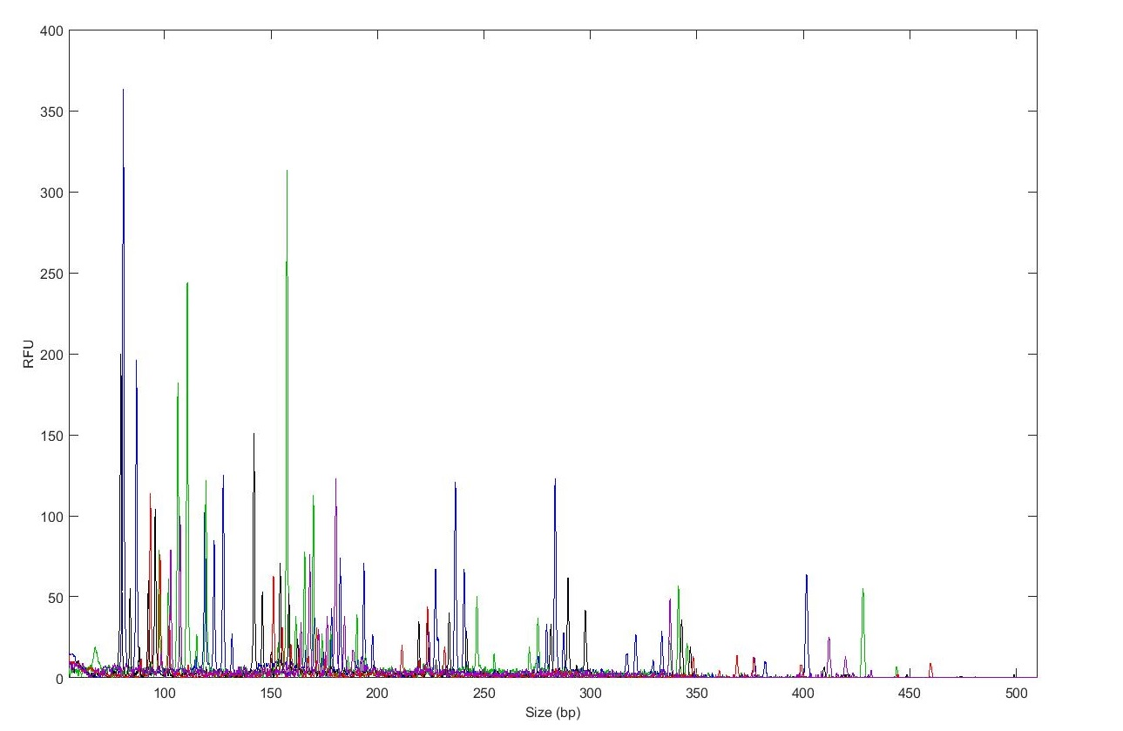
2
Convergence
1.641 | 1.113 | 2.048
Automated Matching
5K/5K?

Slide 30
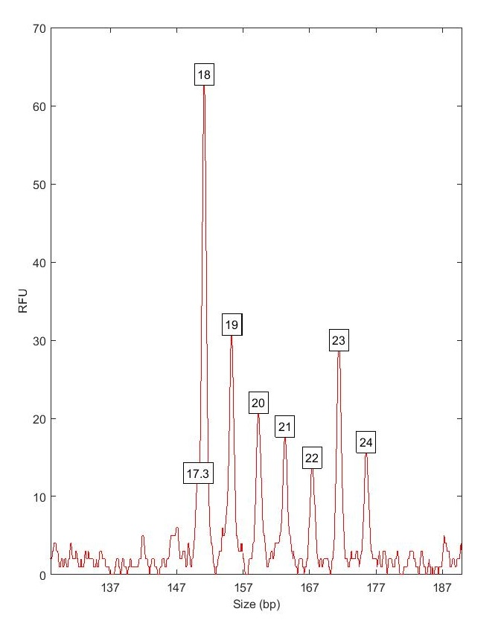
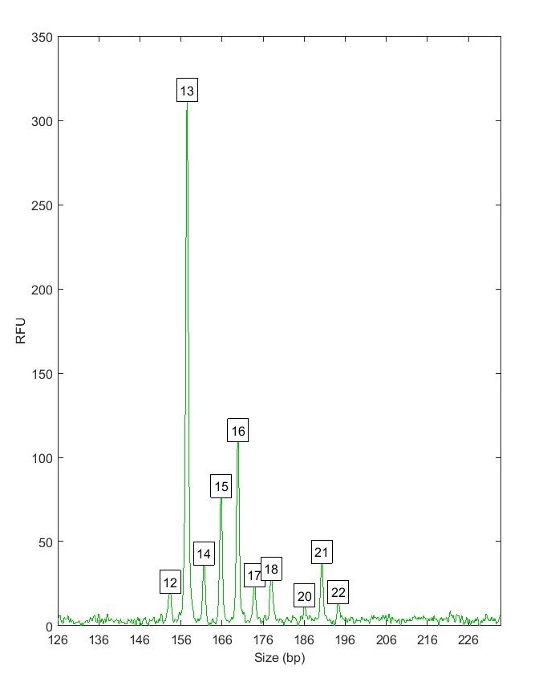
D12S391
D18S51
3 contributors?

Slide 31
Run Conditions
Batched request:
5K/5K
1, 2, or 3 unknown contributors
Identify potential matches for detailed processing

Slide 32
Quality Control
Two of the profiles had been entered into CODIS
LDIS match
Other three were unsuitable for CODIS entry

Slide 33
CODIS Match Evaluation

Slide 34
CODIS Match Evaluation Example #1
Offender | Human Review, 30 minutes | TrueAllele,5 minutes | LR | CPI (1 in)
#1 | Uncertain | Eliminated | 1.5 | 39,000
#2 | Not eliminated | Eliminated | 2.7 | 39,000
#3 | Not eliminated | Match | 73 billion | 39,000

Slide 35
CODIS Match Evaluation Example #2
Offender | MME | CPI (1 in) | LR
#1 | 1.728 x 10⁴ | 65 | 158 trillion

Slide 36
Previously Unidentified Matches
2014: Burglary case, uploaded to SDIS
Offender hit
Match confirmed in laboratory
2017: Process old data, upload to TrueAllele®
3 additional cases from 2012 - 2014
Never entered into CODIS

Slide 37
Can we use the automated process for CODIS screening?
Minimum
#
4x4
CPI
Sample
Major
?
LR
Contributors
Rule?
(1
in
)
2012
3
No
No
28,000
6 quintillion
2013
3
No
No
920
27 trillion
2014
3
No
No
760
9 trillion

Slide 38
CODIS Screening
KL computed by TrueAllele®
Measures information value of inferred genotype
MME calculated by CODIS
Predicts matches at moderate stringency
Compare MME, KL, and LR for CODIS profile assessment

Slide 40
What We Are Implementing
Use KL to predict quality of match
Use MME to filter adventitious matches
High KL – build MME, search CODIS
Low KL – do not upload

Slide 41
Summary
DNA interpretation is automatable
Reduce/eliminate interpretation bottlenecks
Output searched internally and screened for suitable CODIS profiles
Improved quality control
More information recovered from same amount of data

Slide 42
Questions?

