Slide 1
Kern Regional Crime Laboratory
Laboratory Director: Dr. Kevin W. P. Miller
TrueAllele® Work and Workflow:
Kern County’s First Cases
April 23, 2014

Slide 2
Presenters
Kelly Woolard
Garett Sugimoto
Jerry Garza

Slide 3
Overview
Validation study
Procedures/ Casework Workflow
Case examples:
  Sexual assault case – Making something of nothing.
  Soda can case – Using all available information.
  Ax case – Defense gets “1 up’d” a million times over.
Q&A

Slide 4
The Validation
Reasons for validating the TrueAllele® system:
  Is it more informative than manual interpretation?
  Is it a more consistent method of mixture interpretation?
Validation set up:
  Mixtures were set up consisting of 2, 3, 4 and 5 contributors.
  10 mixtures were prepared per mixture group using 5 known references. Each of the mixtures within each mixture group were amplified with 1ng of DNA template and with 200 pg of DNA template.
  The known references were chosen randomly as were the mixture ratios to better approximate casework samples.
  40 total mixtures.

Slide 5
The Validation
Results:
  TrueAllele® was a more informative, reproducible and consistent method of mixture interpretation.
  TrueAllele® had little interpretation variance across the mixture samples containing 2-5 contributors and 200pg-1.0ng of DNA template. There were no significant differences in the regression line slopes between all the samples regardless of the number of contributors and target amount of DNA for amplification.

Slide 6
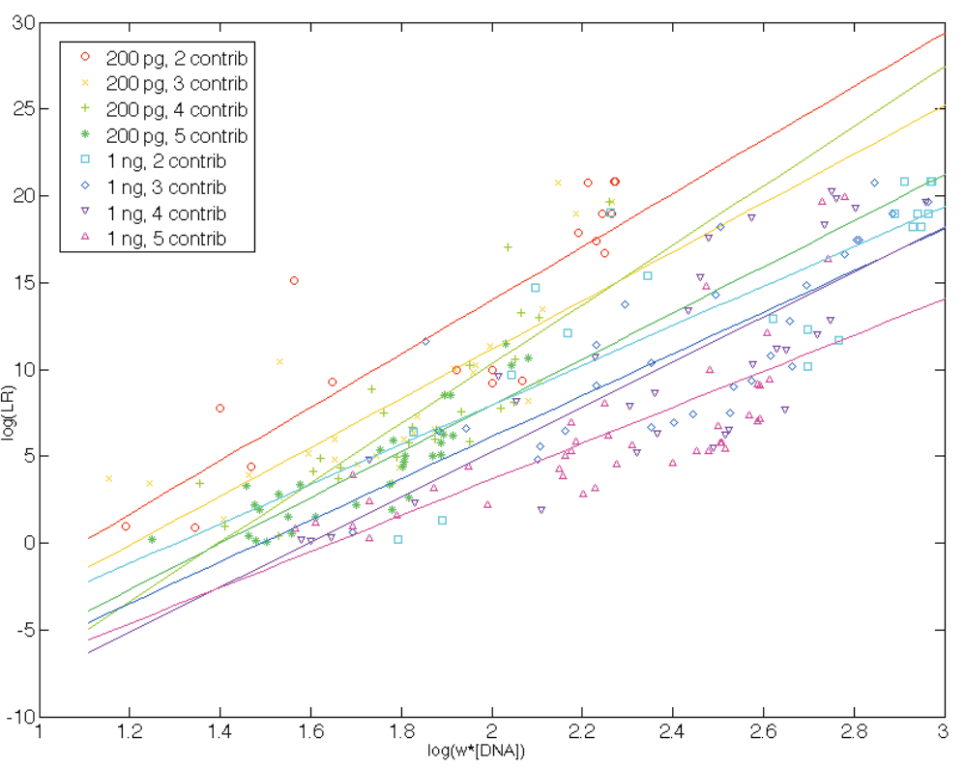

Slide 7
The Validation
Mixture range (%) | Inclusion rate % (1 ng) | Inclusion rate % (200 pg)
50-100 | 100 | 100
25-50 | 100 | 100
10-25 | 100 | 91
5-10 | 82 | 24
1-5 | 40 | 0
0-1 | 0 | 0
TrueAllele® is a very robust system with regards to attaining match statistics with contributors that represent 10%+ of a mixture.
Even at 1-5% of mixtures with 1 ng starting DNA template, TrueAllele® is able to calculate a match statistic 40% of the time.

Slide 8
The Validation
8.4 million total comparisons were made between 10,000 randomly generated profiles using the three FBI ethnic databases.
False exclusions were relatively rare with most coming from low template samples (200pg) and samples with a higher number of contributors (4-5).
False inclusions were also very rare. When a false match did occur, it was rarely a match score of more than 3 log(LR) units. Only six out of 8.4 million false inclusions were greater than 3 log(LR) unit match scores but none were more than 4 log(LR) which is why we set our “cannot exclude” limit at 4 log(LR) units. Additional validation studies by NY State and Virginia crime labs also support our 4 log(LR) unit limit.

Slide 9
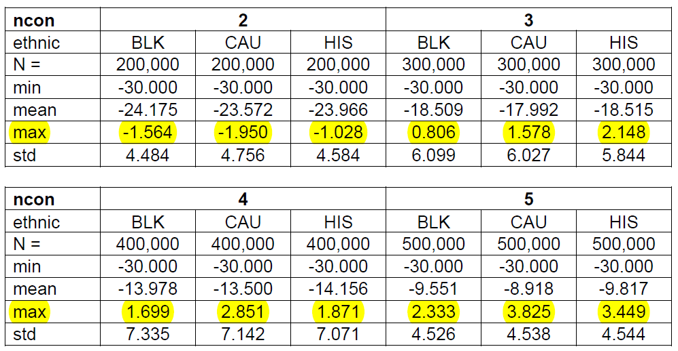
Specificity (1ng mixture samples)

Slide 10
TrueAllele® Analysis Workflow
Analysts manually review profiles using GeneMapper® ID-X
Single source profiles
Two person mixtures
Manual interpretation and statistical calculations using Popstats
Mixture with at least three contributors
Low-level mixtures that are uninterpretable using manual interpretation (below thresholds)
Partial profiles
TrueAllele® analysis

Slide 11
TrueAllele® Analysis Workflow
Performed by trained casework operators
  Upload raw data to system
  Create requests based on number of contributors and condition of profiles (degraded or non-degraded)
    Infer contributors in requests (known reference samples in the case)

Slide 12
Kern Protocol for interpretation of STR profiles using the TrueAllele® Casework System- when to infer contributors
Uncertainty of genotype inference is reduced for some mixture profiles when samples from known contributors are inferred.
  Individuals can be inferred for intimate samples or for samples where it is reasonable to assume their presence based on case-specific information.
  In addition, for the non-intimate samples, the request must be made with and without known reference profiles and log(LR) values must be >4.

Slide 13
Kern Regional Crime Laboratory Interpretation Protocol (Naming Requests)
Example: 12CL12345_D9947X_Q_ncon3_D_100K+D9948X_copy
When copy requests are made, leave the “_copy” at the end of the request name
YYCL##### | Laboratory Number
X####X | Unique ID number (DNA number)
Q/K | Questioned or known item
Ncon# | Number of assumed contributors
N/D | X-degraded option off D- degraded option on
###K | Number of cycles, K= thousand
+X####X | DNA number(s) of known reference profiles inferred to the mixture

Slide 14
Processing Time
Depends on several factors
  Number of processors
  Type of request (degraded vs. non-degraded)
  Number of cycles
  Number of contributors in the mixture
  Nature of the evidence sample
  Total number of samples and requests made in the case

Slide 15
Approximate Request Time
500 cycles ~15 minutes (known reference samples)
50,000 cycles ~6 to 12 hours (two person mixtures)
100,000 cycles ~1 day (three person mixtures and above)
200,000 cycles ~2+ days (nasty three person mixtures and above or difficult samples)

Slide 16
Review of the results from the first round requests
Results are not good
Mixture weights (% contributions for each contributor)
Convergence (how well the system has been able to separate each contributor in the sample)
Genotype probability distributions
Match scores
Results look good
Put in duplicate requests to check for concordance between requests(similar results with match scores within two log(LR) units of each other using the same request parameters)
Make adjustments to requests
Increase cycle time
Infer contributors
Change “degraded” option
Increase or decrease number of contributors in request

Slide 17
Conclusions made
After all sample requests have been completed and concordance between duplicate requests is achieved, compare to known references. Conclusions:
  Cannot Exclude - Positive match scores greater than 4 log (LR) units (>10,000)
  Inconclusive - Match scores between -4 and +4 log(LR) units (-10,000 to 10,000)
  Excluded - Negative match scores less than -4 log (LR) units (<-10,000)

Slide 18
Reporting exclusions and inconclusive results
Excluded | Inconclusive
(Name) is excluded as a potential contributor to the DNA profile obtained from this item. | No conclusion can be drawn as to whether or not (name) could be excluded as a potential contributor to this DNA profile obtained from this item.

Slide 19
Reporting non-exclusions
Cannot Exclude (without individuals inferred) | Cannot Exclude (with individuals inferred)
When a likelihood ratio was calculated using the TrueAllele® Casework system, it was assumed that the evidence sample contained a (single source profile)/(mixture of X unknown contributors). A match was identified between this evidence item and (name) (item #). A match between this evidence item and (name) is X times more probable than a coincidental match to an unrelated person relative to the reference populations listed (see statement #) | When a likelihood ratio was calculated using the TrueAllele® Casework System, it was assumed that the evidence sample contained a mixture of X unknown contributors, and contained DNA from known contributor(s) (name(s)) (item #(s)). A match was identified between this evidence item and name (item #). A match between this evidence item and (name) is X times more probable than a coincidental match to an unrelated person relative to the reference populations listed (see statement #).

Slide 20
Casework Documentation
Request files (.req)
Report file (.txt and .zip)
Match Table (.xls)
All raw data files (.fsa)
All notes are documented in LIMS (JusticeTrax)

Slide 21
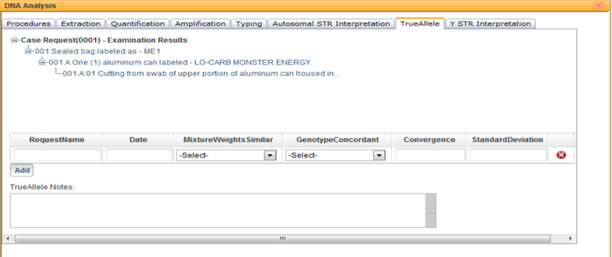
JusticeTrax® Meets TrueAllele®

Slide 22
Sexual Assault Case
Scenario
  Unknown male subject
  Sexual assault case
  Case consisted of 10+ known references and dozens of forensic samples. Most were challenging samples (i.e., touch DNA, low level mixtures)
  All items processed with TrueAllele®
  Prior to TrueAllele® analysis, one sample was eligible for upload to CODIS

Slide 23
Sexual Assault Case
After getting a hit, the offender profile was compared to all evidence items in the case.
Prior to using TrueAllele® Casework, only one sample yielded a profile eligible for a probative manual statistical calculation.
After TrueAllele® analysis, five additional samples yielded reportable matches to the offender.
Six matches linked the subject to multiple cases.

Slide 24
Sexual Assault Case
All of the case samples and known references were compared to each other and there were no non-probative matches other than to the subject.
Case took approximately 2 months to report TrueAllele® results with only 4 TrueAllele® processors.
These cases are currently pending trial.

Slide 25

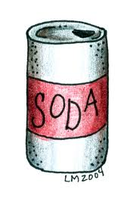
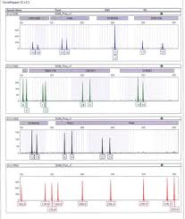

The Soda Can Case
Scenario
  Drinking vessel
  Subject (individual #1) in a homicide drank out of can prior to shooting victim
  Elimination sample (individual #2) owned can and drank out of can (per case information provided)
  Question- is subject (individual #1) a contributor to the DNA profile from the swabbing of mouth of can?
Individual #1
Compare to knowns
➔
➔
Individual #2

Slide 26

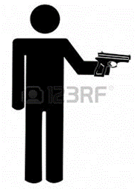
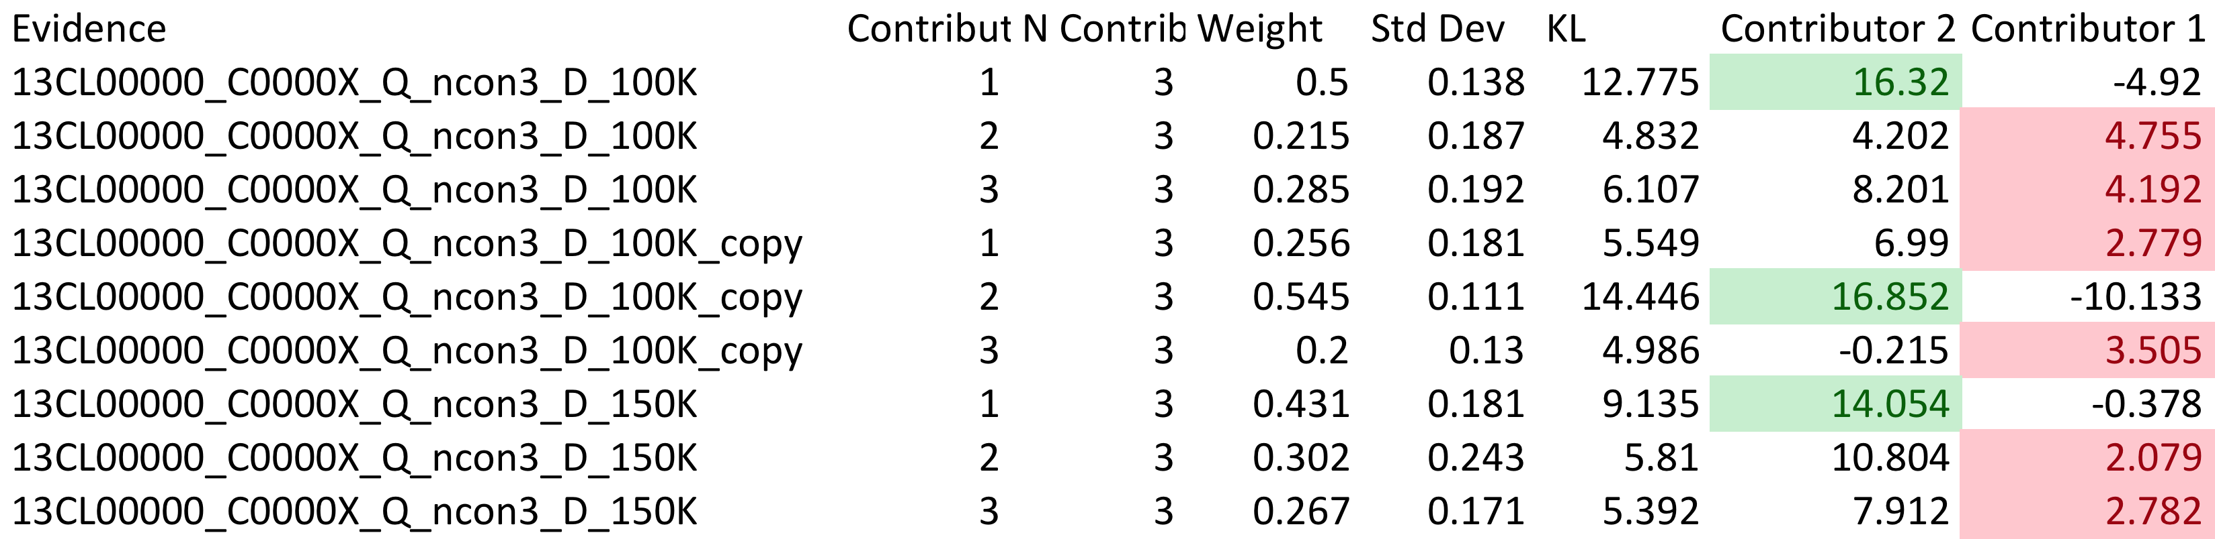
TrueAllele® Requests
Initial requests (round 1)
  Number of unknown contributors = 3
  Degraded option = on
  100K burn in/ 100K read out + copy
  150K burn in/150K read out

Slide 27
Additional Requests (round 2)
  Our protocol states..
    Individuals can be inferred for intimate samples or for samples where it is reasonable to assume their presence based on case-specific information
    In addition, for the non-intimate samples, the request must be made with and without known reference profiles and log(LR) values must be >4.
Therefore, individual 2 could be an inferred as a contributor
Additional requests
  Infer contributor 2
  Number of unknown contributors = 2
  Degraded option = on
  100K burn in/ 100K read out + copy
Evidence | Contributor | N Contrib | Weight | Std Dev | KL | Individual 2 | Individual 1
13CL00000_C0000X_Q_ncon3_D_100K+C1111X | 2 | 3 | 0.235 | 0.117 | 7.12 | -15.667 | 5.483
13CL00000_C0000X_Q_ncon3_D_100K+C1111X | 3 | 3 | 0.2 | 0.13 | 5.541 | -13.423 | 5.647
13CL00000_C0000X_Q_ncon3_D_100K+C1111X_copy | 2 | 3 | 0.218 | 0.125 | 5.95 | -12.865 | 5.624
13CL00000_C0000X_Q_ncon3_D_100K+C1111X_copy | 3 | 3 | 0.222 | 0.124 | 6.412 | -13.411 | 5.533

Slide 28
The Ax Case
Scenario:
  Request for re-analysis of samples previously analyzed and reported out by another laboratory (using manual interpretation methods)
  Raw data files were submitted and uploaded into the system

Slide 29
Sample details
Questioned item:
  1 Ax (three separate swabs were sampled from the item on the handle and blade areas
  All samples were at least three person mixtures
Known reference samples:
  1 Subject

Slide 30
Requests
Three person requests at 100,000 cycles non-degraded
Three person requests at 100,000 cycles degraded*
Four person requests at 100,000 cycles non-degraded
Four person requests at 100,000 cycles degraded

Slide 31
Results of TrueAllele® analysis
Positive match scores for the subject in the minor portion of one of the samples (excluded from the major portion)
Subject was excluded from the other two samples
Sample details:
~ 1ng DNA was amplified
Approximate % contribution for each contributor
83%, 9%, 8%

Slide 32
Comparison of results
Manual Interpretation
TrueAllele® Analysis
Best statistic in a population group:
1 in 8
Best statistic in a population group:
2.4 Million

Slide 33
What’s Next?
TrueAllele® Database
  Evidence profile category (all requests run at 5000 cycles, 3 unknown contributors)
    EVI- Forensic Unknowns
  Reference profile categories (All requests run at 500 cycles)
    SUB- Subjects/suspects named in case file
    VIC- Victims named in case file
    POI- Individuals identified for use as elimination knowns and or not specifically named as victims or subjects within the laboratory documents
    STF- Staff and law enforcement profiles
Match rule | Usage (when they are searched)
EVI to EVI | ALWAYS
EVI to SUB | ALWAYS
EVI to STF | ALWAYS
EVI to POI | Upon request from the DA or ADA of Kern County
EVI to VIC | NEVER

Slide 34
Acknowledgement s
Cybergenetics
Attendees
Dr. Kevin Miller

Slide 35
Questions?

