Slide 1

TrueAllele for Africa
6# African Forensic Forum
University of Cape Town
South Africa
March 2026
Mark W Perlin, PhD, MD, PhD
Cybergenetics, Pittsburgh, PA USA
Cybergenetics © 2003-2026

Slide 2

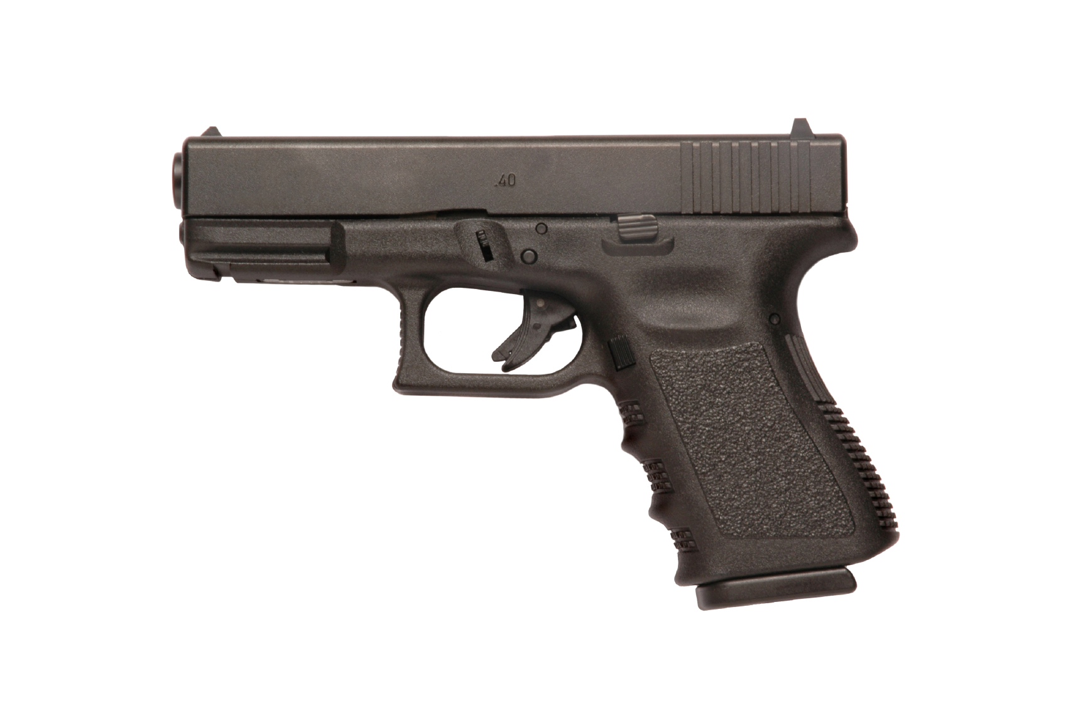

Informative genotyping
2
Inconclusive uninterpretable DNA mixture?
Cybergenetics TrueAllele® computer analysis
Probability preserves identification information
Person A
excluded
Contributor
Unmix the
mixture
1
2
400,000
3
Person B
included
4

Slide 3
UCT scientific research areas
1. Show sexual violence does exist as a problem in Africa
2. Demonstrate that “uninformative” DNA data can be informative
3. Reveal the presence of multiple perpetrators in DNA rape evidence
4. Find serial offenders by comparing DNA evidence between crimes

Slide 4
California serial rapist
Kern Regional Crime Laboratory
garments
blankets
apartment surfaces
skin
body cavities telephones
zip ties
thirty-seven
swabs and cuttings
October 2013
low-level DNA mixtures containing 3 or 4 people

Slide 5
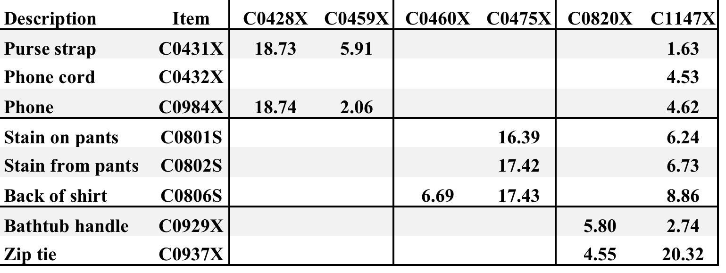
Informative DNA mixtures
8 mixture items vs. 5 victims + 1 suspect
BRJ
likelihood ratio (DNA match statistic)
measures identification information

Slide 6
DNA threshold funnel
Use evidence item
Generate DNA data
Infer genotype
Match
Database

Slide 7
Discard DNA information
Most DNA evidence isn’t reported

Slide 8
Preserve DNA information
TrueAllele infers probabilistic genotype

Slide 9
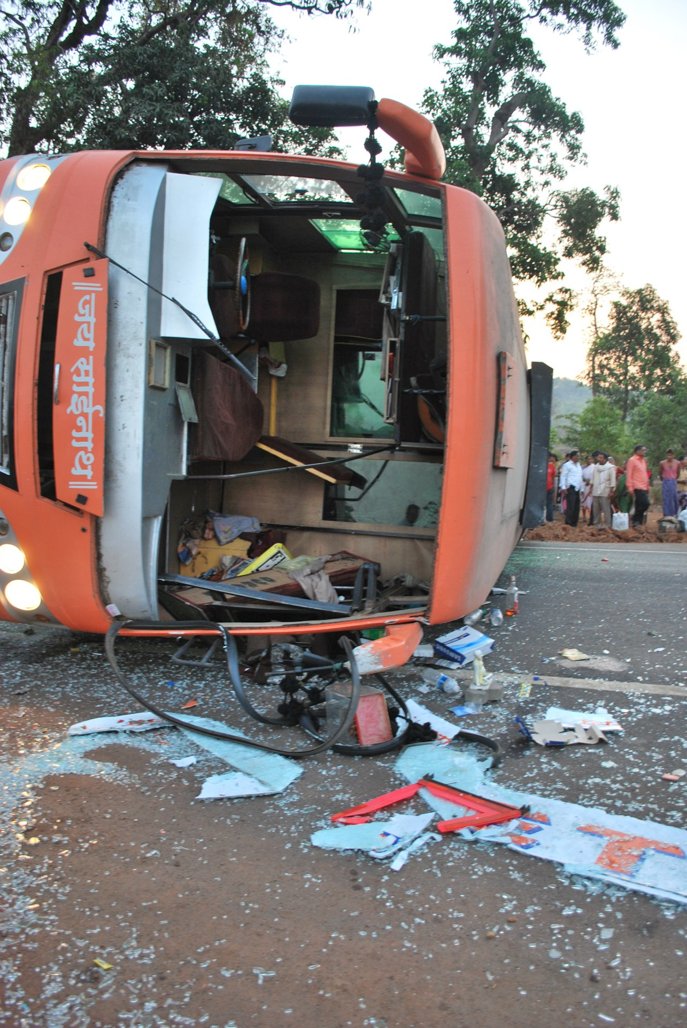
South African bus crash
2008 bus crash in Komatipoort, South Africa
Police recover burned victim remains
Relatives submit DNA to help identify remains
Data sent to Cybergenetics

Slide 10
Victim remains
Victim Remains
AO0553E AO0554E AO0555E AO0556E AO0557E AO0558E AO0559E AO0560E AO0561E AO0562E AO0563E AO0564E AO0565E AO0566E AO0567E

Slide 11
Relatives of missing people
Sample | Relation
AP2438C AP2439C AP2440C AP2441C AP2442C AP2443C AP2444C AP2445C AP2446C AP2447C AP2448C AP2449C AP2450C AP2451C AP2452C AP2455C | Grandfather Daughter Son Mother Son Sister Father Son Unknown Brother Brother Sister Mother Son Father Son

Slide 12
DNA match results
 | Relations of missing persons
Victim remains | AP2439C | AP2440C | AP2441C | AP2442C | AP2444C | AP2445C | AP2446C_3 | AP2451C | AP2455C
AO0553E
AO0554E |  |  |  |  |  |  | 4.45
AO0555E |  |  |  |  |  |  |  | 1.88
AO0556E |  |  |  | 5.03
AO0557E |  |  |  |  |  | 3.57
AO0558E
AO0559E |  |  |  |  |  |  |  |  | 2.95
AO0560E
AO0561E |  |  |  |  | 2.34
AO0562E
AO0563E |  |  | 3.36
AO0564E
AO0565E
AO0566E | 4.03
AO0567E |  | 2.25

Slide 13
TrueAllele identifications
Victim Remains
AO0553E AO0554E AO0555E AO0556E AO0557E AO0558E AO0559E AO0560E AO0561E AO0562E AO0563E AO0564E AO0565E AO0566E AO0567E
Sample | Relation
AP2438C AP2439C AP2440C AP2441C AP2442C AP2443C AP2444C AP2445C AP2446C AP2447C AP2448C AP2449C AP2450C AP2451C AP2452C AP2455C | Grandfather Daughter Son Mother Son Sister Father Son Unknown Brother Brother Sister Mother Son Father Son

Slide 14
All genotyping is probabilistic
Why? Because a genotype is a statistical variable that summarizes DNA data.
A statistical variable has uncertainty.
In math and science, probability is the only valid way to represent uncertainty.
But some genotype probabilities are more accurate and informative than others.

Slide 15
Genotype LR distributions
Contributor
Noncontributor
Frequency
context
Comparison
LR = 200

Slide 16
Measure genotype accuracy
Contributor
Noncontributor
Discrimination
accuracy
99.97%
Error rate
1 in 4,000
Separation

Slide 17
US v. Sandoval
Noncontributor
Contributor
TrueAllele
Accuracy = 100%
Discriminate
between Noncontributor
and Contributor
classifications
Noncontributor
Contributor
STRmix
Accuracy = 91%

Slide 18
LR sensitivity to data threshold
TrueAllele
RFU | nloci | npeaks | △KL | log(LR)
0 | 21 | 210 | 22.4487 | -6.7828
STRmix
RFU | nloci | npeaks | △KL | log(LR)
10 | 19 | 54 | 12.3538 | -3.1580
20 | 18 | 38 | 6.8887 | -6.2917
30 | 16 | 29 | 4.1158 | -3.2046
40 | 14 | 24 | 1.7239 | -0.8440
50 | 12 | 21 | 1.5647 | -0.8173
60 | 10 | 16 | 0.4240 | -0.5886
70 | 9 | 14 | 0.2194 | -0.5065
80 | 9 | 13 | 0.2612 | -0.6204
90 | 8 | 11 | 0.2092 | -0.6071

Slide 19
TrueAllele reliability
Over 40 validation studies
8 peer-reviewed papers
up to 10 contributors, low DNA
Over 50 admissibility rulings
accepted in US, UK, etc.
Over 500 client agencies
including FBI
Sensitive, specific, accurate
informative, easy to use

Slide 20
TrueAllele for Africa
DNA information solves crime
prevents crime, promotes justice
Information preserving genotypes
connect crimes and criminals
more effective DNA database
Computer automation
accurate genotyping and match
scales up for Africa at low cost
Easy to understand and use

Slide 21



21
More information
http://www.cybgen.com/information
• Courses
• Newsletters
• Newsroom
• Presentations
• Publications
• Reliability
• Webinars
http://www.youtube.com/user/TrueAllele
TrueAllele YouTube channel
info@cybgen.com

