Slide 1


Turning Unsearchable Mixtures into Actionable Intelligence for Reliable DNA Evidence
American Academy of Forensic Sciences
Criminalistics Section
February, 2026
New Orleans, LA
Edward Schikel¹, MBA; Terrance Lewis¹, MA;
Matthew Legler², BS; Mark Perlin², PhD, MD, PhD
¹Montgomery County Detective Bureau, Pennsylvania
²Cybergenetics Corp, Pennsylvania
Cybergenetics © 2003-2026

Slide 2
Disclosure
The views and opinions expressed in this presentation are those of the presenters & authors and do not represent any official views or opinions of the American Academy of Forensic Sciences.
Some of the authors are employed by Cybergenetics.
We show the TrueAllele® evidence interpretation technology developed by Cybergenetics.

Slide 3

Burglary
Thefts
Car Break-Ins
Weapons Possession

Slide 4
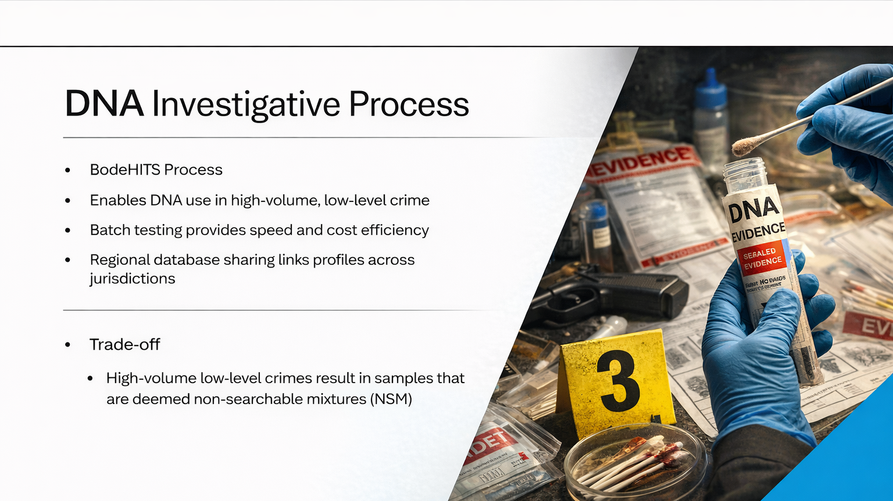

Slide 5
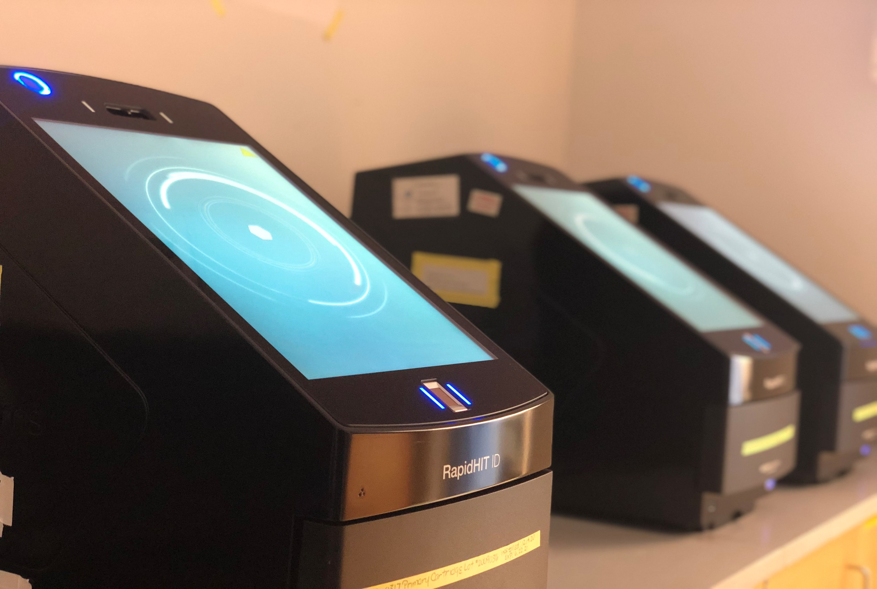
RapidHit Investigative Process
Enables the 90-minute processing of single-source samples, producing DNA profiles for uploading and searching of the BodeHITS Database for regional sharing matches
It allows us to answer investigative questions in real-time

Slide 6
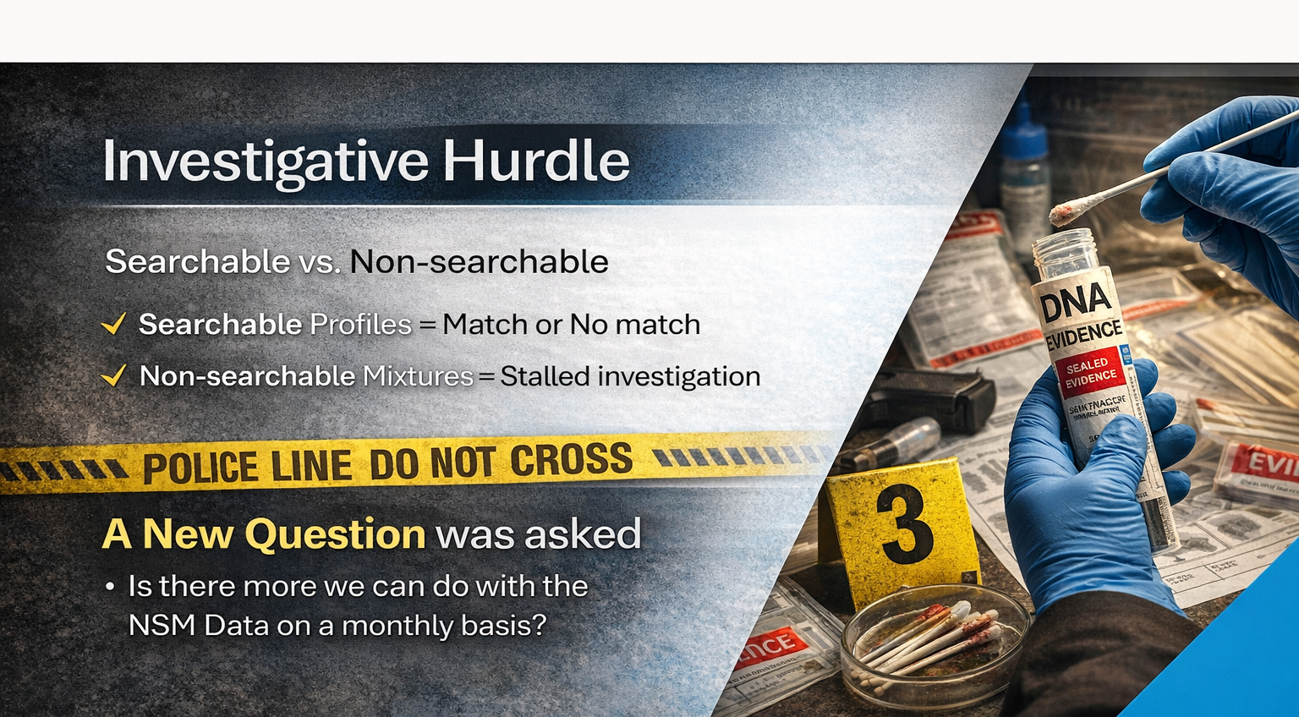

Slide 7
MontCo and Cybergenetics Collaboration
Established TrueAllele Investigative Database (TAID)
Allow us to re-evaluate the NSMs
Started with two years of high-volume low-level crime data
Developed associations between evidence and reference samples

Slide 8
TrueAllele® Technology
Separates data into contributor genotypes
uses all data, no thresholds, 10 contributors
Represents uncertainty using probability
accurate: preserves identification information
unbiased: doesn’t know suspect profile
Reports likelihood ratio match statistic
change in genotype probability, error rates
Automated computer workflow frees people
no calibration, learns from evidence data

Slide 9
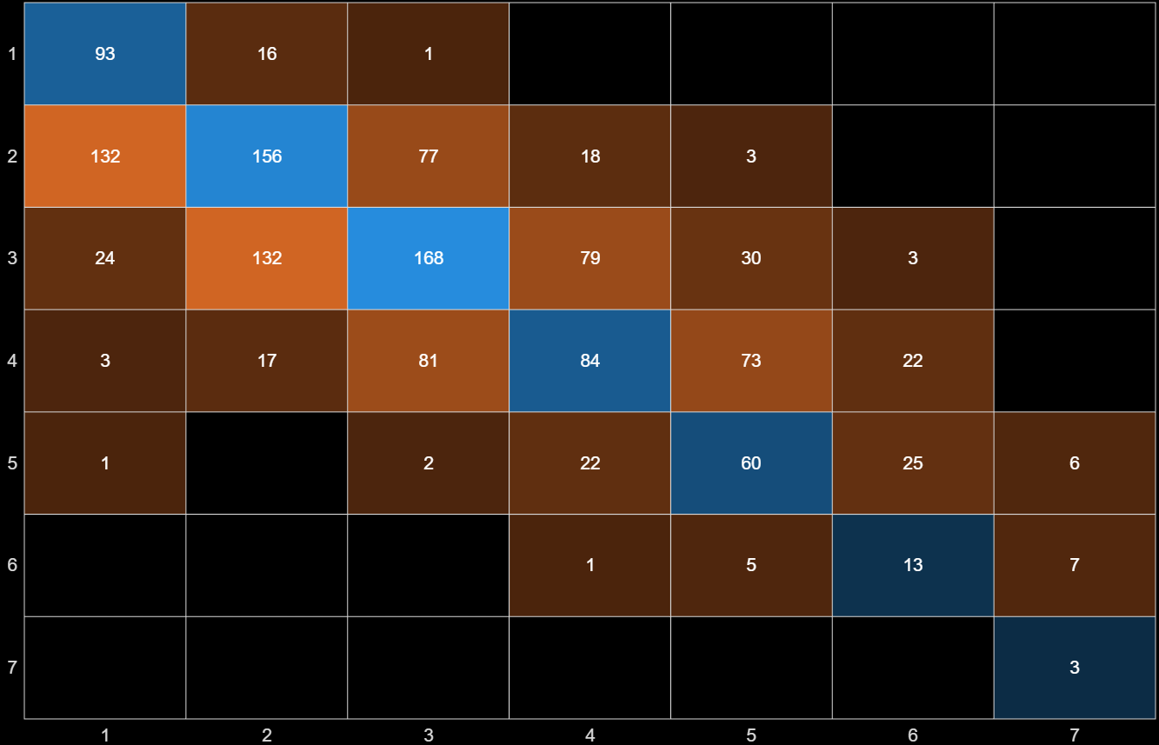
Number of Contributors

Slide 10
TrueAllele Database
Genotype matching database
uploads all genotypes
automated match server
Connects separated genotypes
evidence to evidence
evidence to reference
LR connection strength
records DNA matches

Slide 11
TrueAllele + LIMS = TAID
TrueAllele Identification Database (TAID)
uploads all contributor genotypes
preserves DNA match information
records all strong LR connections
annotates with LIMS information
Reduces human effort ten-fold
Passes cost saving on to investigator
Enables affordable volume crime DNA

Slide 12
Evidence to Evidence

Slide 13
Evidence to Reference

Slide 14
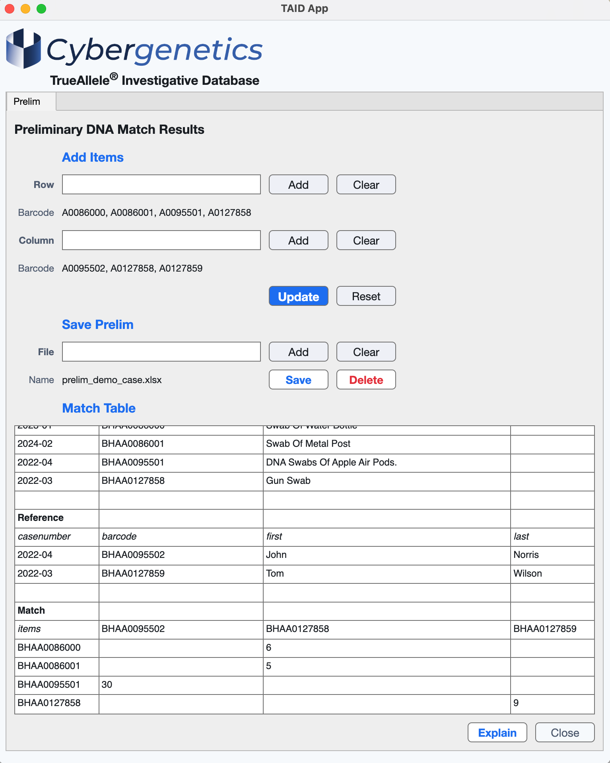

Slide 15
From Mixtures to Clarity
Montgomery Bode data to Cybergenetics
100 DNA items / month
60% evidence, 40% reference
60% unsearchable mixtures unused
TrueAllele ID information improvement
1.32 evidence matches / item
98% of evidence is informative
72% unsearchable mixtures matched

Slide 16
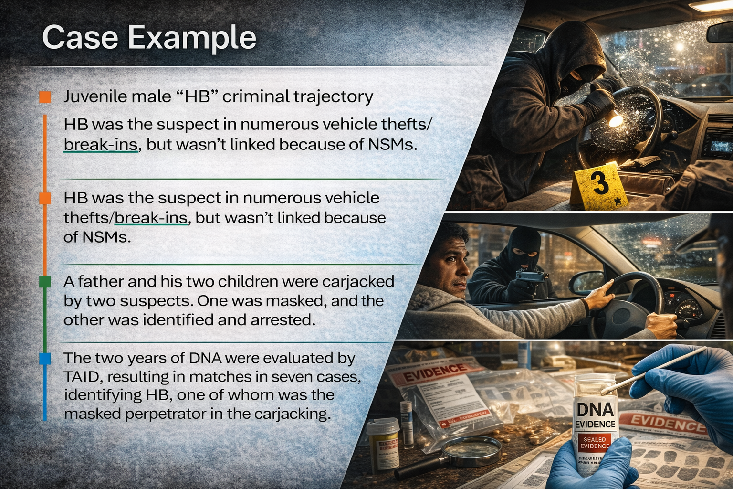

Slide 17
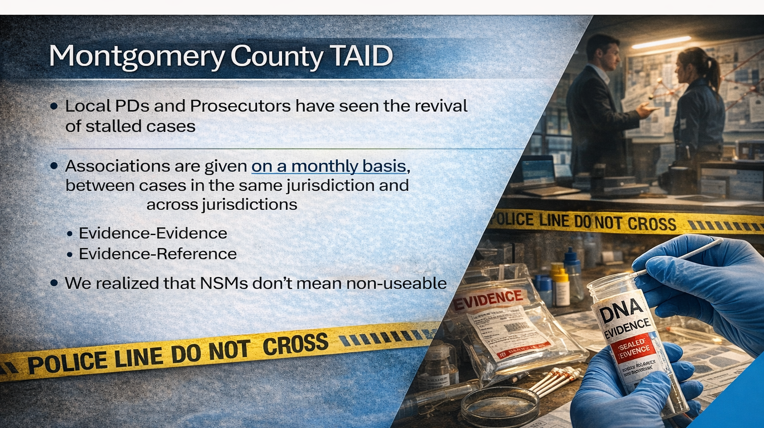

Slide 18
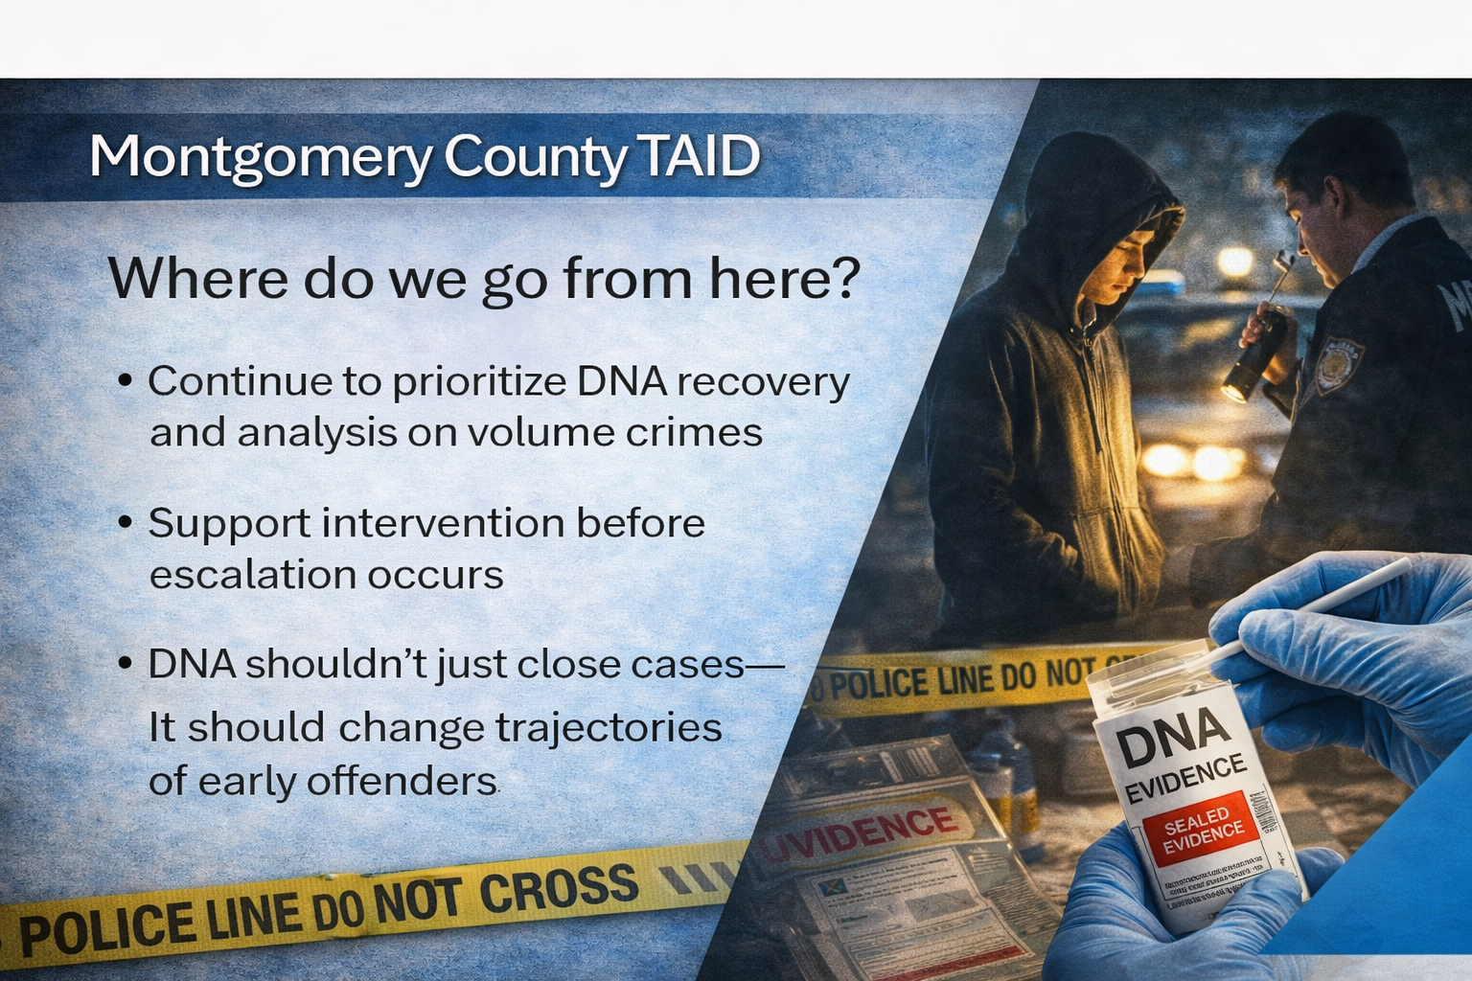

Slide 19




More TAID information
http://www.cybgen.com/information
• Courses
• Newsletters
• Newsroom
• Presentations
• Publications
• Reliability
• Webinars
http://www.youtube.com/user/TrueAllele
TrueAllele YouTube channel
info@cybgen.com

