Slide 1

Solving Complex DNA Mixtures with Next Generation Sequencing
American Academy of Forensic Sciences
Criminalistics Section
February, 2026
New Orleans, LA
Kari Danser, MS; William Allan, MS
Mark Perlin, PhD, MD, PhD
Cybergenetics © 2003-2026

Slide 2
Disclosure
The views and opinions expressed in this presentation are those of the presenters & authors and do not represent any official views or opinions of the American Academy of Forensic Sciences. Some authors are employed by Cybergenetics. We show the TrueAllele® evidence interpretation technology developed by Cybergenetics.
Notes:
5 person mixture

Slide 3
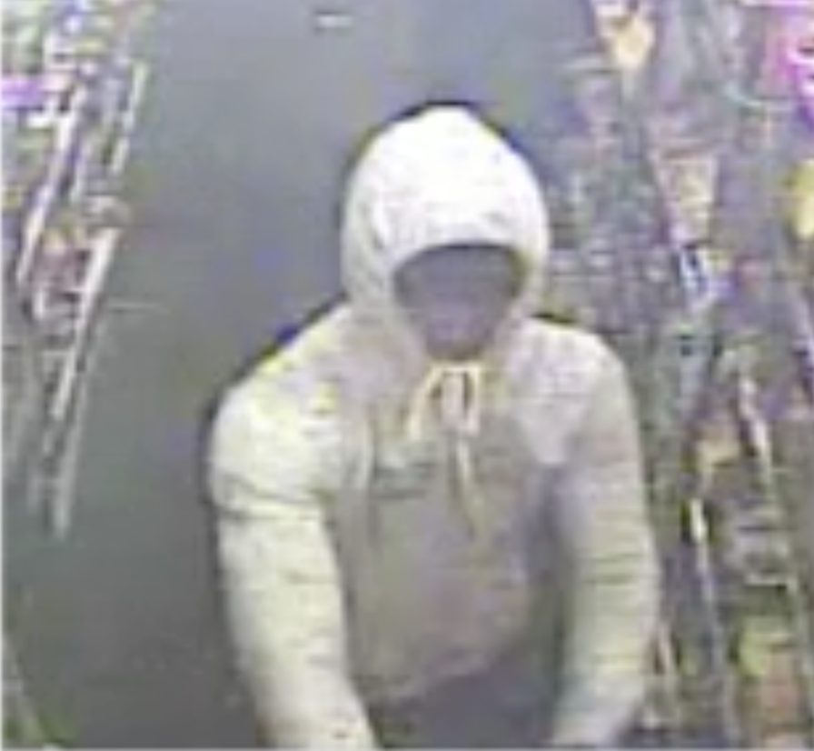
Ohio v. Slater Howell
On April 7, 2014, gas station clerk Babul Kumer Saha was killed before the store was robbed.
Notes:
5 person mixture

Slide 4
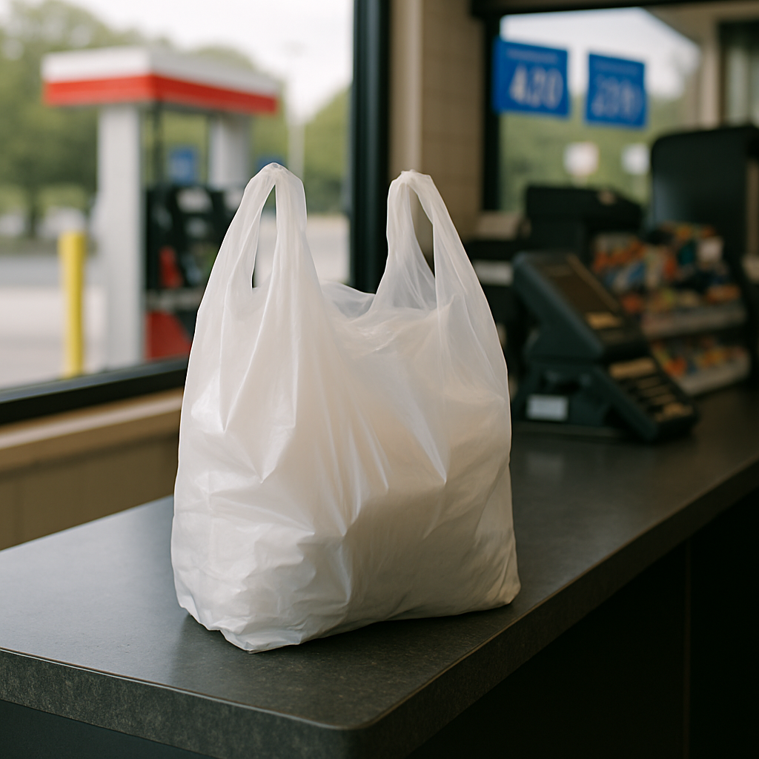
DNA Evidence
DNA samples were collected from a gas pump button, a plastic bag, and a lottery cash register slot.

Slide 5
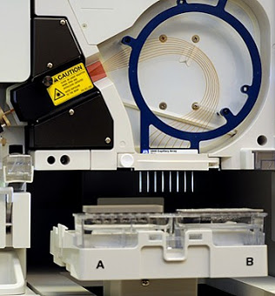
Capillary Electrophoresis (CE)
Fragment analysis
PCR based
STR multiplex
Notes:
Originally STRs were separated by gel
Now STRs are most commonly separated by capillary electrophoresis
cost effective, high throughput, and offers fast turn around
implemented worldwide
PCR
Polymerase Chain Reaction (PCR) gave the ability to make hundreds of millions of copies of specific sequences of DNA in only a few hours
An enzymatic process in which a specific region of DNA is replicated repeatedly to yield many copies of a particular sequence
Involves heating and cooling in a precise thermal cycling pattern
Under perfect conditions with 100% efficiency approximately a billion copies of the target sequence will be made
Multiplexing allows us to look at multiple STR locations in one reaction
Commercial kits were developing involving increasing numbers of STR locations

Slide 6
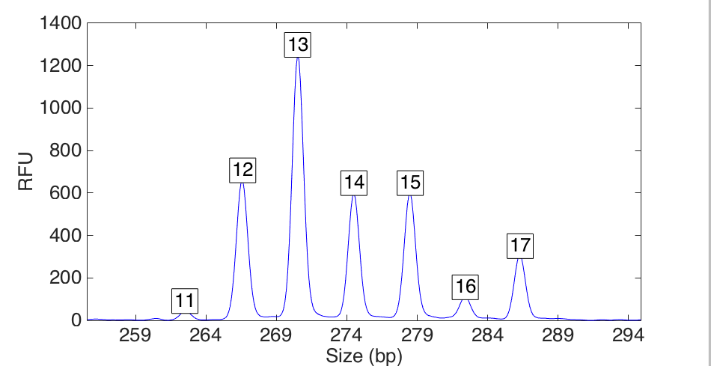
TrueAllele on CE
Quantitative STR data at locus D10
peak size
peak
height

Slide 7
Explaining the CE data
Seven-person DNA mixture

Slide 8
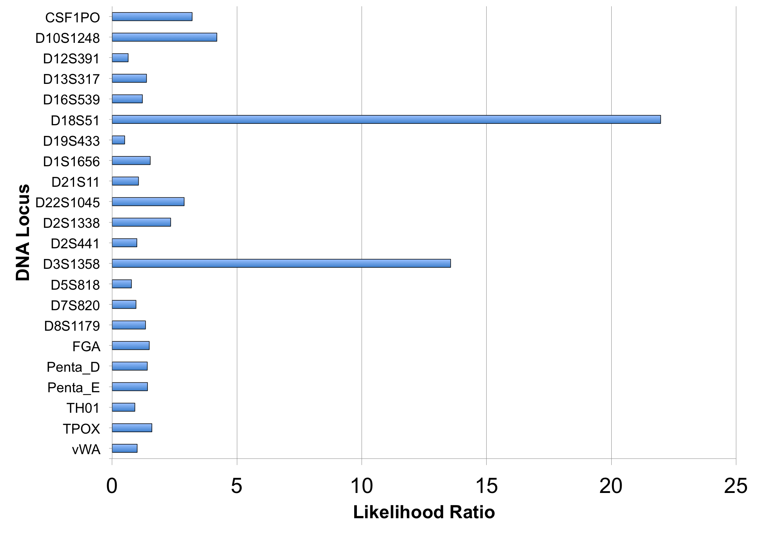
CE Likelihood Ratio (22 loci)

Slide 9
CE LR and error rate
A match between the plastic bag
and Slater Howell is:
98 thousand times more probable
than a coincidental match.
For a match strength of 98 thousand,
only 1 in 119 million people would match as strongly.
Notes:
Get the statement and error rate

Slide 10

Case outcome
In 2017, the jury found Howell guilty. He was sentenced to life in prison.

Slide 11
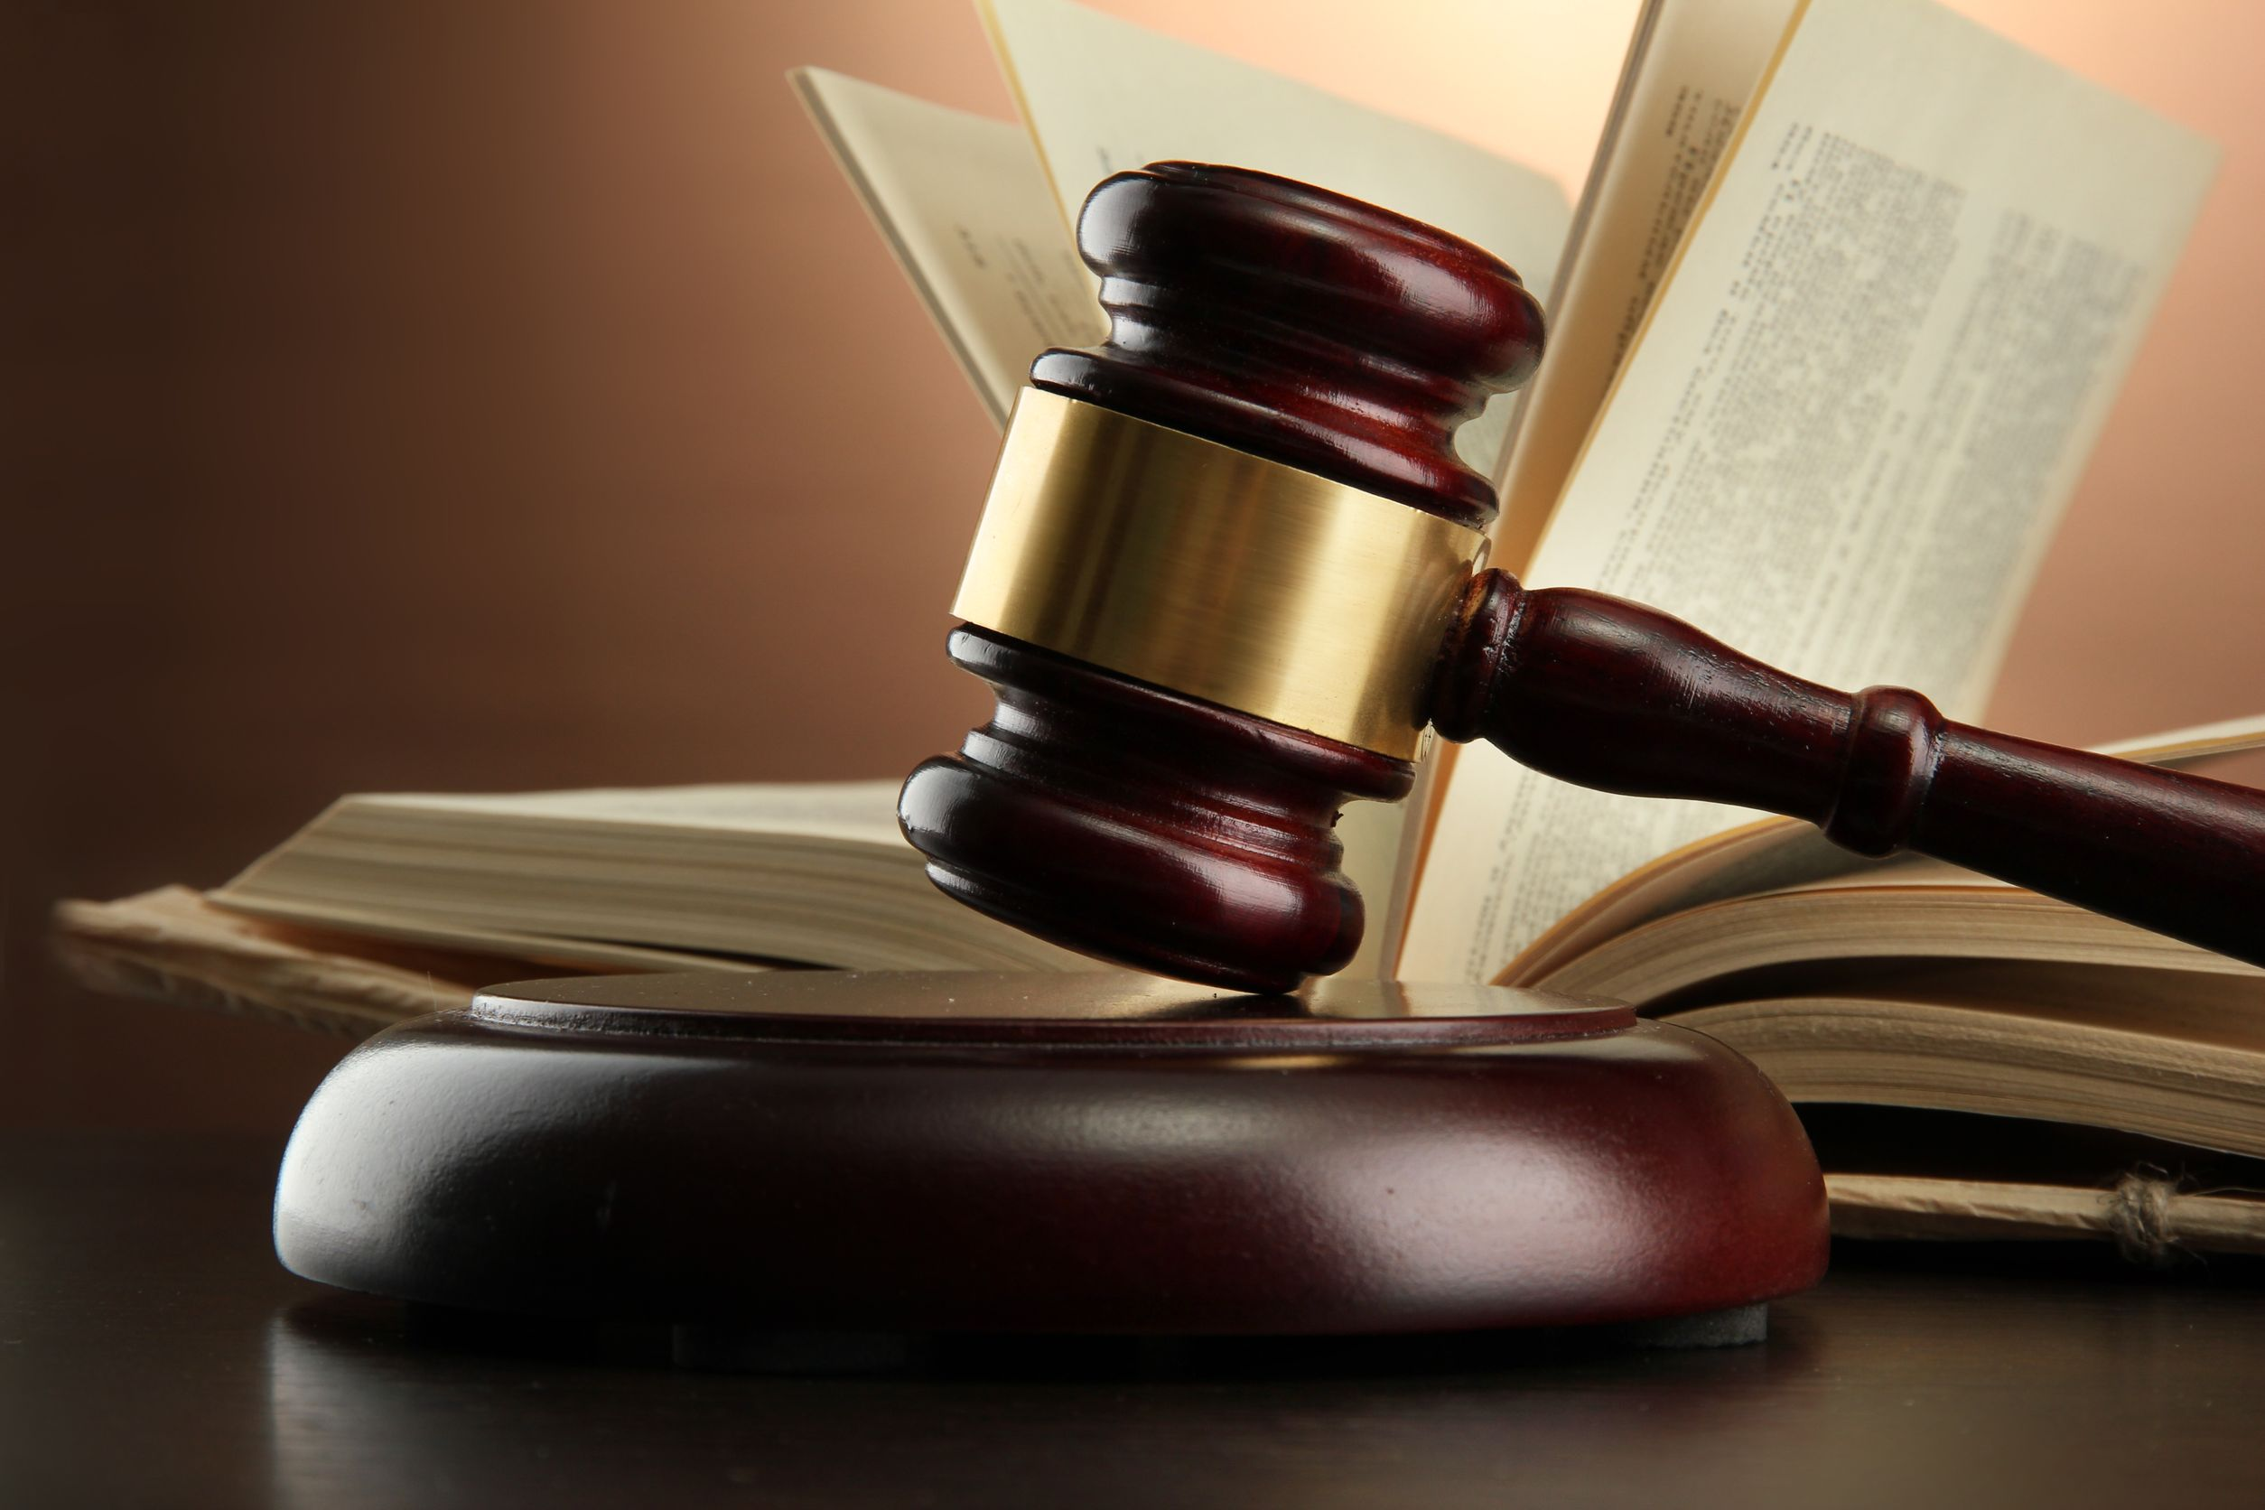
TrueAllele Reliability
Over 40 validation studies
8 peer-reviewed publications
Validated for up 10 unknown contributors
49 successful US admissibility rulings
In 16 different states
3 Ohio Daubert hearings
Federal court acceptance
Appellate precedent in 8 states

Slide 12
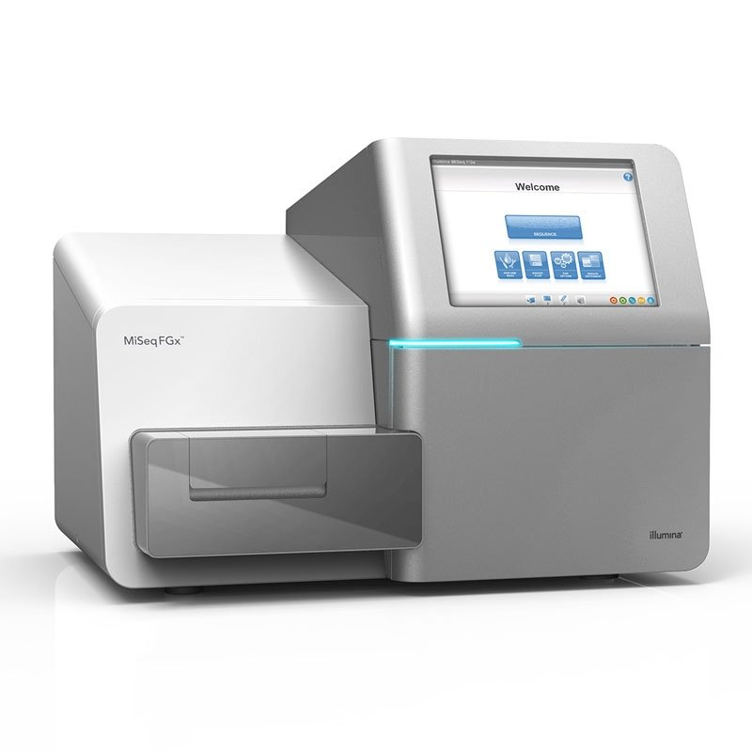
Next Generation Sequencing (NGS)
Sequence analysis
Bridge amplification
STR & SNP multiplex
Notes:
Originally STRs were separated by gel
Now STRs are most commonly separated by capillary electrophoresis
cost effective, high throughput, and offers fast turn around
implemented worldwide
PCR
Polymerase Chain Reaction (PCR) gave the ability to make hundreds of millions of copies of specific sequences of DNA in only a few hours
An enzymatic process in which a specific region of DNA is replicated repeatedly to yield many copies of a particular sequence
Involves heating and cooling in a precise thermal cycling pattern
Under perfect conditions with 100% efficiency approximately a billion copies of the target sequence will be made
Multiplexing allows us to look at multiple STR locations in one reaction
Commercial kits were developing involving increasing numbers of STR locations

Slide 14
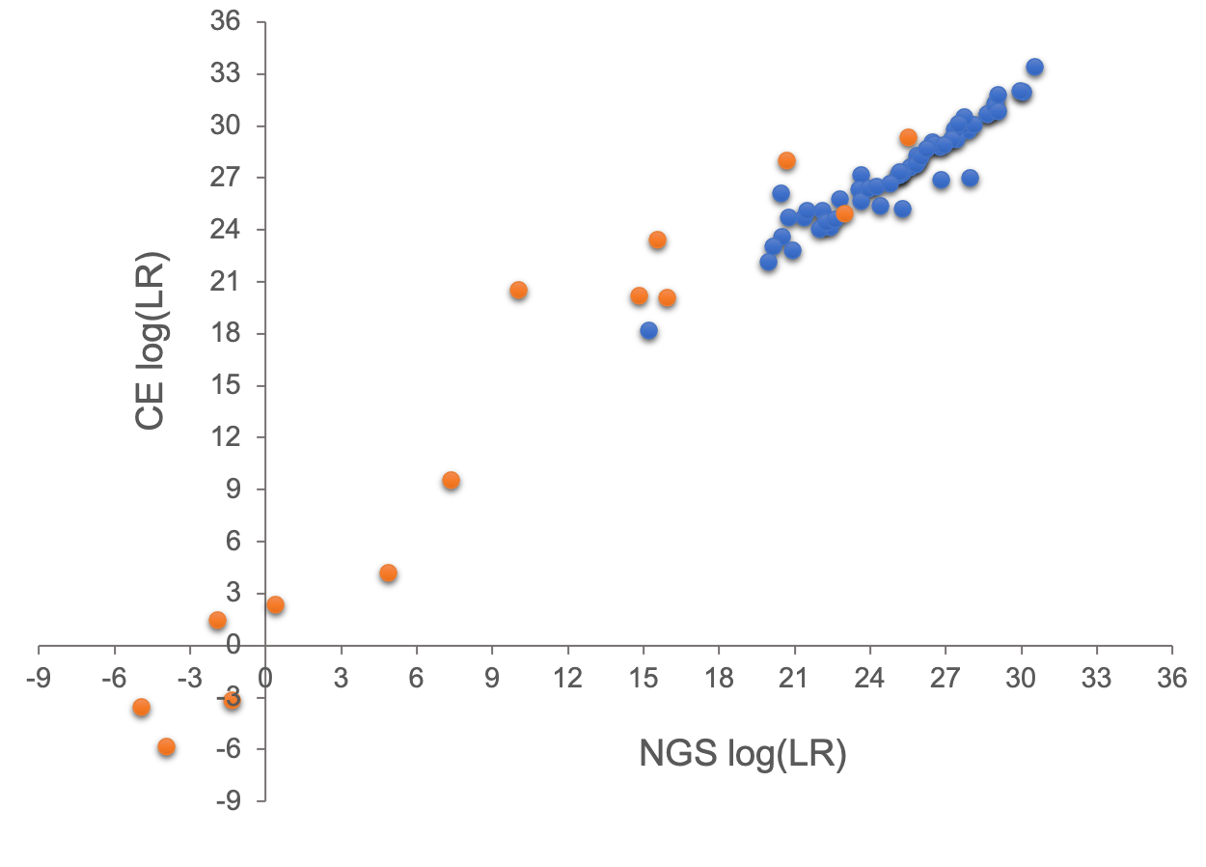
Concordance (CE & NGS)
Single source
DNA mixture

Slide 15
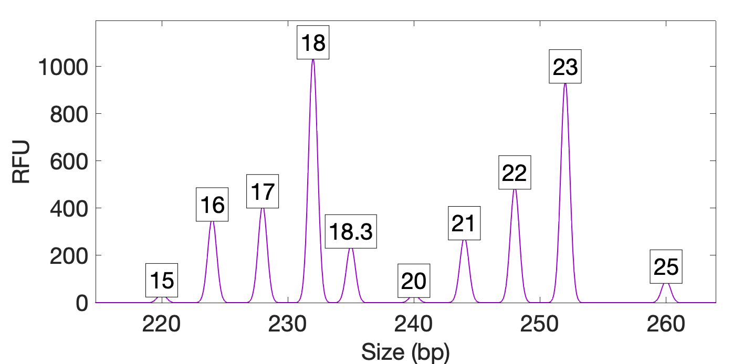
TrueAllele on NGS
Quantitative STR data at locus D12
peak size
peak height
Notes:
New image with NGS data

Slide 16
Explaining the NGS data
Seven-person DNA mixture
Notes:
New image with NGS data and boxes

Slide 17
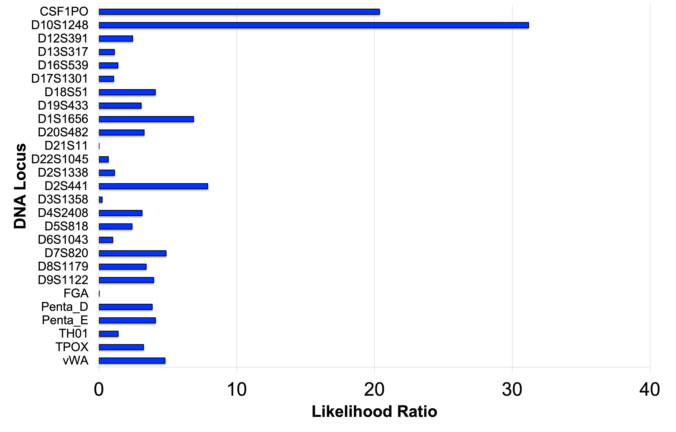
NGS Likelihood Ratio (27 loci)
Notes:
New image

Slide 18
NGS LR and error rate
A match between the evidence item
and the defendant is:
29 million times more probable
than a coincidental match.
For a match strength of 29 million,
only 1 in 12.4 billion people would match as strongly.

Slide 19
CE vs. NGS
Victim
5.35
11.39
0
1
2
3
4
5
6
7
8
9
10
11
12
log(LR)
4.99
7.46
Suspect
0
1
2
3
4
5
6
7
8
9
10
11
12
More loci, more information

Slide 20
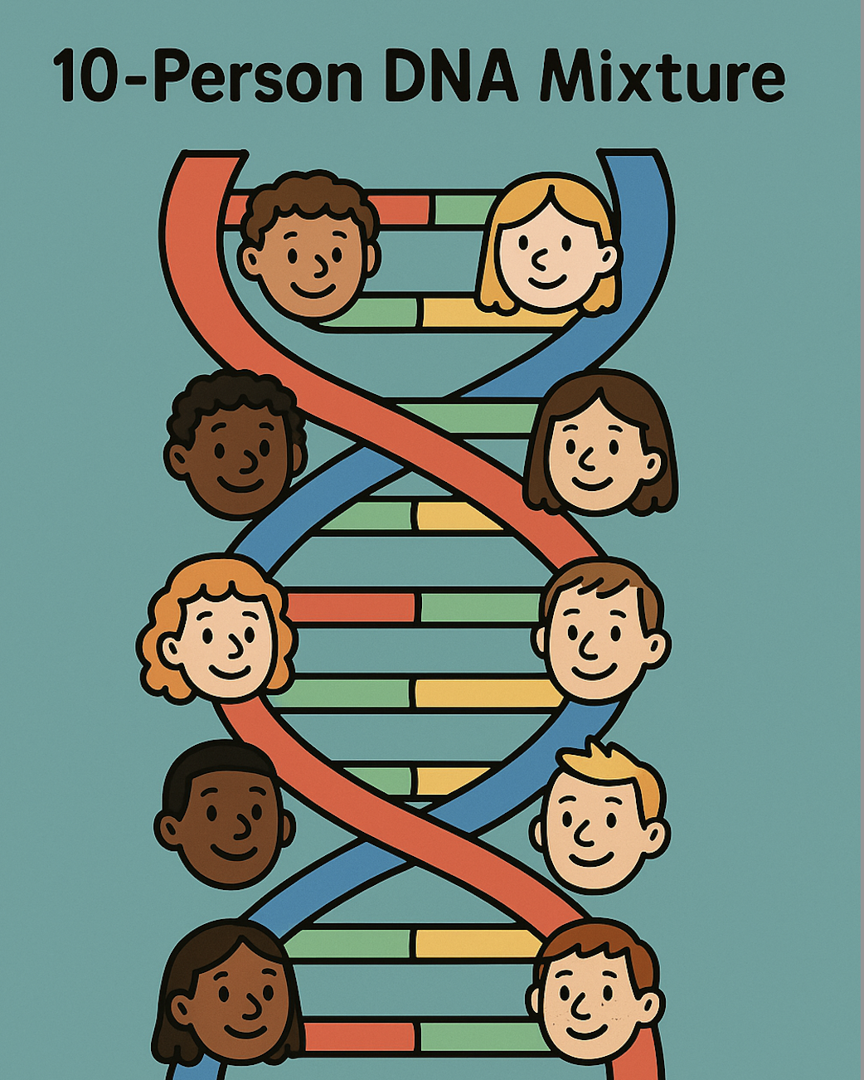
Conclusions
The TrueAllele technology:
uses CE and NGS data
is validated for CE and NGS
solves 10-person mixtures

Slide 21




More information
http://www.cybgen.com/information
• Courses
• Newsletters
• Newsroom
• Presentations
• Publications
• Reliability
• Webinars
http://www.youtube.com/user/TrueAllele
TrueAllele YouTube channel
info@cybgen.com

