Slide 1


Computer Interpretation of RapidHIT Mixtures for DNA Match Information
American Academy of Forensic Sciences
Criminalistics Section
February, 2026
New Orleans, LA
Paul Berry, MS; Baron Andrus, MS
William Allan, MS; Mark Perlin, PhD, MD, PhD
Cybergenetics © 2003-2026

Slide 2
Disclosure
The views and opinions expressed in this presentation are those of the presenters & authors and do not represent any official views or opinions of the American Academy of Forensic Sciences.
Some authors are employed by Cybergenetics.
We show the TrueAllele® evidence interpretation technology developed by Cybergenetics.

Slide 3
RapidHIT™ ID (Applied Biosystems™)
Produces a DNA profile in as little 90 minutes
Swab in, profile out workflow (Lab in a box)
Originally intended for offender reference samples in booking stations

Slide 4
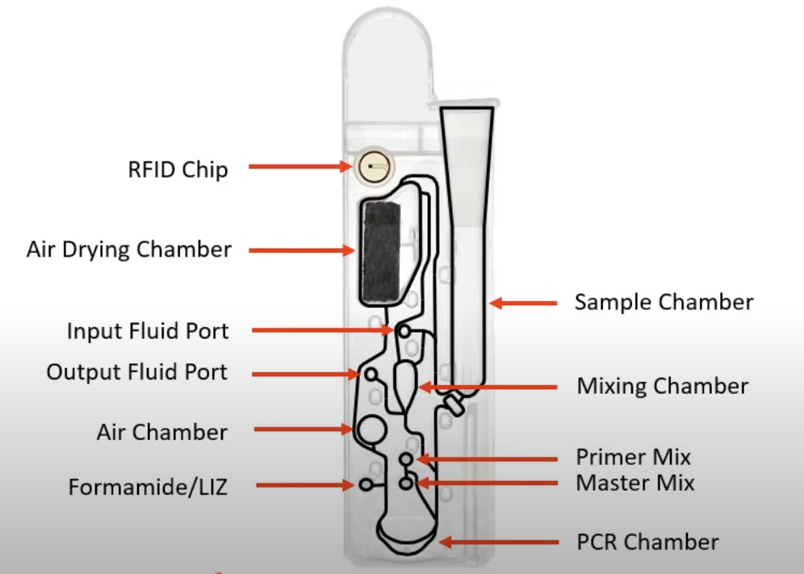
RapidINTEL Plus Cartridge
Designed for forensic purposes
GlobalFiler™ Express Chemistry
Contains internal quality control and quantification markers

Slide 5
Louisiana State Police Crime Lab- Investigative Leads Rapid Program
March 2024
August 2024
July 2025
Purchase and installation of RapidHIT ID Instruments
RapidINTEL Plus Cartridge Validation
Achieved Scope Extension from ANAB

Slide 6
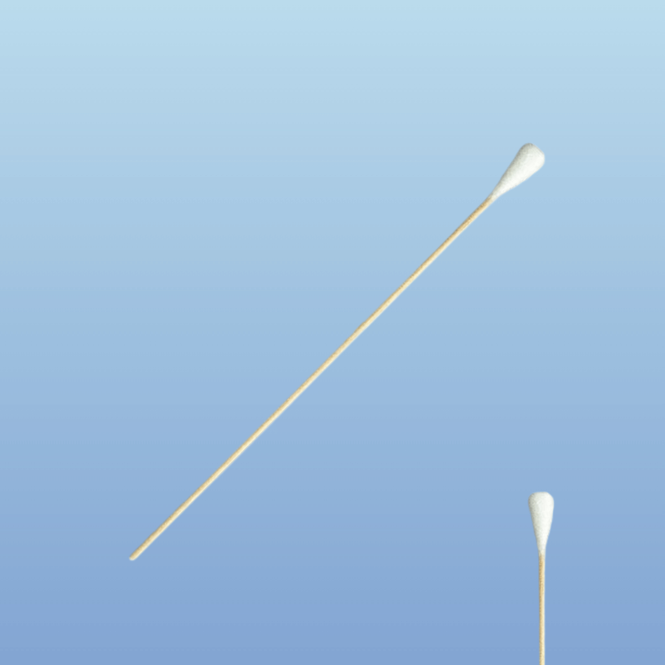
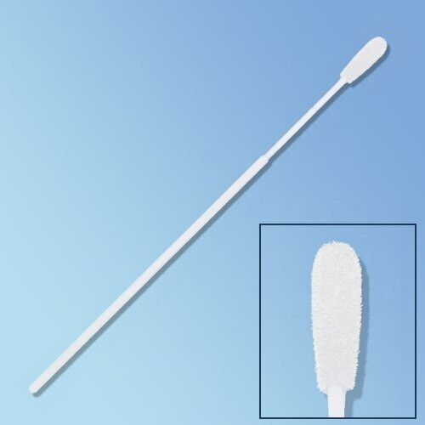
Protocols
15μl of each saliva mixture were spotted on two different substrates in triplicate and were processed with the General Protocol and the Specialized Protocol:
Cotton Swabs
Flocked Swabs

Slide 7
NDIS Submission
Partnered with other partner laboratories to seek FBI approval for the RapidINTEL Plus cartridge
A mixture study was performed by LSP in which saliva samples were collected from donors and combined to simulate mixtures with various proportions.
Mixture | Minor Donor (male) | Major Donor (female)
1:1 | 75μl | 75μl
1:4 | 30μl | 120μl
1:9 | 15μl | 135μl

Slide 8

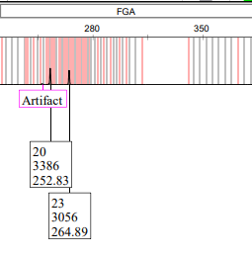
Data Interpretation
During the process of validation and data interpretation, what did we learn?
Heterozygous imbalance >40%
Stochastic effects are common
Can exhibit high rates of random PCR artifacts
LSP decided not to pursue mixture interpretation at that time.
29%

Slide 9
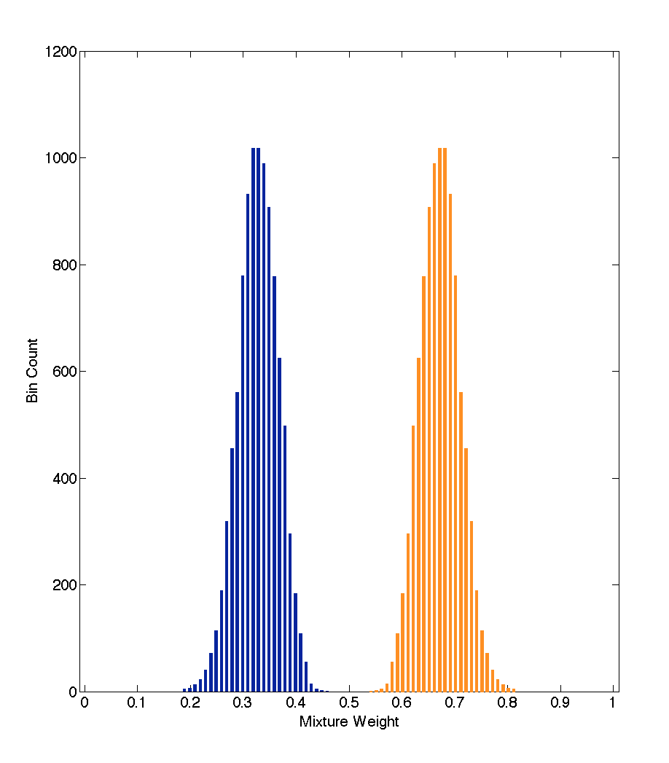
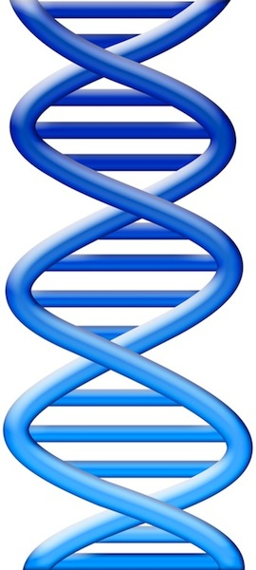
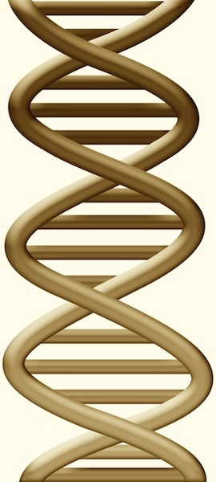
DNA Mixtures
Contributor genotypes
separated from DNA data
DNA mixed together from
multiple people
Minor
Major
Perlin MW, Szabady B. Linear mixture analysis:
a mathematical approach to resolving mixed DNA samples.
Journal of Forensic Sciences. 2001;46(6):1372-7.

Slide 10
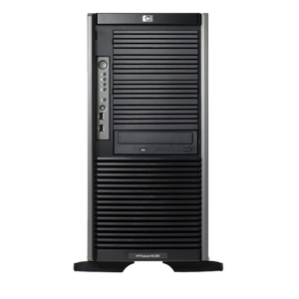
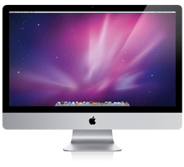
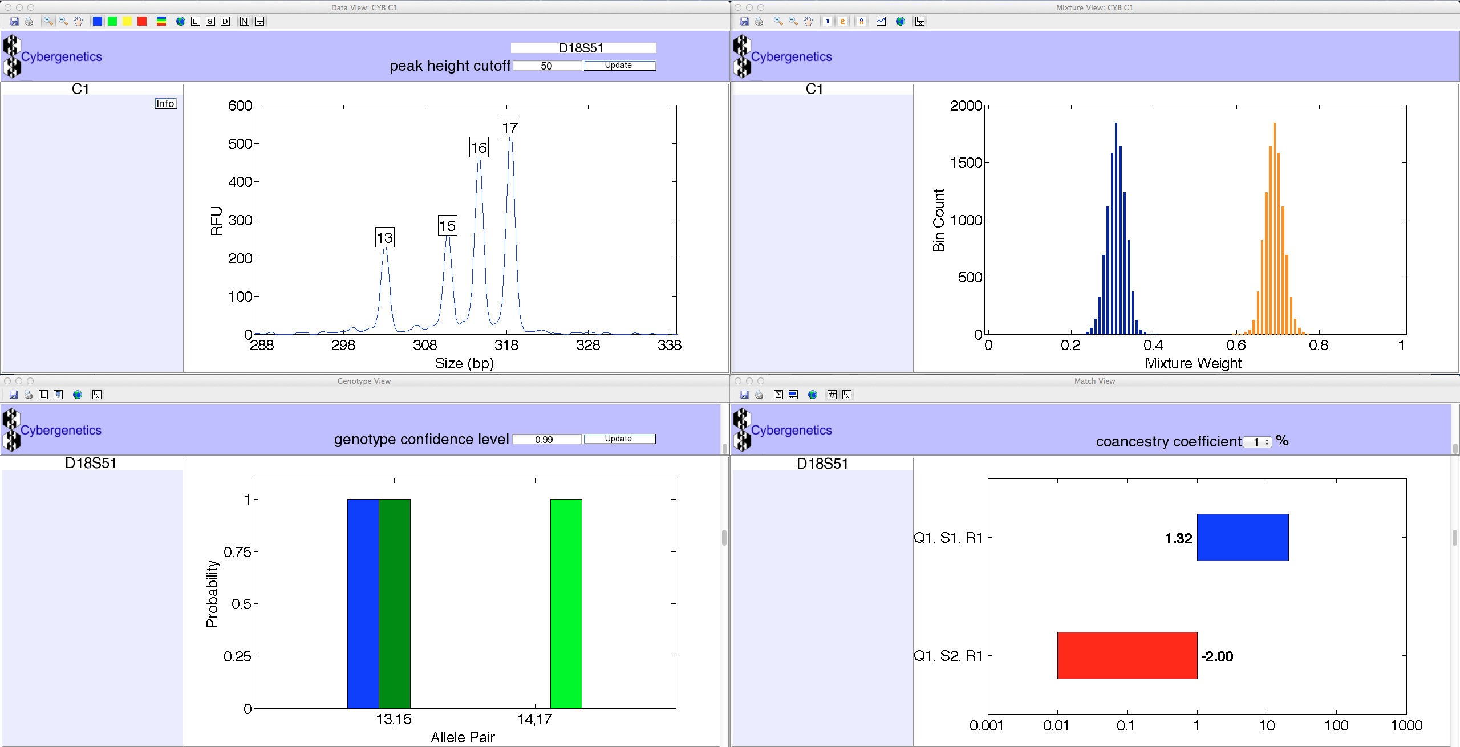
TrueAllele® Technology
Separates data into genotypes
all data, no thresholds,
solves 10 contributors
Probability represents uncertainty
accurate and unbiased
Likelihood ratio match statistic
measures identification information
Automated computer workflow
no calibration, learns from data
Visual User Interface
VUIer™ Software
Parallel Processing
Server Computer
Perlin MW, Legler MM, Spencer CE, Smith JL,
Allan WP, Belrose JL, Duceman BW.
Validating TrueAllele® DNA mixture interpretation.
Journal of Forensic Sciences. 2011;56(6):1430-47.

Slide 11
TrueAllele on Rapid Mixtures
Cybergenetics ran TrueAllele on LSP Rapid mixture data
Time: 30 minutes (short triplicate computer runs)
Information:
Major contributors easily identified (24 ban)
Minor contributors
10% to 20% minor components (15 ban)
1% to 5% minor components (6 ban)
better with specialized-flocked protocol

Slide 12
Minor: General on Cotton

Slide 13
Minor: Specialized on Flocked

Slide 14
Conclusions
On RapidHIT two-person saliva mixtures:
1. TrueAllele is fast and informative
2. Handles small minor contributors
3. No instrument calibration needed
4. Users can get started right away

Slide 15




15
More information
http://www.cybgen.com/information
• Courses
• Newsletters
• Newsroom
• Presentations
• Publications
• Reliability
• Webinars
http://www.youtube.com/user/TrueAllele
TrueAllele YouTube channel
info@cybgen.com

