Slide 1

TrueAllele® Casework takes NGS from the laboratory into the courtroom
Mid-Atlantic Association of Forensic Scientists
Richmond, Virginia
May, 2025
William P. Allan, MS
Kari R. Danser, MS
Mark W Perlin, PhD, MD, PhD
Cybergenetics © 2003-2025

Slide 2
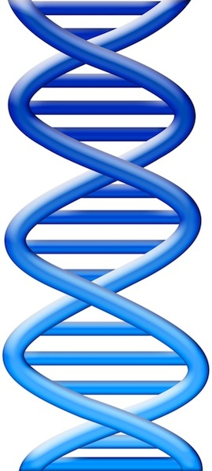
DNA evidence interpretation
Evidence item
Evidence data
Evidence genotype
10
12
Lab
Infer
10,12
DNA from
one person

Slide 3
DNA evidence interpretation
Evidence item
Evidence data
Evidence genotype
10
12
Lab
Infer
10,12
DNA from
one person
Compare
Known genotype
10,12

Slide 4
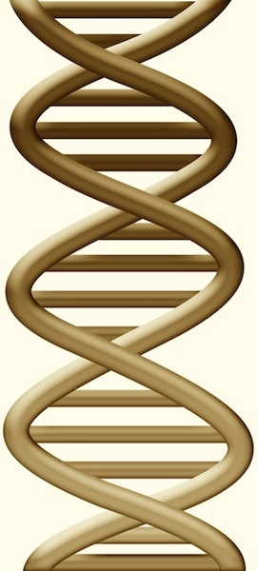
DNA mixture interpretation
Evidence item
Evidence data
Evidence genotype
12
11,12 @ 50%
Lab
11
Infer
10
11,11 @ 30%
10,11 @ 20%
DNA from
two people

Slide 5
DNA mixture interpretation
Evidence item
Evidence data
Evidence genotype
12
11,12 @ 50%
Lab
11
Infer
10
11,11 @ 30%
10,11 @ 20%
DNA from
two people
Compare
Known genotype
11,12

Slide 6
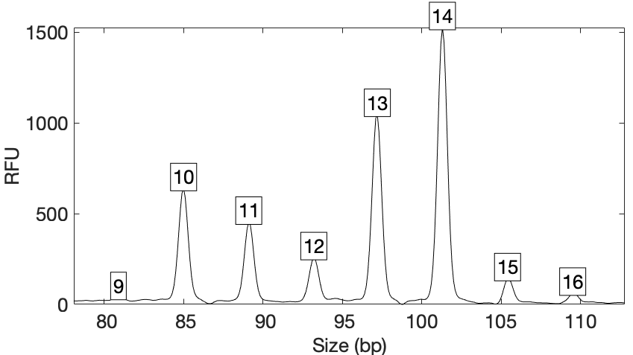
Computers can use all the data
Quantitative peak heights at locus D2S441
peak size
peak height

Slide 7
How the computer thinks
Consider every possible genotype solution
Explain the peak pattern
Better explanation
has a higher
likelihood

Slide 8
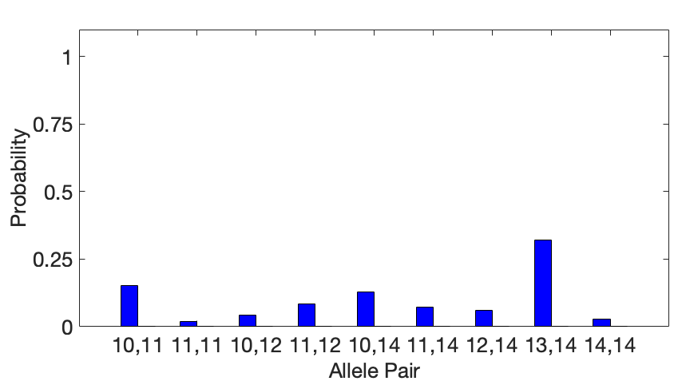
Evidence genotype
Objective genotype determined solely from the DNA data.
Never sees a comparison reference.

Slide 9
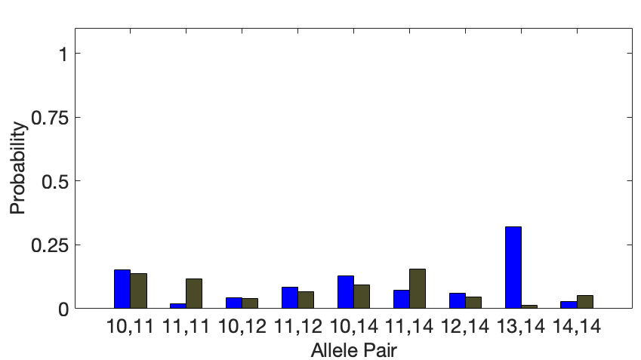
Identification information
How much more does someone match the evidence
than a random person?
Prob(evidence match)
Prob(coincidental match)

Slide 10
DNA match information
How much more does the suspect match the evidence
than a random person?
Prob(evidence match)
Prob(coincidental match)
20x
30%
1.5%

Slide 11
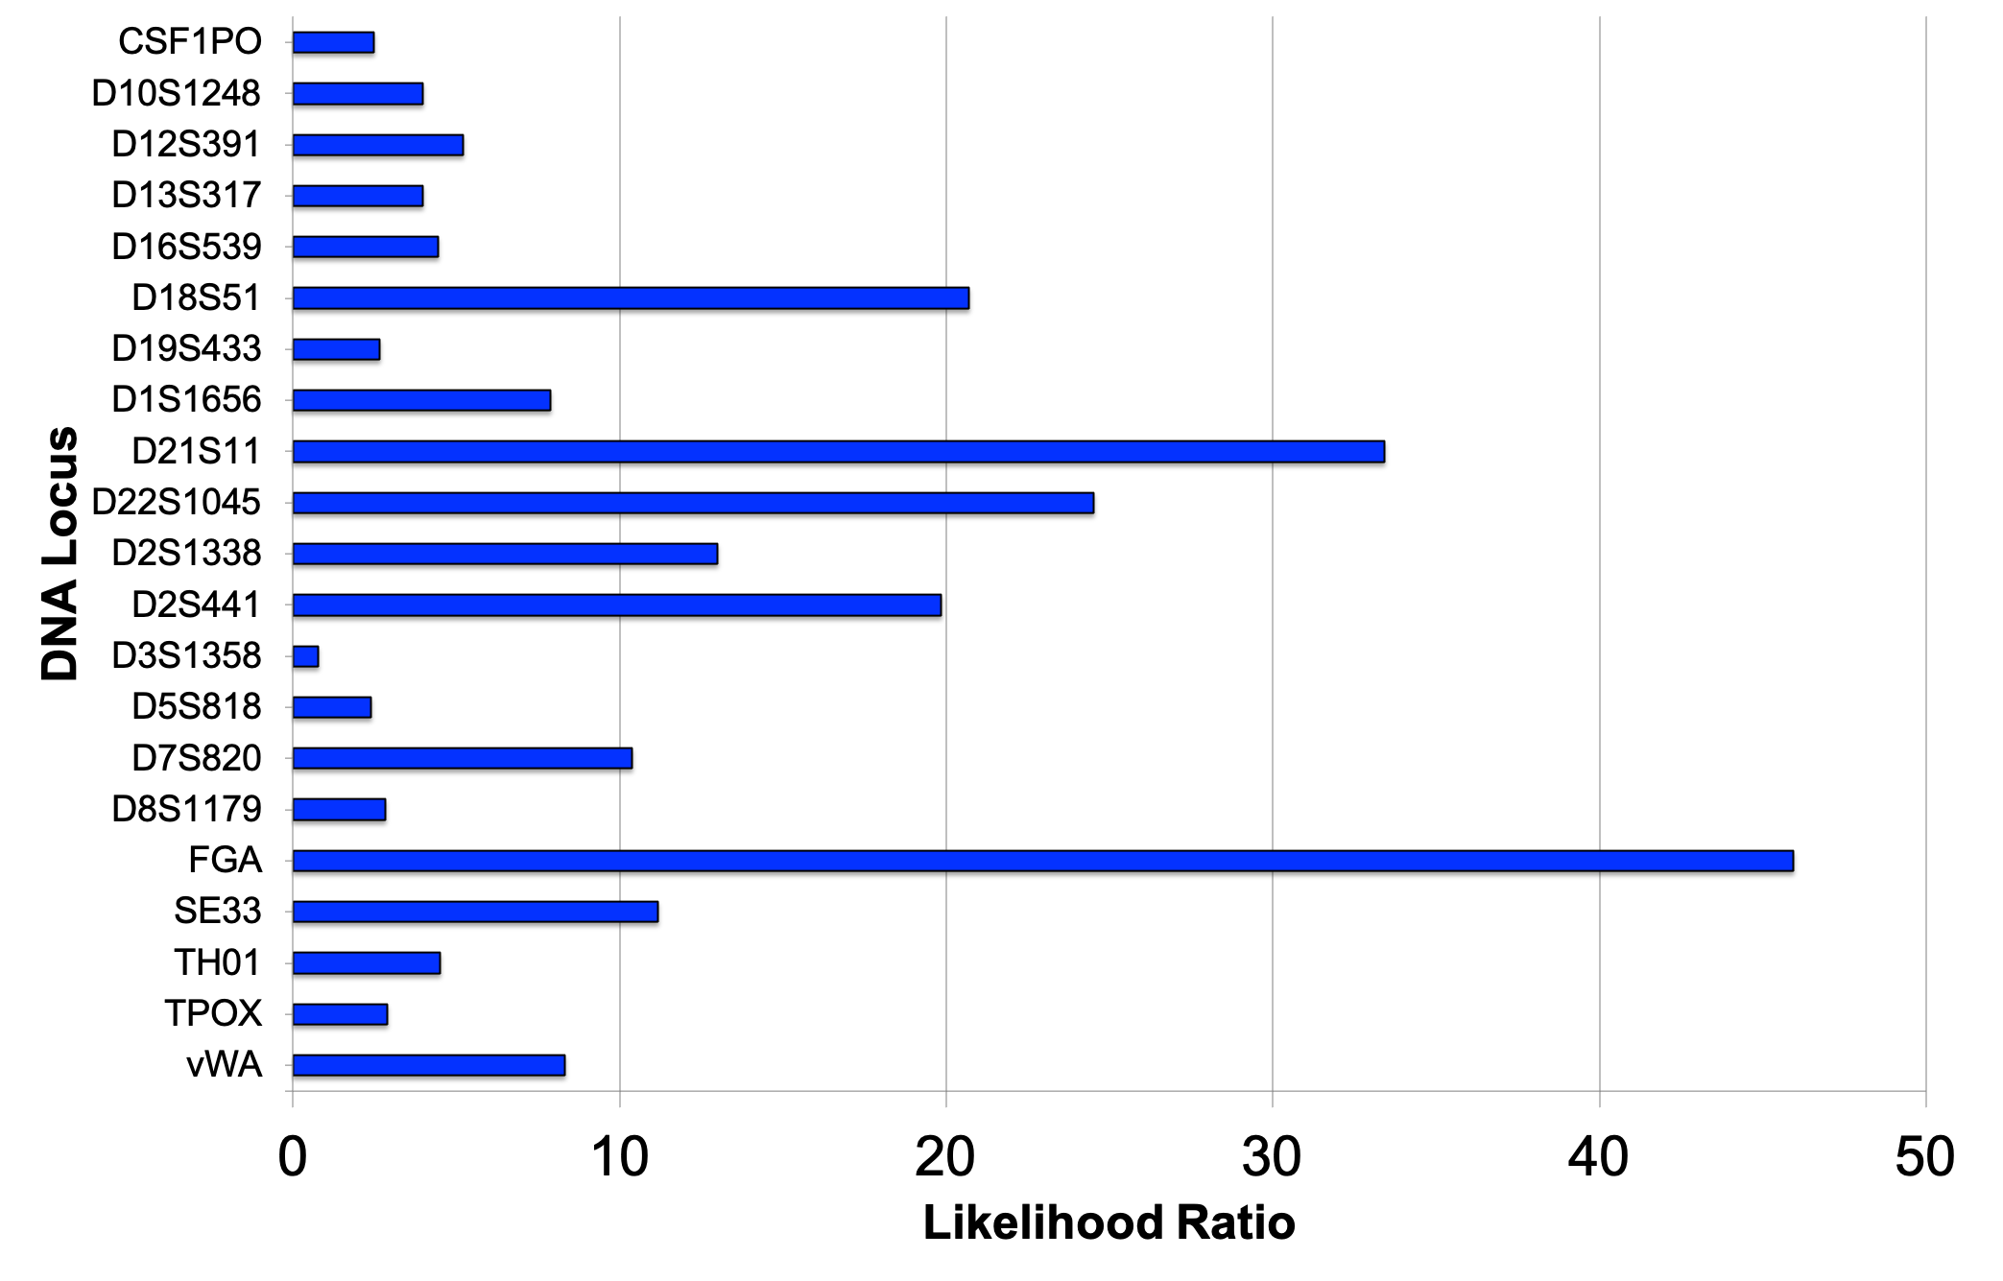
LR information at 21 loci

Slide 12
Report results
A match between the handgun trigger
and John Doe is:
246 quadrillion times more probable than a coincidental match.

Slide 13
Error rate
For a match strength of 246 quadrillion,
on this evidence genotype,
only 1 in 2.34 septillion people would match as strongly.

Slide 14
Court Testimony
Q. What is the final match statistic between the handgun trigger and Mr. Doe?
A. So I will read this directly from my report. A match between the handgun trigger … item 11A … and Mr. John Doe … item 4A is two hundred and forty-six quadrillion times more probable than a coincidental match to an unrelated person. The error rate for this match statistic is one in two septillion people.

Slide 15
TrueAllele validations
Perlin MW, Sinelnikov A. An information gap in DNA evidence interpretation. PLoS ONE. 2009;4(12):e8327.
Ballantyne J, Hanson EK, Perlin MW. DNA mixture genotyping by probabilistic computer interpretation of binomially-sampled laser captured cell populations: Combining quantitative data for greater identification information. Science & Justice. 2013;53(2):103-114.
Perlin MW, Hornyak J, Sugimoto G, Miller K. TrueAllele® genotype identification on DNA mixtures containing up to five unknown contributors. Journal of Forensic Sciences. 2015;60(4):857-868.
Greenspoon SA, Schiermeier-Wood L, Jenkins BC. Establishing the limits of TrueAllele® Casework: a validation study. Journal of Forensic Sciences. 2015;60(5):1263-1276.
Bauer DW, Butt N, Hornyak JM, Perlin MW. Validating TrueAllele® interpretation of DNA mixtures containing up to ten unknown contributors. Journal of Forensic Sciences. 2020; 65(2):380-398.
Perlin MW, Legler MM, Spencer CE, Smith JL, Allan WP, Belrose JL, Duceman BW. Validating TrueAllele® DNA mixture interpretation. Journal of Forensic Sciences. 2011;56(6):1430-1447.
Perlin MW, Belrose JL, Duceman BW. New York State TrueAllele® Casework validation study. Journal of Forensic Sciences. 2013;58(6):1458-1466.
Perlin MW, Dormer K, Hornyak J, Schiermeier-Wood L, Greenspoon S. TrueAllele® Casework on Virginia DNA mixture evidence: computer and manual interpretation in 72 reported criminal cases. PLOS ONE. 2014;(9)3:e92837.

Slide 16
TrueAllele NGS validation
Kern Regional Crime Laboratory (Bakersfield, CA)
MiSeq FGx Sequencing System
Verogen ForenSeq DNA Signature Prep Kit Primer Mix B
Single source sensitivity samples
Mock case samples
  Up to 5 contributors
Concordance samples (CE and NGS)

Slide 17
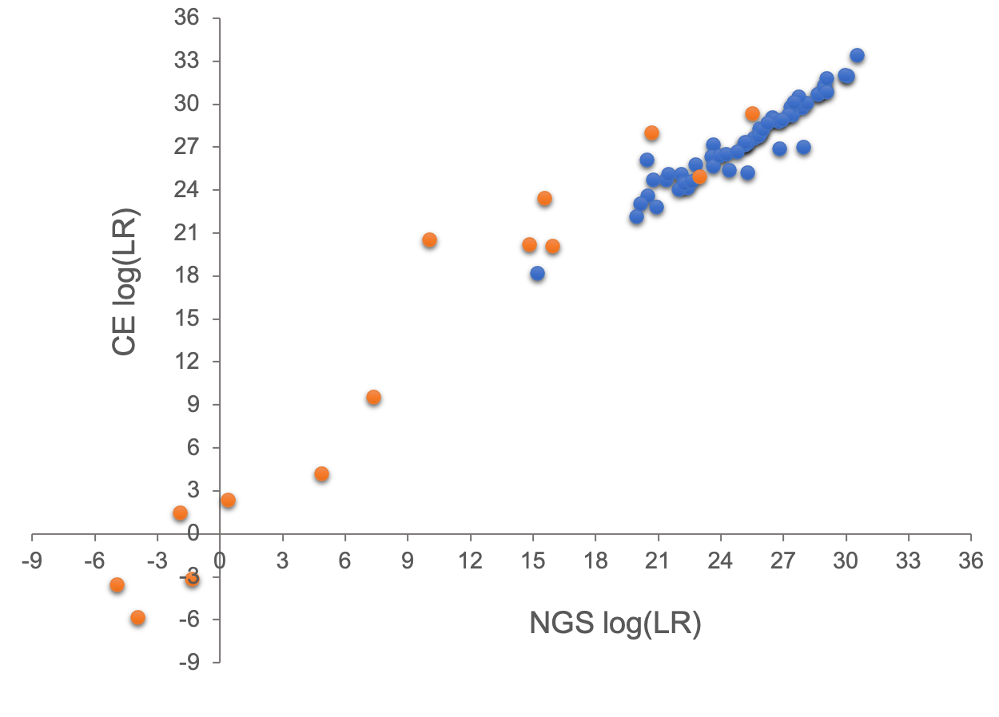
TrueAllele NGS validation

Slide 18
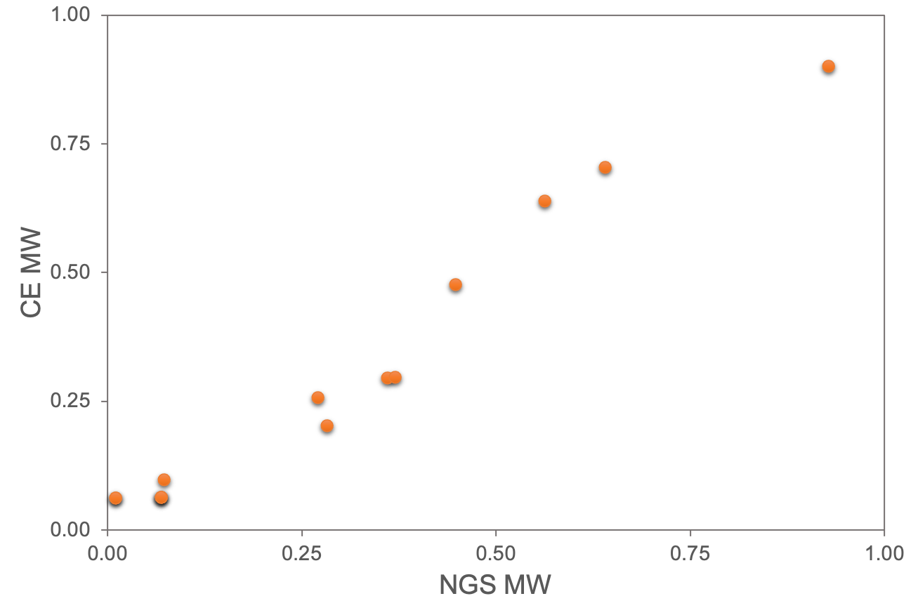
TrueAllele NGS validation

Slide 19
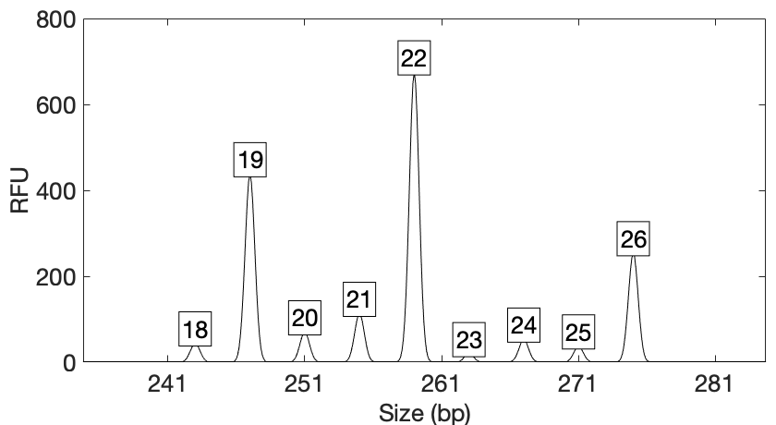
Computers can use all the data
Quantitative peak heights at locus FGA
peak size
peak
height

Slide 20
How the computer thinks
Consider every possible genotype solution

Slide 21
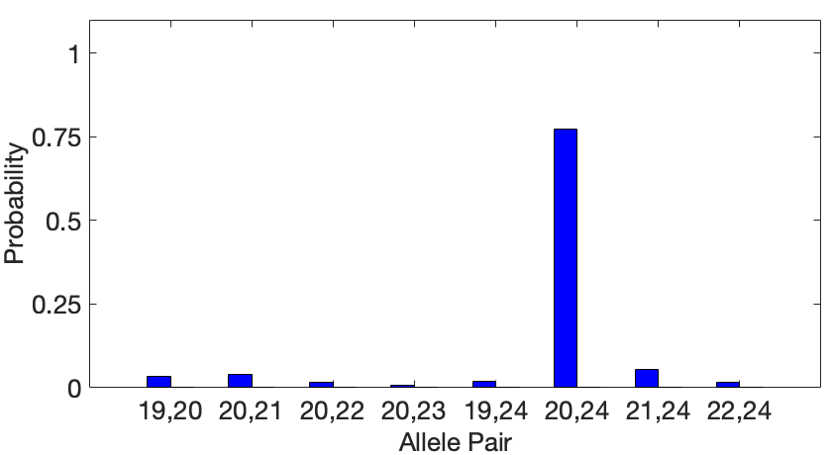
Evidence genotype
Objective genotype determined solely from the DNA data.
Never sees a comparison reference.

Slide 22
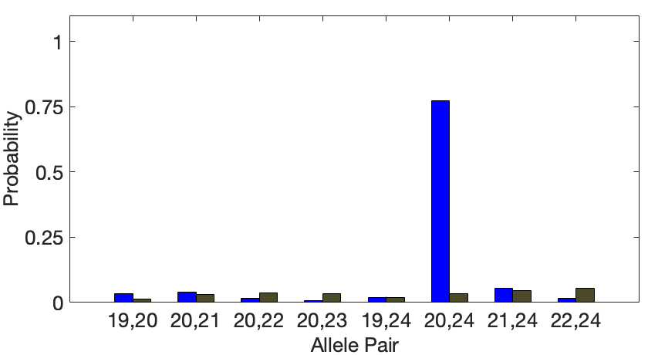
Identification information
How much more does someone match the evidence
than a random person?
Prob(evidence match)
Prob(coincidental match)
Prob(evidence match)
Prob(coincidental match)

Slide 23
DNA match information
How much more does the suspect match the evidence
than a random person?
26x
77%
Prob(evidence match)
Prob(coincidental match)
3%

Slide 24
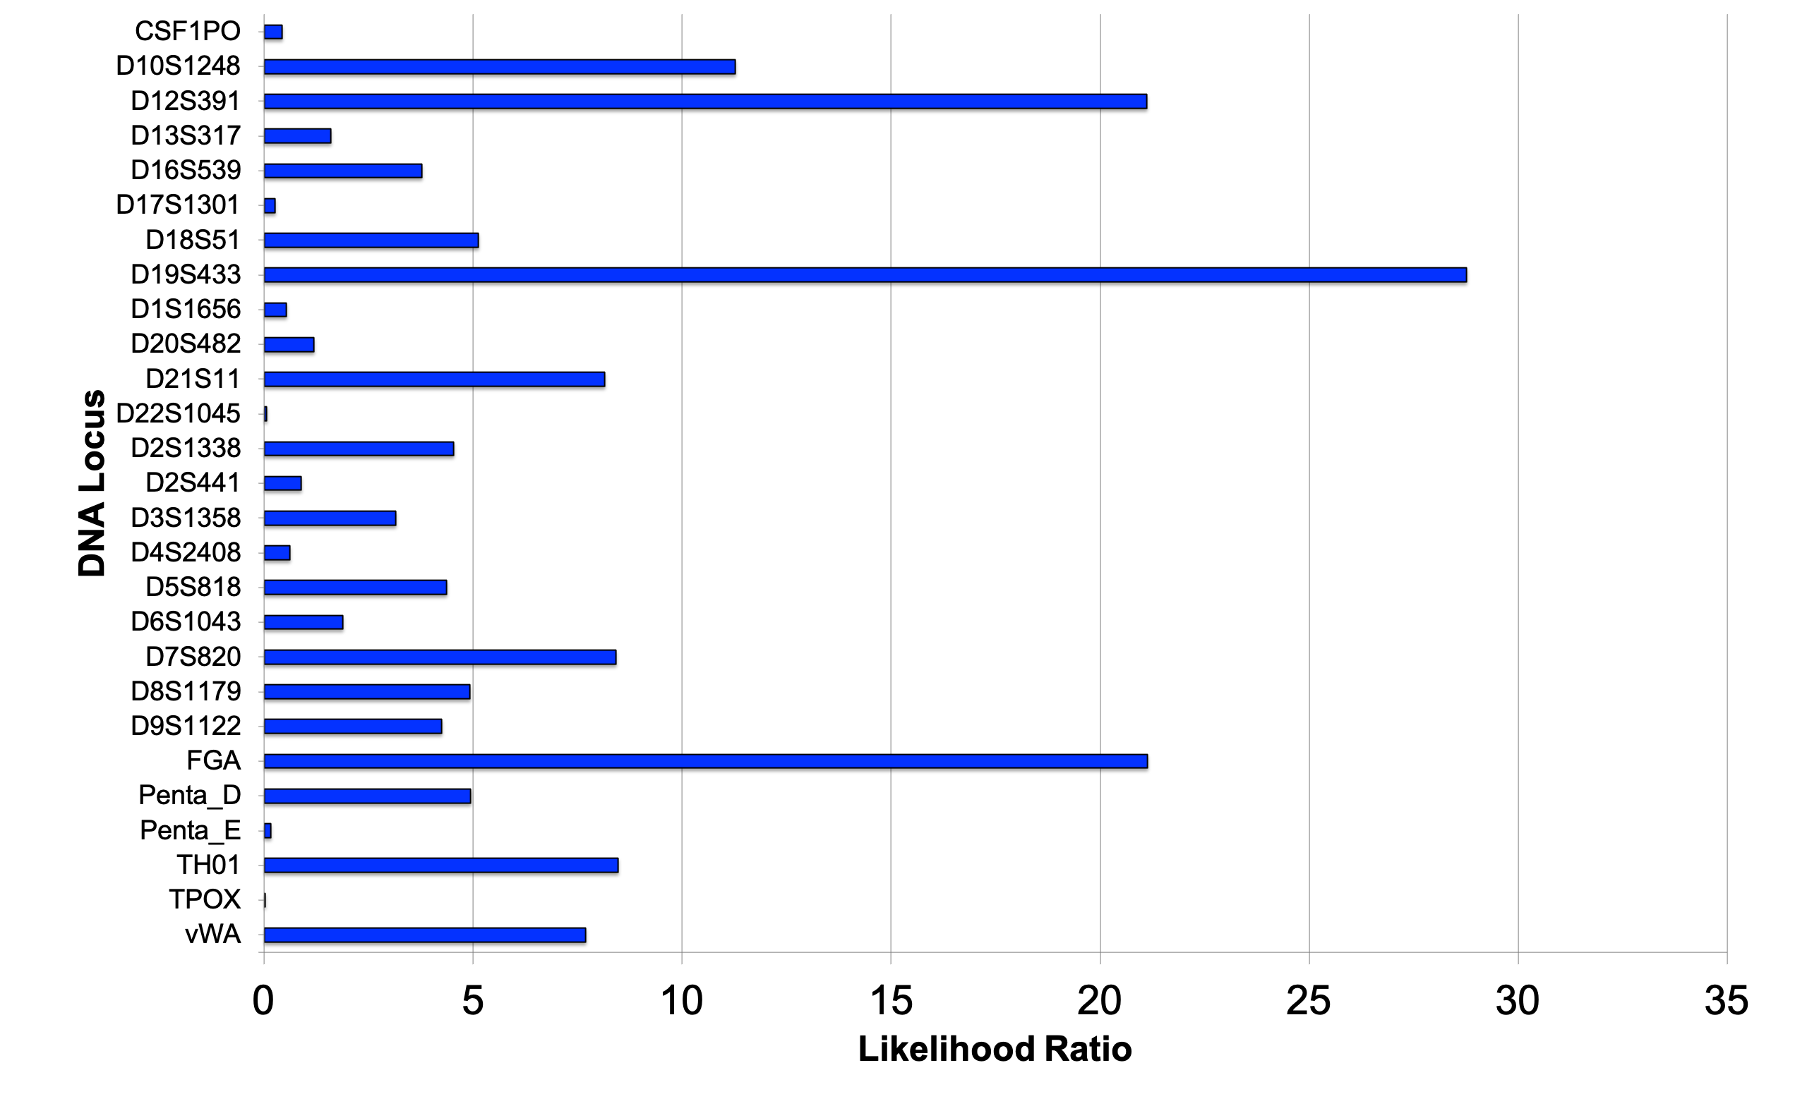
LR information at 27 loci

Slide 25
Report results
A match between the handgun trigger
and John Doe is:
2.69 billion times more probable than a coincidental match.

Slide 26
Error rate
For a match strength of 2.69 billion,
on this evidence genotype,
only 1 in 99.2 billion people would match as strongly.

Slide 27
Court Testimony
Q. What is the final match statistic between the handgun trigger and Mr. Doe?
A. So I will read this directly from my report. A match between the handgun trigger … item 11A … and Mr. John Doe … item 4A is two billion times more probable than a coincidental match to an unrelated person. The error rate for this match statistic is one in ninety-nine billion people.

Slide 28

Conclusion
In Chemistry
PV = nRT
In Physics
F = ma
In TrueAllele
NGS = CE

