Slide 1

Unmixing the Mixture with Next Generation Sequencing
International Symposium on Human Identification
Palm Beach, Florida
November, 2025
Kari R. Danser, MS
William P. Allan, MS
Mark W Perlin, PhD, MD, PhD
Cybergenetics © 2003-2025

Slide 2
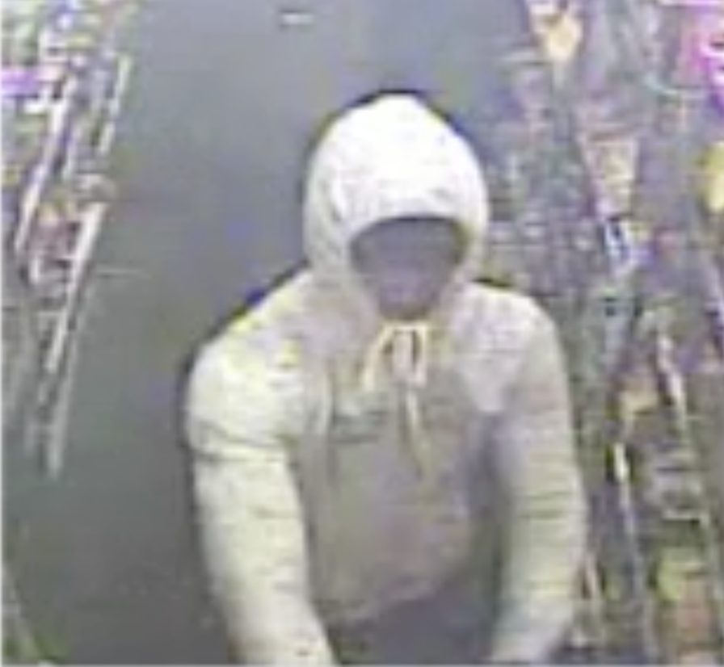
Ohio v. Slater Howell
On April 7, 2014, gas station clerk Babul Kumer Saha was killed before the store was robbed.
Notes:
5 person mixture

Slide 3
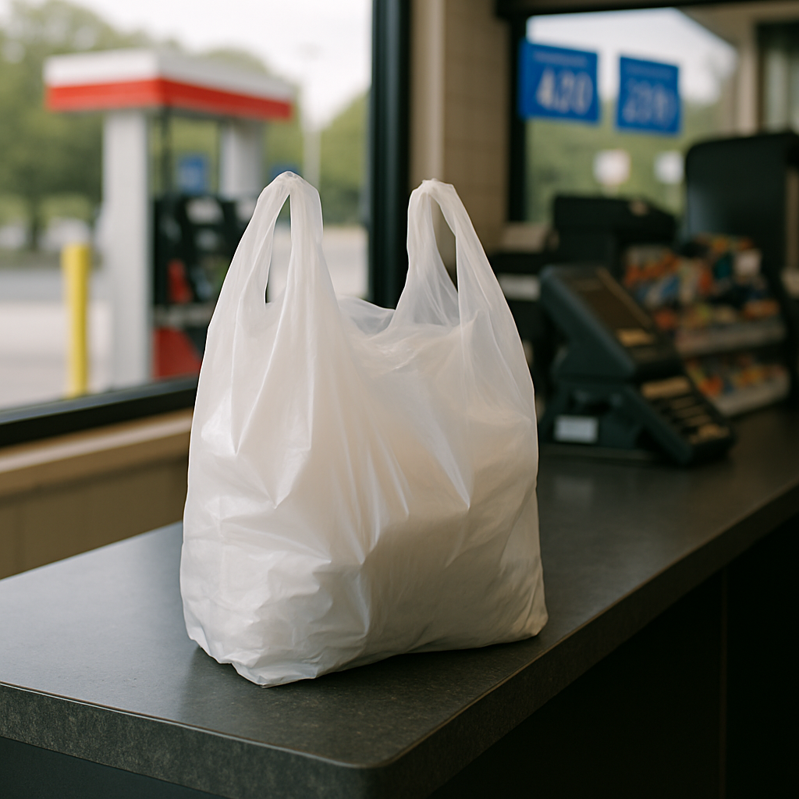
DNA Evidence
DNA samples were collected from a gas pump button, a plastic bag, and a lottery cash register slot.

Slide 4
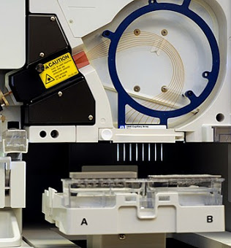
Capillary Electrophoresis (CE)
Fragment analysis
PCR based
STR multiplex
Notes:
Originally STRs were separated by gel
Now STRs are most commonly separated by capillary electrophoresis
cost effective, high throughput, and offers fast turn around
implemented worldwide
PCR
Polymerase Chain Reaction (PCR) gave the ability to make hundreds of millions of copies of specific sequences of DNA in only a few hours
An enzymatic process in which a specific region of DNA is replicated repeatedly to yield many copies of a particular sequence
Involves heating and cooling in a precise thermal cycling pattern
Under perfect conditions with 100% efficiency approximately a billion copies of the target sequence will be made
Multiplexing allows us to look at multiple STR locations in one reaction
Commercial kits were developing involving increasing numbers of STR locations

Slide 5
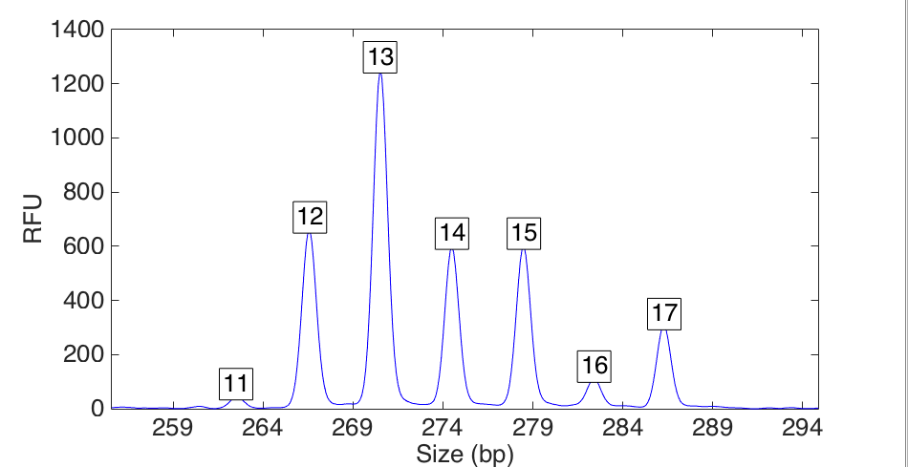
TrueAllele on CE
Quantitative STR data at locus D10
peak size
peak
height

Slide 6
Explaining the CE data
Seven-person DNA mixture

Slide 7
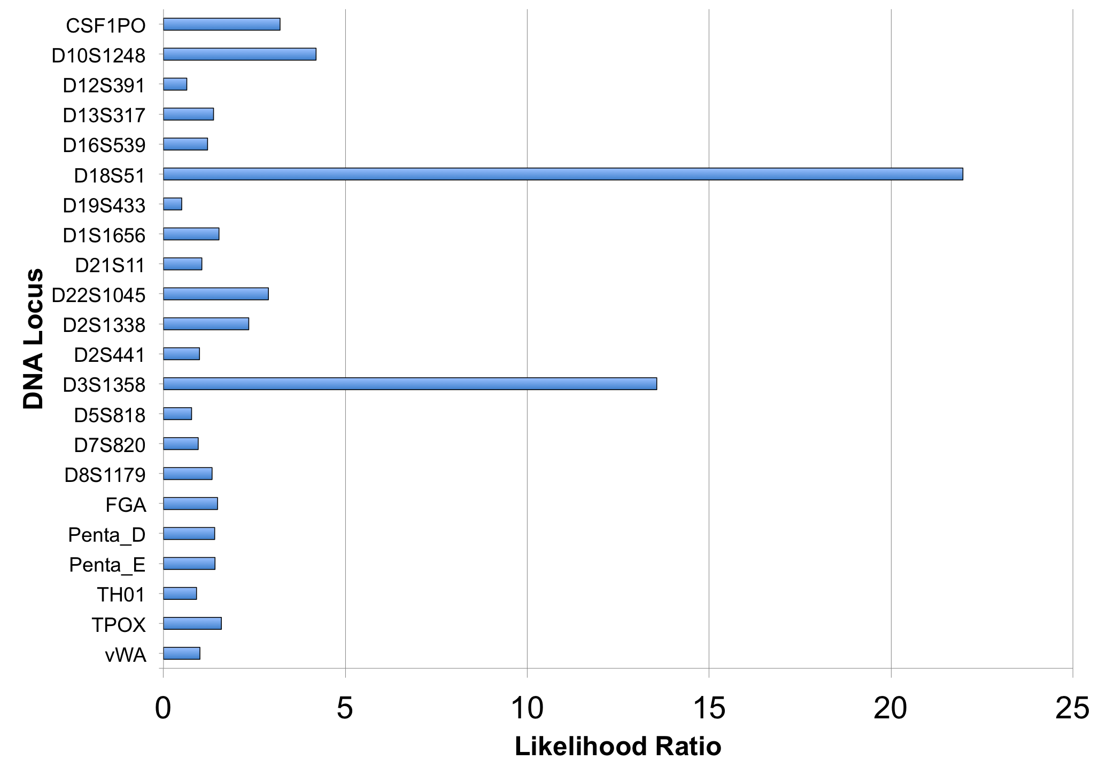
CE Likelihood Ratio (22 loci)

Slide 8
CE LR and error rate
A match between the plastic bag
and Slater Howell is:
98 thousand times more probable than a coincidental match.
For a match strength of 98 thousand,
only 1 in 119 million people would match as strongly.
Notes:
Get the statement and error rate

Slide 9
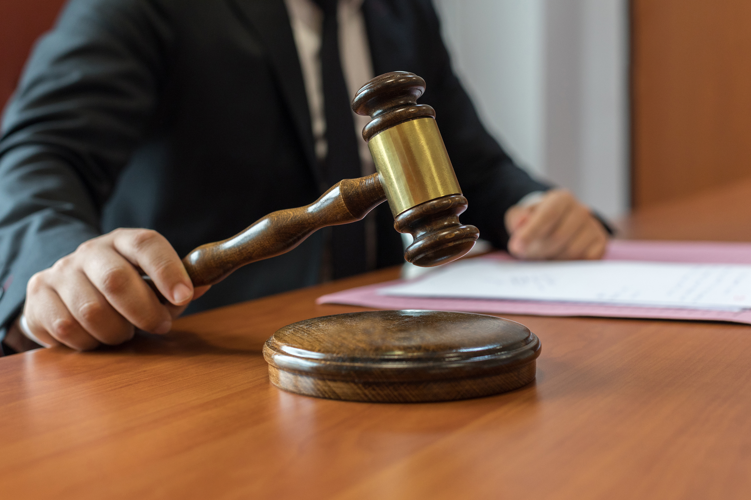
Case outcome
In 2017, the jury found Howell guilty. He was sentenced to life in prison.

Slide 10
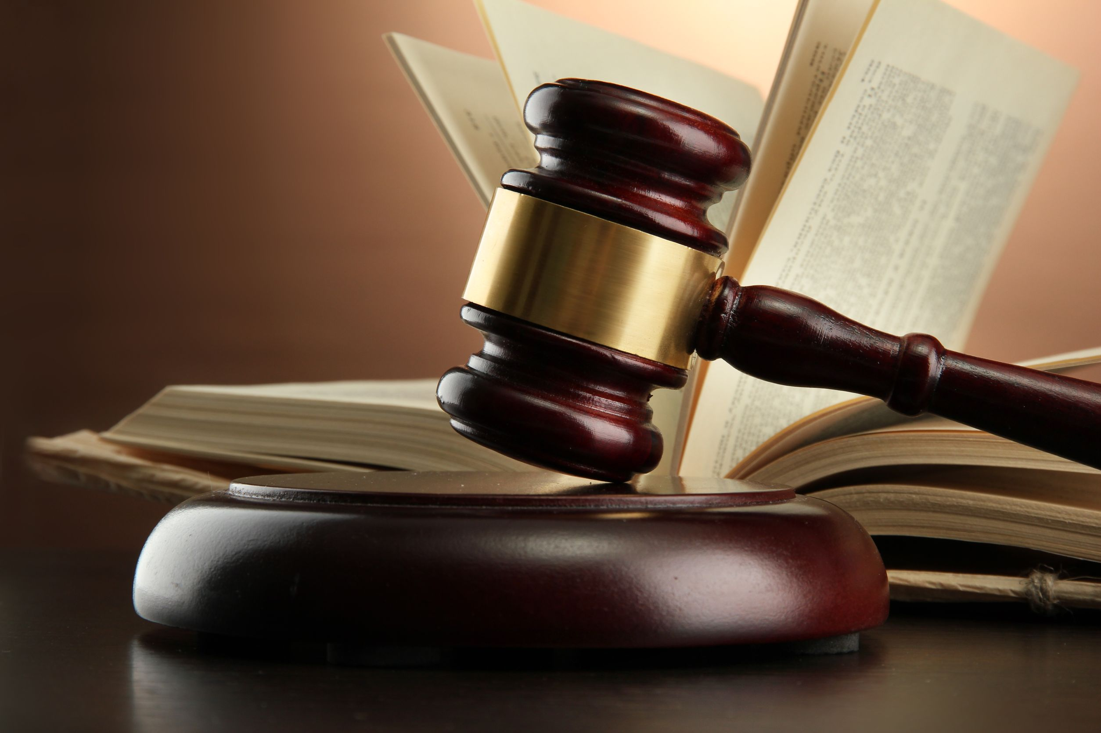
TrueAllele Reliability
Over 40 validation studies
  8 peer-reviewed publications
Validated for up 10 unknown contributors
49 successful US admissibility rulings
  16 different states
  3 Ohio Daubert hearings
  Federal court acceptance
  Appellate precedent in 8 states

Slide 11
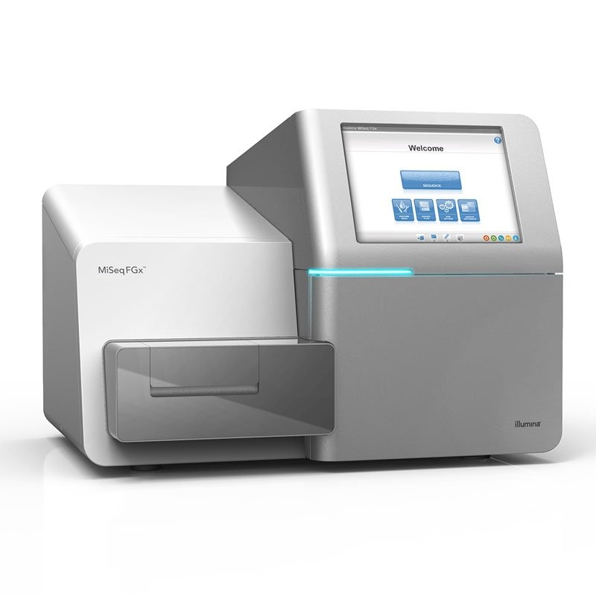
Next Generation Sequencing (NGS)
Sequence analysis
Bridge amplification
STR & SNP multiplex
Notes:
Originally STRs were separated by gel
Now STRs are most commonly separated by capillary electrophoresis
cost effective, high throughput, and offers fast turn around
implemented worldwide
PCR
Polymerase Chain Reaction (PCR) gave the ability to make hundreds of millions of copies of specific sequences of DNA in only a few hours
An enzymatic process in which a specific region of DNA is replicated repeatedly to yield many copies of a particular sequence
Involves heating and cooling in a precise thermal cycling pattern
Under perfect conditions with 100% efficiency approximately a billion copies of the target sequence will be made
Multiplexing allows us to look at multiple STR locations in one reaction
Commercial kits were developing involving increasing numbers of STR locations

Slide 13
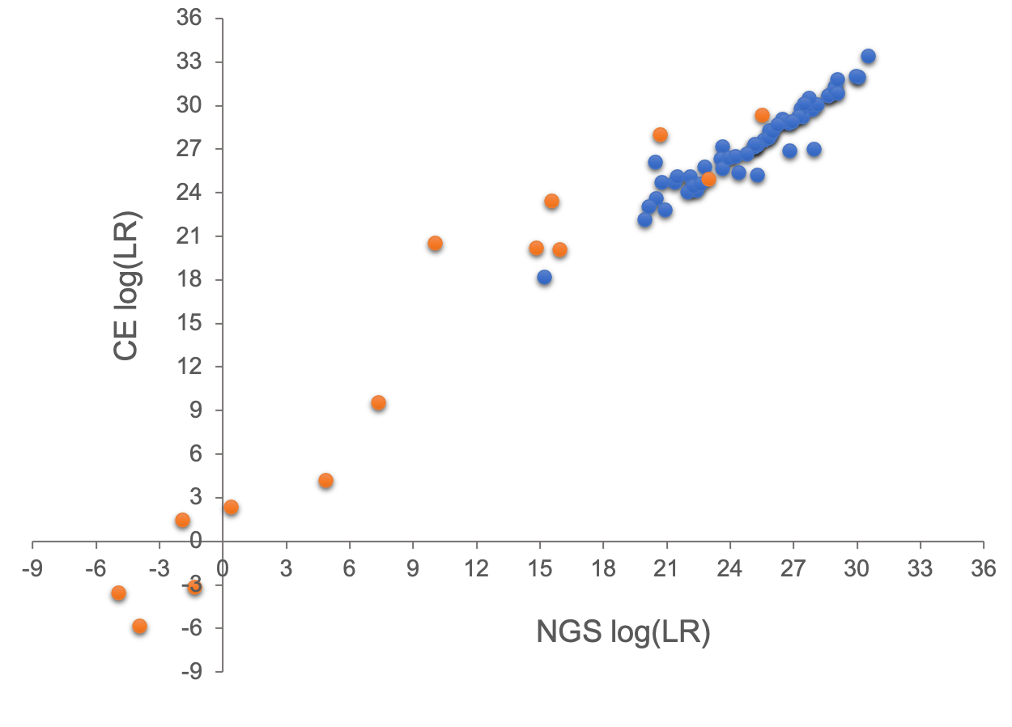
Concordance (CE & NGS)
Single source
DNA mixture

Slide 14
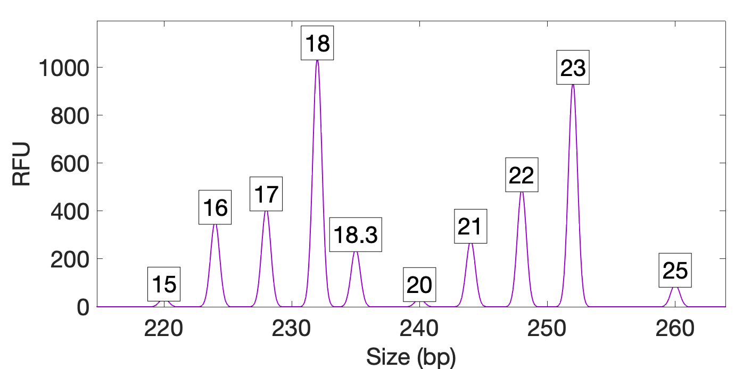
TrueAllele on NGS
Quantitative STR data at locus D12
peak size
peak height
Notes:
New image with NGS data

Slide 15
Explaining the NGS data
Seven-person DNA mixture
Notes:
New image with NGS data and boxes

Slide 16
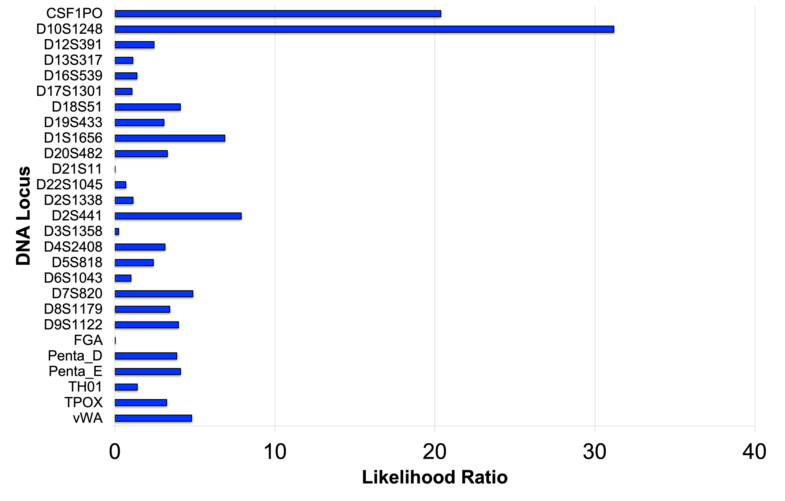
NGS Likelihood Ratio (27 loci)
Notes:
New image

Slide 17
NGS LR and error rate
A match between the evidence item
and the defendant is:
29 million times more probable than a coincidental match.
For a match strength of 29 million,
only 1 in 12.4 billion people would match as strongly.

Slide 18
CE vs. NGS
Victim
5.35
11.39
0
1
2
3
4
5
6
7
8
9
10
11
12
log(LR)
4.99
7.46
Suspect
0
1
2
3
4
5
6
7
8
9
10
11
12
More loci, more information

Slide 19
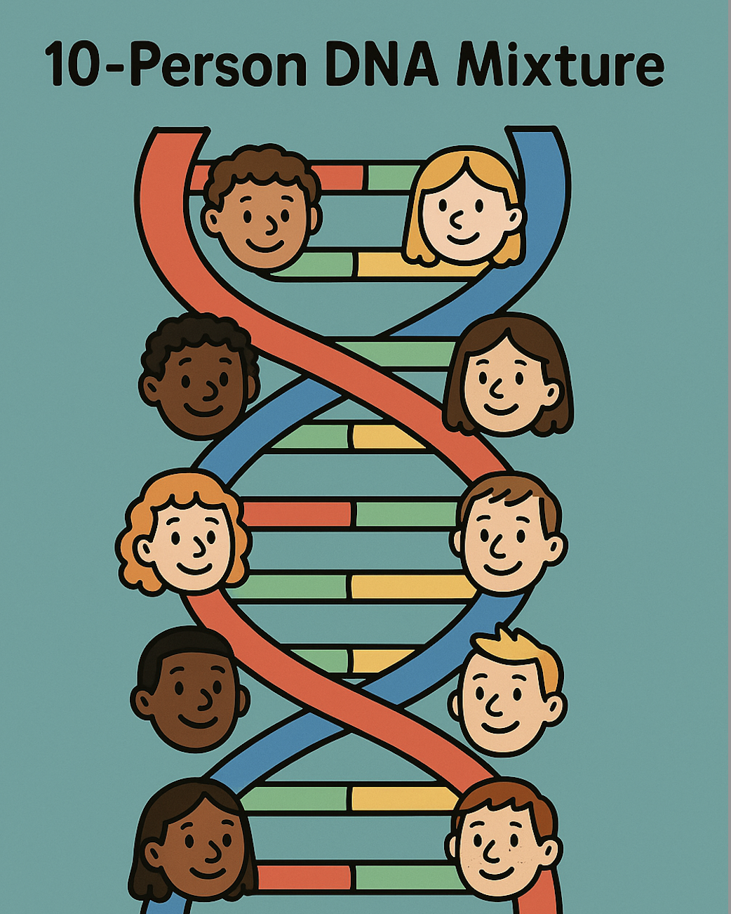
Conclusions
TrueAllele inputs CE and NGS data
TrueAllele solves 10-person mixtures
NGS validation completed (2024)

Slide 20




More information
http://www.cybgen.com/information
• Courses
• Newsletters
• Newsroom
• Presentations
• Publications
• Reliability
• Webinars
http://www.youtube.com/user/TrueAllele
TrueAllele YouTube channel

