Slide 1
Unmixing, Uploading and Connecting DNA Evidence:
TrueAllele® Technology
Illinois Juvenile Officers Association (IJOA)
2025 Conference
Peoria, Illinois
June, 2025
Jonathan B. Perlin, M.S.
Cybergenetics © 2003-2025

Slide 2
TrueAllele technology
Lab: Inconclusive or “uninterpretable” DNA mixture
Cybergenetics TrueAllele can unmix the mixture
Match statistics provide connection information

Slide 3
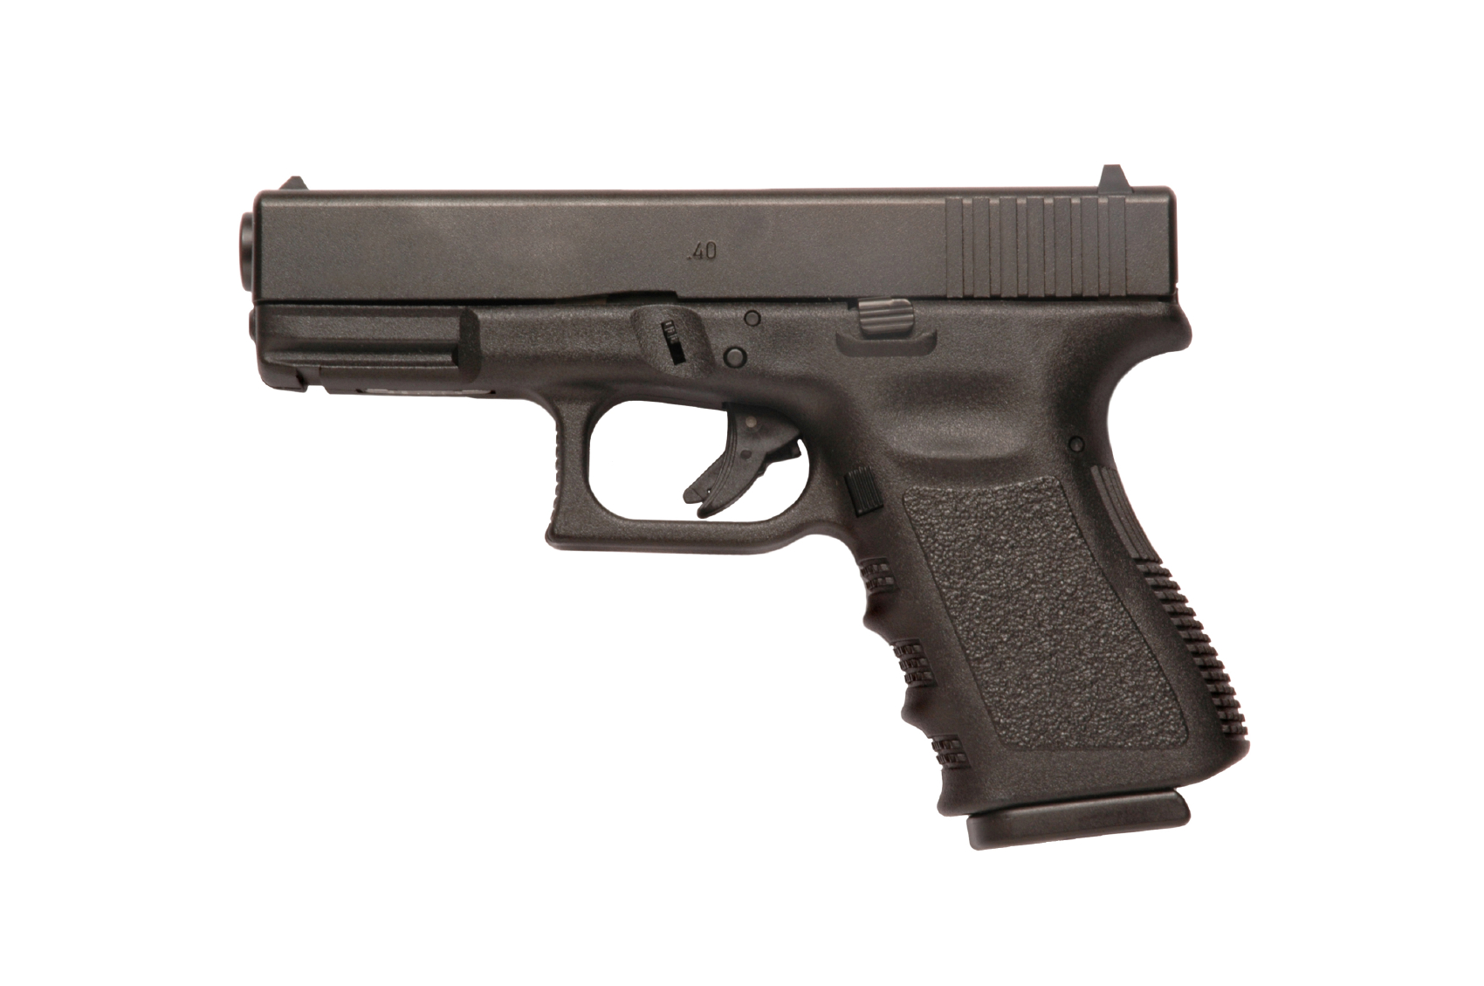
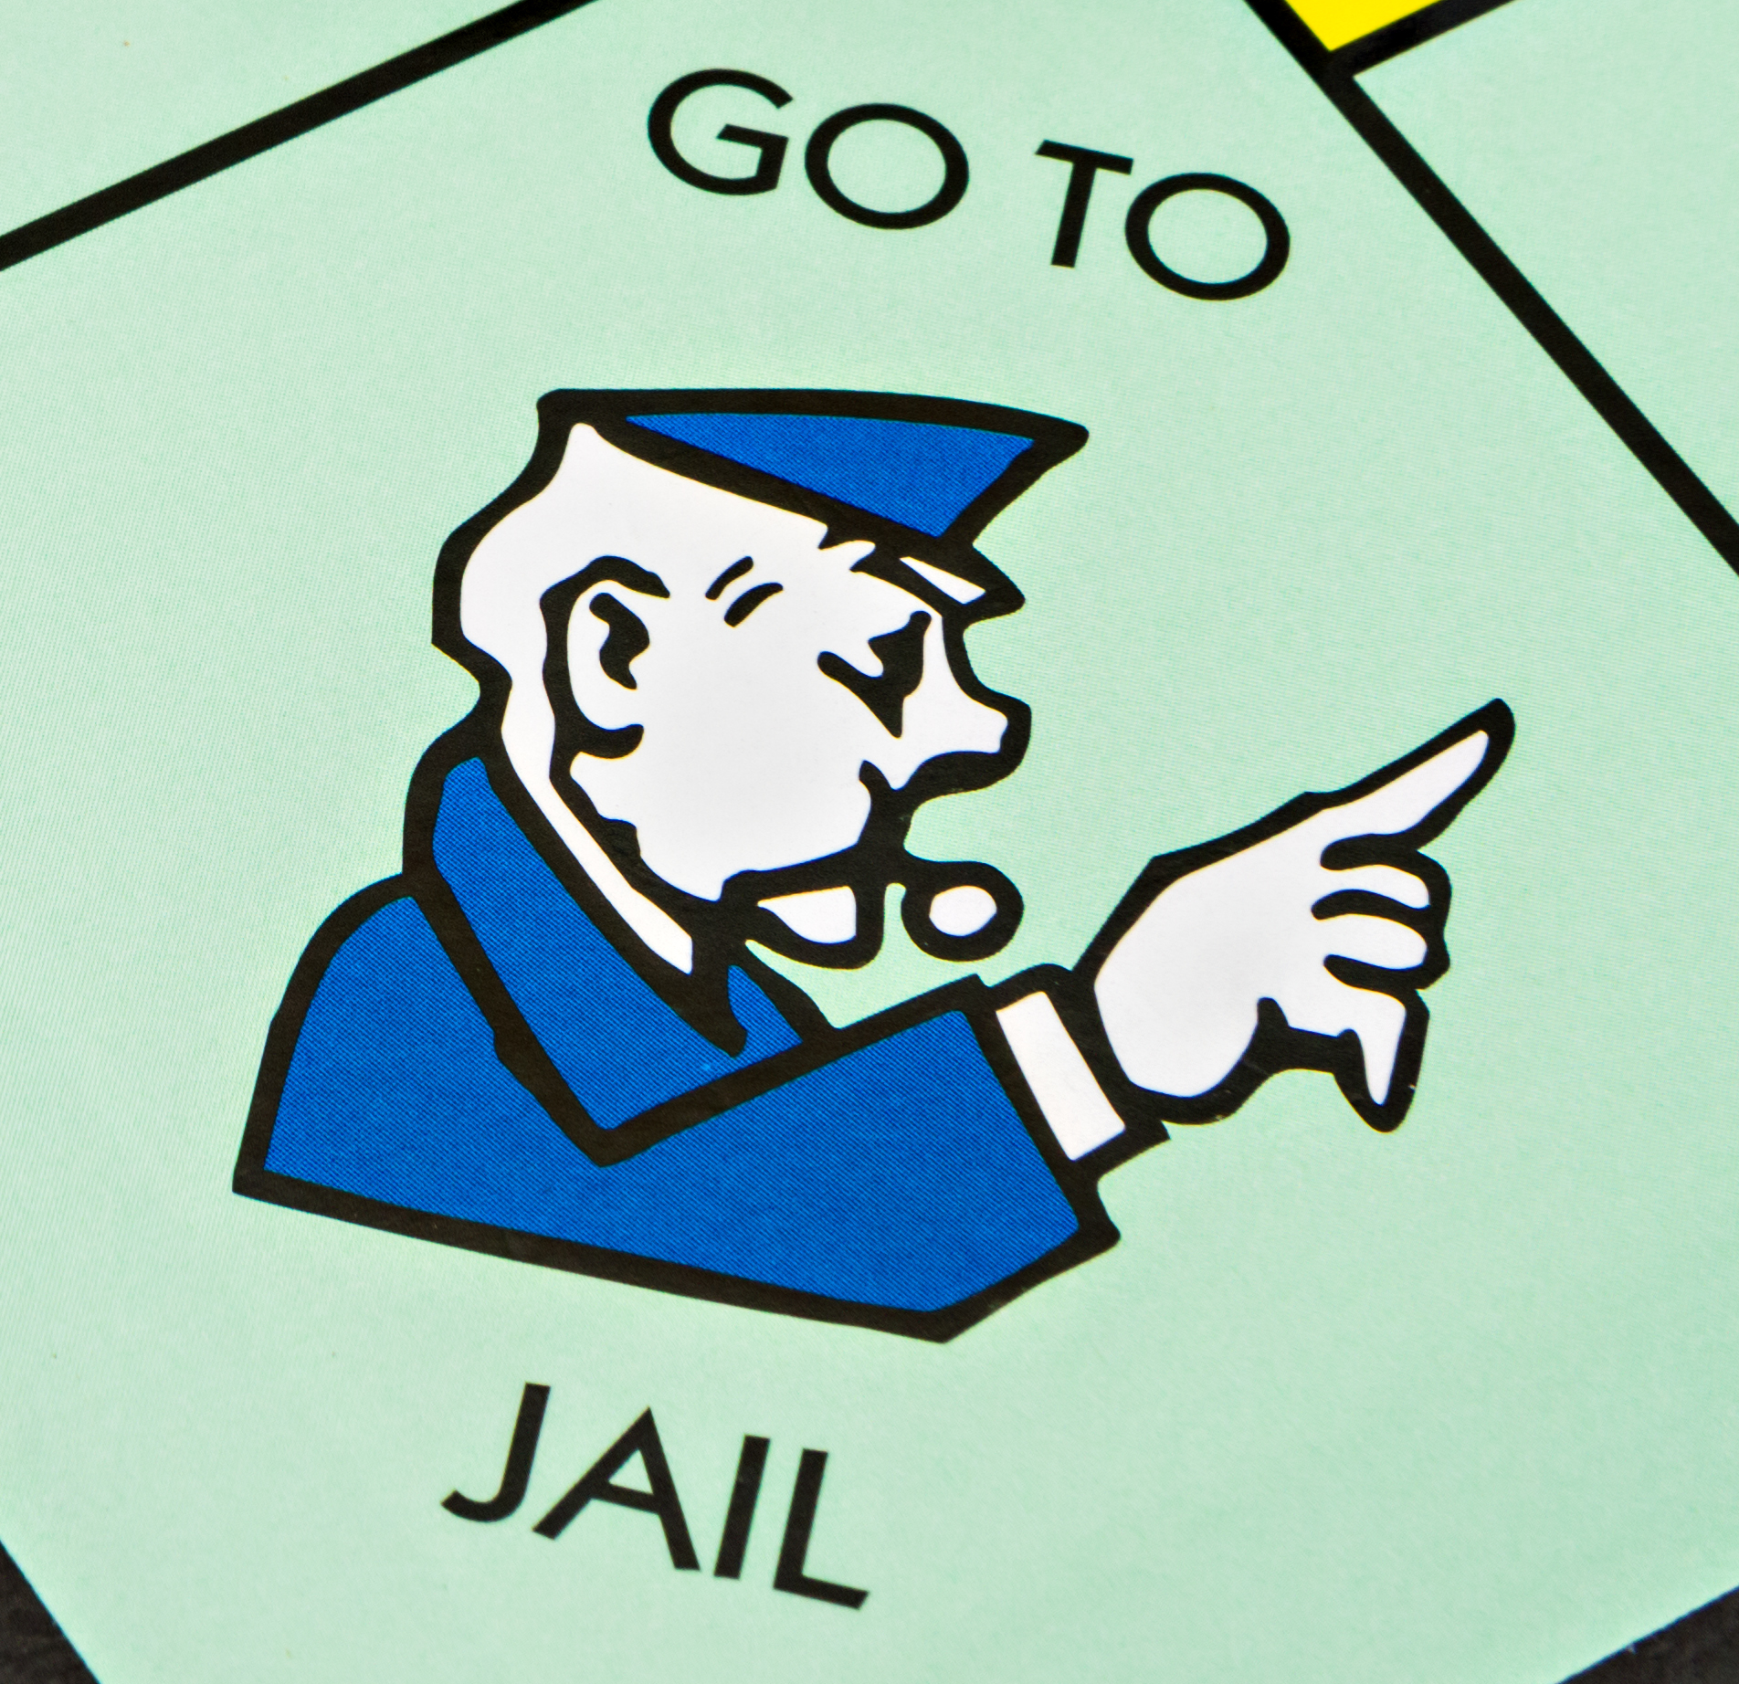
Juvenile gangs
Lab: Inconclusive or “uninterpretable” DNA mixture
Cybergenetics TrueAllele can unmix the mixture
Match statistics provide connection information
Person A
excluded
Contributor
Unmix the
mixture
1
2
400,000
3
Person B
included
4

Slide 4
People have DNA

Slide 5
People leave DNA

Slide 6
People leave DNA on things

Slide 7
People leave DNA on many things

Slide 8
DNA on things helps find the person

Slide 9
DNA mixtures can be hard to interpret

Slide 10
TrueAllele unmixes mixtures,
making them easy to interpret

Slide 11
DNA on multiple evidence items

Slide 12
Connect evidence through shared DNA

Slide 13
“Handprints in the morning dew”
State of Louisiana v. Hilton Wilson and Reokenski Thomas

Slide 14
The crime
July 22, 2013 in Ville Platte, LA
Shots heard on East Washington Street
Joseph & Derrick John

Slide 15
The crime
That night, Joseph John dies in the hospital
3 months later, Derrick John makes identification
Reokenski Thomas becomes a suspect
Reokenski Thomas

Slide 16
The investigation
Shooting was precipitated by an earlier argument
Shell casings and bullet in victim
Footsteps on grass lead up to fence

Slide 17
The evidence: An example of great investigative work
Detective on scene swabbed two handprints
that disturbed the morning dew

Slide 18
Exhibit 13: Swab from post running north and south – A
“Due to the limited nature of the profile, no conclusions regarding the inclusion or exclusion of any contributor can be made.”
Exhibit 14: Swab from post running north and south – B
“…was consistent with being a mixture of DNA from at least two individuals. Due to the nature of the profile, no statistical analysis could be performed at this time. Therefore, no conclusions regarding Hilton Wilson and Reokenski Thomas can be made.”

Slide 19
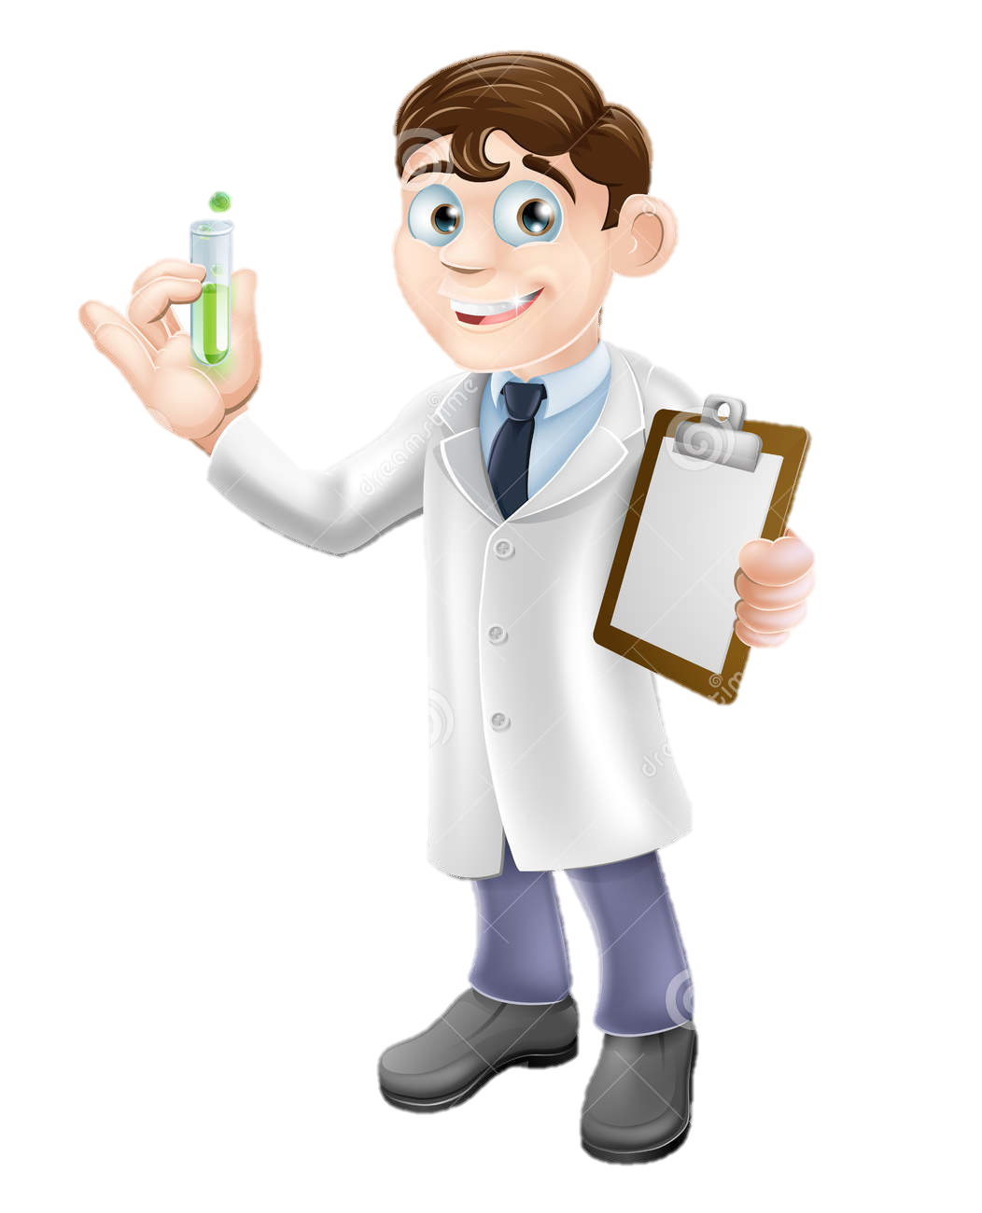
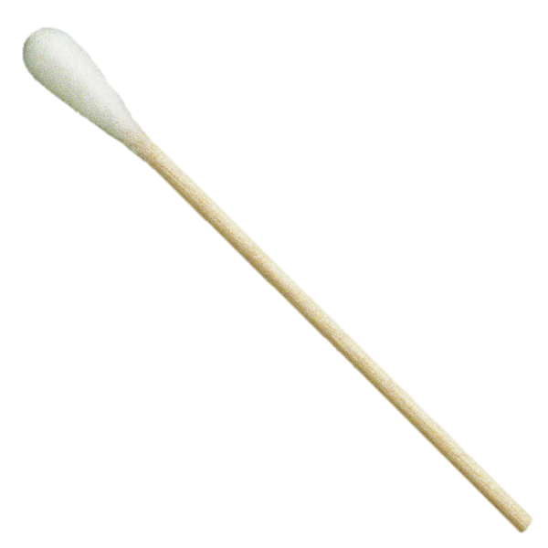
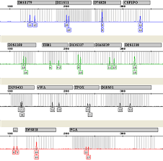
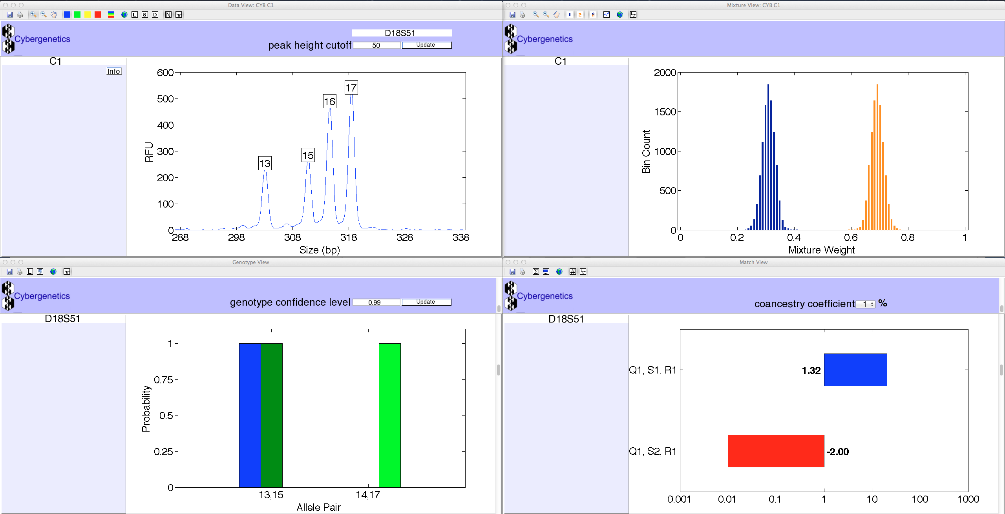
Solving DNA mixtures
R
E
S
U
L
T
S

Slide 20
Are the suspects in the evidence?

Slide 21
Match statistics
Exhibit | Description | 19 Hilton Wilson | 20 Reokenski Thomas | 21 Suspect C | 27 Suspect D
13 | post - A | 70.9 thousand | 335 thousand
14 | post - B | 23.1 million | 6.28 million
13 & 14 | posts - A & B | 157 million | 340 million

Slide 22
DNA evidence in the courtroom
Seven-day trial in Judge Chuck West’s courtroom
ADA Marcus Fontenot introduces DNA evidence
On March 10, 2016, Dr. Mark Perlin testifies at the trial in Ville Platte, LA
TrueAllele match statistics

Slide 23
Guilty verdicts handed down in Thomas-Wilson murder trial
Ville Platte Gazette
TrueAllele statistically matched the defendants’ DNA to
the DNA collected from the fence at the crime scene.
“After seven days of listening to eye witness and expert testimony, an Evangeline Parish Jury of 12 found Reokinski Thomas and Hilton Wilson guilty of first degree murder and attempted first degree murder.”
Ville Platte Today
The prosecutors polled the jury after trial –
the DNA was crucial in obtaining the convictions

Slide 24
Keys to success
Evidence collection
Lab develops DNA
Lab sends data to Cybergenetics
TrueAllele match statistics
Expert testimony
Justice is served
“DNA is key.”
- Investigator Marcus Aucoin

Slide 25
Evidence DNA Database

Slide 26
Reference DNA Database

Slide 27
DNA Database Connections

Slide 28
TrueAllele Database
Unmix
Upload
Connect

Slide 29
CODIS Database
x Unmix
x Upload
x Connect

Slide 30
Case Example: Juvenile Car Theft
Cleveland

Slide 31
37 Incidents

Slide 32
6 Jurisdictions

Slide 33
161 Evidence Items

Slide 34
72 References

Slide 35
CODIS Inconclusives
30 items thought to be ‘inconclusive’

Slide 36
TrueAllele Connections
30 items thought to be ‘inconclusive’
Wrong!
All 30 items had a connection

Slide 37
CODIS Exclusions
12 items thought to be exclusions

Slide 38
TrueAllele Connections
12 items thought to be exclusions
Wrong!
All 12 items had a connection

Slide 39
CODIS Time
2 months from DNA testing to report
+1 month for supplemental reports

Slide 40
TrueAllele Time
2 months from testing to report
+1 month for supplemental reports
1 month from DNA upload to report

Slide 41
Power of the TrueAllele® Database
One example:
Database matched a single suspect across 8 cases and 16 evidence items
One suspect linked to eight cases
Case | Item | Log(LR)
1 | Steering Wheel | 12.45
2 | Steering Wheel | 6.44
3 | Steering Wheel | 2.28
4 | Flashlight | 4.02
 | Steering Wheel | 16.04
 | Steering Wheel | 5.21
5 | Cigar | 6.36
 | Steering Wheel | 9.54
6 | Ignition Key | 2.33
 | Gear Shift | 5.99
7 | Gear Shift | 4.22
 | Driver Door Handle | 3.00
 | Pass. Door Handle | 4.55
8 | Cigar | 13.52
 | Cigarette Butt | 14.84
 | Ziploc Package | 10.32

Slide 42
CODIS wasted time and information
Much TIME to complete
Few evidence CONNECTIONS

Slide 43
TrueAllele computer automation found the answers
Much less TIME
Many evidence CONNECTIONS
scene to scene
scene to suspect

Slide 44
Increased Evidence Clarity
TrueAllele unmixed complex mixtures
Unmixed mixtures into individual DNA
Connected with reference and evidence
Case study
Quickly got accurate and reliable results from “inconclusive” evidence

Slide 45
Benefits for Juvenile Investigators
Stronger leads, fewer dead ends
Less inconclusive, more crimes solved
Probative and reliable DNA evidence
Deterrent + Improved clearance rates
Reduces cost and man hours

Slide 46
Good consequences of better technology
Community benefits
Early identification of repeat juvenile offenders
Opportunity for intervention
Fewer criminals on the street
Better justice through better science

Slide 47
How we can help
When the crime lab says DNA evidence is:
Uninterpretable
Inconclusive
Low level
Too complex
Too many contributors

Slide 48
How we can help
With DNA cases that have:
Partial profiles
Familial mixtures
Degraded remains

Slide 49
How we can help
Solve “uninterpretable” DNA evidence
Build you a better DNA database to:
Unmix “uninterpretable” mixtures
Upload all DNA evidence
Connect evidence to suspects

Slide 50
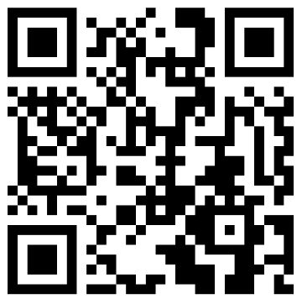
Questions?
LEAVE YOUR INFO
jon@cybgen.com
www.cybgen.com

