Slide 1


How Courts Understand DNA Evidence
Cyril H. Wecht Institute of Forensic Science and Law
Annual Symposium: Topics for the 21st Century
Pittsburgh, Pennsylvania
October 2025
Mark W Perlin, PhD, MD, PhD
Pittsburgh, PA USA
Cybergenetics © 2003-2025

Slide 2
I. Science v. Law
DNA evidence
PCR technology
STR data
Simple DNA (one person), simple interpretation
Complex DNA (mixtures), complex interpretation
DNA match statistics
CPI - simplify data (threshold to qualitative)
TA/LR - explain data (account for quantitative)
September 2025 – Three Cases

Slide 3
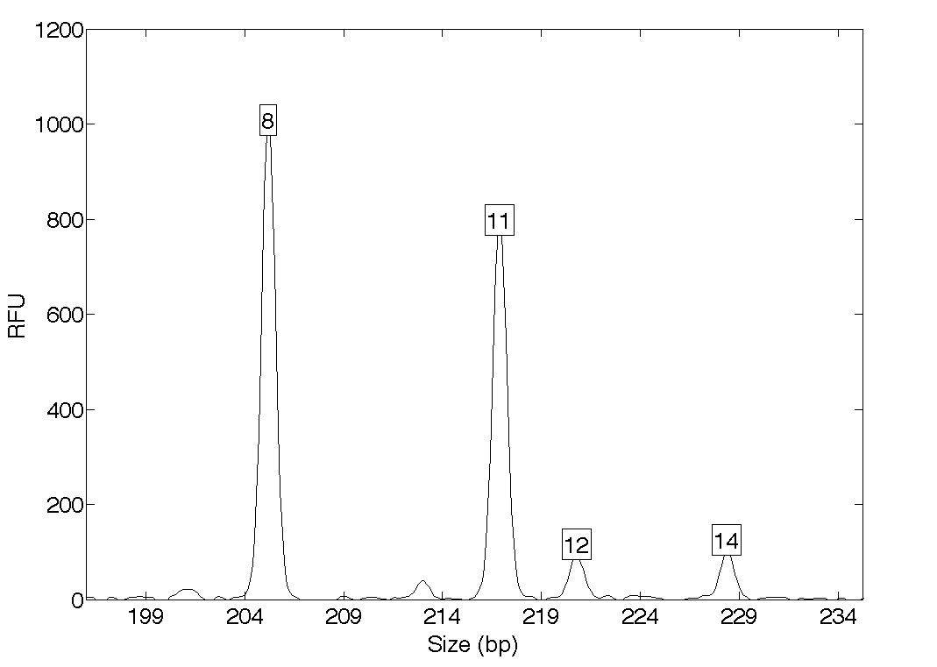
Threshold: simplify the data
Over threshold, peaks are labeled as allele events
All-or-none allele peaks,
each given equal status
Threshold
Under threshold, alleles vanish.

Slide 4
TrueAllele: explain the data
Account for quantitative data
One person's allele pair
Explain the
peak pattern
Better
explanation
has a higher
likelihood
Another person's allele pair

Slide 5
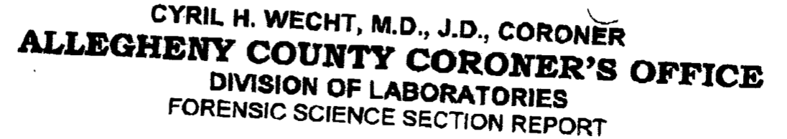
II. Pennsylvania v. Ralph Skundrich
What is a DNA match statistic?
2002. Sexual assault of college student
DNA mixtures: t-shirt and jeans
2011. County lab generated DNA data
Combined probability of inclusion (CPI)
2013. TrueAllele® likelihood ratio (LR)
2014. Trial testimony – DNA match statistics
Sentence: 75-150 years

Slide 6
2023: PCRA Petition
Post-Conviction Relief Act
Ineffective assistance of counsel
Crime lab (CPI): 100,000's (5 zeros)
Cybergenetics (TA): quadrillions (15 zeros)
Argument: Counsel didn't question TrueAllele reliability nor request its source code

Slide 7
2023: Appellate Court
Reversed. Arguable merit?
"The TrueAllele DNA match was evidence of a completely different magnitude.” – Appellate Ruling
15 zeros - 5 zeros
= 10 orders of magnitude
= 10 billion ratio
What is going on?
How is that possible?

Slide 8
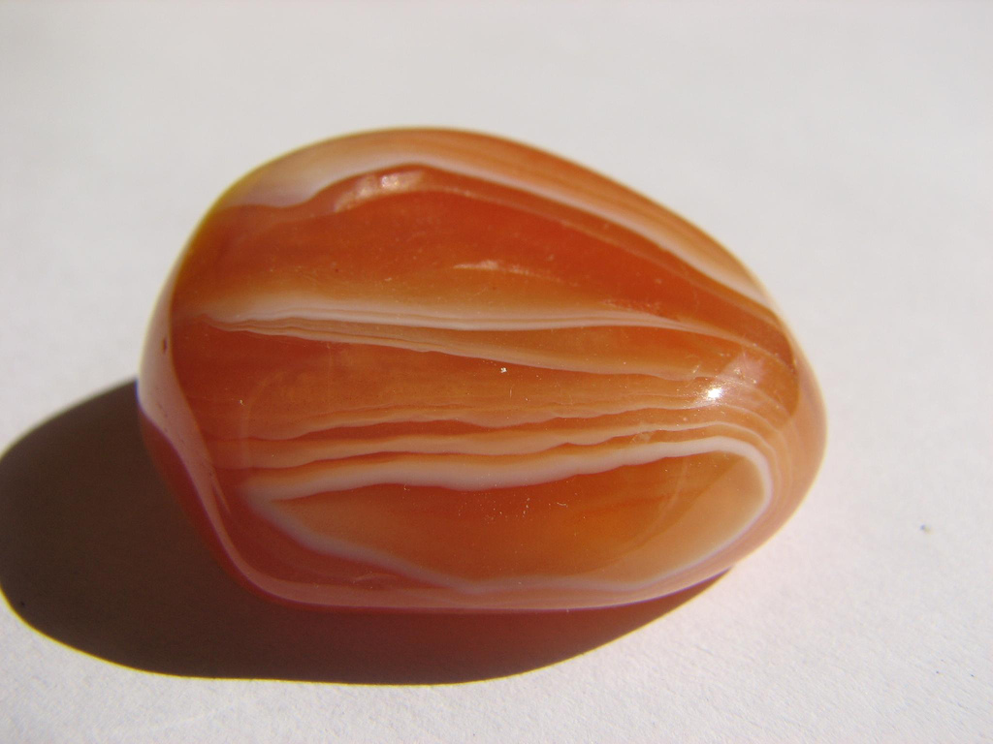
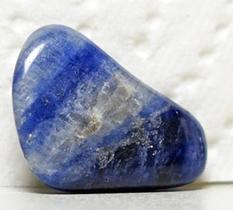



Five Rocks
Orange Rock
1¢
Blue Rock
1¢
Green Rock
1¢
White Rock
1¢
Pink Rock
1¢
Count = 5
Value = 5¢

Slide 9
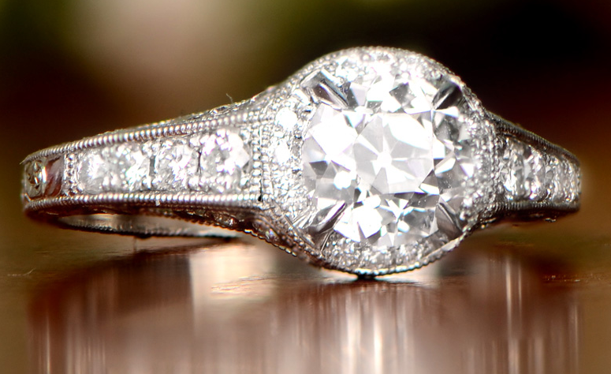
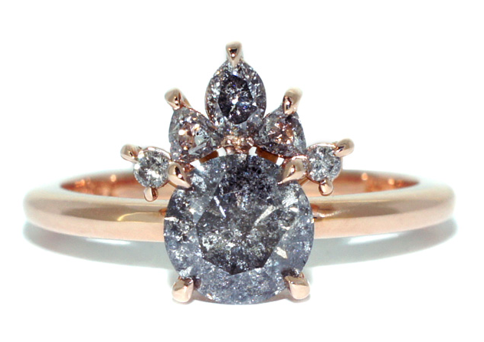
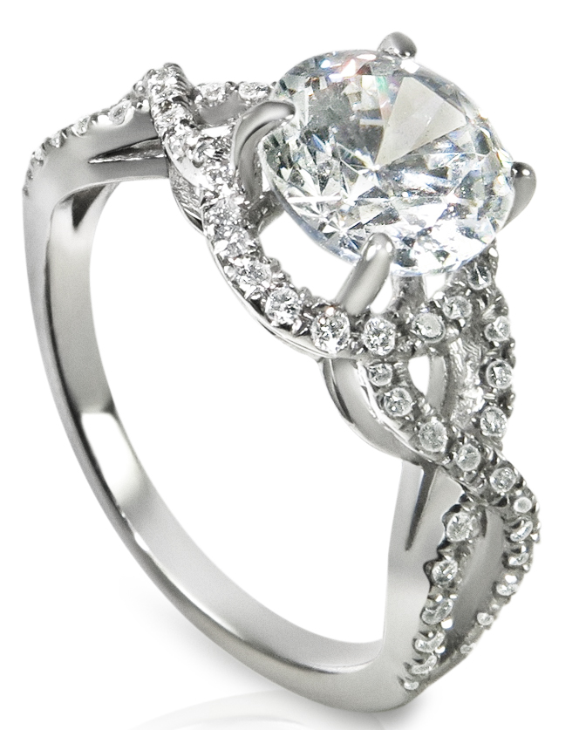
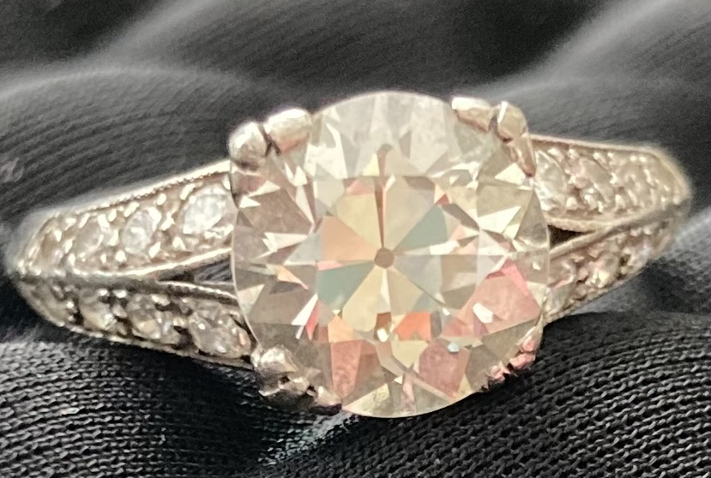
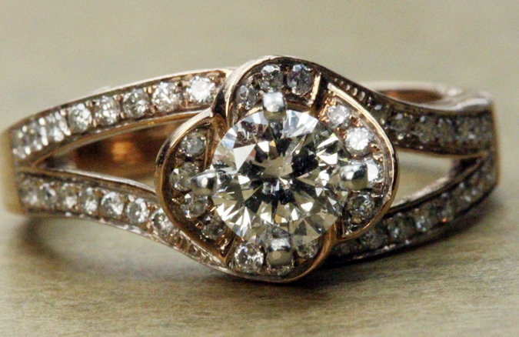
Five Rings
Ring 2
$10,000
Ring 1
$5,000
Ring 3
$15,000
Ring 4
$25,000
Ring 5
$10,000
Count = 5
Value = $65,000

Slide 10

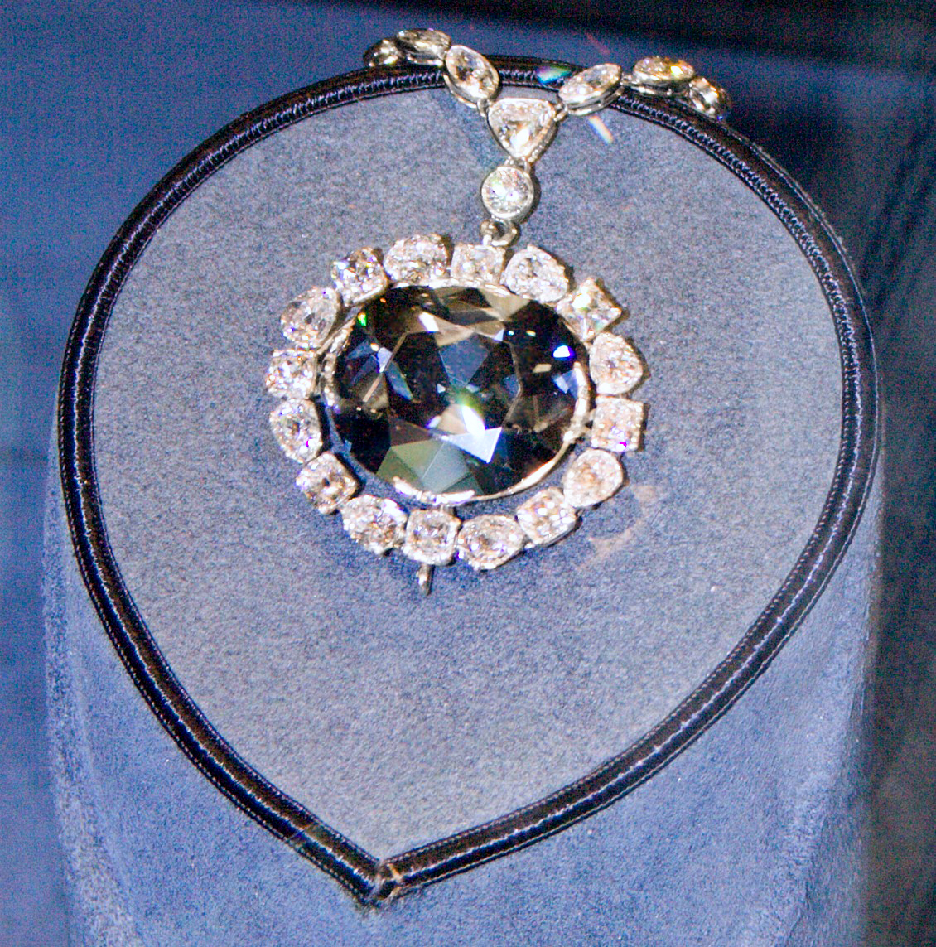
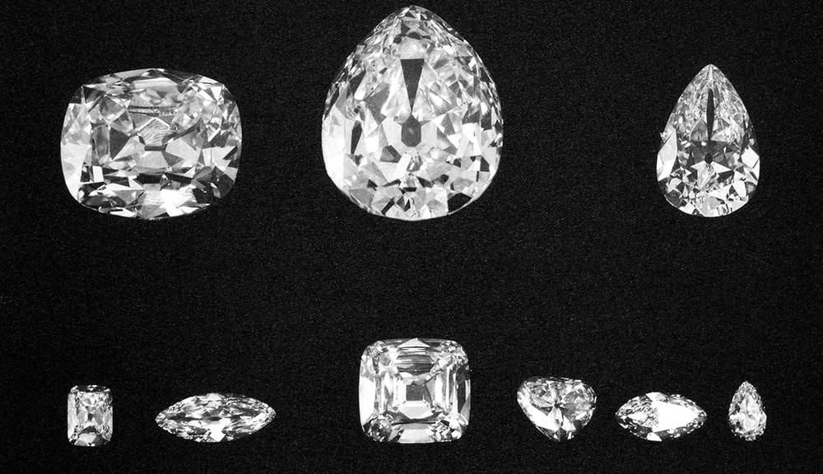


Five Relics
Koh-i-Noor
$500 million
Hope Diamond
$350 million
Cullian Diamond
$400 million
De Beers Centenary
$100 million
The Pink Star Diamond
$71.5 million
Count = 5
Value = $1.3 billion

Slide 11
Rocks v. Relics
Count: 5 every time
Same rock statistic
Value: billion dollars / 10 cents
11 zeros - 1 zero (¢)
= 10 orders of magnitude
= 10 billion ratio
Different rock statistics
Forensic DNA needs probative value, not counts

Slide 12
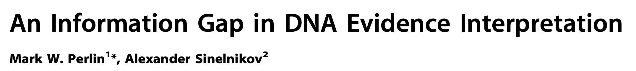

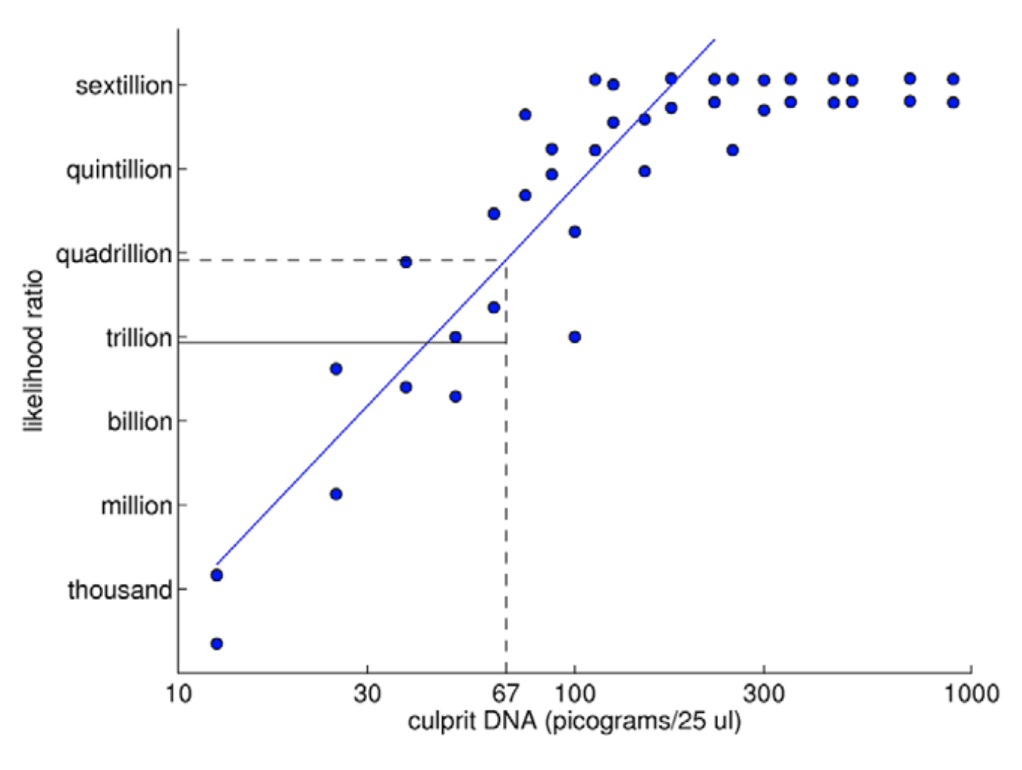
TrueAllele prediction rule
2009

Slide 13
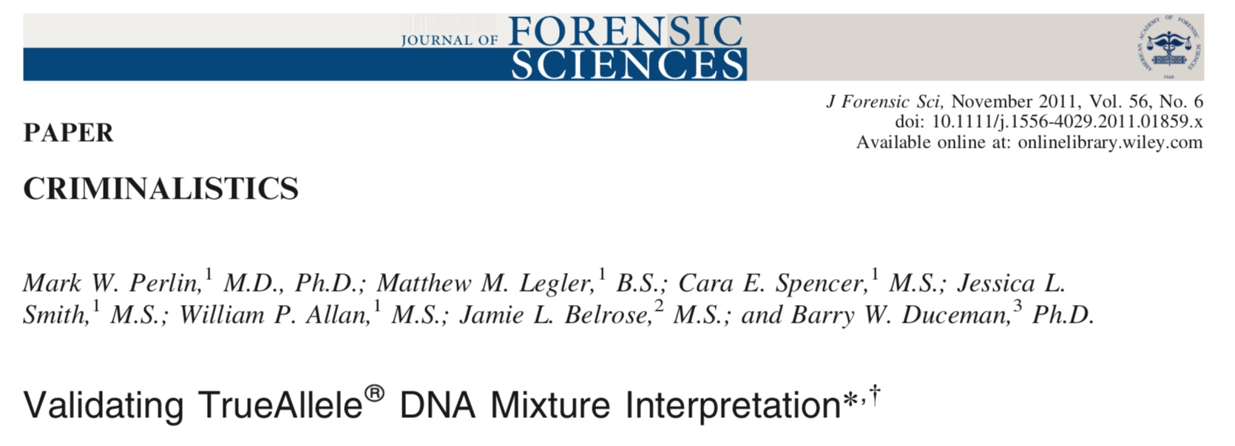
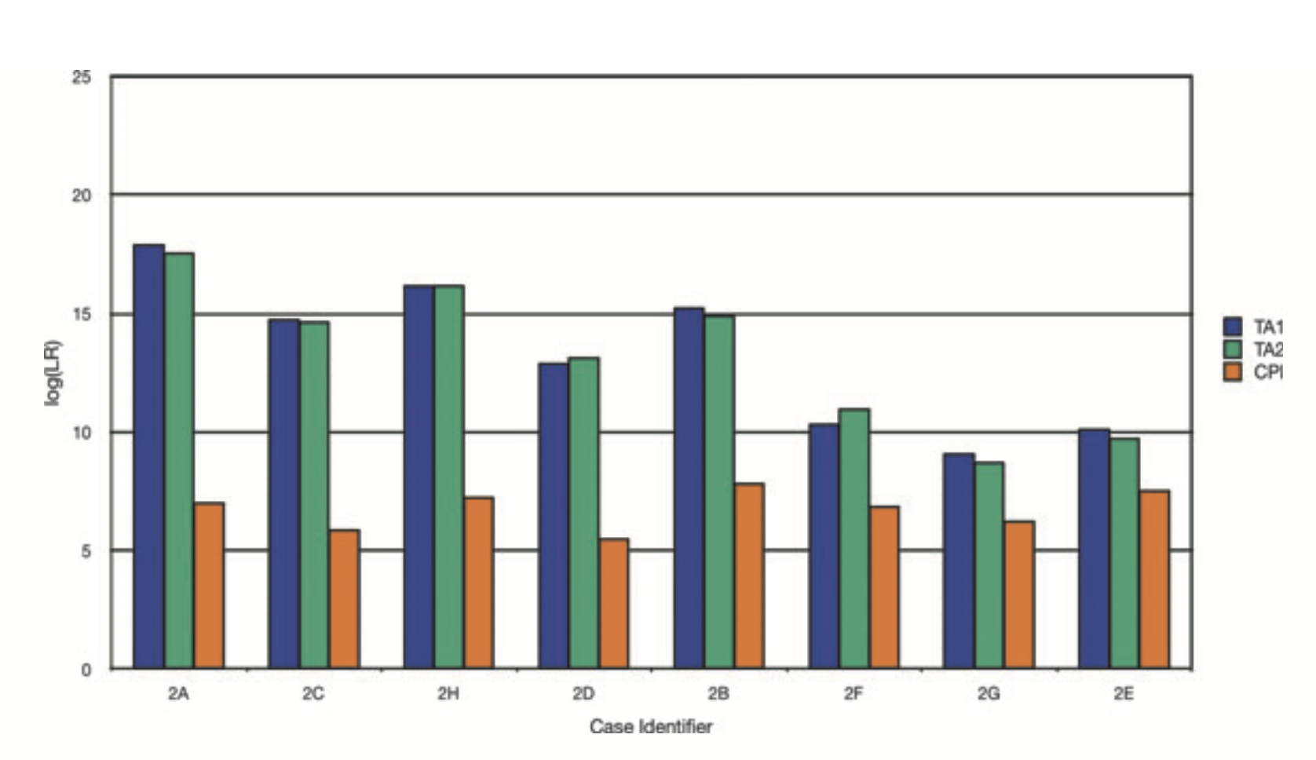

Slide 14
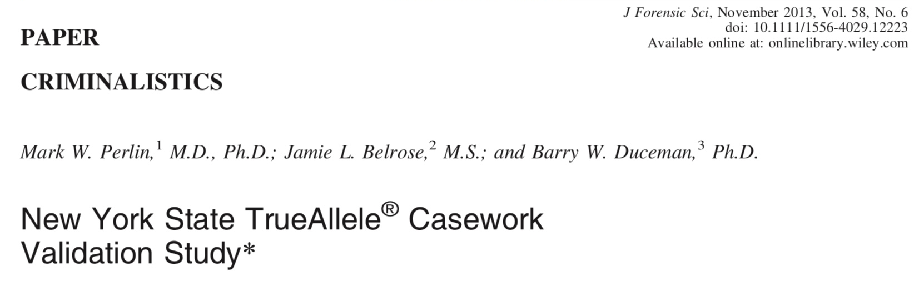
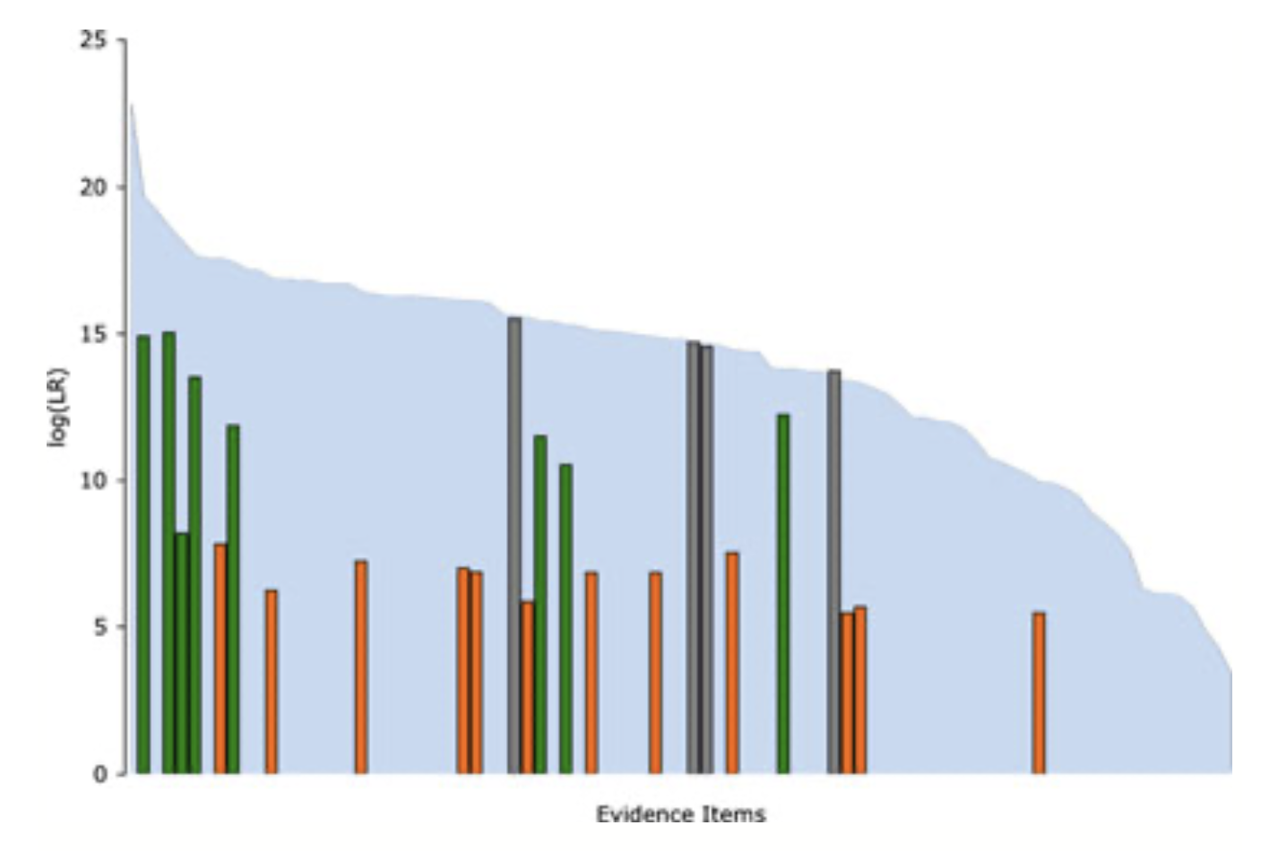

Slide 15
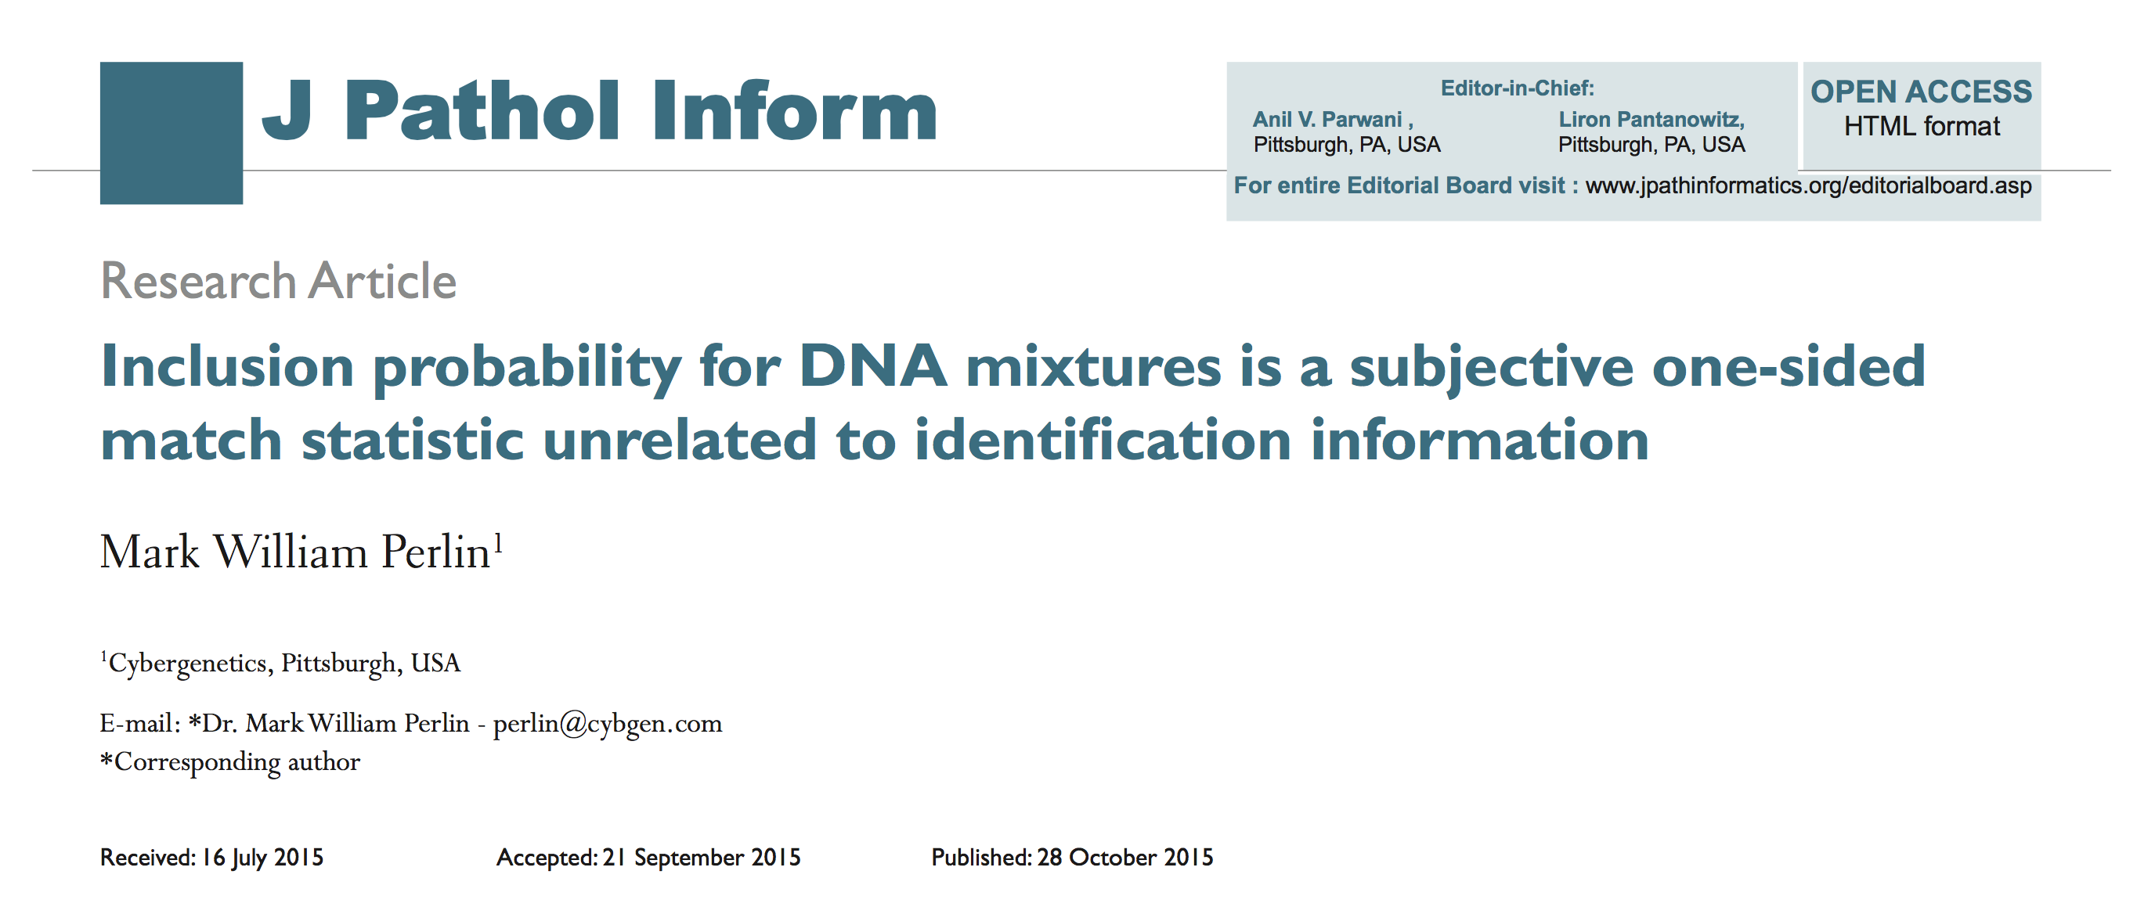
CPI counts inclusion tests
Confused courts for 20 years on countless DNA mixtures

Slide 16
Science answers the court
Why was "The TrueAllele DNA match evidence of a completely different magnitude"?
Because the lab's CPI and TrueAllele measure entirely different things – count v. value
Value matters – how much identification information is the probative reliable match statistic.
Count does not. How many tests were done is incidental, a nonprobative unreliable match statistic.

Slide 17
Opening the door to the past
Court is concerned about unreliable DNA match statistics
Thus, all the state's past CPI crime lab cases – incorrect & inconclusive – must be reopened & corrected.
TrueAllele automation can help audit and remedy these past DNA evidence interpretation failures.

Slide 18
III. Maryland v. Darius Williams
When is a DNA match statistic reliable?
2020. Fatal stabbing
DNA mixtures: victim fingernails
2021. Baltimore lab reported DNA result
TrueAllele® likelihood ratio (LR)
2025. Daubert hearing
Judge admitted TrueAllele

Slide 19
Match statistic result
Baltimore lab’s TrueAllele analysis
Template | MW | logLR | DNA (pg)
3 ng | 8% | 8.62 | 240
419 million
Argument: TrueAllele results “out of scope”
10:1:1 3-person mixture (in case) not done
NIST Report 2024 "Factor space"

Slide 20
TrueAllele reliability
Validation studies
8 peer-reviewed publications
• up to 10-person mixtures
• down to under 1% contributor
36 additional laboratory studies
Admissibility rulings
51 US challenges – 49 wins
Frye, Daubert, Spencer, etc.

Slide 21
Forensic DNA standards
Standards Groups
SWGDAM (FBI), ASB (AAFS)
Probabilistic genotyping (PG)
Reliability based on scientific testing
Additive
• 10 validation axes
• 10 axis gradations
→ 10 + 10 + ... + 10 = 10x10
= 100 experiments
Compliance based on testing axes
under similar conditions

Slide 23
NIST Report 2024
"Factor space"
Multiplicative
• 10 validation axes
• 10 axis gradations
→ 10 x 10 x ... x 10 = 10¹⁰
= 10 billion experiments
Anticipate every possible evidence item
Not done in science
Impossible to do (centuries of testing, $billion)
Unnecessary (bracket by easier & harder items)
19 scientists objected to NIST; 0 agreed
No standards follow this unworkable suggestion

Slide 24
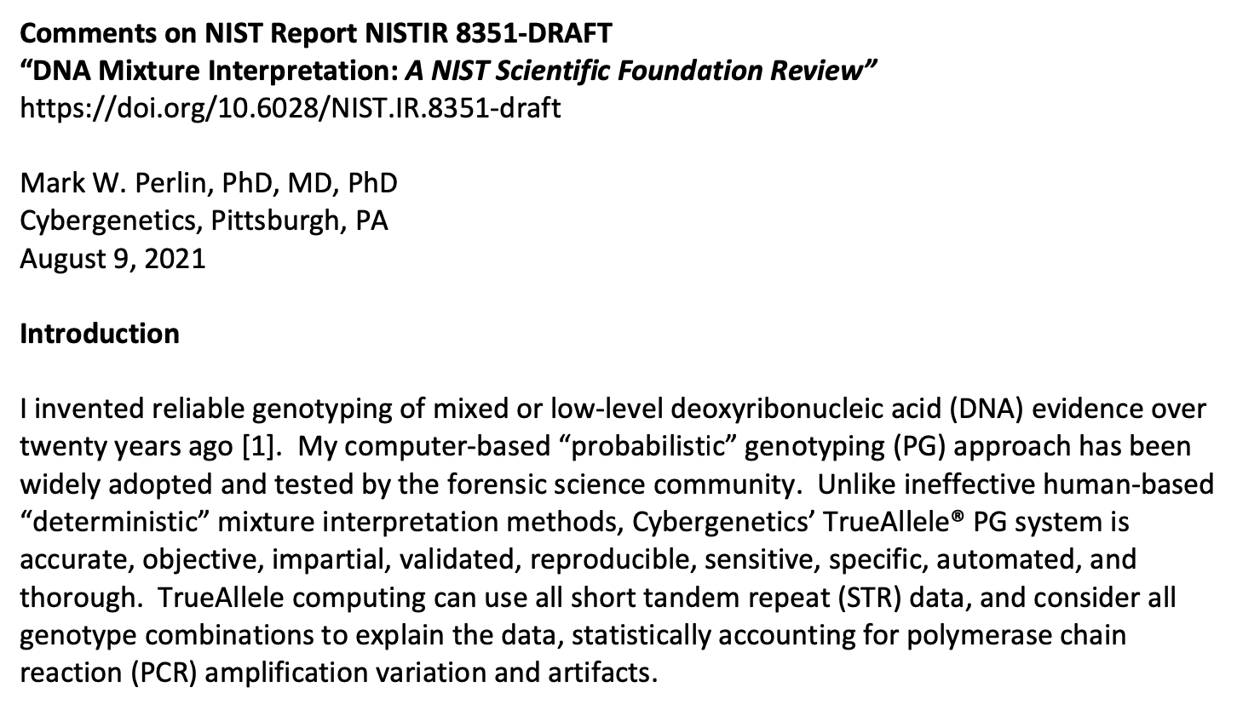

Slide 25
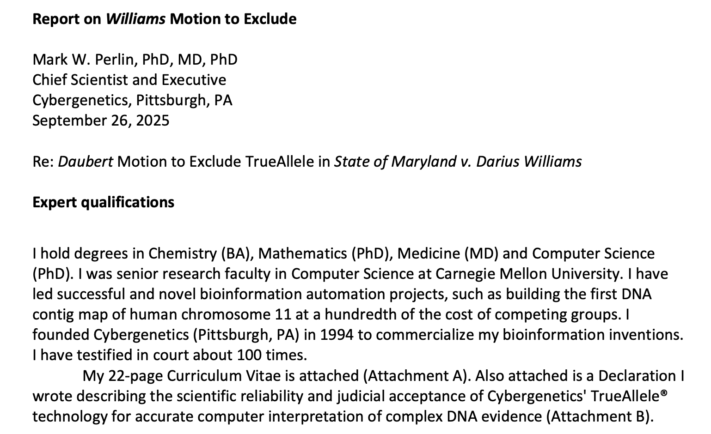

Slide 26
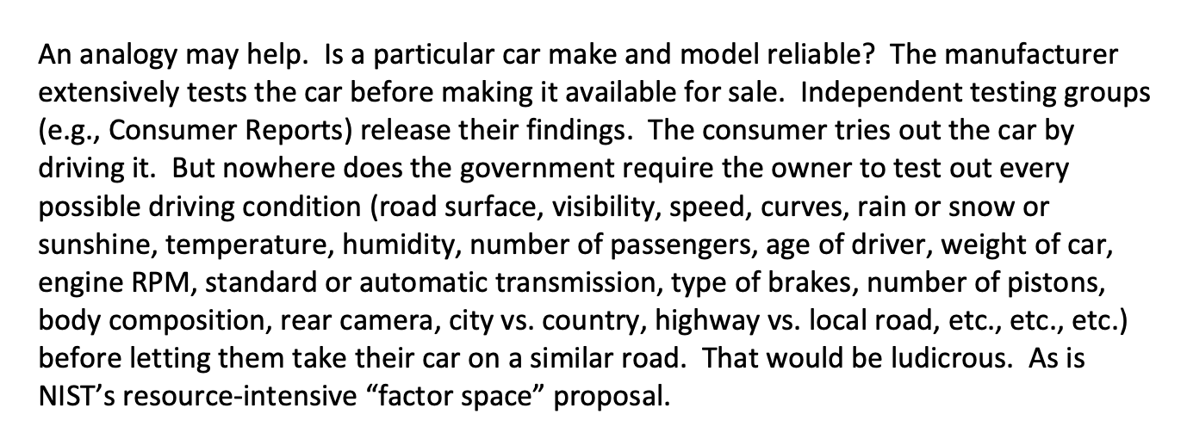

From my Comments & Report

Slide 27
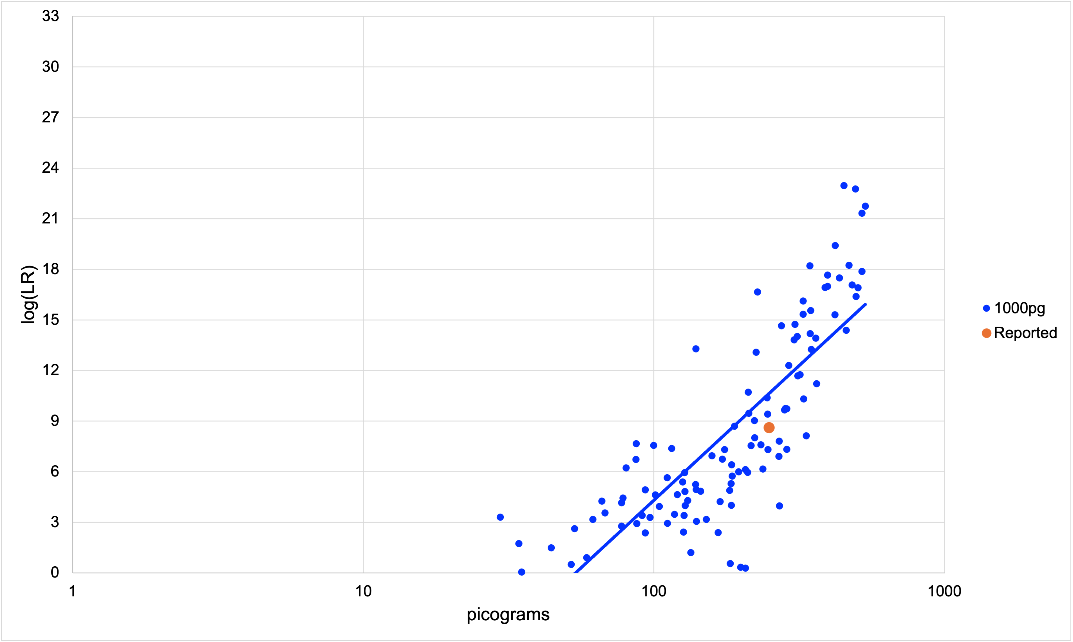
2015 Baltimore TrueAllele validation
Is the case item typical?

Slide 28
IV. Missouri v. Lance Shockley
Whether to test DNA evidence?
2005. Fatal shooting of police officer
Evidence collected, not tested
2009. Murder trial – jury convicted
Judge imposed death sentence
2025. Post-conviction motion
Judge denied DNA testing

Slide 29
PCRA request for DNA testing
10 evidence items
A crime scene cigarette butt
Paper and plastic shotshell wadding
Latent fingerprints
A cell phone

Slide 30
Motion for DNA testing denied
Rejected PCRA theories:
Database, Confession, Redundancy
I. There wasn't "a reasonable probability that the outcome of the trial would have been changed by the discovery of DNA from another person."
II. That "touch DNA analysis was reasonably available to him at the time of trial."

Slide 31
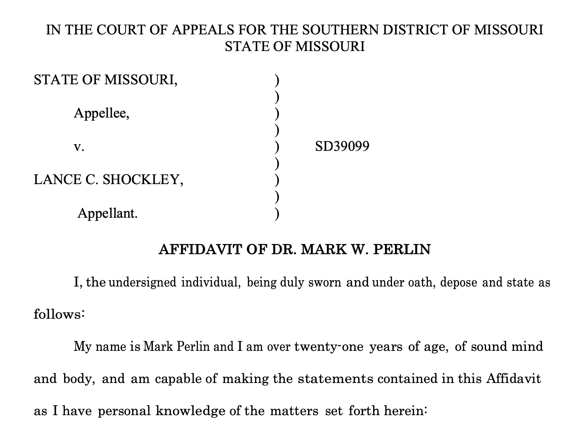
Forensic science disagrees
Four forensic science amicus curiae briefs

Slide 32
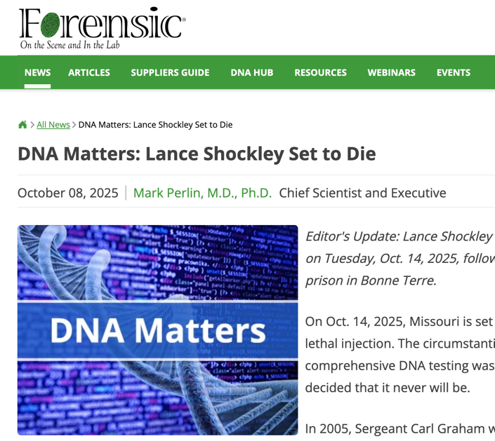
Forensic Magazine article

Slide 33
The article begins …
"On October 14, 2025, Missouri is set to execute Lance Shockley by lethal injection. The circumstantial evidence is compelling, but comprehensive DNA testing wasn’t done—and the courts have decided that it never will be."

Slide 34
Point I response
Why new DNA evidence could have changed the trial outcome
DNA changes case outcomes
For prosecutors and for defenders
Pennsylvania v. Joshua Huber
Texas v. Lydell Grant
Database search identified Jermarico Carter
Confessed when confronted with DNA evidence
Indiana v. Darryl Pinkins and Roosevelt Glenn
Redundancy of three brothers

Slide 35
Point II response
Effective touch DNA analysis was not reasonably available at the time
DNA testing has two parts:
(i) laboratory data generation
(ii) subsequent interpretation of the data
In 2009, TrueAllele was the only effective touch DNA interpretation method

Slide 36
Pennsylvania v. Kevin Foley
FBI Popstats software CPI = 13 thousand
Cybergenetics TrueAllele LR = 189 billion
Frye hearing, TrueAllele admitted, testimony
First-ever use of effective PG DNA interpretation
• Friday, March 20, 2009, Foley jury convicted in Pennsylvania
• Monday, March 23, 2009, Shockley's trial started in Missouri
Shockley would not have known about TrueAllele

Slide 37
The FM article ends …
"DNA matters. Society submits uncertain samples for DNA testing. Computers consider millions of possibilities, weighing probability and deriving scientific truth. The data decides who left their DNA and who did not.
"But there is no uncertainty in the Courts of Missouri. Only one possibility is left. As sure as the sun will set on October 14, pentobarbital will course through Lance Shockley’s veins. And as he departs, so too will the vain hope of DNA truth."

Slide 38

DNA testing denied
The Missouri courts have a local rule that allows them to reject any amicus brief. All four DNA briefs were rejected.
Lance Shockley was pronounced dead at 6:13 p.m. on Tuesday, October 14, 2025, following a lethal injection at the state prison in Bonne Terre.

Slide 39
V. Truth v. Justice
"Truth is what a judge decides." – Berkeley Law professor

Slide 40
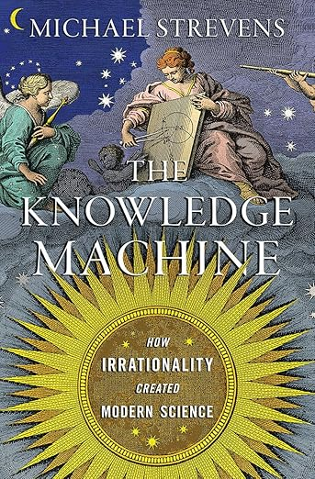
V. Truth v. Justice
"Truth is what a judge decides." – Berkeley Law professor
No. Science is the only effective path to truth.
Empirical testing of hypotheses by experiments and data.

Slide 41
V. Truth v. Justice
41
"Truth is what a judge decides." – Berkeley Law professor
No. Science is the only effective path to truth.
Empirical testing of hypotheses by experiments and data.
Justice is the fairness that law can deliver.
Denying science denies justice

Slide 42
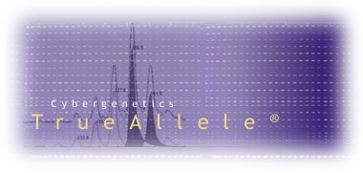

More information
http://www.cybgen.com/information
• Courses
• Newsletters
• Newsroom
• Presentations
• Publications
• Webinars
http://www.youtube.com/user/TrueAllele
TrueAllele YouTube channel
perlin@cybgen.com

