Slide 1

Overcoming Unscientific Opposing Arguments using Relevant Data
American Academy of Forensic Sciences
77th Annual Meeting
Baltimore, Maryland
February, 2025
Jennifer M. Bracamontes, MS
William P. Allan, MS
Mark W Perlin, PhD, MD, PhD
Cybergenetics © 2003-2025

Slide 2
Disclaimer and Disclosure
The views, statements, and content offered in this presentation are solely the work of the presenting author and any co-authors, and does not necessarily reflect any opinions, stances, standards, statements, or policies of the American Academy of Forensic Science. The content has not been reviewed or endorsed by the Academy, its staff, officers, or program leadership.
Cybergenetics created and sells TrueAllele® Casework technology and services.
Jennifer Bracamontes and William Allan are employees of Cybergenetics.
Dr. Mark Perlin is an owner/officer of Cybergenetics.

Slide 3
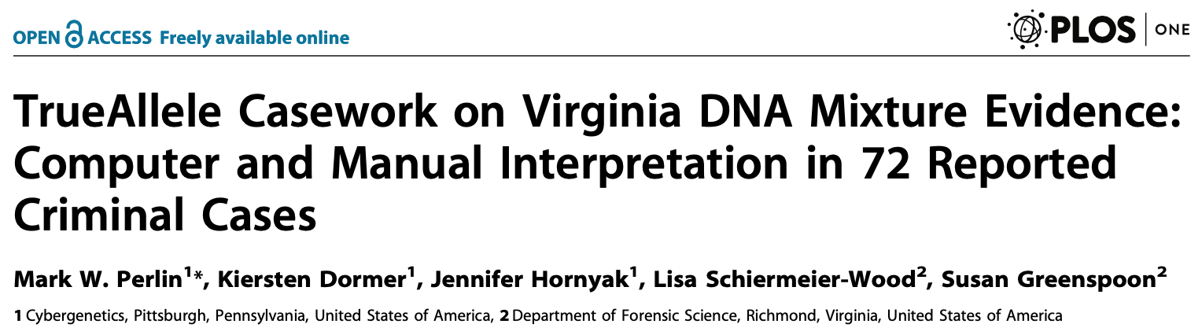
Non-contributor distribution
100 genotypes
10,000 references
A million LR calculations
Sample LR values

Slide 4
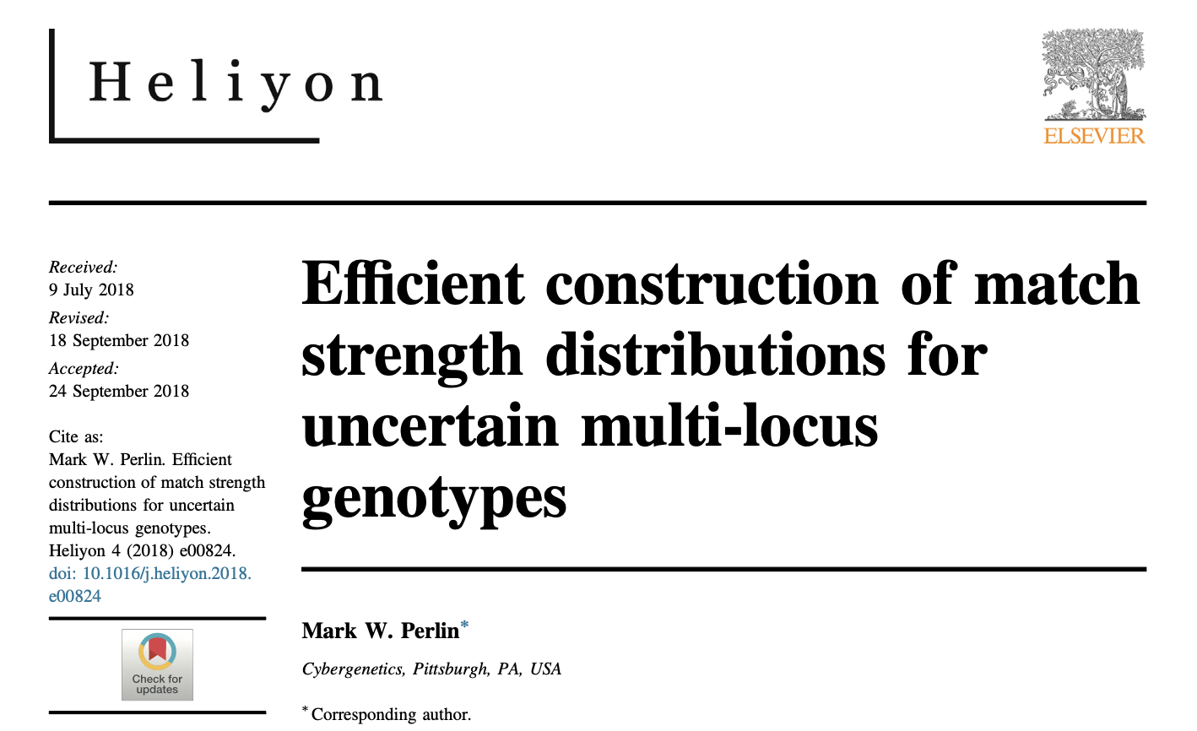
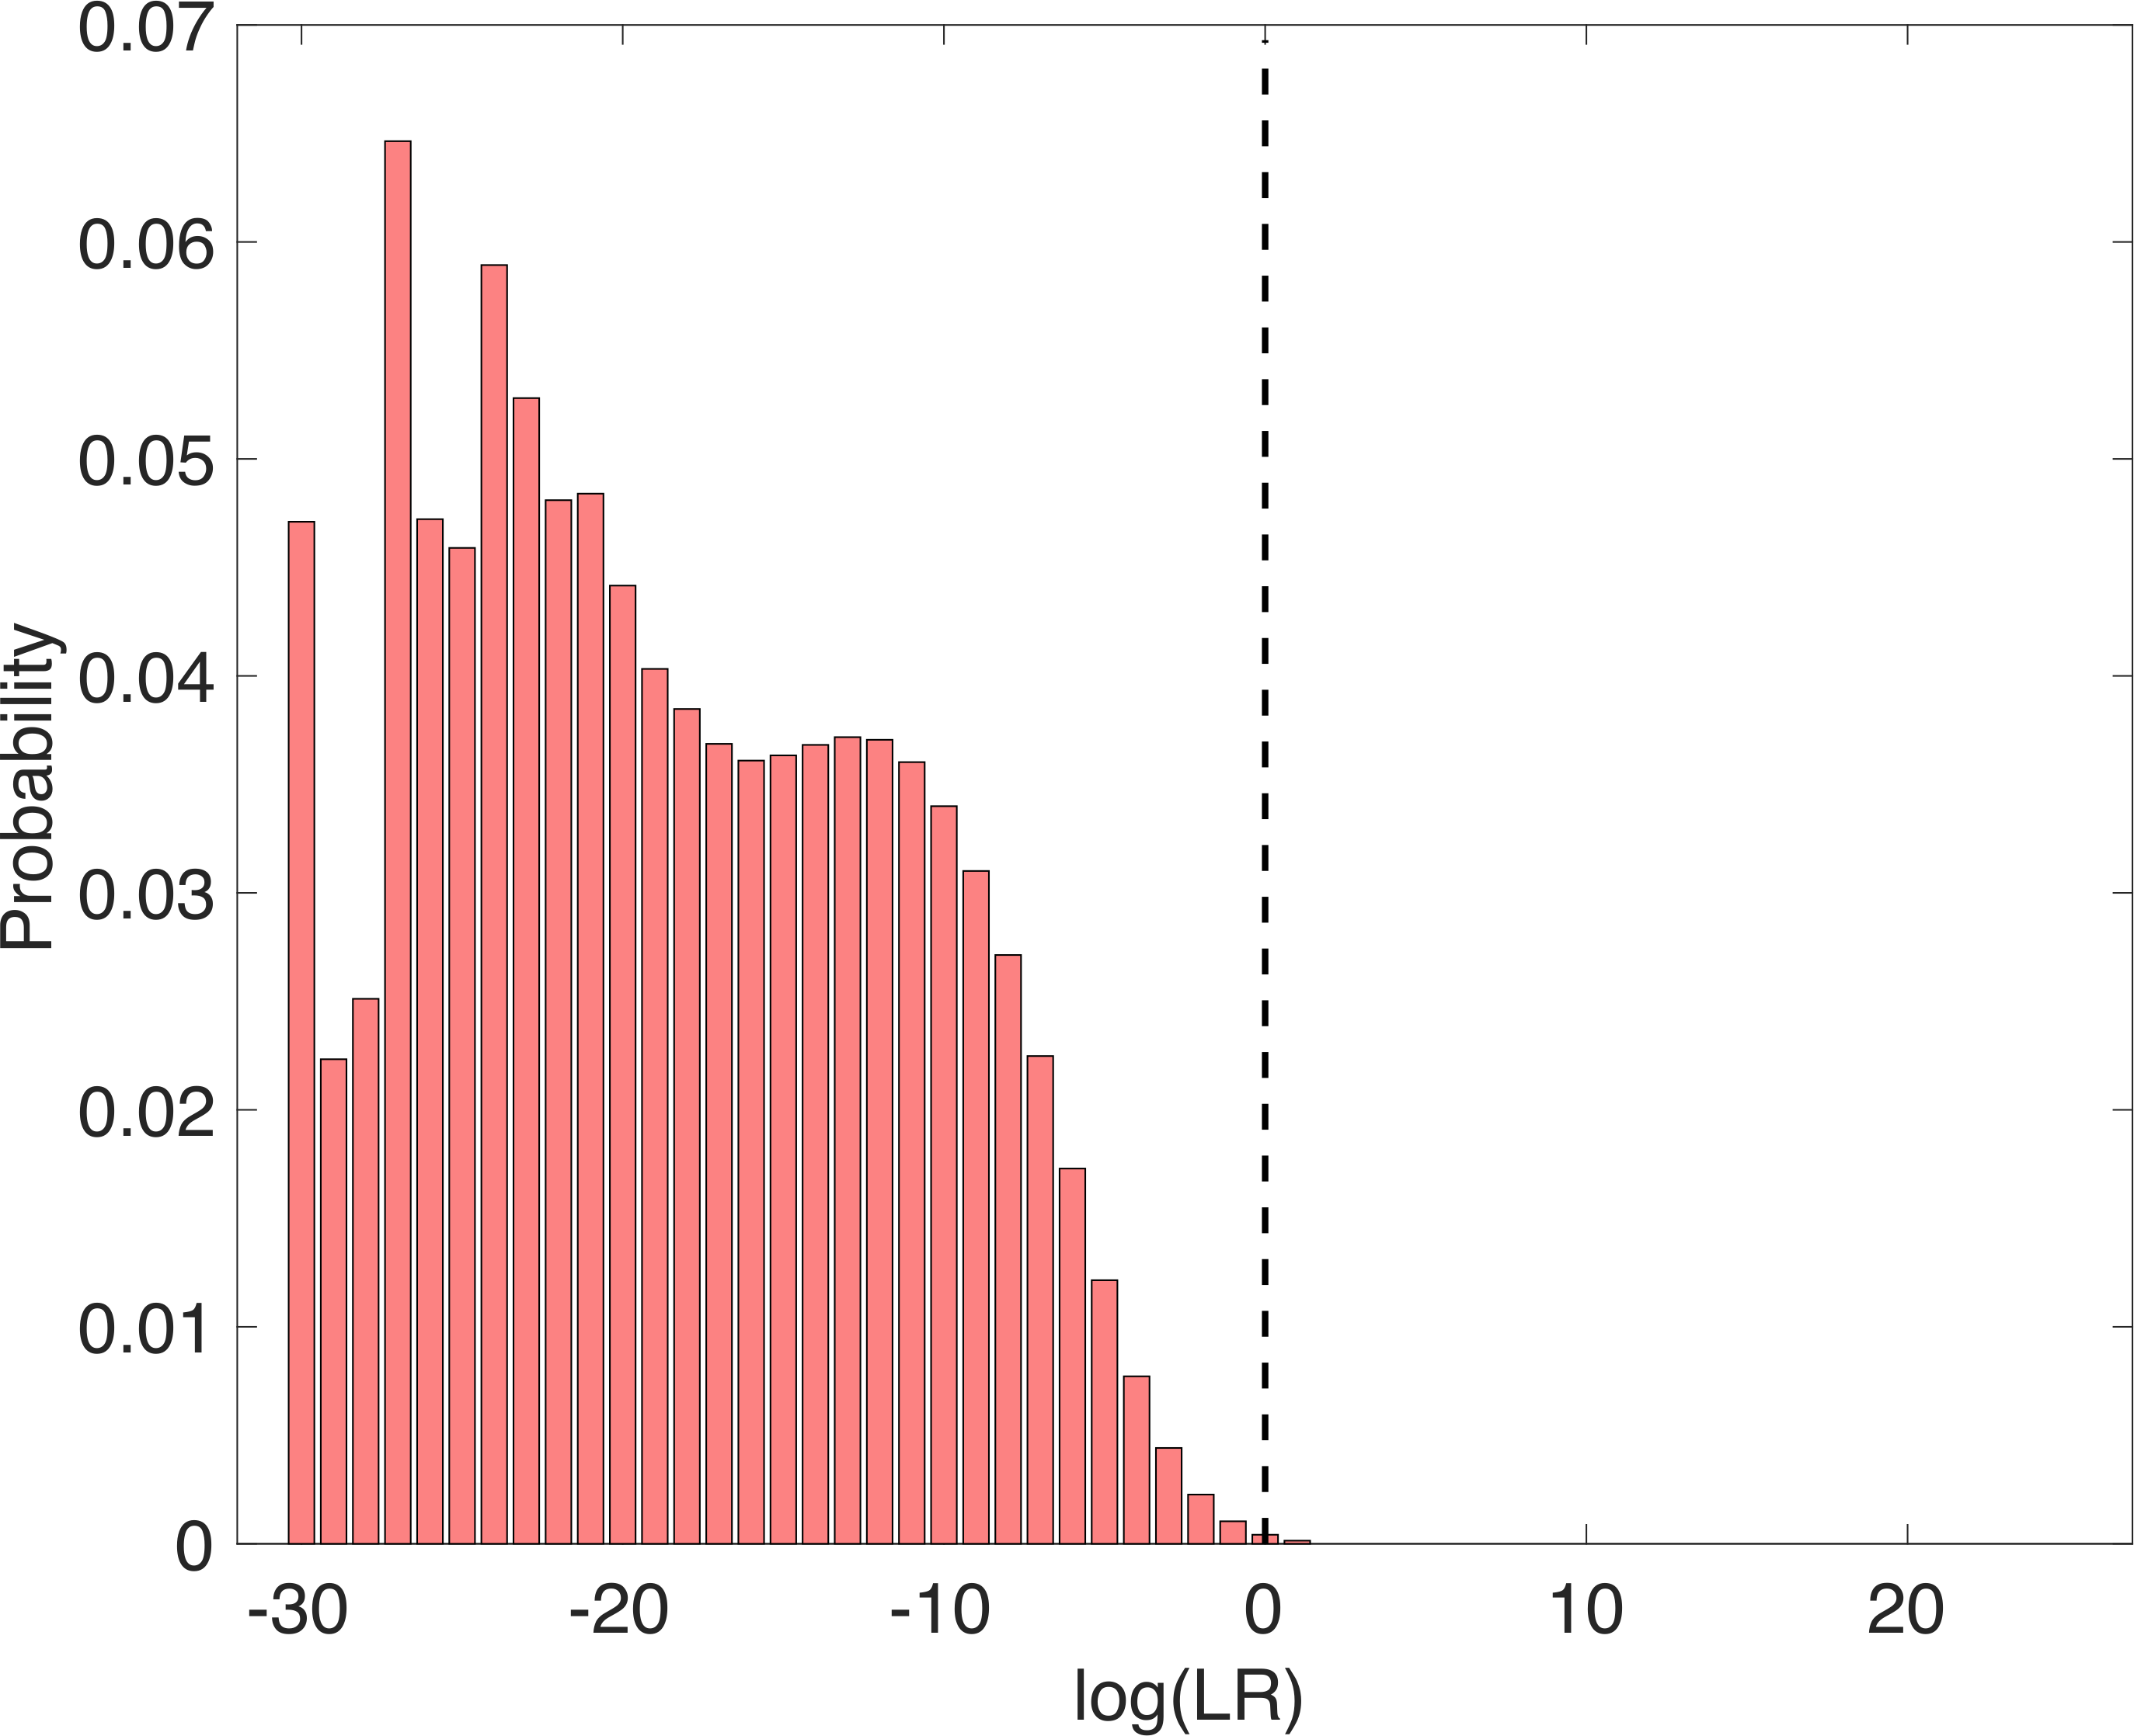
Exact non-contributor distribution
100 genotypes
No references
No LR calculations
Exact composite

Slide 5
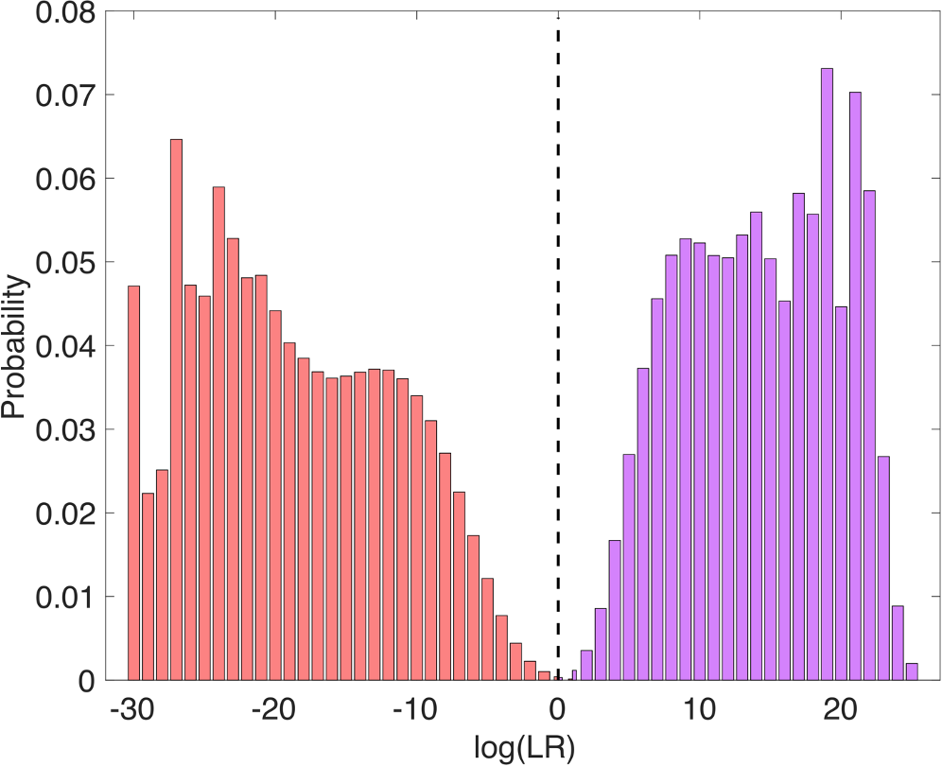
Dual exact LR distributions
Noncontributor
Contributor

Slide 6
Opposition argument
“Ground truth” laboratory data is needed to
validate a probabilistic genotyping system (PGS).
LR distributions show this isn’t so.

Slide 7
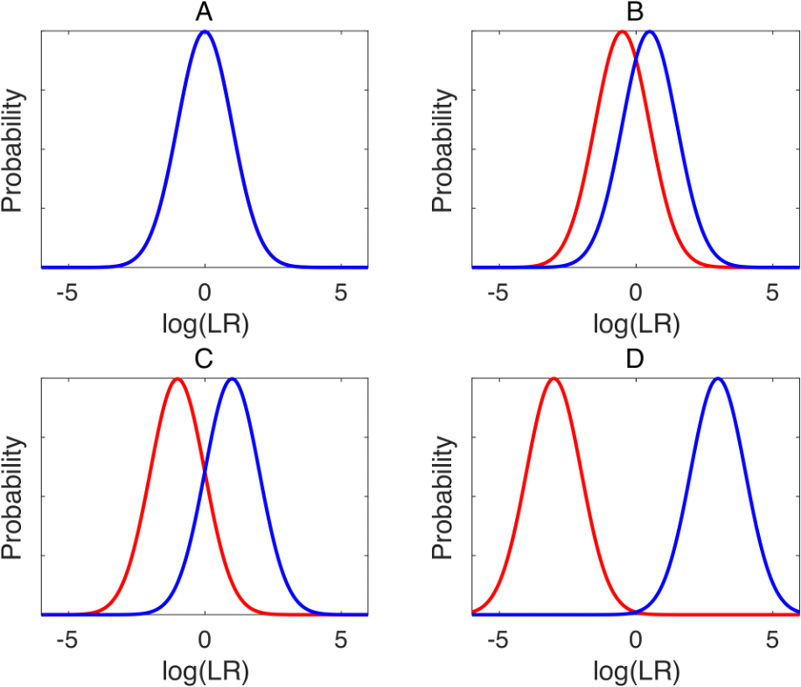
Classification accuracy
A = Pr{left < right}
for sampled (left, right) scores
A = 0.50
A = 0.76
A = 0.98
A = 1.00

Slide 8
Accuracy = 1, Perfect Classifier
Noncontributor
Contributor
A = 1.0000

Slide 9
Validate on casework data
“Since the [TrueAllele] method’s high specificity assures identification hypothesis H with considerable certainty, we can safely examine the Pr{X=x | H} sensitivity distribution of positive log(LR) values.”
- PLOS ONE 2014 Virginia validation study
Similarly, high sensitivity lets us safely examine the specificity distribution of negative log(LR) values.
PGS doesn’t need “ground truth”
to construct LR distributions.

Slide 10
United States v Curtis Johnson
In 2013, men robbed an armored truck outside a New Orleans bank, killing the truck guard in a shootout.
A bandana was collected from the crime scene
A 70 pg sample was a three-person mixture
TrueAllele separated out bandana genotypes
Comparing a 27% contributor with Johnson, LR = 200
2021 – Daubert hearing, TrueAllele admitted, first trial
2022 – Second trial, guilty verdict, 50-year sentence

Slide 11
Opposition argument
Low LR values are unreliable.
LR distributions show this isn’t so.

Slide 12
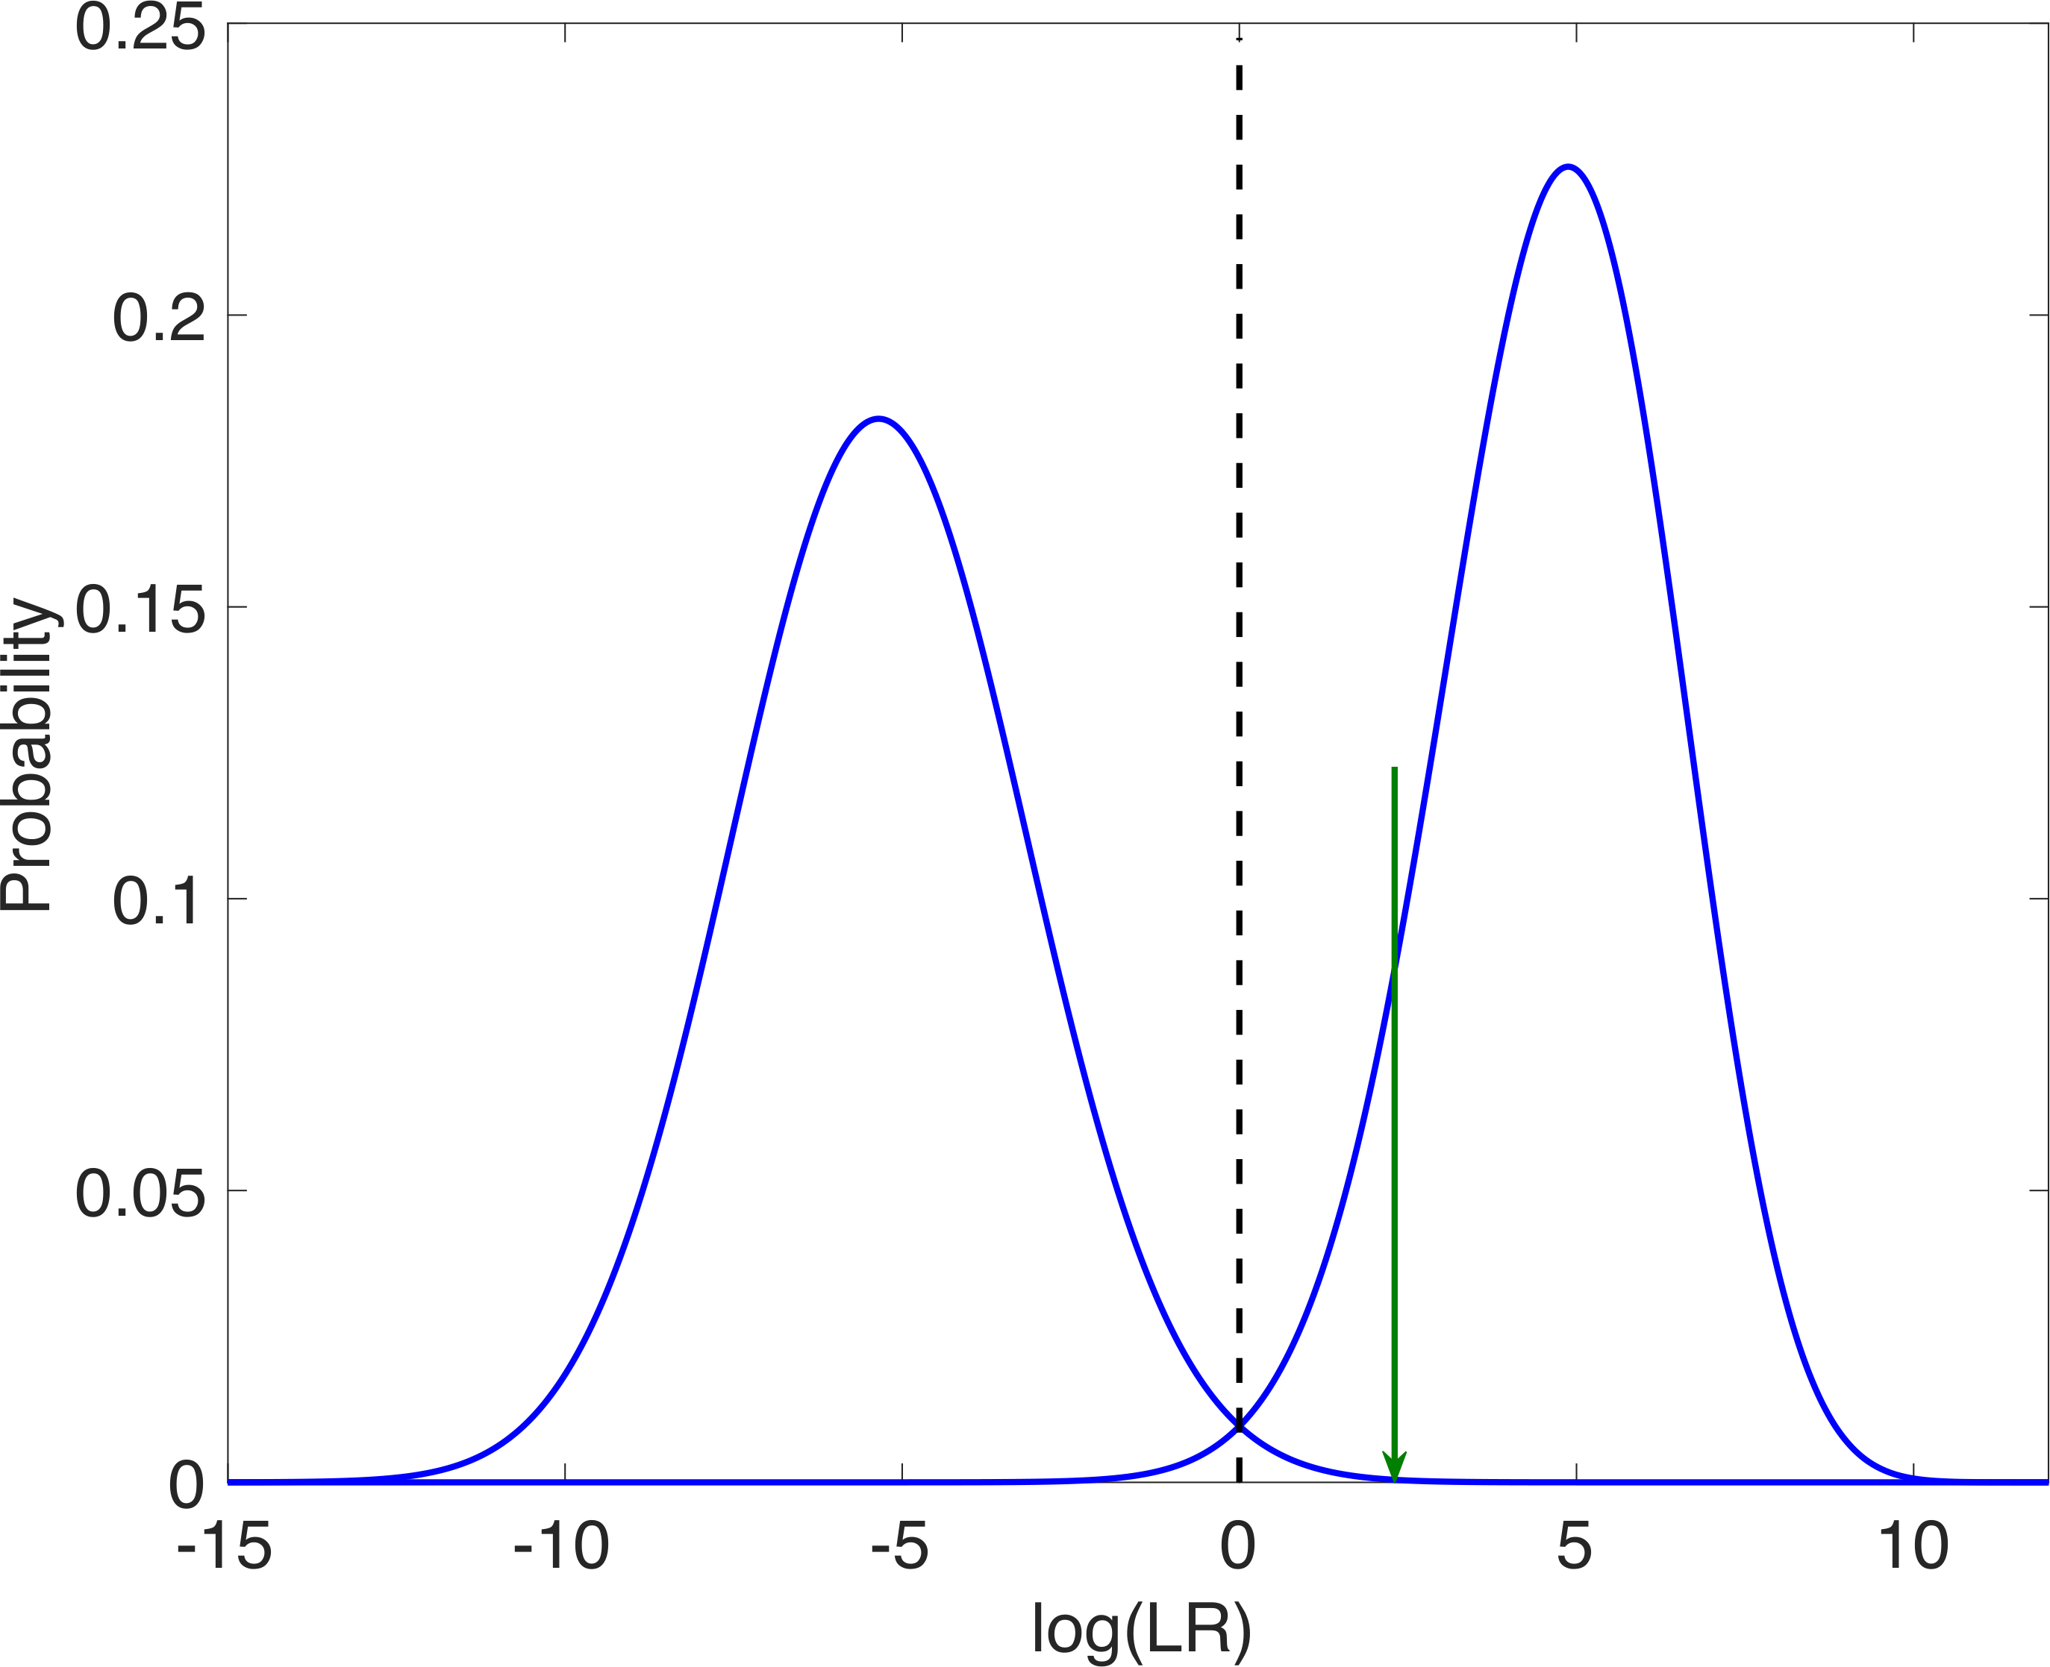
Distribution gives LR error rate
Noncontributor
A = 0.9997

Slide 13
Report LR error rate
A match between the bandana and Johnson is 200 times more probable than coincidence.
For a match strength of 200, only 1 in 4.1 thousand people would match as strongly.
ER ≤ 1/LR
1/4100 ≤ 1/200

Slide 14
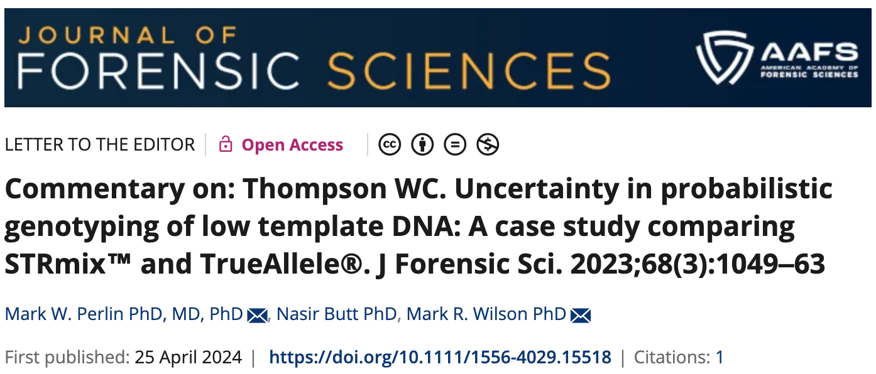
United States v Alejandro Sandoval
Police collected a baggie containing methamphetamine
Defense tested baggie, found a DNA mixture
Two different PG software programs used
Unsuccessful Daubert attempt to challenge OPG
Plea agreement dropped the more serious charge
JFS published a speculative “Case Report”

Slide 15
Opposition argument
TrueAllele and Other PG (OPG)
can give different LR results.
So PGS isn’t reliable!
LR distributions show this isn’t so.

Slide 16
Analytical thresholds
OPG
Threshold (rfu) | Data peaks | log(LR)
90 | 11 | -0.53 ban
40 | 24 | -1.38 ban (reported)
20 | 38 | -7.48 ban
TrueAllele
Threshold (rfu) | Data peaks | log(LR)
none | 210 | -6.08 ban

Slide 17
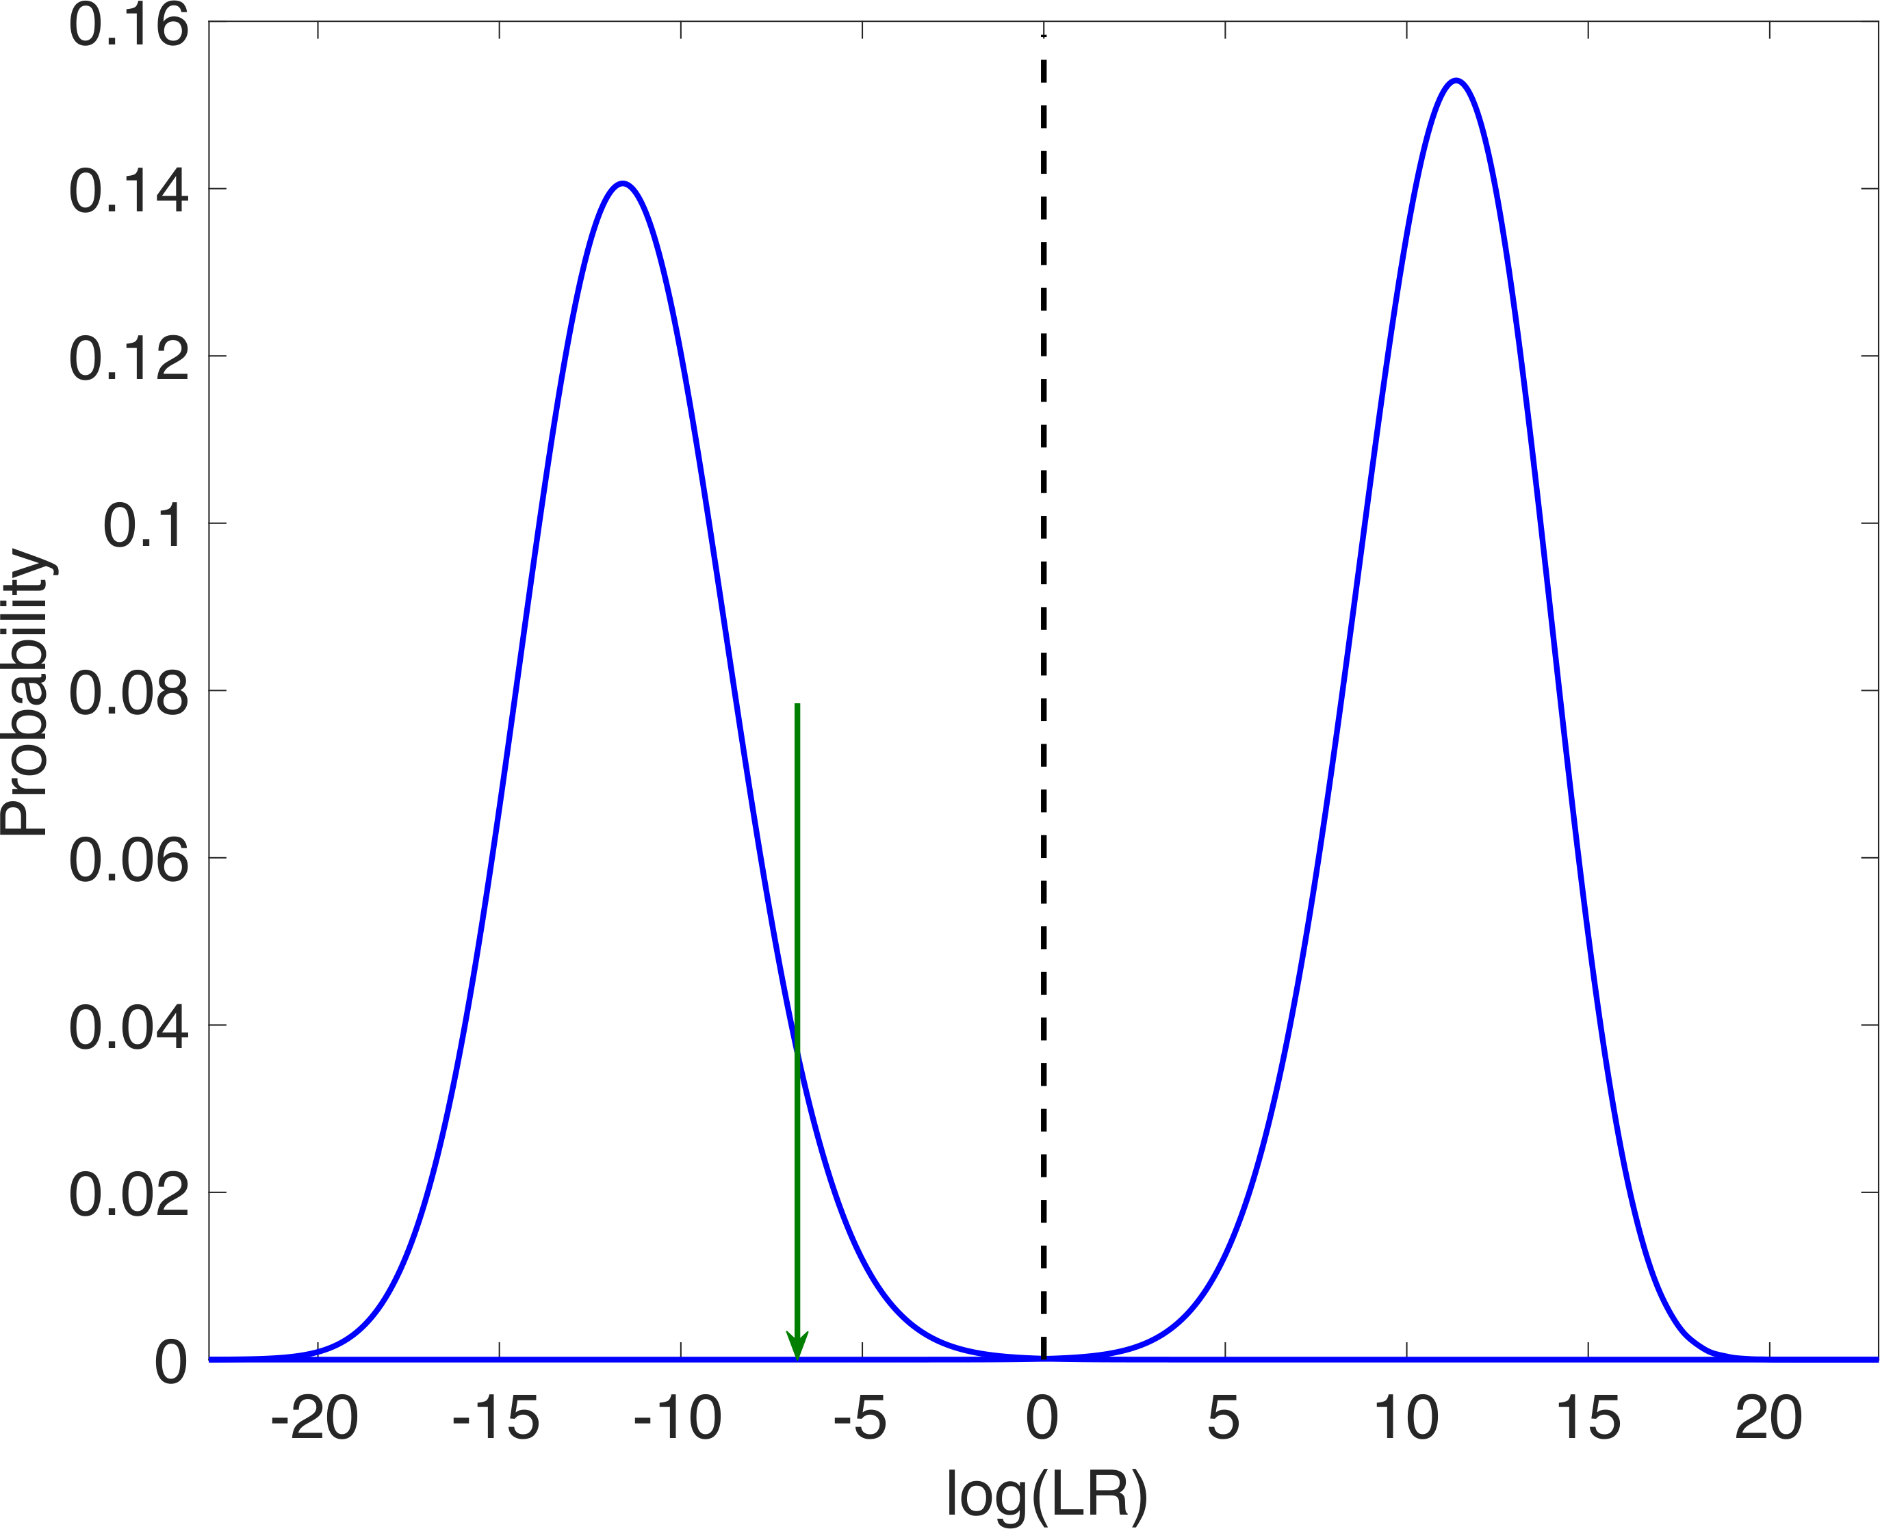
TrueAllele distribution pair
No AT, 210 data peaks
A = 1.0000
-6.08

Slide 18
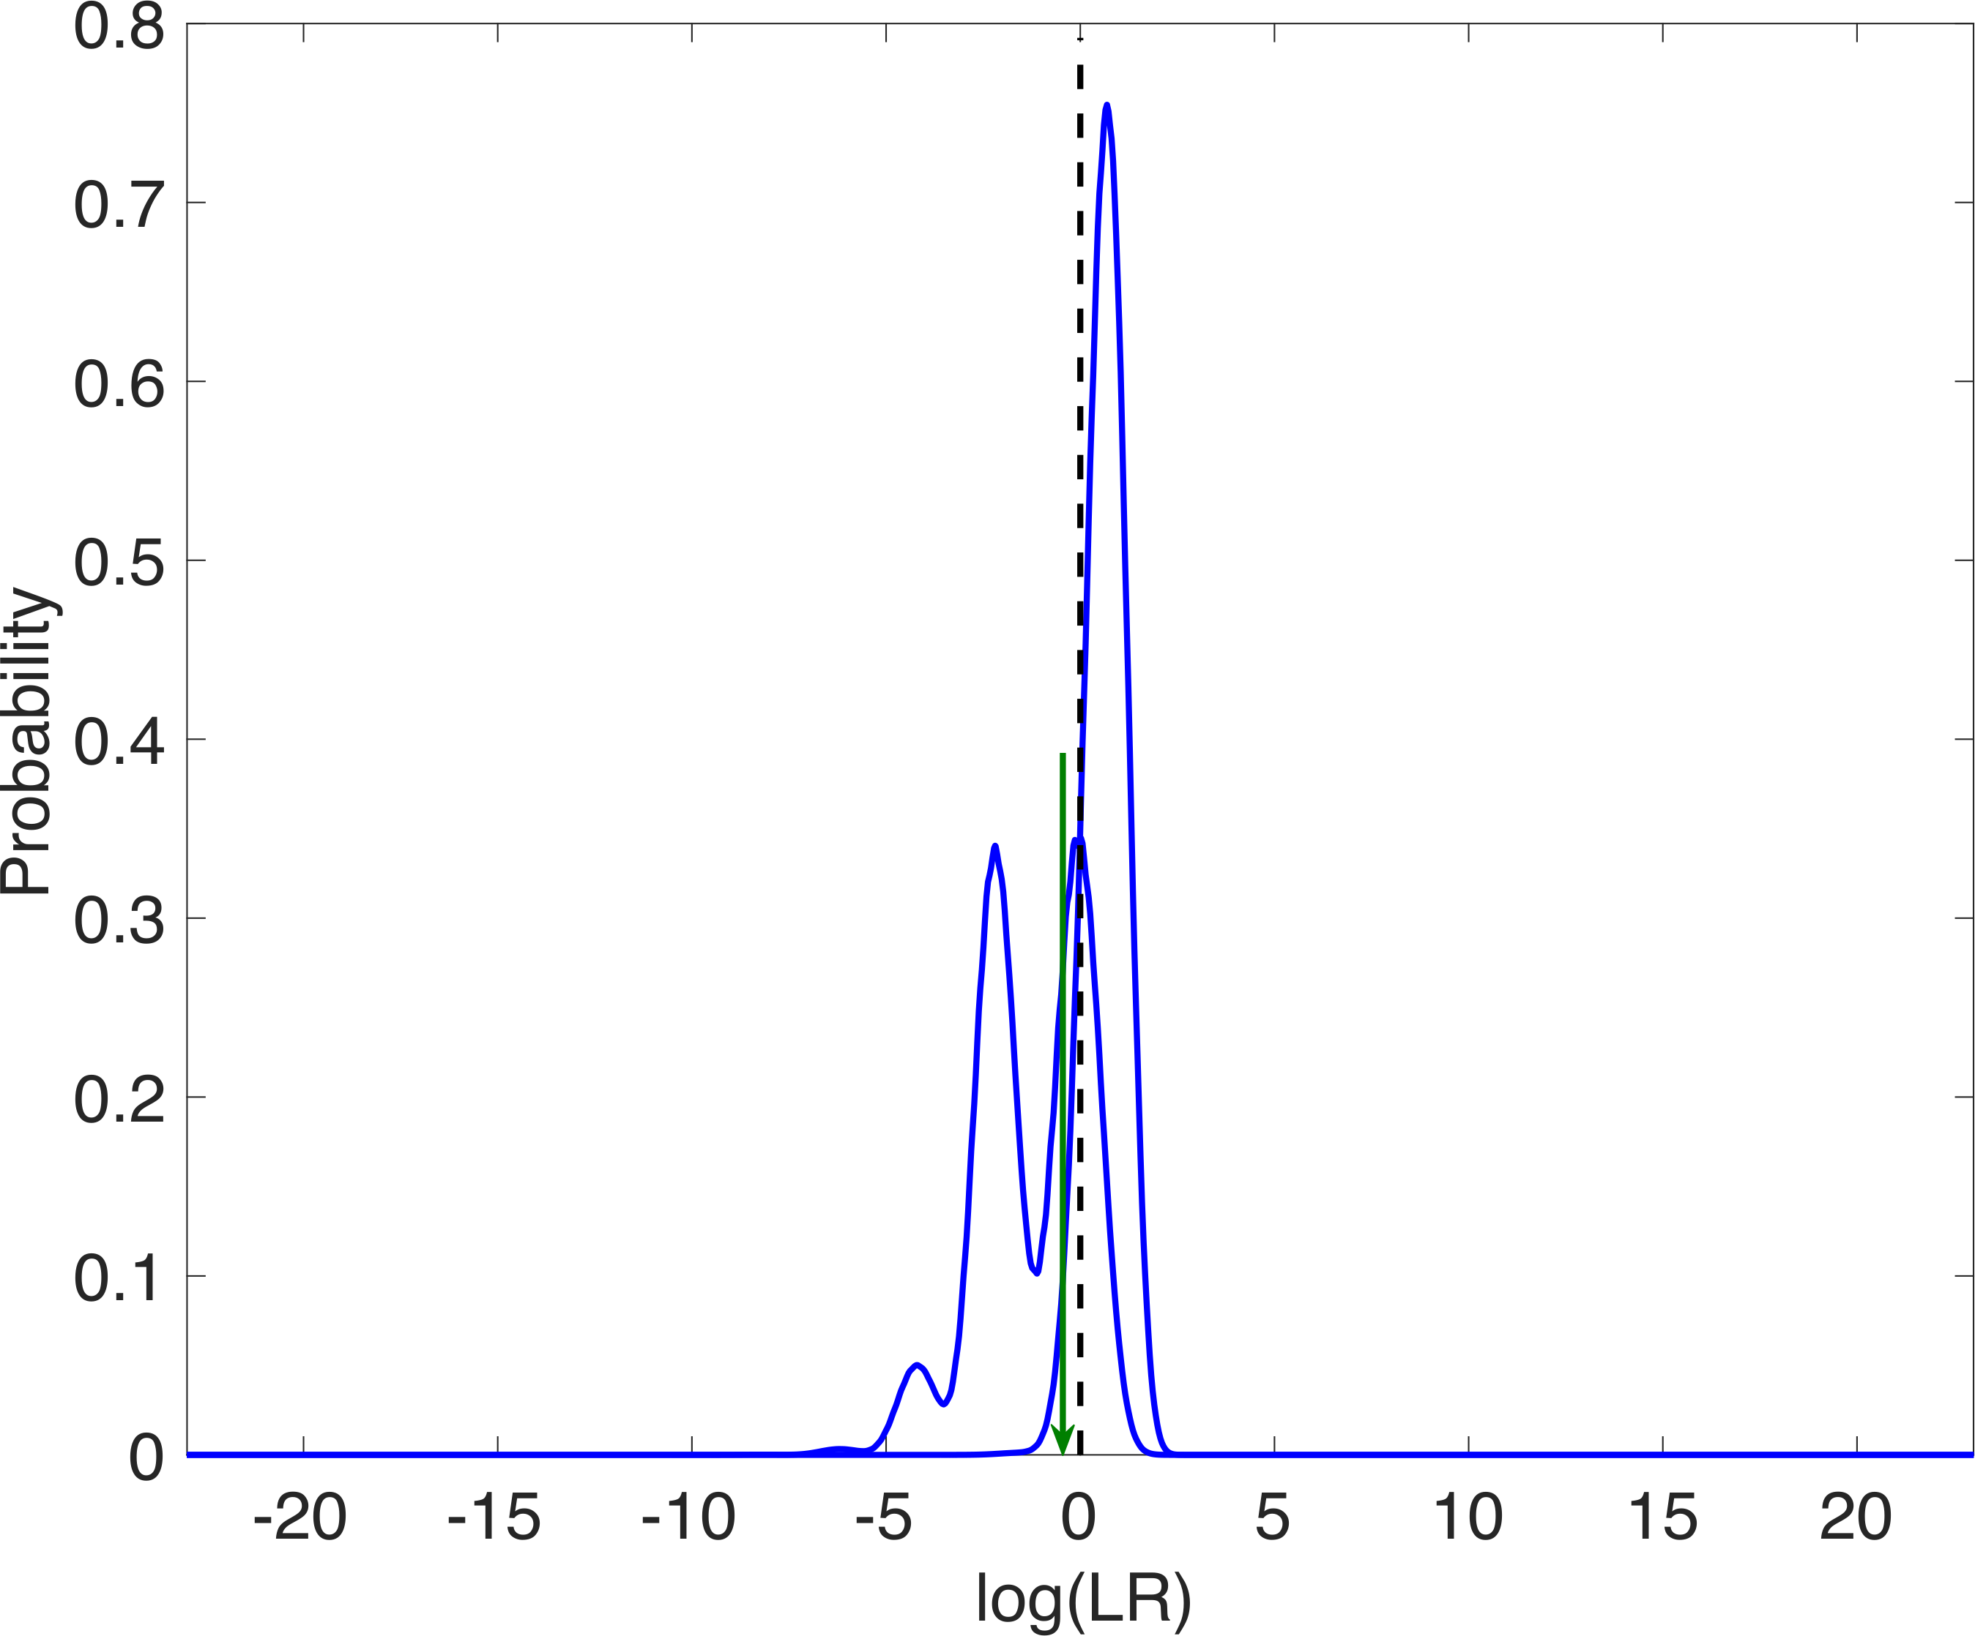

OPG distribution pair
AT = 40 rfu, 24 data peaks
A = 0.9077
-1.38

Slide 19
United States v Ravel Mills
2020 shooting-related homicide in Washington, D.C.
Gun and magazine recovered as evidence
Gun: 6% component of a three-person mixture
  log(LR)= -7.86, log(ER)= -11.18
Magazine: 2% component of a four-person mixture
  log(LR)= -11.21, log(ER)= -14.54
Federal prosecutor requested Daubert hearing
Typical defense expert attack: old-style binary logic
TrueAllele won “on the papers”, no hearing needed

Slide 20
Opposition argument
TrueAllele’s own validation study
shows high LR error rates.
Thus the PGS isn’t reliable!
LR distributions show this isn’t so.

Slide 21
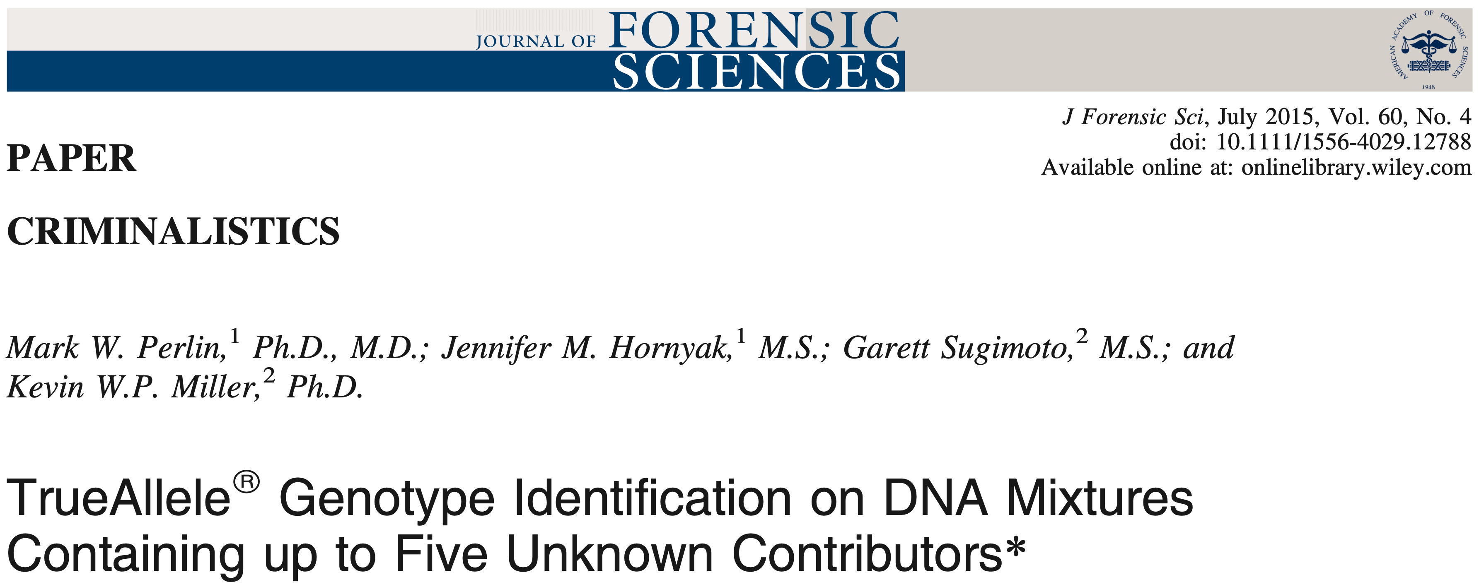
TrueAllele validation study

Slide 22
Opposition argument
Binary error rate (LR < 1 or LR > 1)
in the case’s actual software version
N= | Mixture Range % | count for LR<1 | % for LR<1
20 | 1­–5 | 7 | 35%
17 | 5–10 | 0 | 0%
Binary error rates are simplistic and irrelevant
The likelihood ratio is quantitative
Error rate depends on LR magnitude

Slide 23

Error rate depends on LR
Source | Mixture Weight % |  | log(LR) |  | log(ER)
Gun | 5.89 |  | -7.86 |  | -11.18
Magazine | 2.40 |  | -11.21 |  | -14.54
Validation | 1.63 |  | -3.49 |  | -6.08
 | 1.08 |  | -2.61 |  | -3.84
 | 1.70 |  | -2.47 |  | -4.37
 | 1.32 |  | -1.40 |  | -3.14
 | 2.26 |  | -0.60 |  | -2.69
 | 1.65 |  | -0.54 |  | -2.37
 | 1.40 |  | -0.15 |  | -2.53

Slide 24
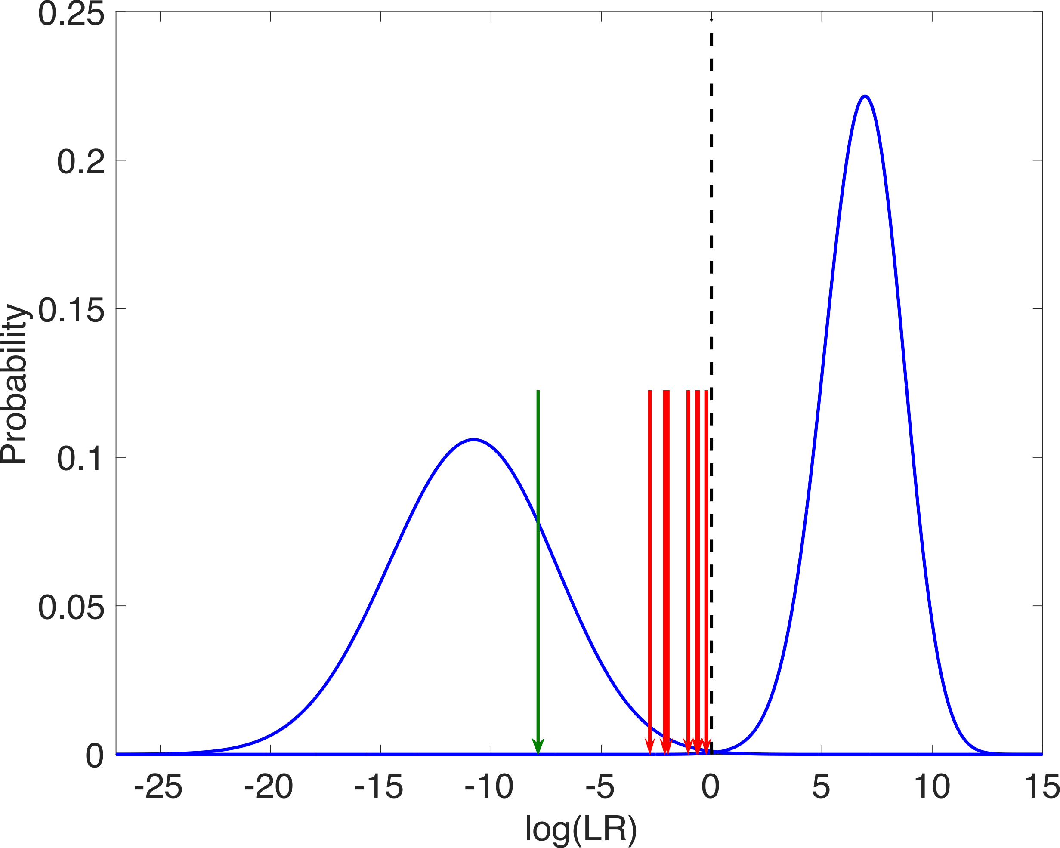
Gun distributions
Noncontributor
Contributor
A = 1.0000

Slide 25
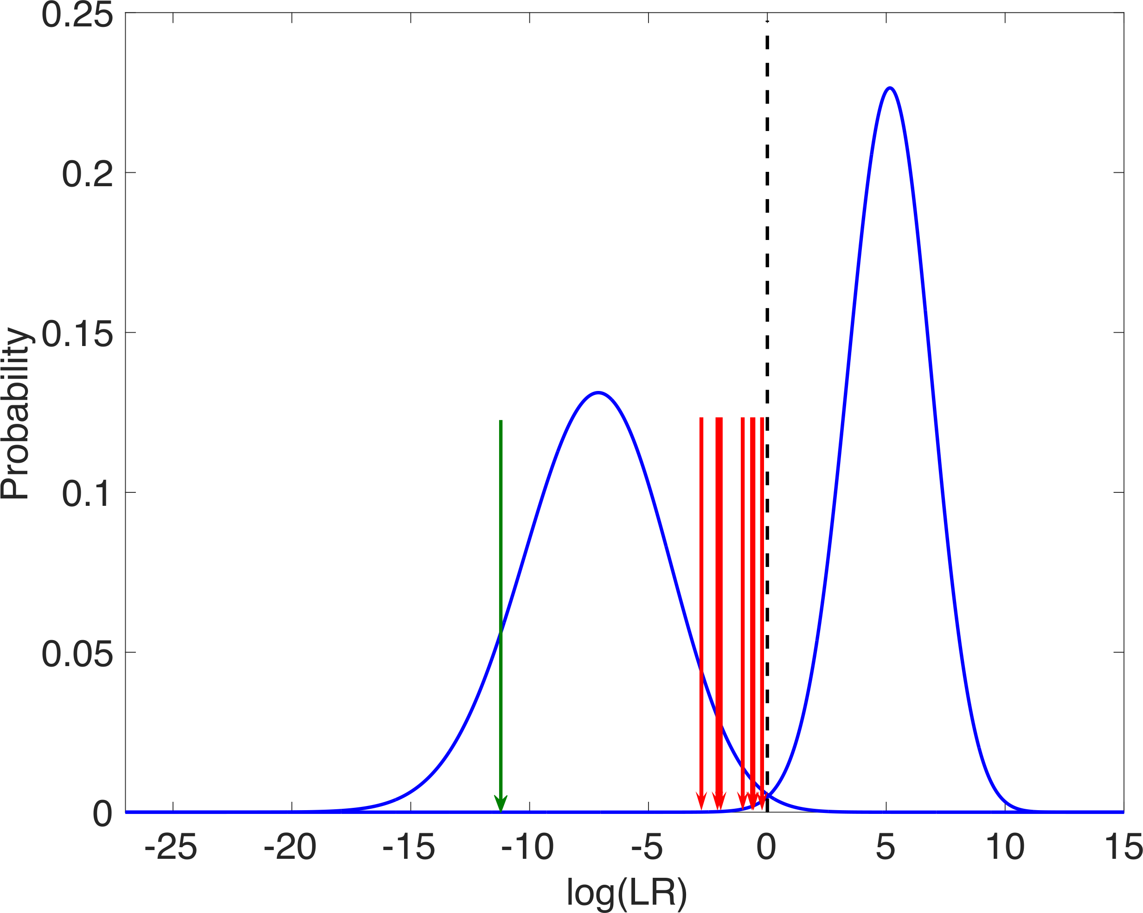
Magazine distributions
Noncontributor
Contributor
A = 0.9999

Slide 26
Conclusions
How to rebut unfounded PGS opposition arguments
Use fully Bayesian PGS on all STR data (no threshold)
Separate mixtures into accurate contributor genotypes
Report all inclusionary and exclusionary LRs
Use LR distributions to report LR error rates
Respond to bad arguments with good LR science

