Slide 1

Getting more from less: low-level DNA mixtures on cartridges
Mid-Atlantic Association of Forensic Scientists Annual Meeting
May 2024
Pittsburgh, PA
Kari R. Danser, MS, Jennifer M. Bracamontes, MS
Megan M. Foley, MS, Matthew M. Legler, BS
Mark W. Perlin, PhD, MD, PhD
Cybergenetics © 2003-2024

Slide 2
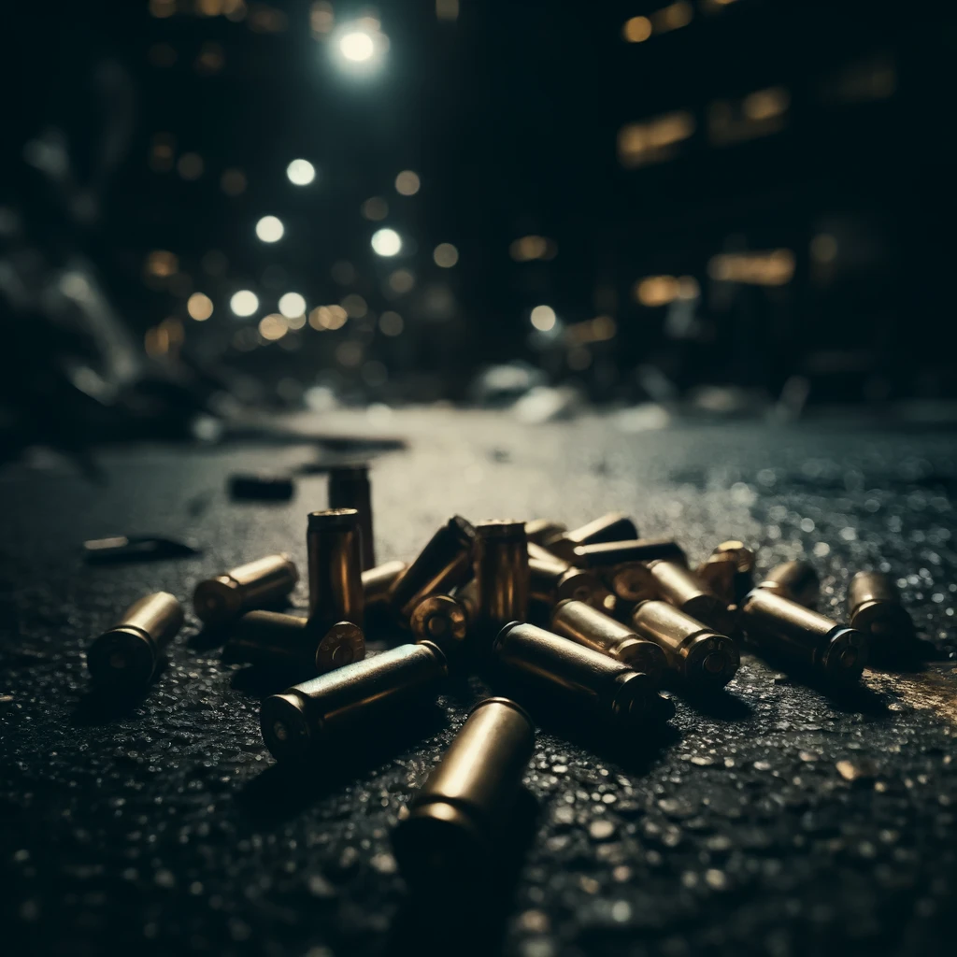
Background
Cartridge casings are the empty shells left behind after a gun was fired¹
Nearly 200,000 cartridge cases are recovered annually at U.S. crime scenes¹
Cartridges that were fired degrade any DNA that was left and have significantly less DNA²
Caliber of the firearm did not have any impact on the amount of DNA recovered²
1.“Shelling out Evidence: NIST Ballistic Standard Helps Tie Guns to Criminals.” NIST, 23 Jan. 2023, www.nist.gov/news-events/news/2012/08/shelling-out-evidence-nist-ballistic-standard-helps-tie-guns-criminals.
2. Prasad, Elisha, et al. “Touch DNA recovery from unfired and fired cartridges: Comparison of swabbing, tape lifting and soaking.” Forensic Science International, vol. 330, Jan. 2022, p. 111101, https://doi.org/10.1016/j.forsciint.2021.111101.

Slide 3
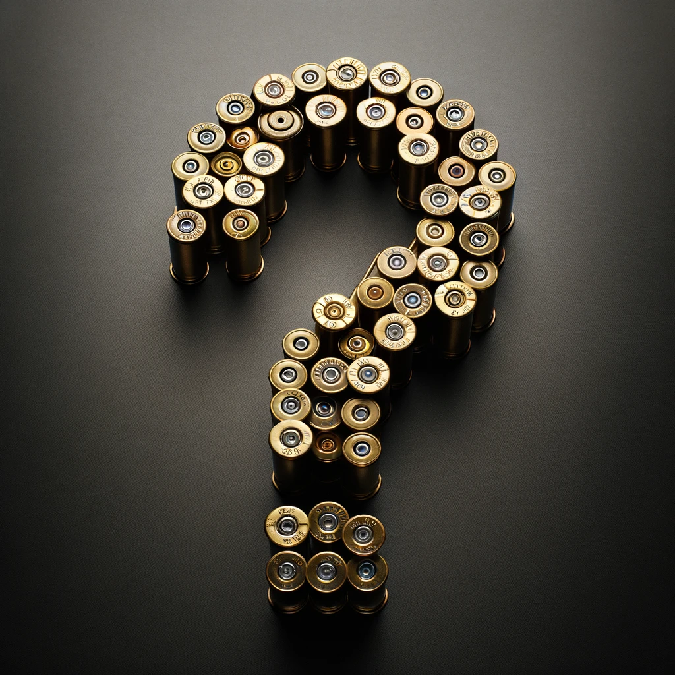
Cartridge Study Main Questions
Can manual interpretation obtain DNA information from cartridge data?
Can TrueAllele® Casework interpretation obtain DNA information from cartridge data?
Which collection method is the most informative for cartridge data?
Which cartridge type produces the most DNA information?

Slide 4
Study Design
Sample creation
DNA collection
DNA extraction
Manual interpretation
TrueAllele interpretation
Information comparison

Slide 5
Sample Creation
Single source data
The reference individual touched various cartridge types
  910 total cartridge casing samples
  Across 7 different cartridge types
Material | Total
45 Fired | 90
45 Unfired | 90
Aluminum Unfired | 150
Brass Fired | 130
Brass Unfired | 150
Nickel Unfired | 150
Steel Unfired | 150

Slide 6
DNA Collection
DNA was collected using five collection types
  Wet:wet
  Wet:dry
  Soak and sonicate
  Tape lift
  Scraping
 | Collection
Material | Wet:Wet | Wet:Dry | Soak and Sonicate | Tape Lift | Scraping
45 Fired | 30 | 30 | 30 | N/A | N/A
45 Unfired | 30 | 30 | 30 | N/A | N/A
Aluminum Unfired | 30 | 30 | 30 | 30 | 30
Brass Fired | 30 | 30 | 10 | 30 | 30
Brass Unfired | 30 | 30 | 30 | 30 | 30
Nickel Unfired | 30 | 30 | 30 | 30 | 30
Steel Unfired | 30 | 30 | 30 | 30 | 30

Slide 7
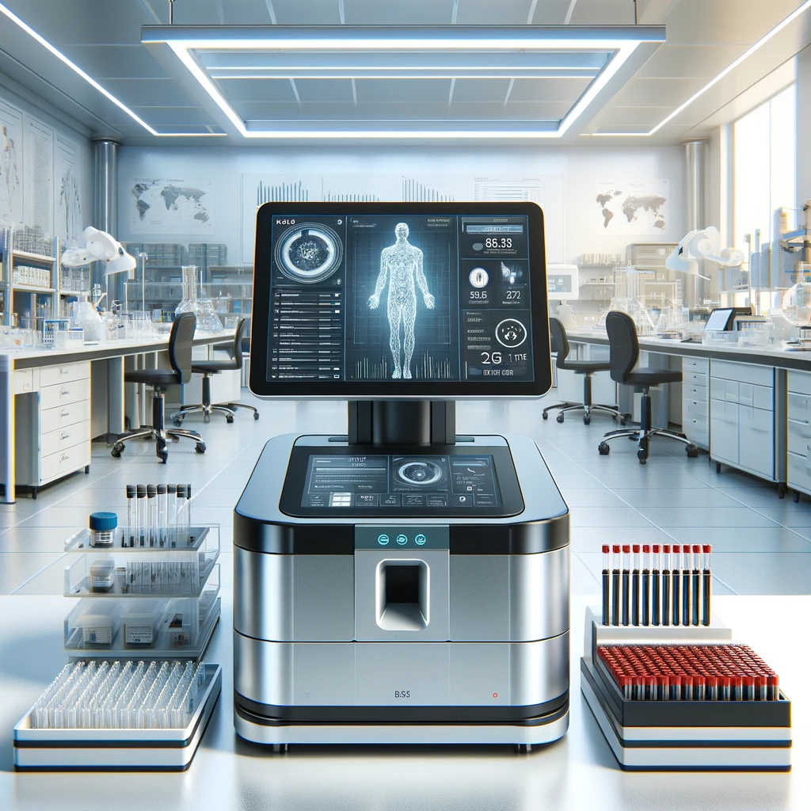
DNA Extraction
Organic extraction
  Organic solvents are used for denaturation
  Denatured proteins are removed then washed
DNA sequencer
  Applied Biosystems® 3500 Genetic Analyzer
STR kit
  Applied Biosystems GlobalFiler™

Slide 8

Manual Interpretation
George Washington University Laboratory manually interpreted the data
A peak height threshold was applied to EPG data to form allele events
Allele counts: how many EPG allele events match a reference

Slide 9
TrueAllele Casework Interpretation
Match statistics

Slide 10


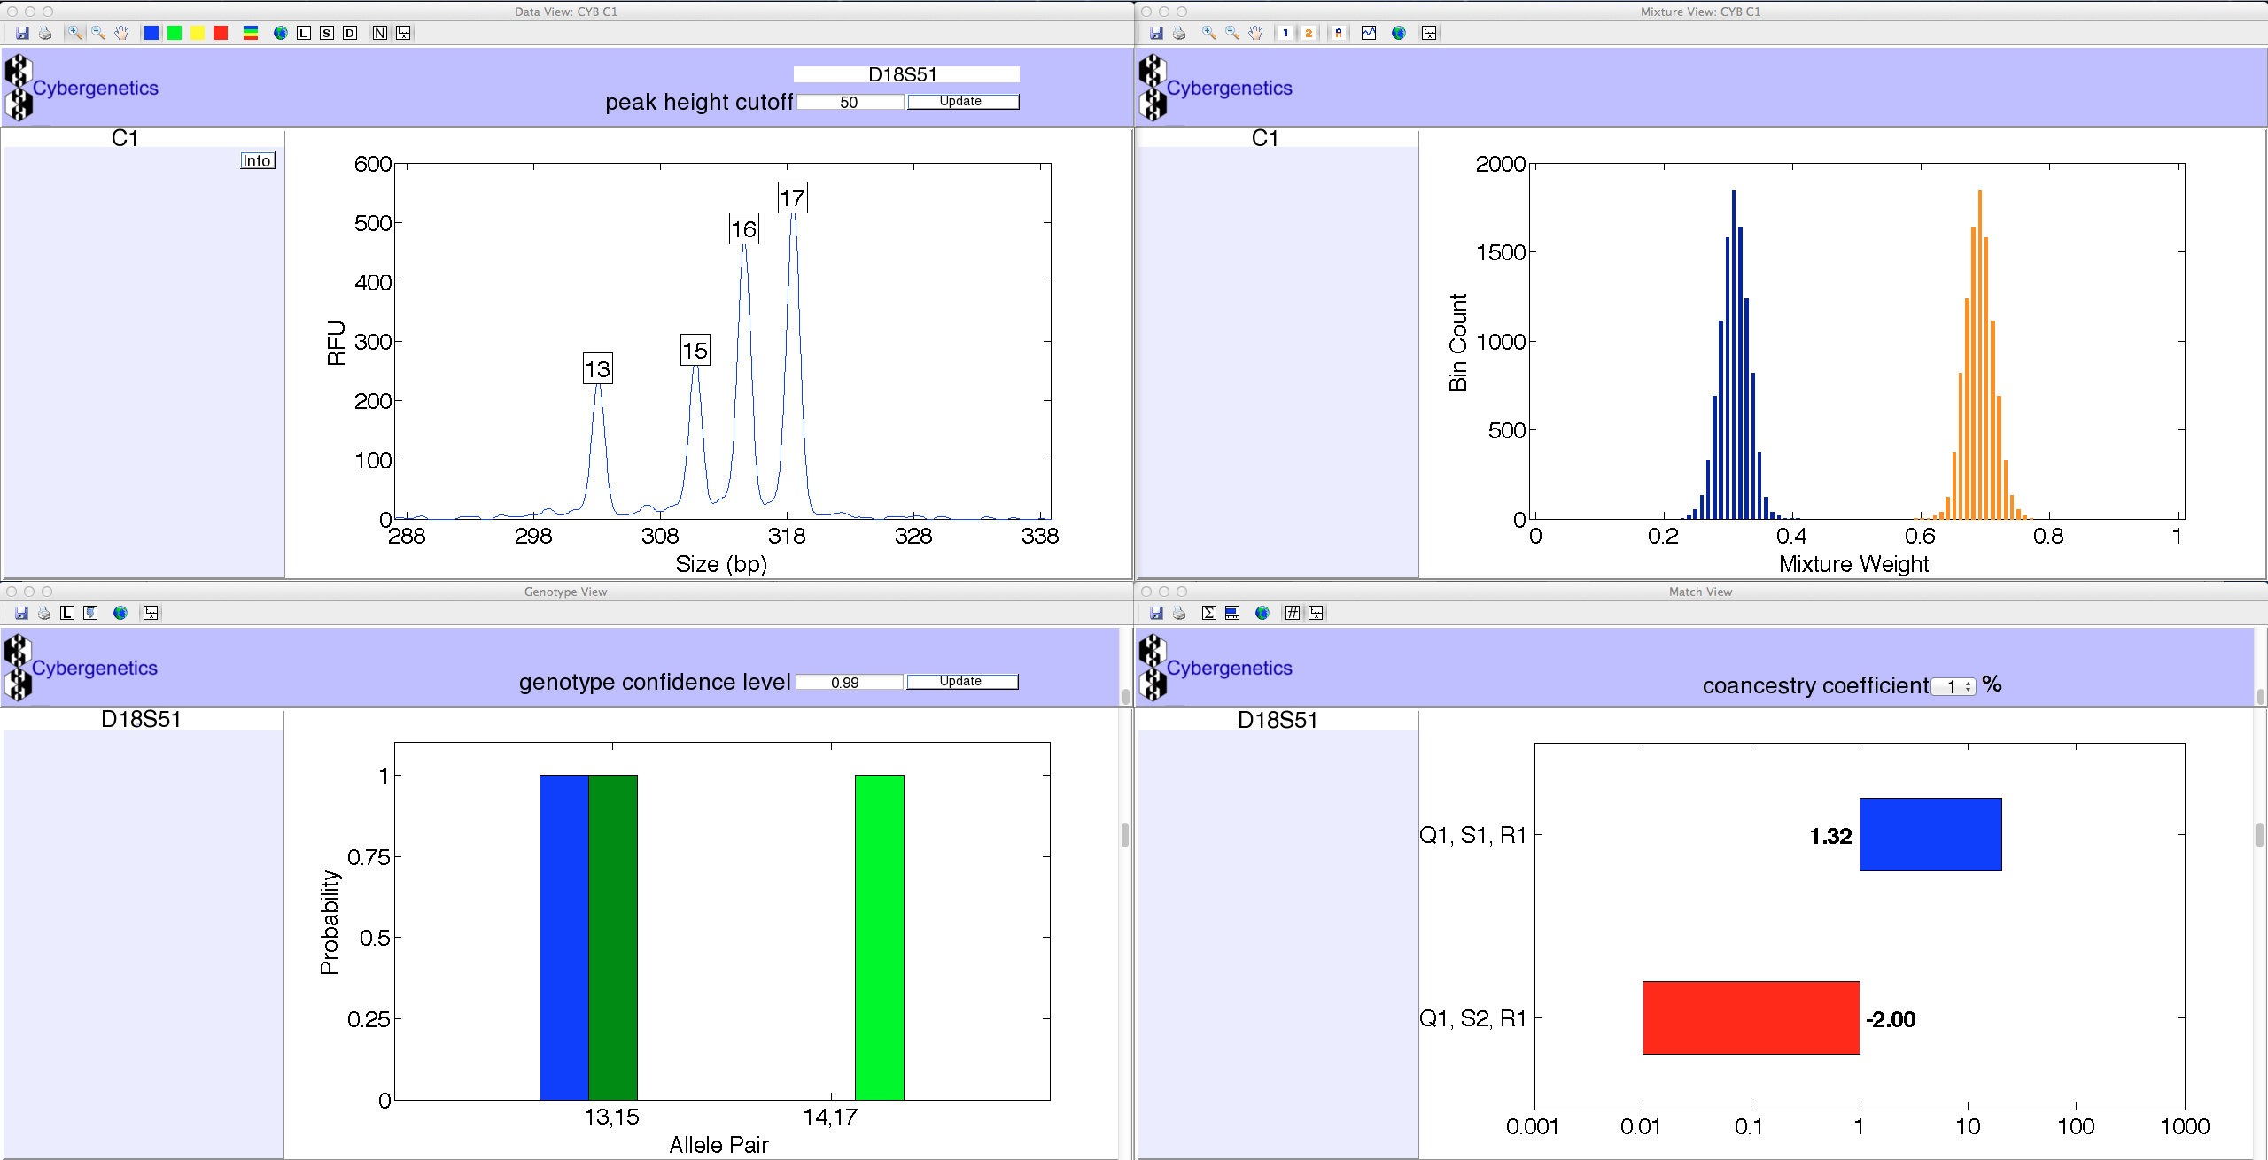

TrueAllele Casework Interpretation – Part 1
Cybergenetics generated TrueAllele requests assuming the samples were single source
Completely objective and unbiased
  TrueAllele processes DNA data without knowing a reference
Kullback-Leibler (KL) genotype statistic
  Quantifies the identification information in a genotype
  The expected log(LR) to the true contributor
Likelihood Ratio (LR) match statistic
  Compares genotype to known reference

Slide 11
Information Comparison – Part 1
Reviewed KL information from single source runs
Most cartridges had a high KL: the DNA was informative
 | Collection
Cartridge Type | Wet:Wet | Wet:Dry | Soak:Sonicate | Tape Lift | Scraping
45 Fired | 16.60 | 13.89 | 14.34 | N/A | N/A
45 Unfired | 15.45 | 17.88 | 11.37 | N/A | N/A
Aluminum Unfired | 24.58 | 25.27 | 16.95 | 27.14 | 18.41
Brass Fired | 24.33 | 20.43 | 10.29 | 18.96 | 13.79
Brass Unfired | 19.10 | 18.74 | 4.88 | 25.54 | 16.17
Nickel Unfired | 21.70 | 23.10 | 8.21 | 23.30 | 9.96
Steel Unfired | 25.01 | 24.03 | 21.28 | 22.89 | 22.85
But …

Slide 12
Problem?

Slide 13
Mixtures and Low-Level Data – Oh no!
Much of the data were mixtures
  Locus EPGs with 3 or more peaks
Low-level data, little DNA: uninformative manual interpretation
  Percentage of low-level samples for each cartridge type (Table)
Manual review couldn’t handle more contributors and sub-threshold peaks
Percentage of Low-Level Samples
Collection
Material | Wet:Wet | Wet:Dry
45 Fired | 40 | 73
45 Unfired | 40 | 36
Aluminum Unfired | 0 | 16
Brass Fired | 3 | 16
Brass Unfired | 6 | 30
Nickel Unfired | 6 | 13
Steel Unfired | 30 | 10

Slide 14
Mixtures – TrueAllele to the rescue!
431 (of 910) samples were found to be mixtures
  47% of the samples were mixtures
  Allele counting couldn’t handle more than one contributor
 | Collection
Material | Wet:Wet | Wet:Dry | Soak and Sonicate | Tape Lift | Scraping
45 Fired | 10 | 7 | 8 | N/A | N/A
45 Unfired | 13 | 15 | 9 | N/A | N/A
Aluminum Unfired | 24 | 17 | 9 | 27 | 11
Brass Fired | 16 | 12 | 1 | 16 | 10
Brass Unfired | 14 | 15 | 0 | 29 | 15
Nickel Unfired | 16 | 20 | 1 | 26 | 6
Steel Unfired | 19 | 21 | 9 | 22 | 13

Slide 15
TrueAllele Interpretation – Round 2
Cybergenetics created requests for the mixture data
TrueAllele Casework processed the requests
  Some items had multiple contributor assumptions
  Samples contained 2 to 5 contributors
TrueAllele found an unknown person in many of the cartridges
  We compared the cartridge samples with the unknown profile

Slide 16
Information Comparison – Round 2
Known reference inclusionary counts
All cartridge samples compared to reference
LR match statistic calculated for each comparison
 | Collection
Material | Wet:Wet | Wet:Dry | Soak and Sonicate | Tape Lift | Scraping
45 Fired | 1 | 0 | 9 | N/A | N/A
45 Unfired | 12 | 19 | 6 | N/A | N/A
Aluminum Unfired | 26 | 18 | 9 | 29 | 11
Brass Fired | 5 | 13 | 1 | 3 | 3
Brass Unfired | 8 | 7 | 1 | 22 | 0
Nickel Unfired | 15 | 24 | 0 | 18 | 3
Steel Unfired | 18 | 22 | 17 | 17 | 14

Slide 17
Information Comparison – Round 2
All cartridge samples were compared to the unknown profile
Unknown profile inclusionary counts
 | Collection
Material | Wet:Wet | Wet:Dry | Soak and Sonicate | Tape Lift | Scraping
45 Fired | 1 | 2 | 2 | N/A | N/A
45 Unfired | 10 | 2 | 8 | N/A | N/A
Aluminum Unfired | 4 | 4 | 0 | 9 | 0
Brass Fired | 14 | 3 | 1 | 5 | 3
Brass Unfired | 9 | 1 | 0 | 10 | 1
Nickel Unfired | 9 | 3 | 1 | 10 | 0
Steel Unfired | 6 | 1 | 3 | 13 | 3

Slide 18

Information Comparison – Round 2
The unknown profile was in many samples
  Found in 138 of the 910 cartridge samples
The unknown profile was informative
  Its KL was 30.36 ban

Slide 19
Example - Nickel Unfired Wet:Wet Collection
31 combinations of the collection and material type
  Table: statistics for one combination (Unfired Nickel + Wet:Wet)
  KL and log(LR) inclusionary averages for the reference and unknown person
  Blank entry: no data available
KL and log(LR)
  The number of zeros after the 1 in the match statistic (ban)
  The inclusionary LR values ranged from 10’s of billions to 10’s of quadrillions (really, really informative)
 | ref inclusion |  | unknown inclusion
# of contrib | KL | log(LR) | KL | log(LR)
1 | 26.86 | 15.08
2 | 15.53 | 10.27 | 22.71 | 16.14
3 | 13.94 | 10.06 | 14.64 | 11.38

Slide 20
LR Example (Reference Inclusion – 3 Contributor)
A log(LR) of 10.0 ban is 10,000,000,000
  Large inclusionary DNA match statistic
  TrueAllele average from 3-person mixtures
 | ref inclusion |  | unknown inclusion
# of contrib | KL | log(LR) | KL | log(LR)
1 | 26.86 | 15.08
2 | 15.53 | 10.27 | 22.71 | 16.14
3 | 13.94 | 10.06 | 14.64 | 11.38
But human review got no information at all!

Slide 21
Who is the unknown?
Who’s DNA is in the unknown profile?
  We don’t know
Maybe it’s someone who had handled the gun
  Same person across multiple cartridge types
  Not restricted to a specific cartridge type

Slide 22
Study Conclusions
Manual interpretation used allele counting and thresholds
  Could only find the known reference
TrueAllele considered additional mixture contributors
  The computer calculated match statistics for both the reference and unknown profile
  The computer’s developed unknown enabled comparison between the different cartridge mixtures
  The known reference was found in 351 samples (205 manually)
  The unknown person was found in 138 samples (0 manually)

Slide 23
Study Conclusions
More informative collection method
  Wet:Wet or Wet:Dry
  Tape lift was close
Least informative was Scraping / Soak and Sonicate
Most informative cartridge type was Aluminum / Steel
The least informative was 45 Fired

Slide 24
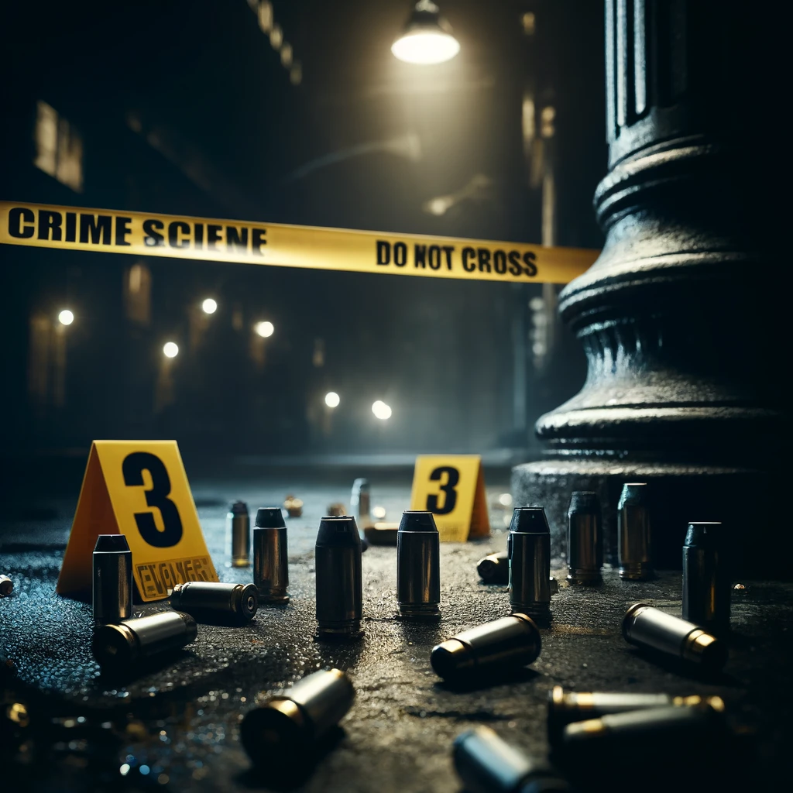
Conclusion
TrueAllele can develop informative data from cartridges
  All DNA data is used, none discarded
  Handles low-level data and minor contributors
  Cartridges are common crime scene evidence
  TrueAllele motivates gathering cartridge evidence
Methods that use less data are less informative
TrueAllele has done almost a hundred cartridge cases, getting more DNA information from crime lab data

Slide 25
Future Directions
Analyze more cartridge data
Study other extraction methods (PrepFiler™ and QIAamp) on these cartridge types and collection methods
Determine the best collection method for each extraction
Compare TrueAllele Casework with other interpretation methods using KL and log(LR) information

Slide 26
Questions?
kari@cybgen.com
www.cybgen.com

