Slide 1

Defeating opposition experts: winning with science
Jennifer M. Bracamontes, MS, William P. Allan, MS, Mark W. Perlin, PhD, MD, PhD
Mid-Atlantic Association of Forensic Scientists Annual Meeting
May 2024
Pittsburgh, PA
Cybergenetics © 2003-2024

Slide 2
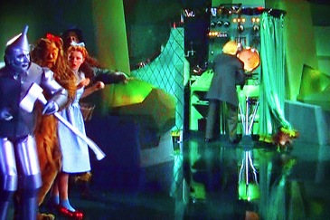
Opposition Arguments
Method Reliability
Method Objectivity
Method Admissibility
Document Discovery
Irrelevant or Misconstrued Topics
Caption: wizard-of-oz-man-behind-the-curtain-exposed © The LAMP, CC BY-NC-ND 2.0 DEED

Slide 3
Admissibility Standards
Frye (1920)
general acceptance standard
“…while courts will go a long way in admitting expert testimony deduced from a well-recognized scientific principle or discovery, the thing from which the deduction is made must be sufficiently established to have gained general acceptance in the particular field in which it belongs.”
Daubert (1993)
Whether the technique or theory in question can be, and has been tested;
Whether it has been subjected to publication and peer review;
Its known or potential error rate;
The existence and maintenance of standards controlling its operation; and
Whether it has attracted widespread acceptance within a relevant scientific community.

Slide 4
Probabilistic Genotyping (PG)
Match statistics
Objective inference

Slide 5
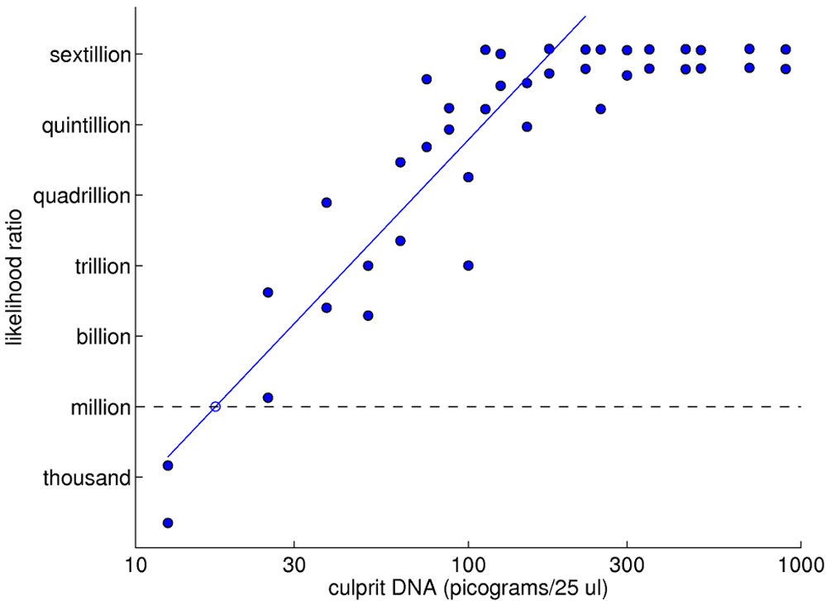
Likelihood Ratio (LR) Predictability
Perlin, M.W. and Sinelnikov, A. An information gap in DNA evidence interpretation. PLoS ONE, 4(12):e8327, 2009.

Slide 6
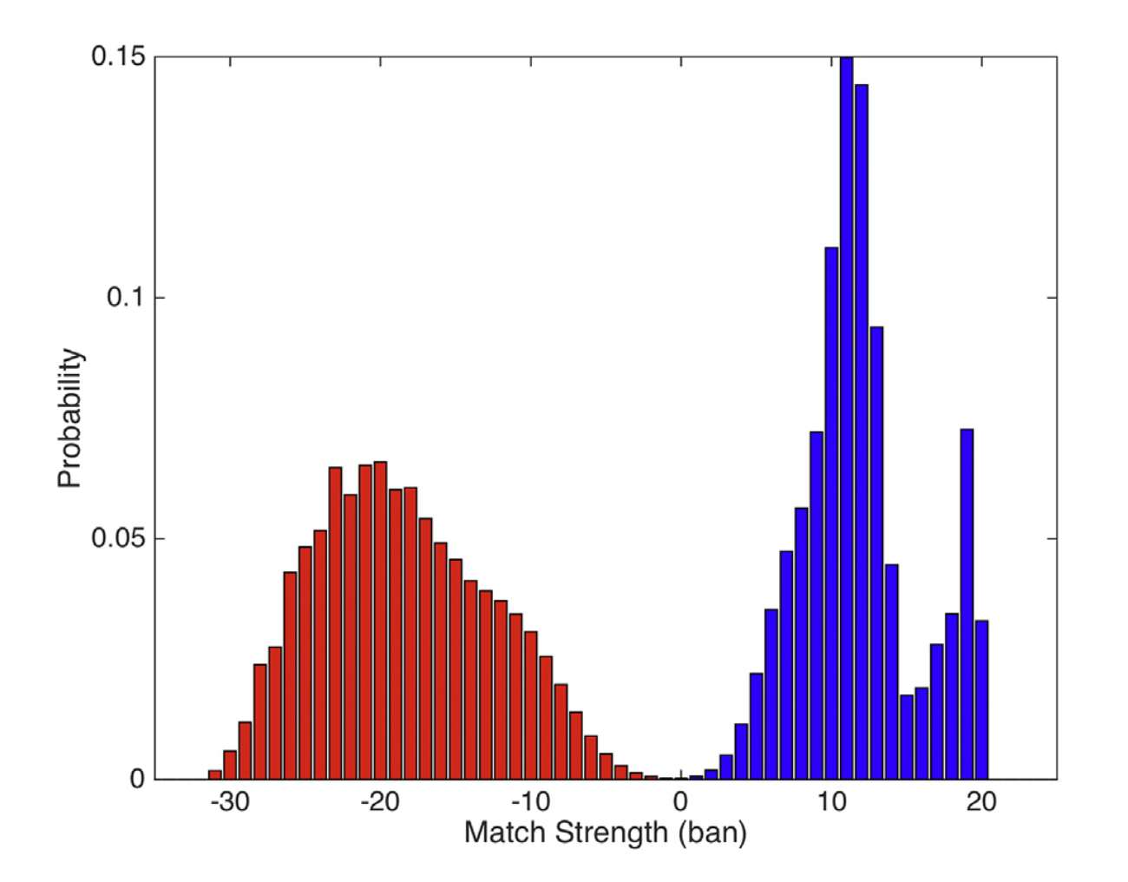
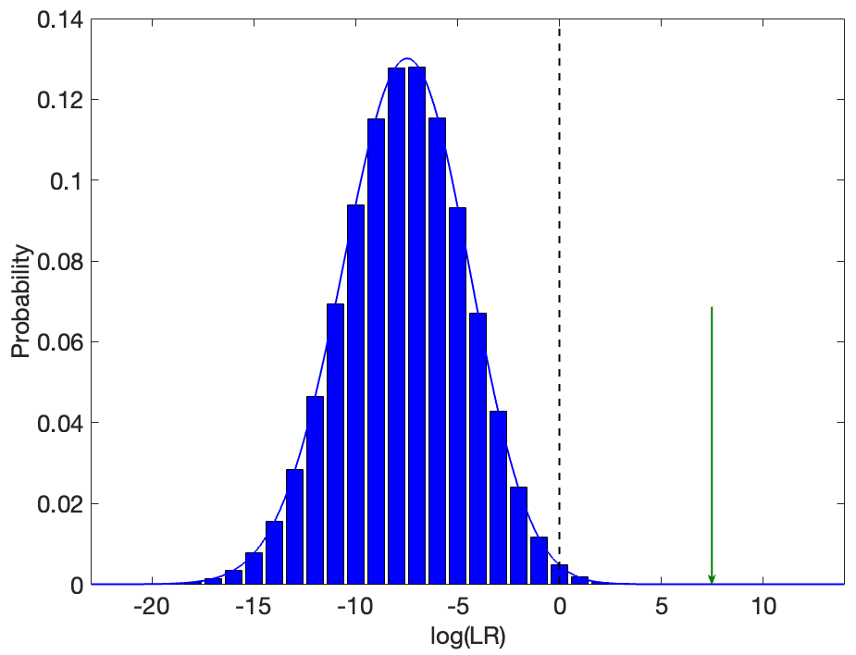
LR Error Rate
Frequency with which a LR match or nonmatch result may be incorrect
Perlin, M.W. Efficient construction of match strength distributions for uncertain multi-locus genotypes. Heliyon, 4(10):e00824, 2018.

Slide 7




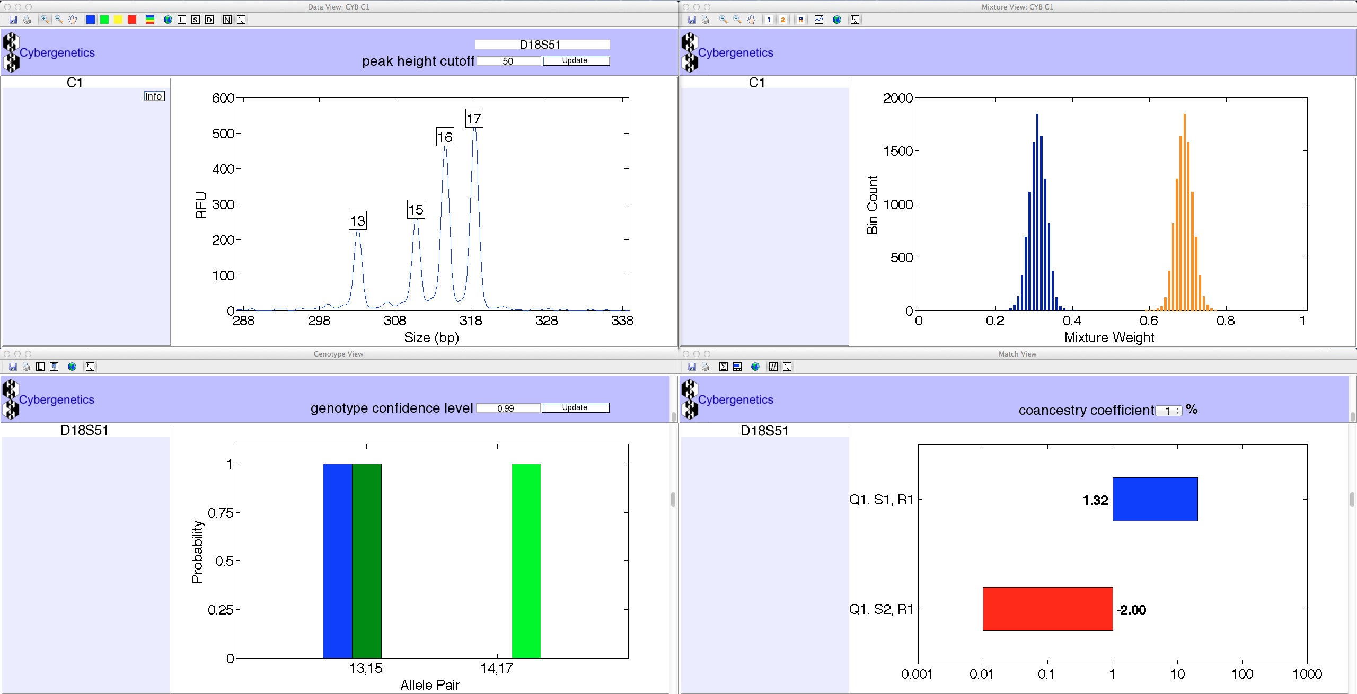

TrueAllele® Casework
Uses all the data (no threshold)
Limited human input/settings
Parallel processing capability
Can statistically include or exclude

Slide 8

TrueAllele Reliability
Tested. 42 validation studies, 8 published
Peer-reviewed. 8 validations, math, & methods
Error rate. Established through validation and for reported LRs
Standards. Complies with PG validation standards and guidelines
Accepted. 46 states, 1,250 cases, 144 trials, 10 user labs
Transparent. Documents, math, software provided
Admissible. 41 rulings, 15 states and federal courts

Slide 9
Method Validation
Empirically test method on data
Calculate error rates (false inclusions, false exclusions)
Stratify error rates
Perlin, M.W., Dormer, K., Hornyak, J., Schiermeier-Wood, L., and Greenspoon, S. TrueAllele Casework on Virginia DNA mixture evidence: computer and manual interpretation in 72 reported criminal cases. PLoS ONE, 9(3):e92837, 2014.

Slide 10
TrueAllele Validation
Study | 1 | 2 | 3 | 4 | 5 | 6 | 7 | 8 | SWGDAM guideline
Sensitivity | 1 | 1 | 1 | 1 | 1 | 1 | 1 | 1 | 3.2.1, 3.2.1.2, 4.1.13
False exclusions |  |  | 1 |  | 1 |  |  |  | 3.2.1.1
Specificity |  |  | 1 | 1 | 1 |  | 1 | 1 | 3.2.2, 3.2.2.2, 4.1.13
False inclusions |  |  | 1 |  | 1 |  |  | 1 | 3.2.2.1
Reproducibility |  |  | 1 | 1 | 1 | 1 | 1 | 1 | 3.2.3, 3.2.3.1, 4.1.13
Accuracy | 1 |  |  |  | 1 |  |  | 1 | 3.2.6
Casework data |  |  |  |  |  | 1 | 1 | 1 | 3.2.4, 3.2.4.1, 4.1.1
Known contributor data | 1 | 1 | 1 | 1 | 1 |  |  |  | 4.1.1
Low-template DNA | 1 |  | 1 |  |  |  |  |  | 4.1.6.2
Manual review comparison | 1 |  |  | 1 |  | 1 | 1 | 1 | 3.2.6.1, 4.2, 4.2.1, 4.2.1.1
Peeling | 1 |  |  | 1 | 1 | 1 | 1 | 1 | 4.1.2, 4.1.2.1
MCMC sampling |  |  |  | 1 | 1 |  |  |  | 3.2.3.2
Contributor sufficiency |  |  | 1 |  | 1 |  |  |  | 4.1.6.4
Invariant behavior |  |  | 1
Match statistic predictability | 1 |  | 1 |  | 1
Observed contributor number |  |  |  |  | 1

Slide 11
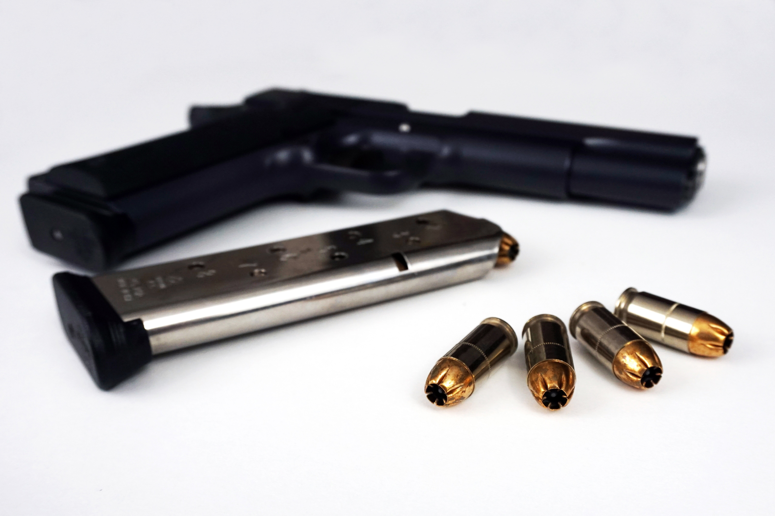
US v. Defendant
2020 shooting-related homicide in Washington, D.C.
Gun and magazine recovered as evidence
Defendant charged with crime
Caption: M Pistol Gun Firearm Handgun Edited _ 2021 © www.reloaderaddict.com, CC BY 2.0 DEED

Slide 12
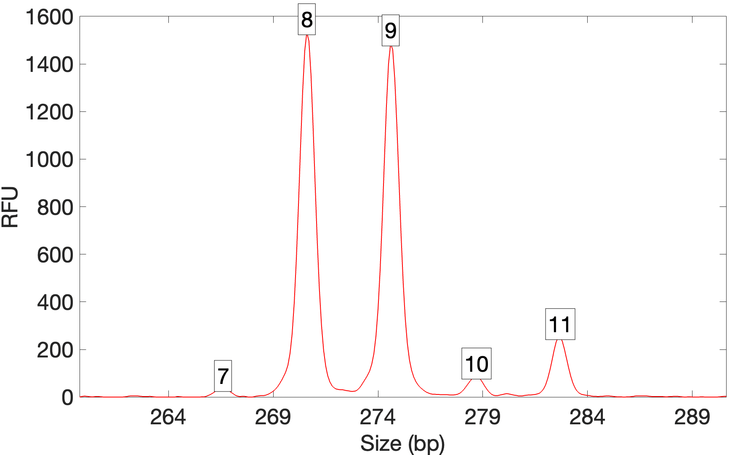
US v. Defendant – Initial Analysis
Gun results
At least 2 contributors
Defendant excluded as major
“Due to the possibility of allelic drop out, no conclusions can be made on the minor alleles.”
Magazine results
3 or more contributors
Defendant excluded as major
“Due to the limited data obtained, no conclusions can be made on the minor alleles that are not part of the major mixture.”
Gun data – locus D7S820

Slide 13
US v. Defendant – PG Analysis
TrueAllele interpretation requested by defense attorneys
PG analysis turned “inconclusive” data into informative results
Item | Description | Contributor | Defendant LR | LR Error Rate
5.1.1 | gun | major | one over 36.1 duodecillion | 1 in 1 googol people
 |  | minor | one over 72.8 million | 1 in 152 billion people
5.2.1 | magazine | major | one over 24.3 undecillion | 1 in 1 googol people
 |  | middle | one over 145 nonillion | 1 in 1 googol people
 |  | minor | one over 161 billion | 1 in 343 trillion people

Slide 14
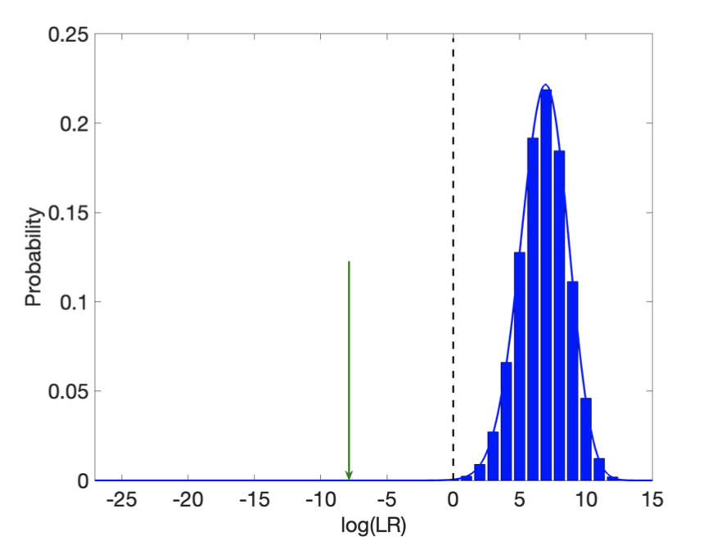
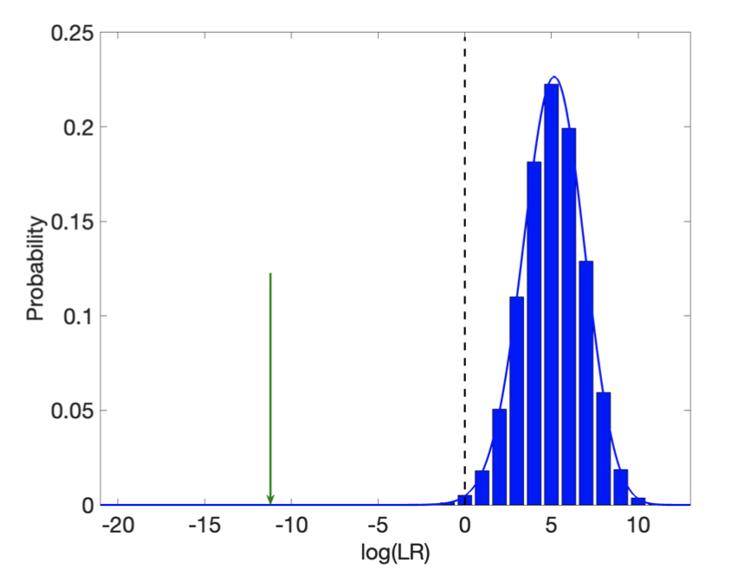
US v. Defendant – LR Error Rate
one over
72.8 million
one over
161 billion
Gun minor contributor (6% MW)
Magazine minor contributor (2% MW)

Slide 15
US v. Defendant: Opposition Arguments
Binary false exclusion rate
Low-template DNA
Contributor genotype separation
Use of match
Accreditation, validation, SWGDAM

Slide 16
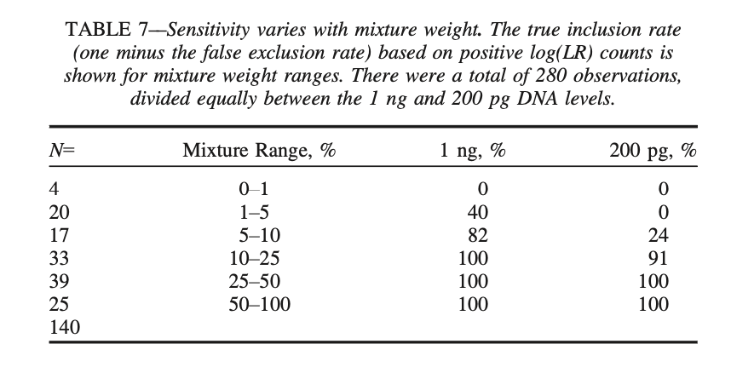
Binary Error Rate
False exclusion percentage calculated from a few genotypes
Perlin, M.W., Hornyak, J.M., Sugimoto, G., and Miller, K.W.P. TrueAllele genotype identification on DNA mixtures containing up to five unknown contributors. Journal of Forensic Sciences, 60(4):857-868, 2015.

Slide 17
Opposition Asserts
TrueAllele has a very high false exclusion rate for minor contributors
60% false exclusion rate for 1-5% mixture contributors (magazine)
18% false exclusion rate for 5-10% mixture contributors (gun)
High false exclusion rate applies to the reported minor contributors in this case
PG report did not note the “unreliable” nature of the evidence
Opposition Fallacy

Slide 18
Binary Error Rate
Relevant binary error rate using case’s software version
N= | Mixture Range % | count for LR<1 | % for LR<1
20 | 1­–5 | 7 | 35%
17 | 5–10 | 0 | 0%
With high template DNA, false exclusion error rate decreased from 60% to 35%
for 1-5% mixture contributors (magazine)

Slide 19

Is binary error rate relevant?

Slide 20
Stratified Error Rates
Source | Mixture Weight % | Exclusionary LR Statistic | log(LR) | Computed Exact LR Error Rate | log(PME)
Magazine | 2.40 | 1 over 161 billion | -11.21 | 1 in 343 trillion | -14.54
Gun | 5.89 | 1 over 72.8 million | -7.86 | 1 in 152 billion | -11.18
Validation | 1.63 | 1 over 3,126 | -3.49 | 1 in 1.21 million | -6.08
 | 1.08 | 1 over 412 | -2.61 | 1 in 6.97 thousand | -3.84
 | 1.70 | 1 over 292 | -2.47 | 1 in 23.3 thousand | -4.37
 | 1.32 | 1 over 25 | -1.40 | 1 in 1.39 thousand | -3.14
 | 2.26 | 1 over 4 | -0.60 | 1 in 490 | -2.69
 | 1.65 | 1 over 3.5 | -0.54 | 1 in 234 | -2.37
 | 1.40 | 1 over 1.4 | -0.15 | 1 in 341 | -2.53
Error rate dependent on LR

Slide 21
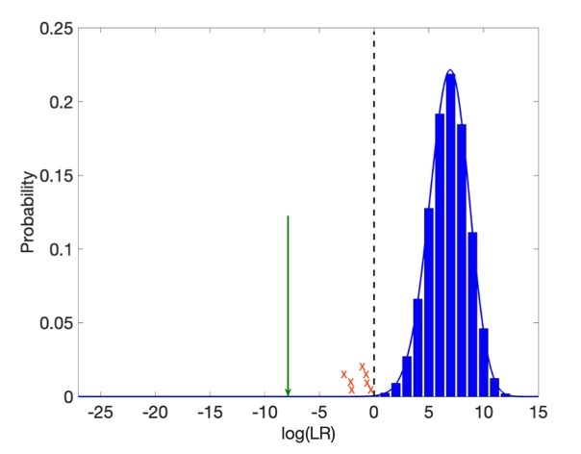
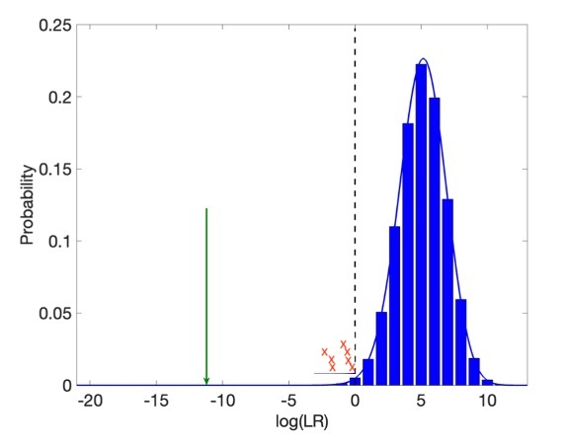
LR Error Comparison
one over
72.8 million
one over
161 billion
Gun minor contributor (6% MW)
Magazine minor contributor (2% MW)

Slide 22
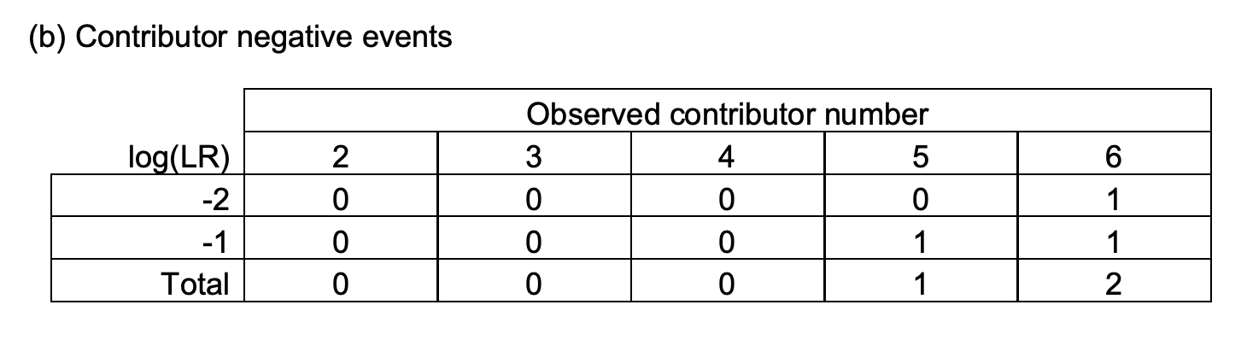
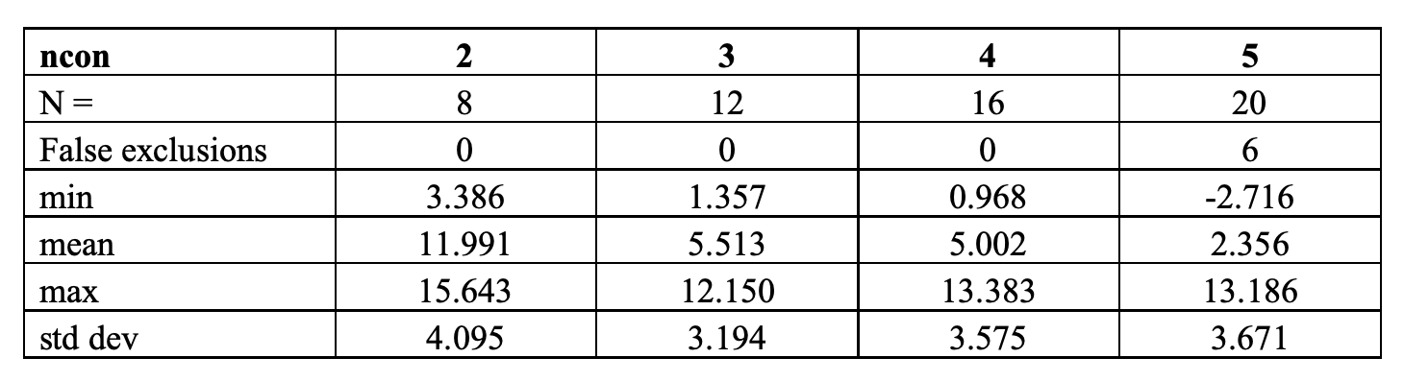
Stratified Binary Error Rates
Bauer, D.W., Butt, N., Hornyak, J.M., and Perlin, M.W. Validating TrueAllele® interpretation of DNA mixtures containing up to ten unknown contributors. Journal of Forensic Sciences, 65(2):380-398, 2020.
Hornyak JM, Schmidt EM, Perlin MW. "Georgia Bureau of Investigation Forensic Biology Unit TrueAllele® Validation.", September 2016.

Slide 23
Response to Opposition Motion Error Rate Statements
Wrong LR software version study
Wrong binary cutoff for false exclusion rate
Considered too few genotype comparisons
Ignored stratified error rates
Misleading LR comparisons

Slide 24

Declaration Conclusion
"In conclusion, TrueAllele satisfies the Daubert prongs for the DNA mixture evidence in this case. The method clearly satisfies the error rate prong, with explicit reporting of low error rates for each reported LR statistic, using the best available error rate determination methods. There is no merit to the government’s motion to preclude. TrueAllele should be admitted under the Daubert standard."

Slide 25

Admissibility Outcome
"The Court denies the government’s motion to preclude evidence of a defense analysis that excluded the defendant as a contributor to the minor components of DNA obtained from a firearm and a magazine. The government’s objections go to weight, not admissibility."

Slide 26
Questions?
jennifer@cybgen.com
www.cybgen.com

