Slide 1

The same DNA answer: everything everywhere all at once
Mid-Atlantic Association of Forensic Scientists
May 2024
Pittsburgh, PA
William Allan, MS, Jennifer Bracamontes, MS, Matthew Legler, Jonathan Perlin, MS, Mark Perlin, PhD, MD, PhD
Cybergenetics © 2003-2024

Slide 2
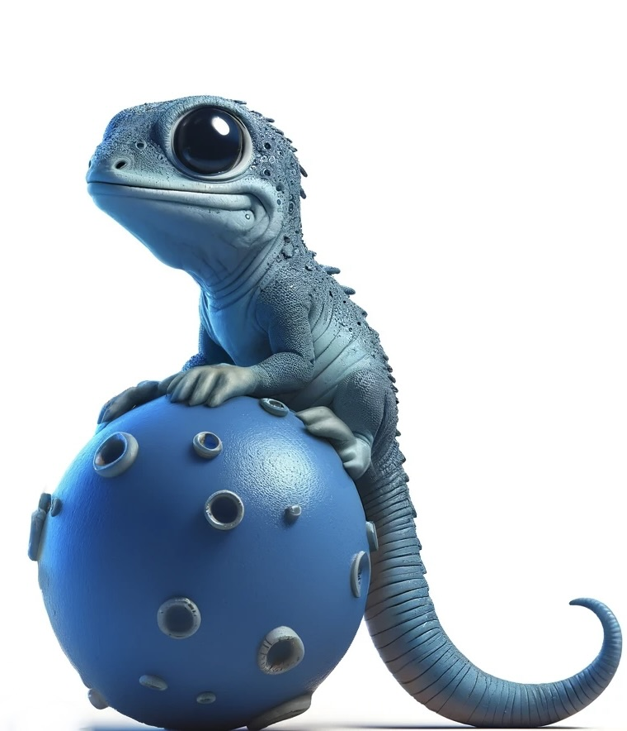
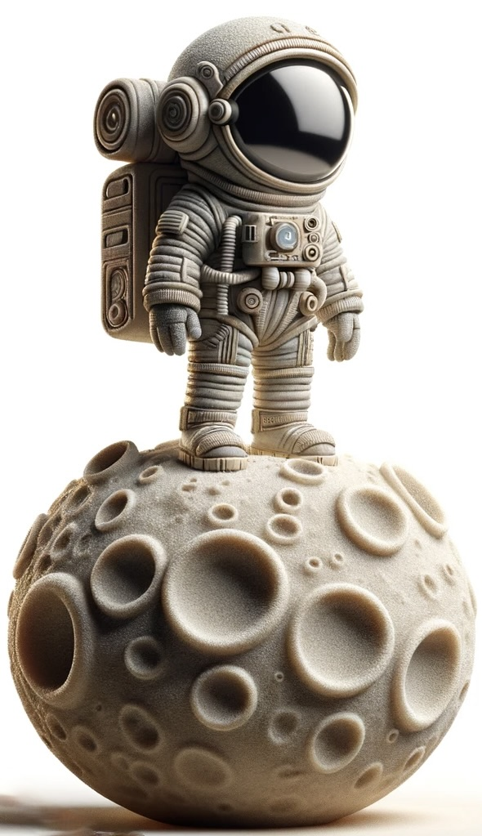
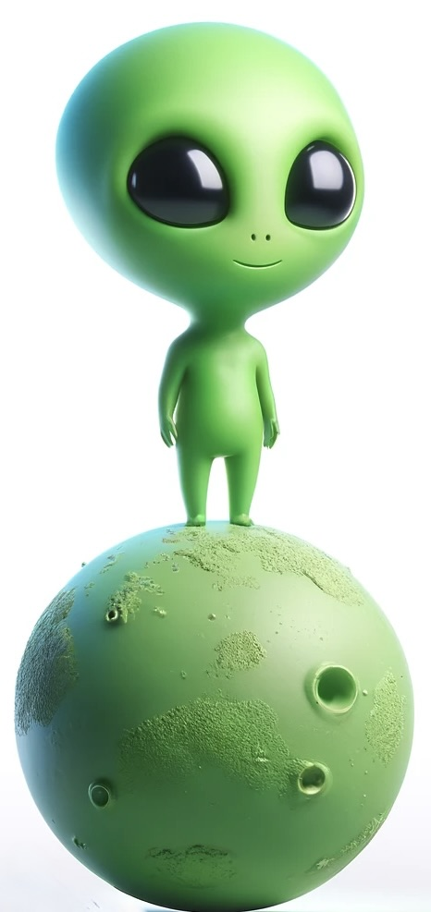
Physical laws are the same for everything, everywhere, all at once
F = ma
Gravity
Motion
Force
Electricity
Magnetism
Light
F = ma
F = ma

Slide 3
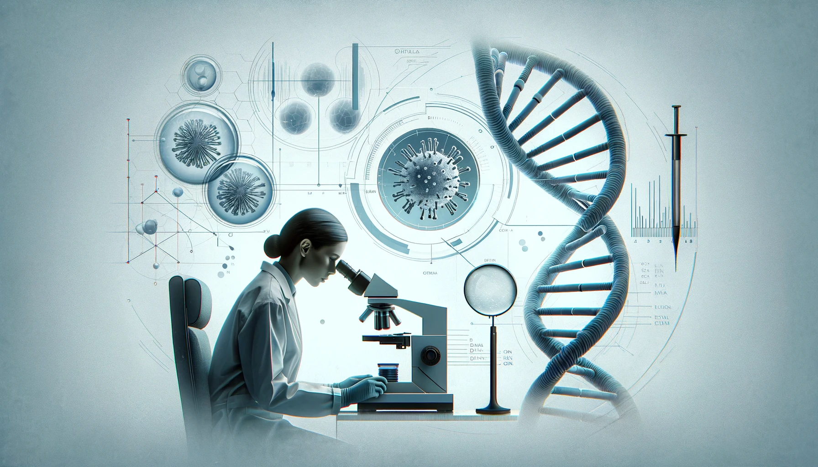
What about the laws of forensic DNA science?
Genotype
Mixture weight
Likelihood ratio
Probability
Inclusion
Exclusion

Slide 4
Protocol differences: sample
Touch DNA?
Damaged DNA?
Too little DNA?
Complex mixtures?
DNA is too old?
Related people?

Slide 5
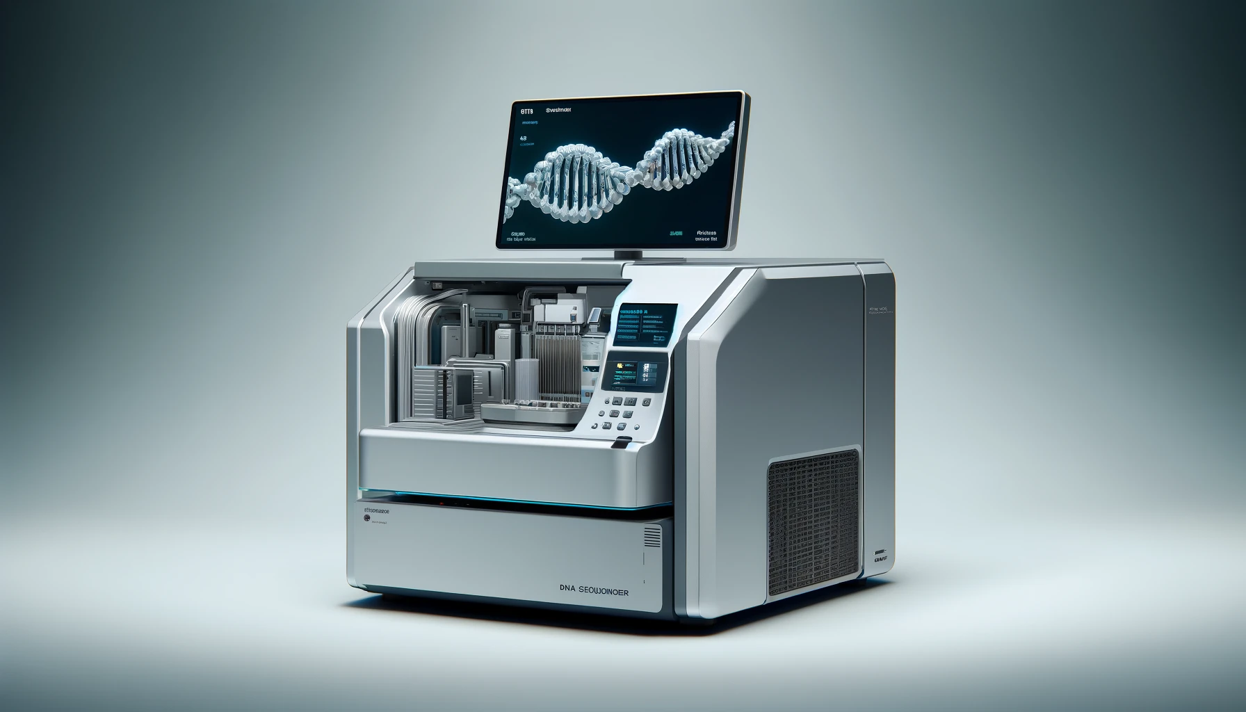
Data differences: laboratory
Extraction
STR kit
Sequencer
EPG, NGS
Reporting
Error rate

Slide 6
Interpretation differences: method
Manually
Thresholds
Calibration
Parameters
Stutter
Computation

Slide 7
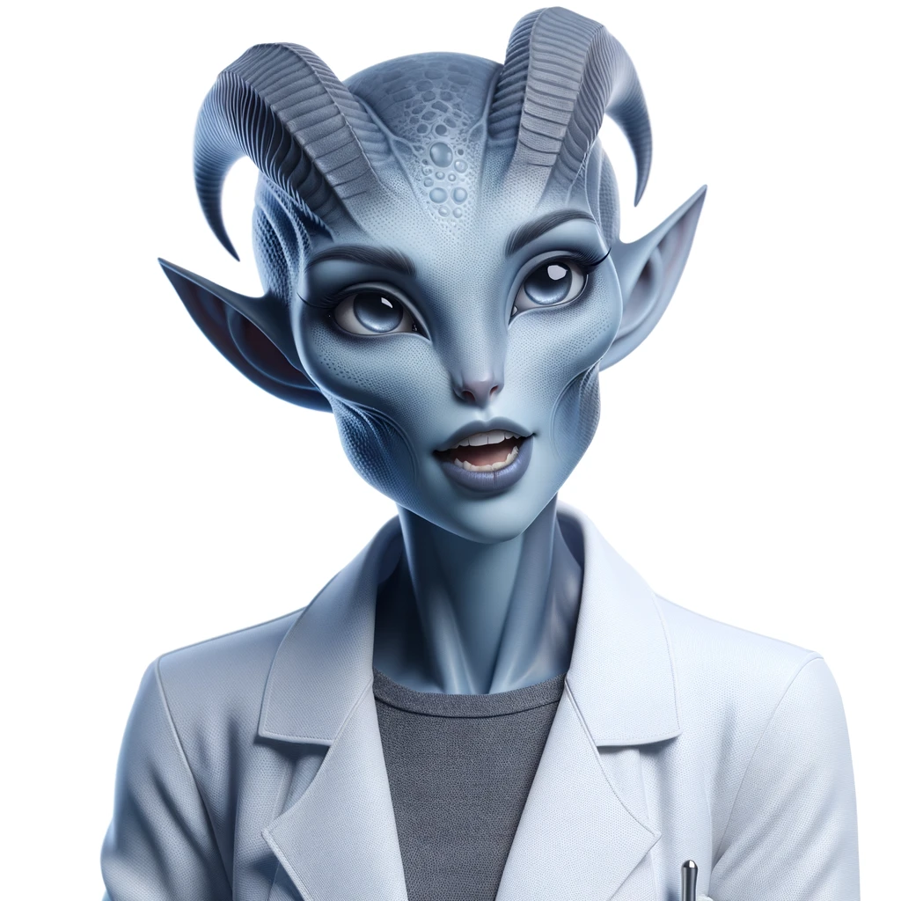

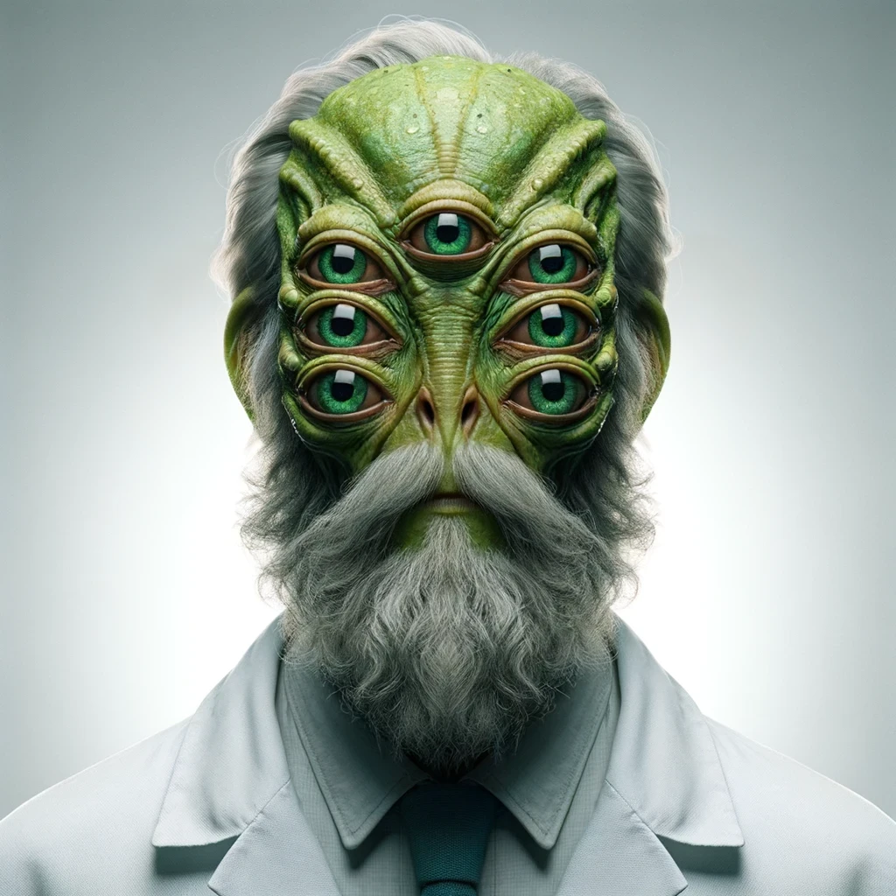
People differences: analyst
Education
Training
Experience
Knowledge
Systems
Preferences

Slide 8
Outcome differences: reporting
Inclusion/Exclusion
Match statistics
Likelihood ratio
“Uninformative”
“Inconclusive”
“No comparison”

Slide 9
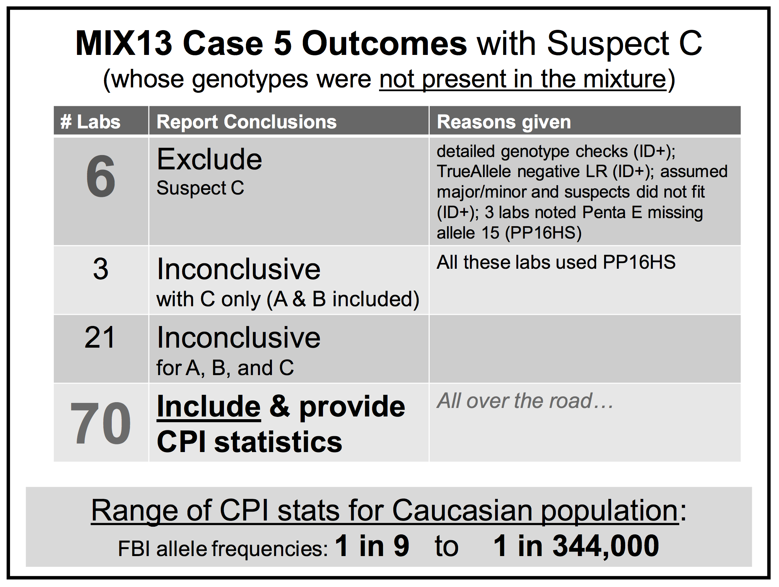
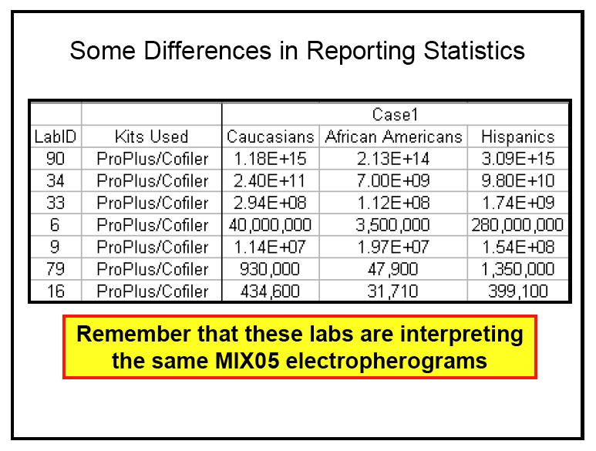
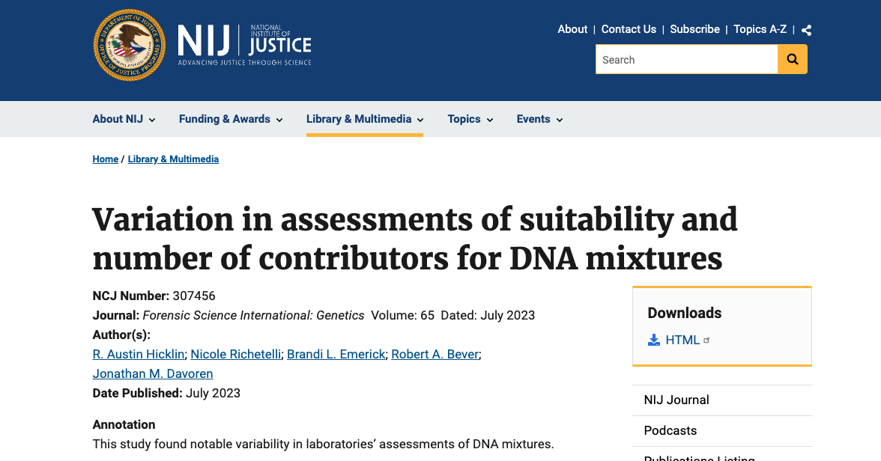
Community differences: different answers

Slide 10
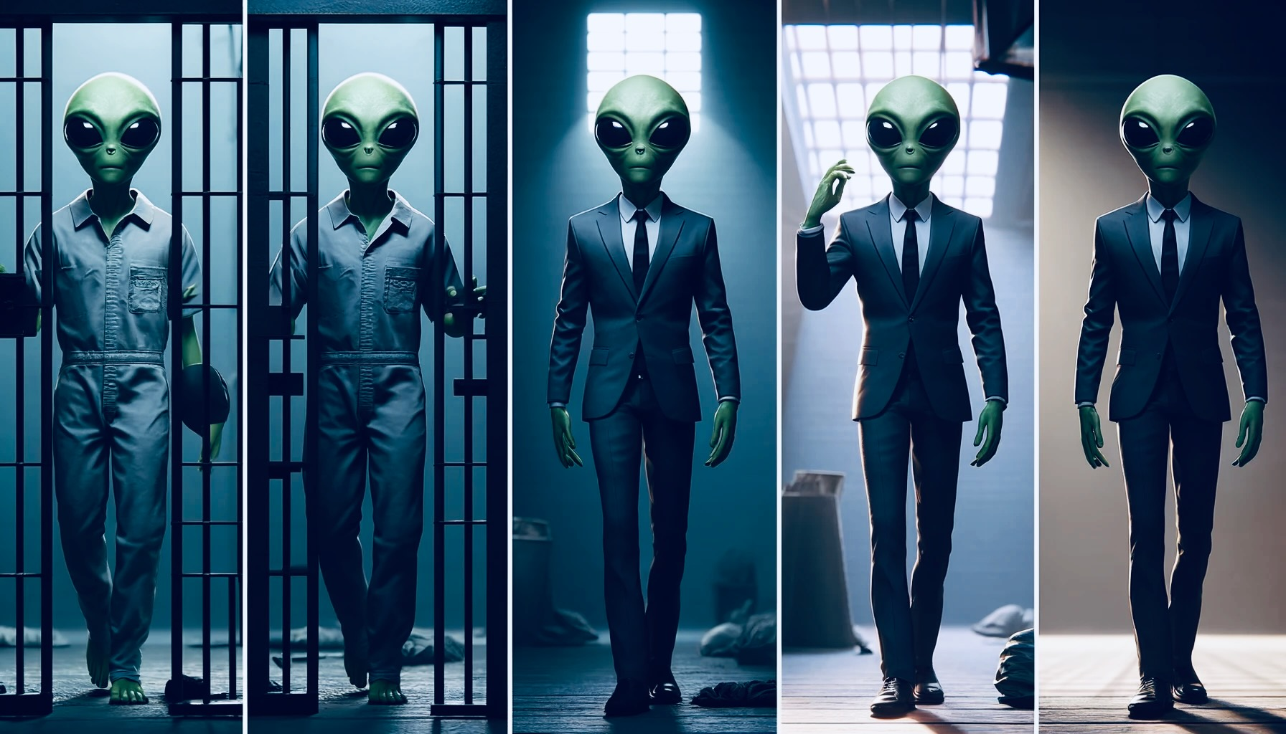
Consequences of differences: multiverse
Same data, different answer
Match vs. not match
Include vs. exclude
Implicate suspect
Exonerate suspect
Silence: no answer at all

Slide 11
TrueAllele laws are the same for everything, everywhere, all at once
d = Gw
Genotype
Mixture weight
Likelihood ratio
Probability
Implicate
Exonerate
d = Gw
d = Gw

Slide 12
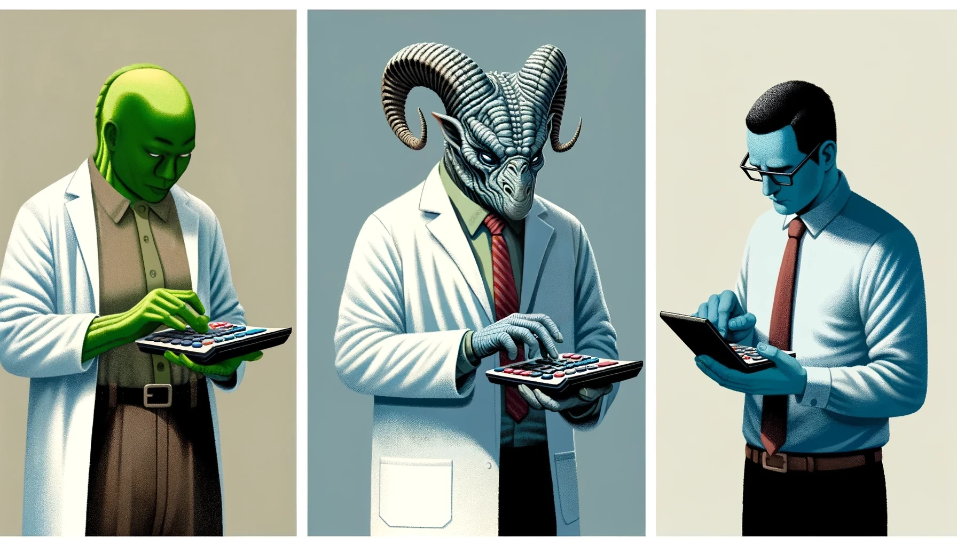
How TrueAllele works
No lab calibration – learns from DNA data
Bayesian inference – uses all the data
No thresholds or other parameters
Explains data peak patterns
Separates contributor genotypes
Gives accurate likelihood ratios
No limits – up to ten contributors
“It’s like using a calculator”

Slide 13
TrueAllele® Proficiency study
Goal was to show that trained analysts were proficient in TrueAllele
Secondary goal was to examine differences in TrueAllele laboratories
  10 participating TrueAllele laboratories
  32 TrueAllele trained analysts

Slide 14
TrueAllele Proficiency study design
Multiple TrueAllele labs submitted a mixture sample
  created in their lab
  representative data
  some samples from adjudicated cases
Also provided a matching reference profile
Sample and reference anonymized
Analysts from labs signed up to participate in study

Slide 15
TrueAllele Proficiency study protocol
Cybergenetics provided each study participant with each of the 10 mixture data samples
Each participating analyst processed each mixture sample
Once all processing completed, references sent out for comparison
  Analysts did not have reference samples when processing the mixture data
  References were not needed for evidence interpretation
Returning results shows that the analyst is proficient in TrueAllele

Slide 16
Mixture samples: STR kits used
Kit | sample
Applied Biosystems™ Globalfiler | 4
Promega PowerPlex® 16 | 1
Promega PowerPlex® Fusion 5C | 3
Promega PowerPlex® Fusion 6C | 1
Qiagen Investigator® 24plex GO! | 1

Slide 17
Mixture samples: DNA sequencers used
Sequencer | sample
ABI310 | 1
ABI3130xl | 2
ABI3500 | 5
ABI3500xl | 2

Slide 18
Mixture samples: number of contributors
DNA contributors | sample
three | 2
four | 7
five | 1

Slide 19
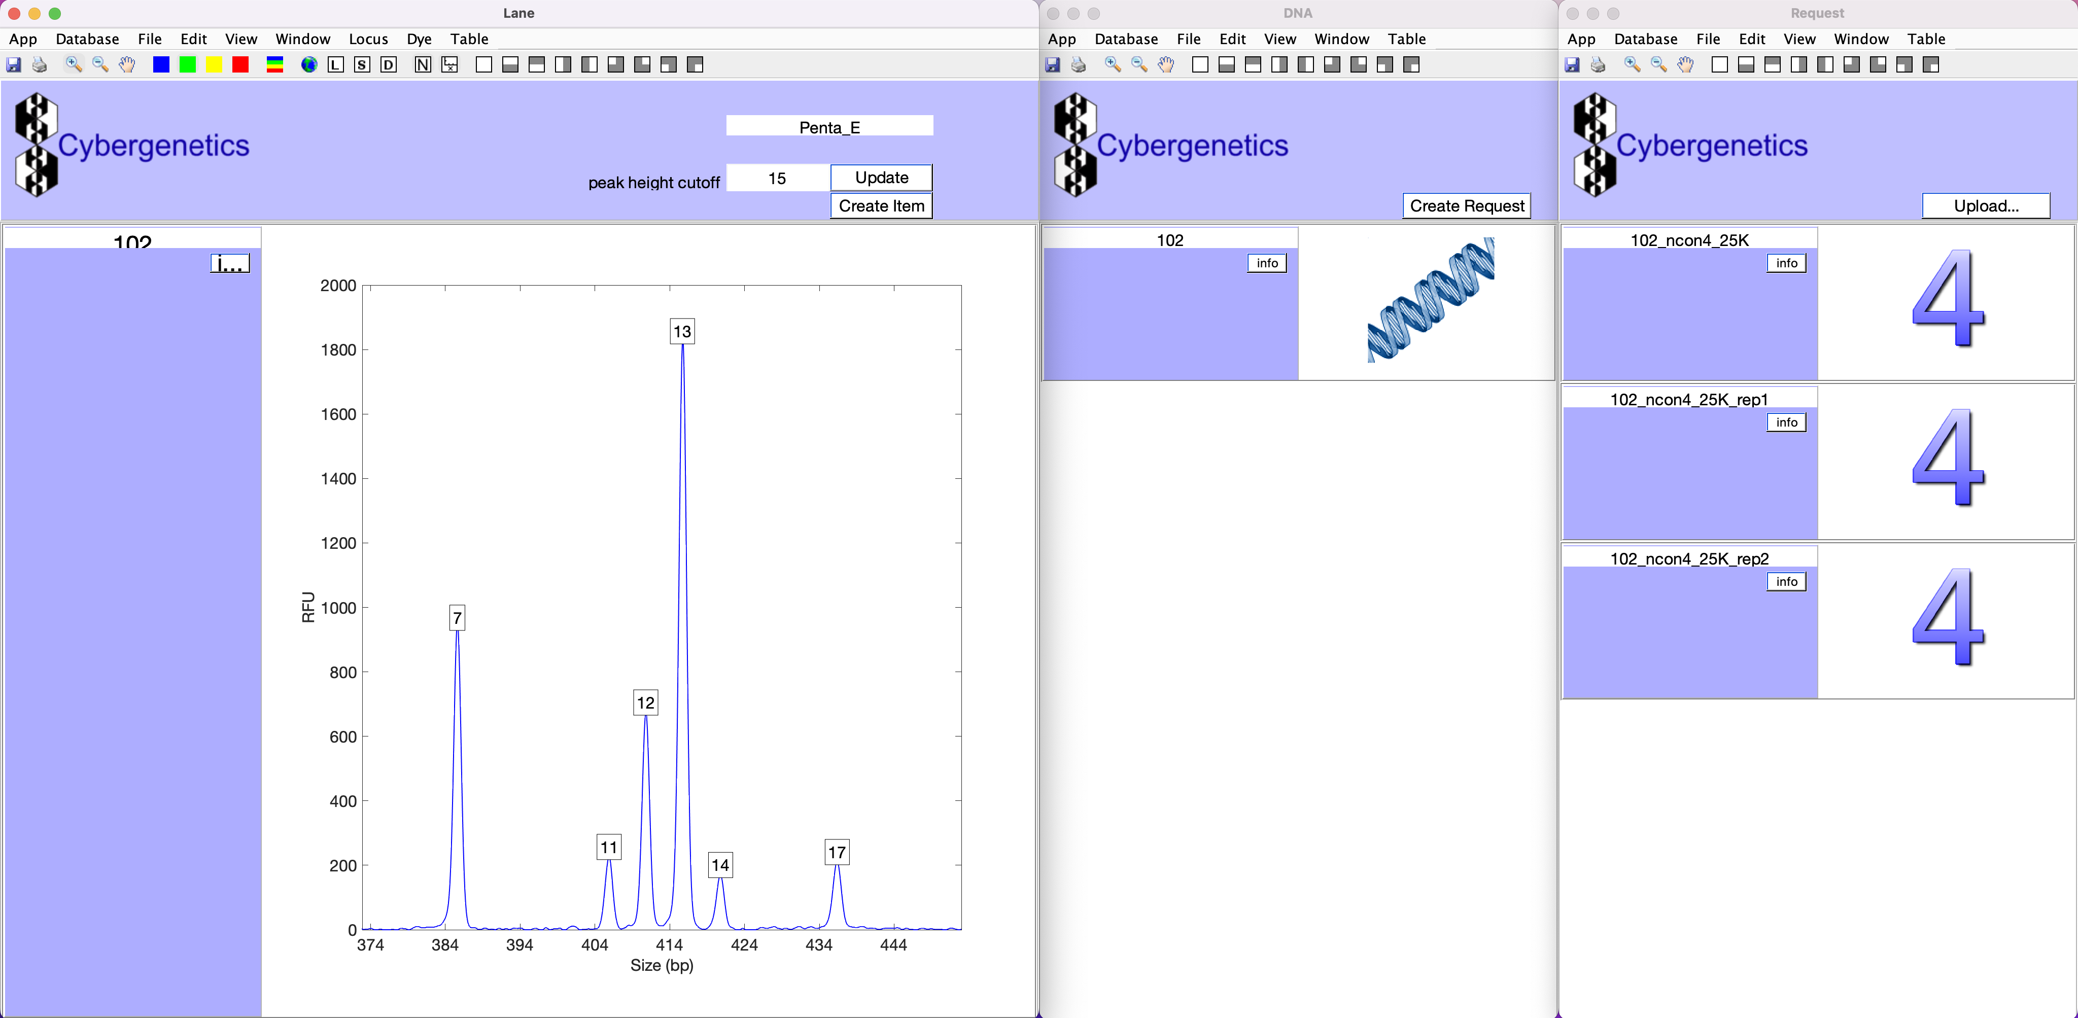
Analyst: task 1
Create ‘request’ for each mixture sample in triplicate
  A request is a computer run
  Replicates show reproducibility

Slide 20
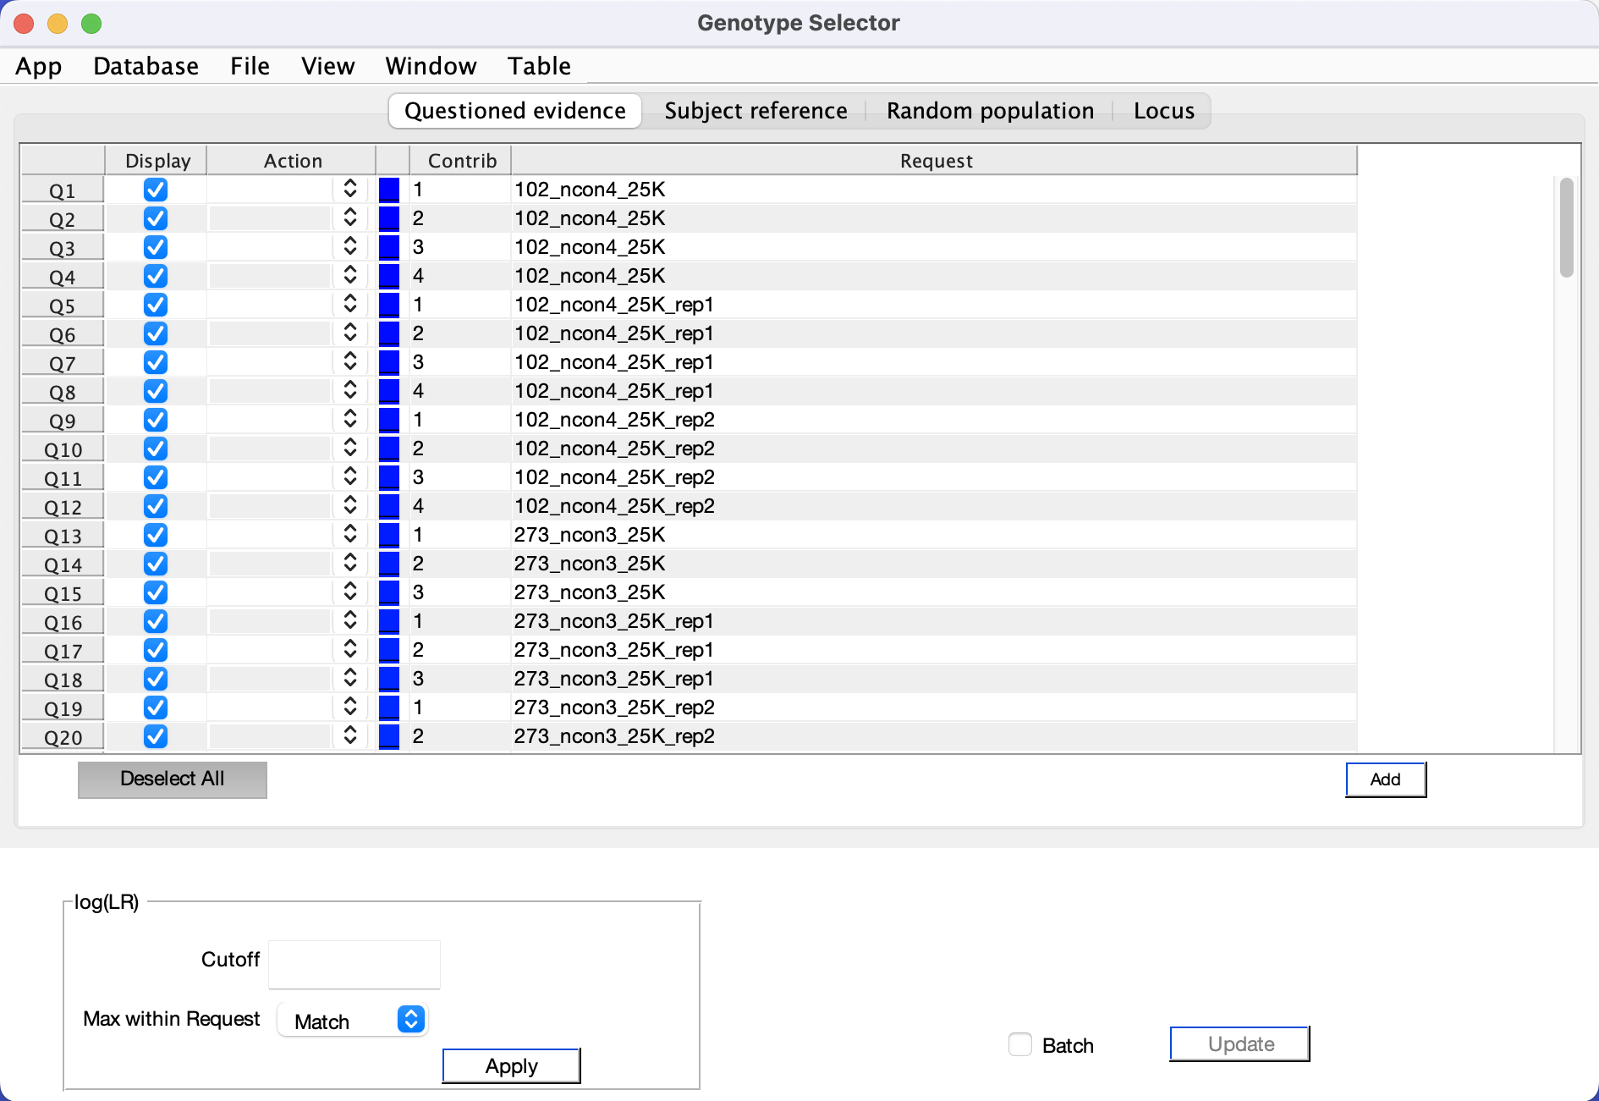
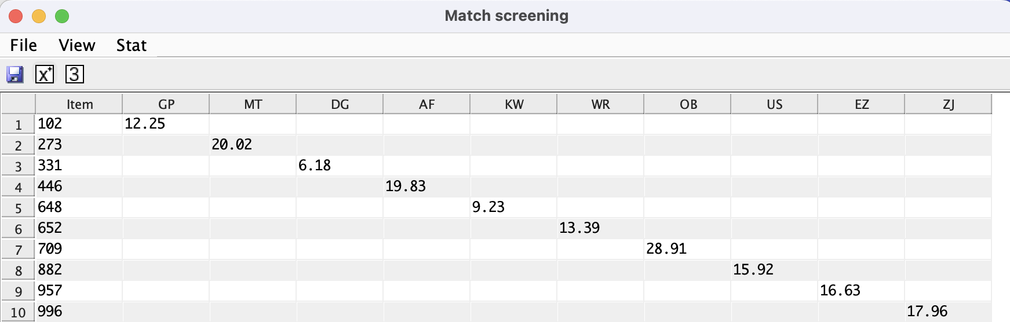
Analyst: task 2
Use TrueAllele to compare evidence with references
  Determine matching reference
  Provide match statistics for each replicate
  Each analyst returns a total of 30 match statistics

Slide 21
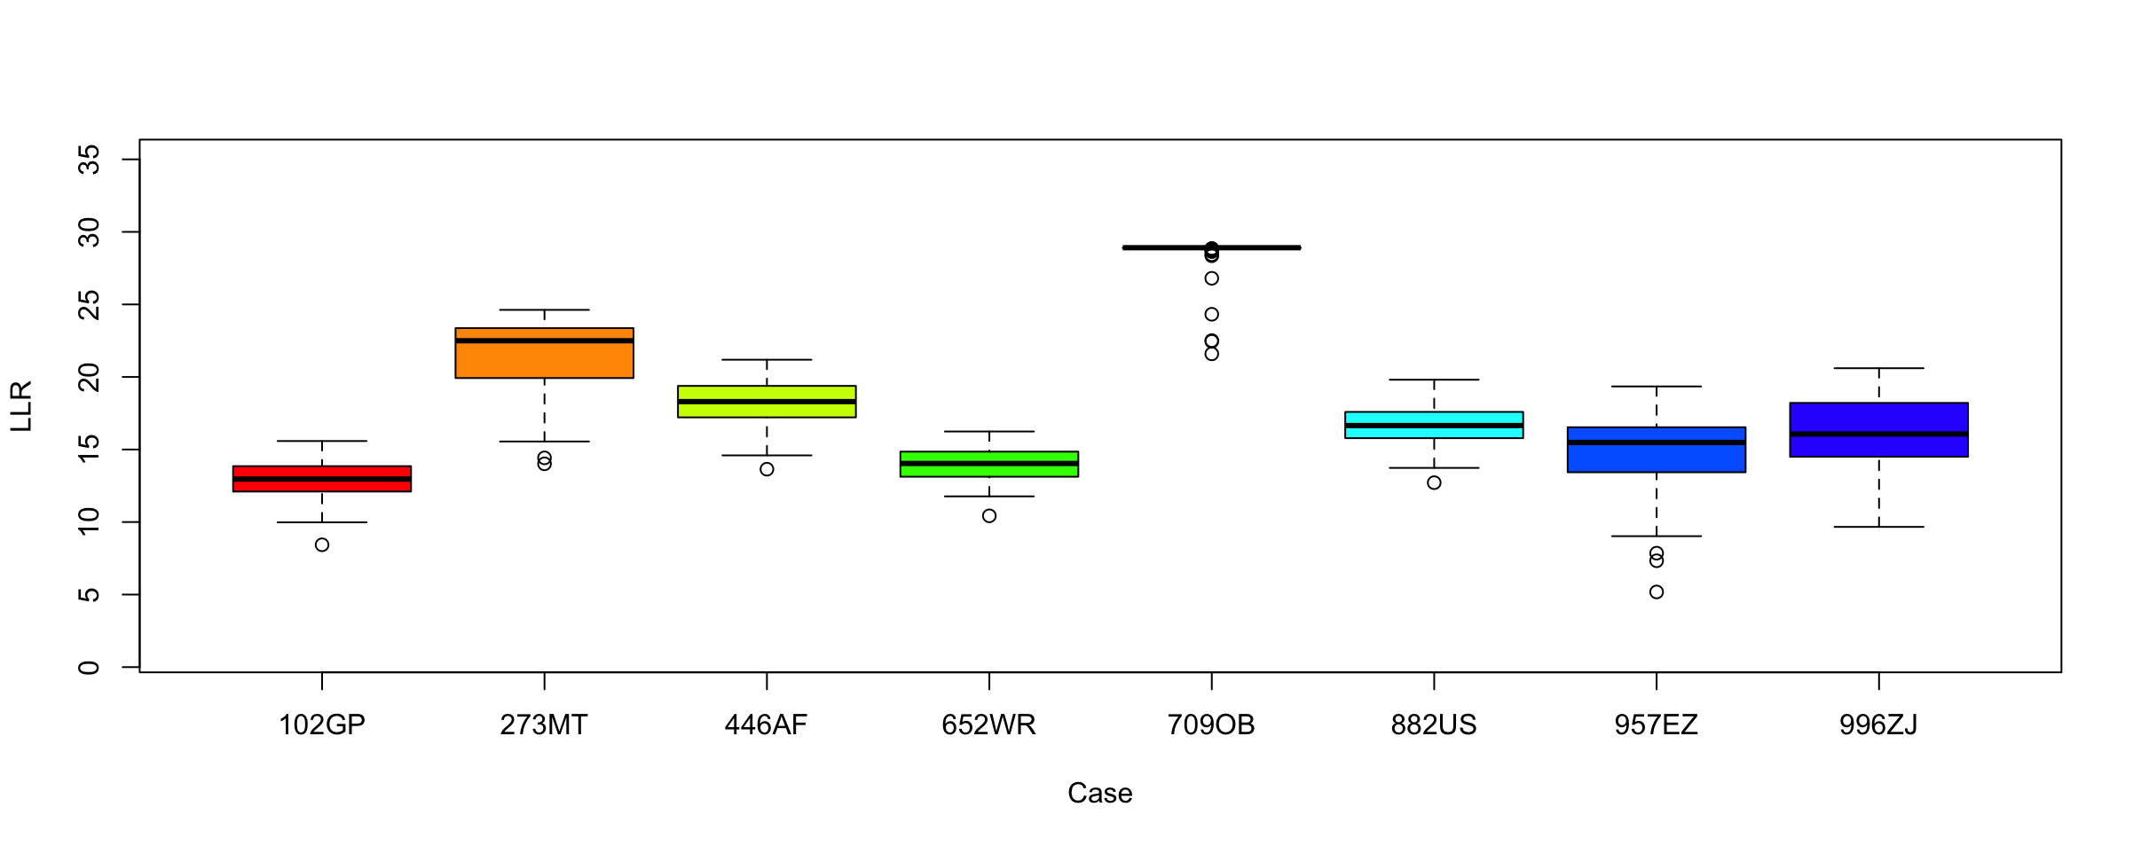
Results: across 8 cases

Slide 22
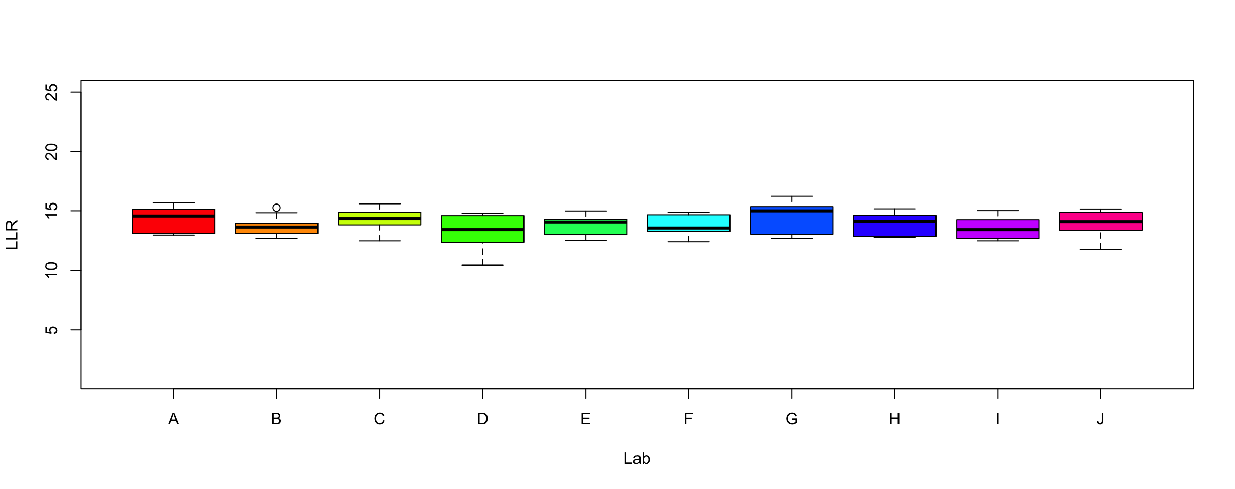
Results: across 10 laboratories
Case 102GP

Slide 23
Results: laboratory
ANOVA (ANalysis Of VAriance)
  Degrees of Freedom: 9
  Sum of Squares: 3
  Mean Square: 4.2
  F-statistic: 1.231
  p-value: 0.273 > 0.05
Any way
Anywhere
Any time
Across all the cases

Slide 24
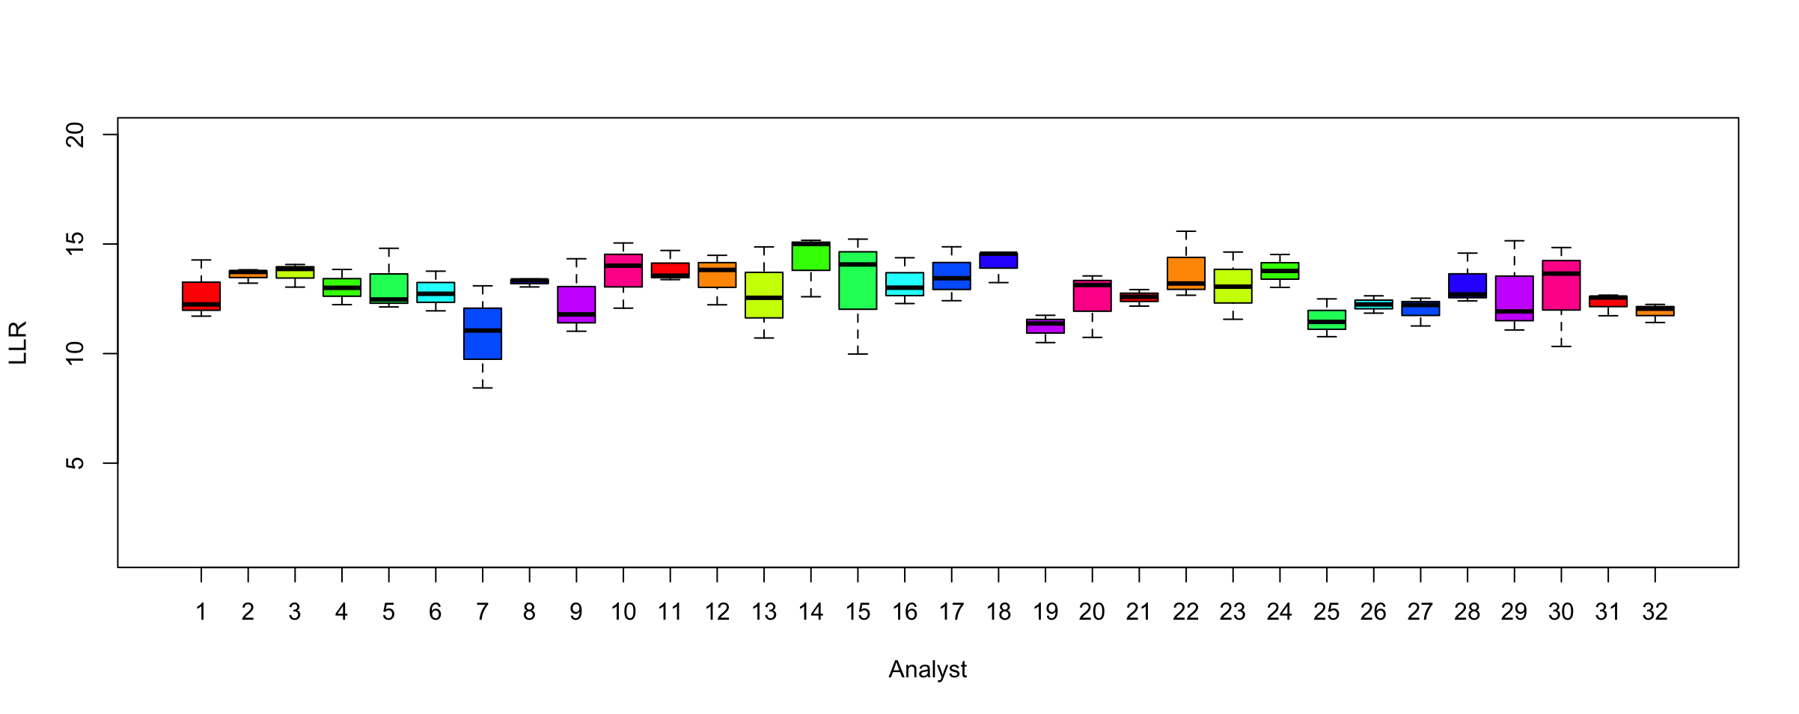
Results: across 32 analysts
Case 102GP

Slide 25
Results: analyst
ANOVA
  Degrees of Freedom: 31
  Sum of Squares: 79
  Mean Square: 2.6
  F-statistic: 0.732
  p-value: 0.856 > 0.05
Any one
Across all the cases

Slide 26
Study conclusions
Analysts
  Education
  Training
  Experience
  Knowledge
  same DNA result
Laboratories
  STR kit
  Sequencer
  Reporting
  Thresholds
  Calibration
  Parameters
  Stutter
  Computation
  same DNA result

Slide 27

Significance: Everything everywhere all at once
The same DNA answer – any way, anywhere, any time, anyone
One validation study applies to all
  Any validated kit, sequencer, or method
Same reliability applies to all
  Trained analysts get the same result
Can process legacy cases
Even opposing experts will get
the same DNA answer

Slide 28


More information
http://www.cybgen.com/information
• Courses
• Newsletters
• Newsroom
• Presentations
• Publications
• Reliability
• Webinars
http://www.youtube.com/user/TrueAllele
TrueAllele YouTube channel

