Slide 1



TrueAllele® Computational Forensics for Solving “Uninterpretable” DNA Mixtures
1
Mark W Perlin, PhD, MD, PhD
Cybergenetics
Dharwad, Karnataka, India
International Conference on
Recent Trends in DNA Forensics
November 2023
Cybergenetics © 2003-2023

Slide 2
Cybergenetics history
2
Innovating the interpretation of forensic DNA evidence
1994. Founded in Pittsburgh, Pennsylvania.
1995. Solved the PCR stutter problem.
2000. Eliminated UK DNA database backlog.
2001. Solved the DNA mixture problem – TrueAllele.
2005. Identified World Trade Center remains.
2009. Testified in world’s first prob genotyping case.
2016. First prob genotyping DNA exoneration.
2020. Validated on 10-unknown mixtures.
2022. Reported on over 1,000 DNA cases.
2023. Used in over 90% of the 50 USA states.

Slide 3
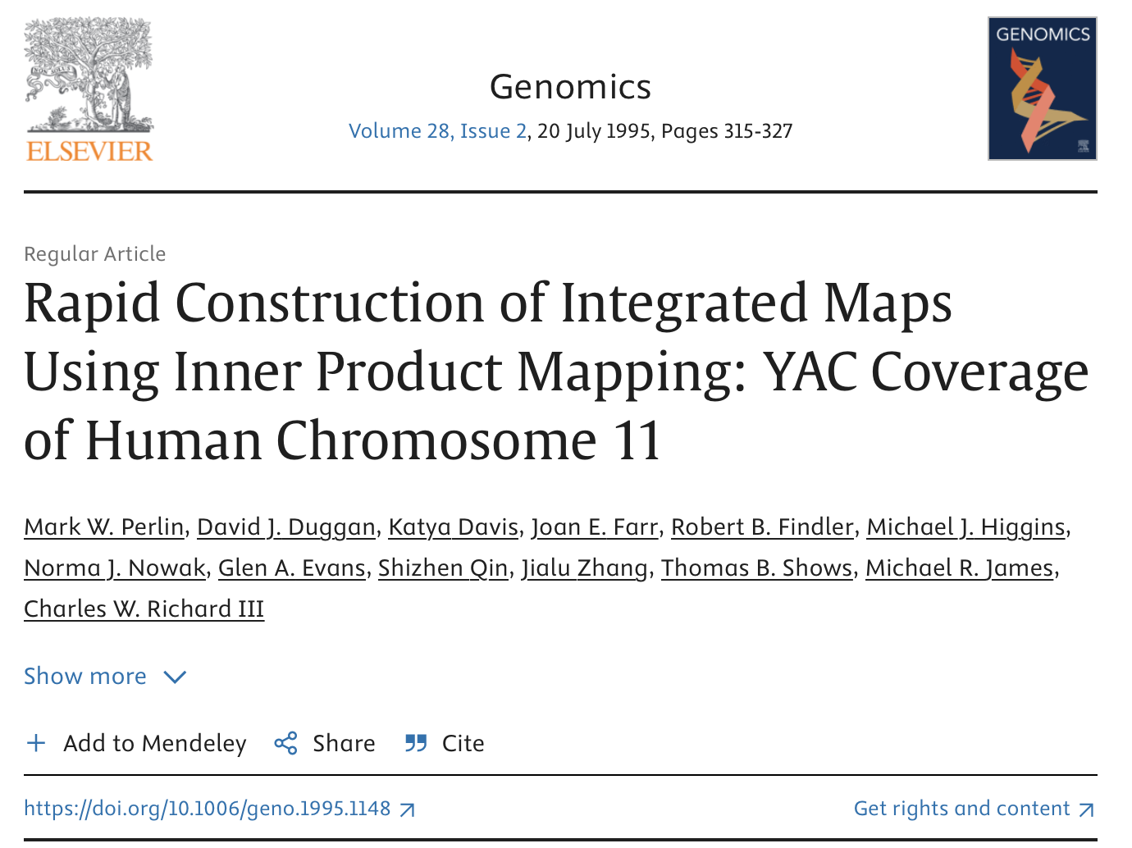
Computational Genomics
3

Slide 4
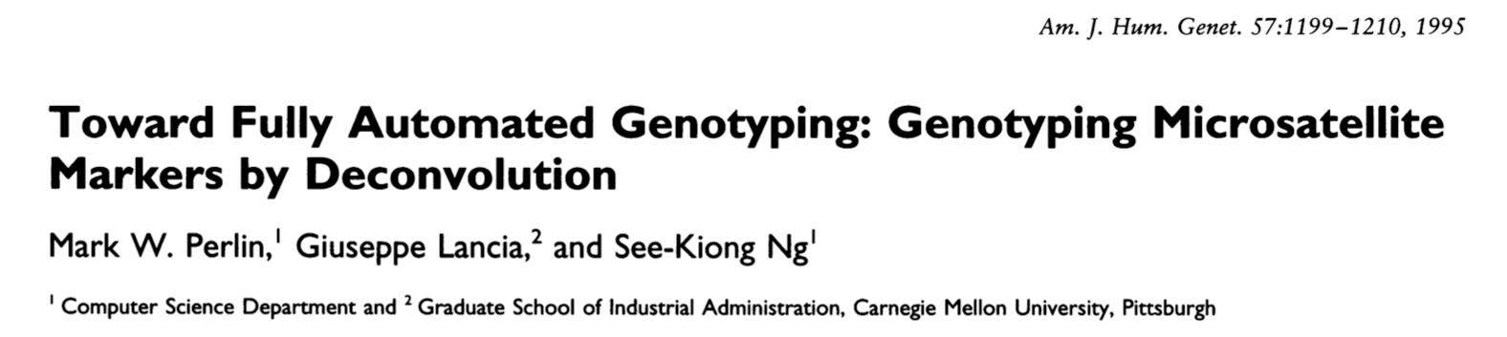
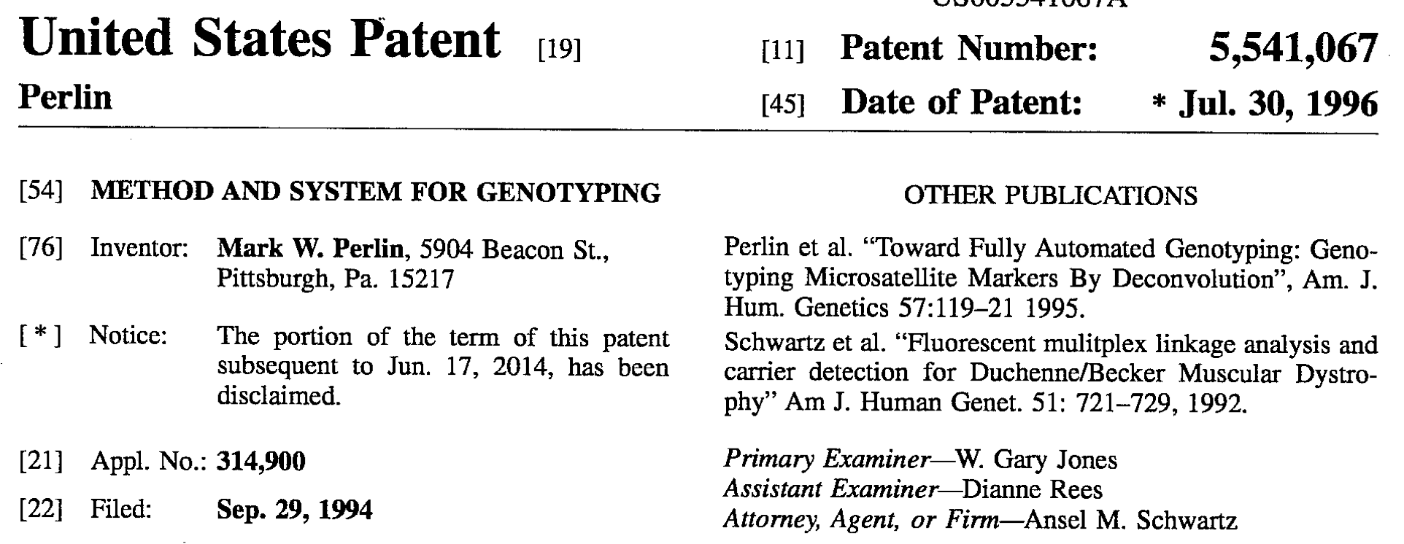
STR genotyping bottleneck
4
1995. Cybergenetics solves the DNA analysis problem.
Replaces ineffective human review with efficient computers.

Slide 5

DNA database backlog
5
Year 2000. Britain. The FSS.
The first national DNA database.
Human review of DNA data fails.
Backlog of 350,000 swabs.
Enter computer automation.
Cybergenetics TrueAllele clears the backlog.
Every year, does another 350,000 samples.
Accurate: eliminates human error (1 in 2,000).
Fast: “swab to DB” turnaround time in 5 days.
Labor-saving: from 100 people down to 6.
Inexpensive: 2-3 computers, not 100 people.

Slide 6
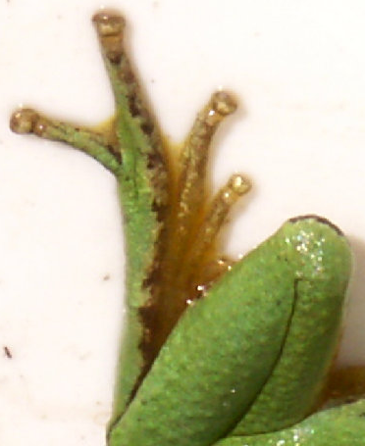
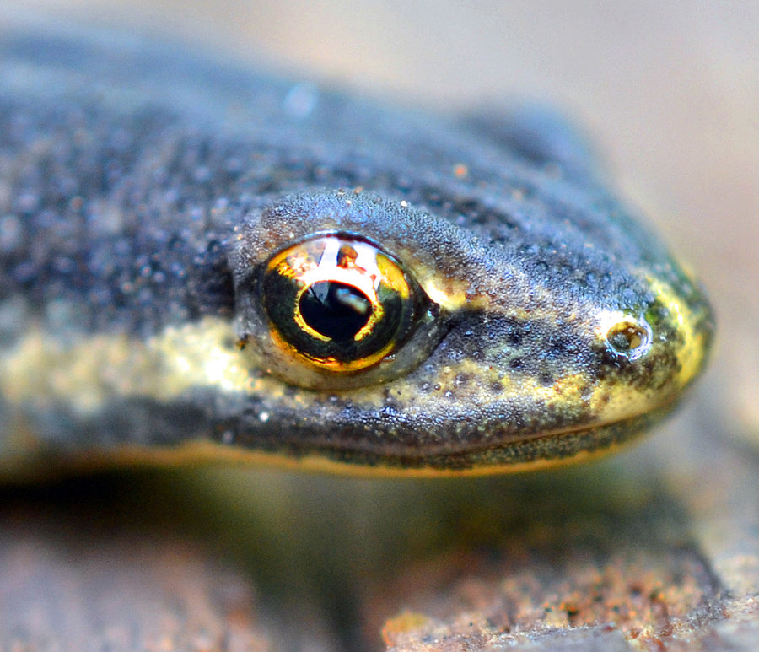

DNA mixtures
eye of newt
toe of frog
Double, double toil and trouble

Slide 7
DNA reporting language
7
“Due to the data being uninterpretable,
no comparison can be made to the reference sample.”
“A match between the evidence and the suspect is a trillion times more probable than coincidence.”

Slide 8
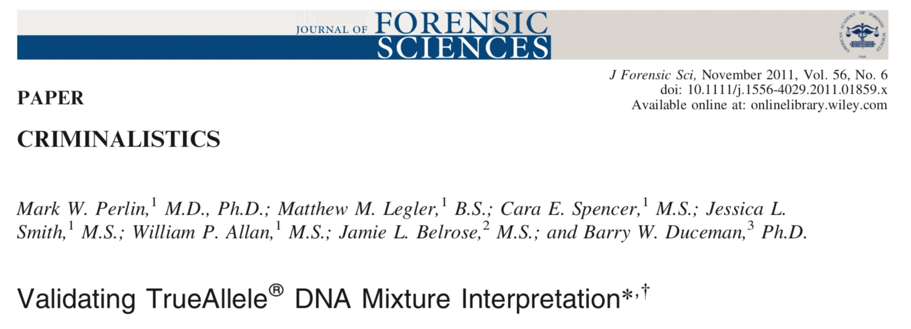
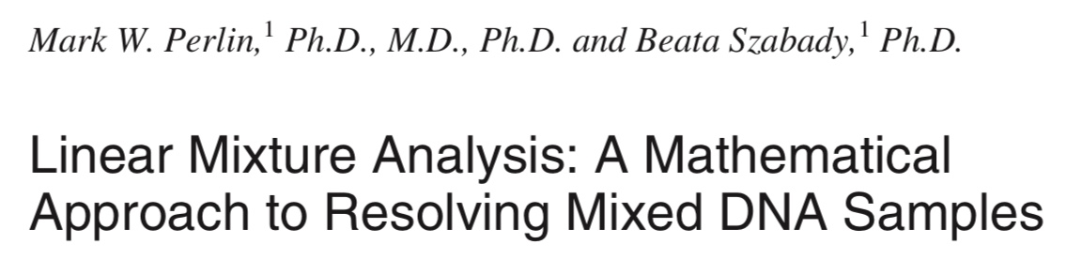
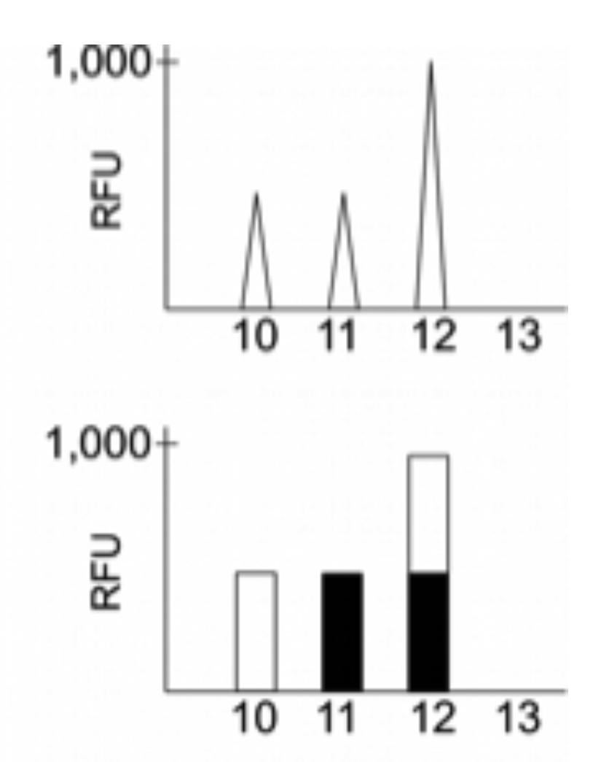
DNA mixtures “uninterpretable”?
2001
DNA peak height data
Sum of genotypes

Slide 9

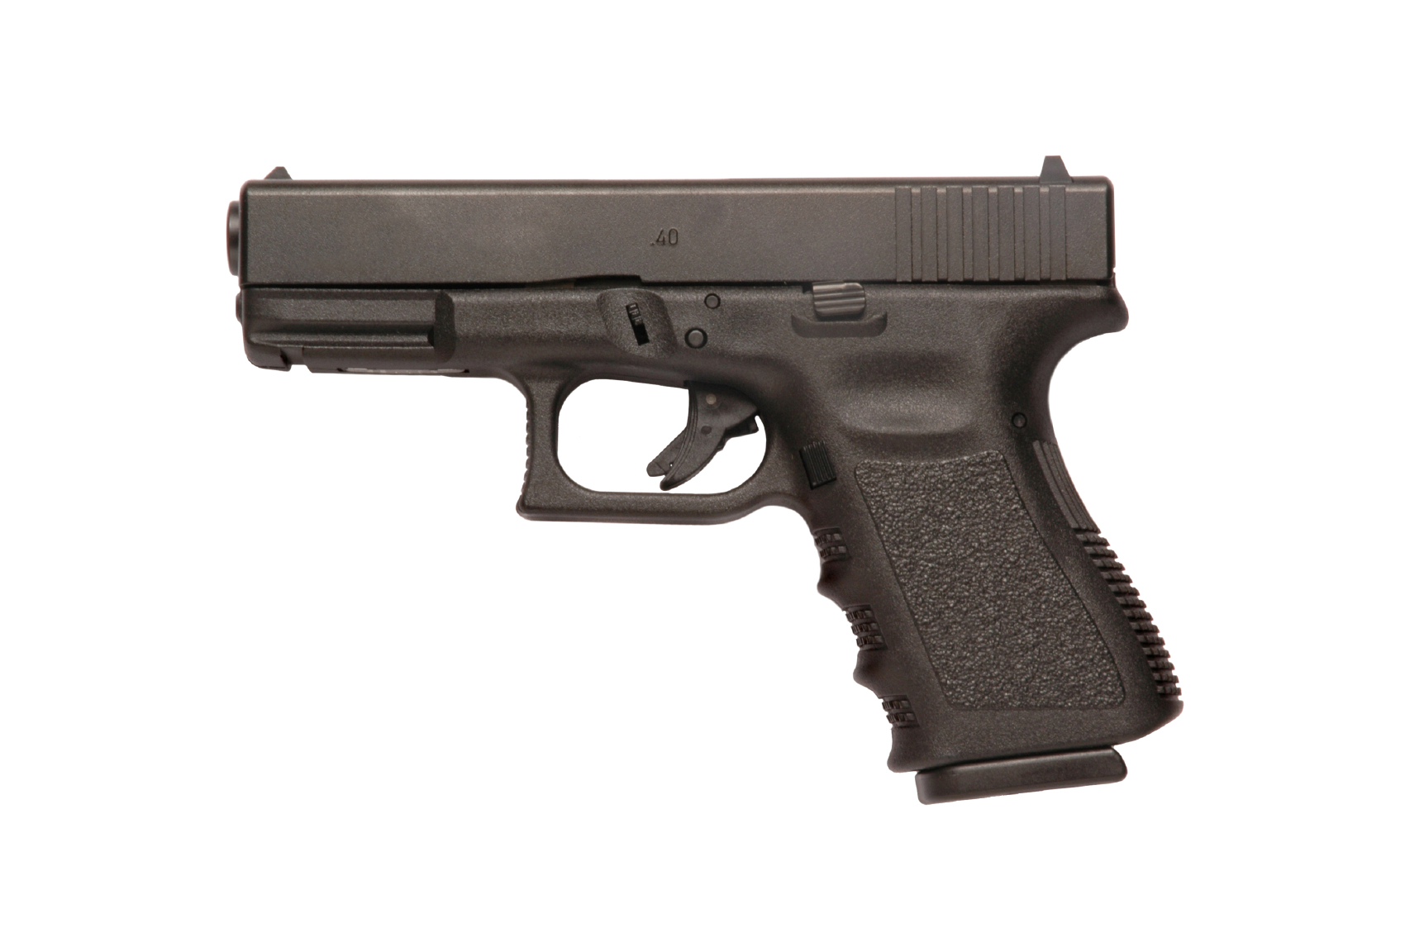

Informative genotyping
9
(Inconclusive or “uninterpretable” DNA mixture)
Cybergenetics TrueAllele analysis unmixes mixtures
Match statistics provide information
Person A
excluded
Contributor
Unmix the
mixture
1
2
400,000
3
Person B
included
4

Slide 10
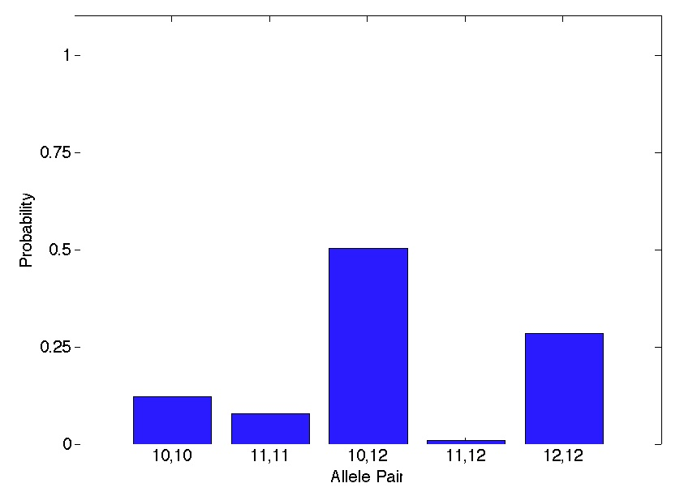
Separated genotypes
10
MW Perlin, MM Legler, CE Spencer, JL Smith, WP Allan, JL Belrose, BW Duceman. Validating TrueAllele® DNA mixture interpretation. Journal of Forensic Sciences, 2011.
Genotype uncertainty expressed through probability
Science
• Bayes (1762)
• Laplace (1812)
• Mendel (1865)
Standards
• SWGDAM (2010)
• ANSI/ASB (2018)
Genotype probability
at each genetic locus
for each contributor
preserves ID information

Slide 11
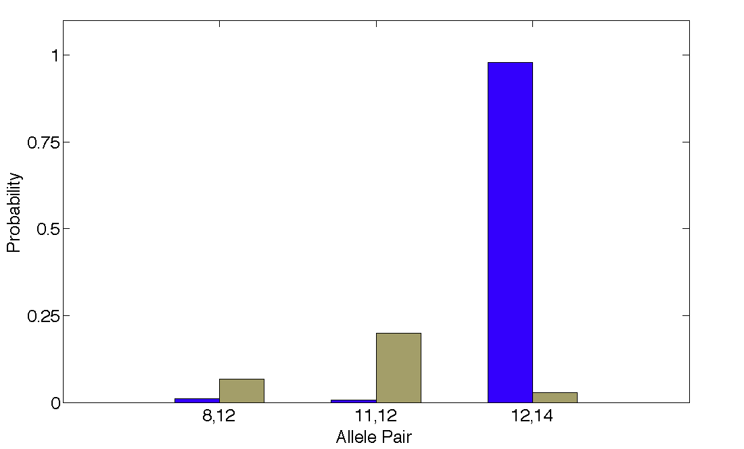
Quantify DNA match information
11
How much more does the suspect match the evidence
than a random person? – the likelihood ratio
35x
98%
Prob(evidence match)
Prob(coincidental match)
3%

Slide 12
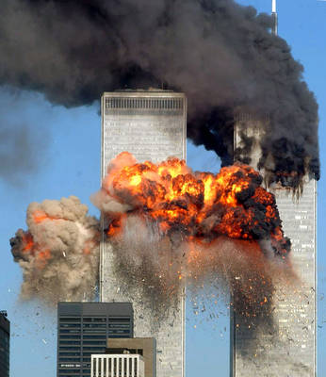
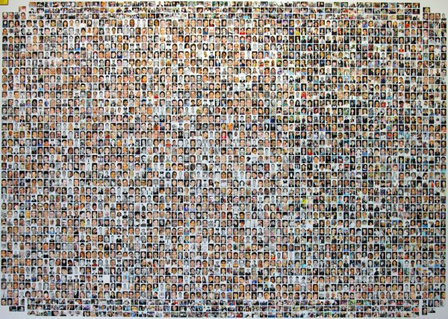
World Trade Center attack
September 11, 2001 in New York City
18,500 remains
2,700 victims

Slide 13
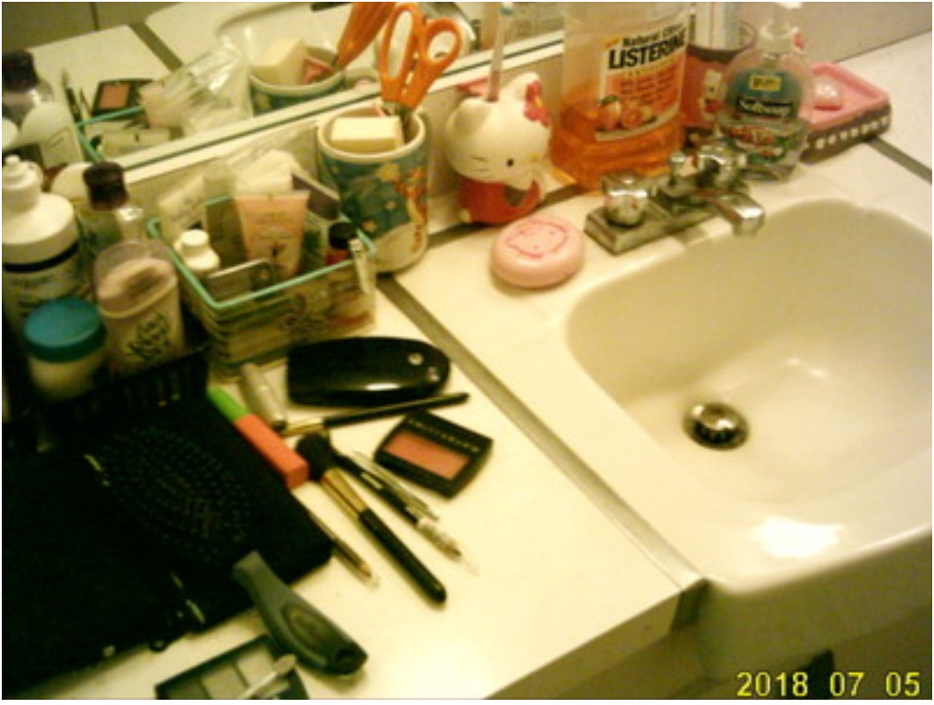
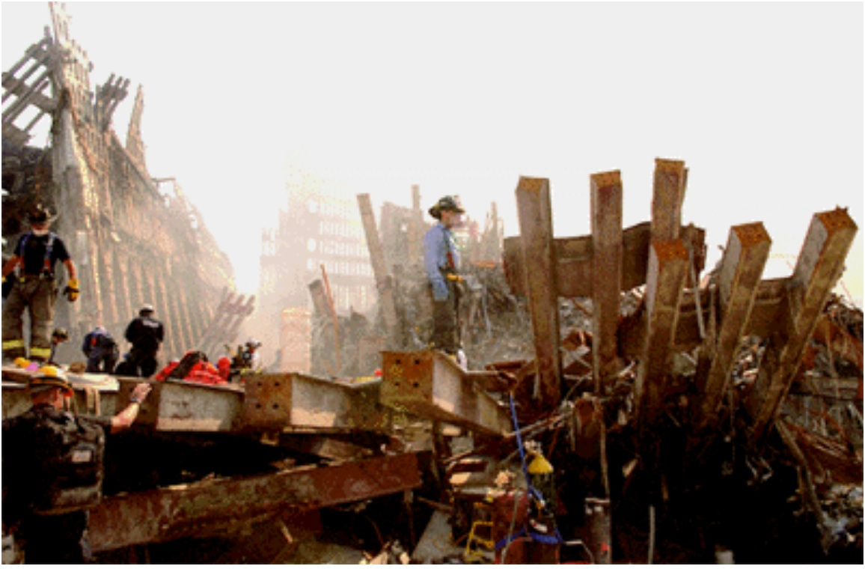
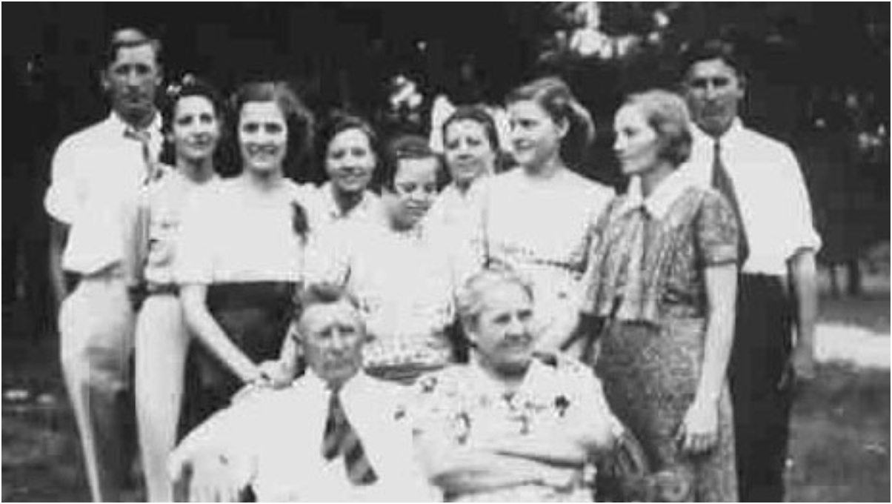
Identify victim remains
Victim Remains
Missing People
Match

Slide 14
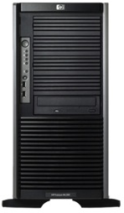
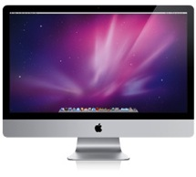

Automated TrueAllele® system
14
Parallel Processing
& Database Servers
Fully automated
Uses all the data
No thresholds or choices
No calibration – case data
VUIer™ Software

Slide 15
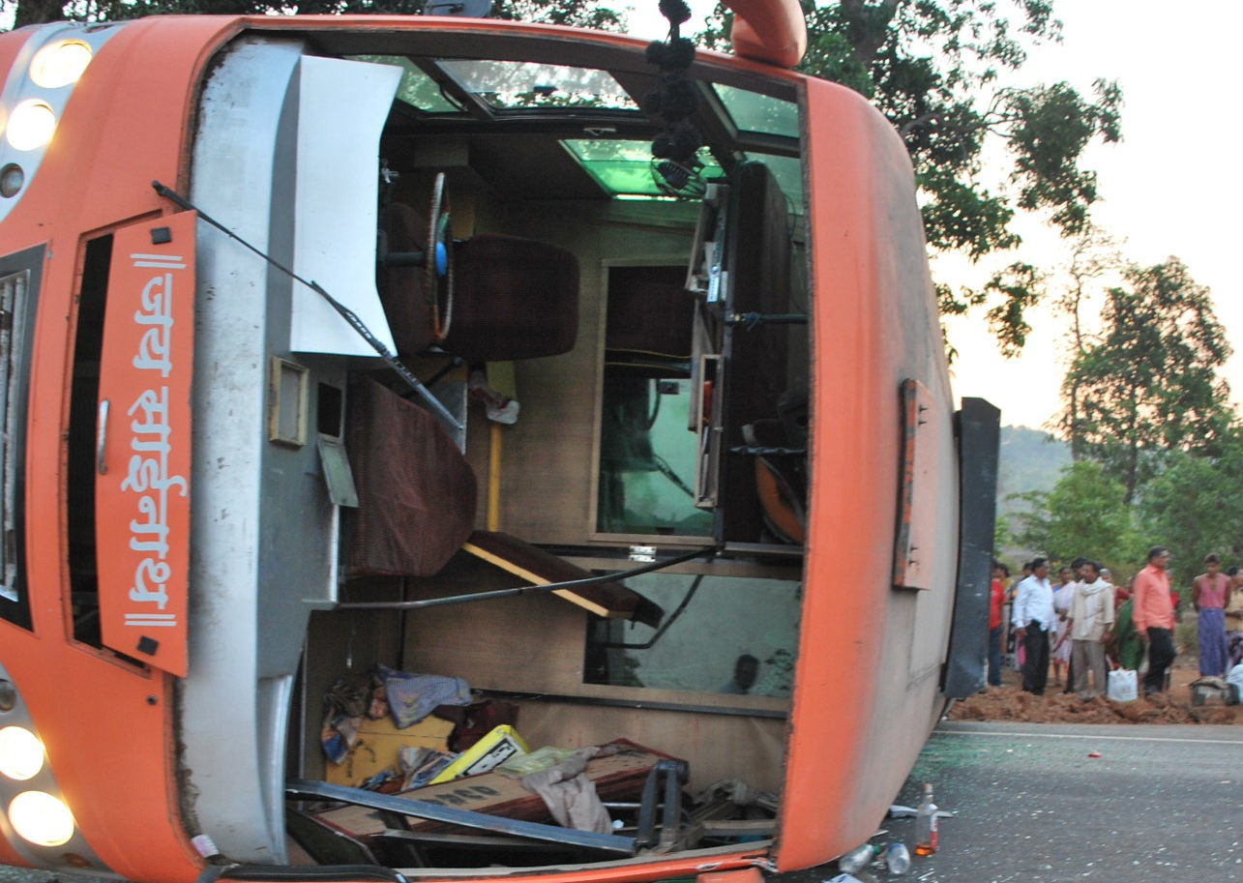
15
Bus crash mass disaster
2008 bus crash in Komatipoort, South Africa
Police recover burned victim remains
Relatives submit DNA to help identify remains
Lab was unable to identify victim remains

Slide 16
Bus crash in South Africa
TrueAllele DVI using relatives
16
From “insufficient information” to identified victims
Victim Remains
AO0553E AO0554E AO0555E AO0556E AO0557E AO0558E AO0559E AO0560E AO0561E AO0562E AO0563E AO0564E AO0565E AO0566E AO0567E
Sample | Relation
AP2438C AP2439C AP2440C AP2441C AP2442C AP2443C AP2444C AP2445C AP2446C AP2447C AP2448C AP2449C AP2450C AP2451C AP2452C AP2455C | Grandfather Daughter Son Mother Son Sister Father Son Unknown Brother Brother Sister Mother Son Father Son

Slide 17
2022 Chandigarh workshop
17
1 TrueAllele database server
12 interpretation processors
20 students (3rd training day)
Task
Have each student use TrueAllele
to identify the victim remains

Slide 18
Student success!
18
15 victim items
16 family items
16 family references
DNA data
15 victim genotypes
16 family genotypes
16 kinship genotypes
Genotypes
15 victim genotypes x 16 kinship genotypes = 240 genotype comparisons
240 comparisons x 20 students = 4,800 total comparisons
Before lunch: | Students uploaded the genotype data
During lunch: | TrueAllele solved all the problems
After lunch: | Students reviewed identification results

Slide 19
Manual mixture interpretation
19
• Inaccurate. Disagrees with true information
• Subjective. Workflow introduces human bias
• Widespread. Millions of case items
• Opaque. Choices use only some of the data
• Biased. Can only include – or give no answer
Inconclusive (case stays open)

Slide 20
TrueAllele® computer technology
20
• Accurate. 42 validation studies, 8 published
• Objective. Workflow removes human bias
• Accepted. Used in 90% of states, and by labs
• Transparent. Give math, software (4GB DVD)
• Neutral. Statistics inclusionary or exclusionary
Informative (case is closed)

Slide 21
How is TrueAllele used?
21
• Prosecution
• Defense
• Investigation
• Post-conviction
• Mass disaster
• Touch DNA
• Complex mixtures
• Kinship, paternity
• DNA database
• Familial search
• Preventing crime

Slide 22
22
Homicide with 7% DNA under victim’s fingernails

Slide 23
Three DNA match scores
23
Same DNA data, better data analysis

Slide 24
Virginia v. David Black
(Kinship homicide)
24
Item | Description | David Black | Bonnie Black | BettyAnn Armstrong | Craig Black | Eleanora Black
08 | Baseball hat velcro strap | 32.5 quintillion | 16.1 billion |  | 1/1.83 thousand | 1/62.6
94 | Master bedroom light switch | 364 million | 8.14 million
95 | Master bathroom light switch | 1/19.5 | 554 million |  |  | 3.63 million

Slide 25
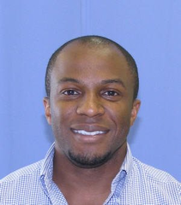
Pennsylvania v. Akaninyene Akan
(Serial rape)
25
Female students raped in their Pittsburgh apartments
Akan accused of serial crimes; tossed cigarette, victim’s clothing
TrueAllele found a DNA match statistic of a quadrillion
Sentenced to 32 years in prison
Akaninyene Efiong Akan

Slide 26
Pennsylvania v. Terry Lipinsky (Incest rape)
26
From “uninterpretable DNA mixture” to closed case

Slide 27
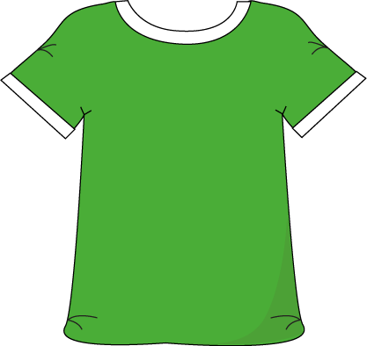
Maryland v. Nelson Clifford
(Serial rape)
27
11%
82%
7%
contributor
1
contributor
2
contributor
3
match
statistic

Slide 28
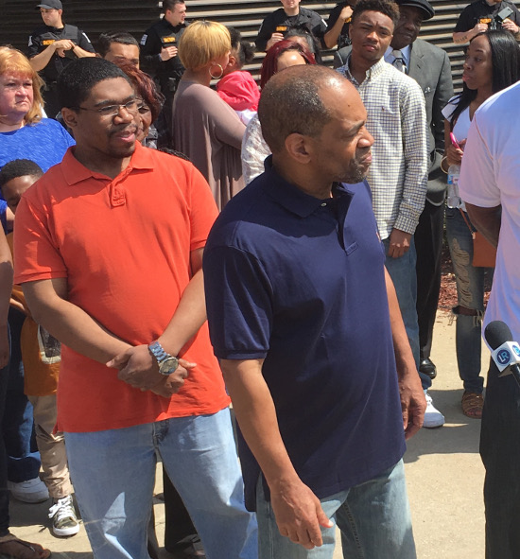
Indiana v. Darryl Pinkins
(TrueAllele exoneration)
28
Wrongfully convicted
Imprisoned for 25 years
Released from prison
April 25, 2016
CBS News 48 Hours
“Guilty Until Proven Innocent”

Slide 29
Information and Automation
29
Information
  No “inconclusive”, close cases
  Accurately weigh DNA evidence
Automation
  Computer does all the work
  Without thousands more people
Easy to use
  Intuitive user interface
  Ask questions in seconds

Slide 30
Peer-reviewed validation studies
30
Perlin MW, Sinelnikov A. An information gap in DNA evidence interpretation. PLoS ONE. 2009;4(12):e8327.
Ballantyne J, Hanson EK, Perlin MW. DNA mixture genotyping by probabilistic computer interpretation of binomially-sampled laser captured cell populations: Combining quantitative data for greater identification information. Science & Justice. 2013;53(2):103-114.
Perlin MW, Hornyak J, Sugimoto G, Miller K. TrueAllele® genotype identification on DNA mixtures containing up to five unknown contributors. Journal of Forensic Sciences. 2015;60(4):857-868.
Greenspoon SA, Schiermeier-Wood L, Jenkins BC. Establishing the limits of TrueAllele® Casework: a validation study. Journal of Forensic Sciences. 2015;60(5):1263-1276.
Bauer DW, Butt N, Hornyak JM, Perlin MW. Validating TrueAllele® interpretation of DNA mixtures containing up to ten unknown contributors. Journal of Forensic Sciences. 2020; 65(2):380-398.
Perlin MW, Legler MM, Spencer CE, Smith JL, Allan WP, Belrose JL, Duceman BW. Validating TrueAllele® DNA mixture interpretation. Journal of Forensic Sciences. 2011;56(6):1430-1447.
Perlin MW, Belrose JL, Duceman BW. New York State TrueAllele® Casework validation study. Journal of Forensic Sciences. 2013;58(6):1458-1466.
Perlin MW, Dormer K, Hornyak J, Schiermeier-Wood L, Greenspoon S. TrueAllele® Casework on Virginia DNA mixture evidence: computer and manual interpretation in 72 reported criminal cases. PLOS ONE. 2014;(9)3:e92837.

Slide 31
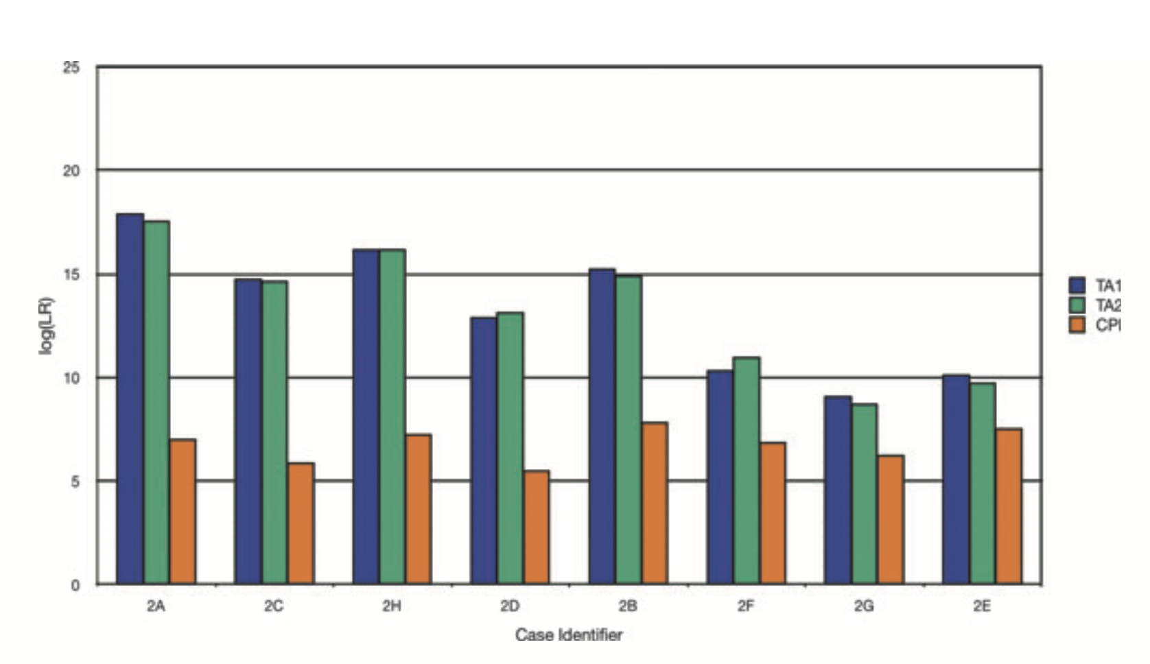
JFS2011
7. TRUEALLELE VALIDATION

Slide 32
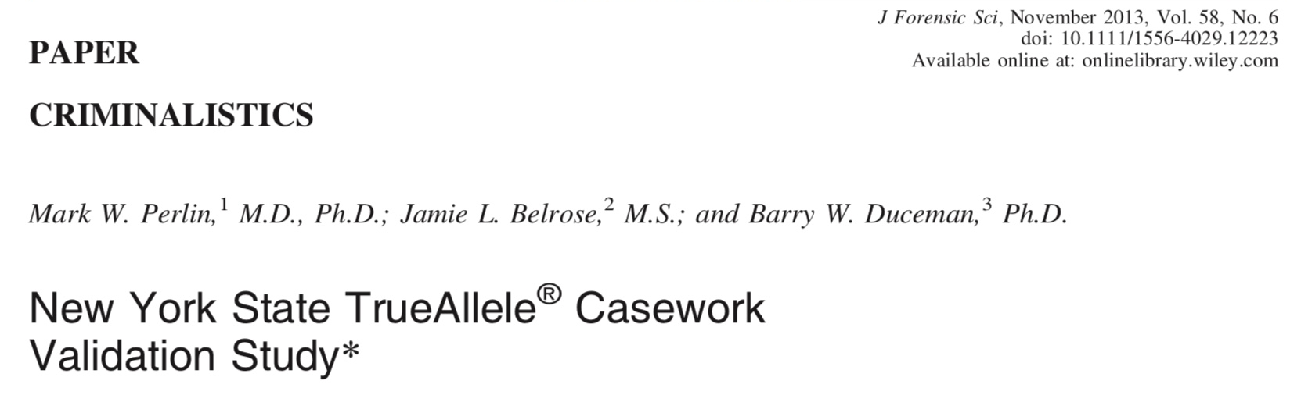
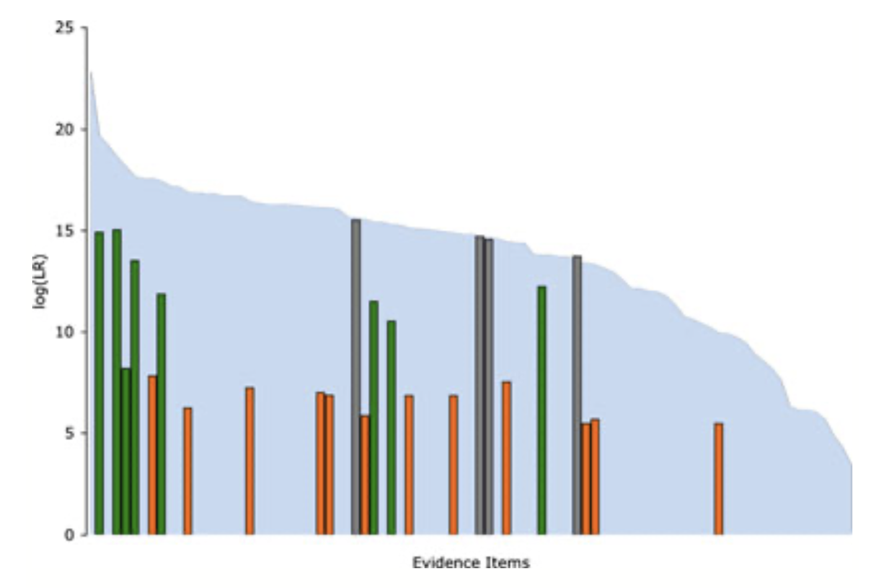
JFS2013

Slide 33
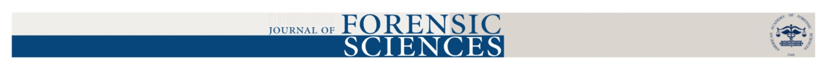
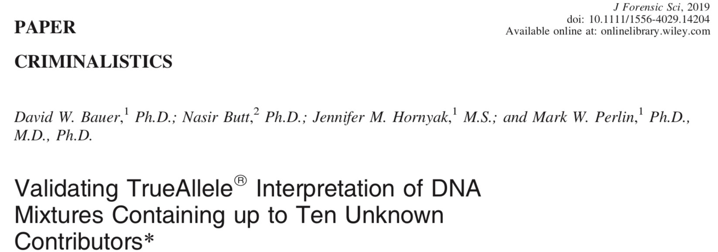
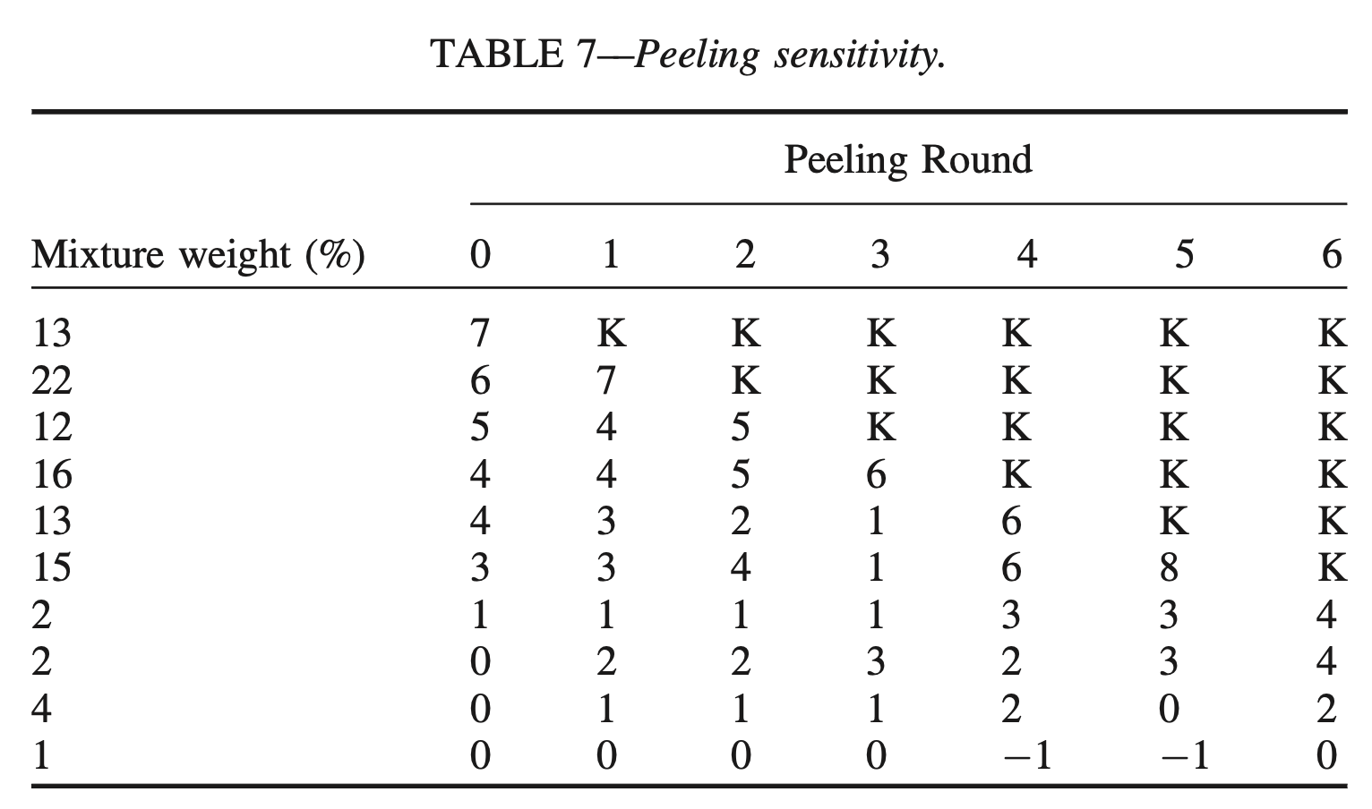
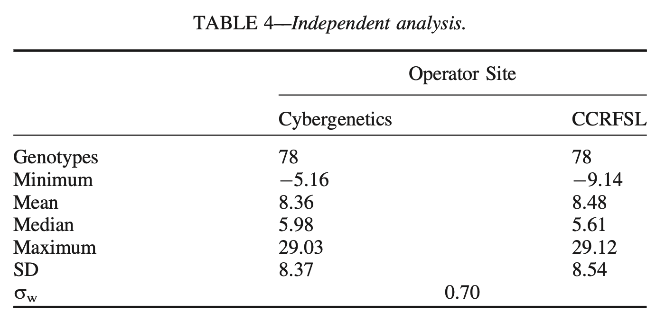

Slide 34
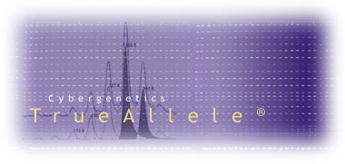


More TrueAllele information
http://www.cybgen.com/information
• Cloud & demo
• Courses
• Newsroom
• Presentations
• Publications
• Webinars
http://www.youtube.com/user/TrueAllele
TrueAllele YouTube channel

