Slide 1



The Science and Law of Automated
DNA Evidence Interpretation
National Forensic Science University
Gandhinagar, Gujarat, India
February, 2023
Mark W Perlin, PhD, MD, PhD
Cybergenetics
Cybergenetics © 2003-2023

Slide 2
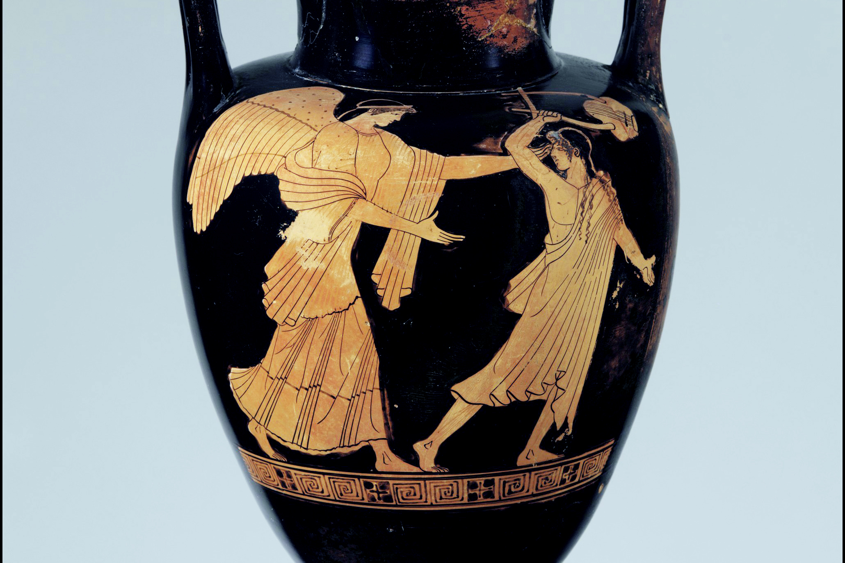
What is Truth?
"Beauty is truth, truth beauty,—that is all
Ye know on earth, and all ye need to know.” - Keats

Slide 3
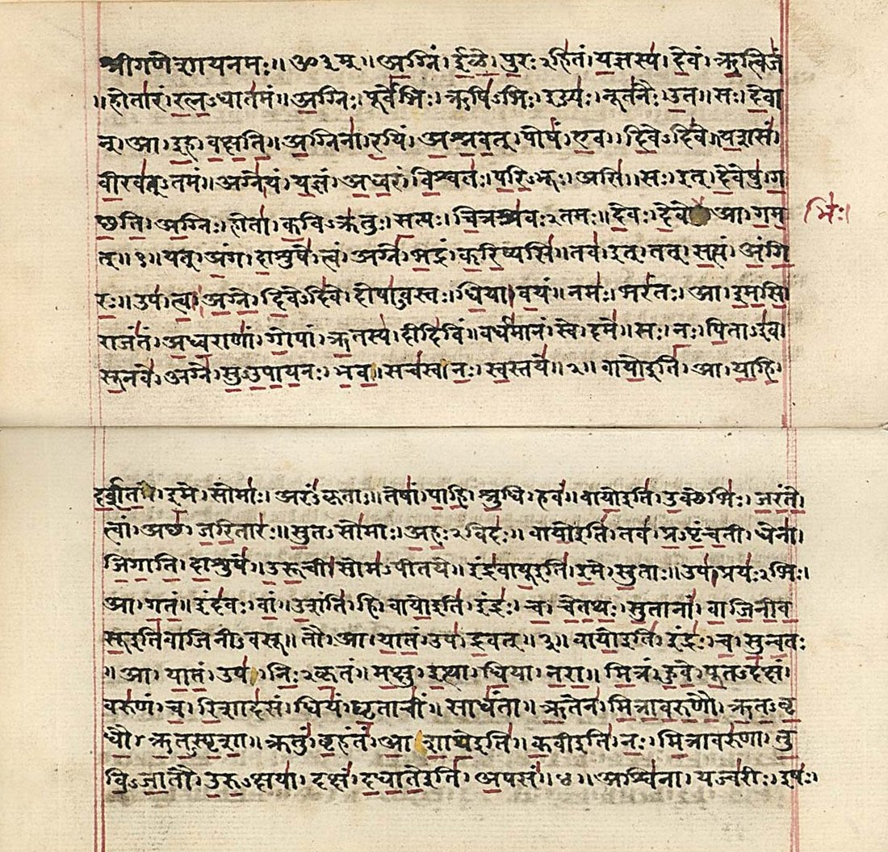
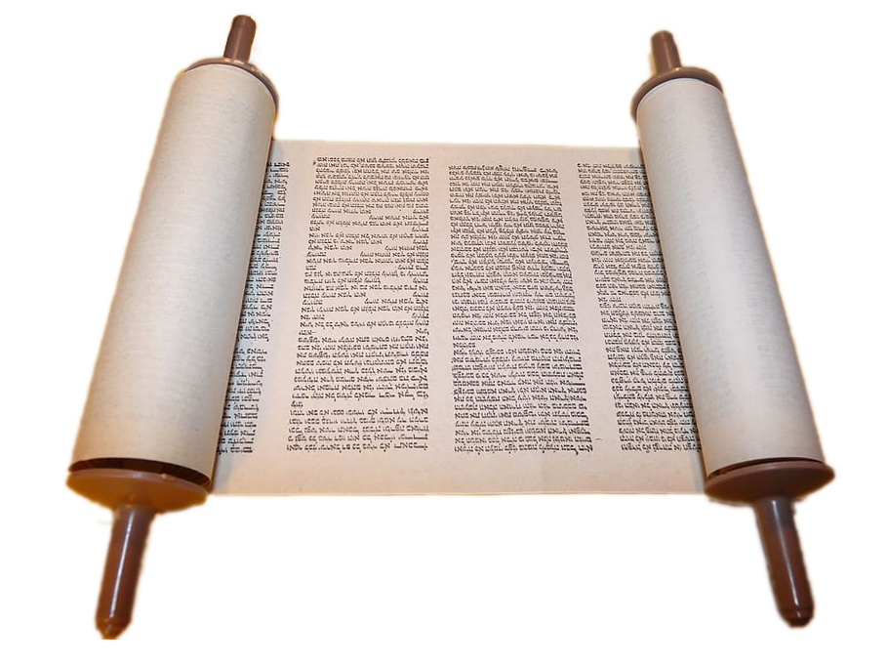

Religious texts

Slide 4
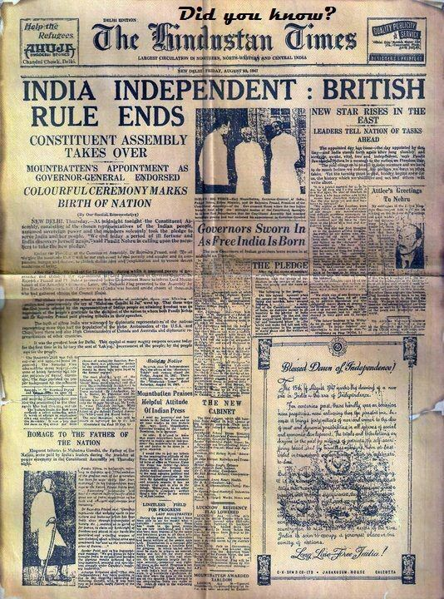
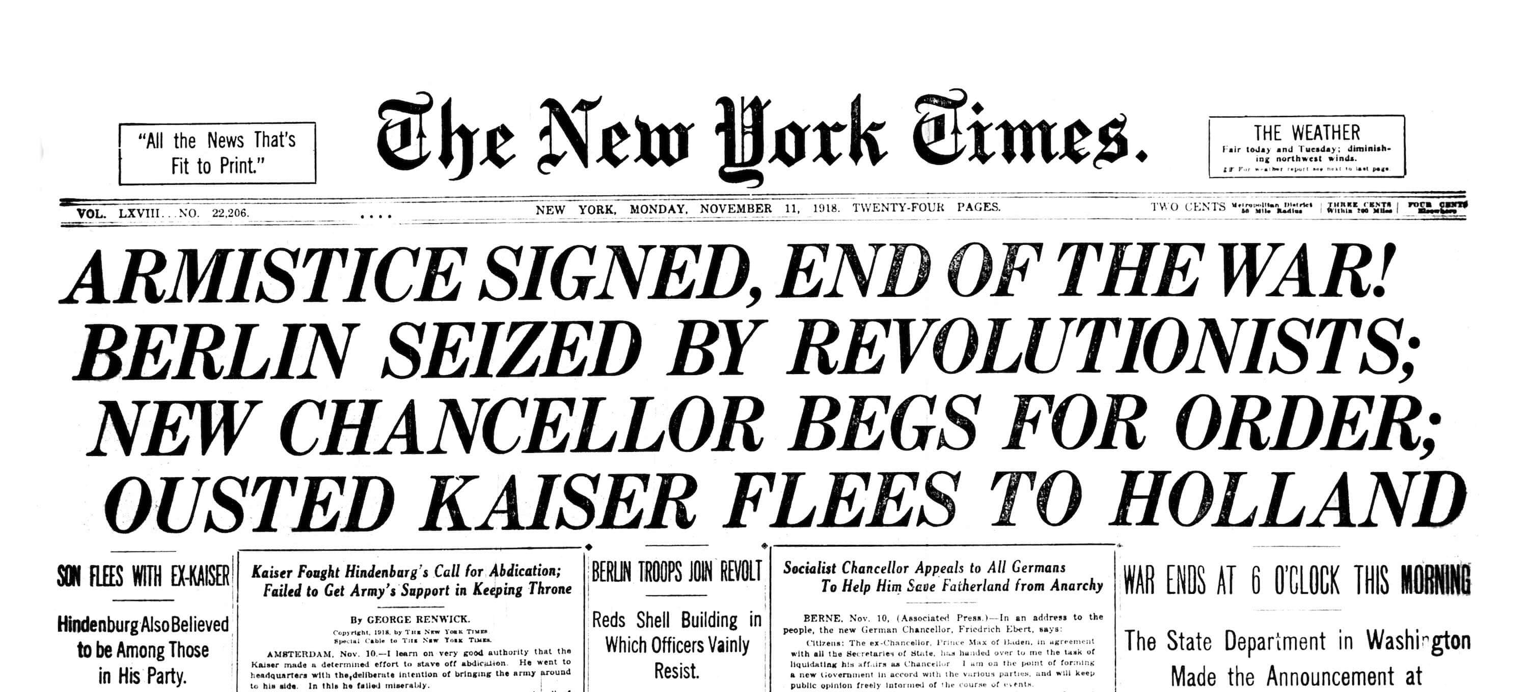
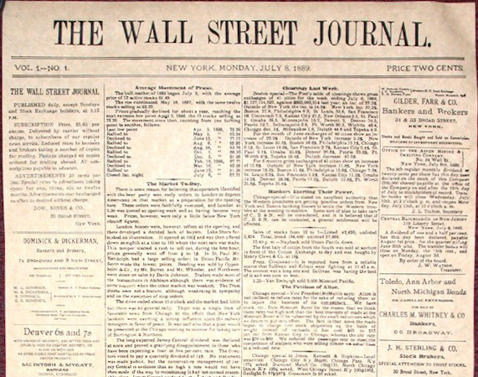
News reporting

Slide 5
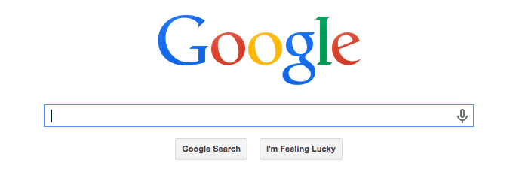
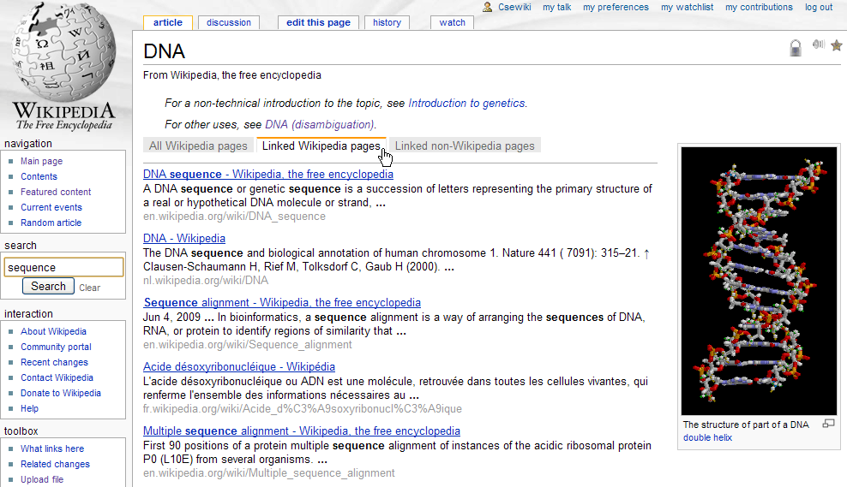
Internet sources

Slide 6


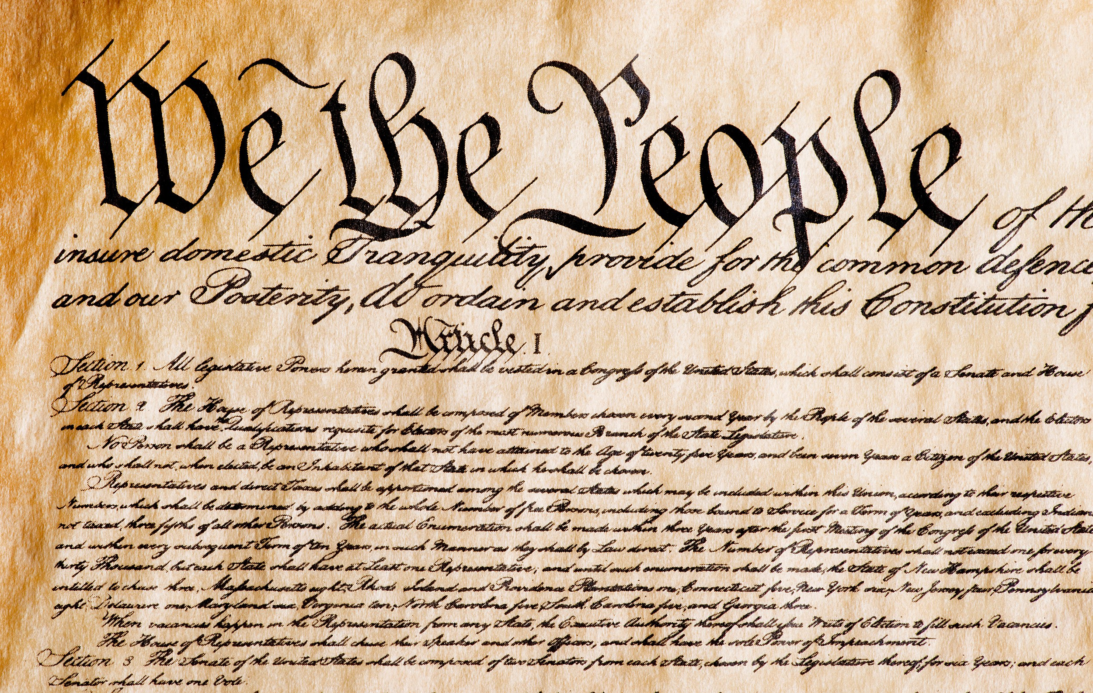
Government authority

Slide 7



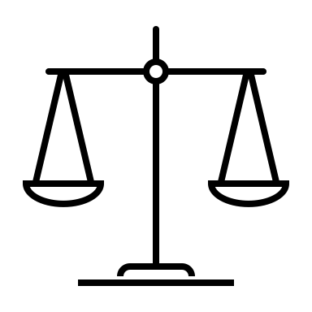
Judicial decisions

Slide 8
Philosophical reasoning
Truth is based on what you:
Think – Rene Descartes
See – David Hume
Know – Immanuel Kant
Do – Ludwig Wittgenstein
“To be is to do” – Socrates
“To do is to be” – Sartre
“Do Be Do Be Do” – Sinatra

Slide 9
What is Science?
The search for truth, based on empirical testing.
Scientific method
Propose explanatory hypothesis
Collect experimental data
Test hypothesis on the data
Natural selection
Virus mutates
Vaccines adapt
Immunity learns

Slide 10
How to represent Uncertainty?
Probability
Pr{hypothesis}
Conditional probability
Pr{hypothesis | data}
Likelihood – explain the data
Pr{data | hypothesis}

Slide 11
How to quantify Information?
Karl Popper – falsify theory
Pr{data | hypothesis} = 0
Thomas Kuhn – confirm paradigm
Pr{data | hypothesis} = 1
Thomas Bayes – posterior probability
Pr{hypothesis | data}
Alan Turing – likelihood ratio (LR)
Pr{data | hypothesis} / Pr{data | alternative}

Slide 12
California v. Lopez
Man accused of rape and murder of girlfriend’s toddler son
• Facing the death penalty, or life in prison.
• The child was 2 years and 10 months old.
• There were bruises to his face, genitals, and rectum.
• An autopsy showed brain swelling, skull fracture, cheek bruises, and asphyxia.
• A rectal swab from the boy showed semen.
• The swab matched the defendant’s DNA.

Slide 13
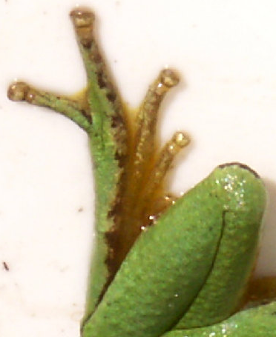
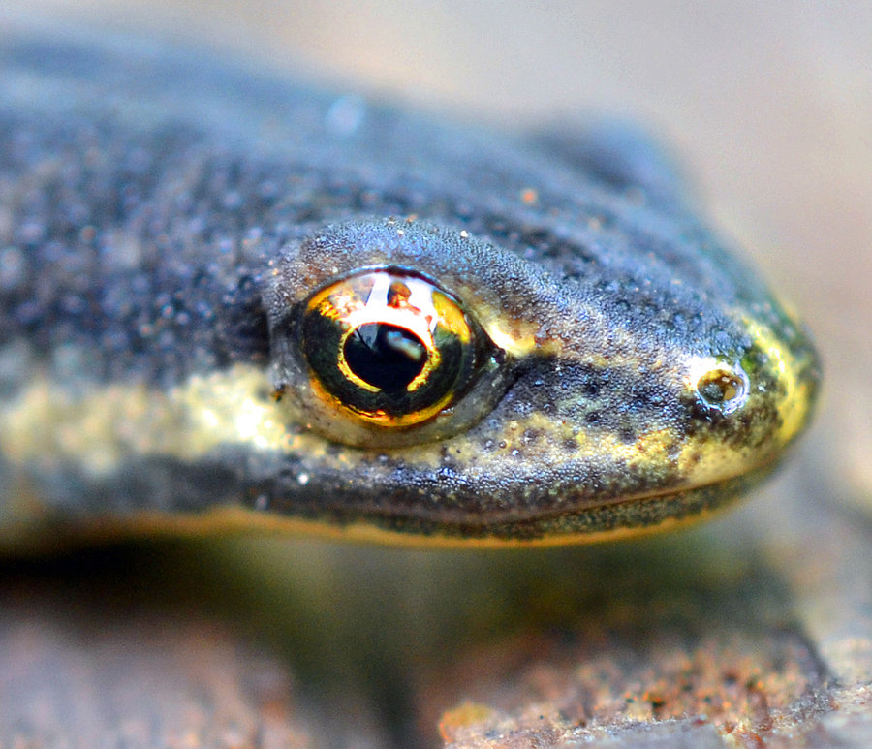

DNA mixture
eye of newt
toe of frog
Double, double toil and trouble

Slide 14
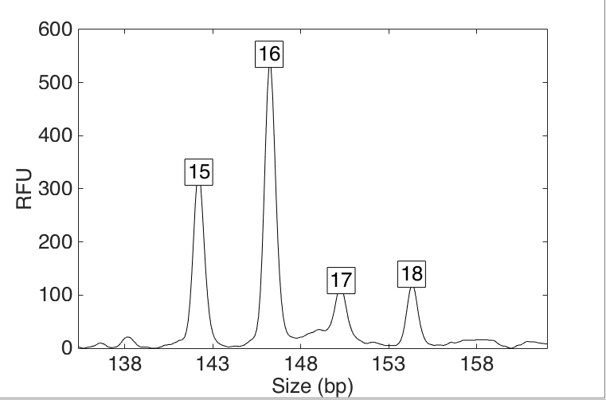
Discard peaks & heights
HUMAN REVIEW
Over threshold, peaks are labeled as allele events
All-or-none allele peaks,
each given equal status
Under threshold, alleles vanish
Threshold

Slide 15
Simplify data to interpret mixture
HUMAN REVIEW
f₁
f₂
f₃
f₄
f₅
Apply threshold to find “alleles”
Add allele frequencies (f₁ + f₂ + …)
Square sum, take reciprocal
Locus “probability of inclusion” (PI)
Multiply locus PI values
Combined (CPI, RMNE) match statistic

Slide 16
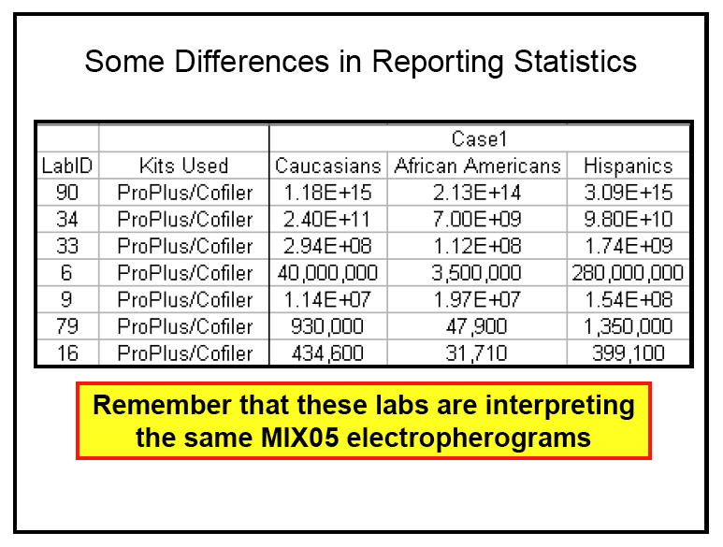
Unreliable DNA mixture statistics
HUMAN REVIEW
NIST (US Commerce Department) study in 2005
Two contributor mixture data, known victim
When not
“inconclusive”:
213 trillion (14)
31 thousand (4)
Forensic science put on notice 15 years ago

Slide 17


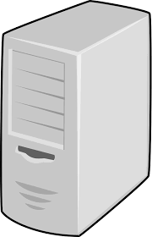


Biased DNA workflow
HUMAN REVIEW
Choose data
Person decides
Calculate statistic
• Put people in the process
• To overcome software limits
• And introduce human bias

Slide 18
NIST: Stochastic threshold
HUMAN REVIEW
Under threshold, discard the locus DNA test entirely
Stochastic
Under stochastic,
locus vanishes
Analytical

Slide 19
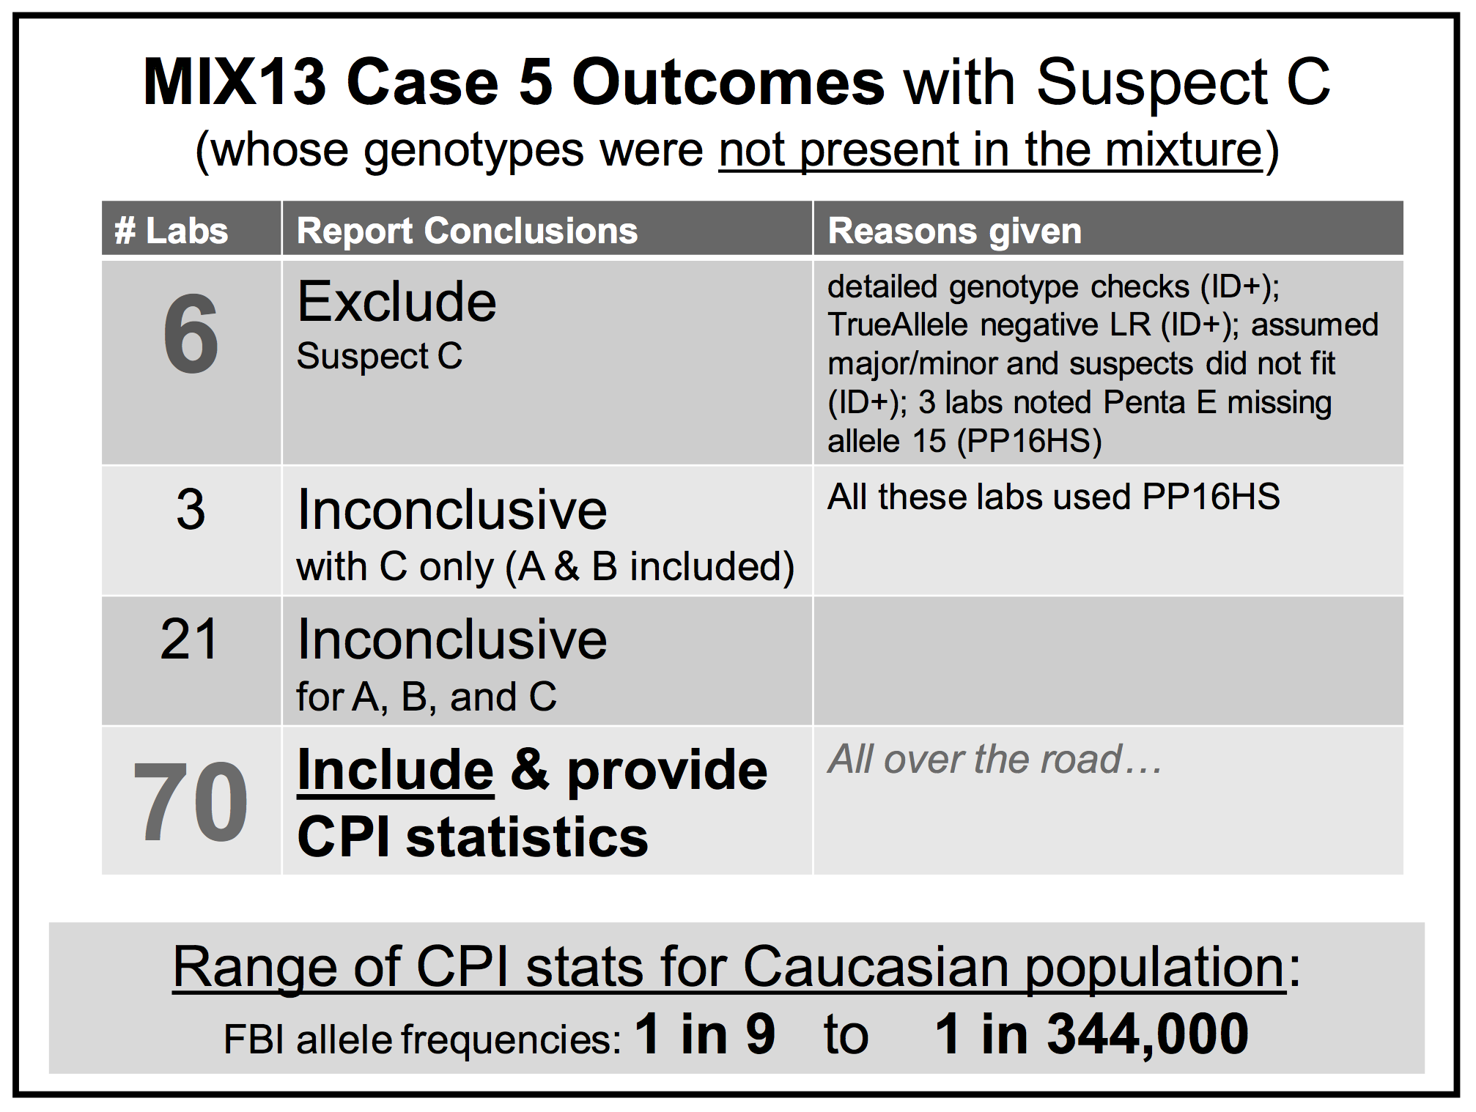
NIST: Thresholds misidentify
HUMAN REVIEW

Slide 20
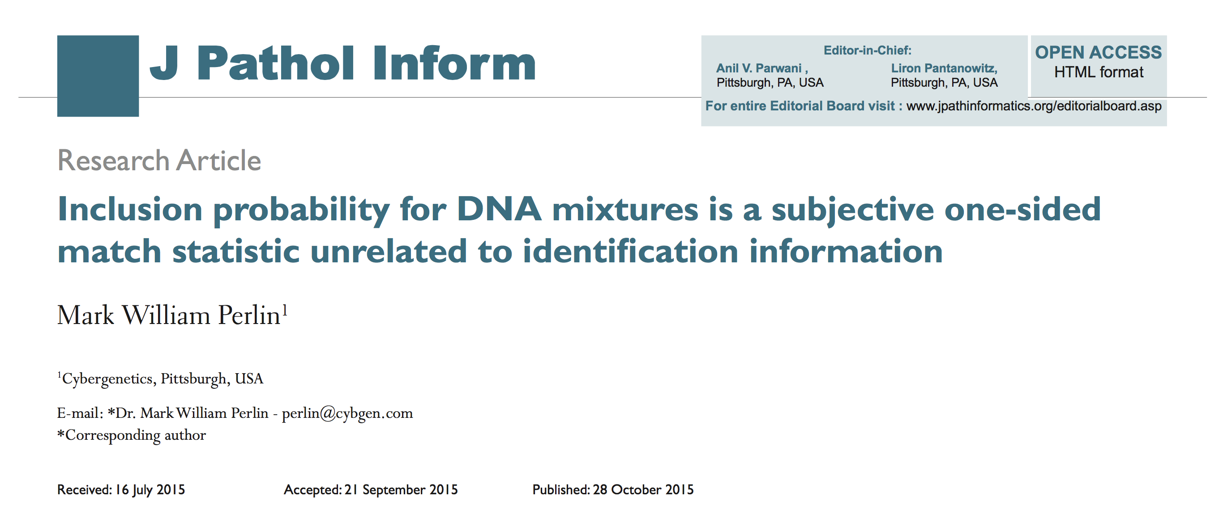
Statistics lack scientific basis
HUMAN REVIEW
CPI/RMNE just counts the number of reported loci

Slide 21
Mixture statistics shut down labs
HUMAN REVIEW
“National accreditation board suspends all DNA testing at D.C. crime lab”
The Washington Post April 27, 2015
Did not comply with FBI standards
“New protocol leads to reviews of
‘mixed DNA’ evidence”
The Texas Tribune September 12, 2015
24,468 lab tests affected

Slide 22
Manual mixture interpretation
HUMAN REVIEW
Incomplete. Discard data, apply thresholds
• Inaccurate. Disagrees with true information
• Subjective. Workflow introduces human bias
• Inoperative. Hundreds of thousands of cases
• Opaque. Choices use only some of the data
• Biased. Can only include – or give no answer
Inconclusive

Slide 23
TrueAllele® computer technology
COMPUTER REVIEW
• Complete. Use all data, no thresholds
• Accurate. 42 validation studies, 8 published
• Objective. Workflow removes human bias
• Accepted. Reported in 46 states, WTC, labs
• Transparent. Give math, software (4GB DVD)
• Neutral. Can statistically include or exclude
Informative

Slide 24
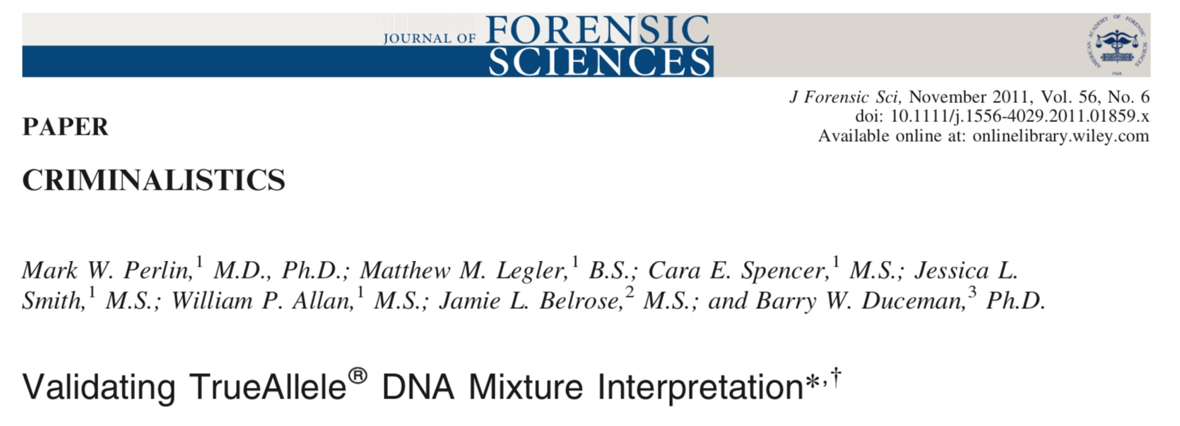
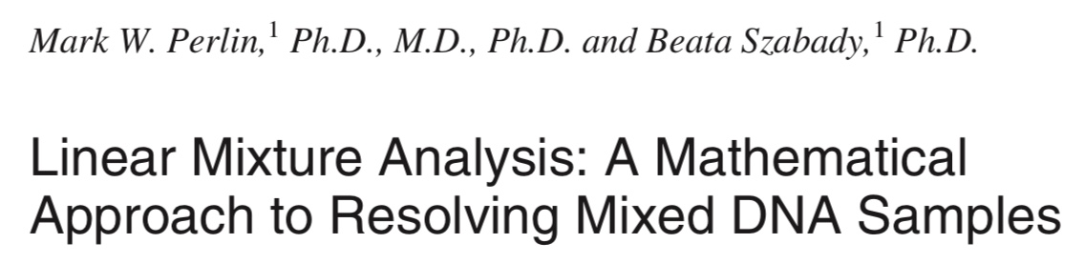
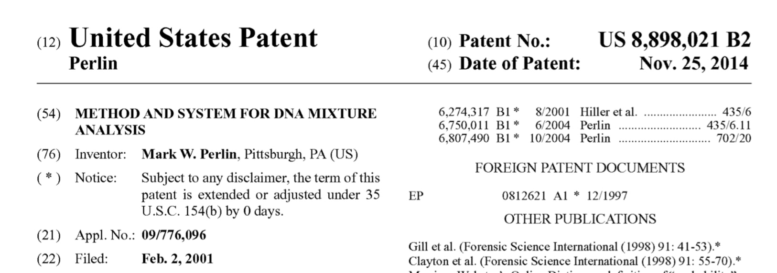
PCR variation measures identity

Slide 25
Peer-reviewed validation studies
Perlin MW, Sinelnikov A. An information gap in DNA evidence interpretation. PLoS ONE. 2009;4(12):e8327.
Ballantyne J, Hanson EK, Perlin MW. DNA mixture genotyping by probabilistic computer interpretation of binomially-sampled laser captured cell populations: Combining quantitative data for greater identification information. Science & Justice. 2013;53(2):103-114.
Perlin MW, Hornyak J, Sugimoto G, Miller K. TrueAllele® genotype identification on DNA mixtures containing up to five unknown contributors. Journal of Forensic Sciences. 2015;60(4):857-868.
Greenspoon SA, Schiermeier-Wood L, Jenkins BC. Establishing the limits of TrueAllele® Casework: a validation study. Journal of Forensic Sciences. 2015;60(5):1263-1276.
Bauer DW, Butt N, Hornyak JM, Perlin MW. Validating TrueAllele® interpretation of DNA mixtures containing up to ten unknown contributors. Journal of Forensic Sciences. 2020; 65(2):380-398.
Perlin MW, Legler MM, Spencer CE, Smith JL, Allan WP, Belrose JL, Duceman BW. Validating TrueAllele® DNA mixture interpretation. Journal of Forensic Sciences. 2011;56(6):1430-1447.
Perlin MW, Belrose JL, Duceman BW. New York State TrueAllele® Casework validation study. Journal of Forensic Sciences. 2013;58(6):1458-1466.
Perlin MW, Dormer K, Hornyak J, Schiermeier-Wood L, Greenspoon S. TrueAllele® Casework on Virginia DNA mixture evidence: computer and manual interpretation in 72 reported criminal cases. PLOS ONE. 2014;(9)3:e92837.

Slide 26
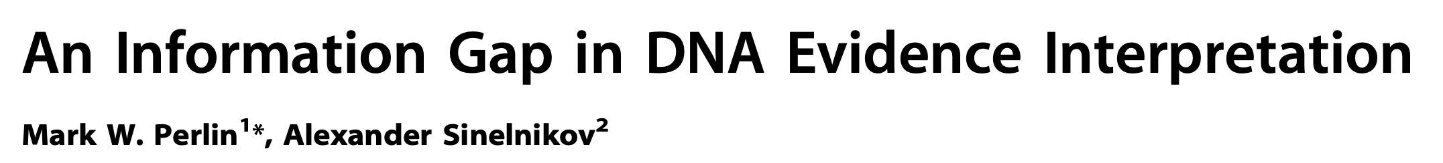

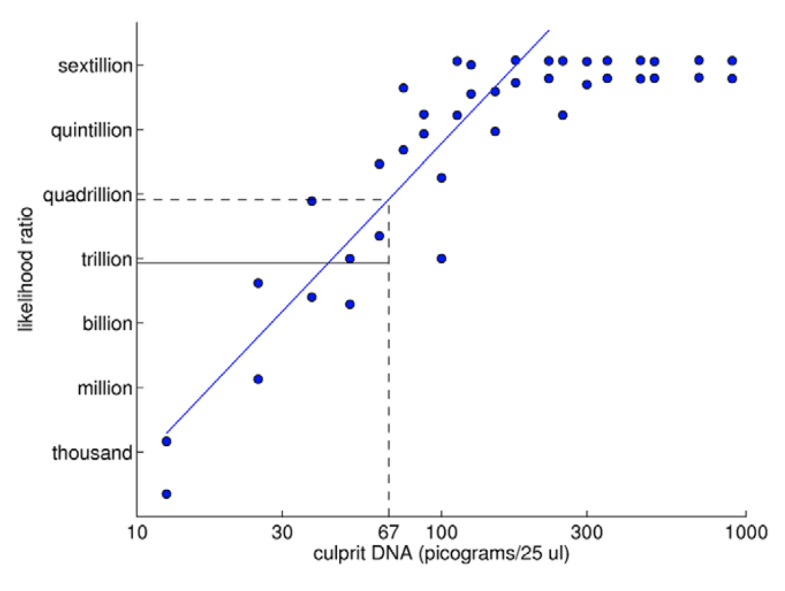
TrueAllele predictability
2009

Slide 27
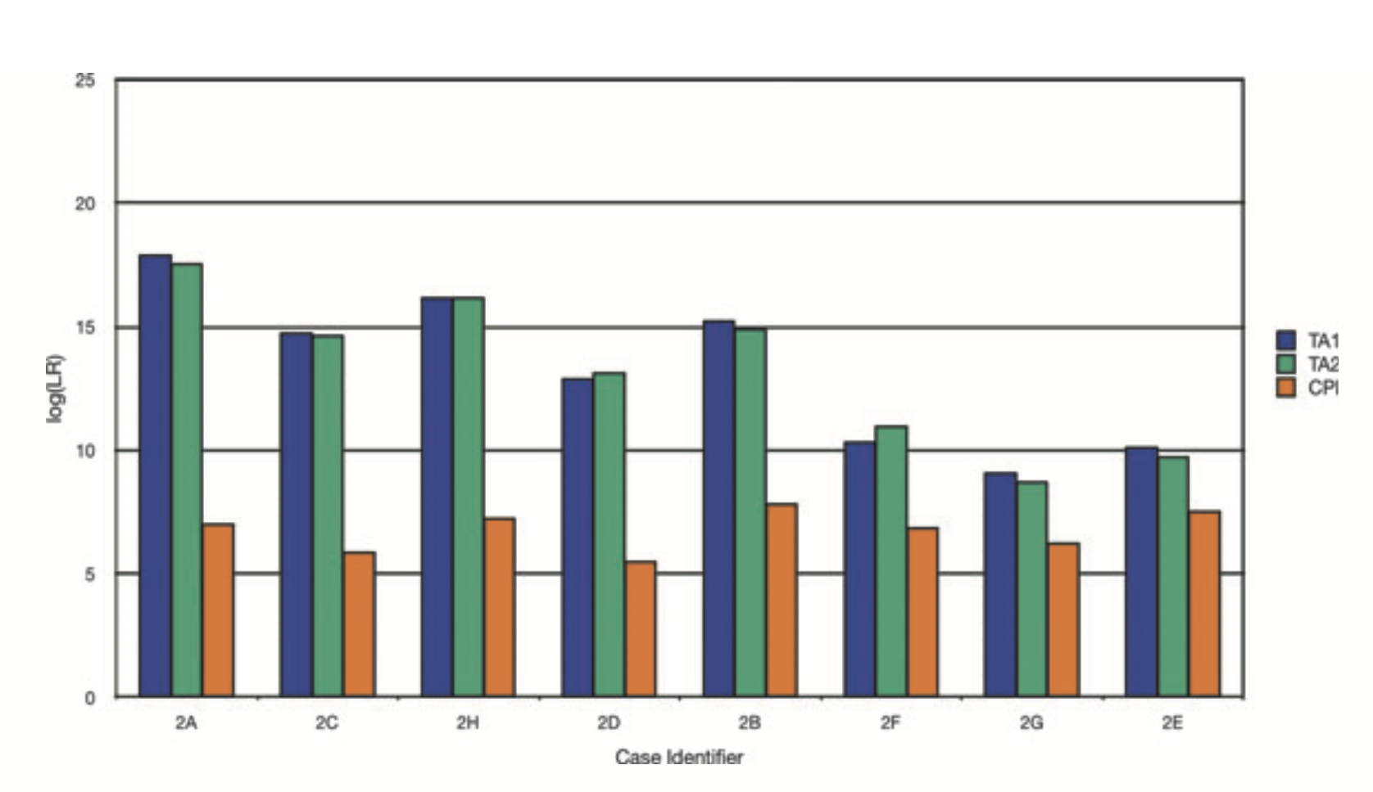

Slide 28
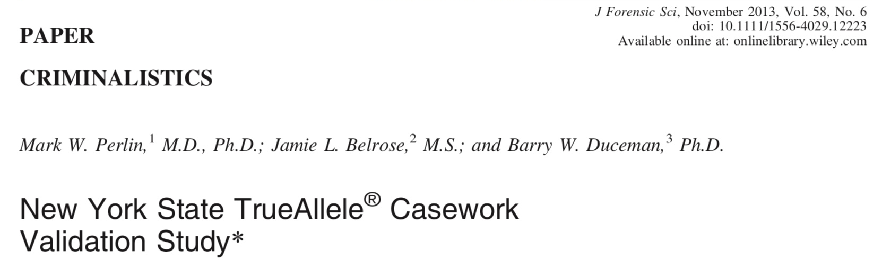
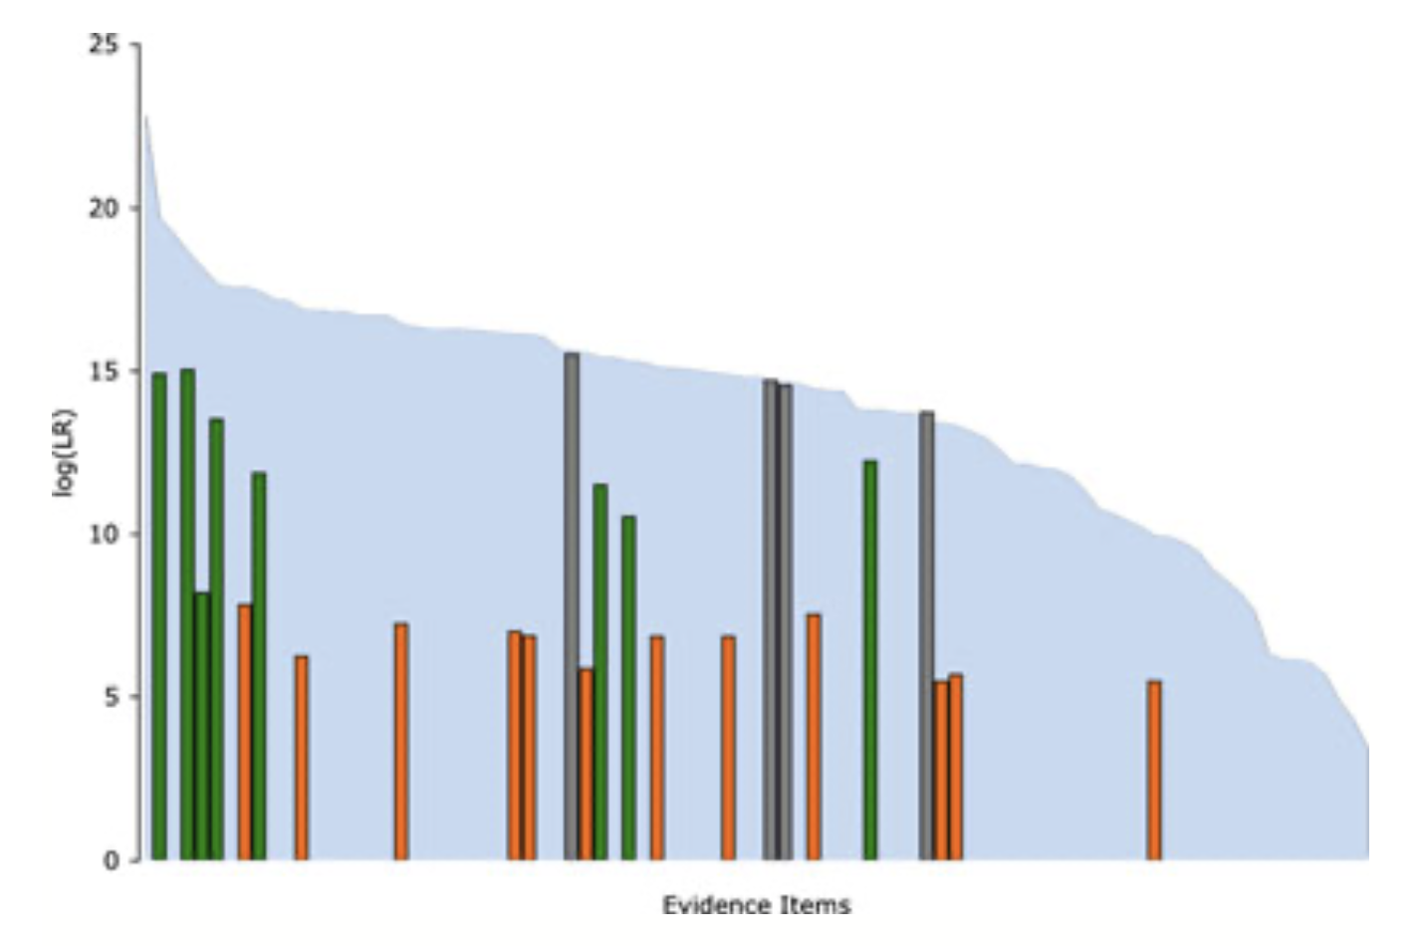

Slide 29
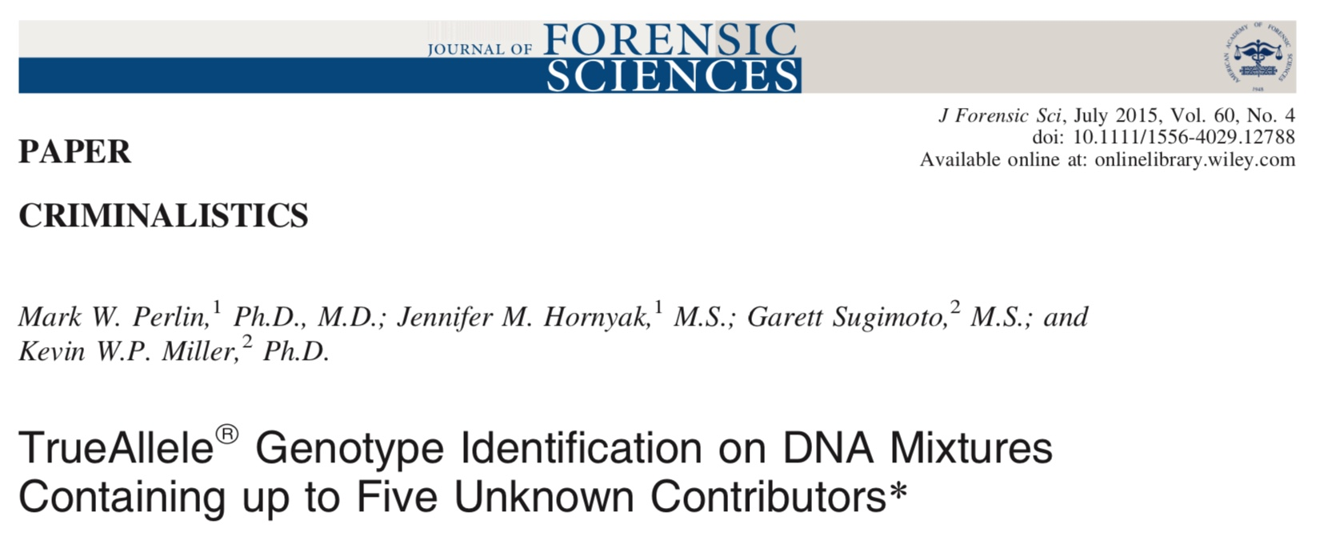
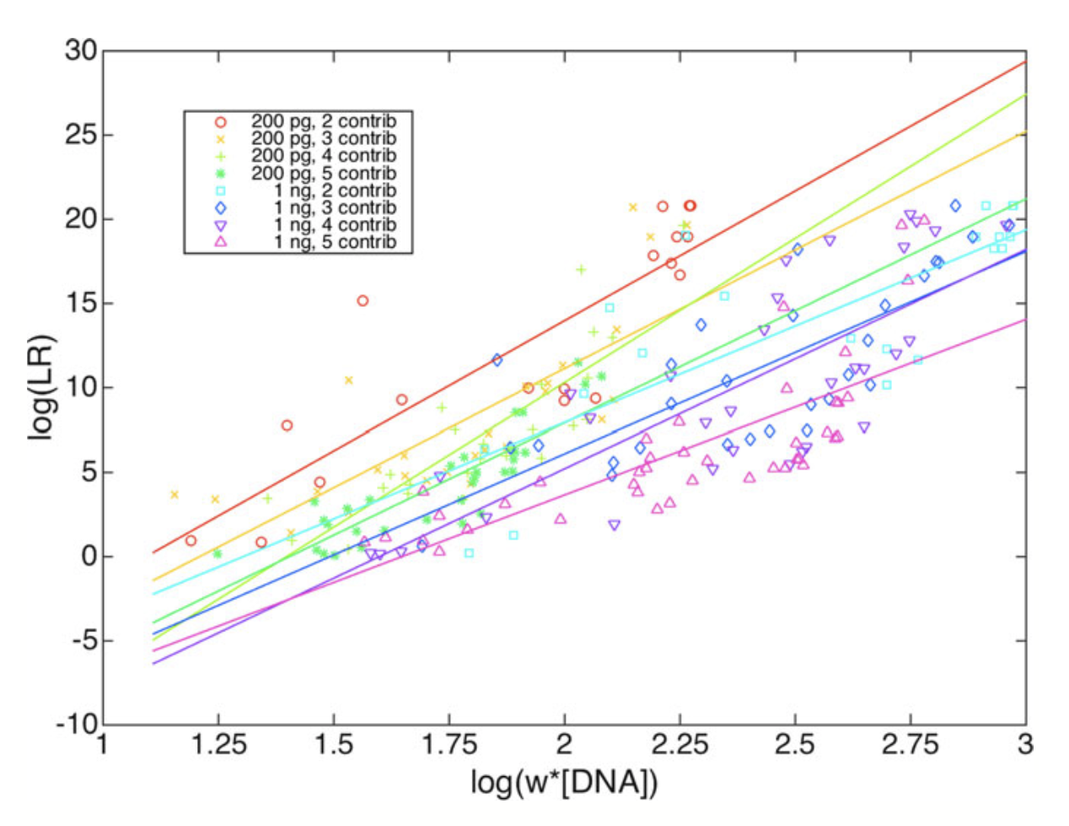

Slide 30
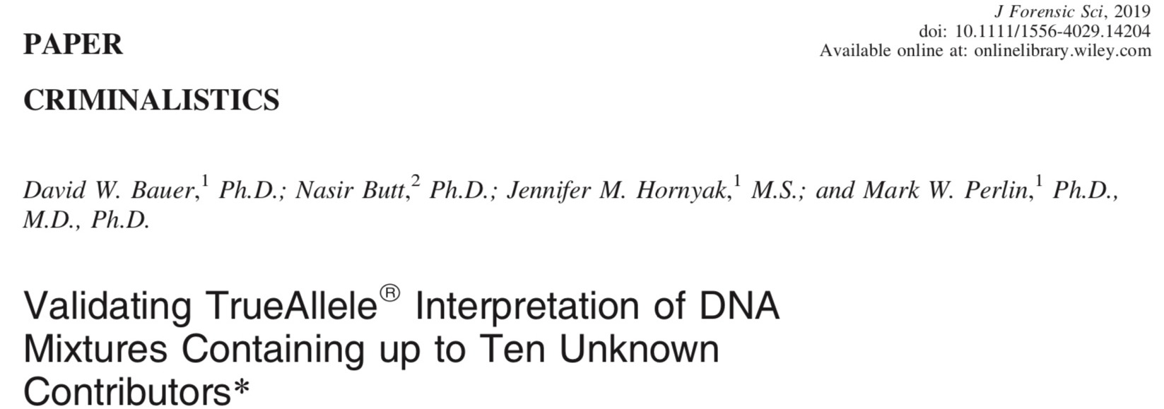
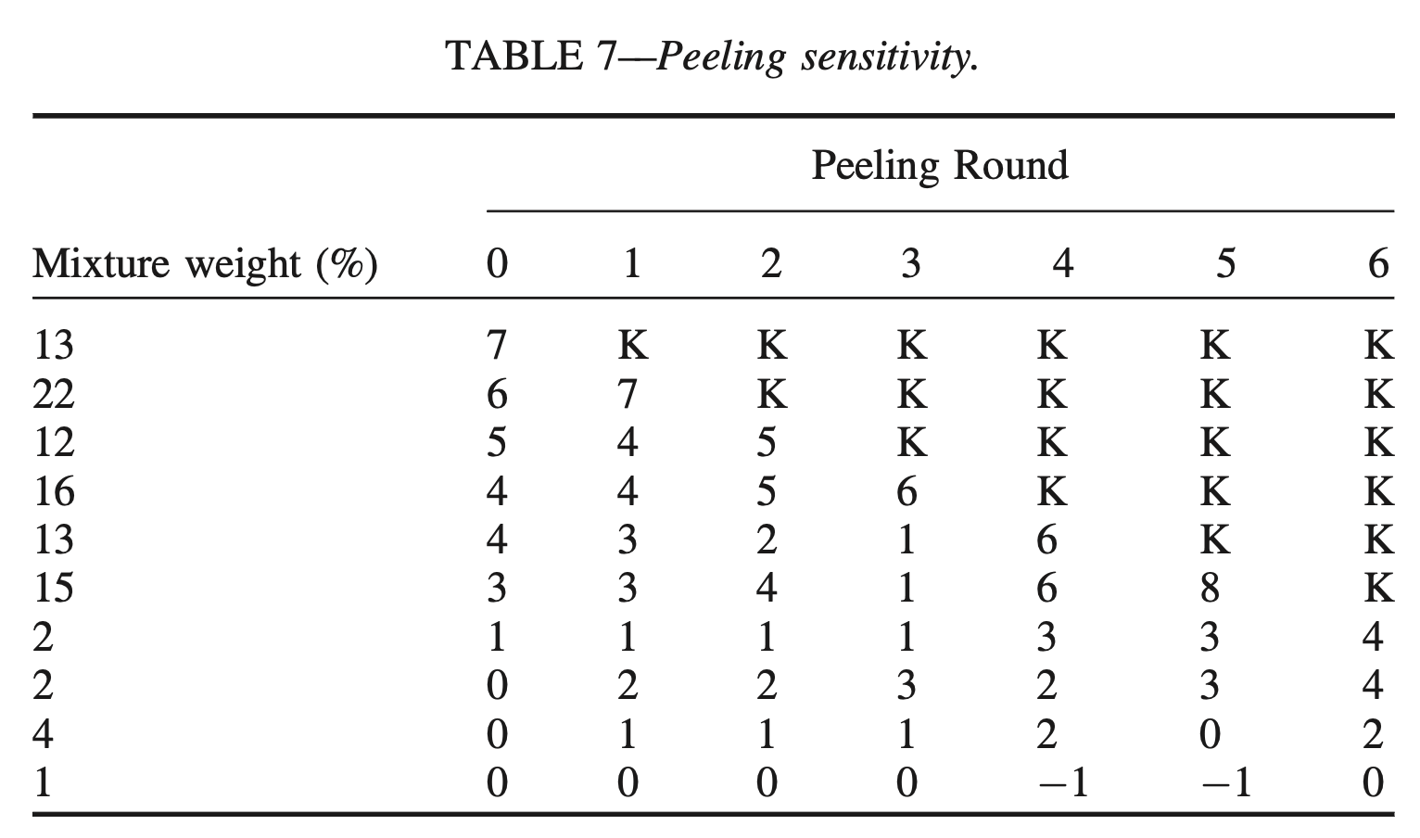
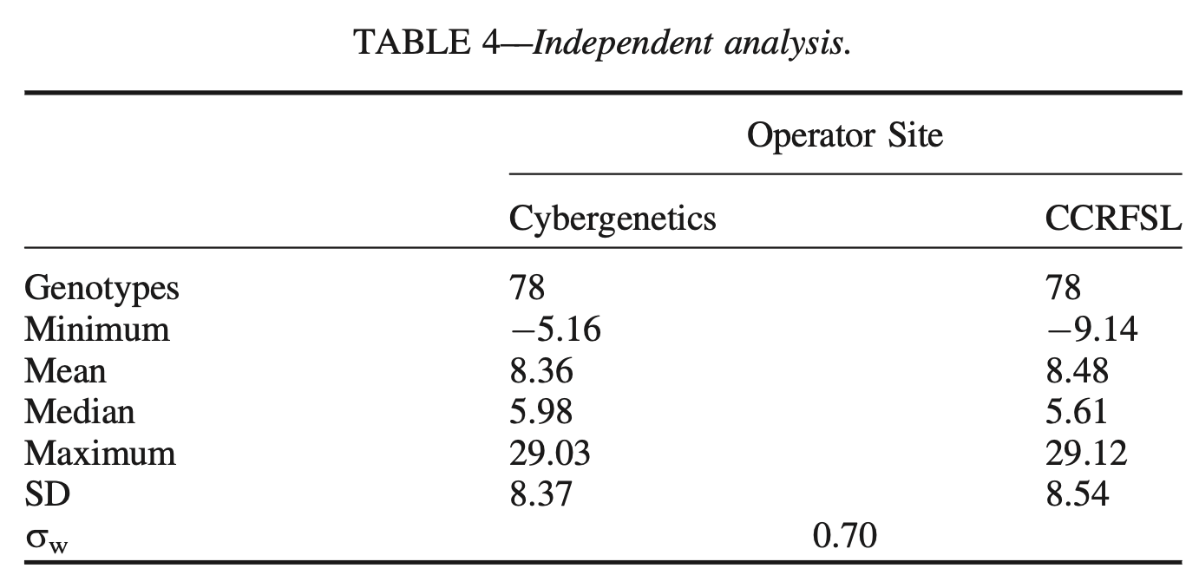

Slide 31
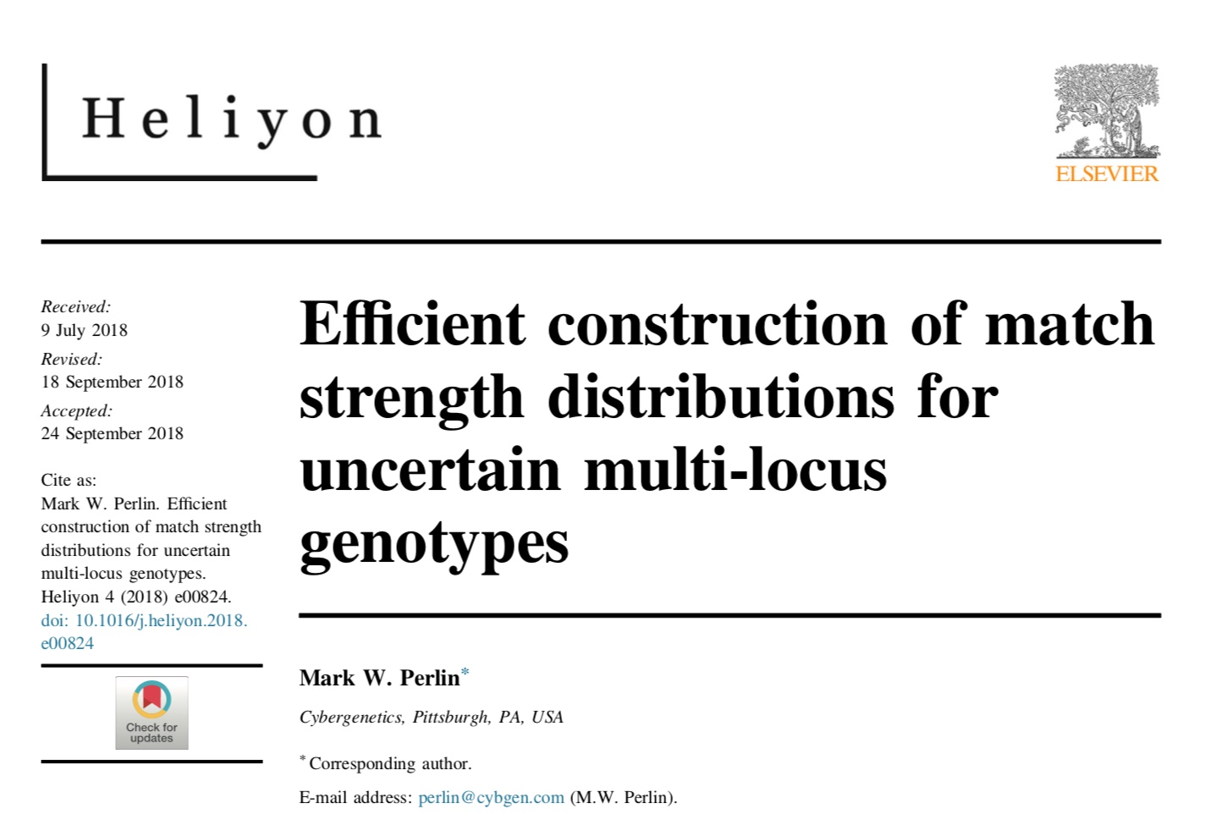
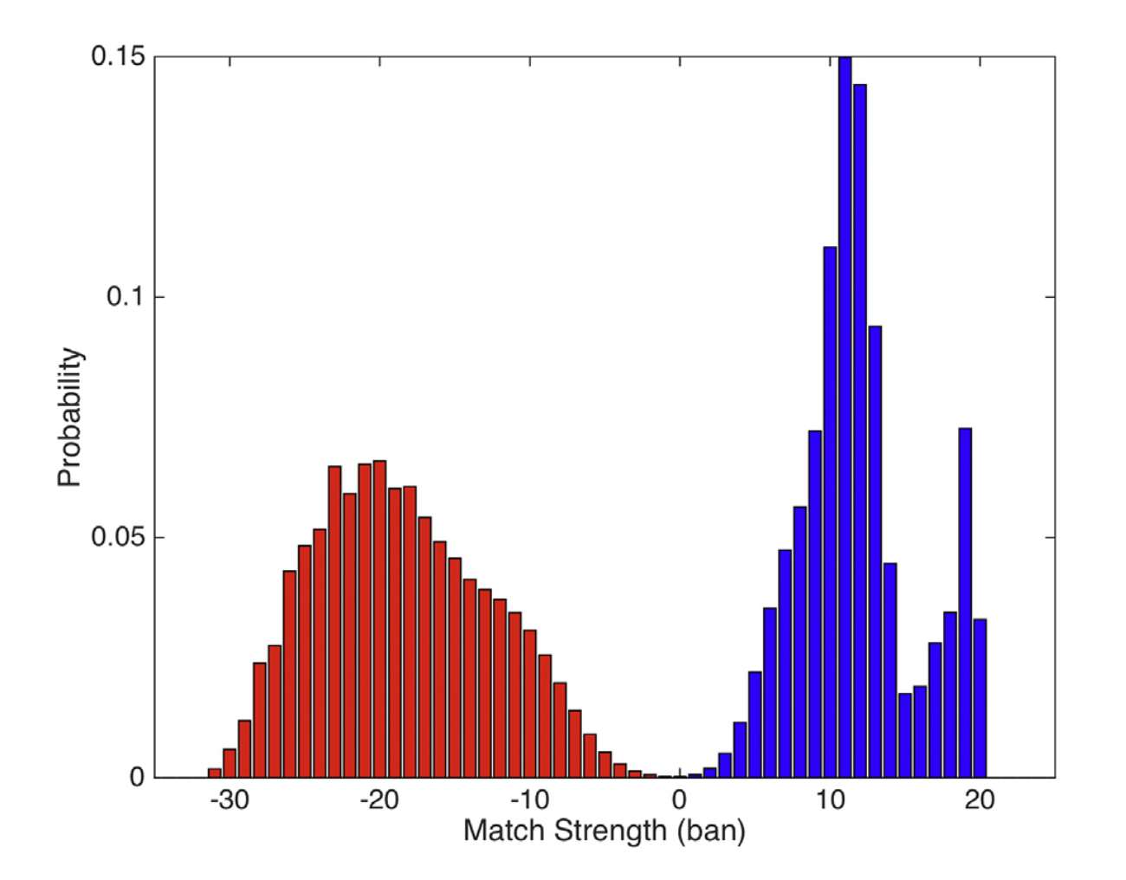
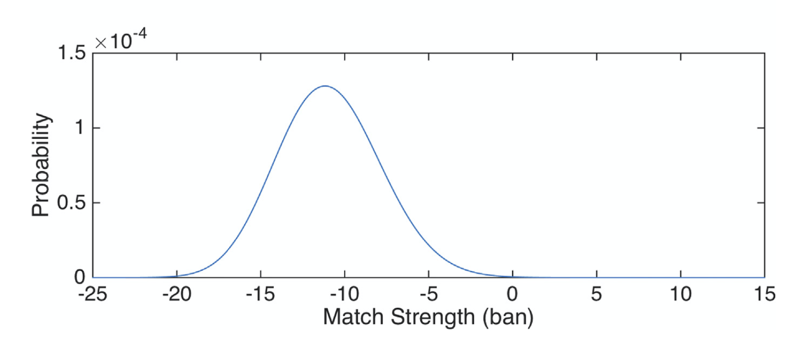
Error rates: reporting & validation

Slide 32
California v. Lopez
Man accused of rape and murder of girlfriend’s toddler son
• Facing the death penalty, or life in prison.
• The child was 2 years and 10 months old.
• There were bruises to his face, genitals, and rectum.
• An autopsy showed brain swelling, skull fracture, cheek bruises, and asphyxia.
• A rectal swab from the boy showed semen.
• The swab matched the defendant’s DNA.

Slide 33

Computer Interpretation of
Quantitative DNA Evidence
People of California v. Manuel Lopez
March, 2020
San Jose, CA
Jennifer M. Bracamontes, MS
Mark W. Perlin, PhD, MD, PhD
Cybergenetics, Pittsburgh, PA
Cybergenetics © 2003-2020

Slide 34
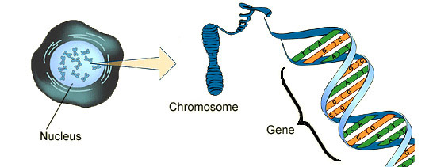
DNA biology
Cell
Chromosome
Locus
Nucleus

Slide 35

Short tandem repeat
DNA locus paragraph
Take me out to the ball game
take me out with the crowd
buy me some peanuts and Cracker Jack
I don't care if I never get back
let me
root root root root root root root root root root
for the home team,
if they don't win, it's a shame for it's one, two, three strikes, you're out
at the old ball game
23 volumes in cell's
DNA encyclopedia
"root" repeated 10 times, so
allele length is 10 repeats

Slide 36
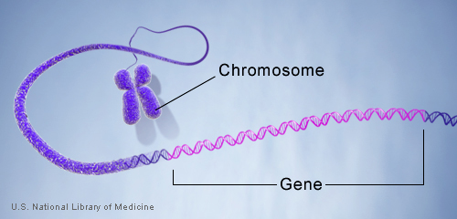
DNA genotype
A genetic locus has
two DNA sentences,
one from each parent.
An allele is the number
of repeated words.
locus
A genotype at a locus
is a pair of alleles.
mother
allele
1
2
3
4
5
6
7
8
9
10
10, 12
ACGT
repeated word
Many alleles allow for
many many allele pairs.
A person's genotype
is relatively unique.
father
allele
1
2
3
4
5
6
7
8
9
10
11
12

Slide 37
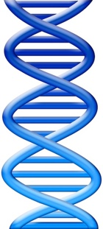
DNA evidence interpretation
Evidence item
Lab
Evidence data
Infer
Evidence genotype
10, 12
10 11 12
DNA from
one person
Compare
Known genotype
10, 12

Slide 38
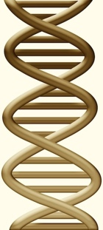
DNA mixture interpretation
Evidence item
Lab
Evidence data
Infer
Evidence genotype
10, 11 @ 20%
11, 11 @ 30%
11, 12 @ 50%
10 11 12
DNA from
two people
Compare
Known genotype
11, 12

Slide 39
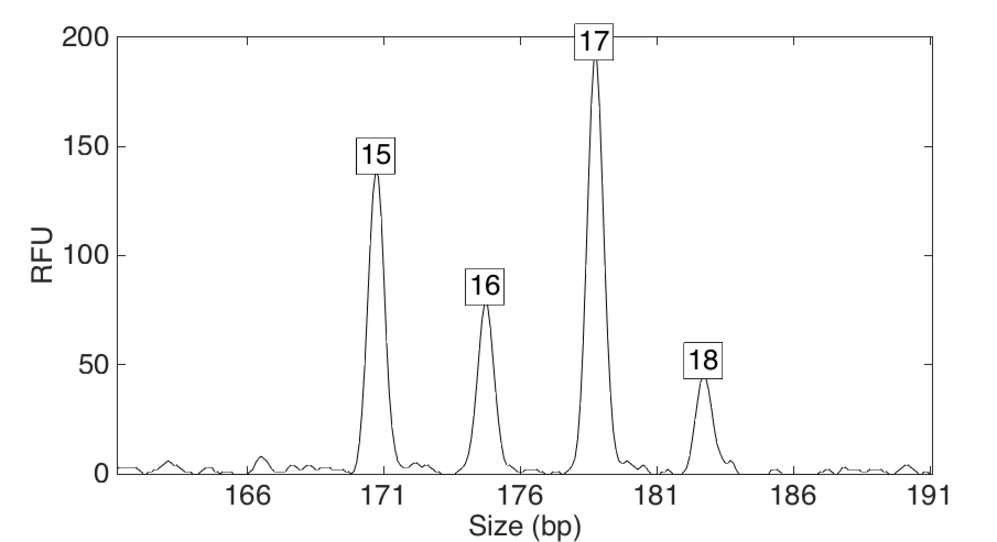
Computers can use all the data
Quantitative peak heights at locus vWA
peak size
peak
height

Slide 40
People may use less of the data
HUMAN REVIEW
Over threshold, peaks are labeled as allele events
All-or-none allele peaks,
each given equal status
Threshold
Under threshold, alleles vanish

Slide 41
How the computer thinks
COMPUTER REVIEW
Consider every possible genotype solution
Better
explanation
has a higher
likelihood
Explain the
peak pattern

Slide 42
How the computer thinks
Consider every possible genotype solution
Better
explanation
has a higher
likelihood
Explain the
peak pattern

Slide 43
How the computer thinks
Consider every possible genotype solution
Better
explanation
has a higher
likelihood
Explain the
peak pattern

Slide 44
How the computer thinks
Consider every possible genotype solution
Better
explanation
has a higher
likelihood
Explain the
peak pattern

Slide 45
How the computer thinks
Consider every possible genotype solution
Worse
explanation
has a lower
likelihood

Slide 46
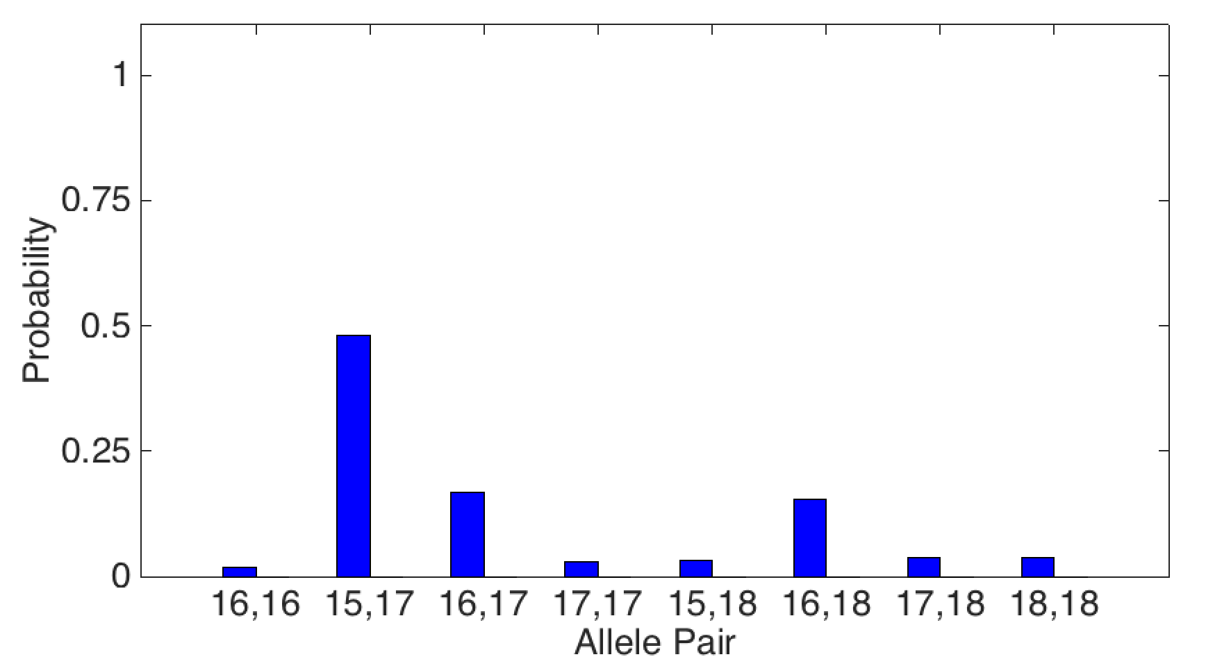
Evidence genotype
Objective genotype determined solely from the DNA data.
Never sees a comparison reference.
48%
17%
16%
2%
3%
3%
4%
4%

Slide 47
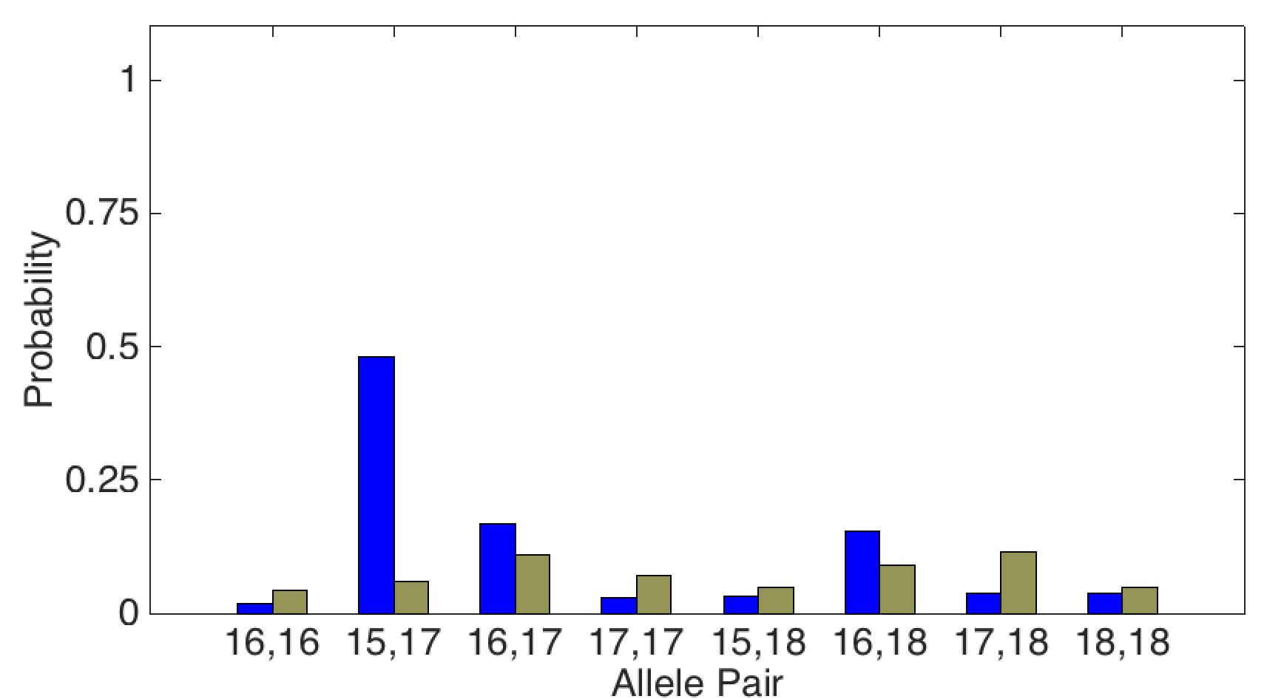
DNA match information
How much more does someone match the evidence
than a random person?
Prob(evidence match)
Prob(coincidental match)
48%
17%
16%
2%
3%
3%
4%
4%

Slide 48
DNA match information
How much more does the victim match the evidence
than a random person?
Prob(evidence match)
8x
Prob(coincidental match)
48%
6%

Slide 49
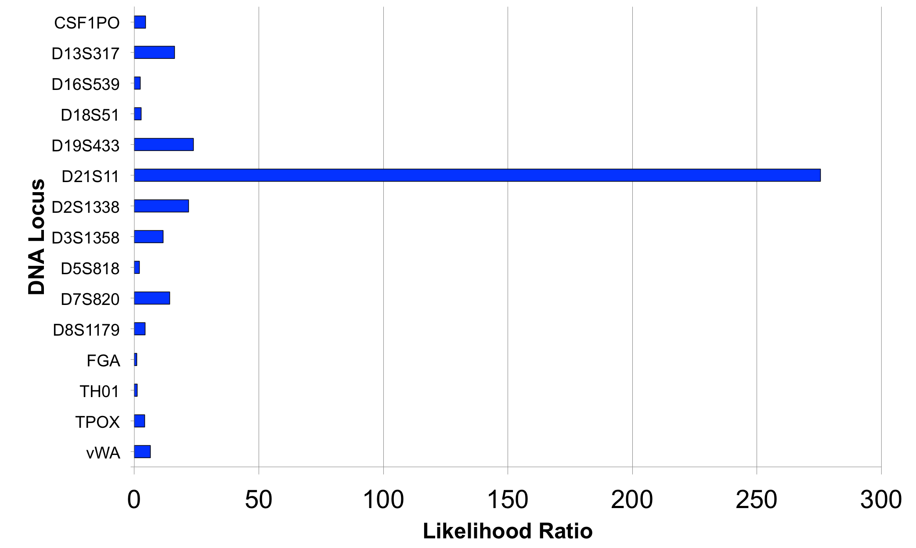
Match information at 15 loci

Slide 50
Is the victim in the evidence?
A match between the folded areas adjacent to bag knot
and Apollo Torres is:
213 trillion times more probable than
a coincidental match to an unrelated African-American person
3.09 trillion times more probable than
a coincidental match to an unrelated Caucasian person
5.08 trillion times more probable than
a coincidental match to an unrelated Southeast Hispanic person
5.15 trillion times more probable than
a coincidental match to an unrelated Southwest Hispanic person

Slide 51
Is the reference in the evidence?
A match between the folded areas adjacent to bag knot
and Arnulfo Torres Jr. is:
910 thousand times more probable than
a coincidental match to an unrelated African-American person
71.9 thousand times more probable than
a coincidental match to an unrelated Caucasian person
94.6 thousand times more probable than
a coincidental match to an unrelated Southeast Hispanic person
14.8 thousand times more probable than
a coincidental match to an unrelated Southwest Hispanic person

Slide 52
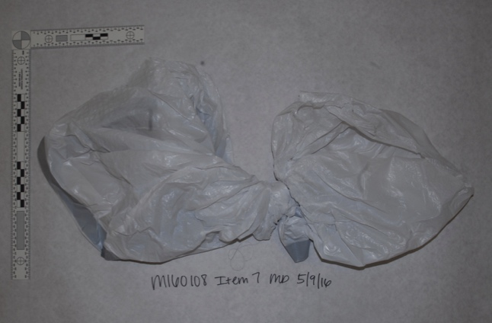
Match statistics
COMPUTER REVIEW
 |  |  | Person in
7-S2 folded areas adjacent to bag knot | 2 REF Iris Torres | X | 21A EC on 17 items | 2.62
 | 3 REF Odin Torres | X | 21D SP on 7 items | X
 | 23 Samantha Torres | X | 7B-4 SP on 8 items | X
 | 24 Manuel Lopez | X | 8C SP on 8 items | 3.42
 | 25 Arnulfo Torres Jr. | 4.17
 | 35 Apollo Torres | 12.76

Slide 53
Match statistics
COMPUTER VS. HUMAN
 |  | CYB | KRCL | SCCCL
7-S2 folded areas adjacent to bag knot | 2 REF Iris Torres | X | X
 | 3 REF Odin Torres | X
 | 23 Samantha Torres | X
 | 24 Manuel Lopez | X | X
 | 25 Arnulfo Torres Jr. | 4.17
 | 35 Apollo Torres | 12.76 | 11.53

Slide 54
Noncontributor Analysis
COMPUTER REVIEW
Perlin, M.W. “Efficient construction of match strength distributions for uncertain multi-locus genotypes.” Heliyon, 4(10):e00824, 2018.

Slide 55
Error Rate
COMPUTER REVIEW
Only 1 in 191 thousand people would match as strongly
14.8 thousand
4.17

Slide 56
Two different views
Prosecution. The defendant raped and killed a two-year old boy who lived in his house.
Defense. An abused toddler died. The defendant had nothing to do with his death.

Slide 57
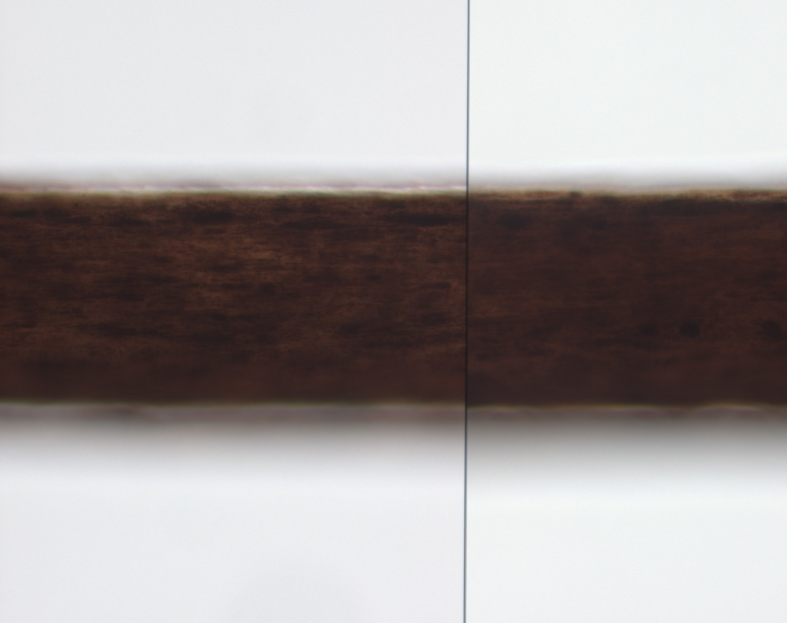
Defendant’s hair on clothes bag?
Comparing strands of hair
under a microscope
Target
Evidence

Slide 58
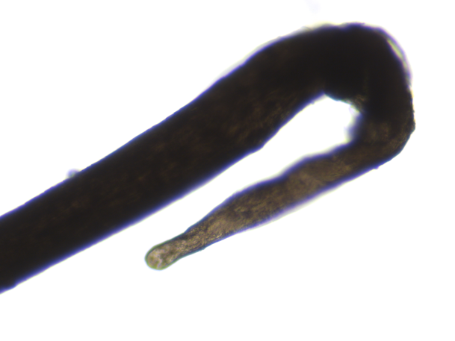
Hair match statistics (DNA,PG)
COMPUTER REVIEW
 |  |  | Person in
H1 hair root found on the bag | 2 REF Sister | X | 21A EC on 17 items | X
 | 3 REF Brother | X | 21D SP on 7 items | X
 | 23 Mother | X | 7B-4 SP on 8 items | X
 | 24 Defendant | X | 8C SP on 8 items | X
 | 25 Brother | X
 | 35 Victim | X

Slide 59
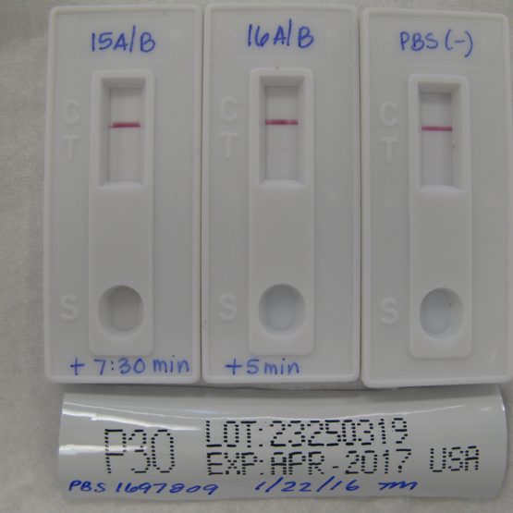
Def’s semen in victim’s rectum?
Weakly positive?
Entirely negative
p30
First in hospital
Later at autopsy

Slide 60
Rectal swabs at hospital (DNA)
COMPUTER REVIEW
 |  |  | Person in
16A/B SP first set of rectal swabs sperm fraction | 2 REF Sister | X | 21A EC on 17 items | X
 | 3 REF Brother | X | 21D SP on 7 items | X
 | 23 Mother | X | 7B-4 SP on 8 items | X
 | 24 Defendant | 3.81 | 8C SP on 8 items | X
 | 25 Brother | X
 | 35 Victim | X

Slide 61
Rectal swabs at autopsy (DNA)
COMPUTER REVIEW
 |  |  | Person in
39A/B SP second set of rectal swabs sperm fraction | 2 REF Sister | X | 21A EC on 17 items | X
 | 3 REF Brother | X | 21D SP on 7 items | X
 | 23 Mother | X | 7B-4 SP on 8 items | X
 | 24 Defendant | X | 8C SP on 8 items | X
 | 25 Brother | X
 | 35 Victim | 2.79

Slide 62
Def’s sperm on victim’s penis?
One cell seen
“How many cells must an analyst see
before they can call it semen?”

Slide 63
Penile swabs (STR)
COMPUTER REVIEW
 |  |  | Person in
38A/B SP second set of penile swabs sperm fraction | 2 REF Sister | X | 21A EC on 17 items | X
 | 3 REF Brother | X | 21D SP on 7 items | X
 | 23 Mother | X | 7B-4 SP on 8 items | X
 | 24 Defendant | X | 8C SP on 8 items | X
 | 25 Brother | X
 | 35 Victim | 7.57
Y-STR positive

Slide 64
Forensic DNA evidence
Crime Laboratory
STR analyzed 97 evidence items
Reported 43 matches
Discovered 1 unknown person
Cybergenetics
Processed 77 items using TrueAllele®
Reported 138 matches
Discovered 5 unknown people

Slide 65
Targeted DNA – manual review
CPI/RMNE just counts how many loci an analyst reported

Slide 66
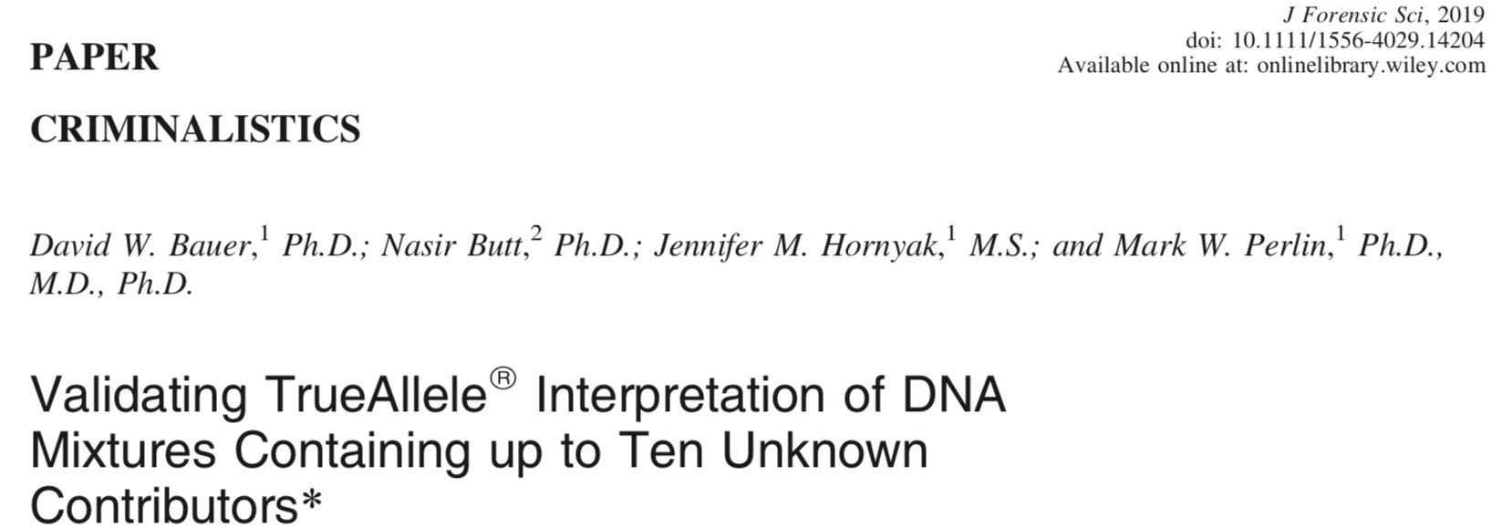
Untargeted DNA
computer review

Slide 67
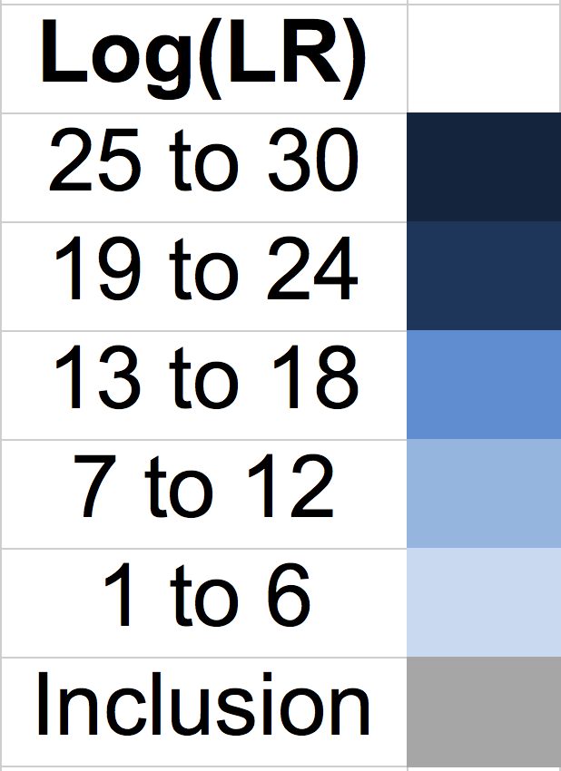
Crime lab vs. TrueAllele
information comparison
First 3 charts
County Crime Lab
Manual review
Second 3 charts Cybergenetics TrueAllele PG

Slide 68
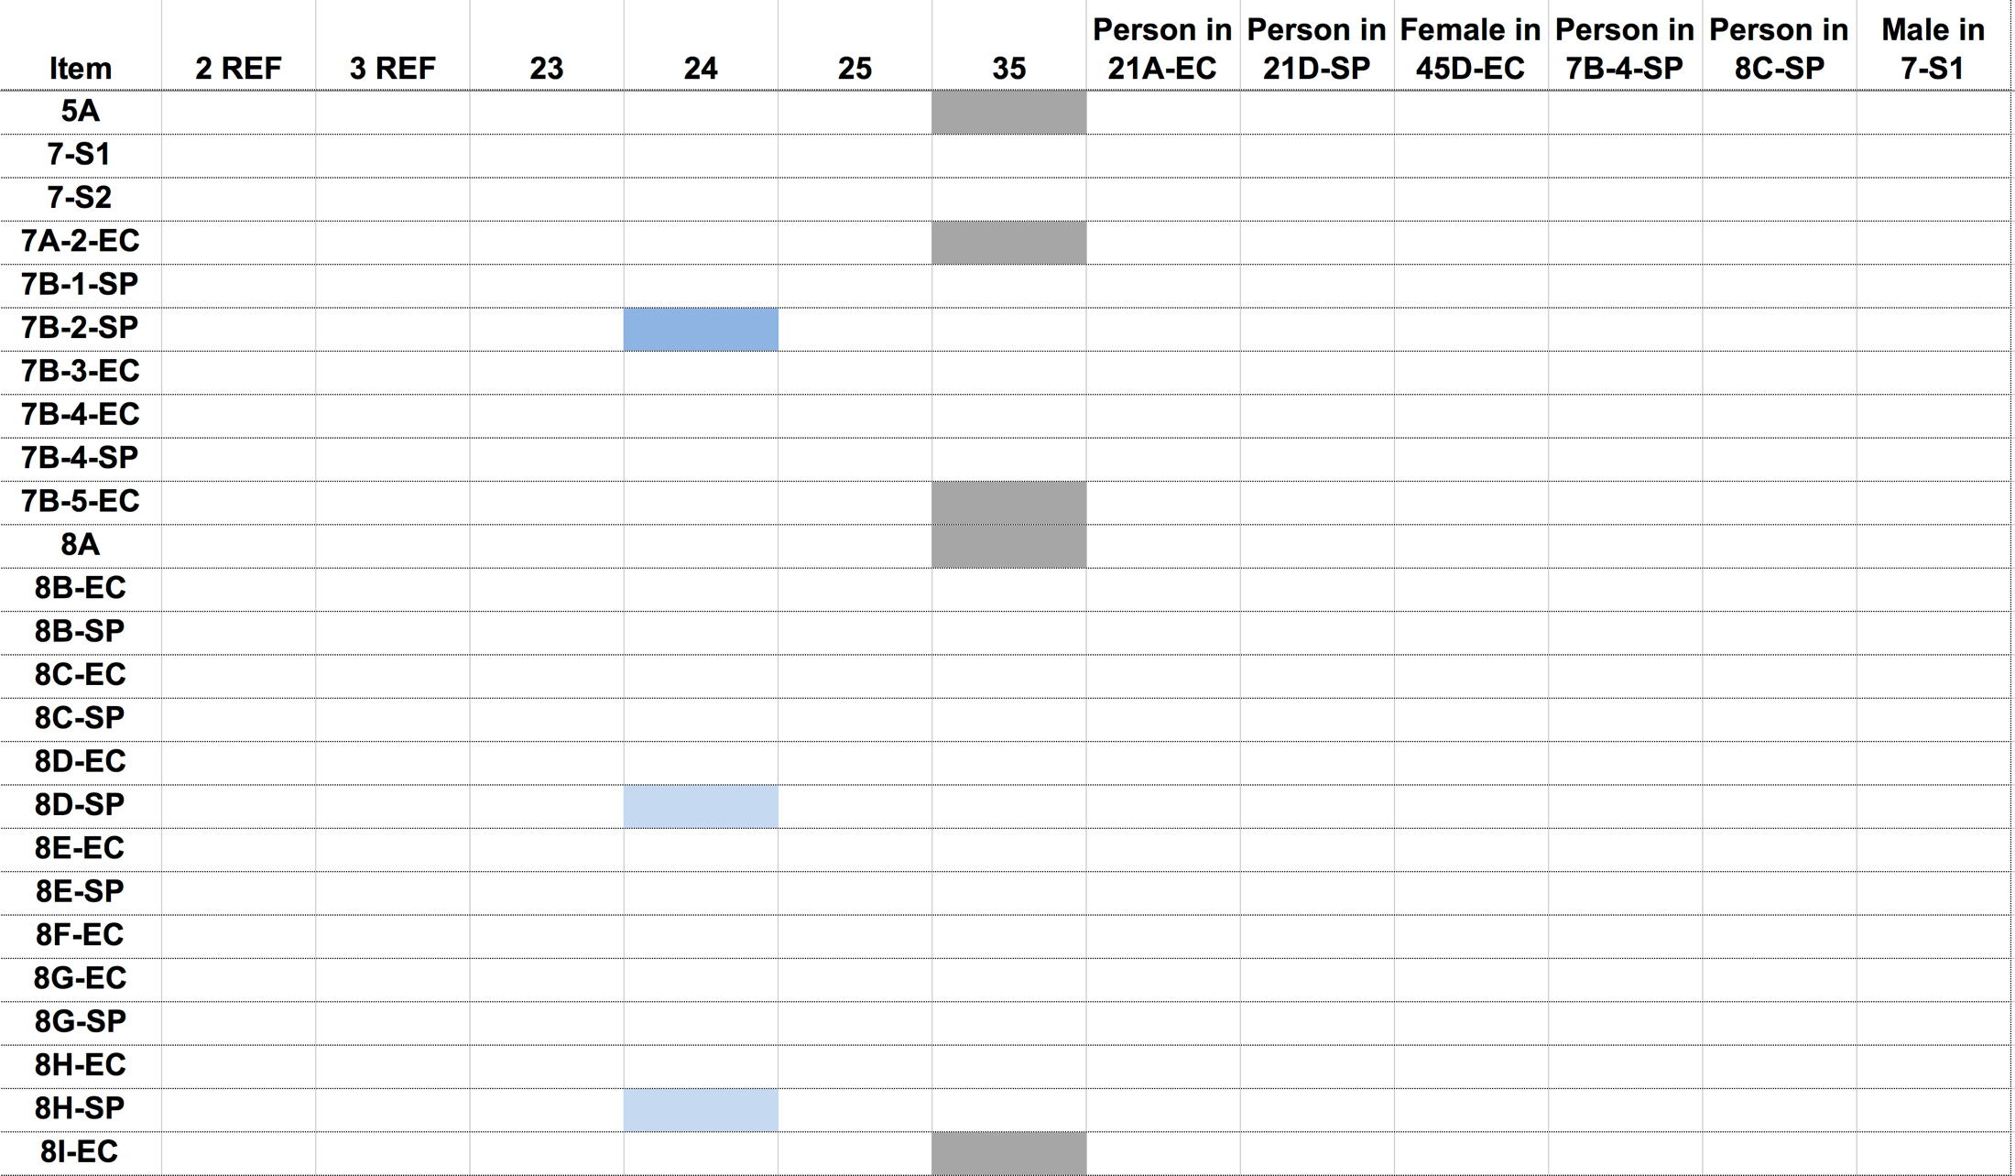
County Crime Lab (1 of 3)
Sister
Brother
Mother
Defendant
Brother
Victim

Slide 69
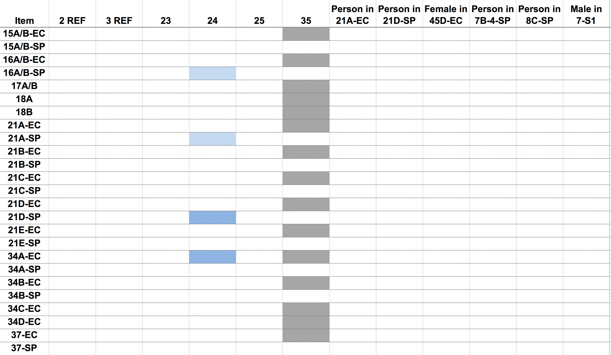
County Crime Lab (2 of 3)
Sister
Brother
Mother
Defendant
Brother
Victim

Slide 70
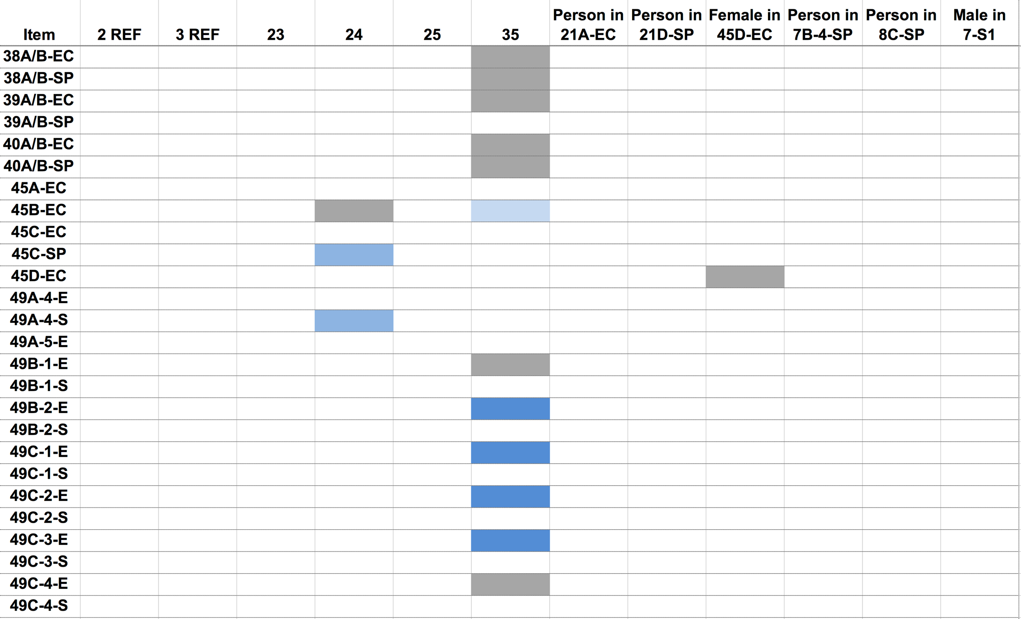
County Crime Lab (3 of 3)
Sister
Brother
Mother
Defendant
Brother
Victim

Slide 71

Cybergenetics TrueAllele (1 of 3)
Sister
Brother
Mother
Defendant
Brother
Victim

Slide 72

Cybergenetics TrueAllele (2 of 3)
Sister
Brother
Mother
Defendant
Brother
Victim

Slide 73

Cybergenetics TrueAllele (3 of 3)
Sister
Brother
Mother
Defendant
Brother
Victim

Slide 74
Two strange puzzles
• Where’s Mom’s DNA?
Lots of different people left lots of DNA,
but the primary caretaker left none.
• Rectal DNA conflict
Why was the defendant’s DNA found
in the initial hospital rectal swabs (Item 16),
but not later at autopsy (Item 39)?

Slide 75
Two different views
Same DNA evidence, different conclusions
Prosecution. The forensic evidence shows that the defendant raped and killed the two-year old boy who lived in his house.
Defense. An abused toddler died. The forensic evidence shows that the defendant had nothing to do with his death.
Confirmation bias
Assume H, conclude H.
Assume ~H, conclude ~H.

Slide 76










The prosecution sees crime
Forensics proves guilt; defendant’s DNA is everywhere

Slide 77





The defense sees no criminal
Lots of people’s DNA in a messy dirty spermy house

Slide 78

Where’s Mom’s DNA?
Q Did you and the defendant have sex that night?
Mother Just a blow job.
Q Did he ejaculate inside your mouth?
A Yeah.
Q What did you do after that?
A Went and cleaned myself off.
Q What did you clean yourself up with?
A Baby wipes.
Q And then what did you do with the baby wipes afterwards?
A Threw them away.
Q Where did you throw the baby wipes away?
A I don't remember if I threw them in the trash can in my bedroom or if I threw them in the restroom trash.

Slide 79

Mother’s DNA masked
Her hands were covered in defendant’s semen
The child was in toilet training.
The child’s primary caregiver had
the defendant’s semen on her hands.
Swamping her own DNA as she attended to her child.
Which is why we couldn’t detect her DNA.
The mother was spreading the defendant’s semen:
from her hands, to baby wipes, to garbage bags,
and whatever she touched – like to her child.
There was no probative value in this expected DNA.

Slide 80
Rectal DNA conflict
Q And in this particular investigation at the hospital, did you collect DNA swabbing from the victim’s anus?
Pathologist Yes, sir.
Q And how did you do that?
A The same way we did for his genitals. Swabs were broken from a sterile package, sterile water was applied. I would place the swabs around the skin of anus in a circular manner, insert an inch to two inches, pull them out, and then they would have been handed off to law enforcement.
Q Okay. So you never stuck the swab into the rectum or into the anus more than two inches?
A Right. The beginning part of the anus and rectum is sufficient.

Slide 81
Rectal/anal cleaning swab
At the hospital. The mother had transferred the defendant’s semen from her hands to the toddler’s bottom. The first pathologist swabbed his anus, cleaning the external (anal) semen onto the swab. Before the swab was rectally inserted, the so-called “rectal swab” already contained external (anal) semen.
At the autopsy. The toddler’s bottom had been cleaned by the first hospital swabbing. No more external (anal) semen; and there never was any internal (rectal) semen. So the second “rectal swab” was devoid of DNA. No external semen to collect.
Misleading terminology: “anal/rectal” swab, not “rectal” swab.

Slide 82
Final verdict
The prosecution was target-driven.
The defense was nontarget-driven.
Forensic experts educated the jury.
The nontargeted scenario better explained the evidence.
The jury acquitted the defendant of all charges.
The county no longer seeks the death penalty.

Slide 83

Crime labs don’t use all DNA data
HUMAN REVIEW
all-or-none
1+1 = 1
threshold
Threshold

Slide 84

Wolfe sisters homicide
On February 6, 2014, Susan Wolfe (44)
and her younger sister Sarah (38, left)
were killed in their East Liberty home in Pittsburgh.

Slide 85
Crime lab didn’t use all DNA data
HUMAN REVIEW
Over threshold, peaks are labeled as allele events
All-or-none allele peaks,
each given equal status
Under threshold, alleles vanish
Threshold

Slide 86
Pennsylvania v. Allen Wade
Thresholds failed to interpret most DNA mixtures
Hat No conclusions
Cup Insufficient data
Fingernails Contamination, insufficient data
Gear shift Insufficient data
Seat lever Cannot be excluded
Knit hat Insufficient data
Sock Too complex, no conclusions

Slide 87
Computers can use all the data
COMPUTER REVIEW
Quantitative peaks at locus vWA
pattern
height
variation

Slide 88
How the computer thinks
Propose genotype solutions
Explain the
peak pattern

Slide 89
How the computer thinks
Add together contributor genotypes
Better
explanation
has a higher
likelihood

Slide 90
How the computer thinks
Consider every possible genotype solution
Explain the
peak pattern
Better
explanation
has a higher
likelihood

Slide 91

Evidence genotype
Objective genotype determined solely from the DNA data.
Never sees a comparison reference.
55%
24%
15%
5%

Slide 92

DNA match information
How much more does the suspect match the evidence
than a random person?
11x
Prob(evidence match)
55%
Prob(coincidental match)
5%

Slide 93

Match information at 15 loci

Slide 94
Is the suspect in the evidence?
A match between the right fingernails
and Allen Wade is:
6.06 trillion times more probable than
a coincidental match to an unrelated Black person
32.5 trillion times more probable than
a coincidental match to an unrelated Caucasian person
8 trillion times more probable than
a coincidental match to an unrelated Hispanic person

Slide 95
Pennsylvania v. Allen Wade
The crime lab reported 5 DNA mixture matches
TrueAllele found 17 matches on the same data
Hat 65.3 thousand Allen Wade
Cup 20.5 thousand Susan Wolfe
Fingernails 6.06 trillion Allen Wade
Gear shift 9.37 million Sarah Wolfe
Seat lever 385 billion Sarah Wolfe
Knit hat 25.7 thousand Allen Wade
Sock 300 Sarah Wolfe

Slide 96
Allen Wade Found Guilty On All Counts In East Liberty Sisters’ Slaying
CBS News, May 23, 2016
PITTSBURGH (KDKA/AP)
• A man accused of killing two sisters who lived next door to him in East Liberty has been found guilty on all counts.
• Allen Wade was accused of shooting Sarah and Susan Wolfe after they returned from work on Feb. 6, 2014, apparently to steal a bank card.
• On Monday morning, a jury found Wade guilty of first-degree murder, robbery, burglary and theft by unlawful taking.

Slide 97

Pennsylvania v. Allen Wade
HUMAN REVIEW
Thresholds failed to interpret DNA mixture
TrueAllele succeeded on the same data
A hat left from a burglary of the Wolfe sister’s home
six weeks before the murder matched
Allen Wade with a 65.3 thousand statistic
Preventable Crime

Slide 98
No information from mixture
HUMAN REVIEW
Crime laboratory DNA report
Crime lab user fee: $5,000
Conclusions:
Item 1 – Swab of textured areas from a handgun
The data indicates that DNA from four (4) or more contributors was obtained from the swab of the handgun. Due to the complexity of the data, no conclusions can be made regarding persons A and B as possible contributors to this mixture.

Slide 99



Computer reanalysis
COMPUTER REVIEW
Cybergenetics TrueAllele report
Match statistics provide information
Person A
excluded
Contributor
Unmix the
mixture
1
2
400,000
3
Person B
included
4

Slide 100
TrueAllele today
Invented math & algorithms | 25 years
Developed computer systems | 20 years
Support users and workflow | 10 laboratories
Routinely used in casework | 400 agencies
Validate system reliability | 42 studies
Educate the community | 100 talks
Train or certify analysts | 800 students
Admissibility challenges | 37 rulings, 15 states and federal
Testify about LR results | 110 trials
Educate lawyers and public | 1,000 people
Make the ideas understandable | 1,100 cases, 46 states

Slide 101


More information
http://www.cybgen.com/information
• Courses
• Newsletters
• Newsroom
• Presentations
• Publications
• Webinars
http://www.youtube.com/user/TrueAllele
TrueAllele YouTube channel
info@cybgen.com

