Slide 1

Identifying Victim Remains Using Kinship Genotype Inference
American Academy of Forensic Sciences Criminalistics Section
February 2023
Orlando, FL
William Allan, MS
Mark Perlin, PhD, MD, PhD
Cybergenetics © 2003-2023

Slide 2
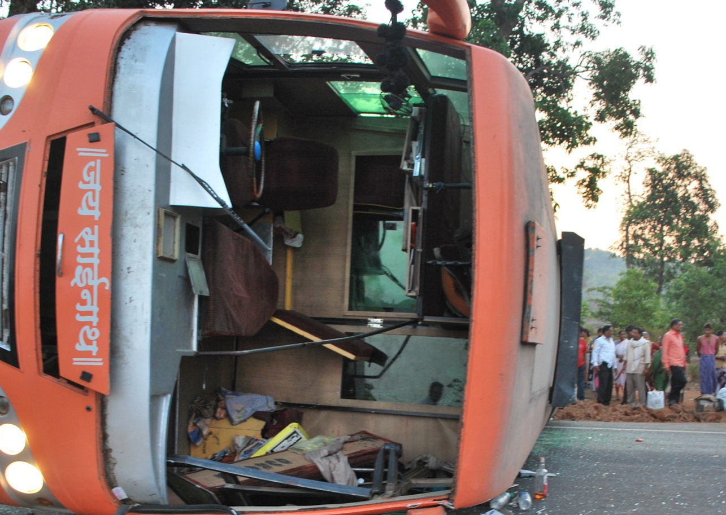
Bus Crash
2008 bus crash in Komatipoort, South Africa
Police recover burned victim remains
Relatives submit DNA to help identify remains
Lab was not able to identify victim remains

Slide 3
Victim Remains
Victim Remains
AO0553E AO0554E AO0555E AO0556E AO0557E AO0558E AO0559E AO0560E AO0561E AO0562E AO0563E AO0564E AO0565E AO0566E AO0567E

Slide 4
Relatives of Missing People
Sample | Relation
AP2438C AP2439C AP2440C AP2441C AP2442C AP2443C AP2444C AP2445C AP2446C AP2447C AP2448C AP2449C AP2450C AP2451C AP2452C AP2455C | Grandfather Daughter Son Mother Son Sister Father Son Unknown Brother Brother Sister Mother Son Father Son

Slide 5
Task: Find DNA Matches
Sample | Relation
AP2438C AP2439C AP2440C AP2441C AP2442C AP2443C AP2444C AP2445C AP2446C AP2447C AP2448C AP2449C AP2450C AP2451C AP2452C AP2455C | Grandfather Daughter Son Mother Son Sister Father Son Unknown Brother Brother Sister Mother Son Father Son
Victim Remains
AO0553E AO0554E AO0555E AO0556E AO0557E AO0558E AO0559E AO0560E AO0561E AO0562E AO0563E AO0564E AO0565E AO0566E AO0567E

Slide 6
Kinship
Relations
paternal
grandfather
paternal
grandmother
maternal grandfather
maternal grandmother
father
mother
sibling1
sibling2
missing
spouse
child1
child2
child3

Slide 7
Crime Lab – No Results
 | 11 | 12
10
11 |  | 11 12

Slide 8
Crime Lab – No Results
 | 11 | 12
10
11 |  | 11 12
 | ? | ?
?
? |  | 11 12

Slide 9
The TrueAllele Approach
Computer automation:
Reference genotypes
Kinship genotypes
Comparison
Match Statistics

Slide 10
Genotype Matching
Family
AP2441C
Victim Remain
AO0563E
3.36
father
mother
missing

Slide 11
Identification Results
 | Relations of missing persons
Victim remains | AP2439C | AP2440C | AP2441C | AP2442C | AP2444C | AP2445C | AP2446C_3 | AP2451C | AP2455C
AO0553E
AO0554E |  |  |  |  |  |  | 4.45
AO0555E |  |  |  |  |  |  |  | 1.88
AO0556E |  |  |  | 5.03
AO0557E |  |  |  |  |  | 3.57
AO0558E
AO0559E |  |  |  |  |  |  |  |  | 2.95
AO0560E
AO0561E |  |  |  |  | 2.34
AO0562E
AO0563E |  |  | 3.36
AO0564E
AO0565E
AO0566E | 4.03
AO0567E |  | 2.25

Slide 12
Matches TrueAllele Found
Sample | Relation
AP2438C AP2439C AP2440C AP2441C AP2442C AP2443C AP2444C AP2445C AP2446C AP2447C AP2448C AP2449C AP2450C AP2451C AP2452C AP2455C | Grandfather Daughter Son Mother Son Sister Father Son Unknown Brother Brother Sister Mother Son Father Son
Victim Remains
AO0553E AO0554E AO0555E AO0556E AO0557E AO0558E AO0559E AO0560E AO0561E AO0562E AO0563E AO0564E AO0565E AO0566E AO0567E

Slide 13
Matches TrueAllele Found
Sample | Relation
AP2438C AP2439C AP2440C AP2441C AP2442C AP2443C AP2444C AP2445C AP2446C AP2447C AP2448C AP2449C AP2450C AP2451C AP2452C AP2455C | Grandfather Daughter Son Mother Son Sister Father Son Unknown Brother Brother Sister Mother Son Father Son
Victim Remains
AO0553E AO0554E AO0555E AO0556E AO0557E AO0558E AO0559E AO0560E AO0561E AO0562E AO0563E AO0564E AO0565E AO0566E AO0567E

Slide 14

You Can Solve it Too

Slide 15
Student Exercise
1 TrueAllele database server
12 interpretation processors
20 students (3rd training day)
Task: have each student use TrueAllele to identify the victim remains

Slide 16
Student Exercise
15 victim items
16 family items
16 family references
15 victim genotypes
16 family genotypes
16 kinship genotypes
15 victim genotypes x 16 kinship genotypes = 240 genotype comparisons
240 comparisons x 20 students = 4,800 total comparisons
before lunch: | students upload genotypes
during lunch: | TrueAllele solves the problems
after lunch: | students review identification results

Slide 17
Conclusions
TrueAllele identifies victim remains
using kinship genotype inference.
The TrueAllele approach is:
Automated
Informative
Easy to use

