Slide 1
Making Something Out of Nothing: the “Inconclusive” Fallacy
American Academy of Forensic Sciences
Jurisprudence Section
February, 2022
Seattle, WA
Kelley Kulick¹, JD; Mark Perlin², PhD, MD, PhD
¹Santa Clara County Public Defender, California
²Cybergenetics Corp, Pennsylvania
Cybergenetics © 2003-2022

Slide 2
Nothing comes of nothing
"You can’t get something for nothing"
– First Law of Thermodynamics
"0 + 0 = 0"
– Peano Postulates of Natural Numbers
"Nothing will come of nothing"
– King Lear, Act I, William Shakespeare

Slide 3
No evidence implies guilt?
Some lawyers argue:
1. Absence of forensic evidence implies guilt.
2. “Inconclusive” DNA evidence means the
defendant is included in the DNA evidence.
Fallacious, wrong & dangerous!

Slide 4
Inconclusive, so not excluded…
“Due to the potential number of contributors and low-level results, no conclusions will be made regarding this DNA profile.”
“Due to the limited amount of information obtained, the comparison between defendant and this DNA mixture is inconclusive.”

Slide 5
Defendant must be included!
Inconclusive
Not Excluded
Guilty

Slide 6
Must “include” or “exclude”?
Misapplication of The Law of the Excluded Middle
Included
Inconclusive
Excluded

Slide 7
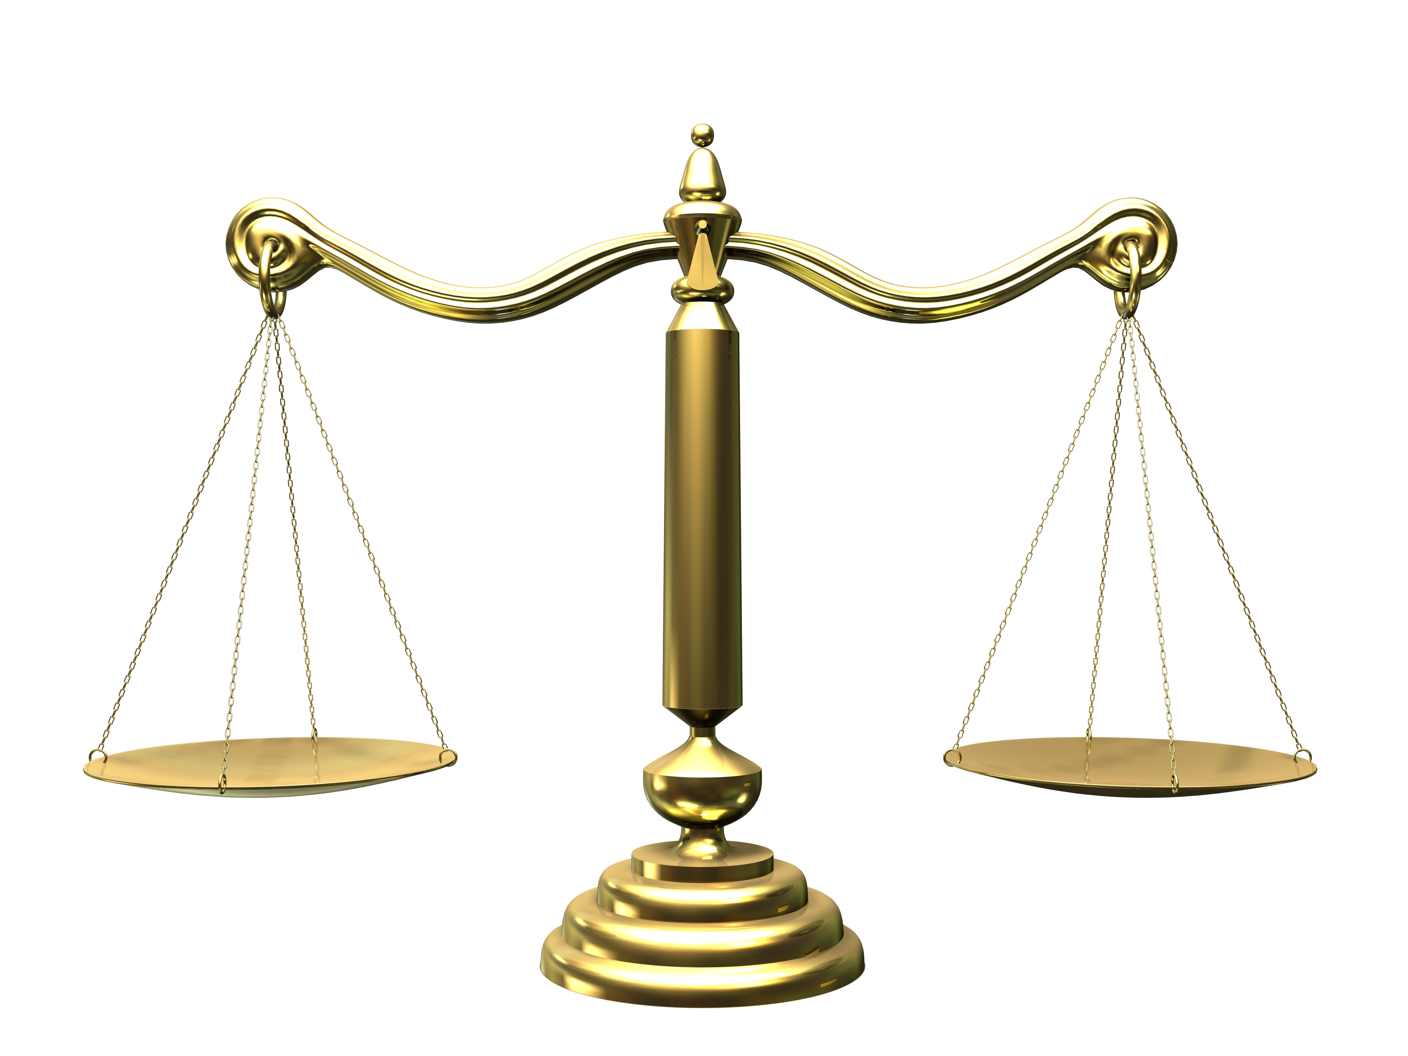
Information from DNA evidence
Hypothesis: Defendant is included in DNA
Alternative: Defendant is excluded from DNA
Evidence support
for included
hypothesis
=
Evidence support
for excluded
alternative
Data support for ”included” and “excluded” are equal
likelihood ratio (LR) equals one

Slide 8
Zero stat, zero information
logarithm of LR measures information
likelihood ratio (LR) equals one
log(one) equals zero
evidence has zero information
There is zero information about inclusion or exclusion.
Zero is NOT a positive log(LR) supporting inclusion.
Zero is NOT a negative log(LR) supporting exclusion.
A zero log(LR) means zero information.

Slide 9
Informative DNA goes unreported
Many crime labs apply thresholds to LR values.
Inclusionary LR of 1000
Exclusionary LR of 1 in 1000
Inconclusive
Discarding scientific information
opens the door for legal mischief.

Slide 10
Error rates enable reporting
Report an error rate that provides a frequency context*
“What’s the chance that someone
who didn’t leave their DNA
would have a match statistic as strong?”
Error rates help prevent the unscientific transformation
of informative DNA evidence into inconclusive results.
* Perlin, M.W. Heliyon, 4(10):e00824, 2018.
Efficient construction of match strength distributions
for uncertain multi-locus genotypes

Slide 11
“Inconclusive” isn’t admissible
FRE Rule 401 – Evidence is relevant if:
it has any tendency to make a fact more or less probable than it would be without the evidence; and
the fact is of consequence in determining the action.
FRE Rule 403 – The court may exclude relevant evidence if its probative value is substantially outweighed by a danger of one or more of the following: unfair prejudice, confusing the issues, misleading the jury, undue delay, wasting time, or needlessly presenting cumulative evidence.

Slide 12
“Inconclusive” fallacy
Unreported forensic evidence
No scientific information
If not “included” then “excluded”
Nothing forensical implies
something nonsensical
Defendants convicted by
nonexistent “forensic evidence”

Slide 13
Criminal Cases

Slide 14
Ethical implications
General Electric Company v. Joiner (1997) 522 U.S. 136
Kumho Tire Company, Ltd. v. Carmichael
(1999) 526 US 137

Slide 15
How to counter the fallacy
Motions to exclude the presentation of inconclusive results (FRE 401, 403, 702)
Motions to limit expert testimony
Presentation of expert testimony to counter fallacy and/or admit LRs with error rates
Motions to preclude fallacious arguments during closings

Slide 16
Conclusions
• Nothing comes of nothing
• Zero information means zero evidence
• Trying to make something from nothing
• No scientific basis for argument
• Always report DNA match statistics
• “Inconclusive” evidence is inadmissible
• Better science leads to better justice
Counter the “inconclusive” fallacy

