Slide 1


Human factors in automated forensic DNA examination
Expert Working Group on Human Factors
in Forensic DNA Interpretation:
Probabilistic Genotype Software
National Institute of Standards and Technology
National Institute of Justice
January 2021
Mark W Perlin, PhD, MD, PhD
Cybergenetics
Pittsburgh, PA
Cybergenetics © 2003-2021

Slide 2
Working group questions
How DNA complexity affects understanding and communication
Explaining probabilistic genotyping results to a jury
Validating a probabilistic genotyping system
Selecting DNA samples in a validation study
When do computers outperform a human analyst
How the LR depends on reference database assumptions
Any ‘manufacturer’s warnings’ for TrueAllele crime labs
Automatic genotype comparison with contamination databases

Slide 3
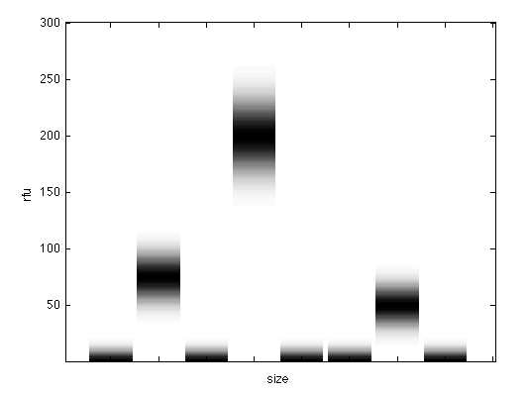
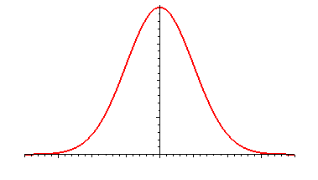
PCR introduces randomness

Slide 4
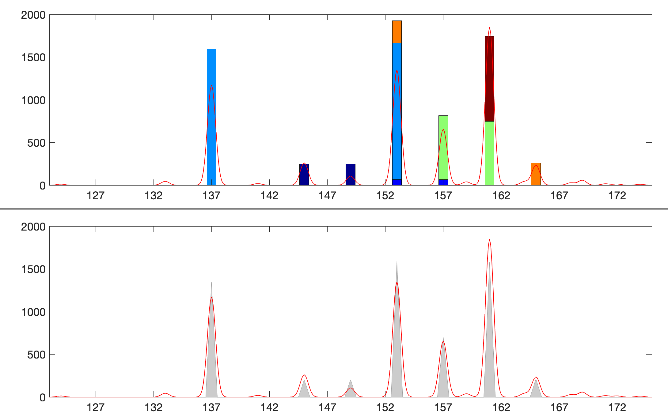
DNA mixtures – many answers

Slide 5
Thresholds introduce error

Slide 6
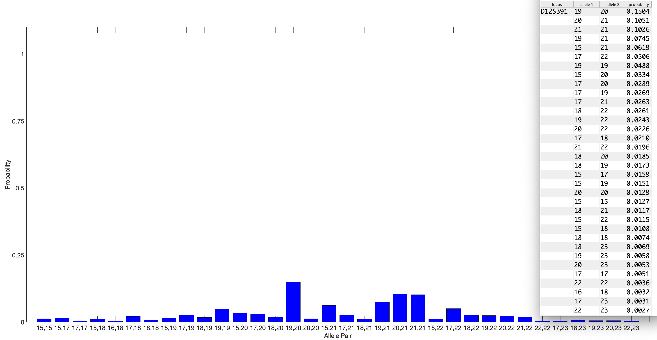
Find all genotypes, with probability
One of 6 contributors to mixture
One of 22 STR loci tested
One of 132 separated locus genotypes

Slide 7
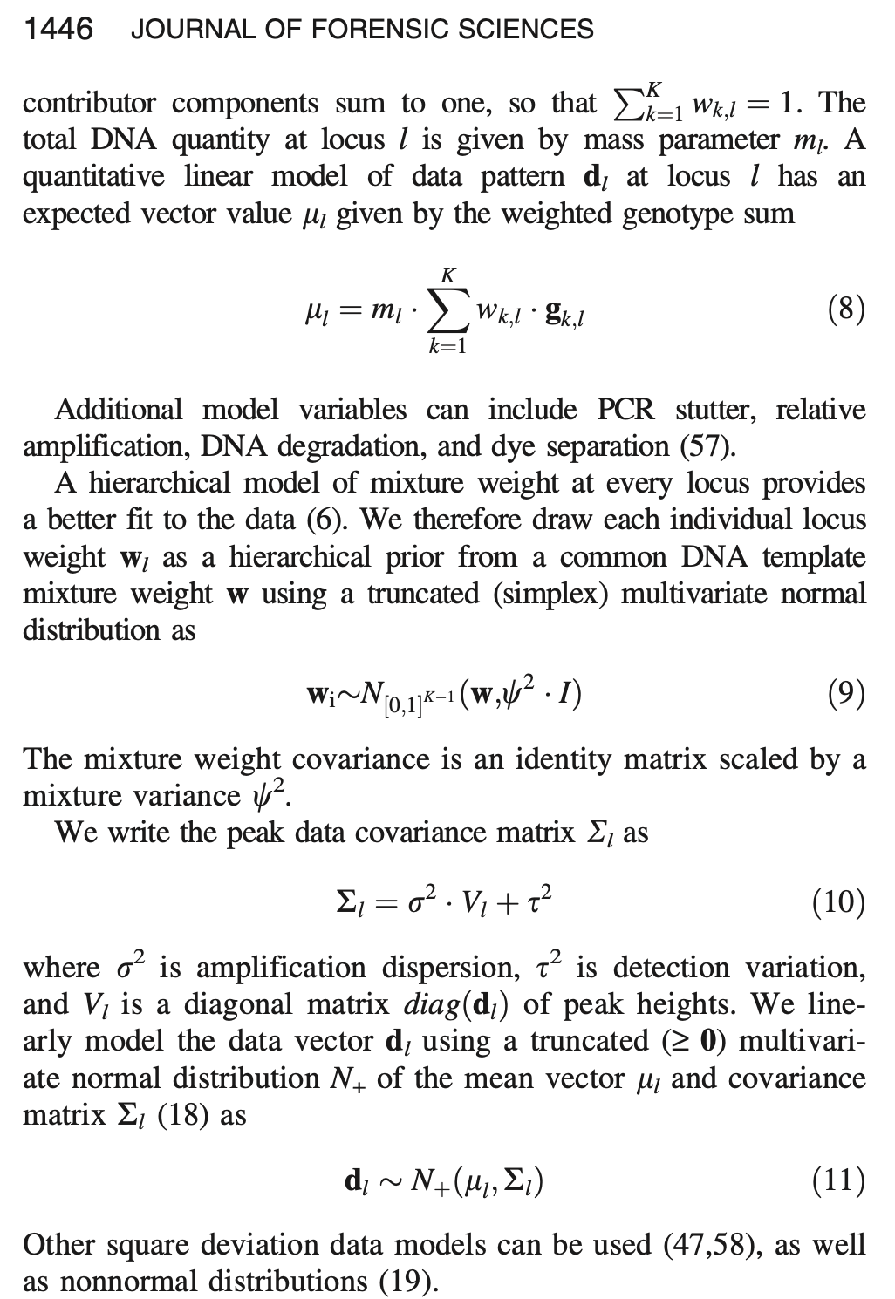
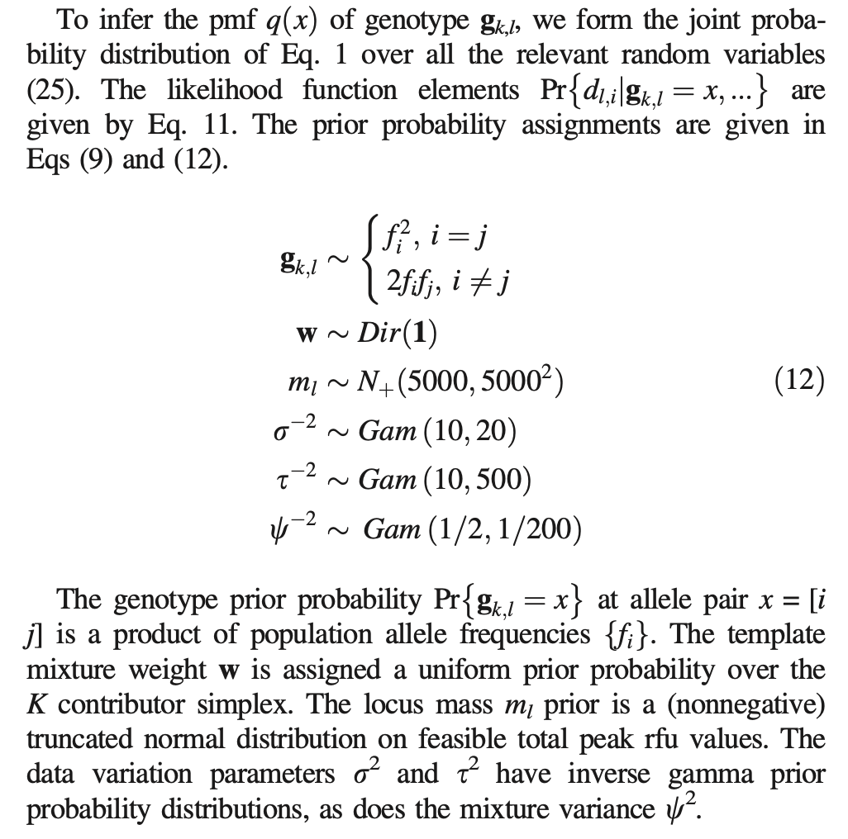
Bayesian modeling
Perlin MW, Legler MM, Spencer CE, Smith JL, Allan WP, Belrose JL, Duceman BW. Validating TrueAllele® DNA mixture interpretation. Journal of Forensic Sciences. 2011;56(6):1430-1447.

Slide 8
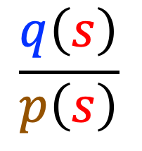
Two-step objective approach
1. Without looking at the suspect’s genotype, find:
Genotype probability q, for all allele pairs,
from analyzing the evidence data
for each contributor at every locus.
2. Afterwards, plug in the suspect’s genotype s:
$$\frac{q\left(s\right)}{p\left(s\right)}$$
LR(s) =

Slide 9
Genotype match distributions
Frequency distribution of noncontributor genotypes
Error rate
rarity of
LR match

Slide 10
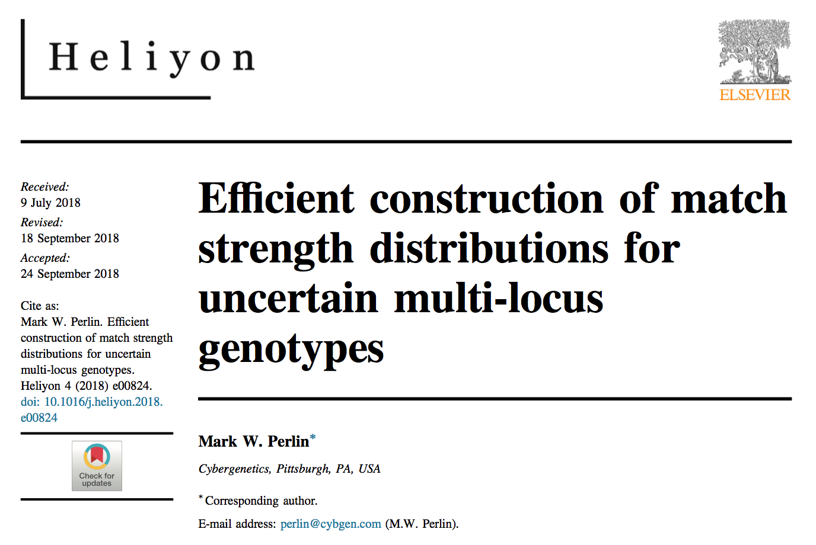

Slide 11
Question 1
How DNA complexity affects understanding and communication
The more complex the analysis gets, the harder it is to communicate.
Are we reaching a point where we cannot understand how it works?
Do we just need to know how often we get it right?

Slide 12
Easy with separated genotypes
Complexity doesn’t affect explanation.
Show results for one contributor’s genotype.
Then explain just like RMP.
100%
Evidence match
probability
Probability of match
to separated
contributor genotype
50%
25%
25%
Random match
probability
Probability of
coincidental match
LR = 4
LR = 2

Slide 13
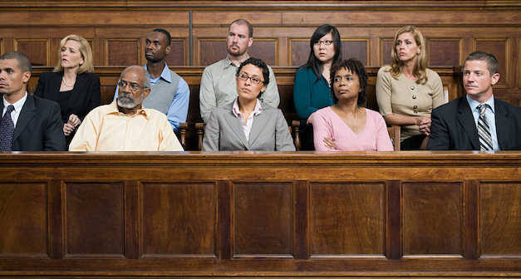
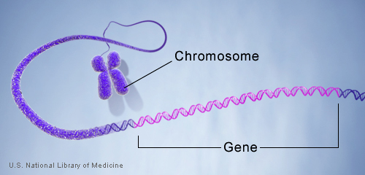
DNA genotype
A genetic locus has
two DNA sentences,
one from each parent.
An allele is the number
of repeated words.
locus
A genotype at a locus
is a pair of alleles.
mother
allele
1
2
3
4
5
6
7
8
9
10
10, 12
ACGT
repeated word
Many alleles allow for
many many allele pairs.
A person's genotype
is relatively unique.
father
allele
1
2
3
4
5
6
7
8
9
10
11
12

Slide 14
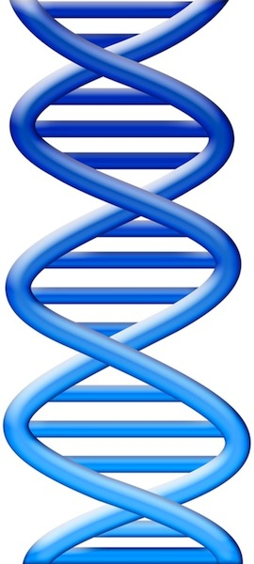
DNA evidence interpretation
Evidence item
Lab
Evidence data
Infer
Evidence genotype
10, 12 @ 100%
10 11 12
DNA from
one person
Compare
Known genotype
10, 12

Slide 15
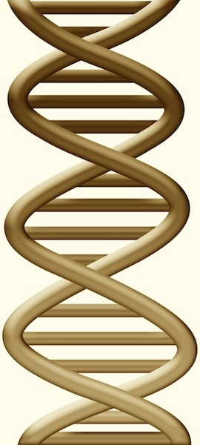
DNA mixture interpretation
Evidence item
Lab
Evidence data
Infer
Evidence genotype
10, 11 @ 20%
11, 11 @ 30%
11, 12 @ 50%
10 11 12
DNA from
two people
Compare
Known genotype
11, 12

Slide 16
Question 2
Explaining probabilistic genotyping results to a jury
What is the most effective way to explain PGS outputs to a jury?

Slide 17
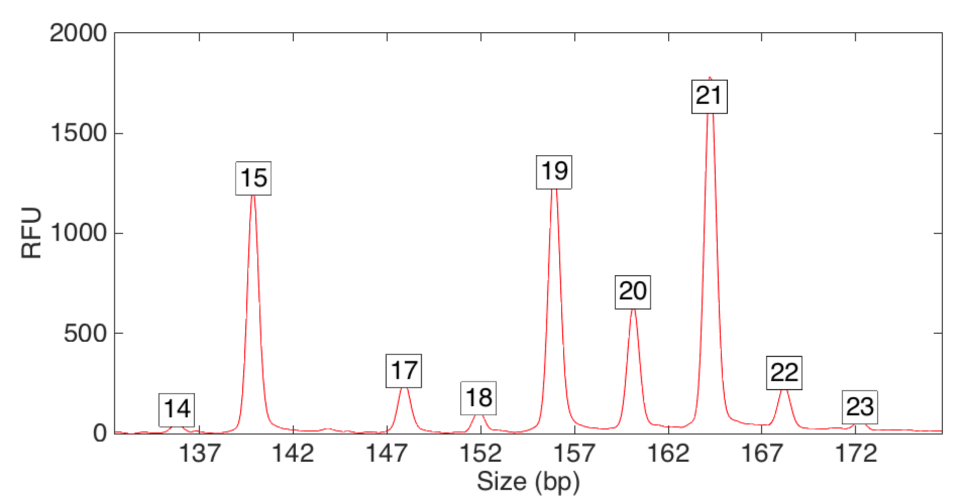
Computers can use all the data
Quantitative peak heights at locus D12S391
peak size
peak
height

Slide 18
How the computer thinks
Consider every possible genotype solution
Better explanation has
a higher likelihood
Explain the
peak pattern

Slide 19
How the computer thinks
Consider every possible genotype solution
Better explanation has
a higher likelihood
Explain the
peak pattern

Slide 20
How the computer thinks
Consider every possible genotype solution
Better explanation has
a higher likelihood
Explain the
peak pattern

Slide 21
How the computer thinks
Consider every possible genotype solution
Better explanation has
a higher likelihood
Explain the
peak pattern

Slide 22
How the computer thinks
Consider every possible genotype solution
Better explanation has
a higher likelihood
Explain the
peak pattern

Slide 23
How the computer thinks
Consider every possible genotype solution
Better explanation has
a higher likelihood
Explain the
peak pattern

Slide 24
How the computer thinks
Consider every possible genotype solution
Worse explanation has
a lower likelihood

Slide 25
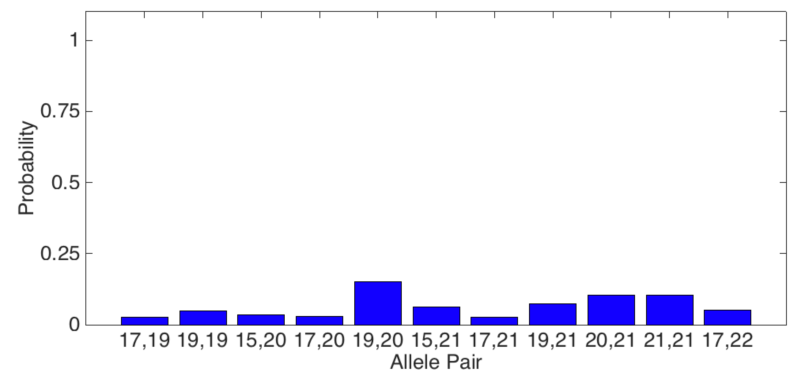
Evidence genotype
Objective genotype determined solely from the DNA data.
Never sees a comparison reference.
One of 132 separated locus genotypes
15%
6%
7%
11%
10%
3%
5%
3%
3%
3%
5%

Slide 26
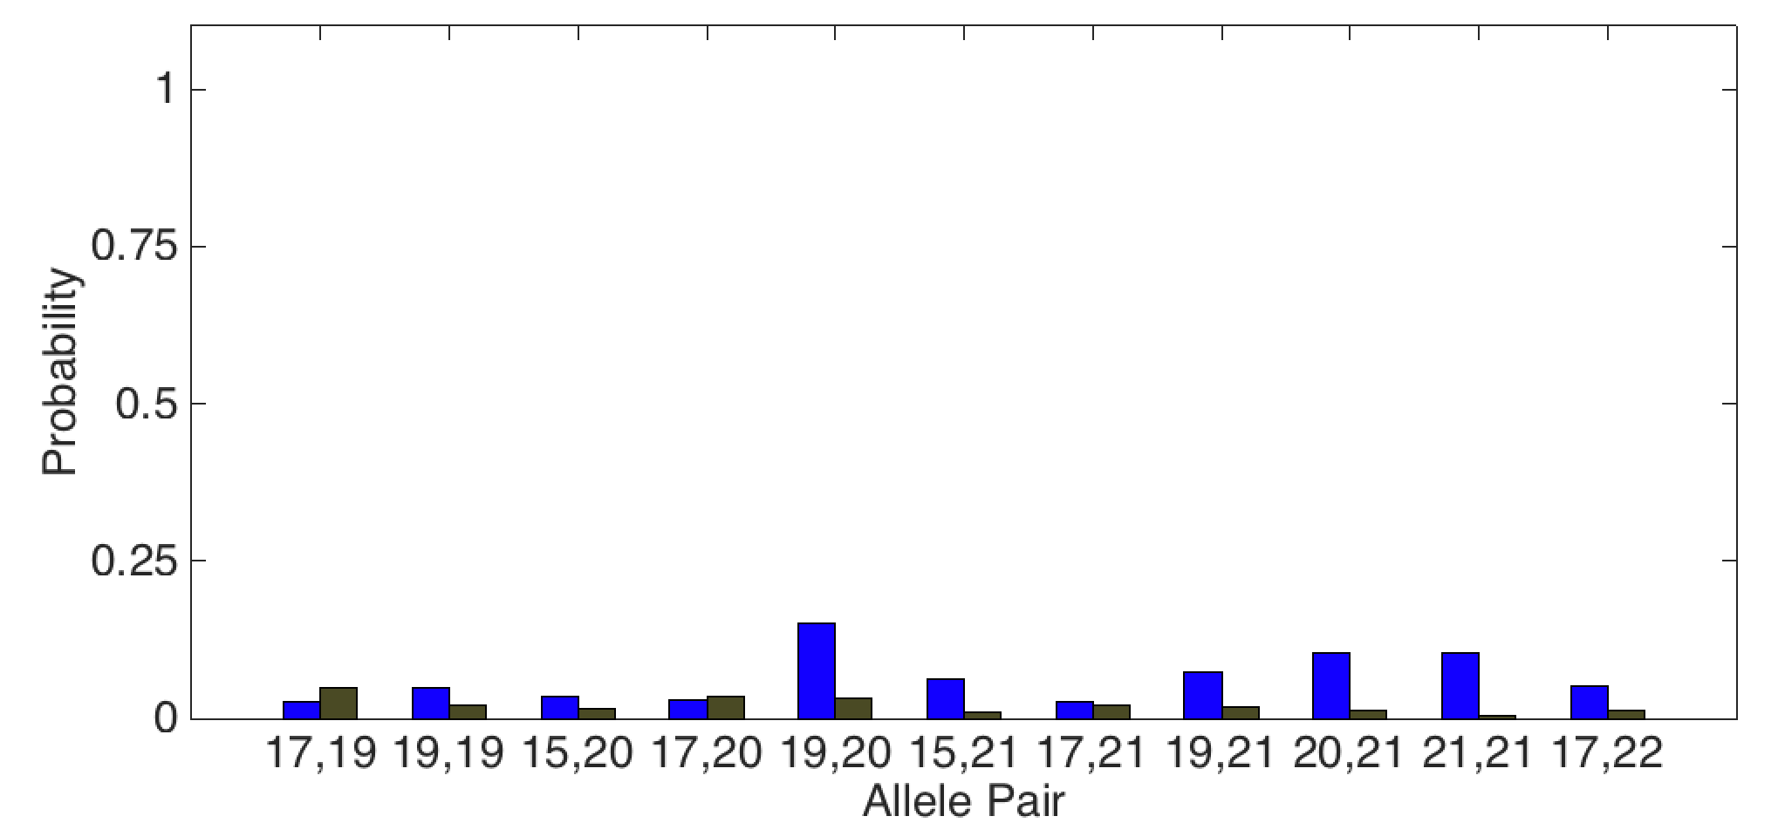
DNA match information
How much more does the suspect match the evidence
than a random person?
Prob(evidence match)
Prob(coincidental match)
5x
15%
3%

Slide 27
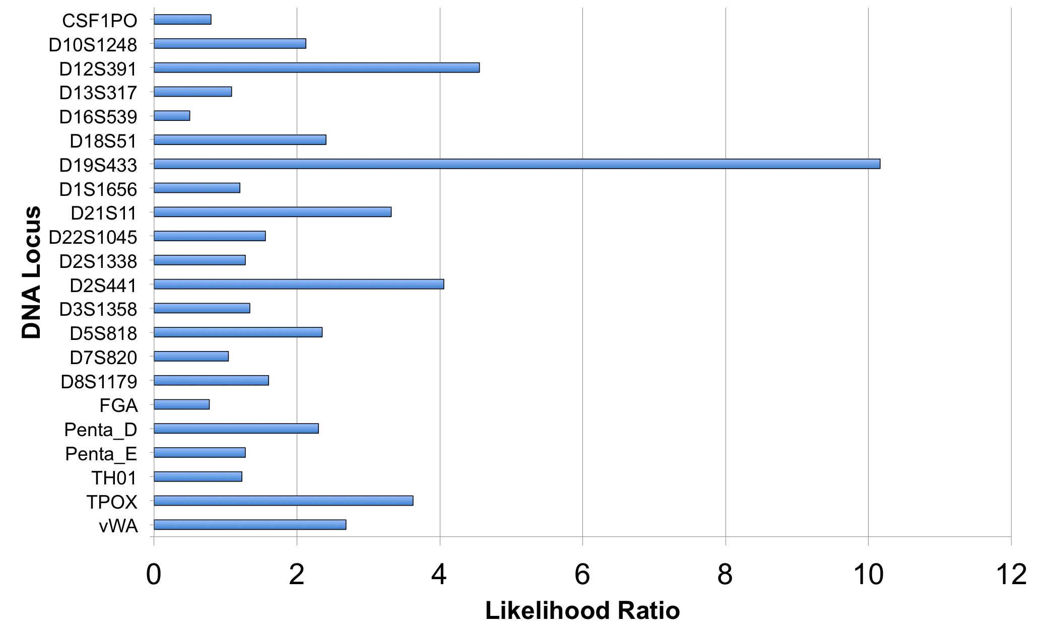
Match information at 22 loci

Slide 28
Is the suspect in the evidence?
A match between the khaki pants
and the defendant is:
470 thousand times more probable than
a coincidental match to an unrelated African-American person
7.64 million times more probable than
a coincidental match to an unrelated Caucasian person
5.12 million times more probable than
a coincidental match to an unrelated Hispanic person

Slide 29
Match statistics
Item | Description | 007 Victim | 009 Defendant
008 | khaki pants | 204 trillion | 470 thousand
LR

Slide 30
Match statistics
Item | Description | 007 Victim | 009 Defendant
008 | khaki pants | 14.31 | 5.67
log(LR)

Slide 31
Non-contributor analysis
5.67
Error rate
1 in
6.1 million

Slide 32
Question 3
Validating a probabilistic genotyping system
What is involved in a validation of a
Probabilistic Genotyping System?

Slide 33
Validation metrics
Specificity
Sensitivity
Reproducibility
Accuracy
Predictability

Slide 34
A. Specificity
The extent to which interpretation does not misidentify the wrong person
True exclusions, without false inclusions
Average of the individual genotype
specificity distributions

Slide 35
Genotype match distribution
Noncontributor

Slide 36
Many genotypes’ match distributions

Slide 37
Composite genotype match distribution
Exact

Slide 38
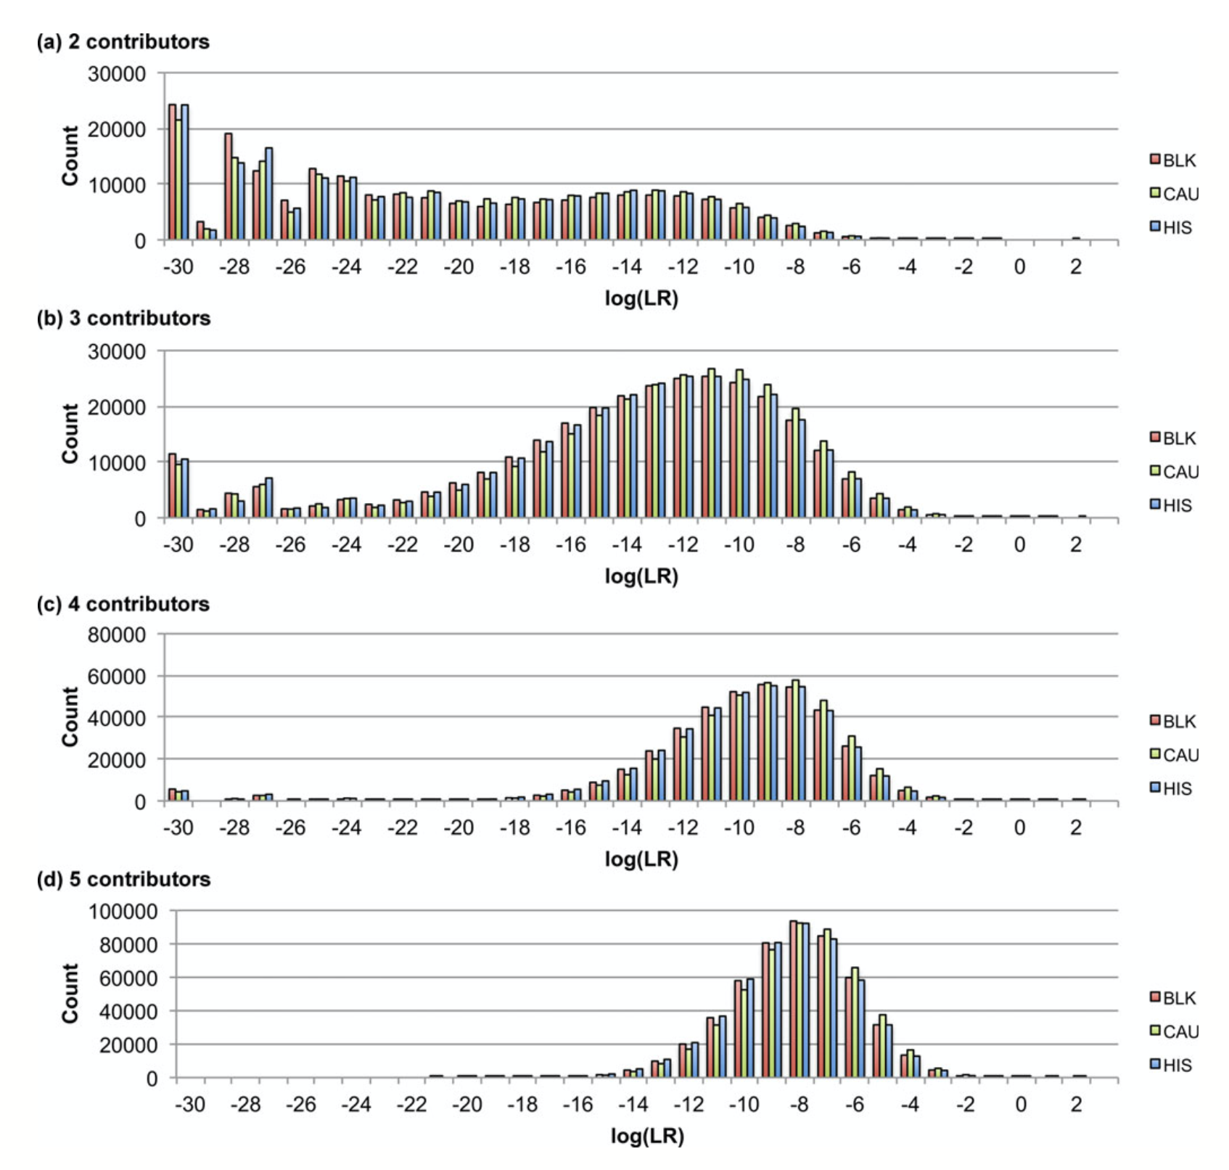
TrueAllele specificity
Perlin MW, Hornyak J, Sugimoto G, Miller K. TrueAllele® genotype identification on DNA mixtures containing up to five unknown contributors. Journal of Forensic Sciences. 2015;60(4):857-868.
Sampled

Slide 39
Exact vs. sampled
Exact
all – 10²⁴ genotypes
accurate
exact probability function
convolution – fast
Sampled
some – 10⁴ genotypes
approximate
sample using random profiles
Monte Carlo – slow

Slide 40
B. Sensitivity
The extent to which interpretation identifies the correct person
True DNA mixture inclusions
Average of the individual genotype
specificity distributions

Slide 41
Genotype match distribution
Contributor

Slide 42
Many genotypes’ match distributions

Slide 43
Composite genotype match distribution

Slide 44
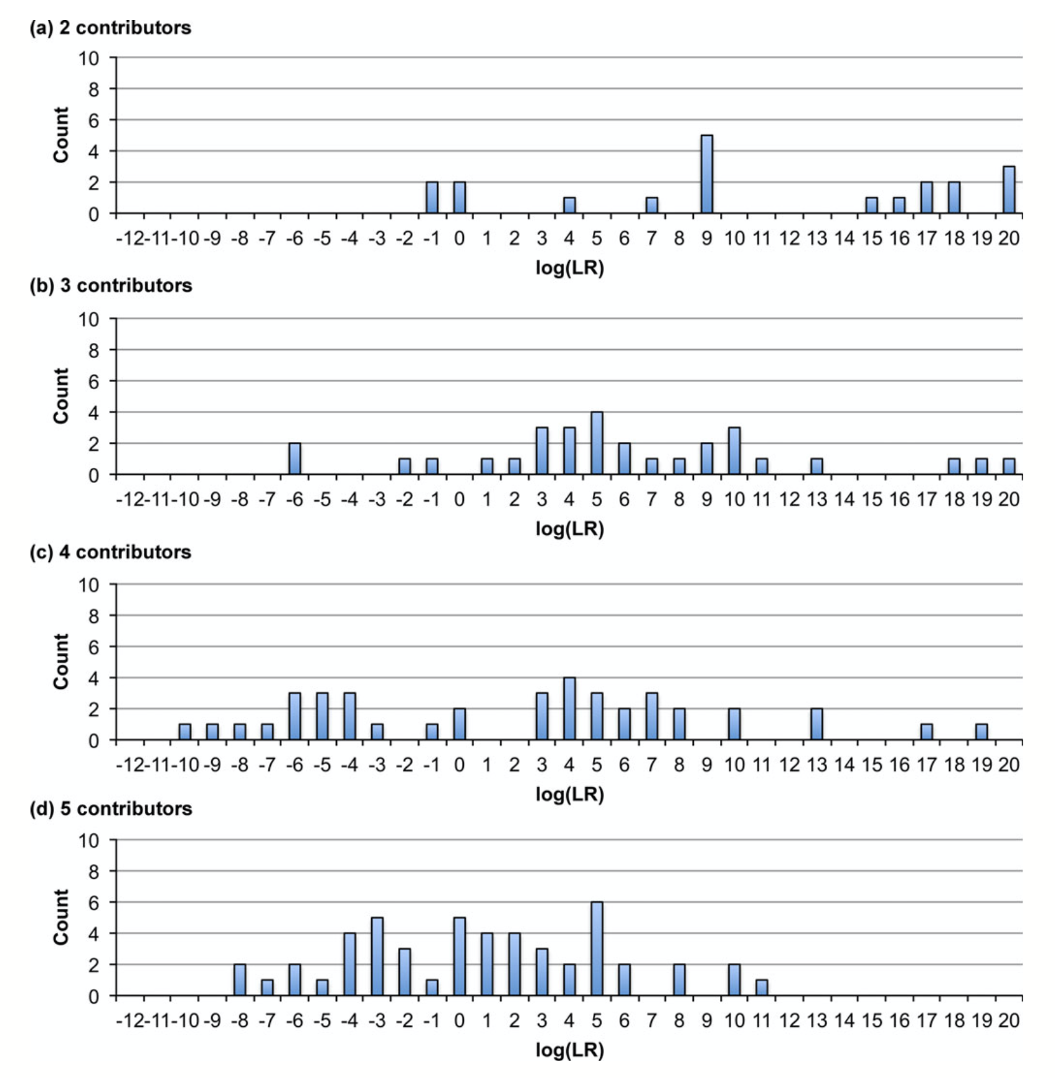
TrueAllele sensitivity
Perlin MW, Hornyak J, Sugimoto G, Miller K. TrueAllele® genotype identification on DNA mixtures containing up to five unknown contributors. Journal of Forensic Sciences. 2015;60(4):857-868.

Slide 45
C. Reproducibility
The extent to which interpretation gives
the same answer to the same question
MCMC computing has sampling variation
duplicate computer runs
on the matching genotypes
measure log(LR) variation

Slide 46
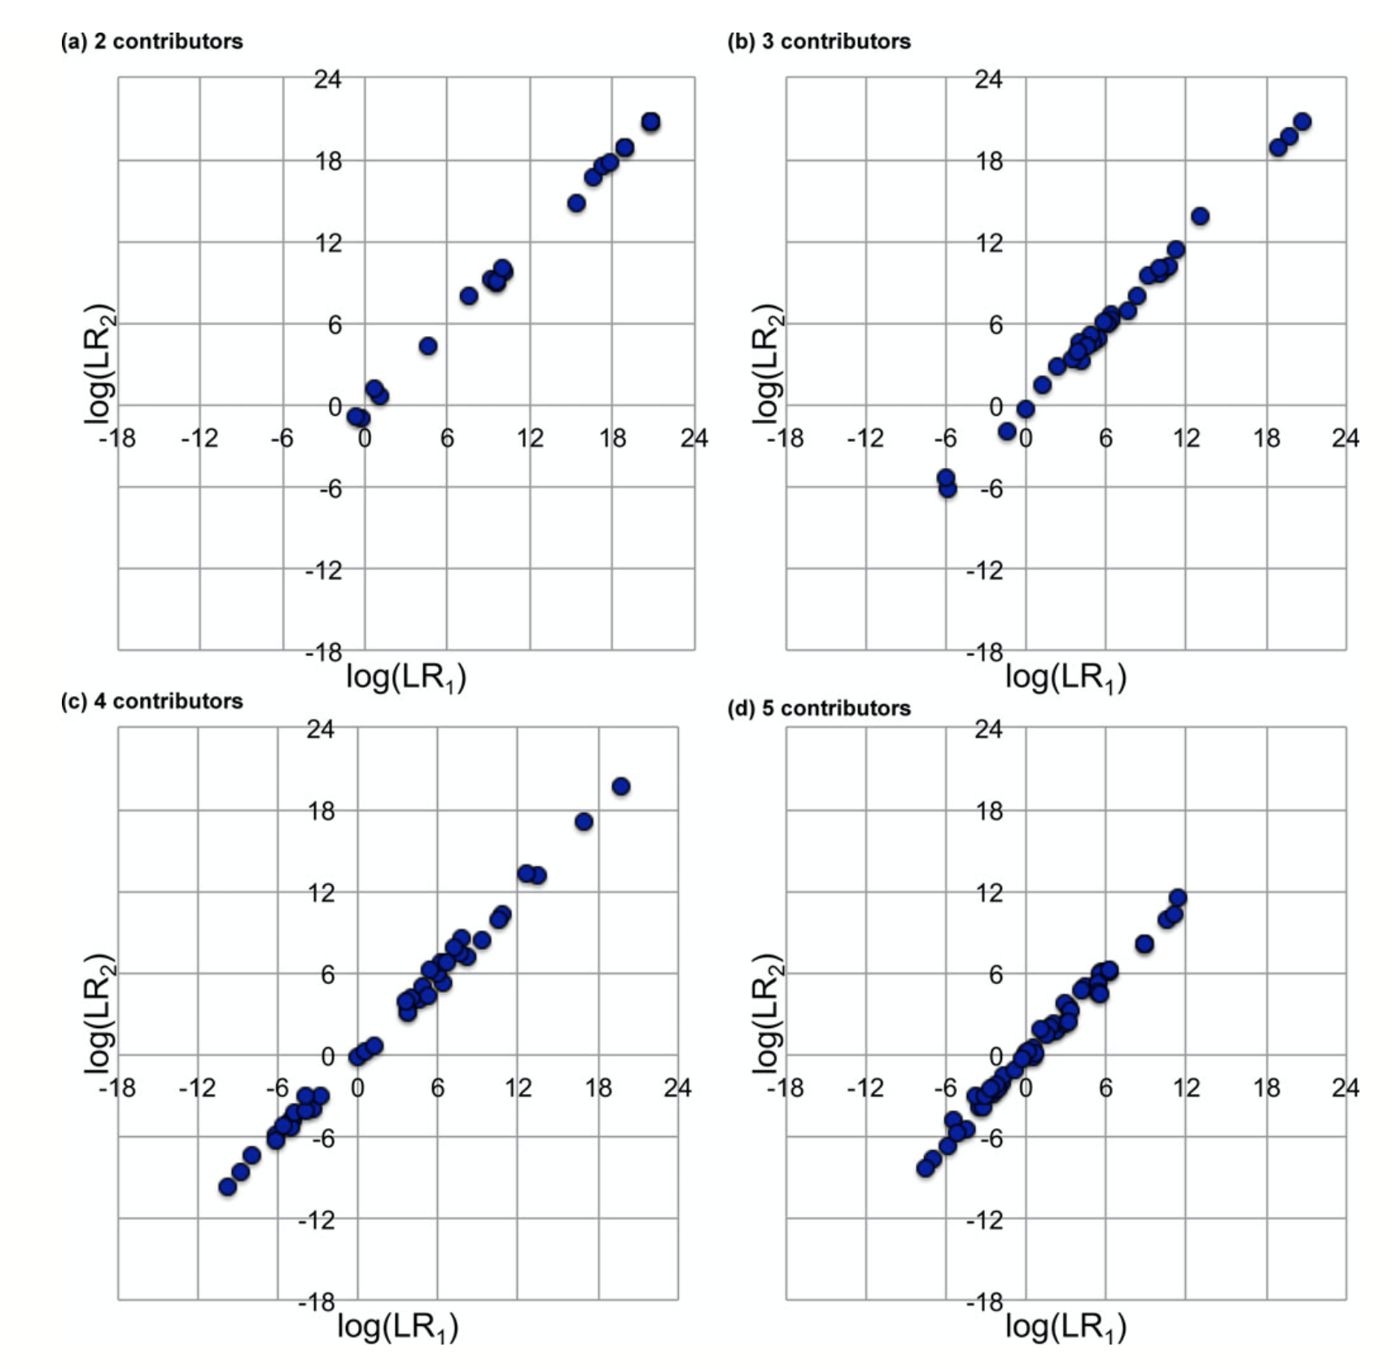
TrueAllele reproducibility
Perlin MW, Hornyak J, Sugimoto G, Miller K. TrueAllele® genotype identification on DNA mixtures containing up to five unknown contributors. Journal of Forensic Sciences. 2015;60(4):857-868.

Slide 47
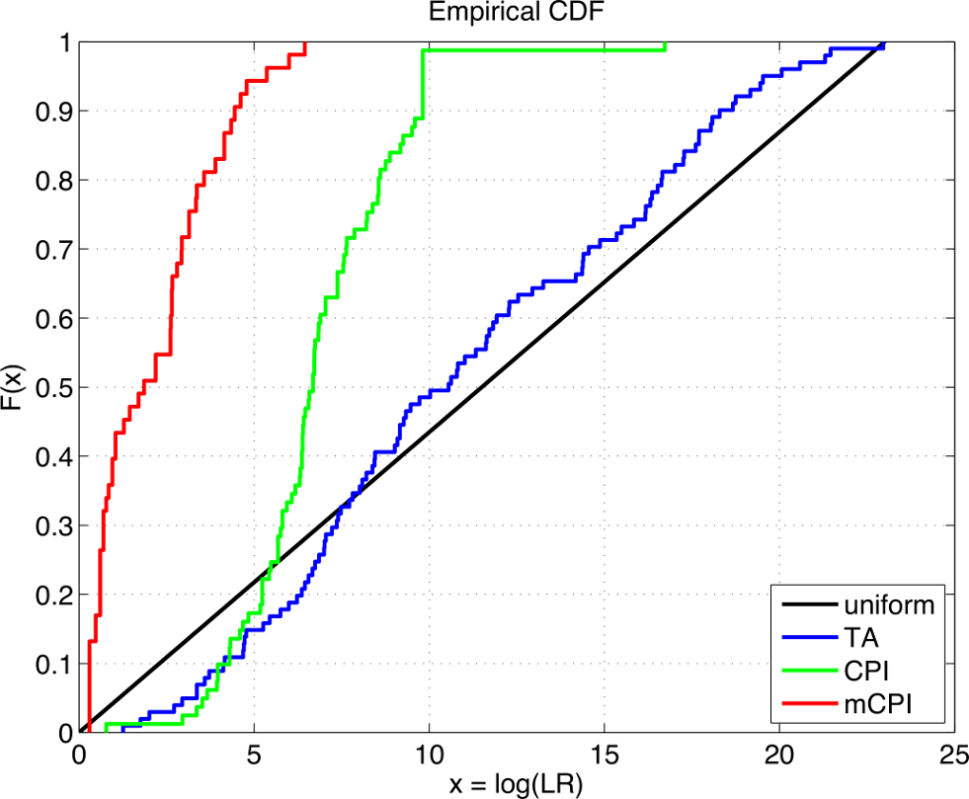
D. TrueAllele accuracy
Perlin MW, Dormer K, Hornyak J, Schiermeier-Wood L, Greenspoon S. TrueAllele® Casework on Virginia DNA mixture evidence: computer and manual interpretation in 72 reported criminal cases. PLOS ONE. 2014;(9)3:e92837.

Slide 48
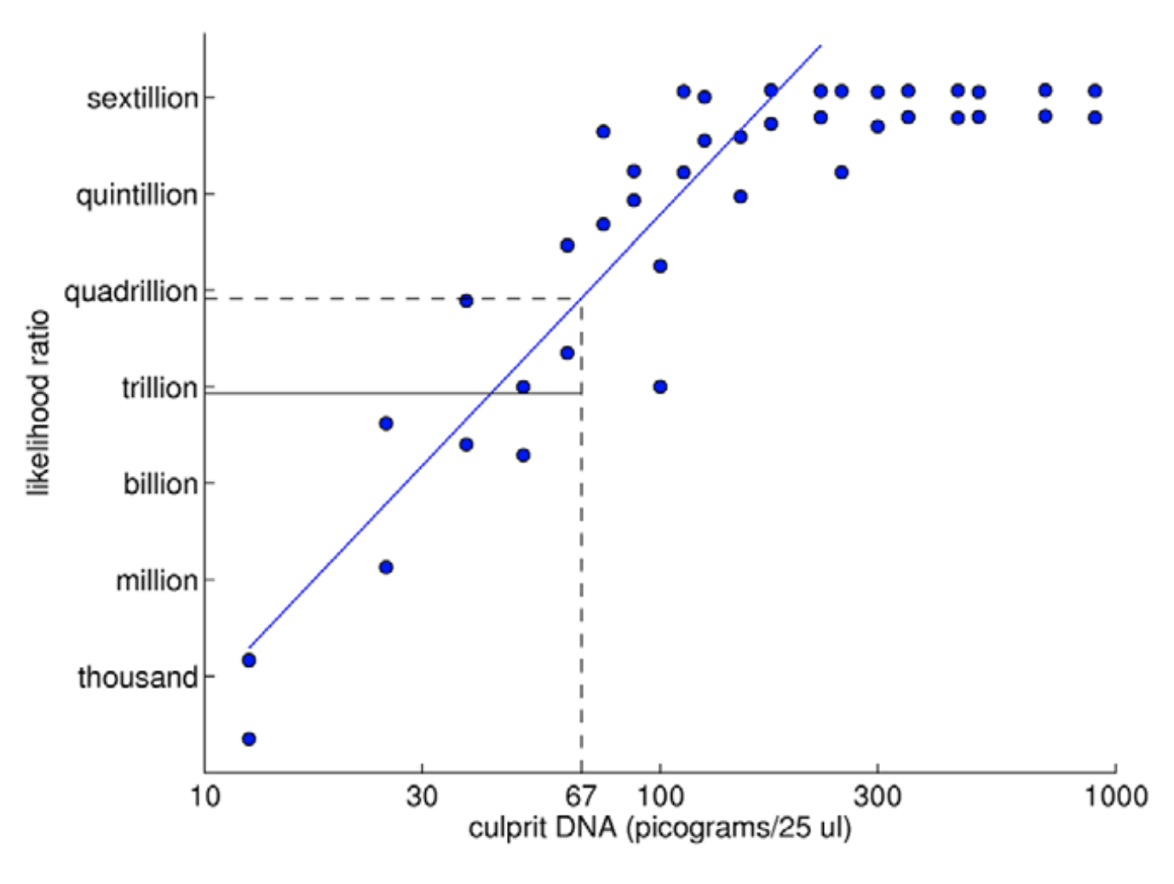
Perlin MW, Sinelnikov A. An information gap in DNA evidence interpretation. PLoS ONE. 2009;4(12):e8327.
E. TrueAllele predictability

Slide 49
Question 4
Selecting DNA samples in a validation study
How do you select samples for validation?
Are the samples pristine or degraded?
Will different sample types produce different results?

Slide 50
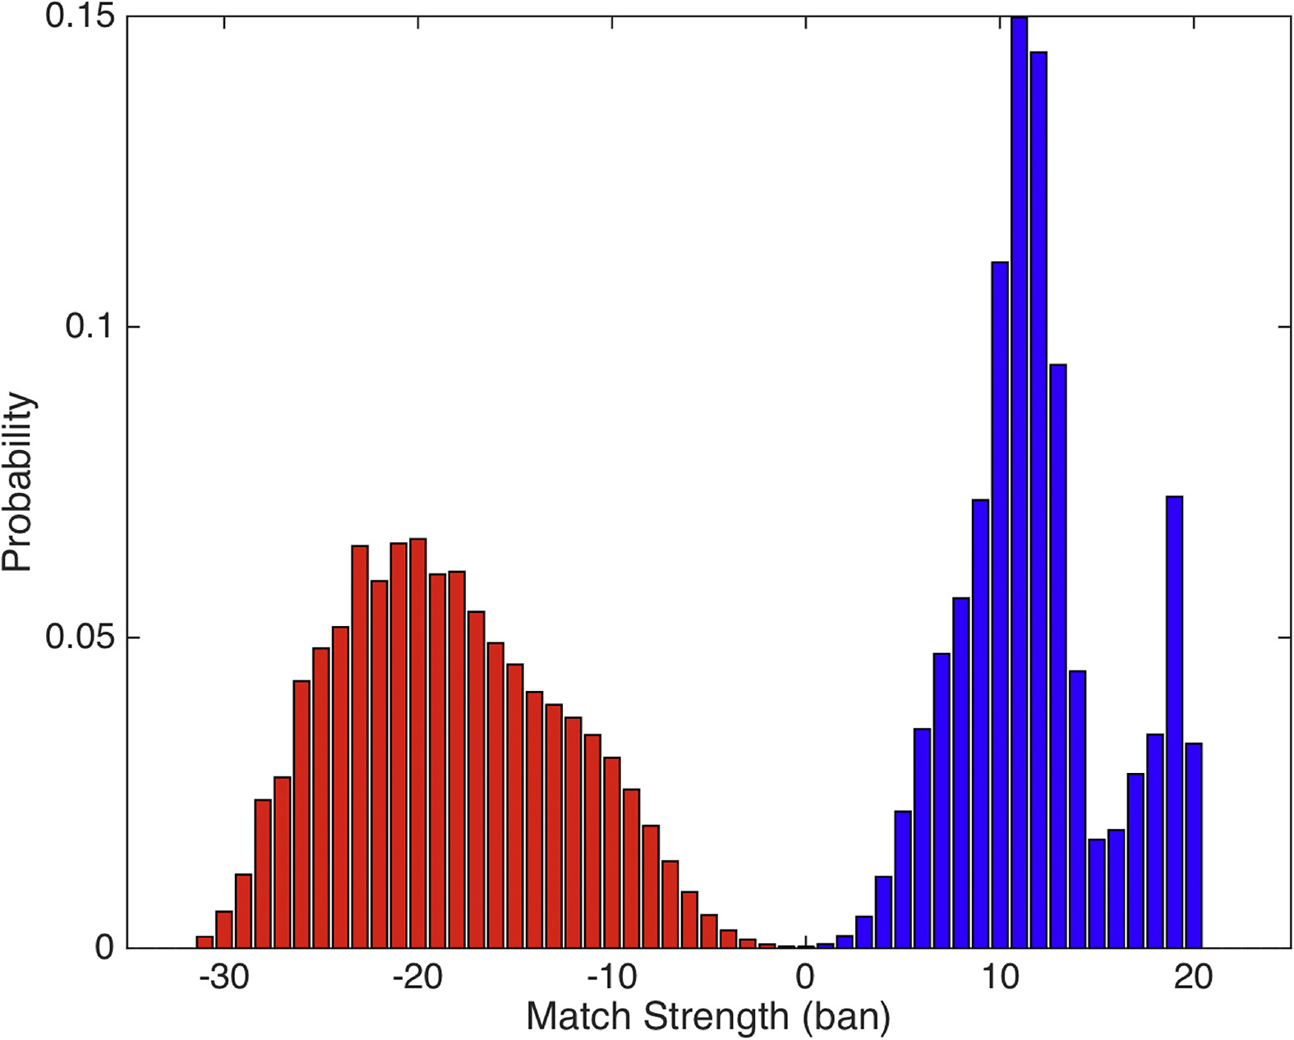
Representative of casework
Typically, uniform aliquots – unrealistic, unrepresentative
Realistic mixtures
• laboratory synthesized – randomized design, pristine
• casework items – most realistic
Match distributions
are inherent in
probabilistic genotypes
& their composites
Don’t need “right” answer
Both kinds of DNA samples
are scientifically workable
and informative

Slide 51
Question 5
When do computers outperform a human analyst
What are the circumstances in which PGS outperforms an analyst?
Is there a way to make these criteria more subjective?

Slide 52
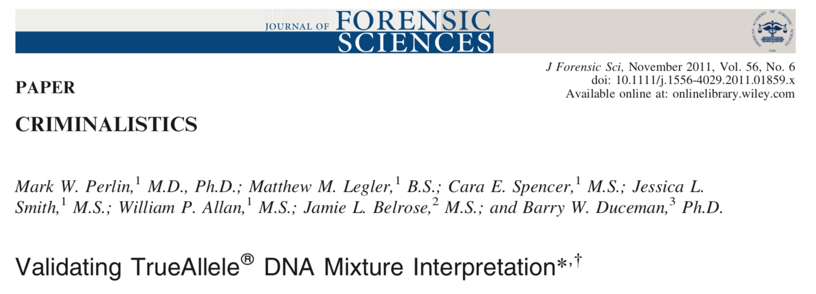
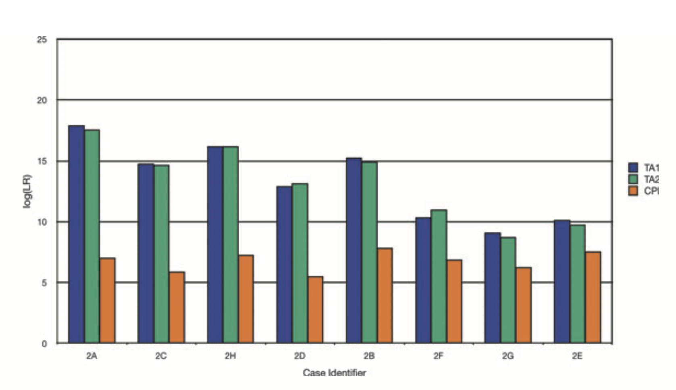

Slide 53
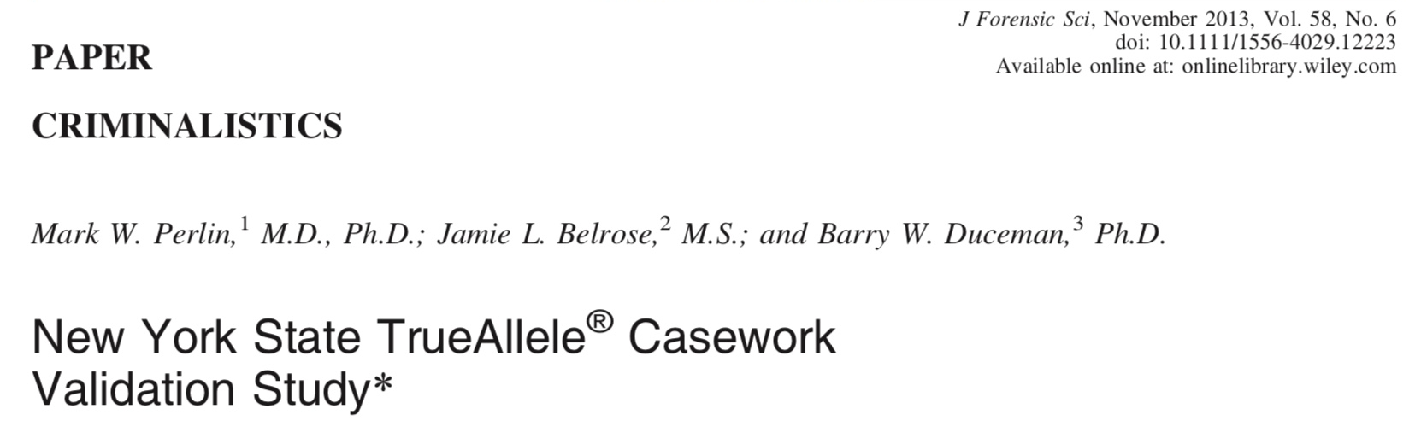
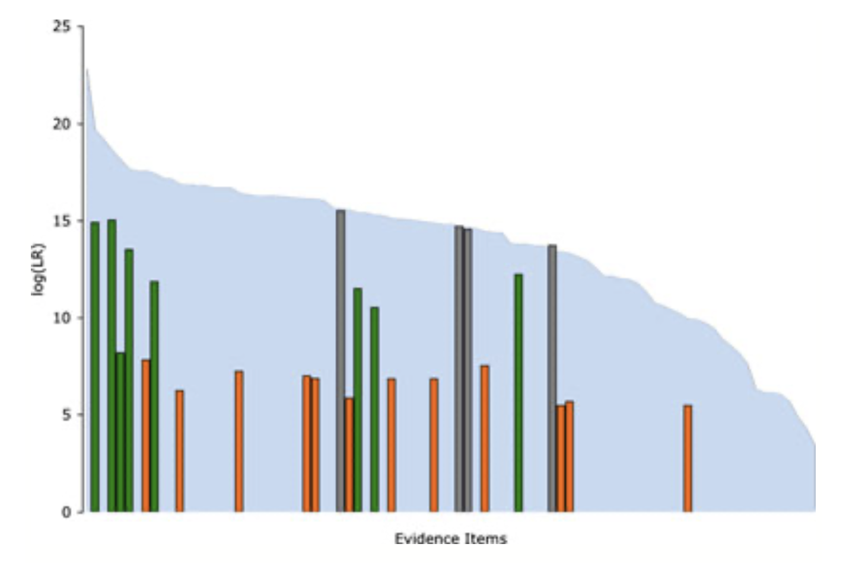

Slide 54
Higher human error
Perlin MW, Dormer K, Hornyak J, Schiermeier-Wood L, Greenspoon S. TrueAllele® Casework on Virginia DNA mixture evidence: computer and manual interpretation in 72 reported criminal cases. PLOS ONE. 2014;(9)3:e92837.
TrueAllele specificity (million samples)
From noncontributor distribution, for LR > 100:
Error rate = 1 in 1,000,000 (0.0001)%
CPI – analytical threshold
5 false positives in 81 comparisons
Error rate = 5 in 81 (6%)
mCPI – stochastic threshold
17 inconclusive results
1 false positive in 53 comparisons
Error rate = 1 in 53 (2%)

Slide 55
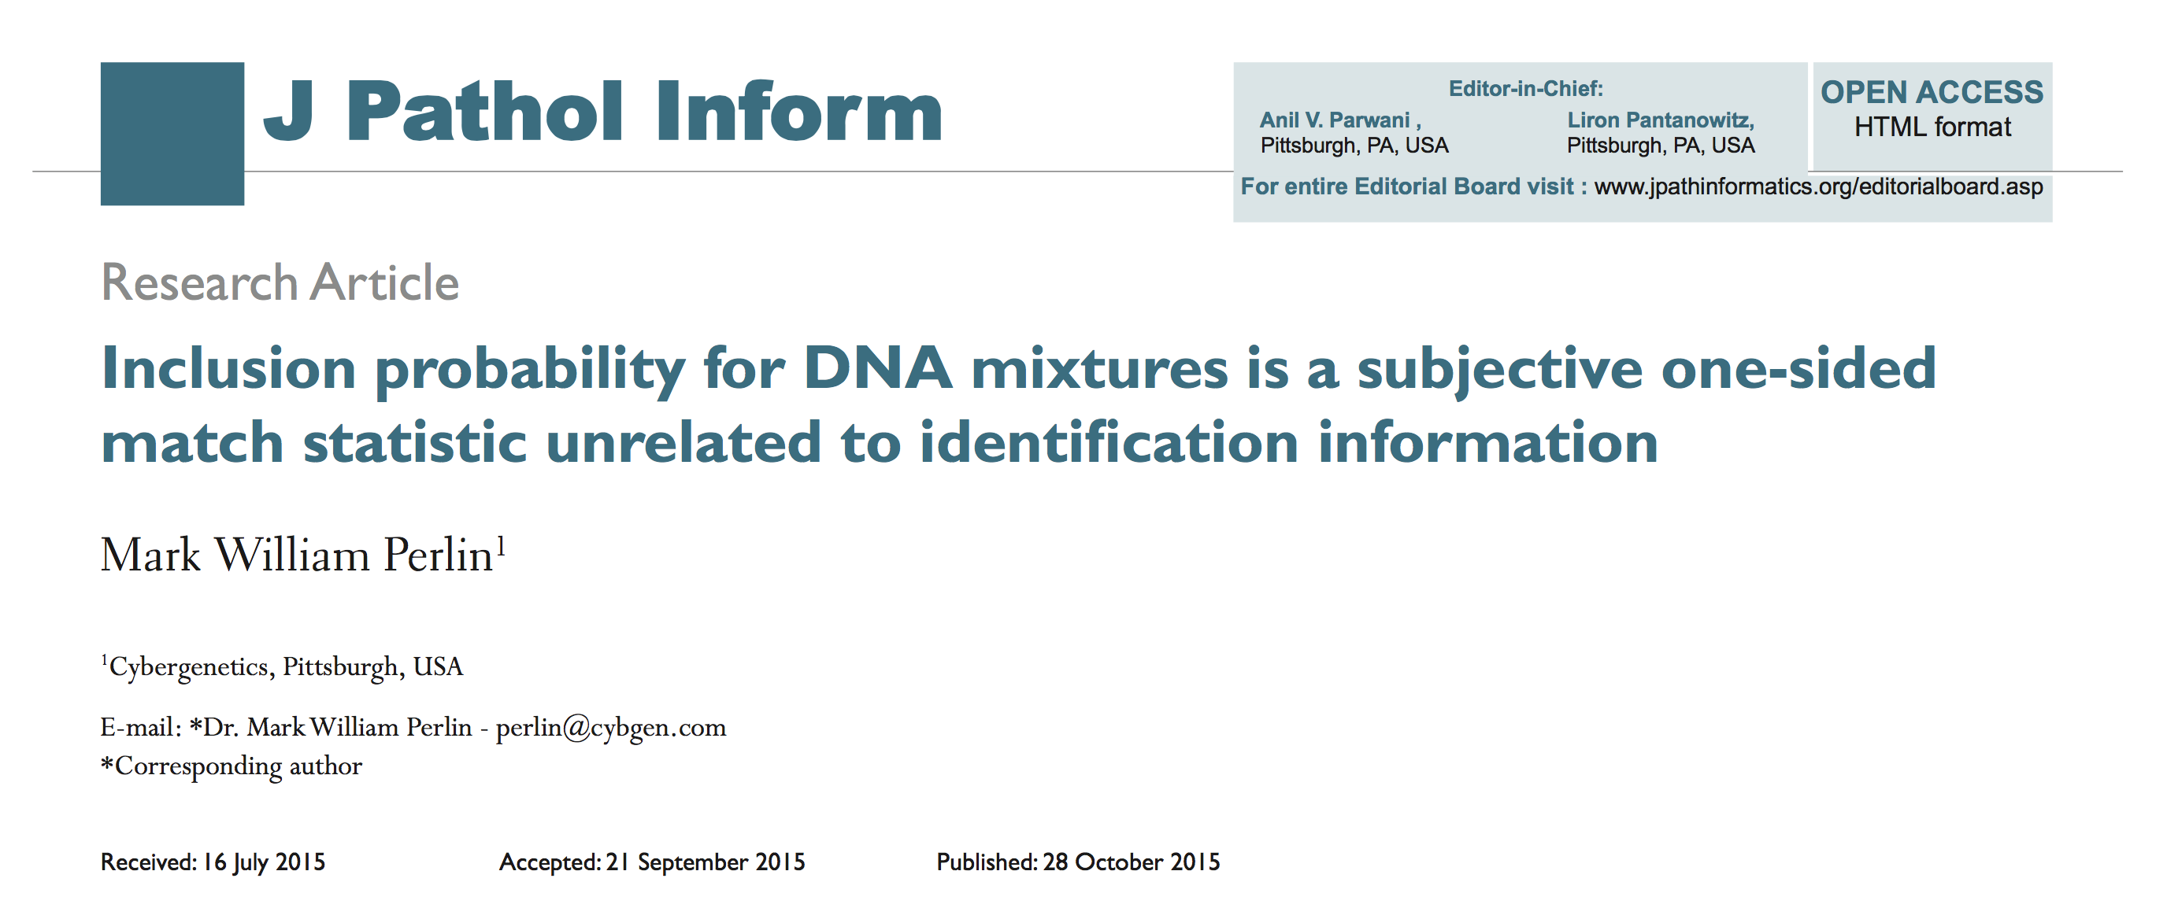
Human review should not be done
CPI just counts subjective number of reported loci

Slide 56
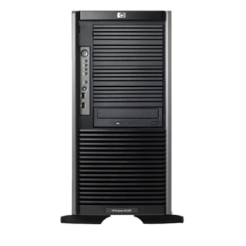

TrueAllele Casework Workflow
ViewStation
User Client
Database
Server
Interpret/Match
Expansion
Visual User Interface
VUIer™ Software
Parallel Processing Computers

Slide 57
Automated operation
Human involvement
optional
no key decisions
Number of contributors
not needed
sufficient number
based on EPG data
Perlin MW, Hornyak J, Sugimoto G, Miller K. TrueAllele® genotype identification on DNA mixtures containing up to five unknown contributors. Journal of Forensic Sciences. 2015;60(4):857-868.
Bauer DW, Butt N, Hornyak JM, Perlin MW. Validating TrueAllele® interpretation of DNA mixtures containing up to ten unknown contributors. Journal of Forensic Sciences. 2020;65(2):380-398.

Slide 58
Question 6
How the LR depends on reference database assumptions
How much does the LR depend on the assumptions
that go into the reference database?

Slide 59
TrueAllele calibration-free
TrueAllele has a full Bayesian model
Does not use laboratory “calibration”
Variables derived from evidence data
Baseline variation – no analytic thresholds
PCR variation – no stochastic thresholds
Stutter parameters – no calibration; learn from data

Slide 60
Question 7
Any ‘manufacturer’s warnings’ for TrueAllele crime labs
What ‘manufacturer’s warnings’ do you presently have for
labs who purchase licenses to your software?

Slide 61
No ‘warnings’
None needed.
Labs learn methods and test system.
Then validate to their comfort level.

Slide 62
Question 8
Automatic genotype comparison with contamination databases
It seems computationally easy now for labs to run PGS against contamination databases, and
to get LRs for the profiles in those databases.
Should labs routinely do these LR database checks on casework, in order to ferret out low level contamination, or
to give fact-finders more context for low suspect LRs?

Slide 63
Automated TrueAllele database
Human-free genotype matching
Yes – TrueAllele labs auto-check contamination
Automated pre-review of cases (seed & harvest)
Automated DNA investigation (property crime)
Automated post-review of past cases (open the past)

Slide 64


Upload and compare all DNA
Evidence
Reference
Genotype database
Genotype database
Match &
Report
Infer &
Upload
Crime scene
Criminals
+

Slide 65
Recommendations for forensic genotyping practice
Use TrueAllele computers to fully automate DNA interpretation
Computers solve 100-dimensional problems that people can’t
Eliminate people from the interpretation process
waste, cost, time, error, labor, limits, bias, impact, …
Have people interact with society, explain results

Slide 66
Scientific literature and technical knowledge
Peer-reviewed journal articles
Internal validation studies
Academic thesis papers
Manufacturer method reports
Data-rich white papers
Patent specifications
On-line talks & tutorials
Empirical testing

Slide 67
Peer-reviewed validation studies
Perlin MW, Sinelnikov A. An information gap in DNA evidence interpretation. PLoS ONE. 2009;4(12):e8327.
Ballantyne J, Hanson EK, Perlin MW. DNA mixture genotyping by probabilistic computer interpretation of binomially-sampled laser captured cell populations: Combining quantitative data for greater identification information. Science & Justice. 2013;53(2):103-114.
Perlin MW, Hornyak J, Sugimoto G, Miller K. TrueAllele® genotype identification on DNA mixtures containing up to five unknown contributors. Journal of Forensic Sciences. 2015;60(4):857-868.
Greenspoon SA, Schiermeier-Wood L, Jenkins BC. Establishing the limits of TrueAllele® Casework: a validation study. Journal of Forensic Sciences. 2015;60(5):1263-1276.
Bauer DW, Butt N, Hornyak JM, Perlin MW. Validating TrueAllele® interpretation of DNA mixtures containing up to ten unknown contributors. Journal of Forensic Sciences. 2020;65(2):380-398.
Perlin MW, Legler MM, Spencer CE, Smith JL, Allan WP, Belrose JL, Duceman BW. Validating TrueAllele® DNA mixture interpretation. Journal of Forensic Sciences. 2011;56(6):1430-1447.
Perlin MW, Belrose JL, Duceman BW. New York State TrueAllele® Casework validation study. Journal of Forensic Sciences. 2013;58(6):1458-1466.
Perlin MW, Dormer K, Hornyak J, Schiermeier-Wood L, Greenspoon S. TrueAllele® Casework on Virginia DNA mixture evidence: computer and manual interpretation in 72 reported criminal cases. PLOS ONE. 2014;(9)3:e92837.

Slide 68
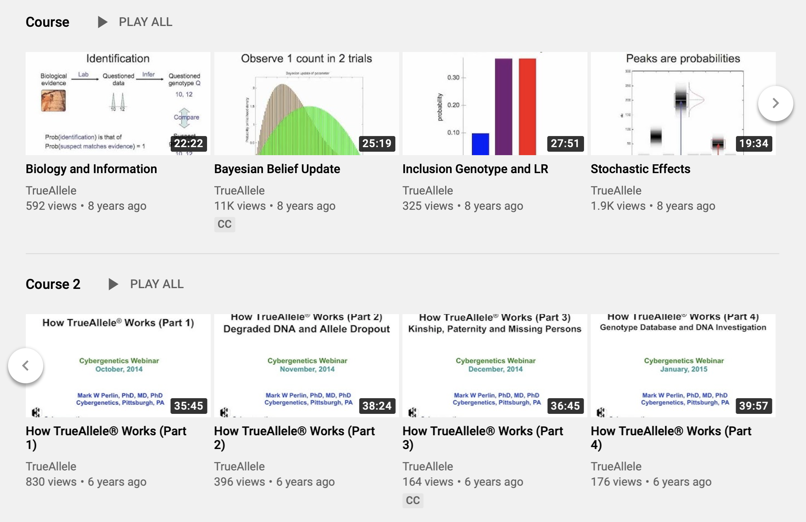

TrueAllele lectures

Slide 69


More information
http://www.cybgen.com/information
• Courses
• Newsletters
• Newsroom
• Presentations
• Publications
• Webinars
http://www.youtube.com/user/TrueAllele
TrueAllele YouTube channel
perlin@cybgen.com

