Slide 1

How TrueAllele® Computing Automates DNA Analysis and Databasing for Mass Disasters
Wecht Institute of Forensic Science & Law
Duquesne University
September, 2021
Pittsburgh, PA
Mark W Perlin, PhD, MD, PhD
Pittsburgh, PA
Cybergenetics © 2003-2021

Slide 2

Meet Sarah

Slide 3
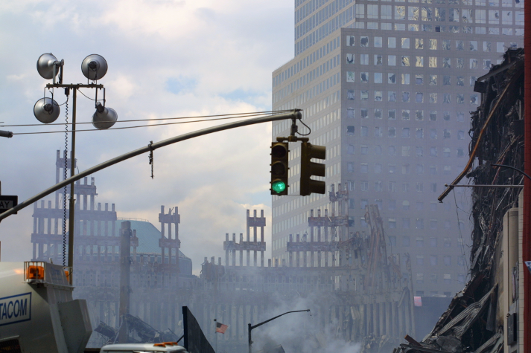
World Trade Center attack
18,000 victim remains collected
2,700 missing people

Slide 4
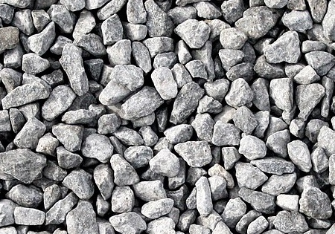
Identifying victim remains
Sarah and others’ remains became charred pebbles
Task: associate the victim remains with the missing people
Closure
• Medical examiner confirms death
• Returns victim remains to family

Slide 5


DNA from biological evidence
Same DNA in victim remains
as DNA from missing people
Approach
Compare victim remains DNA
with missing people DNA
to connect them through same DNA

Slide 6

Not the usual DNA problem
Victim remains
Small amounts of damaged charred DNA
Missing people
No person’s DNA to compare with,
just relatives & personal effects
Need a sophisticated DNA approach
to associate remains with missing

Slide 7
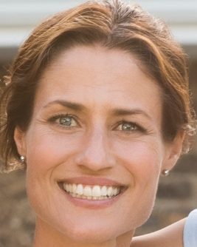
Sarah’s genotype
In nature, we inherit two genomes,
one from Mom and one from Dad
In science, we test a dozen locations,
to find out the pair of inherited alleles
At each genetic locus, that pair of alleles
is the person’s genotype

Slide 8
Amplifying the DNA
We can’t detect just dozens of cells,
but PCR can make us billions of copies
a+b
2a+2b
4a+4b
8a+8b
16a+16b
etc
a
b
But PCR is an imperfect amplifier,
and so introduces randomness
a+b
2a+2b
3a+4b
5a+7b
9a+13b
etc
a
b

Slide 9
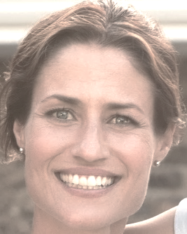
Inferring genotypes
Inferred genotype is only known up to probability
Absolute genotyping
Human review fails when not one clear answer
Determine PCR randomness from DNA data
to produce accurate genotype probability
(Perlin filed patent in 2001)
Probabilistic genotyping
Assigns probability to every allele pair

Slide 10
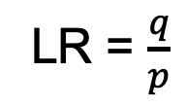
Comparing genotypes
Inferred genotype vs. reference genotype
provides match strength (LR statistic)
LR = $\frac{q}{p}$
Inferred genotype
Reference genotype

Slide 11
WTC victim remains
Which charred pebble came from Sarah?
?
?
?
18,000 victim remains
100,000 DNA tests
(multiple tests on one item)

Slide 12
Limited genotype inference
Older absolute methods can’t interpret imperfect data
 | Absolute
Input | Discard low data
Output | Alleles
Decisions | Make choices
DNA data | Change data
Approach | Black or white
Result | None, inaccurate
Tests | One at a time

Slide 13
Modern genotype inference
Newer probabilistic methods can interpret any data
 | Absolute | Probabilistic
Input | Discard low data | Use all data
Output | Alleles | Genotypes
Decisions | Make choices | Consider everything
DNA data | Change data | Preserve data
Approach | Black or white | Shades of gray
Result | None, inaccurate | Accurate answers
Tests | One at a time | Joint analysis

Slide 14
Joint data analysis
Combine DNA data from different tests for more information
Multiple tests
Profiler Plus
Cofiler
PowerPlex 16
BodePlex 1
BodePlex 2
Big Mini
Produces more definite genotypes, stronger associations

Slide 15
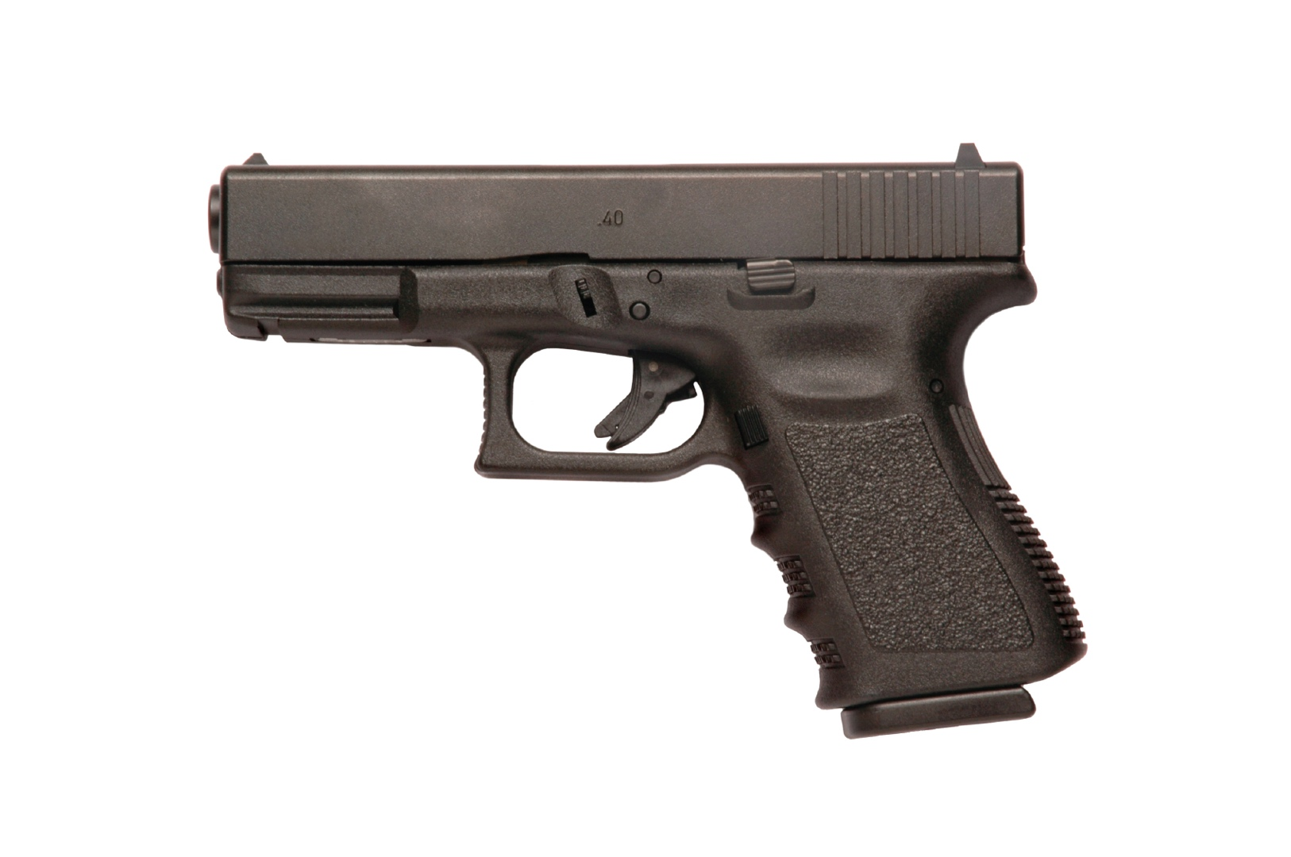
More testing, more information
6
5
4
3

Slide 16
WTC missing people
Relatives: share inherited DNA
why spouse is important
Personal effects: mixtures, low level
Reconstruct genotypes from the missing people
For comparison with victim remains genotypes

Slide 17

Genotypes from family

Slide 18
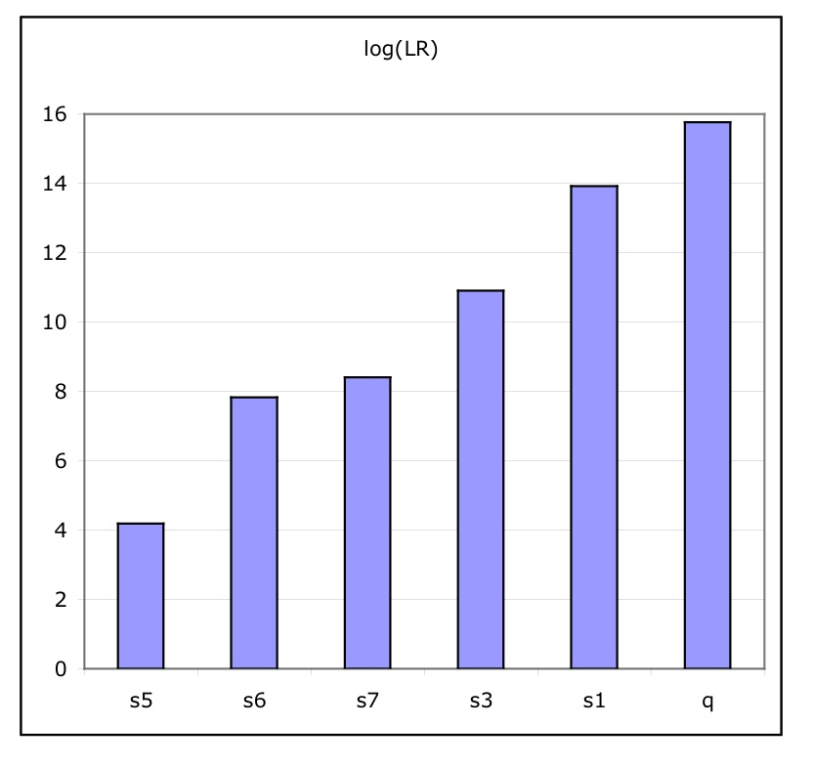
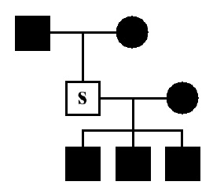
More relatives, more information
1
2
3
4
6
Full

Slide 19

Genotypes from personal effects

Slide 20

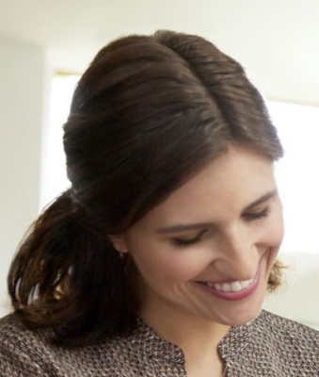


Unmixing mixtures
Separating genotypes from mixed DNA items
Probabilistic genotypes

Slide 21

Relatives + Effects = Information
Reconstructing the missing: Sarah

Slide 22
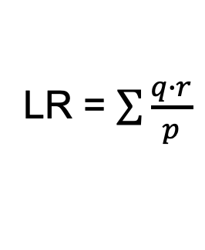
Comparing uncertain genotypes
Inferred VR genotype vs. inferred MP genotype
provides match strength (LR statistic)
LR = $\sum{\frac{q∙r}{p}}$
Inferred genotype from
victim remains
Inferred genotype from
relatives & effects
Just probability: no reference needed

Slide 23



TrueAllele® System
Matching Database
User Interface
Genotype Inference

Slide 24
Entering DNA data
Upload data
Upload requests
(visual check)
User Interface

Slide 25
Coordinating computing
Matching Database
Store data & requests
Store genotypes
Compare genotypes

Slide 26
Inferring genotypes
Probabilistic genotypes
preserve identification information
Victim remains
Parallel computing
Missing persons
Genotype Inference

Slide 27
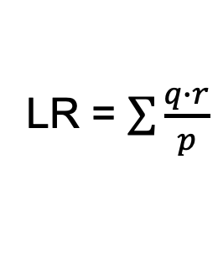
Matching genotypes
Automated
Incremental
Informative
Matching Database
LR = $\sum{\frac{q∙r}{p}}$

Slide 28

Returning Sarah to her family
Identified victim remains

Slide 29
Validating TrueAllele
Concordance on a set of 150 comparisons
between WTC victim remains and missing persons,
using both TrueAllele and NYC lab methods
Dickerson TM, Gajewski C, Ishii A, Desire M, Prinz MK.
“Renewed efforts to identify the victims of the
World Trade Center disaster via DNA testing” (A81).
American Academy of Forensic Sciences 64th Annual Meeting;
Atlanta, GA: AAFS; 2012. p. 73.
Cybergenetics then filed the full WTC comparison results of
18,000 victim remains versus 2,700 missing persons

Slide 30
Scalable database
Rack system, to desktop, to cloud computing
Scalable to any size problem
Can use any DNA marker test (NGS)
Automated computer operation
Genotype matching database
Designed for probabilistic genotypes

Slide 31
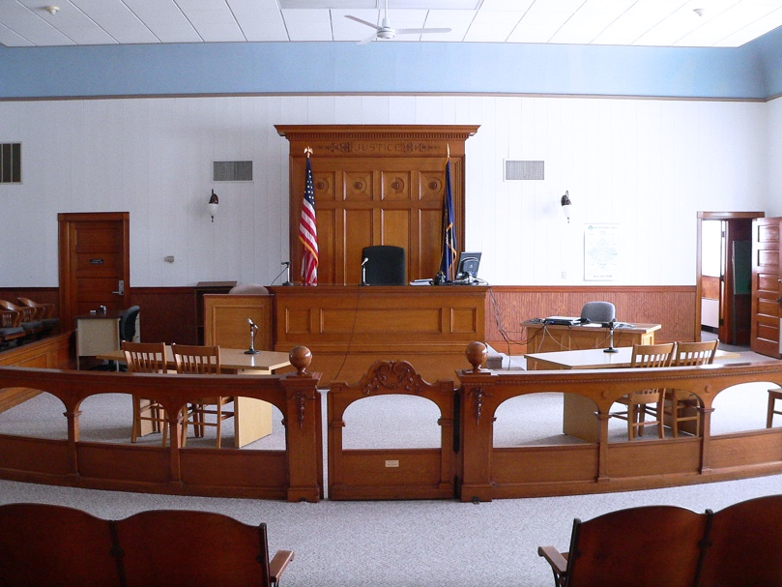
Use in criminal justice
• prosecution, defense, innocence
• reported in 45 states
• over 40 validation studies
(8 peer reviewed)
• over 30 admissibility decisions
• used in 10,000’s of cases
J. Oblock and N. Butt,
"The use of a database feature in the TrueAllele®
Casework system to cross-reference DNA cases",
American Academy of Forensic Sciences 71th Annual Meeting,
Baltimore, MD, 23-Feb-2019.

Slide 32
TrueAllele® for mass disasters
32
Matching Database
User Interface
Genotype Inference

Slide 33


More information
http://www.cybgen.com/information
• Courses
• Newsletters
• Newsroom
• Presentations
• Publications
• Webinars
http://www.youtube.com/user/TrueAllele
TrueAllele YouTube channel
perlin@cybgen.com

