Slide 1



Interdisciplinary Symposium - #S01
To See or Not to See:
Unbiased Answers to Forensic Questions
Eliminating Bias in
Forensic Algorithms and Statistics
Tuesday, February 16, 2021
1:35 - 2:30 pm Central Time
Mark W. Perlin, PhD, MD, PhD
Pittsburgh, PA
Cybergenetics © 2003-2021

Slide 2
1. Targeted approaches in Forensic Science

Slide 3
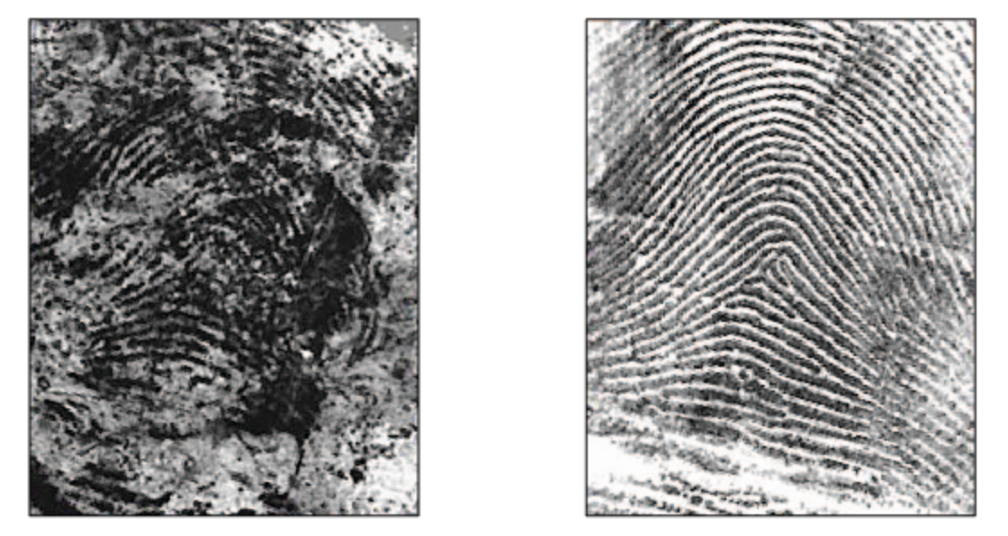
Fingerprint pattern evidence
Latent fingerprint
Madrid bombing
Exemplar fingerprint
Brandon Mayfield

Slide 4
Making a comparison: issues
Evidence
Compare
Target
Alternatives?

Slide 5
Making a comparison: issues
Evidence
Target
Alternatives?
Data Pattern
Compare
Pattern
Complexity?

Slide 6
Making a comparison: issues
Evidence
Target
Alternatives?
Data Pattern
Pattern
Complexity?
Compare
Model Features
Features
Uncertainty?
Choices?

Slide 7
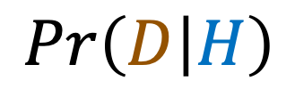
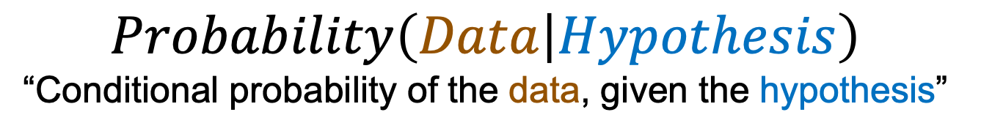
Likelihood assesses choices
$$Probability\left(Data | Hypothesis\right)$$
“Conditional probability of the data, given the hypothesis”
Data (D) is the evidence pattern
Hypothesis (H) chooses target t
$$Pr\left(D | H\right)$$
Likelihood measures how well hypothesis explains the data
A better probability model gives more accurate likelihood
Centering on target t, how well does choice explain the evidence?

Slide 8
2. Human bias in targeted approaches

Slide 9
Making choices
• Choosing evidence items
• Choosing data features
• Choosing target person
• Choosing decision criteria
Restricts possibilities & causes error
• Overstate conclusions
• Ignore other answers
Better methods do not limit choices
Instead, they consider all alternatives

Slide 10
Confirmation bias
With choices comes the risk of confirmation bias
“unwitting selectivity in the
acquisition and use of evidence”
Dr. Raymond Nickerson
Tufts University, Psychology Department
“Confirmation bias: a ubiquitous phenomenon in many guises”
Review of General Psychology, 1998; 2(2):175-220

Slide 11
Hypothesis-driven thought
Hypothesis-Determined Information Seeking and Interpretation
• Restriction of attention to a favored hypothesis
• Preferential treatment of
evidence supporting existing beliefs
• Looking only or primarily for positive cases
• Overweighting positive confirmatory instances
• Seeing what one is looking for

Slide 12
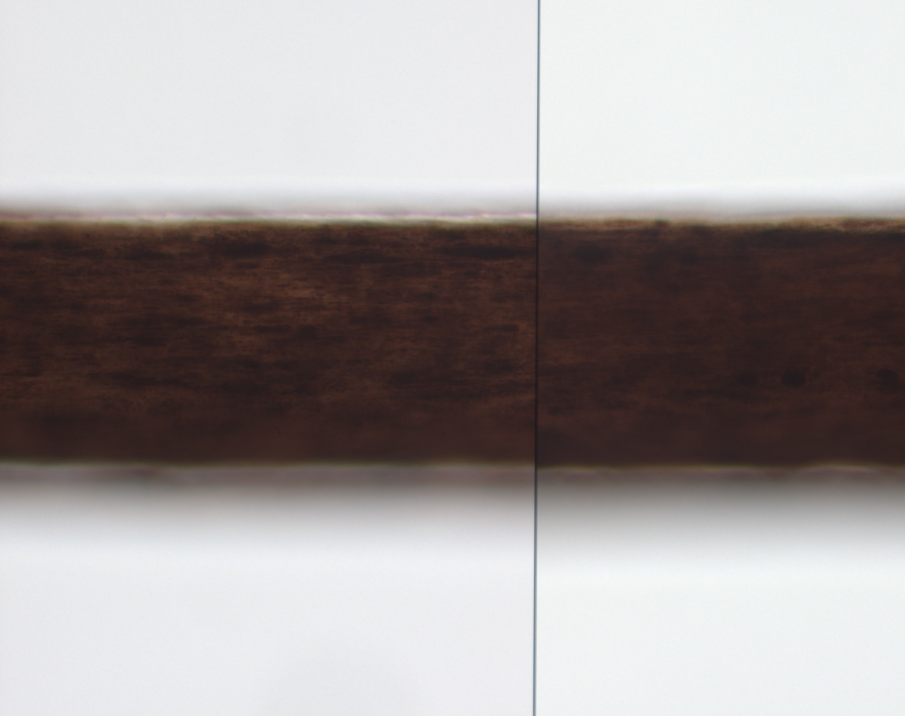
Focus on target: Pr(D|H)
Restriction of attention to a favored hypothesis
Comparing strands of hair
under a microscope
Target
Evidence

Slide 13
Focus on target
Restriction of attention to a favored hypothesis
What does non-target
hair look like?
Non-target?
Evidence

Slide 14
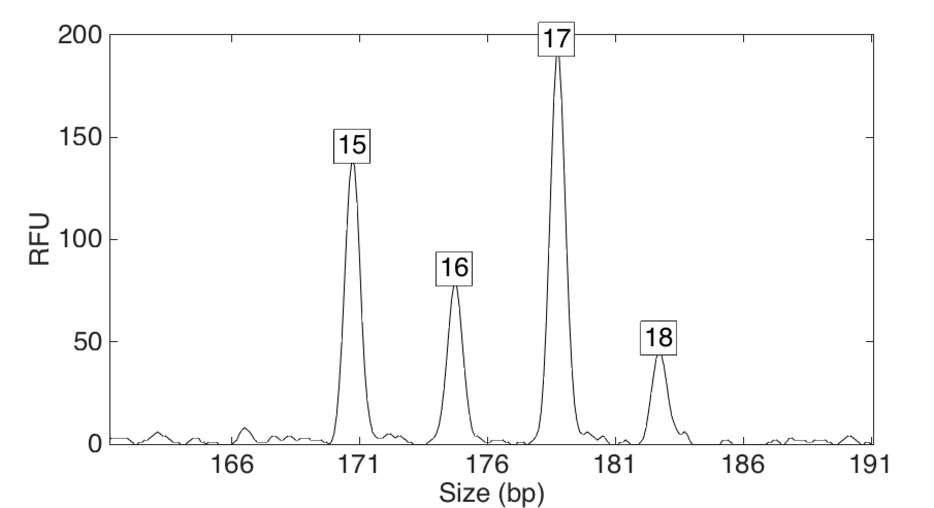
Change data for target: Pr(D|H)
Preferential treatment of evidence supporting existing beliefs
15,15
15,16
15,17
15,18
16,16
16,17
16,18
17,17
17,18
18,18
17,17 target
10 possible
genotype
values
4 alleles

Slide 15
Change data for target
Preferential treatment of evidence supporting existing beliefs
Data thresholds artificially discard exculpatory evidence
15,15
15,16
15,17
16,16
16,17
17,17
6 possible
genotype
values
3 alleles

Slide 16
Change data for target
Preferential treatment of evidence supporting existing beliefs
Higher threshold, less data that points away from target
15,15
15,17
17,17
3 possible
genotype
values
2 alleles

Slide 17
Change data for target
Preferential treatment of evidence supporting existing beliefs
17,17
1 allele
17,17 target
Fewer alternatives
inflates target’s
match statistic

Slide 18
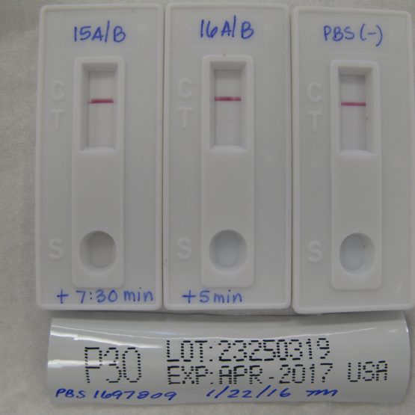
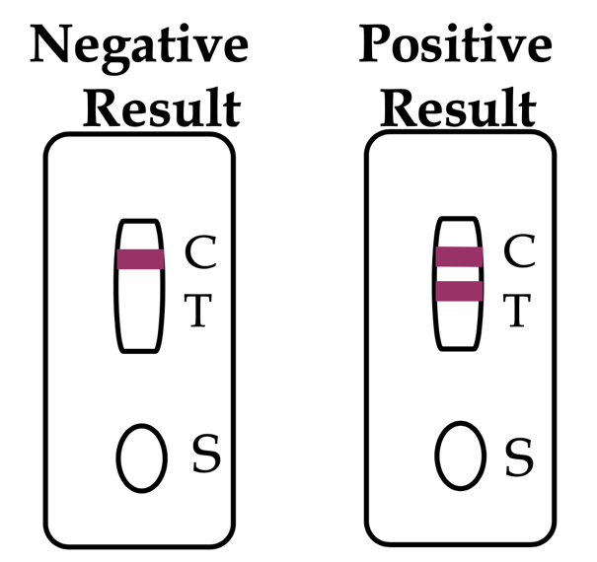
Only the positive: Pr(D+|H)
Looking only or primarily for positive cases
Weakly positive?
Control
Test
First set of tests
p30 test for semen

Slide 19
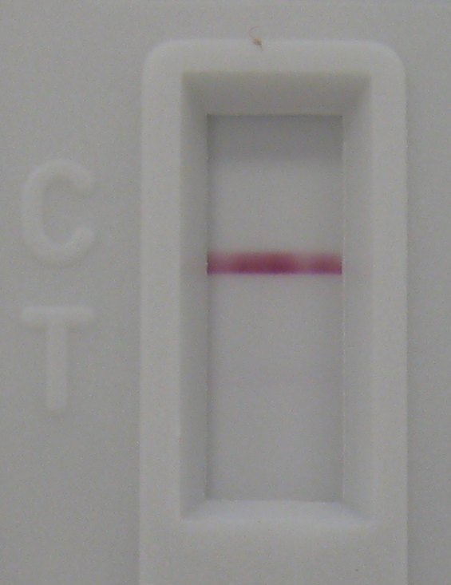
Only the positive
Looking only or primarily for positive cases
Weakly positive?
First set of tests
See the band?
Faintly?
Not at all?

Slide 20
Only the positive
Looking only or primarily for positive cases
Weakly positive?
Entirely negative
Data not shown
to jury at trial
First set of tests
Hospital
Second set of tests
Autopsy

Slide 21
Positive over negative: Pr(D|H)
Overweighting positive confirmatory instances
“How many cells must an analyst see
before they can call it semen?”

Slide 22
Seeing the target: Pr(D|H)
Seeing what one is looking for
DNA from
target defendant
No
No
Yes
Yes
DNA from victim’s body
Face
Scrotum
Rectum
Fingernails
Prosecution
theory
Facial bruising
Scrotal bruising
Anal-rectal injuries
Victim fought back

Slide 23
Seeing the target
Seeing what one is looking for
DNA from
target defendant
No
No
Yes
Yes
DNA from victim’s body
Face
Scrotum
Rectum
Fingernails
DNA from
unknown
person
Yes
Yes
Yes
Yes
Non-target alternative better explains the theory

Slide 24
3. Non-targeted approaches to Forensic Science

Slide 25
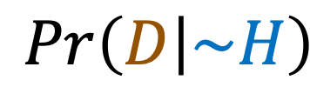
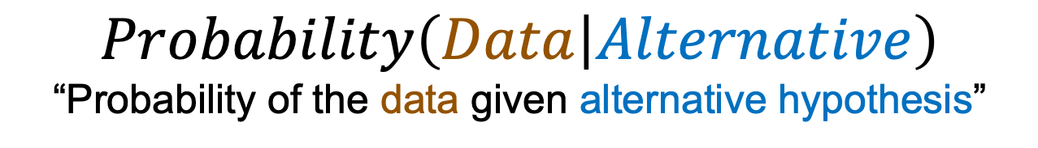
Consider all alternatives
$$Probability\left(Data | Alternative\right)$$
“Probability of the data given alternative hypothesis”
Alternative hypothesis (~H)
What if it’s someone else?
$$Pr\left(D | \sim H\right)$$
Considering the non-targets,
how well do they explain the evidence?

Slide 26
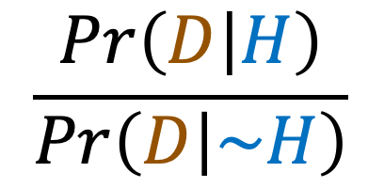


Likelihood ratio
$$\frac{Pr\left(D | H\right)}{Pr\left(D | \sim H\right)}$$
LR =
H
~H
Evaluate the evidence data under both target hypothesis H
and non-targeted complement alternative hypothesis ~H.
H & ~H are mutually exclusive and exhaustive
“an observation gives one little evidence about the probability of the truth of a hypothesis unless the probability of that observation, given that the hypothesis is true, is either substantially larger or substantially smaller than the probability of that observation, given that the hypothesis is false.” – Nickerson
$$Pr\left(D | H\right)$$
$$Pr\left(D | \sim H\right)$$

Slide 27
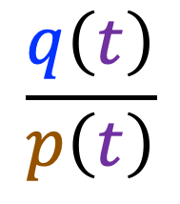
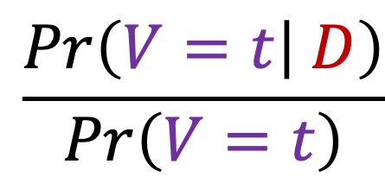
Likelihood ratio forms
Likelihoods are computed from forensic model variables.
A variable V is an uncertain quantity, taking multiple values.
Probability form of the LR (from Bayes Theorem):
Posterior probability q of target t, after examining evidence D.
$$\frac{q\left(t\right)}{p\left(t\right)}$$
$$\frac{Pr\left(V=t | D\right)}{Pr\left(V=t\right)}$$
LR =
=
Prior probability p of target t, before seeing evidence.
Perlin MW. “Explaining the likelihood ratio in DNA mixture interpretation.” Promega's Twenty First International Symposium on Human Identification; San Antonio, TX 2010.

Slide 28
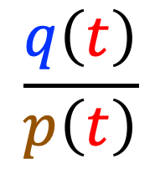
Non-targeted approach
1. Without looking at the target t, find:
Prior probability p(v), for all values v in V,
before looking at the evidence D.
From population prevalence studies.
Posterior probability q(v), for all values v in V,
after analyzing the evidence D.
Usually involves statistical computing.
2. Afterwards, plug in the target value t:
$$\frac{q\left(t\right)}{p\left(t\right)}$$
LR(t) =

Slide 29
4. Decoupling data analysis and comparison

Slide 30
Likelihood for DNA mixture
A four-genotype explanation at one STR locus.
Consider all possible genotypes and amounts.
Better
explanation
has a higher
likelihood
Explain the
peak pattern

Slide 31
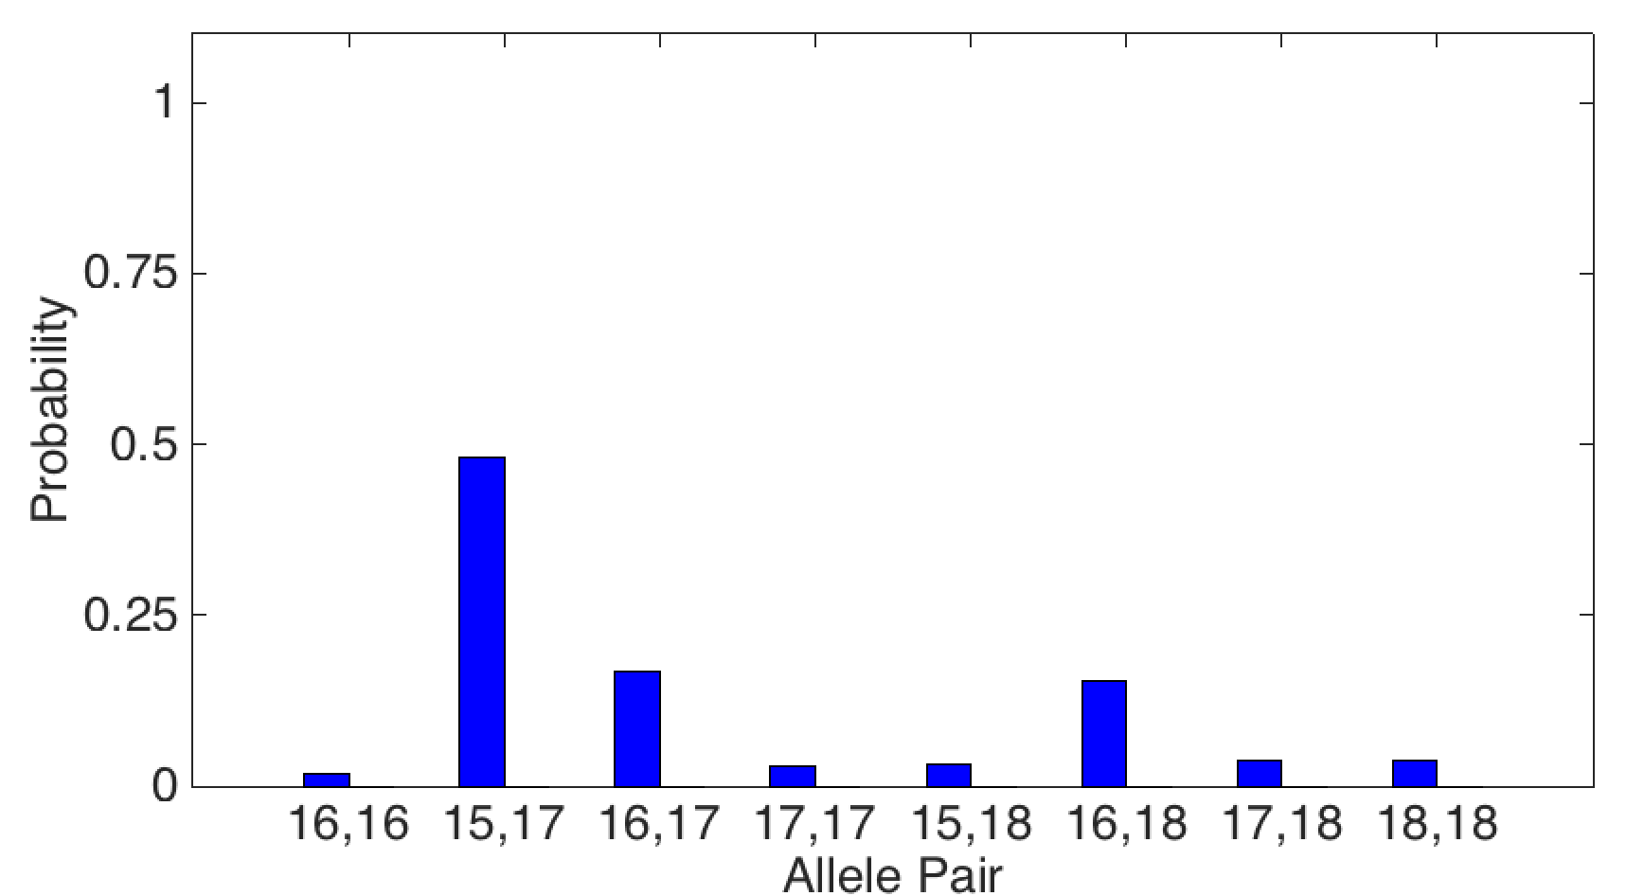
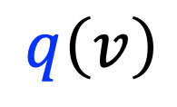
Posterior genotype probability
Separate out an evidence genotype
from the mixture data with statistical computation.
$$q\left(v\right)$$
48%
17%
16%
2%
3%
3%
4%
4%

Slide 32
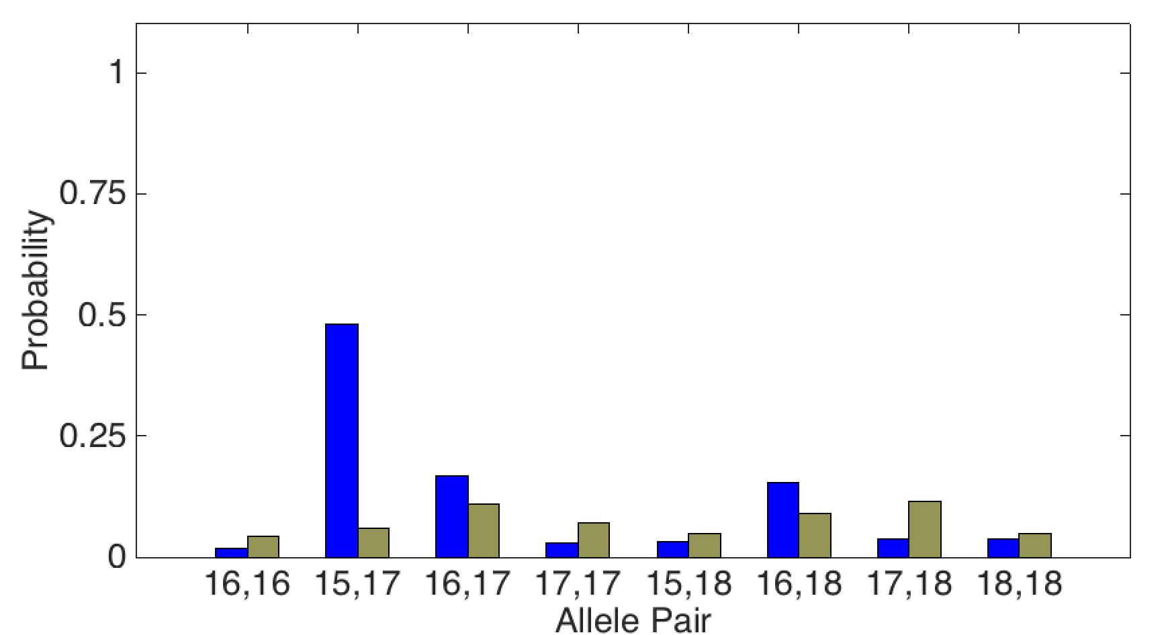
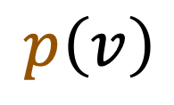
Prior genotype probability
All genotype possibilities considered without bias.
The target isn’t known yet.
$$q\left(v\right)$$
$$p\left(v\right)$$
&
48%
17%
16%
2%
3%
3%
4%
4%

Slide 33
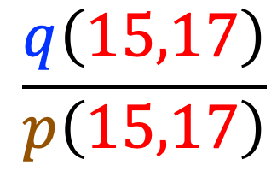
Likelihood ratio – at target
Now set a target t, say the 15,17 allele pair.
Focus on the target only after analyzing evidence.
$$\frac{q\left(15,17\right)}{p\left(15,17\right)}$$
8x
= LR(15,17)
= 8
48%
6%

Slide 34
Objective LR: two steps
• Objective, unbiased two-step approach
• Split LR calculation into two parts
• Eliminate direct pattern comparison
• Work with data features instead
• Use all the STR genotyping data
• Consider all alternative genotypes
Non-targeted probabilistic approach:
Target is unknown when examining evidence data
Approach can eliminate bias in other forensic subdisciplines
Perlin MW, Kadane JB, Cotton RW.
“Match likelihood ratio for uncertain genotypes.”
Law, Probability and Risk. 2009;8(3):289-302.

Slide 35
5. DNA case example: targeted vs. non-targeted

Slide 36
California v. Lopez
Man accused of rape and murder of girlfriend’s toddler son
• Facing the death penalty, or life in prison.
• The child was 2 years and 10 months old.
• There were bruises to his face, genitals, and rectum.
• An autopsy showed brain swelling, skull fracture, cheek bruises, and asphyxia.
• A rectal swab from the boy showed semen.
• The swab matched the defendant’s DNA.

Slide 37
Two different views
Prosecution. The defendant raped and killed a two-year old boy who lived in his house.
Defense. An abused toddler died. The defendant had nothing to do with his death.

Slide 38
Defendant’s hair on clothes bag?
Comparing strands of hair
under a microscope
Target
Evidence

Slide 39
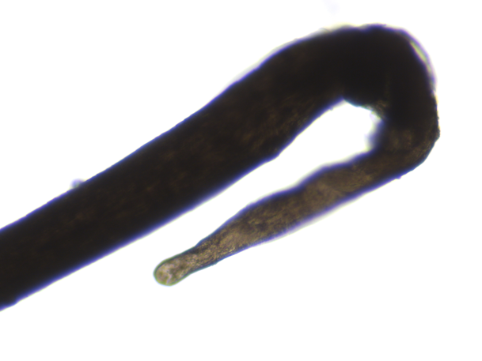
Hair match statistics (DNA,PG)
 |  |  | Person in
H1 hair root found on the bag | 2 REF Sister | X | 21A EC on 17 items | X
 | 3 REF Brother | X | 21D SP on 7 items | X
 | 23 Mother | X | 7B-4 SP on 8 items | X
 | 24 Defendant | X | 8C SP on 8 items | X
 | 25 Brother | X
 | 35 Victim | X

Slide 40
Def’s semen in victim’s rectum?
Weakly positive?
Entirely negative
p30
First in hospital
Later at autopsy

Slide 41
Rectal swabs at hospital (DNA)
 |  |  | Person in
16A/B SP first set of rectal swabs sperm fraction | 2 REF Sister | X | 21A EC on 17 items | X
 | 3 REF Brother | X | 21D SP on 7 items | X
 | 23 Mother | X | 7B-4 SP on 8 items | X
 | 24 Defendant | 3.81 | 8C SP on 8 items | X
 | 25 Brother | X
 | 35 Victim | X

Slide 42
Rectal swabs at autopsy (DNA)
 |  |  | Person in
39A/B SP second set of rectal swabs sperm fraction | 2 REF Sister | X | 21A EC on 17 items | X
 | 3 REF Brother | X | 21D SP on 7 items | X
 | 23 Mother | X | 7B-4 SP on 8 items | X
 | 24 Defendant | X | 8C SP on 8 items | X
 | 25 Brother | X
 | 35 Victim | 2.79

Slide 43
Def’s sperm on victim’s penis?
One cell seen
“How many cells must an analyst see
before they can call it semen?”

Slide 44
Penile swabs (STR)
 |  |  | Person in
38A/B SP second set of penile swabs sperm fraction | 2 REF Sister | X | 21A EC on 17 items | X
 | 3 REF Brother | X | 21D SP on 7 items | X
 | 23 Mother | X | 7B-4 SP on 8 items | X
 | 24 Defendant | X | 8C SP on 8 items | X
 | 25 Brother | X
 | 35 Victim | 7.57
Y-STR positive

Slide 45
Forensic DNA evidence
Crime Laboratory
STR analyzed 97 evidence items
Reported 43 matches
Discovered 1 unknown person
Cybergenetics
Processed 77 items using TrueAllele®
Reported 138 matches
Discovered 5 unknown people

Slide 46
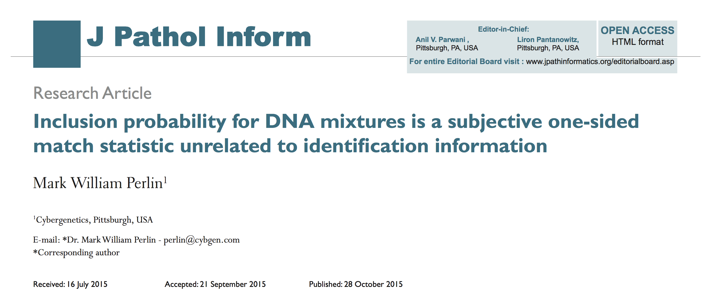
Targeted DNA – manual review
CPI/RMNE just counts how many loci an analyst reported

Slide 47
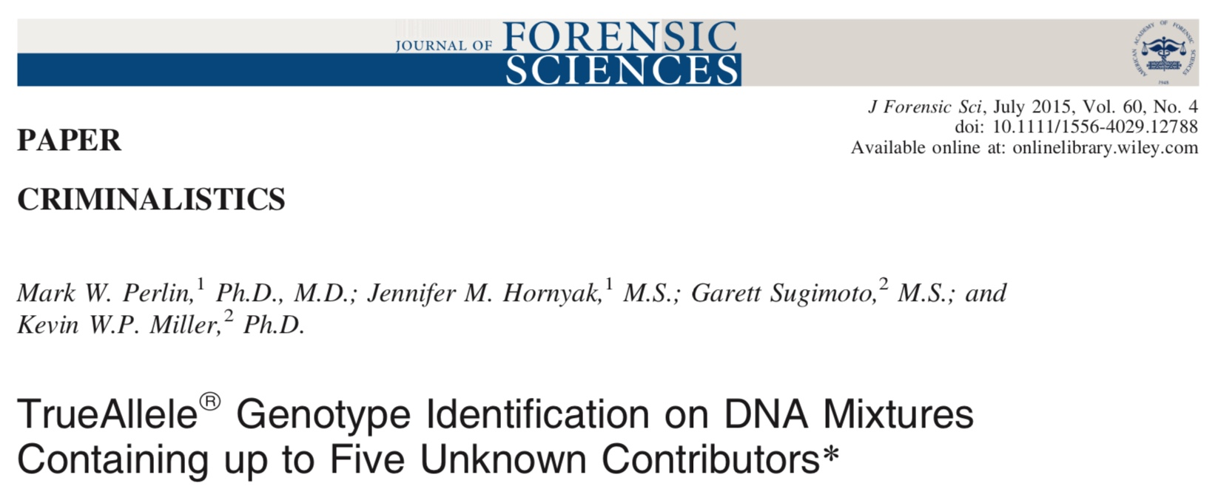
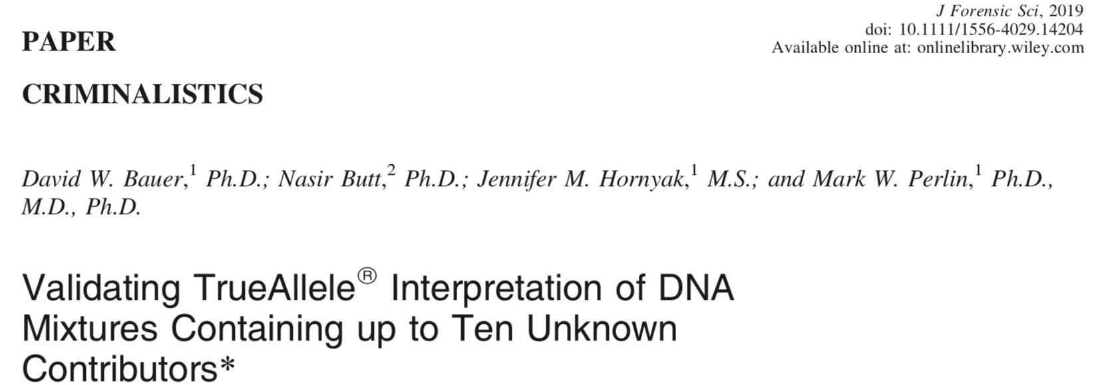
Untargeted DNA
computer review

Slide 48
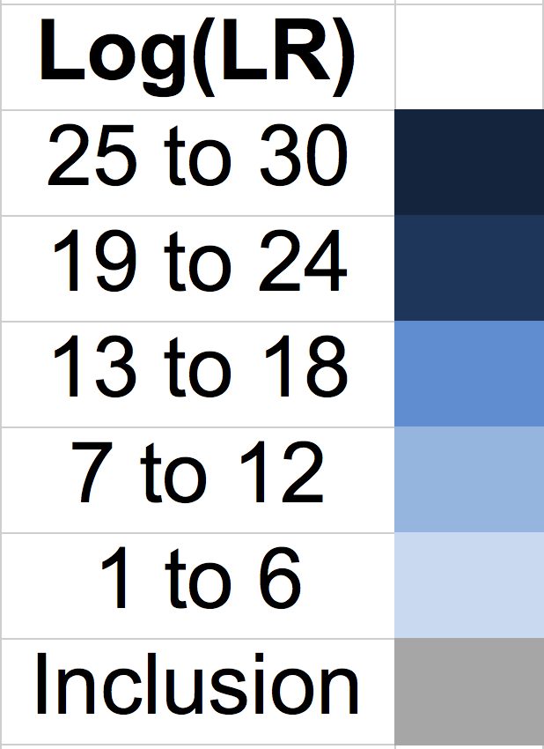
Crime lab vs. TrueAllele
information comparison
First 3 charts
County Crime Lab
Manual review
Second 3 charts Cybergenetics TrueAllele PG

Slide 49
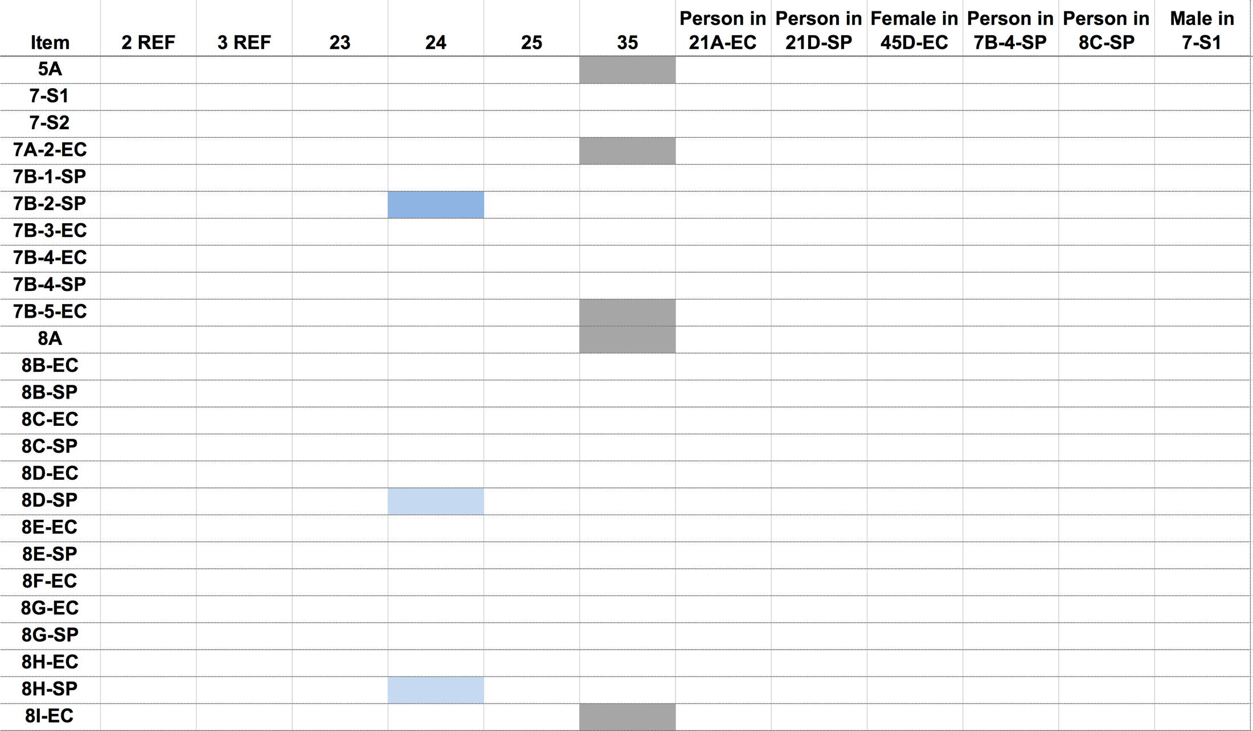
County Crime Lab (1 of 3)
Sister
Brother
Mother
Defendant
Brother
Victim

Slide 50
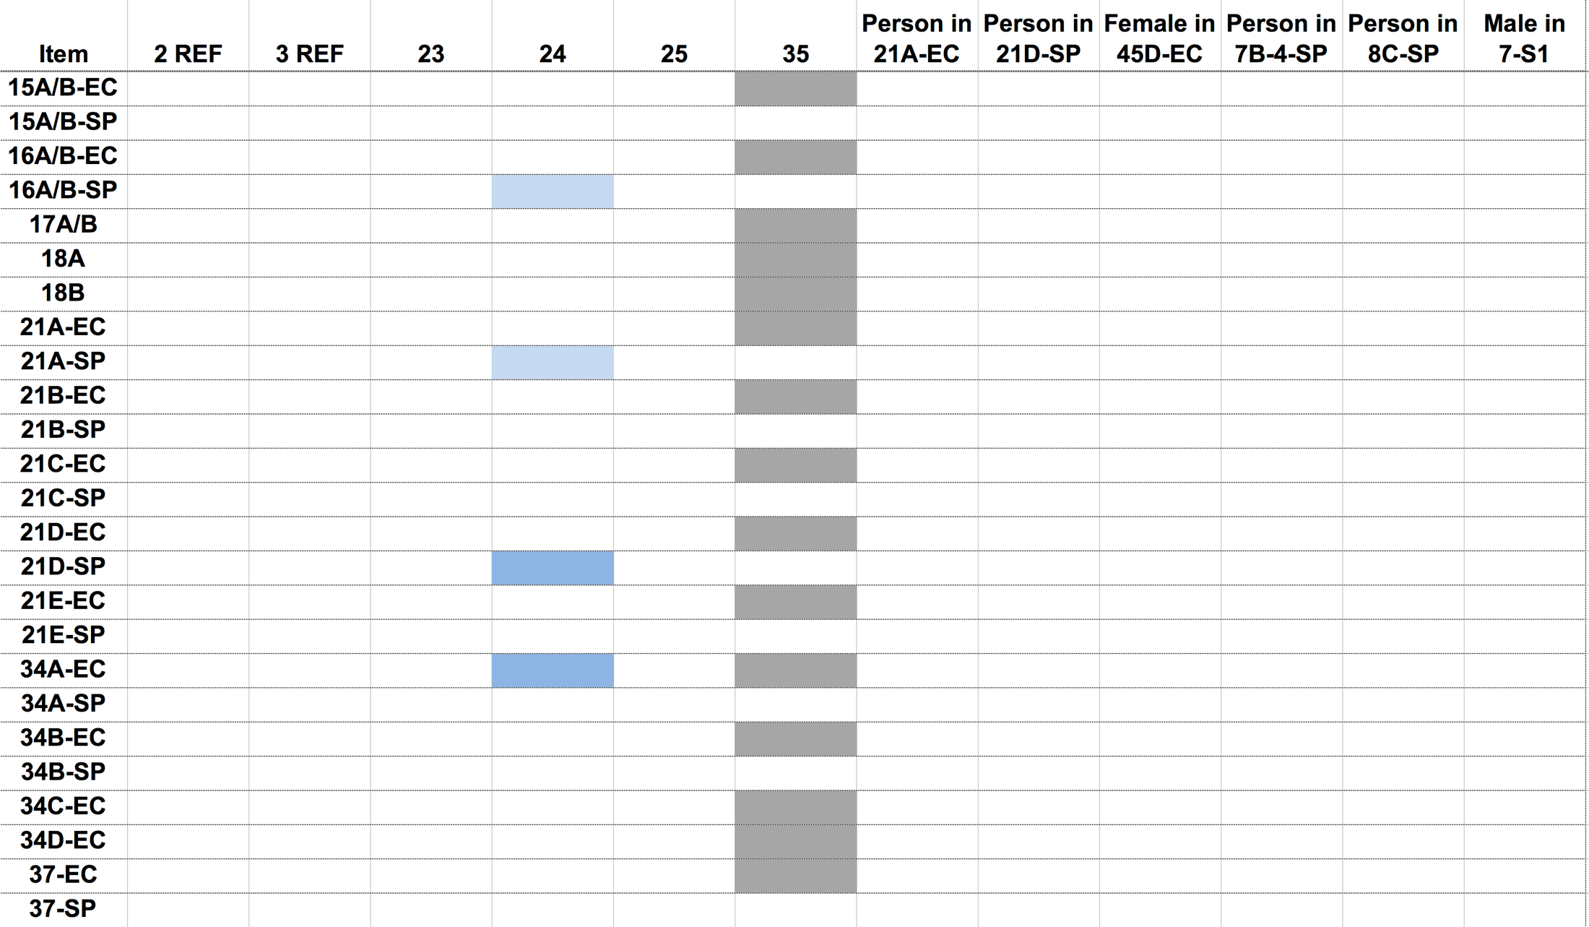
County Crime Lab (2 of 3)
Sister
Brother
Mother
Defendant
Brother
Victim

Slide 51
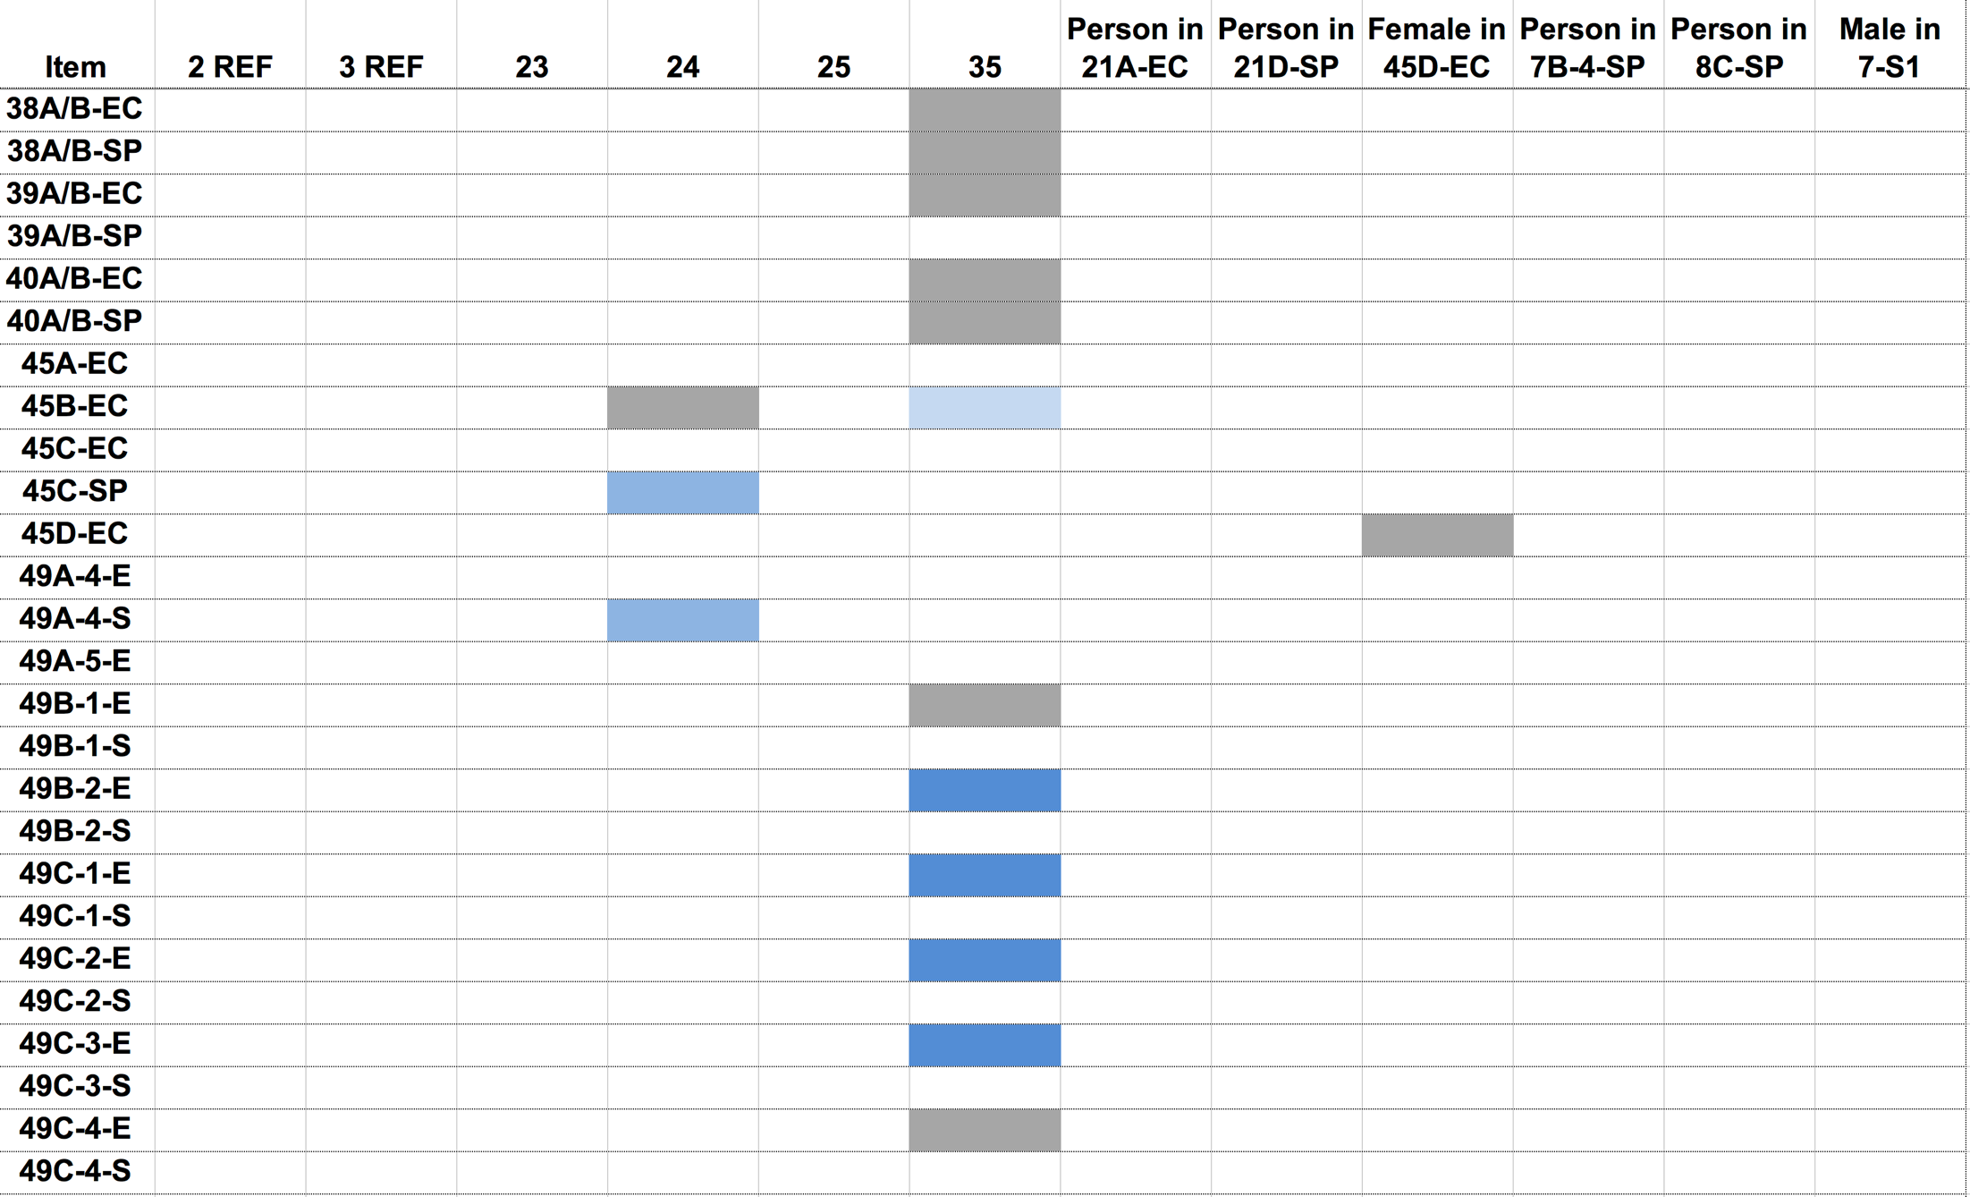
County Crime Lab (3 of 3)
Sister
Brother
Mother
Defendant
Brother
Victim

Slide 52
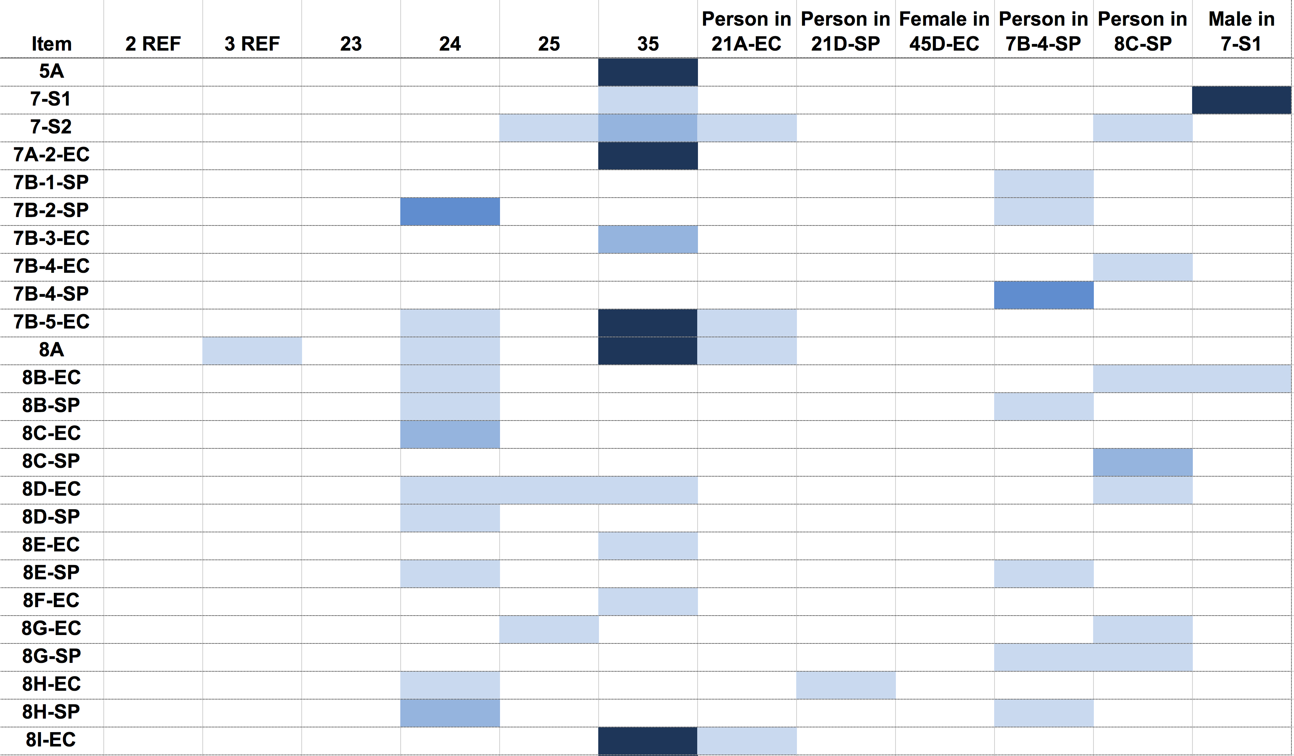
Cybergenetics TrueAllele (1 of 3)
Sister
Brother
Mother
Defendant
Brother
Victim

Slide 53
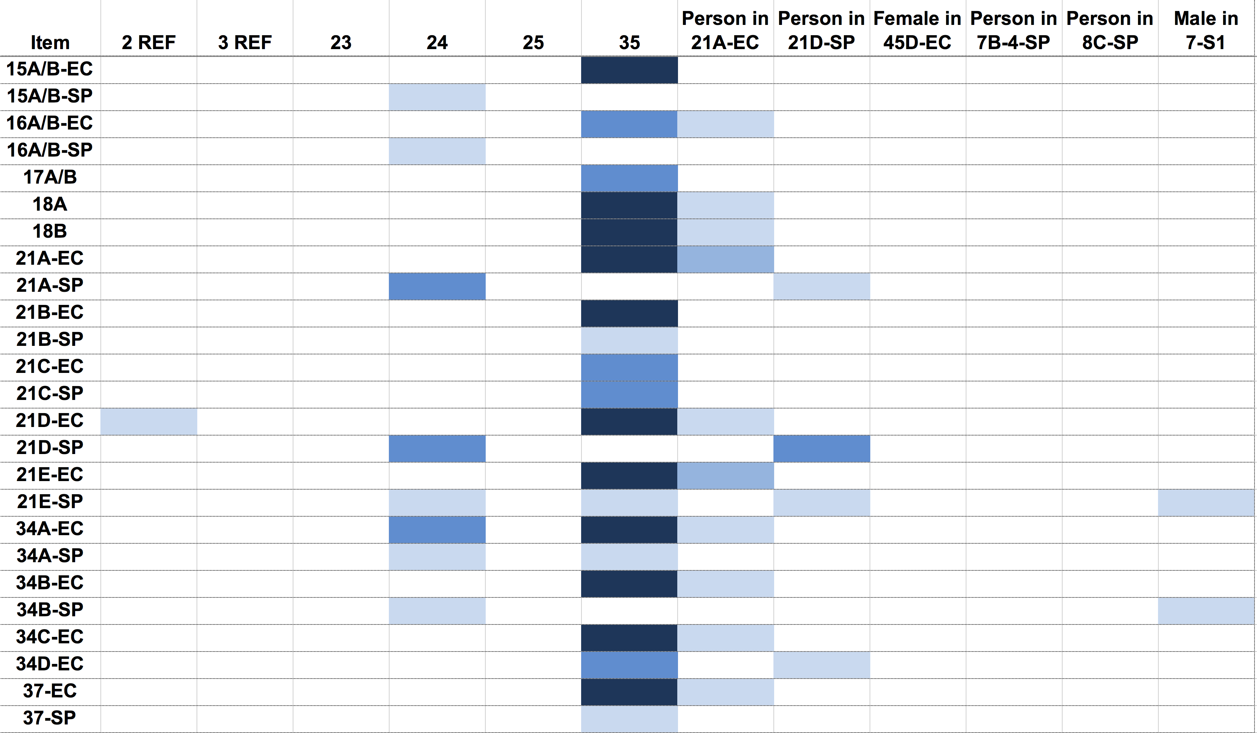
Cybergenetics TrueAllele (2 of 3)
Sister
Brother
Mother
Defendant
Brother
Victim

Slide 54
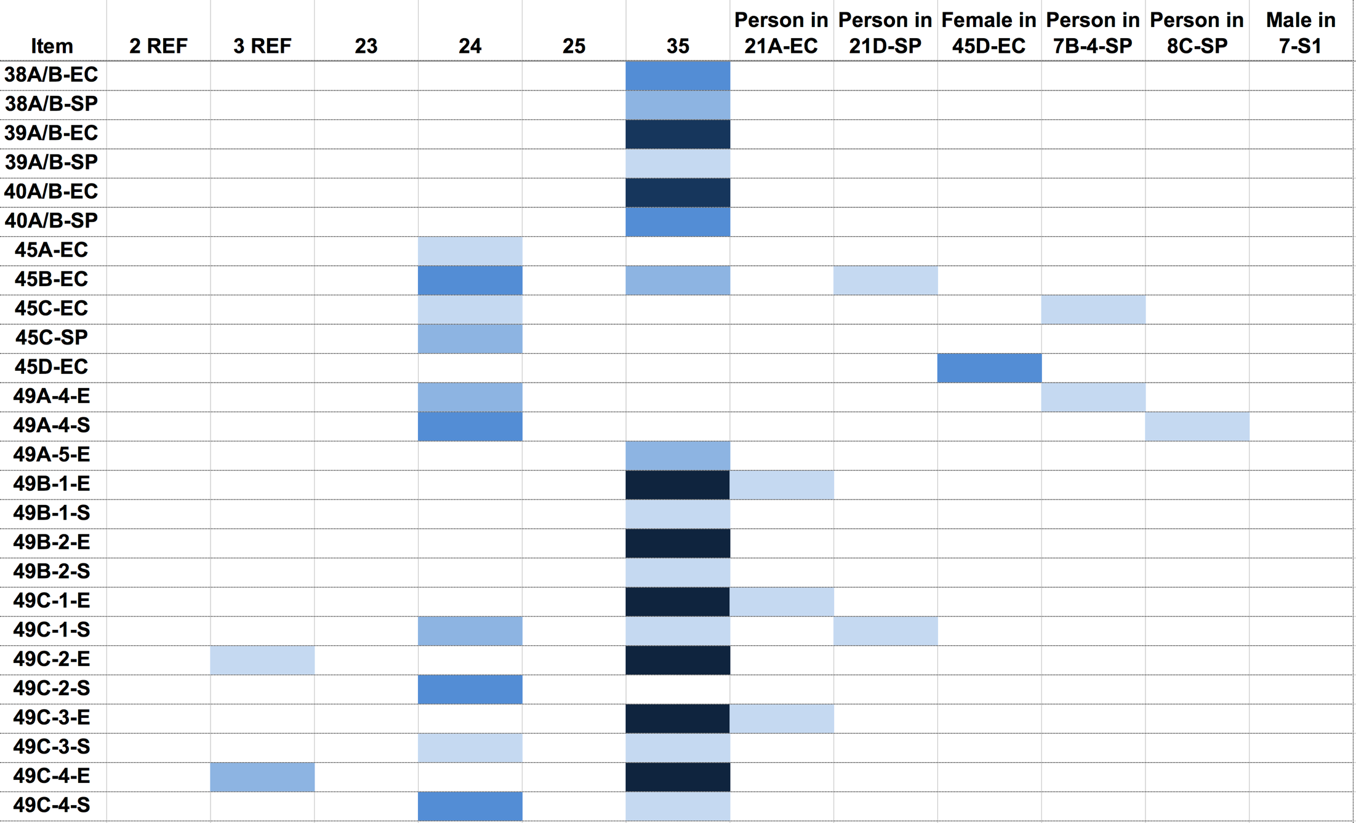
Cybergenetics TrueAllele (3 of 3)
Sister
Brother
Mother
Defendant
Brother
Victim

Slide 55
Two strange puzzles
• Where’s Mom’s DNA?
Lots of different people left lots of DNA,
but the primary caretaker left none.
• Rectal DNA conflict
Why was the defendant’s DNA found
in the initial hospital rectal swabs (Item 16),
but not later at autopsy (Item 39)?

Slide 56
Two different views
Same DNA evidence, different conclusions
Prosecution. The forensic evidence shows that the defendant raped and killed the two-year old boy who lived in his house.
Defense. An abused toddler died. The forensic evidence shows that the defendant had nothing to do with his death.
Confirmation bias
Assume H, conclude H.
Assume ~H, conclude ~H.

Slide 57
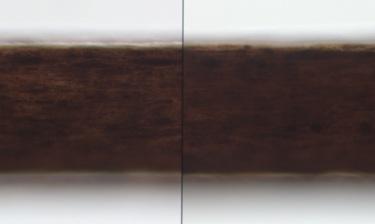
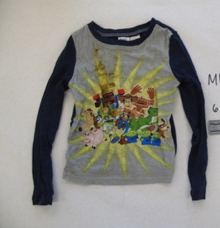
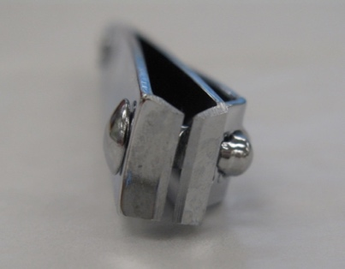
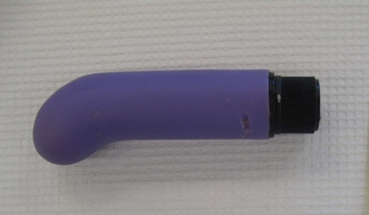
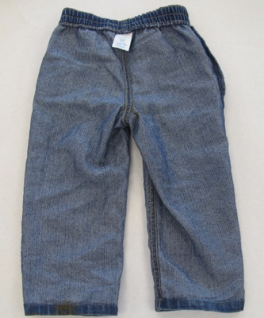
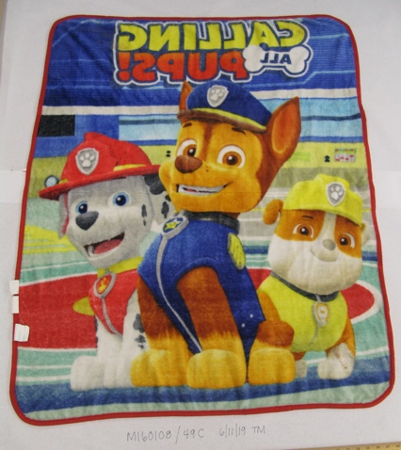
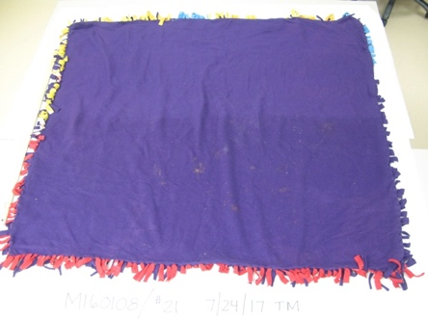
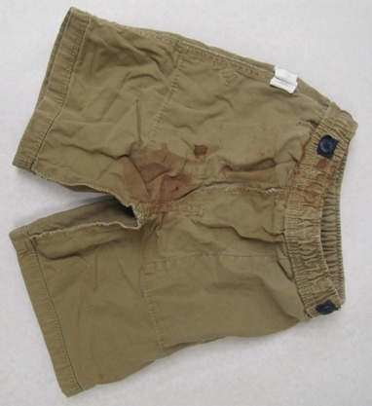
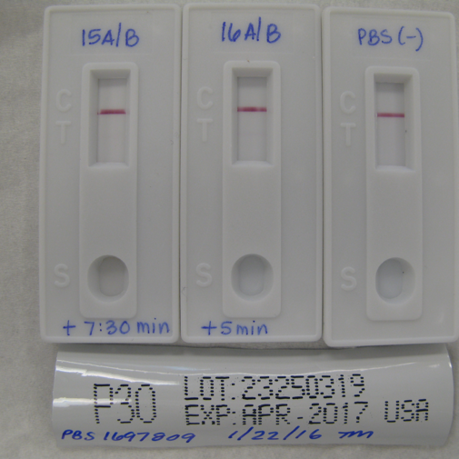
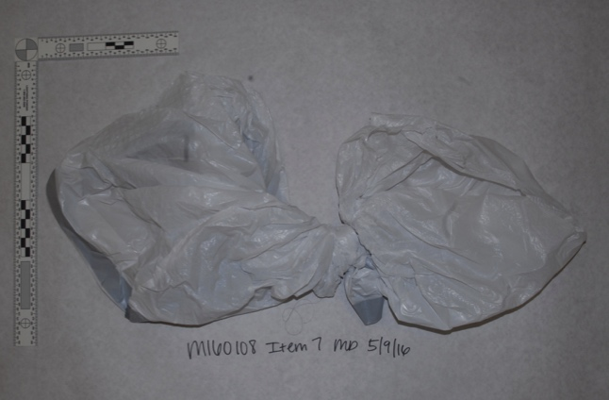
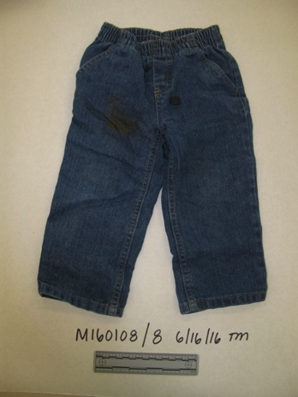
The prosecution sees crime
Forensics proves guilt; defendant’s DNA is everywhere

Slide 58
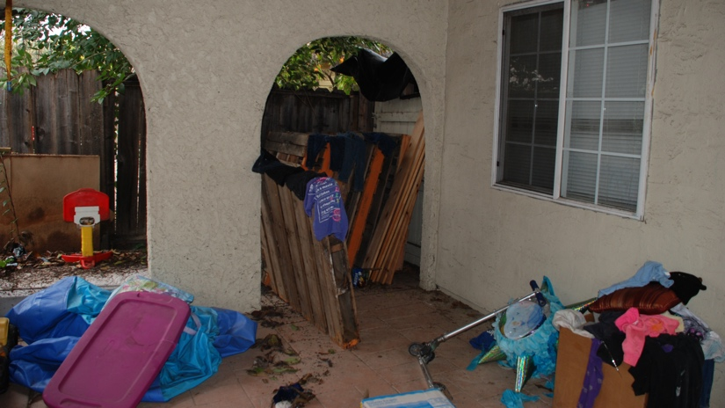
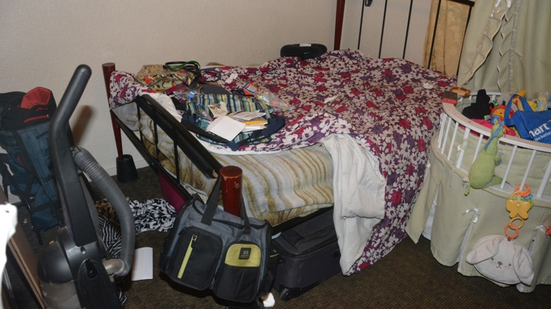
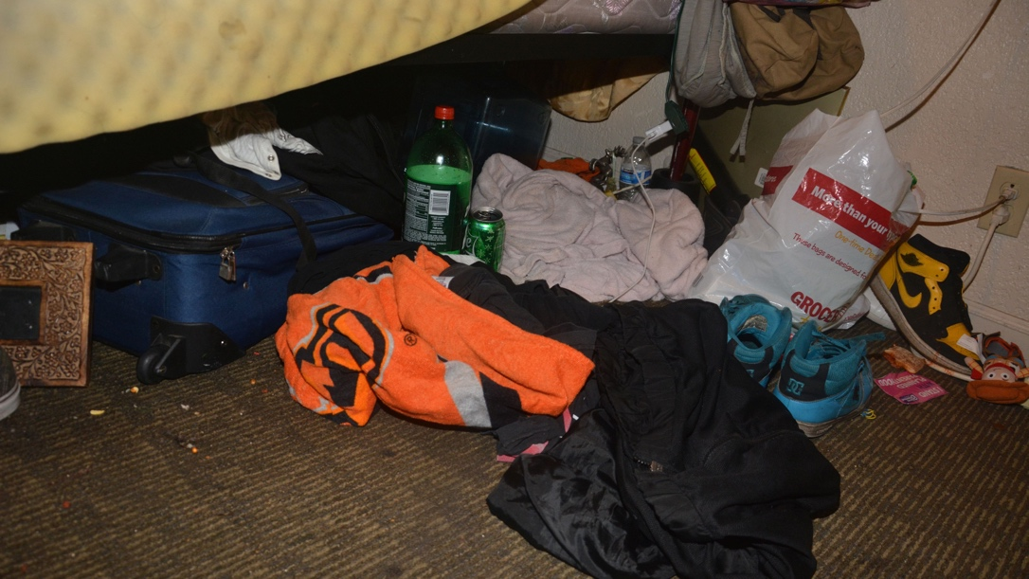
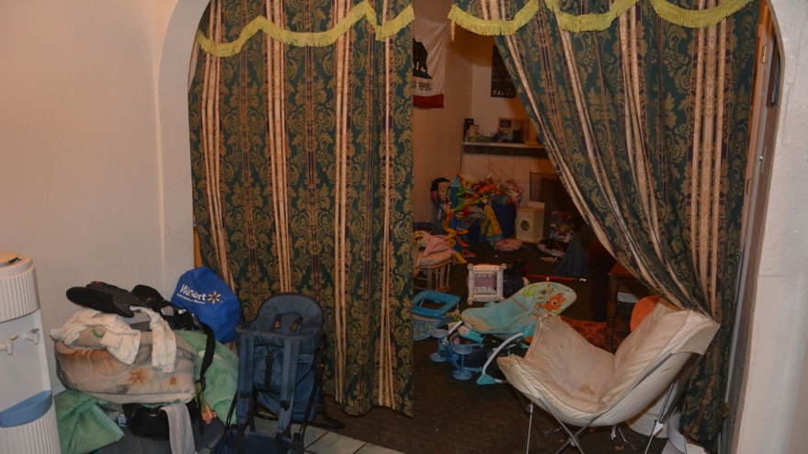
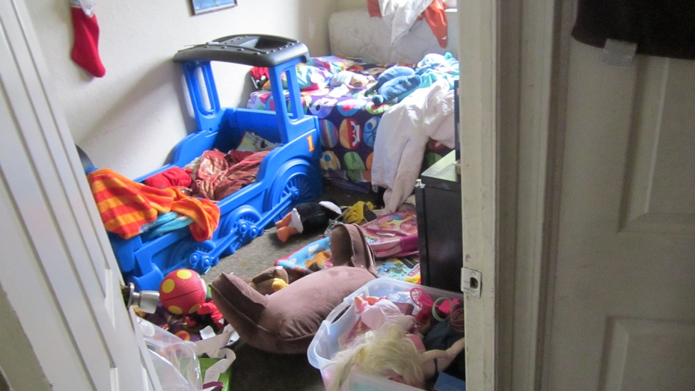
The defense sees no criminal
Lots of people’s DNA in a messy dirty spermy house

Slide 59

Where’s Mom’s DNA?
Q Did you and the defendant have sex that night?
Mother Just a blow job.
Q Did he ejaculate inside your mouth?
A Yeah.
Q What did you do after that?
A Went and cleaned myself off.
Q What did you clean yourself up with?
A Baby wipes.
Q And then what did you do with the baby wipes afterwards?
A Threw them away.
Q Where did you throw the baby wipes away?
A I don't remember if I threw them in the trash can in my bedroom or if I threw them in the restroom trash.

Slide 60

Mother’s DNA masked
Her hands were covered in defendant’s semen
The child was in toilet training.
The child’s primary caregiver had
the defendant’s semen on her hands.
Swamping her own DNA as she attended to her child.
Which is why we couldn’t detect her DNA.
The mother was spreading the defendant’s semen:
from her hands, to baby wipes, to garbage bags,
and whatever she touched – like to her child.
There was no probative value in this expected DNA.

Slide 61
Rectal DNA conflict
Q And in this particular investigation at the hospital, did you collect DNA swabbing from the victim’s anus?
Pathologist Yes, sir.
Q And how did you do that?
A The same way we did for his genitals. Swabs were broken from a sterile package, sterile water was applied. I would place the swabs around the skin of anus in a circular manner, insert an inch to two inches, pull them out, and then they would have been handed off to law enforcement.
Q Okay. So you never stuck the swab into the rectum or into the anus more than two inches?
A Right. The beginning part of the anus and rectum is sufficient.

Slide 62
Rectal/anal cleaning swab
At the hospital. The mother had transferred the defendant’s semen from her hands to the toddler’s bottom. The first pathologist swabbed his anus, cleaning the external (anal) semen onto the swab. Before the swab was rectally inserted, the so-called “rectal swab” already contained external (anal) semen.
At the autopsy. The toddler’s bottom had been cleaned by the first hospital swabbing. No more external (anal) semen; and there never was any internal (rectal) semen. So the second “rectal swab” was devoid of DNA. No external semen to collect.
Misleading terminology: “anal/rectal” swab, not “rectal” swab.

Slide 63
Final verdict
The prosecution was target-driven.
The defense was nontarget-driven.
Forensic experts educated the jury.
The nontargeted scenario better explained the evidence.
The jury acquitted the defendant of all charges.
The county no longer seeks the death penalty.

Slide 64
6. Impact of non-targeted methods on justice

Slide 65
Eliminate human bias
Confirmation bias is real, prevalent, and dangerous
Targeted forensics can introduce confirmation bias
Likelihood ratios consider both targets and nontargets
The LR can be calculated without targeting suspects
Split the calculation into two parts:
1. Examine the evidence for probabilities p & q
for all possible untargeted values
without ever seeing the target
2. After step 1, plug in the target value

Slide 66
Unbiased forensic science
Limited DNA analysis targeted Lopez
The forensics led to his prosecution
He faced the death penalty
Better untargeted methods saved him
Lopez is the tip of the forensic iceberg
Innocent people need better forensics
Victims of crime need better forensics
Past, present & future cases need
accurate, objective, automated solution

Slide 67
Thank you
American Academy
Christopher Milroy
Agnes Winokur
Cybergenetics
William Allan
Jennifer Bracamontes
Public Defender
Kelley Kulick
Michael Ogul
Contact information
perlin@cybgen.com
www.cybgen.com

