Slide 1
Developing investigative leads from a probabilistic genotyping database
David W. Bauer¹, PhD
Nasir Butt², PhD
Jeffrey Oblock²
Mark W. Perlin¹, PhD, MD, PhD
¹Cybergenetics
Pittsburgh, PA
²Cuyahoga County
Forensic Laboratory
Cleveland, OH
Cybergenetics © 2003-2019

Slide 2
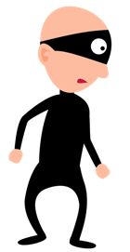
DNA evidence chain
• DNA can provide identification information
• DNA data requires interpretation
Genotype
• Link culprit to crime scene
ATCGACTGATCGACGAGAACTACGATAGAGAC
DATA

Slide 3
A broken link
• Manual methods simplify the data
• DNA identification information lost
Allele
List
• Minimal connection back to culprit
ATCGACTGATCGACGAGAACTACGATAGAGAC
Human
interpretation
DATA

Slide 4
Probabilistic Genotyping
• TrueAlleleTM probabilistic genotyping
• Uses all of the data
• Preserves ID information
Genotype
• Connect culprit to crime scene
ATCGACTGATCGACGAGAACTACGATAGAGAC
DATA

Slide 5
Investigative TrueAllele Database
Create leads for criminal investigations
evidence
suspect
• Link suspect to evidence within cases
• Link suspects to other cases
evidence
suspect
• Link evidence between crime scenes
evidence

Slide 6
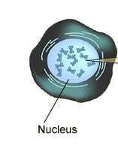
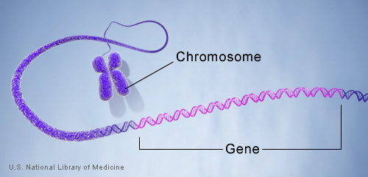
STR genotype
Cell
locus
DNA
ACGT
Mother allele
1
2
3
4
5
6
7
8
9
Father allele
1
2
3
4
5
6
7
8
9
10
11
12

Slide 7
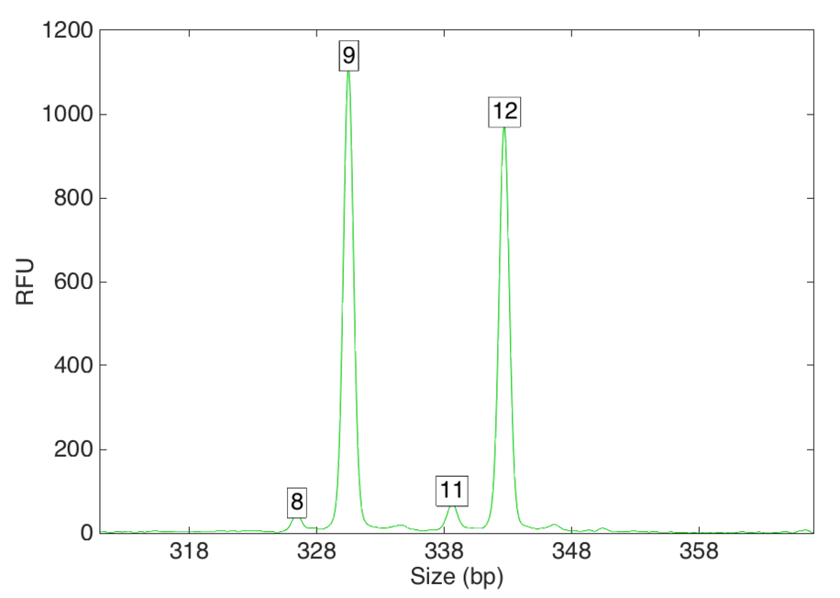
STR data
Task: to infer genotypes from peaks
Data focuses probability
before
after
Single source
9
…
12
…
9, 9
3%
9, 9
9, 10
6%
9, 10
9, 11
3%
RFU
9, 11
9, 12
4%
9, 12
100%
10, 10
2%
10, 10
10, 11
5%
10, 11
10, 12
3%
8
11
10, 12
…
…
Size (bp)

Slide 8
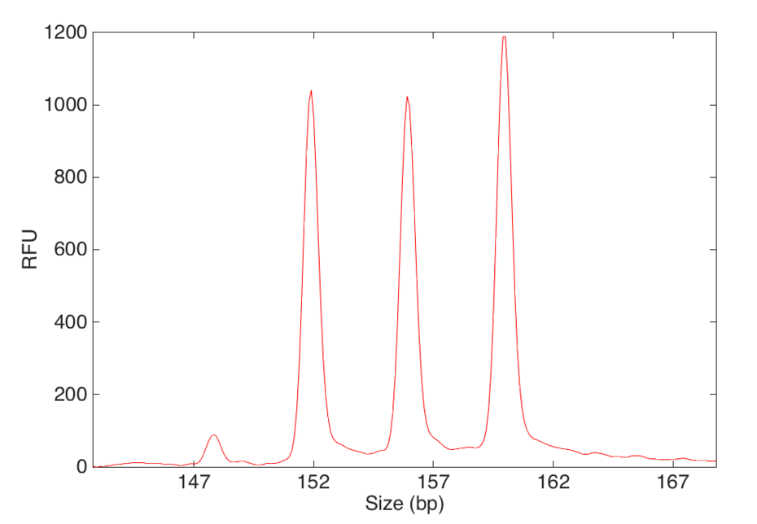
STR mixture data
more complexity
more uncertainty
less focused
probability
9
No single answer
2 person mixture
7
8
…
7, 7
40%
7, 8
2%
RFU
7, 9
3%
8, 8
35%
8, 9
5%
9, 9
15%
Size (bp)
…

Slide 9
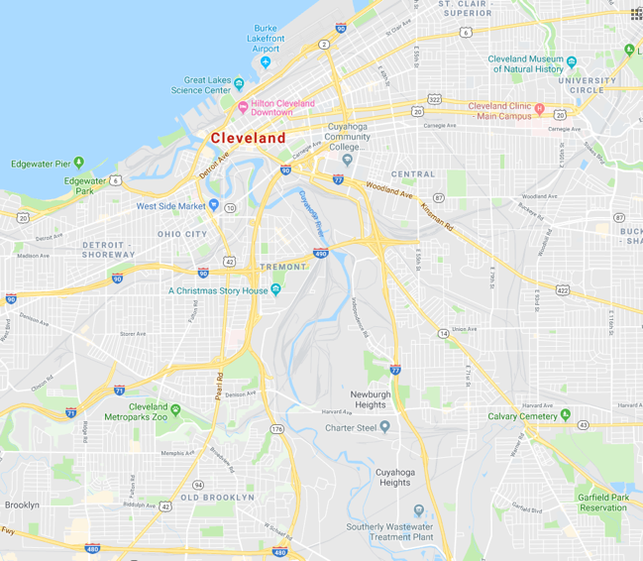
Cleveland auto thefts
• Spike in auto thefts during summer/fall 2015
• Gang involvement suspected
37 cases
• 161 DNA evidence samples
• 72 references samples

Slide 10
The challenges: Throughput
161
evidence samples
72
references
~12,000
comparisons
X
=
12,000
comparisons
10
minutes per
comparison
> 2,000
human-hours
X
=
• A lot of human time performing repetitive task

Slide 11
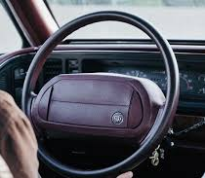
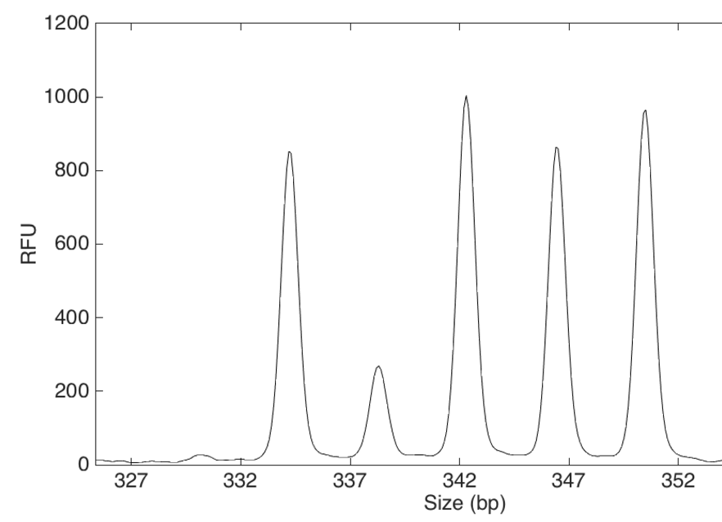
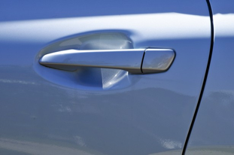
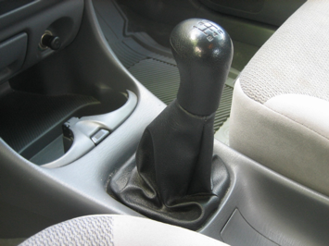
The challenges: Data complexity
Reported
conclusions:
“…complexity of the data…”
“…mixture of at least 3 individuals…”
“…therefore, no further conclusions can be drawn.”
11
13
9
12
RFU
10
8
Size (bp)

Slide 12
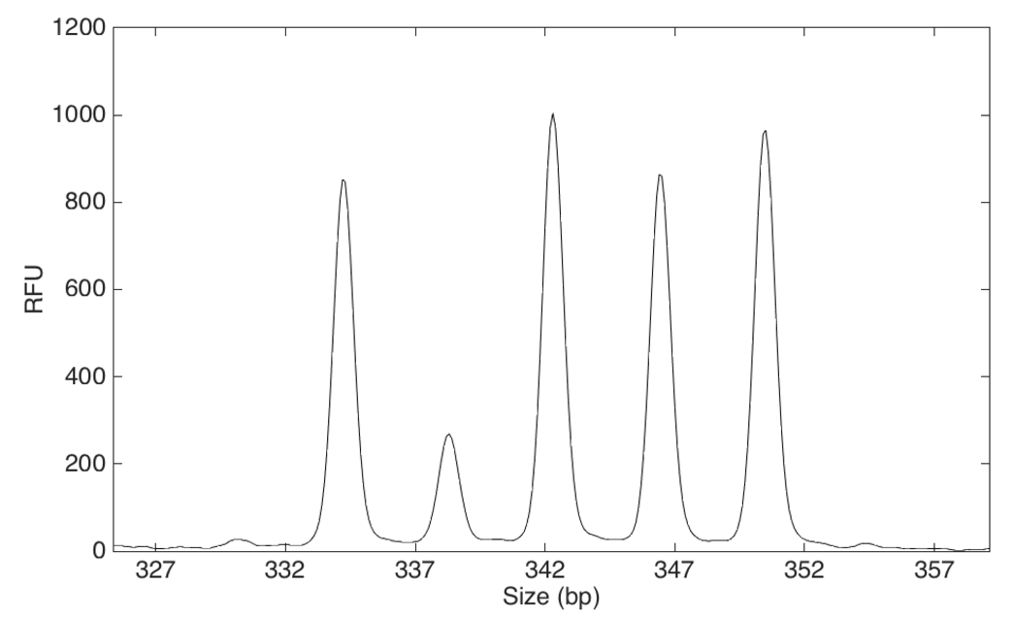
Interpreting complex data
- TrueAllele computer proposes possibilities
- Compares with data to calculate probability
- Good explanations
higher probability
11
13
9
12
minor
major
RFU
middle
10
8
Size (bp)

Slide 13
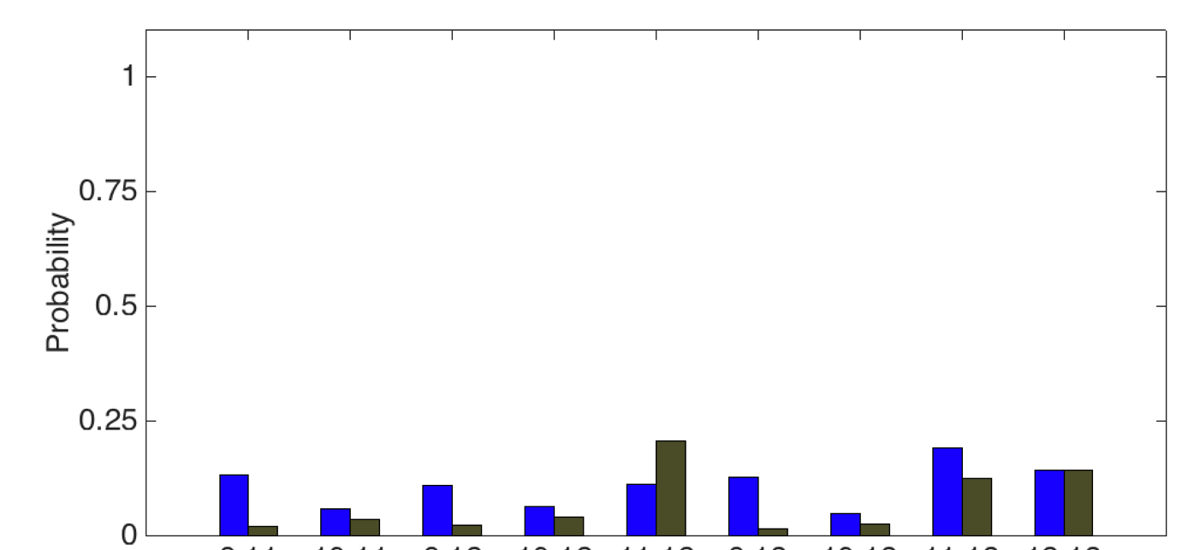
Uncertainty ≠ Uninformative
• TrueAllele separates out genotypes from data
Evidence genotype for major contributor
Probability
9,11
10,11
9,12
10,12
11,12
9,13
10,13
11,13
12,13
Allele pair

Slide 14
Uncertainty ≠ Uninformative
• TrueAllele separates out genotypes from data
Evidence genotype for major contributor
Probability
Allele pair frequency from population
9,11
10,11
9,12
10,12
11,12
9,13
10,13
11,13
12,13
Allele pair

Slide 15
Uncertainty ≠ Uninformative
• Use genotypes to calculate match statistics
Likelihood ratio (LR) =
Prob(evidence match)
Prob(coincidental match)
Probability
7x
14%
2%
9,11
10,11
9,12
10,12
11,12
9,13
10,13
11,13
12,13
Allele pair

Slide 16
Uncertainty ≠ Uninformative
• Allele lists loose identification information
Allele list
9, 10, 11, 12, 13
1/CPI
1.14
Probability
7x
14%
2%
9,11
10,11
9,12
10,12
11,12
9,13
10,13
11,13
12,13
Allele pair
Notes:
3.24, 5.92, 29.7, 34.4, 20.6

Slide 17
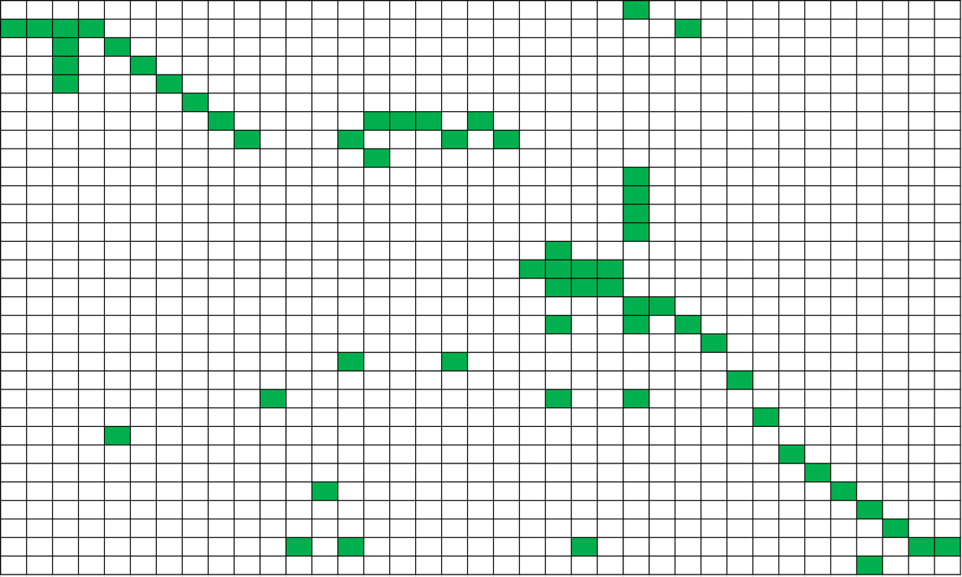
Linking suspects to crimes
161 items
72 references
127 ref-evi
matches
→
1,200 comparisons
→
37 References
31 Cases

Slide 18
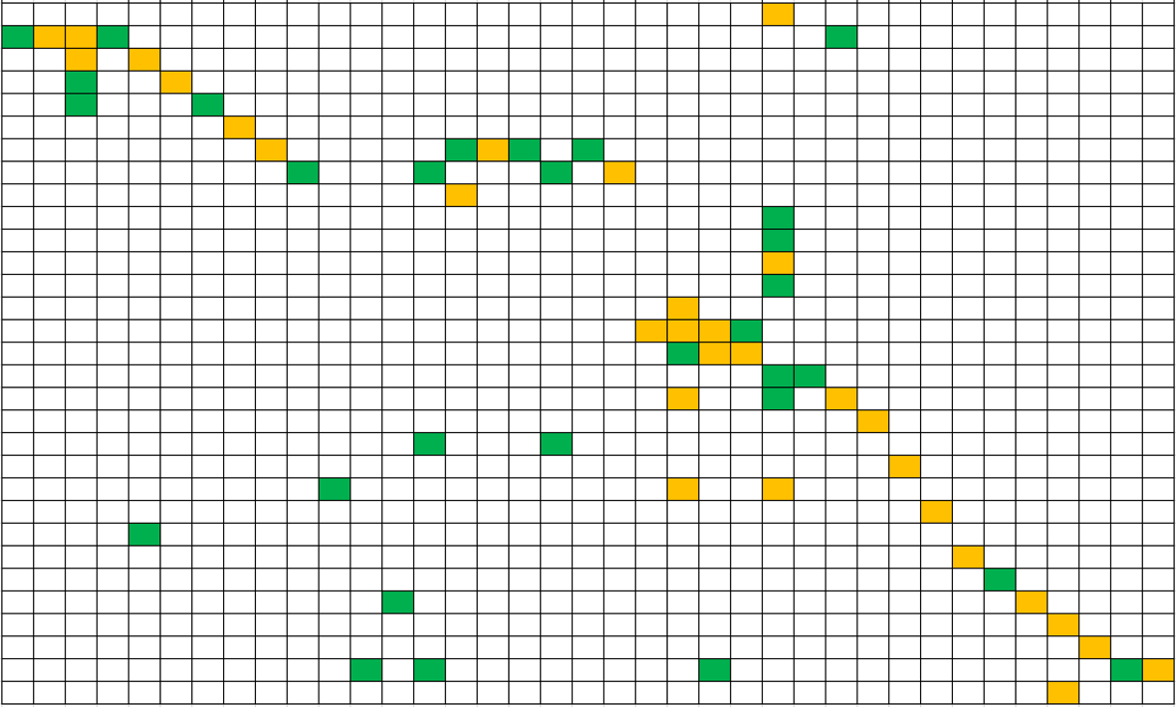
The missing links
TrueAllele
Database
Manual
& T.A.
(59 case-ref)
(31 case-ref)
37 References
31 Cases

Slide 19
Method comparison
Manual review
TrueAllele IPGD
~2 months from data
to interpretations
Few hours of
analyst time
23 references
37 references
30 items ‘inconclusive’
At least one reference association for all 30
12 reported exclusions
12 positive associations

Slide 20
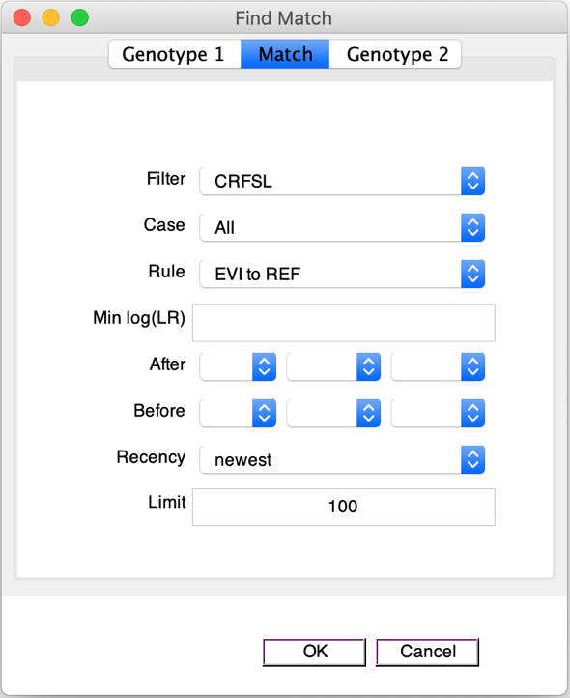
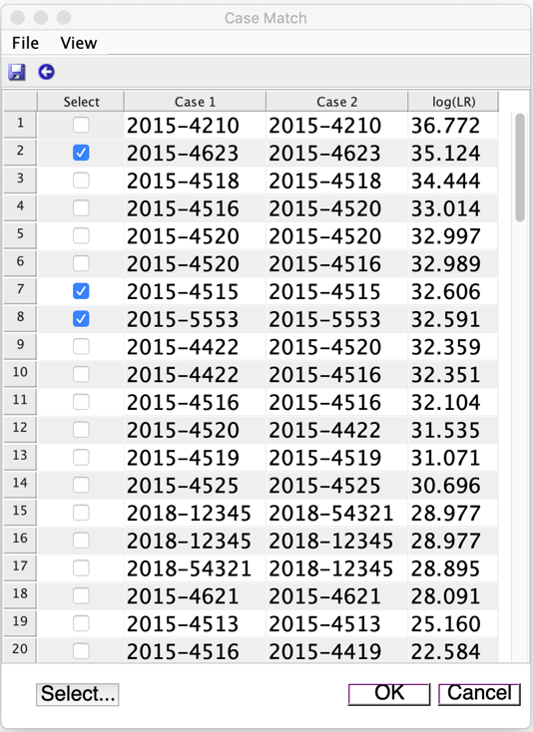
Match review
Search
Download
Notes:
2015-4520-5.1_ncon3_100K 2 3 0.2975 0.0523 14.0146 2015-4515-5_ref 13.7692

Slide 21
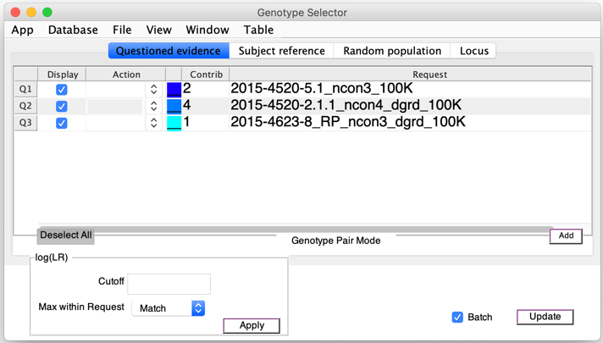
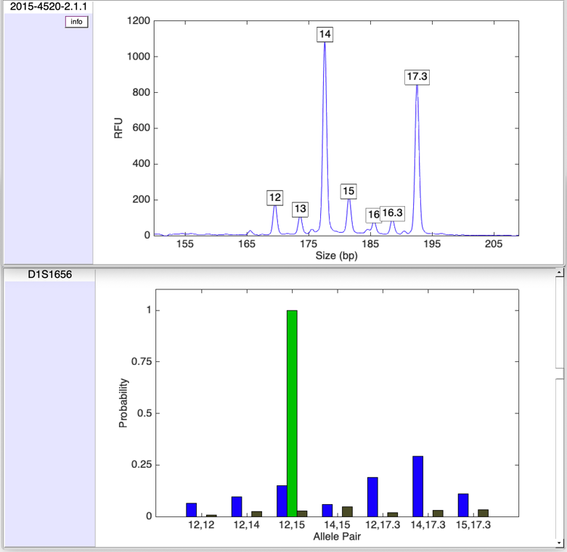
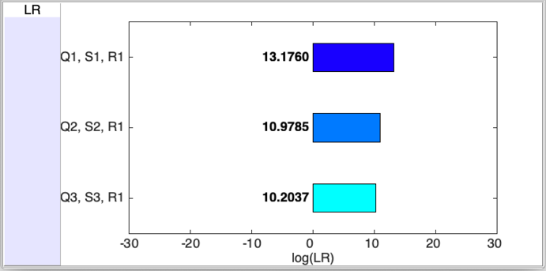
Match review
• Quick and easy access to data, genotypes, match statistics
Notes:
2015-4520-5.1_ncon3_100K 2 3 0.2975 0.0523 14.0146 2015-4515-5_ref 13.7692

Slide 22
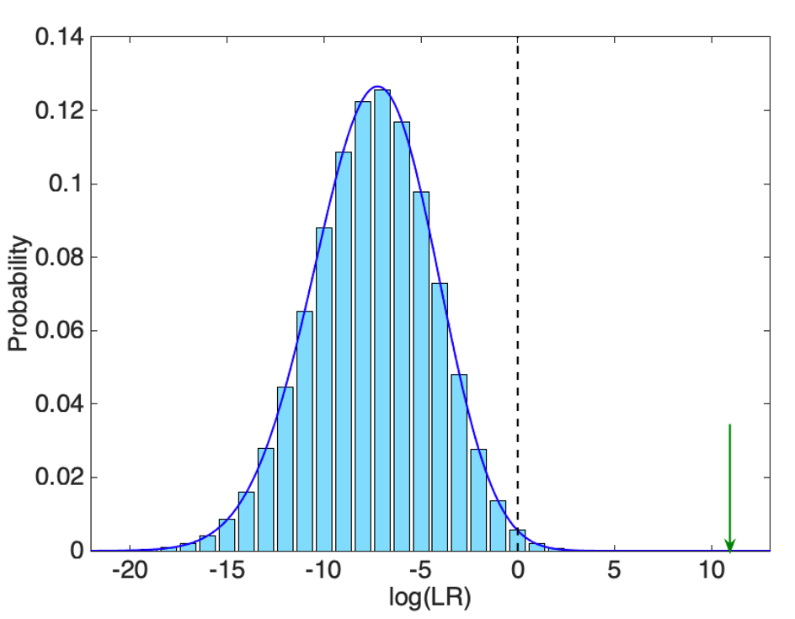
Match rarity
Mean log(LR) = -7.5
• Quantify specificity
Std dev = 3.13
• Calculated for each genotype
For a match strength of 95.2 billion only one in 74.7 trillion people would match as strongly.

Slide 23
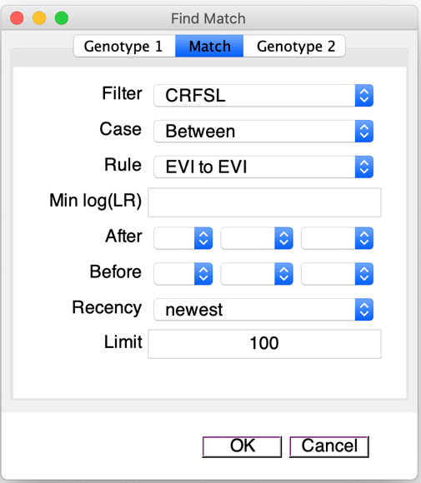
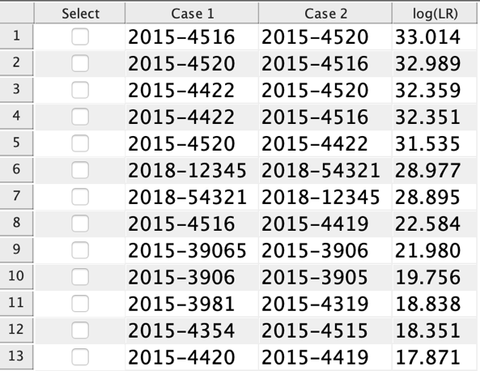
Connecting crime scenes
• Use all the data
• Investigative leads between cases
• Database calculates match statistics between evidence items

Slide 24
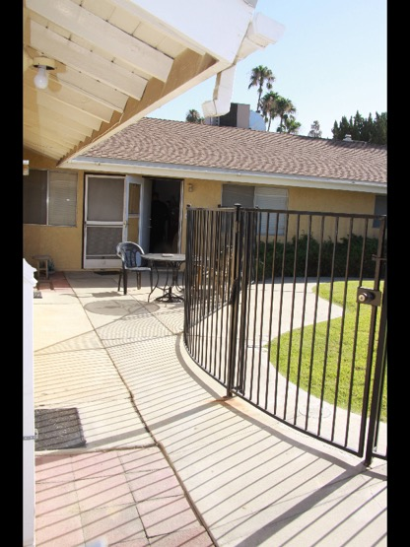
Evidence in action
• July & August 2013 in Bakersfield, CA
• Three separate break-ins and sexual assault cases

Slide 25
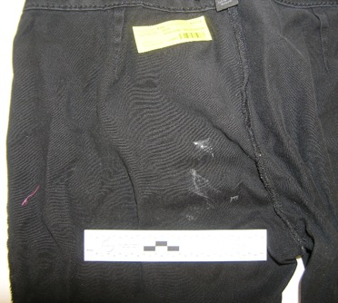
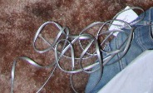
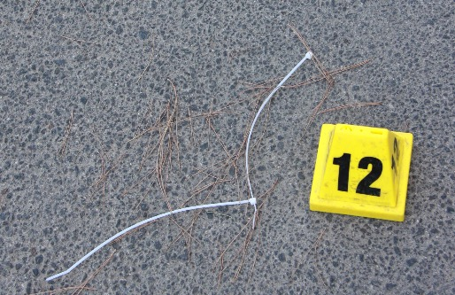
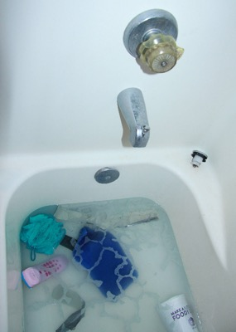
Evidence in action
• 37 swabs and cuttings
Pants
• Low level DNA mixtures
• Evidence matches between cases
• CODIS hit on zip tie
Phone cord
Zip tie in road
Phone
Bathtub handle

Slide 26
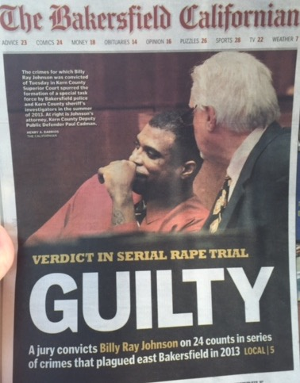
Evidence in action
• 37 swabs and cuttings
• Low level DNA mixtures
• Evidence matches between cases
• CODIS hit on zip tie
• Arrest (2013) and conviction (2015)
Zip tie in road

Slide 27
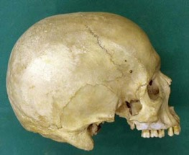
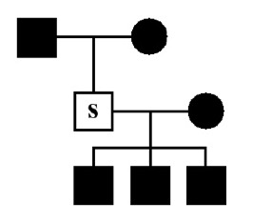
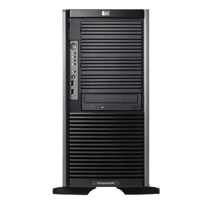
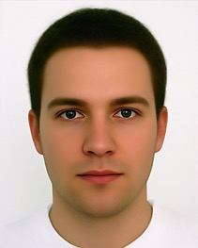
World Trade Center
Powerful TrueAllele Database to identify victim remains
Kinship profile
TrueAllele
database
~18,000 victim
remains samples
~6,500
family references
~2,400
personal effects
~2,700 people

Slide 28
Conclusions
• Automate DNA investigation
• Reduce interpretation bottleneck
• Extract more information from DNA data
• Match suspects to crimes
• Connect crime scenes together

Slide 29
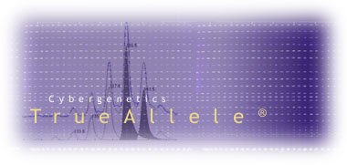
More information
www.cybgen.com
• Courses
• Newsletters
• Newsroom
• Presentations
• Publications
• Webinars
TrueAllele YouTube channel:
http://www.youtube.com/user/TrueAllele
dave@cybgen.com

