Slide 1

TrueAllele for DNA Mixtures
District Attorney’s Association
Spring Meeting
May, 2018
Savannah, GA
Mark W Perlin, PhD, MD, PhD
Pittsburgh, PA
Cybergenetics © 2003-2018

Slide 2
Dr. Mark W. Perlin

Slide 3
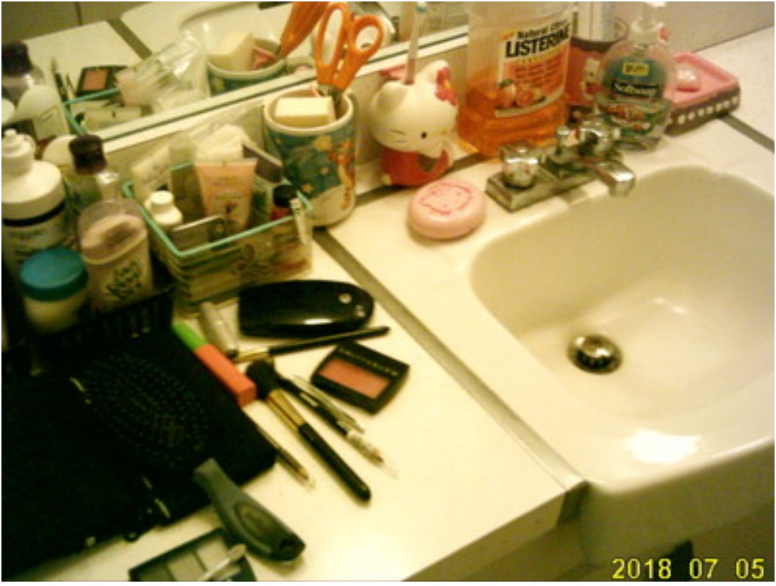
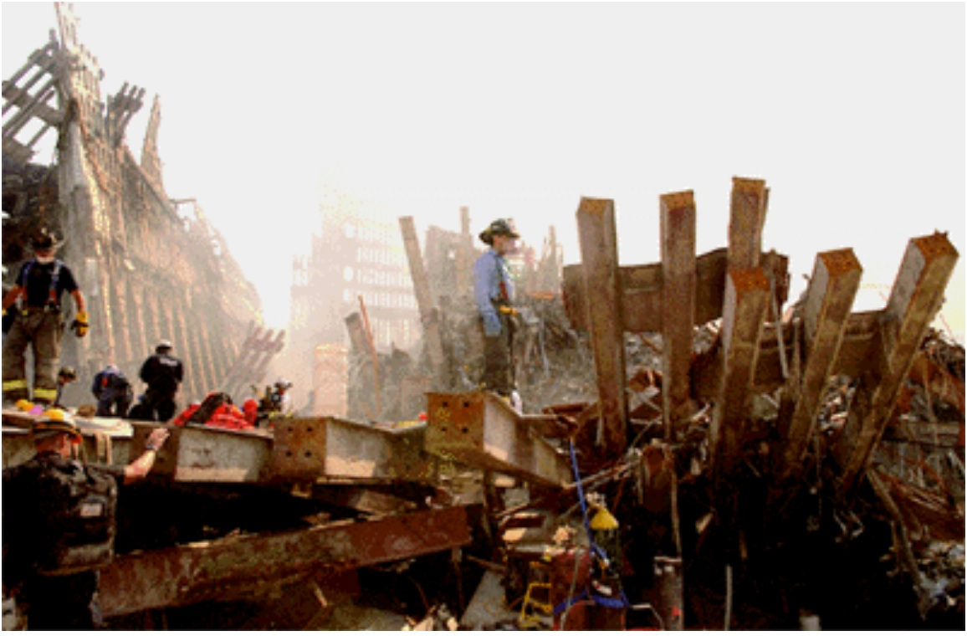
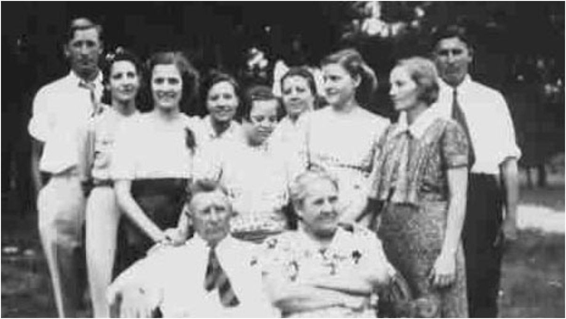
Cybergenetics, Corp
Pittsburgh, Pennsylvania
Victim Remains
Missing People
Match
September 11, 2001 – New York City

Slide 4
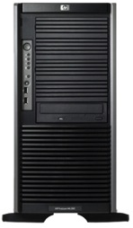


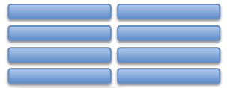
TrueAllele® technology
Parallel Processing
& Database Server
VUIer™ Software

Slide 5
No information from mixture
Crime laboratory DNA report
Crime lab user fee: $5,000
Conclusions:
Item 1 – Swab of textured areas from a handgun
The data indicates that DNA from four (4) or more contributors was obtained from the swab of the handgun. Due to the complexity of the data, no conclusions can be made regarding persons A and B as possible contributors to this mixture.

Slide 6
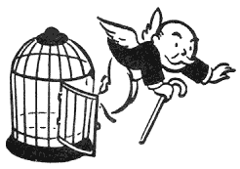
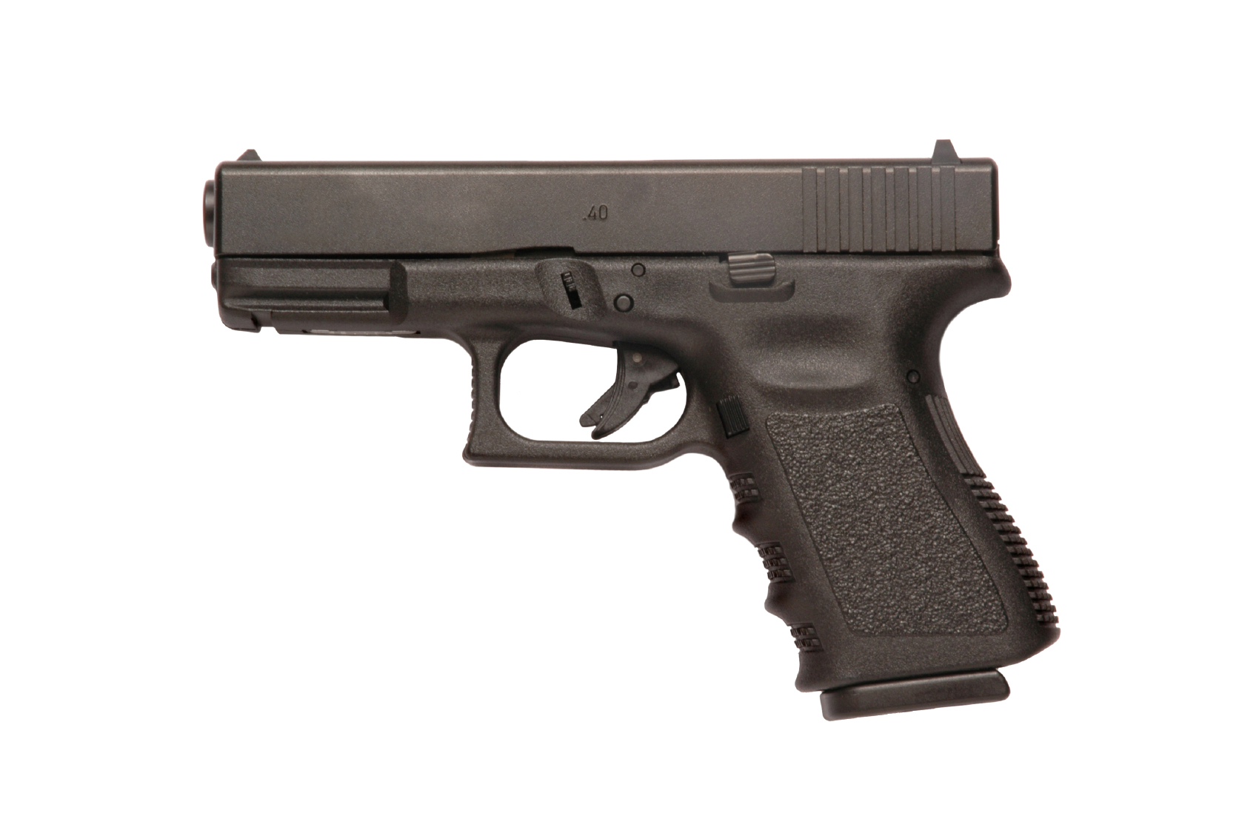

Computer reanalysis
Cybergenetics TrueAllele report
Match statistics provide information
Person A
excluded
Contributor
Unmix the
mixture
1
2
400,000
3
Person B
included
4

Slide 7
How is TrueAllele different?
• Computer interpretation
• Fully Bayesian model
• Accurate
• Objective
• Reliable
• Fast
• Automated
• Uses all the data
• Reports all the information
• Advanced DNA database

Slide 8
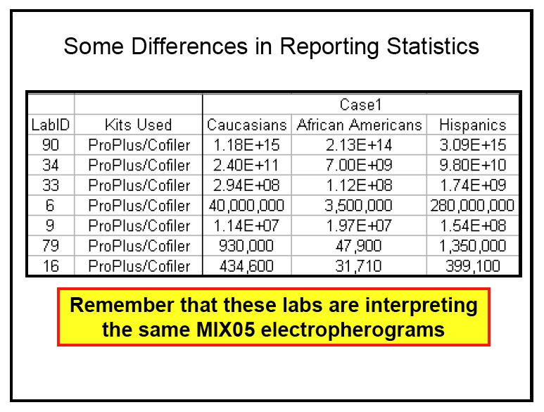
Unreliable DNA mixture statistics
NIST (Commerce Department) study in 2005
Two contributor mixture data, known victim
When not
“inconclusive”:
213 trillion (14)
31 thousand (4)
Forensic DNA labs put on notice 12 years ago

Slide 9
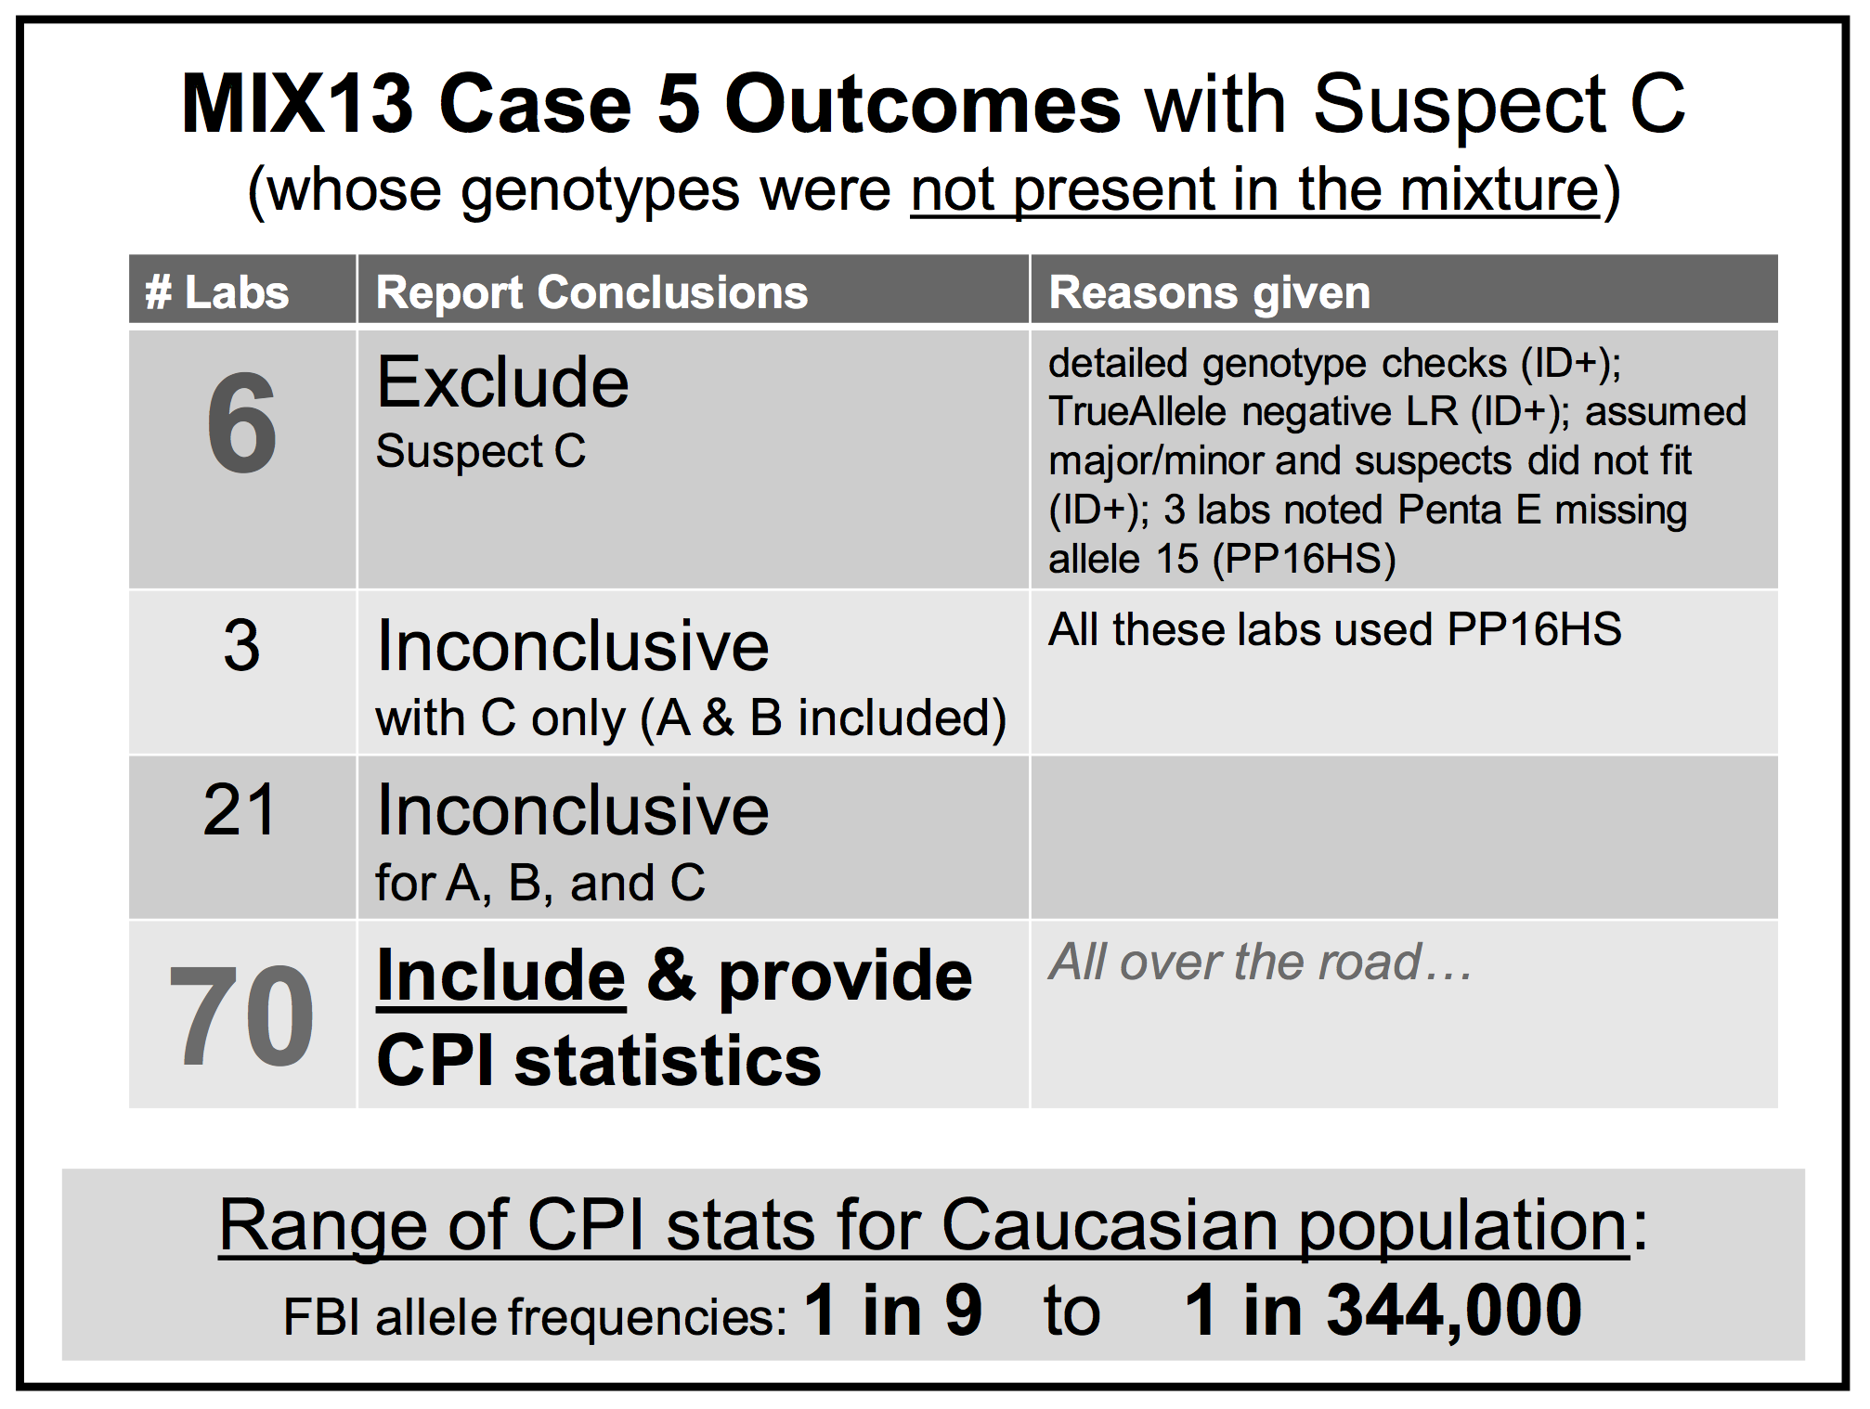
Falsely identify innocent people

Slide 10

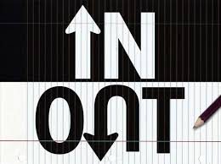


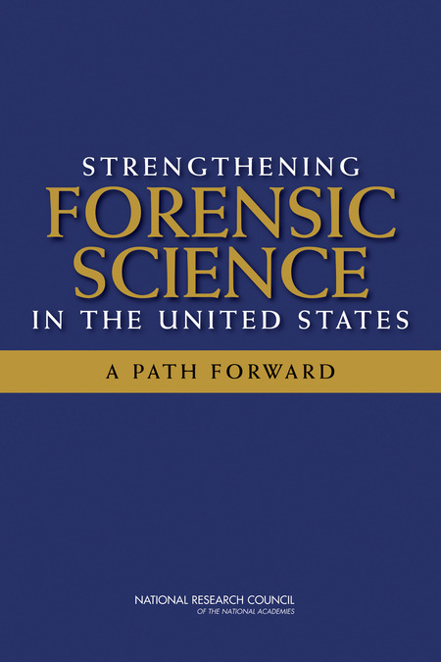
Biased DNA workflow
(1)
Choose data
(3)
Person decides
(2)
Calculate statistic
• Put people in the process
• To overcome software limits
• And introduce human bias

Slide 11
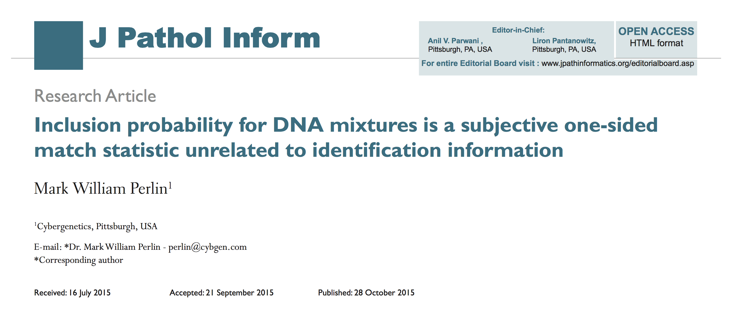
Statistics lack scientific basis
Misled courts for 15 years on countless DNA mixtures

Slide 12
Human mixture interpretation
• Inaccurate. Disagrees with true information
• Subjective. Workflow introduces human bias
• Widespread. Hundreds of thousands of cases
• Opaque. Choices use only some of the data
• Biased. Can only include – or give no answer
Inconclusive

Slide 13
Peer-reviewed validation
Perlin MW, Sinelnikov A. An information gap in DNA evidence interpretation. PLoS ONE. 2009;4(12):e8327.
Ballantyne J, Hanson EK, Perlin MW. DNA mixture genotyping by probabilistic computer interpretation of binomially-sampled laser captured cell populations: Combining quantitative data for greater identification information. Science & Justice. 2013;53(2):103-114.
Perlin MW, Hornyak J, Sugimoto G, Miller K. TrueAllele® genotype identification on DNA mixtures containing up to five unknown contributors. Journal of Forensic Sciences. 2015;60(4):857-868.
Greenspoon SA, Schiermeier-Wood L, Jenkins BC. Establishing the limits of TrueAllele® Casework: a validation study. Journal of Forensic Sciences. 2015;60(5):1263-1276.
Perlin MW, Legler MM, Spencer CE, Smith JL, Allan WP, Belrose JL, Duceman BW. Validating TrueAllele® DNA mixture interpretation. Journal of Forensic Sciences. 2011;56(6):1430-1447.
Perlin MW, Belrose JL, Duceman BW. New York State TrueAllele® Casework validation study. Journal of Forensic Sciences. 2013;58(6):1458-1466.
Perlin MW, Dormer K, Hornyak J, Schiermeier-Wood L, Greenspoon S. TrueAllele® Casework on Virginia DNA mixture evidence: computer and manual interpretation in 72 reported criminal cases. PLOS ONE. 2014;(9)3:e92837.

Slide 14
TrueAllele® computer technology
• Accurate. 35 validation studies, 7 published
• Objective. Workflow removes human bias
• Accepted. Reported in 42 states, used by labs
• Transparent. Give math, software (4GB DVD)
• Neutral. Can statistically include or exclude
Informative

Slide 15
How is TrueAllele used?
• Prosecution
• Defense
• Investigation
• Post-conviction
• Mass disaster
• Touch DNA
• Complex mixtures
• Kinship, paternity
• DNA database
• Preventing crime

Slide 16
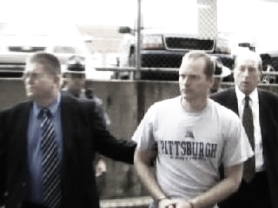
Pennsylvania v. Kevin Foley
Apr 2006: Blairsville Dentist John Yelenic murdered
Nov 2007: Trooper Kevin Foley charged with crime
February 2008: Defense questions 13,000 DNA match score
March 2009: Jury hears 189,000,000,000 TrueAllele statistic

Slide 17
Pennsylvania v. Joshua Huber
Item | Description | Melissa Zuk | Derek Schindler | Joshua Huber
13E | Living room wall bloodstain | 1 in 160 million | 1 in 36 thousand | 11.6 quintillion
29A | Schindler's right hand fingernails |  | 1.37 quintillion | 53.8 thousand
1603461-13A | Left hand fingernails of Melissa Zuk | 17.4 billion |  | 3.35 thousand

Slide 18
Virginia v. David Black
Item | Description | David Black | Bonnie Black | BettyAnn Armstrong | Craig Black | Eleanora Black
08 | Baseball hat velcro strap | 32.5 quintillion | 16.1 billion |  | 1/1.83 thousand | 1/62.6
94 | Master bedroom light switch | 364 million | 8.14 million
95 | Master bathroom light switch | 1/19.5 | 554 million |  |  | 3.63 million

Slide 19
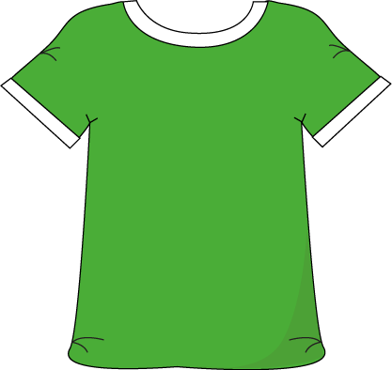
Maryland v. Nelson Clifford
11%
82%
7%
contributor
1
contributor
2
contributor
3
match
statistic

Slide 20
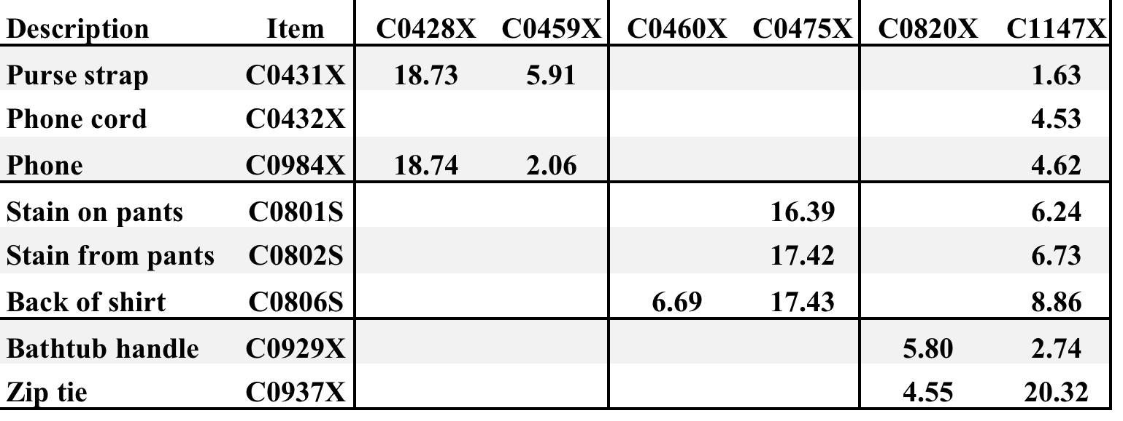
California v. Billy Ray Johnson
8 mixture items vs. 5 victims + 1 suspect
BRJ
DNA match statistics
corroborate victim statements

Slide 21
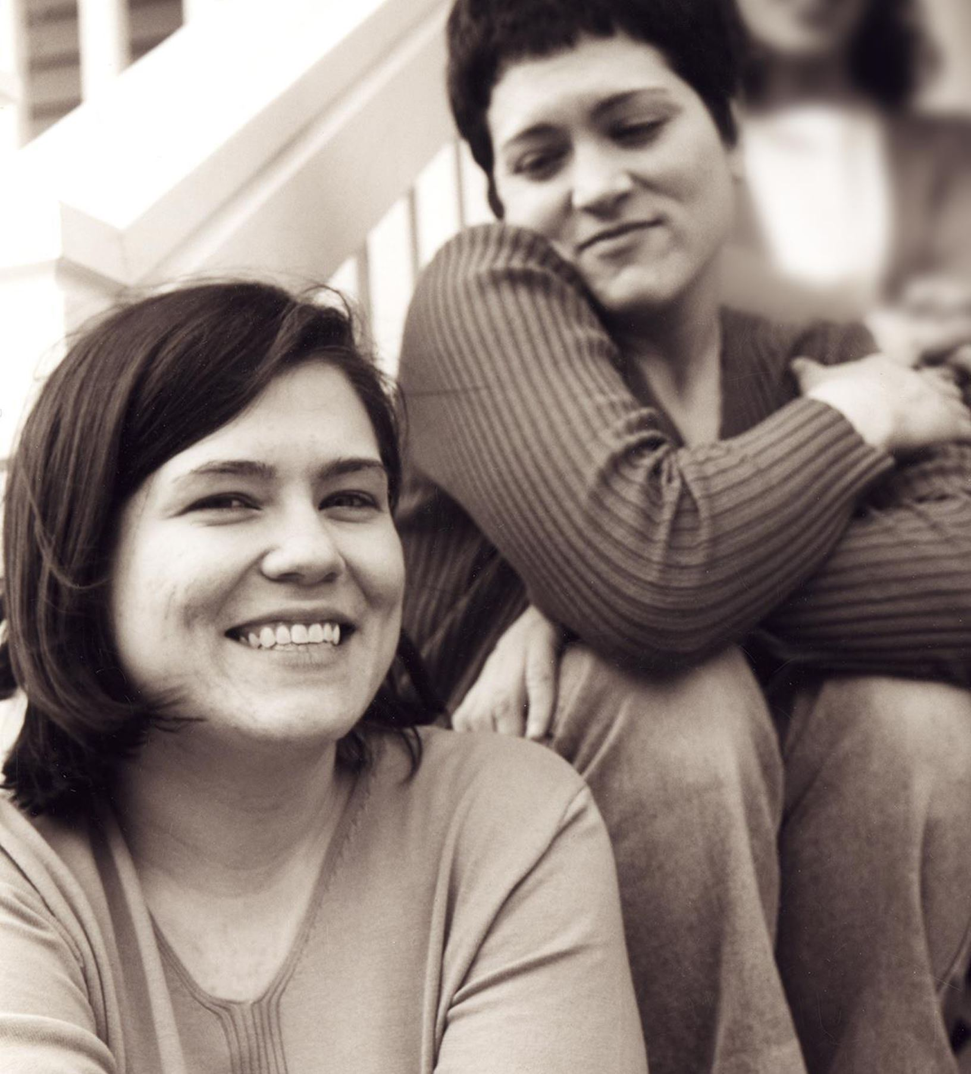
Wolfe sisters homicide
On February 6, 2014, Susan Wolfe (44)
and her younger sister Sarah (38, left)
were killed in their East Liberty home in Pittsburgh.

Slide 22
Pennsylvania v. Allen Wade
Thresholds failed to interpret most DNA mixtures
Hat No conclusions
Cup Insufficient data
Fingernails Contamination, insufficient data
Gear shift Insufficient data
Seat lever Cannot be excluded
Knit hat Insufficient data
Sock Too complex, no conclusions

Slide 23
Pennsylvania v. Allen Wade
The crime lab reported 5 DNA mixture matches
TrueAllele found 17 matches on the same data
Hat 65.3 thousand Allen Wade
Cup 20.5 thousand Susan Wolfe
Fingernails 6.06 trillion Allen Wade
Gear shift 9.37 million Sarah Wolfe
Seat lever 385 billion Sarah Wolfe
Knit hat 25.7 thousand Allen Wade
Sock 300 Sarah Wolfe

Slide 24
Reported DNA match statistics
A match between the right fingernails
and Allen Wade is:
6.06 trillion times more probable than
a coincidental match to an unrelated Black person
32.5 trillion times more probable than
a coincidental match to an unrelated Caucasian person
8 trillion times more probable than
a coincidental match to an unrelated Hispanic person

Slide 25
Allen Wade Found Guilty On All Counts In East Liberty Sisters’ Slaying
CBS News, May 23, 2016
PITTSBURGH (KDKA/AP)
• A man accused of killing two sisters who lived next door to him in East Liberty has been found guilty on all counts.
• Allen Wade was accused of shooting Sarah and Susan Wolfe after they returned from work on Feb. 6, 2014, apparently to steal a bank card.
• On Monday morning, a jury found Wade guilty of first-degree murder, robbery, burglary and theft by unlawful taking.

Slide 26
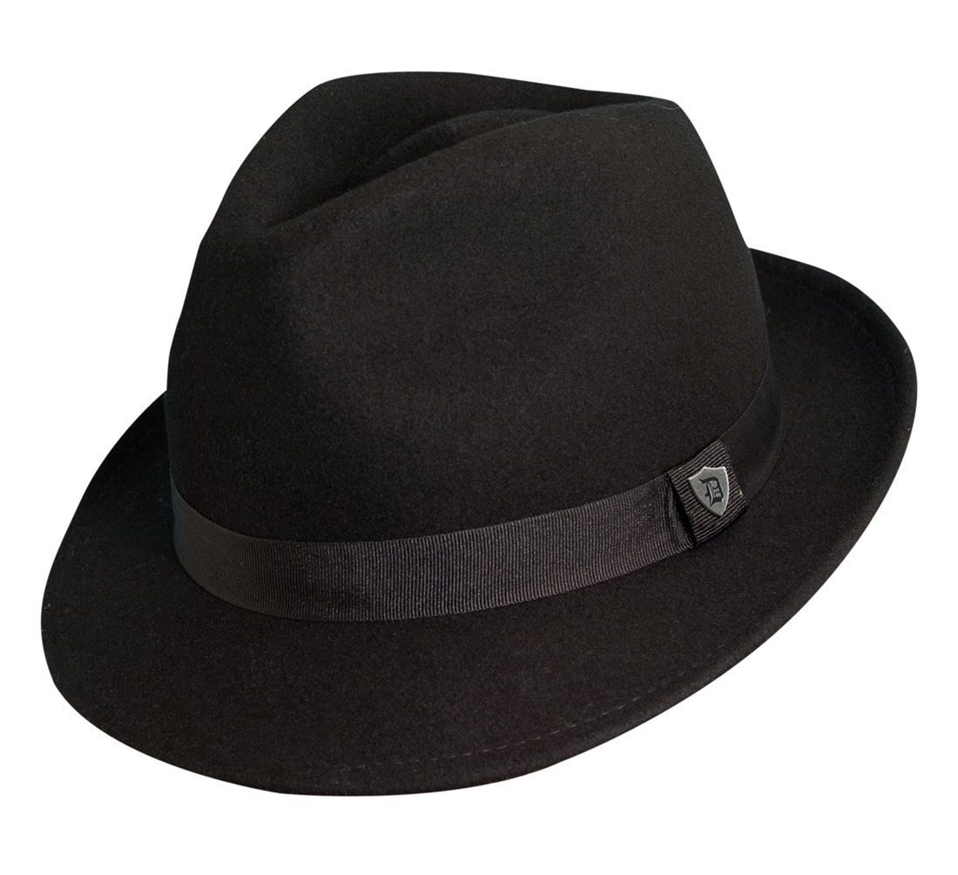
Pennsylvania v. Allen Wade
Thresholds failed to interpret DNA mixture
TrueAllele succeeded on the same data
A hat left from a burglary of the Wolfe sister’s home
six weeks before the murder matched
Allen Wade with a 65.3 thousand statistic
Preventable Crime

Slide 27
Darryl Pinkins imprisoned
1989 – 5 men raped an Indiana woman
Darryl Pinkins and 2 others misidentified
1991 – wrongfully convicted, 65 year sentence
2001 – DNA mixture evidence
2 contributors found, not the accused
but 5 were needed, post-conviction relief denied

Slide 28
TrueAllele Pinkins findings
1. compared evidence with evidence
2. calculated exclusionary match statistics
3. revealed 5% minor mixture contributor
4. jointly analyzed DNA mixture data
5. showed three perpetrators were brothers
found 5 unidentified genotypes,
defendants not linked to the crime

Slide 29
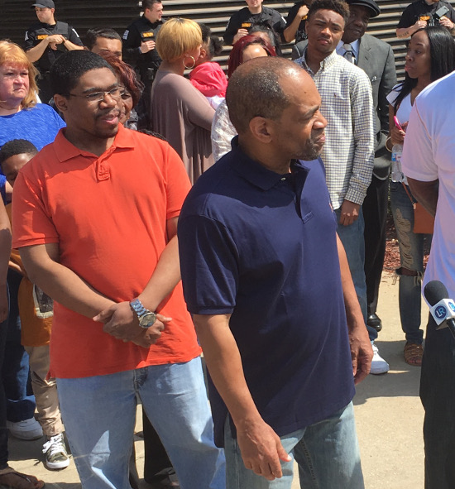
Pinkins exonerated
Indiana
April 25, 2016

Slide 30
TrueAllele report

Slide 31
Trial preparation

Slide 32

Disclosure materials

Slide 33
Daubert hearing

Slide 34
Trial presentation

Slide 35
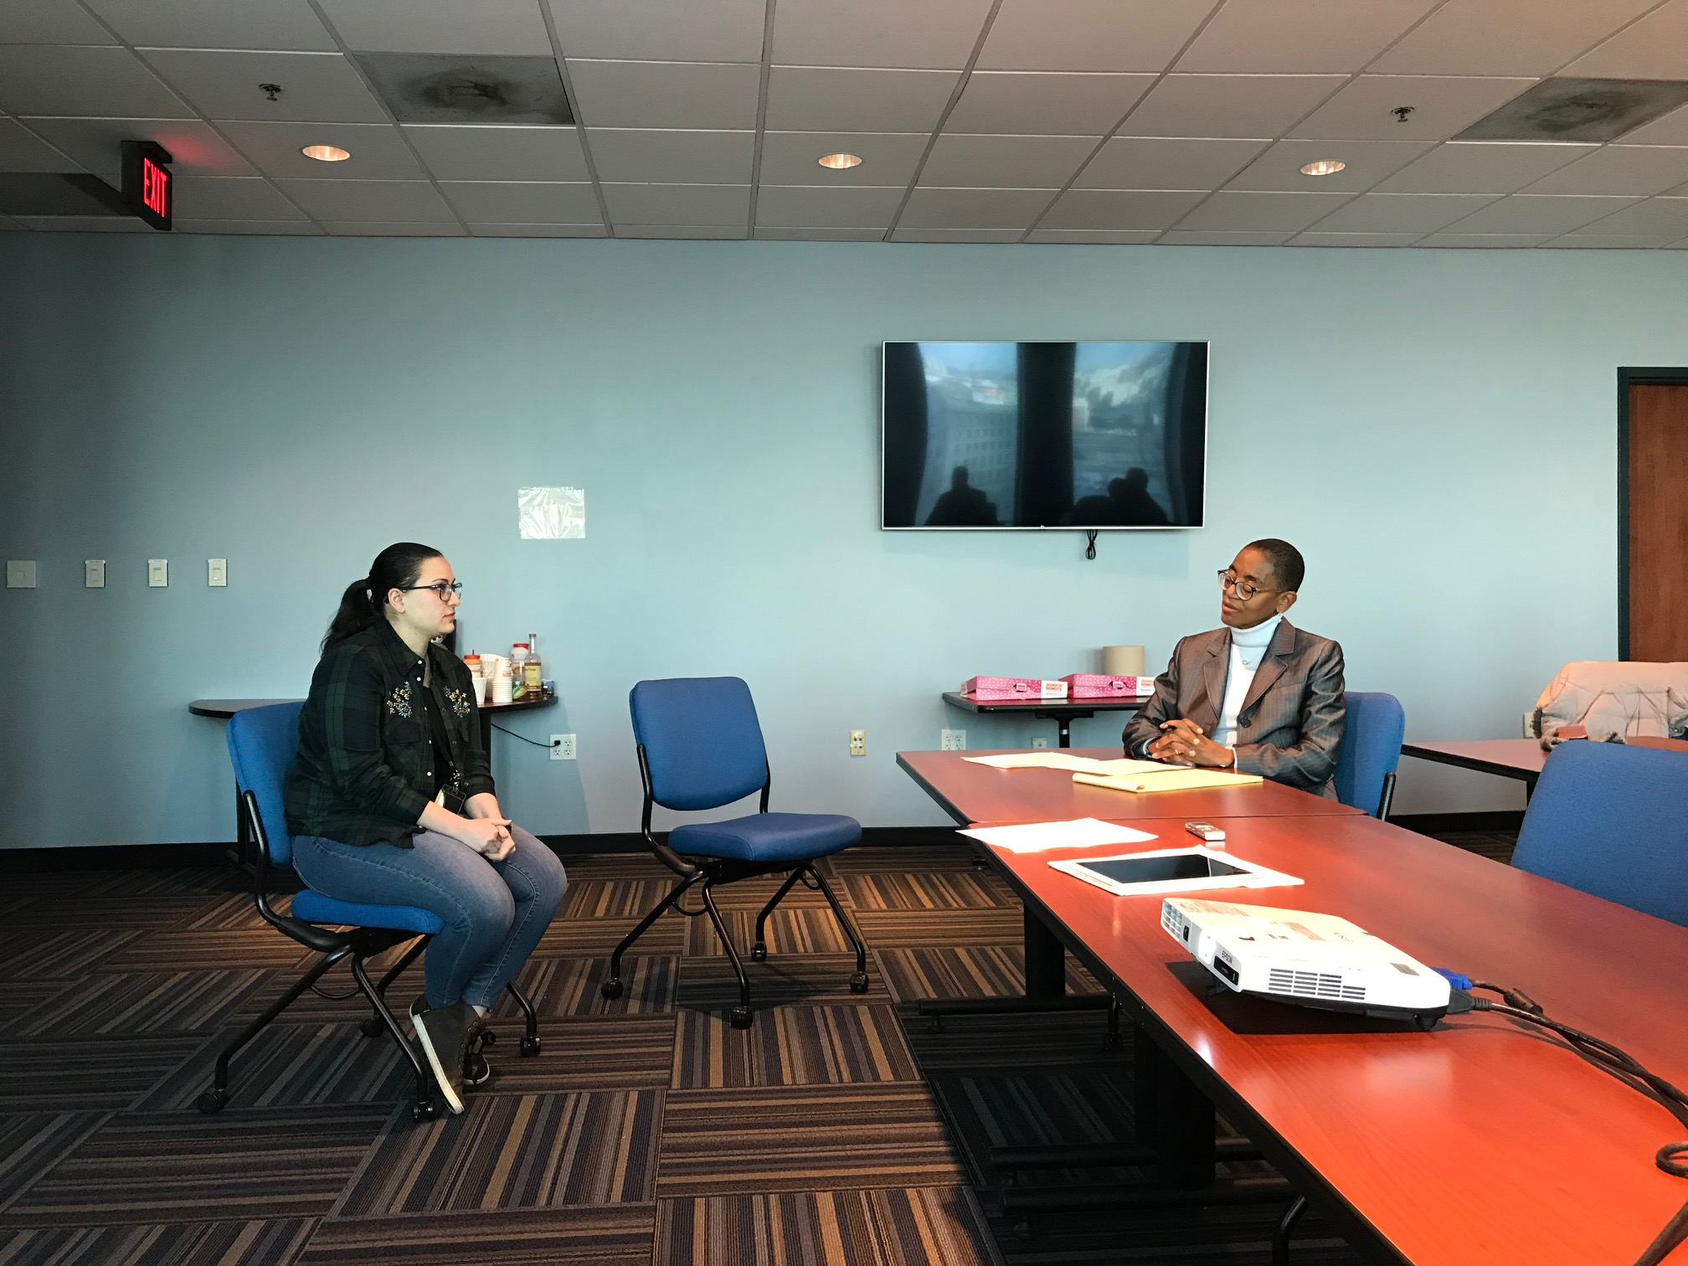
Cybergenetics resource

Slide 36
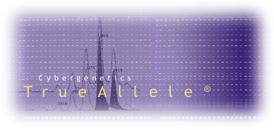

More information
http://www.cybgen.com/information
• Courses
• Newsletters
• Newsroom
• Presentations
• Publications
• Webinars
http://www.youtube.com/user/TrueAllele
TrueAllele YouTube channel
perlin@cybgen.com

