Slide 1

Sitting on the fence:
“Inconclusive” is not a dead end
2017 MACCHIA Conference
August, 2017
Annapolis, MD
Beatriz Pujols, M.S.
Cybergenetics, Pittsburgh, PA

Slide 2
“Handprints in the morning dew”
State of Louisiana v. Hilton Wilson and Reokenski Thomas

Slide 3
The crime
July 22, 2013 in Ville Platte, LA
Shots heard on East Washington Street
Joseph & Derrick John

Slide 4
The crime
That night, Joseph John dies in the hospital
3 months later, Derrick John makes identification
Reokenski Thomas becomes a suspect
Reokenski Thomas

Slide 5
The investigation
Shooting was precipitated by an earlier argument
Shell casings and bullet in victim
Footsteps on grass lead up to fence

Slide 6
The evidence: An example of great investigative work
Detective on scene swabbed two handprints
that disturbed the morning dew

Slide 7
Exhibit 13: Swab from post running north and south – A
“Due to the limited nature of the profile, no conclusions regarding the inclusion or exclusion of any contributor can be made.”
Exhibit 14: Swab from post running north and south – B
“…was consistent with being a mixture of DNA from at least two individuals. Due to the nature of the profile, no statistical analysis could be performed at this time. Therefore, no conclusions regarding Hilton Wilson and Reokenski Thomas can be made.”

Slide 8

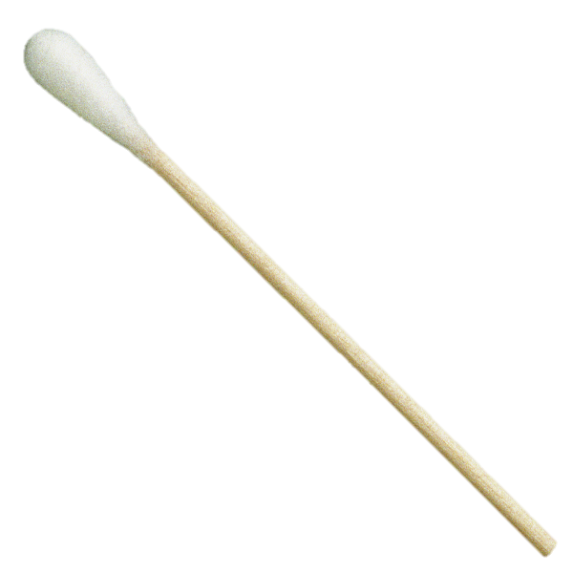
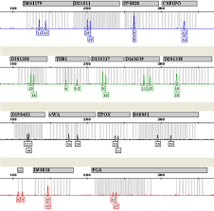

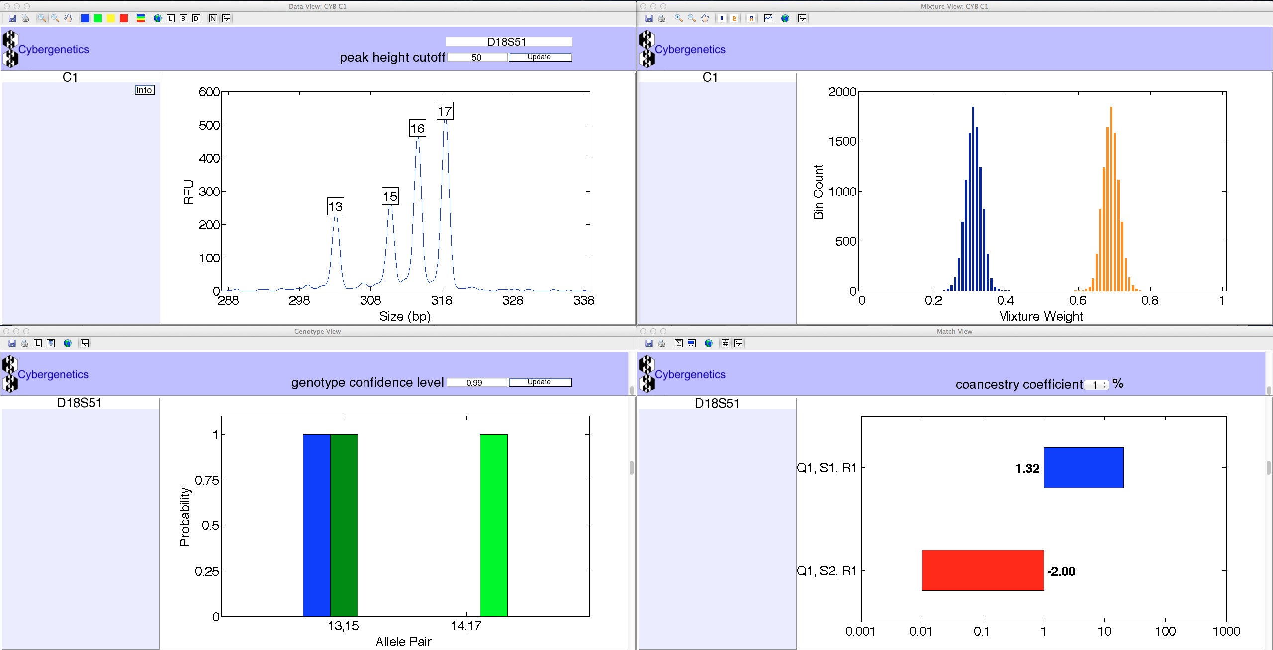
Solving DNA mixtures
R
E
S
U
L
T
S

Slide 9



Are the suspects in the evidence?

Slide 10
Match statistics
Exhibit | Description | 19 Hilton Wilson | 20 Reokenski Thomas | 21 Suspect C | 27 Suspect D
13 | post - A | 70.9 thousand | 335 thousand
14 | post - B | 23.1 million | 6.28 million
13 & 14 | posts - A & B | 157 million | 340 million

Slide 11
DNA evidence in the courtroom
Seven-day trial in Judge Chuck West’s courtroom
ADA Marcus Fontenot introduces DNA evidence
On March 10, 2016, Dr. Mark Perlin testifies at the trial in Ville Platte, LA
TrueAllele match statistics

Slide 12
Guilty verdicts handed down in Thomas-Wilson murder trial
Ville Platte Gazette
TrueAllele statistically matched the defendants’ DNA to
the DNA collected from the fence at the crime scene.
“After seven days of listening to eye witness and expert testimony, an Evangeline Parish Jury of 12 found Reokinski Thomas and Hilton Wilson guilty of first degree murder and attempted first degree murder.”
Ville Platte Today
The prosecutors polled the jury after trial –
the DNA was crucial in obtaining the convictions

Slide 13
Keys to success
Evidence collection
Lab develops DNA
Lab sends data to Cybergenetics
TrueAllele match statistics
Expert testimony
Justice is served
“DNA is key.”
- Investigator Marcus Aucoin

Slide 14
“
“
It’s definitely worth every nickel. It’s going to make a huge difference in law enforcement. It’s worth whatever it costs.
“Dr. Perlin’s testimony was very key. Probably wouldn’t have gotten a conviction without him.”
- Investigator Aucoin

Slide 15

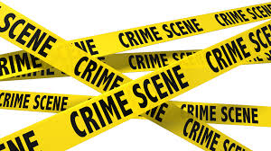


TrueAllele® Experience
Uses
- evidence-to-suspect, solve cold cases
- evidence-to-evidence, connect serial crime
- evidence-to-kinship, find missing people
- kinship-to-reference, conduct familial search
- remains-to-missing, identify disaster victims
Cases
DNA Evidence
Applications
Over 500 case reports filed on DNA evidence
Notes:
Cases
- violent crime
- gang related
- sexual assault
- incest rape
DNA Evidence
- 3, 4, 5, 6, 7 or more people
- touch, degraded and low copy
- non-suspect
- family members
Applications
- investigative
- identification
- warrants
- plea bargains
- trial

Slide 16
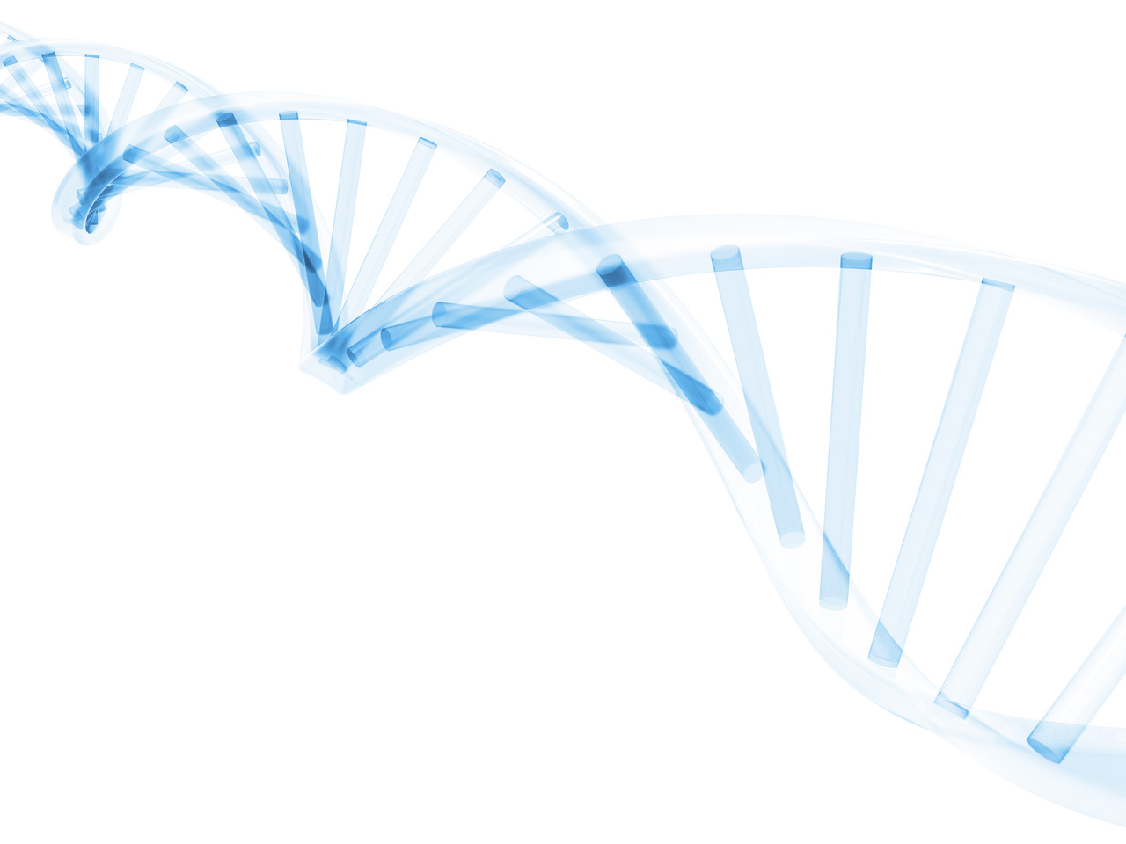
Thank you!
For more information
Beatriz Pujols, M.S.
beatriz@cybgen.com
(412) 683 - 3007
www.cybgen.com

