Slide 1

To include or not to include: the extent is the question
Mid-Atlantic Association of Forensic Scientists
May, 2017
Pittsburgh, PA
Jennifer M. Hornyak, MS
Mark W. Perlin, PhD, MD, PhD
Cybergenetics, Pittsburgh, PA
Cybergenetics © 2003-2017

Slide 2
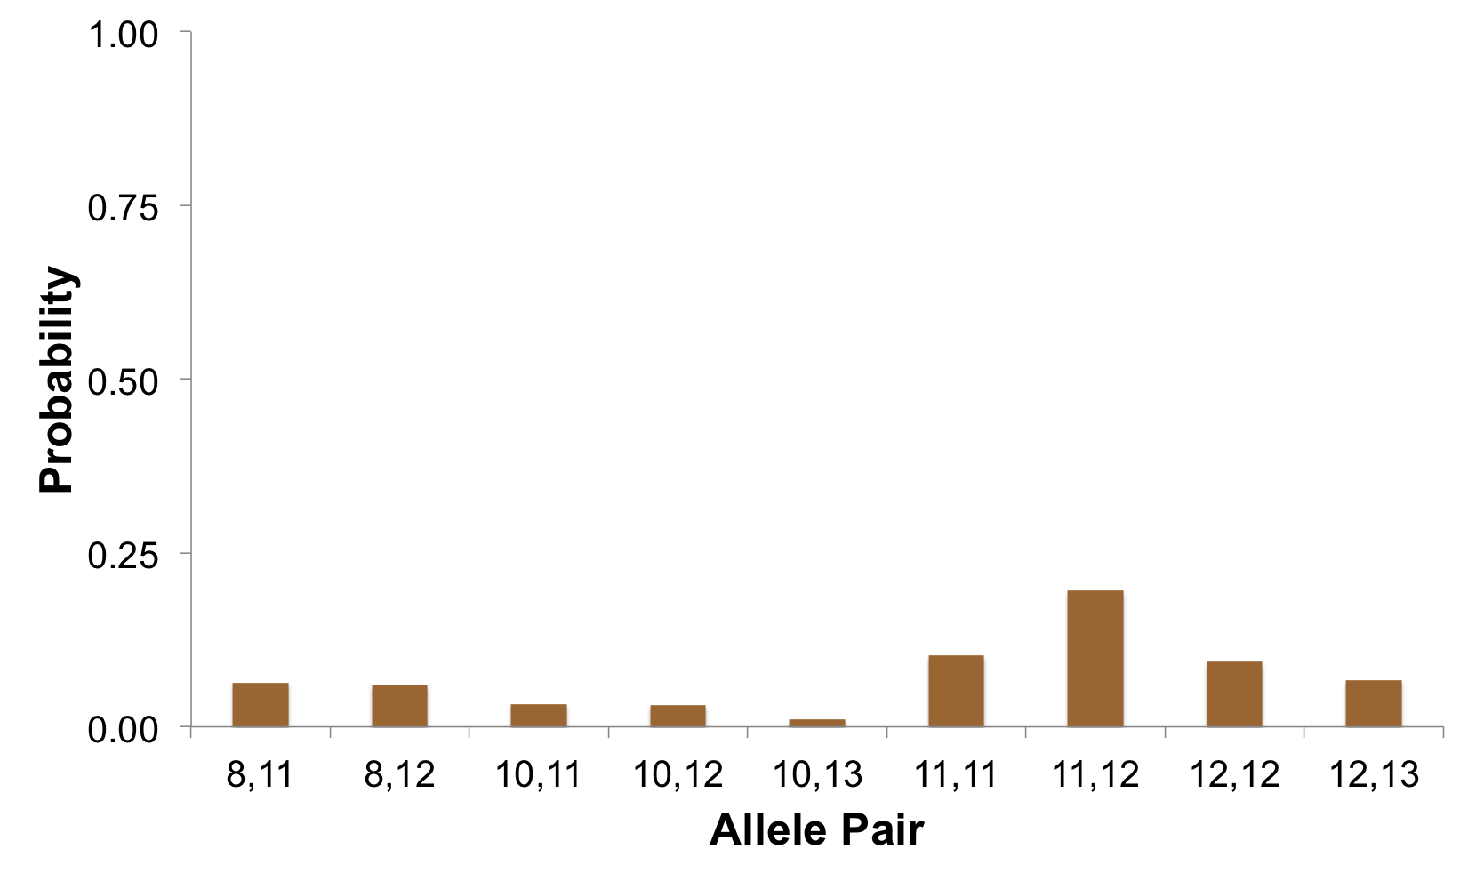
Random genotype
Probability of a random person having a specific allele pair
Diffuse probability
20%
10%
9%
6%
6%
3%
3%
7%
1%

Slide 3
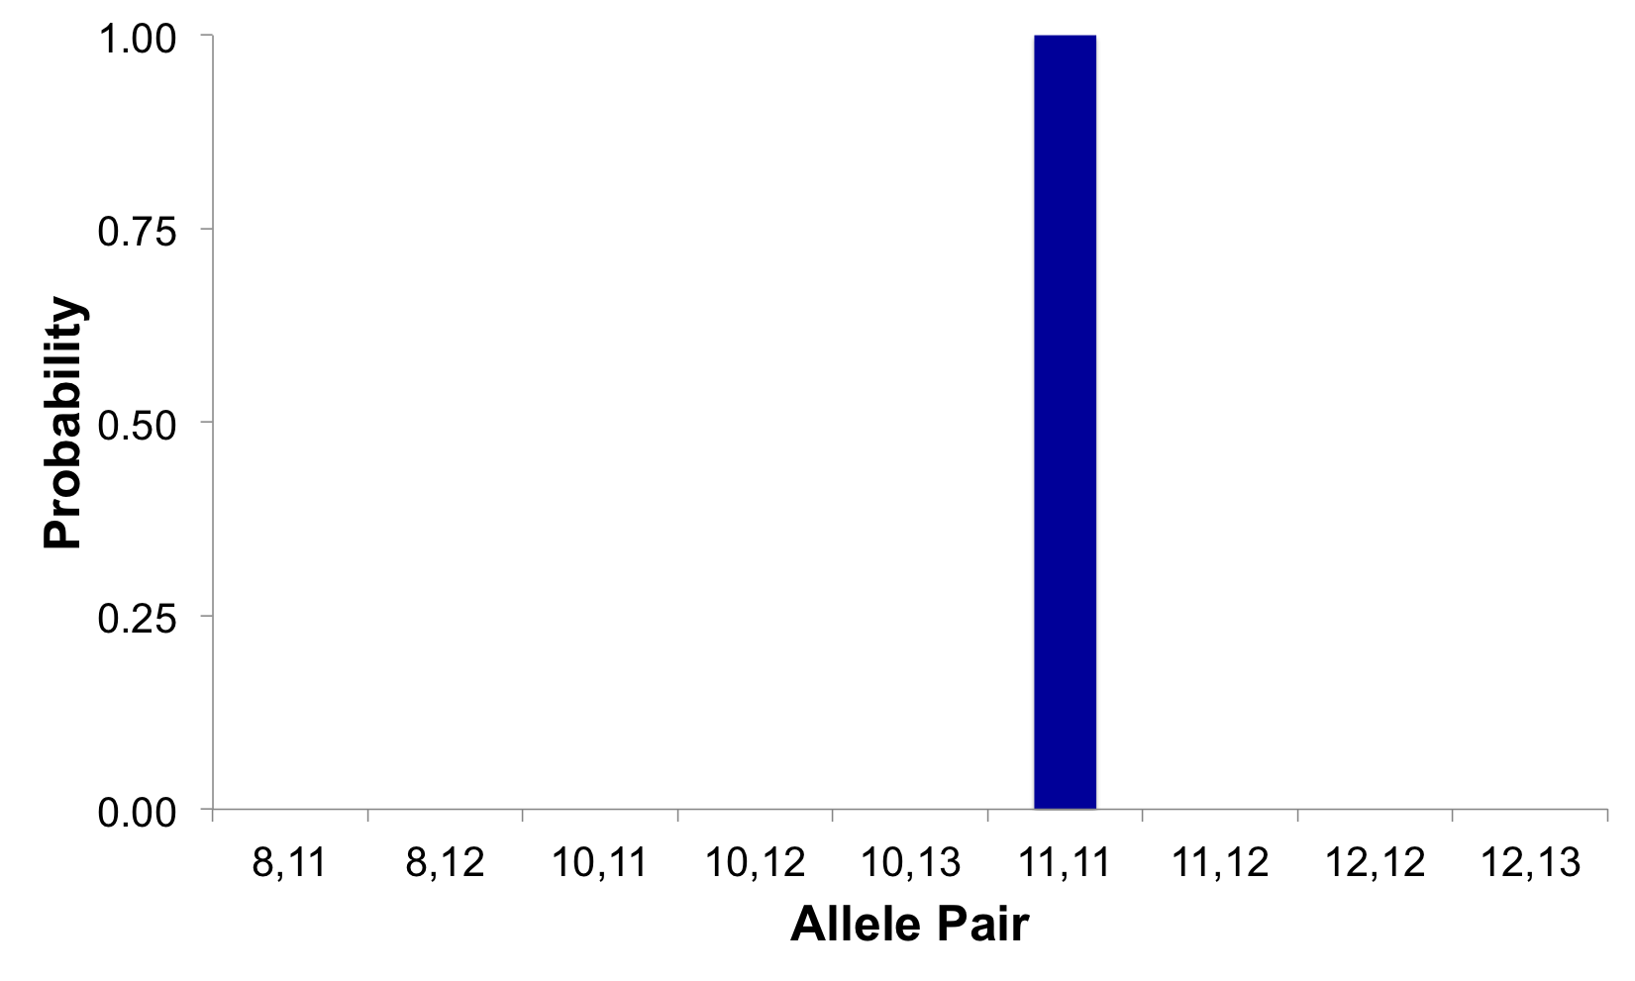
Single source genotype
Evidence genotype for single source DNA
100%
Concentrated probability

Slide 4
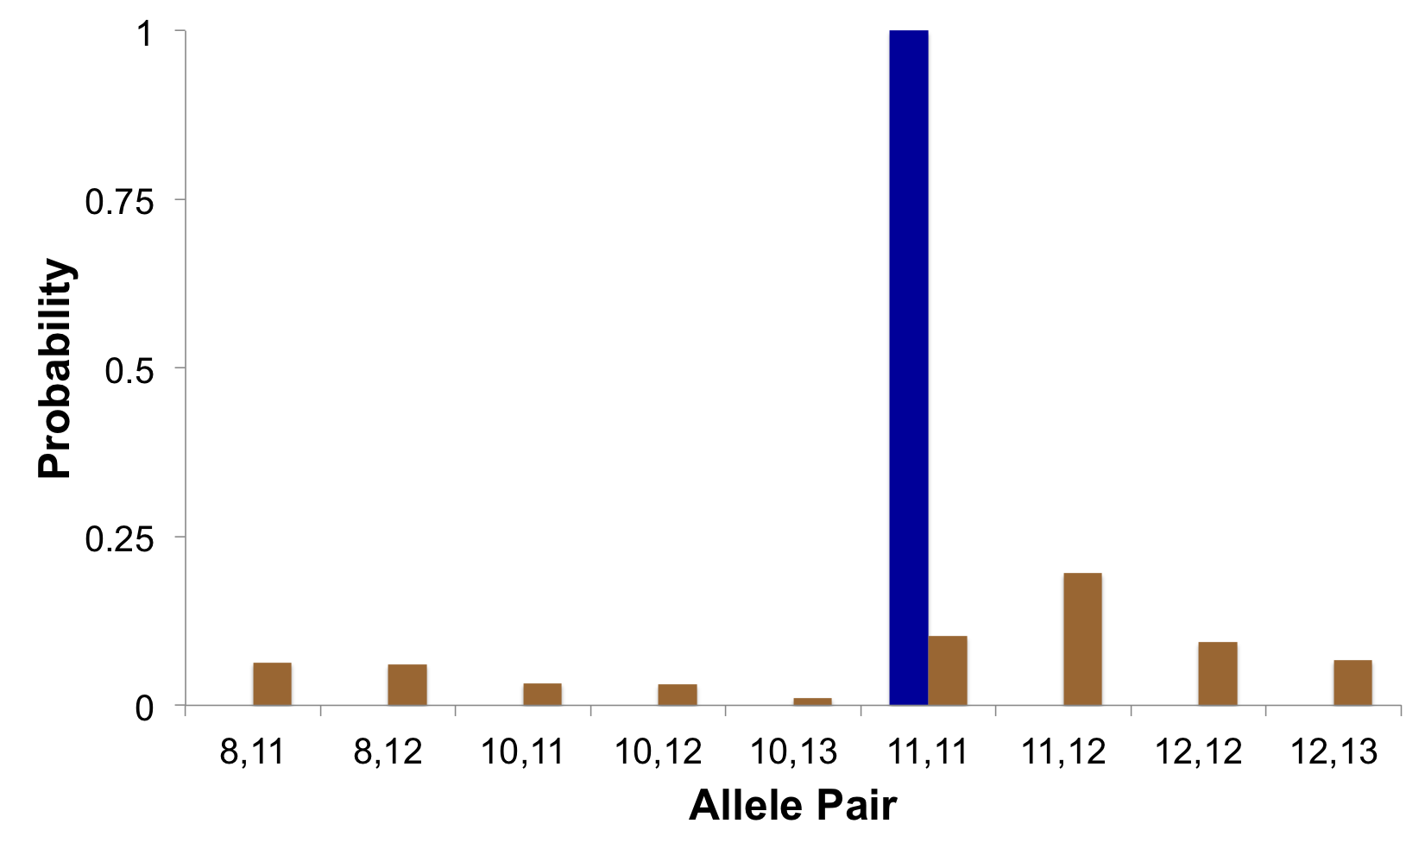
Genotype match
How much more does a reference match the evidence than a random person?
100%
Prob(evidence match)
Prob(coincidental match)
10x
Match statistic
10%

Slide 5
Is the reference in the evidence?
A match between the evidence
and the reference is:
10 times more probable than coincidence
at this one DNA location

Slide 6
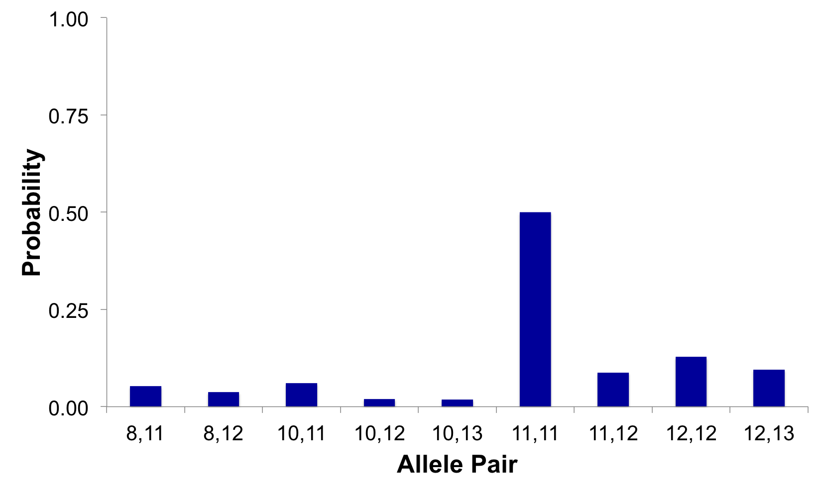
Mixture genotype
Evidence genotype for mixture DNA
50%
Diffuse probability
13%
10%
5%
6%
9%
4%
2%
2%

Slide 7
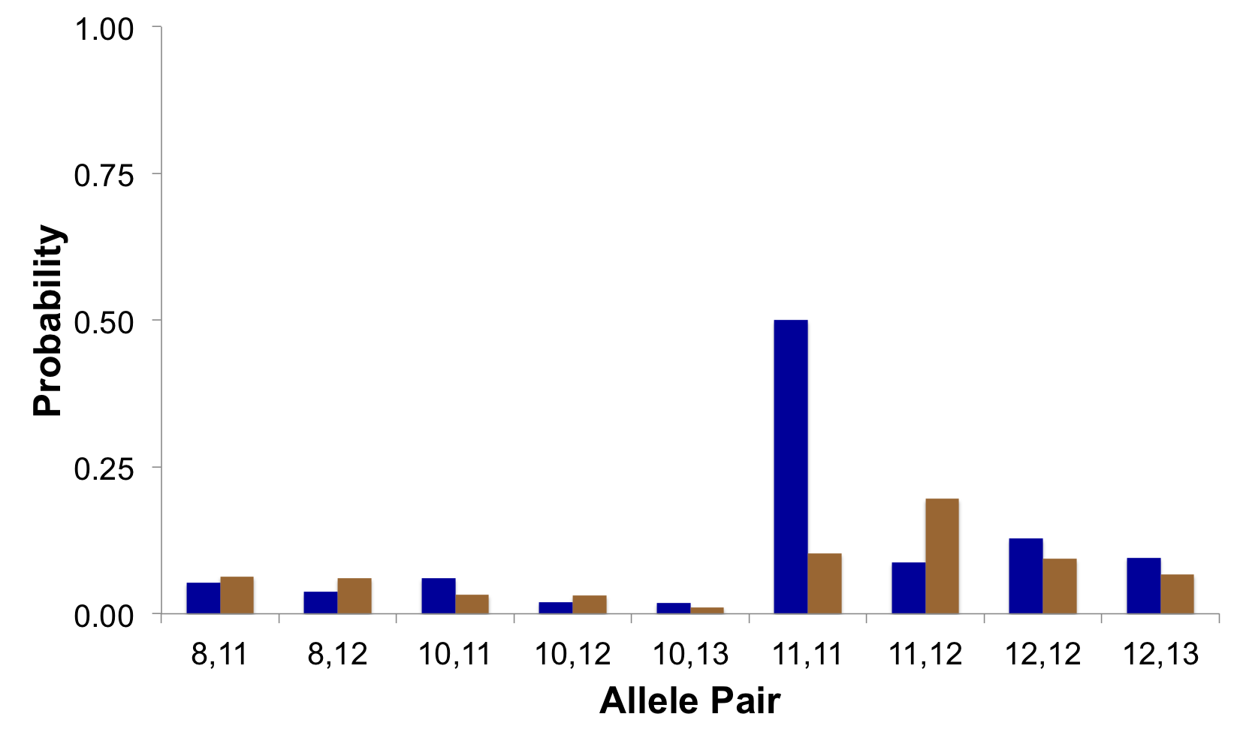
Genotype match
How much more does a reference match the mixture than a random person?
Prob(evidence match)
Prob(coincidental match)
5x
50%
Match statistic
reduction
10%

Slide 8
Is the reference in the mixture?
A match between the mixture evidence
and the reference is:
5 times more probable than coincidence
at this one DNA location

Slide 9
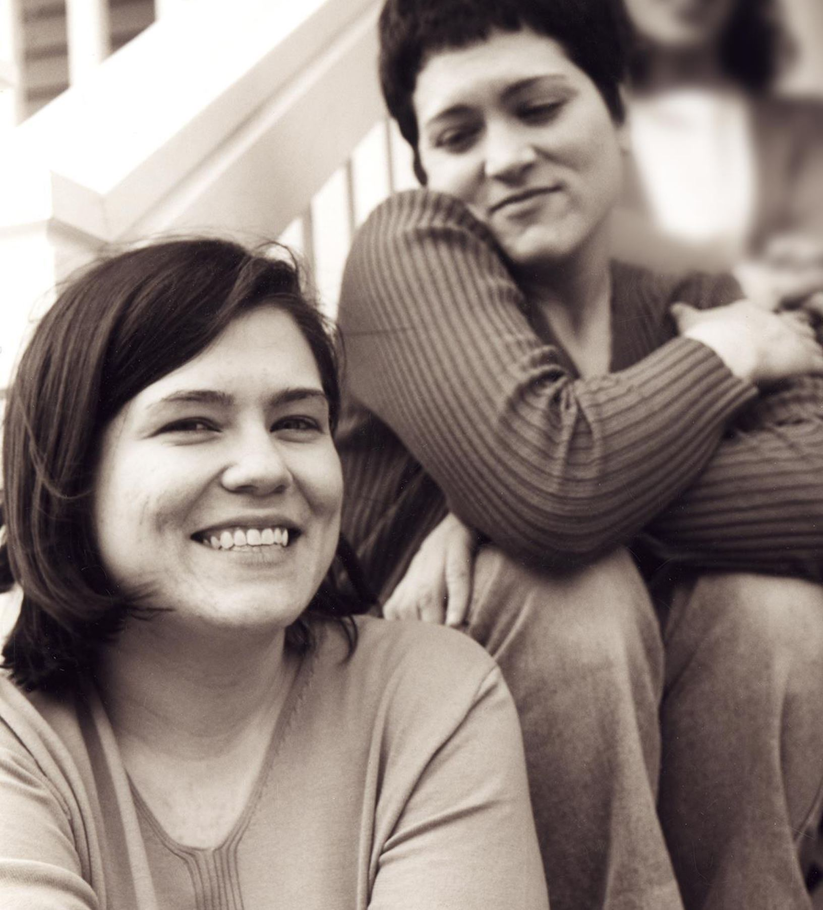
Wolfe sisters homicide
On February 6, 2014, Susan Wolfe (44)
and her younger sister Sarah (38, left)
were killed in their East Liberty home in Pittsburgh.

Slide 10
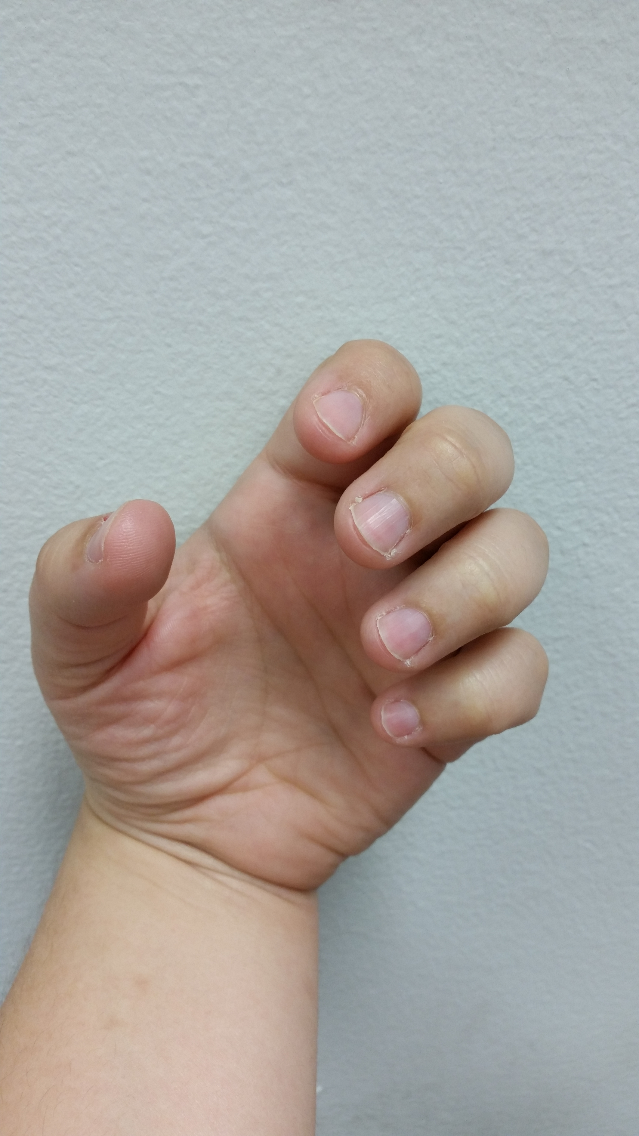
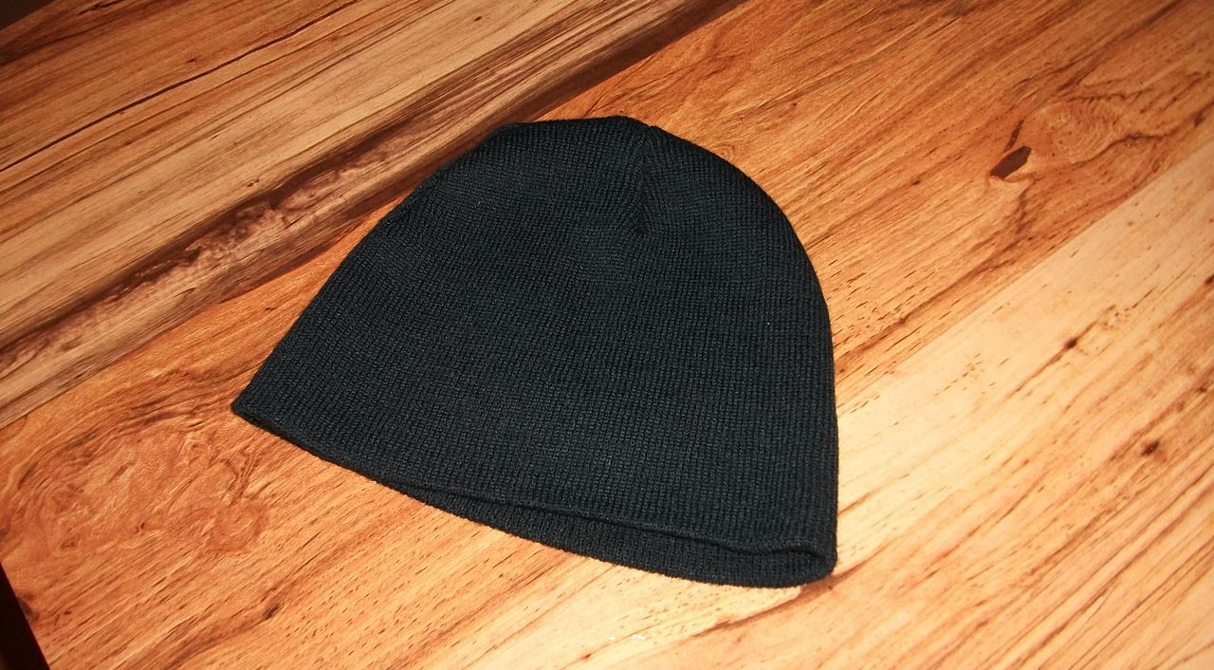
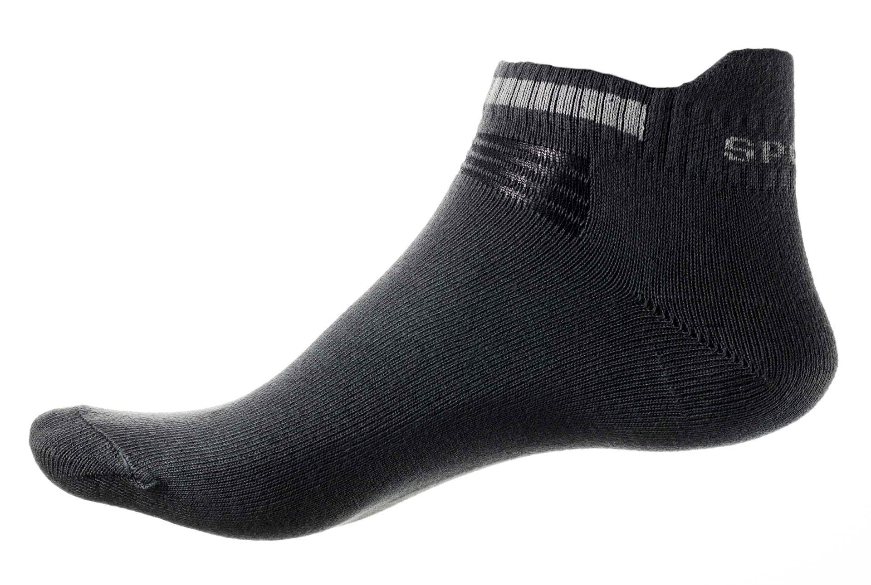
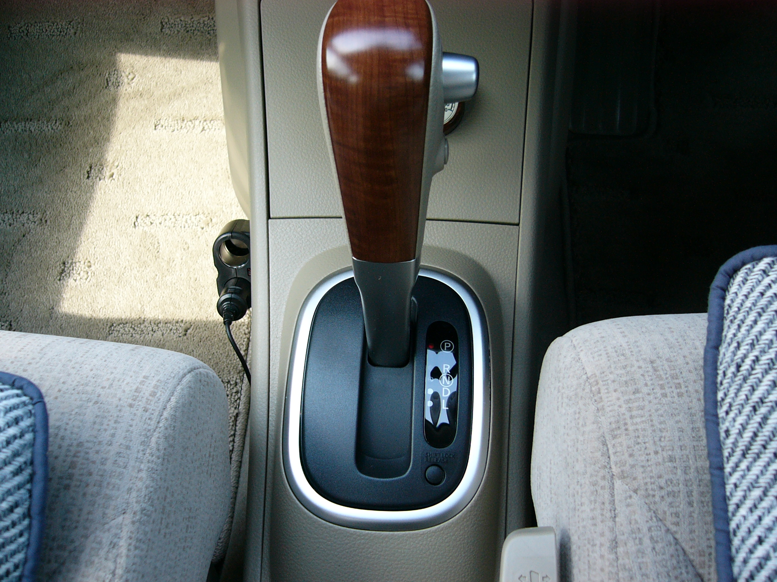
Commonwealth v. Allen Wade
Allen Wade was charged with various counts of criminal homicide, robbery, theft, and firearms violations
DNA evidence was collected from many items

Slide 11
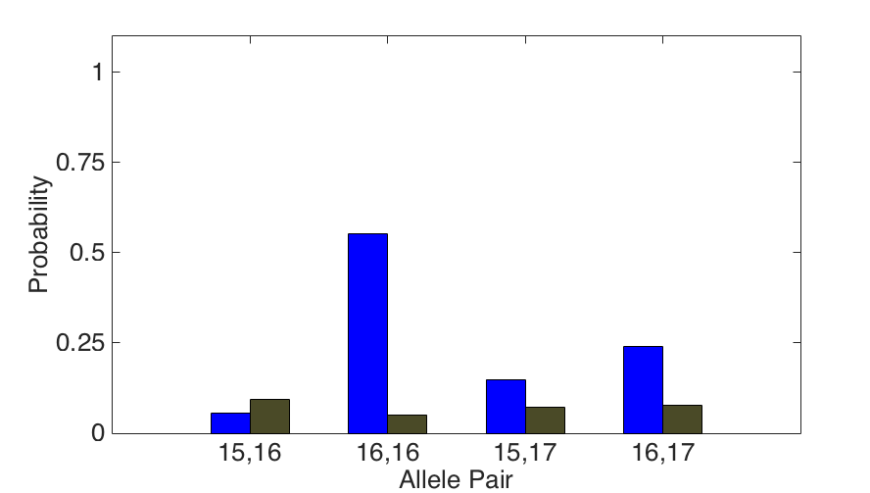
DNA match information
How much more does the suspect match the fingernails
than a random person?
11x
Prob(evidence match)
55%
Prob(coincidental match)
5%

Slide 12
Is the suspect in the evidence?
Calculated at the 15 loci tested
A match between the fingernails
and Allen Wade is:
6.06 trillion times more probable than coincidence

Slide 13
Computer match statistics
TrueAllele found 17 matches
Hat 65.3 thousand Allen Wade
Cup 20.5 thousand Susan Wolfe
Fingernails 6.06 trillion Allen Wade
Gear shift 9.37 million Sarah Wolfe
Seat lever 385 billion Sarah Wolfe
Knit hat 25.7 thousand Allen Wade
Sock 300 Sarah Wolfe
DNA matches lead to verdict…

Slide 14
Allen Wade Found Guilty On All Counts In East Liberty Sisters’ Slaying
CBS News, May 23, 2016
PITTSBURGH (KDKA/AP)
• A man accused of killing two sisters who lived next door to him in East Liberty has been found guilty on all counts.
• Allen Wade was accused of shooting Sarah and Susan Wolfe after they returned from work on Feb. 6, 2014, apparently to steal a bank card.
• On Monday morning, a jury found Wade guilty of first-degree murder, robbery, burglary and theft by unlawful taking.

Slide 15
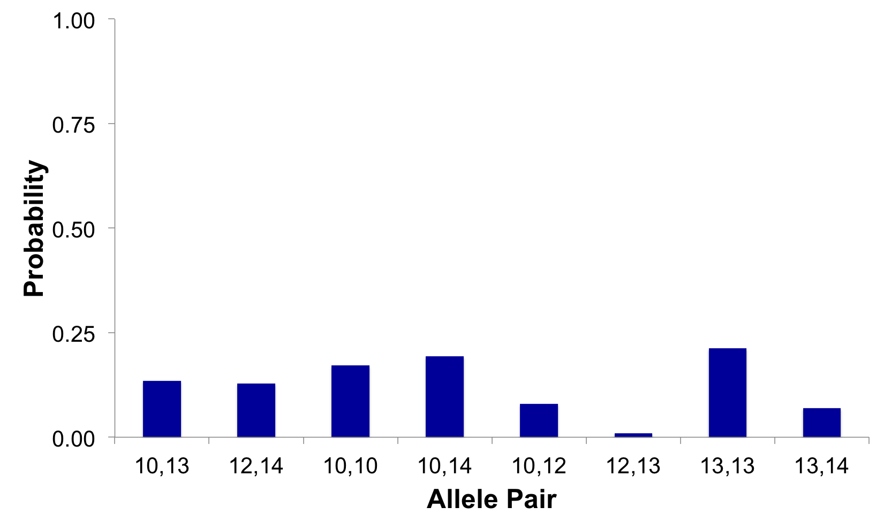
Mixture genotype
Mixture genotypes have diffuse probability
Probability concentrated on allele pairs with support in the data
19%
21%
17%
13%
13%
8%
7%
1%

Slide 16
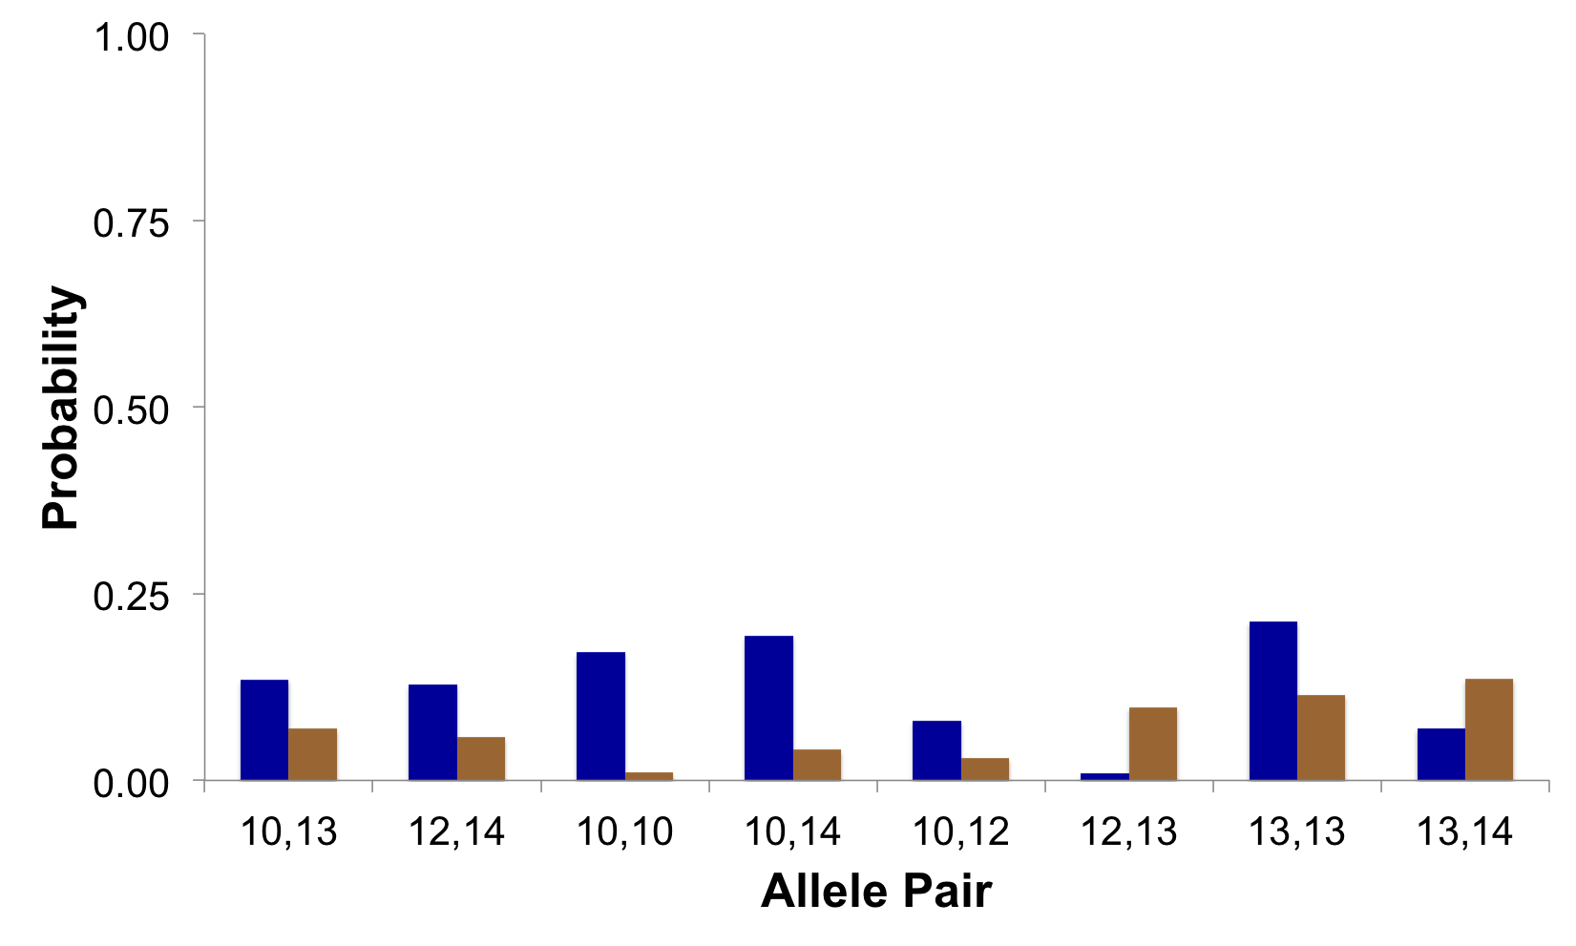
Exclusionary comparison
brown > blue = support for exclusion
Prob(evidence match)
Prob(coincidental match)
0.1x
10%
1%

Slide 17
Is the reference in the mixture?
A match between the mixture evidence
and the reference is:
10 times less probable than coincidence
at this one DNA location

Slide 18
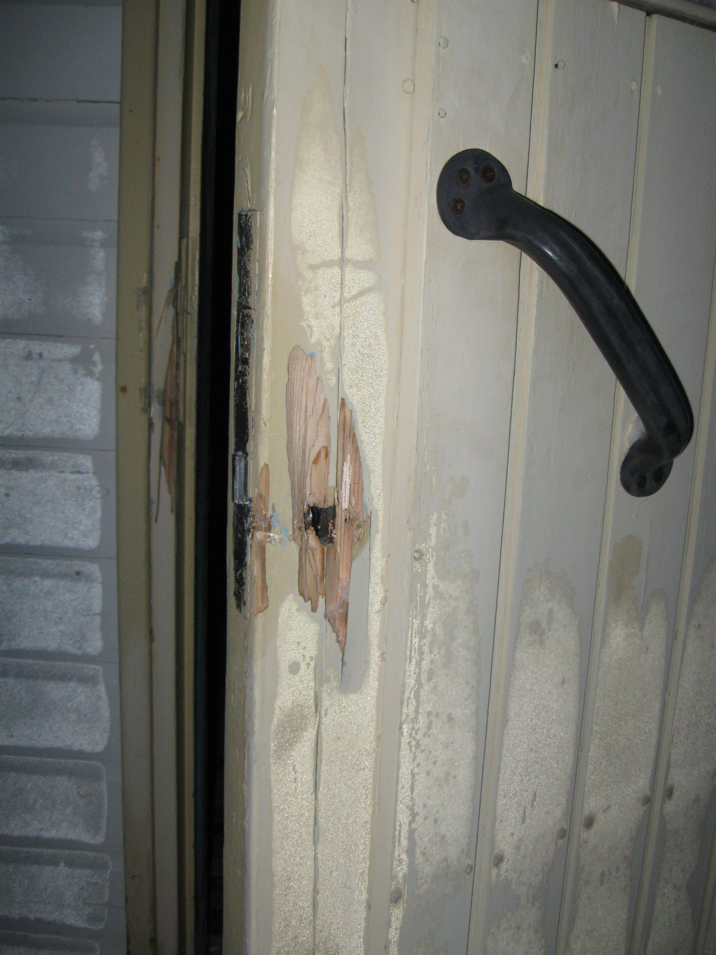
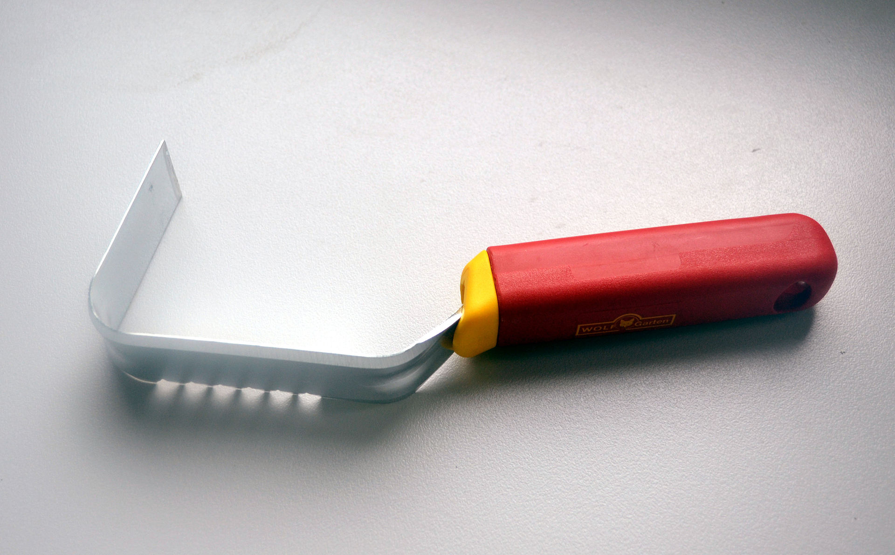
Michael Ciannella, Jr.
Defendant with no prior record maintained his innocence
and never admitted guilt
Cybergenetics contacted on July 18, 2016
Data received July 19, 2016
Preliminary results sent on July 20, 2016
Breaking and entering charge
DNA found on weeder tool

Slide 19
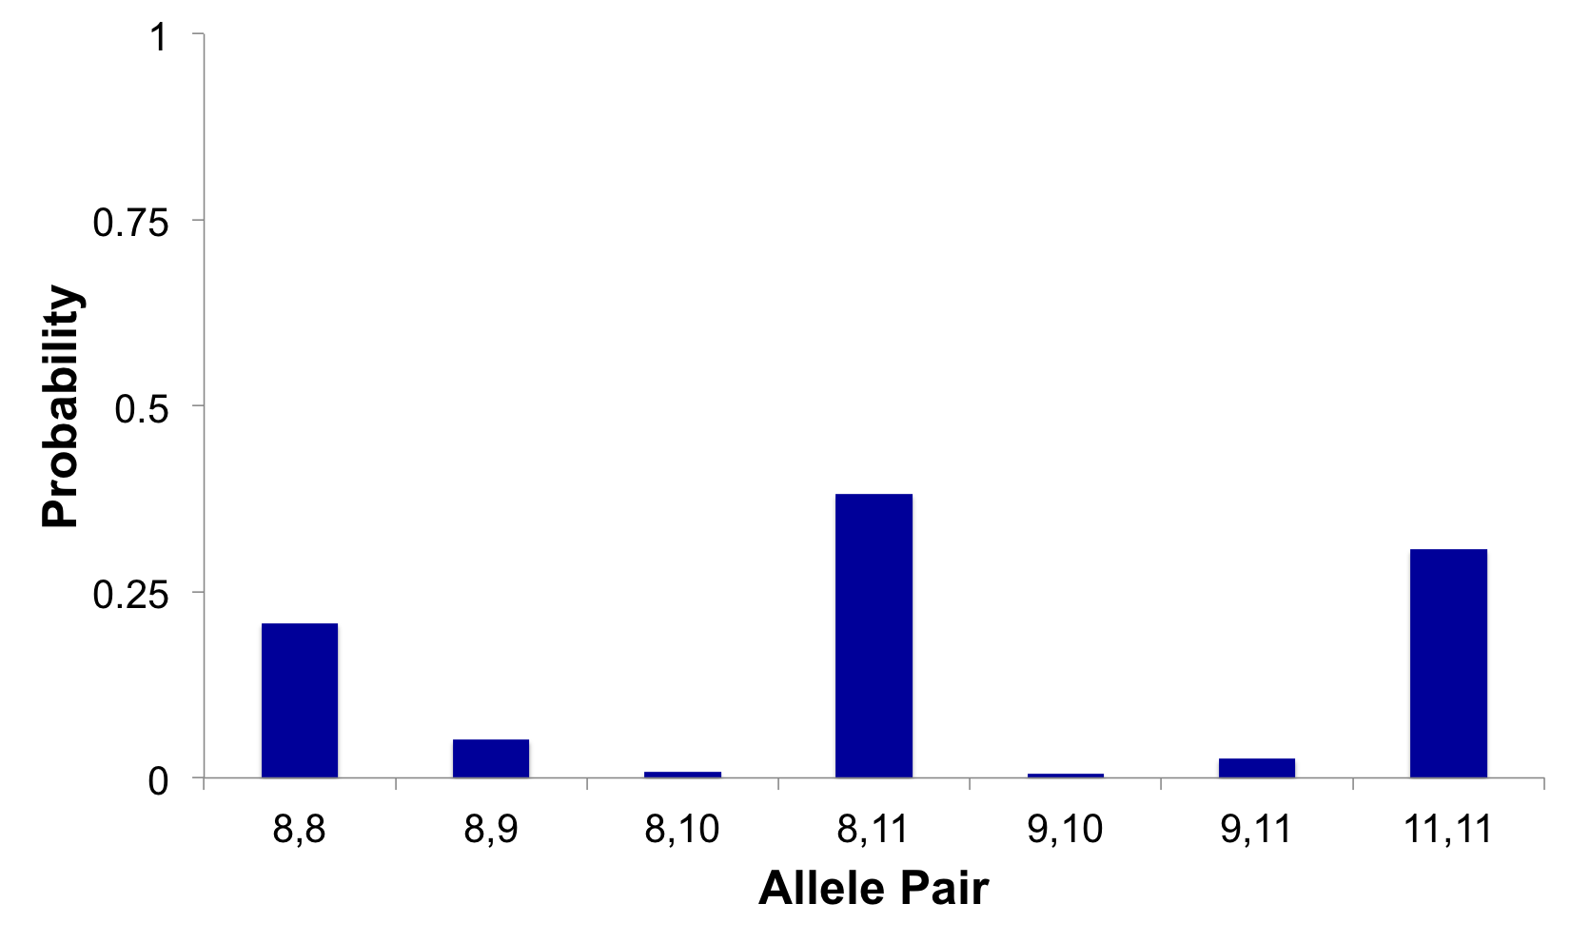
Evidence genotype
Objective genotype determined solely from the DNA data.
Never sees a comparison reference.
38%
31%
21%
5%
3%
1%
1%

Slide 20
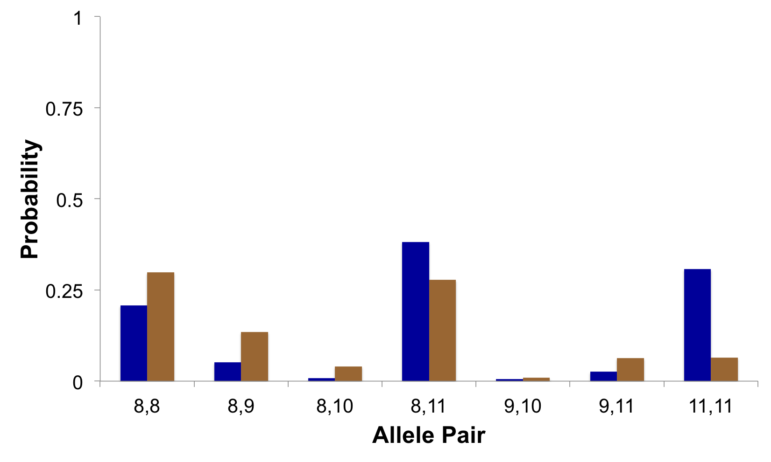
DNA match information
How much more does the defendant match the weeder
than a random person?
Prob(evidence match)
Prob(coincidental match)
13%
0.3x
5%

Slide 21
Is the defendant in the evidence?
Calculated at all 15 loci tested
A match between the weeder
and Michael Ciannella, Jr. is:
2.44 billion times less probable than coincidence

Slide 22
Case outcome
In September 2016, a report with exclusionary results was issued
The defense discussed the DNA results with the prosecution
In November 2016 – Mr. Ciannella was given pretrial probation
Case will be removed from trial list to be dismissed in one year

Slide 23
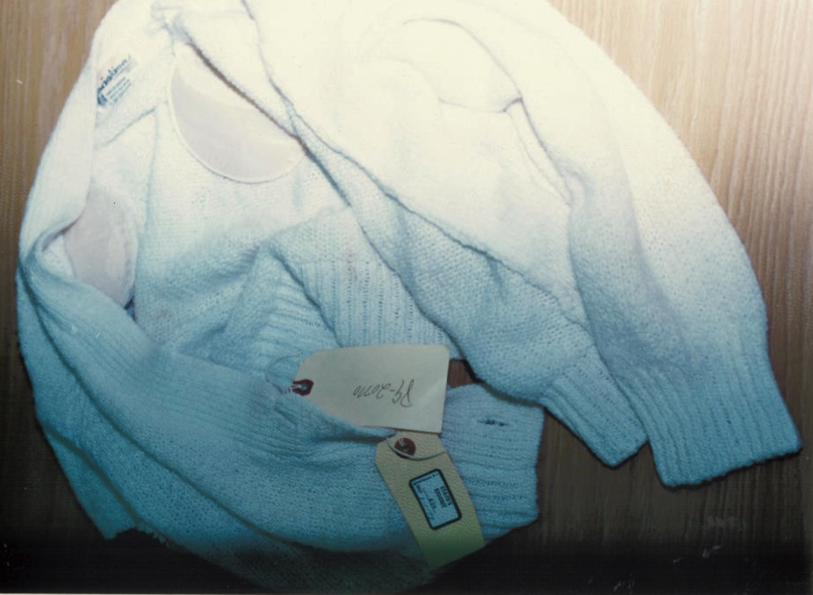
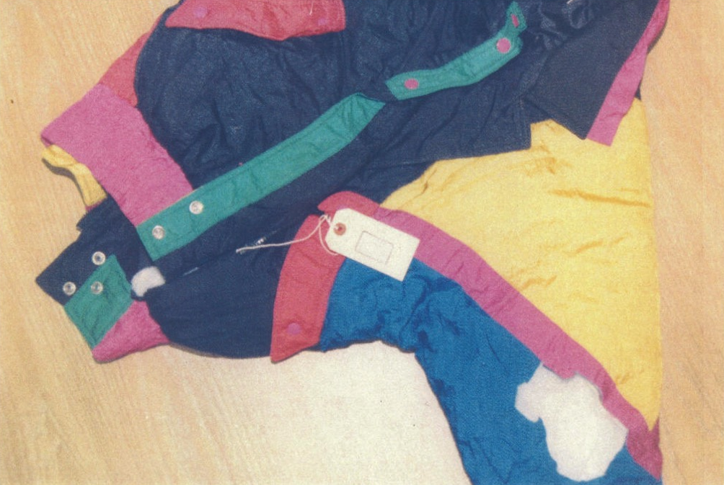
Indiana v. Darryl Pinkins
1989 – 5 men raped an Indiana woman
Darryl Pinkins and 2 others misidentified
1991 – wrongfully convicted, 65 year sentence
2001 – DNA mixture evidence 2 contributors found, not the accused
but 5 were needed, post-conviction relief denied

Slide 24
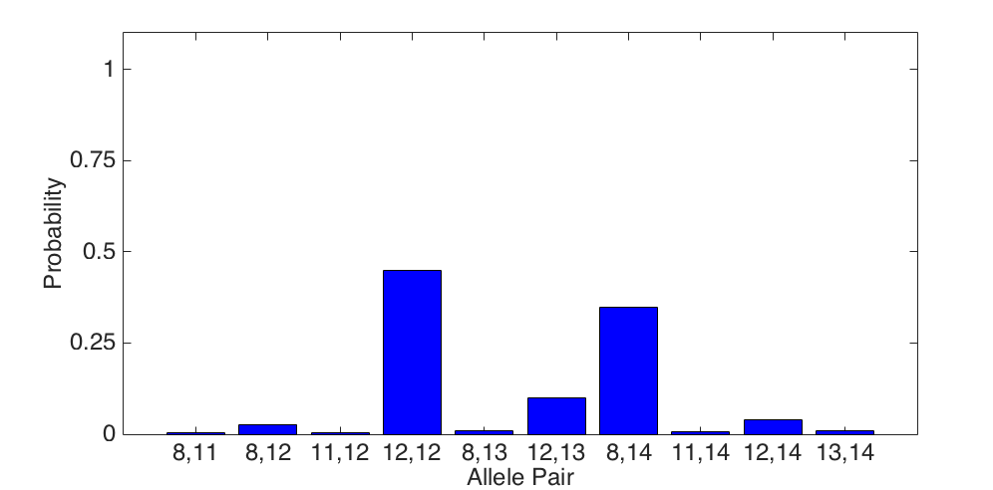
Evidence genotype
Objective genotype determined solely from the DNA data.
Never sees a comparison reference.
45%
34%
10%
1%
2%
1%
1%
1%
4%
1%

Slide 25
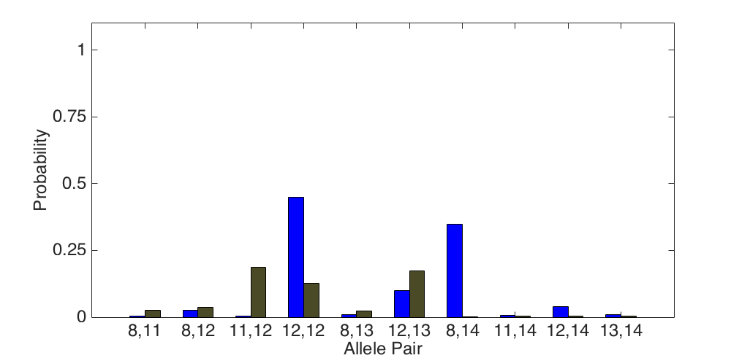
DNA match information
How much more does the defendant match the jacket
than a random person?
Prob(evidence match)
Prob(coincidental match)
0.05x
19%
1%

Slide 26
Is the reference in the evidence?
Calculated at the 9 loci tested
A match between the jacket
and Darryl Pinkins is:
1.1 million times less probable than coincidence

Slide 27
Computer analysis
The TrueAllele computer:
1. compared evidence with evidence
2. calculated exclusionary match statistics
3. revealed 5% minor mixture contributor
4. jointly analyzed DNA mixture data
5. showed three perpetrators were brothers
found 5 unidentified genotypes,
defendants not linked to the crime

Slide 28
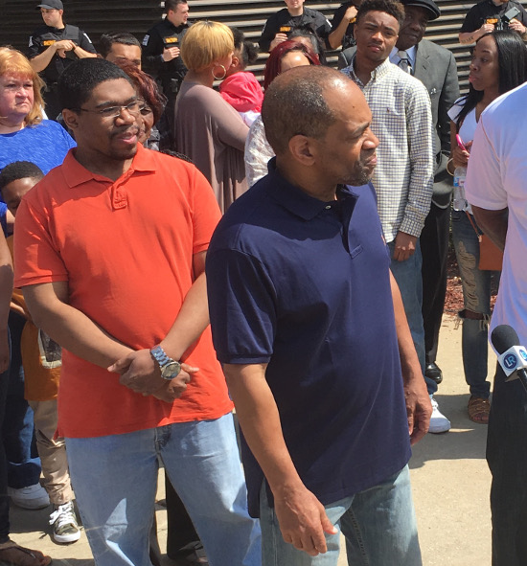
Pinkins exonerated
Indiana
April 25, 2016

Slide 29
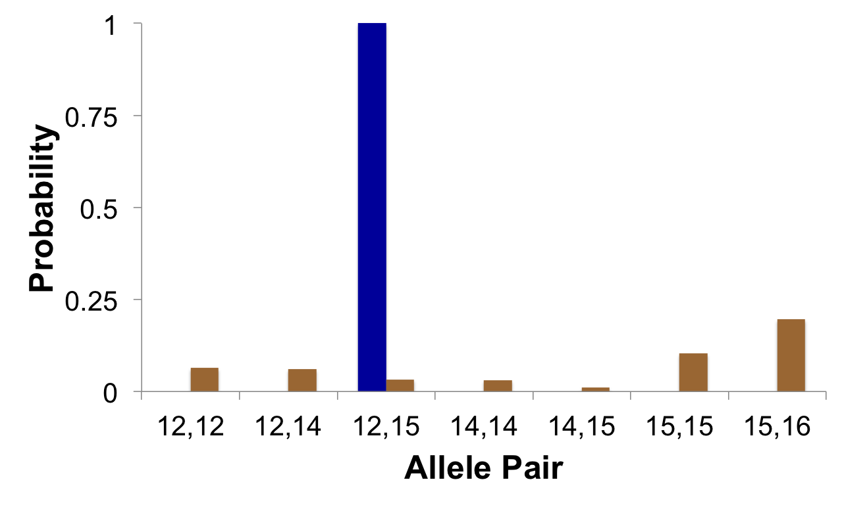
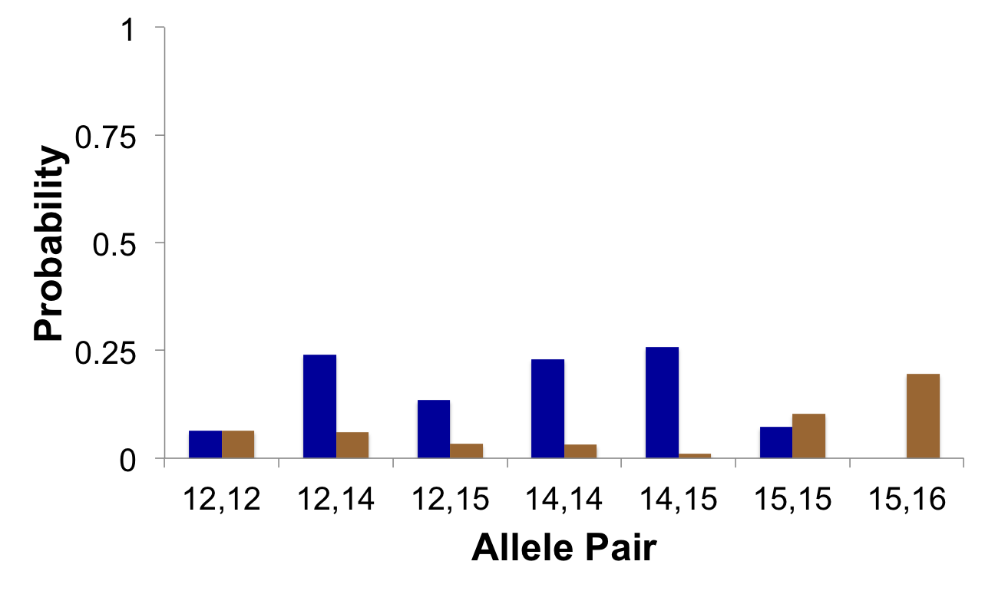
Some of the data
In or out, no in-between
X
Random Match Probability
Combined Probability
of Inclusion
X

Slide 30
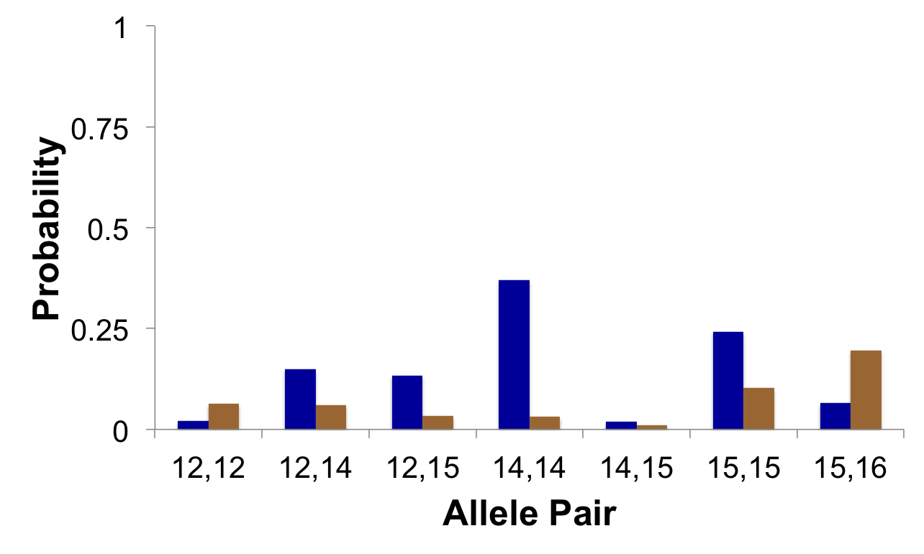
All of the data
Objective, thorough
✔
TrueAllele® Casework
Using all the data leads to more accurate DNA results

Slide 31


More information
http://www.cybgen.com/information
• Courses
• Newsletters
• Newsroom
• Presentations
• Publications
• Webinars
http://www.youtube.com/user/TrueAllele
TrueAllele YouTube channel
jennifer@cybgen.com

