Slide 1

Validating TrueAllele® genotyping on ten contributor DNA mixtures
¹David W. Bauer, PhD
²Nasir Butt, PhD
¹Mark W. Perlin, PhD, MD, PhD
¹Cybergenetics
Pittsburgh, PA
²Cuyahoga County
Forensic Laboratory
Cleveland, OH
Cybergenetics © 2003-2017

Slide 2
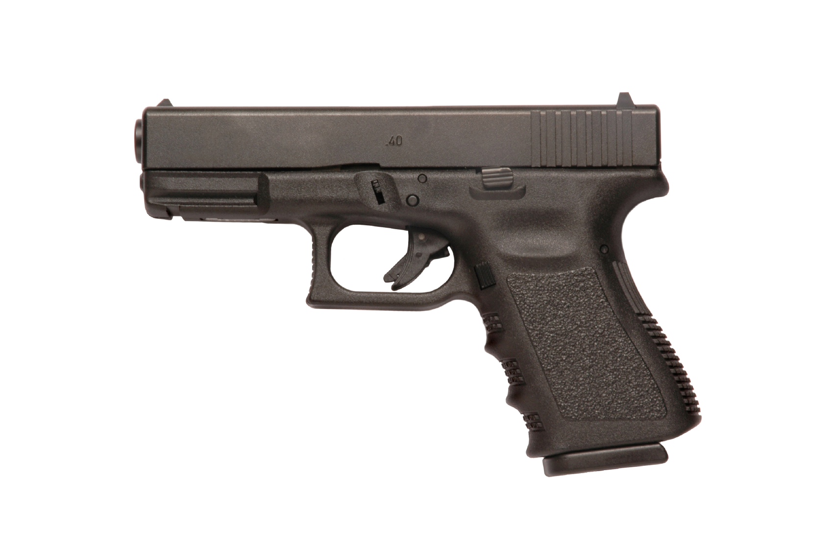
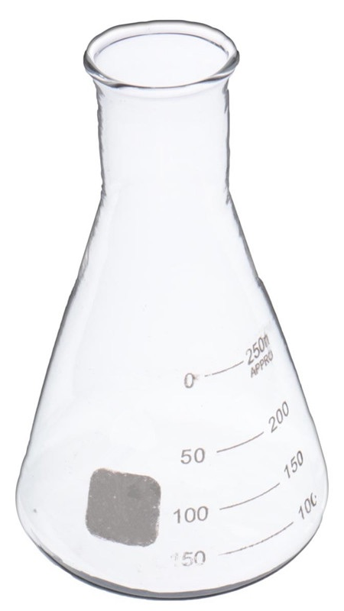
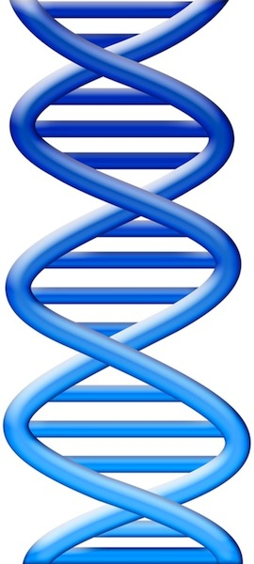

DNA evidence
DATA
Cold cases
Corroborate answers
Create new questions

Slide 3
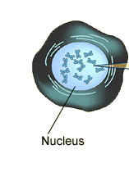
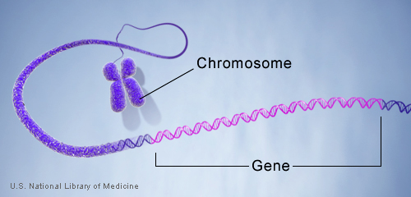
What is an STR?
Cell
locus
DNA
ACGT
Mother allele
1
2
3
4
5
6
7
8
9
Father allele
1
2
3
4
5
6
7
8
9
10
11
12

Slide 4
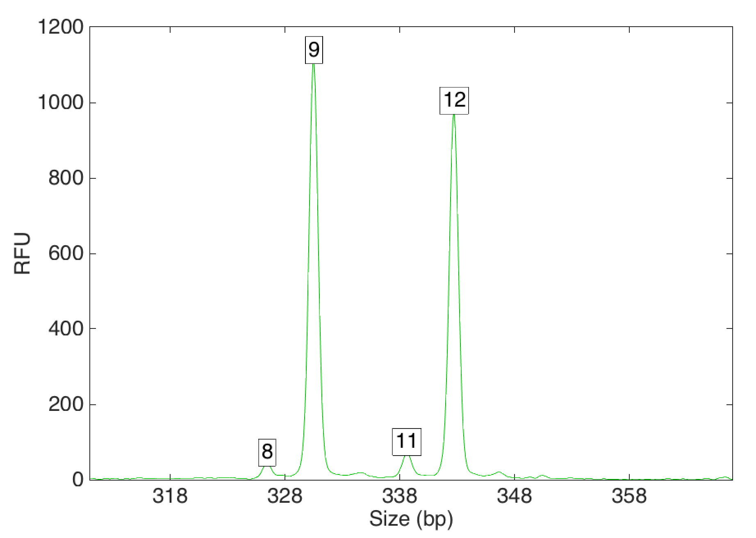
STR data
Task: to infer genotypes from peaks
Data eliminates possibilities
peak size
before
after
Single source
9
…
12
peak
height
…
9, 9
9, 9
9, 10
9, 10
9, 11
RFU
9, 11
9, 12
9, 12
10, 10
10, 10
10, 11
10, 11
10, 12
8
11
10, 12
…
…
Size (bp)

Slide 5
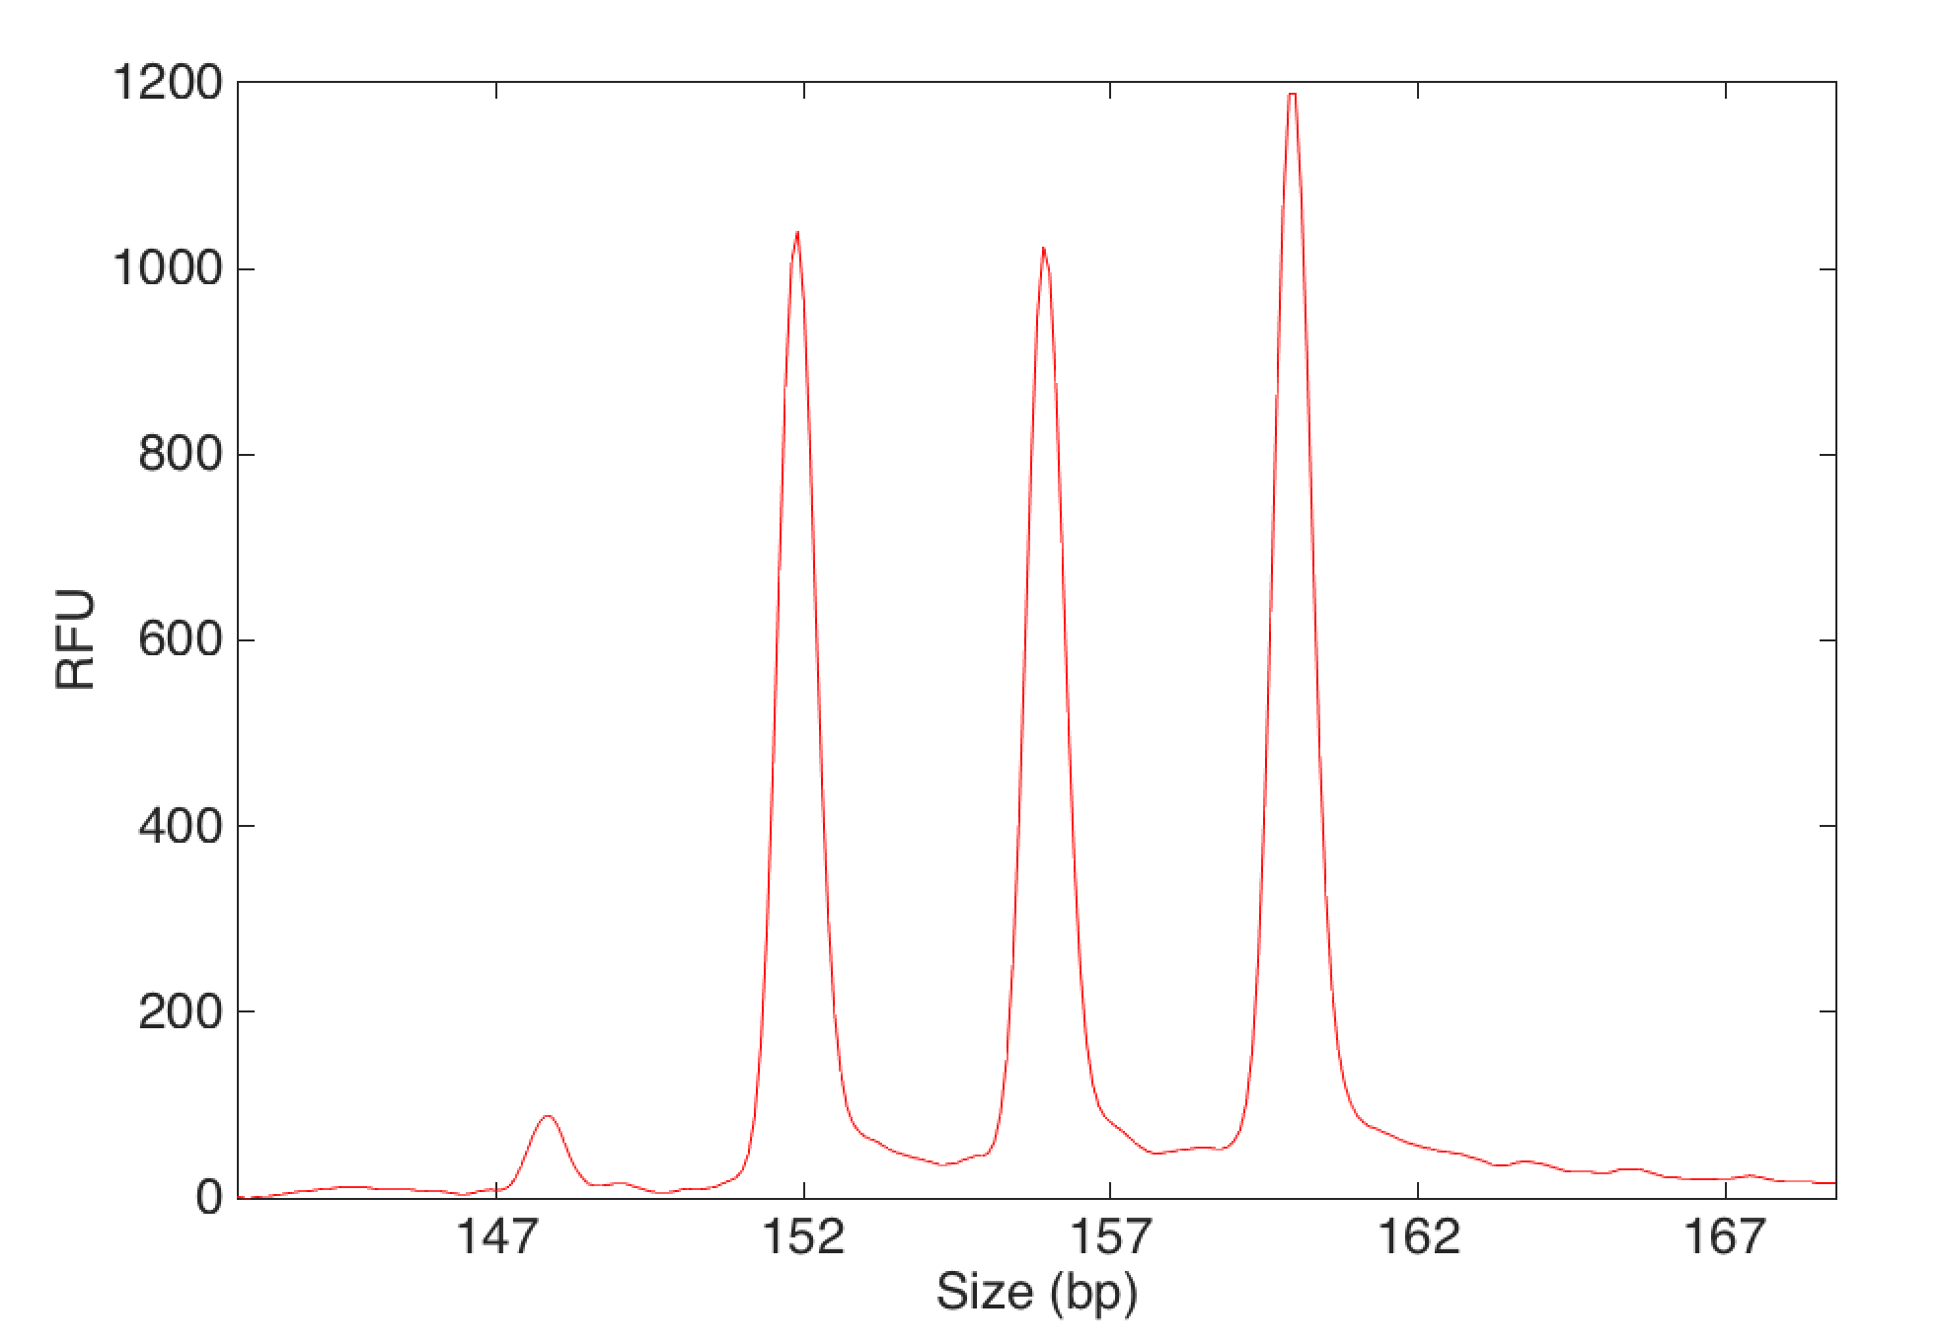
STR mixture data
more contributors
more complexity
more uncertainty
20
2 person mixture
18
No single answer
19
18, 18
18, 19
RFU
18, 20
19, 19
19, 20
17
20, 20
Size (bp)
Notes:
Genotypes separated

Slide 6
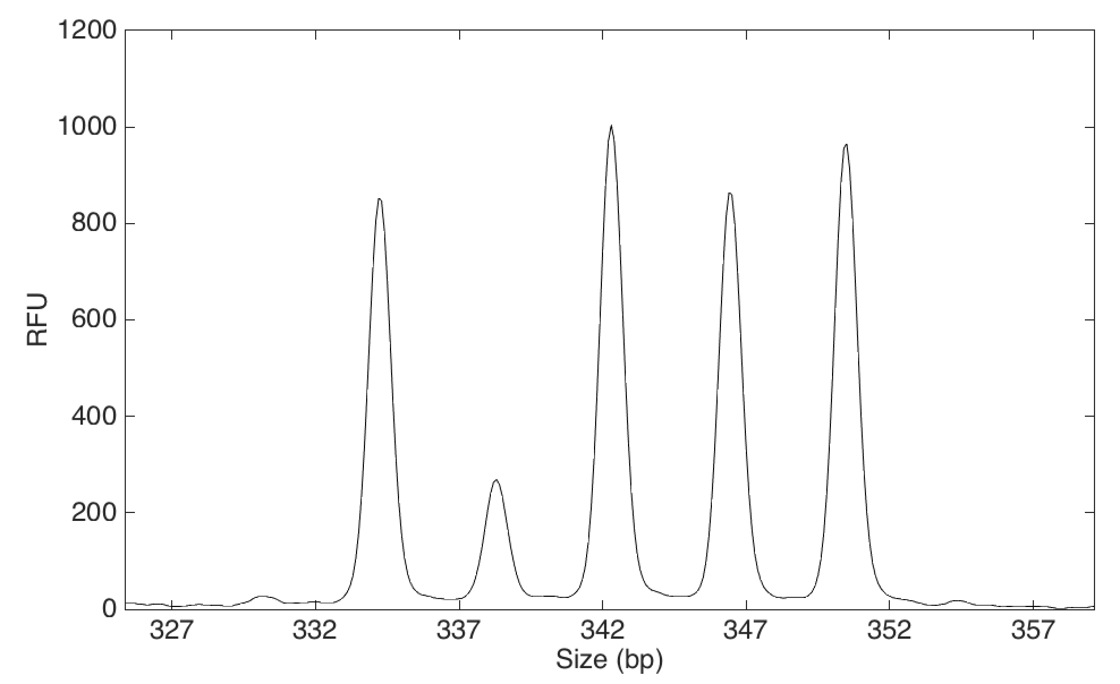
Too complex? – Yes and No
Reported
conclusions:
“Mixture of at least 3 individuals…”
“Number of contributors cannot reasonably be assumed…”
“…therefore, no further conclusions can be drawn.”
3 person mixture
11
13
9
12
RFU
10
8
Size (bp)

Slide 7
How TrueAllele works
- Computer tries thousands of possibilities
- Compares with data to calculate probability
- Good explanations
higher probability
3 person mixture
11
13
9
12
major
minor
RFU
middle
10
8
Size (bp)

Slide 8
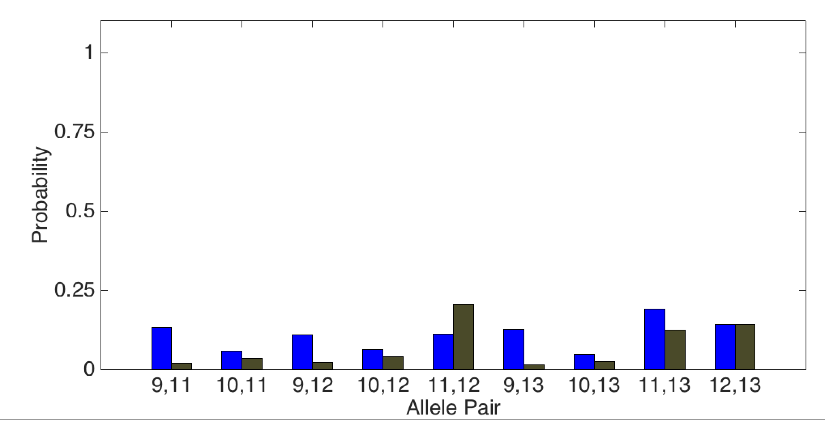
How TrueAllele works
- Handles uncertainty with probability
Prob(evidence match)
Probability
Genotype for the major contributor
9,11
10,11
9,12
10,12
11,12
9,13
10,13
11,13
12,13
Allele pair

Slide 9
Degree of match
Match statistics expressed as the numbers of zeros
Likelihood ratio (LR) =
Prob(evidence match)
Probability
Prob(coincidental match)
9,11
10,11
9,12
10,12
11,12
9,13
10,13
11,13
12,13
Allele pair

Slide 10
Degree of match
Match statistics expressed as the numbers of zeros
Likelihood ratio (LR) =
Prob(evidence match)
Probability
Prob(coincidental match)
7x
14%
2%
9,11
10,11
9,12
10,12
11,12
9,13
10,13
11,13
12,13
Allele pair
log(LR)
=
log(7) = 0.85
log(trillion) = 12
15 loci

Slide 11
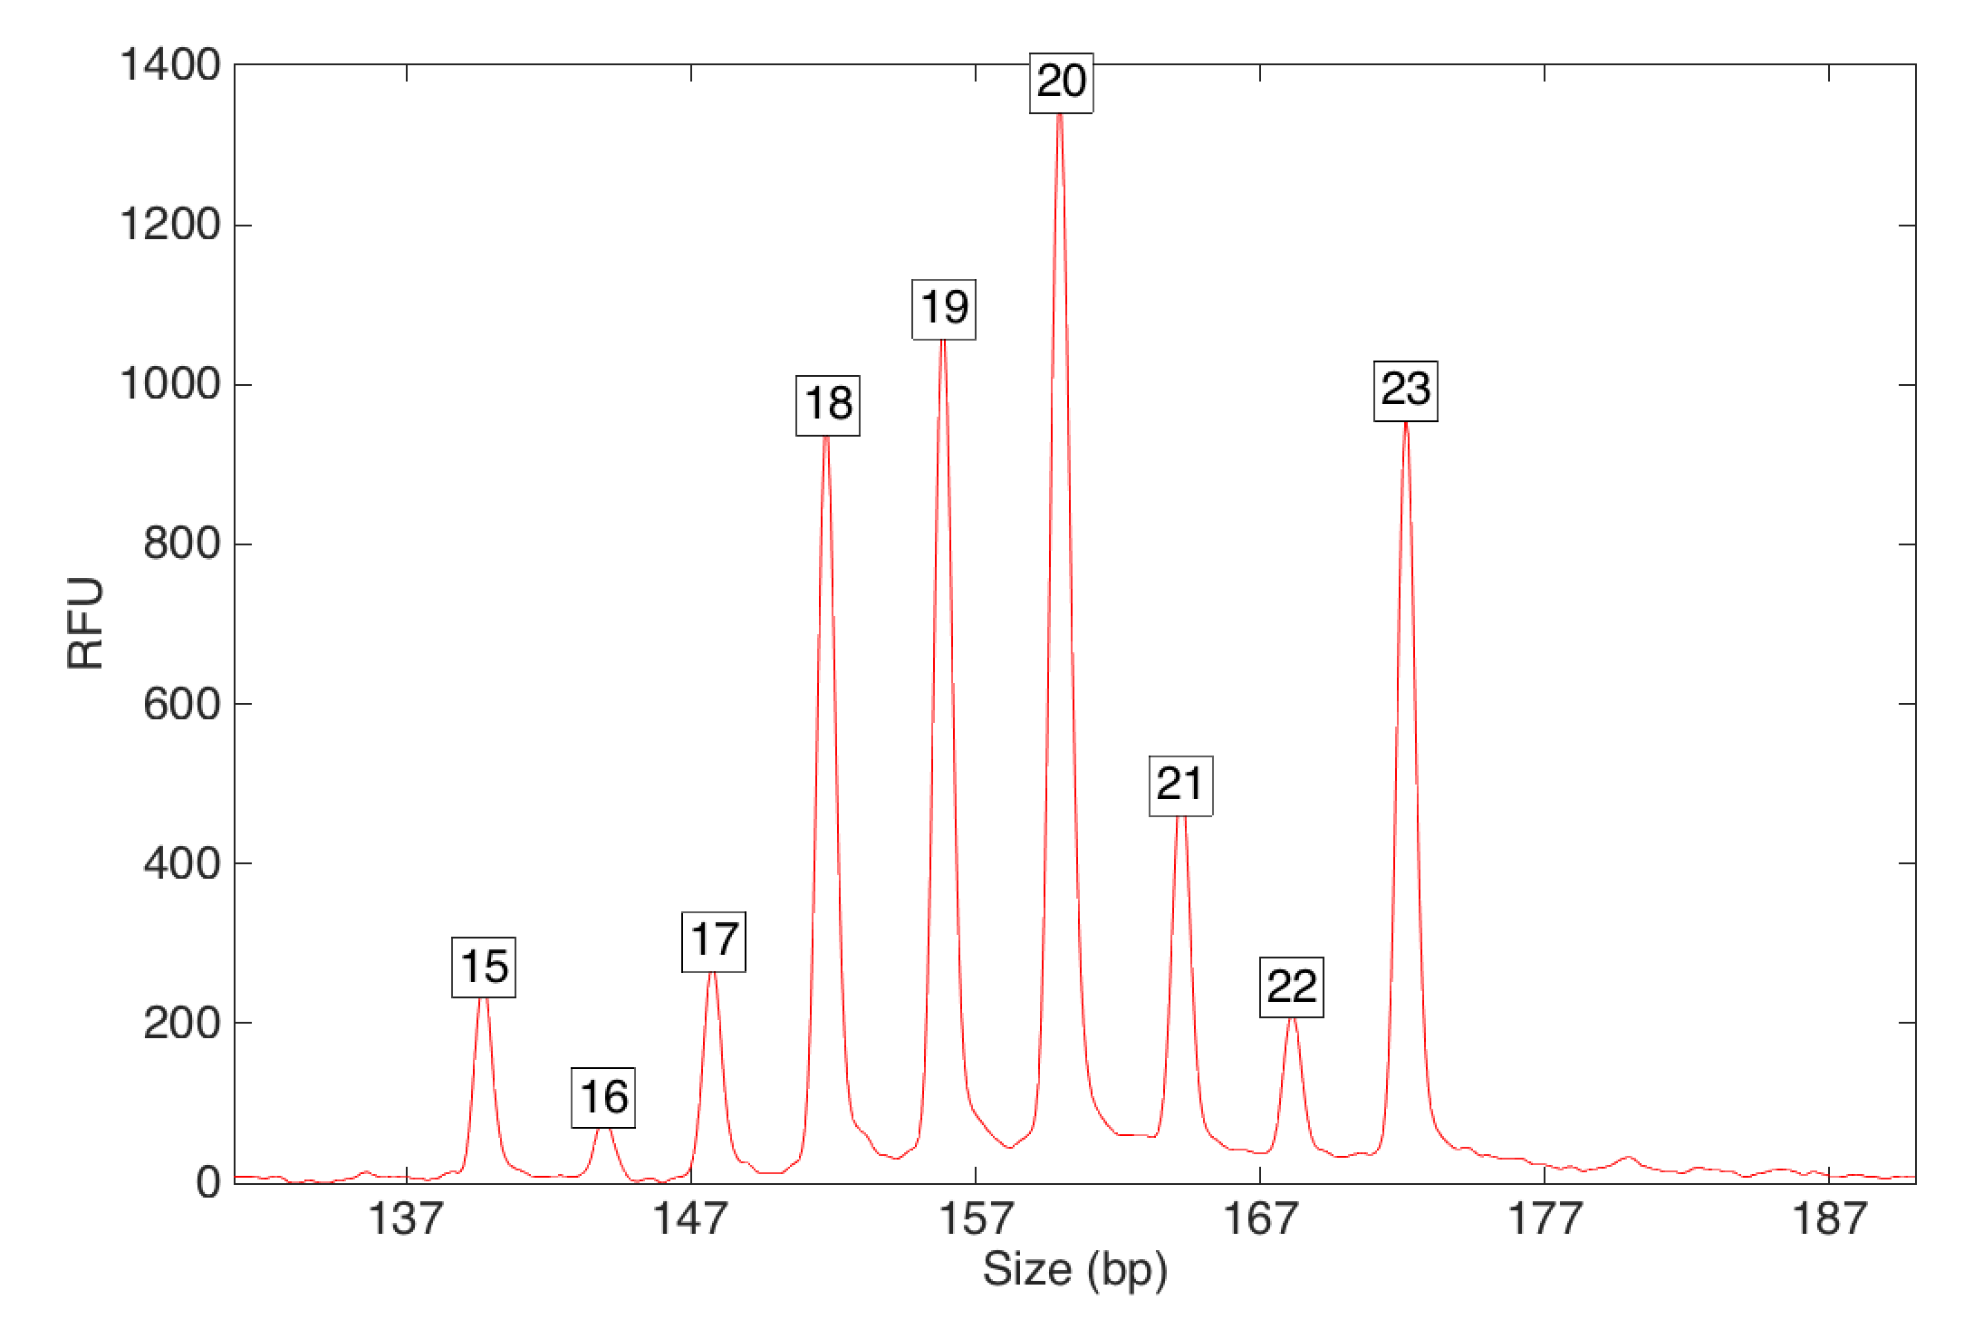
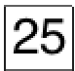
Validation samples
Laboratory created mixtures (2 - 10 person)
Don’t know real contributor number in casework
20
10 person mixture
minors difficult to ‘see’
19
18
23
RFU
21
15
17
22
16
25
Size (bp)

Slide 12
Sensitivity: simplicity from complexity
Match statistics to actual contributors
2 person
Average match strength decreases
3 person
5 person
Max log(LR) nearly constant
6 person
-6
0
6
12
18
24
30
log(LR)

Slide 13
Sensitivity: More or less
log(LR) depends on contributor weight
Match statistics for all samples
30
24
18
stronger
match
log(LR)
12
6
more DNA
0
20
40
60
80
100
-6
contributor weight (%)

Slide 14
Sensitivity: More or less
less DNA
more contributors
30
24
weaker match
2-3 person
18
log(LR)
12
4 person
6
6 person
0
20
40
60
80
100
-6
contributor weight (%)

Slide 15
Specificity
Sensitivity is important, but not sufficient
counts
2 person
-42
-36
-30
-24
-18
-12
-6
0
log(LR)
compare
Each evidence genotype
10,000 random profiles
Match statistic distribution for non-contributors

Slide 16
Specificity
Sensitivity is important, but not sufficient
counts
2 person
non-contributors excluded
3 person
counts
4 person
counts
More contributors
lower specificity
5 - 6 person
counts
-42
-36
-30
-24
-18
-12
-6
0
log(LR)

Slide 17
What limits specificity
Specificity not lost to complexity
0 - 5 %
minors
less specific
counts
counts
10 - 15%
Information
depends on
DNA amount
counts
30 - 50 %
Majors
more specific
counts
≥ 50%
-42
-36
-30
-24
-18
-12
-6
0
log(LR)
Notes:
5 observed

Slide 18
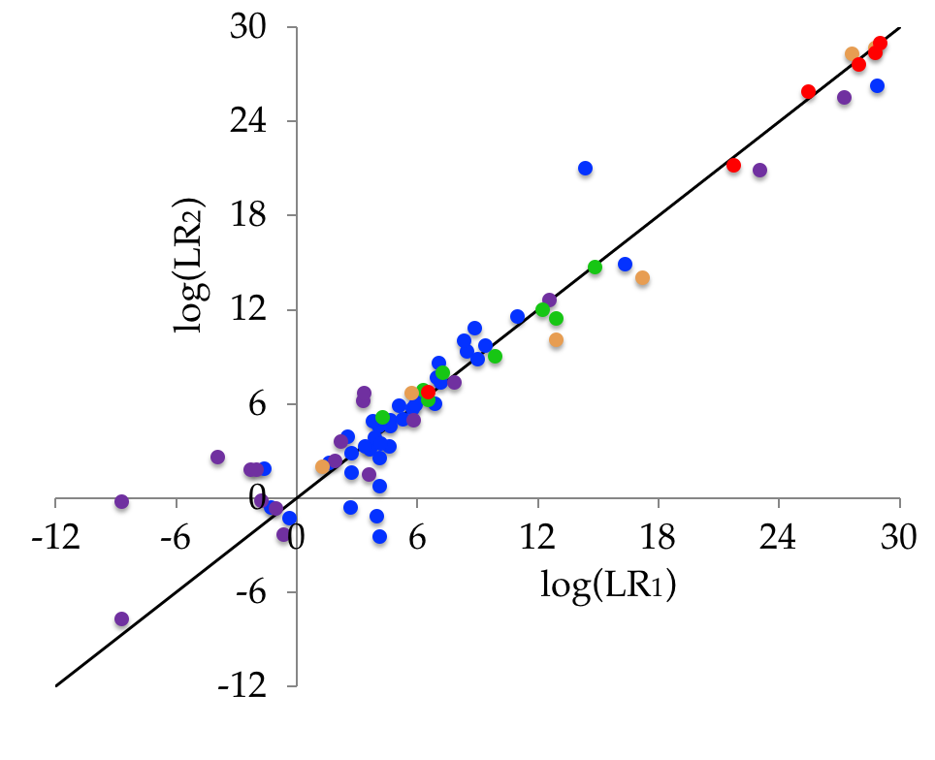
Reproducibility
- Repeatable results using a random search algorithm?
- Compare independnet results for each individual
contribs | within group std dev
2 | 0.08
3 | 0.71
4 | 2.20
5 | 1.65
6 | 1.77
log(LR₂)
log(LR₁)
more complexity
more variation
Notes:
Software uses a random search algorithm

Slide 19
Reproducibility
- Software uses a random search algorithm
- How repeatable are the results?
contribs | within group std dev
2 | 0.08
3 | 0.71
4 | 2.20
5 | 1.65
6 | 1.77
log(LR₂)
log(LR₁)
more complexity
more variation
less DNA

Slide 20
How many contributors?
Don’t know actual contributor number in casework
Does assumed contributor number matter?
20
10 person mixture
19
Actual: 10
18
23
RFU
compare
21
15
17
Observed: 5
22
16
25
Size (bp)

Slide 21
Never too many contributors
Matches to true contributors
counts
-6
0
6
12
18
24
30
log(LR)
Number of assumed contributors does not change results
 | min | mean | std dev | max | N = | False Exclusions
Actual (2-10) | -2.1 | 7.8 | 8.0 | 29.3 | 78 | 9
Observed (2-6) | -9.1 | 7.9 | 8.9 | 29.4 | 78 | 9

Slide 22
Identification comes from information
Observed
Actual
counts
-42
-36
-30
-24
-18
-12
-6
0
log(LR)
‘Extra’ genotypes:
 |  | Counts
 |  | Observed | Actual
log(LR) | 0 | 6,900 | 13,043
 | 1 | 1,866 | 3,334
 | 2 | 327 | 509
 | 3 | 39 | 42
 | 4 | 12 | 9
 | 5 | 0 | 0
- don’t affect chance of false inclusion
- low inclusionary & exclusionary power
Weak matches to
low-information genotypes
Notes:
1 million comparisons

Slide 23
Information grows
Peeling matched references increases information
log(LR)
DATA
1
4
1
3
2
1
2
2
2
2
2
2
3
3
assume known
match
2
1
1
2
3
3
4
15
3
3
4
4
6
8
weight (%)
13
4
2
3
3
6
16
4
4
5
6
12
5
5
5
22
6
7
13
7

Slide 24
Information grows
Peeling matched-references increases information
log(LR)
DATA
1
4
1
3
2
1
2
2
2
2
2
2
3
3
assume known
match
2
1
1
2
3
3
4
15
3
3
4
4
6
8
weight (%)
more information
13
4
2
3
3
6
16
4
4
5
6
Higher match to minors
12
5
5
5
22
6
7
‘Unseen’ minors not lost
13
7

Slide 25
Information includes AND excludes
Peeling matched-references increases information
-7
-3
minor genotypes
After peeling
Before peeling
counts
-30
-24
-18
-12
-6
0
log(LR)
Genotypes for minors more exclusionary

Slide 26
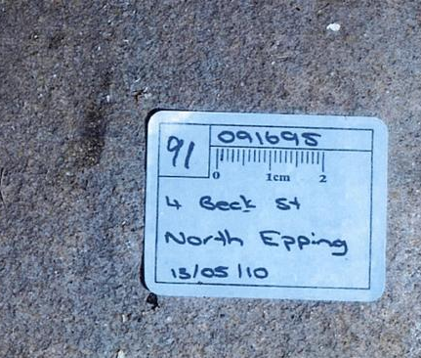
Complexity in casework
more
probative weight
more contributors
more
complexity
Crime:
Quintuple homicide in Sydney Australia
Father, mother, 2 sons, aunt
Suspect:
Brother in-law
Evidence:
Blood stain in suspect’s garage

Slide 27
Complexity in casework
Blood mixture of 5 victims (blood-related)
victim
weight
LR
Son
40%
50 quadrillion
Son
30%
2.2 billion
Father
20%
230 thousand
Aunt
7%
29 thousand
Mother
3%
290

Slide 28
Conclusions
Tested TrueAllele on ten-contributor mixtures
{
• Sensitive
Included true contributors
DNA amount
• Specific
not
Excluded non-contributors
contributor number
• Reproducible
Concordance between runs
• Objective
Data dictate results, not user assumptions

Slide 29


More information
http://www.cybgen.com/information
• Courses
• Newsletters
• Newsroom
• Presentations
• Publications
• Webinars
TrueAllele YouTube channel:
http://www.youtube.com/user/TrueAllele
dave@cybgen.com

