Slide 1

Science & Sorcery in
Forensic DNA Evidence
Science in our World: Certainty & Controversy
Penn State Beaver
April, 2017
Monaca, PA
Mark W Perlin, PhD, MD, PhD
Cybergenetics, Pittsburgh, PA
Cybergenetics © 2003-2017

Slide 2
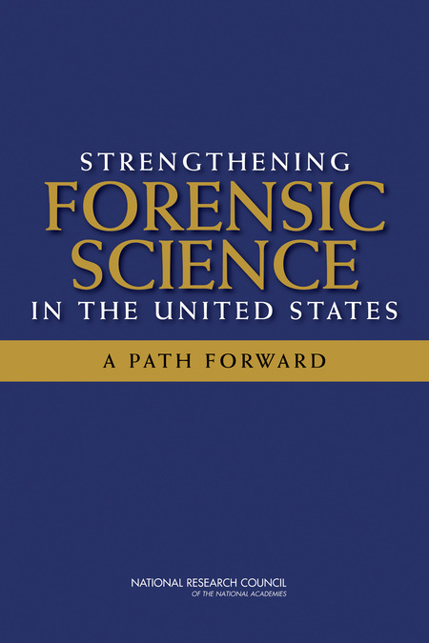
National Academy of Sciences
Trouble in River City
2009
Where’s the “science” in Forensic Science?

Slide 3
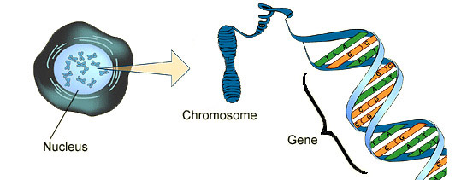
DNA biology
Cell
Chromosome
Locus
Nucleus

Slide 4

Short tandem repeat
DNA locus paragraph
Take me out to the ball game
take me out with the crowd
buy me some peanuts and Cracker Jack
I don't care if I never get back
let me
root root root root root root root root root root
for the home team,
if they don't win, it's a shame for it's one, two, three strikes, you're out
at the old ball game
23 volumes in cell's
DNA encyclopedia
"root" repeated 10 times, so
allele length is 10 repeats

Slide 5
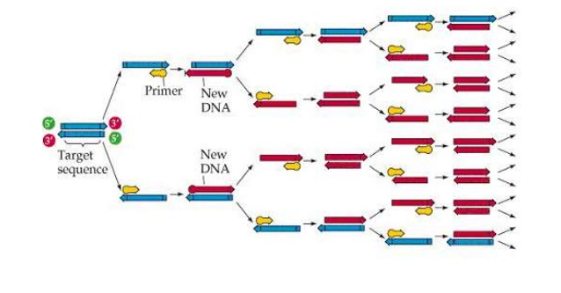
Polymerase chain reaction
1985

Slide 6
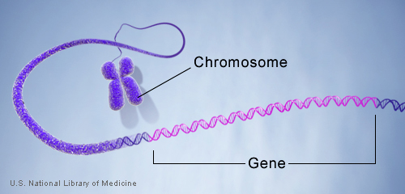
DNA genotype
A genetic locus has
two DNA sentences,
one from each parent.
An allele is the number
of repeated words.
locus
A genotype at a locus
is a pair of alleles.
mother
allele
1
2
3
4
5
6
7
8
9
10
10, 12
ACGT
repeated word
Many alleles allow for
many many allele pairs.
A person's genotype
is relatively unique.
father
allele
1
2
3
4
5
6
7
8
9
10
11
12

Slide 7
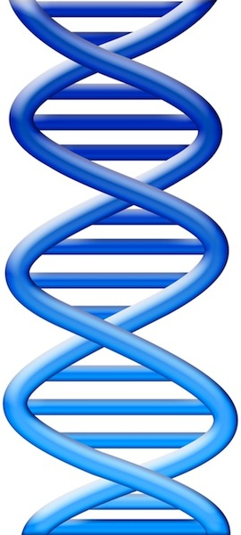
Simple DNA interpretation
Evidence item
Lab
Evidence data
Infer
Evidence genotype
10, 12
10 11 12
DNA from
one person
Compare
Known genotype
10, 12

Slide 8
Pittsburgh skyline

Slide 9
Draw a threshold
1990

Slide 10
Same heights & vacant lots

Slide 11
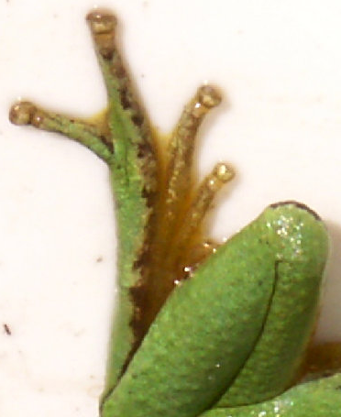
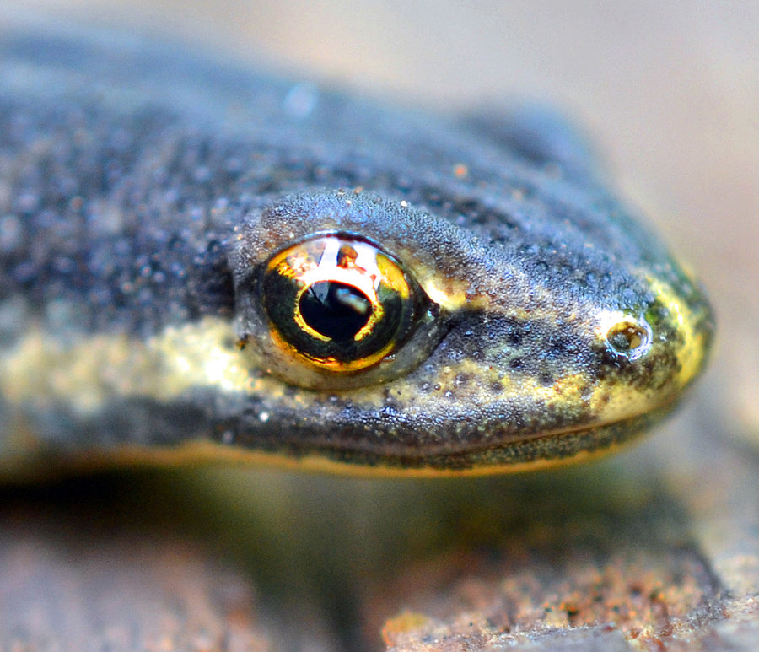

DNA mixture
1995
eye of newt
toe of frog
Double, double toil and trouble

Slide 12
Simplify data to interpret mixture
2000
f₁
f₂
f₃
f₄
f₅
Apply threshold to find “alleles”
Add allele frequencies (f₁ + f₂ + …)
Square sum, take reciprocal
Locus “probability of inclusion” (PI)
Multiply locus PI values
Combined (CPI) match statistic

Slide 13
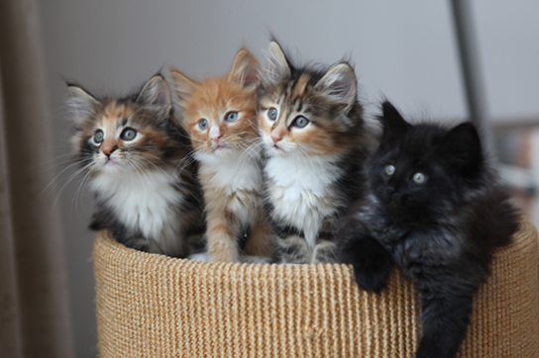
Natural variation

Slide 14
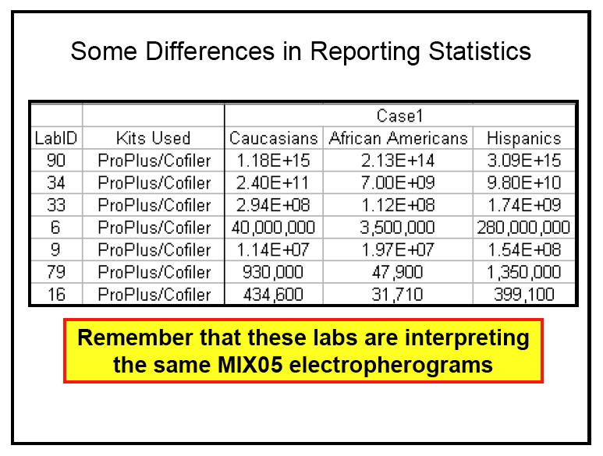
Unreliable DNA mixture statistics
2005
NIST (Commerce Department) study in 2005
Two contributor mixture data, known victim
When not
“inconclusive”:
213 trillion (14)
31 thousand (4)
Forensic DNA labs put on notice ten years ago

Slide 15

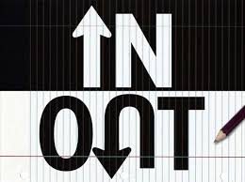
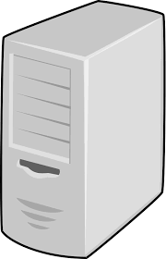

Biased DNA workflow
2010
(1)
Choose data
(3)
Person decides
(2)
Calculate statistic
• Put people in the process
• To overcome software limits
• And introduce human bias

Slide 16
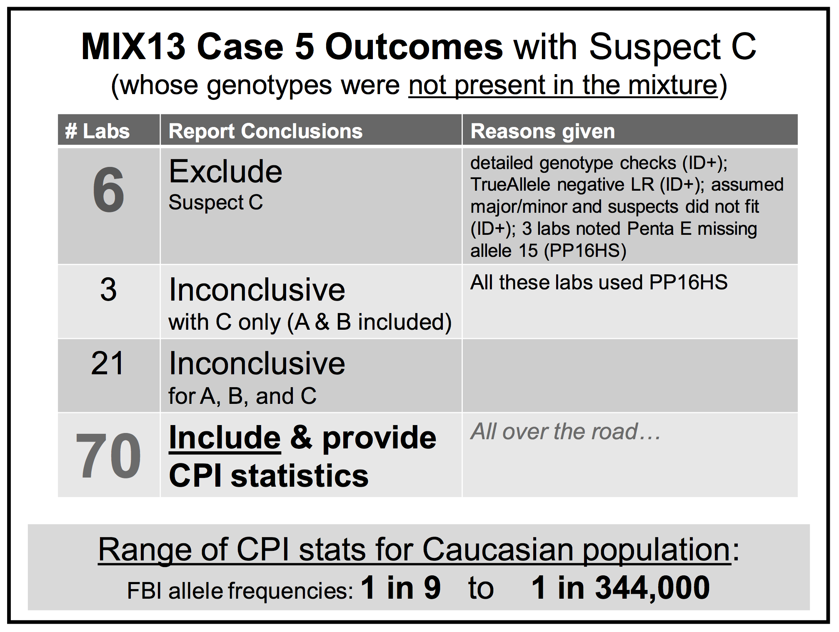
Falsely identify innocent people
2015

Slide 17
Mixture statistics shut down labs
“National accreditation board suspends all DNA testing at D.C. crime lab”
The Washington Post April 27, 2015
Did not comply with FBI standards
“New protocol leads to reviews of
‘mixed DNA’ evidence”
The Texas Tribune September 12, 2015
24,468 lab tests affected

Slide 18
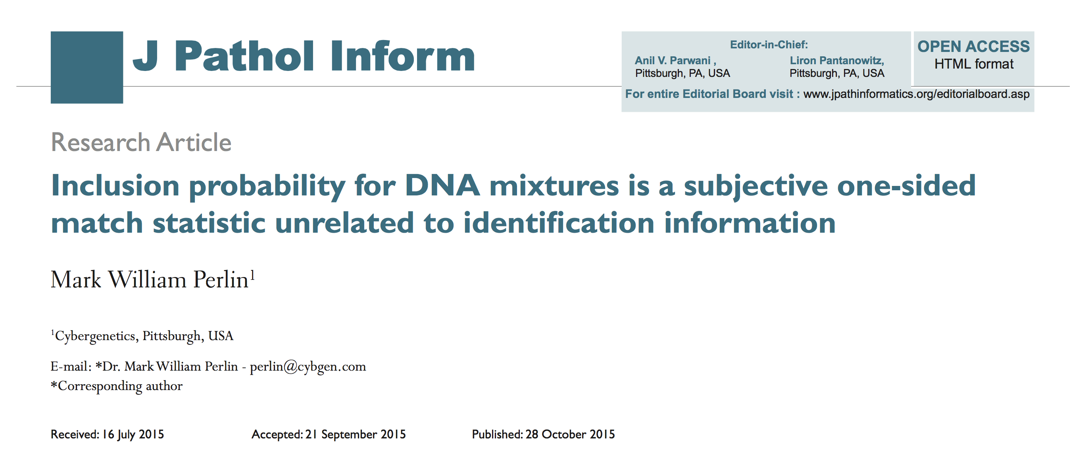
Statistics lack scientific basis
Misled courts for 15 years on countless DNA mixtures

Slide 19
TrueAllele® computer technology
• Accurate. 34 validation studies, 7 published
• Objective. Workflow removes human bias
• Accepted. Reported in 37 states, used by labs
• Transparent. Give math, software (4GB DVD)
• Neutral. Can statistically include or exclude

Slide 20
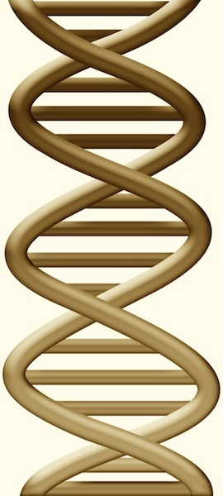
DNA mixture interpretation
Evidence item
Lab
Evidence data
Separate
Evidence genotype
10, 11 @ 20%
11, 11 @ 30%
11, 12 @ 50%
10 11 12
DNA from
two people
Compare
Known genotype
11, 12

Slide 21
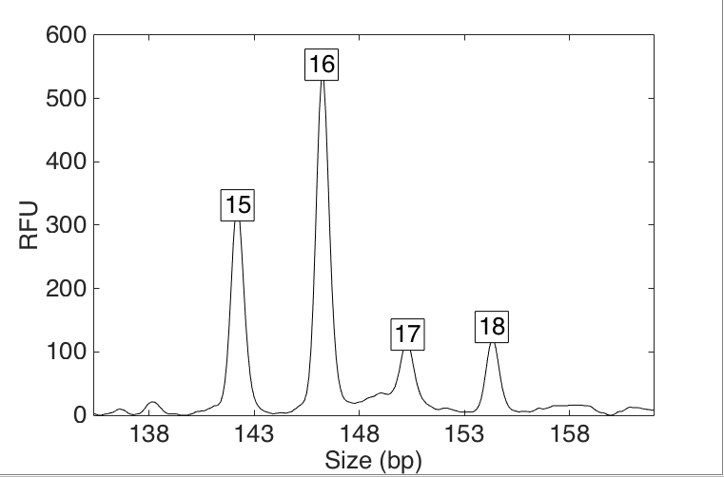
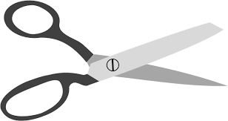
Crime labs don’t use all DNA data
all-or-none
1+1 = 1
threshold
Threshold

Slide 22
Threshold
Mark Perlin © 2011
I've been dealt a losing hand
Drawing lines across the sand
Whose meaning I can't understand
Cause mathematics has been banned
Used to think that one and one
Added up to two in sum
Now they say it's all or none
Arithmetic has been undone

Slide 23
Sing along
Na na-na-na na na
Na-na na na na-na na
Na na-na-na na na
Na-na na na na-na na
soundcloud.com/markperlin/threshold

Slide 24
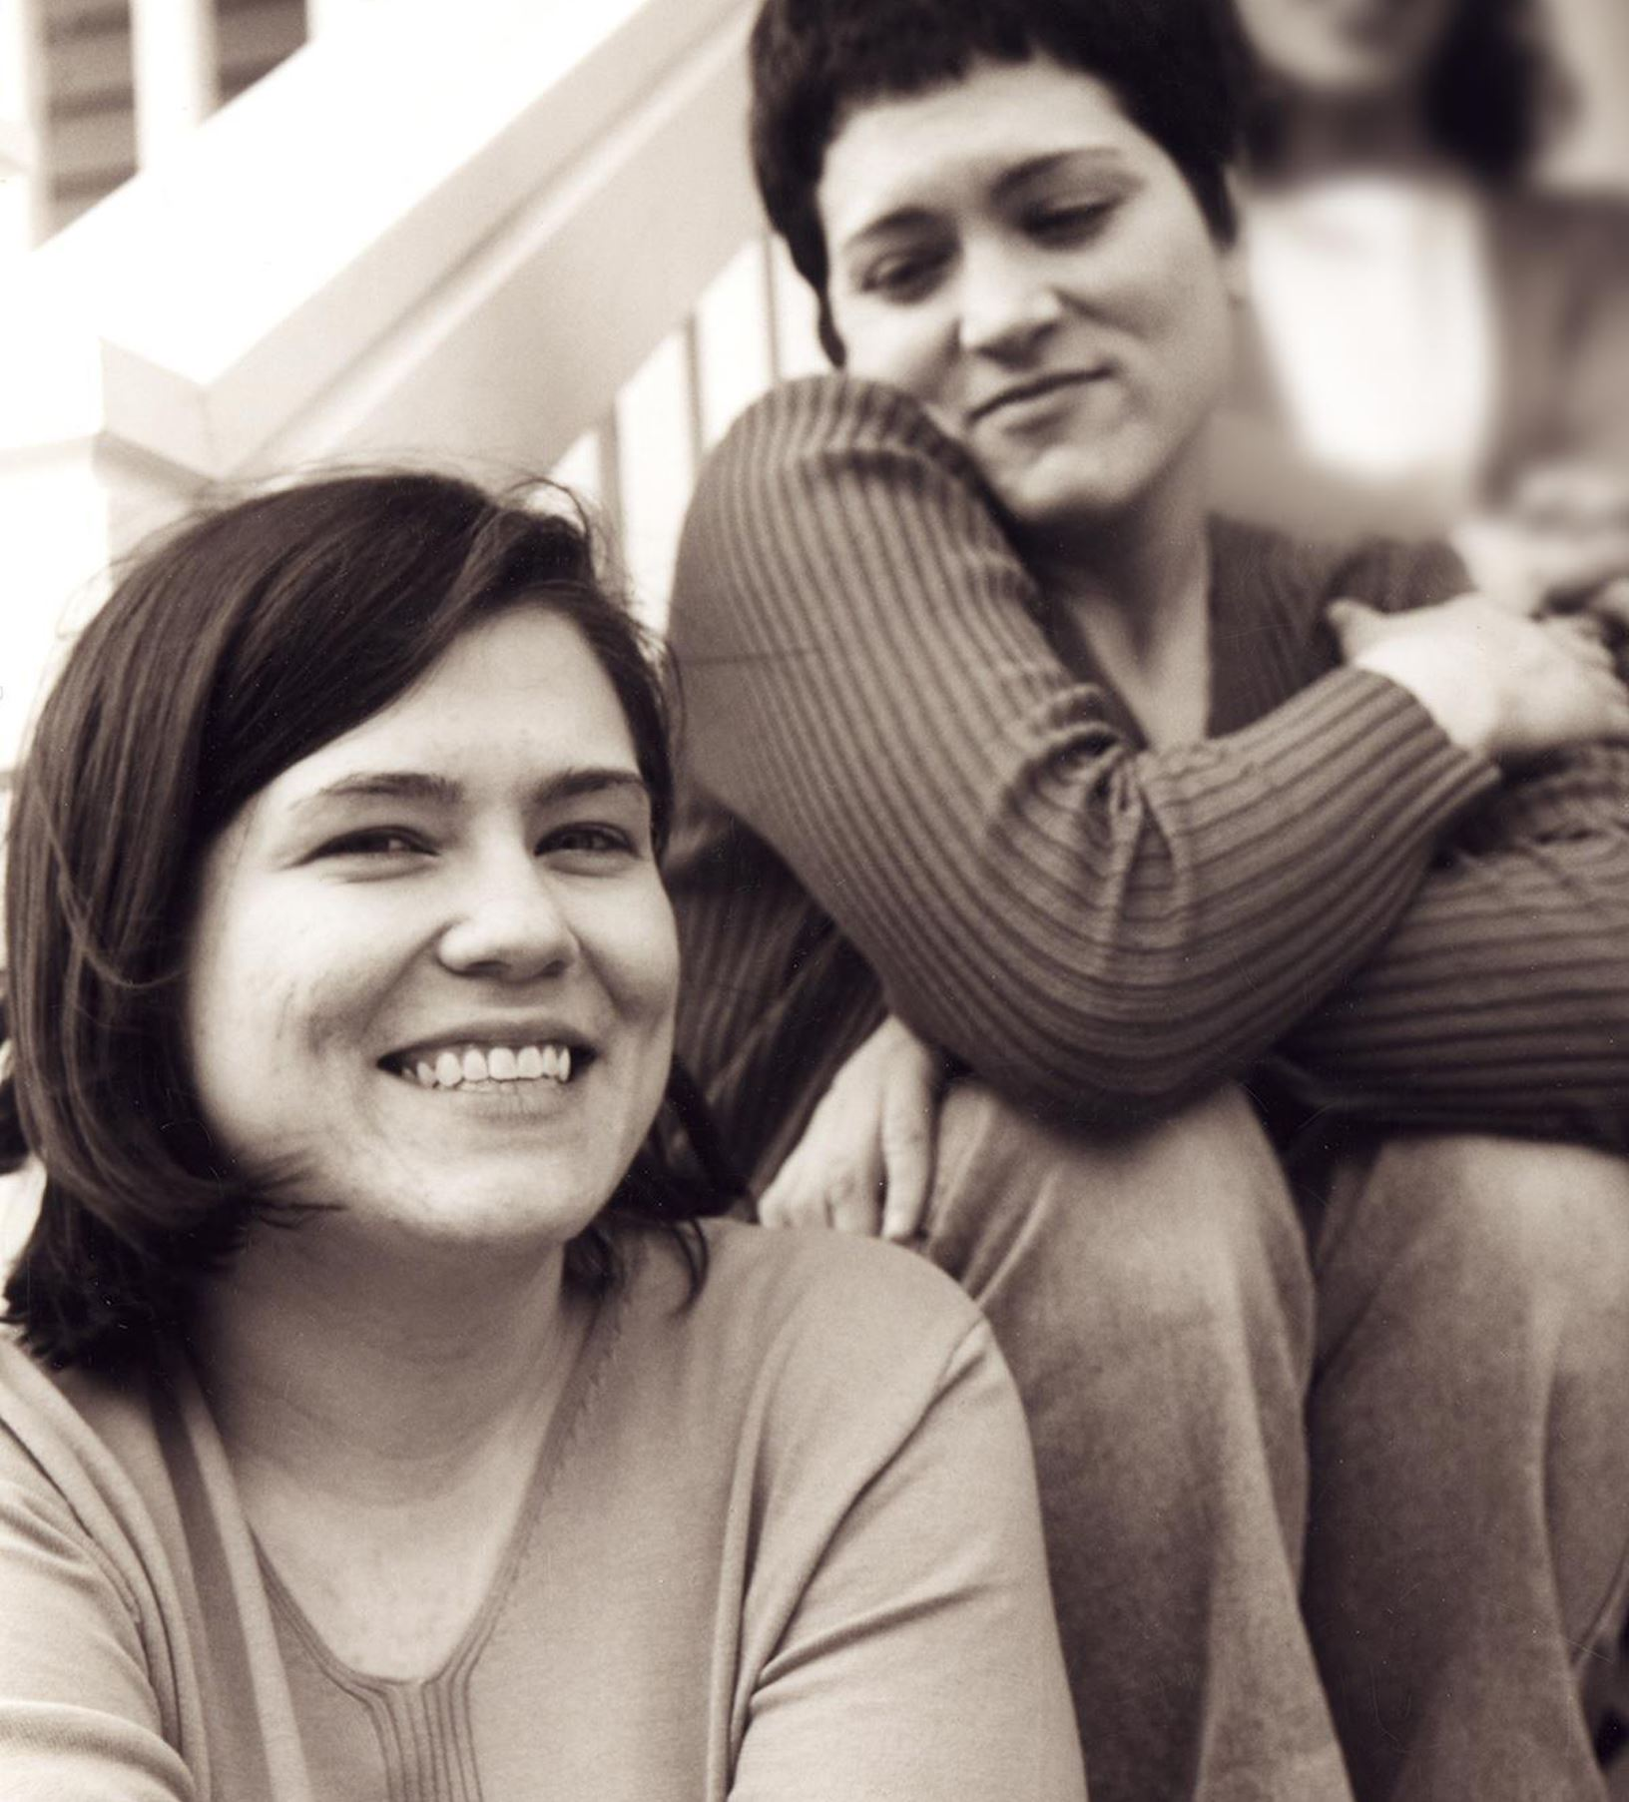
Wolfe sisters homicide
On February 6, 2014, Susan Wolfe (44)
and her younger sister Sarah (38, left)
were killed in their East Liberty home in Pittsburgh.

Slide 25
Crime lab didn’t use all DNA data
Over threshold, peaks are labeled as allele events
All-or-none allele peaks,
each given equal status
Under threshold, alleles vanish
Threshold

Slide 26
Threshold 2
Science should let numbers talk
Not let perpetrators walk
Who can count the victims lost
To criminals who've not been caught
Draw a threshold throw away
The evidence from DNA
Release a killer who should stay
In prison till his dying day

Slide 27
Pennsylvania v. Allen Wade
Thresholds failed to interpret most DNA mixtures
Hat No conclusions
Cup Insufficient data
Fingernails Contamination, insufficient data
Gear shift Insufficient data
Seat lever Cannot be excluded
Knit hat Insufficient data
Sock Too complex, no conclusions

Slide 28
Computers can use all the data
Quantitative peaks at locus vWA
pattern
height
variation

Slide 29
Threshold 3
I am a public employee
The people pay my salary
Yet I pretend I cannot see
The data right in front of me
The rules are written from on high
I follow them but know not why
Trained to make the numbers lie
As innocents are raped or die

Slide 30
Pennsylvania v. Allen Wade
The crime lab reported 5 DNA mixture matches
TrueAllele found 17 matches on the same data
Hat 65.3 thousand Allen Wade
Cup 20.5 thousand Susan Wolfe
Fingernails 6.06 trillion Allen Wade
Gear shift 9.37 million Sarah Wolfe
Seat lever 385 billion Sarah Wolfe
Knit hat 25.7 thousand Allen Wade
Sock 300 Sarah Wolfe

Slide 31
Allen Wade Found Guilty On All Counts In East Liberty Sisters’ Slaying
CBS News, May 23, 2016
PITTSBURGH (KDKA/AP)
• A man accused of killing two sisters who lived next door to him in East Liberty has been found guilty on all counts.
• Allen Wade was accused of shooting Sarah and Susan Wolfe after they returned from work on Feb. 6, 2014, apparently to steal a bank card.
• On Monday morning, a jury found Wade guilty of first-degree murder, robbery, burglary and theft by unlawful taking.

Slide 32
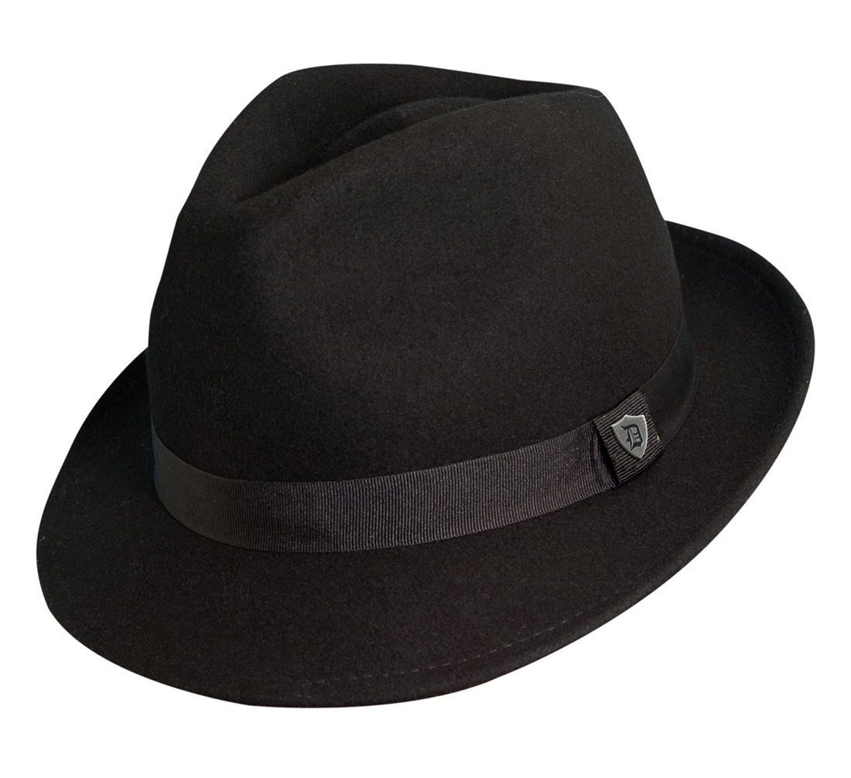
Pennsylvania v. Allen Wade
Thresholds failed to interpret DNA mixture
TrueAllele succeeded on the same data
A hat left from a burglary of the Wolfe sister’s home
six weeks before the murder matched
Allen Wade with a 65.3 thousand statistic
Preventable Crime

Slide 33
Threshold 4
I rather would use TrueAllele
Interpret DNA for real
Let the evidence reveal
Thugs who slash and shoot and steal
But instead I make believe
Ignoring what I plainly see
Science slips to sorcery
As thresholds make a mockery
Of DNA as it should be

Slide 34
How the computer thinks
Consider every possible genotype solution
One person's allele pair
Explain the
peak pattern
Another person's allele pair
Better
explanation
has a higher
likelihood
A third person's allele pair

Slide 35
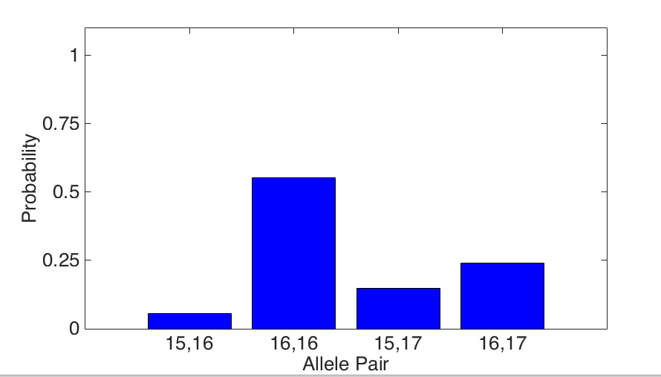
Evidence genotype
Objective genotype determined solely from the DNA data.
Never sees a comparison reference.
55%
24%
15%
5%

Slide 36
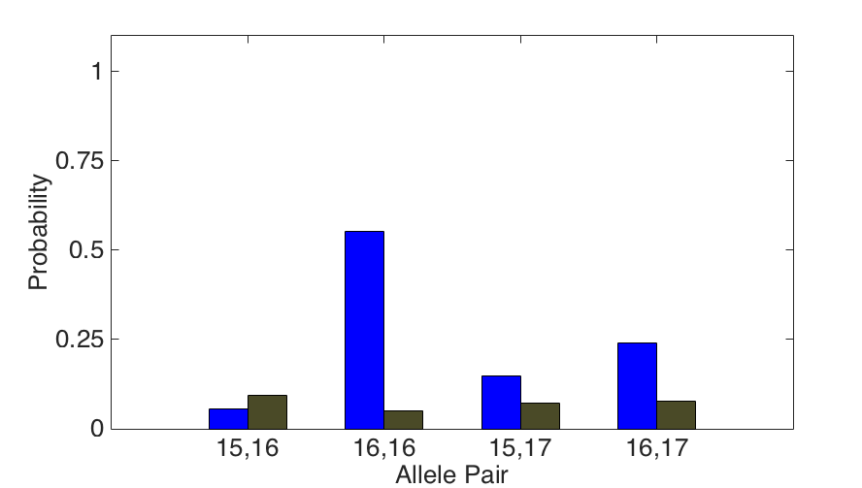
DNA match information
How much more does the suspect match the evidence
than a random person?
11x
Prob(evidence match)
55%
Prob(coincidental match)
5%

Slide 37
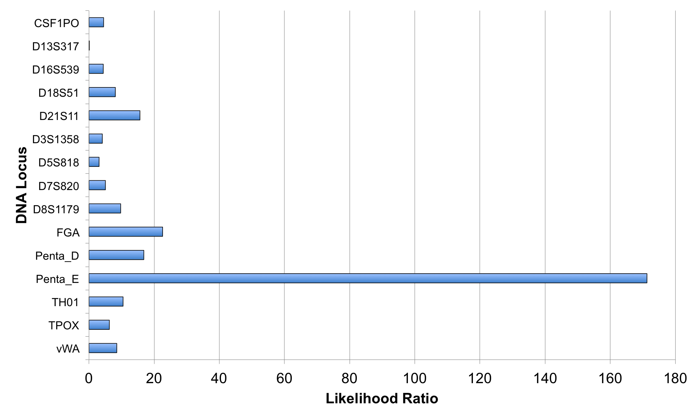
Match information at 15 loci

Slide 38
Is the suspect in the evidence?
A match between the right fingernails
and Allen Wade is:
6.06 trillion times more probable than
a coincidental match to an unrelated Black person
32.5 trillion times more probable than
a coincidental match to an unrelated Caucasian person
8 trillion times more probable than
a coincidental match to an unrelated Hispanic person

Slide 39
Allegheny County: 59 cases, 12 trials, 3 exonerations
Crime | Evidence | Defendant | Outcome | Sentence
rape | clothing | Ralph Skundrich | guilty | 75 years
murder | gun, hat | Leland Davis | guilty | 23 years
rape | clothing | Akaninyene Akan | guilty | 32 years
murder | shotgun shells | James Yeckel, Jr. | guilty plea | 25 years
murder | fingernail | Anthony Morgan | guilty | life
weapons | gun | Thomas Doswell | guilty plea | 1 year
bank robbery | clothing | Jesse Lumberger | guilty | 10 years
drugs | gun | Derek McKissick | guilty plea | 2 1/2 years
drugs | gun | Steve Morgan | guilty plea | 2 1/2 years
murder | door, clothing | Calvin Kane | guilty plea | 20 years
murder | fingernail, clothing | Allen Wade | guilty | life
murder | gun | Jaykwaan Pinckney | guilty plea | 10 years
child rape | clothing | Dhaque Jones | guilty plea | 6 years
shooting | gun | Anthony Jefferson | guilty plea | 4 years
weapons | gun | Zachary Blair | guilty plea | 15 years
weapons | gun | Delmingo Williams | guilty plea | 3 years
incest rape | clothing | Terry L. | guilty | 40 years
bank robbery | hat | Robert Schatzman | guilty | 1 1/2 years
weapons | gun | Rashawn Walker | guilty | 1.5 years
robbery | hat | Lauren Peak | guilty plea | 1 year
rape | body cavity | Freddie Cole | guilty plea | 2 years
murder | gun | Chaz White | guilty plea | 4 years
sex crime | clothing | Christopher Stavish | guilty plea | 2 1/2 years
murder | gun | Jake Knight | guilty | life

Slide 40
Darryl Pinkins imprisoned
1989 – 5 men raped an Indiana woman
Darryl Pinkins and 2 others misidentified
1991 – wrongfully convicted, 65 year sentence
2001 – DNA mixture evidence
2 contributors found, not the accused
but 5 were needed, post-conviction relief denied

Slide 41
TrueAllele Pinkins findings
1. compared evidence with evidence
2. calculated exclusionary match statistics
3. revealed 5% minor mixture contributor
4. jointly analyzed DNA mixture data
5. showed three perpetrators were brothers
found 5 unidentified genotypes,
defendants not linked to the crime

Slide 42
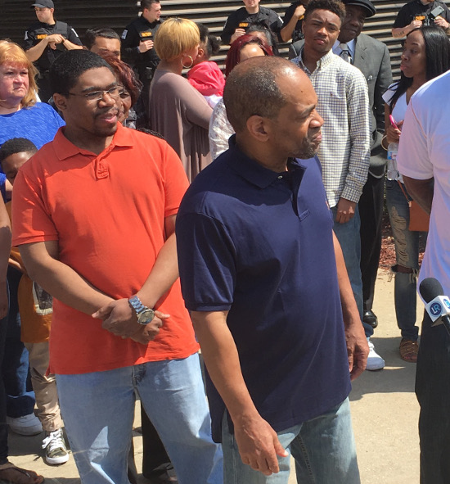
Pinkins exonerated
April 25, 2016

Slide 43
Certainty & controversy
Why do crime labs fail to interpret DNA?
• Expertise in forensic biology
Great at generating DNA data
• Not in computational statistics
Poor at interpreting the data
• Adversarial nature of court
Cross-examination, termination
• Strong incentives on lab process
Focus on data, not information
• Fear of uncertainty, comfort in certainty
Saying nothing avoids controversy

Slide 44
Recommendations
Open DNA to public scrutiny
Revisit all past DNA mixture cases
Educate trial attorneys and judges
Fully automate mixture interpretation
Extensively validate DNA interpretation
Keep methods within their limits
Go beyond laboratory limits

Slide 45
Nonprofit organization
Justice Through Science
1. Reanalyze forgotten DNA evidence
2. Educate lawyers, scientists & society

Slide 46
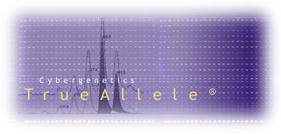

More information
http://www.cybgen.com/information
• Courses
• Newsletters
• Newsroom
• Presentations
• Publications
• Webinars
http://www.youtube.com/user/TrueAllele
TrueAllele YouTube channel
perlin@cybgen.com

