Slide 1

DNA Investigation:
Across the Universe
Pennsylvania Homicide Investigators Association
April, 2016
State College, PA
Mark W Perlin, PhD, MD, PhD
Cybergenetics, Pittsburgh, PA
Cybergenetics © 2003-2016

Slide 2
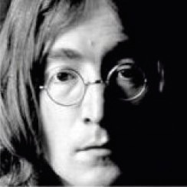

Deposit DNA

Slide 3
Associate DNA
Match
+10

Slide 4
Deposit ‘N Associate
Match
+10

Slide 5
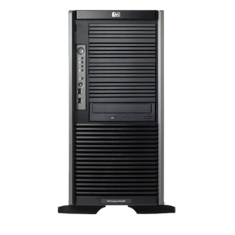

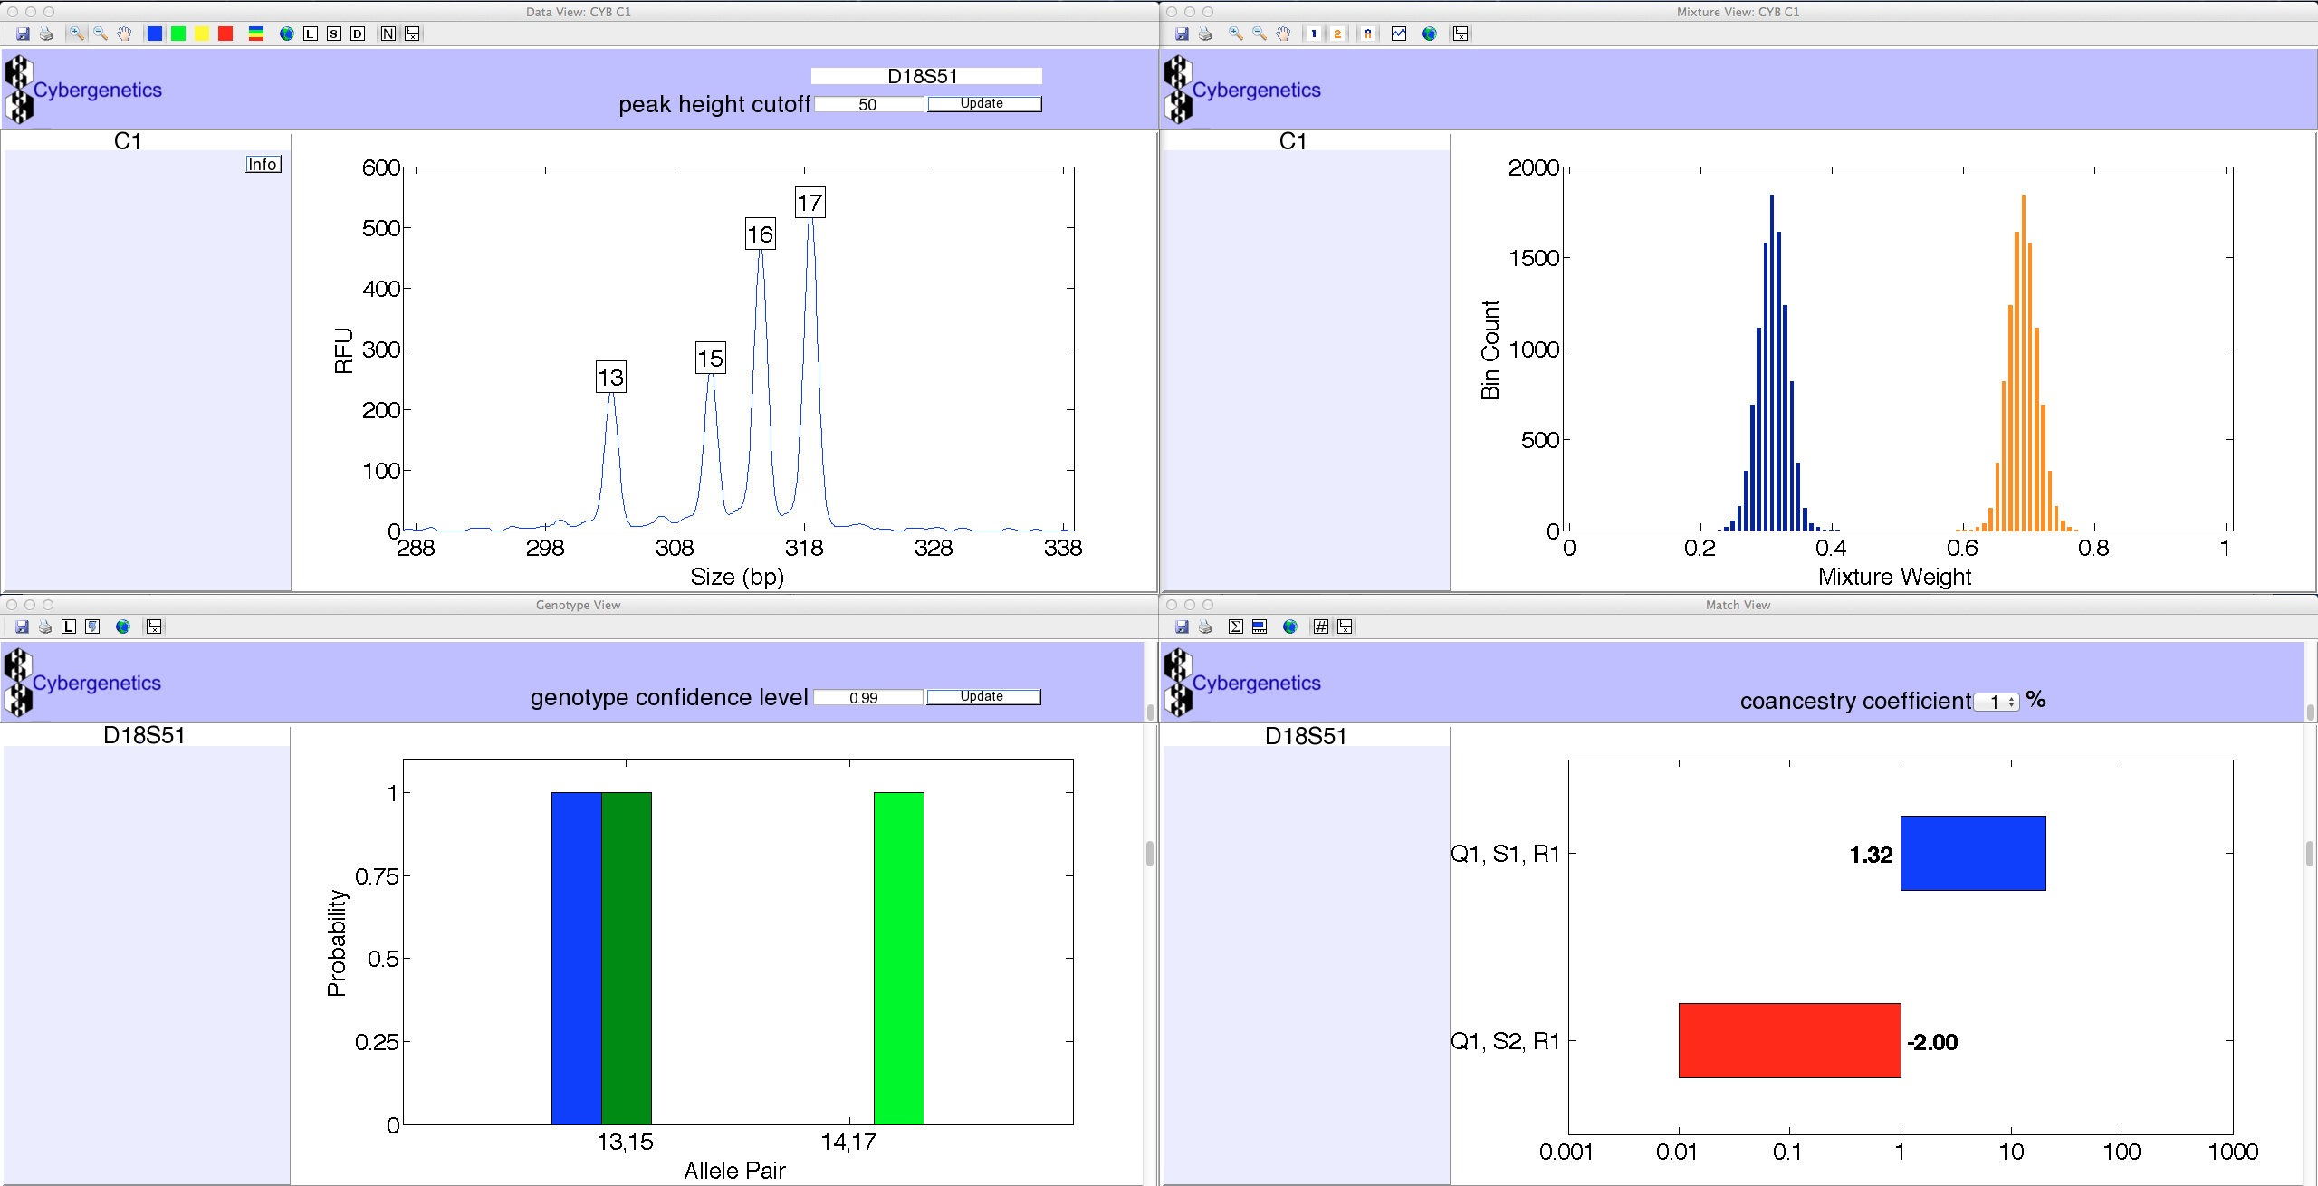
TrueAllele® Casework
ViewStation
User Client
Database
Server
Interpret/Match
Expansion
Visual User Interface
VUIer™ Software
Parallel Processing Computers
Notes:
Describe TrueAllele system (left, middle, right, middle, left)

Slide 6
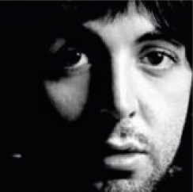
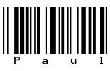
Exclusion
Mismatch
-10

Slide 7
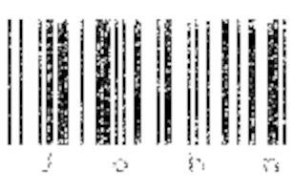
Low-level or degraded
Match
+6

Slide 8
Mixture
Match
+8

Slide 9
Inconclusive mixture
Crime laboratory DNA report
Crime lab user fee: $5,000
Conclusions:
Item 1 – Swab of textured areas from a handgun
The data indicates that DNA from four (4) or more contributors was obtained from the swab of the handgun. Due to the complexity of the data, no conclusions can be made regarding persons A and B as possible contributors to this mixture.

Slide 10
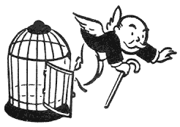
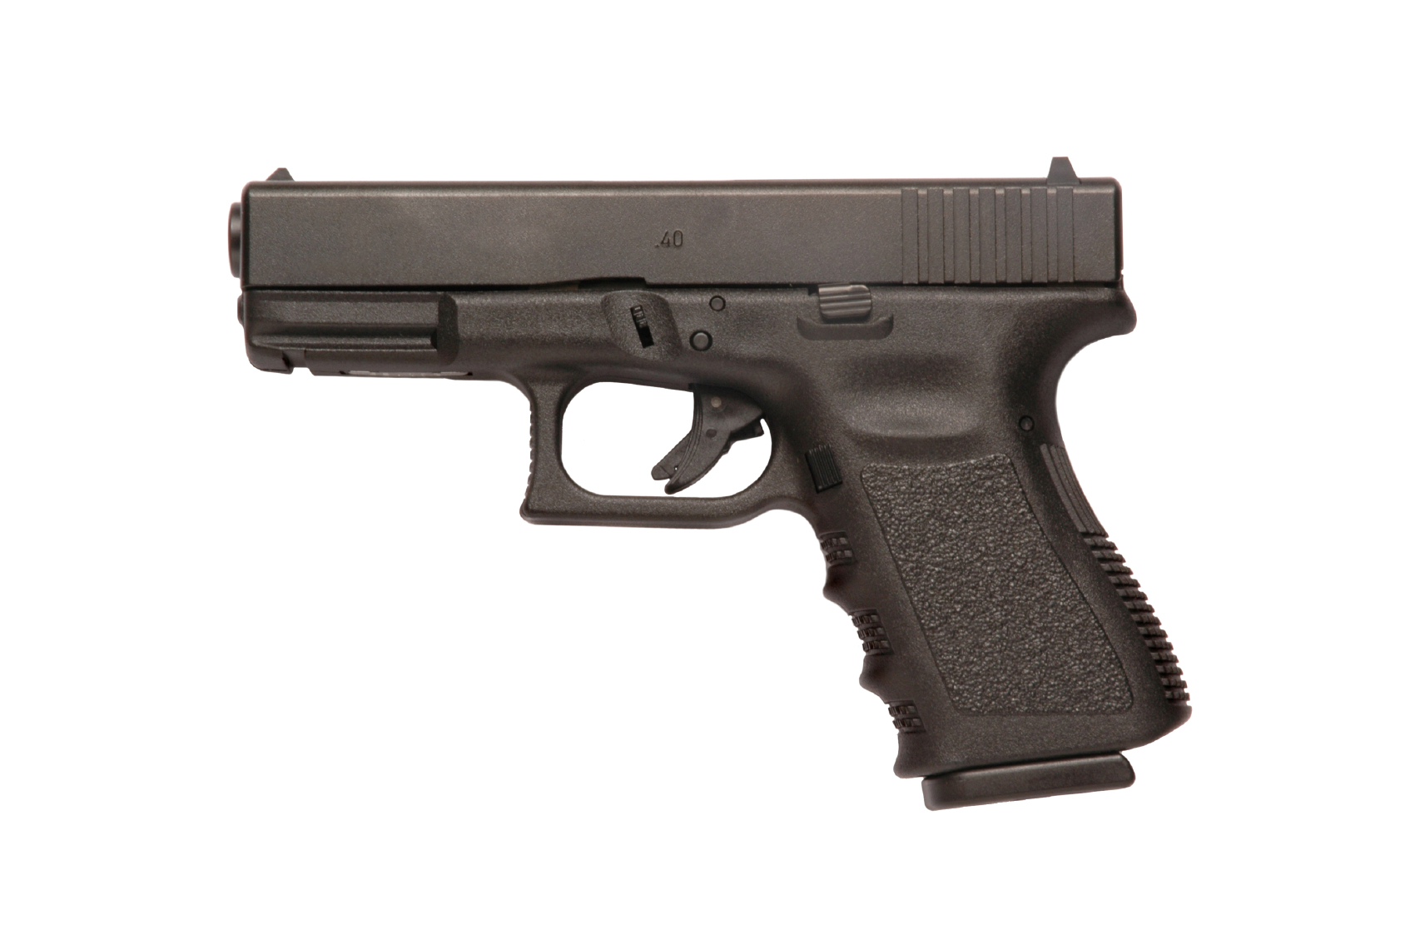

Computer reanalysis
Cybergenetics TrueAllele® report
Match statistics provide information
Person A
excluded
Contributor
Unmix the
mixture
1
2
400,000
3
Person B
included
4

Slide 11
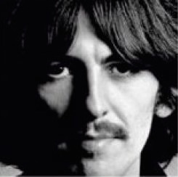
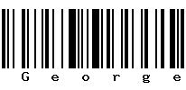
Evidence to Evidence
Match
+8

Slide 12
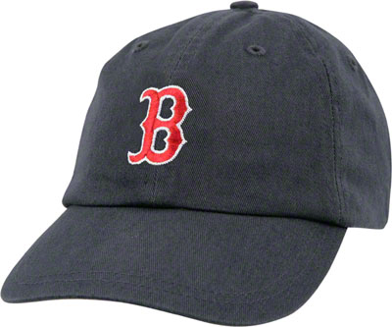
Murder in McKeesport, PA
Notes:
12

Slide 13
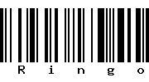
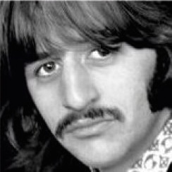
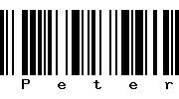
Mixture matches
Match
+9
Match
+16
Notes:
13

Slide 14
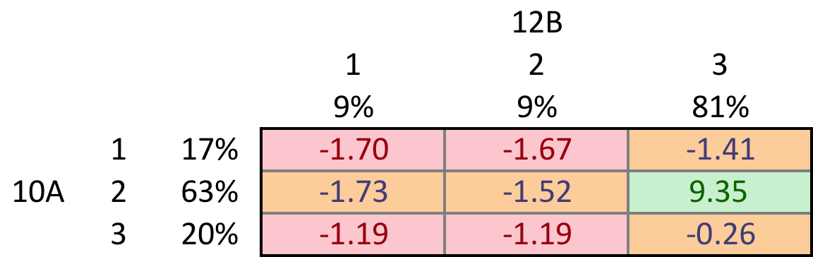
Mixture mismatches
Only Defendant deposited DNA to both items of evidence

Slide 15
Crime scene investigation
Match
+9

Slide 16
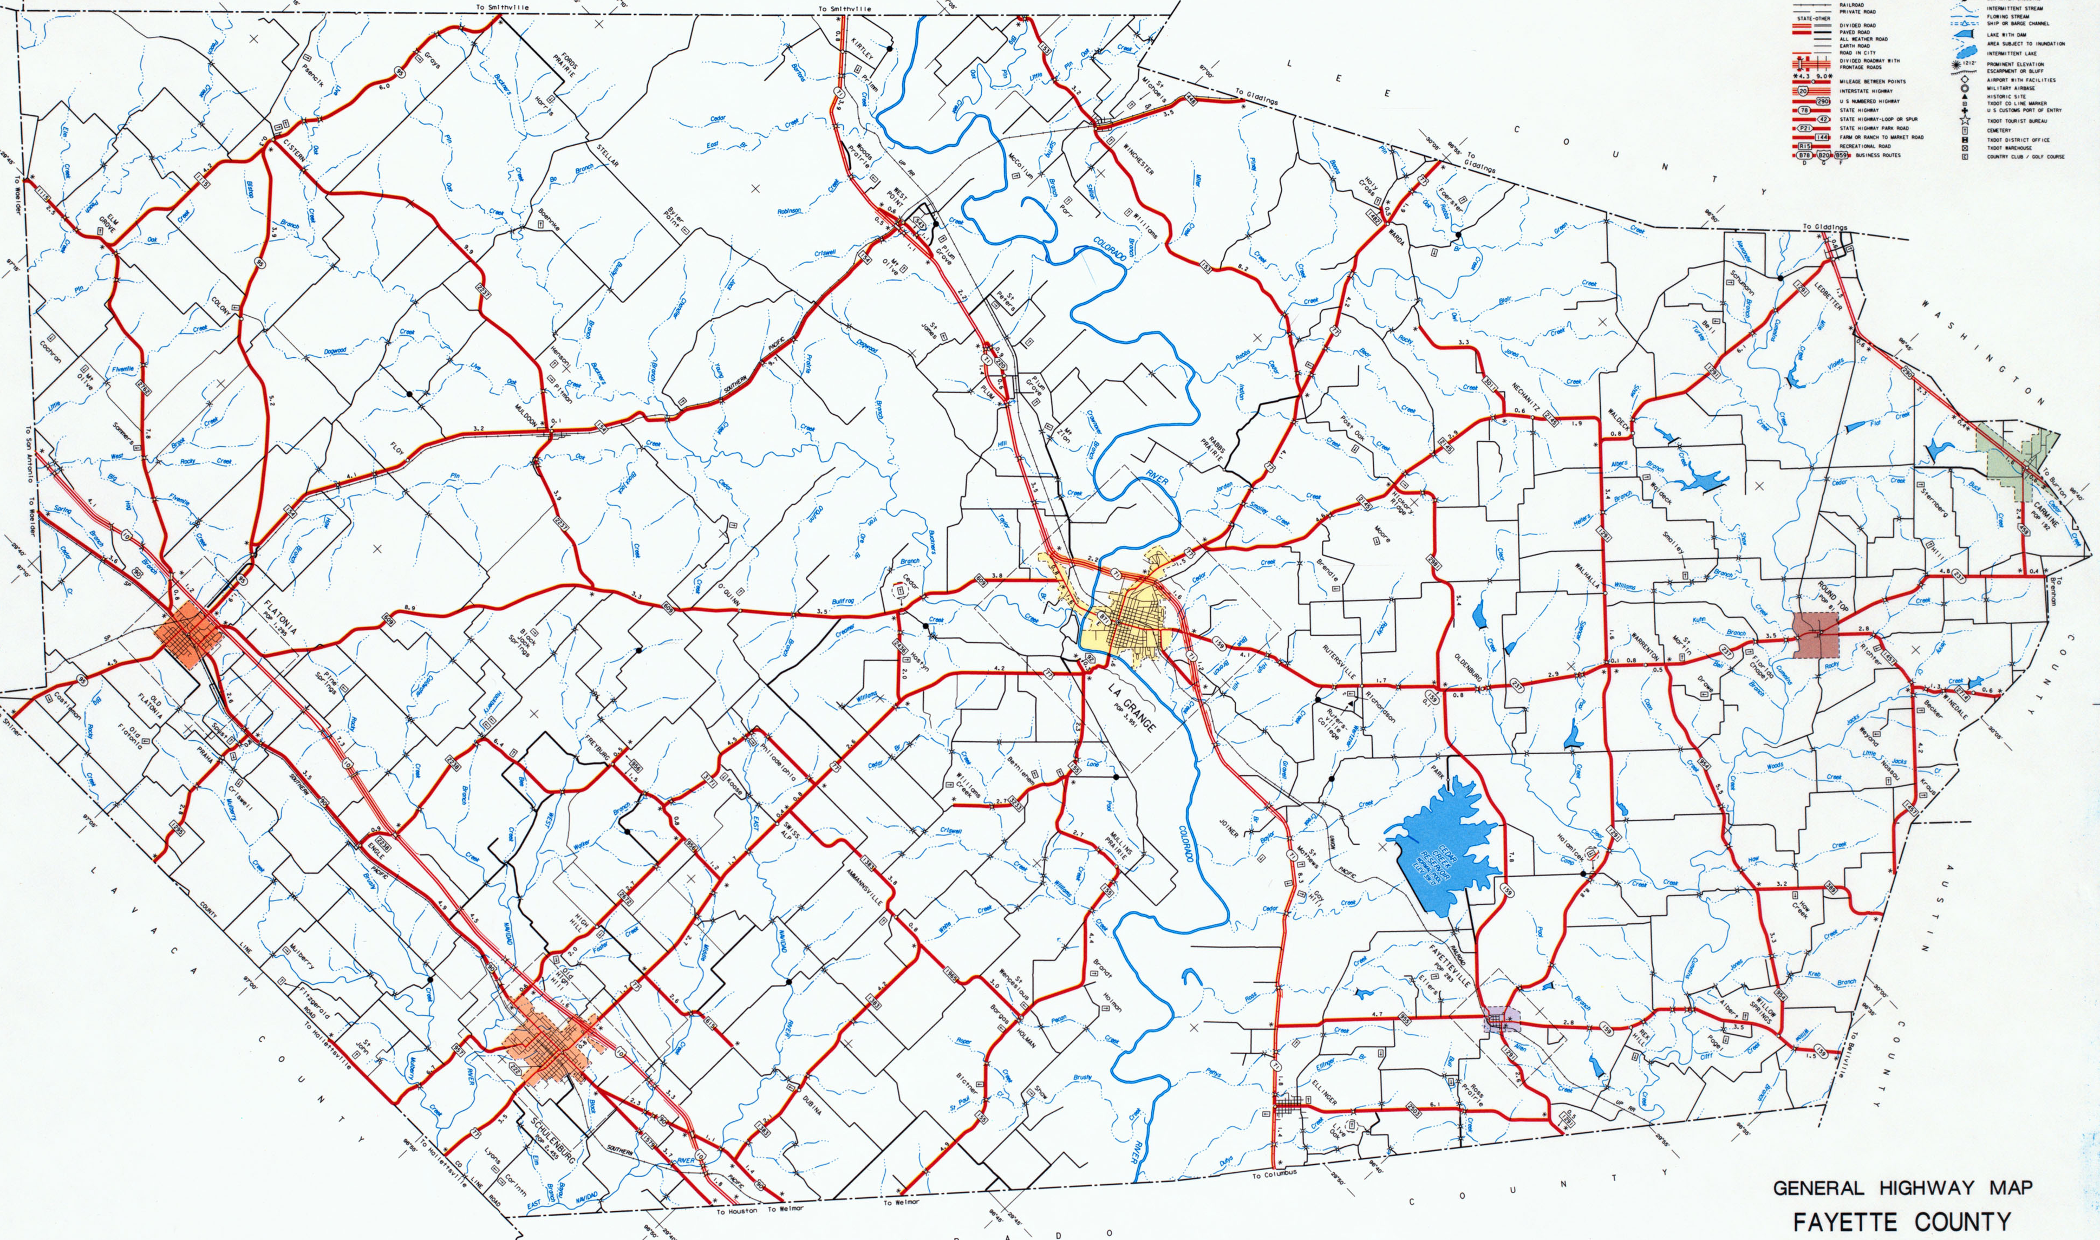
DNA left at 5 different scenes
Market
• hat 1
• hat 2
• overalls
• shirt
Food mart
• gun
• hat
Jewelry
• counter
• safe
Hardware
• safe
• phone
Convenience
• keys
• tape

Slide 17
Serial crime investigation
Suspects: S1, S2, S3, S4, S5
Market
• hat 1
• hat 2
• overalls
• shirt
Food mart
• gun
• hat
Jewelry
• counter
• safe
Hardware
• safe
• phone
Convenience
• keys
• tape

Slide 18
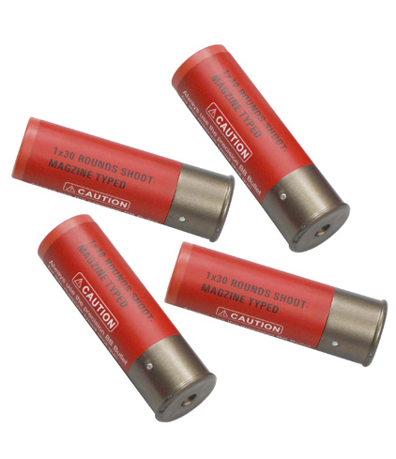
Pennsylvania v James Yeckel, Jr.
Father
(deceased)
Mother
(deceased)
Father
Son
(suspect)
Match
+12
Son
Mother

Slide 19
TrueAllele in Allegheny County
44 cases, 8 trials, 3 DNA exonerations
Crime | Evidence | Defendant | Outcome | Sentence
rape | clothing | Ralph Skundrich | guilty | 75 years
murder | gun, hat | Leland Davis | guilty | 23 years
rape | clothing | Akaninyene Akan | guilty | 32 years
murder | shotgun shells | James Yeckel, Jr. | guilty plea | 25 years
murder | fingernail | Anthony Morgan | guilty | life
weapons | gun | Thomas Doswell | guilty plea | 1 year
bank robbery | clothing | Jesse Lumberger | guilty | 10 years
drugs | gun | Derek McKissick | guilty plea | 2 1/2 years
drugs | gun | Steve Morgan | guilty plea | 2 1/2 years
murder | door, clothing | Calvin Kane | guilty plea | 20 years
murder | gun | Jaykwaan Pinckney | guilty plea | 10 years
child rape | clothing | Dhaque Jones | guilty plea | 6 years
shooting | gun | Anthony Jefferson | guilty plea | 4 years
weapons | gun | Delmingo Williams | guilty plea | 3 years
incest rape | clothing | Terry L. | guilty | 40 years
bank robbery | hat | Robert Schatzman | guilty | pending
weapons | gun | Rashawn Walker | guilty | 1.5 years
robbery | hat | Lauren Peak | guilty plea | 1 year
murder | gun | Chaz White | guilty plea | 4 years

Slide 20
Investigative power
Capability | Human review | TrueAllele
Data choice | Selection bias | Use all data
Uncertainty | Thresholds | Statistics
Neutral | Include only | Include/Exclude
Statistic | How many tests | Match information
Objective | No | Yes
Validated | No (0) | Yes (30)
Accurate | No | Yes
Frye challenge | No | Yes
Item-to-item | No | Yes
Touch DNA | No | Yes
Complex mixtures | 2-3, 50%-100% | 2-10, 5%-100%
Database | 10% | 100%

Slide 21
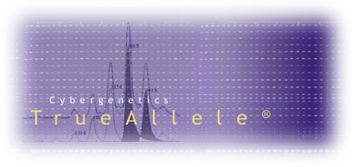

More DNA information
http://www.cybgen.com/information
• Courses
• Newsletters
• Newsroom
• Presentations
• Publications
• Webinars
http://www.youtube.com/user/TrueAllele
TrueAllele YouTube channel
perlin@cybgen.com

