Slide 1

Understanding DNA
Pennsylvania Conference of State Trial Judges
Mid Annual Meeting
Administrative Office of Pennsylvania Courts
Judicial Education Department
February, 2016
Philadelphia, PA
Mark W Perlin, PhD, MD, PhD
Cybergenetics, Pittsburgh, PA
Cybergenetics © 2003-2016

Slide 2
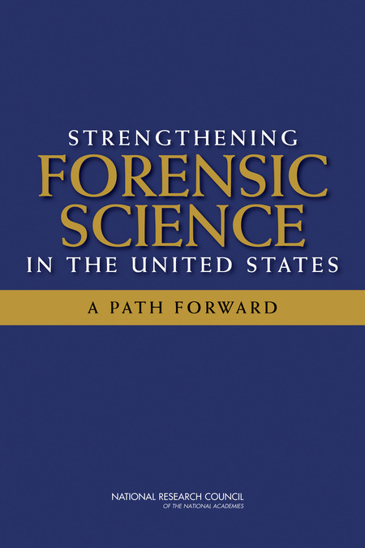
National Academy of Sciences
"Strengthening Forensic Science:
A Path Forward" (2009)
• Human examination bias
• Statistics & reporting
• Underlying scientific basis
Among existing forensic methods, only nuclear DNA analysis has been rigorously shown to have the capacity to consistently, and with a high degree of certainty, demonstrate a connection between an evidentiary sample and a specific individual or source.

Slide 3
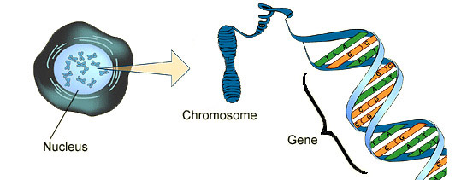
DNA biology
Cell
Chromosome
Locus
Nucleus

Slide 4

Short tandem repeat
DNA locus paragraph
Take me out to the ball game
take me out with the crowd
buy me some peanuts and Cracker Jack
I don't care if I never get back
let me
root root root root root root root root root root
for the home team,
if they don't win, it's a shame for it's one, two, three strikes, you're out
at the old ball game
23 volumes in cell's
DNA encyclopedia
"root" repeated 10 times, so
allele length is 10 repeats

Slide 5
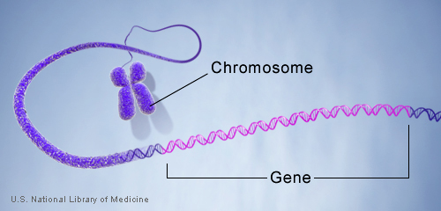
DNA genotype
A genetic locus has
two DNA sentences,
one from each parent.
An allele is the number
of repeated words.
locus
A genotype at a locus
is a pair of alleles.
mother
allele
1
2
3
4
5
6
7
8
9
10
10, 12
ACGT
repeated word
Many alleles allow for
many many allele pairs.
A person's genotype
is relatively unique.
father
allele
1
2
3
4
5
6
7
8
9
10
11
12

Slide 6
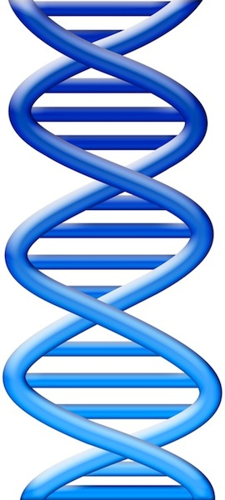
DNA laboratory
Evidence item
Lab
Evidence data
Separations
• Extract
• Amplify
• Detect
10 11 12
DNA from
one person

Slide 7
DNA interpretation
Evidence item
Lab
Evidence data
Infer
Evidence genotype
10, 12
10 11 12
DNA from
one person

Slide 8
DNA match statistic
Evidence item
Lab
Evidence data
Infer
Evidence genotype
10, 12
10 11 12
DNA from
one person
Compare
Known genotype
1
Prob(coincidental match)
10, 12

Slide 9
National Academy of Sciences
"Strengthening Forensic Science:
A Path Forward" (2009)
• Human examination bias
• Statistics & reporting
• Underlying scientific basis
However, ... there may be problems ... with how the DNA was ... interpreted, such as when there are mixed samples

Slide 10
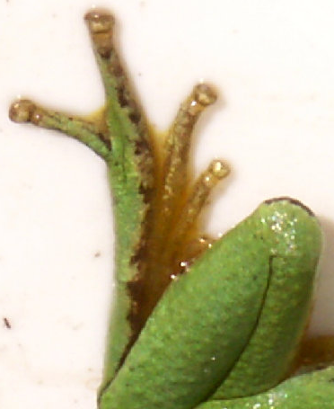
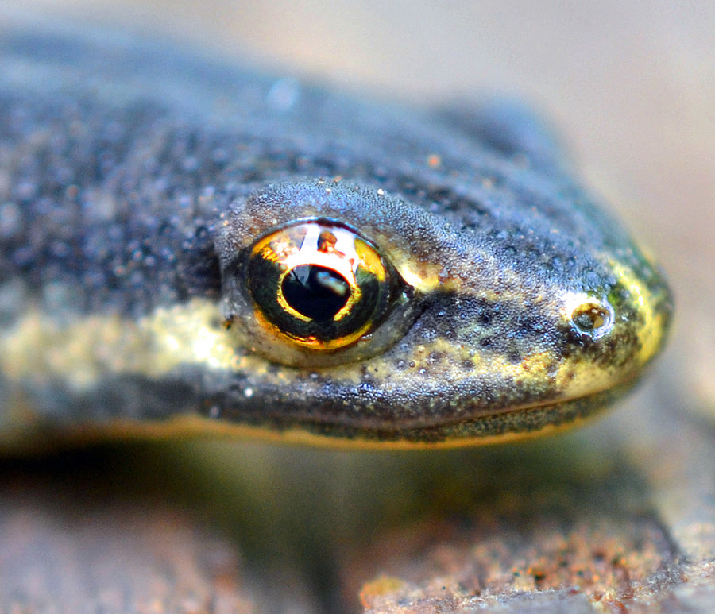

DNA mixture
eye of newt
toe of frog
Double, double toil and trouble

Slide 11
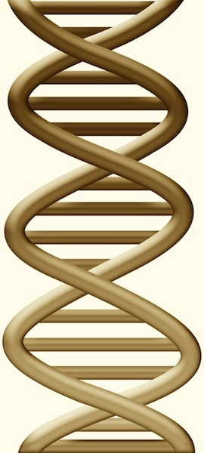
DNA mixture interpretation
Evidence item
Lab
Evidence data
Separate
Evidence
genotypes
10, 12
+
10, 11 @ 20%
11, 11 @ 30%
11, 12 @ 50%
10 11 12
DNA from
two people

Slide 12
DNA match statistic
Evidence item
Lab
Evidence data
Separate
Contributor genotype
10, 11 @ 20%
11, 11 @ 30%
11, 12 @ 50%
10 11 12
DNA from
two people
Compare
Known genotype
Prob(evidence match)
Prob(coincidental match)
11, 12

Slide 13

Pennsylvania v Ralph Skundrich
On July 25, 2002, a Pittsburgh college student, 18,
was threatened with a gun and
sexually assaulted in her Shadyside apartment.
The victim's jeans and T-shirt contained biological evidence.
The Allegheny County crime lab developed
DNA data from the two evidence items.
Skundrich was identified as a suspect after a DNA match was made in the national database in 2009.

Slide 14
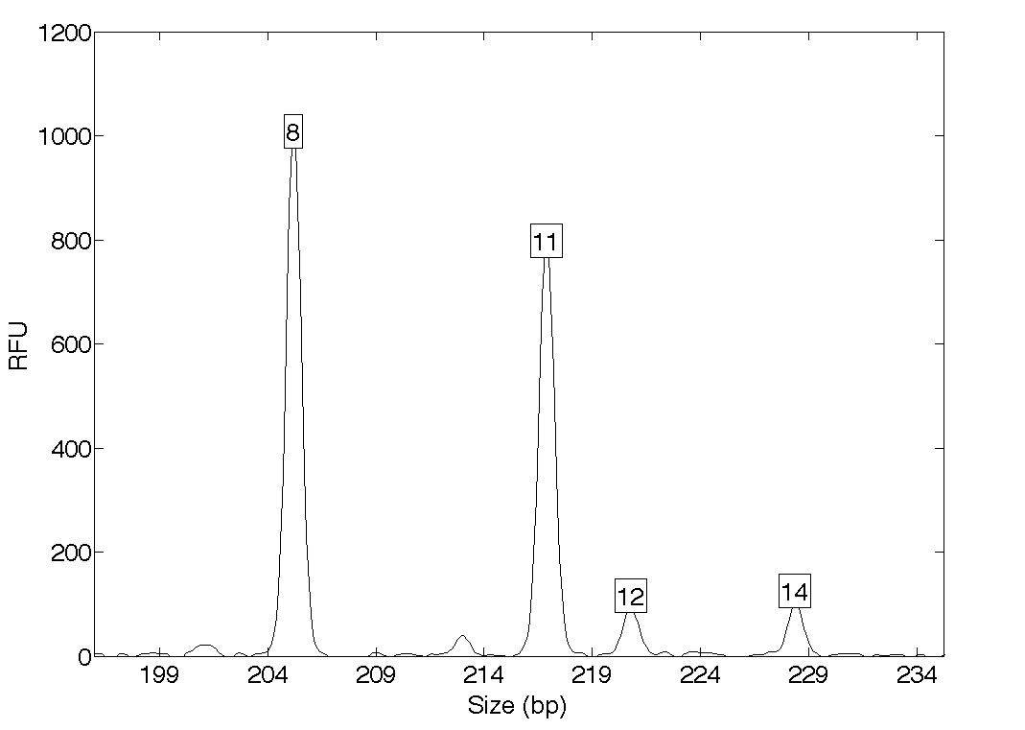
DNA mixture evidence (jeans)
Quantitative peak heights at locus D13S317
peak size
peak
height

Slide 15
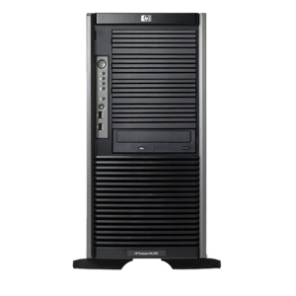

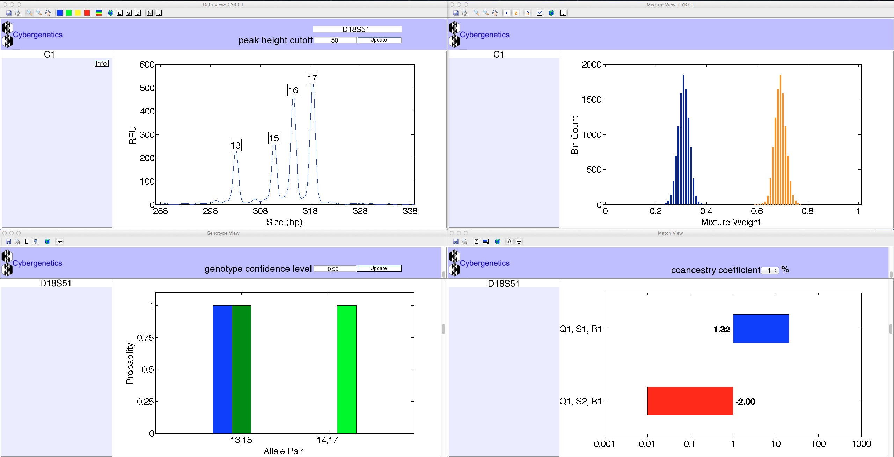
TrueAllele® Casework
ViewStation
User Client
Database
Server
Interpret/Match
Expansion
Visual User Interface
VUIer™ Software
Parallel Processing Computers
Notes:
Describe TrueAllele system (left, middle, right, middle, left)

Slide 16
How the computer thinks
Consider every possible genotype solution
First person's allele pair
Explain the
peak pattern
90%
Second person's allele pair
Better
explanation
has a higher
likelihood
10%

Slide 17
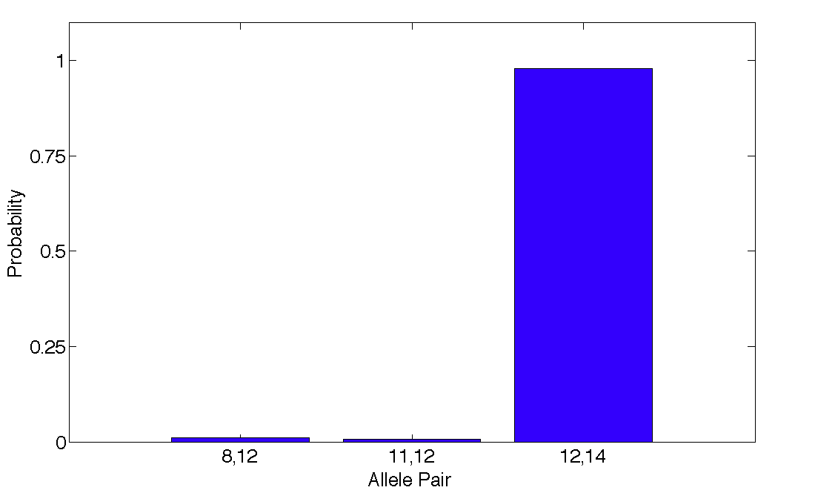
Evidence genotype
Objective genotype determined solely from the DNA data.
Never sees a suspect.
98%
1%
1%

Slide 18
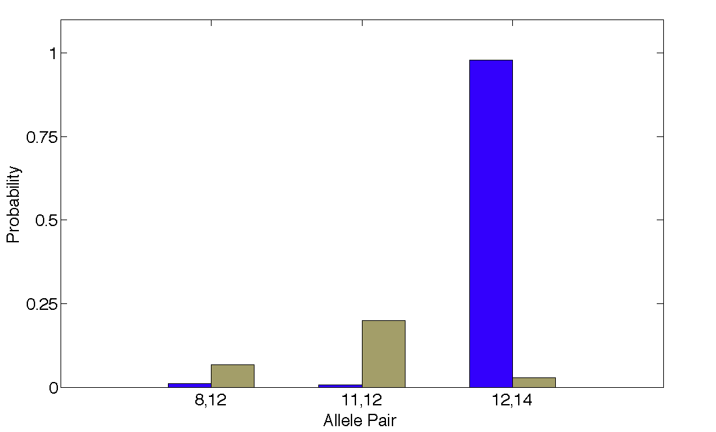
DNA match information
How much more does the suspect match the evidence
than a random person?
35x
98%
Prob(evidence match)
Prob(coincidental match)
3%

Slide 19
Match information at 13 loci
DNA locus
Likelihood ratio (LR)

Slide 20
Is the suspect in the evidence?
A match between the jeans and Ralph Skundrich is:
2.1 quadrillion times more probable than coincidence

Slide 21
Is the suspect in the evidence?
A match between the jeans and Ralph Skundrich is:
2.1 quadrillion times more probable than coincidence
A match between the T-shirt and Ralph Skundrich is:
4.04 quadrillion times more probable than coincidence

Slide 22
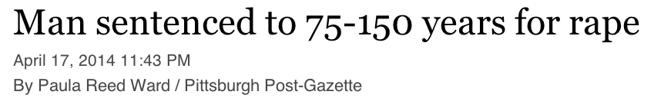
Pennsylvania v Ralph Skundrich
“This case was solved on DNA alone. There's no way he would have been identified otherwise.”
– Prosecutor Janet Necessary
“You need to be removed from society
and you are incapable of being rehabilitated.
Your days of torturing women are over.”
– Judge David Cashman

Slide 23
Crime lab data summary
Over threshold, peaks are labeled as allele events
Allele Pair
8, 8
8, 11
8, 12
8, 14
11, 11
11, 12
11, 14
12, 12
10%12, 14
14, 14
All-or-none allele peaks,
each given equal status
Threshold

Slide 24
Probability of inclusion (PI)
Calculation at locus D13S317
Simple formula: For all "alleles" over threshold,
add up their frequencies, and square the number
(.10 + .32 + .31 + .035)² = (.765)² = .585
Threshold match statistic is 1/PI
1/(.585) = 1.71
Computer match statistic is 35

Slide 25
Match statistic comparison
DNA locus
Likelihood ratio (LR)

Slide 26
Information comparison
Method
Combined PI
TrueAllele
Jeans
280 thousand (5)
2 quadrillion (15)
T-shirt
630 thousand (5)
4 quadrillion (15)

Slide 27
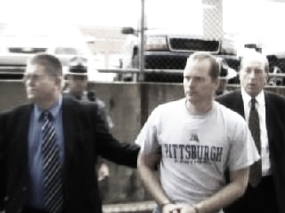
Pennsylvania v Kevin Foley
Apr 2006: Blairsville dentist John Yelenic murdered
in his Indiana County home
Nov 2007: Trooper Kevin Foley charged with crime
Feb 2008: Defense questions 13,000 DNA match score

Slide 28
Three DNA match statistics
Group
FBI
Boston Univ.
Cybergenetics
Method
Combined PI
Victim known
TrueAllele
Result
13,000
22,000,000
189,000,000,000
• Why are there different match results?
• How do mixture interpretation methods differ?
• Which of these methods are reliable?

Slide 29
Different interpretation methods
Method | Victim's genotype | Quantitative data
Combined PI | Not assumed | Threshold
Victim known | Assumed | Threshold
TrueAllele | Assumed | All data

Slide 30
Frye: general acceptance in the relevant community
• Quantitative STR Peak Information
• Genotype Probability Distributions
• Computer Interpretation of STR Data
• Statistical Modeling and Computation
• Likelihood Ratio Literature
• Mixture Interpretation Admissibility
• Computer Systems for Quantitative
DNA Mixture Deconvolution
• TrueAllele Casework Publications

Slide 31
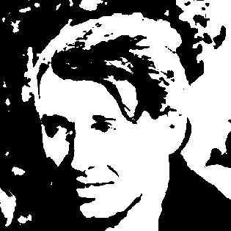
Threshold: all or none

Slide 32
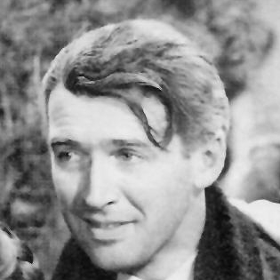

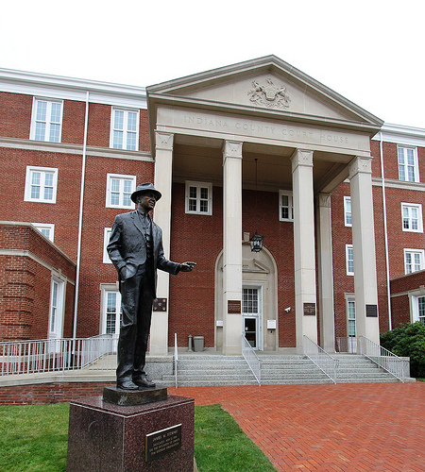
Quantitative: shades of gray

Slide 33
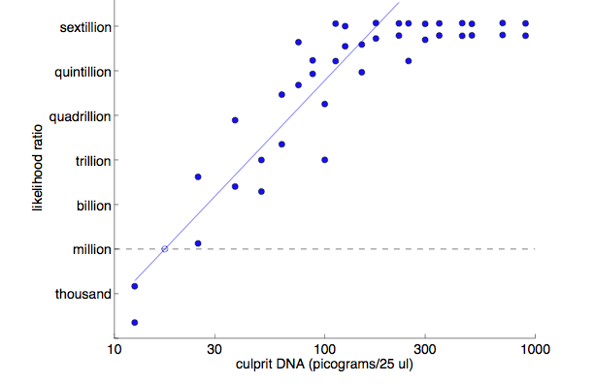
Expected scientific result
15 loci
12 loci
Perlin MW, Sinelnikov A. An information gap in DNA evidence interpretation. PLoS ONE. 2009;4(12):e8327.
67

Slide 34
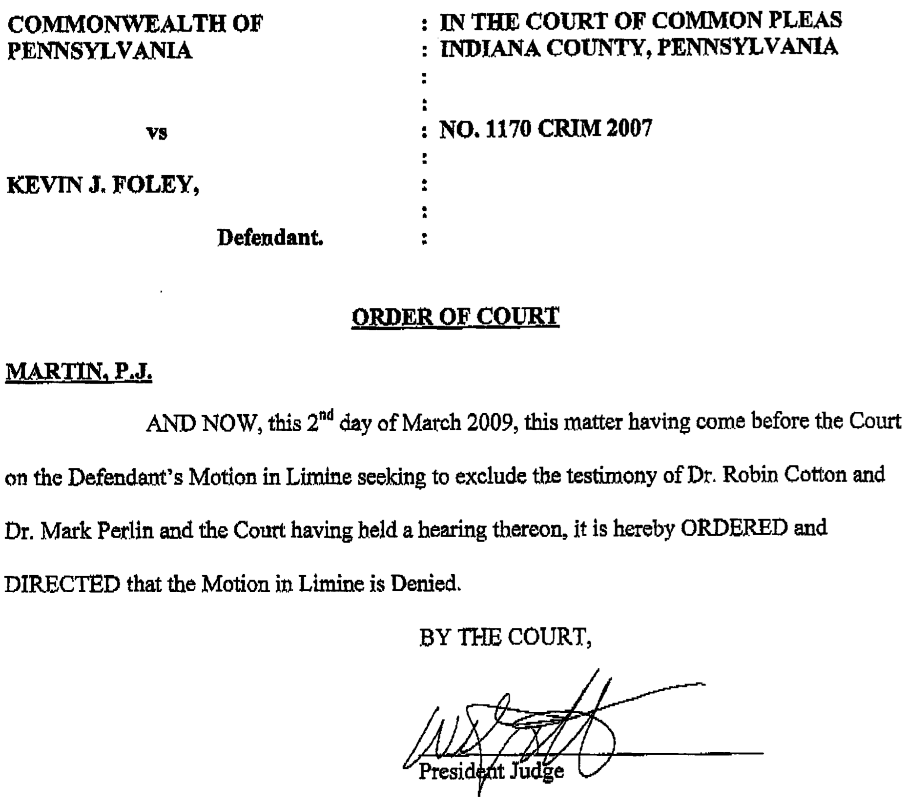
TrueAllele admitted into evidence

Slide 35
Expert testimony
Dr. Perlin explained to the jury why these apparently different results were expected by DNA science. "The less informative methods ignored some of the data," said Dr. Perlin, "while the TrueAllele computation considered all of the available DNA data."
"A scientist may look at the same slide using the naked eye, a magnifying glass, or a microscope," analogized Dr. Perlin. "A computer that considers all the data is a more powerful DNA microscope."

Slide 36
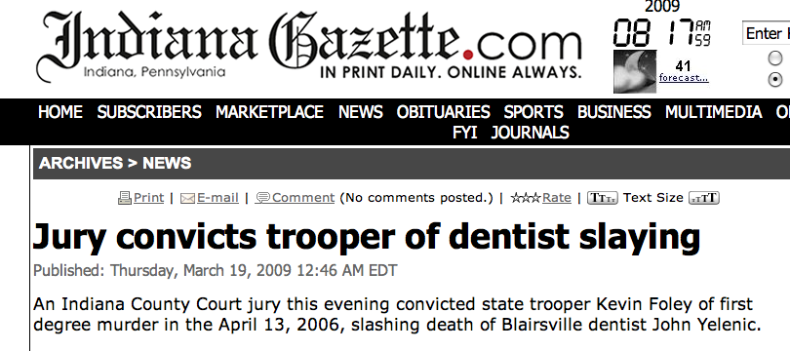
One Verdict
One Verdict
"John Yelenic provided the most eloquent and poignant evidence in this case," said the prosecutor, senior deputy attorney general Anthony Krastek. "He managed to reach out and scratch his assailant," capturing the murderer's DNA under his fingernails.

Slide 37
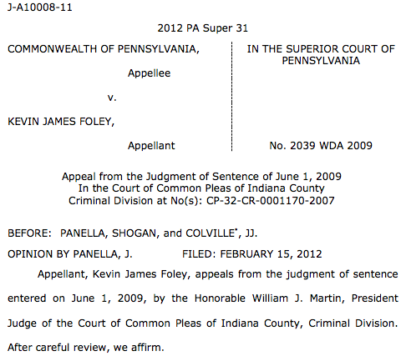
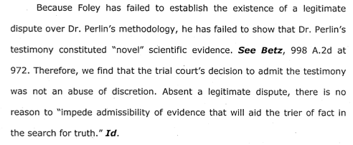
Pennsylvania appellate court
• • •

Slide 38
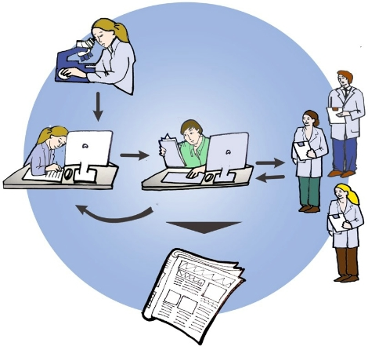
Peer-review process
Do research
Write paper
Independently
& anonymously
review paper
Journal editor
Publish paper

Slide 39



Peer-reviewed validation study

Slide 40
TrueAllele validation papers
Perlin MW, Sinelnikov A. An information gap in DNA evidence interpretation. PLoS ONE. 2009;4(12):e8327.
Ballantyne J, Hanson EK, Perlin MW. DNA mixture genotyping by probabilistic computer interpretation of binomially-sampled laser captured cell populations: Combining quantitative data for greater identification information. Science & Justice. 2013;53(2):103-14.
Perlin MW, Hornyak J, Sugimoto G, Miller K. TrueAllele® genotype identification on DNA mixtures containing up to five unknown contributors. Journal of Forensic Sciences. 2015;on-line.
Greenspoon SA, Schiermeier-Wood L, Jenkins BC. Establishing the limits of TrueAllele® Casework: a validation study. Journal of Forensic Sciences. 2015;in press.
Perlin MW, Legler MM, Spencer CE, Smith JL, Allan WP, Belrose JL, Duceman BW. Validating TrueAllele® DNA mixture interpretation. Journal of Forensic Sciences. 2011;56(6):1430-47.
Perlin MW, Belrose JL, Duceman BW. New York State TrueAllele® Casework validation study. Journal of Forensic Sciences. 2013;58(6):1458-66.
Perlin MW, Dormer K, Hornyak J, Schiermeier-Wood L, Greenspoon S. TrueAllele® Casework on Virginia DNA mixture evidence: computer and manual interpretation in 72 reported criminal cases. PLOS ONE. 2014;(9)3:e92837.

Slide 41
Validation axes
Sensitivity. The extent to which interpretation identifies the correct person.
Truly include, don't falsely exclude.
Specificity. The extent to which interpretation does not misidentify the wrong person.
Truly exclude, don't falsely include.
Reproducibility. The extent to which interpretation gives the same answer to the same question.
Concordant independent computer runs.

Slide 42
Reliability (PA Rule 702)
Testimony by Expert Witness
A witness who is qualified as an expert by knowledge, skill, experience, training, or education may testify in the form of an opinion or otherwise if:
(a) the expert’s scientific, technical, or other specialized knowledge is beyond that possessed by the average layperson;
(b) the expert’s scientific, technical, or other specialized knowledge will help the trier of fact to understand the evidence or to determine a fact in issue; and
(c) the expert’s methodology is generally accepted in the relevant field.

Slide 43
Daubert v. Merrell Dow Pharmaceuticals (1993)
Plaintiff: Bendectin caused birth defects
Defendant: no reliable scientific evidence
Judge as gatekeeper
(1) testable and tested
(2) peer review and publication
(3) known error rate
(4) standards and controls
(5) generally accepted in the relevant community

Slide 44
Frye v. United States (1923)
Defendant: systolic blood pressure deception test
Government: not reliable scientific evidence
Just when a scientific principle or discovery crosses the line between the experimental and demonstrable stages is difficult to define. Somewhere in this twilight zone the evidential force of the principle must be recognized, and while courts will go a long way in admitting expert testimony deduced from a well-recognized scientific principle or discovery, the thing from which the deduction is made must be sufficiently established to have gained general acceptance in the particular field in which it belongs.

Slide 45
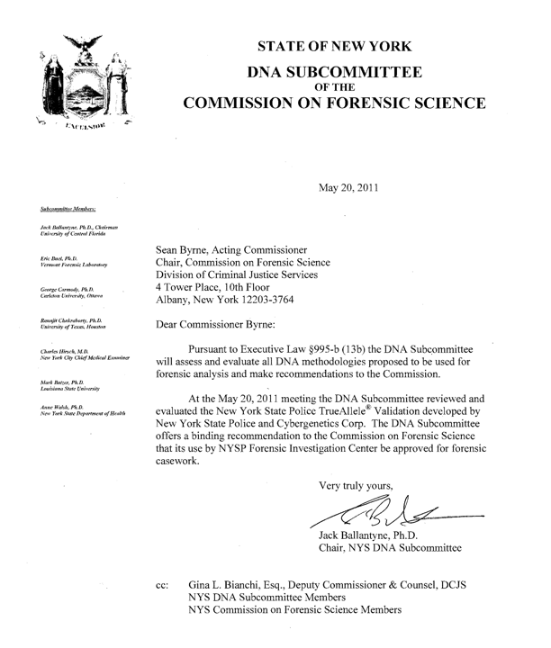
Scientific community

Slide 46
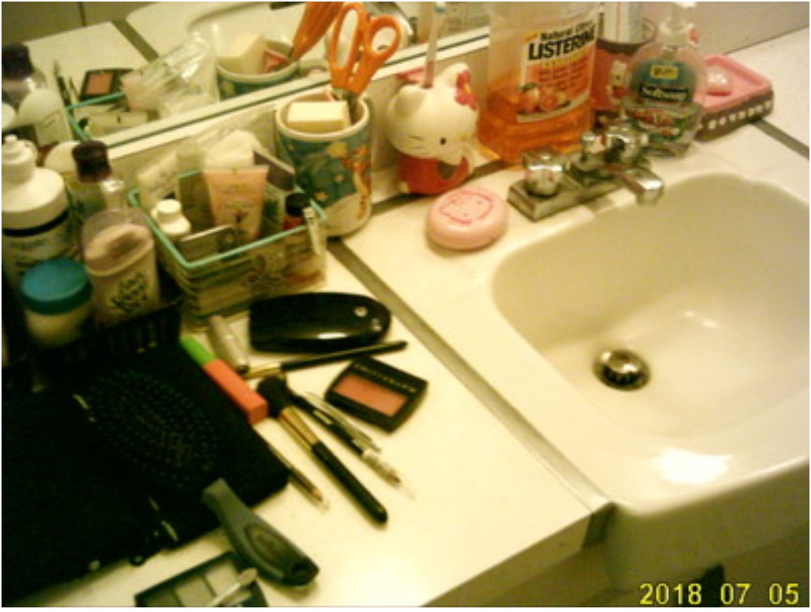
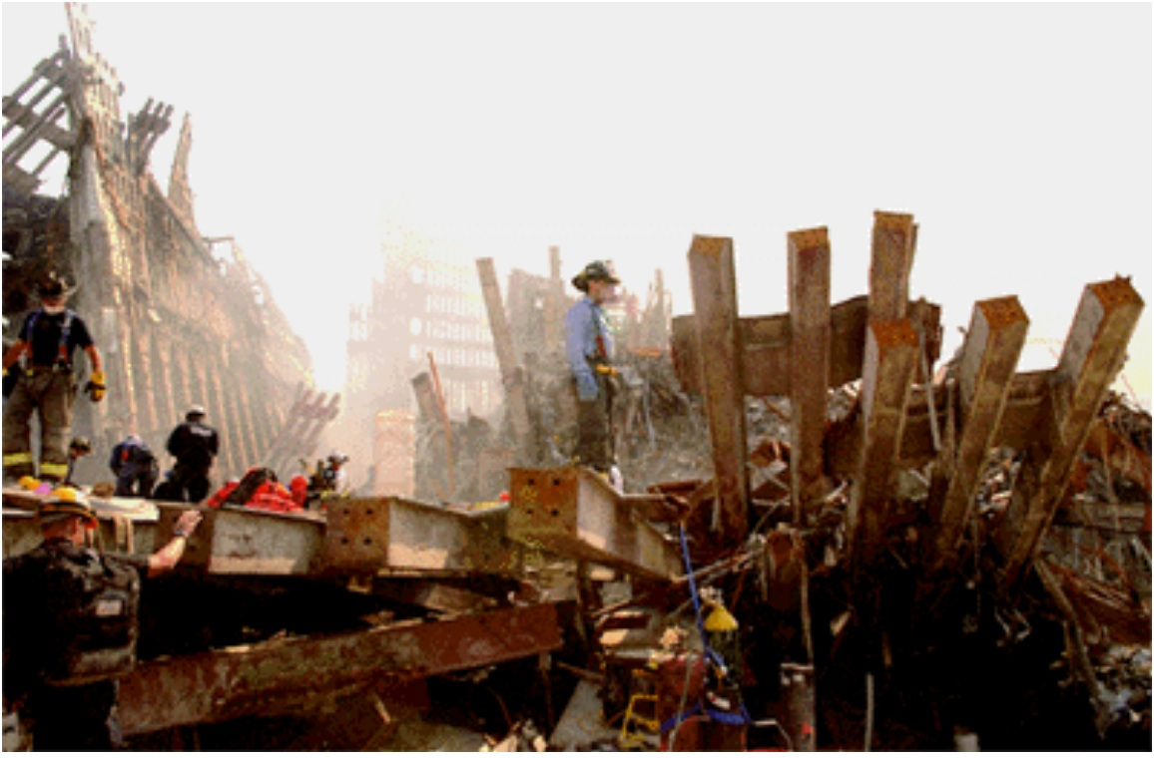
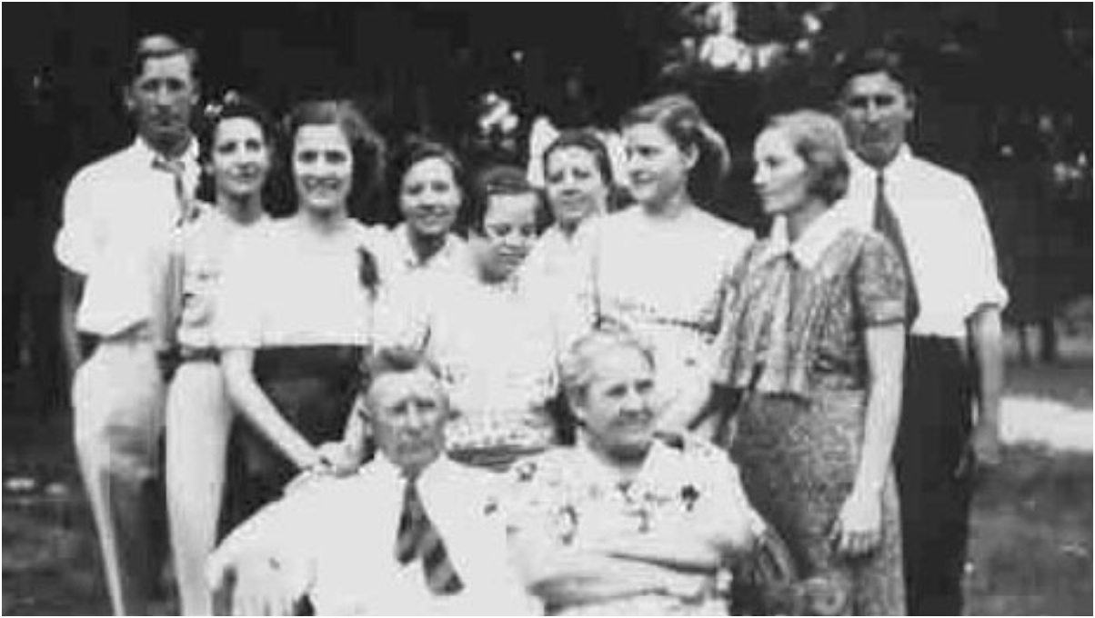
WTC DNA data reanalysis
18,000 victim remains
2,700 missing people
match

Slide 47
Widespread acceptance
Admitted after Frye or Daubert challenge in:
California, Louisiana, New York, Ohio, Pennsylvania, South Carolina, Virginia, Australia & United Kingdom
Crime labs use TrueAllele® system in
California, Maryland, South Carolina & Virginia
Used in five hundred criminal cases in most of the United States, for both prosecution and defense
Seventy criminal cases in Pennsylvania
Adams, Allegheny, Beaver, Berks, Butler, Cambria, Columbia, Delaware, Indiana, Luzerne, Lycoming, Mercer, Mifflin, Pike, Washington, Westmoreland, York

Slide 48
Source code
Source program
computer instructions written in a human-readable computer language
Compiler
Input
Executable program
Output
software that runs on a computer

Slide 49
Discovery request
Rule of Criminal Procedure 573.
Pretrial Discovery and Inspection
(B) Disclosure by the Commonwealth.
(1) Mandatory.
(e) any results ... of scientific tests, expert opinions ... that are within the possession or control of the attorney for the Commonwealth;
(2) Discretionary With the Court.
(a) if the defendant files a motion for pretrial discovery, the court may order ... upon a showing that they are material to the preparation of the defense, and that the request is reasonable:
(iv) any other evidence specifically identified by the defendant, provided the defendant can additionally establish that its disclosure would be in the interests of justice.

Slide 50
Source code as trade secret
“A trade secret may consist of any formula, pattern, device or compilation of information which is used in one's business, and which gives him an opportunity to obtain an advantage over competitors who do not know or use it.”
Crum v. Bridgestone/Firestone N. Am. Tire (2006)
TrueAllele source code is a trade secret
“... scientists can validate the reliability of a computerized process even if the “source code” underlying that process is not available to the public. TrueAllele is proprietary software; it would not be possible to market TrueAllele if it were available for free ... TrueAllele has been tested and validated in peer-reviewed studies.” Pennsylvania v Foley
Courts deny this discovery request –
California, Maryland, New York, Ohio, Pennsylvania, Virginia

Slide 51
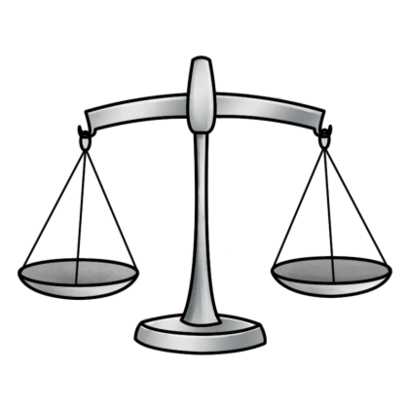
Relevance (PA Rule 403)
Excluding relevant evidence for prejudice, confusion, waste of time, or other reasons
The court may exclude relevant evidence if its probative value is outweighed by a danger of one or more of the following:
• unfair prejudice,
• confusing the issues,
• misleading the jury,
• undue delay,
• wasting time, or
• needlessly presenting cumulative evidence.
probative
force
unfair
prejudice

Slide 52
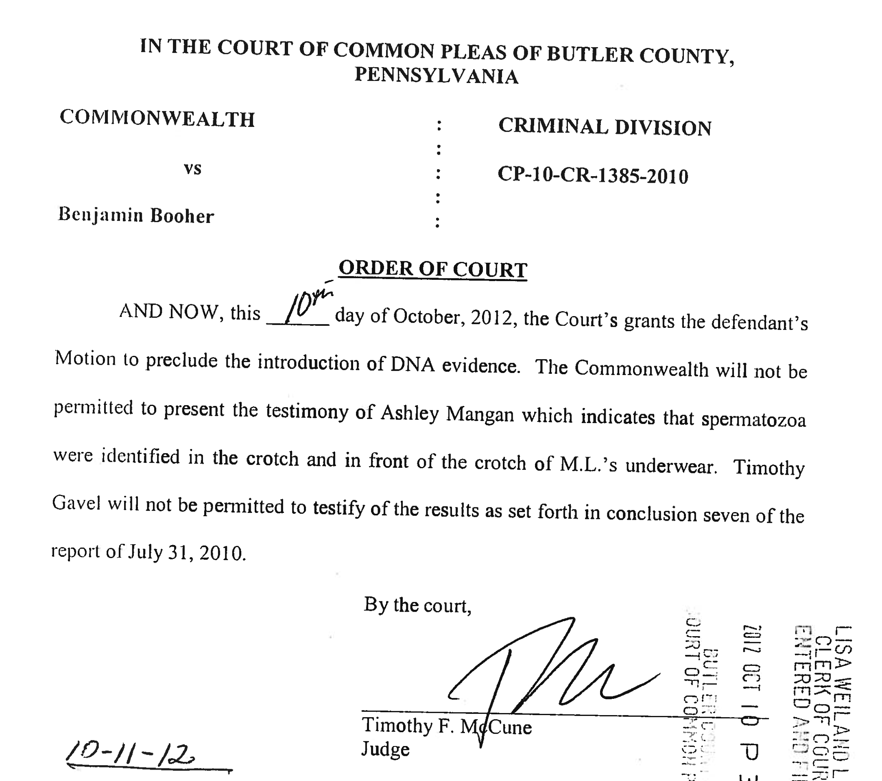
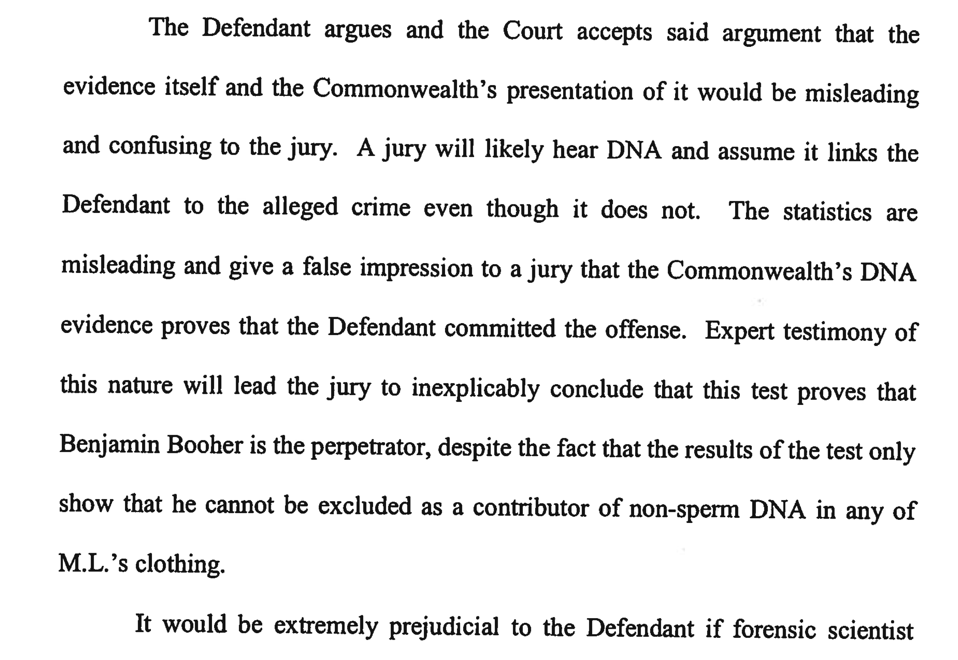
Commonwealth v Booher
DNA excluded as misleading, confusing & prejudicial

Slide 53
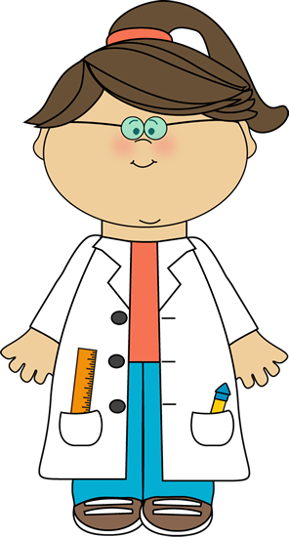

Crime lab DNA interpretation
(1)
Choose, alter, discard, edit, and manipulate the DNA data signals
(2)
Compare defendant's genotype to edited data & decide if he is in the DNA evidence
(3)
If he is "included", then calculate a DNA mixture statistic

Slide 54
Process is not objective science
(1)
Choose, alter, discard, edit, and manipulate the DNA data signals
(2)
Compare defendant's genotype to edited data & decide if he is in the DNA evidence
(3)
If he is "included", then calculate a DNA mixture statistic
• Human examination bias
• Statistics & reporting
• Underlying scientific basis

Slide 55
DNA statistic shuts down labs
“National accreditation board suspends all DNA testing at D.C. crime lab”
The Washington Post April 27, 2015
Did not comply with FBI standards
“New protocol leads to reviews of
‘mixed DNA’ evidence”
The Texas Tribune September 12, 2015
24,468 lab tests affected

Slide 56
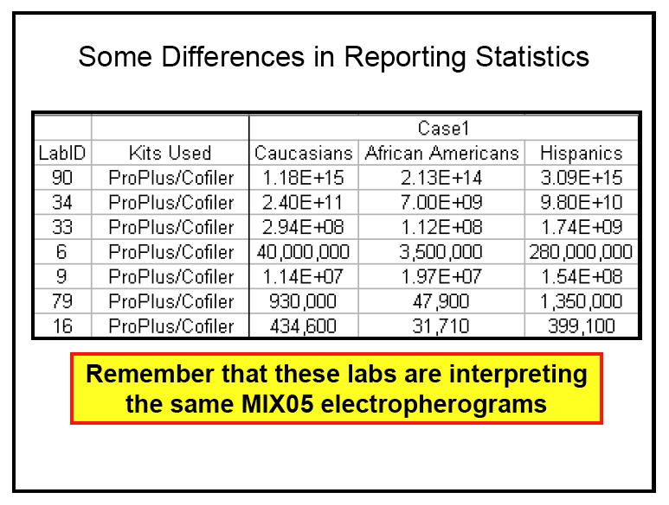
MIX05: Statistics not reproducible
MIX05: NIST mixture interpretation interlaboratory study.
Butler JM, Kline MC, National Institute of Standards and Technology
Promega's Sixteenth International Symposium on Human Identification, 2005
National Institute of Standards and Technology
Two Contributor Mixture Data, Known Victim
213 trillion (14)
31 thousand (4)

Slide 57
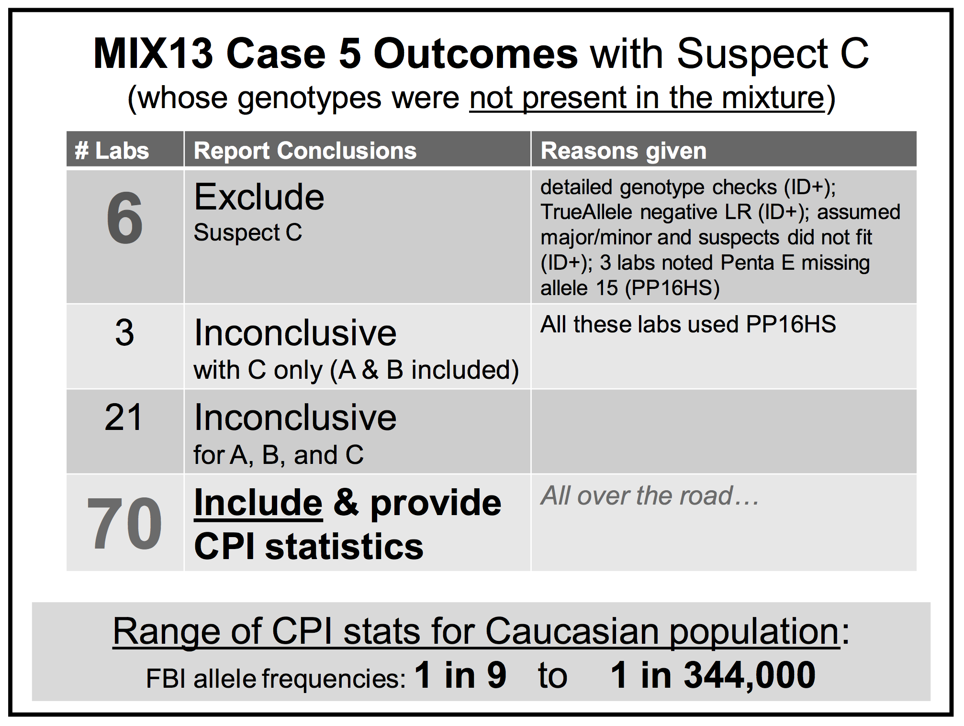
MIX13: Statistics falsely include
MIX13: An interlaboratory study on the present state of DNA mixture interpretation in the U.S.
Coble M, National Institute of Standards and Technology
5th Annual Prescription for Criminal Justice Forensics, Fordham University School of Law, 2014.

Slide 58
CPI lacks probative value
Forensic crime laboratories have generated CPI statistics on hundreds of thousands of DNA mixture evidence items. However, this commonly used match statistic behaves like a random generator of inclusionary values, following the LLN rather than measuring identification information. A quantitative CPI number adds little meaningful information beyond the
analyst’s initial qualitative assessment that a person’s DNA is included in a mixture. Statistical methods for reporting on DNA mixture evidence should be scientifically validated before they are relied upon by criminal justice.

Slide 59
Relevance of CPI
Unvalidated DNA match statistic, unrelated to identification
PA Rule 401
“evidence makes a fact
more or less probable”
PA Rule 403
“outweighed by
a danger of:”
Probative value
none
Unfair prejudice
Confusing the issues
Misleading the jury
Cumulative evidence

Slide 60
Inconclusive mixture
Crime laboratory DNA report
Crime lab user fee: $5,000
Conclusions:
Item 1 – Swab of textured areas from a handgun
The data indicates that DNA from four (4) or more contributors was obtained from the swab of the handgun. Due to the complexity of the data, no conclusions can be made regarding persons A and B as possible contributors to this mixture.

Slide 61
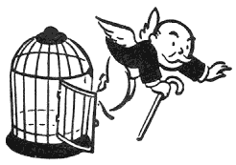
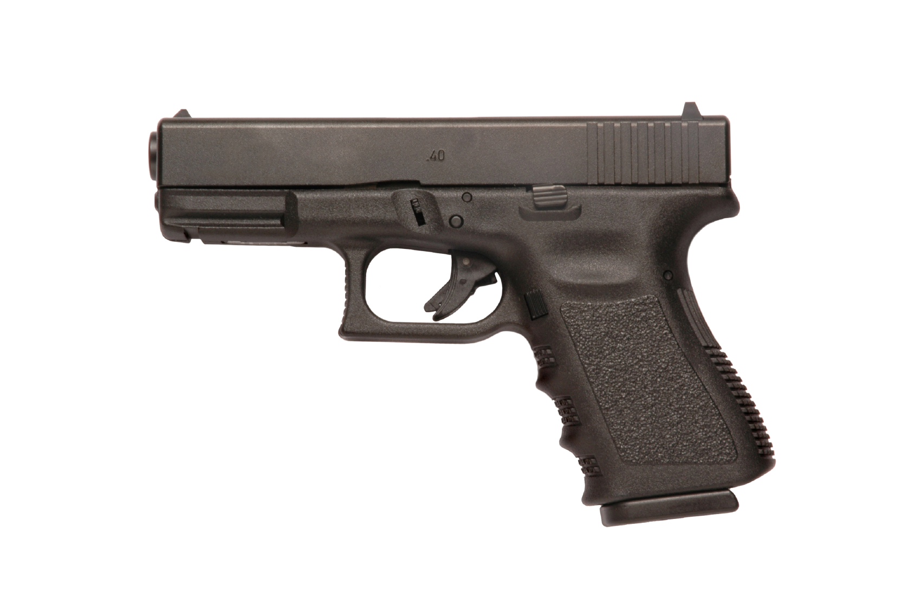

Computer reanalysis
Cybergenetics TrueAllele® report
Match statistics provide information
Person A
excluded
Contributor
Unmix the
mixture
1
2
400,000
3
Person B
included
4

Slide 62
TrueAllele in Allegheny County
40 cases, 8 trials, 3 DNA exonerations
Crime | Evidence | Defendant | Outcome | Sentence
rape | clothing | Ralph Skundrich | guilty | 75 years
murder | gun, hat | Leland Davis | guilty | 23 years
rape | clothing | Akaninyene Akan | guilty | 32 years
murder | shotgun shells | James Yeckel, Jr. | guilty plea | 25 years
murder | fingernail | Anthony Morgan | guilty | life
weapons | gun | Thomas Doswell | guilty plea | 1 year
bank robbery | clothing | Jesse Lumberger | guilty | 10 years
drugs | gun | Derek McKissick | guilty plea | 2 1/2 years
drugs | gun | Steve Morgan | guilty plea | 2 1/2 years
murder | door, clothing | Calvin Kane | guilty plea | 20 years
murder | gun | Jaykwaan Pinckney | guilty plea | 10 years
child rape | clothing | Dhaque Jones | guilty plea | 6 years
shooting | gun | Anthony Jefferson | guilty plea | 4 years
weapons | gun | Delmingo Williams | guilty plea | 3 years
incest rape | clothing | Terry L. | guilty | 40 years
bank robbery | hat | Robert Schatzman | guilty | pending
weapons | gun | Rashawn Walker | guilty | 1.5 years
robbery | hat | Lauren Peak | guilty plea | 1 year
murder | gun | Chaz White | guilty plea | 4 years

Slide 63
Post-conviction relief
Title 42, Chapter 95, Subchapter B
§ 9543(a)(2). Eligibility for PCR
(ii) Ineffective assistance of counsel
(vi) The unavailability … of exculpatory evidence that has subsequently become available and would have changed the outcome …
§ 9543.1. Post-conviction DNA testing
TrueAllele reanalysis of “inconclusive” DNA
or inaccurate DNA match statistics
Han Tak Lee v. Monroe County (PA Innocence)
US Court of Appeals for the Third Circuit (2012)
“fire expert testimony at trial fundamentally unreliable,
so entitled to federal habeas relief on due process claim”

Slide 64
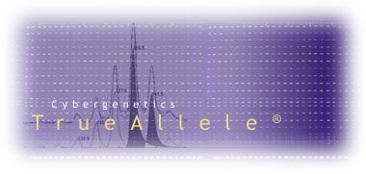

More DNA mixture information
http://www.cybgen.com/information
• Courses
• Newsletters
• Newsroom
• Presentations
• Publications
• Webinars
http://www.youtube.com/user/TrueAllele
TrueAllele YouTube channel
perlin@cybgen.com

