Slide 1

The Probative Power of DNA Mixtures
The Balancing Act of Justice
Louisiana District Attorneys Association
LDAA 39th Annual Conference
June, 2016
Destin, FL
Mark W Perlin, PhD, MD, PhD
Cybergenetics, Pittsburgh, PA
Cybergenetics © 2003-2016

Slide 2
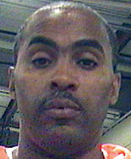
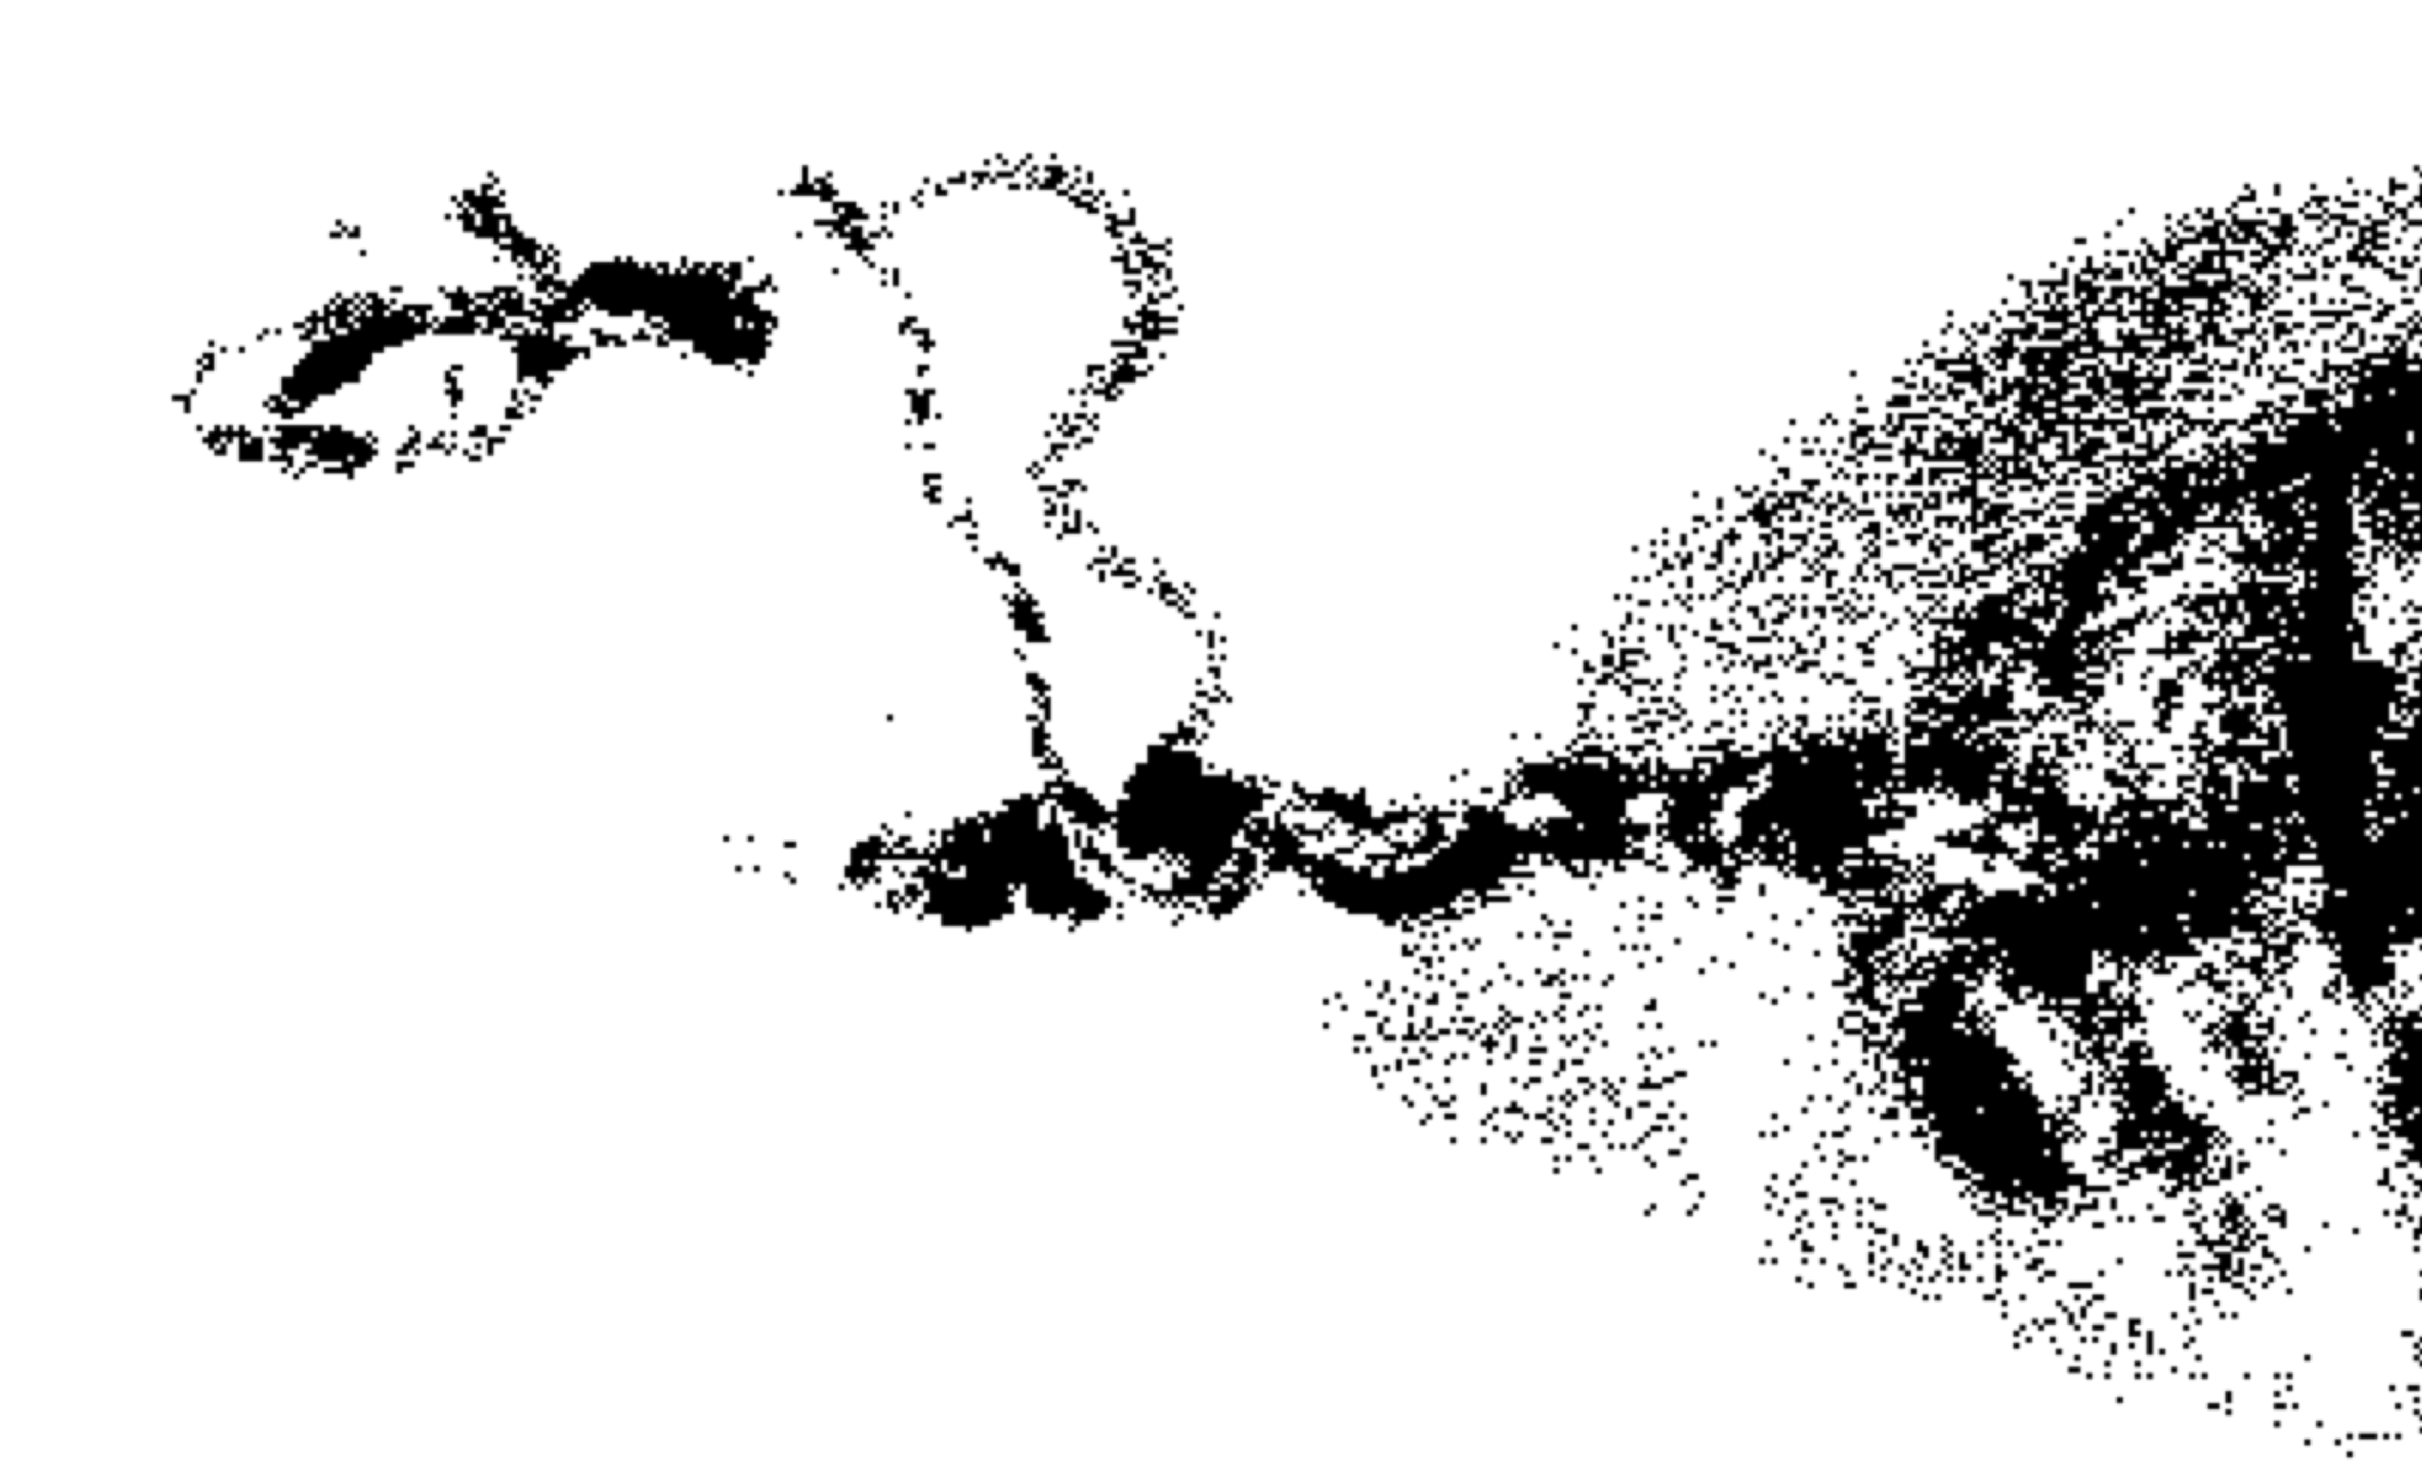
Booker Diggins stays in prison
1987 – aggravated rape, armed robbery
Booker Diggins sentenced to life
2010 – "bulletproof scientific evidence that he is not the guy"
2012 – rape kit found, tested by crime lab (insufficient DNA)
Cybergenetics finds match statistic of 38 thousand
New DNA test points to New Orleans rape convict who was nearly set free
The Times-Picayune

Slide 3
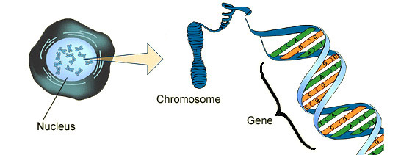
DNA biology
Cell
Chromosome
Locus
Nucleus

Slide 4

Short tandem repeat
DNA locus paragraph
Take me out to the ball game
take me out with the crowd
buy me some peanuts and Cracker Jack
I don't care if I never get back
let me
root root root root root root root root root root
for the home team,
if they don't win, it's a shame for it's one, two, three strikes, you're out
at the old ball game
23 volumes in cell's
DNA encyclopedia
"root" repeated 10 times, so
allele length is 10 repeats

Slide 5
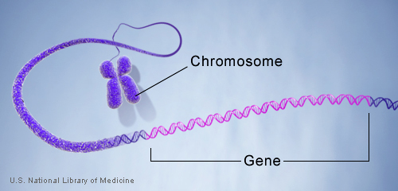
DNA genotype
A genetic locus has
two DNA sentences,
one from each parent.
An allele is the number
of repeated words.
locus
A genotype at a locus
is a pair of alleles.
mother
allele
1
2
3
4
5
6
7
8
9
10
10, 12
ACGT
repeated word
Many alleles allow for
many many allele pairs.
A person's genotype
is relatively unique.
father
allele
1
2
3
4
5
6
7
8
9
10
11
12

Slide 6
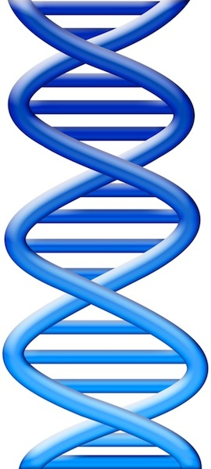
DNA laboratory
Evidence item
Lab
Evidence data
Separations
• Extract
• Amplify
• Detect
10 11 12
DNA from
one person

Slide 7
DNA interpretation
Evidence item
Lab
Evidence data
Infer
Evidence genotype
10, 12
10 11 12
DNA from
one person

Slide 8
DNA match statistic
Evidence item
Lab
Evidence data
Infer
Evidence genotype
10, 12
10 11 12
DNA from
one person
Compare
Known genotype
1
Prob(coincidental match)
10, 12

Slide 9
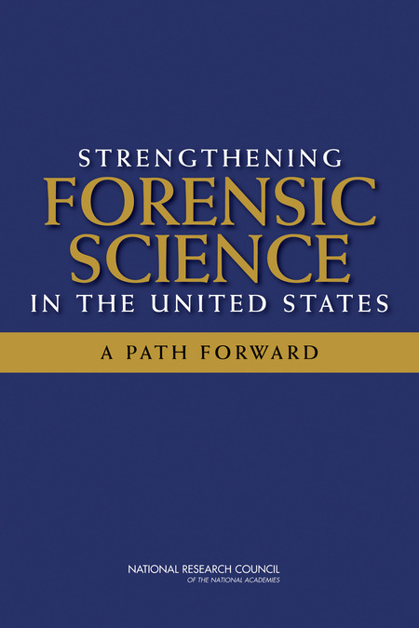
National Academy of Sciences
"Strengthening Forensic Science:
A Path Forward" (2009)
• Human examination bias
• Statistics & reporting
• Underlying scientific basis
DNA Gold Standard
However, ... there may be problems ... with how the DNA was ... interpreted, such as when there are mixed samples

Slide 10
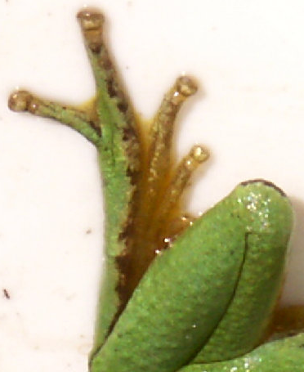
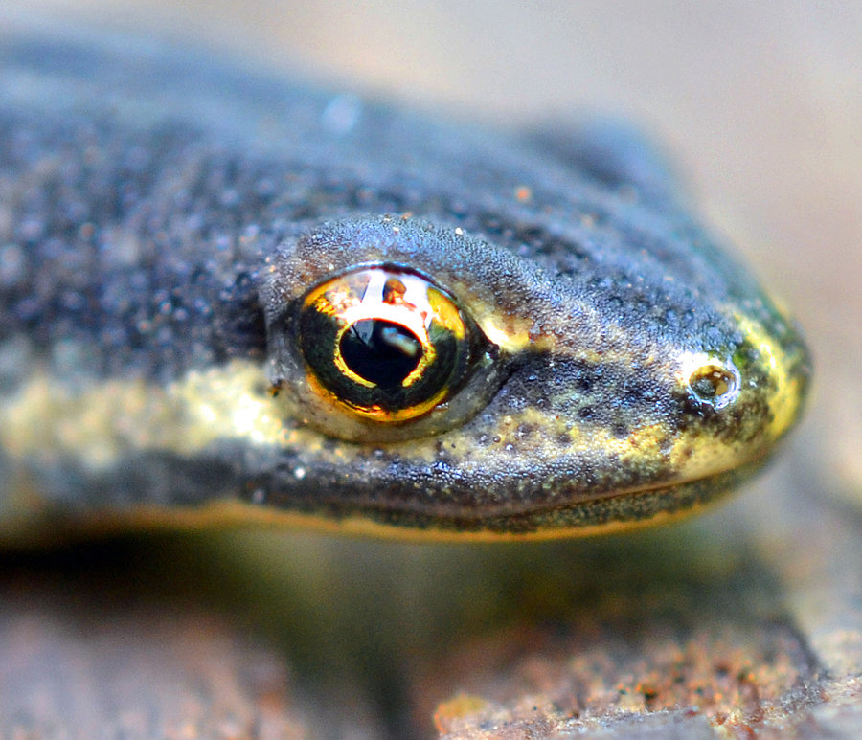

DNA mixture
eye of newt
toe of frog
Double, double toil and trouble

Slide 11
DNA statistic shuts down labs
“National accreditation board suspends all DNA testing at D.C. crime lab”
The Washington Post April 27, 2015
Did not comply with FBI standards
“New protocol leads to reviews of
‘mixed DNA’ evidence”
The Texas Tribune September 12, 2015
24,468 lab tests affected

Slide 12
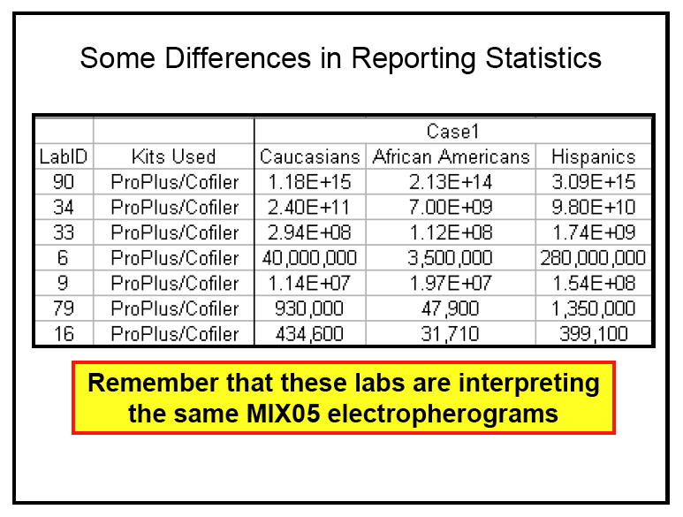
MIX05: Statistics not reproducible
MIX05: NIST mixture interpretation interlaboratory study.
Butler JM, Kline MC, National Institute of Standards and Technology
Promega's Sixteenth International Symposium on Human Identification, 2005
National Institute of Standards and Technology
Two Contributor Mixture Data, Known Victim
213 trillion (14)
31 thousand (4)

Slide 13
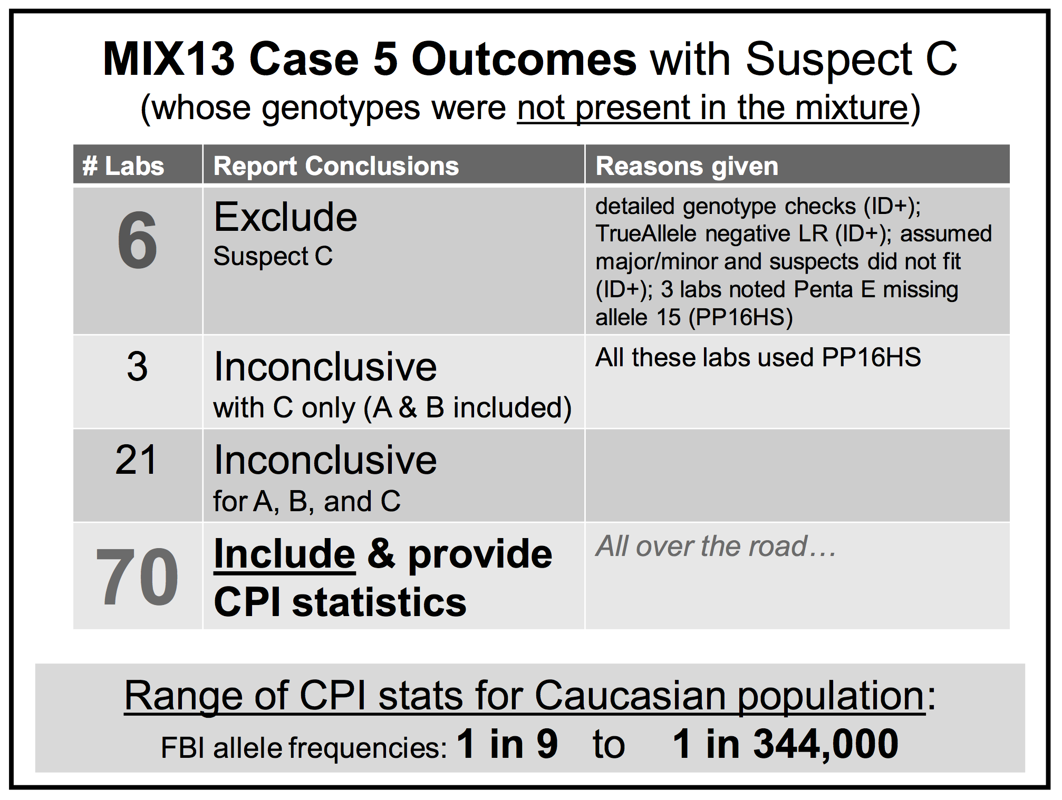
MIX13: Statistics falsely include
MIX13: An interlaboratory study on the present state of DNA mixture interpretation in the U.S.
Coble M, National Institute of Standards and Technology
5th Annual Prescription for Criminal Justice Forensics, Fordham University School of Law, 2014.

Slide 14
CPI lacks probative value
Forensic crime laboratories have generated CPI statistics on hundreds of thousands of DNA mixture evidence items. However, this commonly used match statistic behaves like a random generator of inclusionary values, following the LLN rather than measuring identification information. A quantitative CPI number adds little meaningful information beyond the
analyst’s initial qualitative assessment that a person’s DNA is included in a mixture. Statistical methods for reporting on DNA mixture evidence should be scientifically validated before they are relied upon by criminal justice.

Slide 15
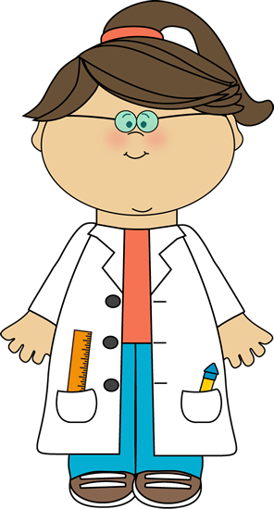

Subjective interpretation
(1)
Choose, alter, discard, edit, and manipulate the DNA data signals
(2)
Compare defendant's genotype to edited data & decide if he is in the DNA evidence
(3)
If he is "included", then calculate a DNA mixture statistic
• Human examination bias
• Statistics & reporting
• Underlying scientific basis

Slide 16
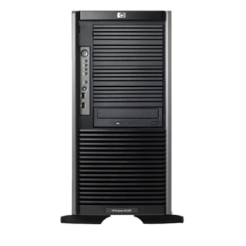

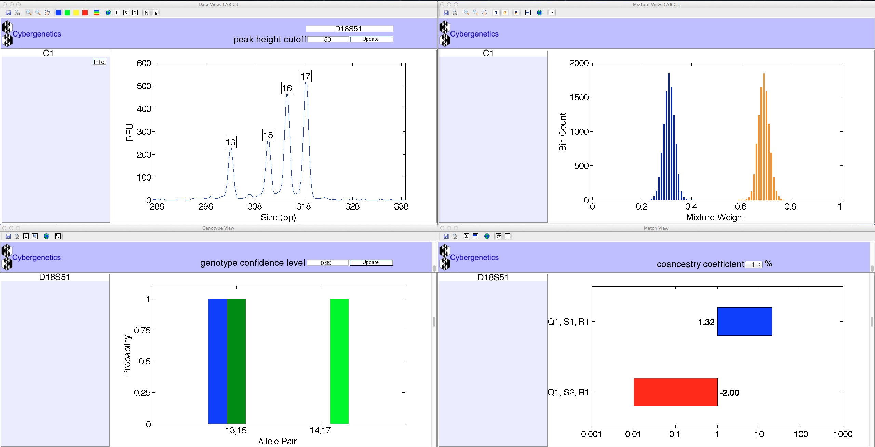
TrueAllele® Casework
ViewStation
User Client
Database
Server
Interpret/Match
Expansion
Visual User Interface
VUIer™ Software
Parallel Processing Computers
Notes:
Describe TrueAllele system (left, middle, right, middle, left)

Slide 17
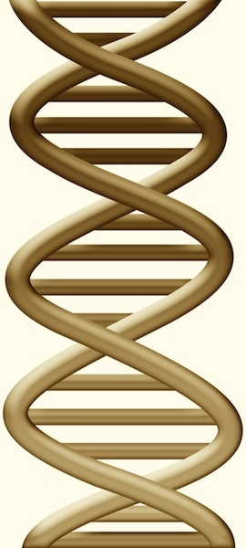
DNA mixture data
Evidence item
Lab
Evidence data
10 11 12
DNA from
two people

Slide 18
DNA mixture interpretation
Evidence item
Lab
Evidence data
Separate
Evidence
genotypes
10, 12
+
10, 11 @ 20%
11, 11 @ 30%
11, 12 @ 50%
10 11 12
DNA from
two people

Slide 19
DNA match statistic
Evidence item
Lab
Evidence data
Separate
Contributor genotype
10, 11 @ 20%
11, 11 @ 30%
11, 12 @ 50%
10 11 12
DNA from
two people
Compare
Known genotype
Prob(evidence match)
Prob(coincidental match)
11, 12

Slide 20
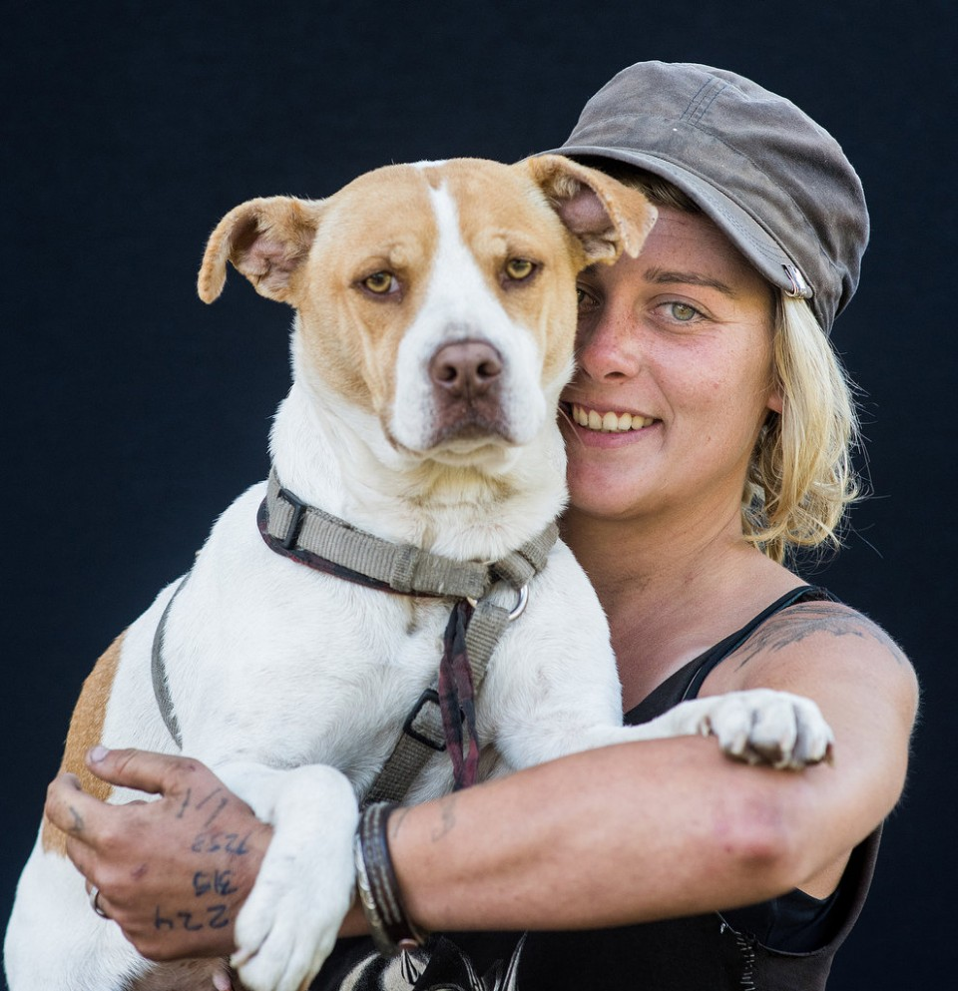
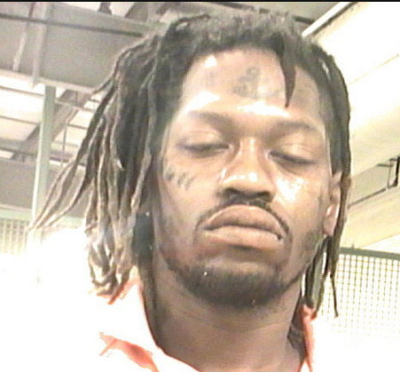
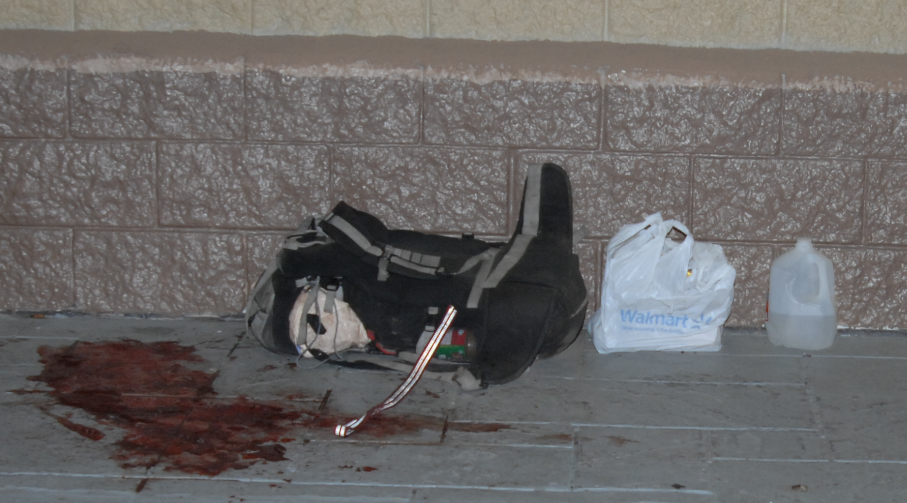
Mixtures corroborate witnesses
Julia "Zoe" Anderson
Christopher Hutsell
Water bottle

Slide 21
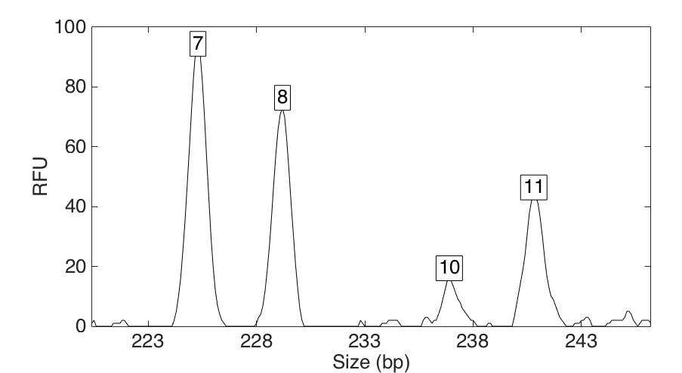
Computers can use all the data
Quantitative peak heights at locus TPOX
peak size
peak
height

Slide 22
How the computer thinks
Consider every possible genotype solution
Explain the
peak pattern
A third person's allele pair
One person's allele pair
Better
explanation
has a higher likelihood
A second person's allele pair

Slide 23
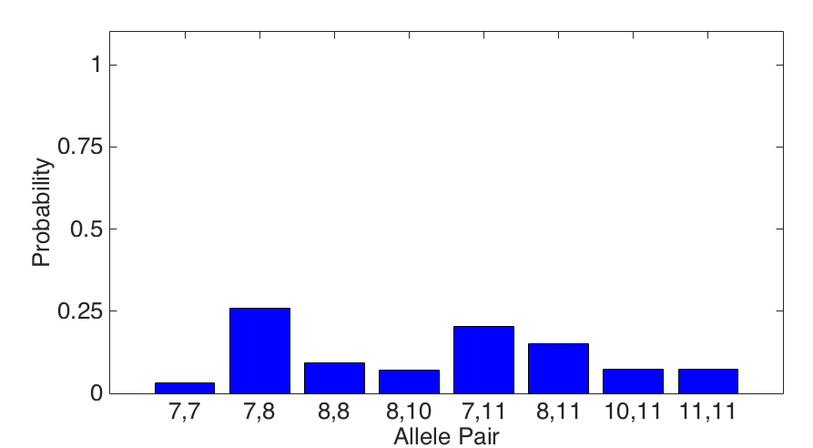
Evidence genotype
Objective genotype determined solely from the DNA data.
Never sees a comparison reference.
26%
20%
15%
9%
7%
7%
7%
3%

Slide 24
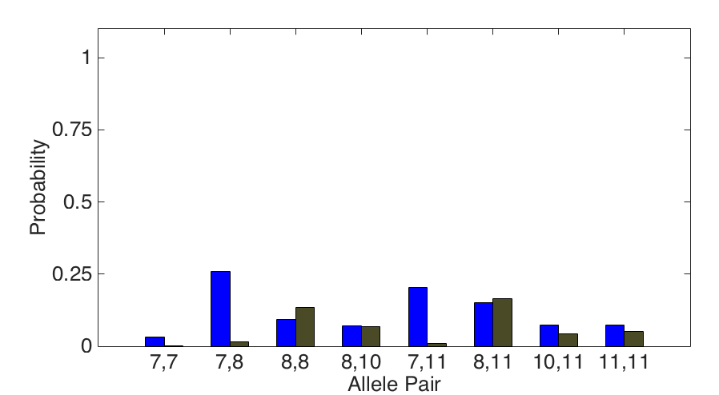
DNA match information
How much more does the suspect match the evidence
than a random person?
Prob(evidence match)
13x
Prob(coincidental match)
26%
2%

Slide 25
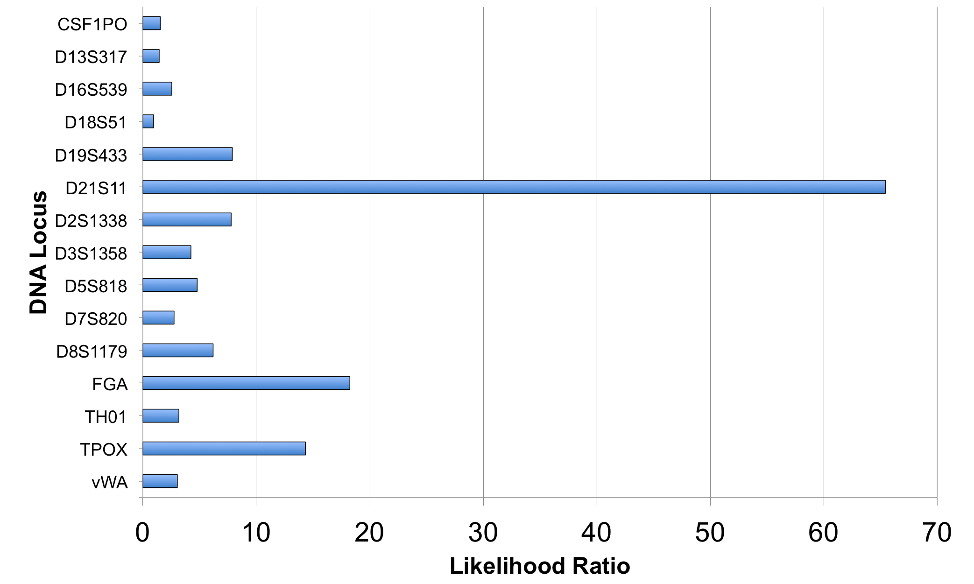
Match information at 15 loci

Slide 26
Is the suspect in the evidence?
A match between the water bottle
and Christopher Hutsell is:
19 billion times more probable than
a coincidental match to an unrelated African-American person
74.9 billion times more probable than
a coincidental match to an unrelated Caucasian person
127 billion times more probable than
a coincidental match to an unrelated Hispanic person

Slide 27
Is the victim in the evidence?
A match between the water bottle
and Julia Zoe Anderson is:
889 thousand times more probable than
a coincidental match to an unrelated African-American person
1.11 million times more probable than
a coincidental match to an unrelated Caucasian person
1.75 million times more probable than
a coincidental match to an unrelated Hispanic person

Slide 28
Life sentence
Jury convicts Christopher Hutsell in
stabbing death of Indiana transient
The Times-Picayune
A New Orleans jury on Tuesday night (November 17, 2015) convicted Christopher Hutsell in the March 19 stabbing death of Julia "Zoe" Anderson. Hutsell, 38 years old and homeless, faces a mandatory sentence of life in prison on a second-degree murder charge after refusing to plead guilty to manslaughter in exchange for a 40-year sentence.

Slide 29
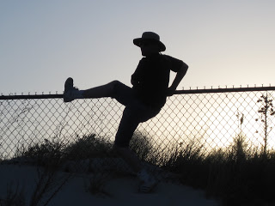
Mixtures reduce coincidence
Fence jumped as shooters fled the scene.
Handprints swabbed by Ville Platte police.
Crime lab unable to determine DNA match.
District Attorney’s Office sent DNA data to
Cybergenetics for statistical analysis.
Ville Platte Gazette

Slide 30
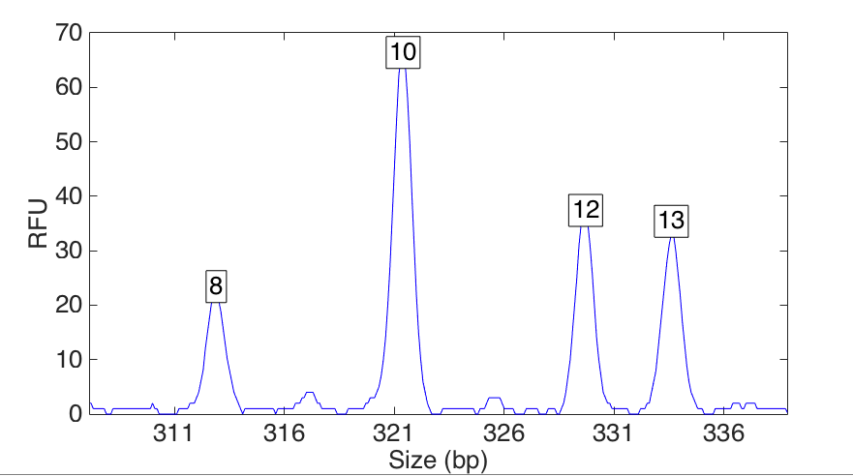
DNA mixture data
Quantitative peak heights at locus CSF1PO

Slide 31
Match statistics
Exhibit | Description | 19 Hilton Wilson | 20 Reokenski Thomas | 21 Raven Gallow | 27 Arlandus Richard
13 | post - A | 70.9 thousand | 335 thousand
14 | post - B | 23.1 million | 6.28 million
13 & 14 | posts - A & B | 157 million | 340 million

Slide 32
Match statistics
Exhibit | Description | 19 Hilton Wilson | 20 Reokenski Thomas | 21 Raven Gallow | 27 Arlandus Richard
13 | post - A | 4.85 | 5.53
14 | post - B | 7.36 | 6.80
13 & 14 | posts - A & B | 8.20 | 8.53

Slide 33
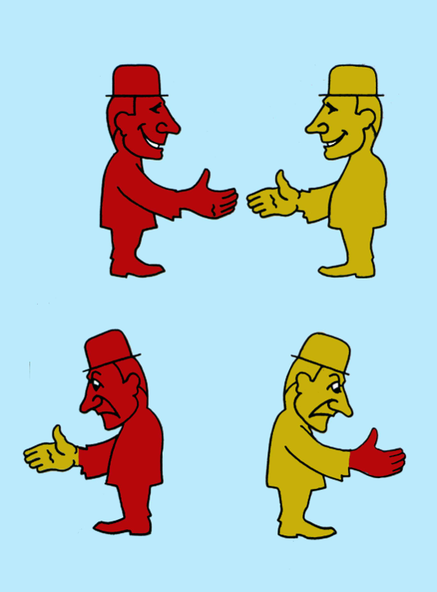
DNA transfer
• How did DNA get there?
• When was DNA deposited?
Multiple mixtures reduce coincidence
Left & right hand mixtures
Both defendants present
Defense: Isn't DNA transfer a possibility?
Expert: Not very likely to happen twice.

Slide 34
Convictions obtained
Guilty verdicts handed down in Thomas-Wilson murder trial
Ville Platte Gazette
TrueAllele statistically matched the defendants’ DNA to
the DNA collected from the fence at the crime scene.
After seven days of listening to eye witness and expert testimony, an Evangeline Parish Jury of 12 found Reokinski Thomas and Hilton Wilson guilty of first degree murder and attempted first degree murder (March 16, 2016).
The prosecutors polled the jury after trial –
the DNA was crucial in obtaining the convictions

Slide 35
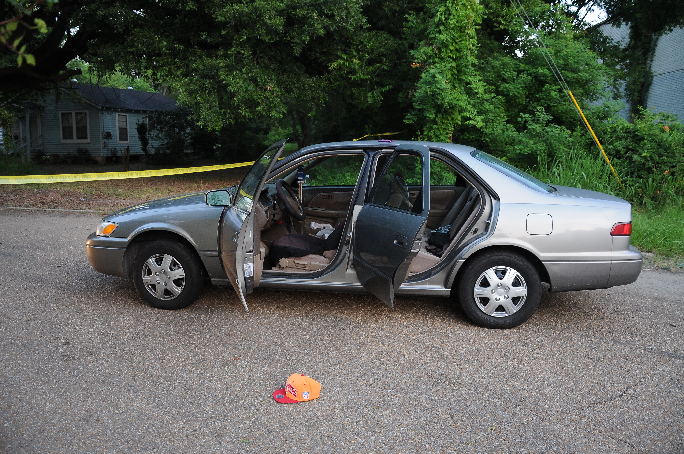
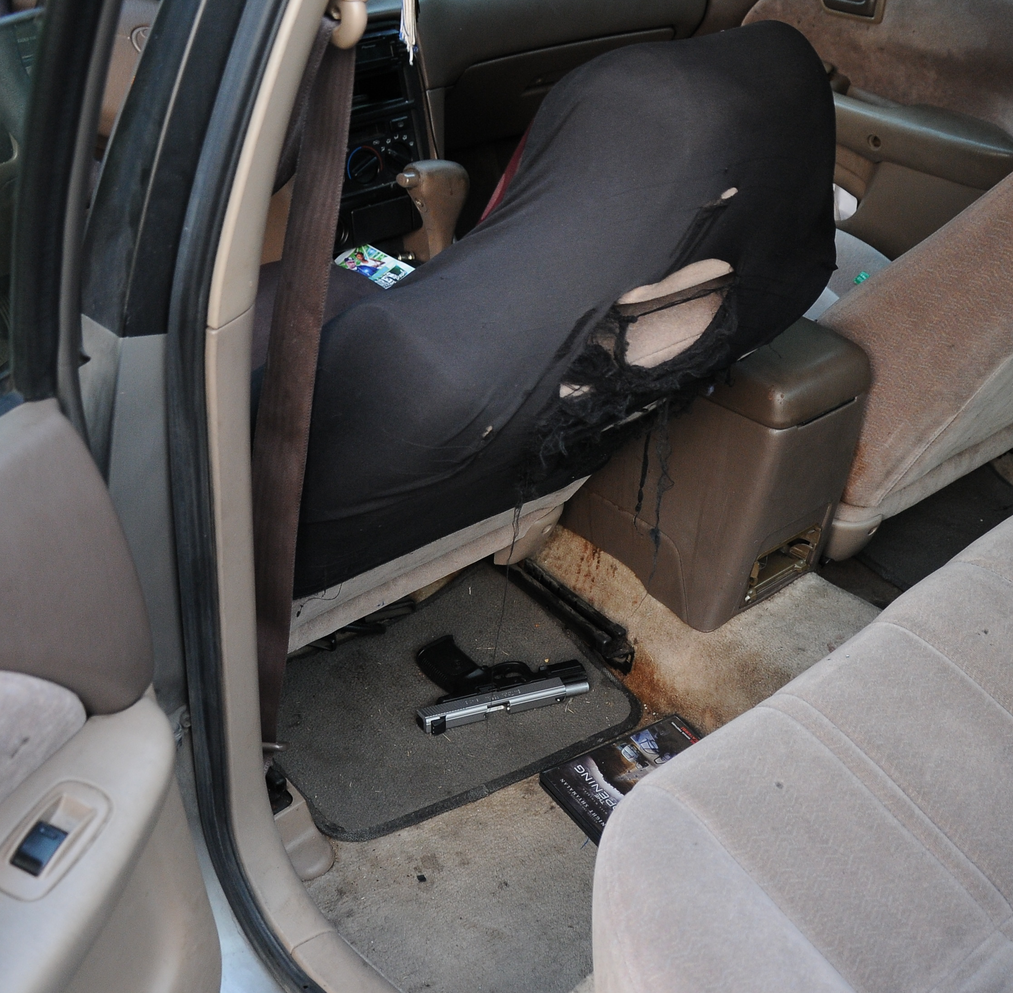
TrueAllele is reliable
On June 30, 2012, Darius Vicks was waiting for a traffic light to change. Jordan Key was a passenger in the Baton Rouge car.
Chattley Chesterfield got out of a vehicle behind them, ran up to the car, and fired three shots into the car, killing Key and injuring Darius Vicks
Crime lab: pistol DNA mixture of 3 people

Slide 36
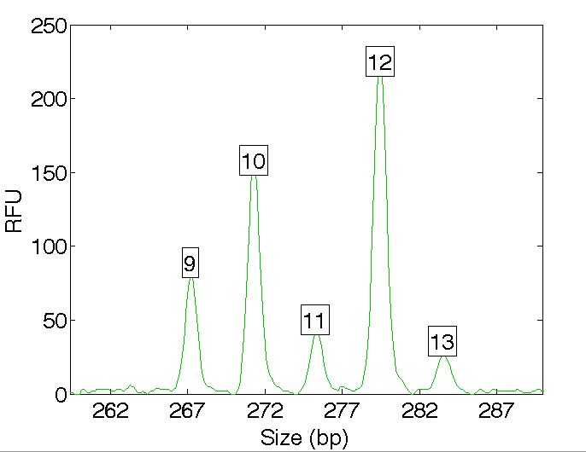
DNA mixture data pattern
Quantitative peak heights at locus D16S539

Slide 37
Older methods use less data
Over threshold, peaks are labeled as allele events
Threshold
All-or-none allele peaks,
each given equal status
Under threshold,
alleles vanish

Slide 38
TrueAllele explains all the data
Consider many possible genotype answers
One person’s allele pair
Second person's allele pair
Third person's allele pair

Slide 39
Are the suspects in the evidence?
A match between the pistol
and Chattley Chesterfield is:
108 thousand times more probable than
a coincidental match to an unrelated Black person
A match between the pistol
and Samuel Nicholas is:
3,210 times more probable than
a coincidental match to an unrelated Black person

Slide 40
Reliability (La. Rule 702)
Testimony by Experts
A witness who is qualified as an expert by knowledge, skill, experience, training, or education may testify in the form of an opinion or otherwise if:
(1) The expert's scientific, technical, or other specialized knowledge will help the trier of fact to understand the evidence or to determine a fact in issue;
(2) The testimony is based on sufficient facts or data;
(3) The testimony is the product of reliable principles and methods; and
(4) The expert has reliably applied the principles and methods to the facts of the case.

Slide 41
Daubert v. Merrell Dow Pharmaceuticals (1993)
Plaintiff: Bendectin caused birth defects
Defendant: no reliable scientific evidence
Judge as gatekeeper
(1) testable and tested
(2) peer review and publication
(3) known error rate
(4) standards and controls
(5) generally accepted in the relevant community

Slide 42
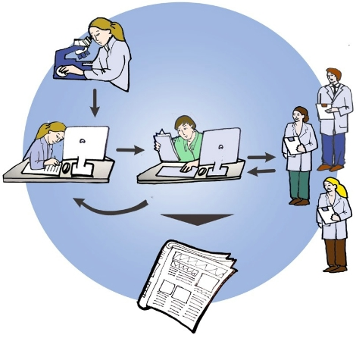
Peer-review process
Do research
Write paper
Independently
& anonymously
review paper
Journal editor
Publish paper

Slide 43



Peer-reviewed validation study

Slide 44
TrueAllele validation papers
Perlin MW, Sinelnikov A. An information gap in DNA evidence interpretation. PLoS ONE. 2009;4(12):e8327.
Ballantyne J, Hanson EK, Perlin MW. DNA mixture genotyping by probabilistic computer interpretation of binomially-sampled laser captured cell populations: Combining quantitative data for greater identification information. Science & Justice. 2013;53(2):103-14.
Perlin MW, Hornyak J, Sugimoto G, Miller K. TrueAllele® genotype identification on DNA mixtures containing up to five unknown contributors. Journal of Forensic Sciences. 2015;60(4):857-868.
Greenspoon SA, Schiermeier-Wood L, Jenkins BC. Establishing the limits of TrueAllele® Casework: a validation study. Journal of Forensic Sciences. 2015;60(5):1263-1276.
Perlin MW, Legler MM, Spencer CE, Smith JL, Allan WP, Belrose JL, Duceman BW. Validating TrueAllele® DNA mixture interpretation. Journal of Forensic Sciences. 2011;56(6):1430-47.
Perlin MW, Belrose JL, Duceman BW. New York State TrueAllele® Casework validation study. Journal of Forensic Sciences. 2013;58(6):1458-66.
Perlin MW, Dormer K, Hornyak J, Schiermeier-Wood L, Greenspoon S. TrueAllele® Casework on Virginia DNA mixture evidence: computer and manual interpretation in 72 reported criminal cases. PLOS ONE. 2014;(9)3:e92837.

Slide 45
Validation axes
Sensitivity. The extent to which interpretation identifies the correct person.
Truly include, don't falsely exclude.
Specificity. The extent to which interpretation does not misidentify the wrong person.
Truly exclude, don't falsely include.
Reproducibility. The extent to which interpretation gives the same answer to the same question.
Concordant independent computer runs.

Slide 46
Sensitivity
Perlin MW, Dormer K, Hornyak J, Schiermeier-Wood L, Greenspoon S. TrueAllele® Casework on Virginia DNA mixture evidence: computer and manual interpretation in 72 reported criminal cases. PLOS ONE. 2014;(9)3:e92837.
The extent to which interpretation identifies the correct person
True DNA mixture inclusions
101 reported genotype matches
82 with DNA statistic over a million

Slide 47
TrueAllele sensitivity
log(LR) match distribution
11.05
113 billion
TrueAllele

Slide 48
Specificity
The extent to which interpretation does not misidentify the wrong person
True exclusions, without false inclusions
101 matching genotypes x 10,000 random references
x 3 ethnic populations,
for over 1,000,000 nonmatching comparisons

Slide 49
TrueAllele specificity
log(LR) mismatch distribution
– 19.47

Slide 50
Reproducibility
The extent to which interpretation gives
the same answer to the same question
Statistical computing has sampling variation
duplicate computer runs
on 101 matching genotypes
measure log(LR) variation

Slide 51
TrueAllele reproducibility
Concordance in two independent computer runs
standard deviation
(within-group)
0.305

Slide 52
Comparison of methods
6.83
6.68 million
CPI
2.15
140
mCPI
11.05
113 billion
TrueAllele

Slide 53
Information varies with amount
Match statistic
DNA amount

Slide 54
Accuracy of methods
CPI
mCPI
TrueAllele

Slide 55
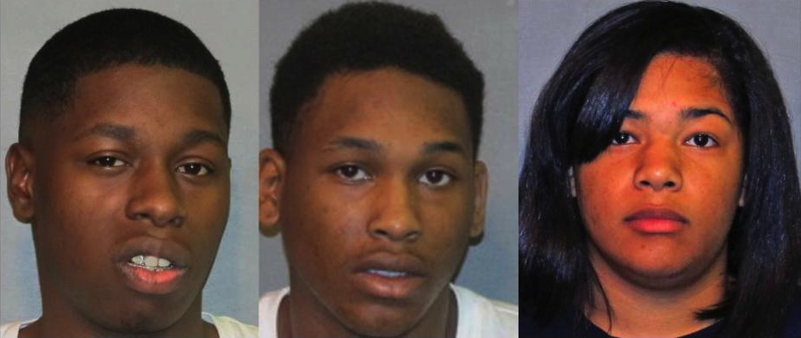
Chesterfield and Dyson convicted
Chesterfield
Nicholas
Dyson
Baton Rouge rapper Samuel “Mista Cain” Nicholas was found not guilty in the 2012 shooting death of an 18-year-old man and wounding another.
The East Baton Rouge Parish jury, however, convicted the accused triggerman, Chattley Chesterfield, 21, and an accomplice, Essence Dyson, 24, each of second-degree murder and aggravated battery.

Slide 56
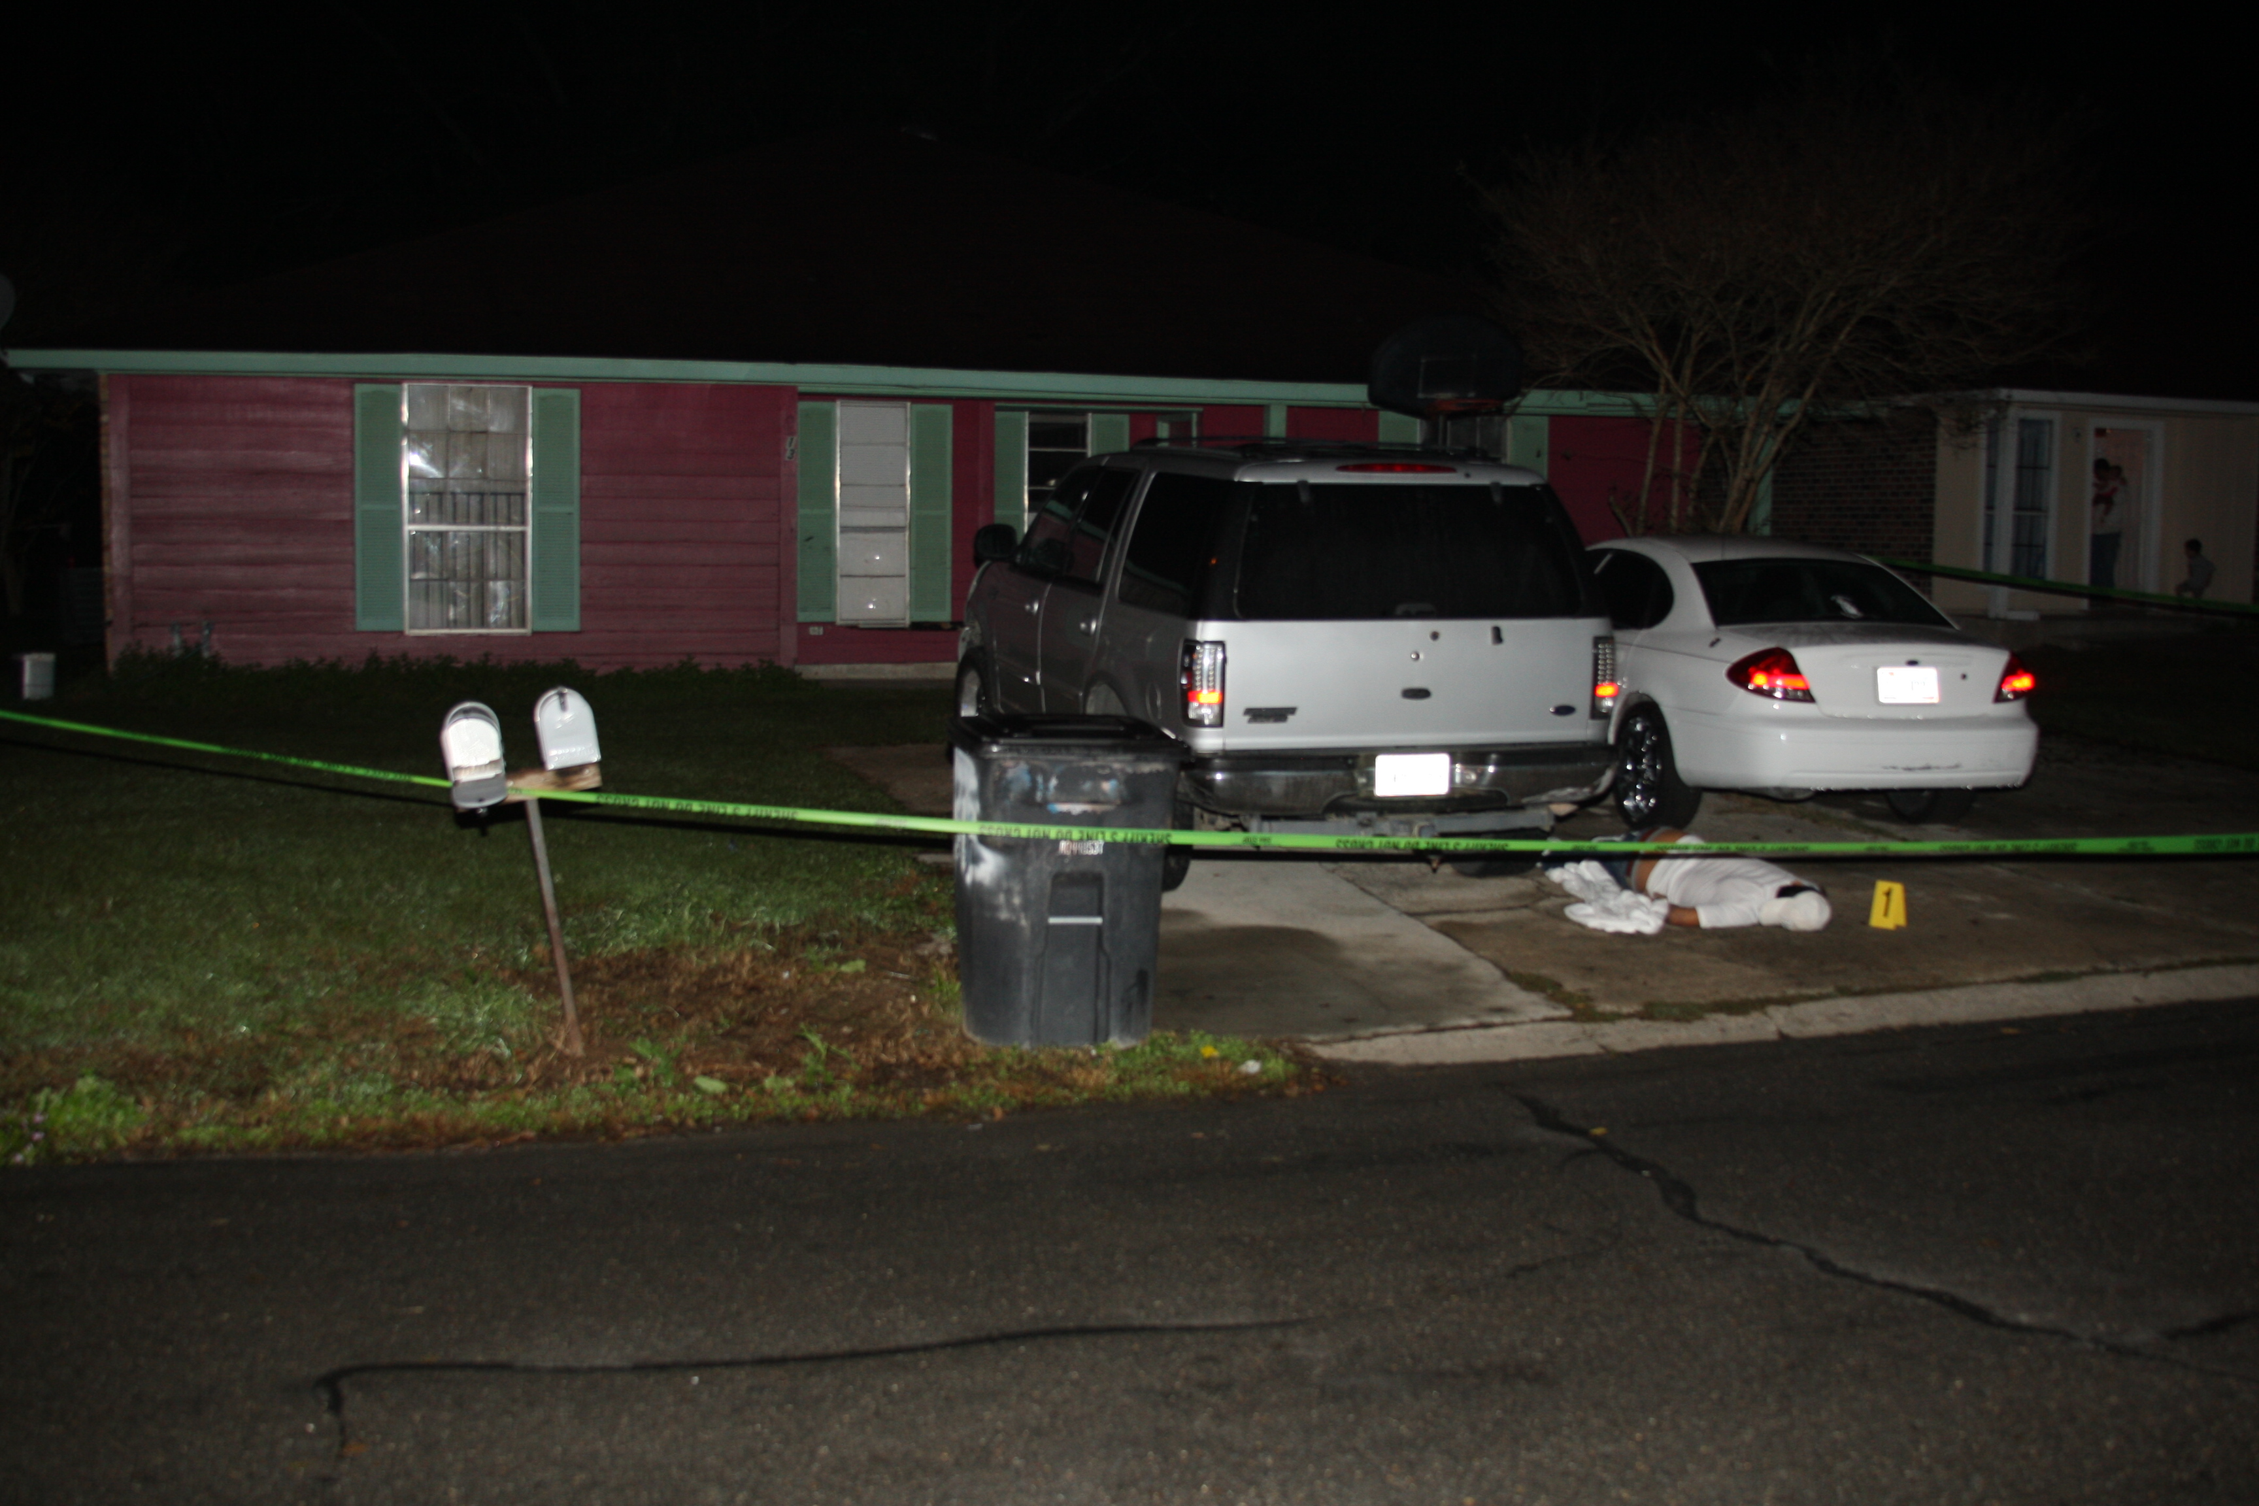
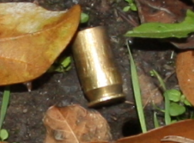
Resolving limited DNA
• DNA from a .45 cartridge case
• Insufficient data for manual interpretation
• Sent for TrueAllele computer analysis

Slide 57
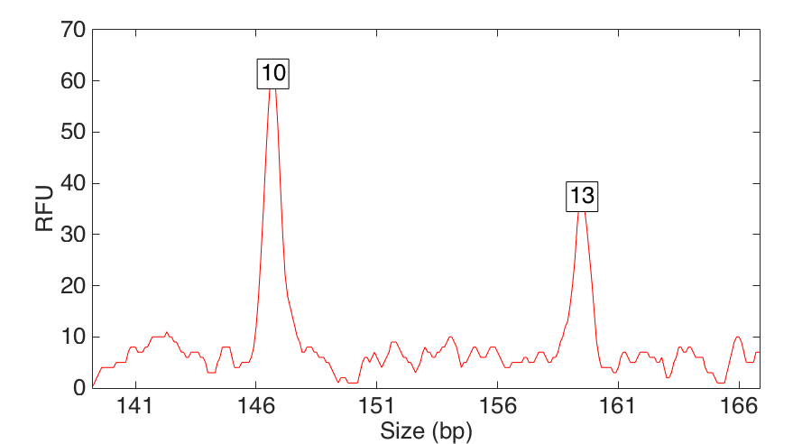
Small DNA amount
Quantitative peak heights at locus D5S818

Slide 58
Match statistic error rate

Slide 59
Life sentence
Man sentenced to life without parole for 2011 murder
KPLC 7 News, Lake Charles, Louisiana
Corderrius Mitchell, 24, of Baton Rouge, was found guilty of principal to first-degree murder, aggravated flight from an officer and reckless operation charges in the shooting death of 26-year-old Fausto Ortiz-Herrera, Baton Rouge.
Witnesses said three men may have tried to rob Herrera and shot him when he tried to run away.

Slide 60
Louisiana outcomes
Crime | Evidence | Defendant | Outcome | Sentence
murder | pants pockets | Brian Williams | guilty plea
murder | fingernail | Emilio Calderon | guilty | life
murder | .45 shell | Corderrius Mitchell | guilty | life
rape | tampon string | Booker Diggins | guilty | life
murder | pistol | Chattley Chesterfield | guilty | life
murder | fence post | Hilton Wilson | guilty | life
murder | fence post | Reokenski Thomas | guilty | life
molestation | bra cup | Henry Lewis, Jr | guilty | 50 years
murder | handcuffs | Robert Barthelemy | guilty | life
murder | water bottle | Christopher Hutsell | guilty | life

Slide 61
TrueAllele in Louisiana
30 cases, 5 trials, 1 Daubert
Parish:
Acadia
Ascension
Baton Rouge
Evangeline
Jefferson
Iberia
Orleans
Sabine
St. James
Crime laboratory:
Acadiana
Baton Rouge
Hardware
Software
Training
Validation
Protocols

Slide 62
Widespread acceptance
Admitted after Frye or Daubert challenge in:
California, Indiana, Louisiana, Massachusetts, New York, Ohio, Pennsylvania, South Carolina, Virginia, Australia & United Kingdom
Crime labs use TrueAllele® system in
California, Maryland, South Carolina & Virginia
Used in five hundred criminal cases in most of the United States, for both prosecution and defense

Slide 63
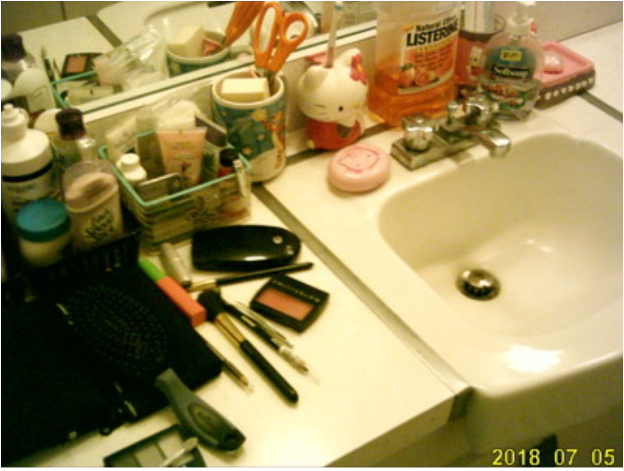
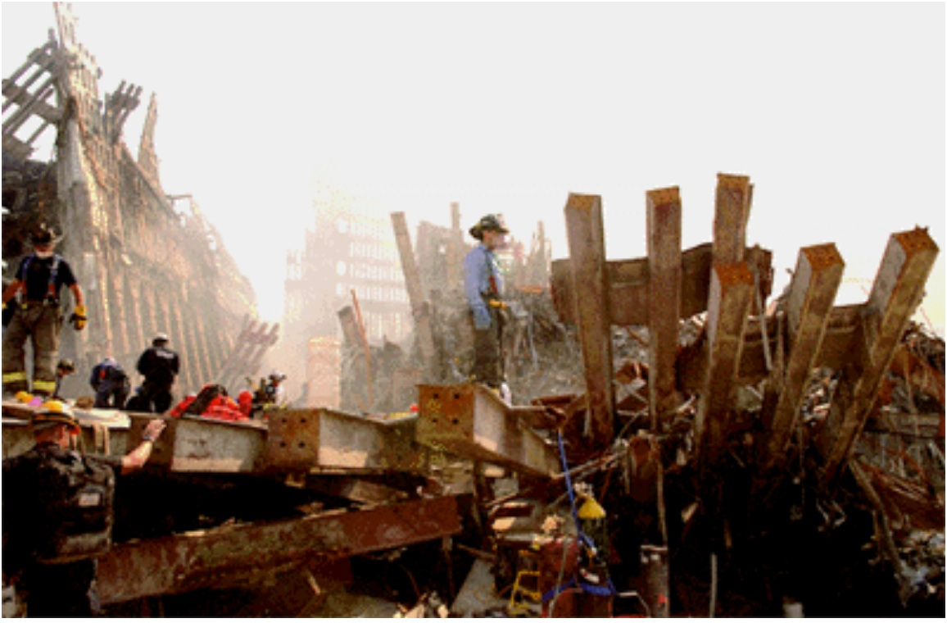
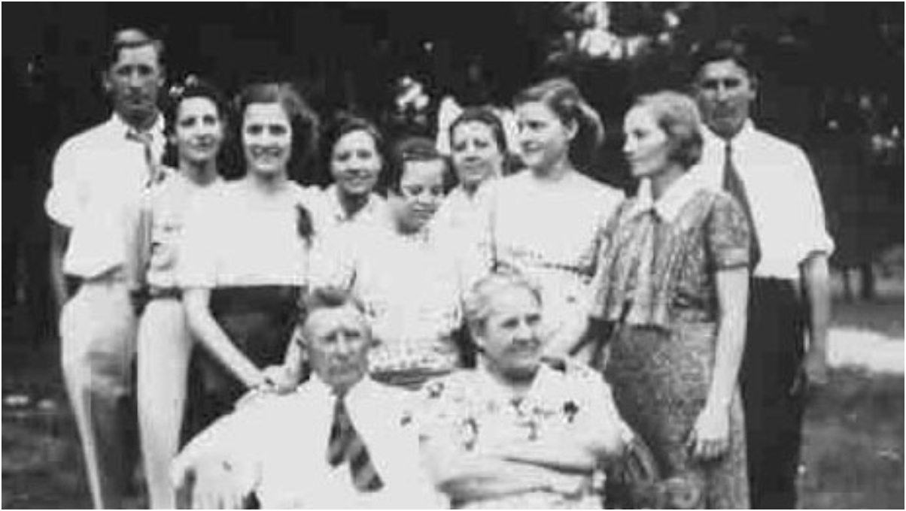
WTC DNA data reanalysis
18,000 victim remains
2,700 missing people
match

Slide 64
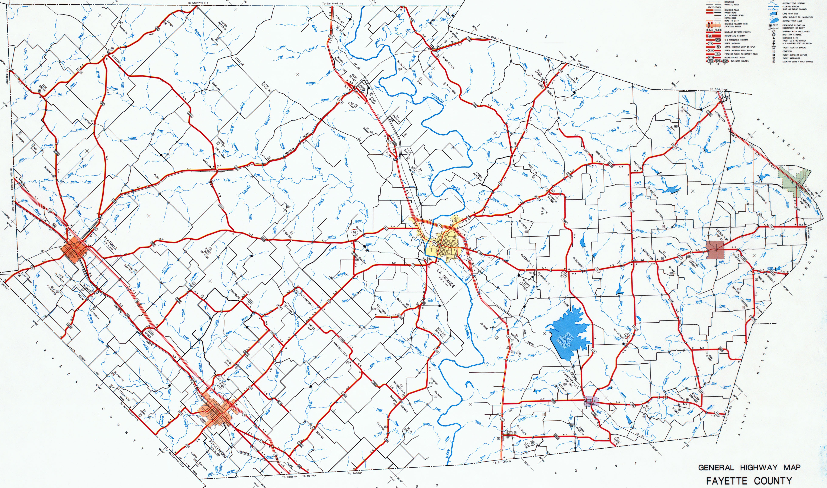
TrueAllele database
Suspects: S1, S2, S3, S4, S5
Market
• hat 1
• hat 2
• overalls
• shirt
Food mart
• gun
• hat
Jewelry
• counter
• safe
Hardware
• safe
• phone
Convenience
• keys
• tape

Slide 65
Inconclusive mixture
Crime laboratory DNA report
Crime lab user fee: $5,000
Conclusions:
Item 1 – Swab of textured areas from a handgun
The data indicates that DNA from four (4) or more contributors was obtained from the swab of the handgun. Due to the complexity of the data, no conclusions can be made regarding persons A and B as possible contributors to this mixture.

Slide 66
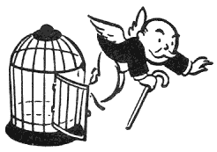
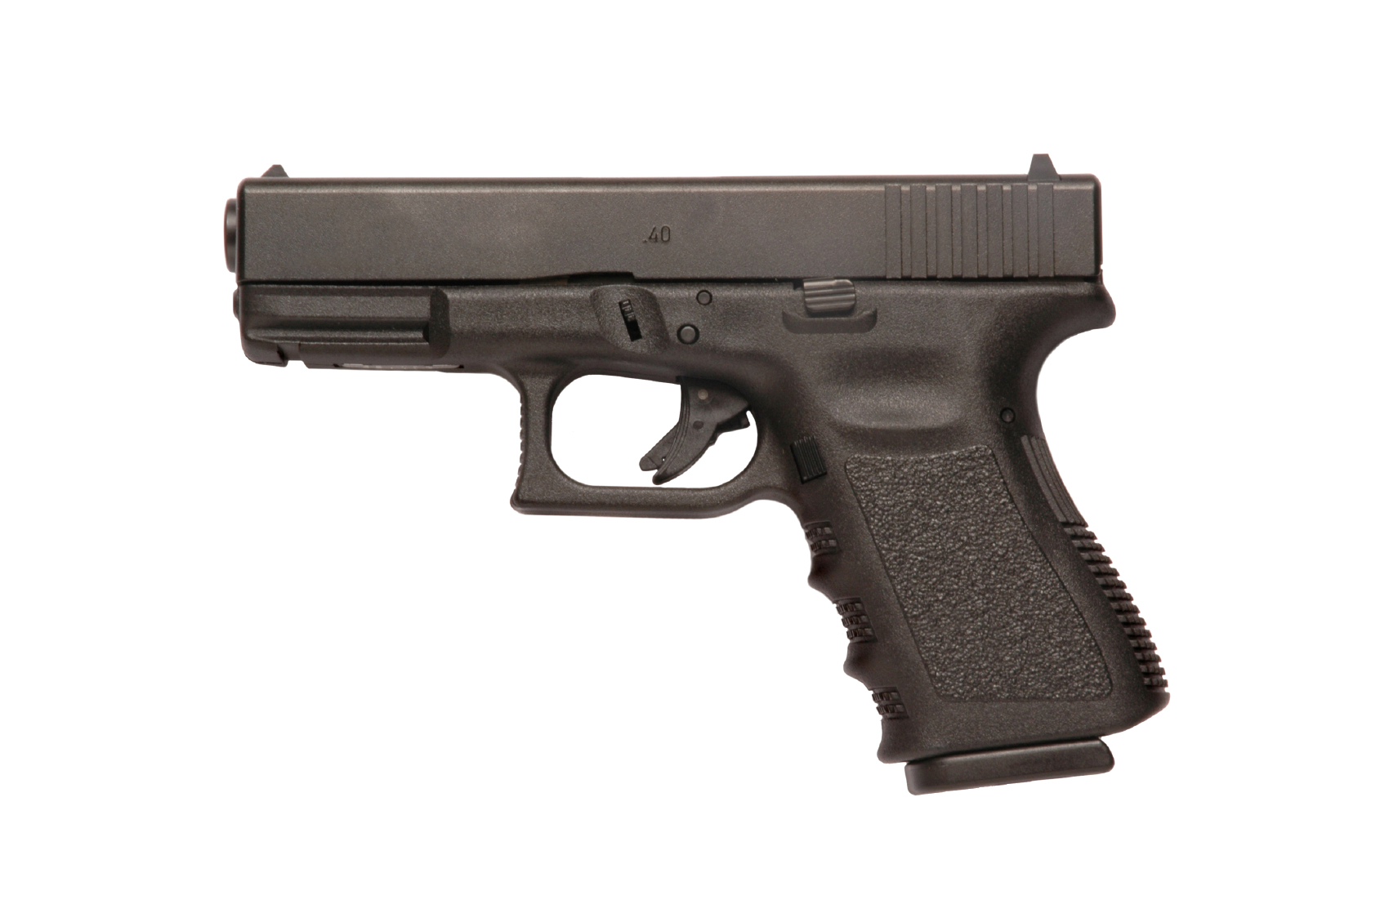

Computer reanalysis
Cybergenetics TrueAllele® report
Match statistics provide information
Person A
excluded
Contributor
Unmix the
mixture
1
2
400,000
3
Person B
included
4

Slide 67
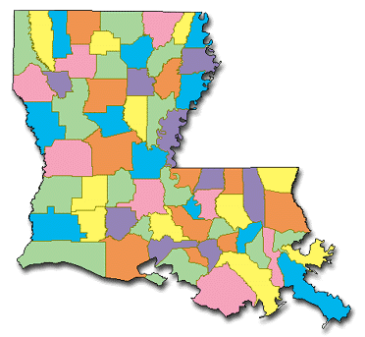
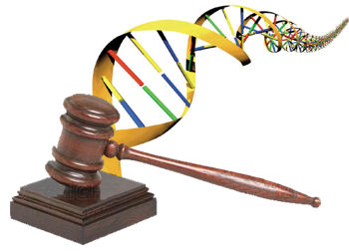
Leading the way
The probative power of DNA evidence
• Accurate
• Objective
• Understandable

Slide 68


More DNA mixture information
http://www.cybgen.com/information
• Courses
• Newsletters
• Newsroom
• Presentations
• Publications
• Webinars
http://www.youtube.com/user/TrueAllele
TrueAllele YouTube channel
perlin@cybgen.com

