Slide 1

Justice Denied:
Mr. Hopkins Invisible Semen
American Investigative Society of Cold Cases
AISOCC Annual Conference
June, 2016
St. Louis, MO
Mark W Perlin, PhD, MD, PhD
Cybergenetics, Pittsburgh, PA
Cybergenetics © 2003-2016

Slide 2
DNA evidence in context
Probative
• Suspect not at scene
• Can’t explain the DNA
• Presence suggests guilt
Non-probative
• Suspect was there before
• Easily explains the DNA
• Doesn’t indicate guilt

Slide 3
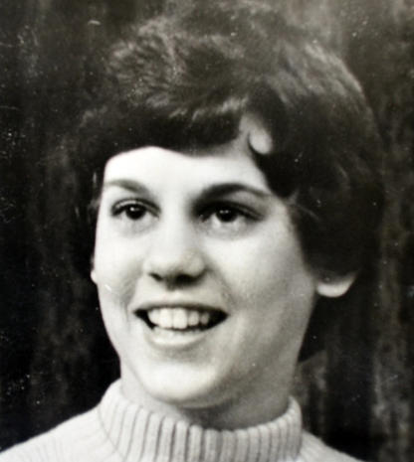
1979 murder of Janet Walsh
• 23 year old woman
• Monaca, Pennsylvania
• strangled with bandana
• face down in her bed
• nightshirt top only
• bathrobe tie on hands
• divorcing husband
• multiple partners
Janet Walsh

Slide 4
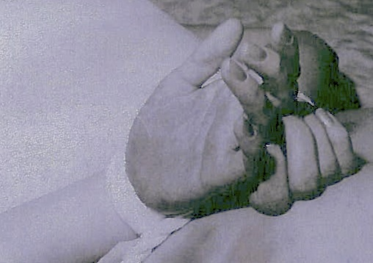
The crime scene
blue nightshirt
bathrobe tie
Viewed as homicide, not sex crime

Slide 5
Police suspects
• estranged husband
• boss (sleeping with him)
• co-worker “prime suspect”
• friend (night murdered)

Slide 6
2010 DNA analysis
• cold case funding
• serologist found 100 DNA spots
• thought death was a sex crime
• semen is easy to find, so …
• sperm hunt found 15 regions
• DNA evidence of previous lovers
DNA found on:
• blue nightshirt
• bathrobe tie

Slide 7
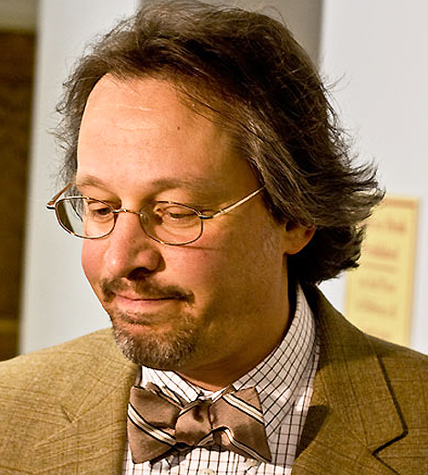
Prosecutor theory
• sexual misadventure
• man straddling woman
• bandana asphyxiation
• ejaculates, and hits
nightshirt & robe tie
• explains coincidental
location on two items
Frank Martocci
How and when the DNA got there
(unusual expert testimony)

Slide 8
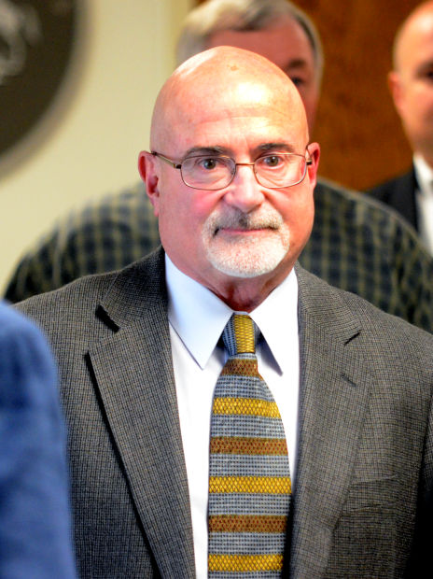
Pennsylvania v Hopkins
• local councilman
• former lover of Walsh
• successful businessman
• known philanderer
• no motive, solid alibi
• four other suspects
• cast-off sample obtained
• his DNA matches the
nightshirt & robe tie
(flat sheet, 2 spots)
Gregory Scott Hopkins

Slide 9
DNA evidence
sexual act
death
clothing
sheets

Slide 10

Defense theory
• Hopkins wasn’t there
when Walsh died
• old DNA from before
• no coincidences
• DNA is expected
• no semen on hands
• with prior sexual relations,
DNA is not probative
Hon. James Ross
DNA doesn’t say how or when it was left
(typical expert testimony)

Slide 11
Two competing hypotheses
Prosecution:
Mr. Hopkins committed the crime
Semen deposited at the time of death
Defense:
Mr. Hopkins did not commit the crime
Semen left before the time of death

Slide 12
Fact 1: Proximity of semen stains
Hopkins DNA on:
• bathrobe tie
• blue nightshirt
• flat sheet (2 spots)

Slide 13
Note on the flat sheets
• direct cloth contact, either way
• transfer DNA from other items
• adds no new information
• consistent with explanations of both
prosecution and defense
• not probative or helpful here

Slide 14
Prosecution explains proximity
Prosecution hypothesis:
Mr. Hopkins committed the crime
Semen deposited at the time of death
Explains the proximity of semen stains
by direct ejaculation during strangling
Says there is no other possibility

Slide 15

DNA transfer
Increases with:
• moisture
• pressure
• friction
• absorbent
cotton material

Slide 16
From nightshirt to robe tie
• Walsh struggled, perspired
• back moist, shirt wet
• old semen stain on shirt
• wet shirt moistens robe tie
• pressure and friction from
tied hands behind back
• sperm moves from shirt
to bathrobe tie
• DNA detected years later

Slide 17
Defense explains proximity
Defense hypothesis:
Mr. Hopkins did not commit the crime
Semen left before the time of death
Explain the proximity of semen stains
by DNA transfer during strangling,
due to moisture, pressure & material
Sexual relationship, other possibilities

Slide 18

Fact 1: Proximity of semen stains
Both hypotheses explain the data
Explanations cancel each other out
DNA proximity is not probative

Slide 19
Fact 2: Invisible semen stains
Not seen (1979) on:
• bathrobe tie
• blue nightshirt
• flat sheet (2 spots)
Checked (1979) by:
• police investigator (hours)
• pathologist (days)
• coroner (days)
• criminalist at lab (weeks)

Slide 20
Prosecution explains invisibility
Prosecution hypothesis:
Mr. Hopkins committed the crime
Semen deposited at the time of death
All four semen stains were invisible,
so the four examiners didn’t see them;
or, Mr. Hopkins shoots invisible semen
low chance for
blue nightshirt
invisible stain
low chance for
bathrobe tie
invisible stain
low chance for
top sheet #1
invisible stain
low chance for
top sheet #2
invisible stain
x
x
x

Slide 21
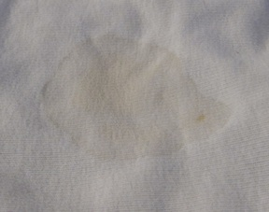
Fresh semen
• dries in 2-6 hours
• crusted stain
• noticeable border
• visible in ordinary light
• stiff, starchy consistency
• forensic test in 1979
visual and tactile exam

Slide 22

Faded semen
• 2 weeks to 2 months
• creasing and rubbing
• crust flakes off
• wetting disperses
• washing cleanses
• rugged sperm cells stay
often invisible to eye

Slide 23
Defense explains invisibility
Defense hypothesis:
Mr. Hopkins did not commit the crime
Semen left before the time of death
Not fresh semen, so no fresh stains
Faded over weeks or months
by rubbing, wetting or washing

Slide 24

Fact 2: Invisible semen stains
Defense hypothesis better explains the evidence than prosecution hypothesis.
DNA invisibility supports exculpatory.

Slide 25
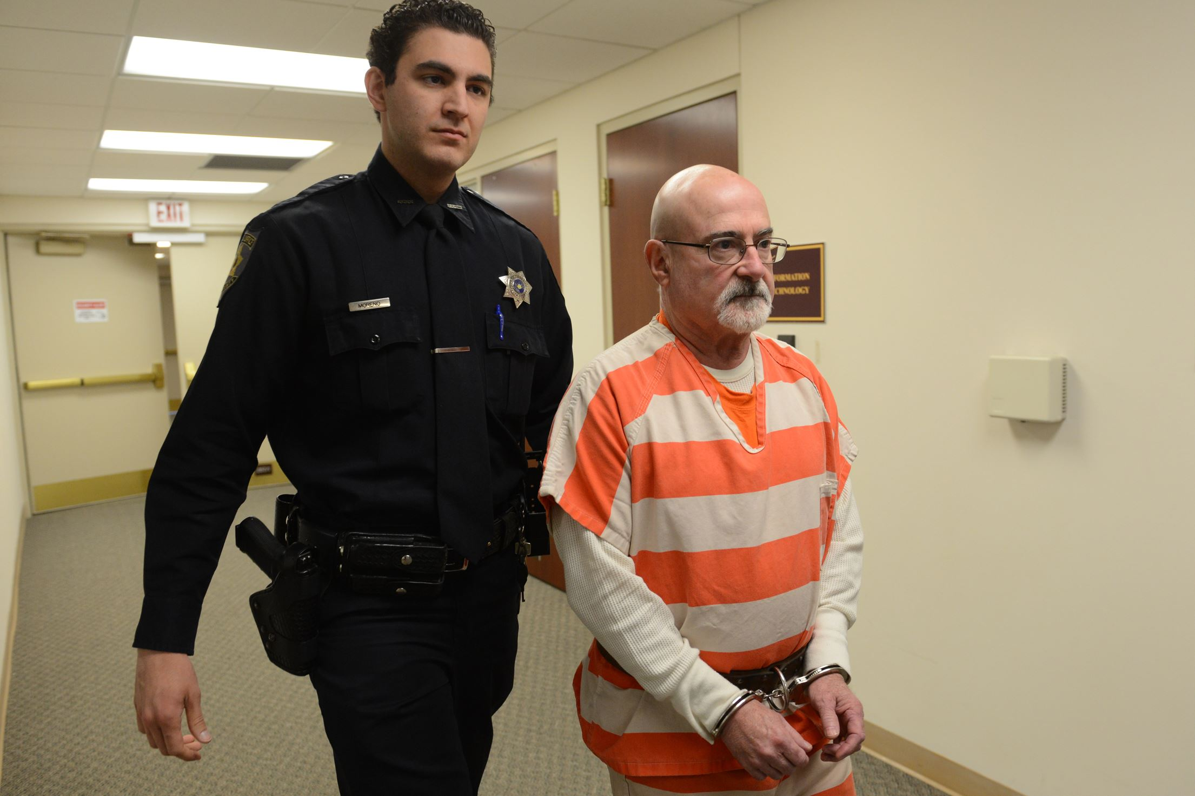
Hopkins convicted by DNA
November 22, 2013

Slide 26


Slide 28
Jurors swayed by DNA
Even though:
• Experts can’t say how or when DNA was left
• Yet that was the crux of prosecution’s case
• No DNA expert for prosecution on “coincidence”
• Mr. Hopkins’ invisible semen was exculpatory
• Sentenced to 8 years in prison on bogus DNA

Slide 29
Sources of human bias
• Serologist: ascertainment bias
• Investigator: confirmation bias
• Prosecutor: competition bias
• Jurors: social disapproval bias

Slide 30

Forensic policy questions
R. 702
• Should non-experts be allowed to testify on DNA?
• Can they opine on how and when DNA was left?
• Trial judge said “no”, but overturned on appeal.
• Is DNA too prejudicial when results non-probative?
• Can jurors understand when DNA isn’t relevant?
• Mr. Hopkins’ invisible semen was exculpatory.
• How can defendants be convicted on bogus DNA?
R. 403

Slide 31


TrueAllele® interpretation
http://www.cybgen.com/information
• Courses
• Newsletters
• Newsroom
• Presentations
• Publications
• Webinars
http://www.youtube.com/user/TrueAllele
TrueAllele YouTube channel
perlin@cybgen.com

