Slide 1

Data-driven DNA forensic science:
TrueAllele® computation
Computational Health Informatics
University of Cape Town, South Africa
August 2024
Mark W Perlin, PhD, MD, PhD
Pittsburgh, PA USA
Cybergenetics © 2003-2024

Slide 2
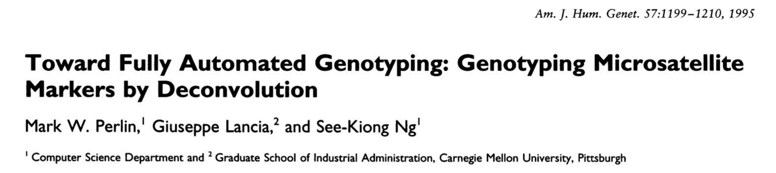
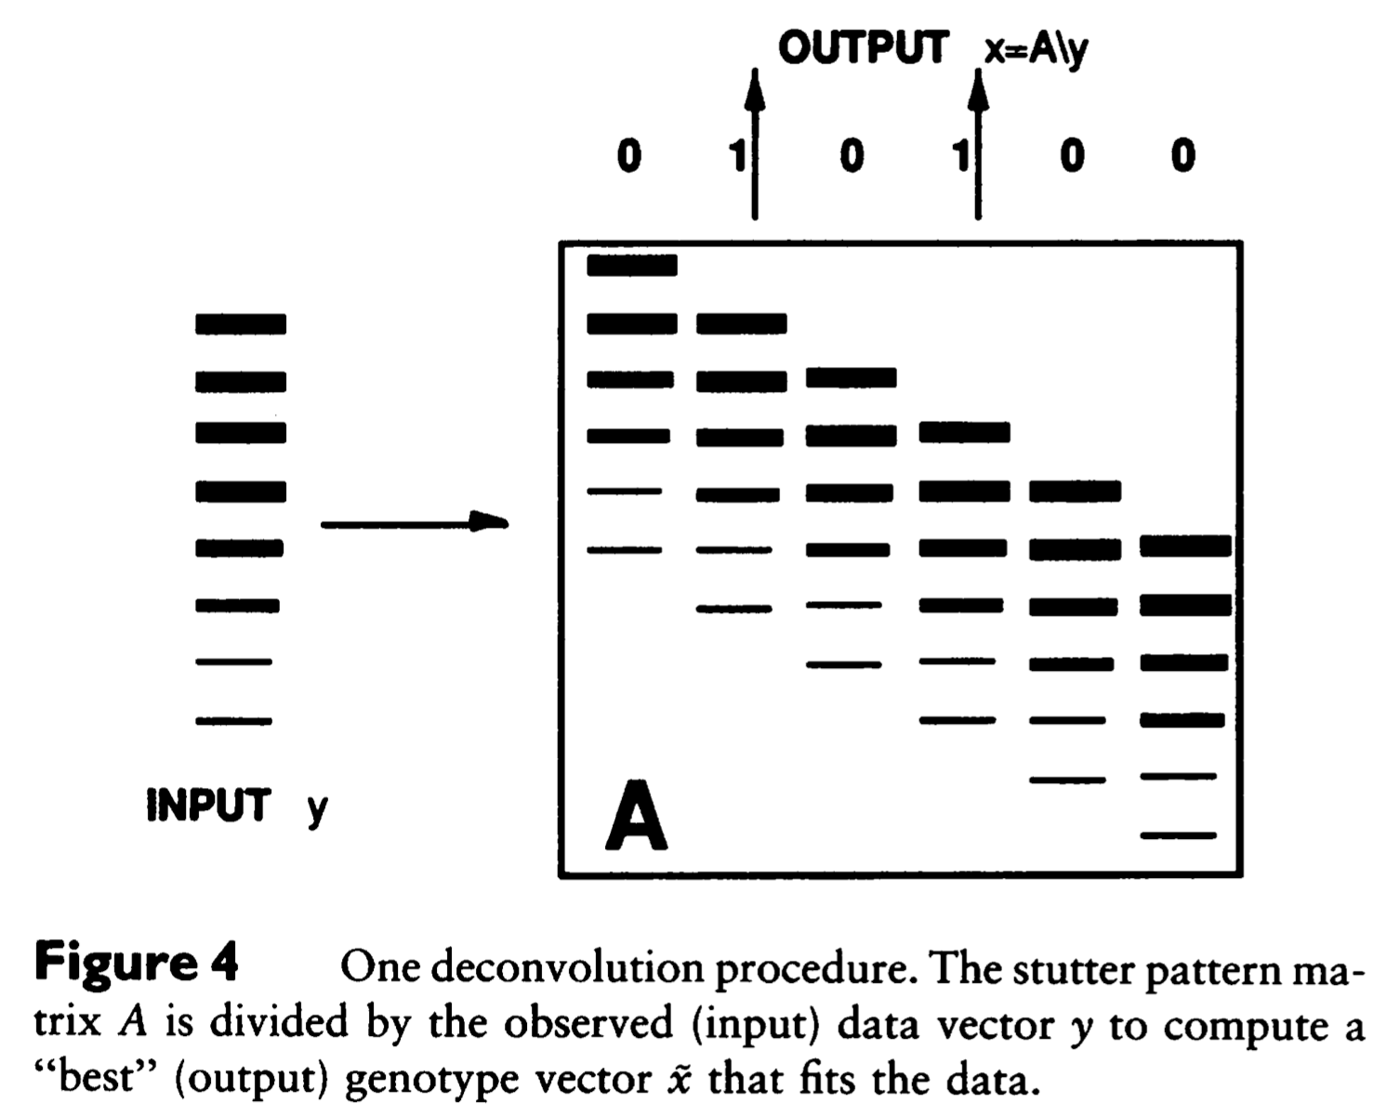
STR stutter artifact

Slide 3

DNA database backlog
Year 2000. Britain. The FSS.
The first national DNA database.
Human review of DNA data fails.
Backlog of 350,000 swabs.
Enter computer automation.
Cybergenetics TrueAllele clears the backlog.
Every year, does another 350,000 samples.
Accurate: eliminates human error (1 in 2,000).
Fast: “swab to DB” turnaround time in 5 days.
Labor-saving: from 100 people down to 6.
Inexpensive: 2-3 computers, not 100 people.

Slide 4
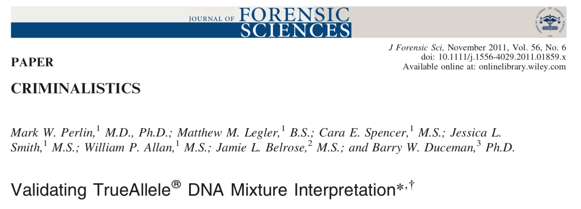
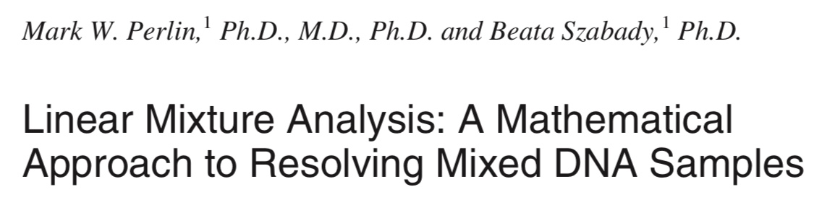
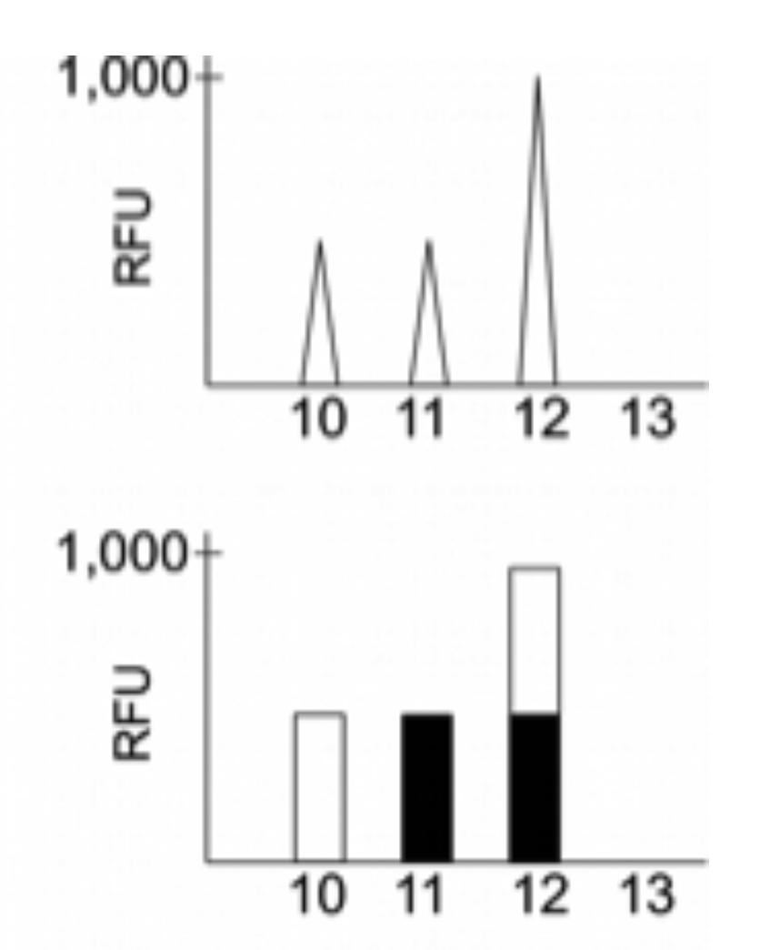
Solving DNA mixtures
2001
DNA peak height data
Sum of genotypes

Slide 5
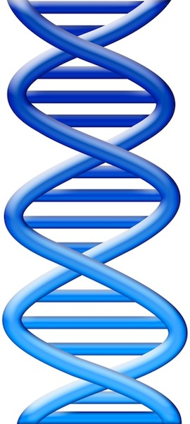

DNA mixture data
Evidence item
Evidence data
First contributor
genotype is known:
12
Lab
11
10
10,12
DNA from
two people
What is the second unknown
contributor genotype?

Slide 6
Bayesian modeling & computation
Evidence data
2nd evidence genotype
12
11,12 @ 50%
11
Infer
10
11,11 @ 30%
10,11 @ 20%
Posterior
∝
Likelihood
x Prior
Pr{genotype | data, …}
∝
Pr{data | genotype, …}
x Pr{genotype}

Slide 7
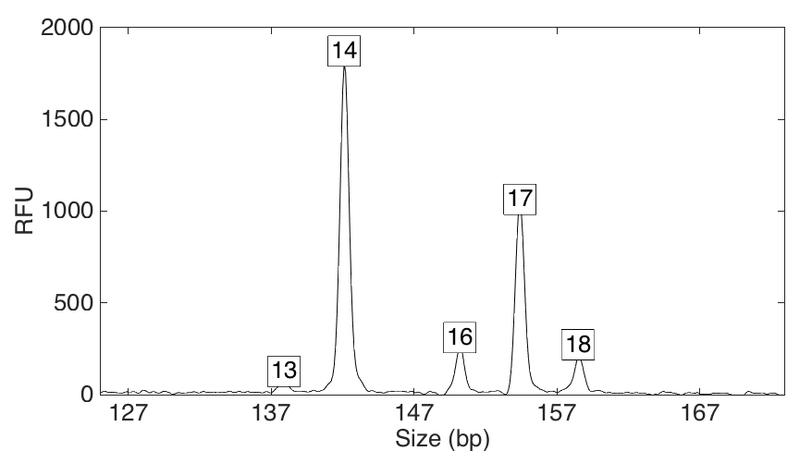
Computers can use all the data
Quantitative peak heights at locus vWA
peak size
peak
height

Slide 8
People may use less of the data
Over threshold, peaks are labeled as allele events
All-or-none allele peaks,
each given equal status
Threshold
Under threshold, alleles vanish

Slide 9
How the computer thinks
Consider every possible genotype solution
Explain the
peak pattern
Better
explanation
has a higher
likelihood

Slide 10
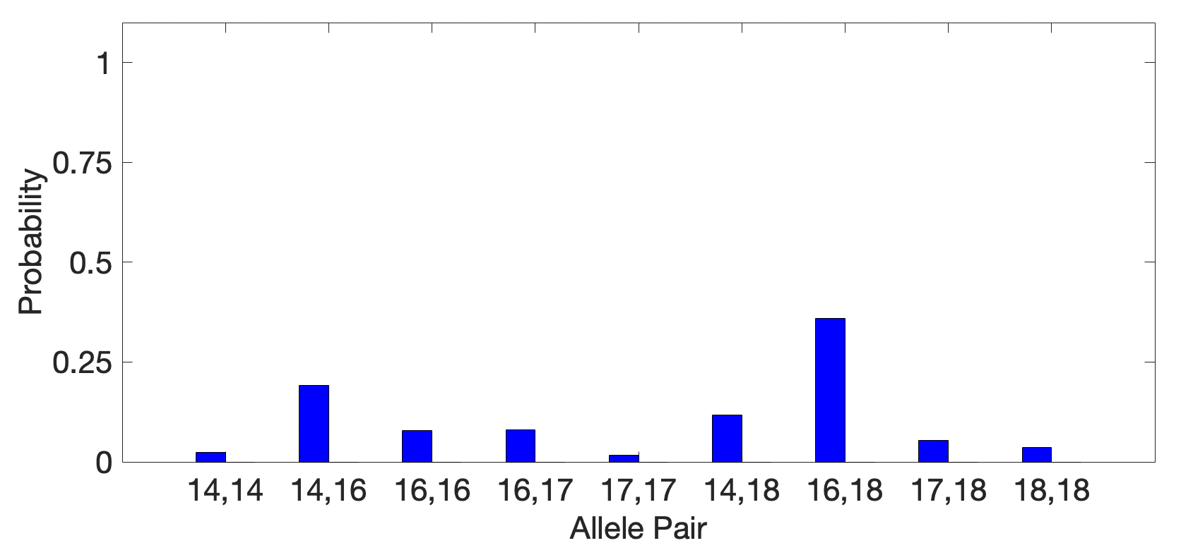
Unmixed contributor genotype
Objective genotype determined solely from the DNA data.
Evidence solution doesn’t know comparison reference.
36%
19%
8%
8%
12%
2%
2%
5%
4%

Slide 11
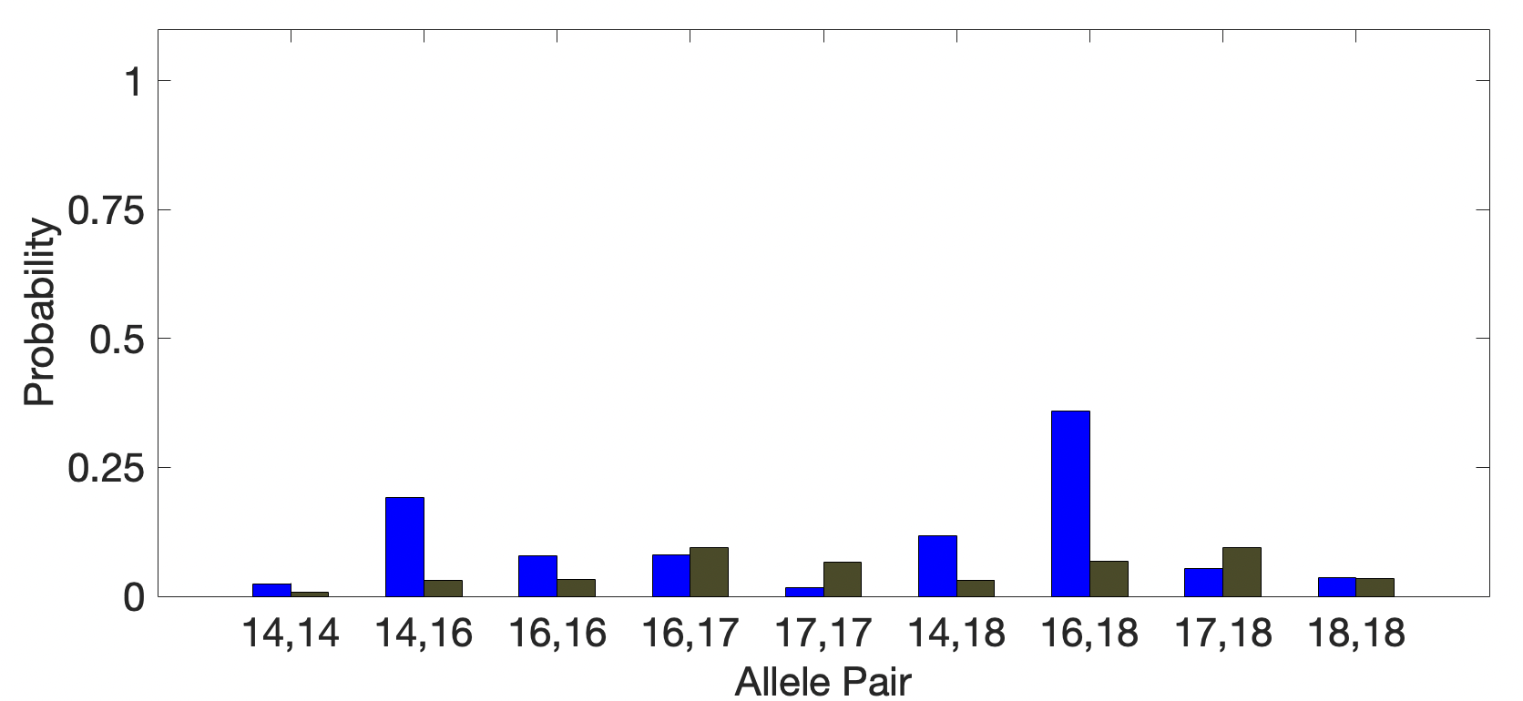
DNA match information
How much more does suspect match the evidence
than a random person?
Prob(evidence match)
Prob(coincidental match)
4x
36%
8%

Slide 12
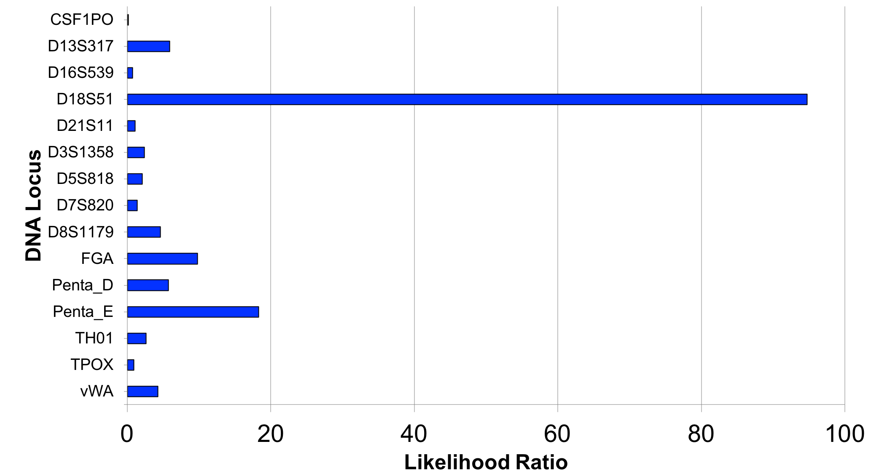
Match information at 15 loci

Slide 13
Is the suspect in the evidence?
A match between the item
and the defendant is:
971 million times more probable than
a coincidental match to an unrelated African-American person
20.6 million times more probable than
a coincidental match to an unrelated Caucasian person
47.2 million times more probable than
a coincidental match to an unrelated Hispanic person

Slide 14

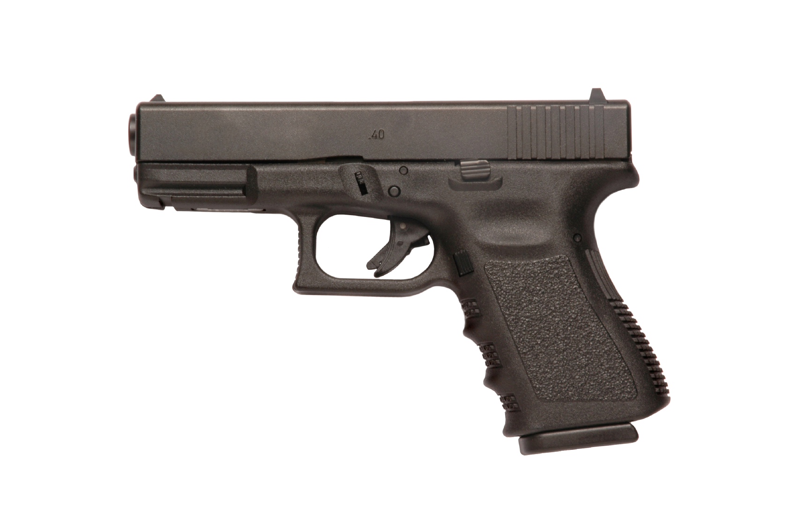

Informative genotyping
(Inconclusive uninterpretable DNA mixture)
Cybergenetics TrueAllele analysis
Match statistics provide information
Person A
excluded
Contributor
Unmix the
mixture
1
2
400,000
3
Person B
included
4

Slide 15
TrueAllele® computer solution
• Accurate. 43 validation studies, 8 published
• Objective. Workflow removes human bias
• Accepted. Reported in 46 states, used by 10 labs
• Transparent. Give math, software (4GB DVD)
• Neutral. Can statistically include or exclude

Slide 16
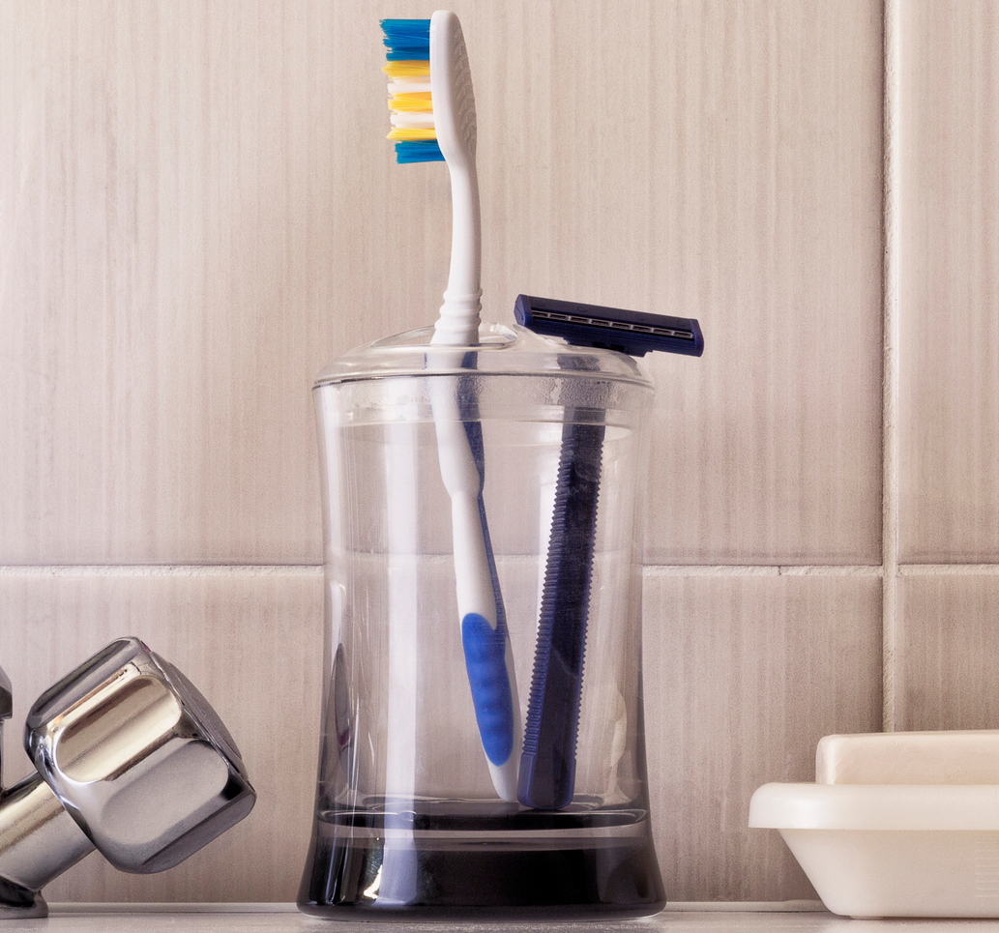
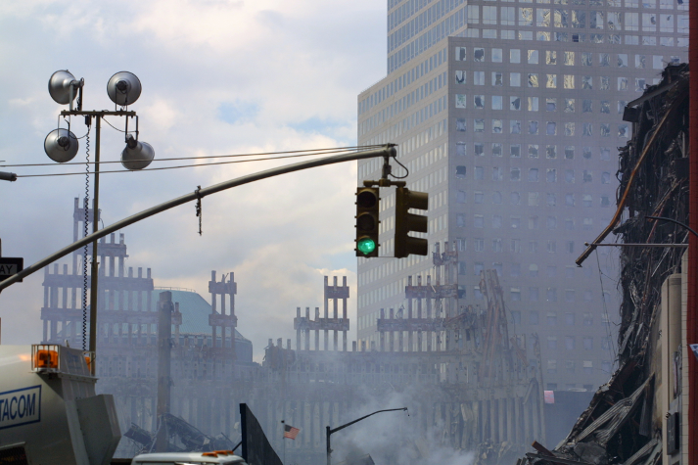

World Trade Center
World’s first modern DNA database case – TrueAllele
18,000 victim remains
2,700 missing people
match
September 11, 2001 – New York City

Slide 17
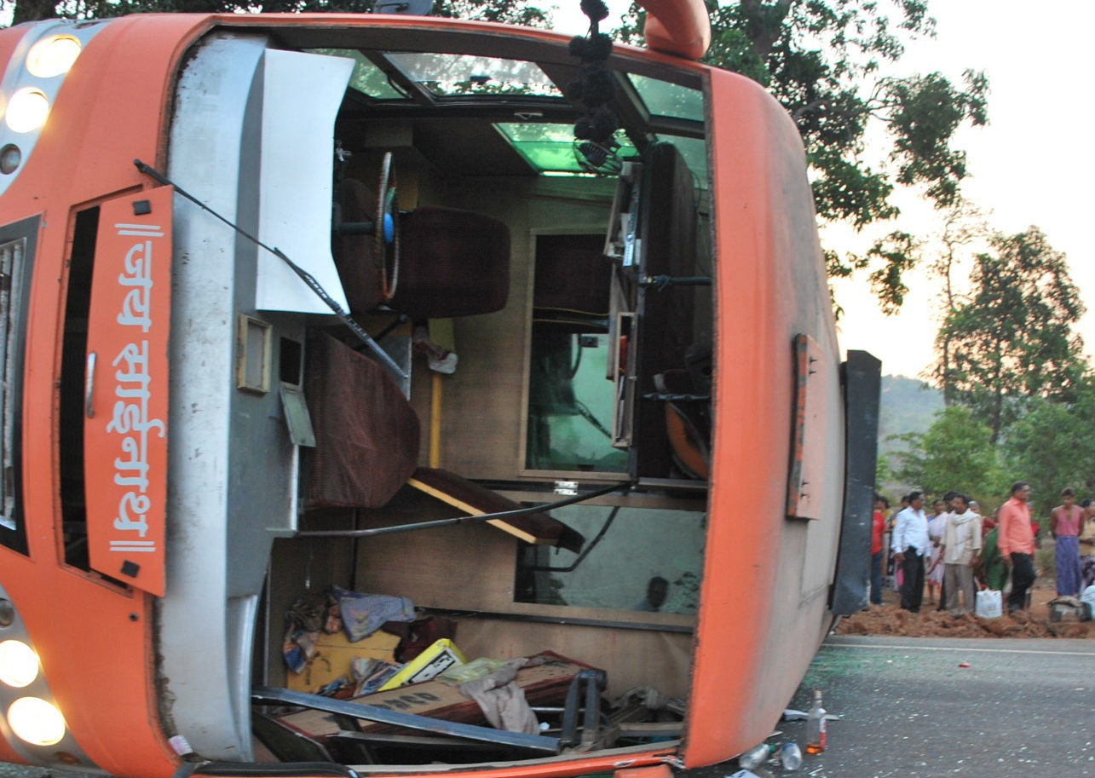
Komatipoort Bus Crash
2008 bus crash in Komatipoort, South Africa
Police recover burned victim remains
Relatives submit DNA to help identify remains
SAPS lab unable to identify victim remains

Slide 18
Genotype Matching
Family
AP2441C
father
mother
Victim Remains
AO0563E
3.36
missing

Slide 19
TrueAllele Matches
Victim Remains
AO0553E AO0554E AO0555E AO0556E AO0557E AO0558E AO0559E AO0560E AO0561E AO0562E AO0563E AO0564E AO0565E AO0566E AO0567E
Sample | Relation
AP2438C AP2439C AP2440C AP2441C AP2442C AP2443C AP2444C AP2445C AP2446C AP2447C AP2448C AP2449C AP2450C AP2451C AP2452C AP2455C | Grandfather Daughter Son Mother Son Sister Father Son Unknown Brother Brother Sister Mother Son Father Son

Slide 20
Student Exercise
15 victim genotypes x 16 kinship genotypes
= 240 genotype match comparisons
240 comparisons x 20 students
= 4,800 total match comparisons
before lunch: | students upload genotypes
during lunch: | TrueAllele solves all problems
after lunch: | students review identification results
TrueAllele automation: fast workflow

Slide 21
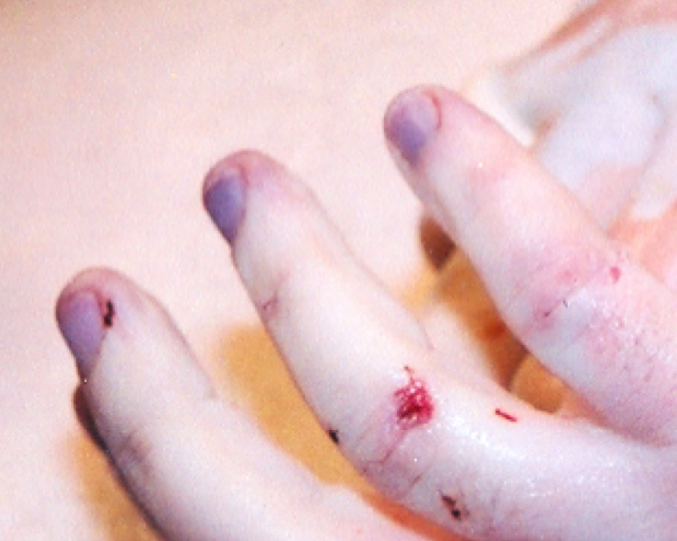
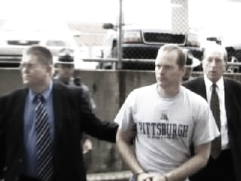
Pennsylvania v. Kevin Foley
World’s first modern DNA analysis case – TrueAllele
Apr 2006: Blairsville Dentist John Yelenic murdered
Nov 2007: Trooper Kevin Foley charged with crime
February 2008: Defense questions 13,000 DNA match score
March 2009: Jury hears 189,000,000,000 TrueAllele statistic

Slide 22
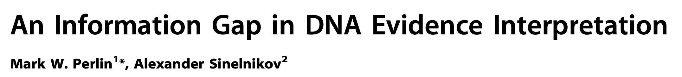

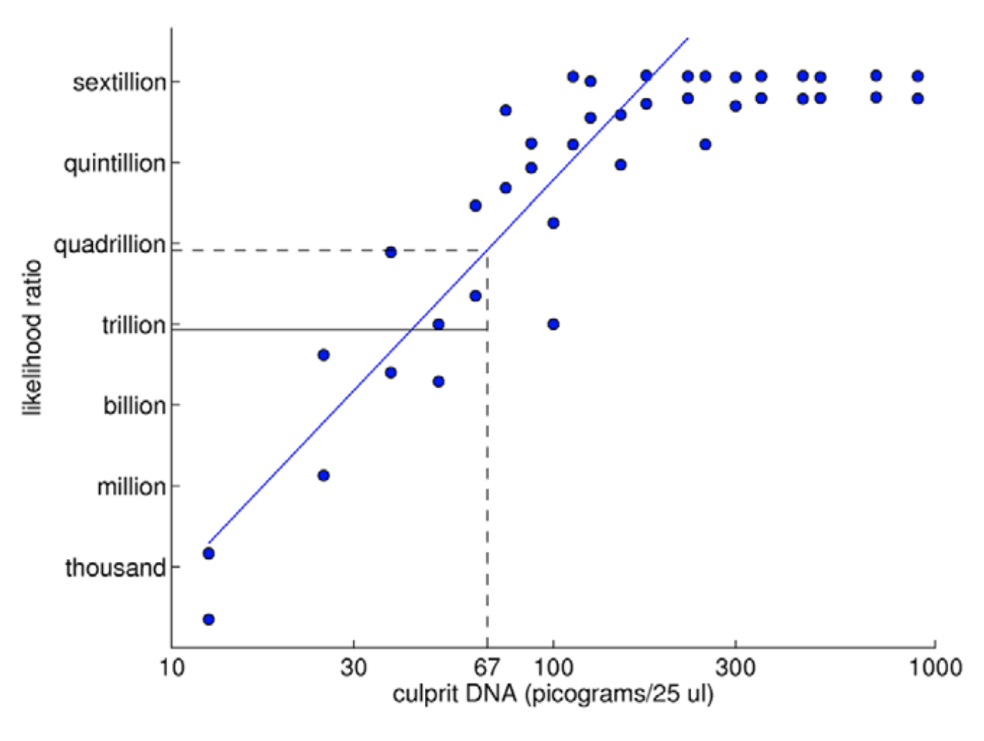
TrueAllele predictability
2009

Slide 23
Peer-reviewed validation studies
Perlin MW, Sinelnikov A. An information gap in DNA evidence interpretation. PLoS ONE. 2009;4(12):e8327.
Ballantyne J, Hanson EK, Perlin MW. DNA mixture genotyping by probabilistic computer interpretation of binomially-sampled laser captured cell populations: Combining quantitative data for greater identification information. Science & Justice. 2013;53(2):103-114.
Perlin MW, Hornyak J, Sugimoto G, Miller K. TrueAllele® genotype identification on DNA mixtures containing up to five unknown contributors. Journal of Forensic Sciences. 2015;60(4):857-868.
Greenspoon SA, Schiermeier-Wood L, Jenkins BC. Establishing the limits of TrueAllele® Casework: a validation study. Journal of Forensic Sciences. 2015;60(5):1263-1276.
Bauer DW, Butt N, Hornyak JM, Perlin MW. Validating TrueAllele® interpretation of DNA mixtures containing up to ten unknown contributors. Journal of Forensic Sciences. 2020; 65(2):380-398.
Perlin MW, Legler MM, Spencer CE, Smith JL, Allan WP, Belrose JL, Duceman BW. Validating TrueAllele® DNA mixture interpretation. Journal of Forensic Sciences. 2011;56(6):1430-1447.
Perlin MW, Belrose JL, Duceman BW. New York State TrueAllele® Casework validation study. Journal of Forensic Sciences. 2013;58(6):1458-1466.
Perlin MW, Dormer K, Hornyak J, Schiermeier-Wood L, Greenspoon S. TrueAllele® Casework on Virginia DNA mixture evidence: computer and manual interpretation in 72 reported criminal cases. PLOS ONE. 2014;(9)3:e92837.

Slide 24
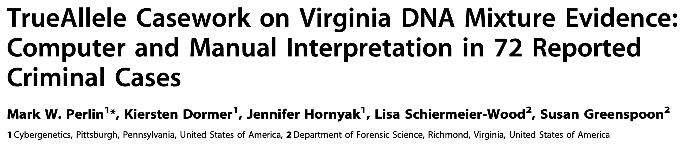
TrueAllele reliability
2014
Validation axes
• objective
• sensitive
• specific
• reproducible
• accurate

Slide 25
Sensitivity
The extent to which interpretation identifies the correct person
True DNA mixture inclusions
101 reported genotype matches
82 with DNA statistic over a million

Slide 26
TrueAllele sensitivity
log(LR) match distribution
11.05 (5.42)
113 billion
TrueAllele

Slide 27
Comparison with human review
6.83 (2.22)
6.68 million
CPI
2.15 (1.68)
140
mCPI
11.05 (5.42)
113 billion
TrueAllele

Slide 28
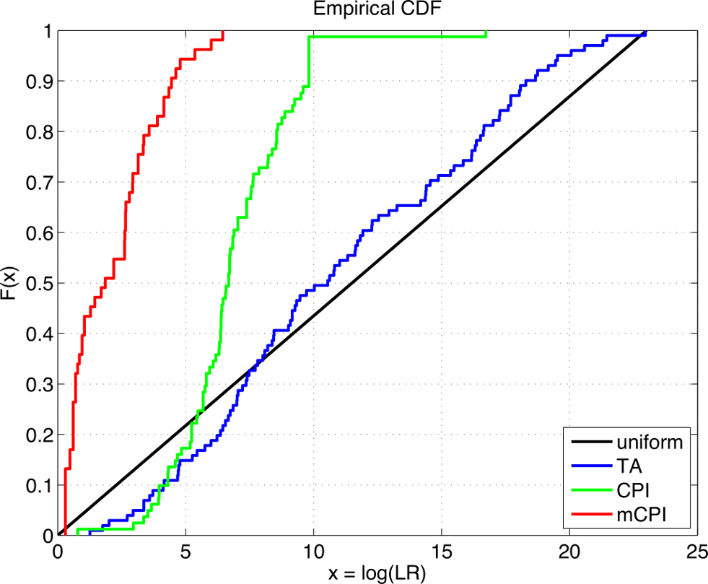
TrueAllele accuracy

Slide 29
Specificity
The extent to which interpretation does not misidentify the wrong person
True exclusions, without false inclusions
101 matching genotypes x 10,000 random references
x 3 ethnic populations,
for over 1,000,000 nonmatching comparisons

Slide 30
TrueAllele specificity
log(LR) nonmatch distribution
– 19.47

Slide 31
Higher human error rate
TrueAllele specificity (million samples)
From noncontributor distribution, for LR > 100:
Error rate = 1 in 1,000,000 (0.0001)%
CPI – analytical threshold
5 false positives in 81 comparisons
Error rate = 5 in 81 (6%)
mCPI – stochastic threshold
17 inconclusive results
1 false positive in 53 comparisons
Error rate = 1 in 53 (2%)

Slide 32
Reproducibility
The extent to which interpretation gives
the same answer to the same question
MCMC computing has sampling variation
duplicate computer runs
on 101 matching genotypes
measure log(LR) variation

Slide 33
TrueAllele reproducibility
Concordance in two independent computer runs
standard deviation
(within-group)
0.305

Slide 34
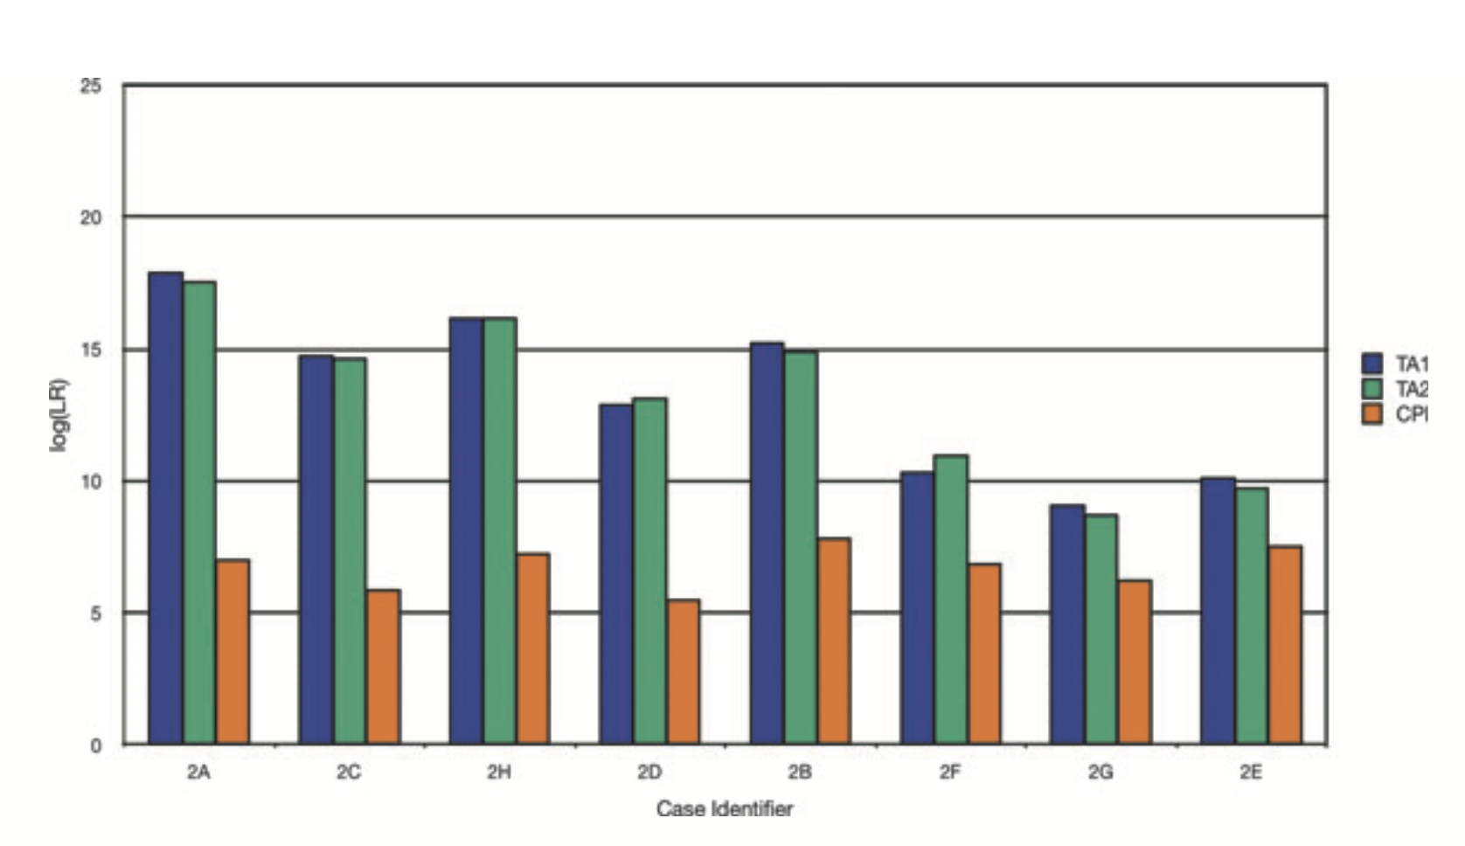

Slide 35
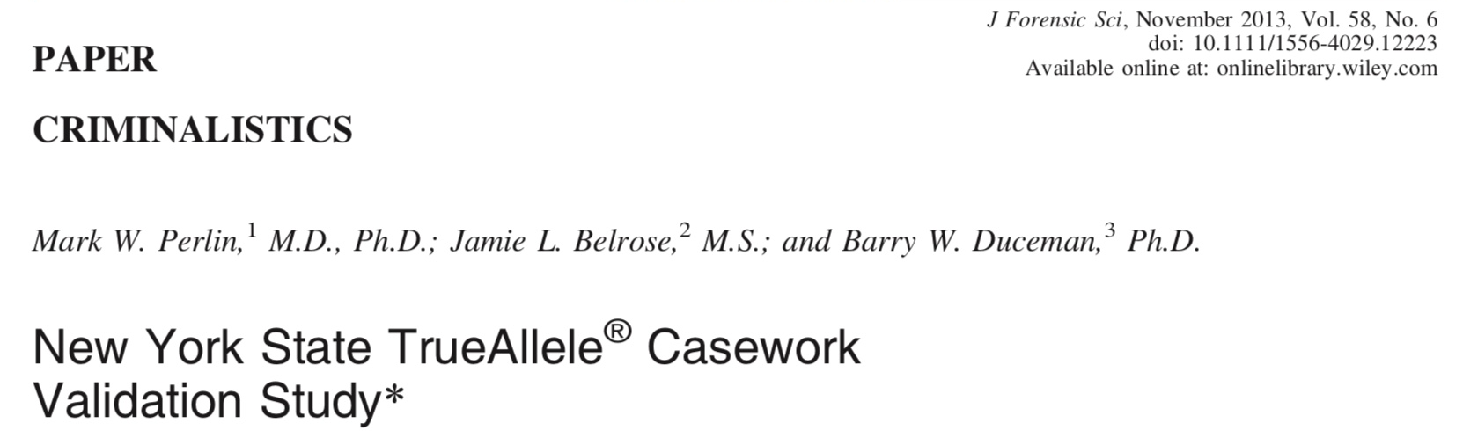
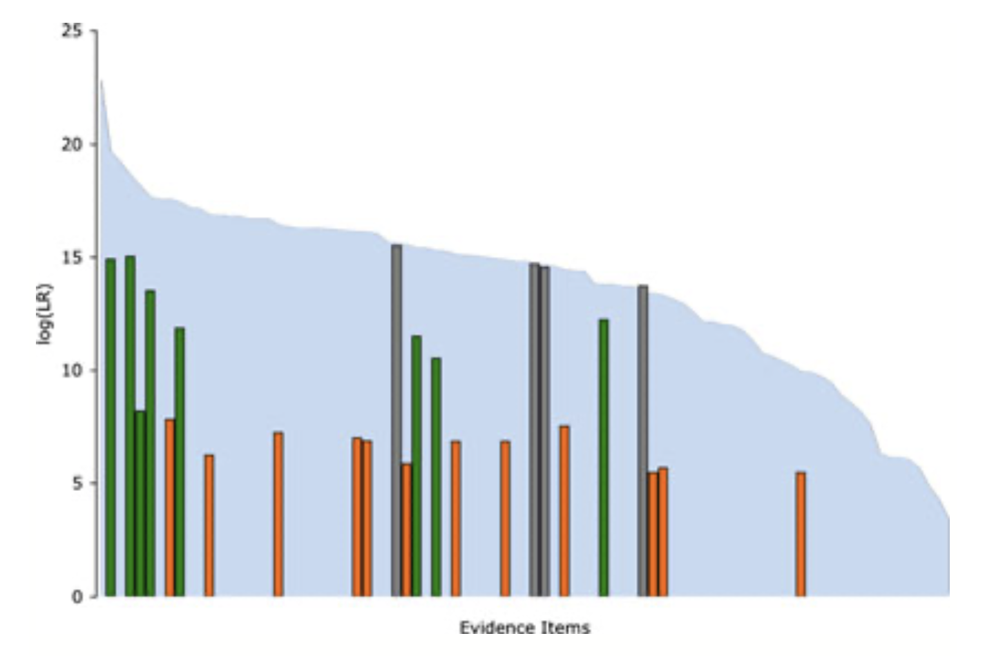

Slide 36
CPI is always a million

Slide 37
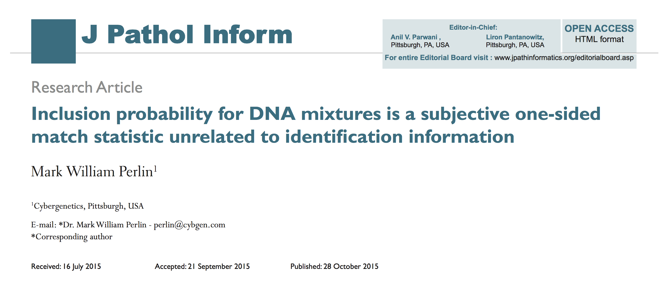
Statistics lack scientific basis
Misled courts for 15 years on countless DNA mixtures

Slide 38
Uncorrelated with information

Slide 39
Inclusion just counts tests
One-sided Match Statistic
Truncated Normal Distribution
Positive Tail Centered at Zero
Uncorrelated with Identification Information
Inclusion Distribution Has a Positive Mean
Law of Large Numbers
Why CPI is Always a Million
A subjective one-sided match statistic unrelated to identification information

Slide 40
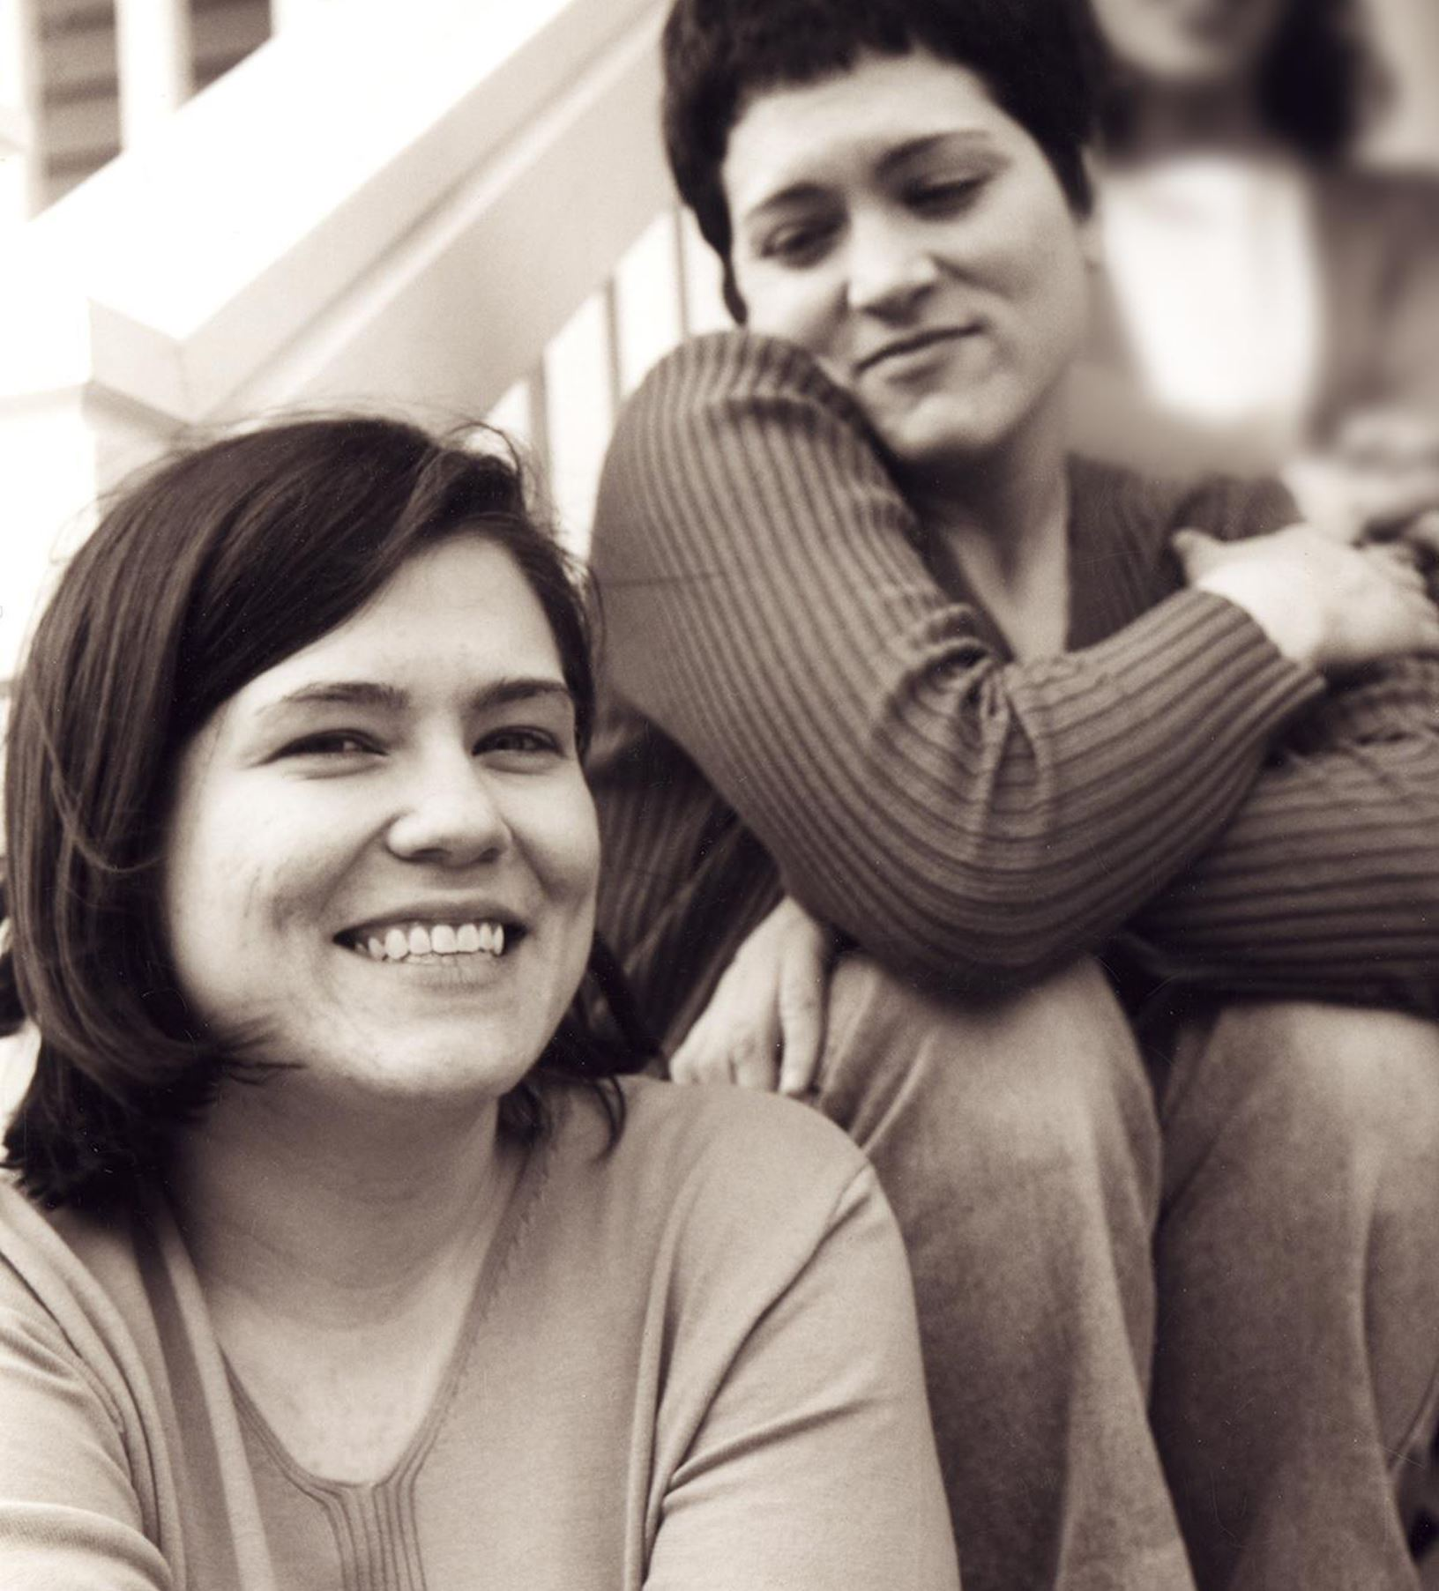
Wolfe sisters homicide
On February 6, 2014, Susan Wolfe (44)
and her younger sister Sarah (38, left)
were killed in their East Liberty home in Pittsburgh.

Slide 41
Pennsylvania v. Allen Wade
Thresholds failed to interpret most DNA mixtures
Hat No conclusions
Cup Insufficient data
Fingernails Contamination, insufficient data
Gear shift Insufficient data
Seat lever Cannot be excluded
Knit hat Insufficient data
Sock Too complex, no conclusions

Slide 42
Pennsylvania v. Allen Wade
The crime lab reported 5 DNA mixture matches
TrueAllele found 17 matches on the same data
Hat 65.3 thousand Allen Wade
Cup 20.5 thousand Susan Wolfe
Fingernails 6.06 trillion Allen Wade
Gear shift 9.37 million Sarah Wolfe
Seat lever 385 billion Sarah Wolfe
Knit hat 25.7 thousand Allen Wade
Sock 300 Sarah Wolfe

Slide 43
Allen Wade Found Guilty On All Counts In East Liberty Sisters’ Slaying
CBS News, May 23, 2016
PITTSBURGH (KDKA/AP)
• A man accused of killing two sisters who lived next door to him in East Liberty has been found guilty on all counts.
• Allen Wade was accused of shooting Sarah and Susan Wolfe after they returned from work on Feb. 6, 2014, apparently to steal a bank card.
• On Monday morning, a jury found Wade guilty of first-degree murder, robbery, burglary and theft by unlawful taking.

Slide 44
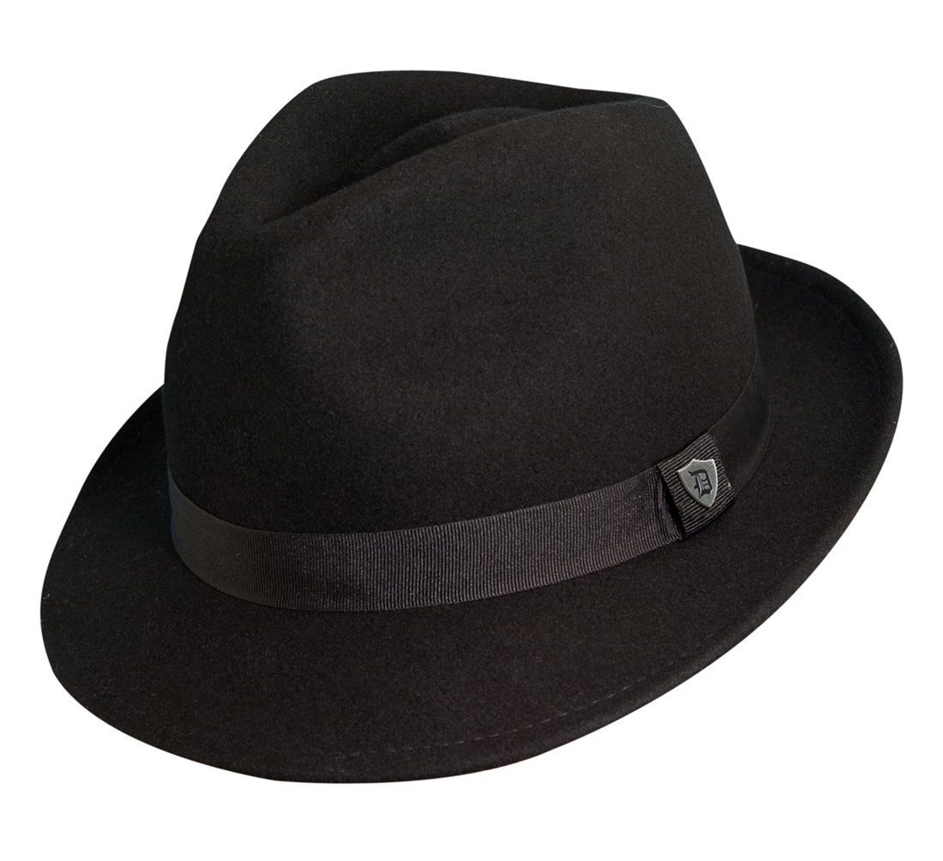
Pennsylvania v. Allen Wade
Thresholds failed to interpret DNA mixture
TrueAllele succeeded on the same data
A hat left from a burglary of the Wolfe sister’s home
six weeks before the murder matched
Allen Wade with a 65.3 thousand statistic
Preventable Crime

Slide 45
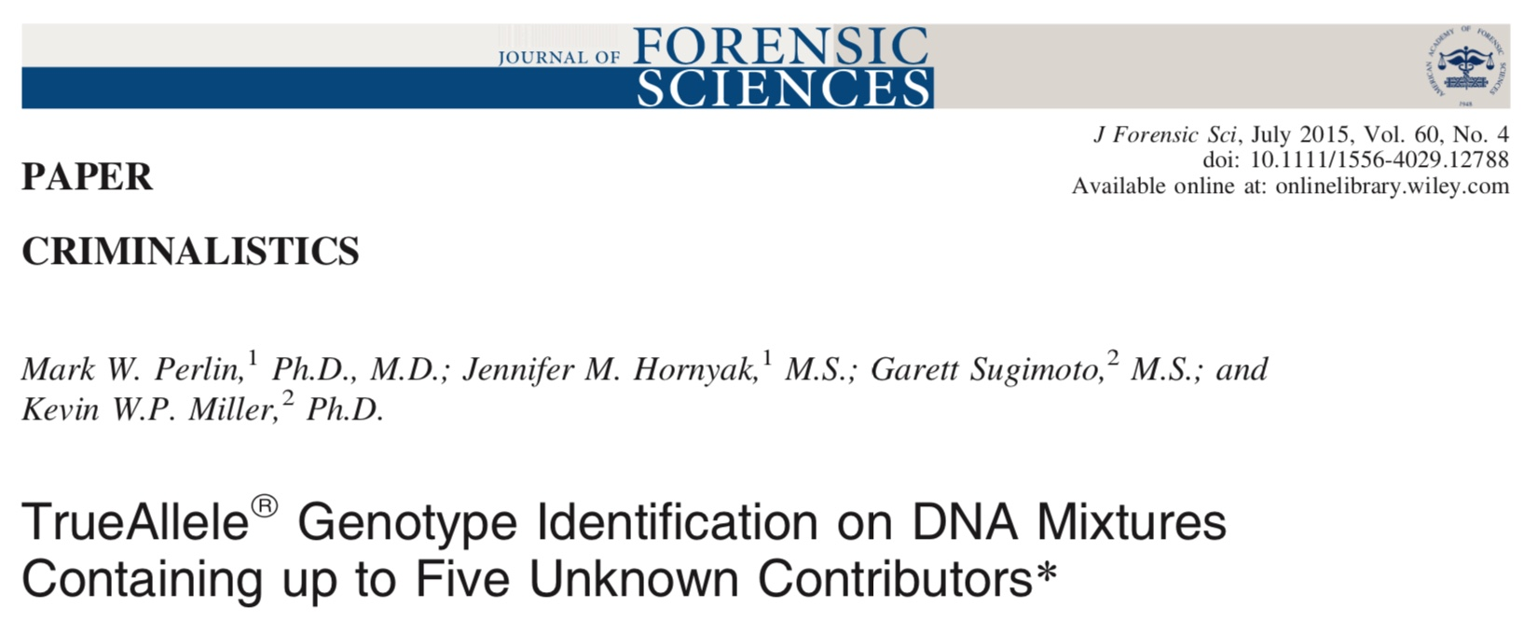
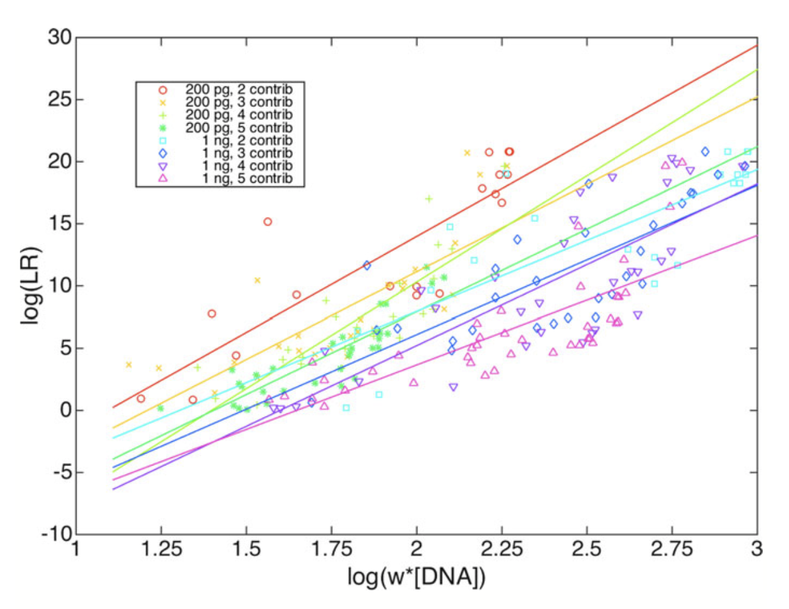

Slide 46
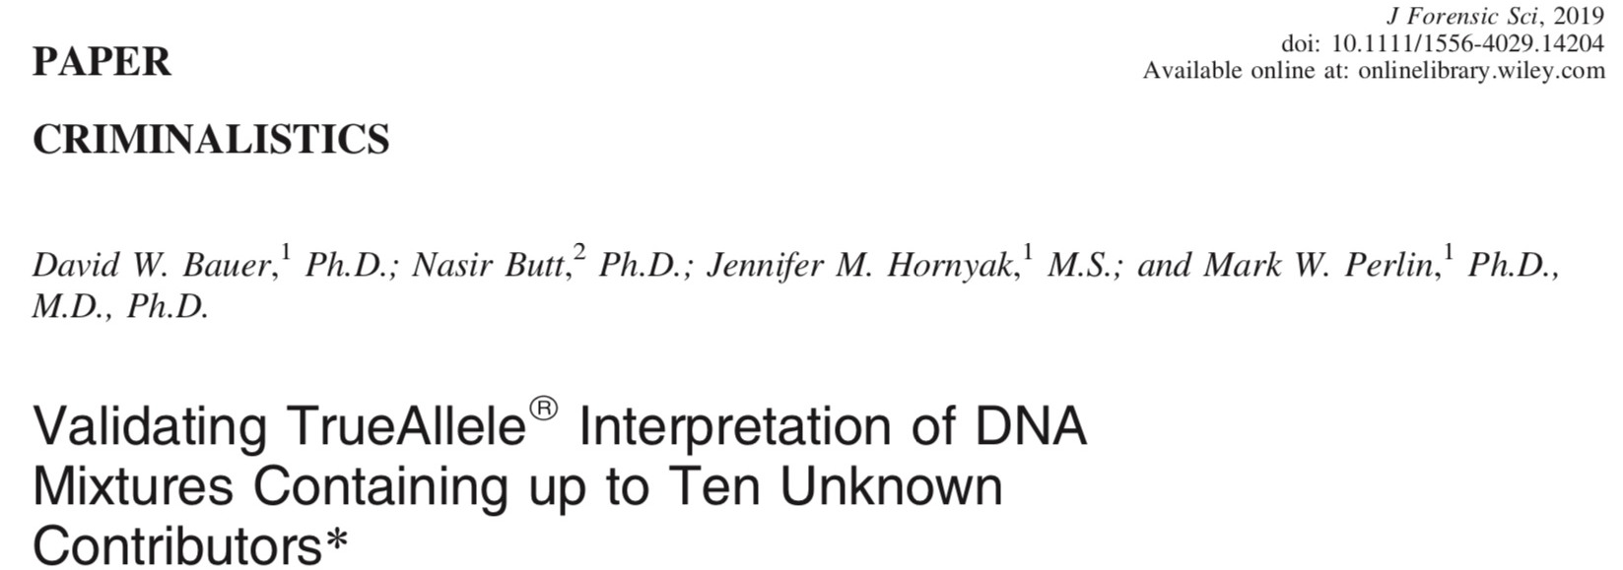
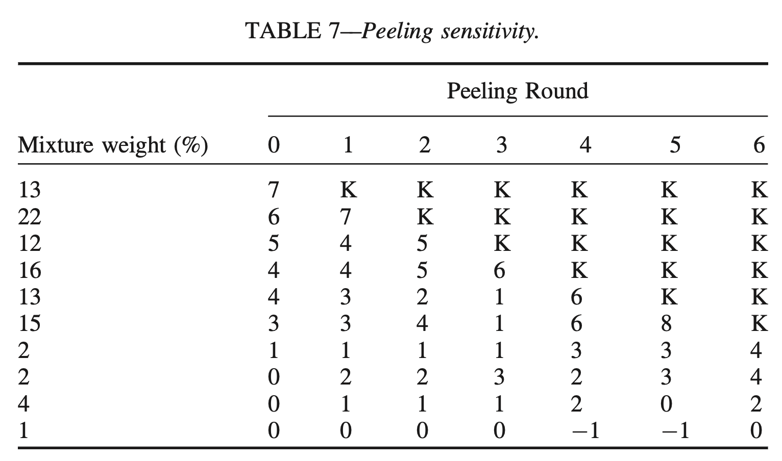
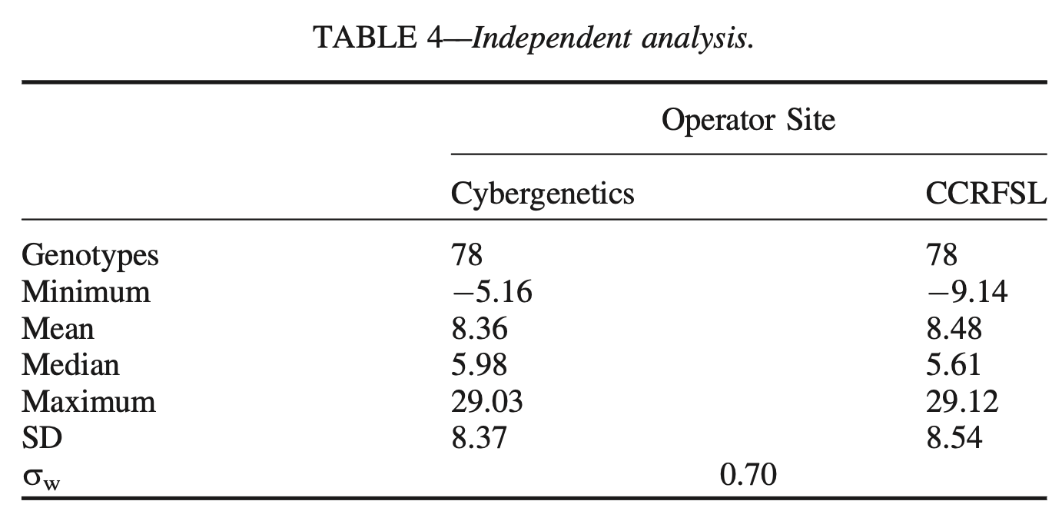

Slide 47
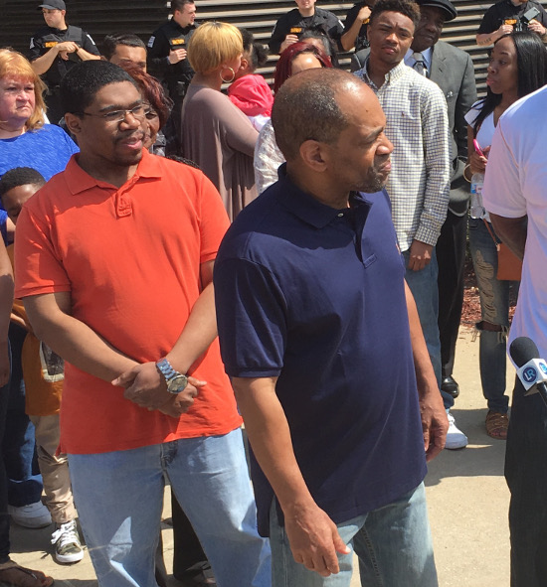
Indiana v. Darryl Pinkins
Wrongfully convicted
Imprisoned for 25 years
Released from prison
April 25, 2016
CBS News 48 Hours
“Guilty Until Proven Innocent”

Slide 48
TrueAllele Pinkins findings
1. compared evidence with evidence
2. calculated exclusionary match statistics
3. revealed 5% minor mixture contributor
4. jointly analyzed DNA mixture data
5. showed three perpetrators were brothers
found 5 unidentified genotypes,
defendants not linked to the crime
Search CODIS?

Slide 49
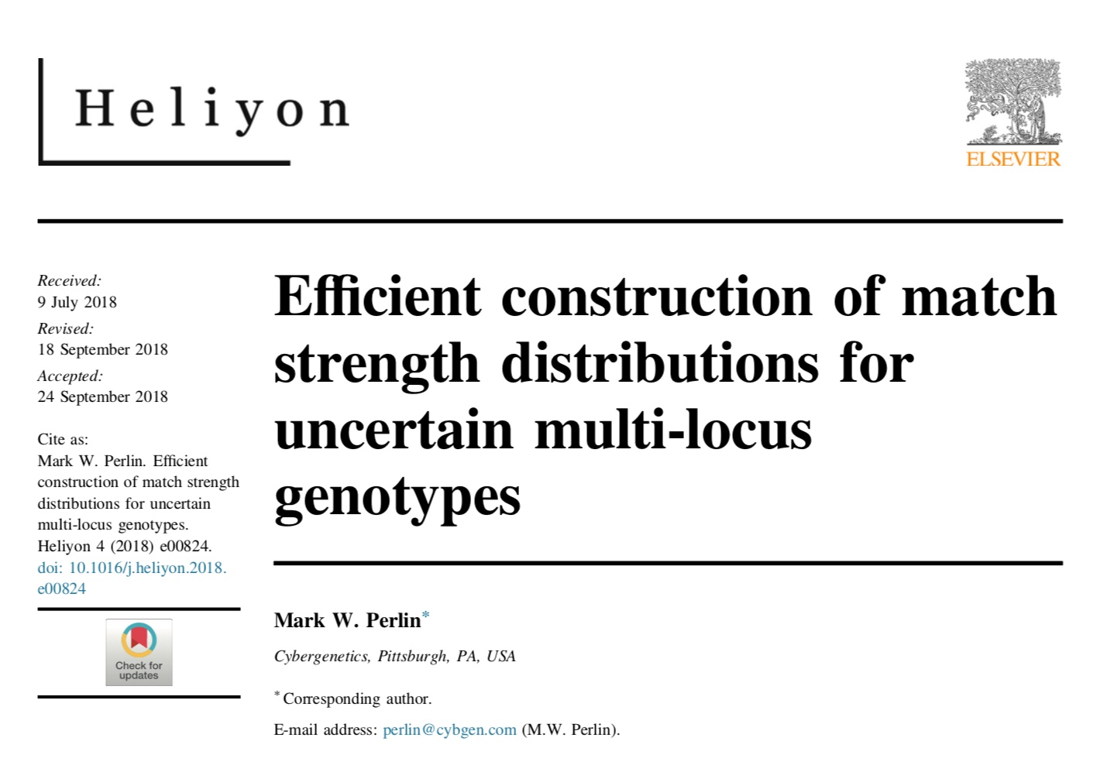
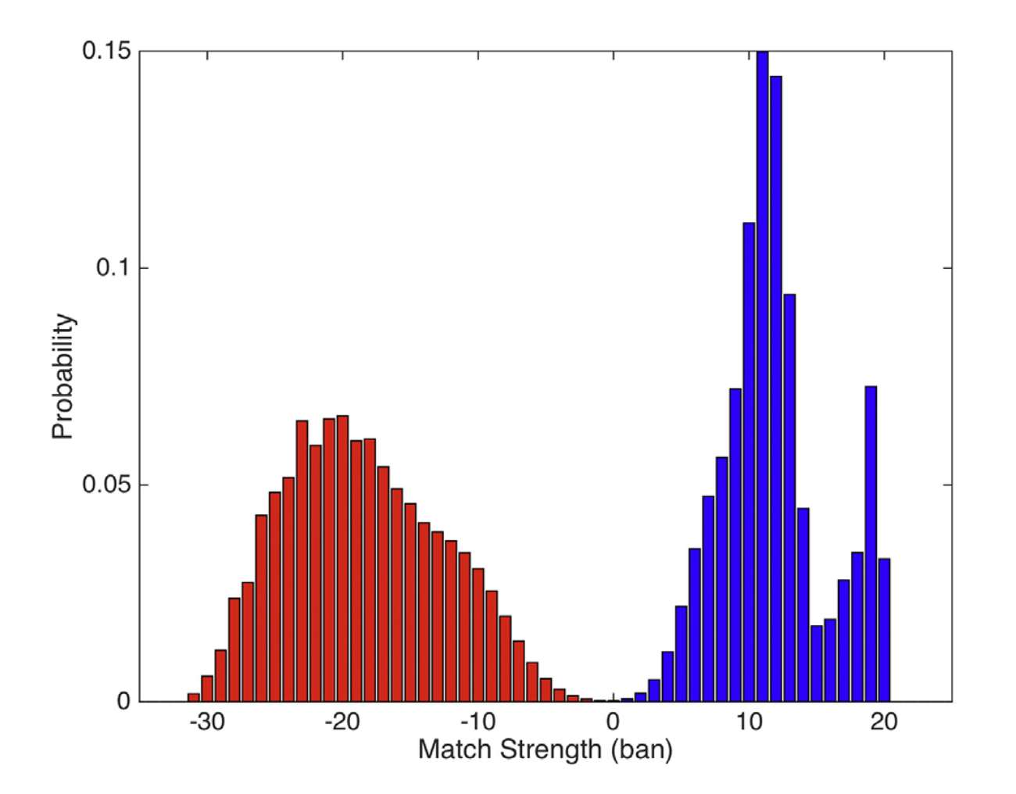
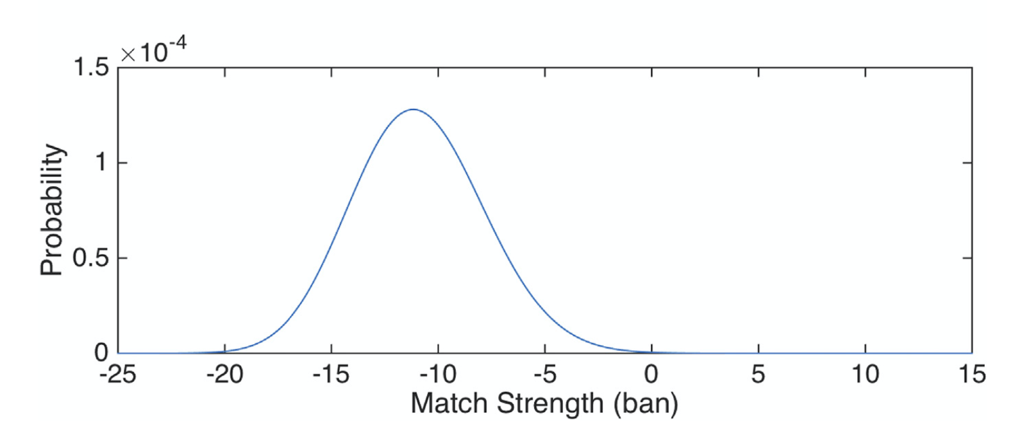

Slide 50
Error Rate
Only 1 in 385 million people would match as strongly
20.6
million
7.31

Slide 51
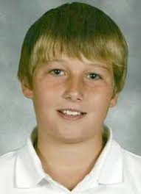
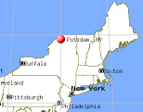
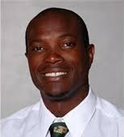
New York v. Nick Hillary
Garrett Phillips (12)
Died from strangulation
October 24, 2011
Oral “Nick” Hillary
Arrested for murder
May 15, 2013

Slide 52
TrueAllele findings in Hillary
2013. 26 Identifiler tests on left fingernails
Mixture of 95% victim + 5% other
No statistical connection to Hillary
Advised Minifiler for degraded DNA
2014. More lab data on left fingernails
9 tests using new kit & machine
NYSP requested TrueAllele analysis
Again, no connection to Hillary

Slide 53
Other PG software forces users to choose their data
3 amplifications
at D8 locus
Victim
Foreign
Defendant
Exculpatory
V
V
expert
report
F
D
D
X
X
X
X
X
other choices

Slide 54
Thresholds change answers
LR
include
exclude
Different choices, different answers
Software does not agree with itself

Slide 55
Judge’s admissibility ruling
The Expert conceded at the hearing that no internal validation studies were performed by the State crime lab for the use of the Software on casework samples developed at the lab.
As a result the Expert was forced to pick and choose data from different “reliable sources” and input parameters into the program in such a way that he believed the system would tolerate.
ORDERED that the defendant’s motion to preclude the prosecution from calling an expert witness to testify on their direct case regarding any conclusion reached by the use of the Software is granted as the prosecution cannot lay a foundation for the introduction of evidence that had not been internally validated.

Slide 56

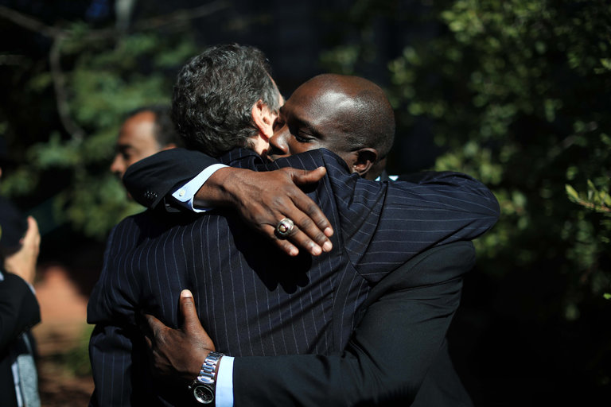
Nick Hillary acquitted
Oral Nicholas Hillary Acquitted in Potsdam Boy’s Killing
September 28, 2016

Slide 57
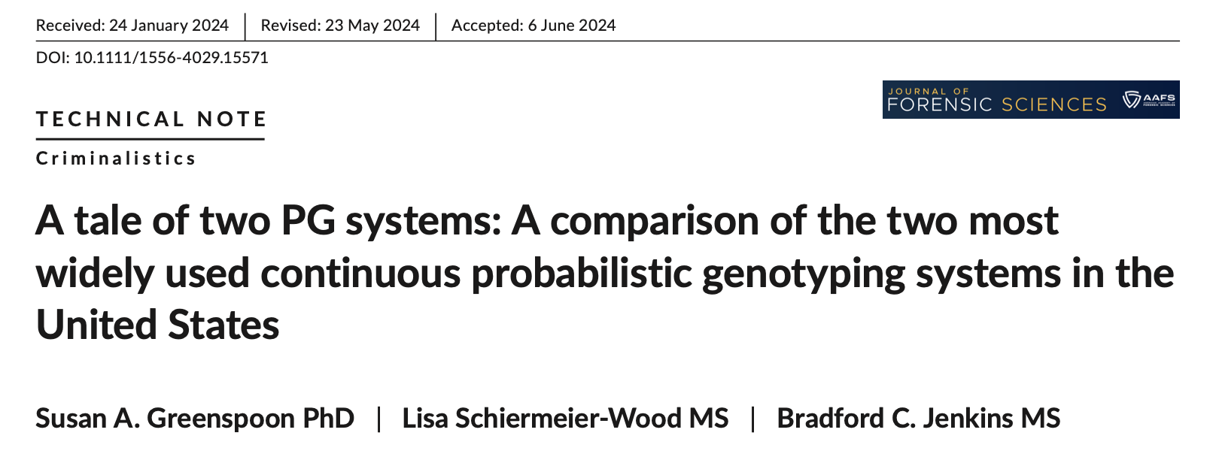
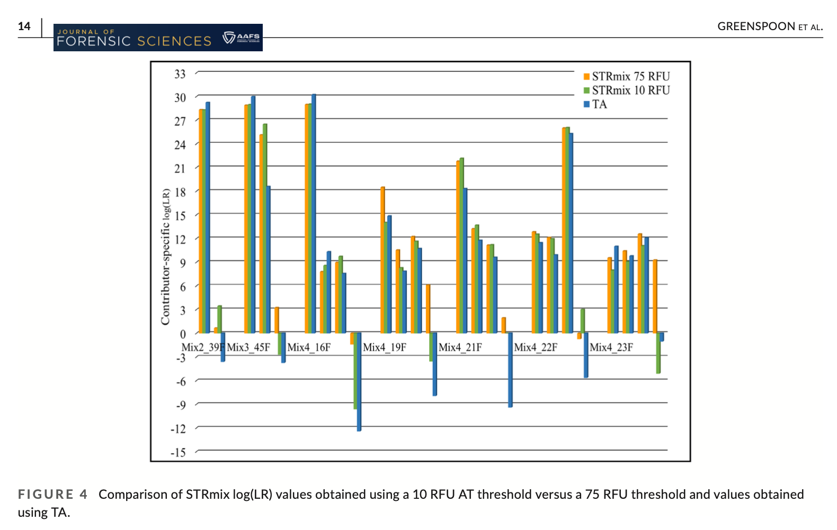

Slide 58
44 US admissibility rulings
Commonwealth of Pennsylvania v Kevin Foley (admitted, 2009; appellate precedent, 2012)
People of California v Dupree Langston (admitted, 2013)
Commonwealth of Virginia v Matthew Brady (admitted, 2013)
State of Ohio v Maurice Shaw (admitted, 2014)
State of Louisiana v Chattley Chesterfield & Samuel Nicolas (admitted, 2014)
People of New York v John Wakefield (admitted, 2015; appellate precedent, 2019; high court precedent, 2022)
State of South Carolina v Jaquard Aiken (admitted, 2015)
Commonwealth of Massachusetts v Heidi Bartlett (admitted, 2016)
State of Indiana v Dugniqio Forest (admitted, 2016)
State of Indiana v Malcolm Wade (admitted, 2016)
State of Washington v Emanuel Fair (admitted, 2017)
State of Louisiana v Harold Houston (admitted, 2017)
State of Indiana v Randal Coalter (admitted, 2017)
State of Nebraska v Charles Simmer (admitted, 2018; appellate precedent, 2019)
State of Indiana v Vaylen Glazebrook (admitted, 2018)
State of Ohio v David Mathis (admitted, 2018)
State of Florida v Lajayvian Daniels (admitted, 2018; appellate precedent, 2021)
State of Tennessee v Demontez Watkins (admitted, 2018; appellate precedent, 2021)
State of Georgia v Thaddus Nundra (admitted, 2019; appellate precedent, 2023)
State of Georgia v Monte Baugh & Thaddeus Howell (admitted, 2019)
State of Louisiana v Kyle Russ (admitted, 2019)
People of New York v Casey Wilson (admitted, 2019)
State of Georgia v Alexander Battle (admitted, 2019)
United States v Lenard Gibbs (admitted, 2019)
State of Georgia v Guy Sewell (admitted, 2019)
State of Georgia v Adedoja Bah (admitted, 2019)
State of Georgia v Nathaniel Day (admitted, 2019)
State of Tennessee v Abdullah Powell (admitted, 2021)
State of Georgia v Zarren Garner (admitted, 2021)
United States v Curtis Johnson, Jr. (admitted, 2021)
State of Georgia v Rahul Joseph Das (admitted, 2021)
State of Maryland v Tyrone Harvin (admitted, 2021)
State of Maryland v Gregory Jones (not used, Daubert not applied, 2021)
State of Georgia v Lashumbia Session (admitted, 2021)
State of Georgia v Bryan Byers (admitted, 2022)
State of Louisiana v Dermell Lewis, Corey Major, & Gerald Parker (admitted, 2022)
State of Louisiana v James Tabb (admitted, 2022)
State of Louisiana v Shawn Briscoe and Lance McIntyre (not used due to timeliness, 2022)
United States v Hunter Anderson (admitted, 2023)
State of Louisiana v Corlious Dyson (admitted, 2023)
United States v Ravel Mills (admitted, 2023)
United States v Damond Lockett (admitted, 2023)
State of Georgia v Erin Stephon Arms (admitted, 2023)
State of Ohio v Michael Carter (admitted, 2024)

Slide 59
TrueAllele today
Invented math & algorithms | 30 years
Developed computer systems | 25 years
Support users and workflow | 10 laboratories; 100,000 items
Routinely used in casework | 450 agencies
Validate system reliability | 43 studies
Educate the community | 175 talks
Train or certify analysts | 400 students
Admissibility challenges | 44 rulings, 15 states and federal
Testify about LR results | 145 trials
Educate lawyers and public | 1,000 people
Make the ideas understandable | 1,250 cases, 46 (of 50) states

Slide 60
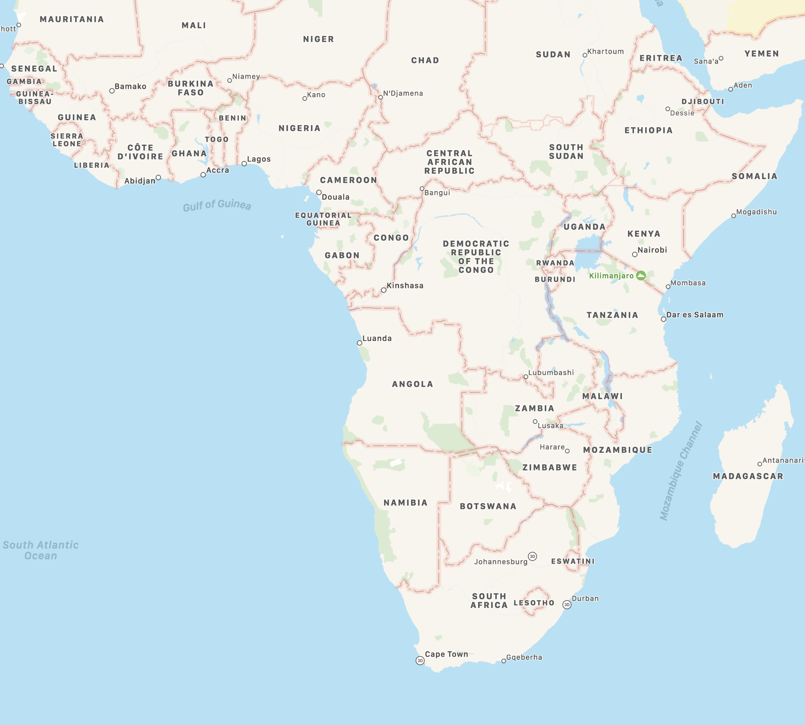
TrueAllele can help Africa
Informative
• Accurate
• Unbiased
Automated
• Few analysts
• Large population
Effective
• Solve crime
• Prevent rape

