Slide 1


AI delivers accurate and objective forensic DNA evidence
Mark W Perlin, PhD, MD, PhD
Pittsburgh, PA
Cybergenetics © 2003-2024

Slide 2
DNA evidence is powerful
2
Inculpatory evidence
A DNA match can find people where they shouldn’t be.
Exculpatory evidence
A DNA nonmatch can show that someone wasn’t there.
DNA is easy with simple evidence

Slide 3
Types of DNA evidence
3
Single source
Occurs when one person leaves their DNA on an item.
Simple evidence.
DNA mixture
Occurs when two or more people leave their DNA.
Most common form of DNA evidence.
DNA mixtures are hard for people to analyze

Slide 4
Solving complex mixtures
4
Human intelligence
Simplifies the DNA data to simplify the problem.
And usually gets the wrong answer.
Computer intelligence
Explains the DNA data to unmix the mixture.
And gets the right answer.
DNA is easy for complex evidence,
but only with smart AI computers.

Slide 5

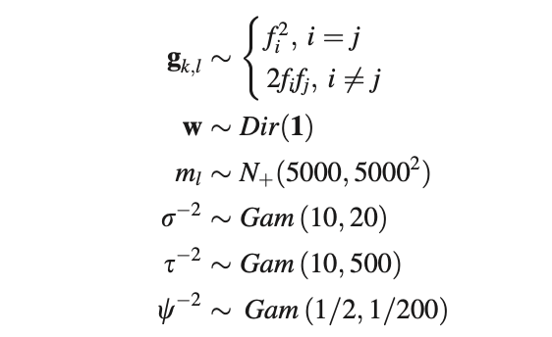
Bayesian probability equations
5
Smart computers can solve math
that is impossible for people.

Slide 6
Focus of the talk
6
1. Human DNA interpretation fails
Losing truth harms justice
2. Computer artificial intelligence succeeds
Finding truth helps justice
3. Humans suppress computer intelligence
Hiding truth harms justice

Slide 7
New York v John Wakefield
7
In April, 2010, Brett Wentworth (41) was found dead
in his apartment, strangled with an electric guitar cord.
The police collected biological evidence was from amp cord
sections, plus his shirt collar and forearm.
The New York State Police lab examined the DNA mixtures.
Comparing the evidence with suspect John Wakefield (44)
found very little DNA match information.

Slide 8
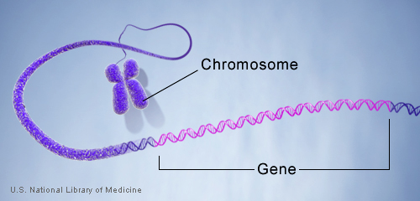
DNA genotype
8
A genetic locus has
two DNA sentences,
one from each parent.
An allele is the number
of repeated words.
locus
A genotype at a locus
is a pair of alleles.
mother
allele
1
2
3
4
5
6
7
8
9
10
10, 12
ACGT
repeated word
Many alleles allow for
many many allele pairs.
A person's genotype
is relatively unique.
father
allele
1
2
3
4
5
6
7
8
9
10
11
12

Slide 9
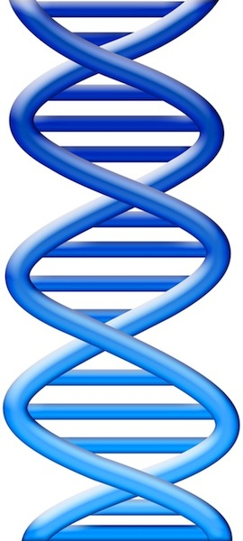
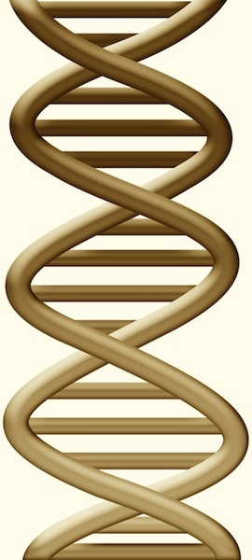
DNA evidence interpretation
9
Evidence item
Lab
Evidence data
Infer
Evidence genotype
10, 12 @ 50%
11, 12 @ 30%
12, 12 @ 20%
10 11 12
Compare
Known genotype
10, 12

Slide 10
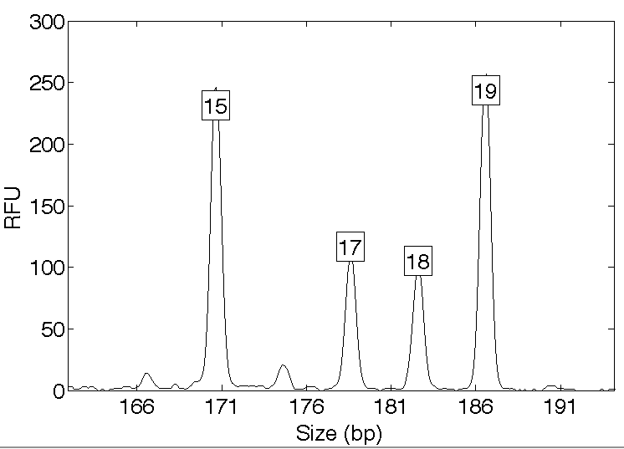
Computers can use all the data
10
Quantitative peak heights at locus vWA
peak size
peak
height

Slide 11
People may use less of the data
11
Over threshold, peaks are labeled as allele events
Threshold
All-or-none allele peaks,
each given equal status
Under threshold, alleles vanish

Slide 12
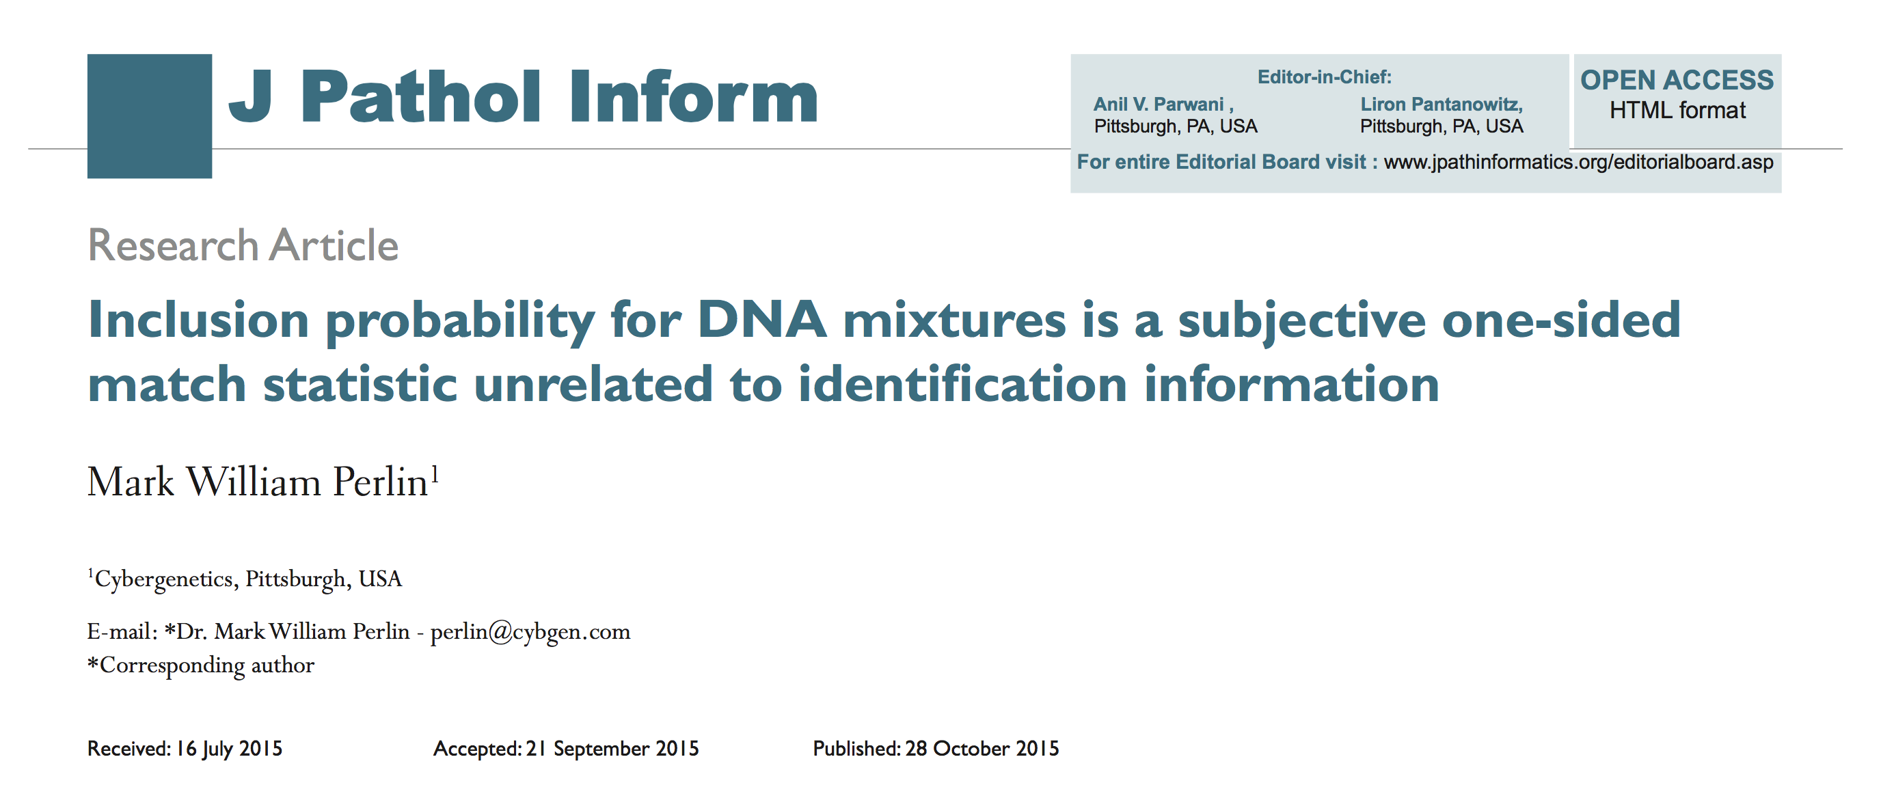
Human review CPI match statistic: subjective, biased & uninformative
12

Slide 13
Finding truth through science
13
16th – Francis Bacon; empiricism, testing
17th – Isaac Newton; math & physics
18th – Thomas Bayes; inverse probability
H hypothesis, D data
How data updates our belief in a hypothesis
Pr{H | D} ∝ Pr{D | H} x Pr{H}
Posterior probability
Likelihood
Prior probability

Slide 14
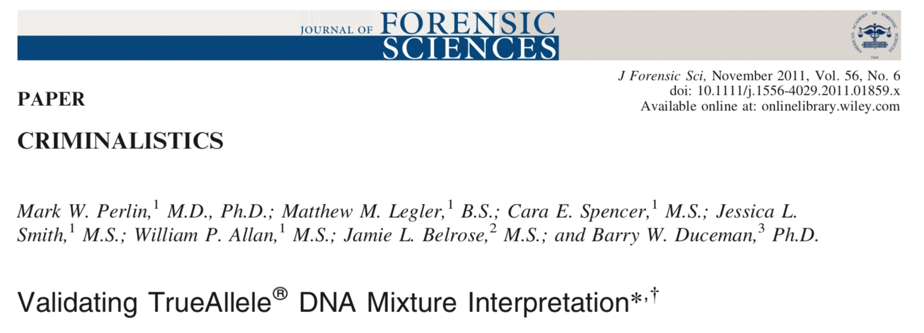
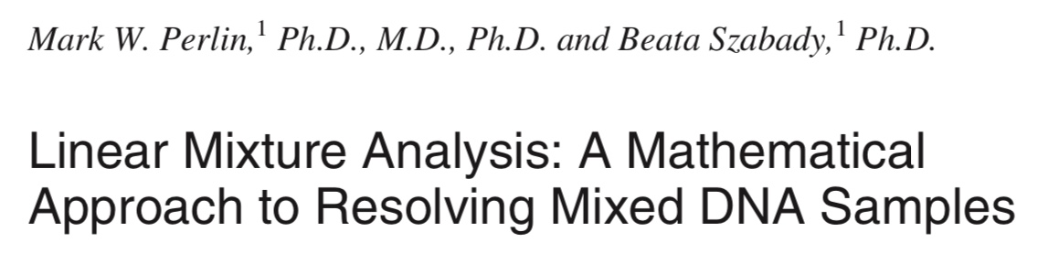
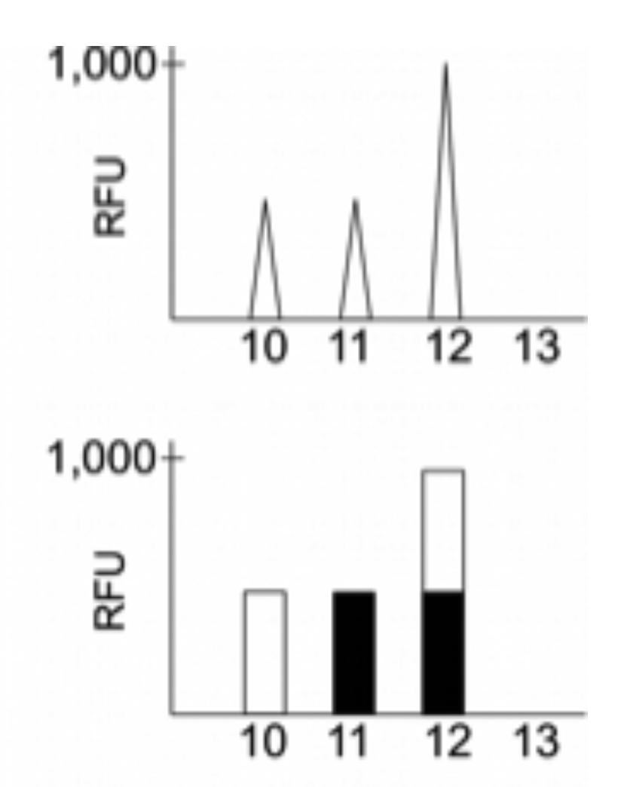
Explaining DNA mixtures
2001
DNA peak height data
Sum of genotypes

Slide 15
TrueAllele® computer solution
• Accurate. 43 validation studies, 8 published
• Objective. Workflow removes human bias
• Accepted. Reported in 47 states, used by 10 labs
• Transparent. Give math, software, 4GB DVD
• Neutral. Can statistically include or exclude

Slide 16
How the computer thinks
16
Consider every possible genotype solution
One person’s allele pair
Explain the
peak pattern
Another person's allele pair
Better
explanation
has a higher
likelihood

Slide 17
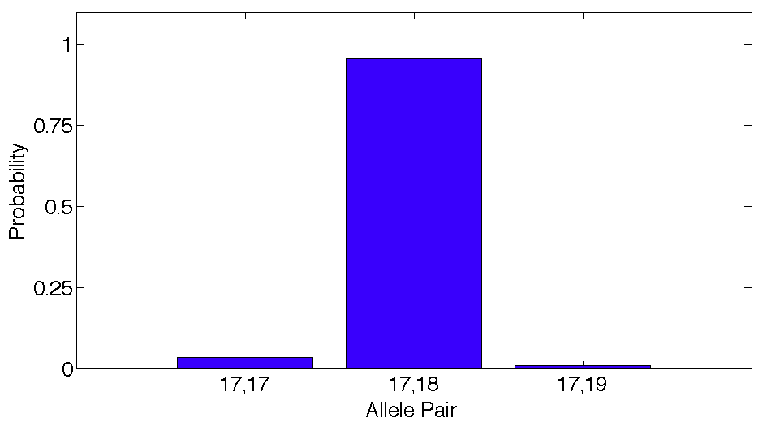
Evidence genotype - probability
17
Objective genotype determined solely from the DNA data.
Never sees a comparison reference.
96%
3%
1%

Slide 18
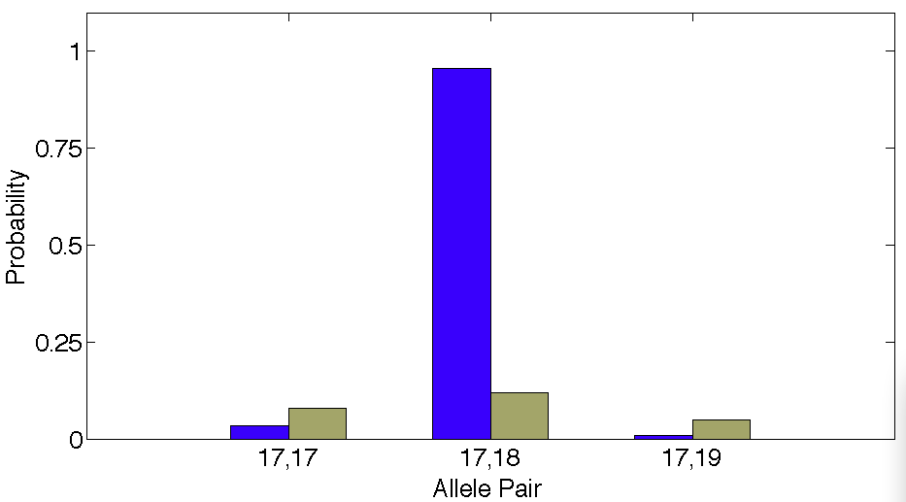
DNA match information
18
How much more does the suspect match the evidence
than a random person?
8x
96%
Prob(evidence match)
Prob(coincidental match)
12%

Slide 19
Is the suspect in the evidence?
19
A match between the amp cord
and John Wakefield is:
5.88 billion times more probable than
a coincidental match to an unrelated Black person
300 million times more probable than
a coincidental match to an unrelated Caucasian person
2.25 billion times more probable than
a coincidental match to an unrelated Hispanic person

Slide 20
Match statistics
20

Slide 21
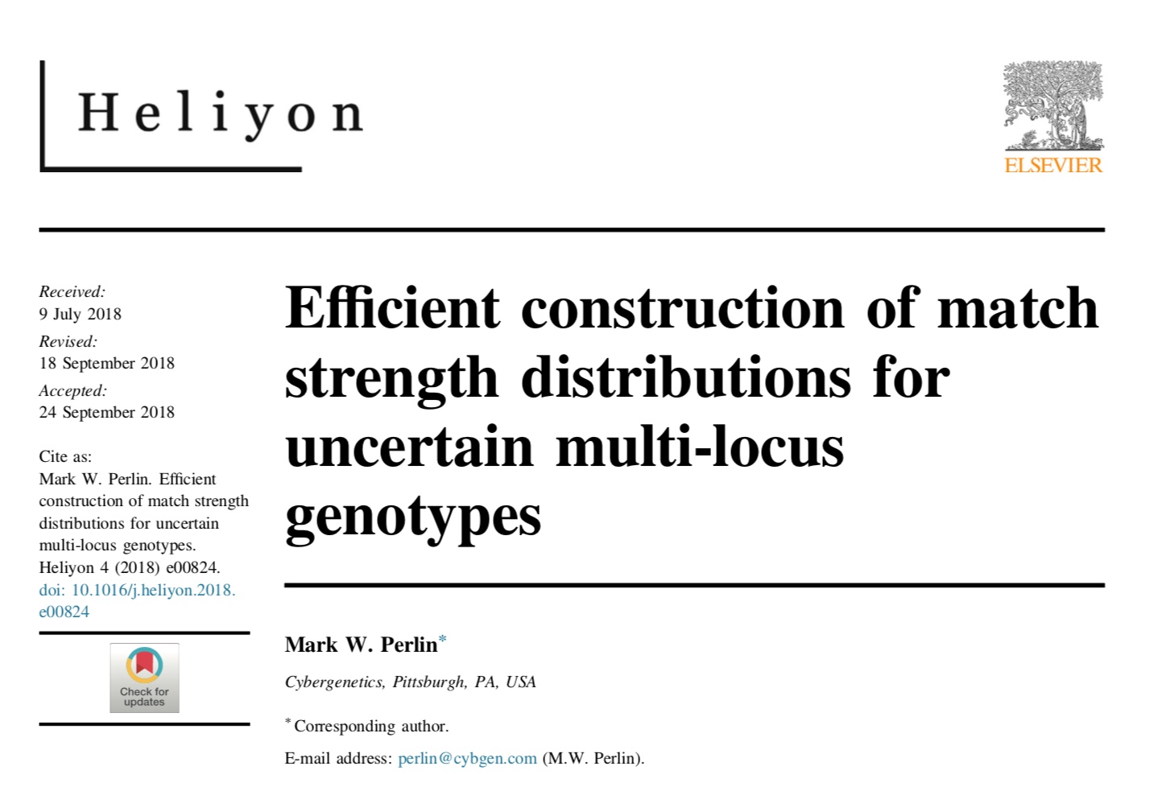
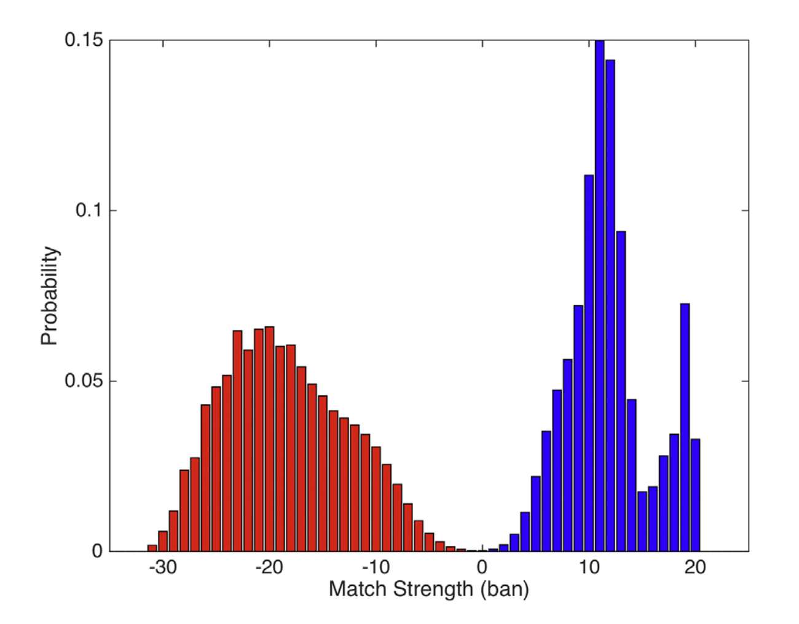
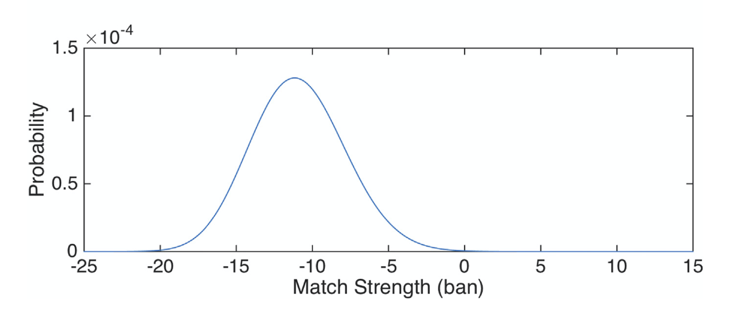
Error rate

Slide 22
Peer-reviewed validation studies
22
Perlin MW, Sinelnikov A. An information gap in DNA evidence interpretation. PLoS ONE. 2009;4(12):e8327.
Ballantyne J, Hanson EK, Perlin MW. DNA mixture genotyping by probabilistic computer interpretation of binomially-sampled laser captured cell populations: Combining quantitative data for greater identification information. Science & Justice. 2013;53(2):103-114.
Perlin MW, Hornyak J, Sugimoto G, Miller K. TrueAllele® genotype identification on DNA mixtures containing up to five unknown contributors. Journal of Forensic Sciences. 2015;60(4):857-868.
Greenspoon SA, Schiermeier-Wood L, Jenkins BC. Establishing the limits of TrueAllele® Casework: a validation study. Journal of Forensic Sciences. 2015;60(5):1263-1276.
Bauer DW, Butt N, Hornyak JM, Perlin MW. Validating TrueAllele® interpretation of DNA mixtures containing up to ten unknown contributors. Journal of Forensic Sciences. 2020; 65(2):380-398.
Perlin MW, Legler MM, Spencer CE, Smith JL, Allan WP, Belrose JL, Duceman BW. Validating TrueAllele® DNA mixture interpretation. Journal of Forensic Sciences. 2011;56(6):1430-1447.
Perlin MW, Belrose JL, Duceman BW. New York State TrueAllele® Casework validation study. Journal of Forensic Sciences. 2013;58(6):1458-1466.
Perlin MW, Dormer K, Hornyak J, Schiermeier-Wood L, Greenspoon S. TrueAllele® Casework on Virginia DNA mixture evidence: computer and manual interpretation in 72 reported criminal cases. PLOS ONE. 2014;(9)3:e92837.

Slide 23
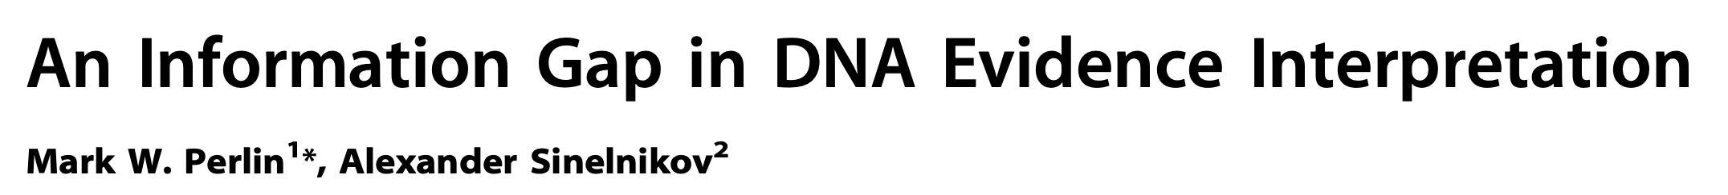

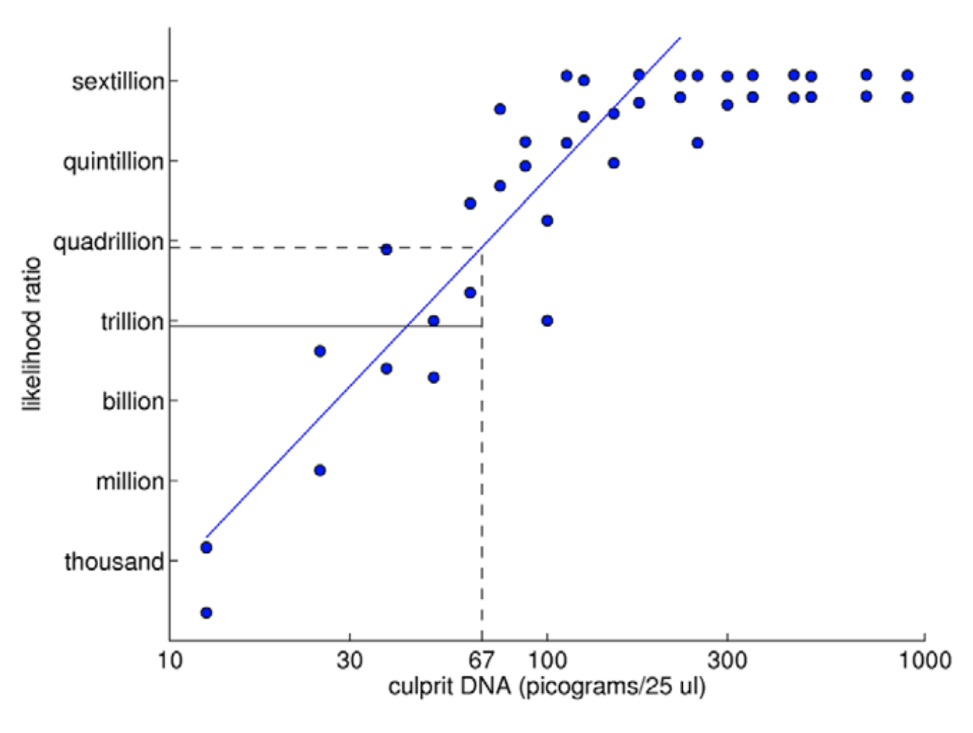
TrueAllele predictability
2009

Slide 24
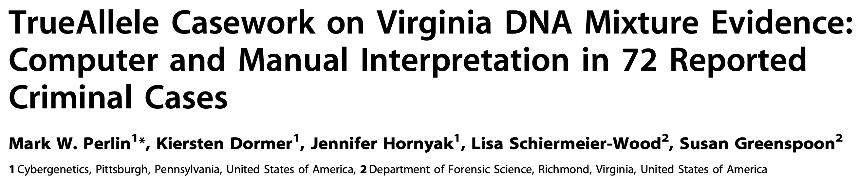
TrueAllele reliability
2014
Validation axes
• sensitive
• specific
• reproducible

Slide 25
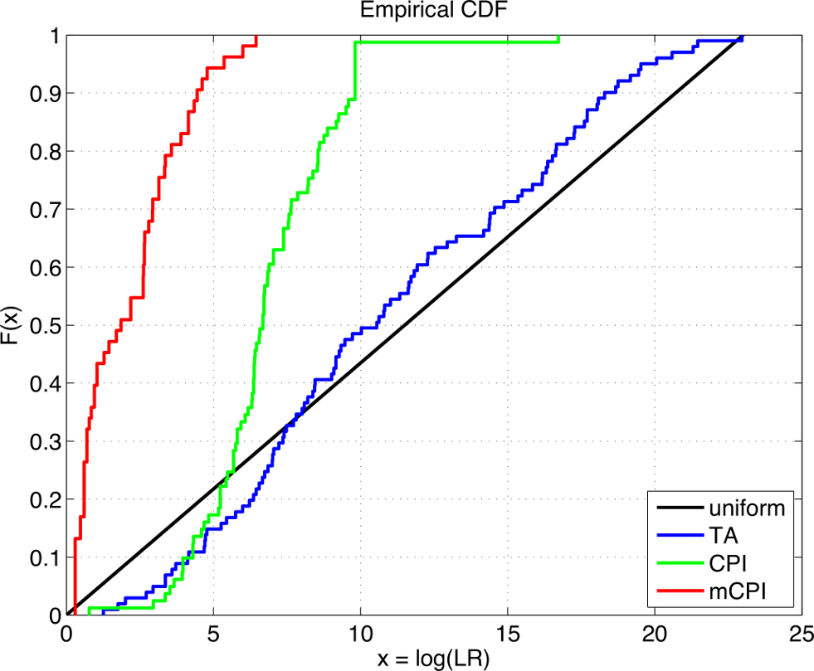
TrueAllele accuracy
25

Slide 26
Higher human error rate
26
TrueAllele specificity (million samples)
From noncontributor distribution, for LR > 100:
Error rate = 1 in 1,000,000 (0.0001)%
CPI – analytical threshold
5 false positives in 81 comparisons
Error rate = 5 in 81 (6%)
mCPI – stochastic threshold
17 inconclusive results
1 false positive in 53 comparisons
Error rate = 1 in 53 (2%)

Slide 27
TrueAllele reproducibility
27
Concordance in two independent computer runs
standard deviation
(within-group)
0.305

Slide 28
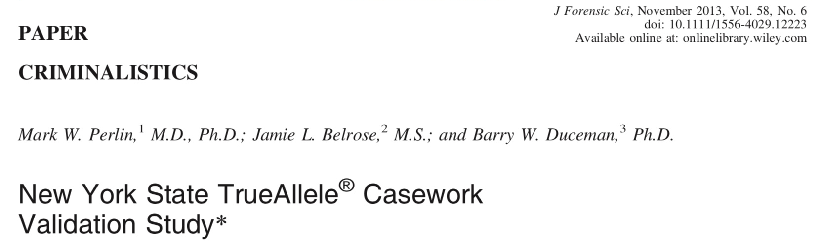
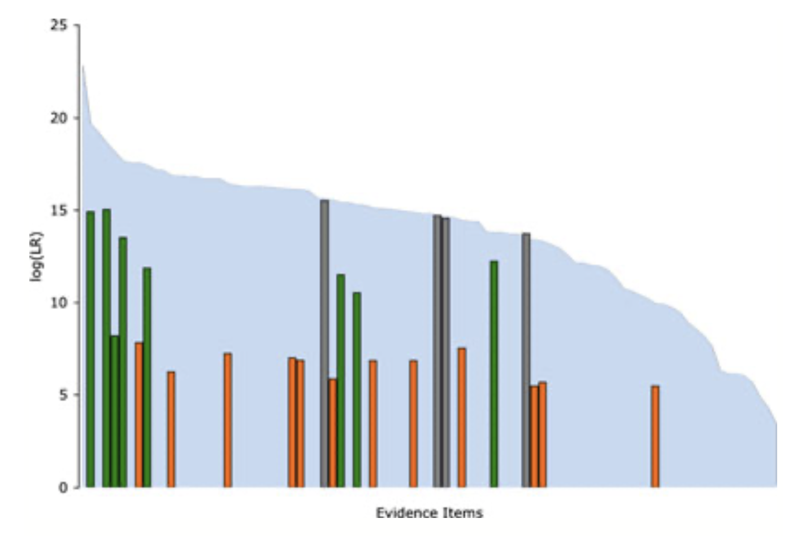
Computers find information
Humans fail 70% of the time

Slide 29
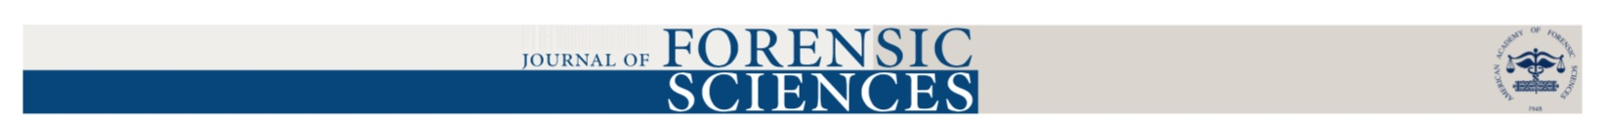
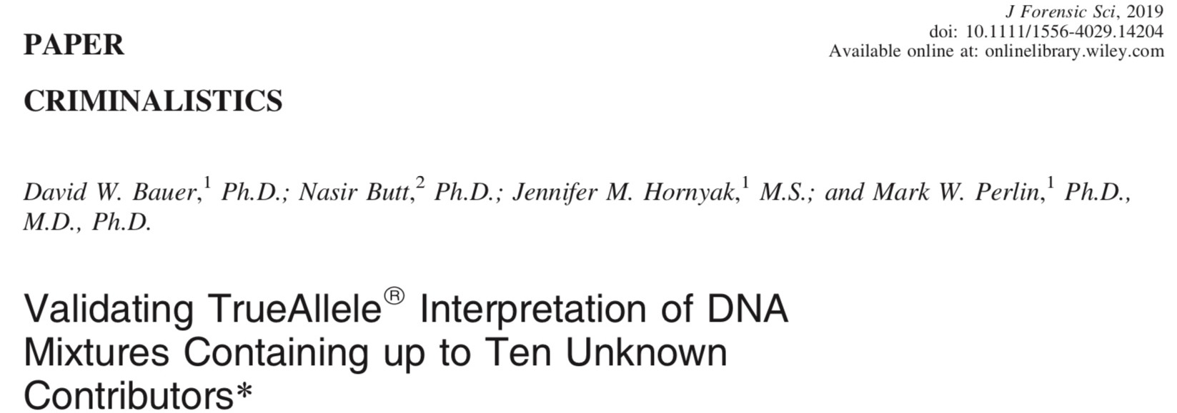
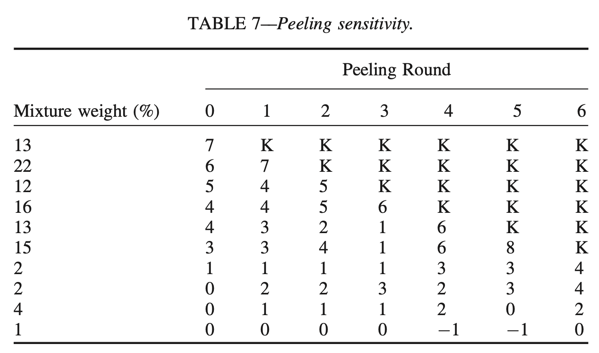
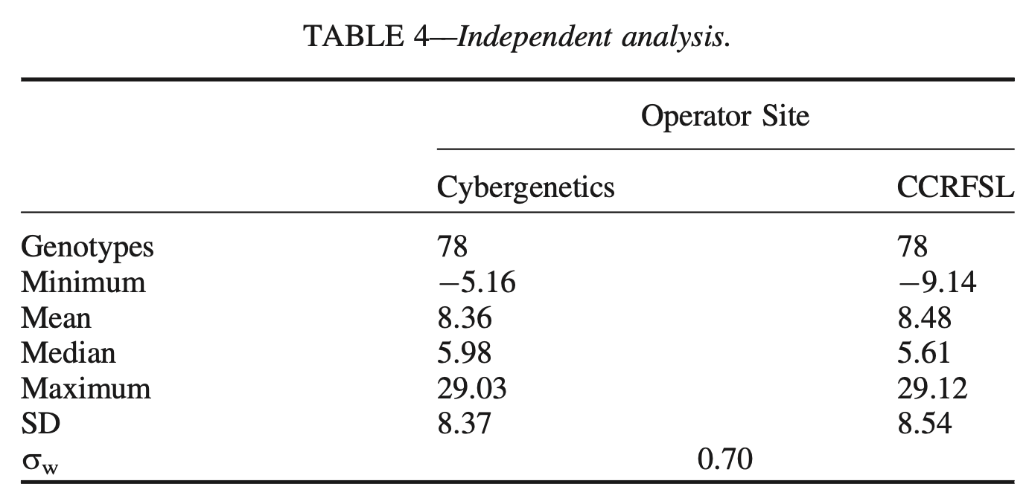

Slide 30
TrueAllele acceptance
30
Invented math & algorithms | 30 years
Developed computer systems | 25 years
Support users and workflow | 10 laboratories; 100,000 items
Routinely used in casework | 525 agencies (FBI)
Validate system reliability | 43 studies
Educate the community | 175 talks
Train or certify analysts | 400 students
Admissibility challenges | 44 rulings, 15 states and federal
Testify about LR results | 145 trials
Educate lawyers and public | 1,000 people
Make the ideas understandable | 1,250 cases, 47 states

Slide 31
Frye & Daubert
31
Testing
Error rate
Peer review
General acceptance

Slide 32
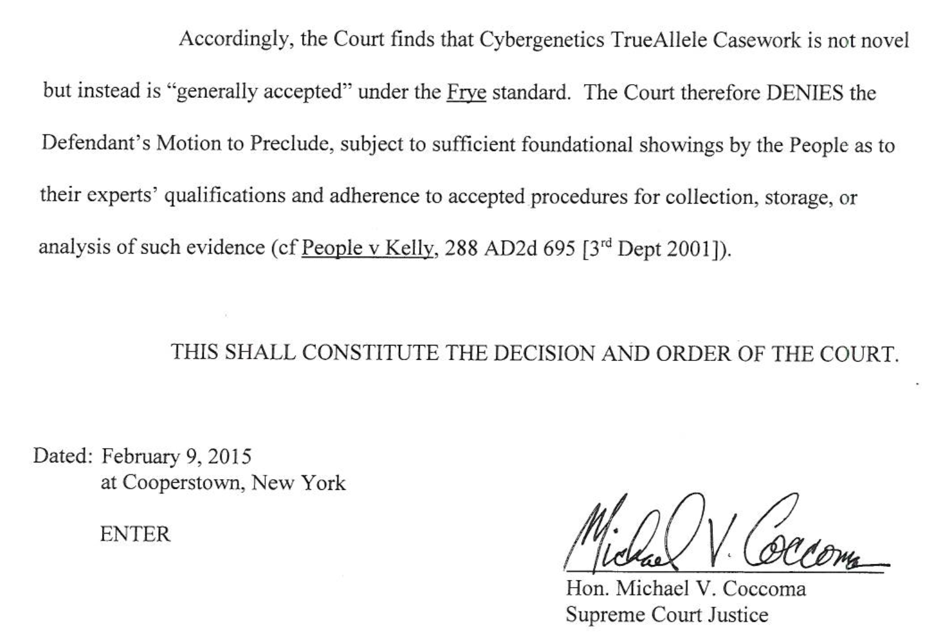
Wakefield Frye ruling

Slide 33
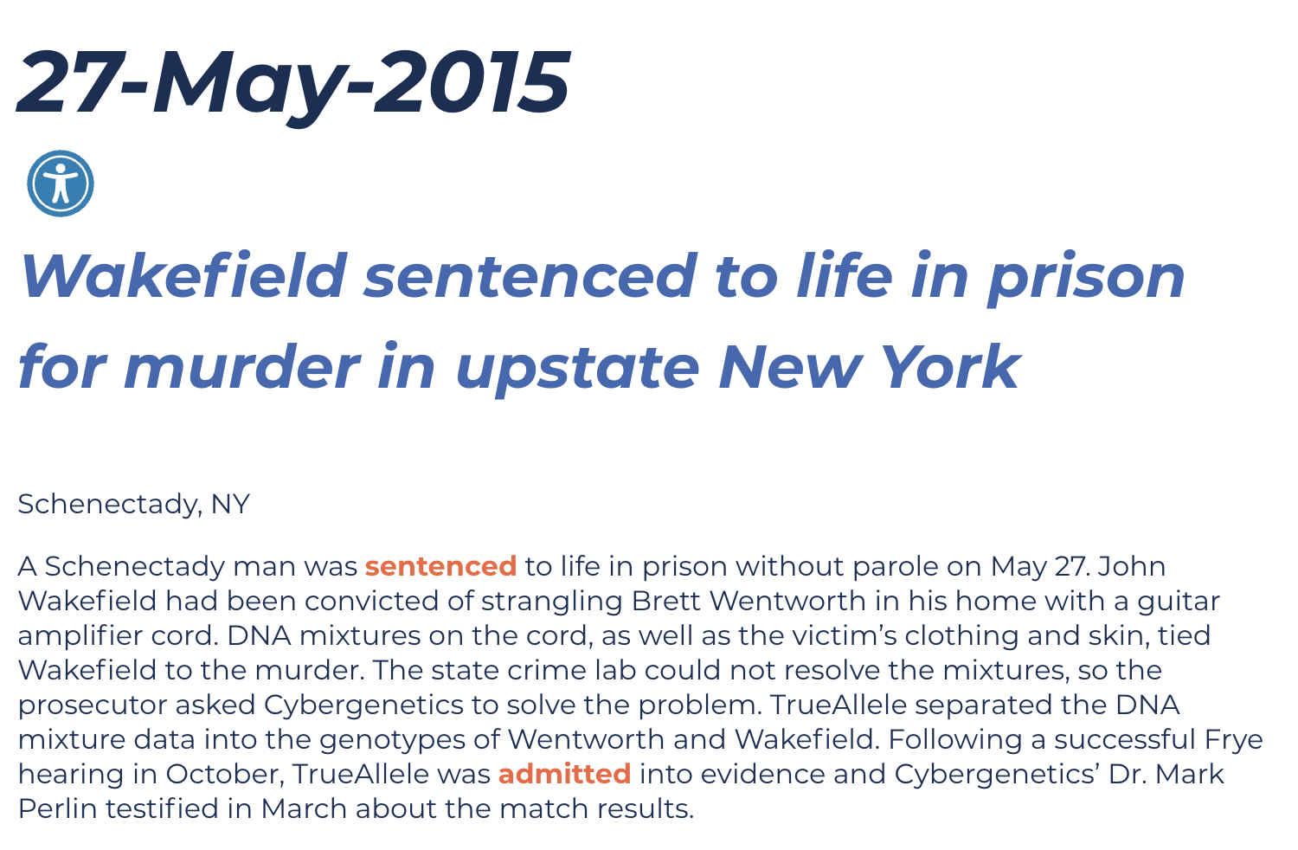
Verdict & sentence

Slide 34
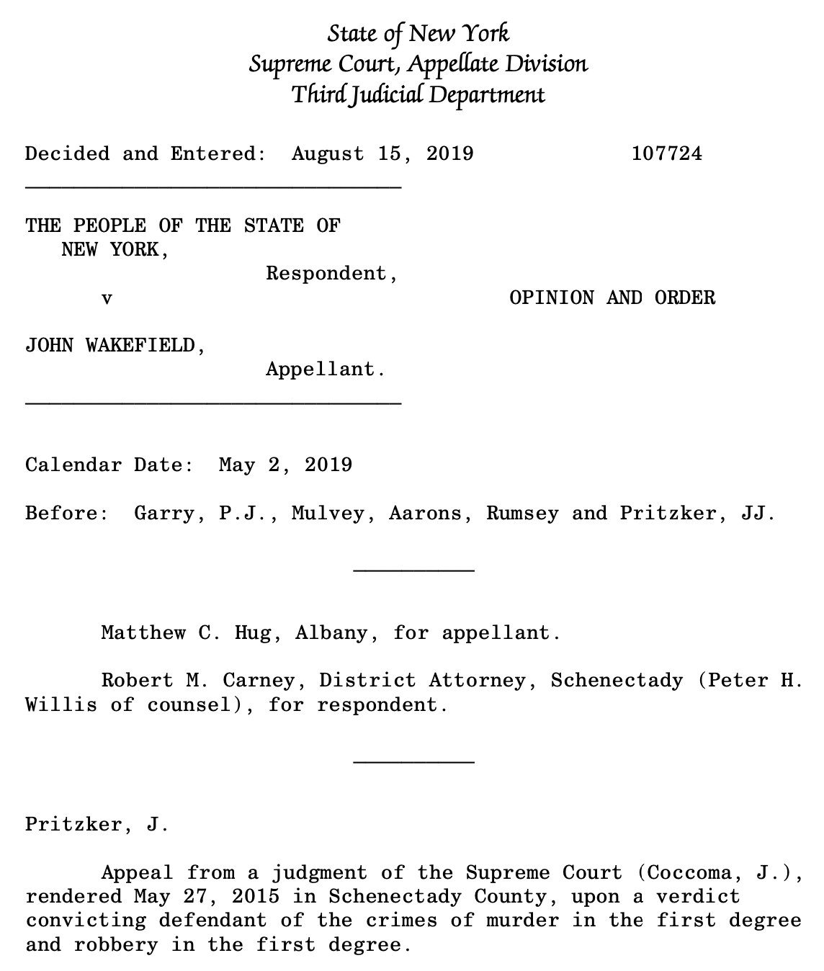

Slide 35
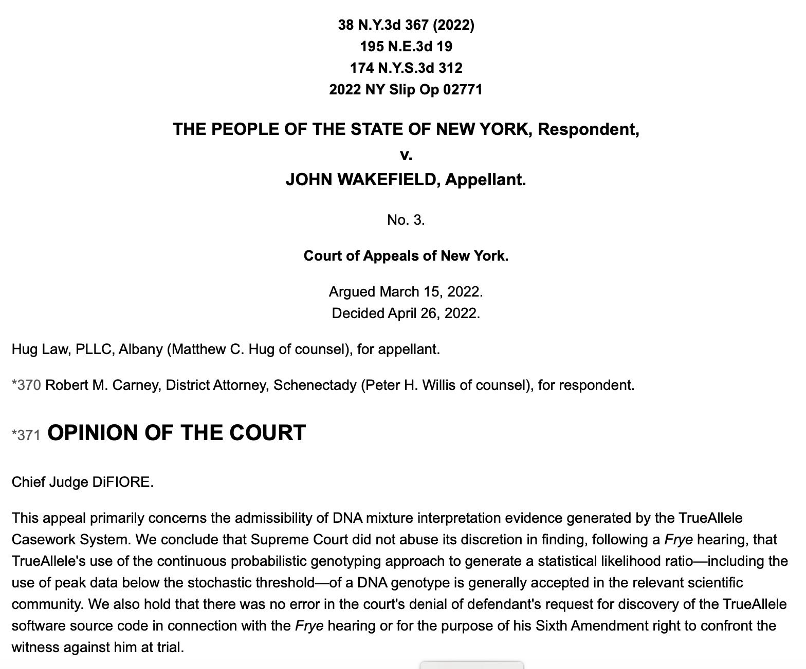

Slide 36
44 US admissibility rulings
Commonwealth of Pennsylvania v Kevin Foley (admitted, 2009; appellate precedent, 2012)
People of California v Dupree Langston (admitted, 2013)
Commonwealth of Virginia v Matthew Brady (admitted, 2013)
State of Ohio v Maurice Shaw (admitted, 2014)
State of Louisiana v Chattley Chesterfield & Samuel Nicolas (admitted, 2014)
People of New York v John Wakefield (admitted, 2015; appellate precedent, 2019; high court precedent, 2022)
State of South Carolina v Jaquard Aiken (admitted, 2015)
Commonwealth of Massachusetts v Heidi Bartlett (admitted, 2016)
State of Indiana v Dugniqio Forest (admitted, 2016)
State of Indiana v Malcolm Wade (admitted, 2016)
State of Washington v Emanuel Fair (admitted, 2017)
State of Louisiana v Harold Houston (admitted, 2017)
State of Indiana v Randal Coalter (admitted, 2017)
State of Nebraska v Charles Simmer (admitted, 2018; appellate precedent, 2019)
State of Indiana v Vaylen Glazebrook (admitted, 2018)
State of Ohio v David Mathis (admitted, 2018)
State of Florida v Lajayvian Daniels (admitted, 2018; appellate precedent, 2021)
State of Tennessee v Demontez Watkins (admitted, 2018; appellate precedent, 2021)
State of Georgia v Thaddus Nundra (admitted, 2019; appellate precedent, 2023)
State of Georgia v Monte Baugh & Thaddeus Howell (admitted, 2019)
State of Louisiana v Kyle Russ (admitted, 2019)
People of New York v Casey Wilson (admitted, 2019)
State of Georgia v Alexander Battle (admitted, 2019)
United States v Lenard Gibbs (admitted, 2019)
State of Georgia v Guy Sewell (admitted, 2019)
State of Georgia v Adedoja Bah (admitted, 2019)
State of Georgia v Nathaniel Day (admitted, 2019)
State of Tennessee v Abdullah Powell (admitted, 2021)
State of Georgia v Zarren Garner (admitted, 2021)
United States v Curtis Johnson, Jr. (admitted, 2021)
State of Georgia v Rahul Joseph Das (admitted, 2021)
State of Maryland v Tyrone Harvin (admitted, 2021)
State of Maryland v Gregory Jones (not used, Daubert not applied, 2021)
State of Georgia v Lashumbia Session (admitted, 2021)
State of Georgia v Bryan Byers (admitted, 2022)
State of Louisiana v Dermell Lewis, Corey Major, & Gerald Parker (admitted, 2022)
State of Louisiana v James Tabb (admitted, 2022)
State of Louisiana v Shawn Briscoe and Lance McIntyre (not used due to timeliness, 2022)
United States v Hunter Anderson (admitted, 2023)
State of Louisiana v Corlious Dyson (admitted, 2023)
United States v Ravel Mills (admitted, 2023)
United States v Damond Lockett (admitted, 2023)
State of Georgia v Erin Stephon Arms (admitted, 2023)
State of Ohio v Michael Carter (admitted, 2024)

Slide 37
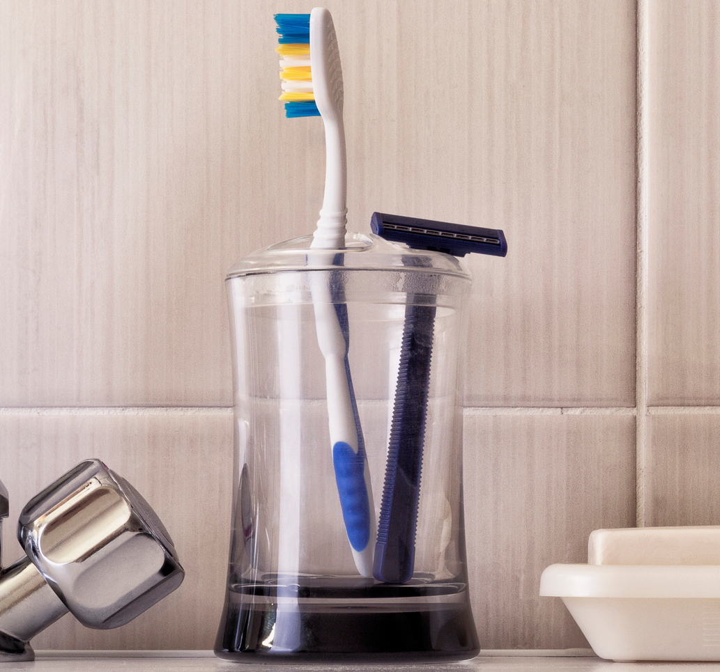
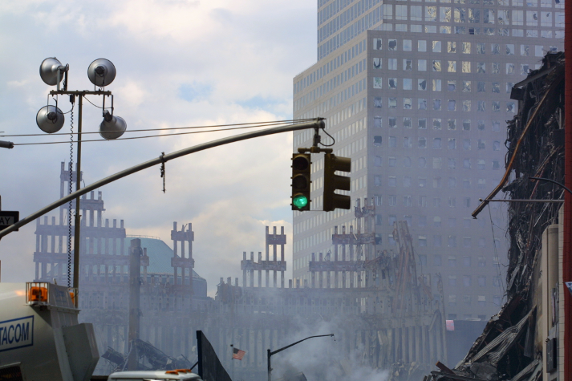

World Trade Center
World’s first modern DNA database case – TrueAllele
37
18,000 victim remains
2,700 missing people
match
September 11, 2001 – New York City

Slide 38
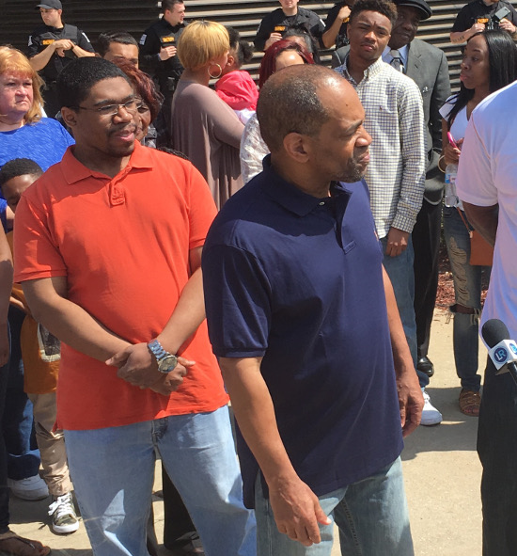
Indiana v. Darryl Pinkins
World’s first modern DNA exoneration case – TrueAllele
38
Wrongfully convicted
Imprisoned for 25 years
Released from prison
April 25, 2016
CBS News 48 Hours
“Guilty Until Proven Innocent”

Slide 39
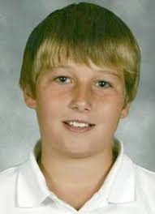
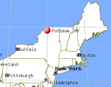
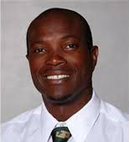
New York v. Nick Hillary
Issues with some human-limited computer software
Garrett Phillips (12)
Died from strangulation
October 24, 2011
Oral “Nick” Hillary
Arrested for murder
May 15, 2013

Slide 40
TrueAllele findings in Hillary
2013. 26 Identifiler tests on left fingernails
Mixture of 95% victim + 5% other
No statistical connection to Hillary
We advised Minifiler for degraded DNA
2014. More lab data on left fingernails
9 tests using new kit & machine
NYSP requested TrueAllele analysis
Again, no connection to Hillary

Slide 41
Other PG software forces users to choose their data
3 amplifications
at D8 locus
subjective
threshold
Victim
Foreign
Defendant
Exculpatory
V
V
expert
report
F
D
D
X
X
X
X
X
other choices

Slide 42
Thresholds change PGS answers
LR
include
exclude
Different data choices, contradictory answers.
PGS STRmix™ does not agree with itself.

Slide 43
Judge does not admit STRmix
The Expert was forced to pick and choose data from different “reliable sources” and input parameters into the [STRmix] program in such a way that he believed the system would tolerate.
ORDERED that the defendant’s motion to preclude the prosecution from calling an expert witness to testify regarding any conclusion reached by the use of the [STRmix] Software is granted.

Slide 44

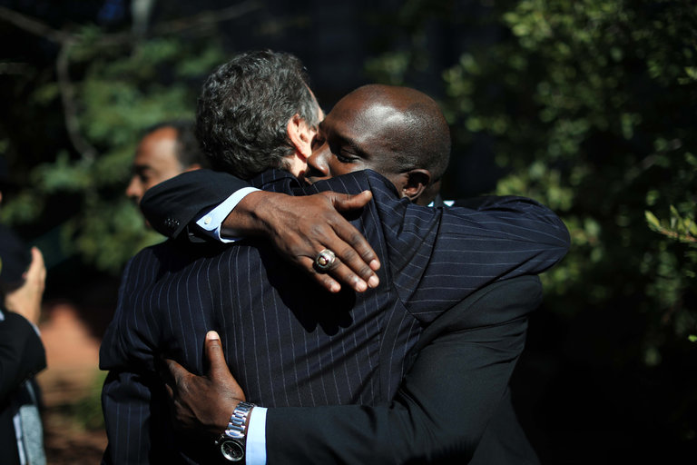
Nick Hillary acquitted
Oral Nicholas Hillary Acquitted in Potsdam Boy’s Killing
September 28, 2016

Slide 45
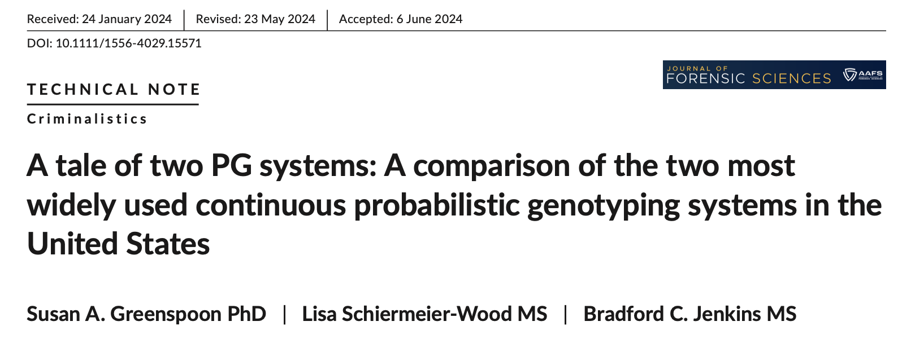
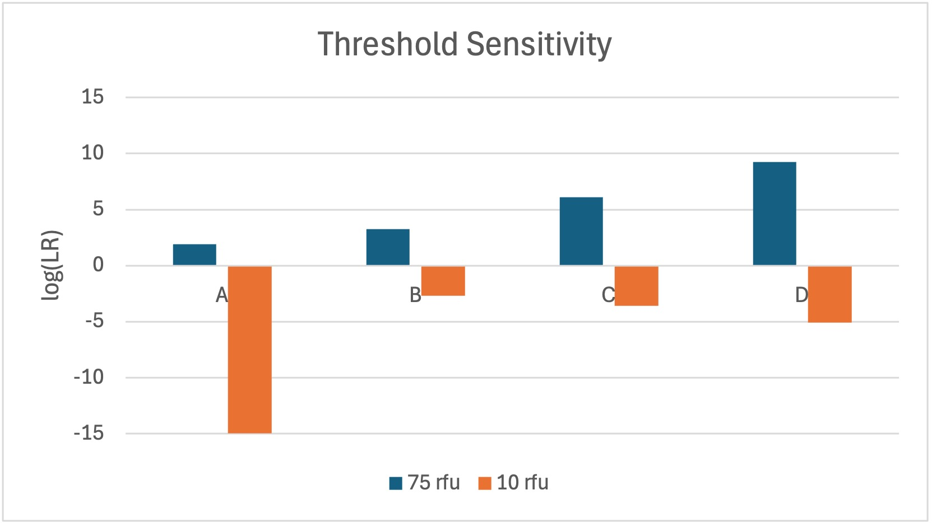
45
Adapted from Figure 4 (STRmix™ LR values)

Slide 46
How to hide truth from courts
46
• Make false statements
• Distract from truth
• Refuse to test method
• Accuse others of lying

Slide 47
Try to block AI computers
47
• Source code is needed to cross-examine software.
• Insist on “ground truth” to dismiss valid testing studies.
• Mislabel transparent software as a “black box”.
• PA v. Washington. Make up incorrect LR definitions.
• US v. Anderson. Demand impossible discovery items.
• US v. Mills. Focus on small LRs, ignore error rate.
* FL v. Daniels. Demand irrelevant “internal” validation.
• US v. Johnson. Pretend low-level DNA is different.
• NIST. Ignore government agency conflicts and bias.
* NE v. Simmer. Laud ad hoc PCAST, ignore standards.
* US v. Gissantaner. Change Daubert prong meaning.
• US v. Sandoval. Ignore how thresholds discard data.
• NY v. Hillary. Claim different methods are the same.

Slide 48
PA v. Washington
48
M.W. Perlin, "Distorting DNA evidence: methods of math distraction", American Academy of Forensic Sciences 70th Annual Meeting, Seattle, WA, 22-Feb-2018.
Focus on the LR numerator, ignore the ratio:
The defendant does not have the highest probability genotype.
Other genotypes have probabilities that add up to over half.
The match probability between the evidence and defendant is small.

Slide 49
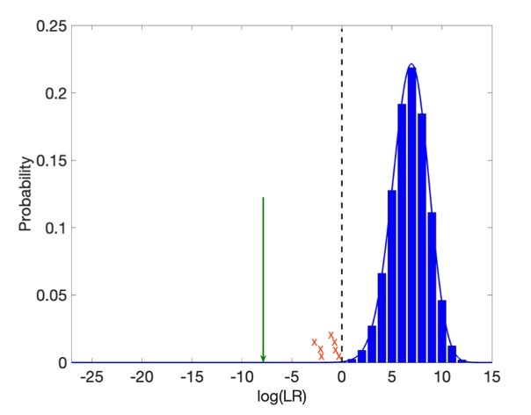
US v. Mills
49
Gun minor contributor (6% MW)
one over
72.8 million
True genotype
log(LR) values
Validation

Slide 50
National Institute of Standards and Technology (NIST)
50
Fear. Create false crisis
CPI failure, MIX05 (2005)
Add new threshold (2010)
Bias. Promote foreign product
Product launch (2013)
Company on-site (2014)
Deceit. Misquote science (2016)
Goal. Regulatory funding & power

Slide 51
NE v. Simmer
51
The two most widely used methods (STRmix and TrueAllele) appear to be reliable within a certain range, based on the available evidence and the inherent difficulty of the problem. Specifically, these methods appear to be reliable for three-person mixtures in which the minor contributor constitutes at least 20 percent of the intact DNA in the mixture and in which the DNA amount exceeds the minimum level required for the method. – PCAST, relying on NIST’s Dr. John Butler
(Cites 2015 TrueAllele® validation paper in JFS on five-contributor mixtures that demonstrates reliability beyond these artificial limits.)
Recommends: The President should request and Congress should provide increased appropriations to NIST of (a) $4 million to support the evaluation activities described above and (b) $10 million to support increased research activities in forensic science, including on complex DNA mixtures, latent fingerprints, voice/speaker recognition, and face/iris biometrics.
Visit to Washington, DC

Slide 52
US v. Sandoval
52
William Thompson. J Forensic Sci. 2023.
Uncertainty in probabilistic genotyping of low template DNA:
A case study comparing STRmix™ and TrueAllele®.
20 conceptual errors
120 mistaken assertions
Data issue: change threshold, change STRmix answer
“To expect competing for-profit companies to refrain from overclaiming and to fully disclose all uncertainties surrounding their findings is apparently expecting too much. To expect courts to regulate these matters as part of their review of admissibility apparently is also expecting too much. If these matters are to be addressed at all, they will need to be addressed by the forensic science community through the standards development process.” - Thompson

Slide 53
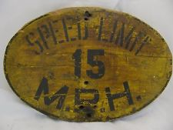
Man limits machines
53
In 1901, Connecticut passed a speed limit law for automobiles. The city speed limit was 12 miles per hour. The rural limit was 15 miles per hour.
Near a horse, cars had to slow down. If the horse was scared, the car had to stop.

Slide 54
Why man restrains the machine
54
Pride
Fear
Envy
Greed
Power
But limiting truth in forensic DNA science harms justice.
Wrongful convictions, wrongful acquittals.

Slide 55
The information incentive
55
Human-based labs are funded by failure.
They are paid to process DNA samples.
Computer-based methods deliver success.
They produce accurate & objective information.
Finding DNA information delivers justice;
losing or hiding information does not.
Government should fund DNA labs based on
how much useable information they produce.

Slide 56
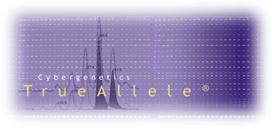

More information
http://www.cybgen.com/information
• Courses
• Newsletters
• Newsroom
• Presentations
• Publications
• Webinars
http://www.youtube.com/user/TrueAllele
TrueAllele YouTube channel
perlin@cybgen.com

