Slide 1


Opening the DNA Past with
TrueAllele® Automation
1
Virginia Association of Commonwealth's Attorneys
Justice & Professionalism Meeting
Mark W Perlin, PhD, MD, PhD
Cybergenetics, Pittsburgh, PA
Cybergenetics © 2003-2021

Slide 2
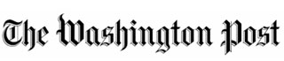
Failed DNA data interpretation
2
Virginia reevaluates DNA evidence in 375 cases
July 16, 2011
“Mixture cases are their own little nightmare,” says William Vosburgh, director of the D.C. police’s crime lab. “It gets really tricky in a hurry.”
“If you show 10 colleagues a mixture,
you will probably end up with 10 different answers”
Dr. Peter Gill, Human Identification E-Symposium, 2005

Slide 3
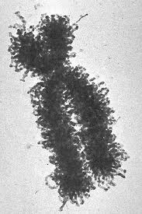
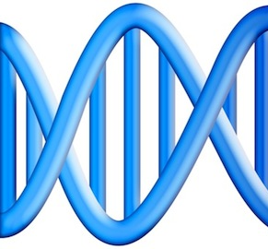

One person, one genotype
3
locus
15
16

Slide 4
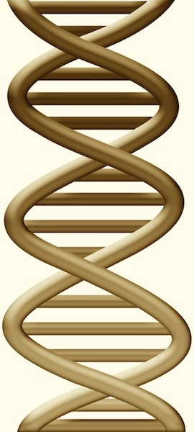

Two people, two genotypes
4
locus
15
16
17
18

Slide 5
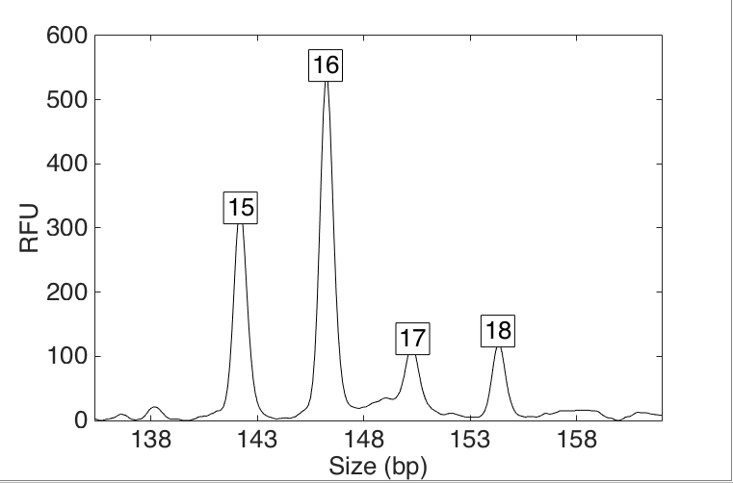
DNA mixture data
At a genetic locus, peak heights show allele amounts
• heights
• pattern
• variation

Slide 6
Human review simplifies data
Arbitrary thresholds lose identification information
All-or-none allele peaks,
get equal status
Under threshold, alleles vanish
Threshold

Slide 7
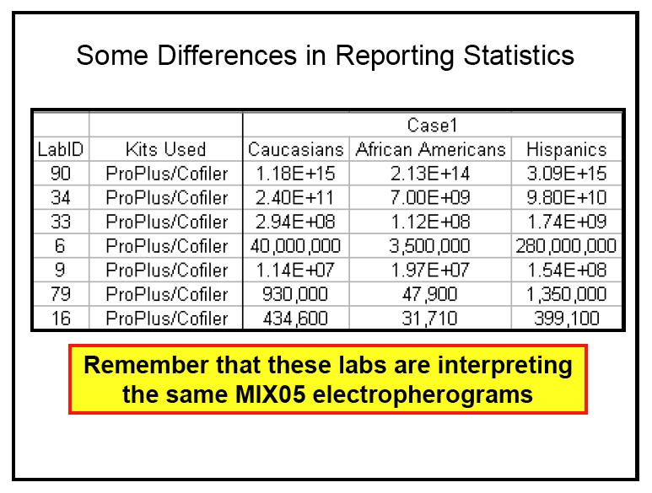
Unreliable DNA mixture statistics
NIST (US Commerce Department) study in 2005
Two contributor mixture data, known victim
When not
“inconclusive”:
213 trillion (14)
31 thousand (4)
Forensic science put on notice 15 years ago

Slide 8

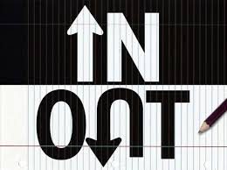



Biased DNA workflow
(1)
Choose data
(2)
Person decides
(3)
Calculate statistic
• Put people in the process
• To overcome software limits
• And introduce human bias

Slide 9
NIST: Stochastic threshold
Under threshold, discard the locus DNA test entirely
Stochastic
Under stochastic,
locus vanishes
Analytical

Slide 10
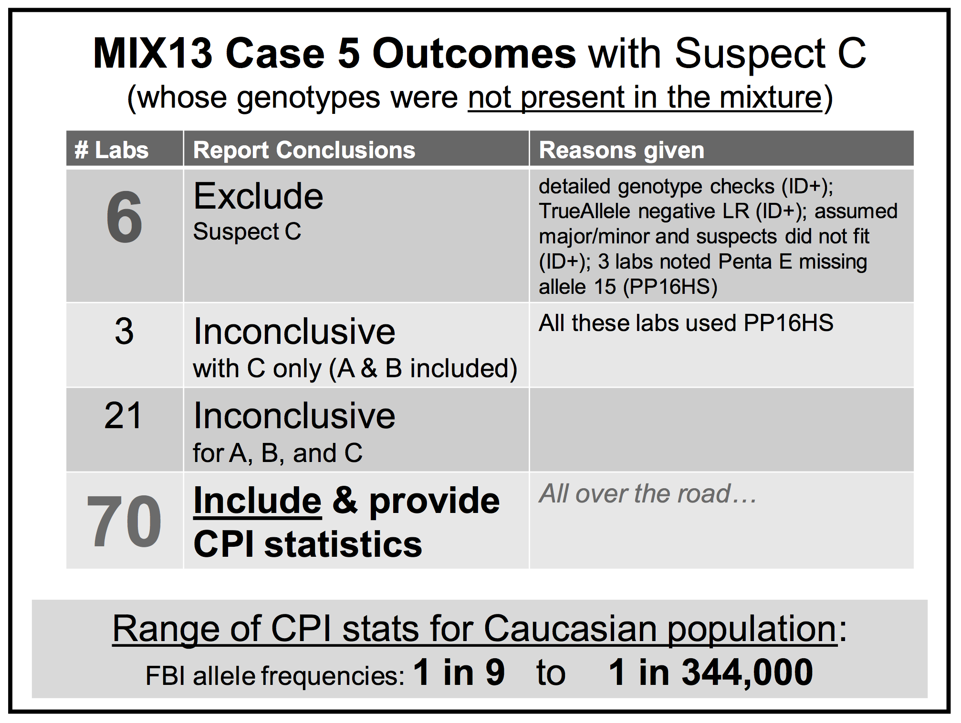
NIST: Thresholds misidentify

Slide 11
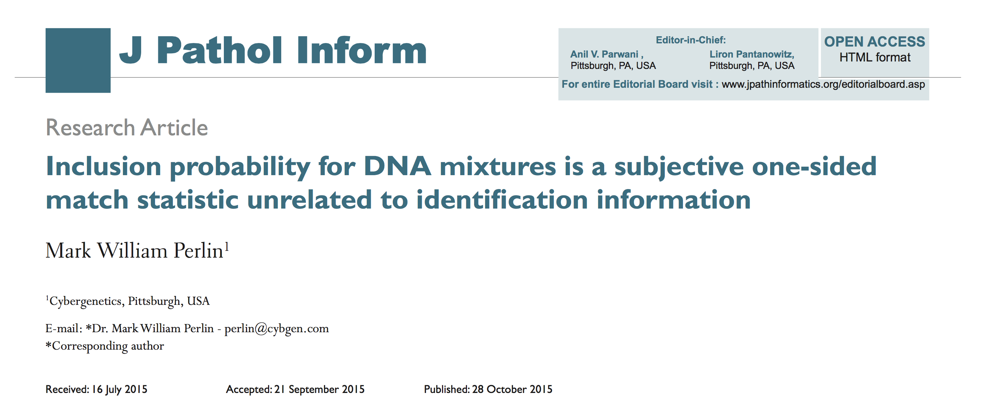
Statistics lack scientific basis
CPI has an analyst count up “included” loci

Slide 12
Mixture statistics shut down labs
“National accreditation board suspends all DNA testing at D.C. crime lab”
The Washington Post April 27, 2015
Did not comply with FBI standards
“New protocol leads to reviews of
‘mixed DNA’ evidence”
The Texas Tribune September 12, 2015
24,468 lab tests affected

Slide 13
Human mixture interpretation
Incomplete. Discard data, apply thresholds
• Inaccurate. Disagrees with true information
• Subjective. Workflow introduces human bias
• Inoperative. Hundreds of thousands of cases
• Opaque. Choices use only some of the data
• Biased. Can only include – or give no answer
Inconclusive

Slide 14
TrueAllele® computer solution
• Complete. Use all data, no thresholds
• Accurate. 42 validation studies, 8 published
• Objective. Workflow removes human bias
• Accepted. Reported in 45 states, WTC, labs
• Transparent. Give math, software (4GB DVD)
• Neutral. Can statistically include or exclude
Informative

Slide 15
TrueAllele explains the data
Considers all genotype combinations, doesn’t see the “suspect”
• objective
• uses all data
• no threshold

Slide 16
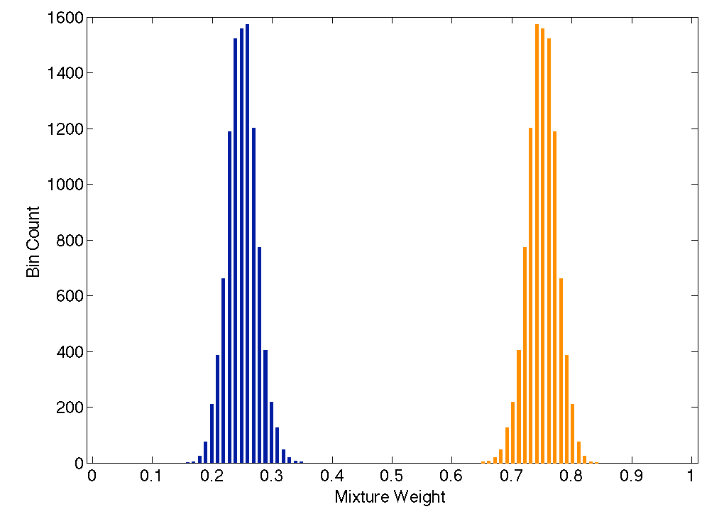
TrueAllele unmixes mixtures
16
Separates the mixture data into contributor components
25%
75%

Slide 17
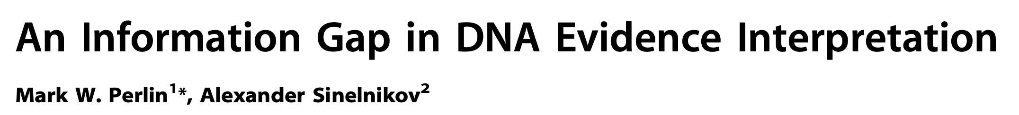

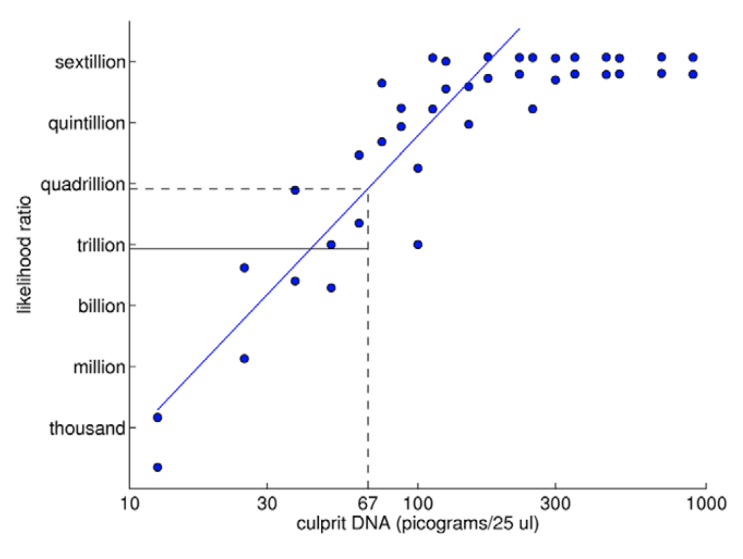
TrueAllele predictability
2009

Slide 18
Daubert reliability prongs
Is testing possible? Has it been tested?
Error rates & standards
Subjected to peer review and publication
General acceptance in relevant scientific community

Slide 19
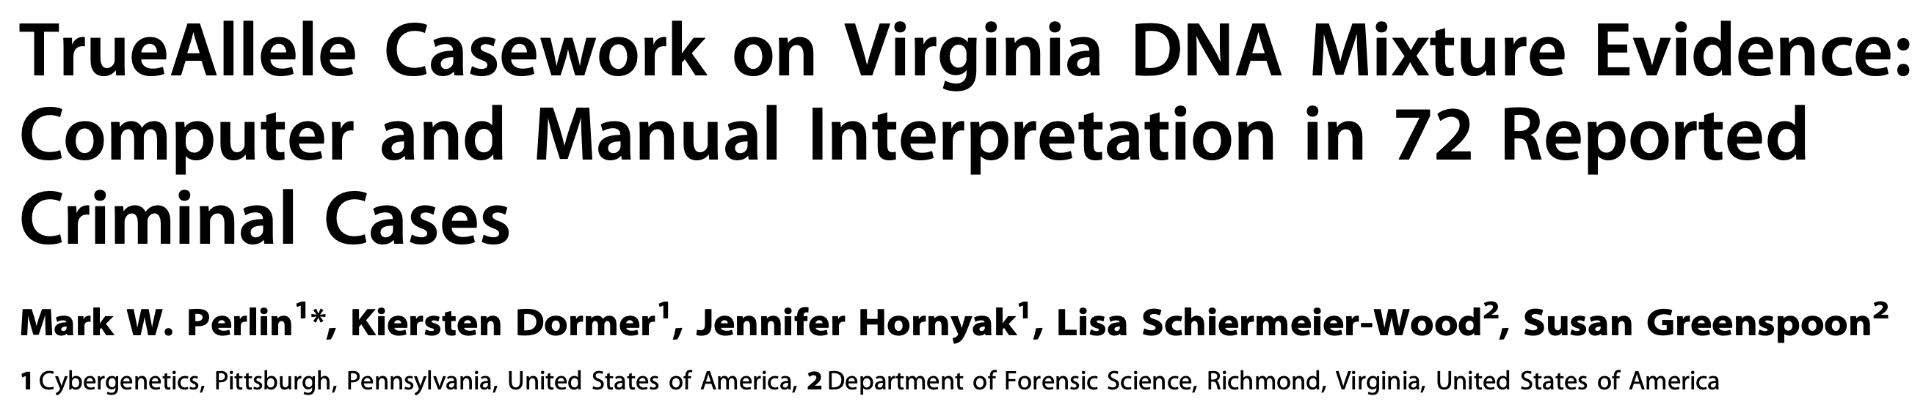
TrueAllele testing
2014
Validation axes
• sensitive
• specific
• reproducible

Slide 20
TrueAllele (& human) error rates
20
TrueAllele specificity (million samples)
From noncontributor distribution, for LR > 100:
Error rate = 1 in 1,000,000 (0.0001)%
CPI – analytical threshold
5 false positives in 81 comparisons
Error rate = 5 in 81 (6%)
mCPI – stochastic threshold
17 inconclusive results
1 false positive in 53 comparisons
Error rate = 1 in 53 (2%)

Slide 21
TrueAllele peer review
21
Perlin MW, Sinelnikov A. An information gap in DNA evidence interpretation. PLoS ONE. 2009;4(12):e8327.
Ballantyne J, Hanson EK, Perlin MW. DNA mixture genotyping by probabilistic computer interpretation of binomially-sampled laser captured cell populations: Combining quantitative data for greater identification information. Science & Justice. 2013;53(2):103-114.
Perlin MW, Hornyak J, Sugimoto G, Miller K. TrueAllele® genotype identification on DNA mixtures containing up to five unknown contributors. Journal of Forensic Sciences. 2015;60(4):857-868.
Greenspoon SA, Schiermeier-Wood L, Jenkins BC. Establishing the limits of TrueAllele® Casework: a validation study. Journal of Forensic Sciences. 2015;60(5):1263-1276.
Bauer DW, Butt N, Hornyak JM, Perlin MW. Validating TrueAllele® interpretation of DNA mixtures containing up to ten unknown contributors. Journal of Forensic Sciences. 2020; 65(2):380-398.
Perlin MW, Legler MM, Spencer CE, Smith JL, Allan WP, Belrose JL, Duceman BW. Validating TrueAllele® DNA mixture interpretation. Journal of Forensic Sciences. 2011;56(6):1430-1447.
Perlin MW, Belrose JL, Duceman BW. New York State TrueAllele® Casework validation study. Journal of Forensic Sciences. 2013;58(6):1458-1466.
Perlin MW, Dormer K, Hornyak J, Schiermeier-Wood L, Greenspoon S. TrueAllele® Casework on Virginia DNA mixture evidence: computer and manual interpretation in 72 reported criminal cases. PLOS ONE. 2014;(9)3:e92837.

Slide 22
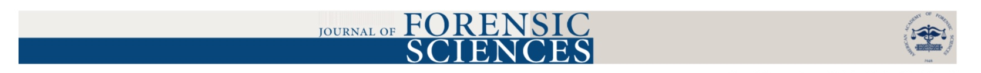
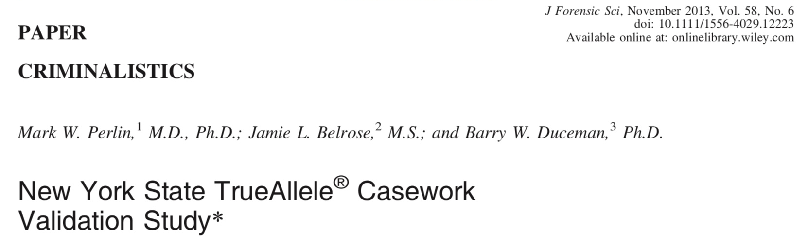
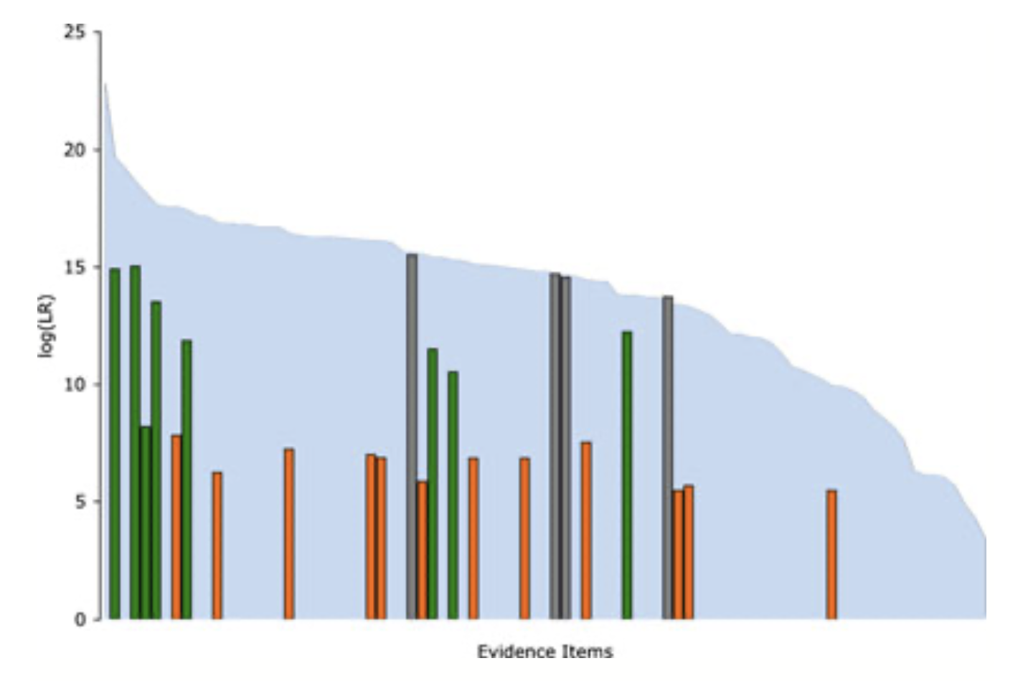
Human review failed 70% of the time,
giving no match statistic, even though
the DNA evidence was informative.

Slide 23
TrueAllele general acceptance
23
Invented math & algorithms | 25 years
Developed computer systems | 20 years
Support users and workflow | 10 laboratories
Routinely used in casework | 10 crime labs
Validate system reliability | 42 studies
Educate the community | 100 talks
Train or certify analysts | 400 students
Admissibility challenges | 29 rulings, 14 states
Testify about LR results | 102 trials
Educate lawyers and public | 1,000 people
Make the ideas understandable | 1,000 cases, 45 states

Slide 24
29 US admissibility rulings
Commonwealth of Pennsylvania v Kevin Foley (admitted, 2009; appellate precedent, 2012)
People of California v Dupree Langston (admitted, 2013)
Commonwealth of Virginia v Matthew Brady (admitted, 2013)
State of Ohio v Maurice Shaw (admitted, 2014)
State of Louisiana v Chattley Chesterfield & Samuel Nicolas (admitted, 2014)
People of New York v John Wakefield (admitted, 2015; appellate precedent, 2019)
State of South Carolina v Jaquard Aiken (admitted, 2015)
Commonwealth of Massachusetts v Heidi Bartlett (admitted, 2016)
State of Indiana v Dugniqio Forest (admitted, 2016)
State of Indiana v Malcolm Wade (admitted, 2016)
State of Washington v Emanuel Fair (admitted, 2017)
State of Louisiana v Harold Houston (admitted, 2017)
State of Indiana v Randal Coalter (admitted, 2017)
State of Nebraska v Charles Simmer (admitted, 2018; appellate precedent, 2019)
State of Indiana v Vaylen Glazebrook (admitted, 2018)
State of Ohio v David Mathis (admitted, 2018)
State of Florida v Lajayvian Daniels (admitted, 2018)
State of Tennessee v Demontez Watkins (admitted, 2018)
State of Georgia v Thaddus Nundra (admitted, 2019)
State of Georgia v Monte Baugh & Thaddeus Howell (admitted, 2019)
State of Louisiana v Kyle Russ (admitted, 2019)
People of New York v Casey Wilson (admitted, 2019)
State of Georgia v Alexander Battle (admitted, 2019)
United States v Lenard Gibbs (admitted, 2019)
State of Georgia v Guy Sewell (admitted, 2019)
State of Georgia v Adedojah Bah (admitted, 2019)
State of Georgia v Nathaniel Day (admitted, 2019)
State of Tennessee v Abdullah Powell (admitted, 2021)
United States v Curtis Johnson (admitted, 2021)

Slide 25
Virginia v. Black
Item | Description | David Black | Bonnie Black | BettyAnn Armstrong | Craig Black | Eleanora Black
08 | Baseball hat velcro strap | 32.5 quintillion | 16.1 billion |  | 1/1.83 thousand | 1/62.6
94 | Master bedroom light switch | 364 million | 8.14 million
95 | Master bathroom light switch | 1/19.5 | 554 million |  |  | 3.63 million

Slide 26

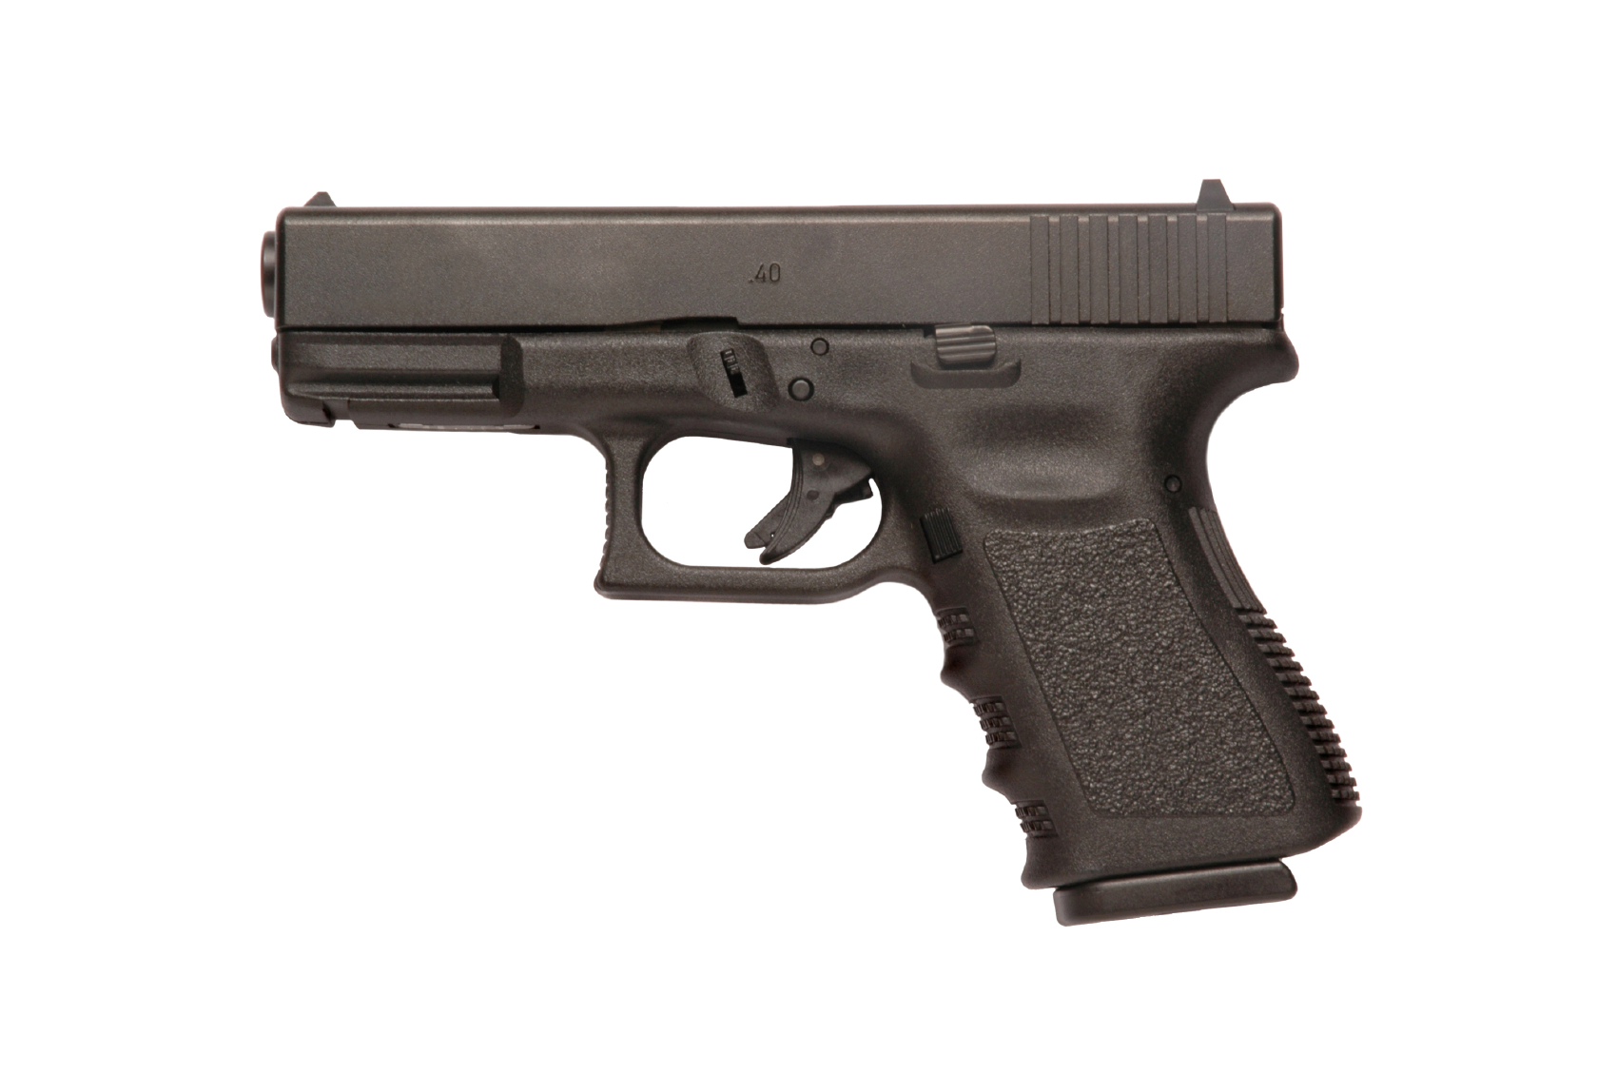

Pennsylvania v. McBride
Cybergenetics TrueAllele reanalysis
Match statistics provide information
Person A
excluded
Contributor
Unmix the
mixture
1
2
400,000
3
Person B
included
4

Slide 27
Indiana v. Pinkins & Glenn
Historical cases
1989 – 5 men raped an Indiana woman
Darryl Pinkins and 2 others misidentified
1991 – wrongfully convicted, 65 year sentence
2001 – DNA mixture evidence
2 contributors found, not the accused
but 5 were needed, post-conviction relief denied

Slide 28
TrueAllele Pinkins findings
1. compared evidence with evidence
2. calculated exclusionary match statistics
3. revealed 5% minor mixture contributor
4. jointly analyzed DNA mixture data
5. showed three perpetrators were brothers
found 5 unidentified genotypes,
defendants not linked to the crime

Slide 29
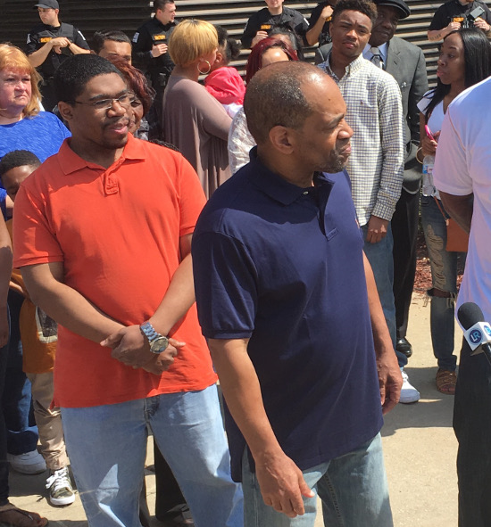
Pinkins exonerated
Indiana
April 25, 2016

Slide 30
Georgia v. Gates
1977, Johnnie Lee Gates admits to murder,
is convicted and sentenced to death
• Mental deficiency
• Brought to crime scene for confession, touched items
• Prosecutor struck all black jurors in several capital cases
• Two newly discovered ligatures – four-contributor mixtures
• Lab’s human review finds DNA mixtures “inconclusive”

Slide 31
TrueAllele match statistics
Item | Description | Johnny Lee Gates
76C2573-032 | robe belt side 1 swab | one in 1.5 million
76C2573-033 | robe belt side 2 swab | one in 134 thousand
76C2573-034 | front of black tie swab | one in 4.33 million
76C2573-035 | back of black tie swab | one in 963 million
76C2573-042 | robe belt M-vac filter | one in 902 trillion
76C2573-044 | black tie M-vac filter | one in 825 billion
DNA doesn’t “fall off”

Slide 32
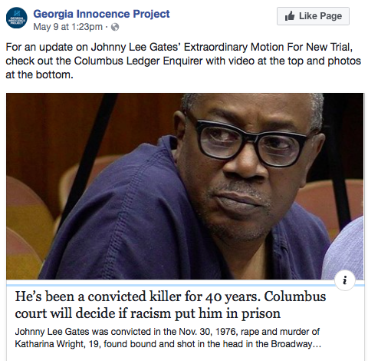
New trial, released from prison

Slide 33
Texas v. Grant
2011, Houston lab fails to interpret DNA mixture
from fingernails of 2010 murder victim;
crime lab testifies DNA is inconclusive
Lydell Grant convicted of murder
and receives a life sentence
2019, Innocence Project of Texas
sends DNA data to Cybergenetics

Slide 34
Match statistics
Item | Description | 12.1.1 Aaron Scheerhoorn | 13.1 Lydell Grant
12.2.1.1 | right hand fingernails | 18.61 | -12.93

Slide 35
Non-matching evidence genotype
TrueAllele also inferred a non-matching evidence genotype from the right-hand fingernails. The probabilistic genotype of this unknown contributor has an expected LR match statistic of 18.2 trillion.
A CODIS-searchable allele list was derived from the probabilistic genotype at a 90% credible level.
Should additional reference genotypes become available, Cybergenetics can compare them with the probabilistic genotype to calculate DNA match statistics.

Slide 36
Unprecedented CODIS search
• In 2019, TrueAllele crime lab searches CODIS
• Search finds the unknown fingernail person
• Confronted in Georgia, killer confesses to crime
Government was not pleased by our use of
better science to reveal the truth in this case

Slide 37
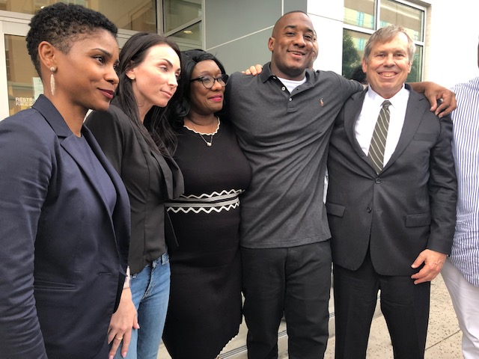
Grant released, exonerated
• Grant eventually released from prison
• In 2021, Lydell Grant finally exonerated

Slide 38
New York v. Robinson
Crime laboratory reported “inconclusive” results
Prosecutor: from “inconclusive” to “guilty”
TrueAllele | Victim | Defendant
fingernail | 57.2 septillion | one in 1.18 trillion
Crime laboratory later reported a weak exclusion

Slide 39
Pennsylvania v. Huber
Modern cases
Item | Description | Melissa Zuk | Derek Schindler | Joshua Huber
13E | Living room wall bloodstain | 1 in 160 million | 1 in 36 thousand | 11.6 quintillion
29A | Schindler's right hand fingernails |  | 1.37 quintillion | 53.8 thousand
1603461-13A | Left hand fingernails of Melissa Zuk | 17.4 billion |  | 3.35 thousand

Slide 40
California v. Lopez
Man accused of rape and murder of girlfriend’s toddler son
• Facing the death penalty, or life in prison.
• The child was 2 years and 10 months old.
• There were bruises to his face, genitals, and rectum.
• An autopsy showed brain swelling, skull fracture, cheek bruises, and asphyxia.
• A rectal swab from the boy showed semen.
• The swab matched the defendant’s DNA.

Slide 41
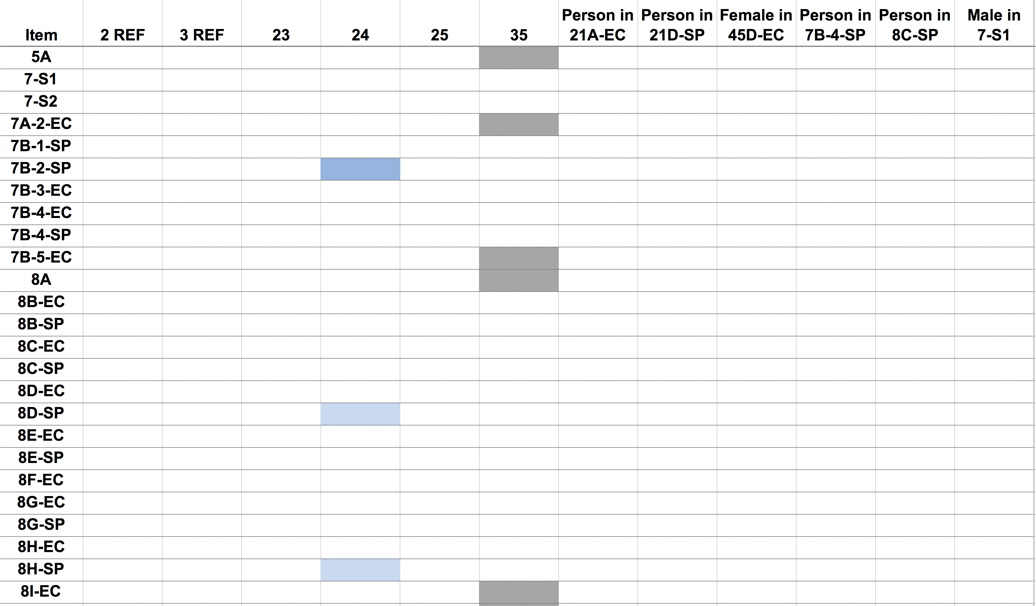
County Crime Lab (1 of 3)
Sister
Brother
Mother
Defendant
Brother
Victim

Slide 42
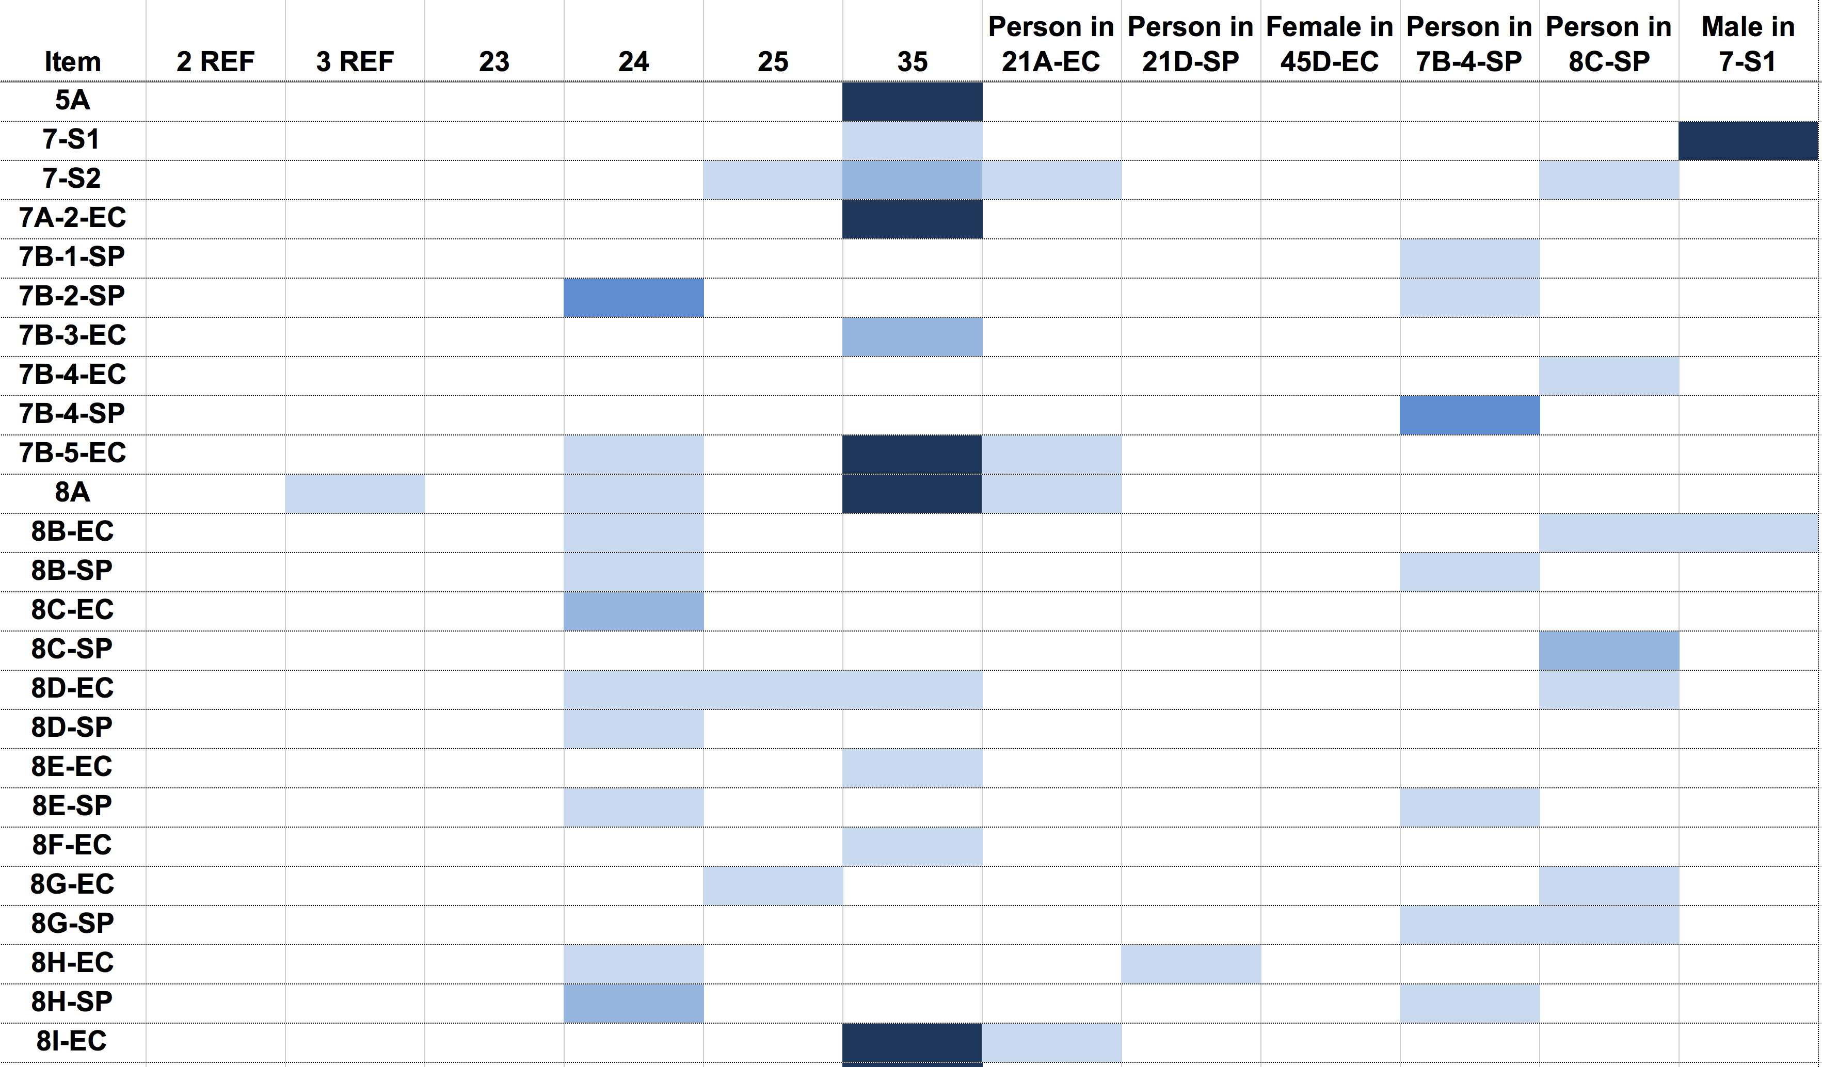
Cybergenetics TrueAllele (1 of 3)
Sister
Brother
Mother
Defendant
Brother
Victim

Slide 43
Two strange puzzles
• Where’s Mom’s DNA?
Lots of different people left lots of DNA,
but the primary caretaker left none.
• Rectal DNA conflict
Why was the defendant’s DNA found
in the initial hospital rectal swabs (Item 16),
but not later at autopsy (Item 39)?

Slide 44
Final verdict
The prosecution was target-driven.
The defense was nontarget-driven.
Cybergenetics experts educated the jury.
The nontargeted scenario better explained the evidence.
The jury acquitted the defendant of all charges.
The county no longer seeks the death penalty.

Slide 45
Human review has failed
• Inaccurate, unvalidated, biased
• Inconclusive, uninformative
• Unreliable, irrelevant, fails prongs
Inclusion probability for DNA mixtures
is a subjective one-sided match statistic
unrelated to identification information (JPI)
Hundreds of thousands of past cases
have informative DNA evidence, but:
• meaningless DNA statistics
• no DNA statistics
• no exclusionary statistics

Slide 46
TrueAllele automation succeeds
• Accurate, validated, unbiased
• Gives stats & error rates, informative
• Reliable, relevant, passes prongs
TrueAllele mixture interpretation
is a reliable method (PLoS):
objective, sensitive, specific, reproducible, accurate
The automated TrueAllele computer process
can be run on large batches of DNA cases
with minimal human effort

Slide 47
How to open the past
Commonwealth’s Attorneys can:
1. Request electronic DNA data from state lab
2. Send the data to Cybergenetics for processing
3. Get back accurate identification information
TrueAllele can report all DNA match results
(without cutoffs or limits, for or against)
because it gives exact error rates on every match statistic
Better science leads to better justice

