Slide 1

TrueAllele® validation:
Computer interpretation of
DNA mixture evidence
Mark W Perlin, PhD, MD, PhD
Cybergenetics, Pittsburgh, PA
Cybergenetics © 2003-2021

Slide 2
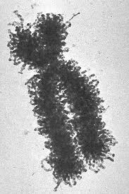
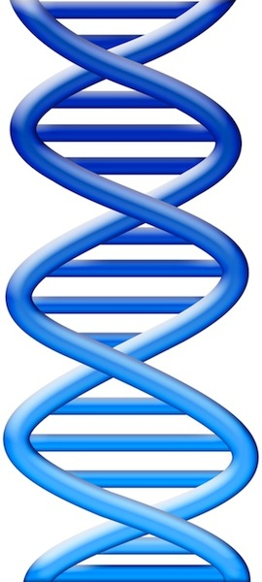

One person, one genotype
locus
7
14

Slide 3
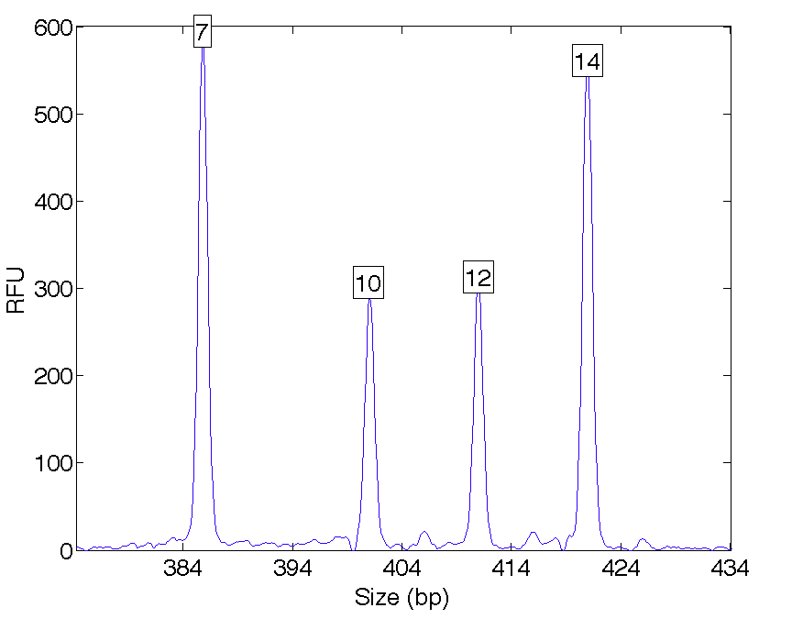
DNA data
One or two allele peaks at a locus

Slide 4
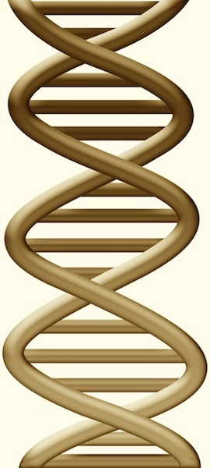

Two people, two genotypes
locus
7
14
10
12

Slide 5
DNA mixture problem
Quantitative peak heights at a locus
peak size
peak
height

Slide 6
Data summary – “alleles”
Over threshold, peaks are labeled as allele events
Allele Pair
7, 7
7, 10
7, 12
7, 14
10, 10
10%10, 12
10, 14
12, 12
12, 14
14, 14
All-or-none allele peaks,
each given equal status
Analytical
Threshold

Slide 7
CPI information
6.83 (2.22)
6.68 million
CPI
Combined probability of inclusion

Slide 8
SWGDAM 2010 guidelines
Higher threshold for human review
Allele Pair
7, 7
7, 10
7, 12
7, 14
10, 10
0%10, 12
10, 14
12, 12
12, 14
14, 14
Under threshold, alleles less used
Stochastic
Threshold
Analytical
Threshold

Slide 9
Modified CPI information
6.83 (2.22)
6.68 million
CPI
2.15 (1.68)
140
mCPI

Slide 10
SWGDAM 2010 guidelines
3.2.2. If a stochastic threshold based on peak height is not used in the evaluation of DNA typing results, the laboratory must establish alternative criteria (e.g., quantitation values or use of a probabilistic genotype approach) for addressing potential stochastic amplification. The criteria must be supported by empirical data and internal validation and must be documented in the standard operating procedures.
Use TrueAllele® Casework for DNA mixture statistics

Slide 11
TrueAllele® computer solution
• Accurate. 41 validation studies, 8 published
• Objective. Workflow removes human bias
• Accepted. Reported in 44 states, used by labs
• Transparent. Give math, software (4GB DVD)
• Neutral. Can statistically include or exclude

Slide 12
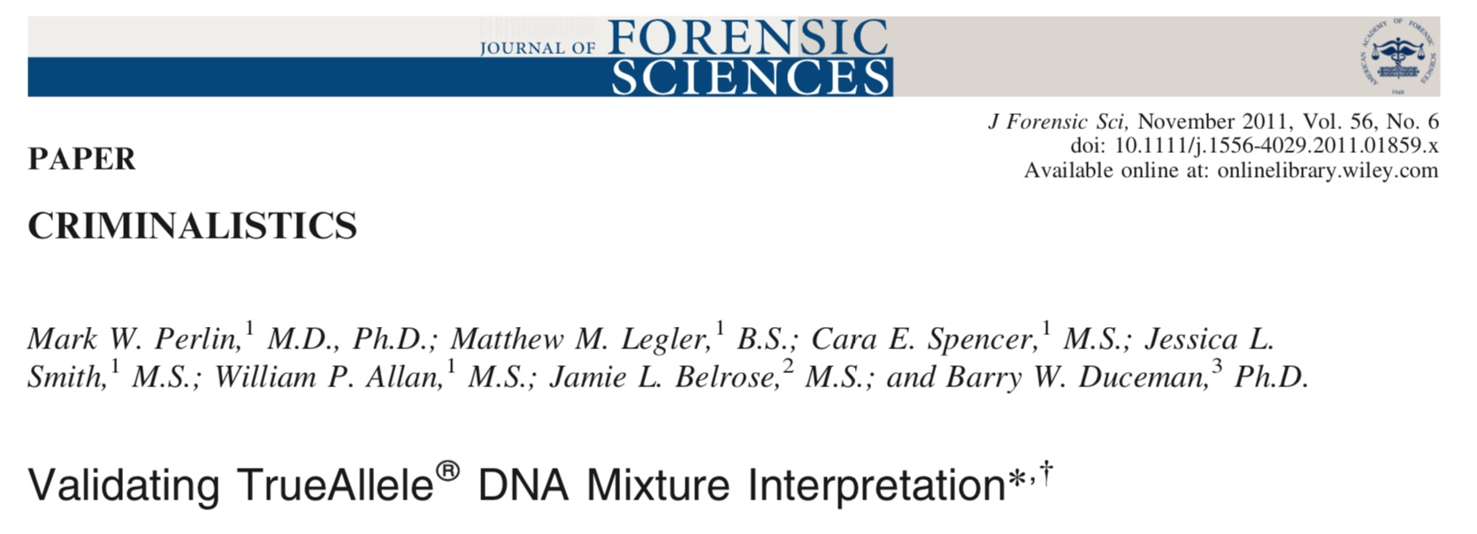
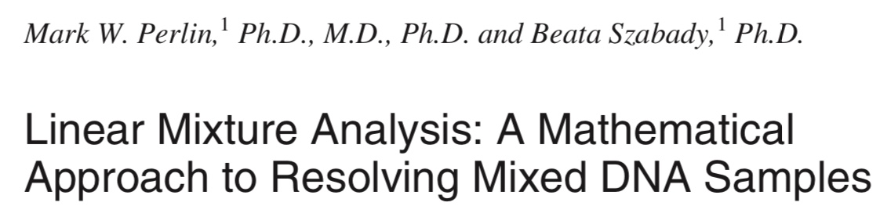
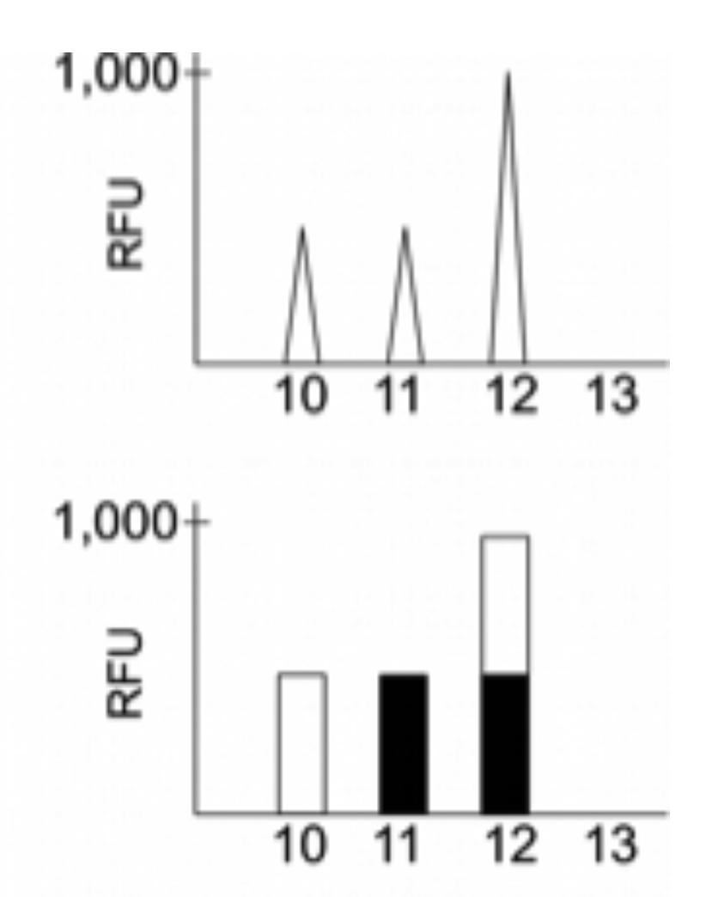
Explaining DNA mixtures
2001
DNA peak height data
Sum of genotypes

Slide 13
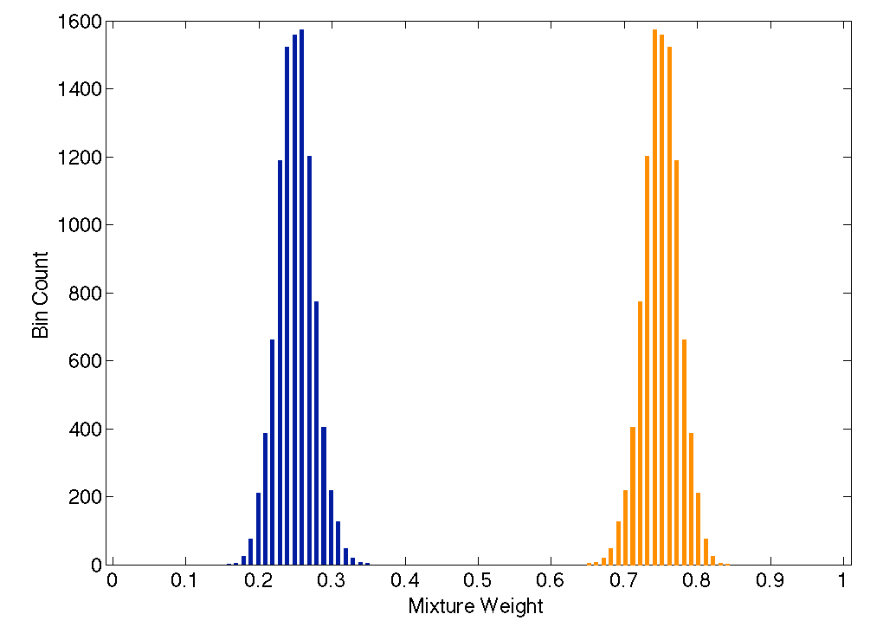
Mixture separation
Separate the mixture data into contributor components
25%
75%

Slide 14
Genotyping objectivity
Thorough: consider every possible genotype solution
Objective: does not know the comparison genotype
Allele Pair
7, 7
7, 10
7, 12
7, 14
10, 10
98%10, 12
10, 14
12, 12
12, 14
14, 14
Victim's allele pair
Explain the
peak pattern
Another person's allele pair
Better
explanation
has a
higher likelihood

Slide 15
Peer-reviewed validation studies
Perlin MW, Sinelnikov A. An information gap in DNA evidence interpretation. PLoS ONE. 2009;4(12):e8327.
Ballantyne J, Hanson EK, Perlin MW. DNA mixture genotyping by probabilistic computer interpretation of binomially-sampled laser captured cell populations: Combining quantitative data for greater identification information. Science & Justice. 2013;53(2):103-114.
Perlin MW, Hornyak J, Sugimoto G, Miller K. TrueAllele® genotype identification on DNA mixtures containing up to five unknown contributors. Journal of Forensic Sciences. 2015;60(4):857-868.
Greenspoon SA, Schiermeier-Wood L, Jenkins BC. Establishing the limits of TrueAllele® Casework: a validation study. Journal of Forensic Sciences. 2015;60(5):1263-1276.
Bauer DW, Butt N, Hornyak JM, Perlin MW. Validating TrueAllele® interpretation of DNA mixtures containing up to ten unknown contributors. Journal of Forensic Sciences. 2020; 65(2):380-398.
Perlin MW, Legler MM, Spencer CE, Smith JL, Allan WP, Belrose JL, Duceman BW. Validating TrueAllele® DNA mixture interpretation. Journal of Forensic Sciences. 2011;56(6):1430-1447.
Perlin MW, Belrose JL, Duceman BW. New York State TrueAllele® Casework validation study. Journal of Forensic Sciences. 2013;58(6):1458-1466.
Perlin MW, Dormer K, Hornyak J, Schiermeier-Wood L, Greenspoon S. TrueAllele® Casework on Virginia DNA mixture evidence: computer and manual interpretation in 72 reported criminal cases. PLOS ONE. 2014;(9)3:e92837.

Slide 16
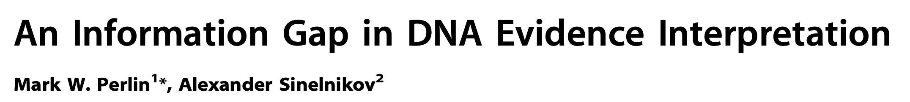

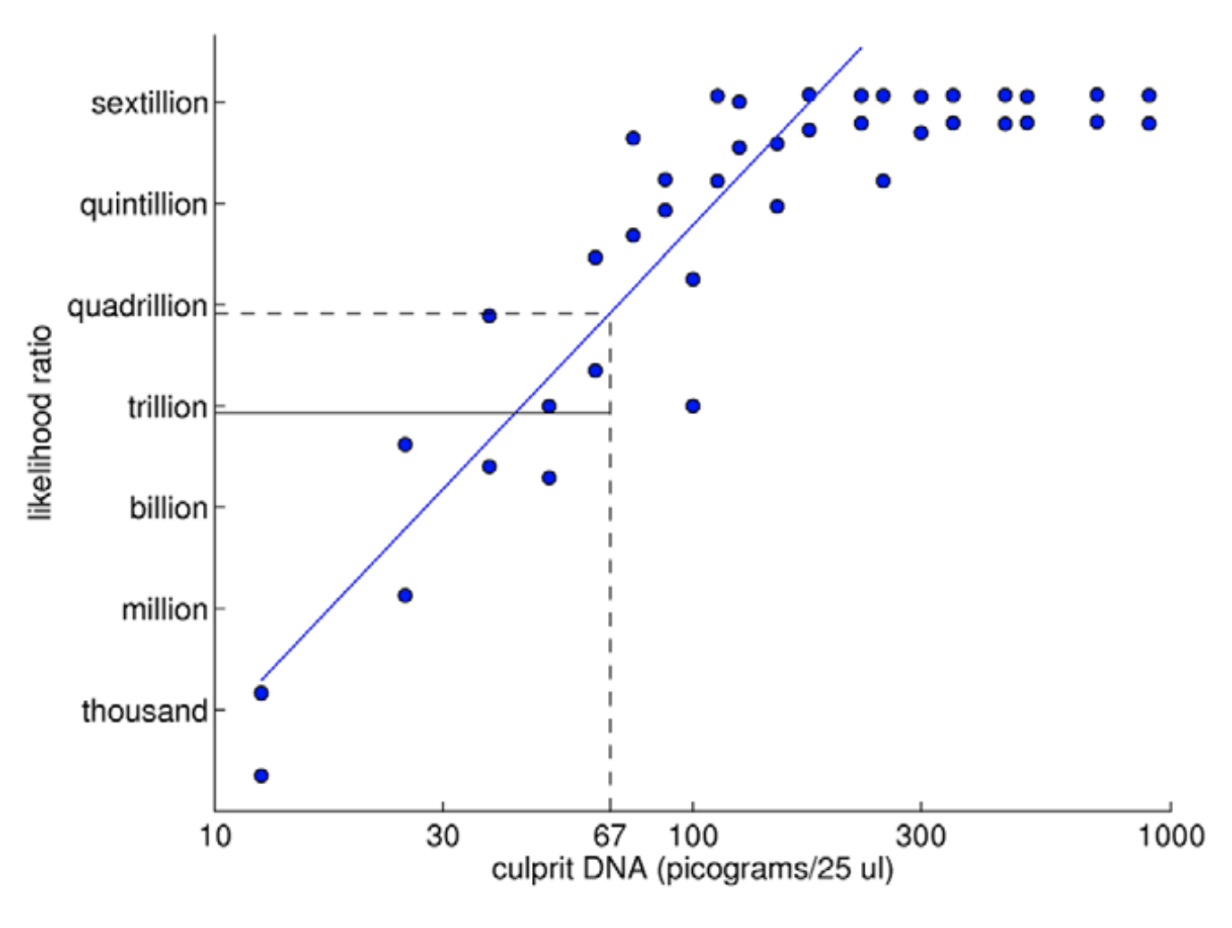
TrueAllele predictability
2009

Slide 17
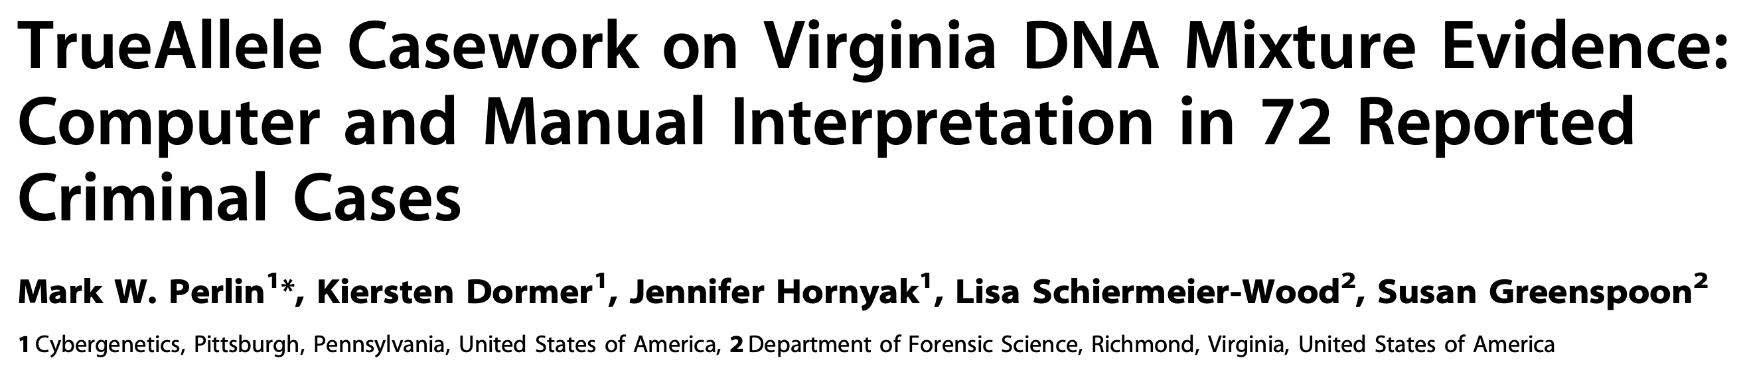
TrueAllele reliability
2014
Validation axes
• sensitive
• specific
• reproducible

Slide 18
Sensitivity
The extent to which interpretation identifies the correct person
True DNA mixture inclusions
101 reported genotype matches
82 with DNA statistic over a million

Slide 19
TrueAllele sensitivity
log(LR) match distribution
11.05 (5.42)
113 billion
TrueAllele

Slide 20
Comparison
6.83 (2.22)
6.68 million
CPI
2.15 (1.68)
140
mCPI
11.05 (5.42)
113 billion
TrueAllele

Slide 21
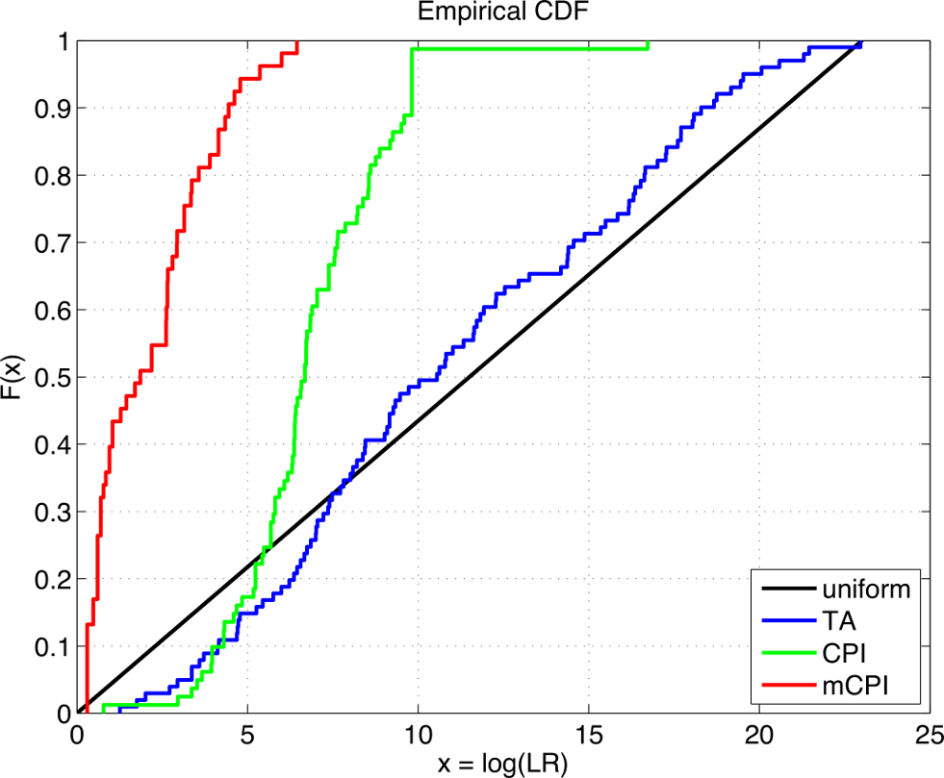
TrueAllele accuracy

Slide 22
Specificity
The extent to which interpretation does not misidentify the wrong person
True exclusions, without false inclusions
101 matching genotypes x 10,000 random references
x 3 ethnic populations,
for over 1,000,000 nonmatching comparisons

Slide 23
TrueAllele specificity
log(LR) nonmatch distribution
– 19.47

Slide 24
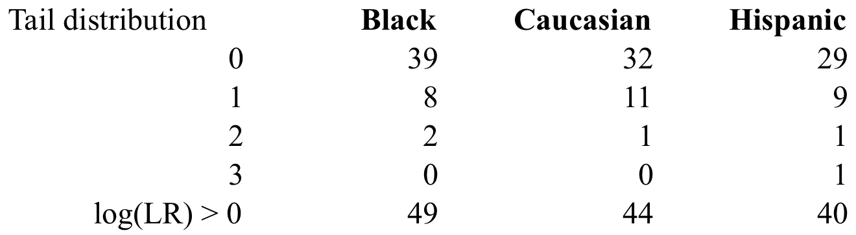
False positives
in over 1,000,000 comparisons per group
false positive rate is under 1 in 20,000 (0.005%)
for LR > 100, rate is 1 in 1,000,000 (0.0001)%

Slide 25
Higher human error rate
TrueAllele specificity (million samples)
From noncontributor distribution, for LR > 100:
Error rate = 1 in 1,000,000 (0.0001)%
CPI – analytical threshold
5 false positives in 81 comparisons
Error rate = 5 in 81 (6%)
mCPI – stochastic threshold
17 inconclusive results
1 false positive in 53 comparisons
Error rate = 1 in 53 (2%)

Slide 26
Reproducibility
The extent to which interpretation gives
the same answer to the same question
MCMC computing has sampling variation
duplicate computer runs
on 101 matching genotypes
measure log(LR) variation

Slide 27
TrueAllele reproducibility
Concordance in two independent computer runs
standard deviation
(within-group)
0.305

Slide 28
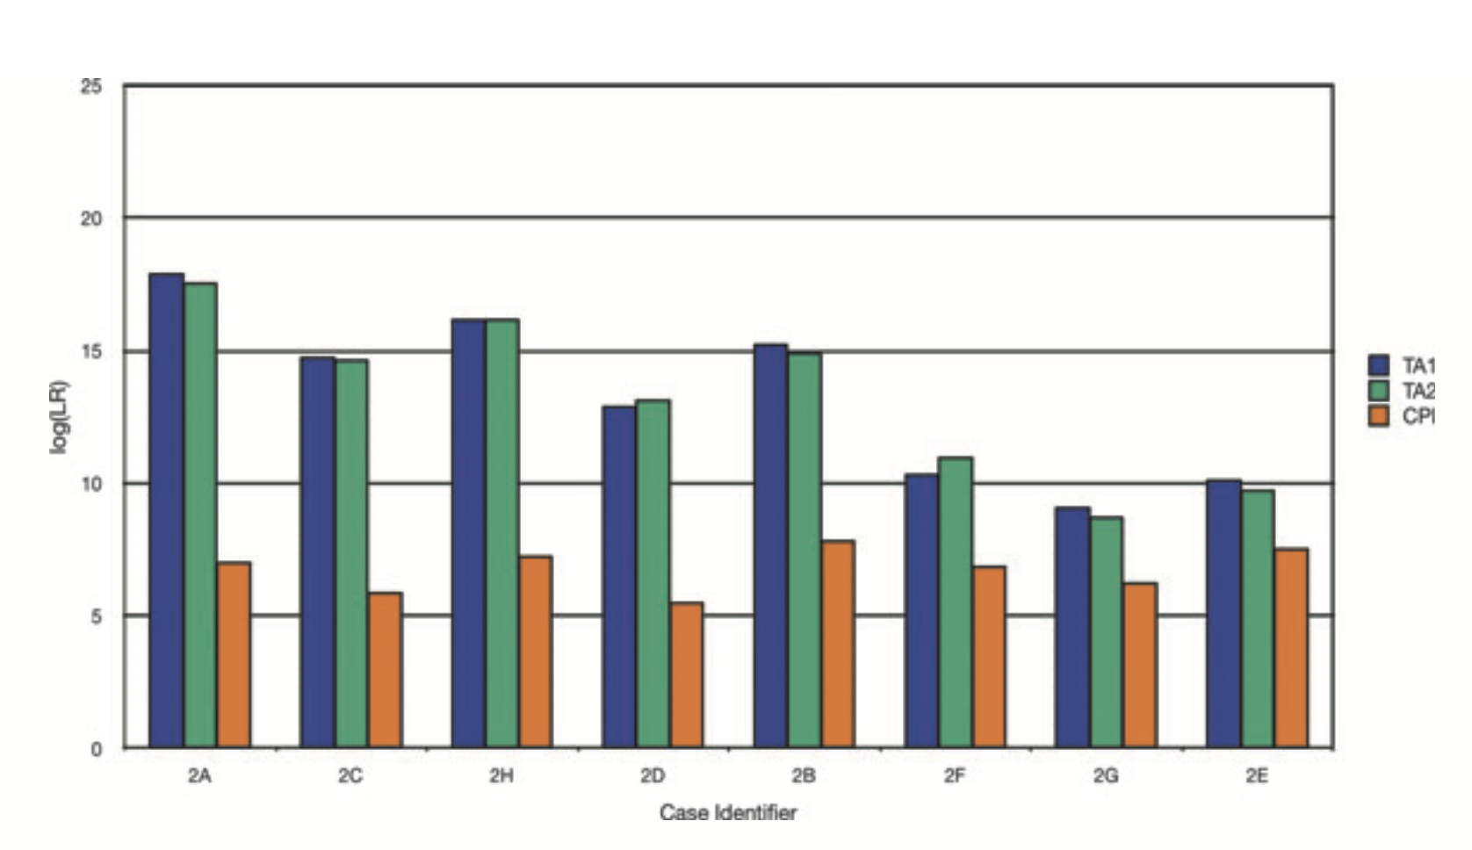

Slide 29
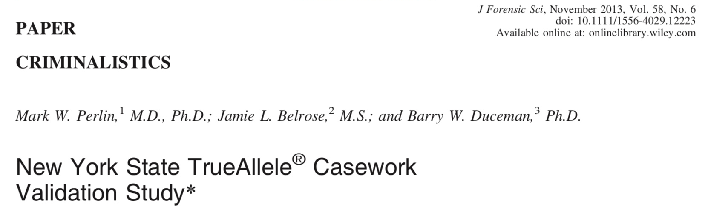
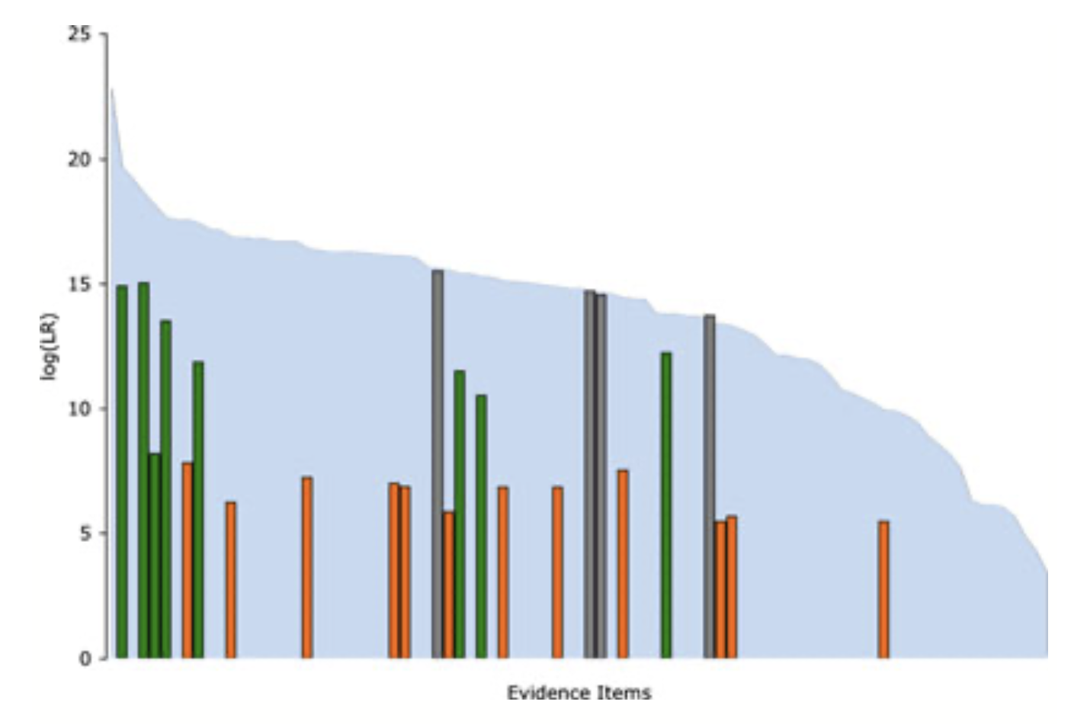

Slide 30
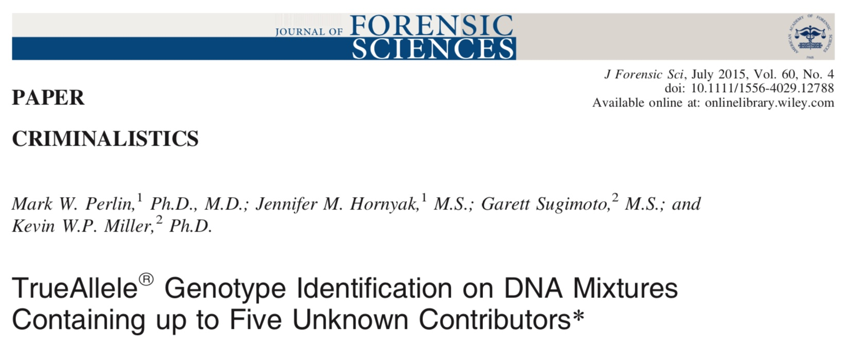
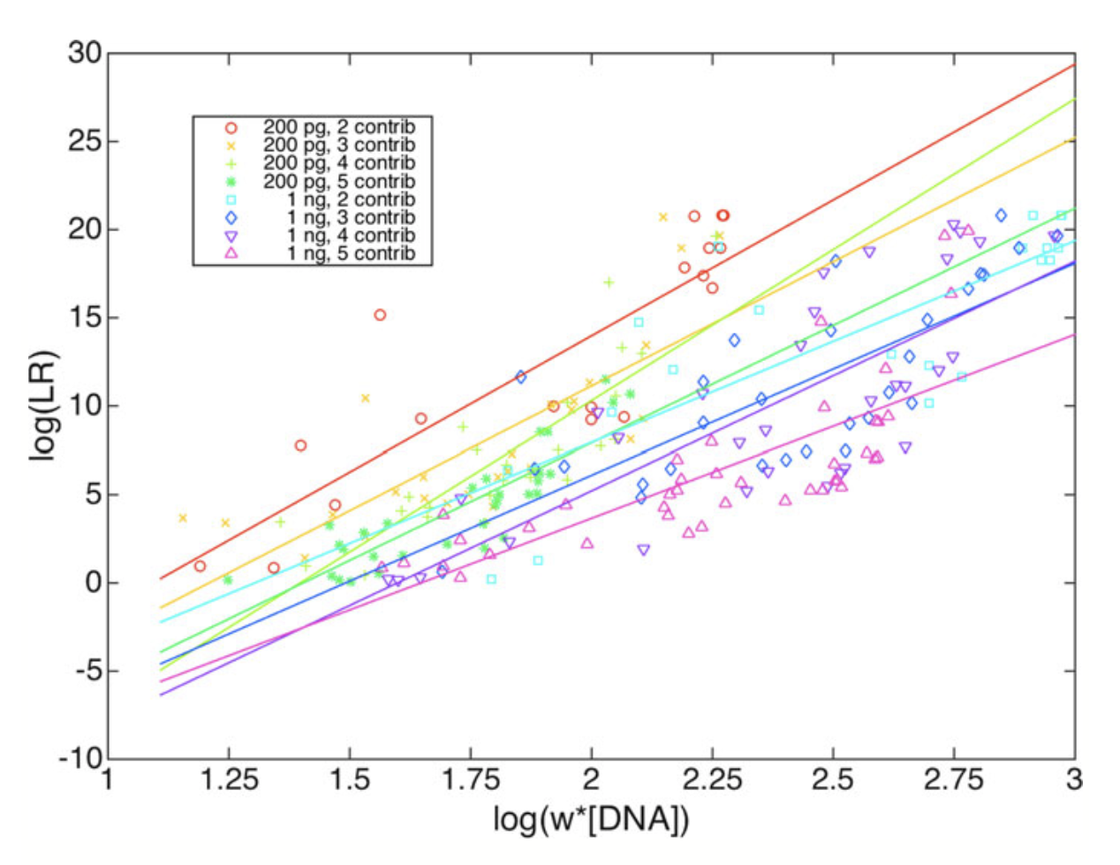

Slide 31
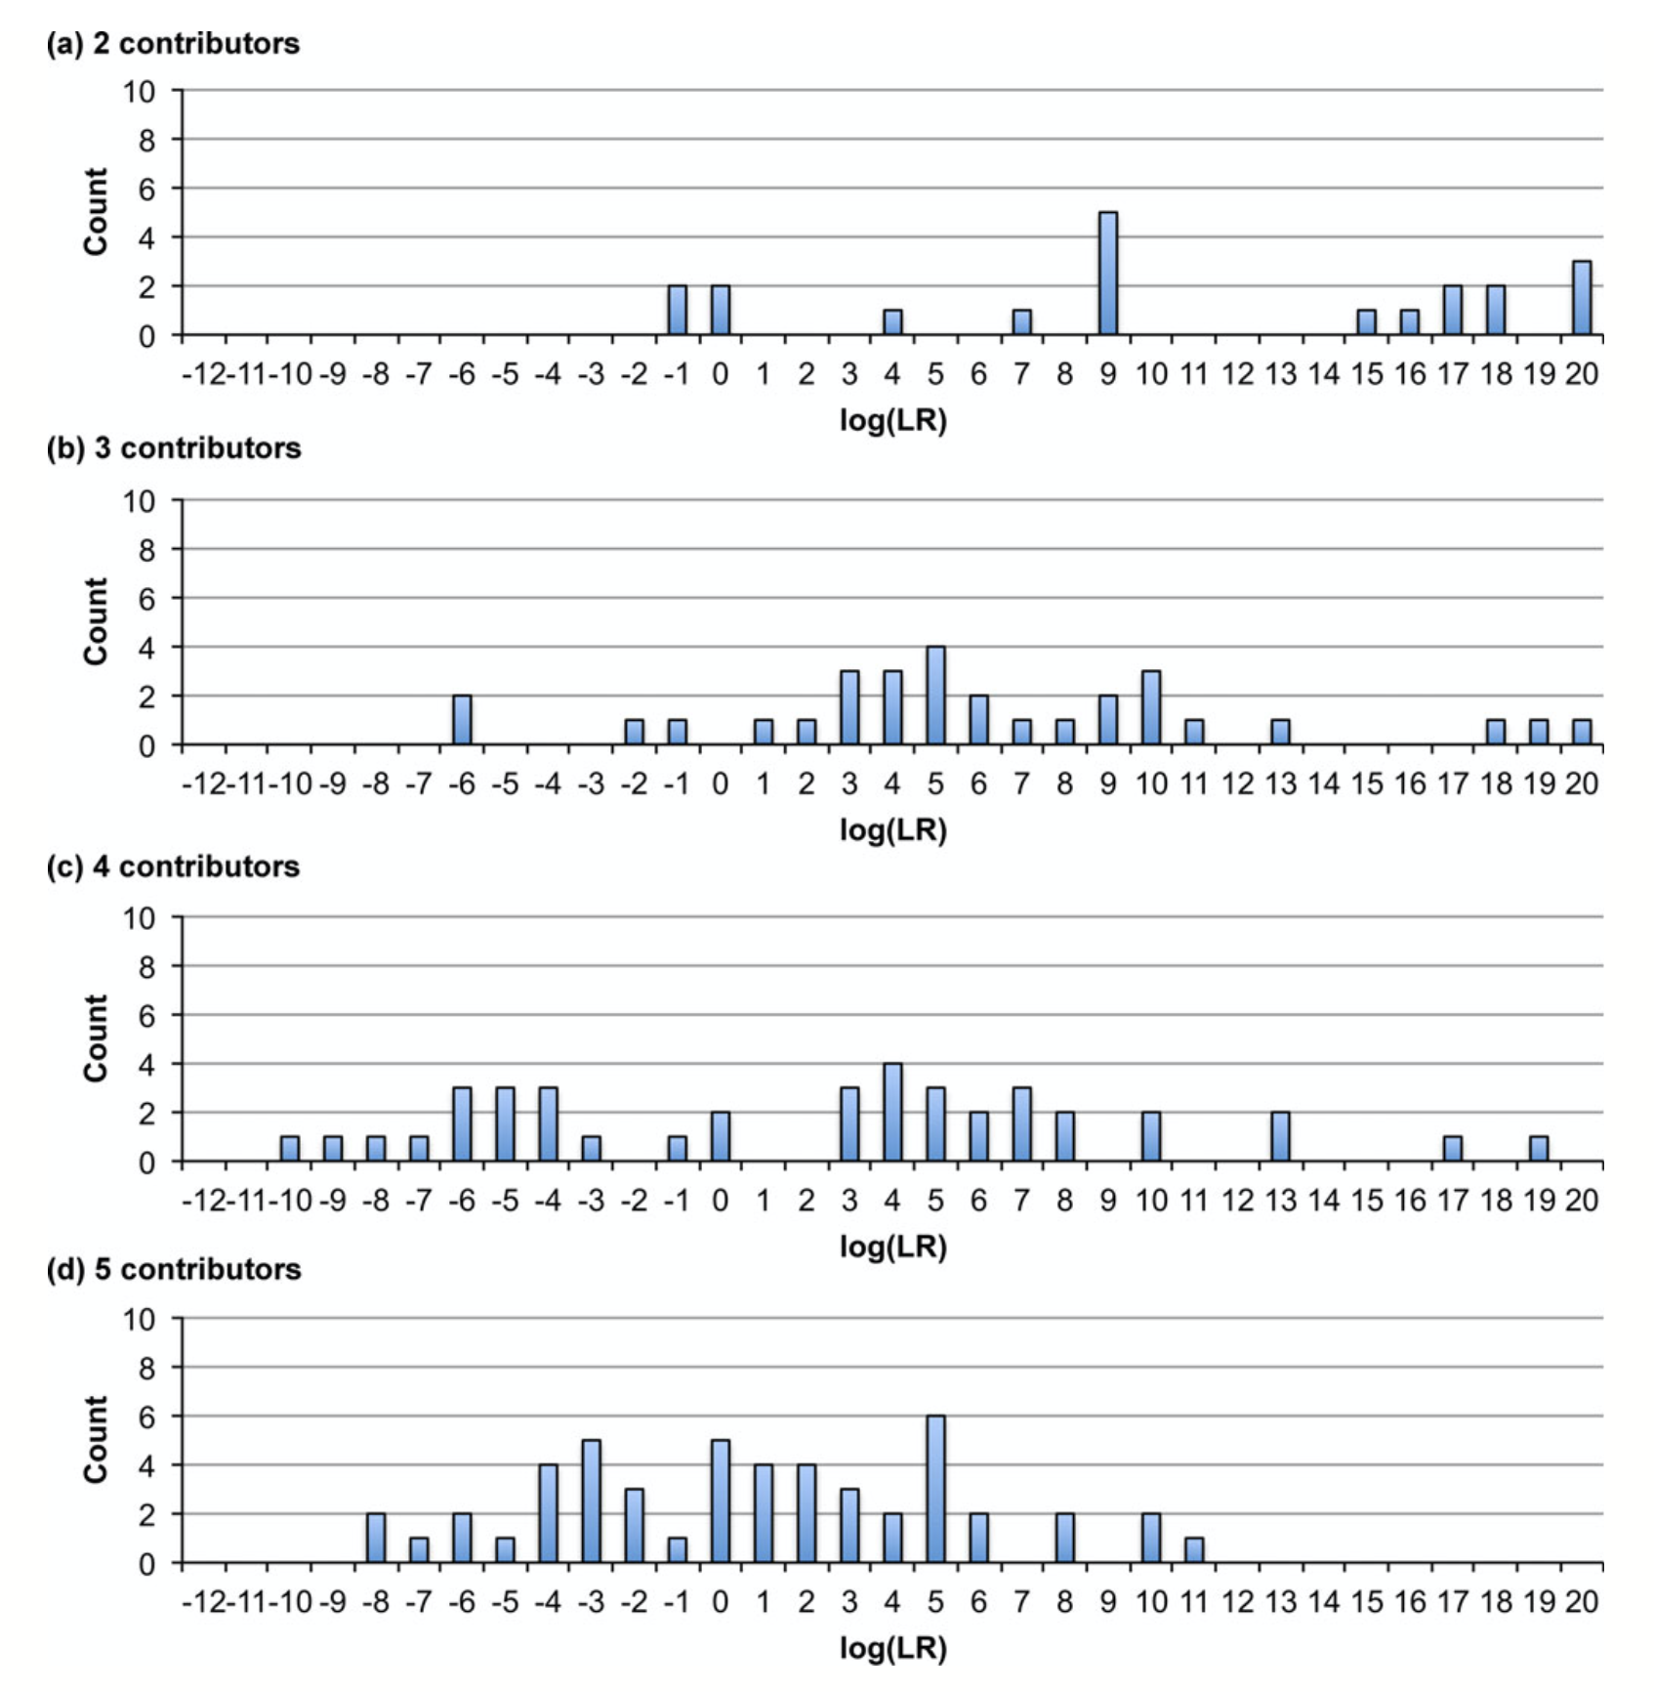
TrueAllele sensitivity
200 pg

Slide 32
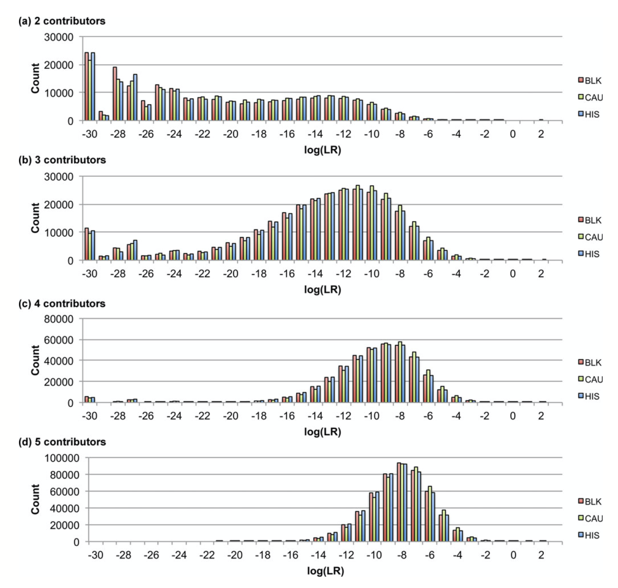
TrueAllele specificity
200 pg

Slide 33
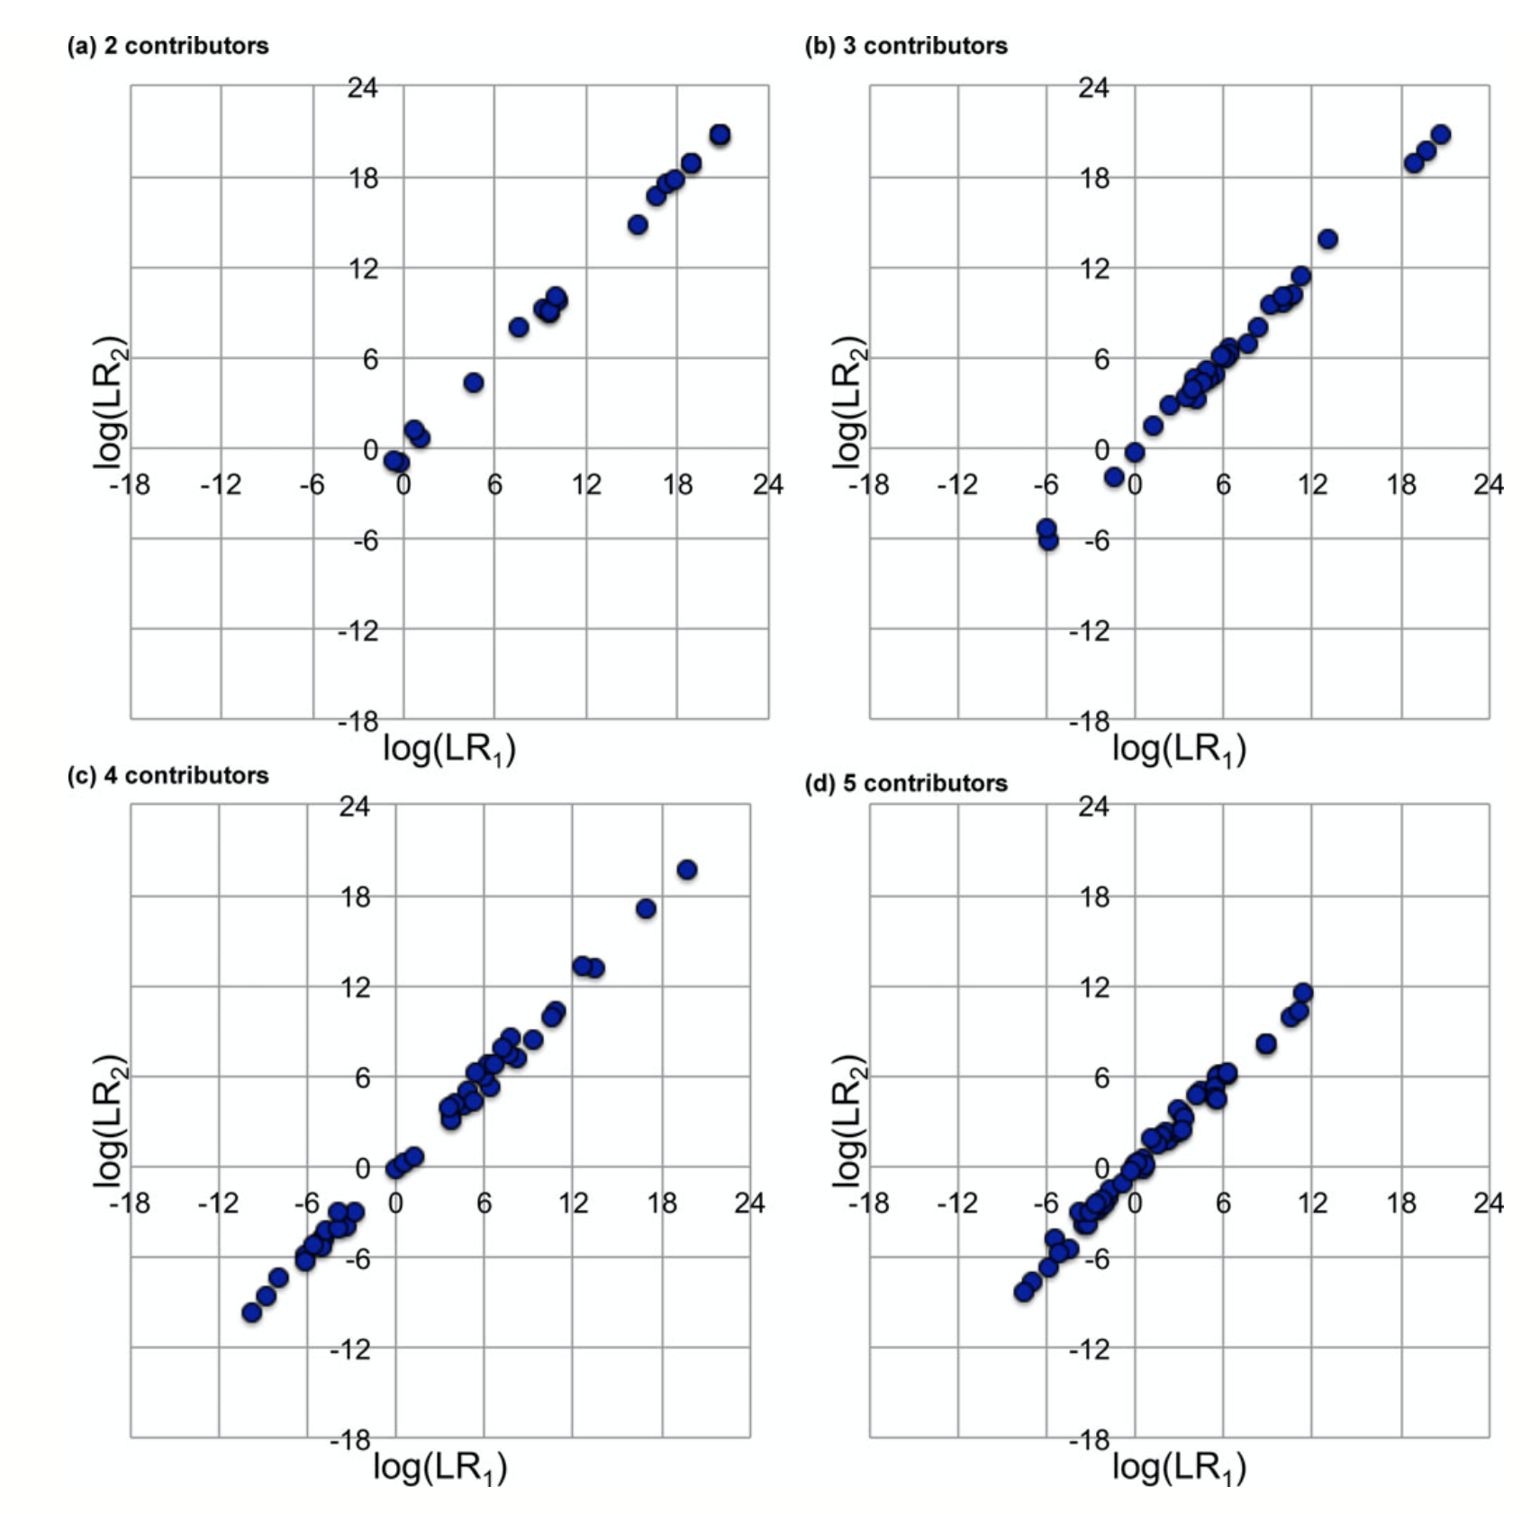
TrueAllele reproducibility
200 pg

Slide 34
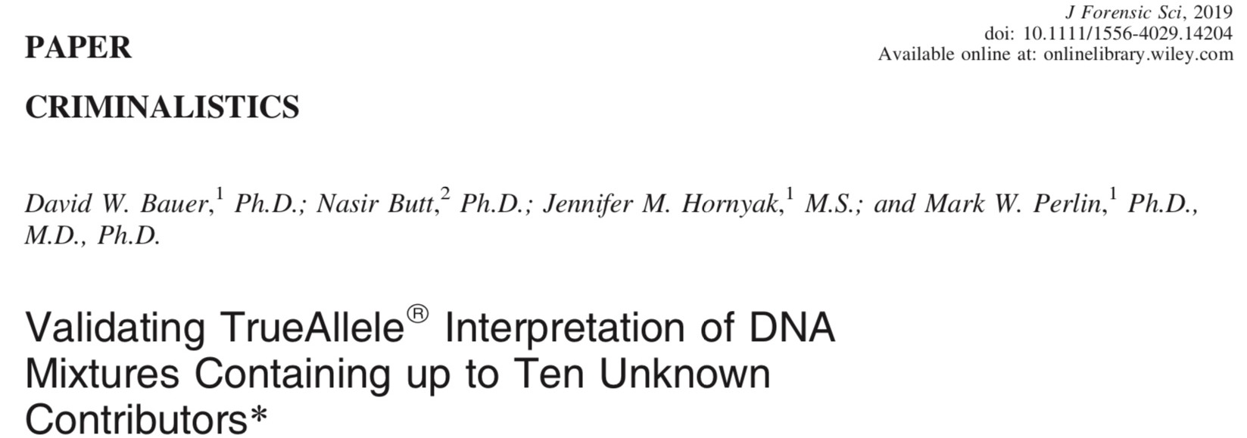
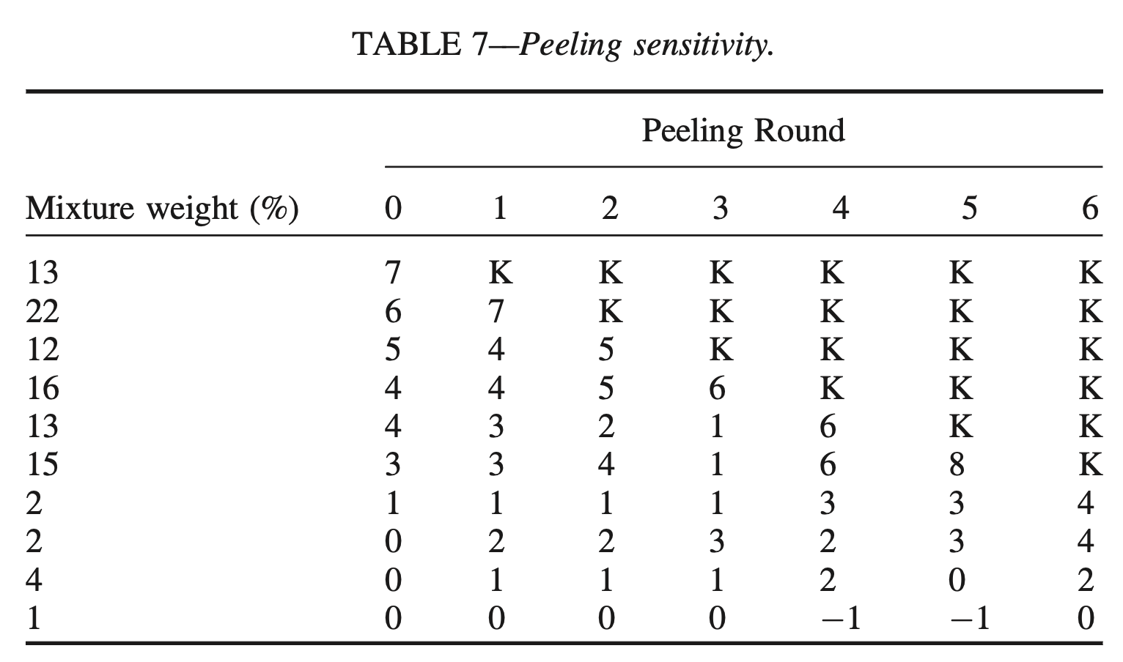
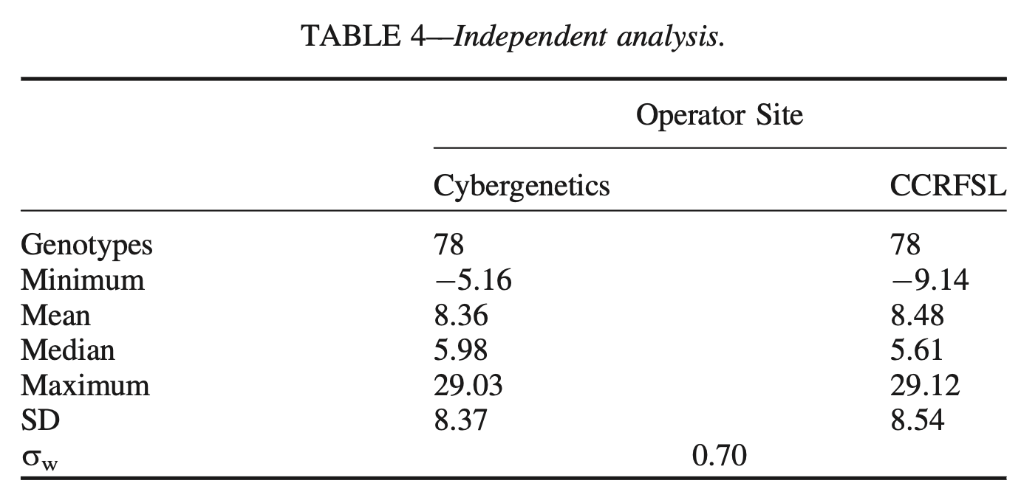

Slide 35
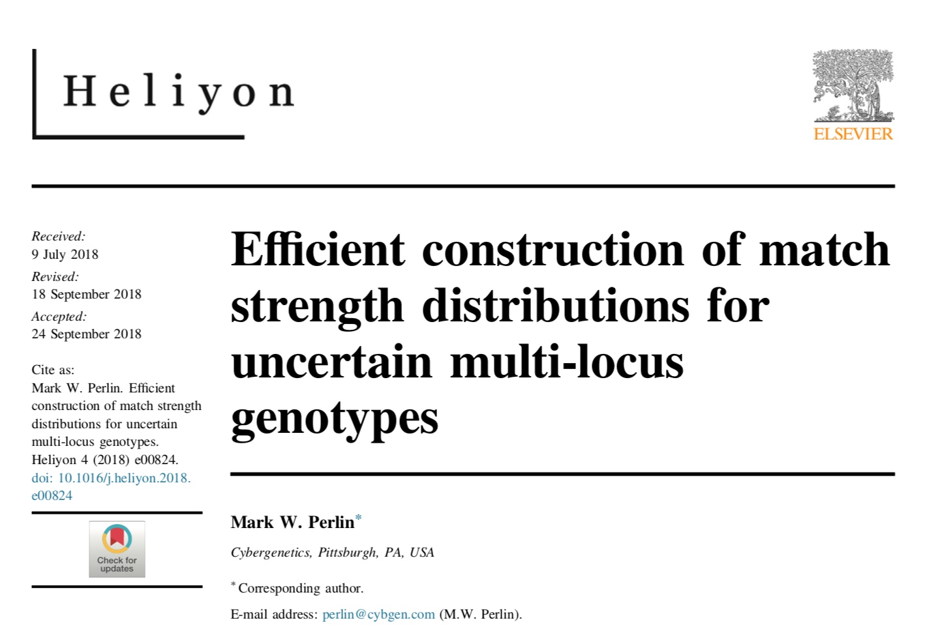
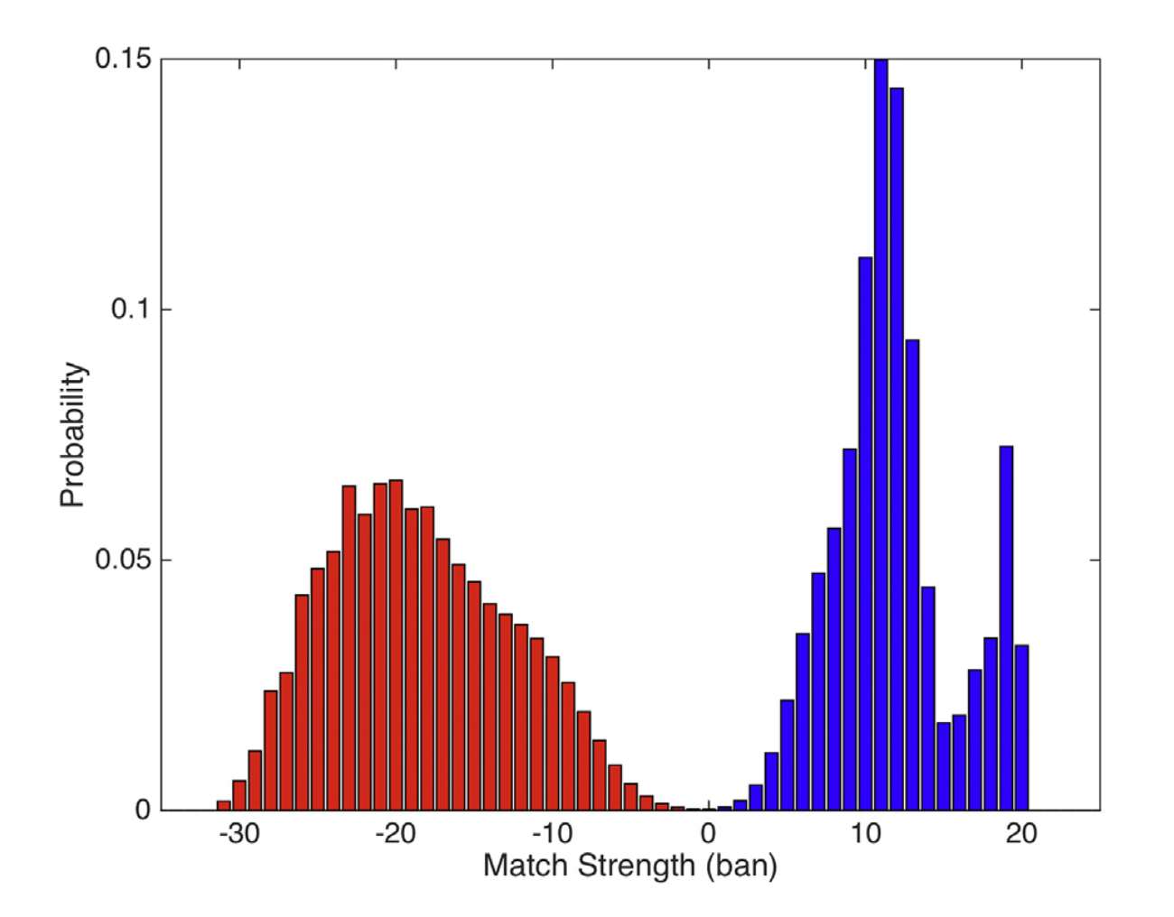
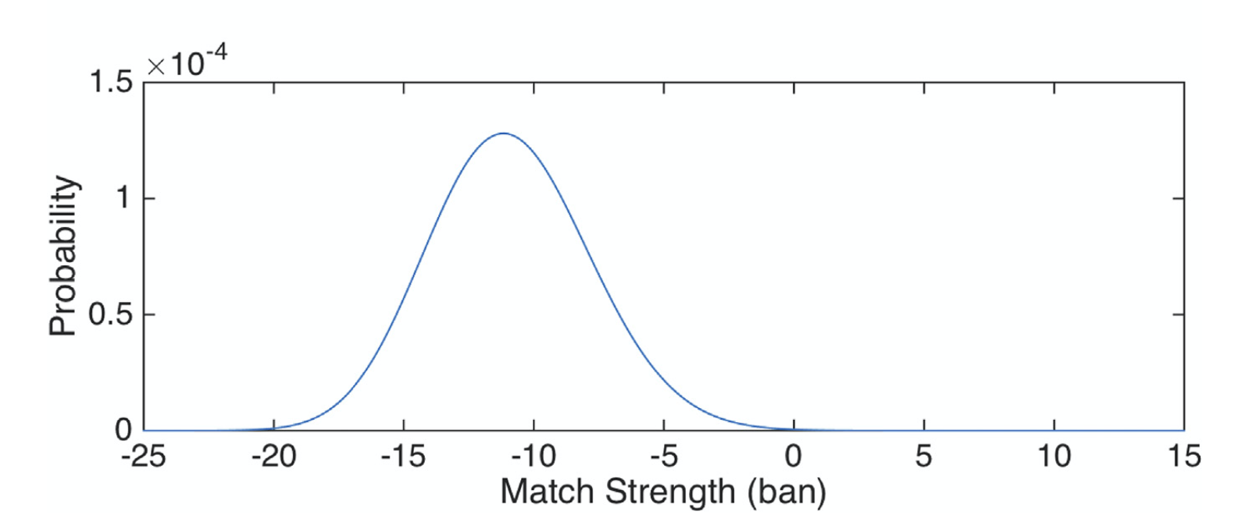

Slide 36
Over 25 admissibility rulings
Commonwealth of Pennsylvania v Kevin Foley (admitted, 2009; appellate precedent, 2012)
People of California v Dupree Langston (admitted, 2013)
Commonwealth of Virginia v Matthew Brady (admitted, 2013)
State of Ohio v Maurice Shaw (admitted, 2014)
State of Louisiana v Chattley Chesterfield & Samuel Nicolas (admitted, 2014)
People of New York v John Wakefield (admitted, 2015; appellate precedent, 2019)
State of South Carolina v Jaquard Aiken (admitted, 2015)
Commonwealth of Massachusetts v Heidi Bartlett (admitted, 2016)
State of Indiana v Dugniqio Forest (admitted, 2016)
State of Indiana v Malcolm Wade (admitted, 2016)
State of Washington v Emanuel Fair (admitted, 2017)
State of Louisiana v Harold Houston (admitted, 2017)
State of Indiana v Randal Coalter (admitted, 2017)
State of Nebraska v Charles Simmer (admitted, 2018; appellate precedent, 2019)
State of Indiana v Vaylen Glazebrook (admitted, 2018)
State of Ohio v David Mathis (admitted, 2018)
State of Florida v Lajayvian Daniels (admitted, 2018)
State of Tennessee v Demontez Watkins (admitted, 2018)
State of Georgia v Thaddus Nundra (admitted, 2019)
State of Georgia v Monte Baugh & Thaddeus Howell (admitted, 2019)
State of Louisiana v Kyle Russ (admitted, 2019)
People of New York v Casey Wilson (admitted, 2019)
State of Georgia v Alexander Battle (admitted, 2019)
United States v Lenard Gibbs (admitted, 2019)
State of Georgia v Guy Sewell (admitted, 2019)
State of Georgia v Adedojah Bah (admitted, 2019)
State of Georgia v Nathaniel Day (admitted, 2019)
State of Tennessee v Abdullah Powell (admitted, 2021)

Slide 37
TrueAllele today
Invented math & algorithms | 25 years
Developed computer systems | 20 years
Support users and workflow | 10 laboratories
Routinely used in casework | 8 crime labs
Validate system reliability | 42 studies
Educate the community | 100 talks
Train or certify analysts | 400 students
Admissibility challenges | 28 rulings, 14 states
Testify about LR results | 100 trials
Educate lawyers and public | 1,000 people
Make the ideas understandable | 975 cases, 44 states

Slide 38
Conclusions
Perlin MW, Dormer K, Hornyak J, Schiermeier-Wood L, Greenspoon S.
TrueAllele® Casework on Virginia DNA mixture evidence: computer and manual interpretation in 72 reported criminal cases. PLOS ONE. 2014;(9)3:e92837.
TrueAllele Casework DNA mixture interpretation is:
A reliable method
• objective
• sensitive
• specific
• reproducible
• accurate
TrueAllele computer genotyping is more effective than human review

