Slide 1

Mining the Mixture:
A DNA Analyst Explains (2)
New York State
Judicial Summer Seminars
The New York State Judicial Institute
June, 2019
Rye Brook, NY
Mark W Perlin, PhD, MD, PhD
Pittsburgh, PA
Cybergenetics © 2003-2019

Slide 2
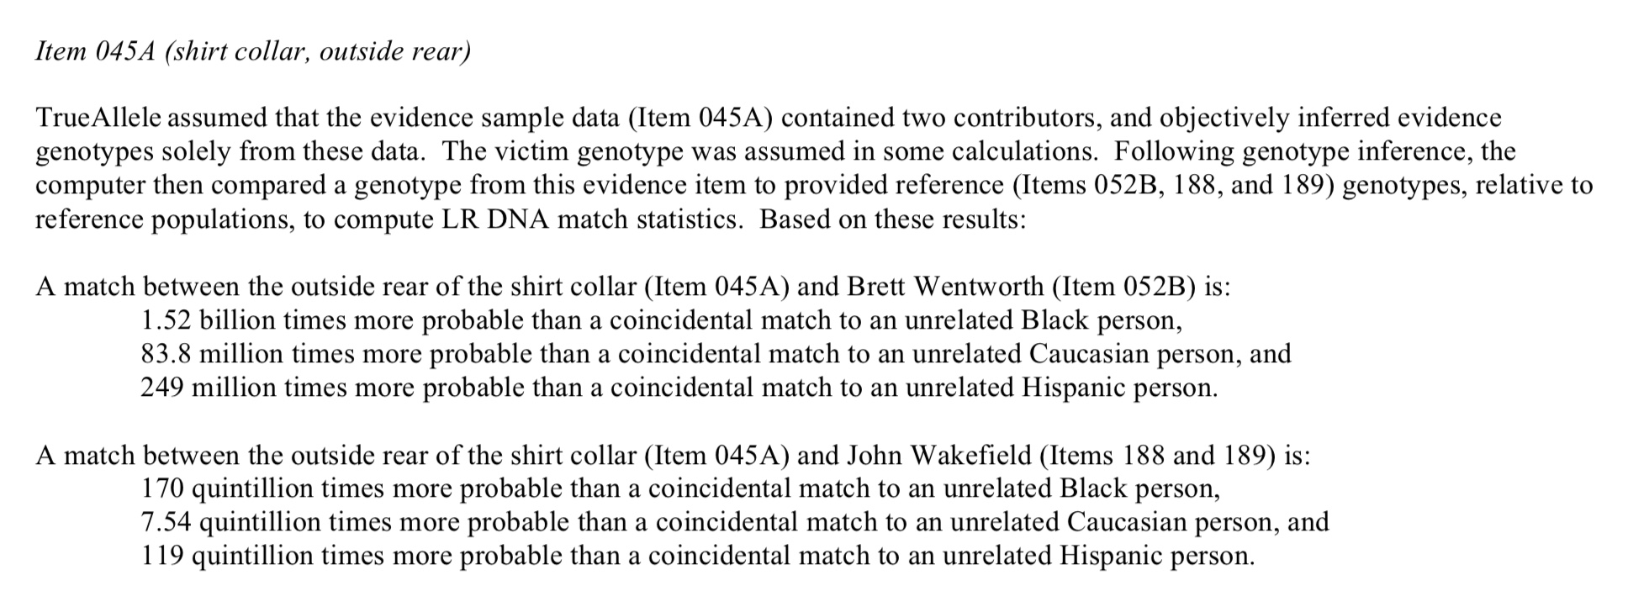
TrueAllele report
A match between the evidence and the defendant
is a quintillion times more probable than coincidence
The probability of the evidence given the prosecution’s hypothesis is a quintillion times more than given the defense hypothesis

Slide 3
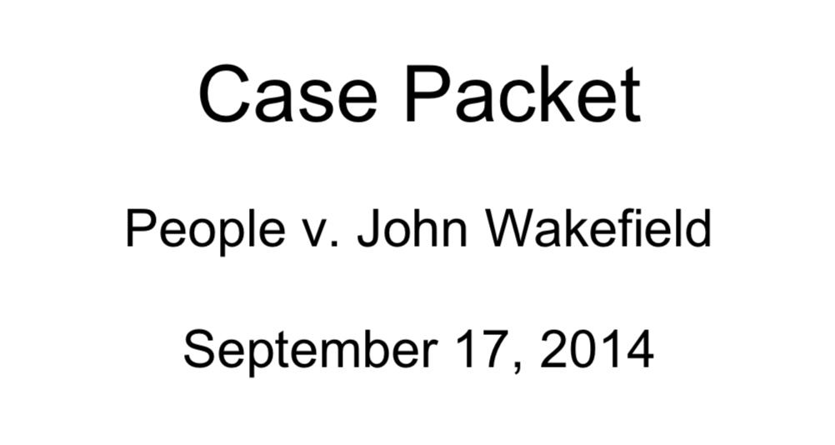

Case disclosure packet

Slide 4
Disclosure materials

Slide 5
Computer Interpretation of
Quantitative DNA Evidence
People v. John Wakefield
October, 2014
Schenectady, NY
Mark W Perlin, PhD, MD, PhD
Cybergenetics, Pittsburgh, PA
Cybergenetics © 2003-2014

Slide 6
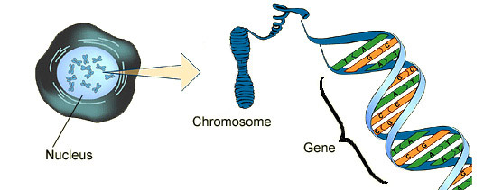
DNA biology
Cell
Chromosome
Locus
Nucleus

Slide 7
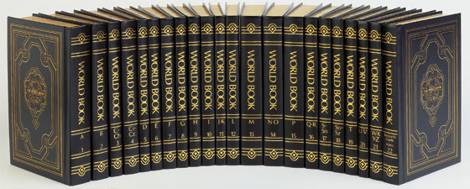
Short tandem repeat
DNA locus paragraph
Take me out to the ball game
take me out with the crowd
buy me some peanuts and Cracker Jack
I don't care if I never get back
let me
root root root root root root root root root root
for the home team,
if they don't win, it's a shame for it's one, two, three strikes, you're out
at the old ball game
23 volumes in cell's
DNA encyclopedia
"root" repeated 10 times, so
allele length is 10 repeats

Slide 8
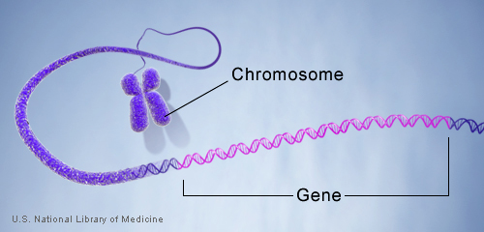
DNA genotype
A genetic locus has
two DNA sentences,
one from each parent.
An allele is the number
of repeated words.
locus
A genotype at a locus
is a pair of alleles.
mother
allele
1
2
3
4
5
6
7
8
9
10
10, 12
ACGT
repeated word
Many alleles allow for
many many allele pairs.
A person's genotype
is relatively unique.
father
allele
1
2
3
4
5
6
7
8
9
10
11
12

Slide 9
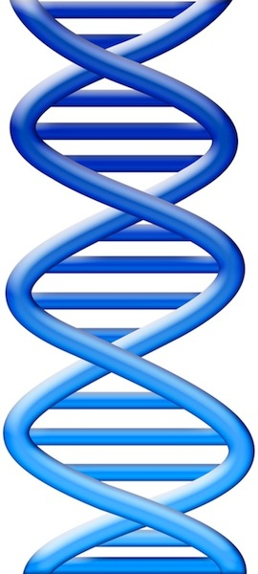
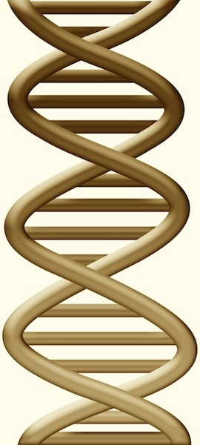
DNA evidence interpretation
Evidence item
Lab
Evidence data
Infer
Evidence genotype
10, 12 @ 50%
11, 12 @ 30%
12, 12 @ 20%
10 11 12
Compare
Known genotype
10, 12

Slide 10
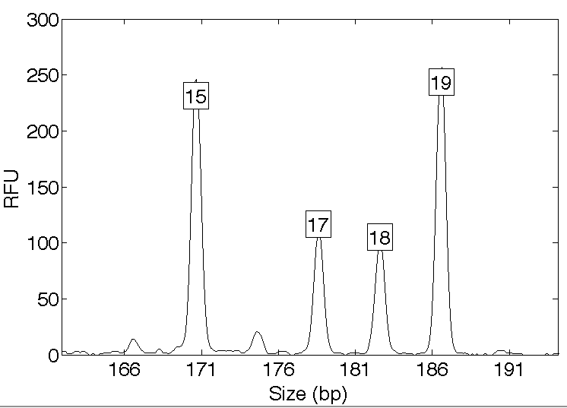
Computers can use all the data
Quantitative peak heights at locus vWA
peak size
peak
height

Slide 11
People may use less of the data
Over threshold, peaks are labeled as allele events
Threshold
All-or-none allele peaks,
each given equal status
Under threshold, alleles vanish

Slide 12
How the computer thinks
Consider every possible genotype solution
One person’s allele pair
Explain the
peak pattern
Another person's allele pair
Better
explanation
has a higher
likelihood

Slide 13
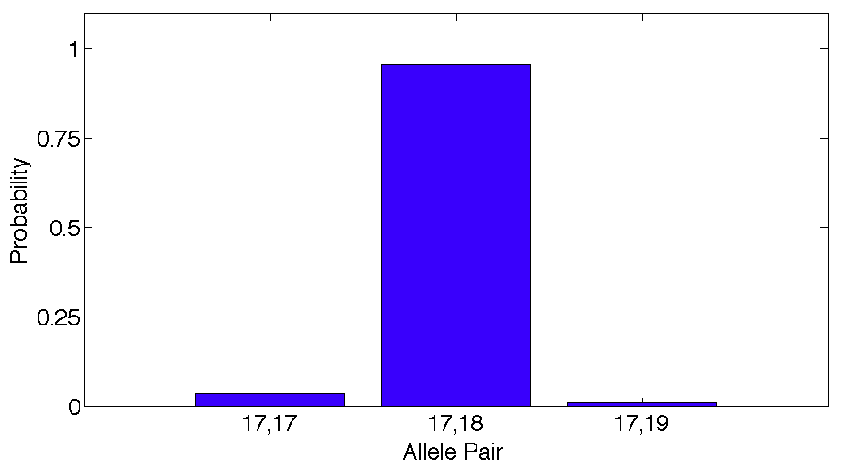
Evidence genotype
Objective genotype determined solely from the DNA data.
Never sees a comparison reference.
96%
3%
1%

Slide 14
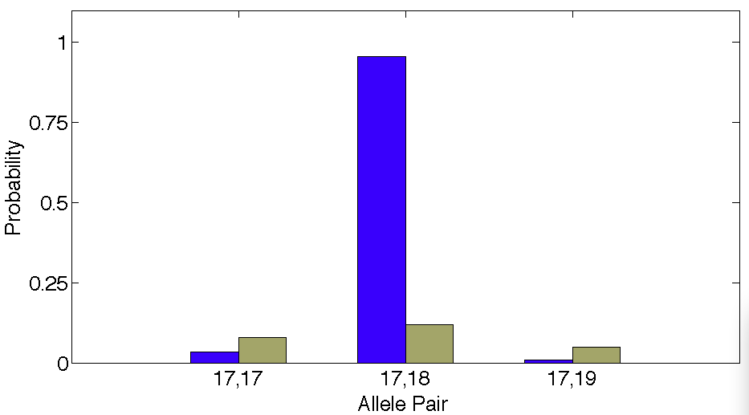
DNA match information
How much more does the suspect match the evidence
than a random person?
8x
96%
Prob(evidence match)
Prob(coincidental match)
12%

Slide 15
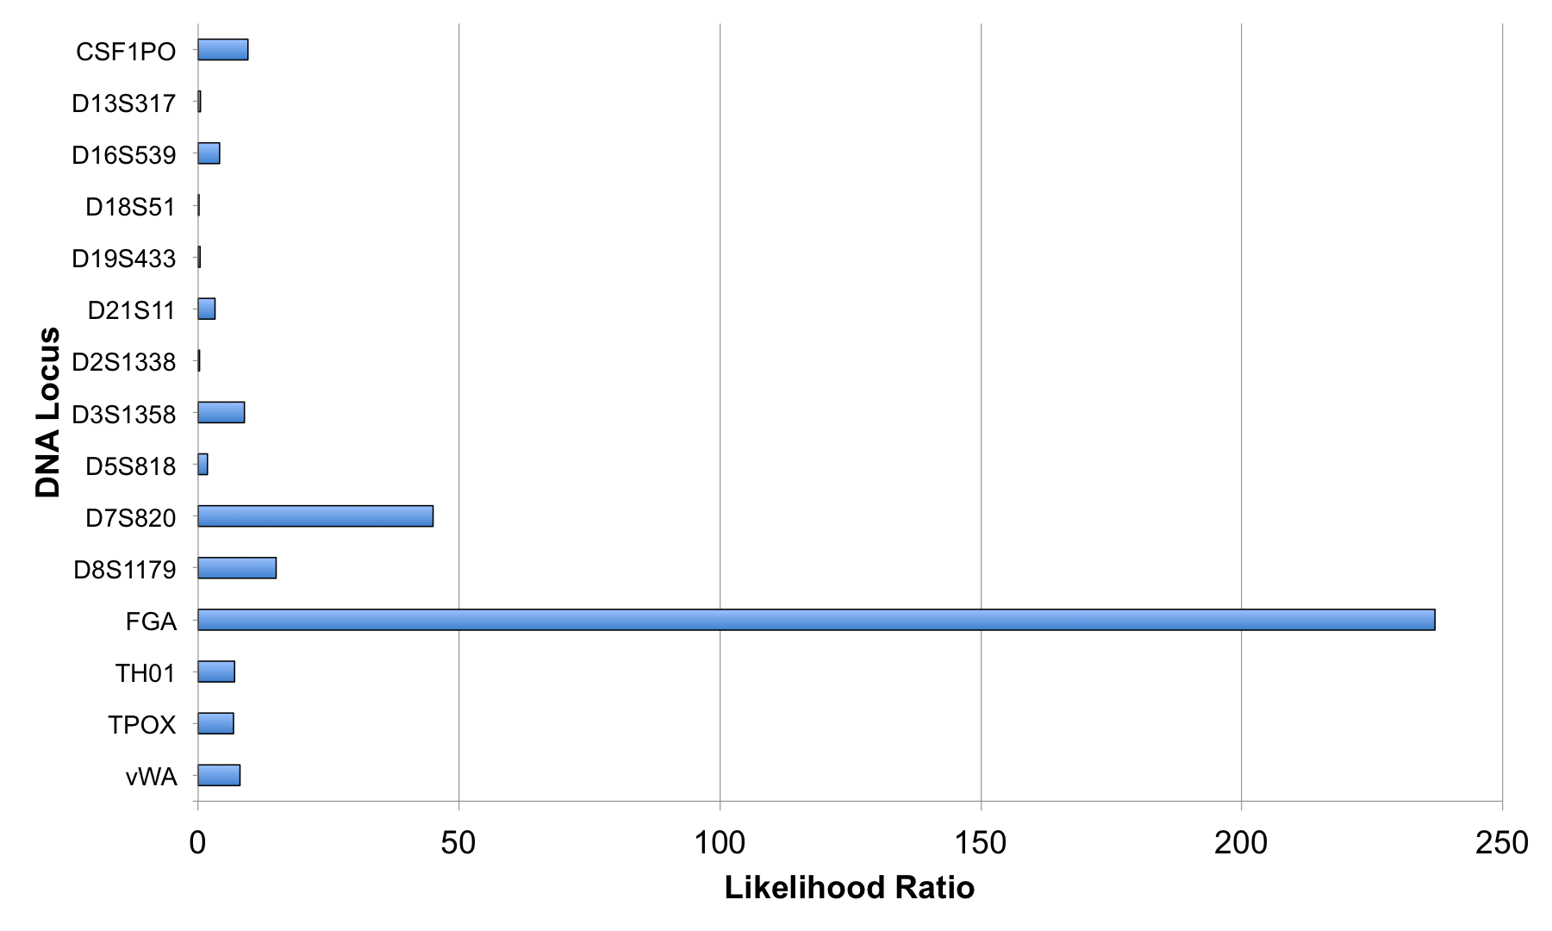
Match information at 15 loci

Slide 16
Is the suspect in the evidence?
A match between the amp cord
and John Wakefield is:
5.88 billion times more probable than
a coincidental match to an unrelated Black person
300 million times more probable than
a coincidental match to an unrelated Caucasian person
2.25 billion times more probable than
a coincidental match to an unrelated Hispanic person

Slide 17
Is the victim in the evidence?
A match between the amp cord
and Brett Wentworth is:
221 quintillion times more probable than
a coincidental match to an unrelated Black person
478 quadrillion times more probable than
a coincidental match to an unrelated Caucasian person
906 quadrillion times more probable than
a coincidental match to an unrelated Hispanic person

Slide 18
Match statistics

Slide 19
Frye hearing

Slide 20
Validated genotyping method
Perlin MW, Sinelnikov A. An information gap in DNA evidence interpretation. PLoS ONE. 2009;4(12):e8327.
Ballantyne J, Hanson EK, Perlin MW. DNA mixture genotyping by probabilistic computer interpretation of binomially-sampled laser captured cell populations: Combining quantitative data for greater identification information. Science & Justice. 2013;53(2):103-114.
Perlin MW, Hornyak J, Sugimoto G, Miller K. TrueAllele® genotype identification on DNA mixtures containing up to five unknown contributors. Journal of Forensic Sciences. 2015;60(4):857-868.
Greenspoon SA, Schiermeier-Wood L, Jenkins BC. Establishing the limits of TrueAllele® Casework: a validation study. Journal of Forensic Sciences. 2015;60(5):1263-1276.
Perlin MW, Legler MM, Spencer CE, Smith JL, Allan WP, Belrose JL, Duceman BW. Validating TrueAllele® DNA mixture interpretation. Journal of Forensic Sciences. 2011;56(6):1430-1447.
Perlin MW, Belrose JL, Duceman BW. New York State TrueAllele® Casework validation study. Journal of Forensic Sciences. 2013;58(6):1458-1466.
Perlin MW, Dormer K, Hornyak J, Schiermeier-Wood L, Greenspoon S. TrueAllele® Casework on Virginia DNA mixture evidence: computer and manual interpretation in 72 reported criminal cases. PLOS ONE. 2014;(9)3:e92837.

Slide 21
Sensitivity
The extent to which interpretation identifies the correct person
True DNA mixture inclusions
101 reported genotype matches
82 with DNA statistic over a million

Slide 22
Specificity
The extent to which interpretation does not misidentify the wrong person
True exclusions, without false inclusions
101 matching genotypes x 10,000 random references
x 3 ethnic populations,
for over 1,000,000 nonmatching comparisons

Slide 23
Reproducibility
The extent to which interpretation gives
the same answer to the same question
MCMC computing has sampling variation
duplicate computer runs
on 101 matching genotypes
measure log(LR) variation

Slide 24
General acceptance
Invented math & algorithms | 20 years
Developed computer systems | 15 years
Support users and workflow | 10 laboratories
Routinely used in casework | 8 crime labs
Validate system reliability | 37 studies
Educate the community | 100 talks
Train & certify analysts | 200 students
Go to court for admissibility | 25 rulings
Testify about LR results | 85 trials
Educate lawyers and laymen | 1,000 people
Make the ideas understandable | 700 cases, 43 states

Slide 25

Eliminated NYS DNA backlog
TrueAllele Expert System On-Line
Expert system on-line
60,000
55,000
50,000
45,000
40,000
Samples
35,000
30,000
25,000
20,000
15,000
10,000
5,000
0
Mar. 06
June 06
Sep. 06
Dec. 06
Mar. 07
June 07
Sep. 07
Dec. 07
Mar. 08
June 08
Sep. 08
Dec. 08
Month / Year

Slide 26
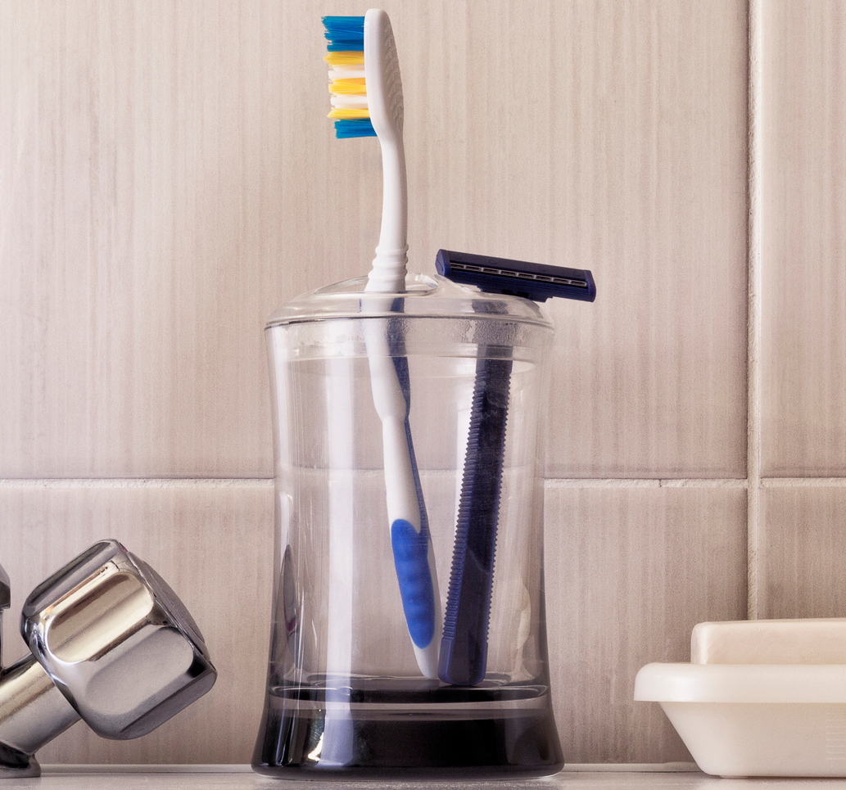
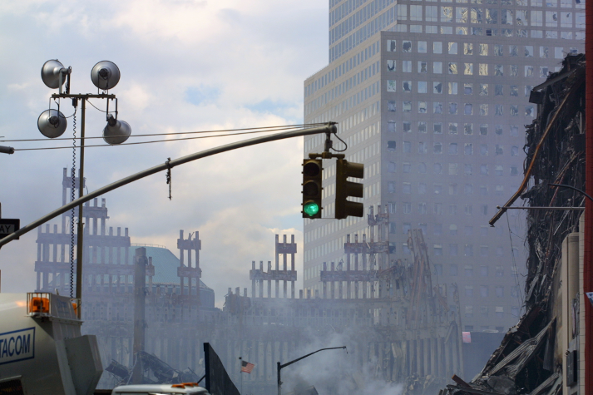

Reanalyzed WTC DNA data
18,000 victim remains
2,700 missing people
match

Slide 27
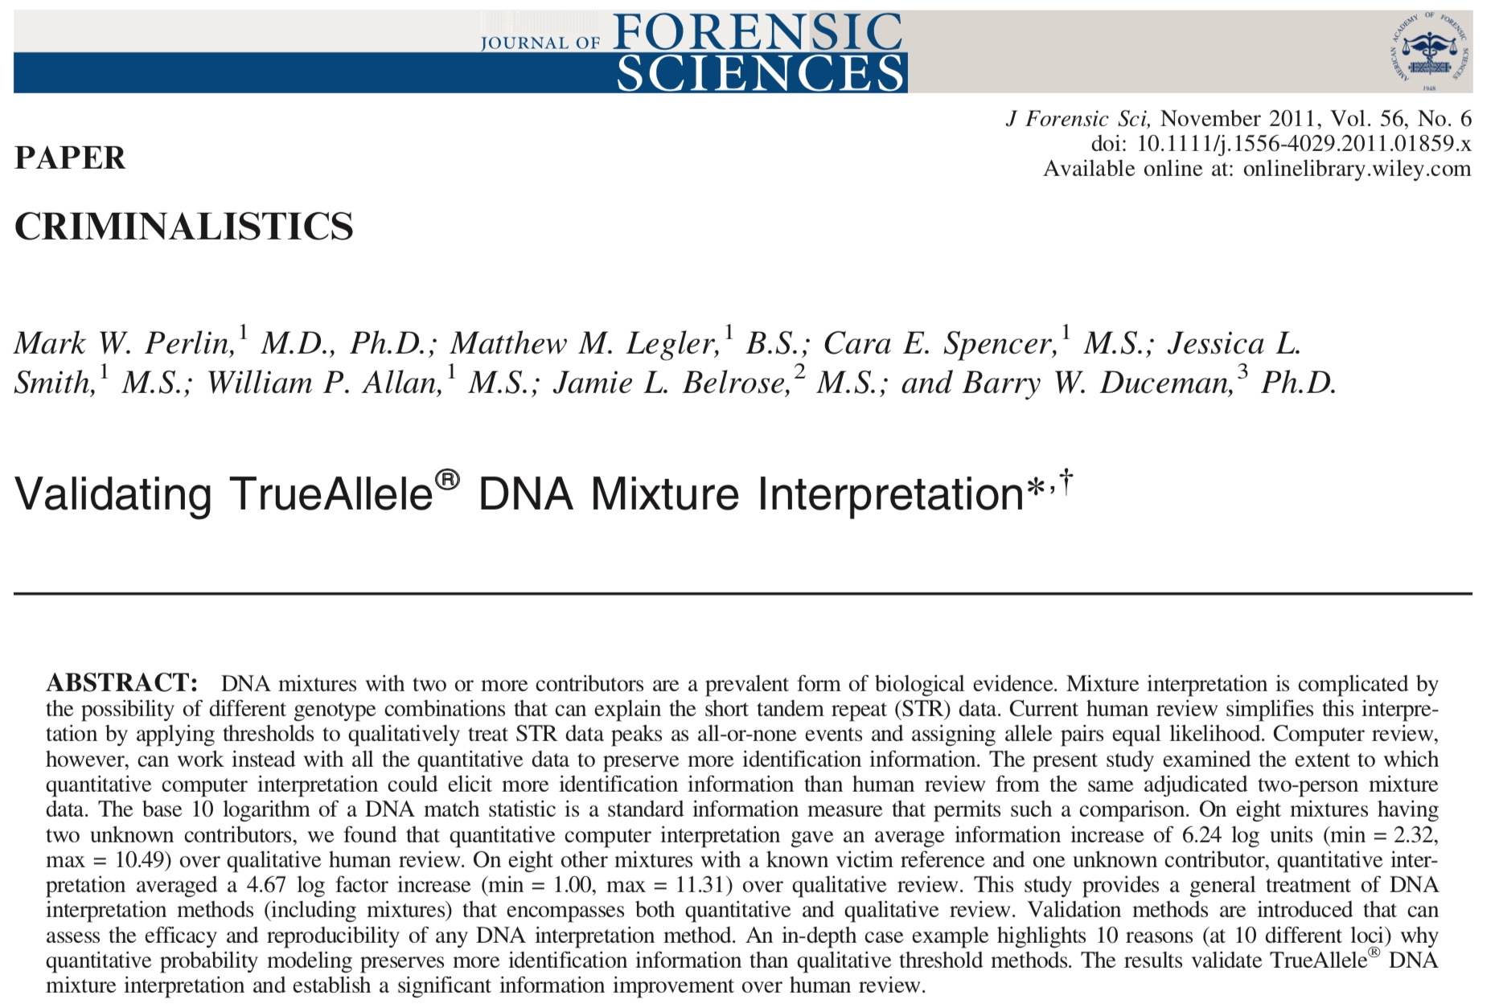

Slide 28
Preserves more match information
13.26
6.24
7.03

Slide 29
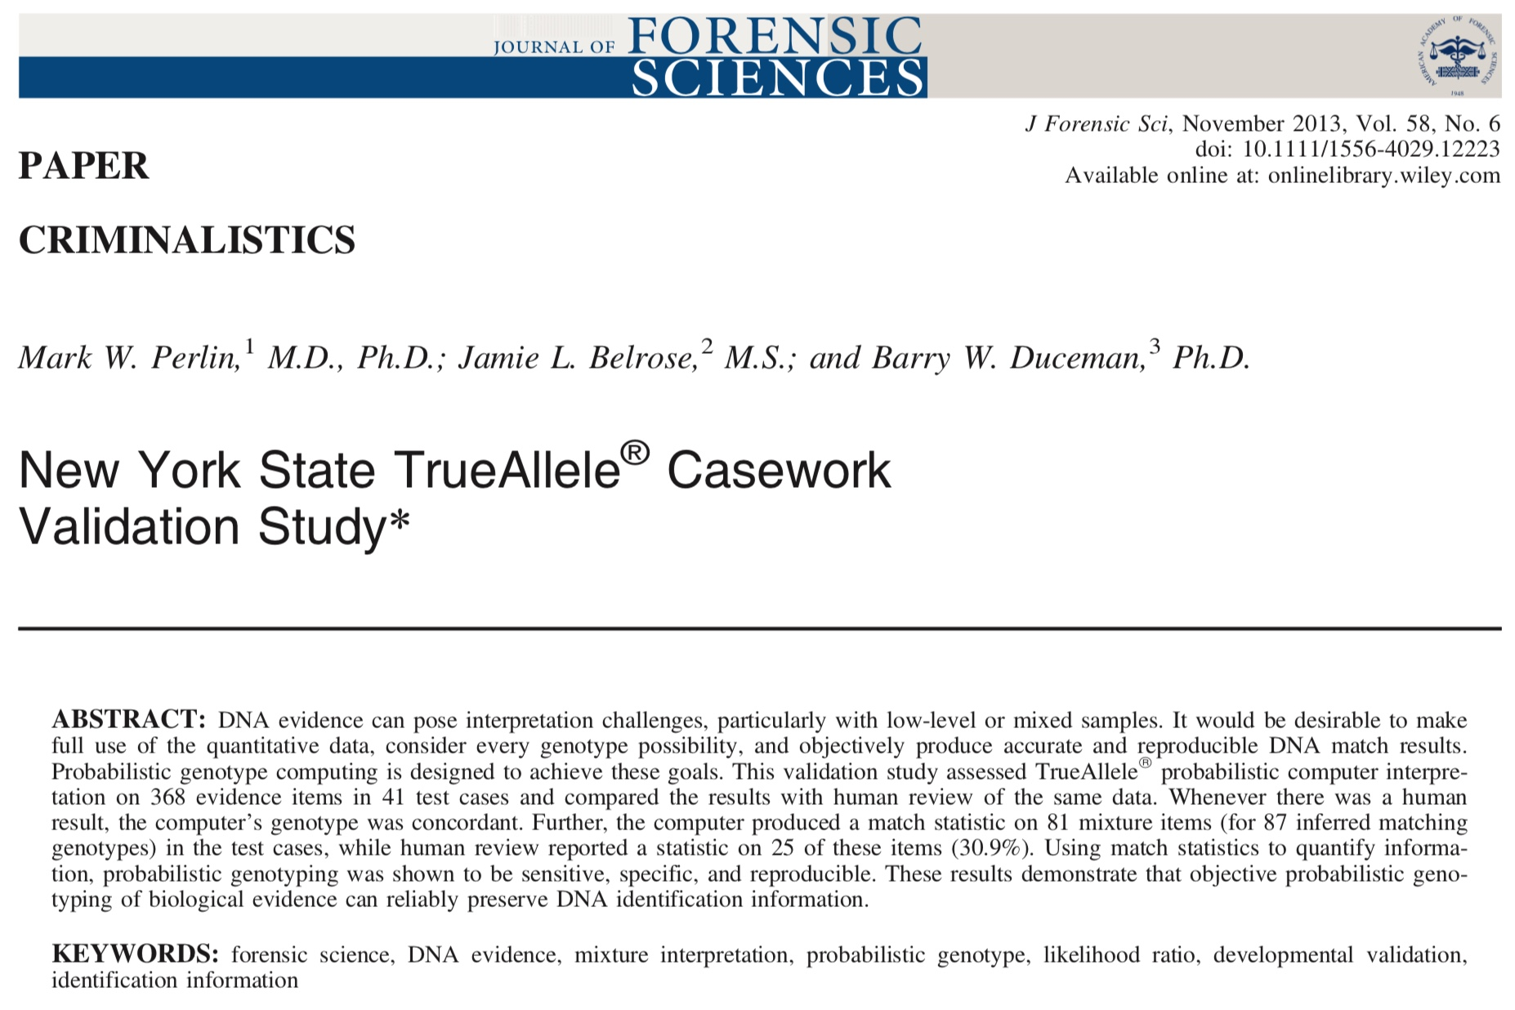

Slide 30
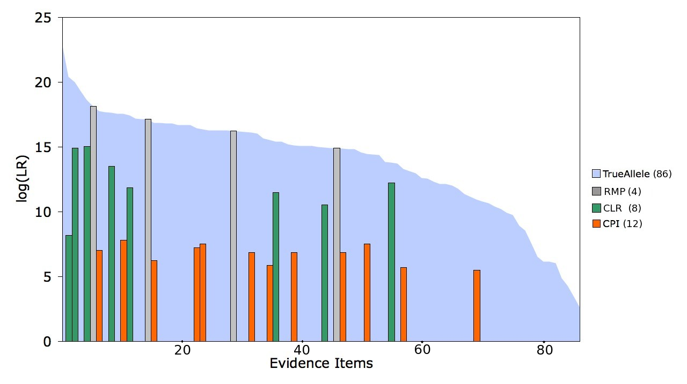
Lots more match information

Slide 31
That other methods discard
25
+
27

Slide 32
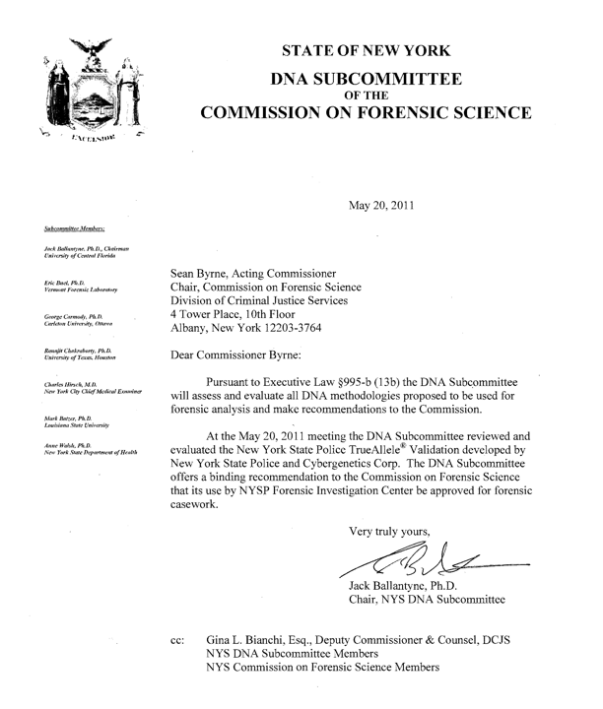
Approved

Slide 33
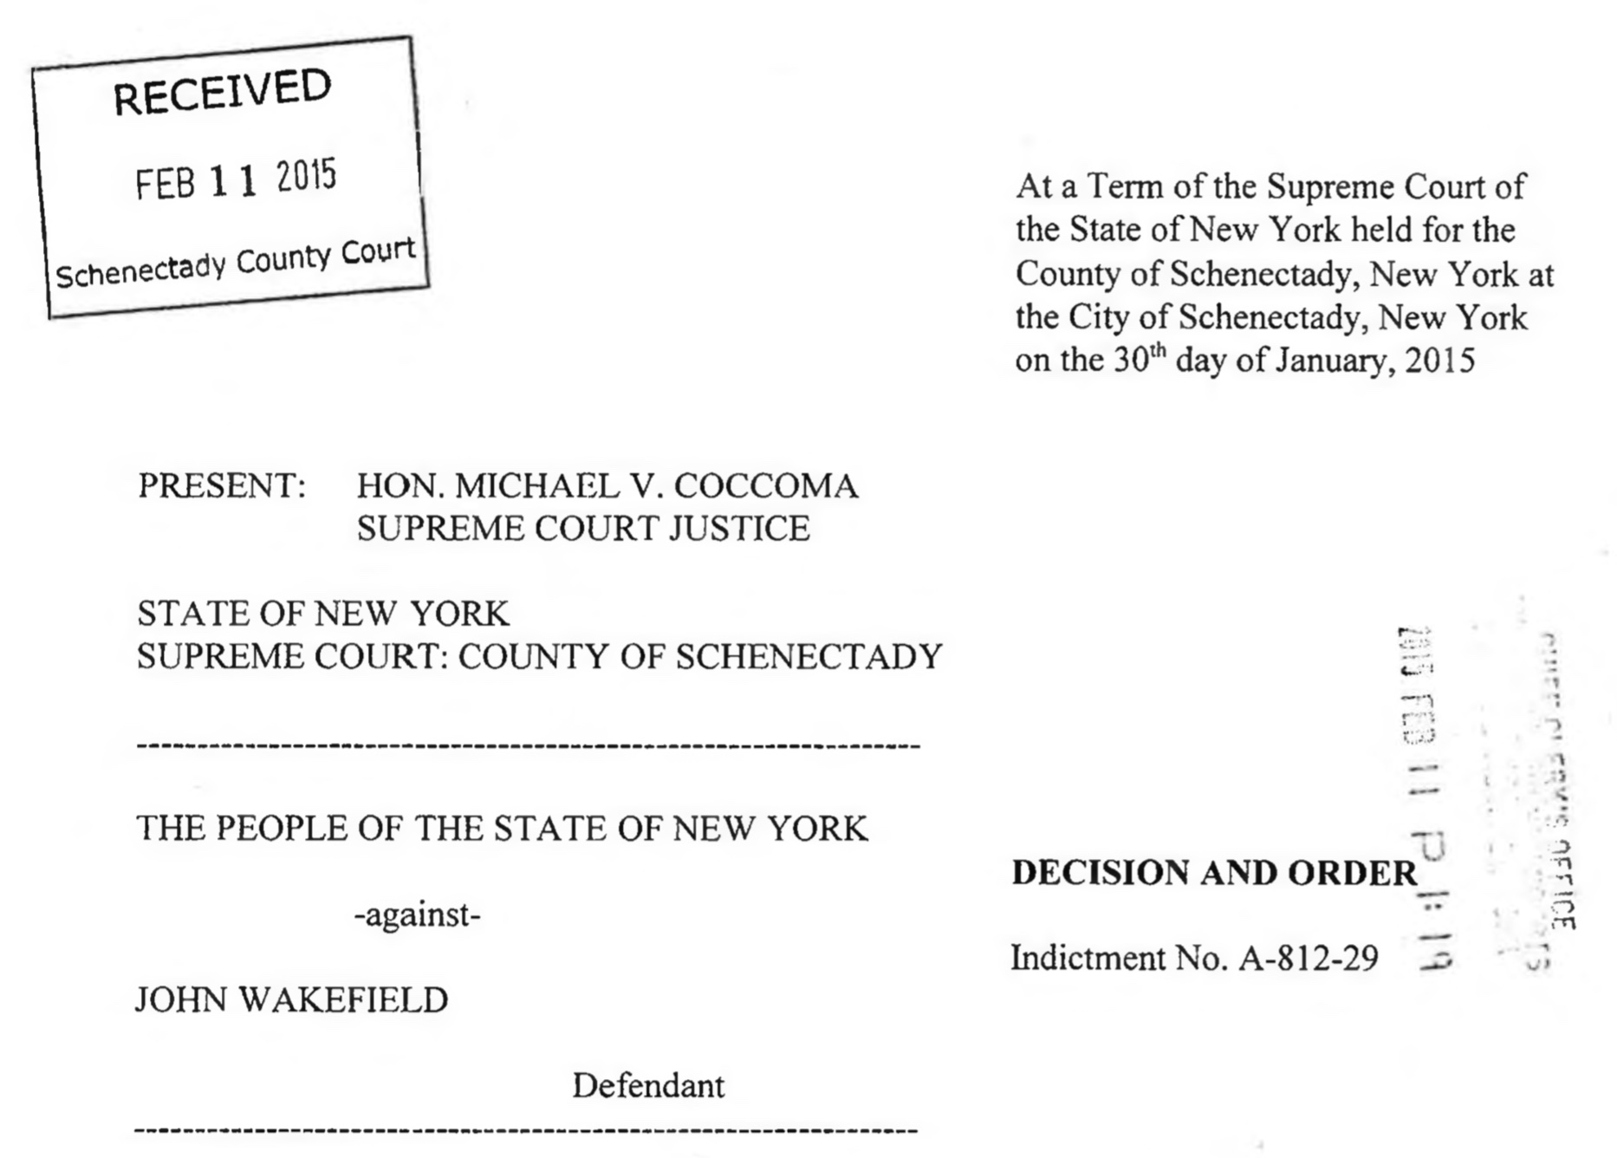

Slide 34
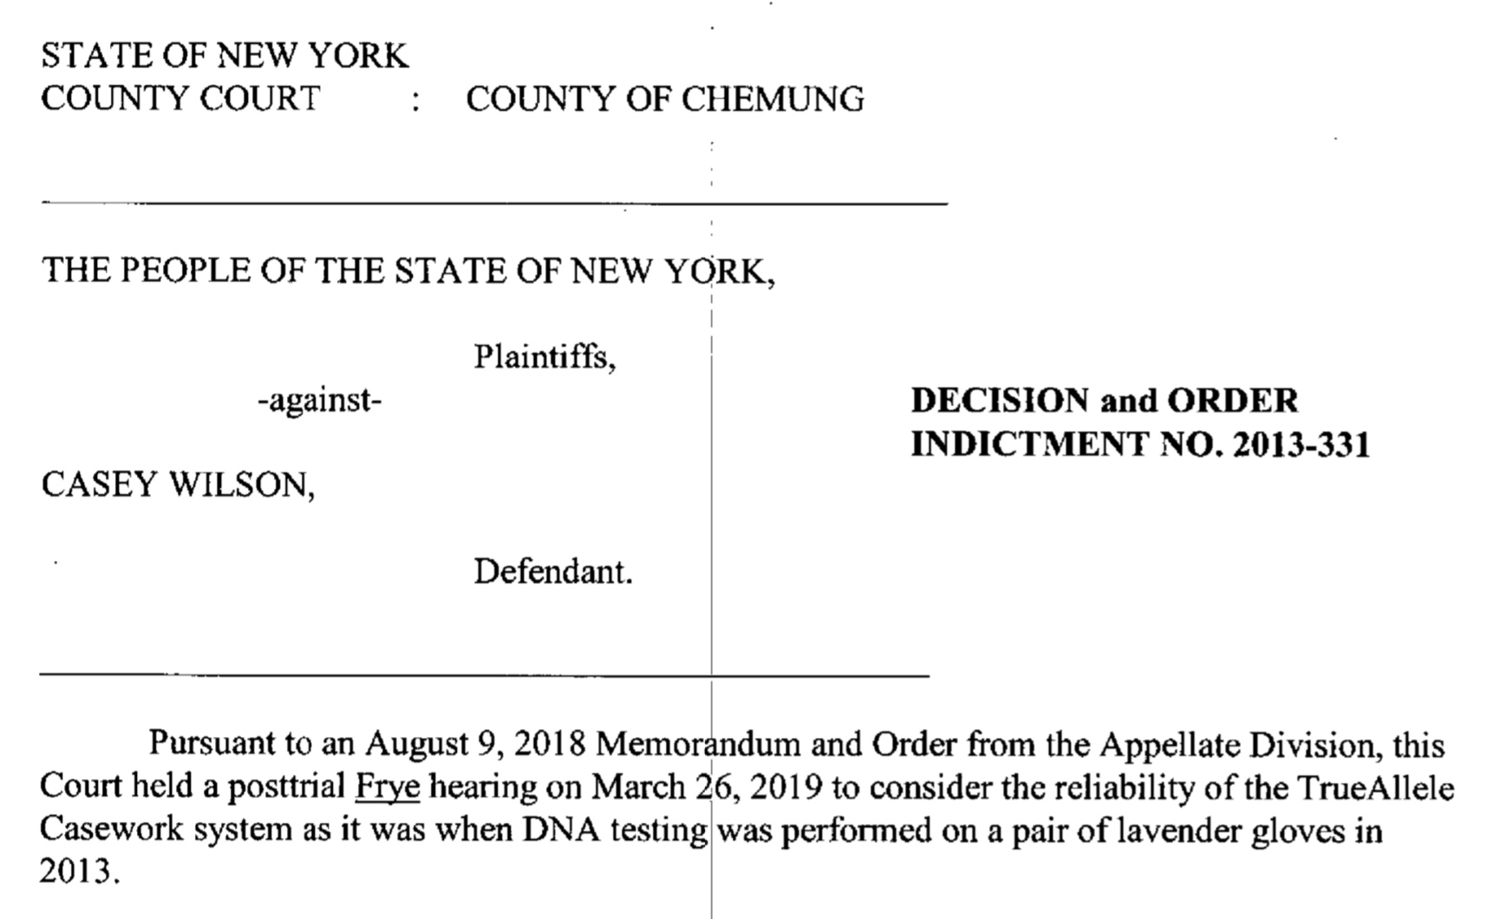

Slide 35
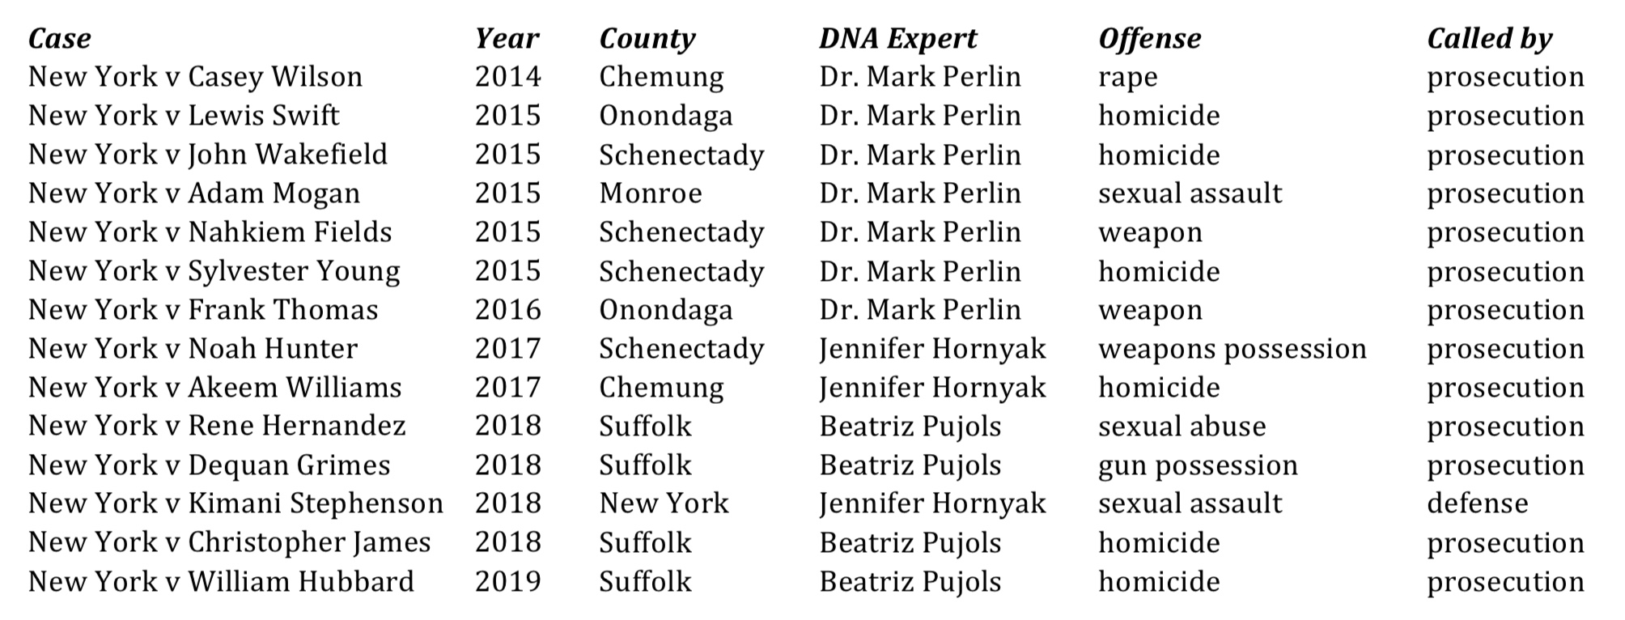
New York TrueAllele trials

Slide 36
Computer Interpretation of
Quantitative DNA Evidence
People of New York v. Kimani Stephenson
June, 2018
New York, NY
Jennifer M. Hornyak, MS
Cybergenetics, Pittsburgh, PA
Cybergenetics © 2003-2018

Slide 37
When nothing means everything
Item | Description | BC BC | KS Kimani Stephenson
1, dresLB | left breast area of dress | 25.8 quadrillion | one in 418 octillion
1, dress2 | left front area of dress, sample 2 | 14.2 billion | one in 74.7 septillion
2, jackLB | left breast area of jacket | 1.91 sextillion | one in 220 thousand

Slide 38
Computer Interpretation of
Quantitative DNA Evidence
State of Georgia v. Johnny Lee Gates
May, 2018
Columbus, GA
Mark W. Perlin, PhD, MD, PhD
Cybergenetics, Pittsburgh, PA
Cybergenetics © 2003-2018

Slide 39
Match statistics
Item | Description | 76C2573-004 Johnny Lee Gates
76C2573-032 | robe belt side 1 swab | one in 1.5 million
76C2573-033 | robe belt side 2 swab | one in 134 thousand
76C2573-034 | front of black tie swab | one in 4.33 million
76C2573-035 | back of black tie swab | one in 963 million
76C2573-042 | robe belt M-vac filter | one in 902 trillion
76C2573-044 | black tie M-vac filter | one in 825 billion

Slide 40
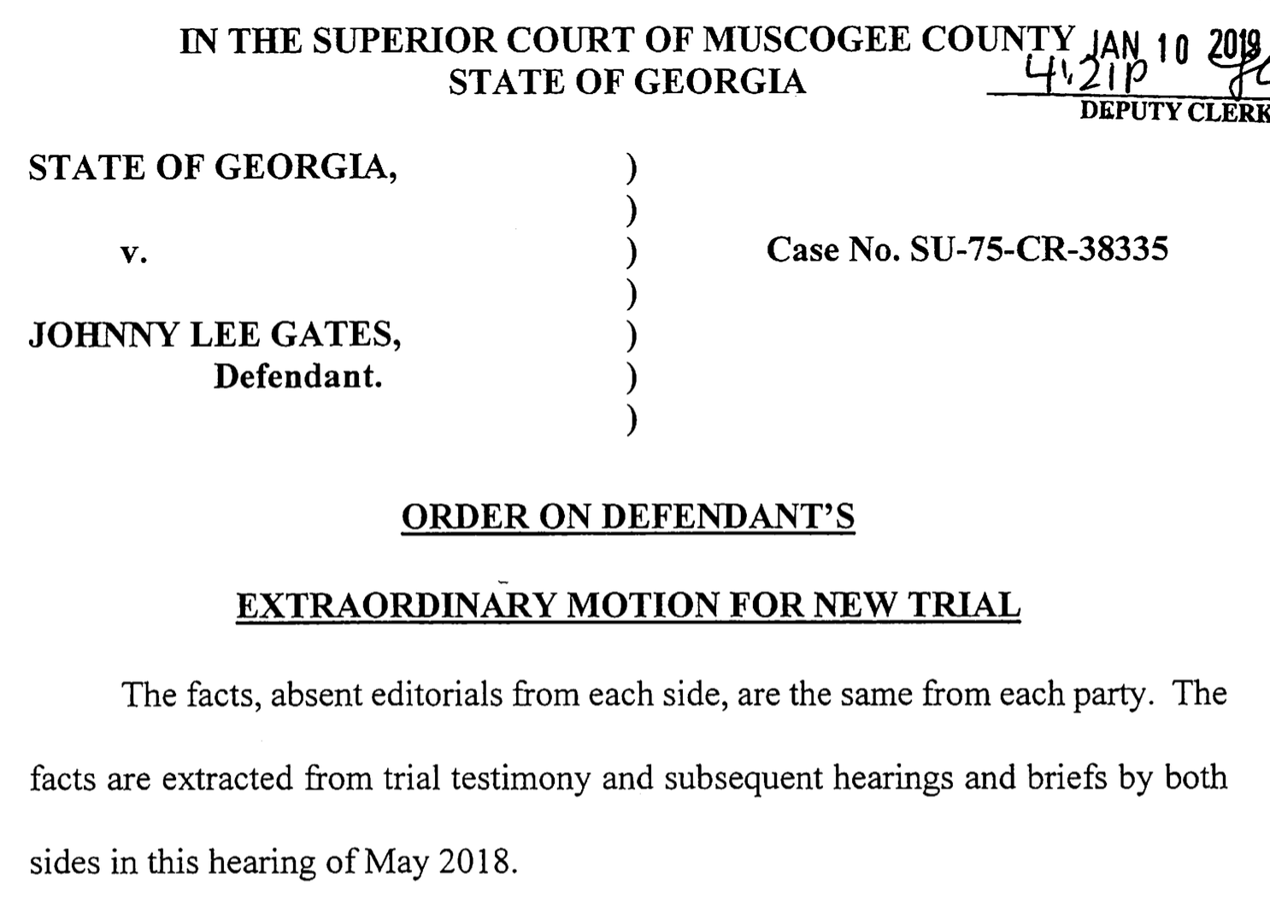

Slide 41
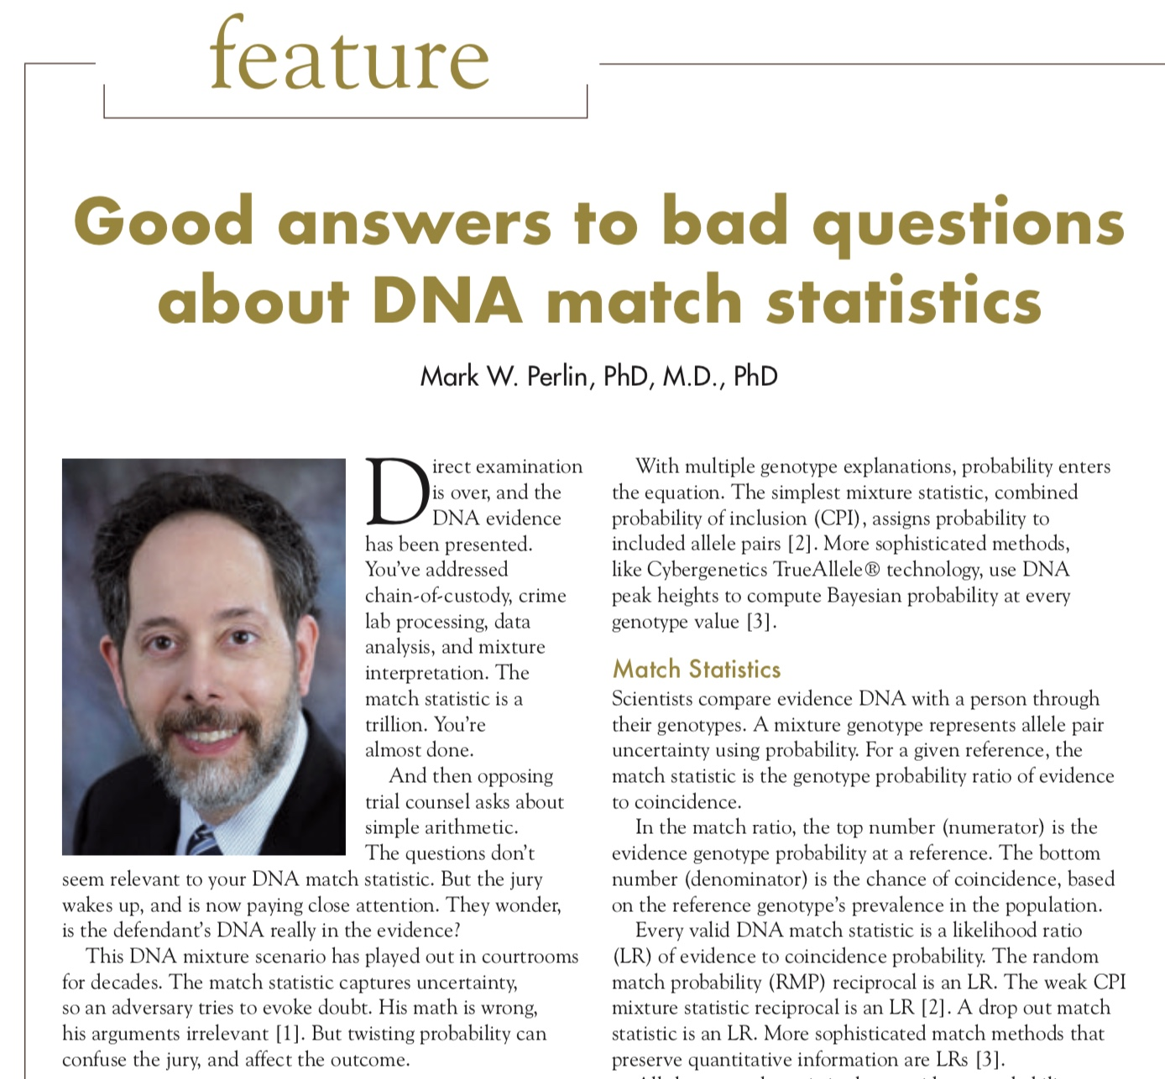

Slide 42
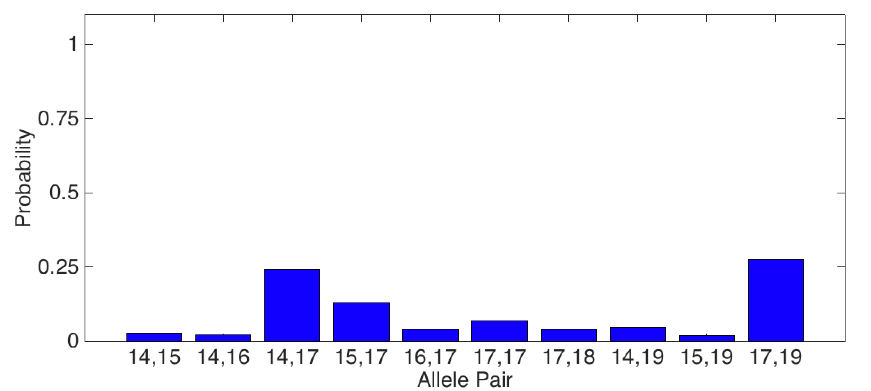
Ploy 1: “Highest Probability”
The 17,19 gives the
highest probability
but defendant
has a 14,17
24%
28%

Slide 43
Example testimony
DEF EXPERT: The 8,11 at the CSF locus for this particular analysis was the fourth most probable genotype reported.
DEFENDER: Explain what you're saying to us.
DEF EXPERT: There are three genotypes other than 8,11 that have been accorded a higher probability.
DEFENDER: Okay. And D13? We're just going to go down through them.
DEF EXPERT: It was the second highest, this one listed in the table, is the second most probable.

Slide 44
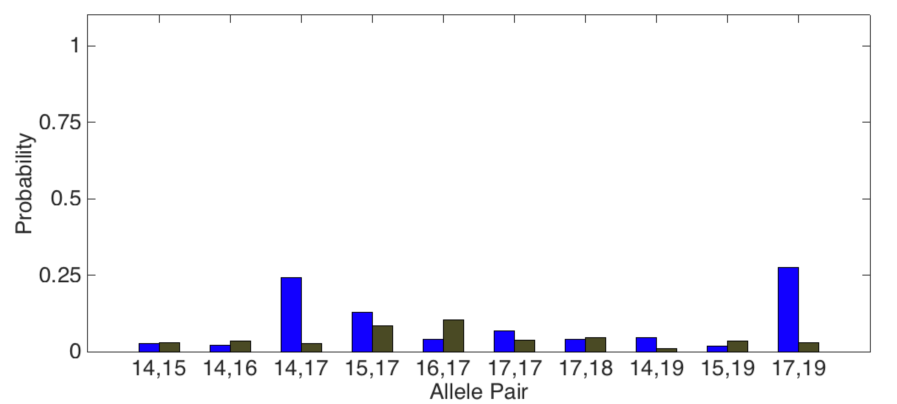
Fallacy explained
17,19 is not relevant
to match statistic
but the 14,17
of defendant
is relevant to LR
Relevant
24%
28%
3%

Slide 45
How to respond
PROSECUTOR: I'm going to object to the relevance of this unless they can bring some sort of expert opinion to bear on it, what's the significance.
THE COURT: So I would sustain that objection. So I would disallow your ability to get into that because it's outside the scope of the expert report.

Slide 46
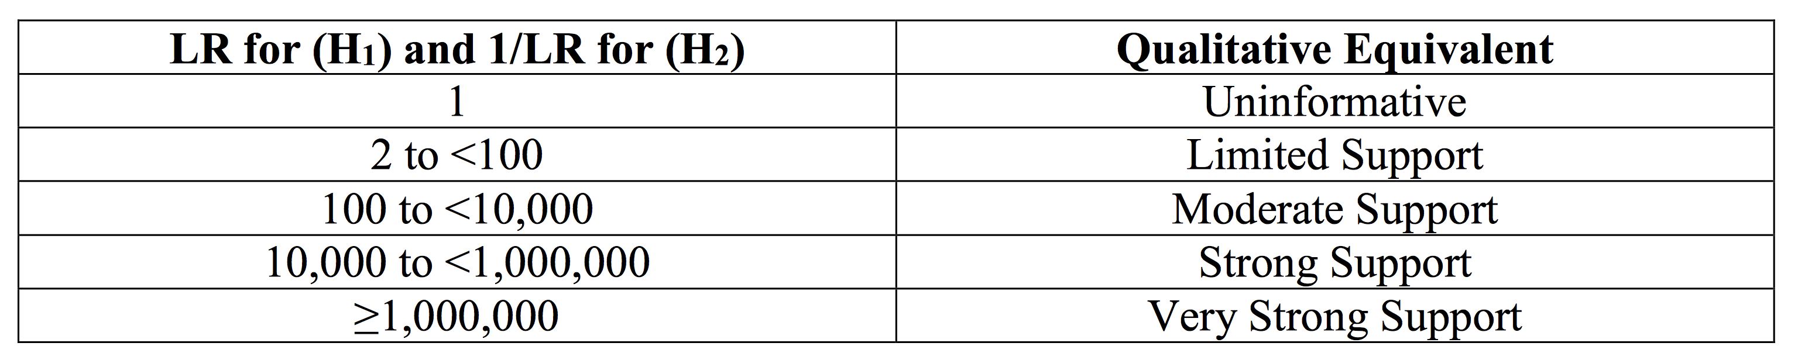
Verbal equivalents?
• hides the real match strength information
• not what a DNA expert actually believes
• misleads the jury about “million” (Koehler)
Just report LR error, along with the LR,
when the match strength is under a million

Slide 47
Allegheny County: 75 cases, 15 trials, 8 exonerations
Crime | Evidence | Defendant | Outcome | Sentence
rape | clothing | Ralph Skundrich | guilty | 75 years
murder | gun, hat | Leland Davis | guilty | 23 years
rape | clothing | Akaninyene Akan | guilty | 32 years
murder | shotgun shells | James Yeckel, Jr. | guilty plea | 25 years
murder | fingernail | Anthony Morgan | guilty | life
weapons | gun | Thomas Doswell | guilty plea | 1 year
bank robbery | clothing | Jesse Lumberger | guilty | 10 years
drugs | gun | Derek McKissick | guilty plea | 2 1/2 years
drugs | gun | Steve Morgan | guilty plea | 2 1/2 years
murder | door, clothing | Calvin Kane | guilty plea | 20 years
murder | fingernail, clothing | Allen Wade | guilty | life
murder | gun | Jaykwaan Pinckney | guilty plea | 10 years
child rape | clothing | Dhaque Jones | guilty plea | 6 years
shooting | gun | Anthony Jefferson | guilty plea | 4 years
weapons | gun | Zachary Blair | guilty plea | 15 years
weapons | gun | Delmingo Williams | guilty plea | 3 years
incest rape | clothing | Terry L. | guilty | 40 years
bank robbery | hat | Robert Schatzman | guilty | 1 1/2 years
weapons | gun | Rashawn Walker | guilty | 1.5 years
robbery | hat | Lauren Peak | guilty plea | 1 year
rape | body cavity | Freddie Cole | guilty plea | 2 years
murder | gun | Chaz White | guilty plea | 4 years
sex crime | clothing | Christopher Stavish | guilty plea | 2 1/2 years
murder | gun | Jake Knight | guilty | life

Slide 48
Open the past
We can overcome the past failures
of DNA mixture interpretation.
There have been 100,000’s of mixtures
wrongly reported as “inconclusive”
or given inaccurate match statistics.
TrueAllele automation can open the past.
It can use all the data, without people,
to accurately reprocess old cases.
To free the innocent, and find the guilty.

Slide 49
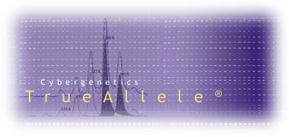

More information
http://www.cybgen.com/information
• Courses
• Newsletters
• Newsroom
• Presentations
• Publications
• Webinars
http://www.youtube.com/user/TrueAllele
TrueAllele YouTube channel
perlin@cybgen.com

