Slide 1

Mining the Mixture:
A DNA Analyst Explains
New York State
Judicial Summer Seminars
The New York State Judicial Institute
June, 2019
Rye Brook, NY
Mark W Perlin, PhD, MD, PhD
Pittsburgh, PA
Cybergenetics © 2003-2019

Slide 2
Dr. Mark W. Perlin

Slide 3
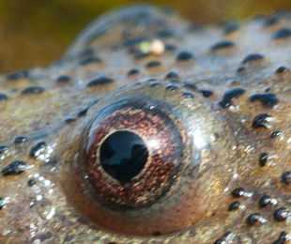
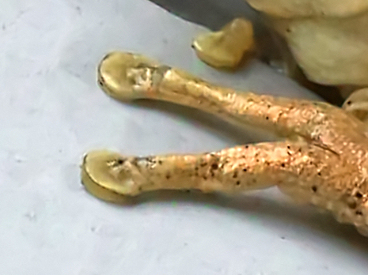

DNA mixture
eye of newt
toe of frog
Double, double toil and trouble

Slide 4
Crime lab analysts simplify data to interpret mixtures
Applying a threshold unreliably gives
the same heights & vacant lots

Slide 5
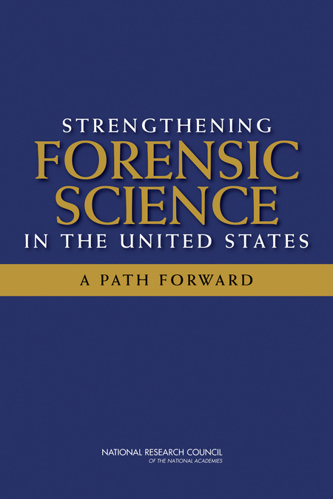
National Academy of Sciences
Trouble in River City
2009
Where’s the “science” in Forensic Science?

Slide 6
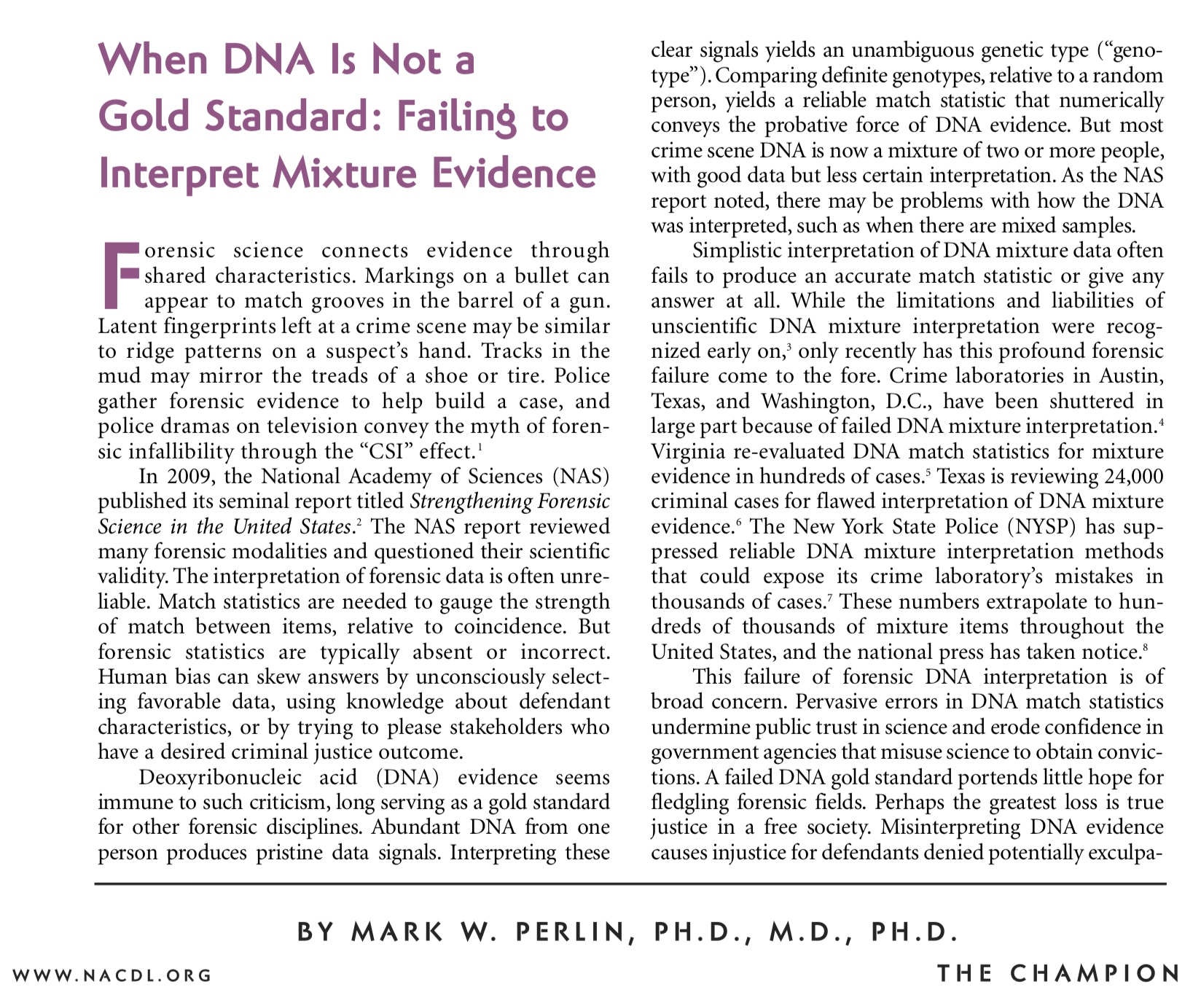

Slide 7
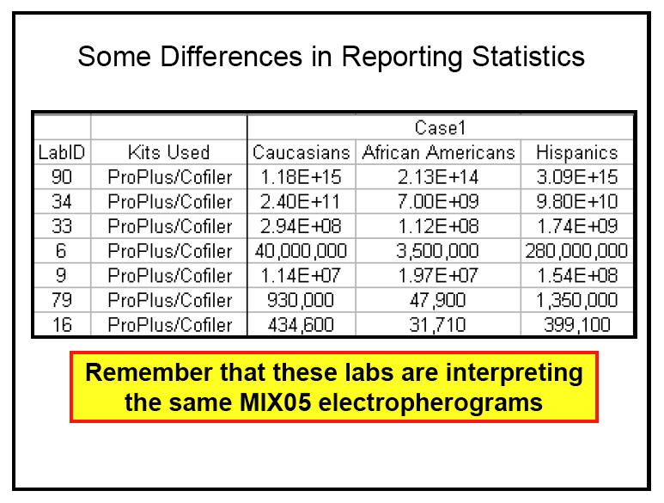
Unreliable DNA mixture statistics
NIST (Commerce Department) study in 2005
Two contributor mixture data, known victim
When not
“inconclusive”:
213 trillion (14)
31 thousand (4)
Forensic DNA labs put on notice 15 years ago

Slide 8
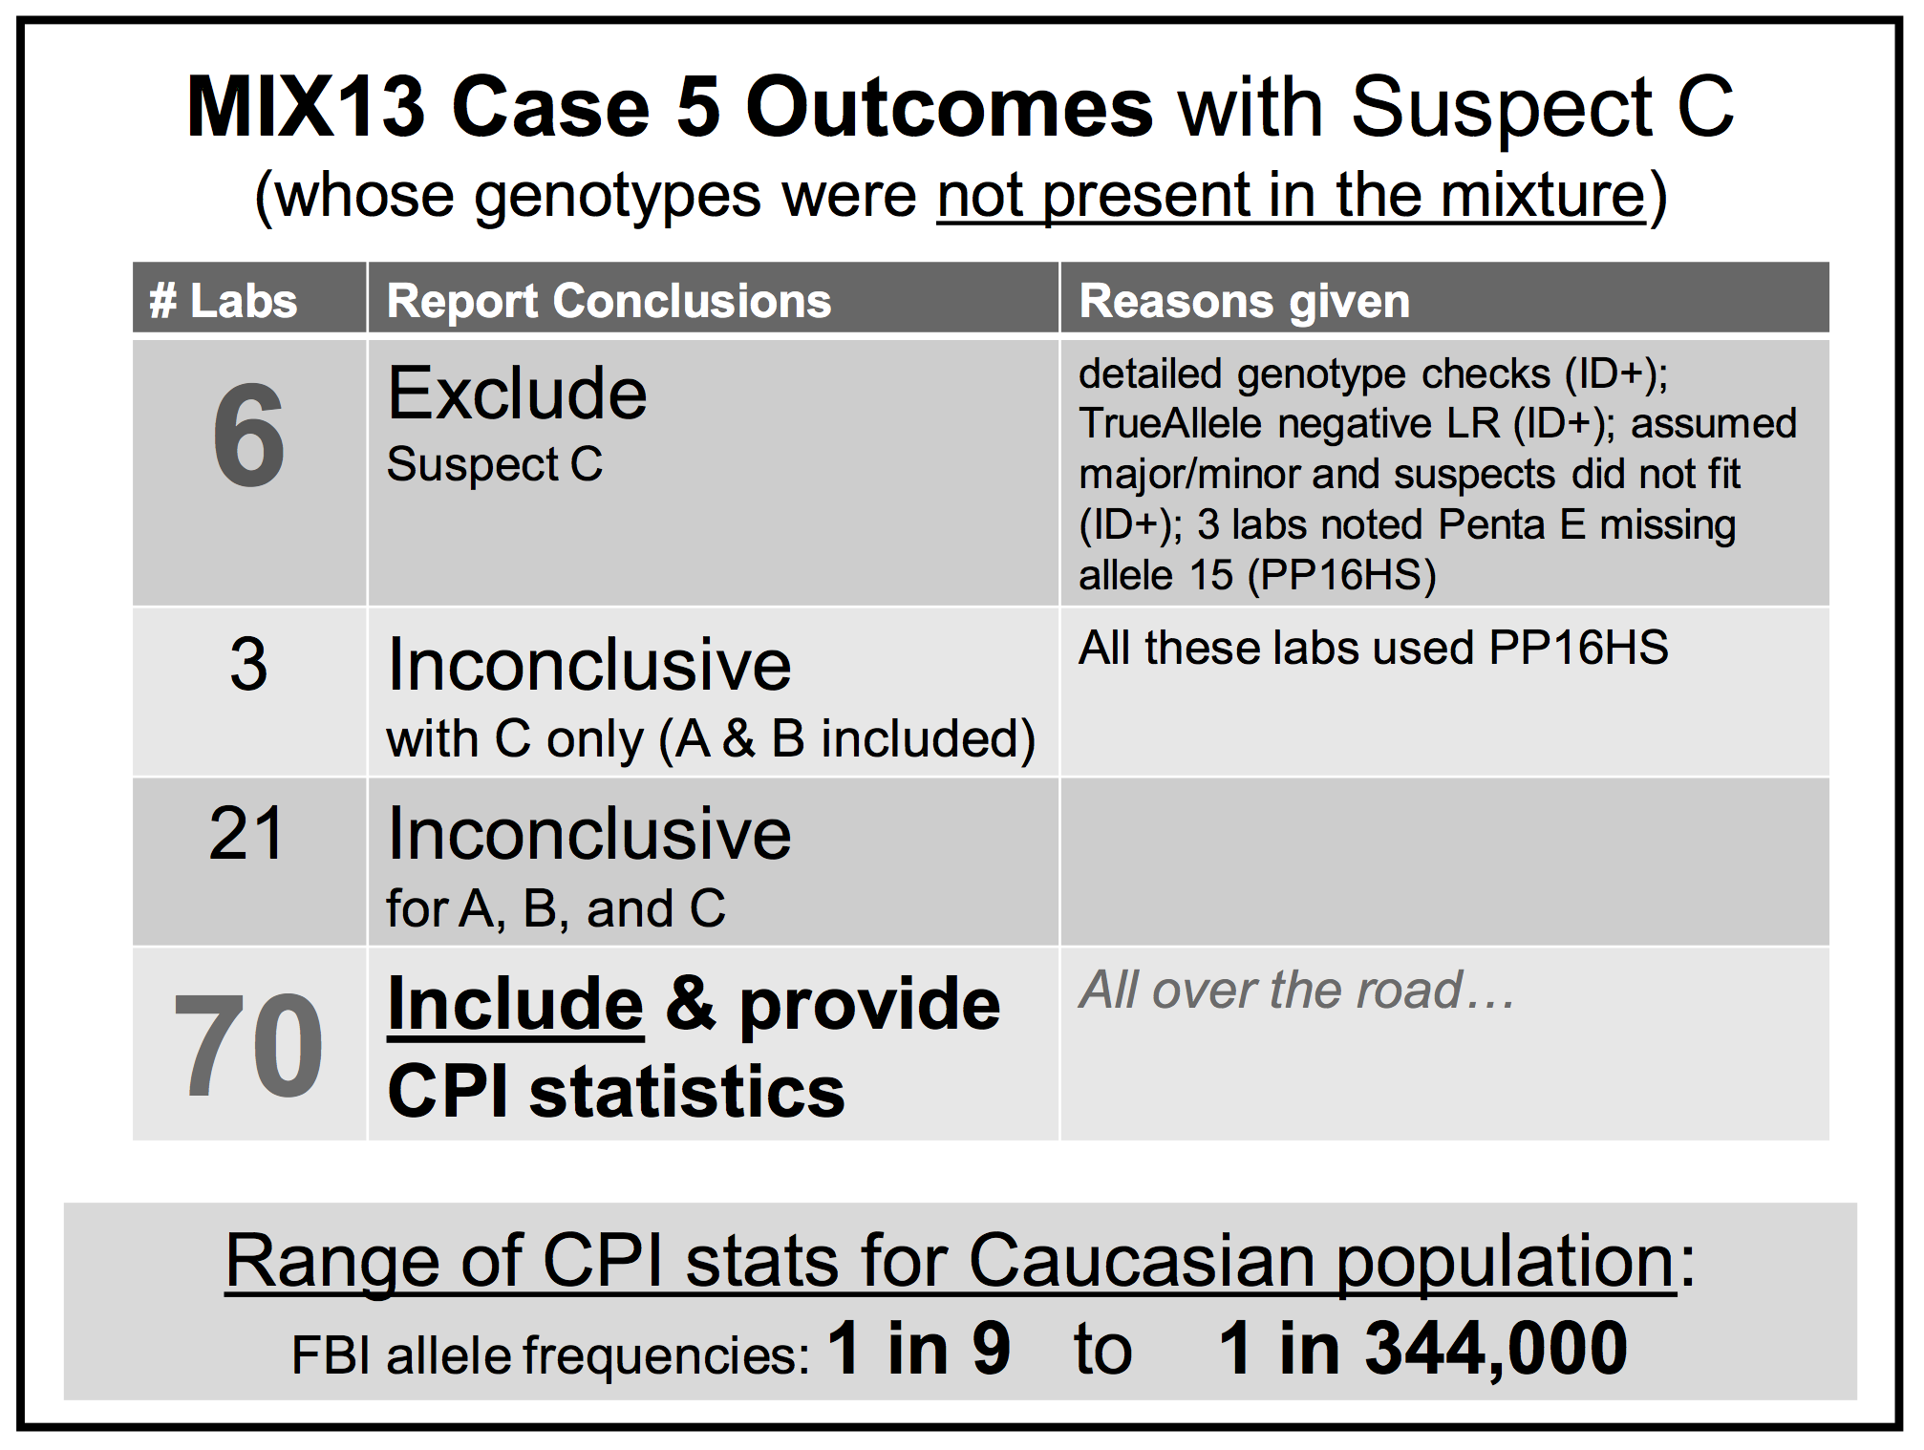
Falsely identify innocent people

Slide 9




Biased DNA workflow
(1)
Choose data
(3)
Person decides
(2)
Calculate statistic
• Put people in the process
• To overcome software limits
• And introduce human bias

Slide 10
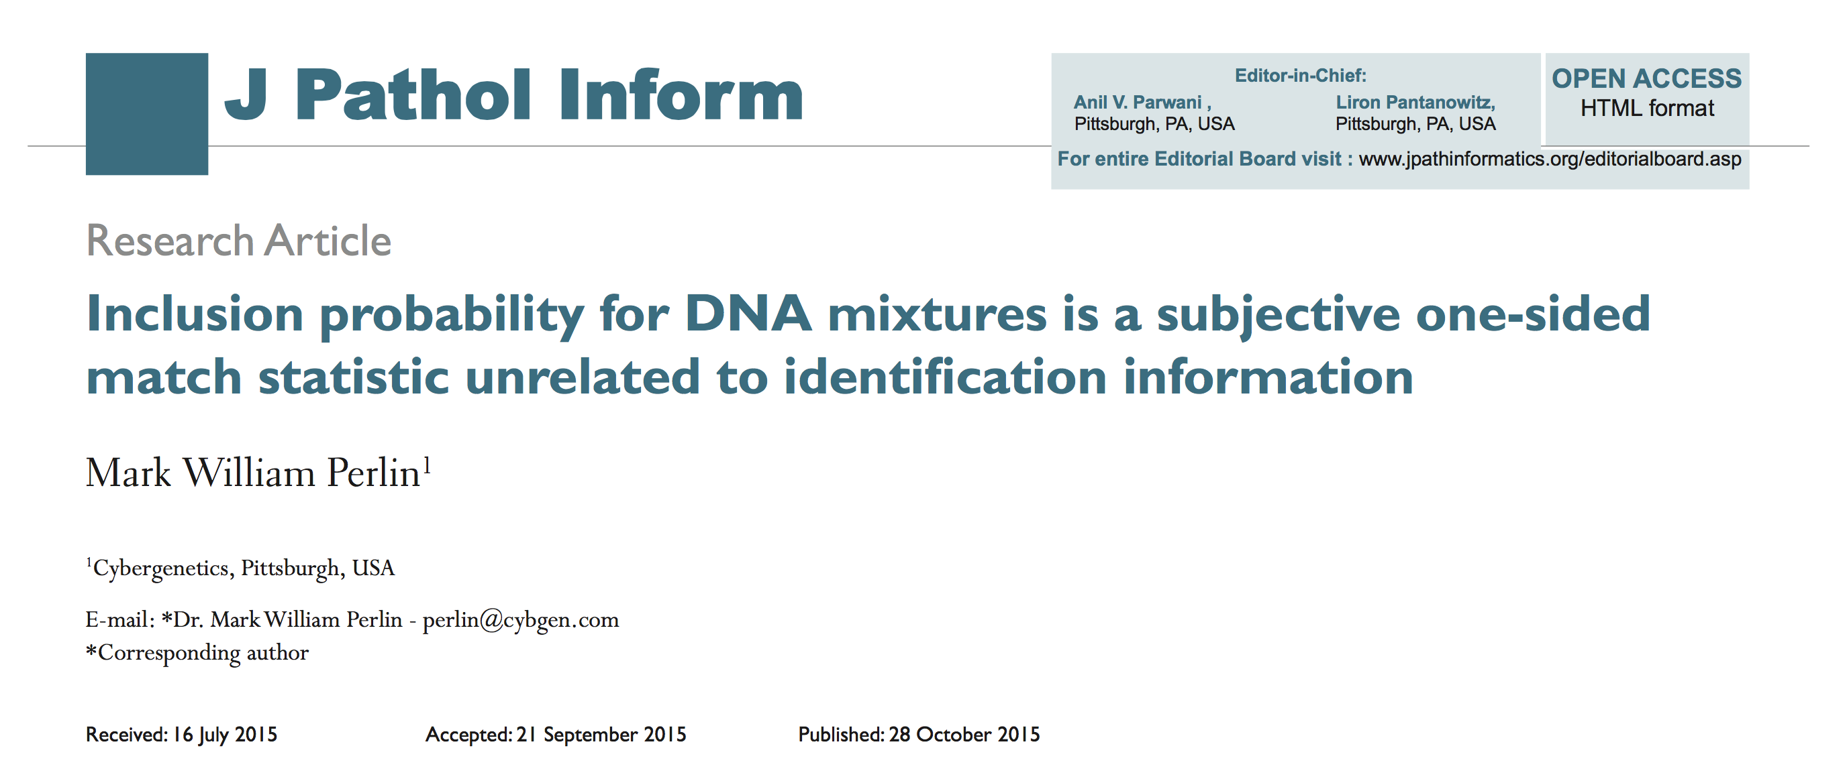
Good evidence, wrong answers
Misled courts for 15 years on most DNA mixtures

Slide 11
Human mixture interpretation
• Inaccurate. Disagrees with true information
• Subjective. Workflow introduces human bias
• Widespread. Hundreds of thousands of cases
• Opaque. Choices use only some of the data
• Biased. Can only include – or give no answer
Inconclusive

Slide 12
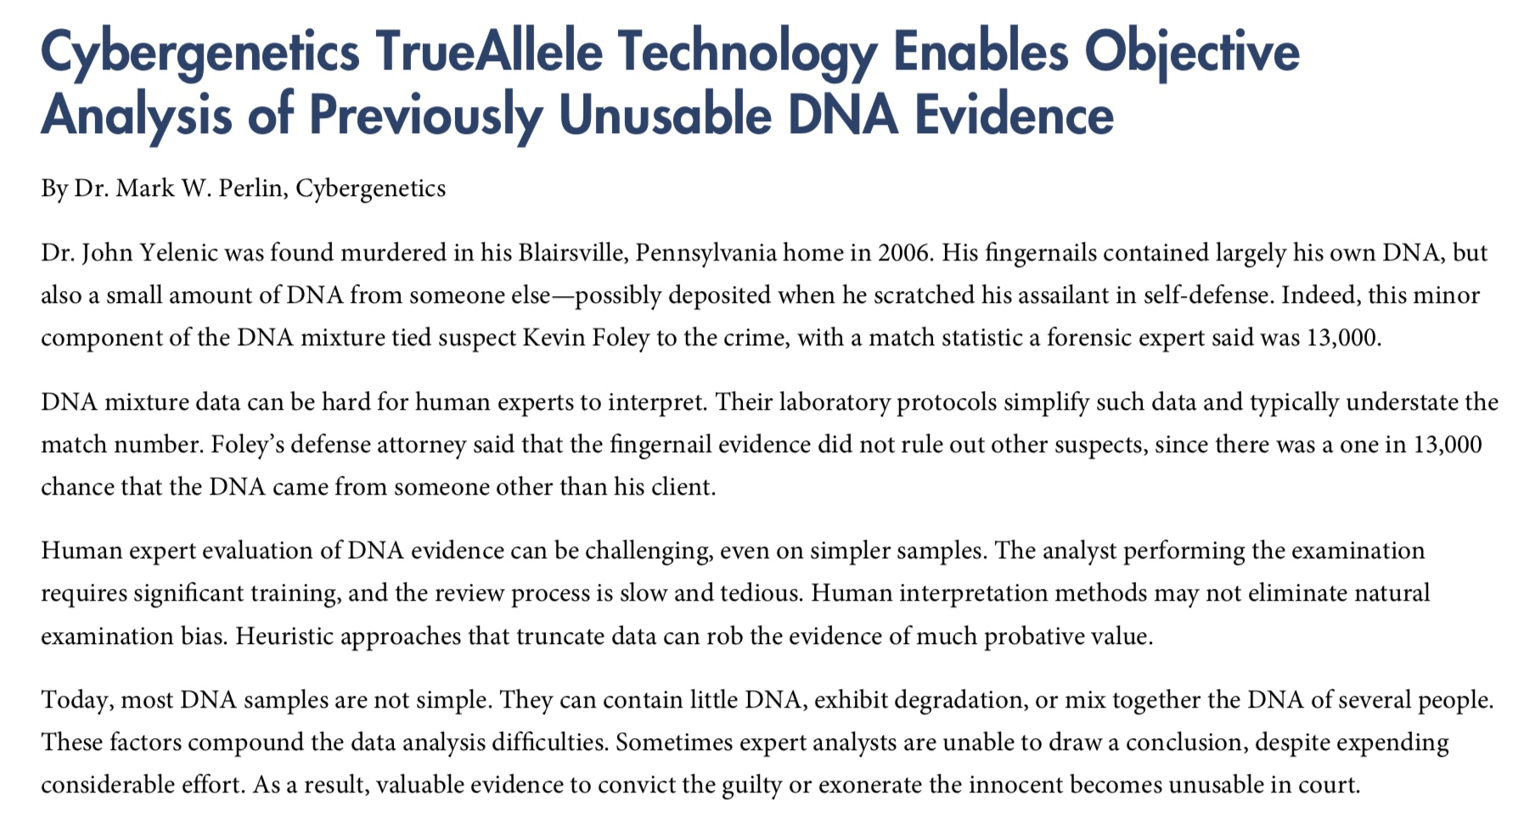
MathWorks Newsletters: Technical Article. 2013:1-4.

Slide 13
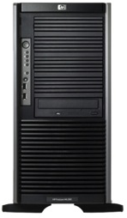


TrueAllele® technology
Parallel Processing
& Database Servers
Fully automated
Uses all the data
No thresholds or choices
No calibration – case data
VUIer™ Software

Slide 14
No human information from mixture
Crime laboratory DNA report
Crime lab user fee: $5,000
Conclusions:
Item 1 – Swab of textured areas from a handgun
The data indicates that DNA from four (4) or more contributors was obtained from the swab of the handgun. Due to the complexity of the data, no conclusions can be made regarding persons A and B as possible contributors to this mixture.

Slide 15

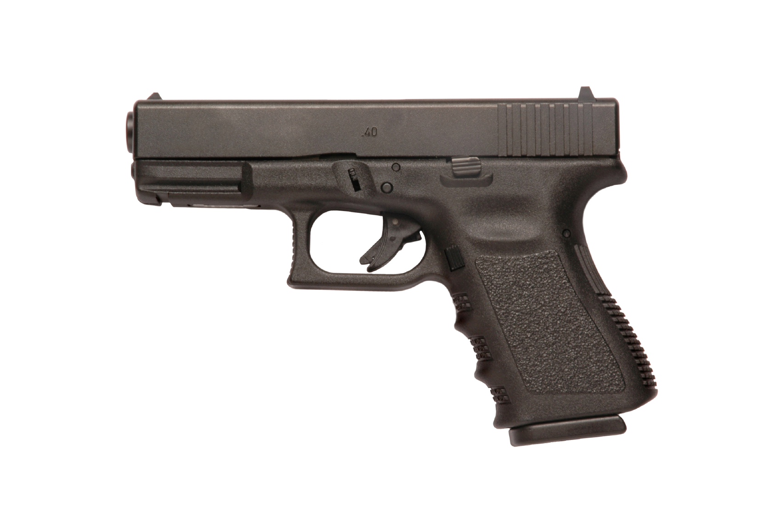

Probabilistic genotyping
Cybergenetics TrueAllele report
Match statistics provide information
Person A
excluded
Contributor
Unmix the
mixture
1
2
400,000
3
Person B
included
4

Slide 16
TrueAllele® computer technology
• Accurate. 35+ validation studies, 7 published
• Objective. Workflow removes human bias
• Accepted. Reported in 43 states, used by labs
• Transparent. Give math, software (4GB DVD)
• Neutral. Can statistically include or exclude
Informative

Slide 17

Objective workflow
(1)
Enter all data
(2)
Calculate statistic
(3)
Math decides
• Keep people out of the process
• Because software is robust
• And eliminate human bias

Slide 18
How is TrueAllele used?
• Prosecution
• Defense
• Investigation
• Post-conviction
• Mass disaster
• Touch DNA
• Complex mixtures
• Kinship, paternity
• DNA database
• Preventing crime

Slide 19
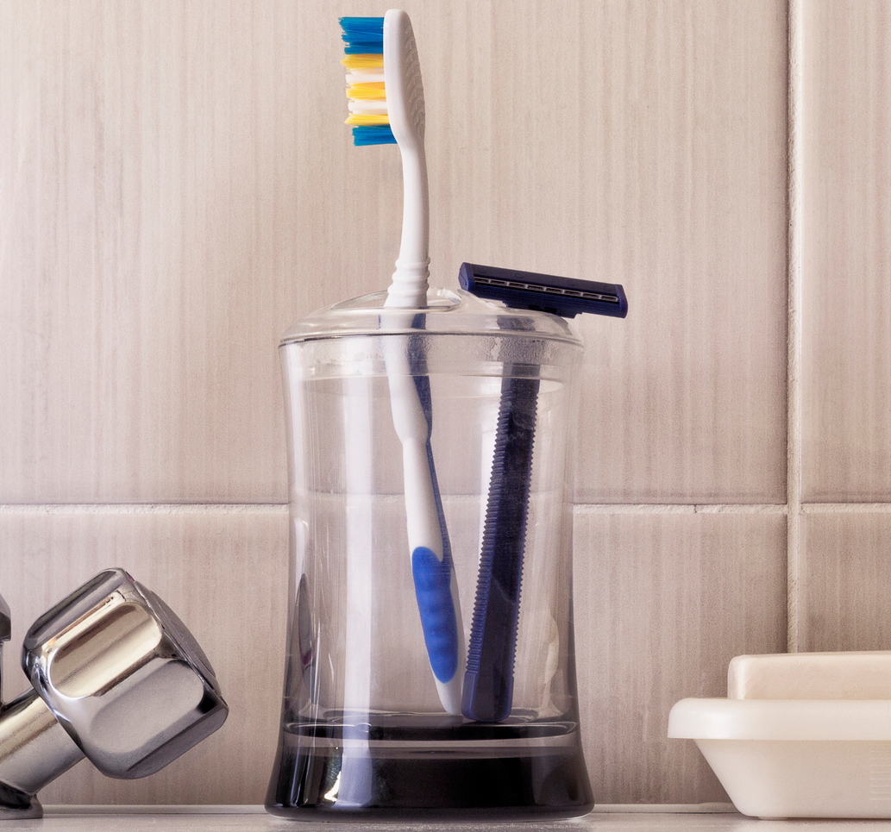
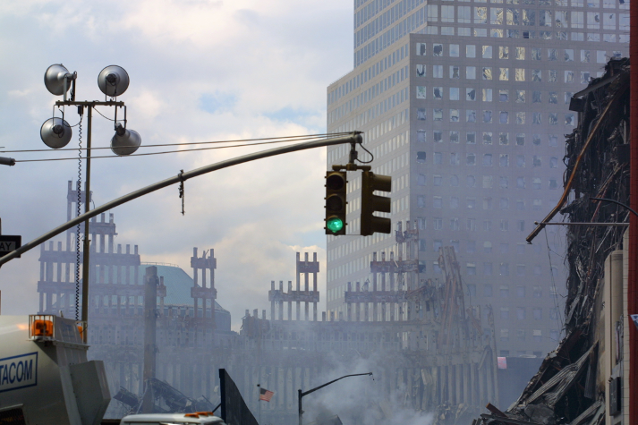

World Trade Center
18,000 victim remains
2,700 missing people
match
September 11, 2001 – New York City

Slide 20
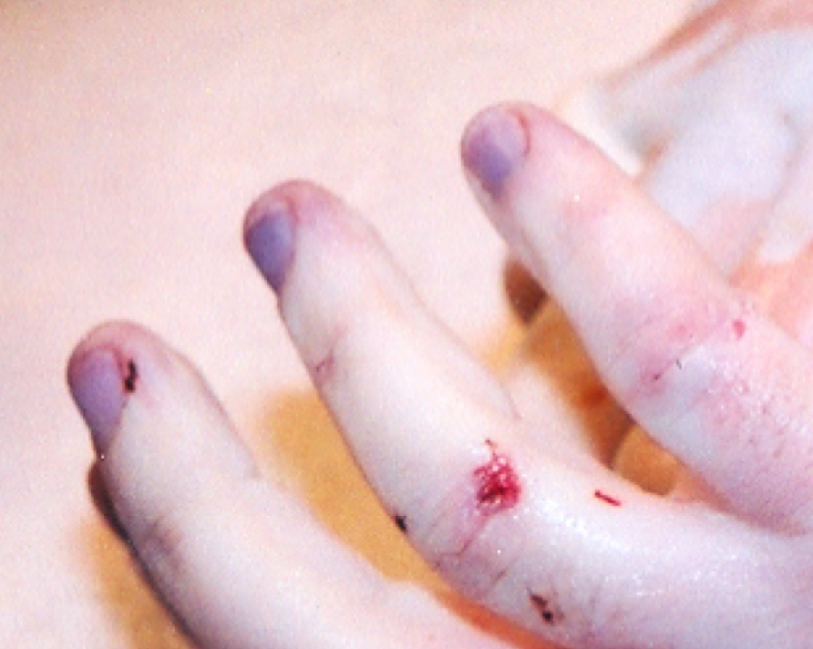
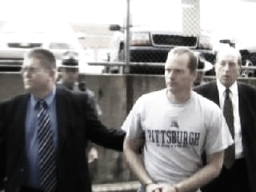
Pennsylvania v. Kevin Foley
Apr 2006: Blairsville Dentist John Yelenic murdered
Nov 2007: Trooper Kevin Foley charged with crime
February 2008: Defense questions 13,000 DNA match score
March 2009: Jury hears 189,000,000,000 TrueAllele statistic

Slide 21
Pennsylvania v. Joshua Huber
Item | Description | Melissa Zuk | Derek Schindler | Joshua Huber
13E | Living room wall bloodstain | 1 in 160 million | 1 in 36 thousand | 11.6 quintillion
29A | Schindler's right hand fingernails |  | 1.37 quintillion | 53.8 thousand
1603461-13A | Left hand fingernails of Melissa Zuk | 17.4 billion |  | 3.35 thousand

Slide 22
Virginia v. David Black
Item | Description | David Black | Bonnie Black | BettyAnn Armstrong | Craig Black | Eleanora Black
08 | Baseball hat velcro strap | 32.5 quintillion | 16.1 billion |  | 1/1.83 thousand | 1/62.6
94 | Master bedroom light switch | 364 million | 8.14 million
95 | Master bathroom light switch | 1/19.5 | 554 million |  |  | 3.63 million

Slide 23

Maryland v. Nelson Clifford
11%
82%
7%
contributor
1
contributor
2
contributor
3
match
statistic

Slide 24
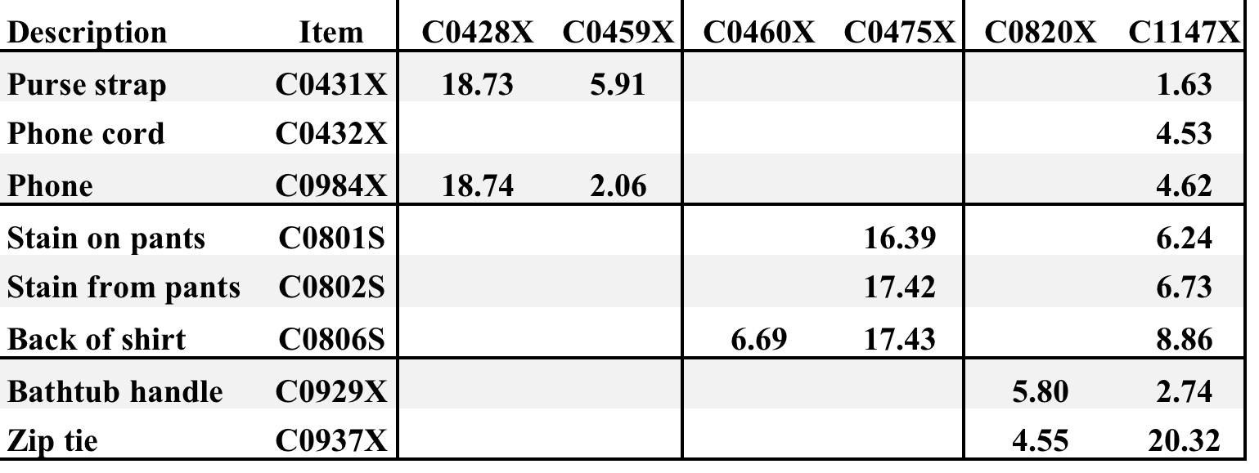
California v. Billy Ray Johnson
8 mixture items vs. 5 victims + 1 suspect
BRJ
DNA match statistics
corroborate victim statements

Slide 25
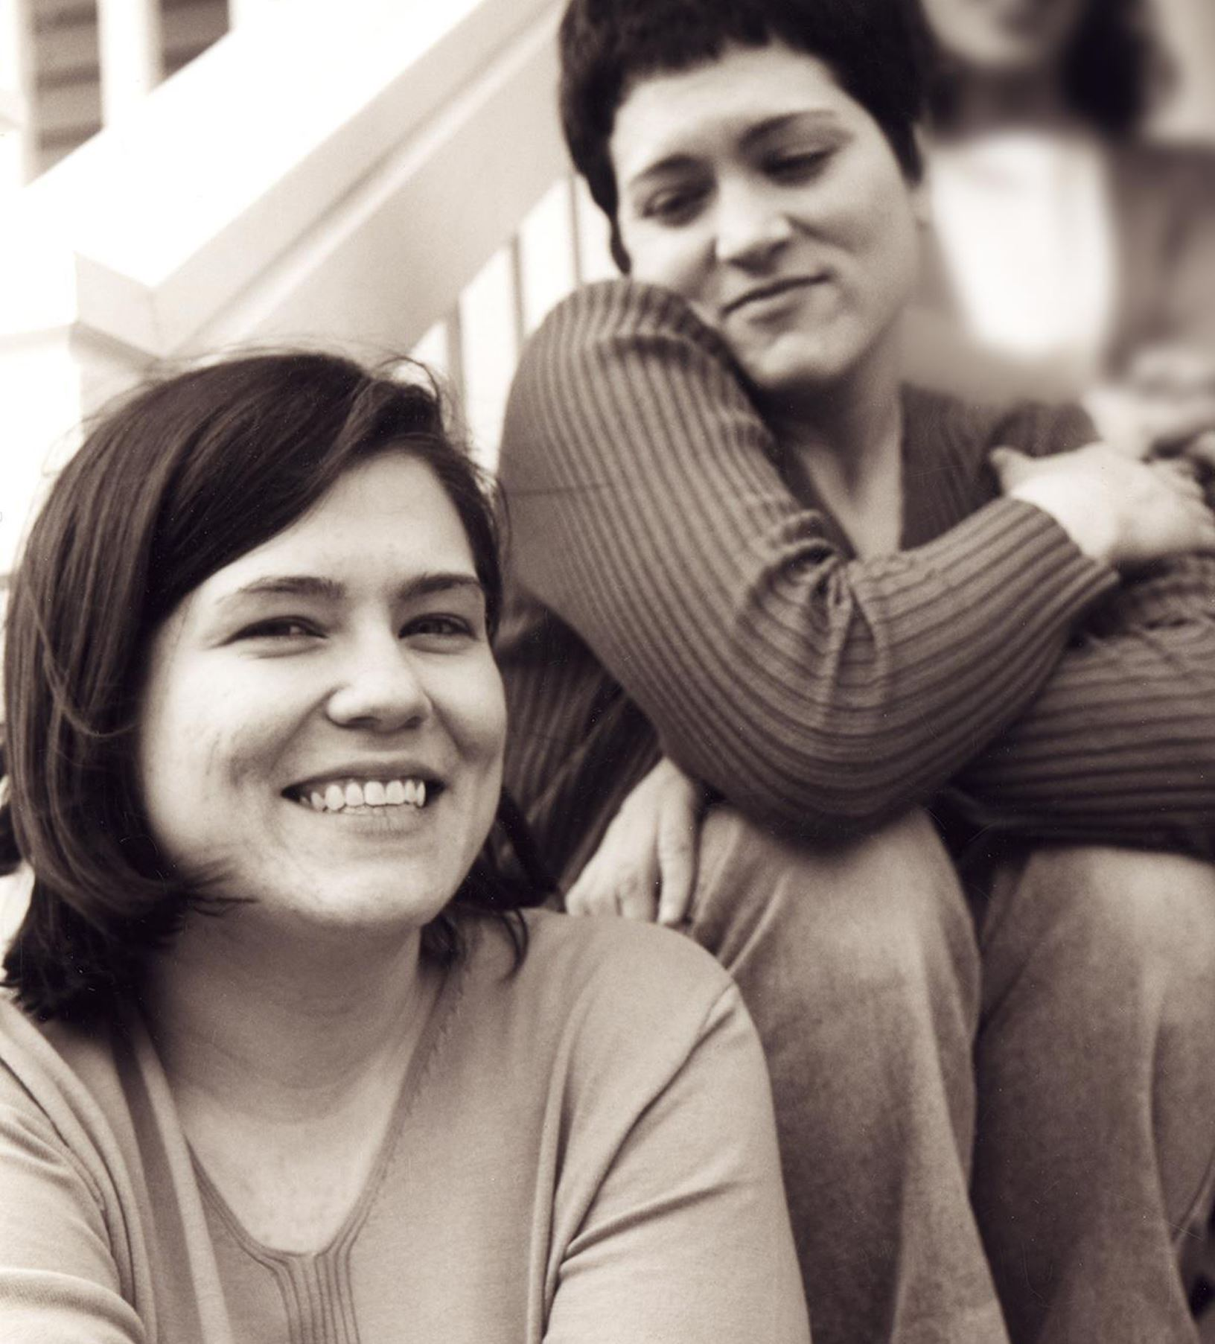
Wolfe sisters homicide
On February 6, 2014, Susan Wolfe (44)
and her younger sister Sarah (38, left)
were killed in their East Liberty home in Pittsburgh.

Slide 26
Pennsylvania v. Allen Wade
Thresholds failed to interpret most DNA mixtures
Hat No conclusions
Cup Insufficient data
Fingernails Contamination, insufficient data
Gear shift Insufficient data
Seat lever Cannot be excluded
Knit hat Insufficient data
Sock Too complex, no conclusions

Slide 27
Pennsylvania v. Allen Wade
The crime lab reported 5 DNA mixture matches
TrueAllele found 17 matches on the same data
Hat 65.3 thousand Allen Wade
Cup 20.5 thousand Susan Wolfe
Fingernails 6.06 trillion Allen Wade
Gear shift 9.37 million Sarah Wolfe
Seat lever 385 billion Sarah Wolfe
Knit hat 25.7 thousand Allen Wade
Sock 300 Sarah Wolfe

Slide 28
Reported DNA match statistics
A match between the right fingernails
and Allen Wade is:
6.06 trillion times more probable than
a coincidental match to an unrelated Black person
32.5 trillion times more probable than
a coincidental match to an unrelated Caucasian person
8 trillion times more probable than
a coincidental match to an unrelated Hispanic person

Slide 29
Allen Wade Found Guilty On All Counts In East Liberty Sisters’ Slaying
CBS News, May 23, 2016
PITTSBURGH (KDKA/AP)
• A man accused of killing two sisters who lived next door to him in East Liberty has been found guilty on all counts
• Allen Wade was accused of shooting Sarah and Susan Wolfe after they returned from work, apparently to steal bank card
• On Monday morning, a jury found Wade guilty of first-degree murder, robbery, burglary and theft by unlawful taking

Slide 30
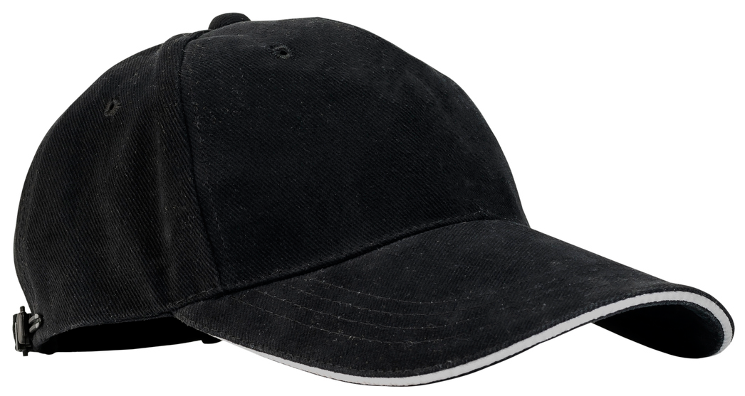
Pennsylvania v. Allen Wade
Thresholds failed to interpret DNA mixture
TrueAllele succeeded on the same data
A hat left from a burglary of the Wolfe sister’s home
six weeks before the murder matched
Allen Wade with a 65.3 thousand statistic
Preventable Crime

Slide 31
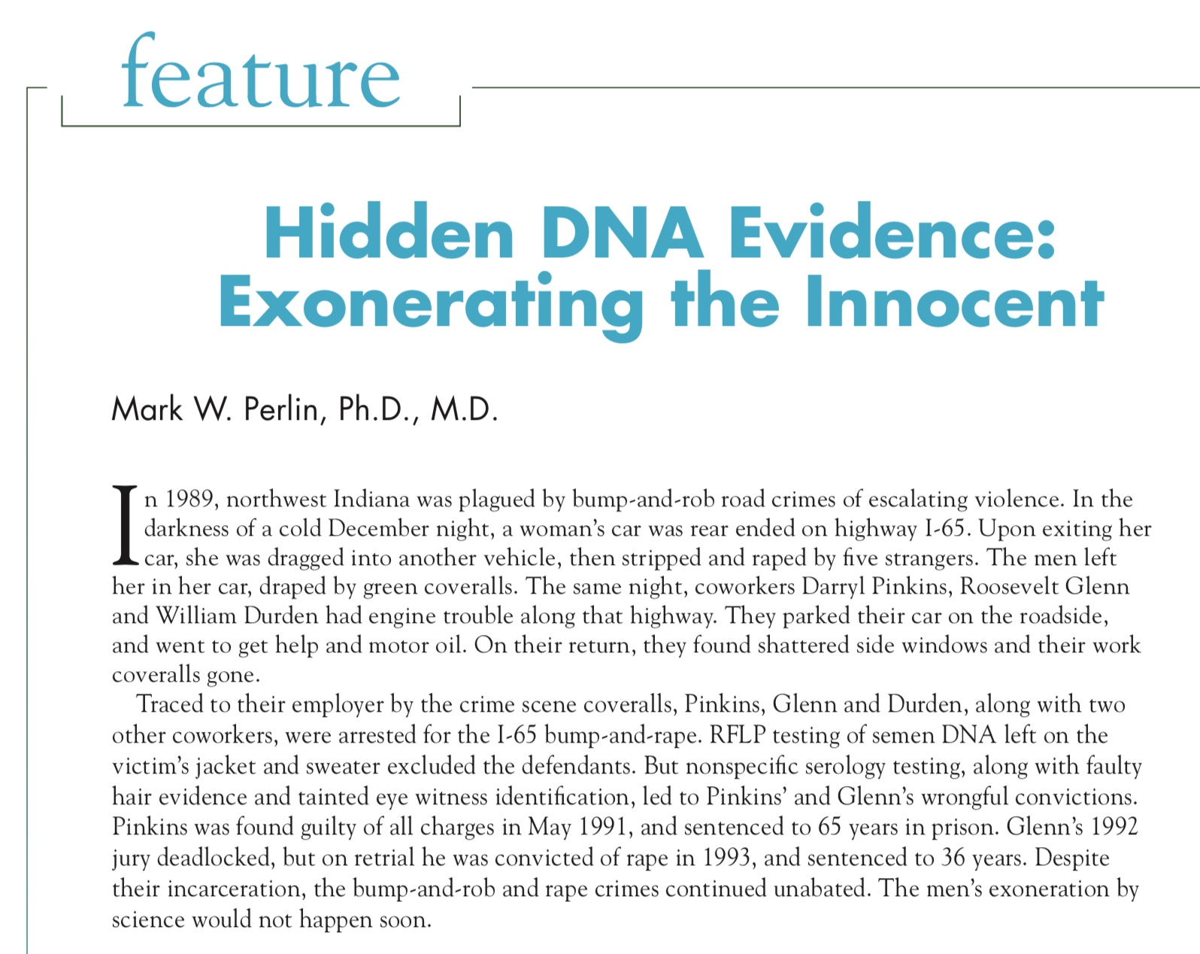

Slide 32
Darryl Pinkins imprisoned
1989 – 5 men raped an Indiana woman
Darryl Pinkins and 2 others misidentified
1991 – wrongfully convicted, 65 year sentence
2001 – DNA mixture evidence
2 contributors found, not the accused
but 5 were needed, post-conviction relief denied

Slide 33
TrueAllele Pinkins findings
1. compared evidence with evidence
2. calculated exclusionary match statistics
3. revealed 5% minor mixture contributor
4. jointly analyzed DNA mixture data
5. showed three perpetrators were brothers
found 5 unidentified genotypes,
defendants not linked to the crime

Slide 34
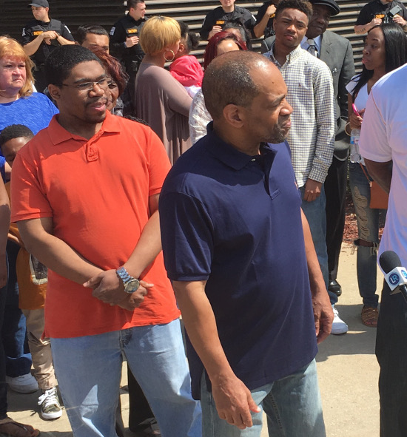
Pinkins released
April 25, 2016
CBS News 48 Hours
“Guilty Until Proven Innocent”

Slide 35
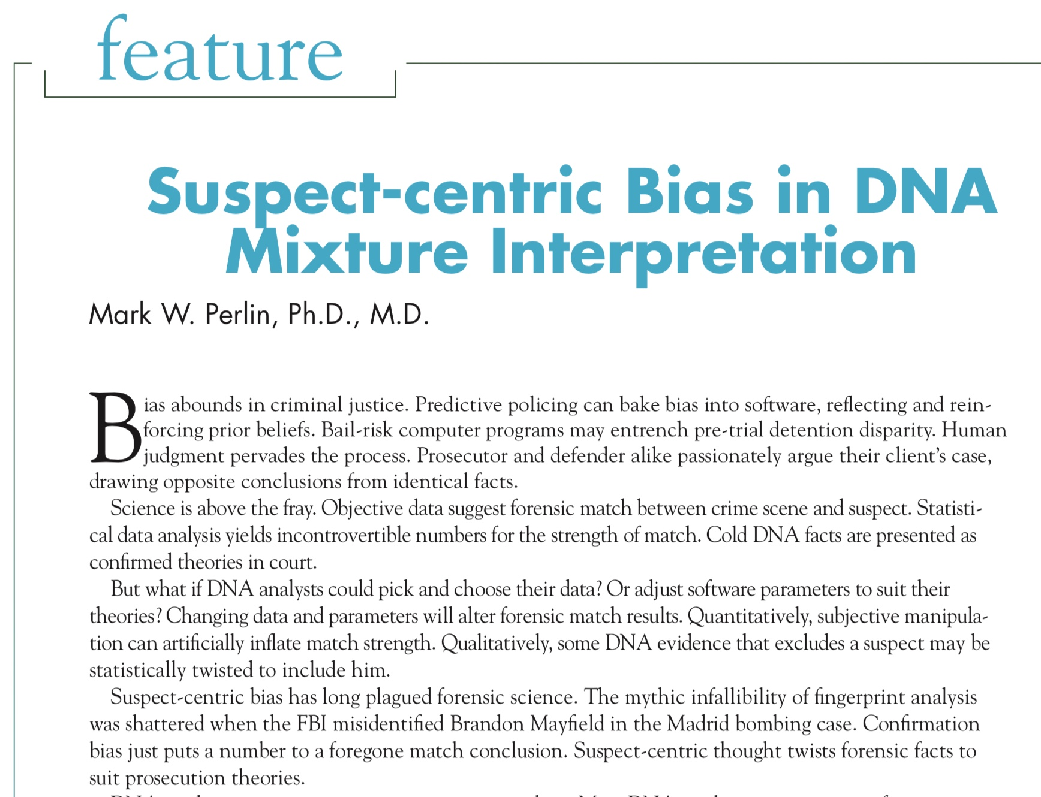

Slide 36
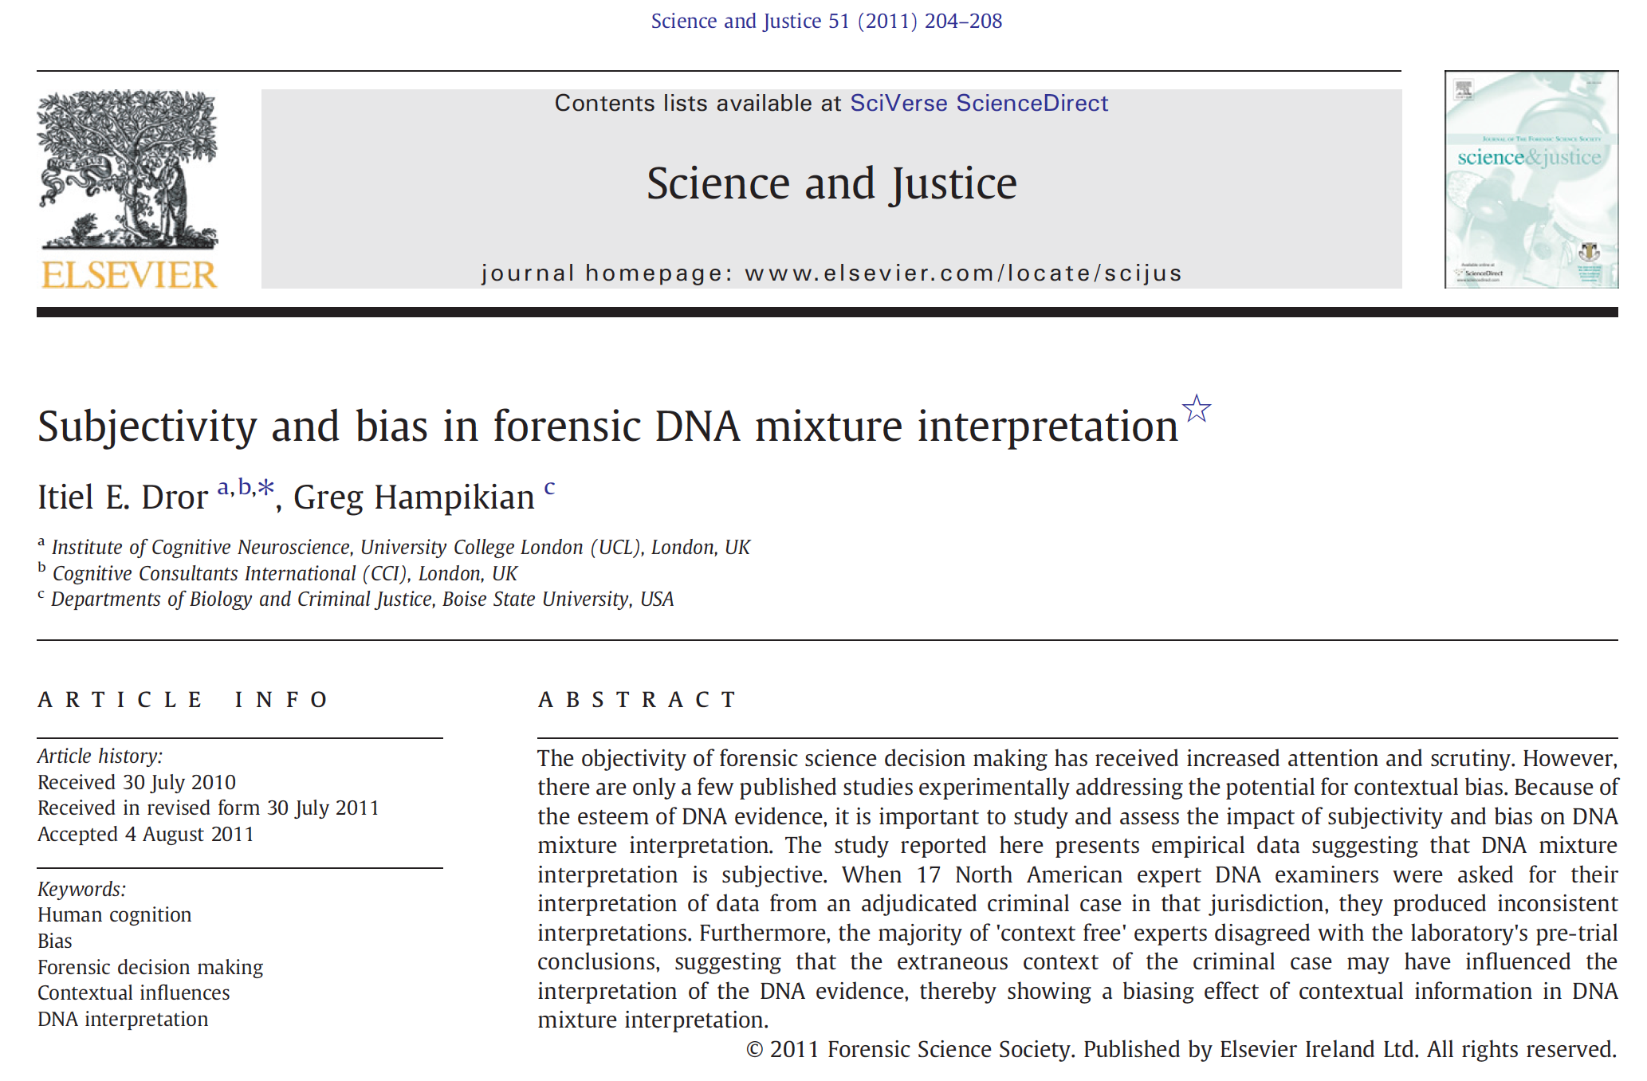

Slide 37
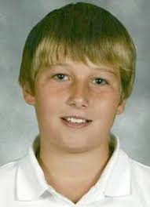
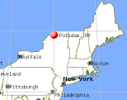
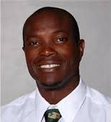
New York v. Nick Hillary
Garrett Phillips (12)
Died from strangulation
October 24, 2011
Oral “Nick” Hillary
Arrested for murder
May 15, 2013

Slide 38
DNA evidence and results
150 biological evidence items,
with focus on DNA under victim’s fingernails
Other software finds match statistic of ten million,
connecting victim’s fingernails to defendant’s DNA
Unknown minor contributor is 0.4% or 1:250,
a very, very small amount of DNA

Slide 39
F.R.E. Rule 702
Sufficient data
Reliable method
Reliably apply method to data

Slide 40
Sufficient data
Mixture
• ratio is 1:250
• less than 1 cell
Fingernail data show
low mixture amount
& low peak heights
for minor contributor
Peak height
• 30 to 70 rfu

Slide 41
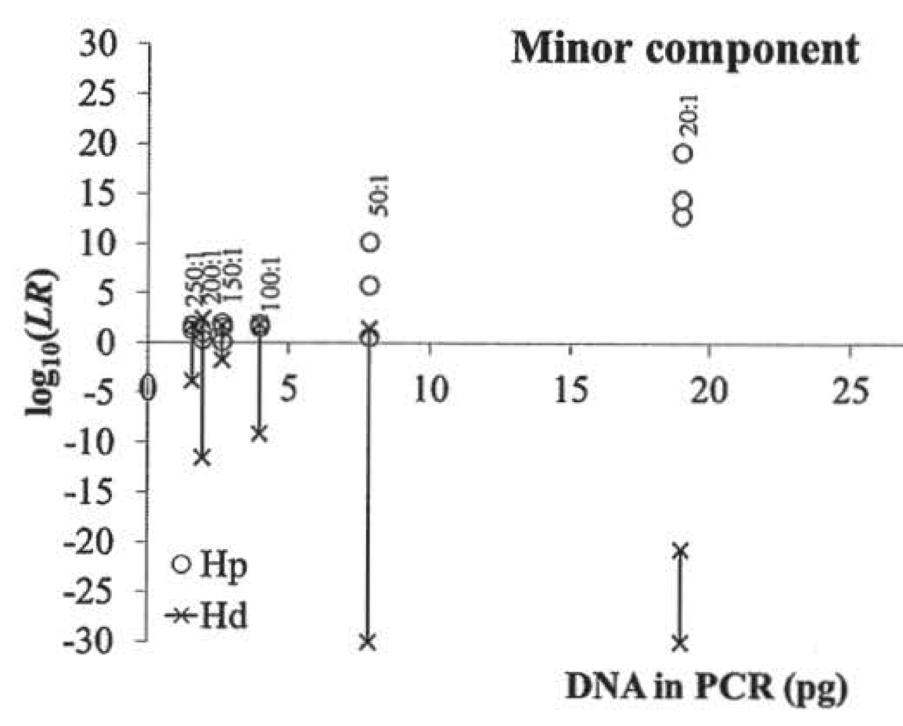
Reliable method
donor not donor
o
x
Mixture (validation)
• ratio of 1:25
• many cells
donor
Peak threshold
• 30 rfu in study
1
2
3
cells
not
donor

Slide 42
Reliably apply method to data
donor not donor
o
x
Mixture (case)
• ratio is 1:250
• less than 1 cell
log(LR)
2
1
Peak threshold
• 30 rfu in study
• 50 rfu in case
cell

Slide 43
Choose threshold level
LR
include
exclude
Different choices, different answers
Software does not agree with itself

Slide 44
Pick and choose data
3 amplifications
at D8 locus
Victim
Foreign
Defendant
Exculpatory
V
V
expert
report
F
D
D
X
X
X
X
X
other choices

Slide 45
STRmix™ results precluded
Dr. Buckleton conceded at the hearing that no internal validation studies were performed by the New York State Police crime lab for the use of STRmix on casework samples developed at the lab.
As a result Dr. Buckleton was forced to pick and choose data from different “reliable sources” and input parameters into the program in such a way that he believed the system would tolerate.
ORDERED that the defendant’s motion to preclude the prosecution from calling an expert witness to testify on their direct case regarding any conclusion reached by the use of STRmix is granted as the prosecution cannot lay a foundation for the introduction of evidence that had not been internally validated.

Slide 46

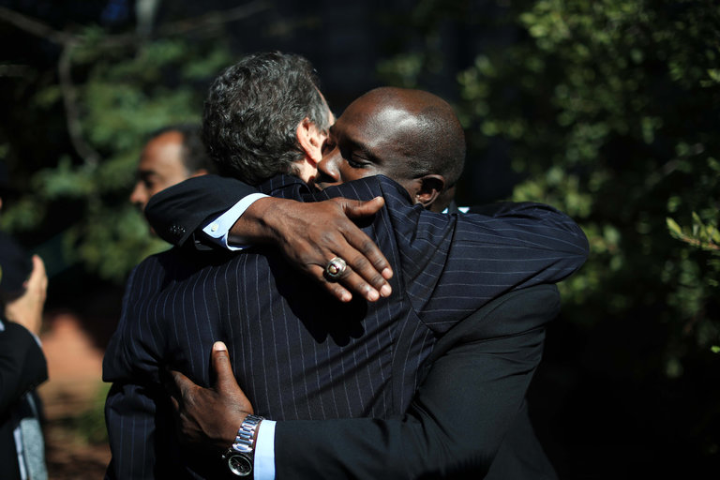
Hillary acquitted
Oral Nicholas Hillary Acquitted in Potsdam Boy’s Killing
September 28, 2016
“Who Killed Garrett Phillips?”
HBO on July 9, 2019

