Slide 1

TrueAllele Workshop:
Unlocking DNA profile interpretation for Africa
6# African Forensic Forum
University of Cape Town
South Africa
March 2026
Mark W Perlin, PhD, MD, PhD
Cybergenetics, Pittsburgh, PA USA
Cybergenetics © 2003-2026

Slide 2
Kinship IPG
Paternity
Maternity
Missing Person
Mixture with Kinship

Slide 3
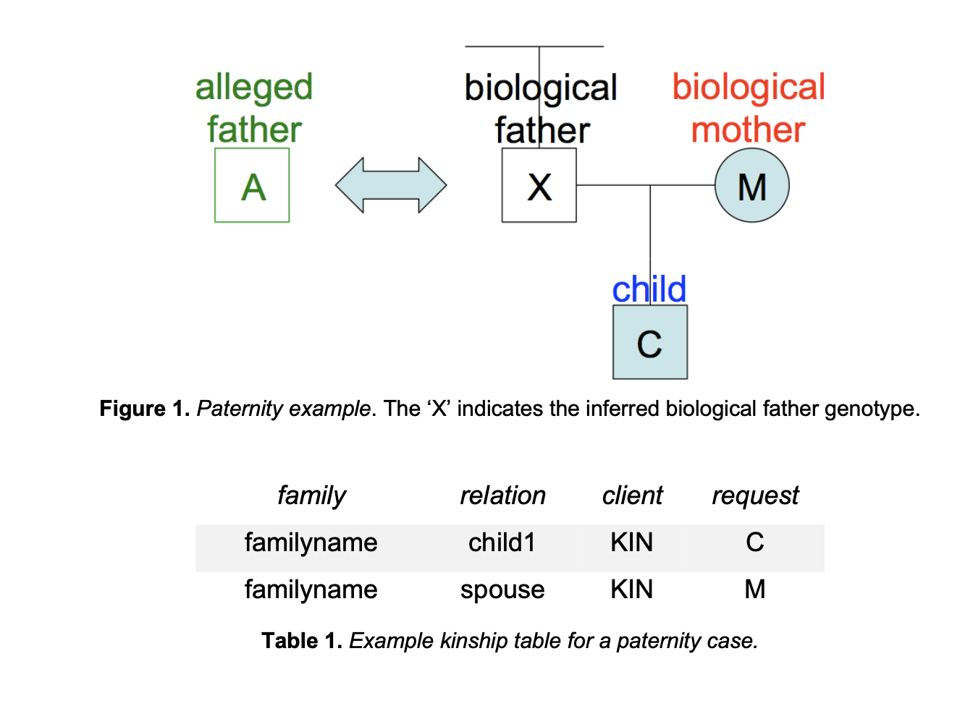
Paternity

Slide 4
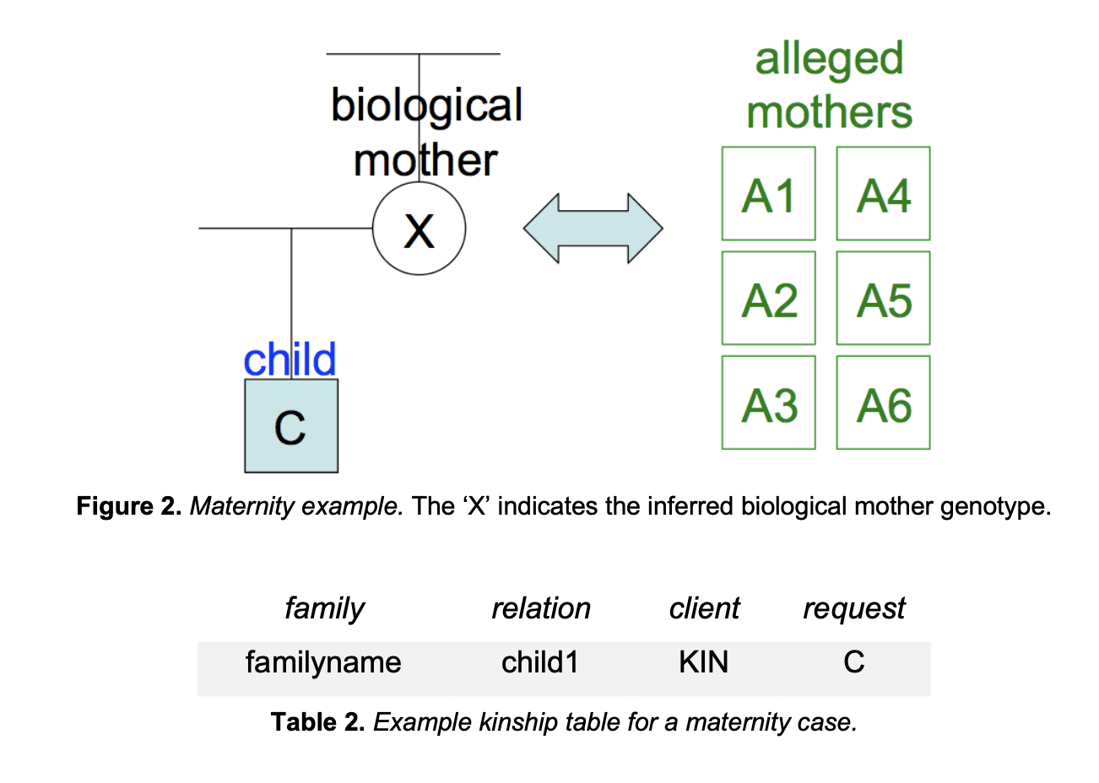
Maternity

Slide 5
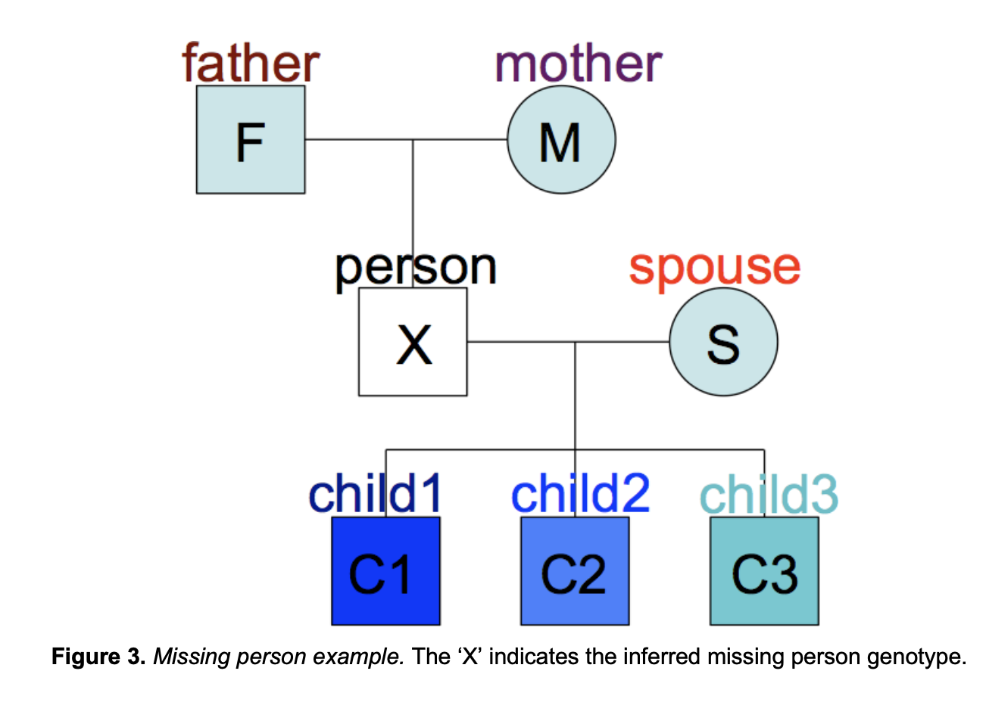
Missing Person

Slide 6
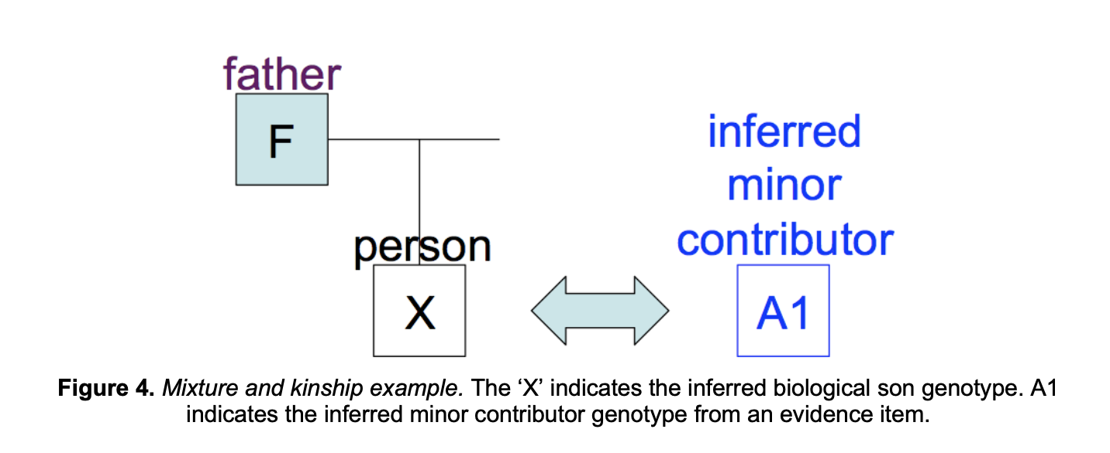
Mixture with Kinship

Slide 7
Kinship Cases
Four half-siblings (UCT)
New York daughter rape
Pennsylvania two-parent murder

Slide 8
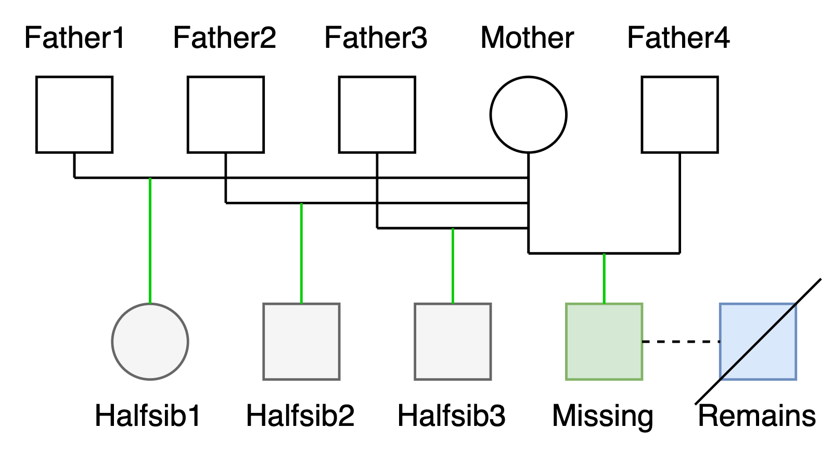
Four half-siblings (UCT)

Slide 9
4 Half-sib remains identification

Slide 10
New York daughter rape

Slide 11
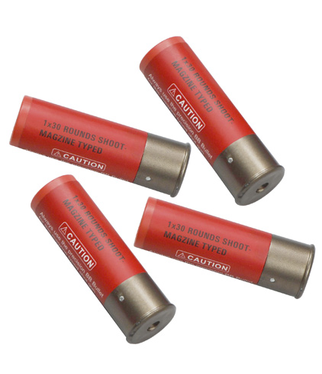
Pennsylvania v James Yeckel
11
“No conclusions?”

Slide 12
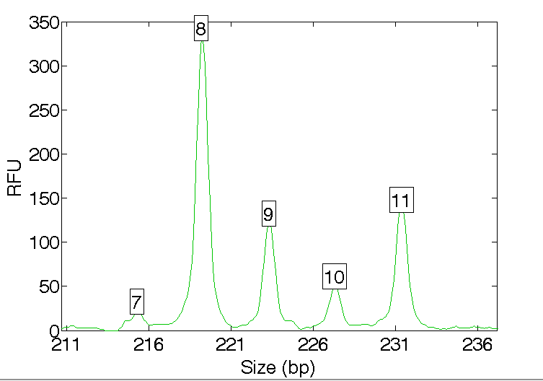
STR data
12
Quantitative peak heights at locus D7S820

Slide 13
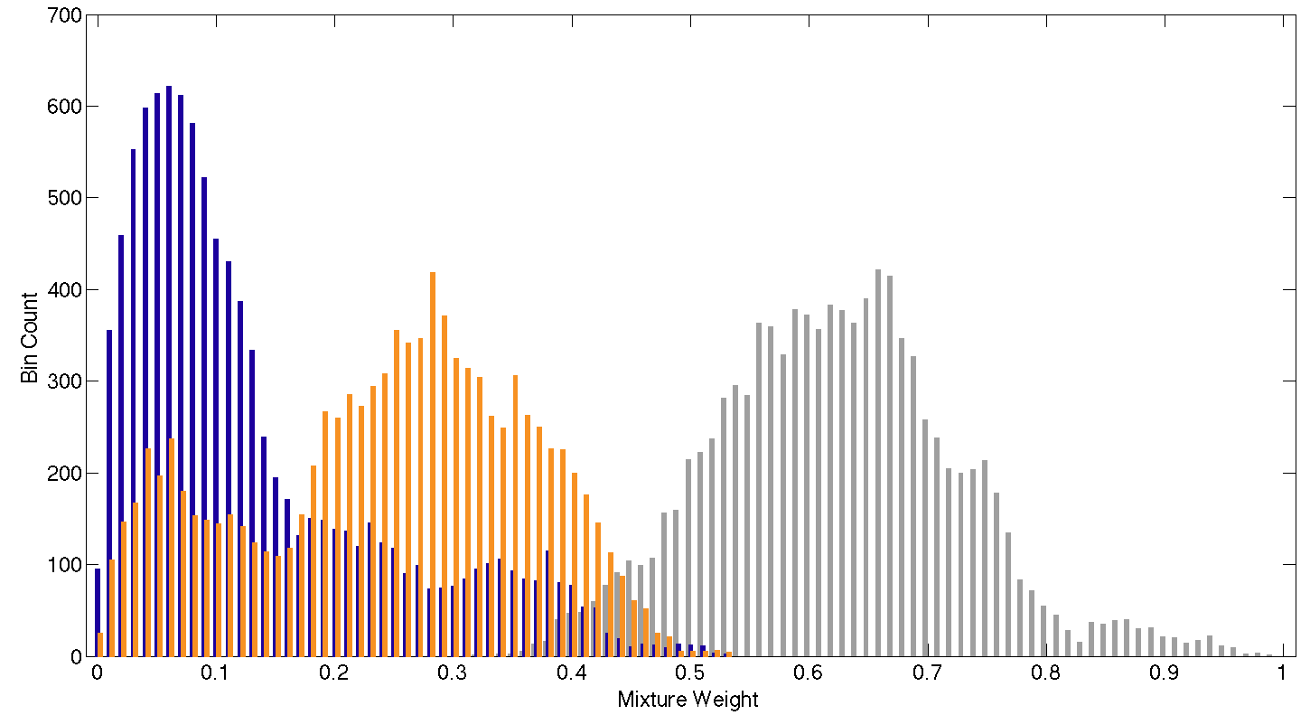
Mixture separation
13
Mother
Son
Father

Slide 14
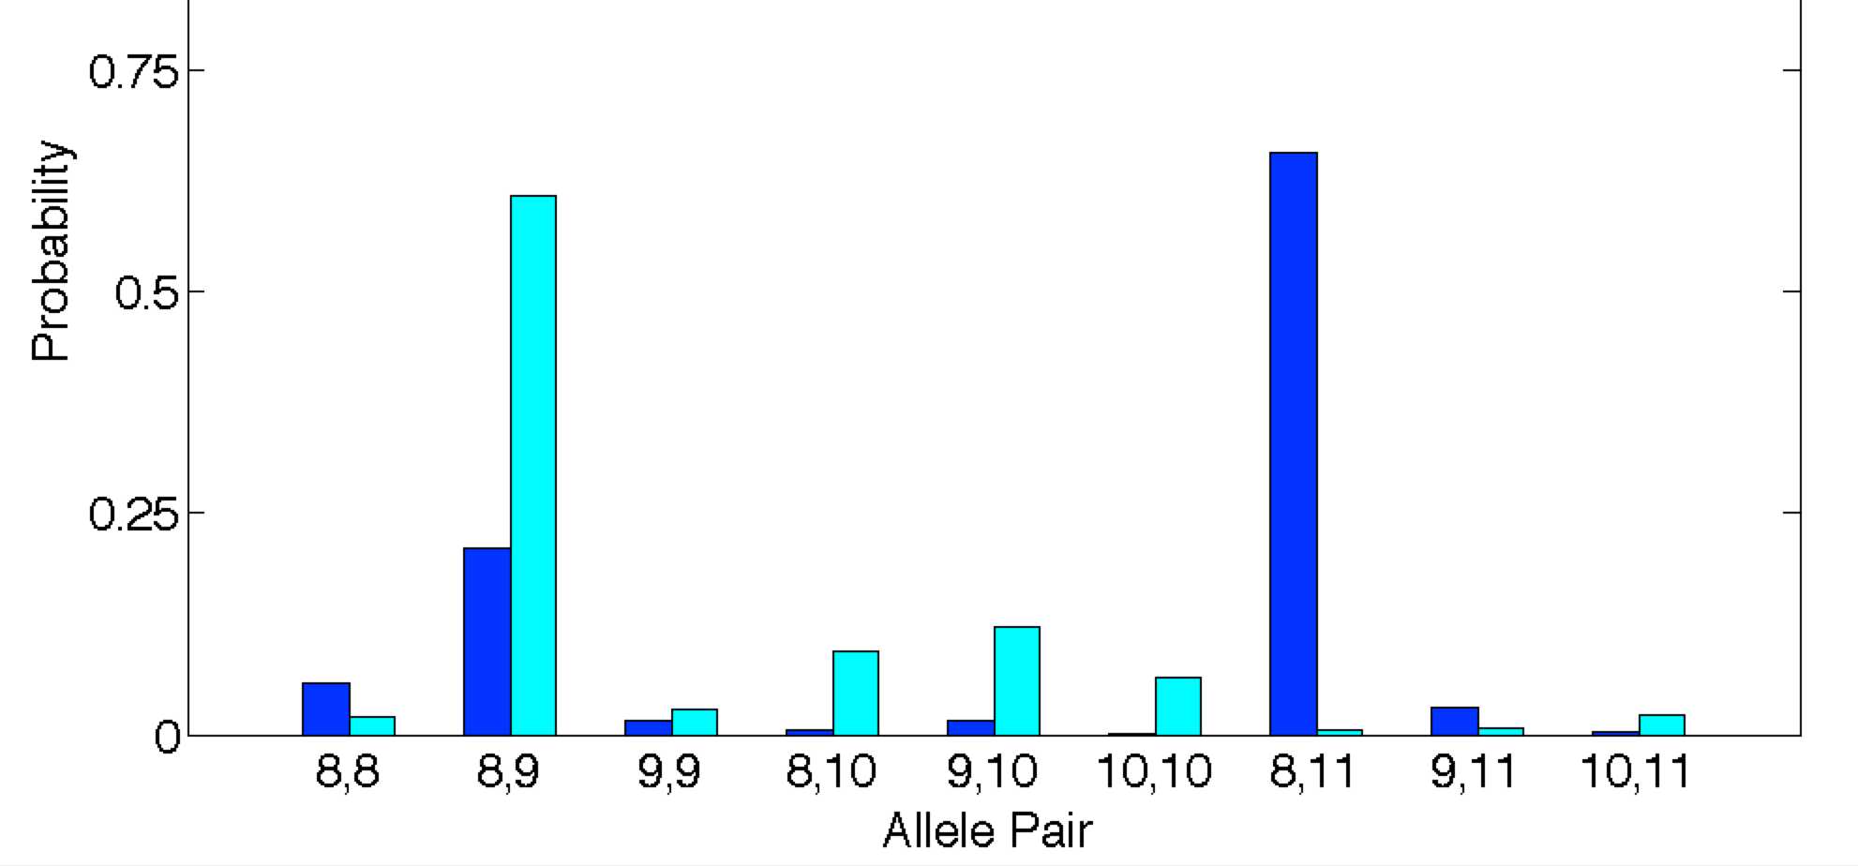
Genotype separation
14
Separate the mixture data into contributor genotypes
Minor
Major

Slide 15
Reported match statistic
15
The computer’s LR information
A match between the shotgun shell
and James Yeckel is
6.13 trillion times more probable than
a coincidental match to an unrelated Caucasian person

Slide 16
Why DNA investigation fails
Rape kits are processed, but:
Data isn’t used
Mixtures aren’t separated
Genotypes aren’t uploaded
Database isn’t searched

Slide 17


DDG CODIS database we have
Evidence
Reference
Allele database
Allele database
Match
Upload
Upload
Crime scene
Possible suspect
+
Unseparated mixtures

Slide 18
TrueAllele IPG database we need
Evidence
Reference
Genotype database
Genotype database
Match
Upload
Upload
Crime scene
Possible suspect
+
Separated genotypes

Slide 19
Identifying Victim Remains Using Kinship Genotype Inference
American Academy of Forensic Sciences Criminalistics Section
February 2023
Orlando, FL
William Allan, MS
Mark Perlin, PhD, MD, PhD
Cybergenetics © 2003-2023

Slide 20
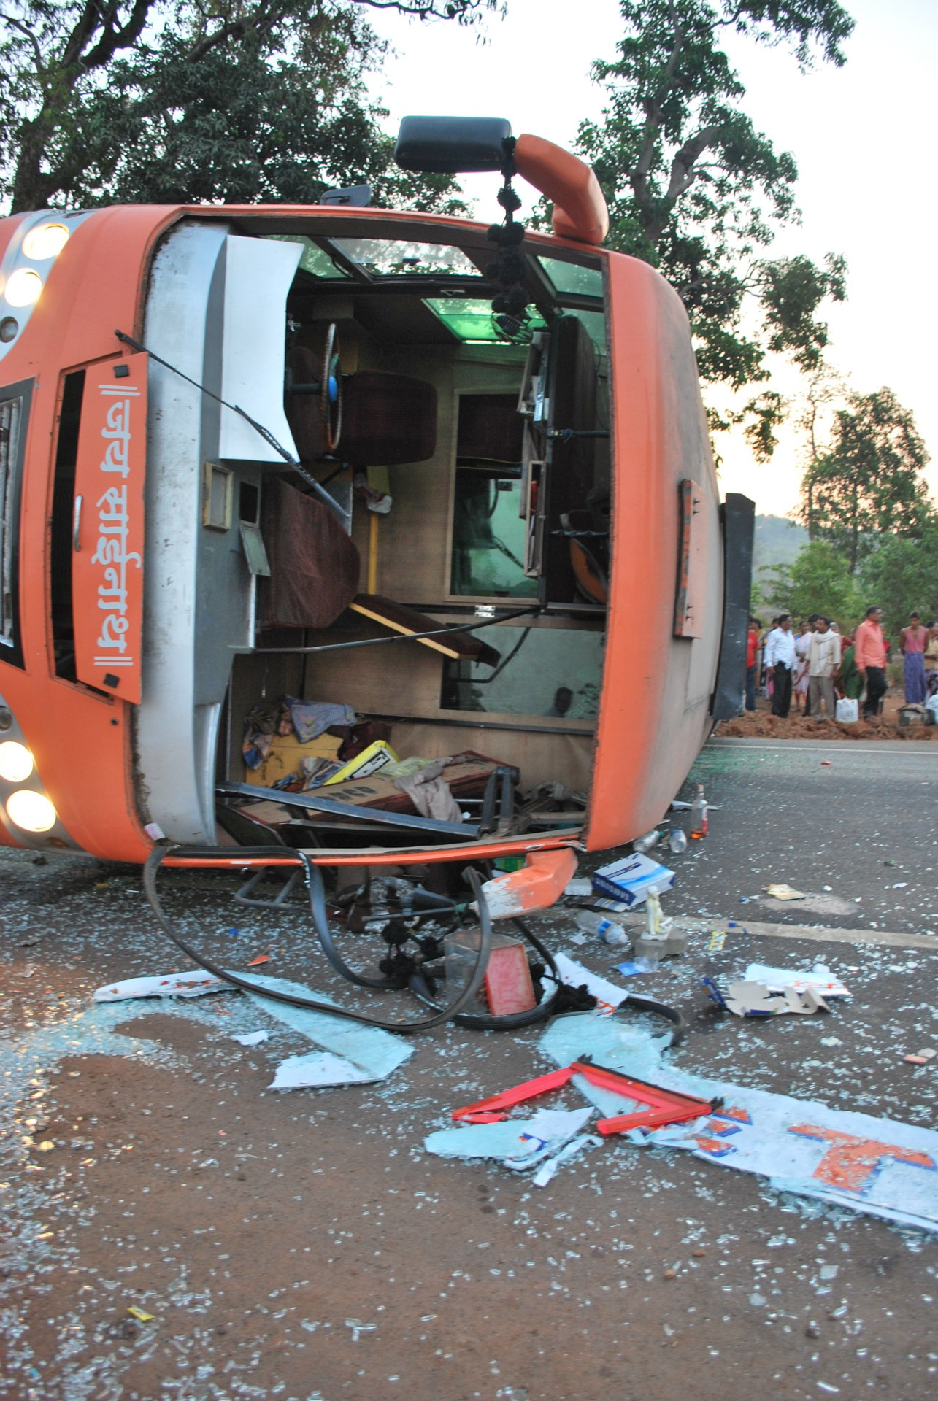
African Bus Crash
• 2008 bus crash in Komatipoort, South Africa
• Police recover burned victim remains
• Relatives submit DNA to help identify remains
• Lab couldn’t identify remains. Sent DNA data to Cybergenetics.

Slide 21
Victim Remains
Victim Remains
AO0553E AO0554E AO0555E AO0556E AO0557E AO0558E AO0559E AO0560E AO0561E AO0562E AO0563E AO0564E AO0565E AO0566E AO0567E

Slide 22
Relatives of Missing People
Sample | Relation
AP2438C AP2439C AP2440C AP2441C AP2442C AP2443C AP2444C AP2445C AP2446C AP2447C AP2448C AP2449C AP2450C AP2451C AP2452C AP2455C | Grandfather Daughter Son Mother Son Sister Father Son Unknown Brother Brother Sister Mother Son Father Son

Slide 23
Task: Find DNA Matches
Victim Remains
AO0553E AO0554E AO0555E AO0556E AO0557E AO0558E AO0559E AO0560E AO0561E AO0562E AO0563E AO0564E AO0565E AO0566E AO0567E
Sample | Relation
AP2438C AP2439C AP2440C AP2441C AP2442C AP2443C AP2444C AP2445C AP2446C AP2447C AP2448C AP2449C AP2450C AP2451C AP2452C AP2455C | Grandfather Daughter Son Mother Son Sister Father Son Unknown Brother Brother Sister Mother Son Father Son
?

Slide 24
Kinship Relations
paternal
grandfather
paternal
grandmother
maternal grandfather
maternal grandmother
father
mother
sibling1
sibling2
missing
spouse
child1
child2
child3

Slide 25
Matching Genotypes
Family
AP2441C
K
father
mother
Victim Remain
AO0563E
3.36
?
missing

Slide 26
DNA Match Results
 | Relations of missing persons
Victim remains | AP2439C | AP2440C | AP2441C | AP2442C | AP2444C | AP2445C | AP2446C_3 | AP2451C | AP2455C
AO0553E
AO0554E |  |  |  |  |  |  | 4.45
AO0555E |  |  |  |  |  |  |  | 1.88
AO0556E |  |  |  | 5.03
AO0557E |  |  |  |  |  | 3.57
AO0558E
AO0559E |  |  |  |  |  |  |  |  | 2.95
AO0560E
AO0561E |  |  |  |  | 2.34
AO0562E
AO0563E |  |  | 3.36
AO0564E
AO0565E
AO0566E | 4.03
AO0567E |  | 2.25

Slide 27
Matches TrueAllele Found
Victim Remains
AO0553E AO0554E AO0555E AO0556E AO0557E AO0558E AO0559E AO0560E AO0561E AO0562E AO0563E AO0564E AO0565E AO0566E AO0567E
Sample | Relation
AP2438C AP2439C AP2440C AP2441C AP2442C AP2443C AP2444C AP2445C AP2446C AP2447C AP2448C AP2449C AP2450C AP2451C AP2452C AP2455C | Grandfather Daughter Son Mother Son Sister Father Son Unknown Brother Brother Sister Mother Son Father Son

Slide 28
Student Exercise
1 TrueAllele database server
12 interpretation processors
20 students (3rd training day)
Task: have every student use TrueAllele
to identify the victim remains

Slide 29
Student Outcome
15 victim items
16 family items
16 family references
15 victim genotypes
16 family genotypes
16 kinship genotypes
15 victim genotypes x 16 kinship genotypes = 240 genotype comparisons
240 comparisons x 20 students = 4,800 total comparisons
before lunch: | students upload genotypes
during lunch: | TrueAllele infers and matches
after lunch: | students review identification results

Slide 30
Conclusions
TrueAllele identifies victim remains
using kinship genotype inference
The TrueAllele approach is:
Automated
Informative
Easy to use

Slide 31
Database Cases
World Trade Center disaster
England v. Stuart Burton rape
Texas v. Lydell Grant exoneration

Slide 32
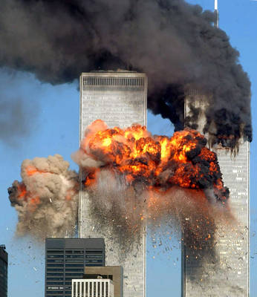
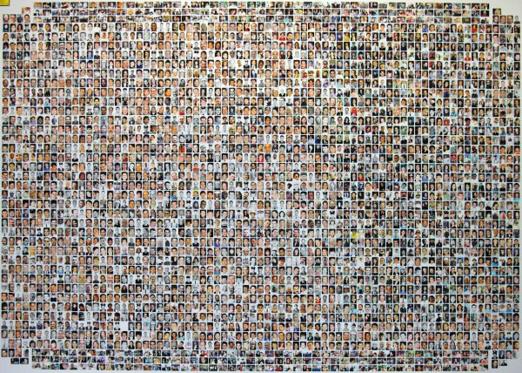
World Trade Center attack
September 11, 2001 in New York City
18,500 remains
2,700 victims

Slide 33
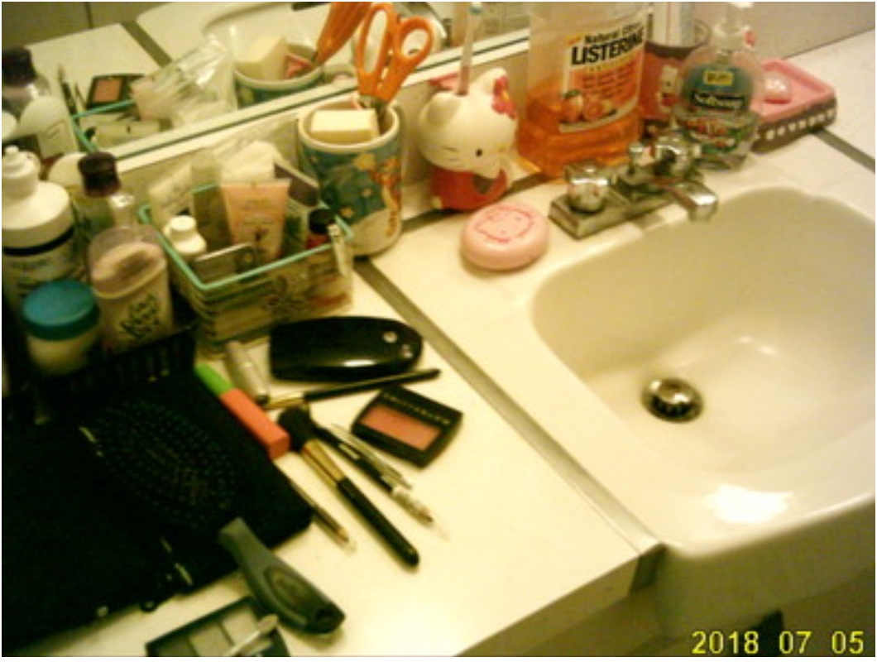
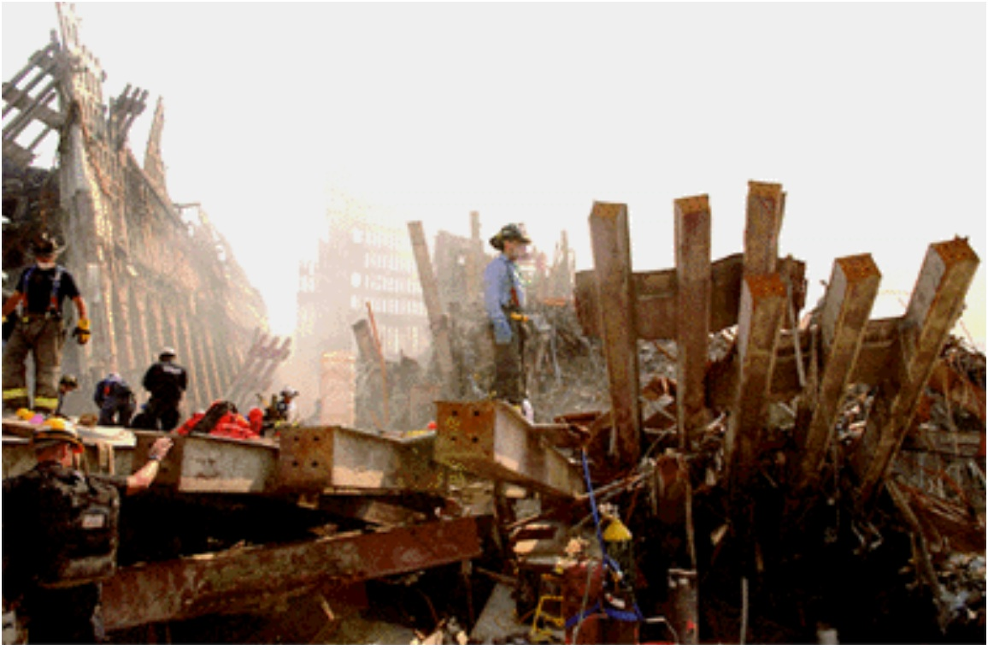
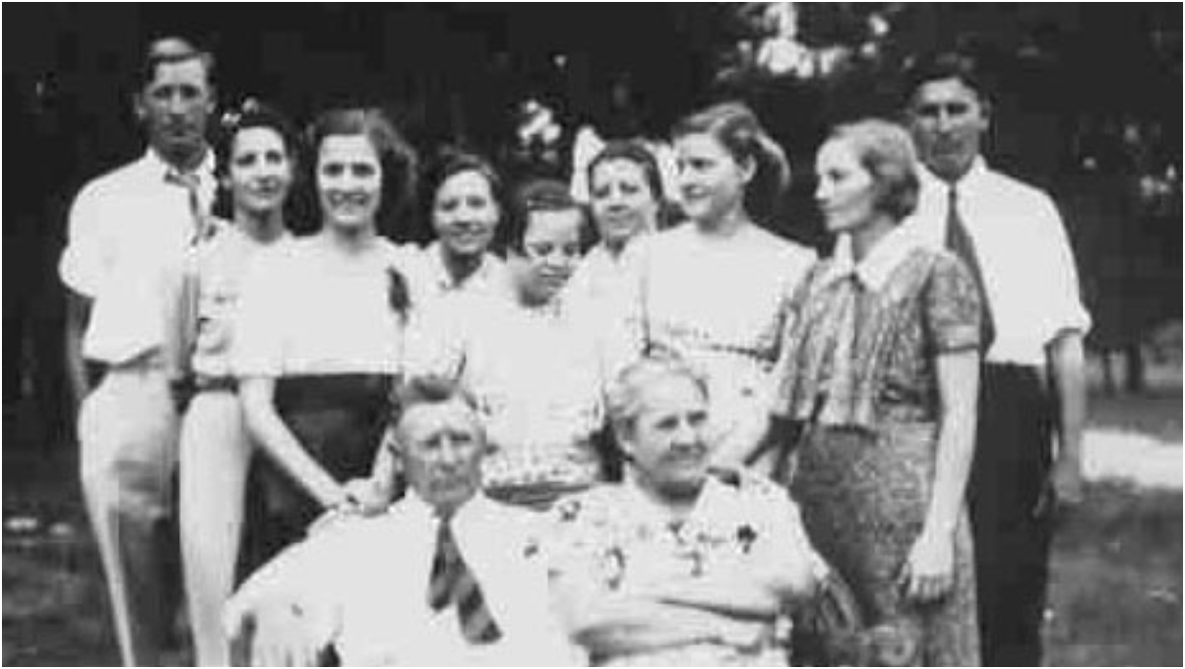
Identify victim remains
Victim Remains
Missing People
Match

Slide 34
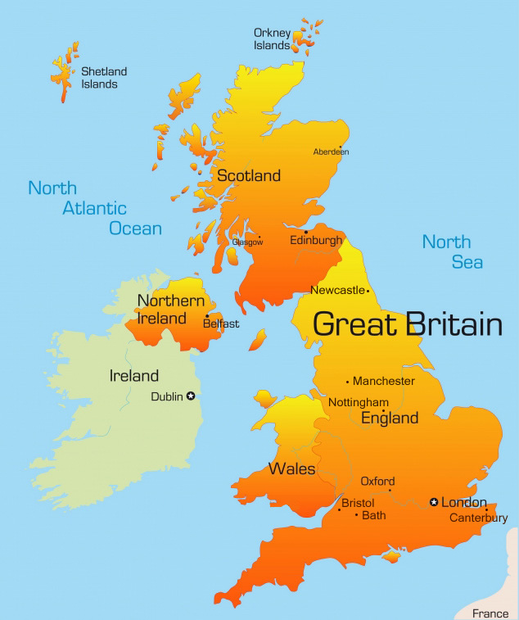
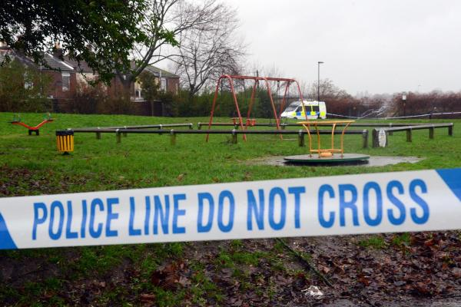
Southampton rapist
Stranger rape on New Year's Eve

Slide 35
DNA rape kit report
A trace amount of semen detected on vaginal swabs was submitted for DNA profiling
The DNA profile contained limited information.
A speculative search was done of the National DNA Database. The search found 13 profiles,
1 in the Hampshire area.
Due to the low level and incomplete nature of the DNA profile, it is not suitable for routine statistical evaluation.

Slide 36
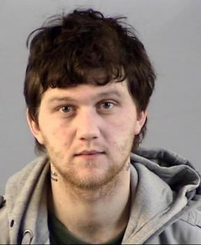
Is the suspect in the evidence?
A match between the vaginal swabs
and Stuart Ashley Burton is
17 thousand times more probable than coincidence.

Slide 37
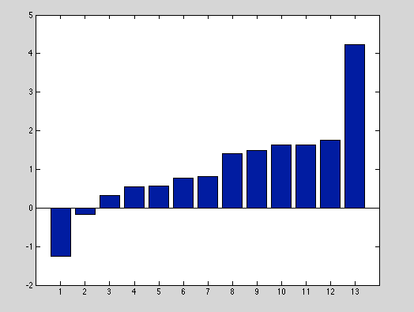
Separating database hits
0
4
log(LR)
Other
Burton

Slide 38



Non-contributor distribution
Mean = -2.7
Stdev = 1.5
log(LR)

Slide 39
Separating hits statistically
non-contributor distribution
1 in a
thousand
1 in a
million
Other
Burton

Slide 40
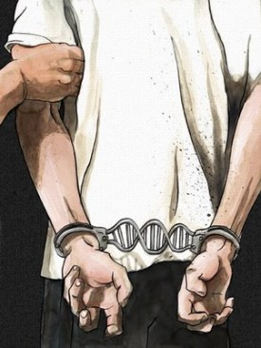
DNA leads to conviction
Mr. Burton pleaded guilty to the
rape committed on January 1, 2014.
He was sentenced to 12 years in prison.
Defendant also convicted of having sex with 13 year old girl

Slide 41
Texas v. Lydell Grant
2011, Houston lab fails to interpret DNA mixture
from fingernails of 2010 murder victim;
crime lab testifies DNA is inconclusive
Lydell Grant convicted of murder
and receives a life sentence
2019, Innocence Project of Texas
sends DNA data to Cybergenetics

Slide 42
Match statistics
Item | Description | 12.1.1 Aaron Scheerhoorn | 13.1 Lydell Grant
12.2.1.1 | right hand fingernails | 18.61 | -12.93

Slide 43
Non-matching evidence genotype
TrueAllele also inferred a non-matching evidence genotype from the right-hand fingernails. The probabilistic genotype of this unknown contributor has an expected LR match statistic of 18.2 trillion.
A CODIS-searchable allele list was derived from the probabilistic genotype at a 90% credible level.
Should additional reference genotypes become available, Cybergenetics can compare them with the probabilistic genotype to calculate DNA match statistics.

Slide 44
Unprecedented CODIS search
• In 2019, TrueAllele crime lab searches CODIS
• Search finds the unknown fingernail person
• Confronted in Georgia, killer confesses to crime
Government was not pleased by our use of
better science to reveal the truth in this case

Slide 45
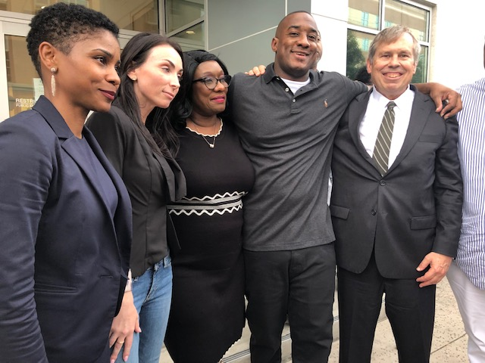
Grant released, exonerated
• Grant eventually released from prison
• In 2021, Lydell Grant finally exonerated

Slide 46
TrueAllele reliability
Over 40 validation studies
8 peer-reviewed papers
≤10 contributors, low DNA
Over 50 admissibility rulings
accepted in US, UK, etc.
Over 500 client agencies
including FBI
Sensitive, specific, accurate
informative, easy to use

Slide 47
Peer-reviewed validation studies
47
Perlin MW, Sinelnikov A. An information gap in DNA evidence interpretation. PLoS ONE. 2009;4(12):e8327.
Ballantyne J, Hanson EK, Perlin MW. DNA mixture genotyping by probabilistic computer interpretation of binomially-sampled laser captured cell populations: Combining quantitative data for greater identification information. Science & Justice. 2013;53(2):103-114.
Perlin MW, Hornyak J, Sugimoto G, Miller K. TrueAllele® genotype identification on DNA mixtures containing up to five unknown contributors. Journal of Forensic Sciences. 2015;60(4):857-868.
Greenspoon SA, Schiermeier-Wood L, Jenkins BC. Establishing the limits of TrueAllele® Casework: a validation study. Journal of Forensic Sciences. 2015;60(5):1263-1276.
Bauer DW, Butt N, Hornyak JM, Perlin MW. Validating TrueAllele® interpretation of DNA mixtures containing up to ten unknown contributors. Journal of Forensic Sciences. 2020; 65(2):380-398.
Perlin MW, Legler MM, Spencer CE, Smith JL, Allan WP, Belrose JL, Duceman BW. Validating TrueAllele® DNA mixture interpretation. Journal of Forensic Sciences. 2011;56(6):1430-1447.
Perlin MW, Belrose JL, Duceman BW. New York State TrueAllele® Casework validation study. Journal of Forensic Sciences. 2013;58(6):1458-1466.
Perlin MW, Dormer K, Hornyak J, Schiermeier-Wood L, Greenspoon S. TrueAllele® Casework on Virginia DNA mixture evidence: computer and manual interpretation in 72 reported criminal cases. PLOS ONE. 2014;(9)3:e92837.

Slide 48
TrueAllele education
TrueAllele training courses
introduction to methods
advanced problem solving
self-paced workbooks
Free for Africa
UCT – 2023
Zambia – 2024
6#AFF attendees
follow-up course

Slide 49
TrueAllele for Africa
DNA information solves crime
prevents crime, promotes justice
IPG TrueAllele database
connects crimes and criminals
DDG CODIS is less effective
Computer automation
accurate genotyping and match
scales up for Africa at low cost
Easy to understand and use

Slide 50



50
More information
http://www.cybgen.com/information
• Courses
• Newsletters
• Newsroom
• Presentations
• Publications
• Reliability
• Webinars
http://www.youtube.com/user/TrueAllele
TrueAllele YouTube channel
info@cybgen.com

