Slide 1

TrueAllele Workshop:
Unlocking DNA profile interpretation for Africa
6# African Forensic Forum
University of Cape Town
South Africa
March 2026
Mark W Perlin, PhD, MD, PhD
Cybergenetics, Pittsburgh, PA USA
Cybergenetics © 2003-2026

Slide 2
Introduction
Who is Dr. Perlin?
What is Cybergenetics?
Why Africa?

Slide 3
Scope of the Problem
More than 79 million girls and women—over 1 in 5 (20%)—across sub-Saharan Africa have experienced rape or sexual assault before turning 18 – UNICEF, 2024
Globally, about 1 in 3 (30%) of women worldwide have been subjected to either physical and/or sexual intimate partner violence or non-partner sexual violence in their lifetime – WHO, 2018
In the Republic of South Africa
53,498 sexual offenses:
42,780 rapes + 7,483 sexual assaults
were reported – SAPS, 2023

Slide 4


Slide 5
But most DNA evidence isn’t used
As we explain in this workshop
Complex DNA is considered “uninterpretable”
So crime labs avoid generating complex DNA data.
Their data analysis cannot interpret it.
But faster, better, cheaper computer methods
can interpret complex DNA

Slide 6
But most DNA evidence isn’t used
As we explain in this workshop
Complex DNA is considered “uninformative”
Crime labs avoid generating complex DNA data.
Simple analysis cannot get information from it.
But faster, better, cheaper computer methods
can get information from complex DNA

Slide 7
UCT Scientific Research Areas
1. Show sexual violence does exist as a problem in Africa
2. Demonstrate that “uninformative” DNA data can be informative
3. Reveal the presence of multiple perpetrators in DNA rape evidence
4. Find serial offenders by comparing DNA evidence between crimes

Slide 8
Simple Profile Genotyping

Slide 10
DNA Discarding Genotyping (DDG)

Slide 11
DDG Threshold Funnel
Use evidence item
Generate DNA data
Infer genotype
Match
Database

Slide 12
Information Preserving Genotyping (IPG)

Slide 14
Determin
Finds the Hidden Parameters
Represents uncertainty as probability
The genotype
of each contributor
at every locus
How much of
each contributor,
how degraded
PCR variation,
stutter, rel amp
at every locus

Slide 15

Computer Interpretation of
Quantitative DNA Evidence
People v Casey Wilson
September, 2014
Elmira, New York
Mark W Perlin, PhD, MD, PhD
Cybergenetics, Pittsburgh, PA
Cybergenetics © 2003-2014

Slide 16
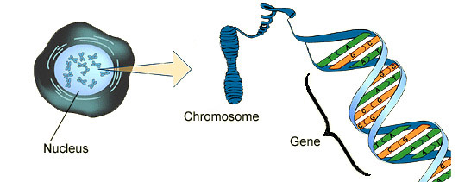
DNA biology
Cell
Chromosome
Locus
Nucleus

Slide 17

Short tandem repeat
DNA locus paragraph
Take me out to the ball game
take me out with the crowd
buy me some peanuts and Cracker Jack
I don't care if I never get back
let me
root root root root root root root root root root
for the home team,
if they don't win, it's a shame for it's one, two, three strikes, you're out
at the old ball game
23 volumes in cell's
DNA encyclopedia
"root" repeated 10 times, so
allele length is 10 repeats

Slide 18
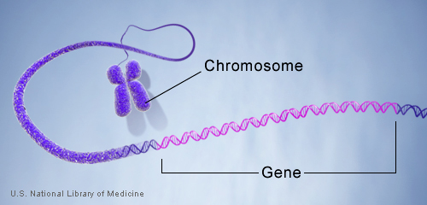
DNA genotype
A genetic locus has
two DNA sentences,
one from each parent.
An allele is the number
of repeated words.
locus
A genotype at a locus
is a pair of alleles.
mother
allele
1
2
3
4
5
6
7
8
8, 9
ACGT
repeated word
Many alleles allow for
many many allele pairs.
A person's genotype
is relatively unique.
father
allele
1
2
3
4
5
6
7
8
9

Slide 19
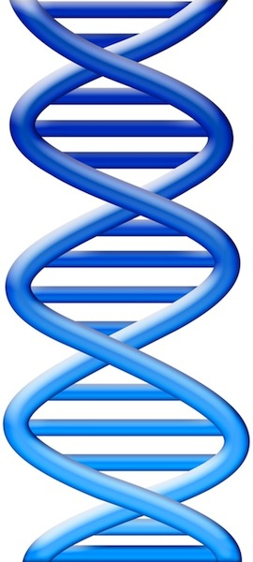
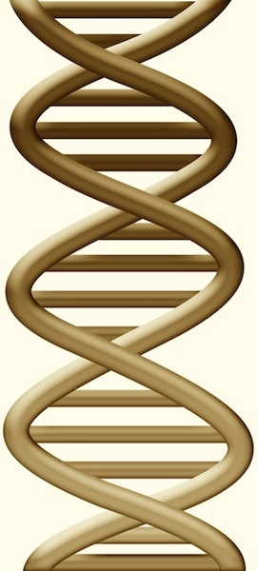
DNA evidence interpretation
Evidence item
Lab
Evidence data
Infer
Evidence genotype
10, 12 @ 50%
11, 12 @ 30%
12, 12 @ 20%
10 11 12
Compare
Known genotype
10, 12

Slide 20
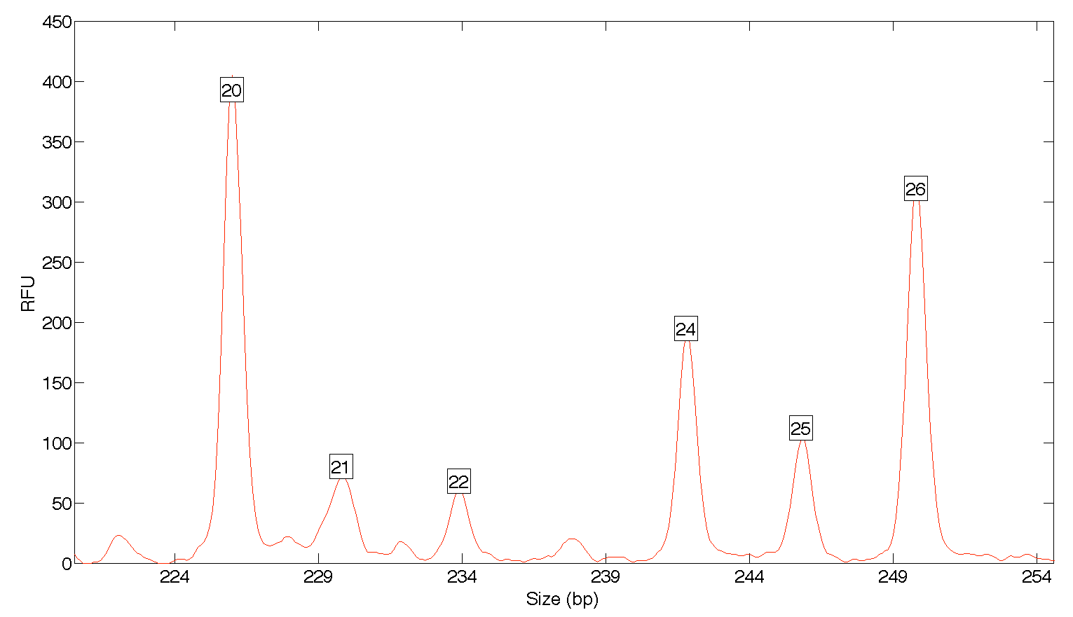
Computers can use all the data
Quantitative peak heights at locus FGA
peak size
peak
height

Slide 21
People may use less of the data
Over threshold, peaks are labeled as allele events
All-or-none allele peaks,
each given equal status
Threshold
Under threshold, alleles vanish

Slide 22
How the computer thinks
Consider every possible genotype solution
Explain the
peak pattern
One person’s allele pair
Another person's allele pair
A third person's allele pair
Better
explanation
has a higher
likelihood

Slide 23
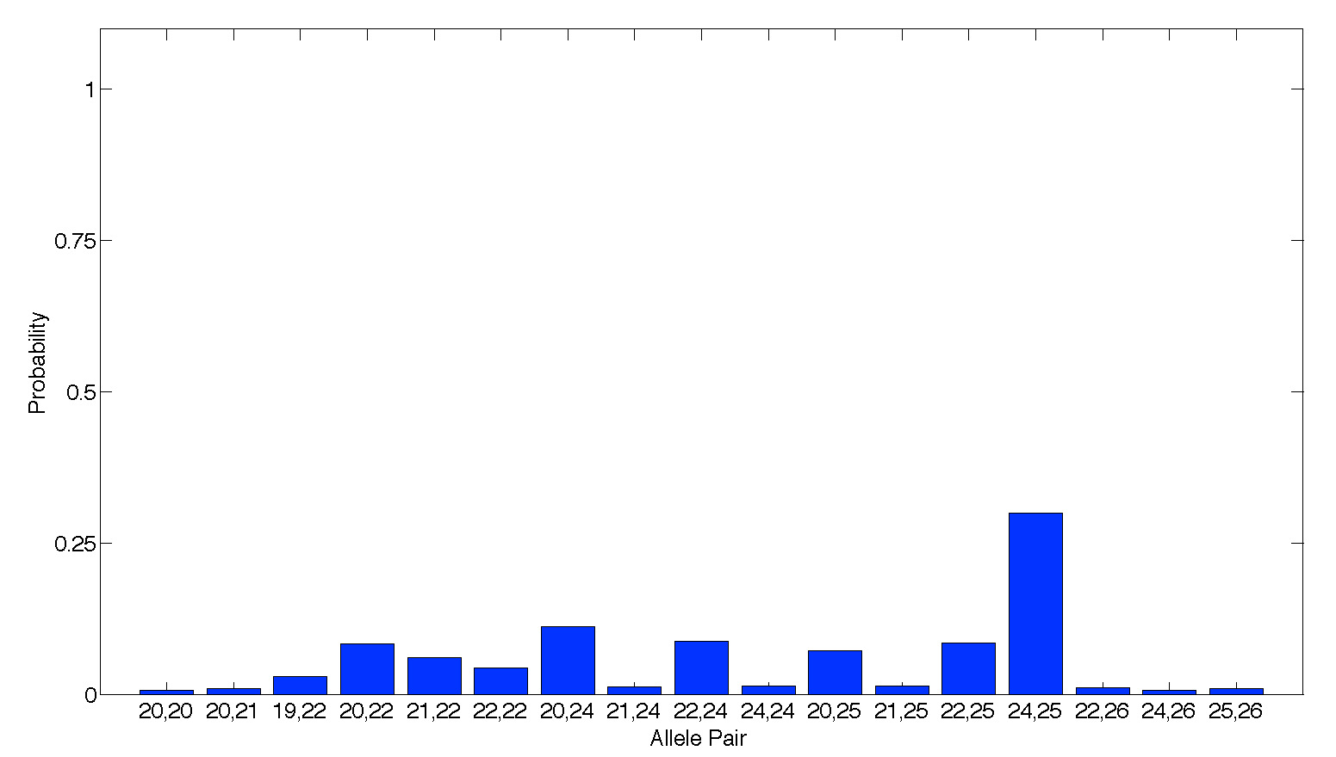
Evidence genotype
Objective genotype determined solely from the DNA data.
Never sees a reference.
30%
8%
11%
9%
8%
6%
4%
7%
1%
2%
3%
2%
2%
2%
2%
1%
2%

Slide 24
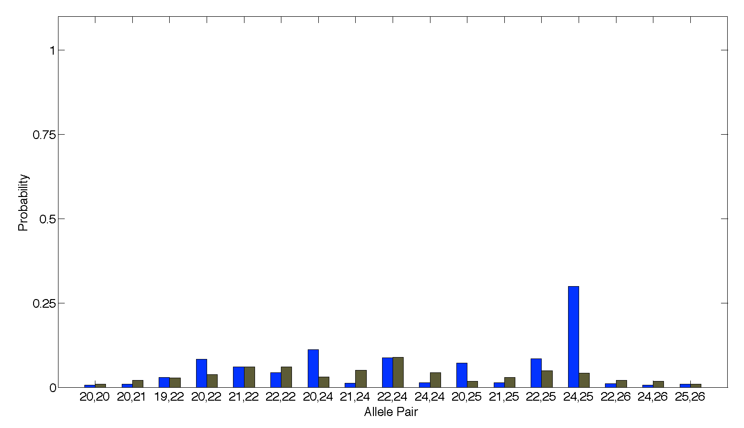
DNA match information
How much more does the suspect match the evidence
than a random person?
Prob(evidence match)
8.1x
Prob(coincidental match)
30%
3.7%

Slide 25
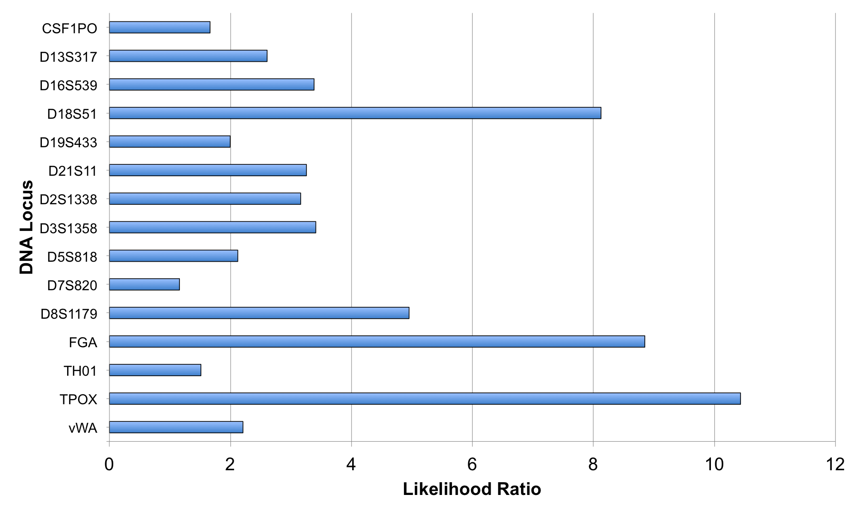
Match information at 15 loci

Slide 26
Is the suspect in the evidence?
A match between the glove
and Casey Wilson is:
31.3 million times more probable than
a coincidental match to an unrelated Black person
66.3 million times more probable than
a coincidental match to an unrelated Caucasian person
98.1 million times more probable than
a coincidental match to an unrelated Hispanic person

Slide 27
Match statistics
Item | Description | 15B Danielle Brown | 24A Elijah Milo | 20A Casey Wilson
17D-E | Purple knit glove | 17.97 | -0.43 | 5.91
18D-E | Purple knit glove | 14.72 | 4.16 | 7.50

Slide 28
Match statistics
Item | Description | 15B Danielle Brown | 24A Elijah Milo | 20A Casey Wilson
17D-E | Purple knit glove | 930 quadrillion | 1/2.72 | 817 thousand
18D-E | Purple knit glove | 520 trillion | 14.6 thousand | 31.3 million

Slide 29
Sexual Assault Cases
California v. Billy Ray Johnson
Maryland v. Nelson Clifford
Indiana v. Darryl Pinkins & Roosevelt Glenn

Slide 30
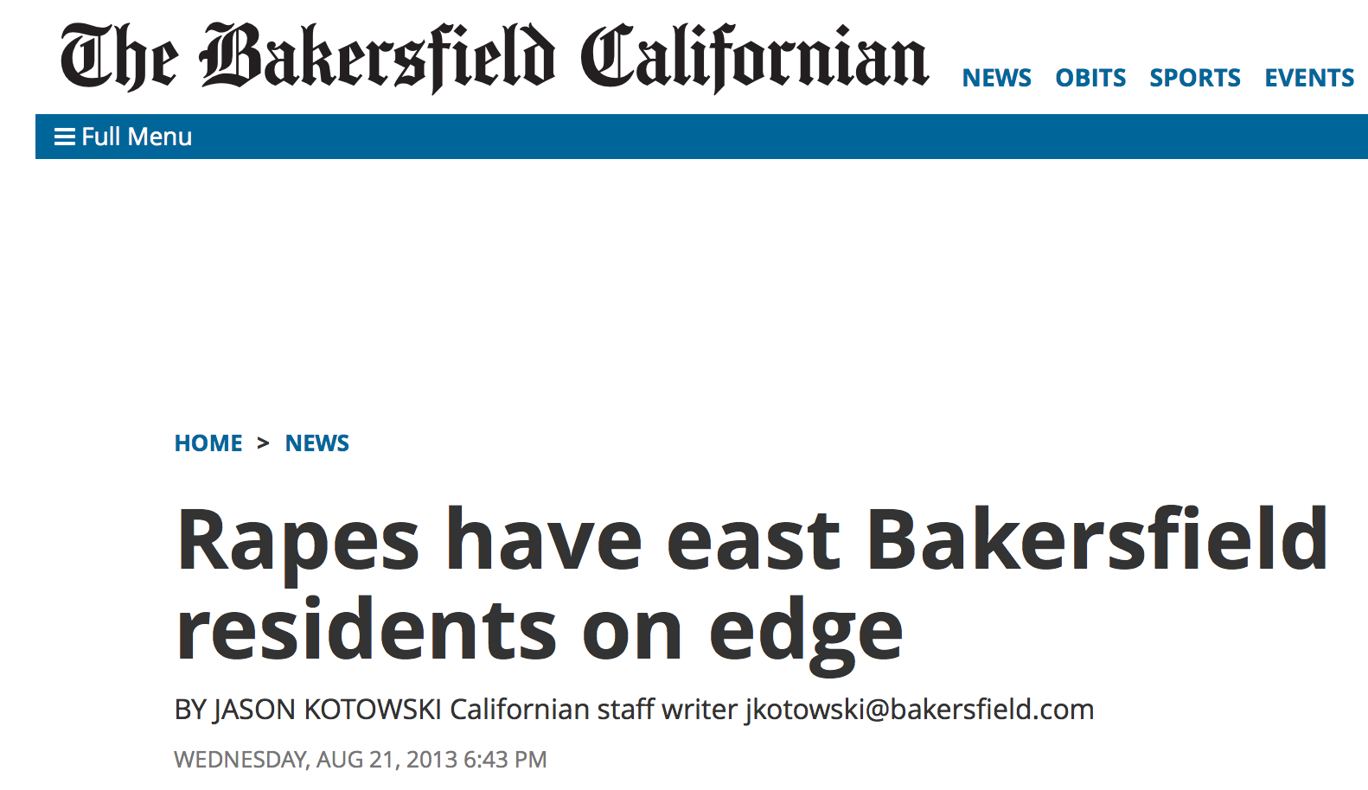
July & August 2013

Slide 31
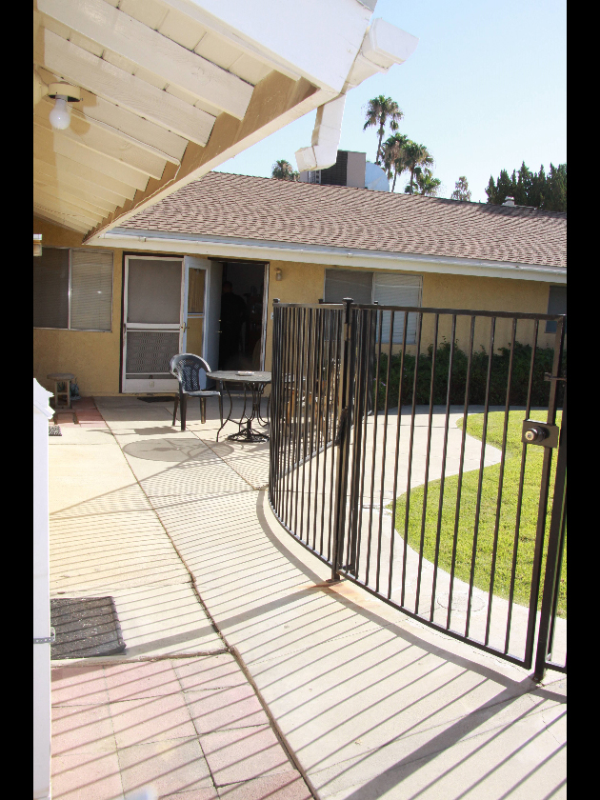
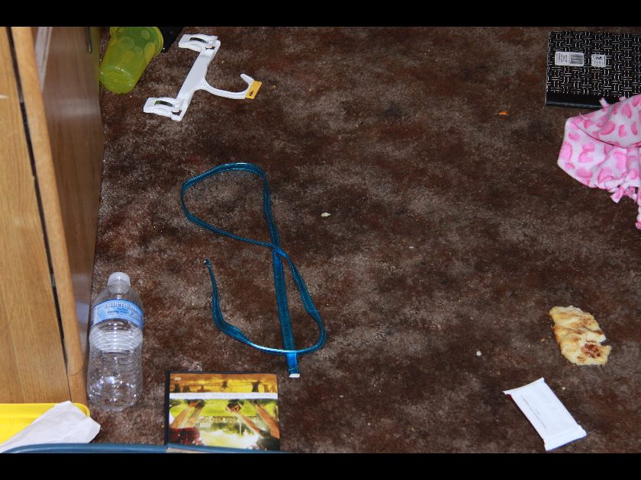
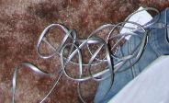
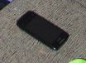
Crime scene #1
Purse strap
Phone cord
Phone

Slide 32
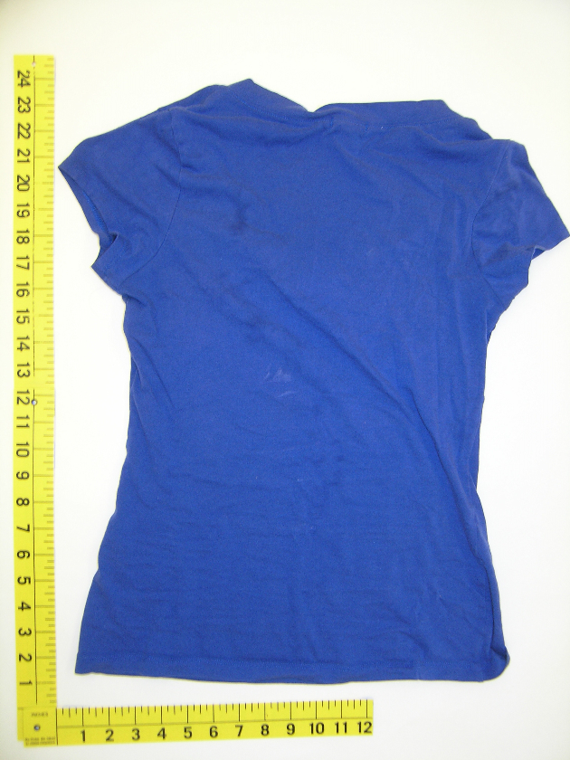
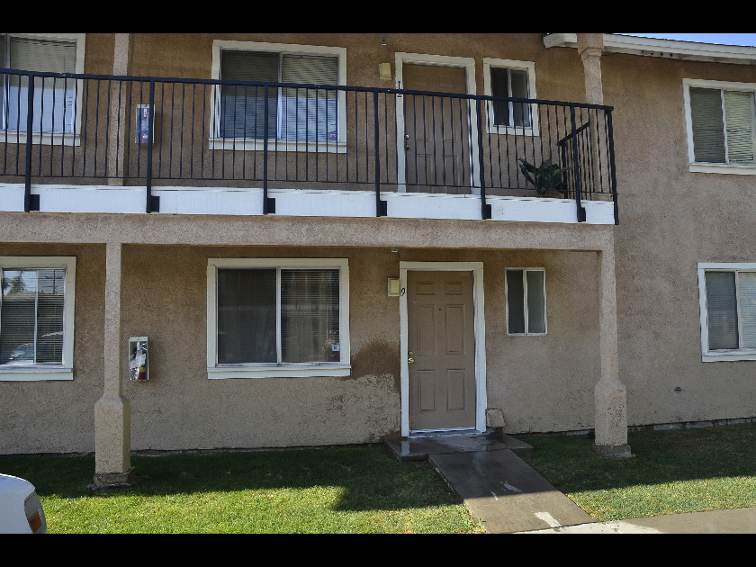
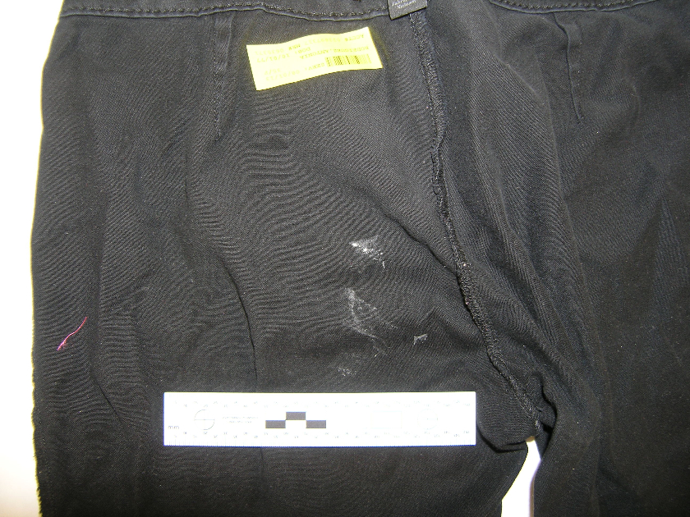
Crime scene #2
Shirt
stain
Pants

Slide 33
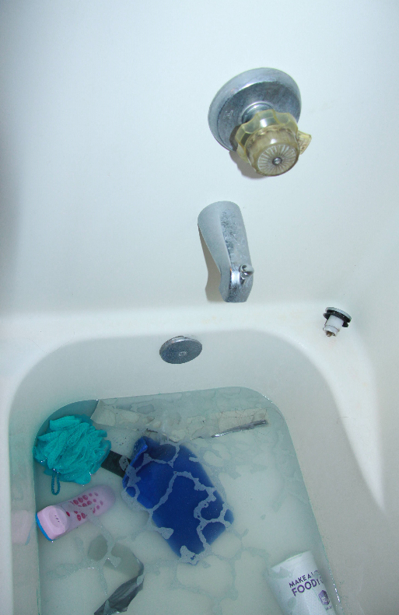
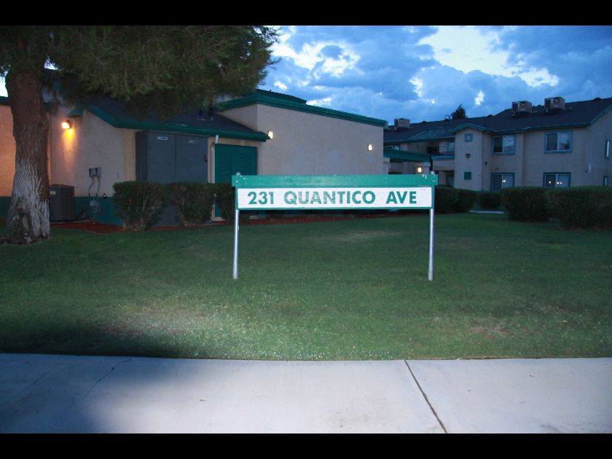
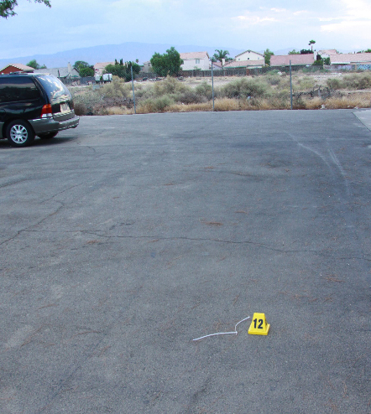
Crime scene #3
Bathtub handle
Zip tie in road

Slide 34
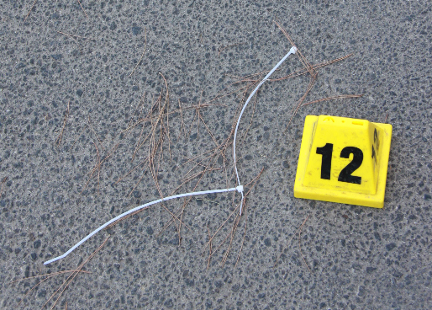
DNA database hit
Major contributor to DNA
of zip tie in road
Billy Ray Johnson

Slide 35
Biological evidence
Kern Regional Crime Laboratory
garments
blankets
apartment surfaces
skin
body cavities telephones
zip ties
thirty seven
swabs and cuttings
Early October 2013
low-level DNA mixtures containing 3 or 4 people

Slide 36
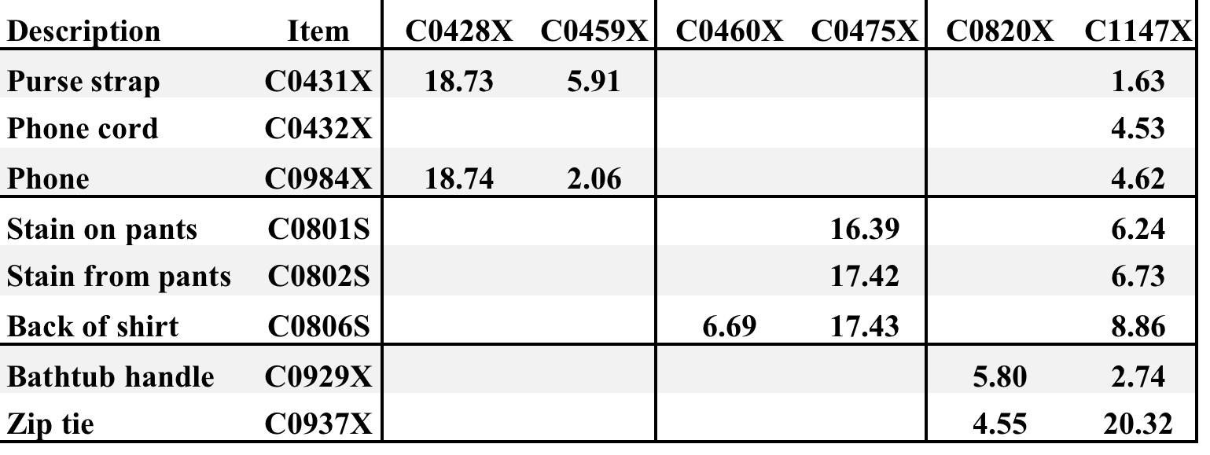
Informative DNA mixtures
8 mixture items vs. 5 victims + 1 suspect
BRJ
DNA match statistics
corroborate victim statements

Slide 37
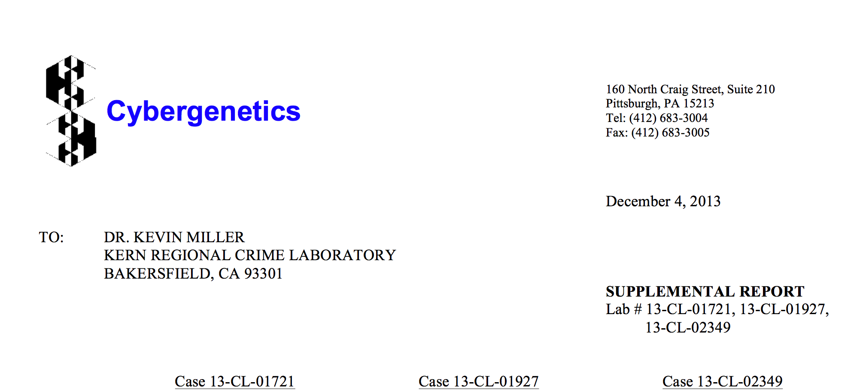

December 2013: Grand Jury
Cybergenetics TrueAllele Report
Arrest

Slide 38
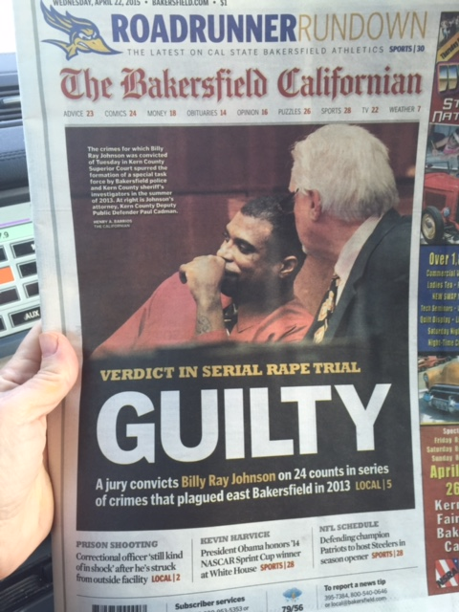
April 2015

Slide 39
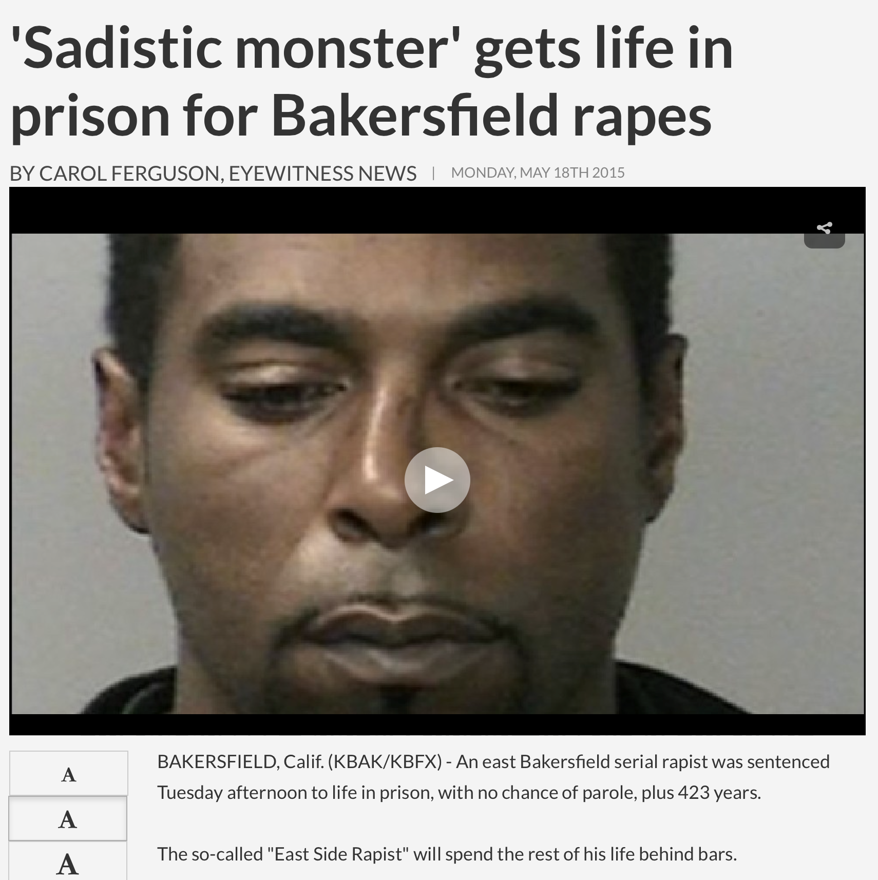
May 2015

Slide 40
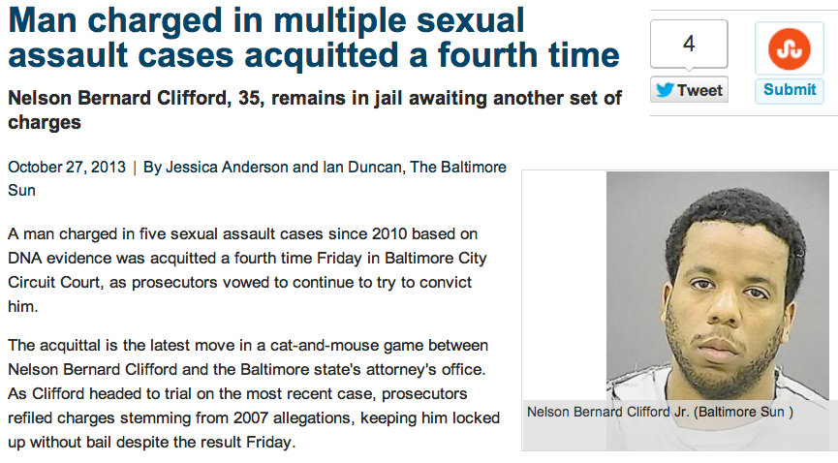
Maryland serial rapist
Did suspect Nelson Clifford contribute his DNA
to the victim's clothing in a fifth case?

Slide 41
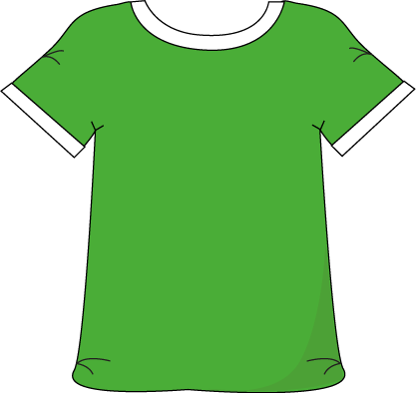
Separated DNA mixture
11%
82%
7%
contributor
1
contributor
2
contributor
3
LR
log(LR)

Slide 42
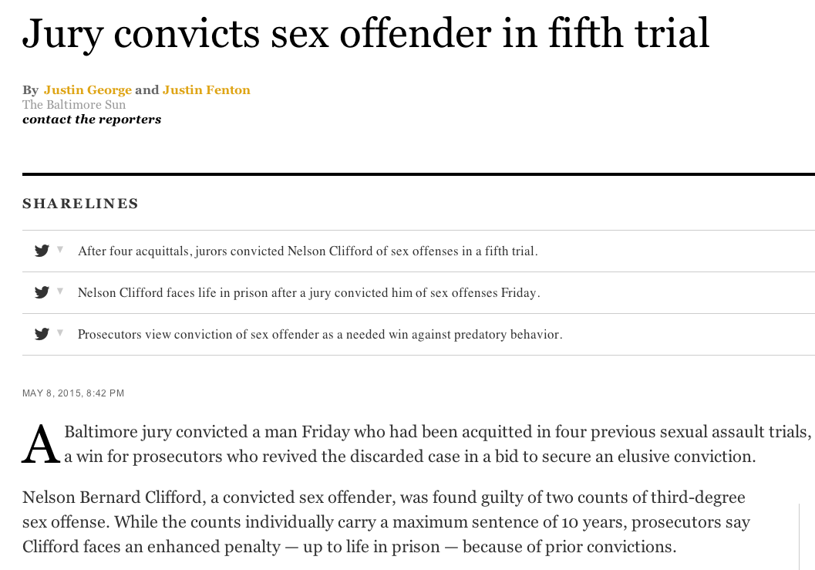
Clifford outcome

Slide 43
Darryl Pinkins imprisoned
1989 – 5 men raped an Indiana woman
Darryl Pinkins and 2 others misidentified
1991 – wrongfully convicted, 65 year sentence
2001 – DNA mixture evidence
2 contributors found, not the accused
but 5 were needed, post-conviction relief denied

Slide 44
TrueAllele Pinkins findings
1. compared evidence with evidence
2. calculated exclusionary match statistics
3. revealed 5% minor mixture contributor
4. jointly analyzed DNA mixture data
5. showed three perpetrators were brothers
found 5 unidentified genotypes,
defendants not linked to the crime

Slide 45
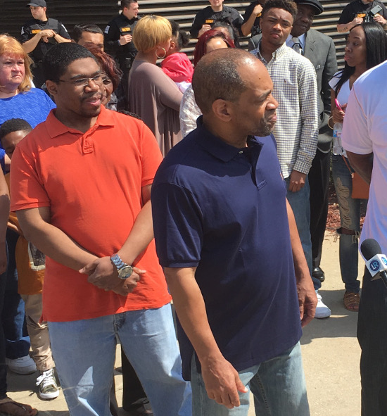
Pinkins exonerated
Indiana
April 25, 2016

Slide 46
Homicide Cases
Pennsylvania v. Allen Wade
Northern Ireland v. Brian Shivers
Australia v. Robert Xie

Slide 47
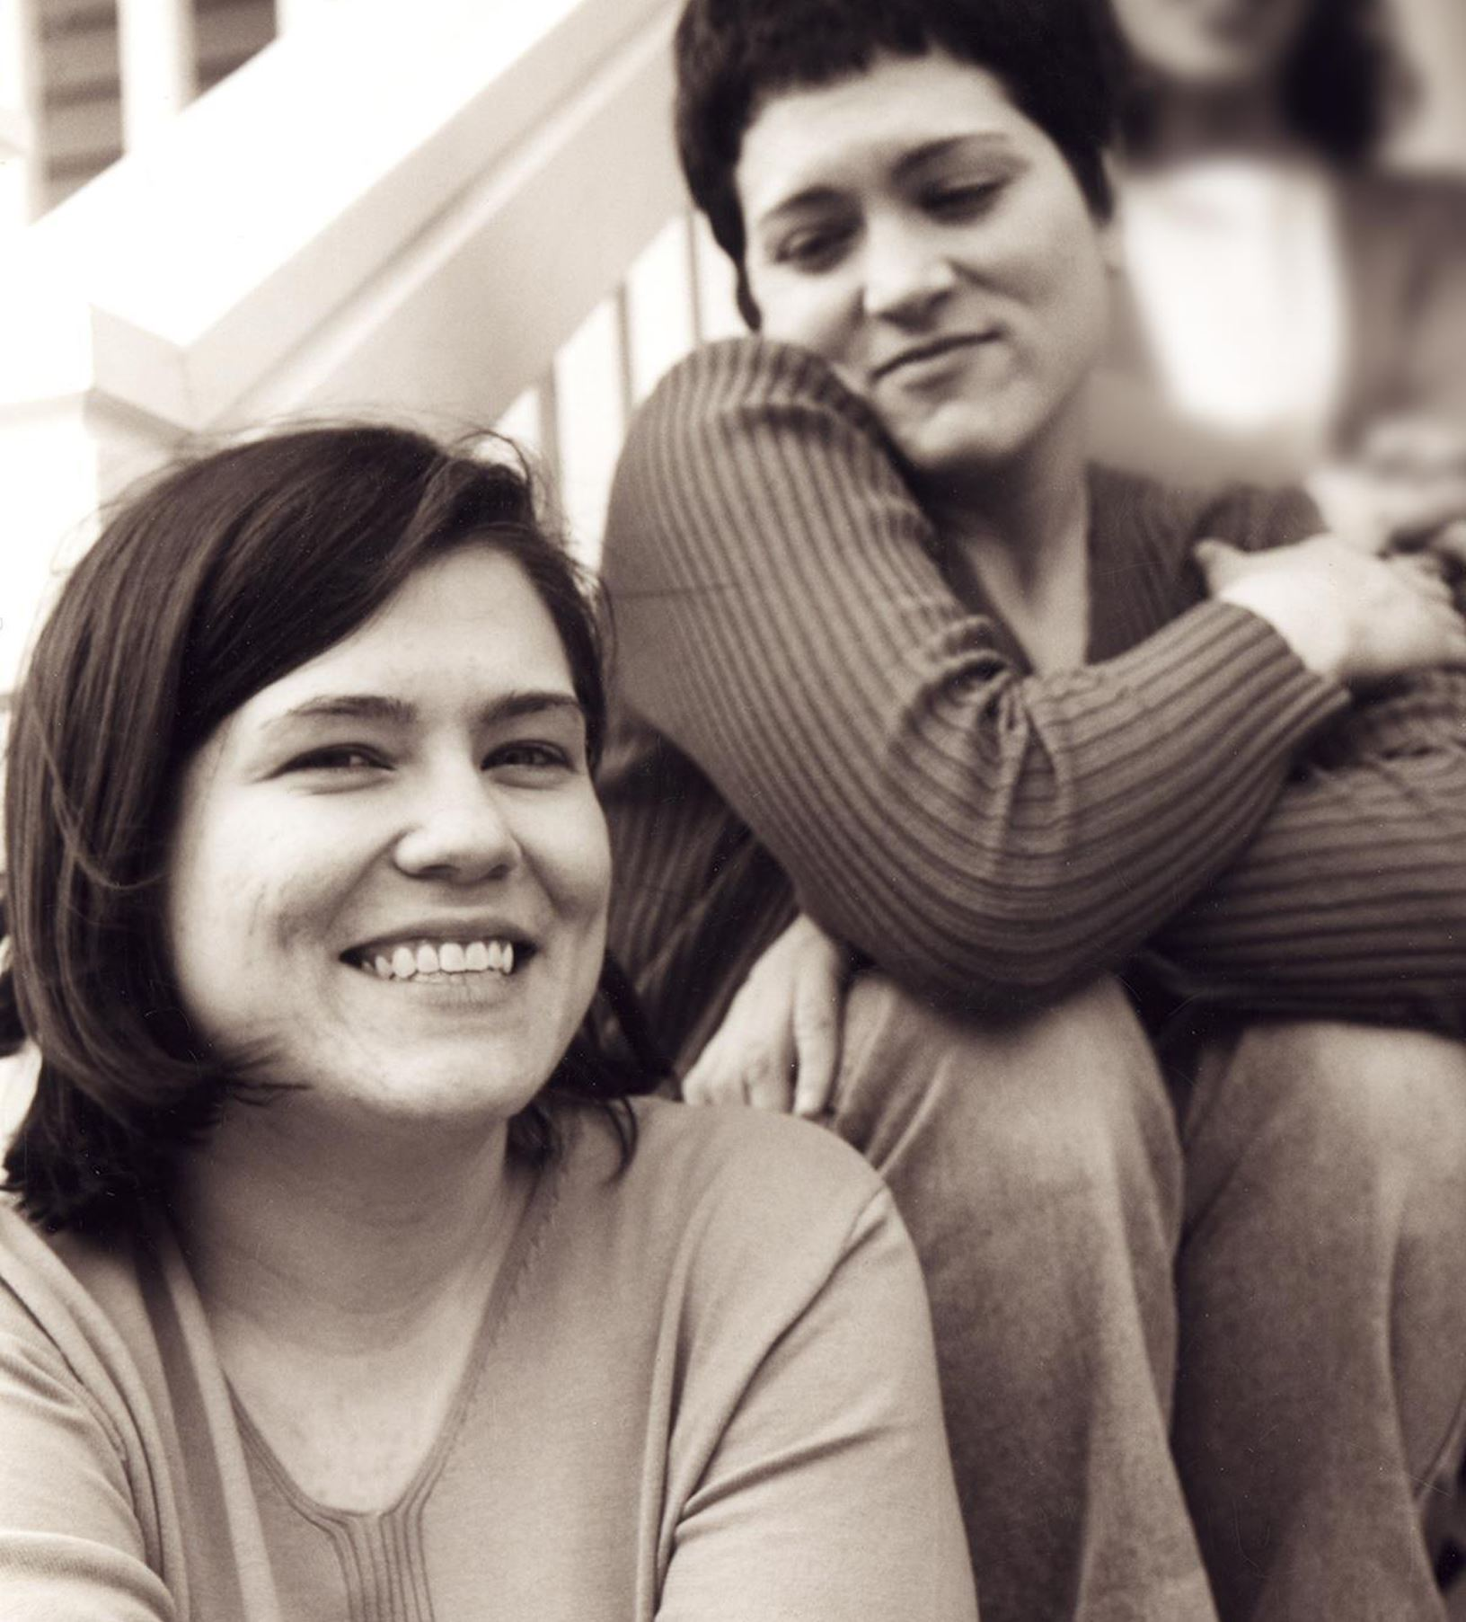
Wolfe sisters homicide
47
On February 6, 2014, Susan Wolfe (44)
and her younger sister Sarah (38, left)
were killed in their East Liberty home in Pittsburgh.

Slide 48
Pennsylvania v. Allen Wade
48
Thresholds failed to interpret most DNA mixtures
Hat No conclusions
Cup Insufficient data
Fingernails Contamination, insufficient data
Gear shift Insufficient data
Seat lever Cannot be excluded
Knit hat Insufficient data
Sock Too complex, no conclusions

Slide 49
Pennsylvania v. Allen Wade
49
The crime lab reported 5 DNA mixture matches
TrueAllele found 17 matches on the same data
Hat 65.3 thousand Allen Wade
Cup 20.5 thousand Susan Wolfe
Fingernails 6.06 trillion Allen Wade
Gear shift 9.37 million Sarah Wolfe
Seat lever 385 billion Sarah Wolfe
Knit hat 25.7 thousand Allen Wade
Sock 300 Sarah Wolfe

Slide 50
Allen Wade Found Guilty On All Counts In East Liberty Sisters’ Slaying
50
CBS News, May 23, 2016
PITTSBURGH (KDKA/AP)
• A man accused of killing two sisters who lived next door to him in East Liberty has been found guilty on all counts.
• Allen Wade was accused of shooting Sarah and Susan Wolfe after they returned from work on Feb. 6, 2014, apparently to steal a bank card.
• On Monday morning, a jury found Wade guilty of first-degree murder, robbery, burglary and theft by unlawful taking.

Slide 51
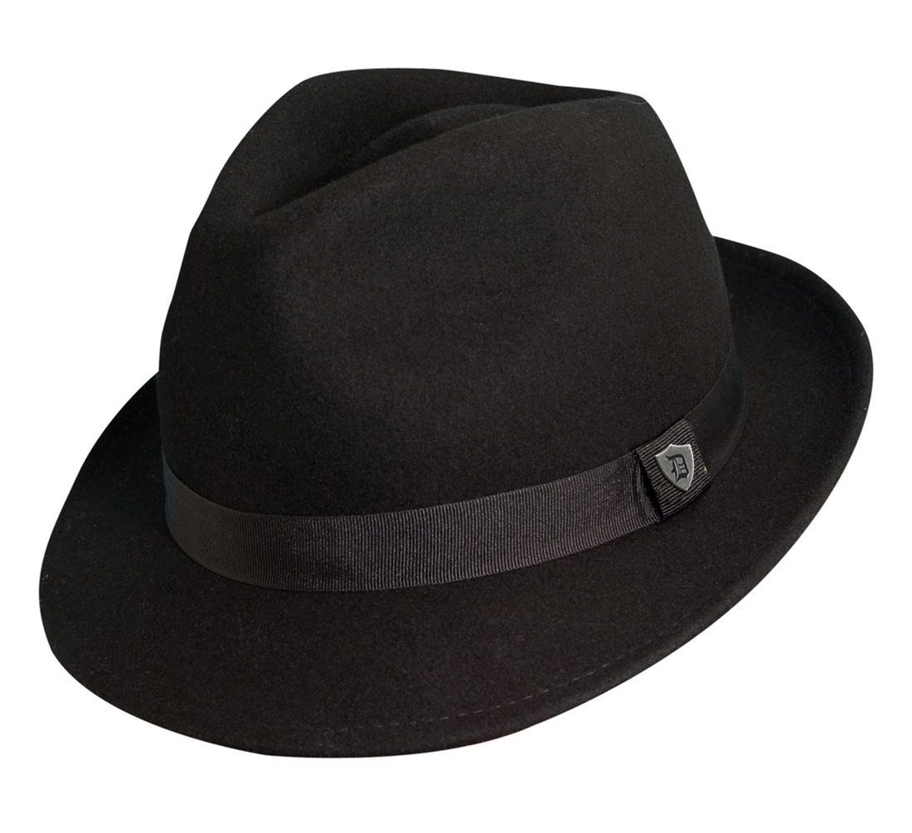
Pennsylvania v. Allen Wade
51
Thresholds failed to interpret DNA mixture
TrueAllele succeeded on the same data
A hat left from a burglary of the Wolfe sister’s home
six weeks before the murder matched
Allen Wade with a 65.3 thousand statistic
Preventable Crime

Slide 52
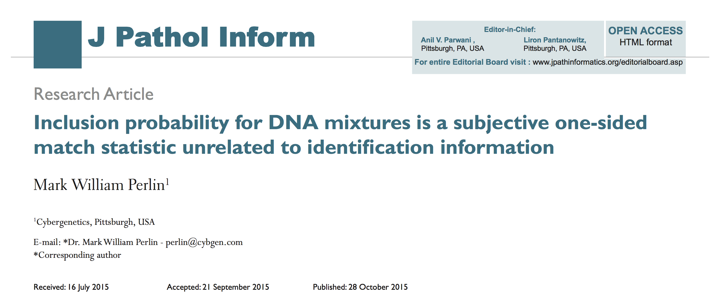
Statistics lack scientific basis
52
CPI (RMNE) misled courts on countless DNA mixtures

Slide 53
Uncorrelated with information
53

Slide 54
Inclusion just counts tests
54
One-sided Match Statistic
Truncated Normal Distribution
Positive Tail Centered at Zero
Uncorrelated with Identification Information
Inclusion Distribution Has a Positive Mean
Law of Large Numbers
Why CPI is Always a Million
A subjective one-sided match statistic unrelated to identification information

Slide 55
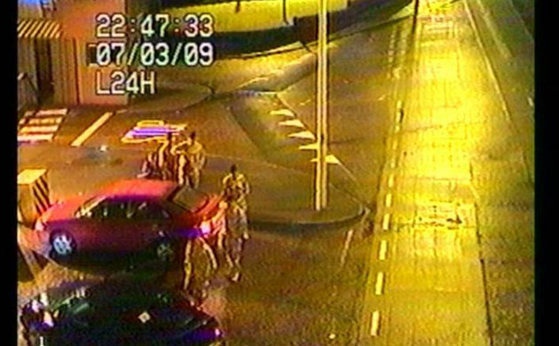
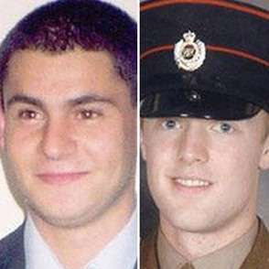
Massereene Barracks Attack
March 7, 2009 in Antrim, Northern Ireland
Homicide victims
Patrick
Azimkar
Mark
Quinsey
Real Irish Republican Army claimed responsibility

Slide 56
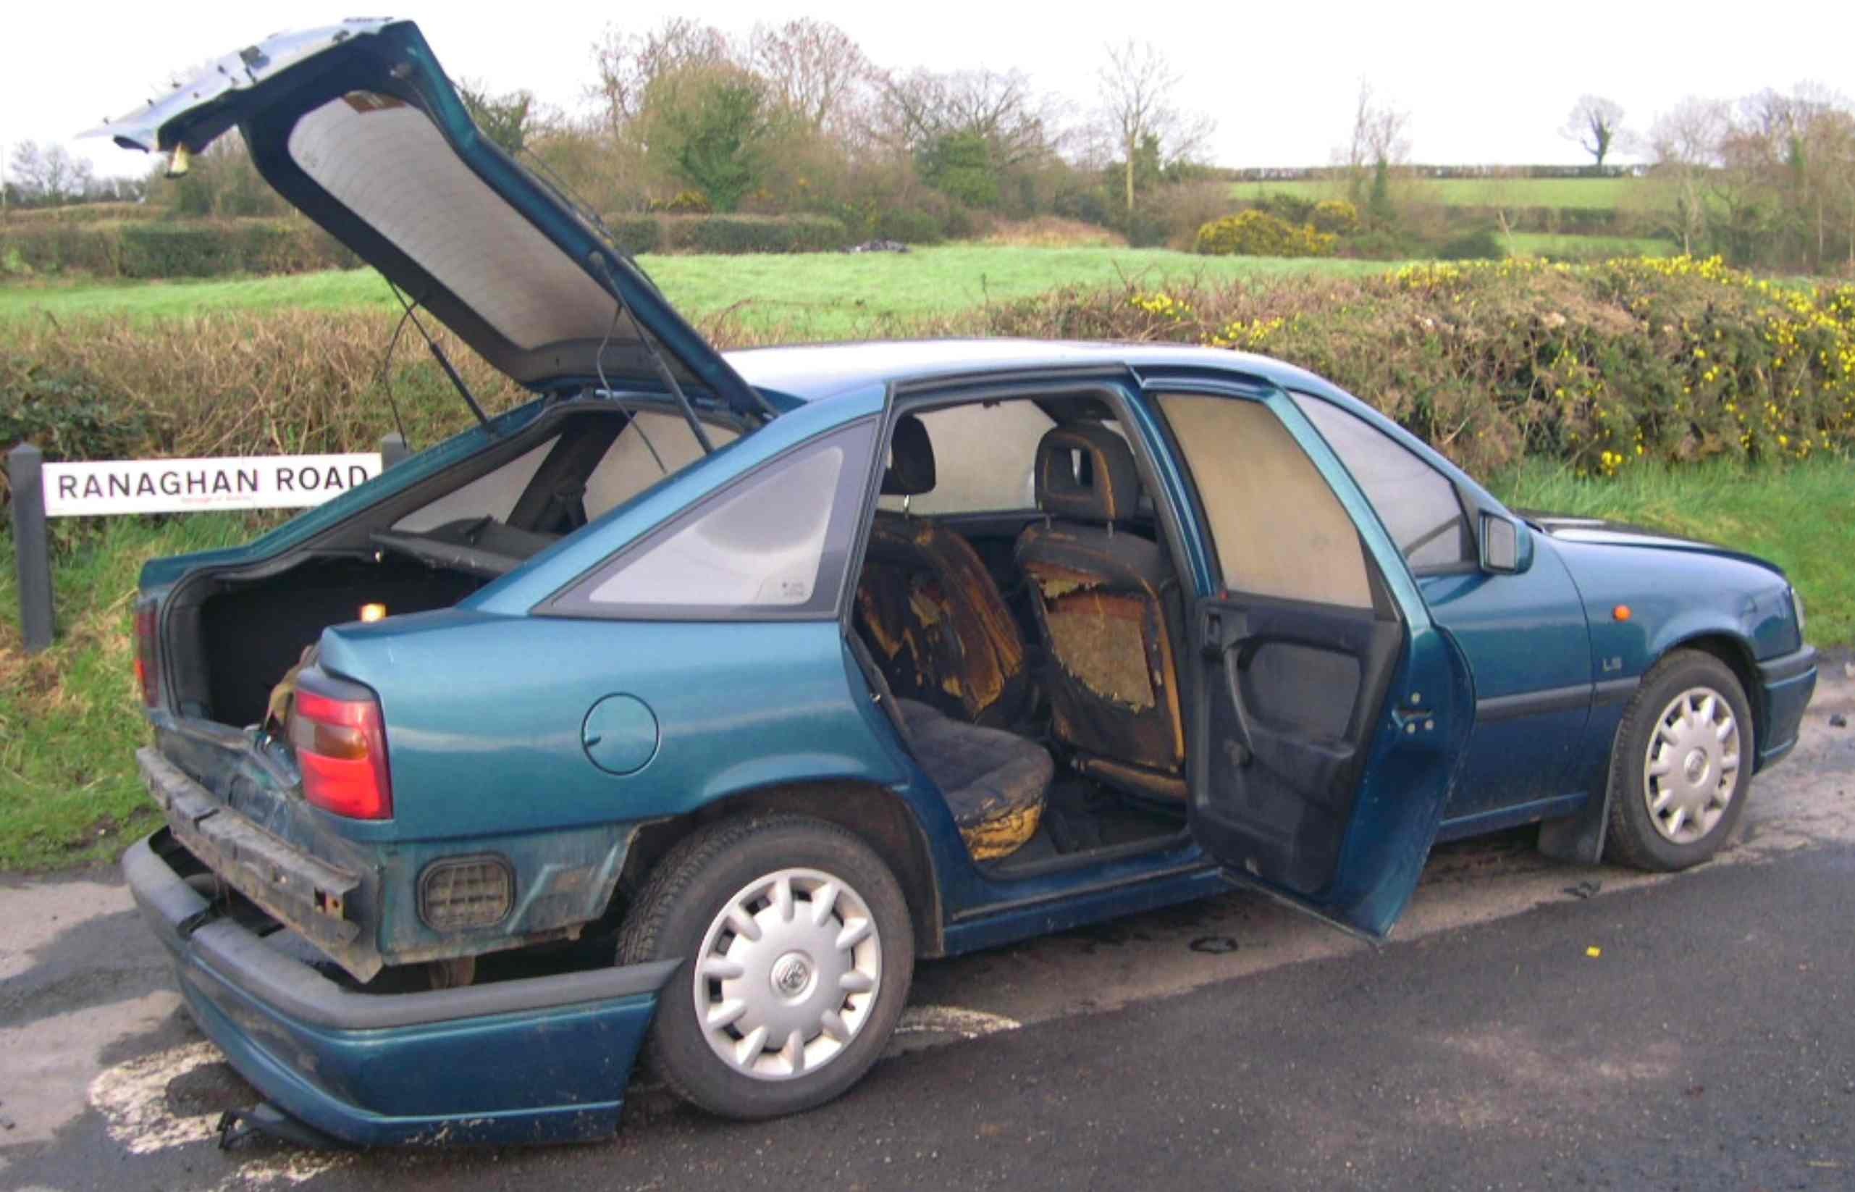
Abandoned Burned Car

Slide 57
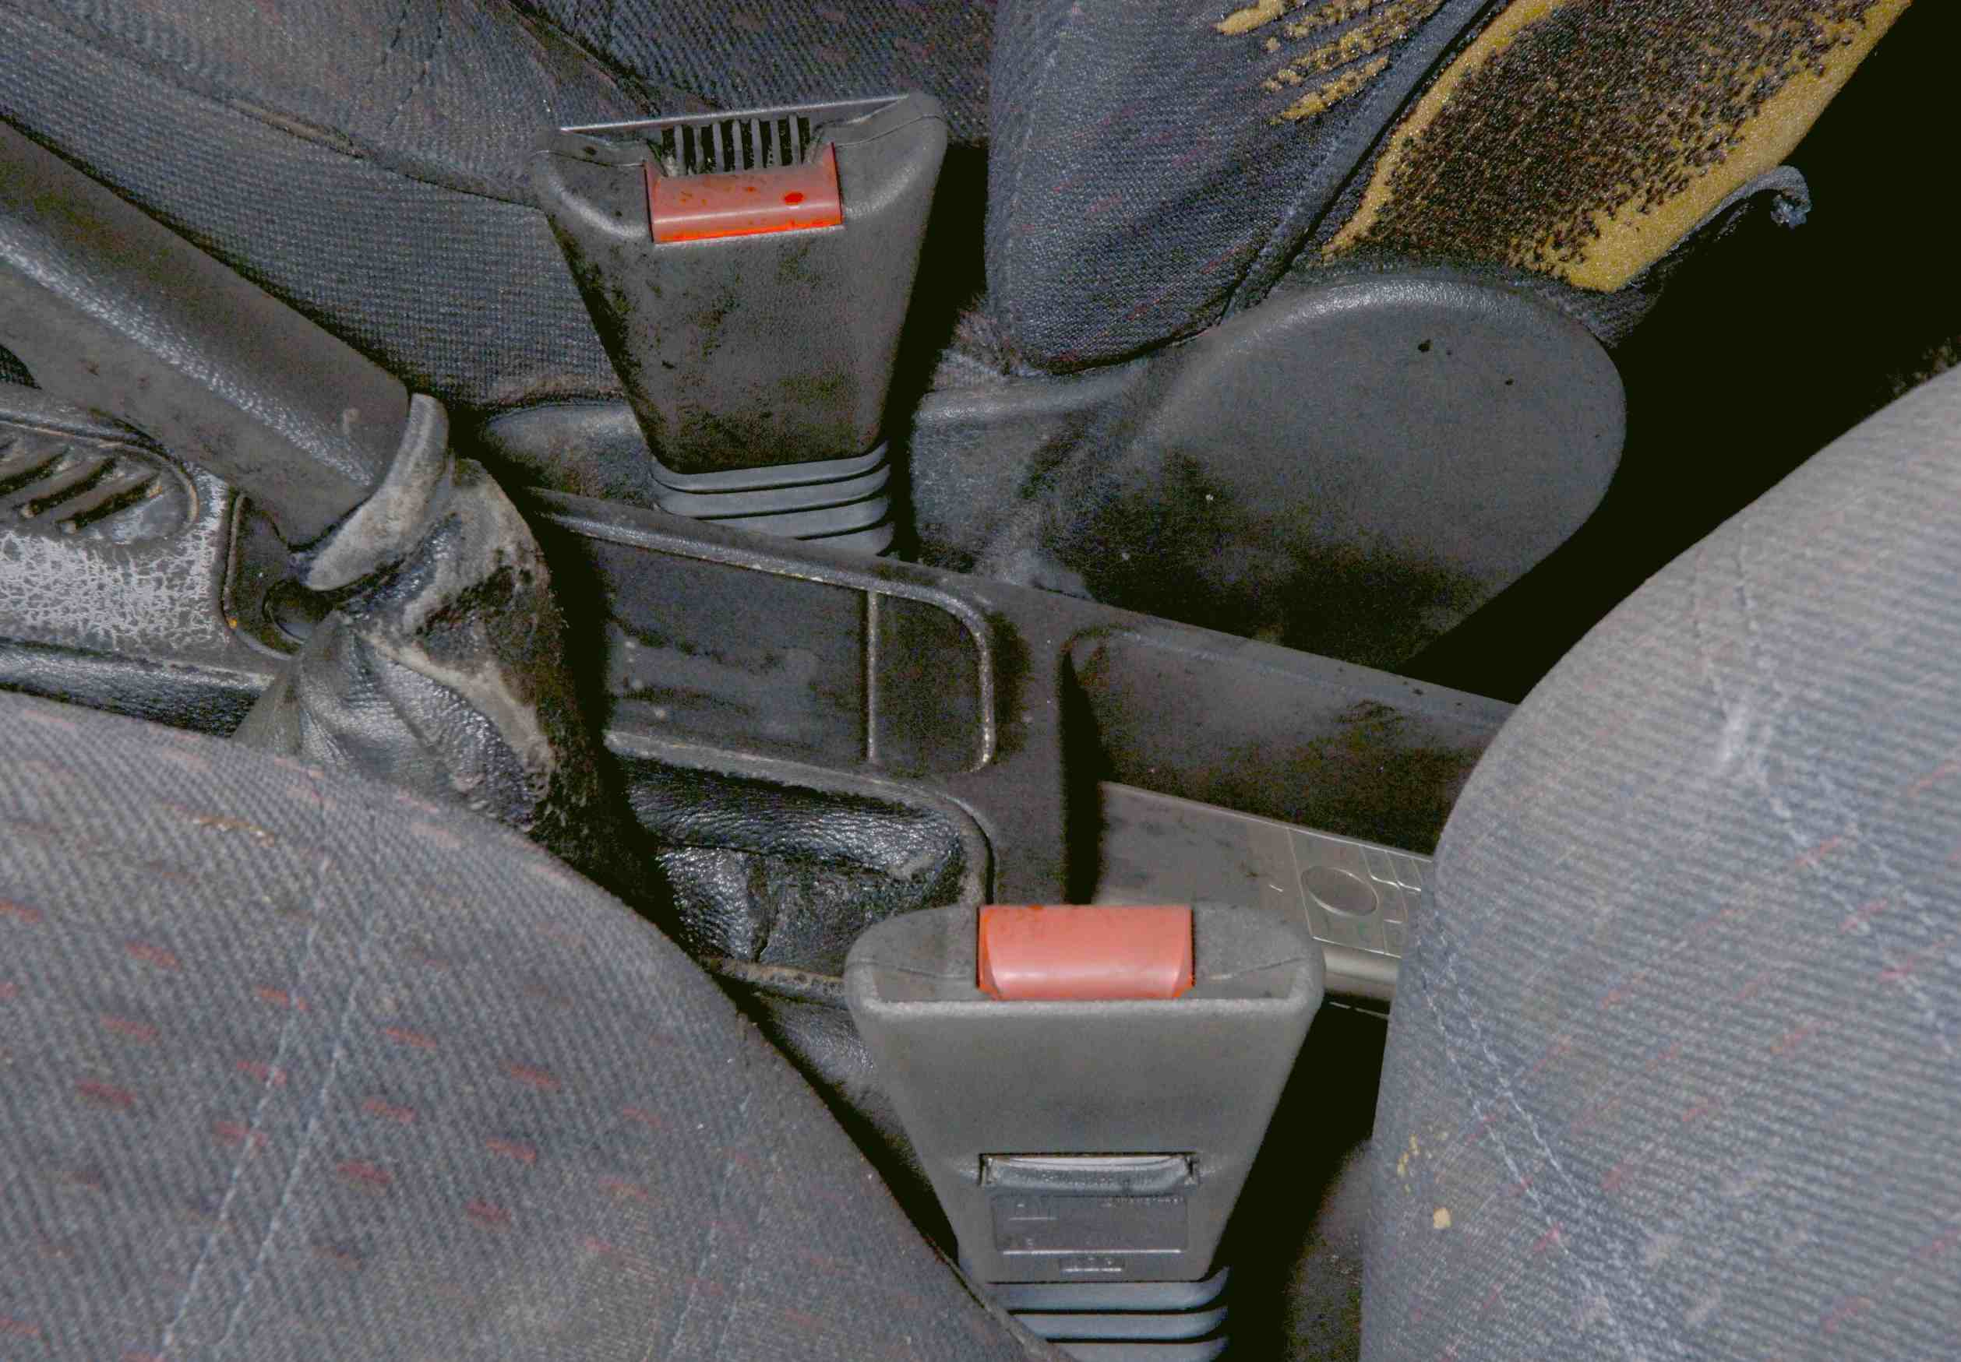
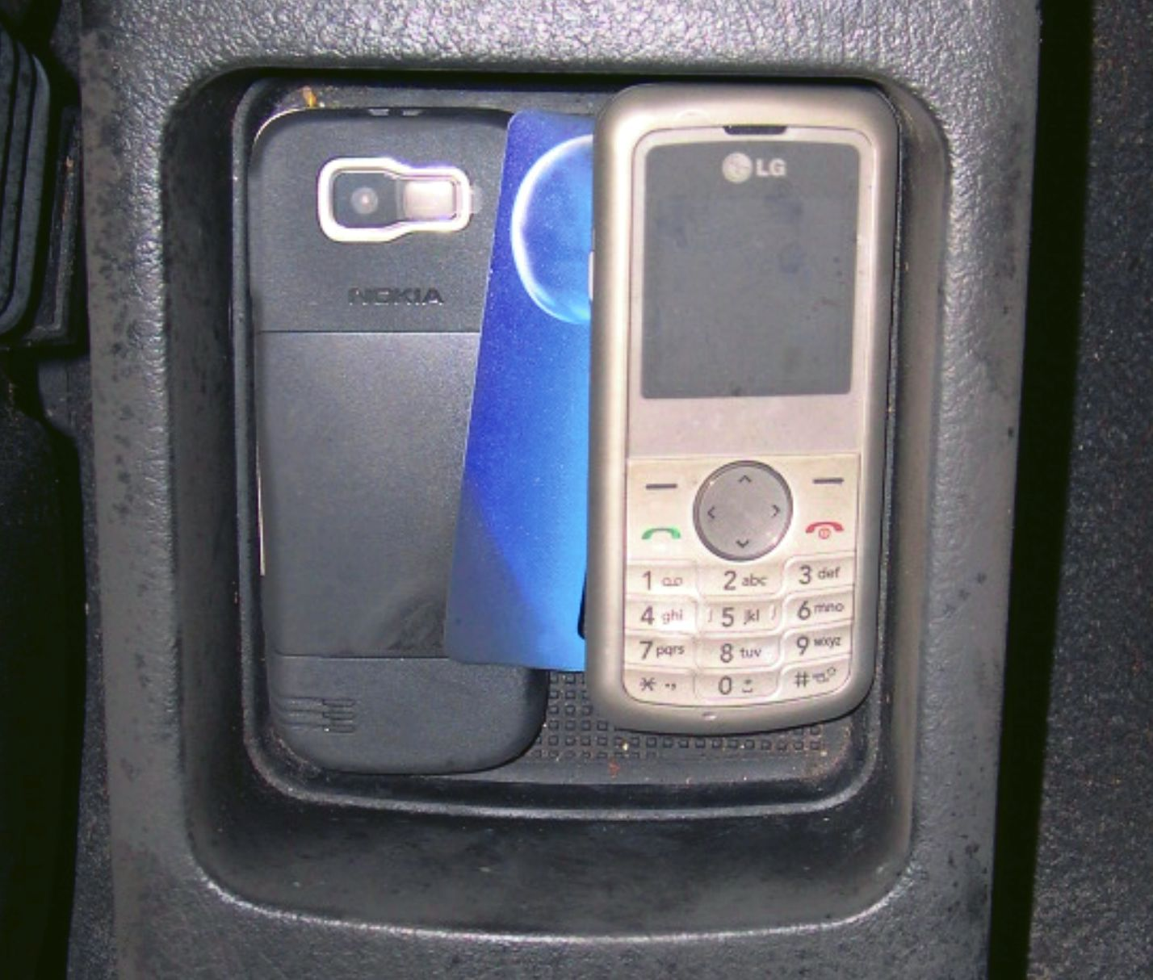
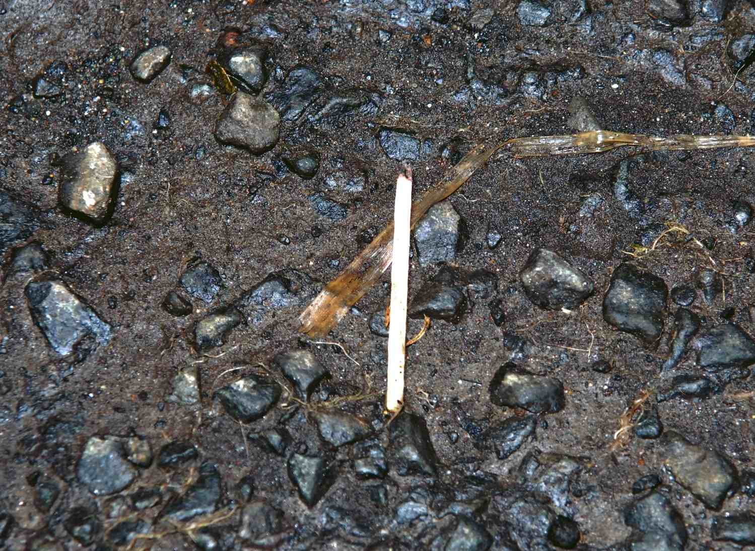
Touch DNA Evidence
match stick
at side of road
passenger side
safety belt buckle
cell phone in
center console

Slide 58
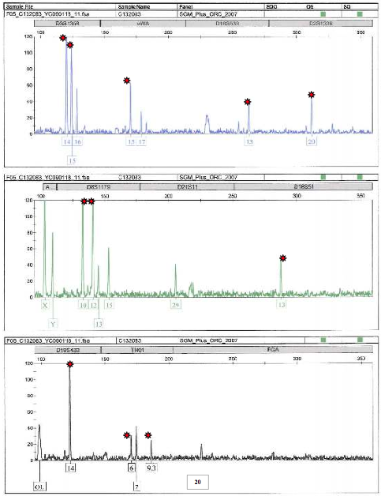
Data Ambiguity
D3
vWA
D18
D2
DNA
mixture
D8
D21
D18
allele
drop out
D18
TH01
FGA
low DNA
quantity
no DNA
visible

Slide 59

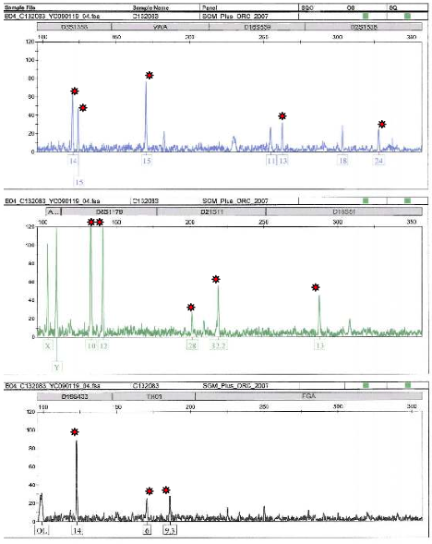
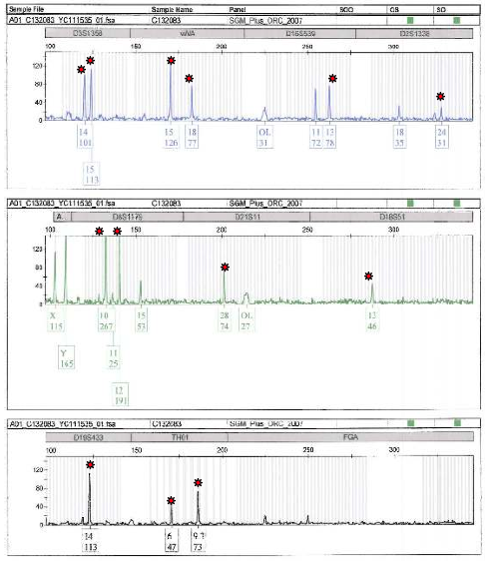
Much Data,
Little Consensus
No Match Statistic
Brian
Shivers
0
2
1
a
b
c

Slide 60
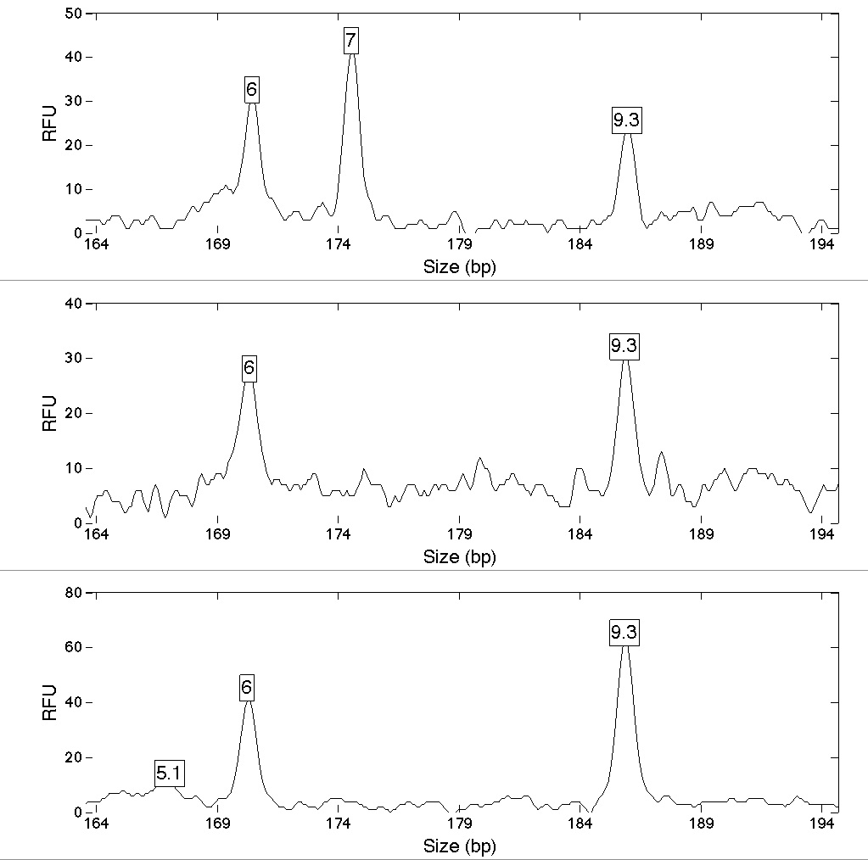
Joint Likelihood Function
a
TH01 locus
3 amplifications
b
c

Slide 61
Combining DNA Evidence
data
singles
pairs
all three
1.40
2.75
a
a
a
b
25
560
1.43
4.60
6.04
b
b
a
c
a
b
c
27
40,000
1.1 million
0.75
4.42
c
c
b
c
6
26,000
STR tests
10
20
30

Slide 62

Computer's Match Statistics
5.91 trillion
Colin
Duffy
6.01 billion
Brian
Shivers
1.1 million

Slide 63
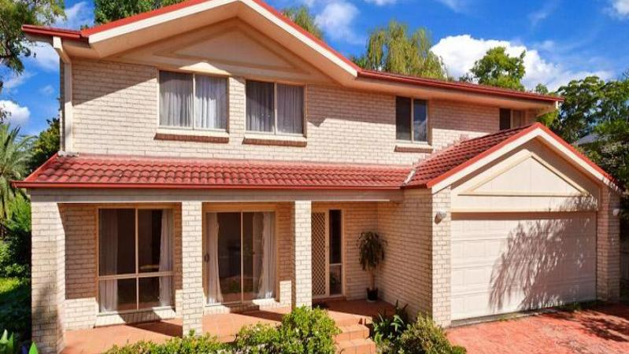
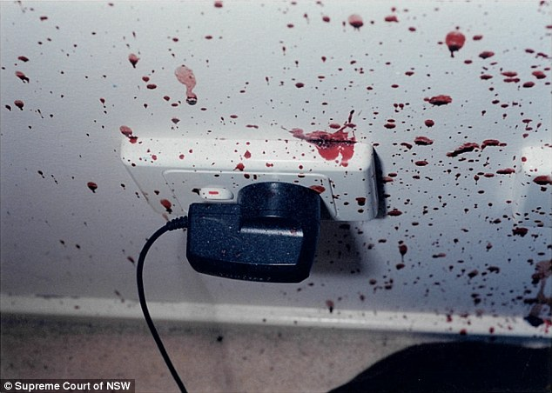
The Queen v. Robert Xie
On the night of 18 July 2009, in a Sydney suburb,
five Lin family members were bludgeoned to death
in their North Epping home (Australia).

Slide 64
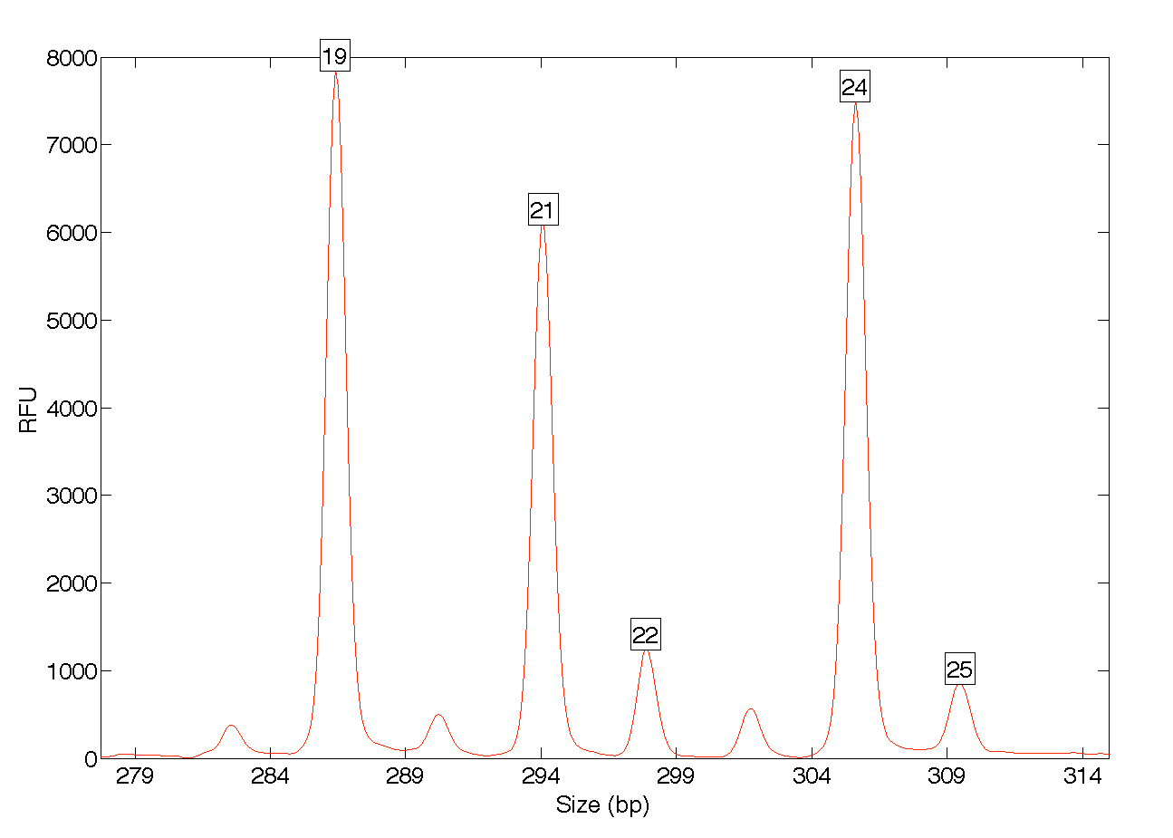
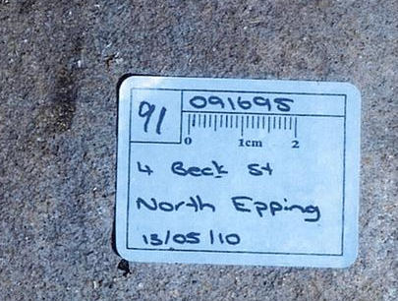
Blood stain 91
Suspicion fell on the wife’s brother-in-law, Robert Xie.
Xie had cleaned his garage floor that morning.
Police examined the garage floor stains.
FGA locus

Slide 65
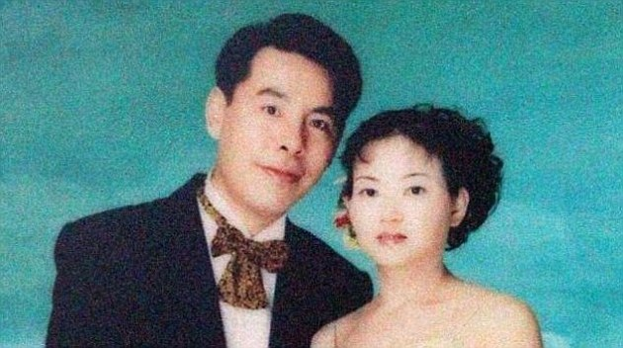
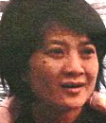
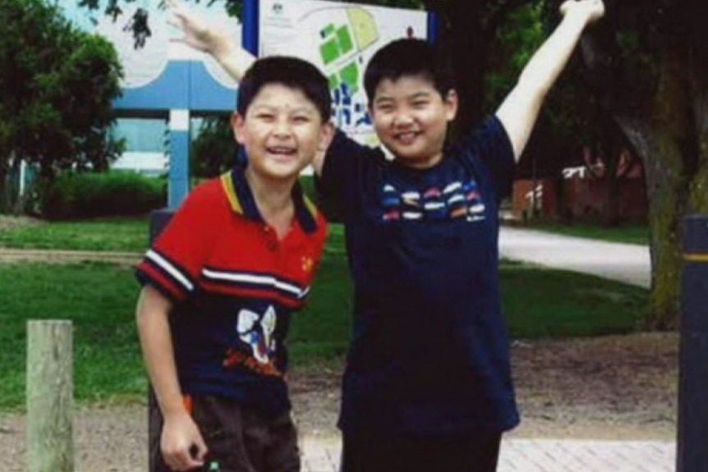
A family question
Forensic question #1: Is there DNA from
the Lin family in the garage floor mixture?
Min (45)
Yun Li (43)
Yun Bin (39)
Henry (12)
Terry (9)

Slide 66
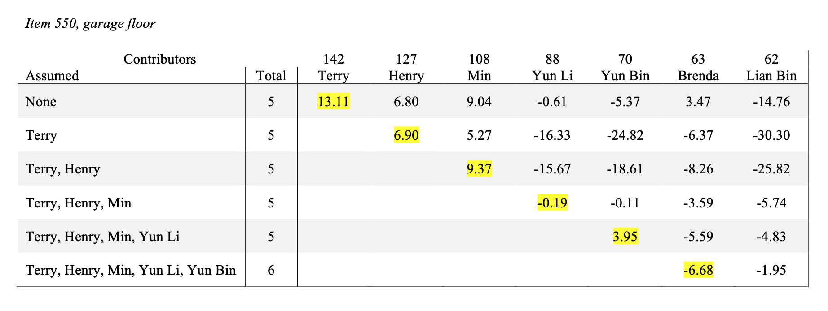
A peeling answer
Without peeling, all five relatives look associated.
Kinship allele sharing? Or is their DNA truly there?
With peeling, four of them are clearly there.

Slide 67
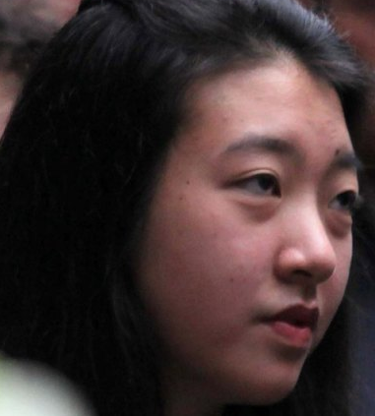
The missing sister
Forensic question #2:
Is Brenda Lin’s DNA in the garage floor mixture?
Min (45)
Yun Li (43)
Yun Bin (39)
?
Henry (12)
Terry (9)
Brenda (15)

Slide 68
Peeling reveals the truth
Without peeling, Brenda Lin might be present.
Sibling allele sharing? Or is her DNA truly there?
With peeling, Brenda’s DNA clearly isn’t there.

