Slide 1
Peeling Away Uncertainty: A Probabilistic Approach to DNA Mixture Deconvolution
American Academy of Forensic Sciences
Criminalistics Section
February, 2022
Seattle, WA
William Allan¹, MS; Hajara Chaudhry², MS; John Donahue³, MA;
Mark Perlin¹, PhD, MD, PhD; Mark Wilson², PhD
¹Cybergenetics Corp, Pennsylvania
²George Mason University, Virginia
³Beaufort County Sheriff’s Office, South Carolina
Cybergenetics © 2003-2022

Slide 2
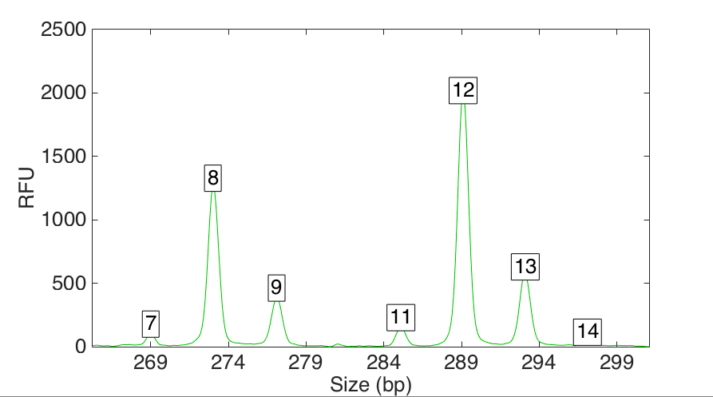
Genotype mixing

Slide 3
Genotype unmixing

Slide 4
Information measurement
LR
Evidence genotype
Reference genotype
likelihood ratio (LR) = change in genotype probability
made by DNA evidence
log(LR) is a standard information measure

Slide 5
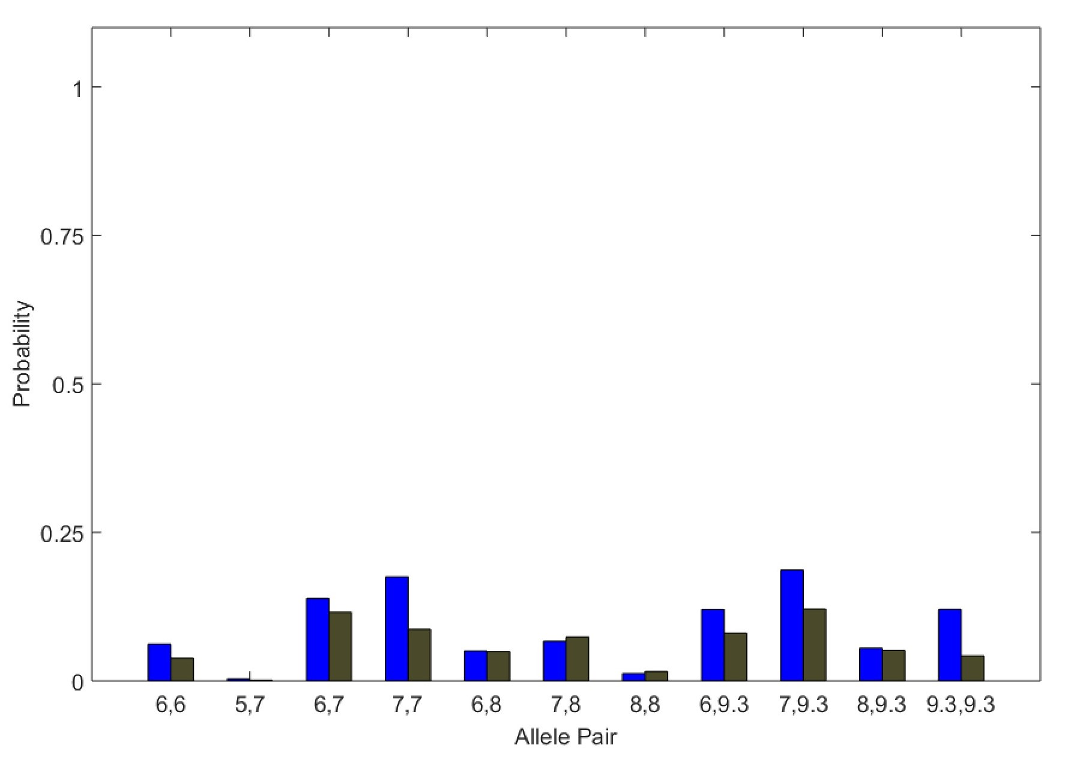
Genotype uncertainty
Diffuse probability distribution
Reduces match information

Slide 6
Genotype conditioning
• Assumes a contributor genotype in genotype
inference
• Performed iteratively, in subsequent analyses
• Focuses the inference on the other unknown
contributor genotypes
Improves genotype separation by
reducing uncertainty

Slide 7
The “peeling” process
Condition with reference
Most informative contributor
Mixture separation
All unknowns
Zero unknowns
Zero Unknowns
solve for MW
Continue until one
contributor remains

Slide 8
Beaufort data for GMU study
• Dataset
2, 3, 4, and 5 contributor mixtures
GlobalFiler PCR Kit
AB 3500xl Genetic Analyzer
• TrueAllele®
25k MCMC cycles, in duplicate
Conditioned based on highest LR
70 references for comparison

Slide 9
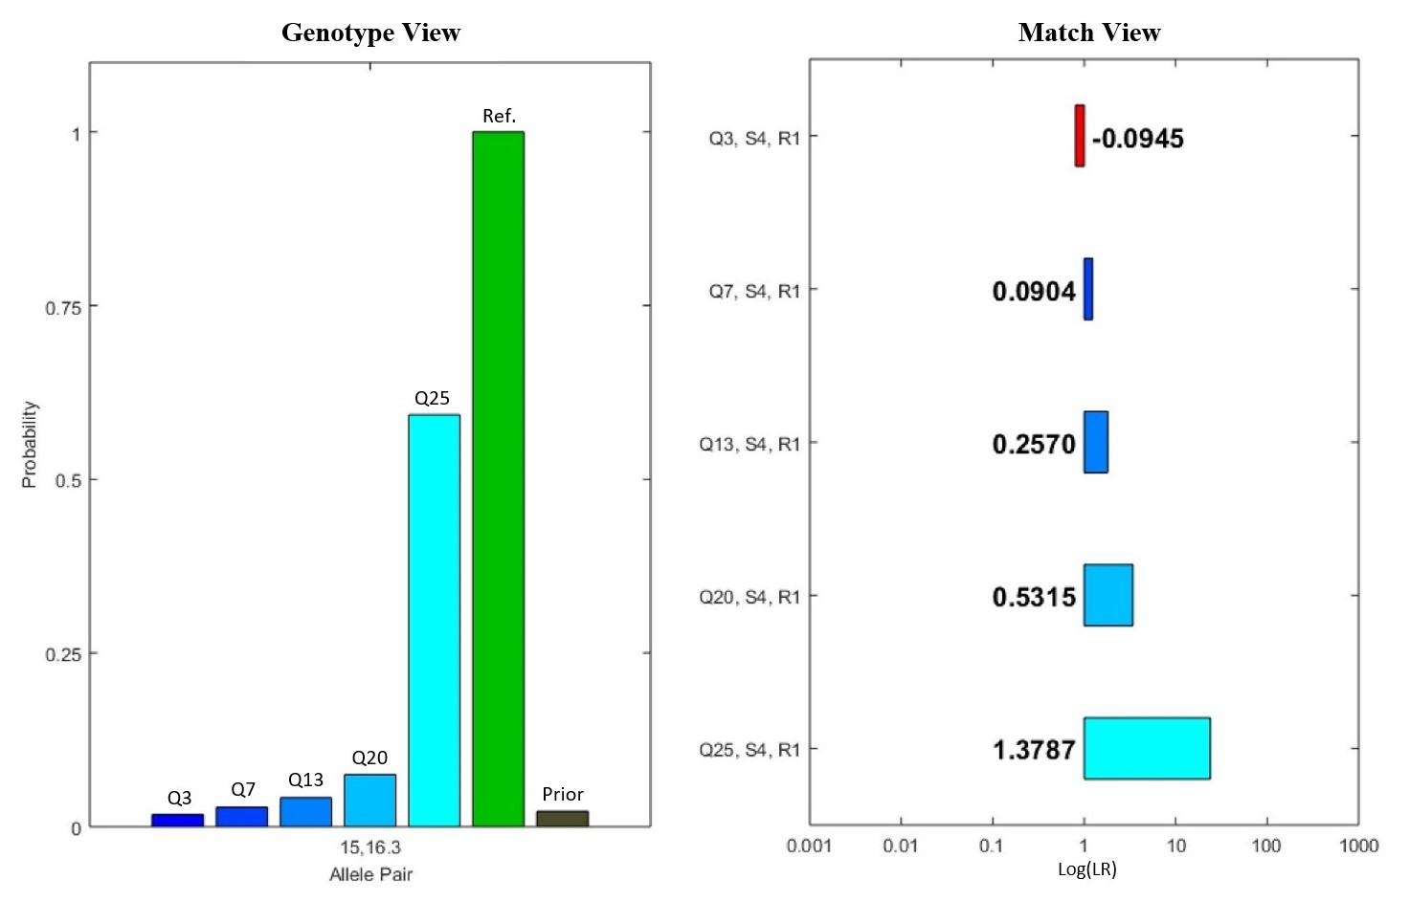
Reducing genotype uncertainty
Subject 34 in 5-con mixture at D1S1656

Slide 10
Increasing information yield
5-contributor mixture
Conditioning improves genotype separation for overlapping contributors,
match information doubled overall

Slide 11
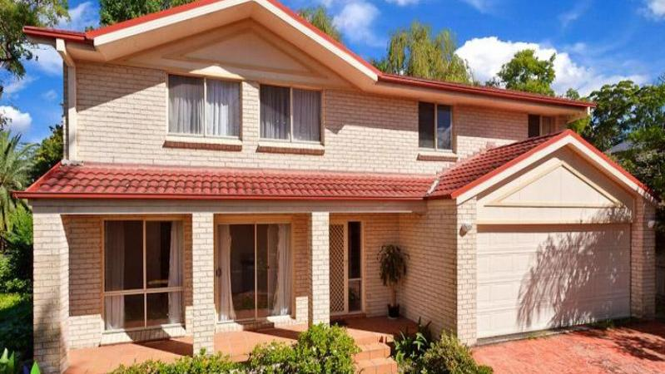
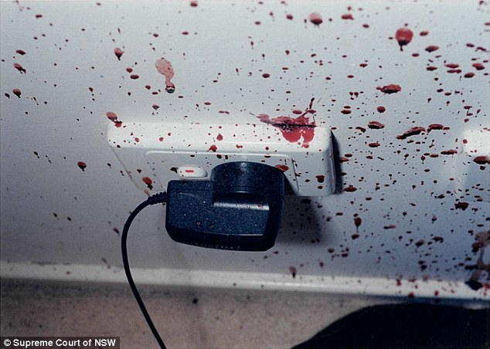
The Queen v. Robert Xie
On the night of 18 July 2009, in a Sydney suburb,
five Lin family members were bludgeoned to death
in their North Epping home (Australia).

Slide 12
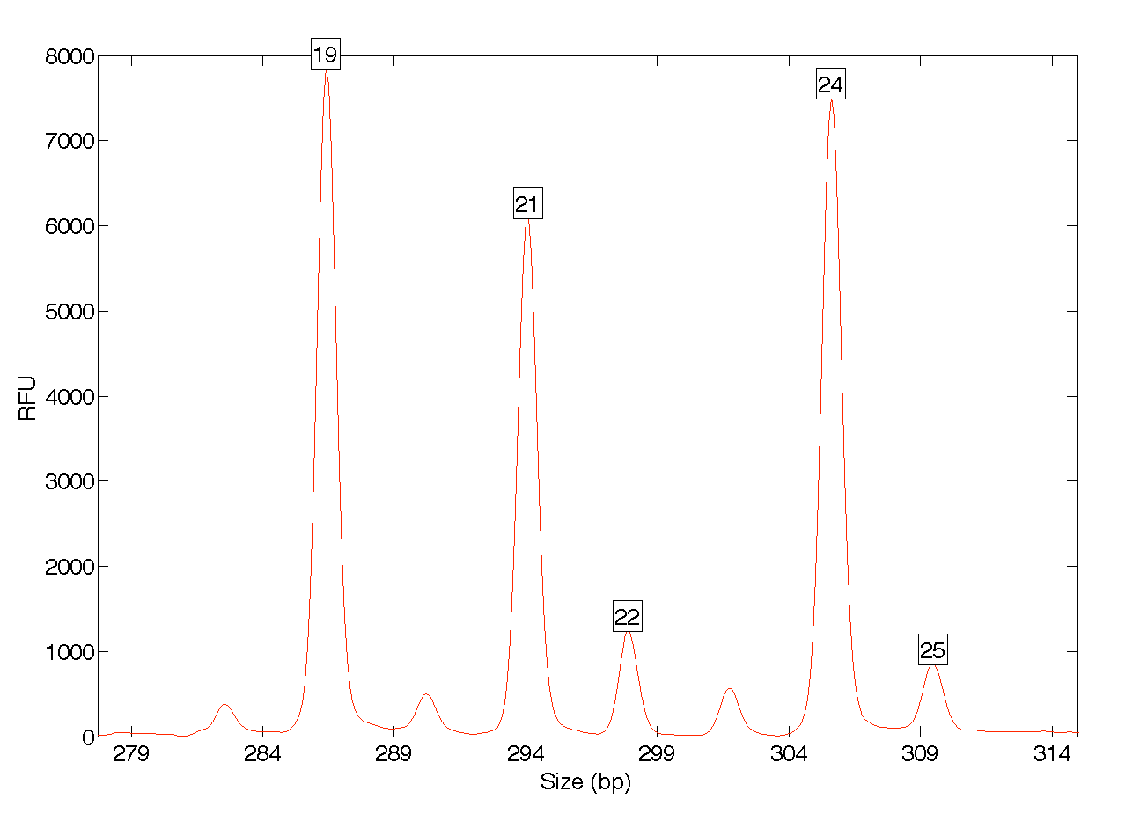
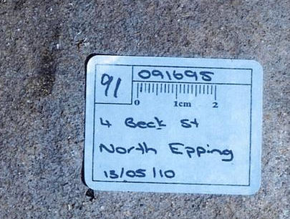
Blood stain 91
Suspicion fell on the wife’s brother-in-law, Robert Xie.
Xie had cleaned his garage floor that morning.
Police examined the garage floor stains.
FGA locus

Slide 13
A family question
Forensic question #1: Is there DNA from
the Lin family in the garage floor mixture?
Min (45)
Yun Li (43)
Yun Bin (39)
Henry (12)
Terry (9)

Slide 14
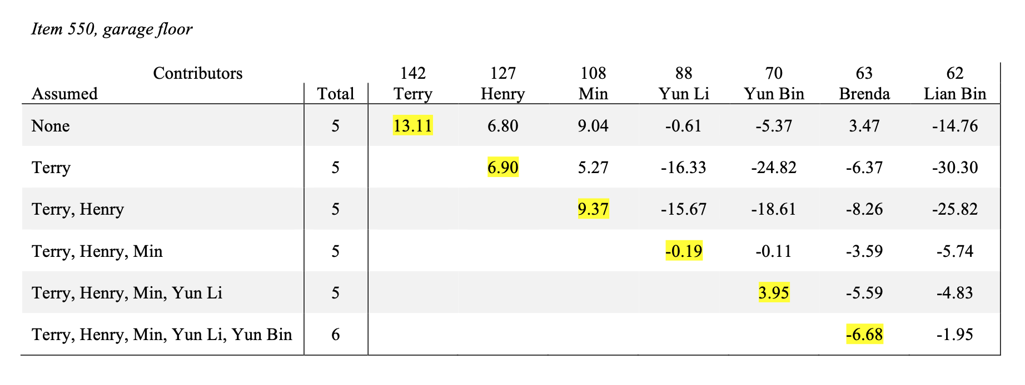
A peeling answer
Without peeling, all five relatives look associated.
Kinship allele sharing? Or is their DNA truly there?
With peeling, four of them are clearly there.

Slide 15
The missing sister
Forensic question #2:
Is Brenda Lin’s DNA in the garage floor mixture?
Min (45)
Yun Li (43)
Yun Bin (39)
?
Henry (12)
Terry (9)
Brenda (15)

Slide 16
Peeling reveals the truth
Without peeling, Brenda Lin might be present.
Sibling allele sharing? Or is her DNA truly there?
With peeling, Brenda’s DNA clearly isn’t there.

Slide 17
Conclusions
• Mixture data contain DNA identification information
• DNA comparisons are made through genotypes
• The likelihood ratio measures match information
• Genotype conditioning can increase information
• Successive “peeling” rounds reveal DNA matches
• Laboratory study demonstrates efficacy
• Criminal case application shows utility
Better use of DNA data can give
more identification information

