Slide 1
Genotype Information Criteria for Forensic DNA Databases
2019 AAFS Annual Scientific Meeting
February 23, 2018

Slide 2
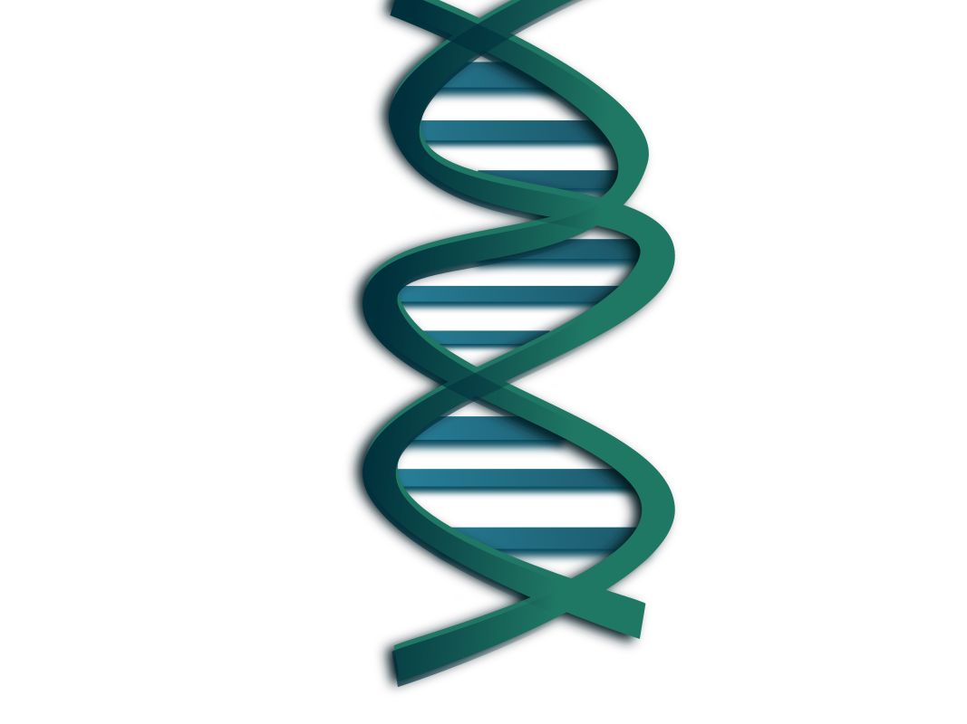
CODIS Searches
Allele to Allele Comparison
High certainty genotypes - good
Low certainty genotypes?

Slide 3
NDIS Upload Criteria
Specimen Category | Max Alleles per Locus | Moderate Match Estimate
Forensic Mixture | 4 | 1 in 10 million

Slide 4
Falling Through the Cracks
What about mixtures that have high information but do not meet upload criteria?
How do you identify mixtures with high match information?

Slide 5
Probabilistic Genotyping
Kullback-Leibler Divergence (KL)
Measure of information gain in Bayesian inference
Posterior (after computer inference) vs. prior (before computer inference)

Slide 6
Advantages of KL for Databases
Estimate of match information (LR) in absence of reference sample
Calculated over entire profile, not a subset of loci
Can be used to identify high information mixtures

Slide 7
Methods
Process all samples in TrueAllele®
Assess KL of inferred genotypes
Determine viability for CODIS
KL <10 = typically insufficient for CODIS
KL >10 = sufficient but specimen category varies

Slide 8
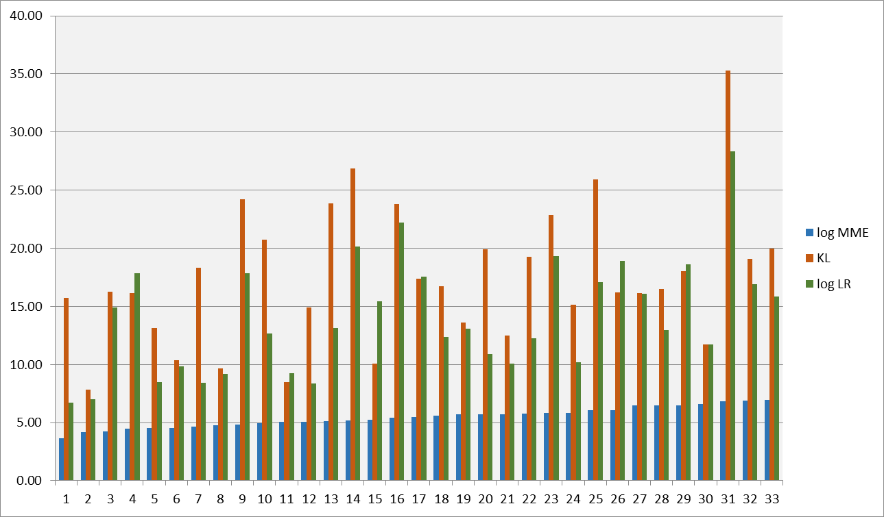

Slide 9
Case Example
Assault case – female victim, male suspect
Three questioned swabs
No victim sample submitted

Slide 10
Case Example
Item | Quantity | Amplified? | Result | Weight
#1 | ~300 pg | Yes | Mixture (2) | 57 / 43
#2 | ~170 pg | Yes | Minimal | N/A
#3 | ~10 pg | No | N/A | N/A

Slide 11
Case Example
Examiner focused on Item 1 for CODIS entry
Manual data review – 14 loci (8 core) entered
Insufficient MME for NDIS; uploaded to SDIS

Slide 12
SDIS Search #1
June 2017
28 candidate matches
Human review (>1 hour)
25 eliminated
3 candidates requested for additional testing (expanded loci)

Slide 13
SDIS Search #1
July 2017
Expanded loci testing complete
Human review
All three excluded
Summary – 28 candidates, 0 hits, ~1.5 hours human time (entry & review)

Slide 14
Additional Testing
October 2017
Victim standard submitted
TrueAllele® victim match, log LR 14.8 (630 trillion)
Examiner manually refines CODIS profile
MME still insufficient for NDIS
Uploads to SDIS

Slide 15
SDIS Search #2
October
2 new candidate matches
One eliminated
One identified and confirmed
Summary – 2 candidates, 1 hits, ~15 minutes human time

Slide 16
SDIS Searches Summary
30 candidates
1 hit
~2 hours human analysis/review
Four months searching
Offender was not identified in initial search!

Slide 17
Could We Improve?
Use TrueAllele® at candidate match review?

Slide 18
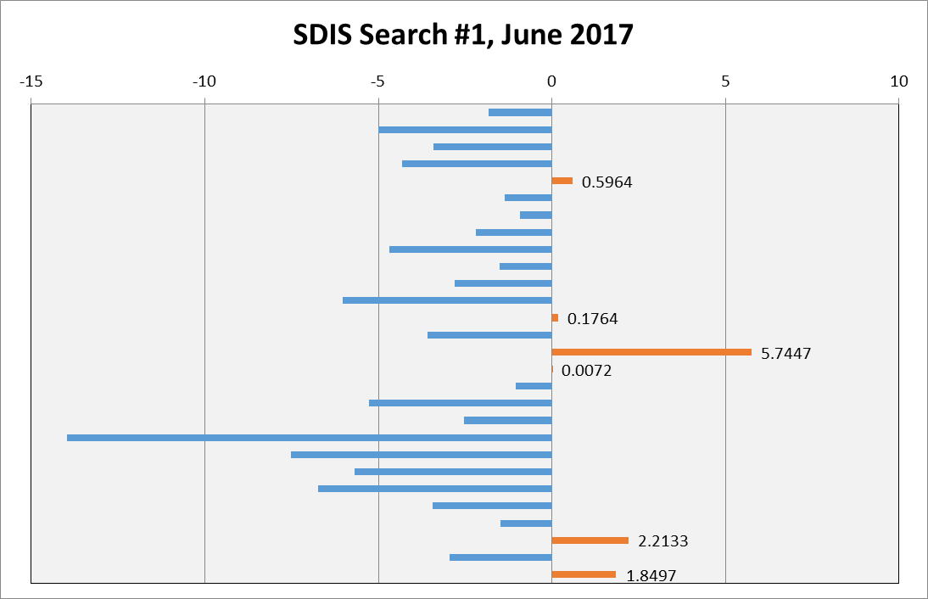
TrueAllele® Match Review

Slide 19
Could We Improve?
Use TrueAllele® to select alleles for CODIS entry?

Slide 20
TrueAllele® for CODIS Entry
Victim
Candidate
Sample
Review
Method
Searches
Matches
Needed
Time
for Hit?
Human
30
2
Yes
~2
hrs
~15
TrueAllele
®
3
1
No
minutes

Slide 21
TrueAllele® for CODIS Entry
SC has created Probabilistic Genotyping index
No MME, max of 8 alleles per locus
Minimum 7 original core loci

Slide 22
TrueAllele® for CODIS Entry
Search against single source profiles only
Mixtures that were previously ineligible for searching
Several hits to date

Slide 23
Summary
MME is good predictor for number of matches but not quality of data
KL is good predictor of match strength
High information mixture data is not being searched
Probabilistic mechanism is needed

Slide 24
Thank you!

