Slide 1
An Automated Genotype Database for Associating Counterfeit Drug Evidence
American Academy of Forensic Sciences Criminalistics Section
February 2023
Orlando, FL
Matthew Legler
William Allan, MS
Mark Perlin, PhD, MD, PhD
Cybergenetics © 2003-2023

Slide 2
Background Counterfeit pharmaceuticals
Counterfeit pharmaceuticals kill over 100,000 people each year
In two decades, the number of incidents has grown from 200 to 4,400
Pfizer Global Security tested 250 Xanax purchases online; 96% were counterfeit
The annual $100 billion counterfeit drug market rivals the $250 billion illicit drug trade

Slide 3
Counterfeit drug project
Private company has a collection of samples from known counterfeit drug packages
DNA lab generated STR data over an 18-month period, November 2018 through May 2020
Analyzed 133 samples, representing 103 package evidence items
The lab analysis produced no information
Can a TrueAllele Database find more?

Slide 4
Cybergenetics processing
Process all of the data in TrueAllele® Casework
103 items (swabs from vials, packaging, seals, etc.)
Data typically contained 2 to 5 contributors
Task - Find connections between different collections of counterfeit drugs
Data received: May 27, 2020
First results returned: June 3, 2020

Slide 5
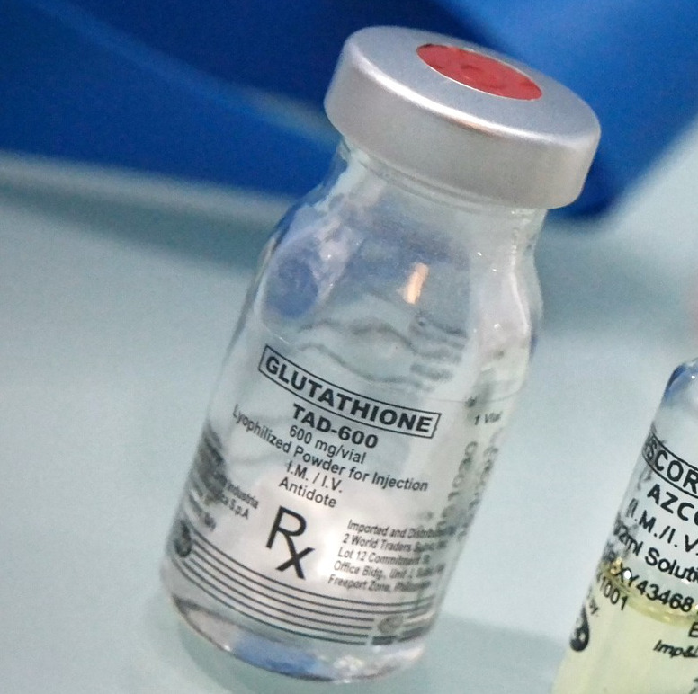
vial and label edges
collected by Lab Tech AS
February 2019
Manufacturer Case
Case 5
Laboratory: Item is “Not Searchable Mixture”
TrueAllele: Expected match statistic of a nonillion (10³⁰)

Slide 6
1 nonillion
metal seal, vial label, flip cap and bottom rim
collected by Lab Tech JD
May 2019
Manufacturer Case
Case 5
Case 8
Laboratory: Both items are “Not Searchable Mixtures”
TrueAllele: Finds match statistic association of a nonillion (10³⁰)

Slide 7
1 nonillion
Manufacturer Case
Case 5
Case 8
Case 19
10 octillion
100 sextillion
Laboratory: All items are “Not Searchable Mixtures”
TrueAllele: Finds a cluster of matches
carton, vial, patient insert
collected by Lab Tech PN
January 2020

Slide 8
Nov 2018
Feb 2020
Manufacturer Case
Case 1 | Case 12
Case 2 | Case 13
Case 3 | Case 14
Case 4 | Case 15
Case 5 | Case 16
Case 6 | Case 17
Case 7 | Case 18
Case 8 | Case 19
Case 9 | Case 20
Case 10 | Case 21
Case 11
TrueAllele Database found
150 DNA matches within this
1 counterfeit drug cluster
(the laboratory found none)

Slide 9
vial and label edges
collected by Lab Tech AS
February 2019
Marker | Allele 1 | Allele 2 | Allele 3
AMELO | X | Y
CSF1PO | 11 | 14
D10S1248 | 14 | 15
D12S391 | 17.3 | 20
D13S317 | 10 | 11 | 13
D16S539 | 11 | 12
D18S51 | 14 | 16
D19S433 | 12 | 14
D1S1656 | 16 | 17.3
D21S11 | 27 | 29
D22S1045 | 11 | 15
D2S1338 | 17 | 20+
D2S441 | 14
D3S1358 | 14 | 17
D5S818 | 11 | 13+
D7S820 | 11
D8S1179 | 13 | 15
FGA | 22
SE33 | 13.2 | 27.2
TH01 | 7 | 9.3
TPOX | 8 | 11
vWA | 15 | 16
CODIS database searchable profile
Generated by TrueAllele Database
Expected database match statistic
of 10 billion (10¹⁰)
Expected TrueAllele® match statistic
of a nonillion (10³⁰)
to the true perpetrator
Manufacturer Case
Case 5

Slide 10
Results – The Numbers
DNA data from 103 counterfeit packages
 | TrueAllele Genotypes | Failed Allele Lists
Information | 723 DNA connections | 0
CODIS profiles | 6 | 0
Interpretation time | 1 week | 1 year + 6 months

Slide 11
Probabilistic databases overcome allele database obstacles
Allele Databases
Limited uploads, limited information
Probabilistic databases
Everything can be uploaded, preserve information
Probabilities
[10 11] 0.90
[10 12] 0.10
Alleles
10, 11, 12

Slide 12
Probabilistic databases overcome allele database obstacles
MME vs KL
Moderate Match Estimate
must exceed a pre-set threshold
reduce CODIS hits
KL (Kullback–Leibler)
provides expected log(LR) information
not a limit on evidence upload

Slide 13
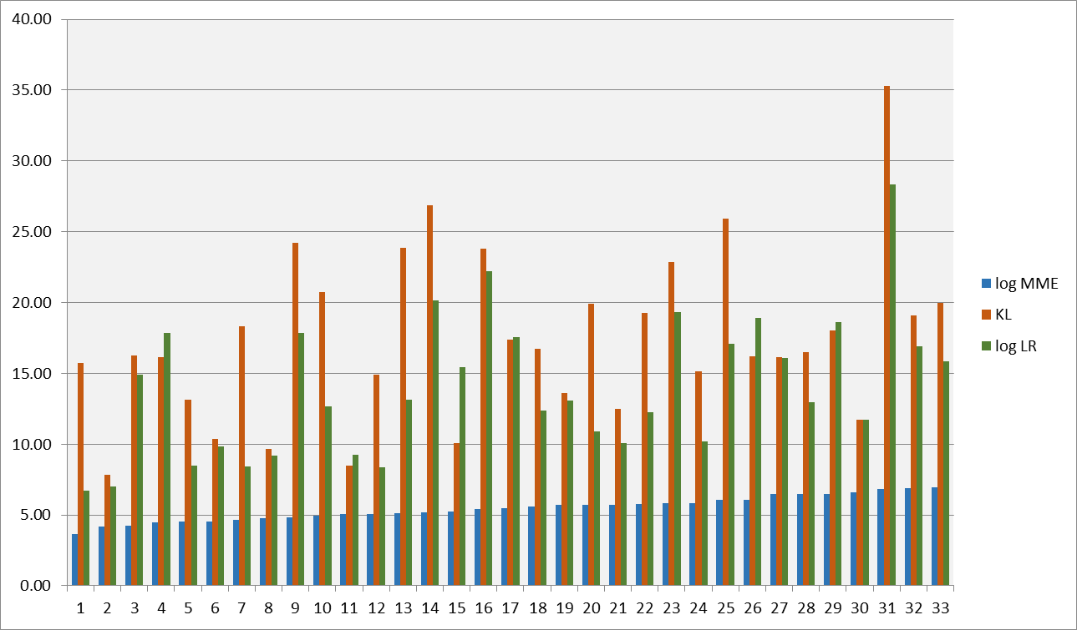
Information prediction: MME vs KL
33 hits (Not to NDIS) from a lab comparing log(MME), KL and log(LR)
J. Donahue and M. Perlin, "Genotype information criteria for forensic DNA databases", American Academy of Forensic Sciences 71th Annual Meeting, Baltimore, MD, 23-Feb-2019.

Slide 14
Database as investigative tool Drug distribution sites
Fentanyl, Meth
Can you find the original producers and suppliers?
Data – drug baggies, vials, scales, etc. collected at distribution sites
Task – find shared contributors across multiple locations, produce profiles for database search

Slide 15
Database as investigative tool Organized retail crime
For organized retail crime and retail theft
Is there a shared contributor on recovered items?
Database to identify and link criminals and evidence
Maps the crime scene connecting suspects and evidence items

Slide 16
Conclusions
Able to interpret in 1 week, 1½ years worth of data
Found 723 DNA matches and 6 CODIS-searchable profiles
Did not require extensive manual data review
Database automatically compared the DNA data
An automated, informative DNA database can catch counterfeiters and save lives
Can be extended to other big DNA data problems, such as illicit drug production and organized retail theft

