Slide 1

Understanding DNA Evidence
Beaver County Courthouse
March, 2016
Beaver, PA
Mark W Perlin, PhD, MD, PhD
Cybergenetics, Pittsburgh, PA
Cybergenetics © 2003-2016

Slide 2
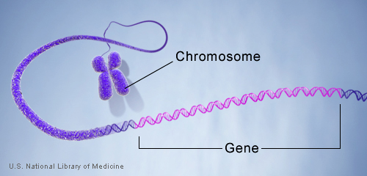
DNA genotype
A genetic locus has
two DNA sentences,
one from each parent.
An allele is the number
of repeated words.
locus
A genotype at a locus
is a pair of alleles.
mother
allele
1
2
3
4
5
6
7
8
9
10
10, 12
ACGT
repeated word
Many alleles allow for
many many allele pairs.
A person's genotype
is relatively unique.
father
allele
1
2
3
4
5
6
7
8
9
10
11
12

Slide 3
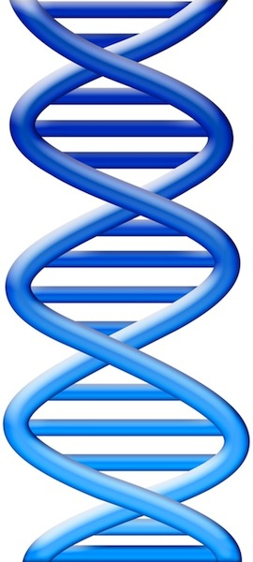
DNA match statistic
Evidence item
Lab
Evidence data
Infer
Evidence genotype
10, 12
10 11 12
DNA from
one person
Compare
Known genotype
1
Prob(coincidental match)
10, 12

Slide 4
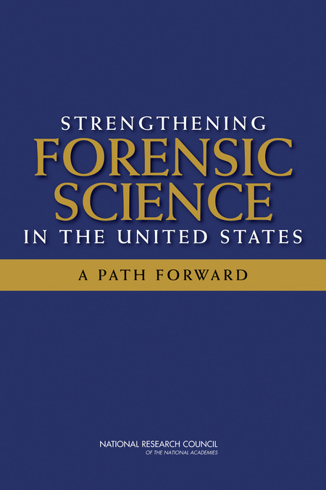
National Academy of Sciences
"Strengthening Forensic Science:
A Path Forward" (2009)
• Human examination bias
• Statistics & reporting
• Underlying scientific basis
Among existing forensic methods, only nuclear DNA analysis has been rigorously shown to have the capacity to consistently, and with a high degree of certainty, demonstrate a connection between an evidentiary sample and a specific individual or source.

Slide 5
National Academy of Sciences
"Strengthening Forensic Science:
A Path Forward" (2009)
• Human examination bias
• Statistics & reporting
• Underlying scientific basis
However, ... there may be problems ... with how the DNA was ... interpreted, such as when there are mixed samples

Slide 6
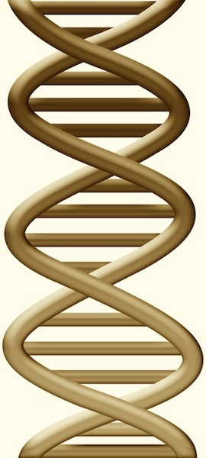
DNA match statistic
Evidence item
Lab
Evidence data
Separate
Contributor genotype
10, 11 @ 20%
11, 11 @ 30%
11, 12 @ 50%
10 11 12
DNA from
two people
Compare
Known genotype
Prob(evidence match)
Prob(coincidental match)
11, 12

Slide 7

Pennsylvania v Ralph Skundrich
On July 25, 2002, a Pittsburgh college student, 18,
was threatened with a gun and
sexually assaulted in her Shadyside apartment.
The victim's jeans and T-shirt contained biological evidence.
The Allegheny County crime lab developed
DNA data from the two evidence items.
Skundrich was identified as a suspect after a DNA match was made in the national database in 2009.

Slide 8
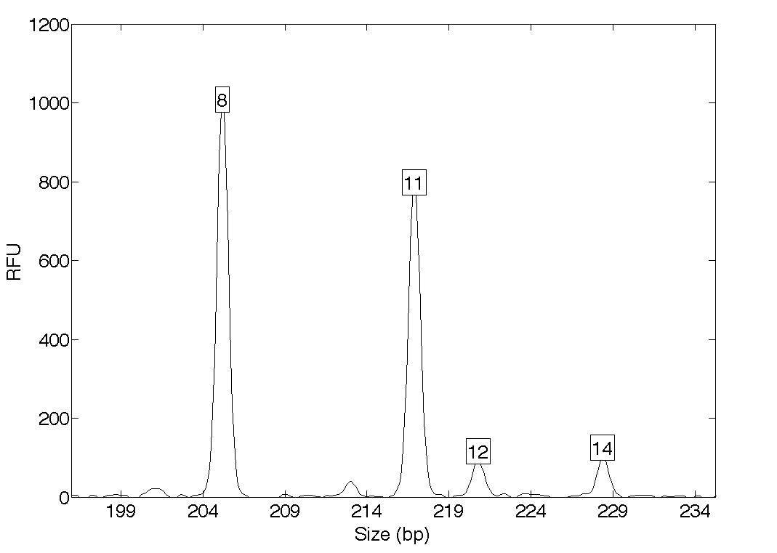
DNA mixture evidence (jeans)
Quantitative peak heights at locus D13S317
peak size
peak
height

Slide 9
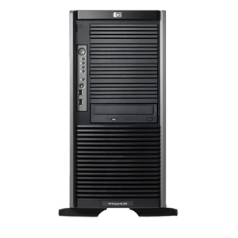

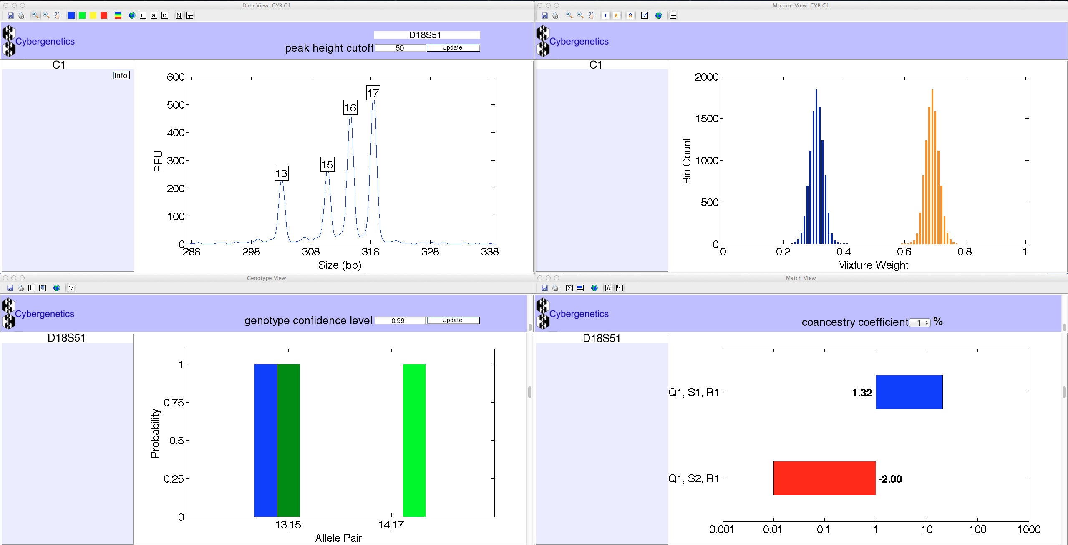
TrueAllele® Casework
ViewStation
User Client
Database
Server
Interpret/Match
Expansion
Visual User Interface
VUIer™ Software
Parallel Processing Computers
Notes:
Describe TrueAllele system (left, middle, right, middle, left)

Slide 10
How the computer thinks
Consider every possible genotype solution
First person's allele pair
Explain the
peak pattern
90%
Second person's allele pair
Better
explanation
has a higher
likelihood
10%

Slide 11
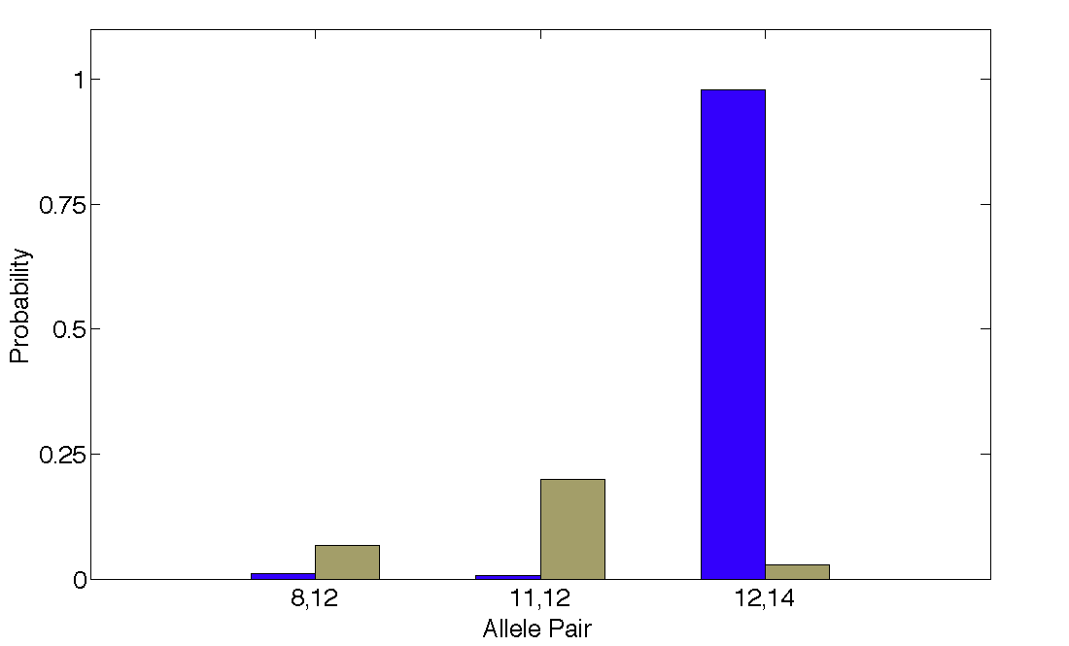
DNA match information
How much more does the suspect match the evidence
than a random person?
35x
98%
Prob(evidence match)
Prob(coincidental match)
3%

Slide 12
Match information at 13 loci
DNA locus
Likelihood ratio (LR)

Slide 13
Is the suspect in the evidence?
A match between the jeans and Ralph Skundrich is:
2.1 quadrillion times more probable than coincidence
A match between the T-shirt and Ralph Skundrich is:
4.04 quadrillion times more probable than coincidence

Slide 14
Crime lab data summary
Over threshold, peaks are labeled as allele events
Allele Pair
8, 8
8, 11
8, 12
8, 14
11, 11
11, 12
11, 14
12, 12
10%12, 14
14, 14
All-or-none allele peaks,
each given equal status
Threshold

Slide 15
Match statistic comparison
DNA locus
Likelihood ratio (LR)

Slide 16
Information comparison
Method
Combined PI
TrueAllele
Jeans
280 thousand (5)
2 quadrillion (15)
T-shirt
630 thousand (5)
4 quadrillion (15)

Slide 17
Reliability (PA Rule 702)
Testimony by Expert Witness
A witness who is qualified as an expert by knowledge, skill, experience, training, or education may testify in the form of an opinion or otherwise if:
(a) the expert’s scientific, technical, or other specialized knowledge is beyond that possessed by the average layperson;
(b) the expert’s scientific, technical, or other specialized knowledge will help the trier of fact to understand the evidence or to determine a fact in issue; and
(c) the expert’s methodology is generally accepted in the relevant field.

Slide 18
TrueAllele validation papers
Perlin MW, Sinelnikov A. An information gap in DNA evidence interpretation. PLoS ONE. 2009;4(12):e8327.
Ballantyne J, Hanson EK, Perlin MW. DNA mixture genotyping by probabilistic computer interpretation of binomially-sampled laser captured cell populations: Combining quantitative data for greater identification information. Science & Justice. 2013;53(2):103-14.
Perlin MW, Hornyak J, Sugimoto G, Miller K. TrueAllele® genotype identification on DNA mixtures containing up to five unknown contributors. Journal of Forensic Sciences. 2015;on-line.
Greenspoon SA, Schiermeier-Wood L, Jenkins BC. Establishing the limits of TrueAllele® Casework: a validation study. Journal of Forensic Sciences. 2015;in press.
Perlin MW, Legler MM, Spencer CE, Smith JL, Allan WP, Belrose JL, Duceman BW. Validating TrueAllele® DNA mixture interpretation. Journal of Forensic Sciences. 2011;56(6):1430-47.
Perlin MW, Belrose JL, Duceman BW. New York State TrueAllele® Casework validation study. Journal of Forensic Sciences. 2013;58(6):1458-66.
Perlin MW, Dormer K, Hornyak J, Schiermeier-Wood L, Greenspoon S. TrueAllele® Casework on Virginia DNA mixture evidence: computer and manual interpretation in 72 reported criminal cases. PLOS ONE. 2014;(9)3:e92837.

Slide 19
Validation axes
Sensitivity. The extent to which interpretation identifies the correct person.
Truly include, don't falsely exclude.
Specificity. The extent to which interpretation does not misidentify the wrong person.
Truly exclude, don't falsely include.
Reproducibility. The extent to which interpretation gives the same answer to the same question.
Concordant independent computer runs.

Slide 20
Widespread acceptance
Admitted after Frye or Daubert challenge in:
California, Louisiana, New York, Ohio, Pennsylvania, South Carolina, Virginia, Australia & United Kingdom
Crime labs use TrueAllele® system in
California, Maryland, South Carolina & Virginia
Used in five hundred criminal cases in most of the United States, for both prosecution and defense
Seventy criminal cases in Pennsylvania
Adams, Allegheny, Beaver, Berks, Butler, Cambria, Columbia, Delaware, Indiana, Luzerne, Lycoming, Mercer, Mifflin, Pike, Washington, Westmoreland, York

Slide 21
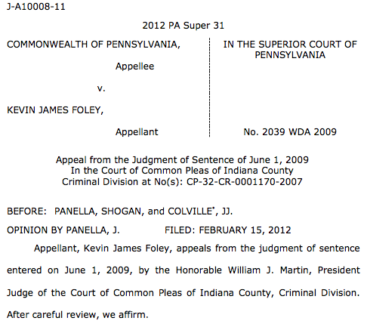
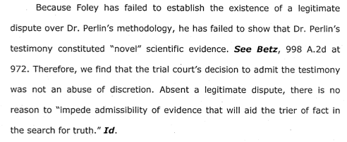
Pennsylvania appellate court
• • •

Slide 22
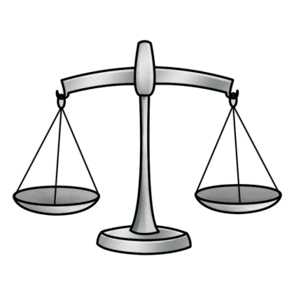
Relevance (PA Rule 403)
Excluding relevant evidence for prejudice, confusion, waste of time, or other reasons
The court may exclude relevant evidence if its probative value is outweighed by a danger of one or more of the following:
• unfair prejudice,
• confusing the issues,
• misleading the jury,
• undue delay,
• wasting time, or
• needlessly presenting cumulative evidence.
probative
force
unfair
prejudice

Slide 23
DNA statistic shuts down labs
“National accreditation board suspends all DNA testing at D.C. crime lab”
The Washington Post April 27, 2015
Did not comply with FBI standards
“New protocol leads to reviews of
‘mixed DNA’ evidence”
The Texas Tribune September 12, 2015
24,468 lab tests affected

Slide 24
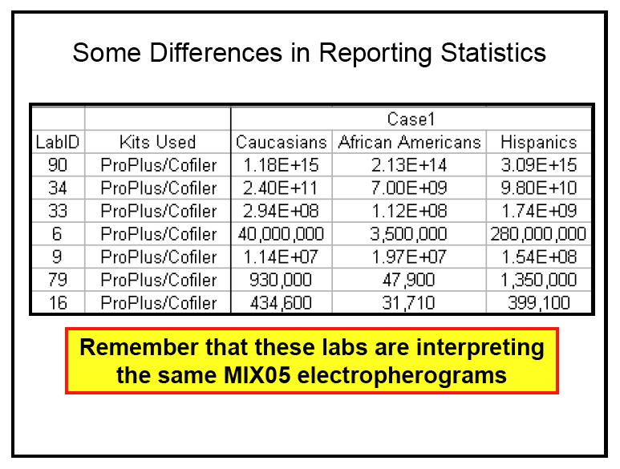
MIX05: Statistics not reproducible
MIX05: NIST mixture interpretation interlaboratory study.
Butler JM, Kline MC, National Institute of Standards and Technology
Promega's Sixteenth International Symposium on Human Identification, 2005
National Institute of Standards and Technology
Two Contributor Mixture Data, Known Victim
213 trillion (14)
31 thousand (4)

Slide 25
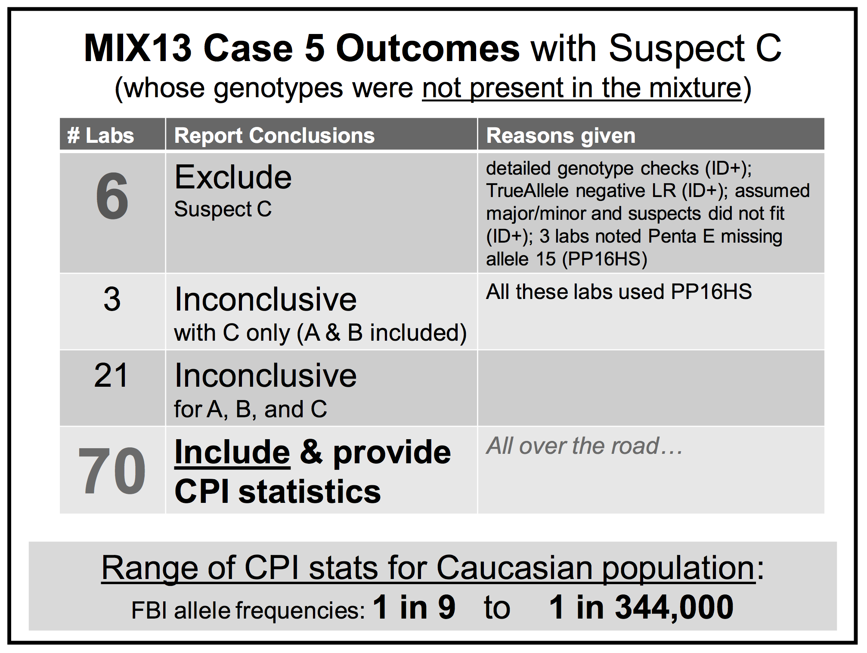
MIX13: Statistics falsely include
MIX13: An interlaboratory study on the present state of DNA mixture interpretation in the U.S.
Coble M, National Institute of Standards and Technology
5th Annual Prescription for Criminal Justice Forensics, Fordham University School of Law, 2014.

Slide 26


Process is not objective science
(1)
Choose, alter, discard, edit, and manipulate the DNA data signals
(2)
Compare defendant's genotype to edited data & decide if he is in the DNA evidence
(3)
If he is "included", then calculate a DNA mixture statistic
• Human examination bias
• Statistics & reporting
• Underlying scientific basis

Slide 27
CPI lacks probative value
Forensic crime laboratories have generated CPI statistics on hundreds of thousands of DNA mixture evidence items. However, this commonly used match statistic behaves like a random generator of inclusionary values, following the LLN rather than measuring identification information. A quantitative CPI number adds little meaningful information beyond the
analyst’s initial qualitative assessment that a person’s DNA is included in a mixture. Statistical methods for reporting on DNA mixture evidence should be scientifically validated before they are relied upon by criminal justice.

Slide 28
Relevance of CPI
Unvalidated DNA match statistic, unrelated to identification
PA Rule 401
“evidence makes a fact
more or less probable”
PA Rule 403
“outweighed by
a danger of:”
Probative value
none
Unfair prejudice
Confusing the issues
Misleading the jury
Cumulative evidence

Slide 29
Inconclusive mixture
Crime laboratory DNA report
Crime lab user fee: $5,000
Conclusions:
Item 1 – Swab of textured areas from a handgun
The data indicates that DNA from four (4) or more contributors was obtained from the swab of the handgun. Due to the complexity of the data, no conclusions can be made regarding persons A and B as possible contributors to this mixture.

Slide 30
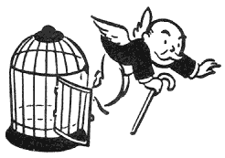
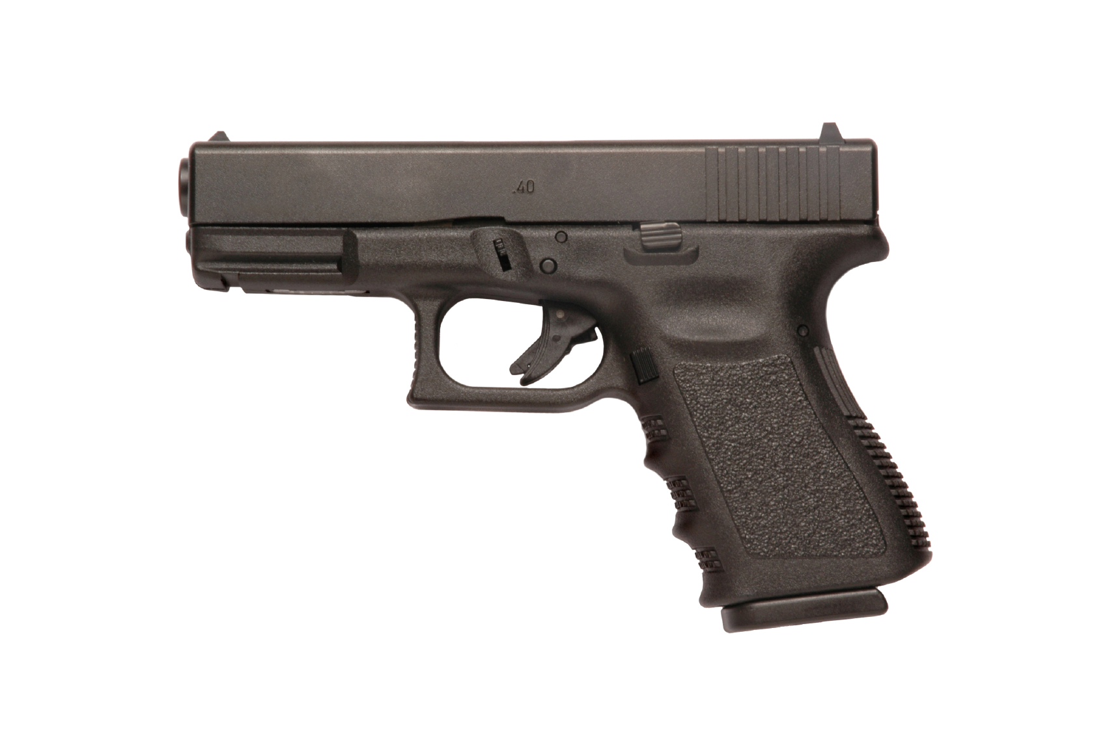

Computer reanalysis
Cybergenetics TrueAllele® report
Match statistics provide information
Person A
excluded
Contributor
Unmix the
mixture
1
2
400,000
3
Person B
included
4

Slide 31
TrueAllele in Allegheny County
40 cases, 8 trials, 3 DNA exonerations
Crime | Evidence | Defendant | Outcome | Sentence
rape | clothing | Ralph Skundrich | guilty | 75 years
murder | gun, hat | Leland Davis | guilty | 23 years
rape | clothing | Akaninyene Akan | guilty | 32 years
murder | shotgun shells | James Yeckel, Jr. | guilty plea | 25 years
murder | fingernail | Anthony Morgan | guilty | life
weapons | gun | Thomas Doswell | guilty plea | 1 year
bank robbery | clothing | Jesse Lumberger | guilty | 10 years
drugs | gun | Derek McKissick | guilty plea | 2 1/2 years
drugs | gun | Steve Morgan | guilty plea | 2 1/2 years
murder | door, clothing | Calvin Kane | guilty plea | 20 years
murder | gun | Jaykwaan Pinckney | guilty plea | 10 years
child rape | clothing | Dhaque Jones | guilty plea | 6 years
shooting | gun | Anthony Jefferson | guilty plea | 4 years
weapons | gun | Delmingo Williams | guilty plea | 3 years
incest rape | clothing | Terry L. | guilty | 40 years
bank robbery | hat | Robert Schatzman | guilty | pending
weapons | gun | Rashawn Walker | guilty | 1.5 years
robbery | hat | Lauren Peak | guilty plea | 1 year
murder | gun | Chaz White | guilty plea | 4 years

Slide 32


More DNA mixture information
http://www.cybgen.com/information
• Courses
• Newsletters
• Newsroom
• Presentations
• Publications
• Webinars
http://www.youtube.com/user/TrueAllele
TrueAllele YouTube channel
perlin@cybgen.com

