Slide 1

Delivering Computer Automation in Forensic DNA Science
Legal Medicine & Forensic Science
Duquesne University Law School
March, 2022
Pittsburgh, PA
Mark W Perlin, PhD, MD, PhD
Pittsburgh, PA
Cybergenetics © 2003-2022

Slide 2
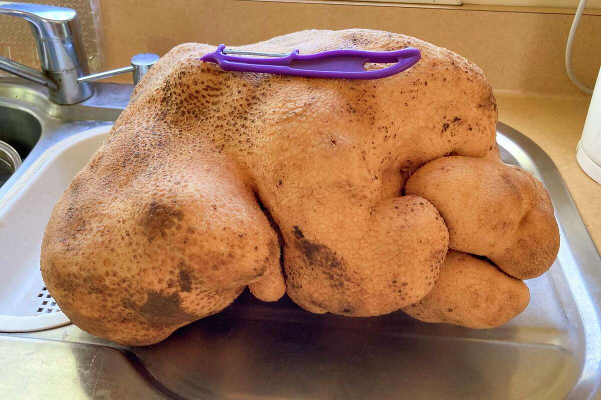
The power of DNA testing
Nice try but no potato for New Zealand
News: Fails to make the Guinness World Records (March 2022)

Slide 3
Florida v. Lajayvian Daniels
In May of 2014
A Palm Beach County gas station was robbed at gunpoint.
Clerk Shihab Mahmud (22) was shot and killed.
Charred clothing, a charred hat, and a pair of sneakers
were found within a mile of the crime scene.
The Palm Beach County Sheriff’s Office crime lab developed
DNA mixture data from the clothing, hat, and sneakers.
Due to the degraded nature of the data,
the lab was unable to fully interpret some mixtures.

Slide 4
TrueAllele® computer solution
• Accurate. 42 validation studies, 8 published
• Objective. Workflow removes human bias
• Accepted. Reported in 45 states, used by 10 labs
• Transparent. Give math, software (4GB DVD)
• Neutral. Can statistically include or exclude

Slide 5
Computer Interpretation of
Quantitative DNA Evidence
State of Florida v. Lajayvian Daniels
May, 2018
West Palm Beach, FL
William P. Allan, MS
Cybergenetics, Pittsburgh, PA
Cybergenetics © 2003-2018

Slide 6
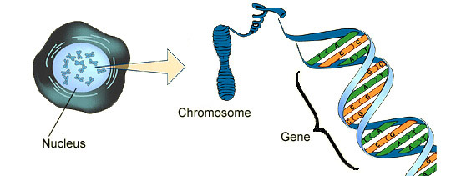
DNA biology
Cell
Chromosome
Locus
Nucleus

Slide 7

Short tandem repeat
DNA locus paragraph
Take me out to the ball game
take me out with the crowd
buy me some peanuts and Cracker Jack
I don't care if I never get back
let me
root root root root root root root root root root
for the home team,
if they don't win, it's a shame for it's one, two, three strikes, you're out
at the old ball game
23 volumes in cell's
DNA encyclopedia
"root" repeated 10 times, so
allele length is 10 repeats

Slide 8
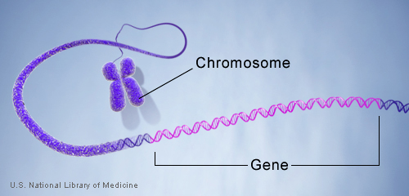
DNA genotype
A genetic locus has
two DNA sentences,
one from each parent.
An allele is the number
of repeated words.
locus
A genotype at a locus
is a pair of alleles.
mother
allele
1
2
3
4
5
6
7
8
9
10
10, 12
ACGT
repeated word
Many alleles allow for
many many allele pairs.
A person's genotype
is relatively unique.
father
allele
1
2
3
4
5
6
7
8
9
10
11
12

Slide 9
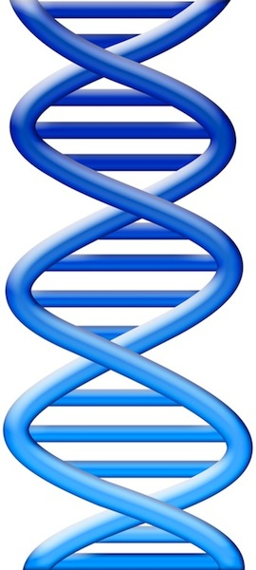
DNA evidence interpretation
Evidence item
Lab
Evidence data
Infer
Evidence genotype
10, 12
10 11 12
DNA from
one person
Compare
Known genotype
10, 12

Slide 10
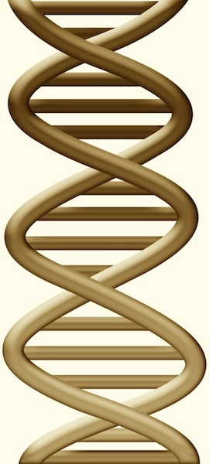
DNA mixture interpretation
Evidence item
Lab
Evidence data
Infer
Evidence genotype
10, 11 @ 20%
11, 11 @ 30%
11, 12 @ 50%
10 11 12
DNA from
two people
Compare
Known genotype
11, 12

Slide 11
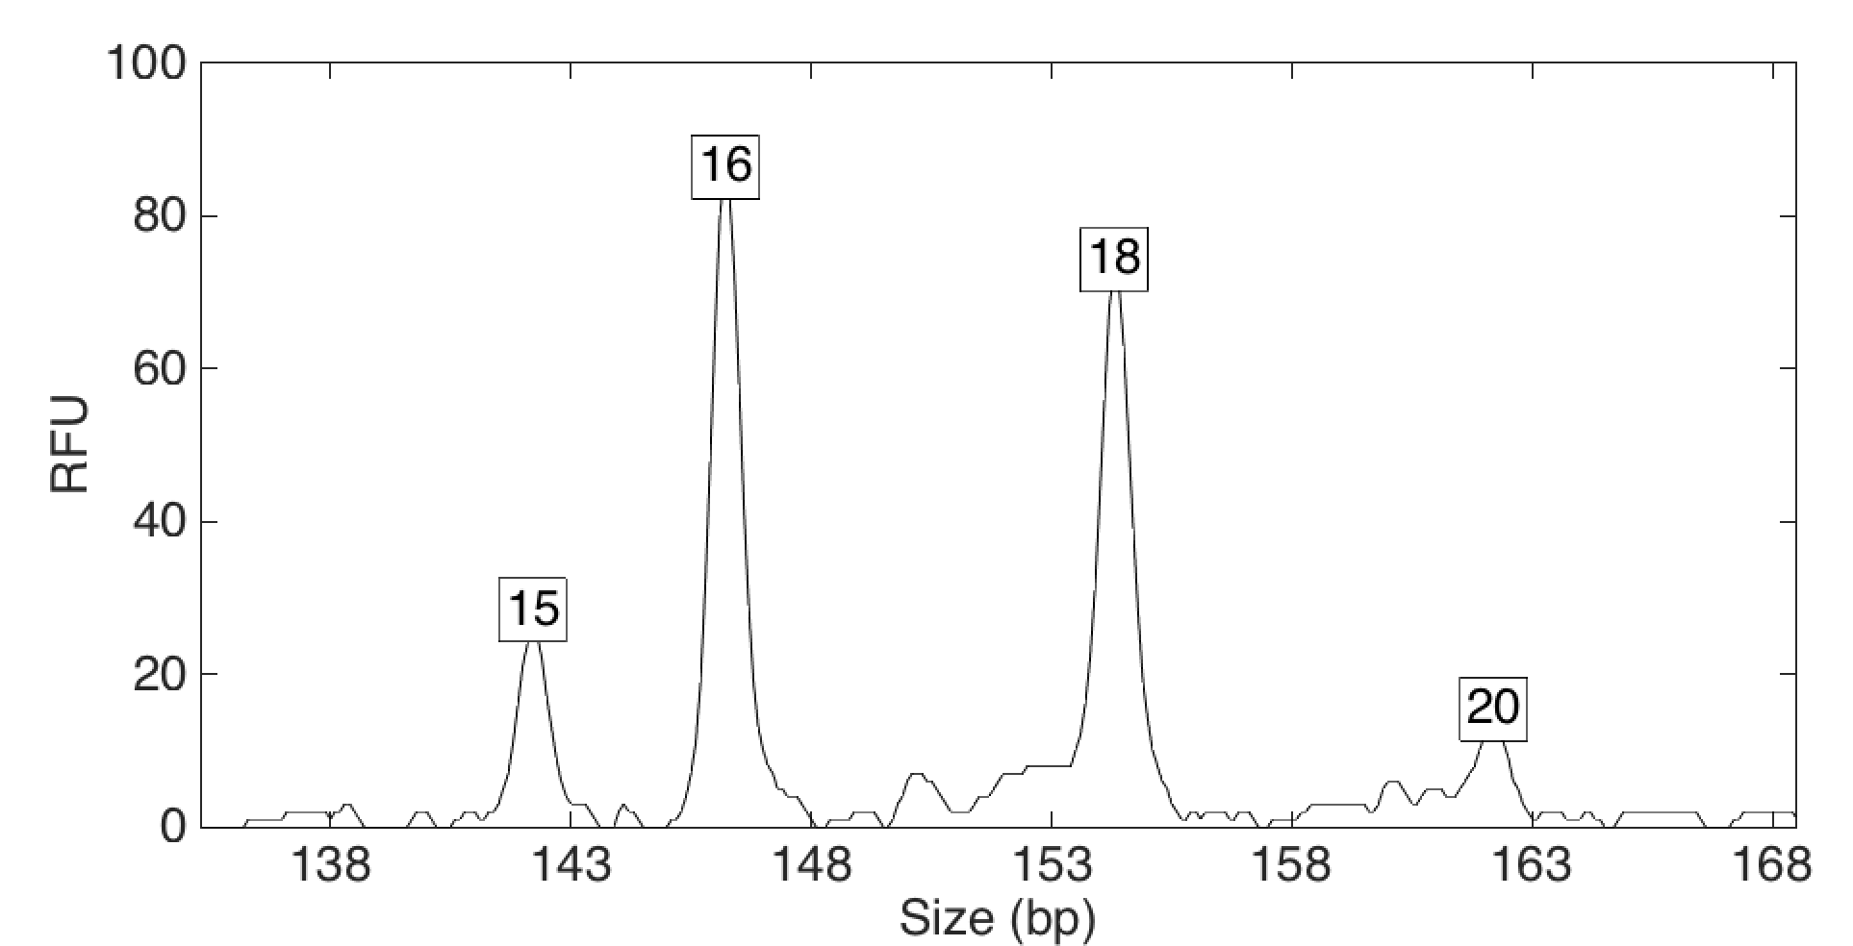
Computers can use all the data
Quantitative peak heights at locus vWA
peak size
peak
height

Slide 12
How the computer thinks
Consider every possible genotype solution
Explain the
peak pattern
Better explanation
has a higher
likelihood

Slide 13
How the computer thinks
Consider every possible genotype solution
Explain the
peak pattern
Better explanation
has a higher
likelihood

Slide 14
How the computer thinks
Consider every possible genotype solution
Worse explanation
has a lower
likelihood

Slide 15
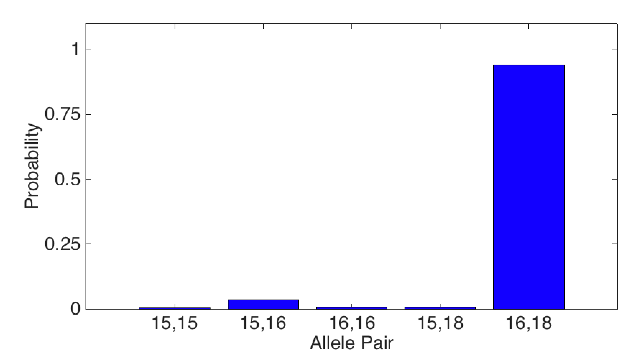
Evidence genotype
Objective genotype determined solely from the DNA data.
Never sees a comparison reference.
94%
1%
3%
1%
1%

Slide 16
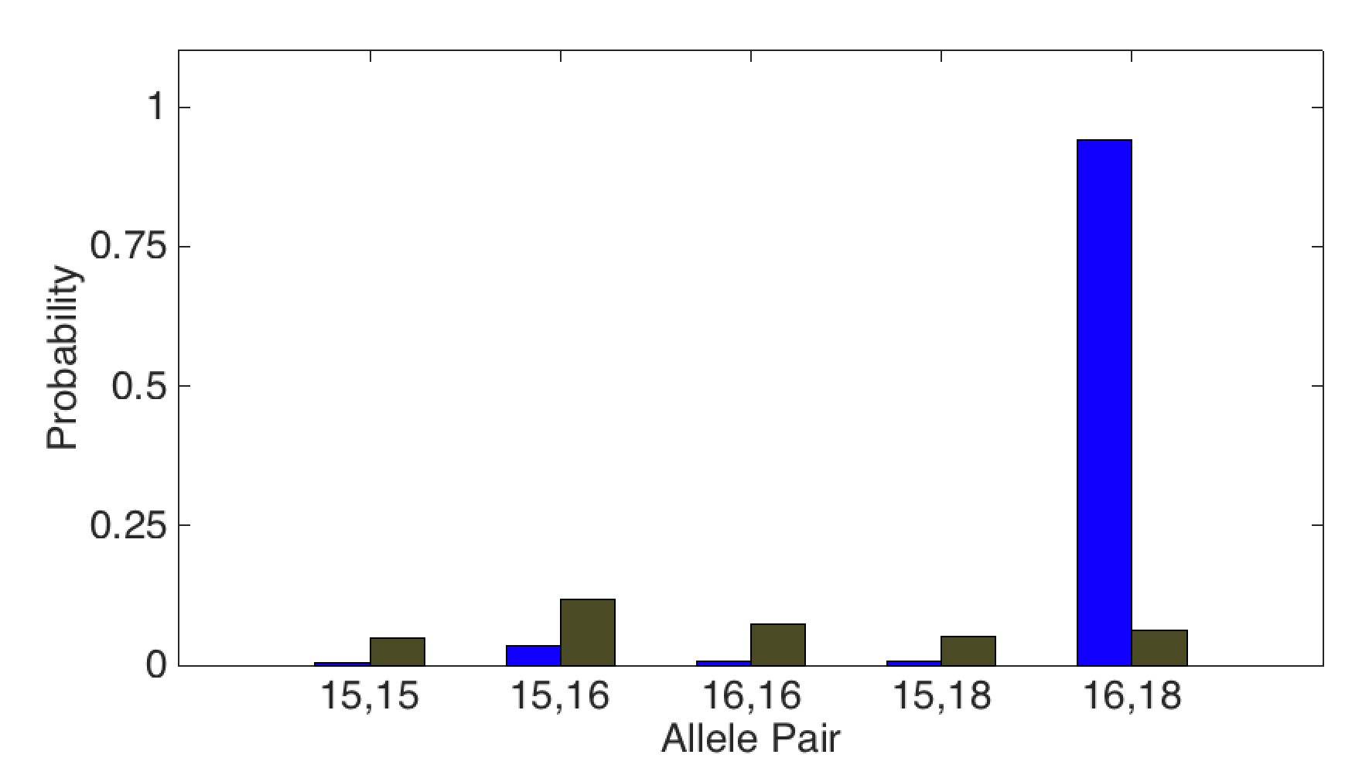
DNA match information
How much more does the suspect match the evidence
than a random person?
15x
94%
Prob(evidence match)
Prob(coincidental match)
6%

Slide 17
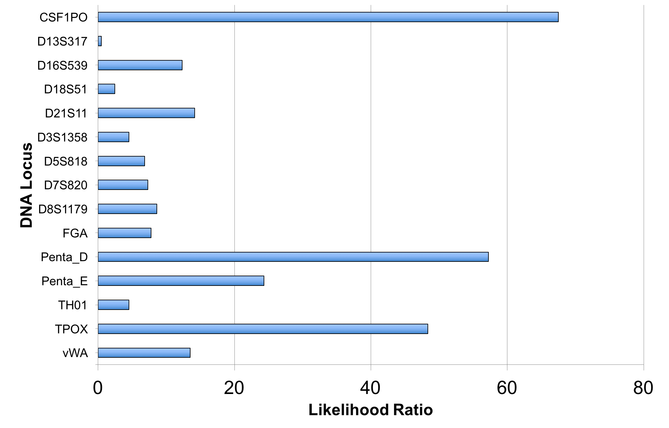
Match information at 15 loci

Slide 18
Is the suspect in the evidence?
A match between the charred clothing
and Lajayvian Daniels is:
872 trillion times more probable than
a coincidental match to an unrelated African-American person
104 quintillion times more probable than
a coincidental match to an unrelated Caucasian person
37.5 quintillion times more probable than
a coincidental match to an unrelated Hispanic person

Slide 19
Match statistics
Item | Description | 3 Franklin Washington | 6 Shihab Mahmud | 9 Lajayvian Daniels
2-1 | Charred hat | 29.3 thousand
3-2 | Charred clothing |  |  | 872 trillion
3-4 | Charred clothing |  |  | 77.1 million
4A-1 | Pair of black Adidas sneakers, right sneaker |  |  | 194 quadrillion
4B-2 | Pair of black Adidas sneakers, left sneaker |  |  | 789 billion

Slide 20
Match statistics
Item | Description | 3 Franklin Washington | 6 Shihab Mahmud | 9 Lajayvian Daniels
2-1 | Charred hat | 4.47
3-2 | Charred clothing |  |  | 14.94
3-4 | Charred clothing |  |  | 7.89
4A-1 | Pair of black Adidas sneakers, right sneaker |  |  | 17.29
4B-2 | Pair of black Adidas sneakers, left sneaker |  |  | 11.90

Slide 21
Admissibility challenge
Defendant’s Motion to Exclude the Interpretation of
DNA Mixtures by the TrueAllele Software Due to the
Failure to Perform the Required Internal Validation
The defendant alleged that the results of the TrueAllele analysis were not admissible because the evidentiary requirements under Frye had not been met. Specifically, the defendant argued that the TrueAllele interpretation process lacked an internal validation mechanism, as “required” under generally accepted national standards.

Slide 22
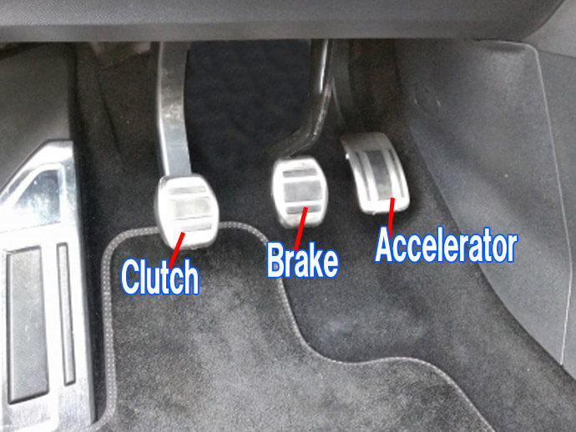
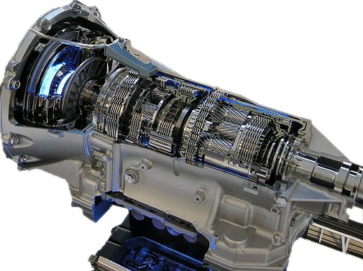
Irrelevant standard
If a standard isn’t relevant to a technology,
then it isn’t applicable to that technology.
TrueAllele doesn’t need or use calibration parameters,
because it learns that information from the data.
Manual transmission
has a clutch
Automatic transmission
has no clutch

Slide 23
TrueAllele® validation:
Computer interpretation of
DNA mixture evidence
Mark W Perlin, PhD, MD, PhD
Cybergenetics, Pittsburgh, PA
Cybergenetics © 2003-2022

Slide 24
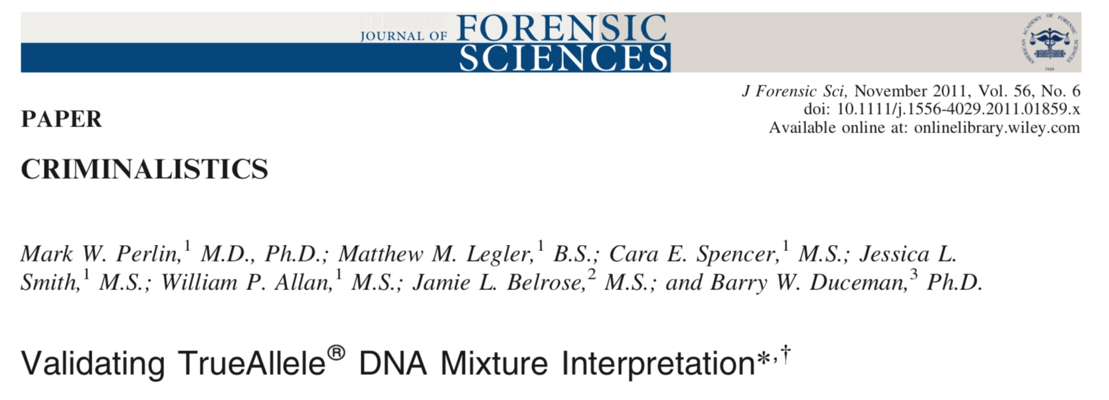
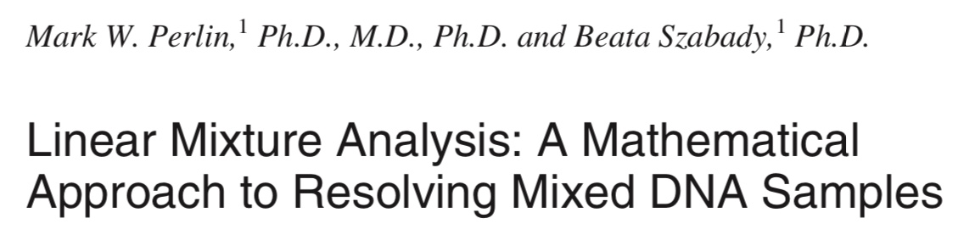
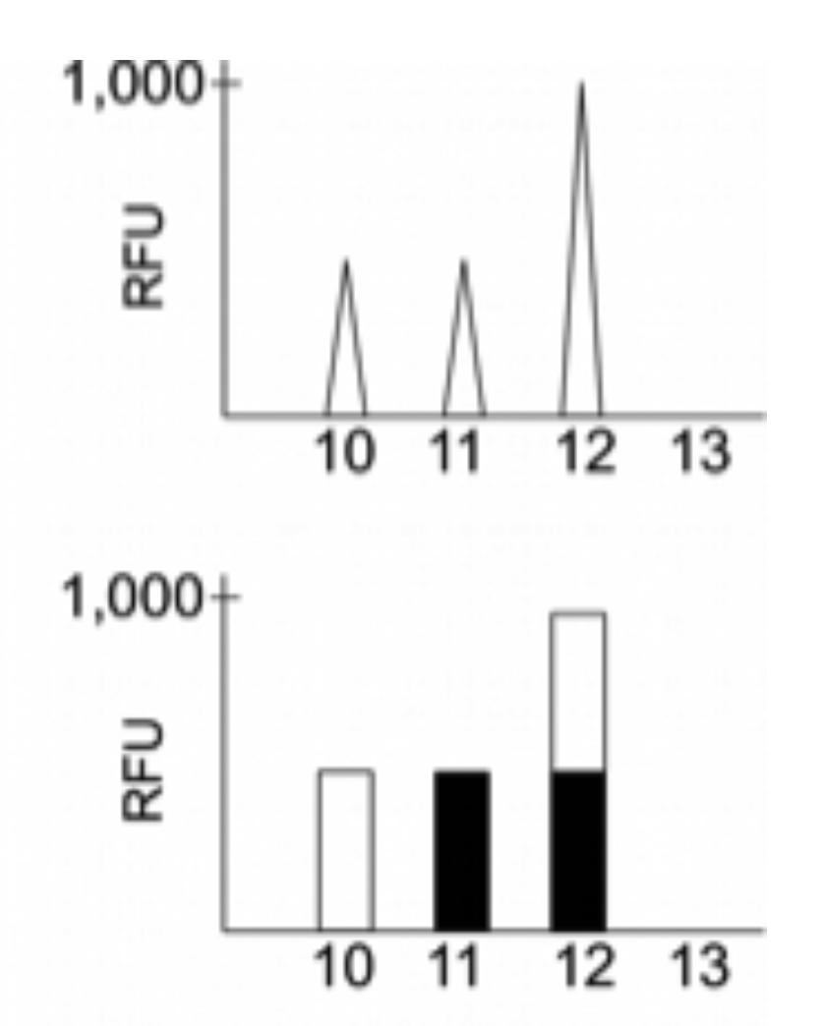
Explaining DNA mixtures
2001
DNA peak height data
Sum of genotypes

Slide 25
Peer-reviewed validation studies
25
Perlin MW, Sinelnikov A. An information gap in DNA evidence interpretation. PLoS ONE. 2009;4(12):e8327.
Ballantyne J, Hanson EK, Perlin MW. DNA mixture genotyping by probabilistic computer interpretation of binomially-sampled laser captured cell populations: Combining quantitative data for greater identification information. Science & Justice. 2013;53(2):103-114.
Perlin MW, Hornyak J, Sugimoto G, Miller K. TrueAllele® genotype identification on DNA mixtures containing up to five unknown contributors. Journal of Forensic Sciences. 2015;60(4):857-868.
Greenspoon SA, Schiermeier-Wood L, Jenkins BC. Establishing the limits of TrueAllele® Casework: a validation study. Journal of Forensic Sciences. 2015;60(5):1263-1276.
Bauer DW, Butt N, Hornyak JM, Perlin MW. Validating TrueAllele® interpretation of DNA mixtures containing up to ten unknown contributors. Journal of Forensic Sciences. 2020; 65(2):380-398.
Perlin MW, Legler MM, Spencer CE, Smith JL, Allan WP, Belrose JL, Duceman BW. Validating TrueAllele® DNA mixture interpretation. Journal of Forensic Sciences. 2011;56(6):1430-1447.
Perlin MW, Belrose JL, Duceman BW. New York State TrueAllele® Casework validation study. Journal of Forensic Sciences. 2013;58(6):1458-1466.
Perlin MW, Dormer K, Hornyak J, Schiermeier-Wood L, Greenspoon S. TrueAllele® Casework on Virginia DNA mixture evidence: computer and manual interpretation in 72 reported criminal cases. PLOS ONE. 2014;(9)3:e92837.

Slide 26
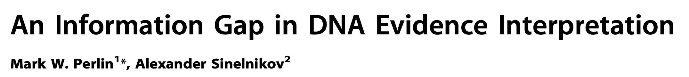

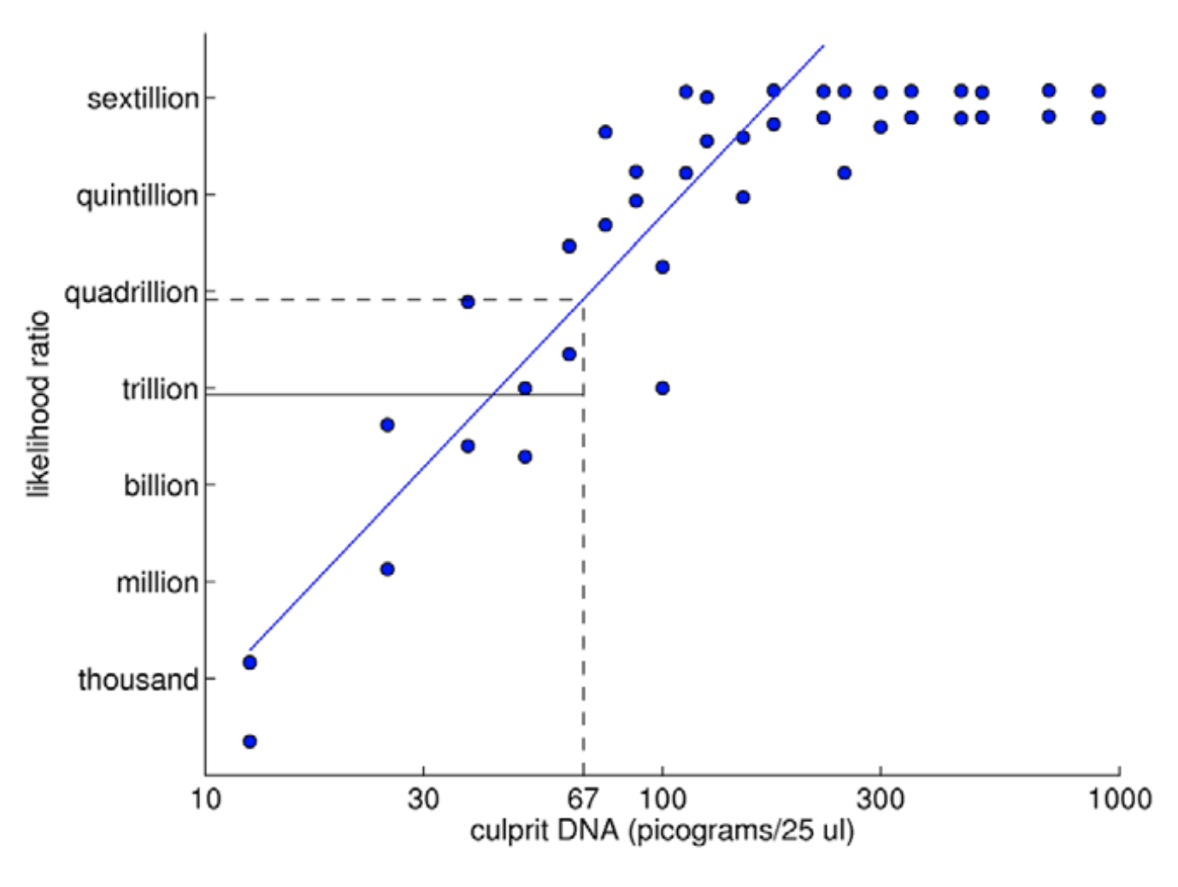
TrueAllele predictability
2009

Slide 27
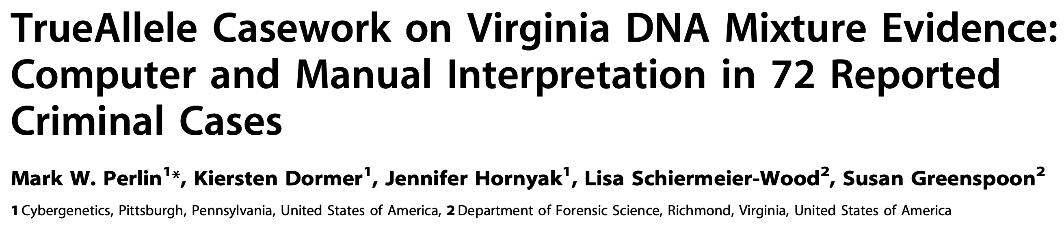
TrueAllele reliability
2014
Validation axes
• sensitive
• specific
• reproducible

Slide 28
Sensitivity
The extent to which interpretation identifies the correct person
True DNA mixture inclusions
101 reported genotype matches
82 with DNA statistic over a million

Slide 29
TrueAllele sensitivity
log(LR) match distribution
11.05 (5.42)
113 billion
TrueAllele

Slide 30
Comparison with human review
6.83 (2.22)
6.68 million
CPI
2.15 (1.68)
140
mCPI
11.05 (5.42)
113 billion
TrueAllele

Slide 31
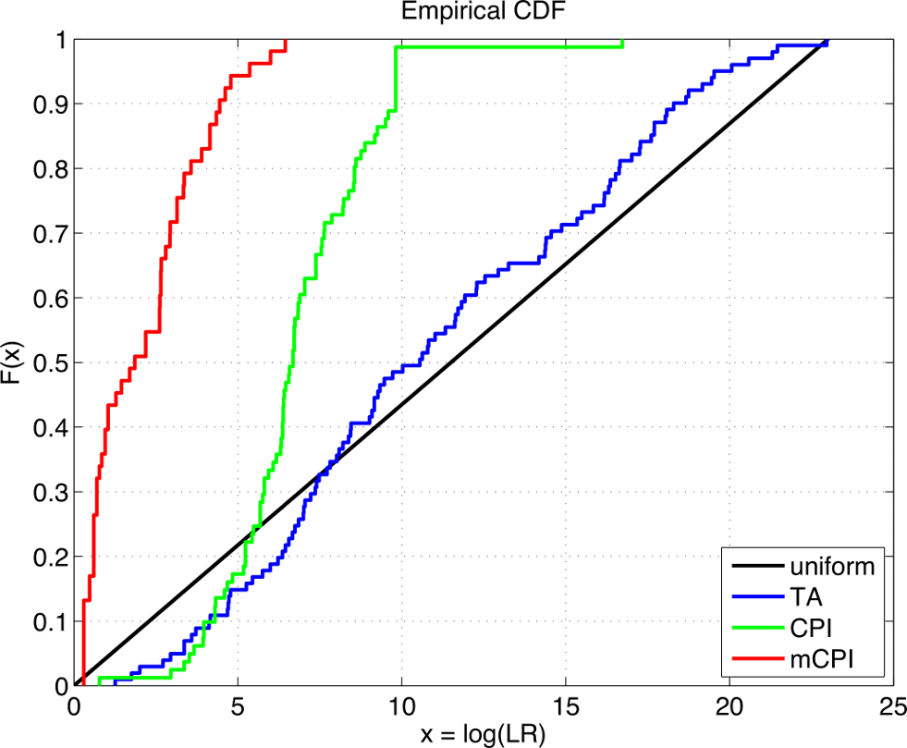
TrueAllele accuracy

Slide 32
Specificity
The extent to which interpretation does not misidentify the wrong person
True exclusions, without false inclusions
101 matching genotypes x 10,000 random references
x 3 ethnic populations,
for over 1,000,000 nonmatching comparisons

Slide 33
TrueAllele specificity
log(LR) nonmatch distribution
– 19.47

Slide 34
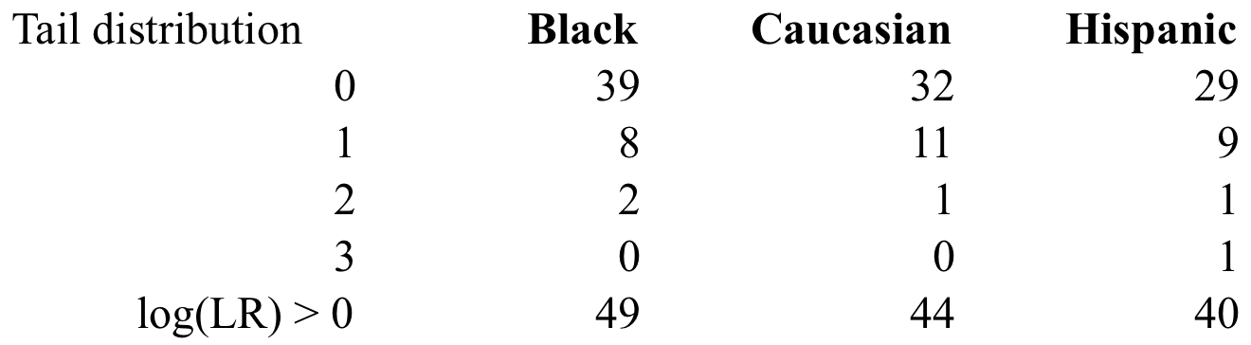
False positives
in over 1,000,000 comparisons per group
false positive rate is under 1 in 20,000 (0.005%)
for LR > 100, rate is 1 in 1,000,000 (0.0001)%

Slide 35
Higher human error rate
TrueAllele specificity (million samples)
From noncontributor distribution, for LR > 100:
Error rate = 1 in 1,000,000 (0.0001)%
CPI – analytical threshold
5 false positives in 81 comparisons
Error rate = 5 in 81 (6%)
mCPI – stochastic threshold
17 inconclusive results
1 false positive in 53 comparisons
Error rate = 1 in 53 (2%)

Slide 36
Reproducibility
The extent to which interpretation gives
the same answer to the same question
MCMC computing has sampling variation
duplicate computer runs
on 101 matching genotypes
measure log(LR) variation

Slide 37
TrueAllele reproducibility
Concordance in two independent computer runs
standard deviation
(within-group)
0.305

Slide 38
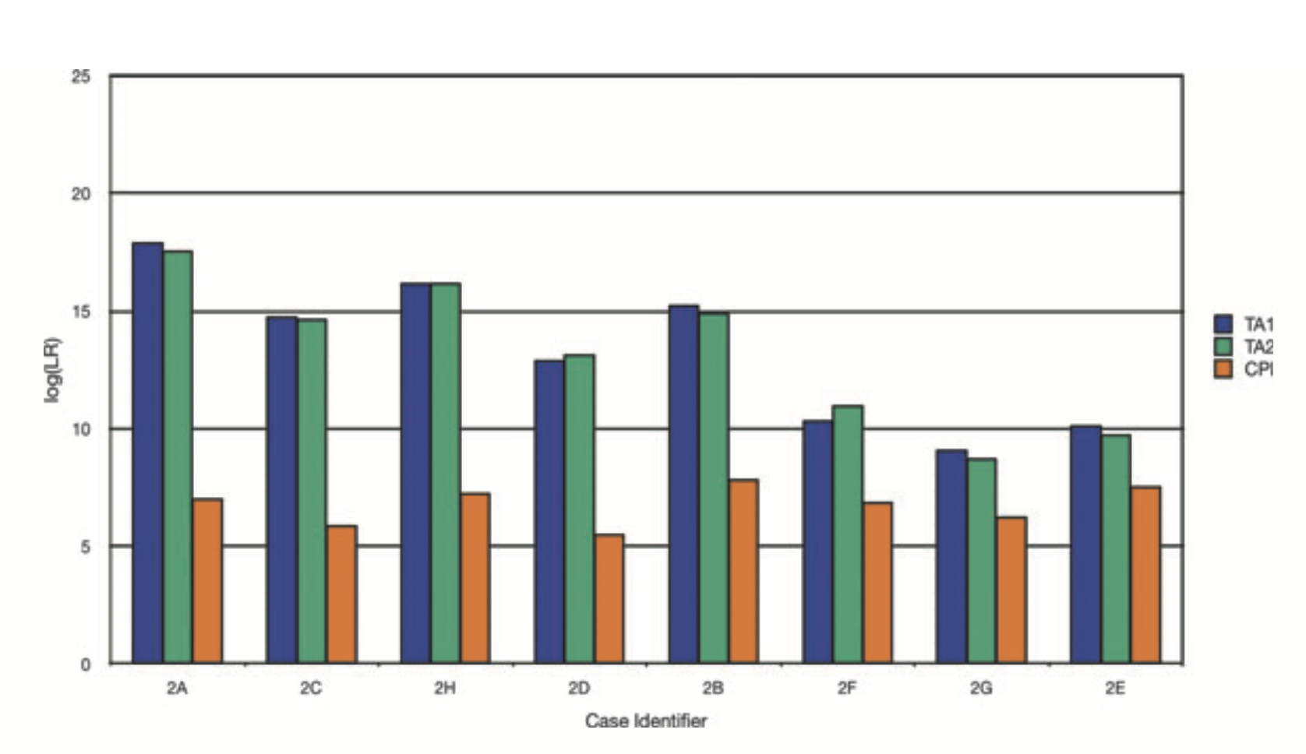

Slide 39
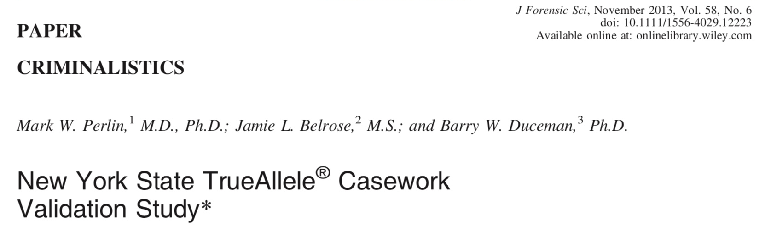
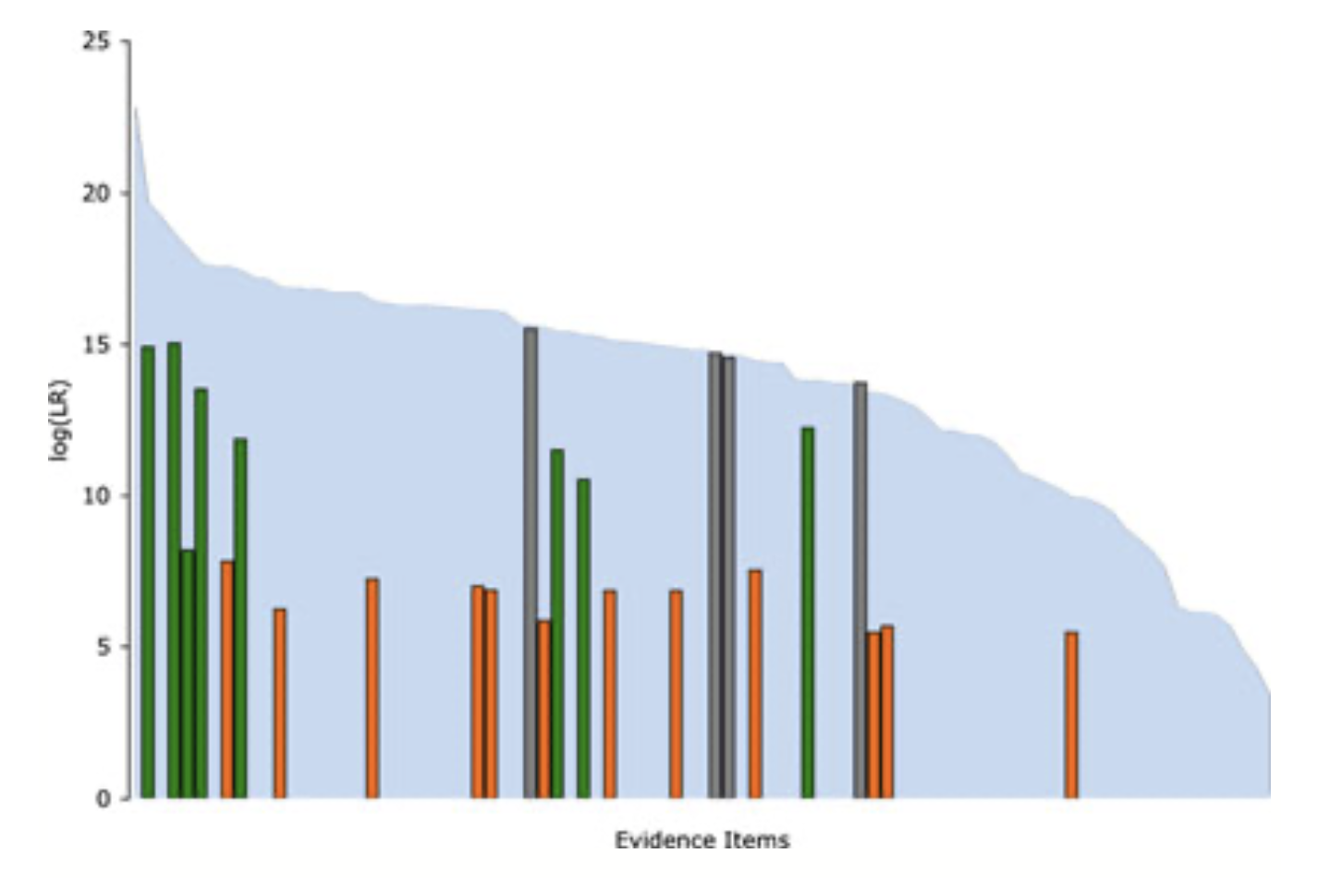

Slide 40
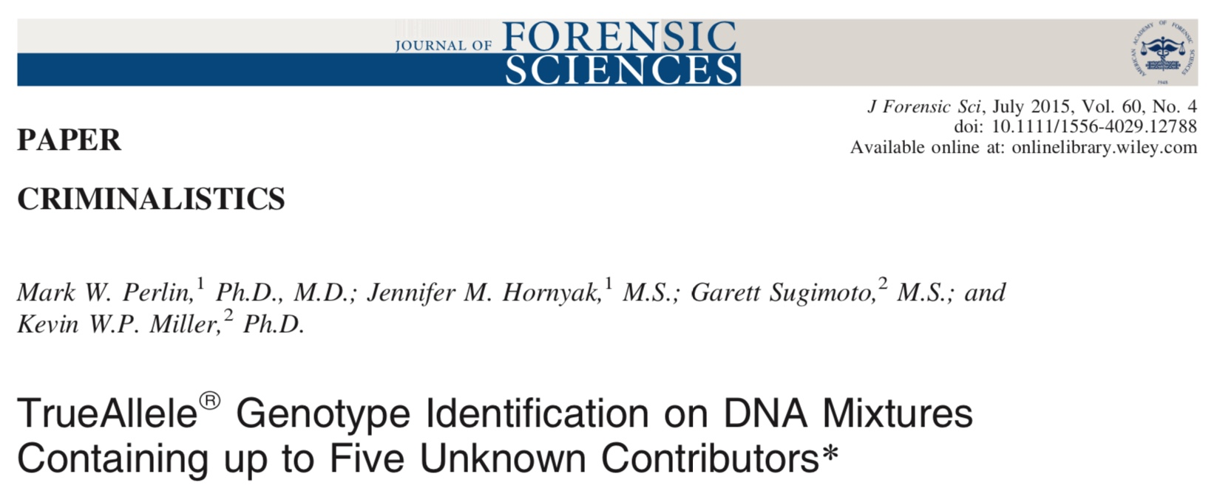
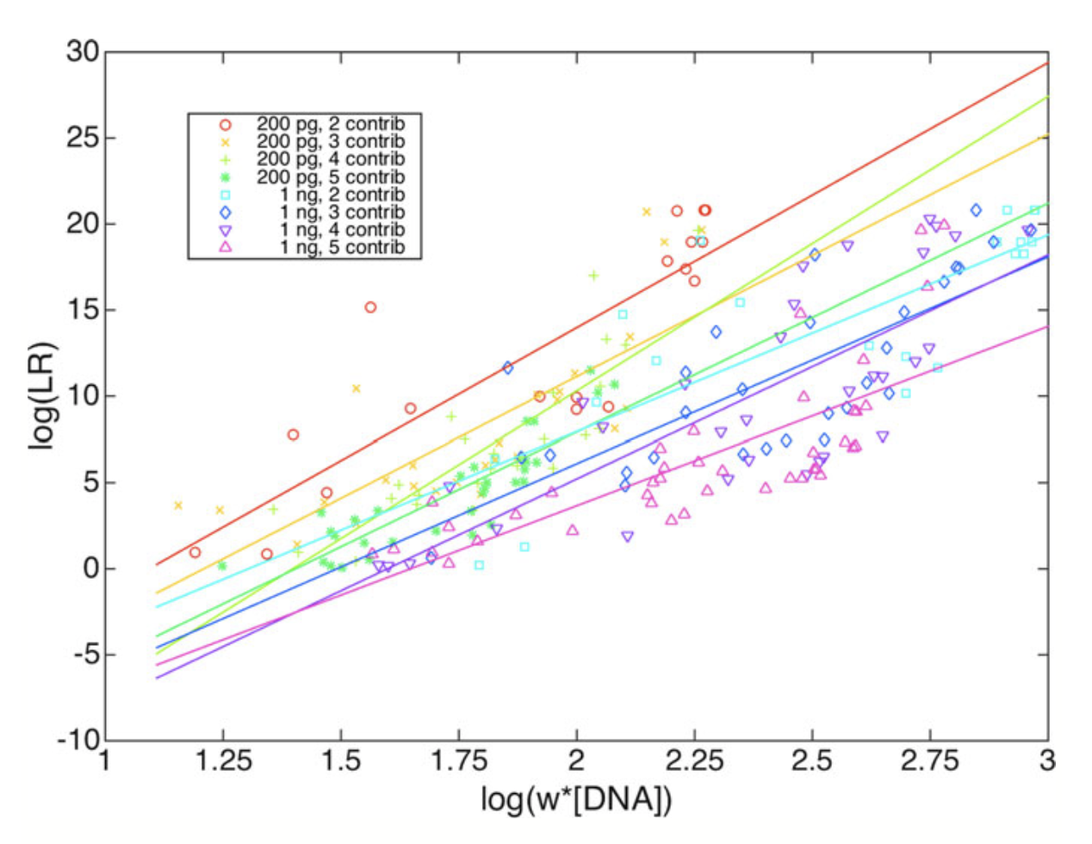

Slide 41
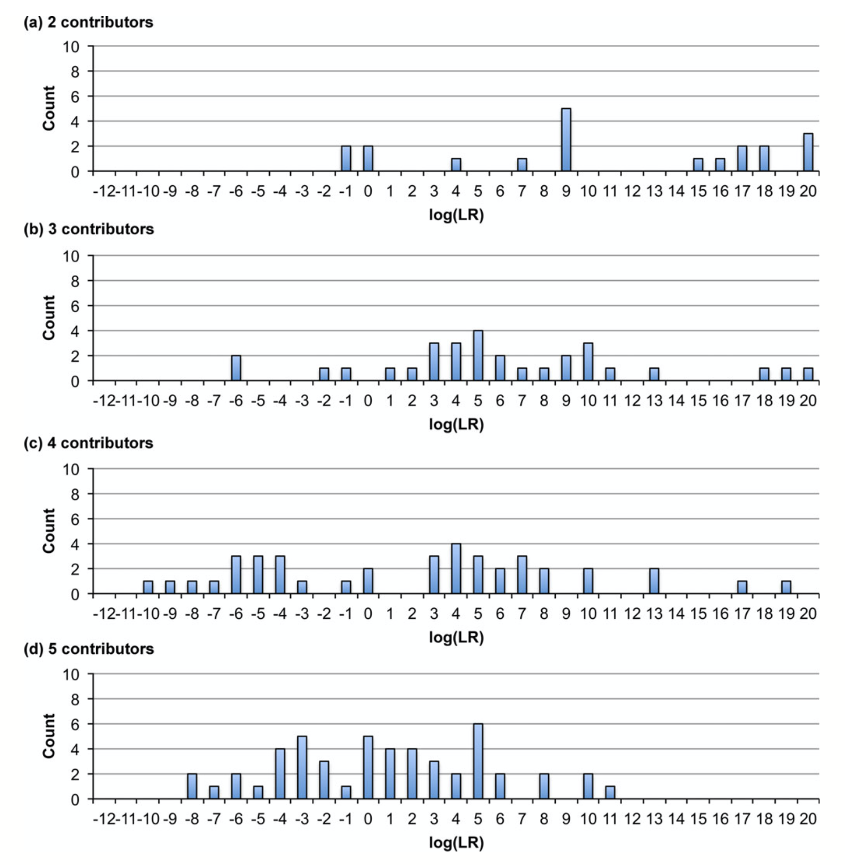
TrueAllele sensitivity
200 pg

Slide 42
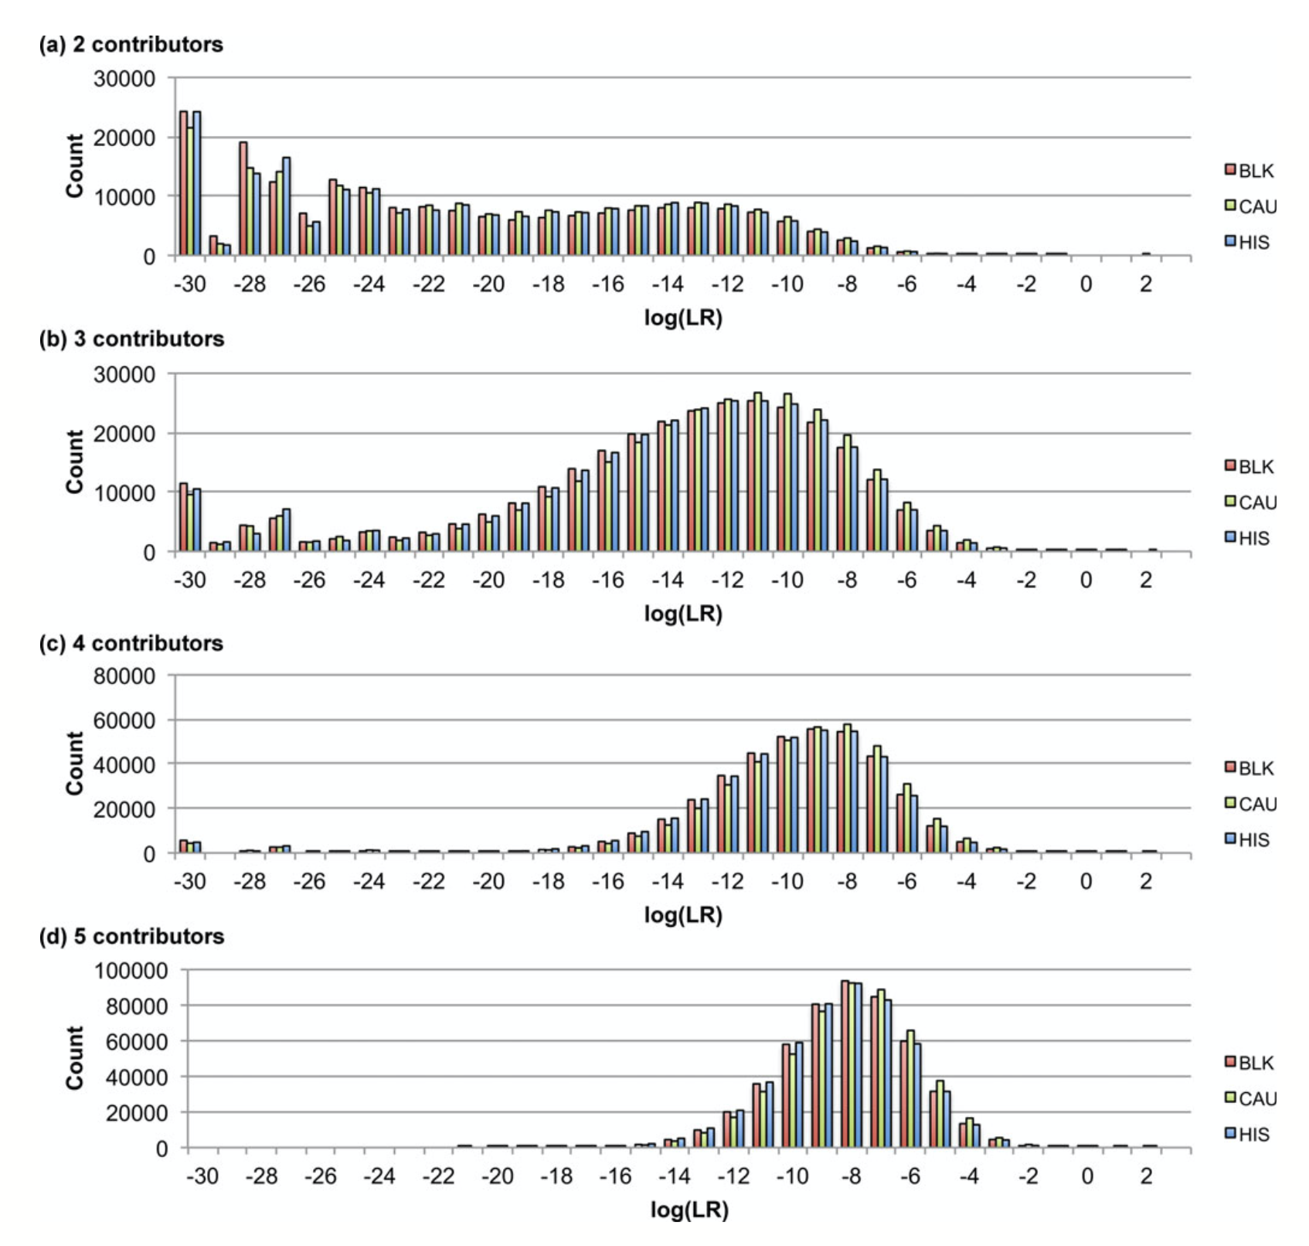
TrueAllele specificity
200 pg

Slide 43
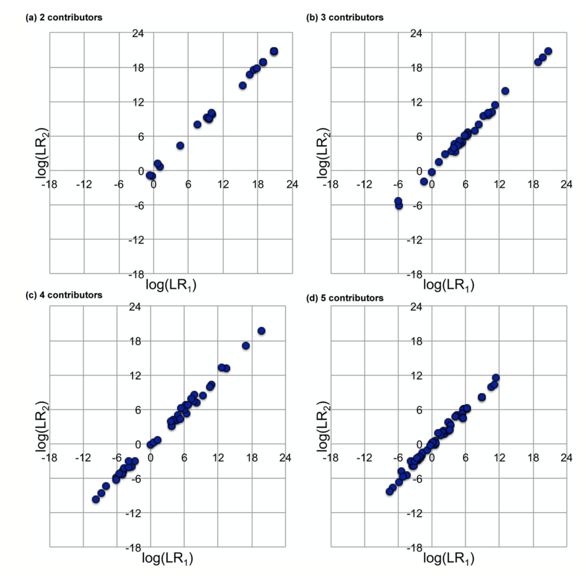
TrueAllele reproducibility
200 pg

Slide 44
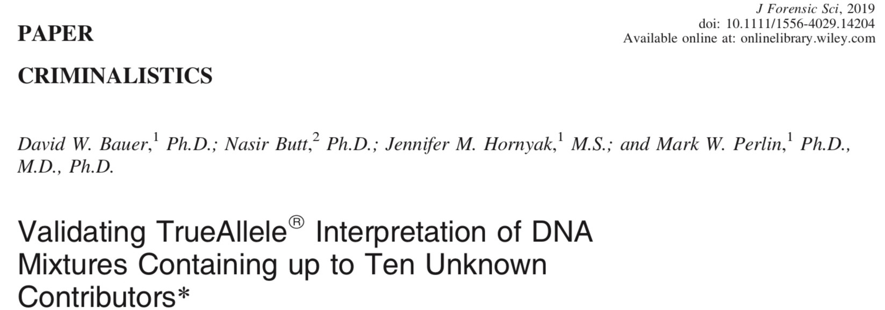
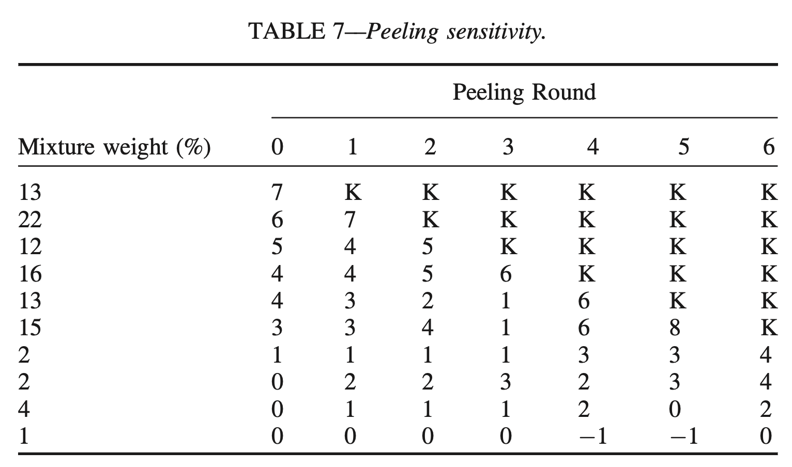
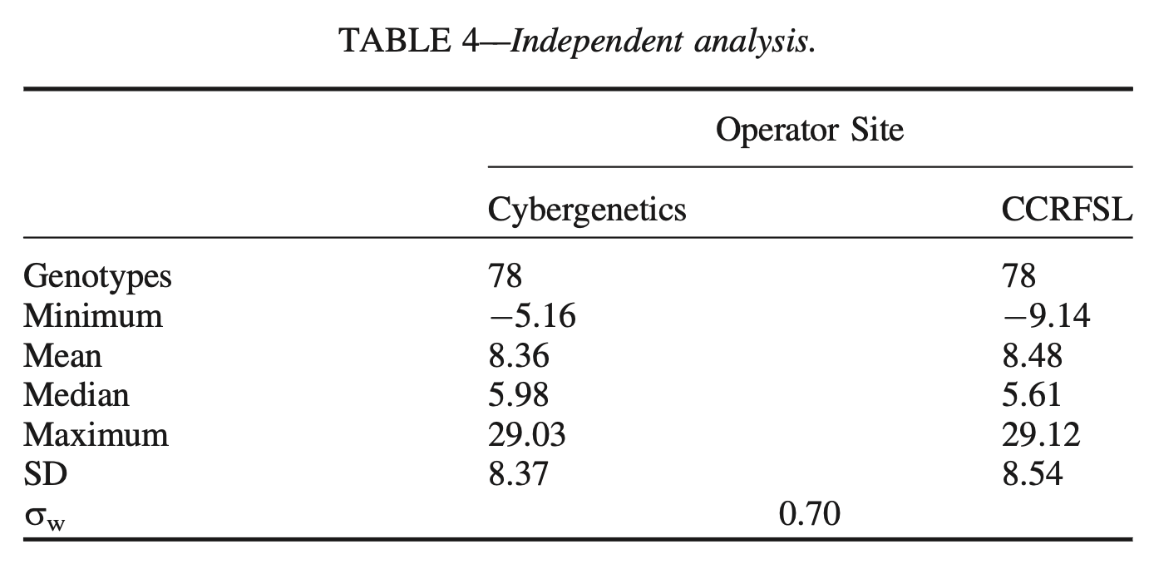

Slide 45
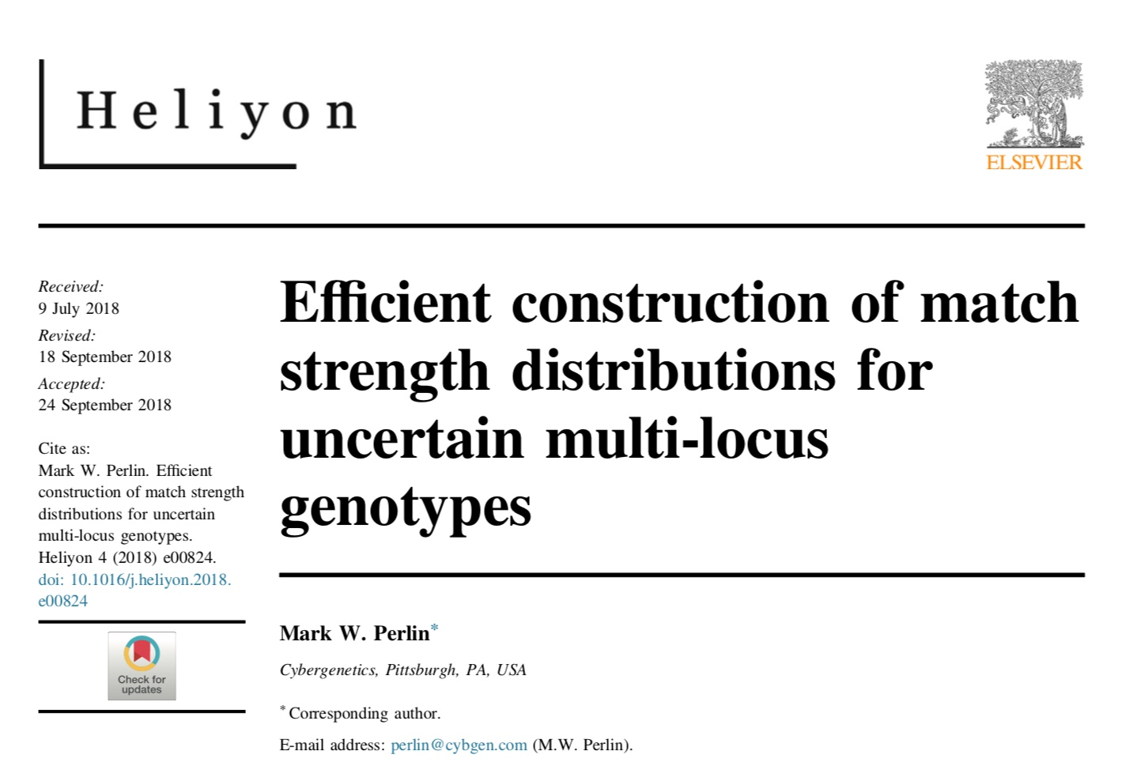
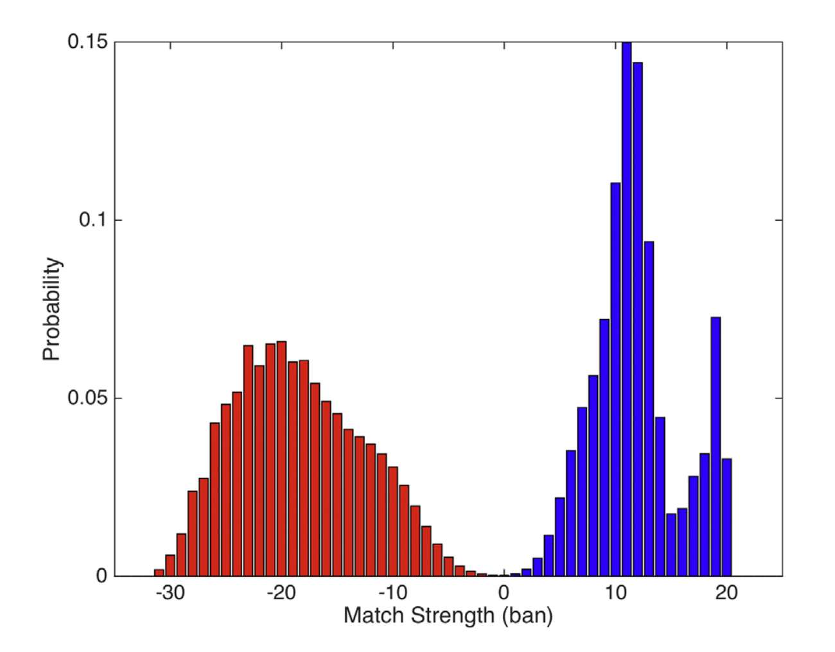
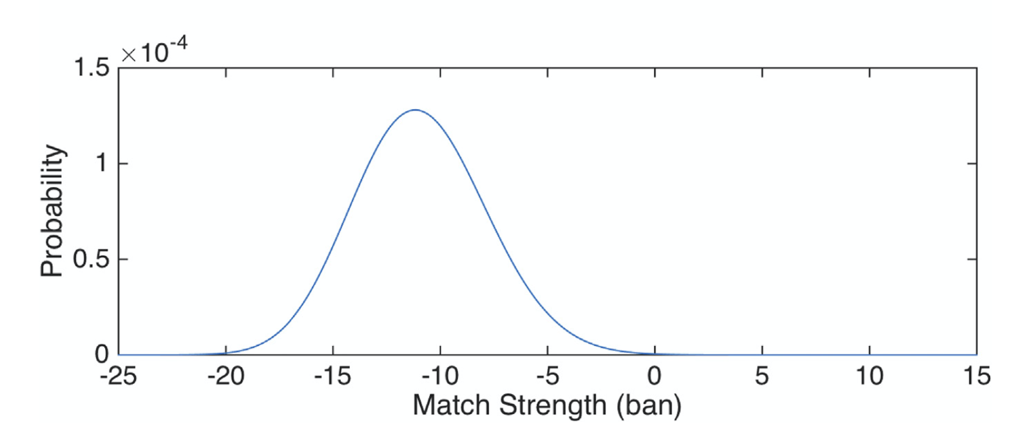

Slide 46
34 US admissibility rulings
Commonwealth of Pennsylvania v Kevin Foley (admitted, 2009; appellate precedent, 2012)
People of California v Dupree Langston (admitted, 2013)
Commonwealth of Virginia v Matthew Brady (admitted, 2013)
State of Ohio v Maurice Shaw (admitted, 2014)
State of Louisiana v Chattley Chesterfield & Samuel Nicolas (admitted, 2014)
People of New York v John Wakefield (admitted, 2015; appellate precedent, 2019)
State of South Carolina v Jaquard Aiken (admitted, 2015)
Commonwealth of Massachusetts v Heidi Bartlett (admitted, 2016)
State of Indiana v Dugniqio Forest (admitted, 2016)
State of Indiana v Malcolm Wade (admitted, 2016)
State of Washington v Emanuel Fair (admitted, 2017)
State of Louisiana v Harold Houston (admitted, 2017)
State of Indiana v Randal Coalter (admitted, 2017)
State of Nebraska v Charles Simmer (admitted, 2018; appellate precedent, 2019)
State of Indiana v Vaylen Glazebrook (admitted, 2018)
State of Ohio v David Mathis (admitted, 2018)
State of Florida v Lajayvian Daniels (admitted, 2018; appellate precedent, 2021)
State of Tennessee v Demontez Watkins (admitted, 2018; appellate precedent, 2021)
State of Georgia v Thaddus Nundra (admitted, 2019)
State of Georgia v Monte Baugh & Thaddeus Howell (admitted, 2019)
State of Louisiana v Kyle Russ (admitted, 2019)
People of New York v Casey Wilson (admitted, 2019)
State of Georgia v Alexander Battle (admitted, 2019)
United States v Lenard Gibbs (admitted, 2019)
State of Georgia v Guy Sewell (admitted, 2019)
State of Georgia v Adedoja Bah (admitted, 2019)
State of Georgia v Nathaniel Day (admitted, 2019)
State of Tennessee v Abdullah Powell (admitted, 2021)
State of Georgia v Zarren Garner (admitted, 2021)
United States v Curtis Johnson, Jr. (admitted, 2021)
State of Georgia v Rahul Joseph Das (admitted, 2021)
State of Maryland v Tyrone Harvin (admitted, 2021)
State of Maryland v Gregory Jones (not used, Daubert not applied, 2021)
State of Georgia v Lashumbia Session (admitted, 2021)

Slide 47
TrueAllele today
Invented math & algorithms | 25 years
Developed computer systems | 20 years
Support users and workflow | 10 laboratories
Routinely used in casework | 10 crime labs
Validate system reliability | 42 studies
Educate the community | 100 talks
Train or certify analysts | 400 students
Admissibility challenges | 34 rulings, 15 states and federal
Testify about LR results | 106 trials
Educate lawyers and public | 1,000 people
Make the ideas understandable | 1,070 cases, 45 states

Slide 48
Conclusions
Perlin MW, Dormer K, Hornyak J, Schiermeier-Wood L, Greenspoon S.
TrueAllele® Casework on Virginia DNA mixture evidence: computer and manual interpretation in 72 reported criminal cases. PLOS ONE. 2014;(9)3:e92837.
TrueAllele Casework DNA mixture interpretation is:
A reliable method
• objective
• sensitive
• specific
• reproducible
• accurate
TrueAllele computer genotyping is more effective than human review

Slide 49
Background Reading
Background Reading binder exhibit
Is there background reading that can help the court understand the method?
Does the reading include a glossary?
Are there magazine articles and book chapters for lawyers?

Slide 50
Validation Paper
Validation Paper binder exhibit
What is peer-review?
How many peer-reviewed TrueAllele validation studies have been published?
Were the validations conducted independently of the current case?
Do these studies test TrueAllele and establish error rates?

Slide 51
Validation Study
Validation Study binder exhibit
How many other validation studies have been conducted?
Who has conducted these studies?
How are these studies related to the current case?
Do these additional studies test TrueAllele and establish error rates?

Slide 52
Forensic Application
Forensic Application binder exhibit
Has TrueAllele only been used by prosecutors?
Was it used to help identify victim remains in the World Trade Center disaster?
Has the federal government used TrueAllele to help establish DNA standards?

Slide 53
DNA Exoneration
DNA Exoneration binder exhibit
Has TrueAllele helped exonerate the innocent?
How many innocent men has TrueAllele helped free from prison?
Has Cybergenetics sometimes done these exonerations pro bono?

Slide 54
Regulatory Approval
Regulatory Approval binder exhibit
Do regulatory bodies oversee TrueAllele or related systems?
What state regulators have assessed and approved TrueAllele?

Slide 55
Standards Compliance
Standards Compliance binder exhibit
Are there accepted validation standards and guidelines for probabilistic genotyping?
What is the FBI’s SWGDAM (Scientific Working Group on DNA Analysis Methods)? What is ANSI (American National Standards Institute)?
What is ASB (American Academy of Forensic Sciences Standards Board)?
Do these organizations issue standards for validating probabilistic genotyping?
Does TrueAllele validation comply with all of these standards and guidelines?

Slide 56
National Standards
Validating probabilistic genotyping
• SWGDAM 2010 (§3.2.2) (January, 2010) – probabilistic genotype computer interpretation
• SWGDAM 2015 (June 15, 2015) –
probabilistic genotyping validation guidelines
• ANSI/ASB Standard 020 (September 2018) – mixture validation and interpretation standards
• ANSI/ASB Standard 040 (September 2019) –
DNA interpretation and comparison standards
• ANSI/ASB Standard 018 (July 2020) –
probabilistic genotyping validation standards
• FBI QAS 2020 (Section 8) (July 1, 2020) –
DNA quality assurance validation standards

Slide 57
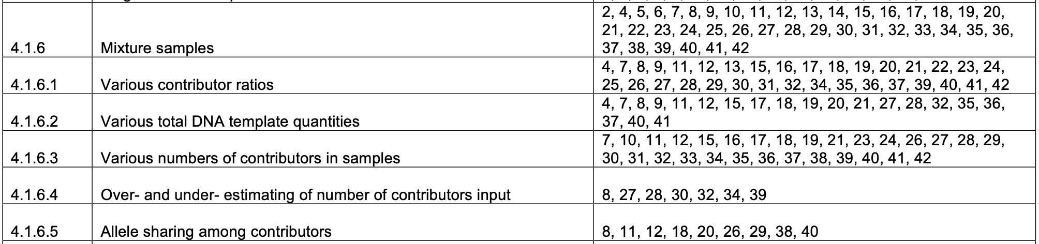
Complying with Standards
Based on empirical testing of software on DNA data
Developmental & internal validation
Internal validation: The acquisition of test data within the laboratory to verify the functionality of the system, the accuracy of statistical parameters, the appropriateness of analytical and statistical parameters, and the determination of limitations of the system.

Slide 58
Method Reports
Method Reports binder exhibit
Is the mathematics underlying TrueAllele available?
Are Cybergenetics TrueAllele procedures provided?
Can TrueAllele calculate an error rate for each reported match statistic?
Was that done in this case?

Slide 59
General Acceptance
General Acceptance binder exhibit
How many TrueAllele reports has Cybergenetics issued?
  In how many states?
In how many trials has Cybergenetics testified?
  In how many states?
Has TrueAllele been used by both prosecution and defense?
How many crime labs use TrueAllele for DNA mixture analysis?
How many scientific papers cite TrueAllele publications?
Is probabilistic genotyping generally accepted in the forensic community?
  Does the FBI use probabilistic genotyping?

Slide 60
Related Systems
Related Systems binder exhibit
Are there other probabilistic genotyping systems for computing match statistics?
How many other software systems are there?
Do crime labs use these methods to calculate match statistics for DNA mixtures?

Slide 61
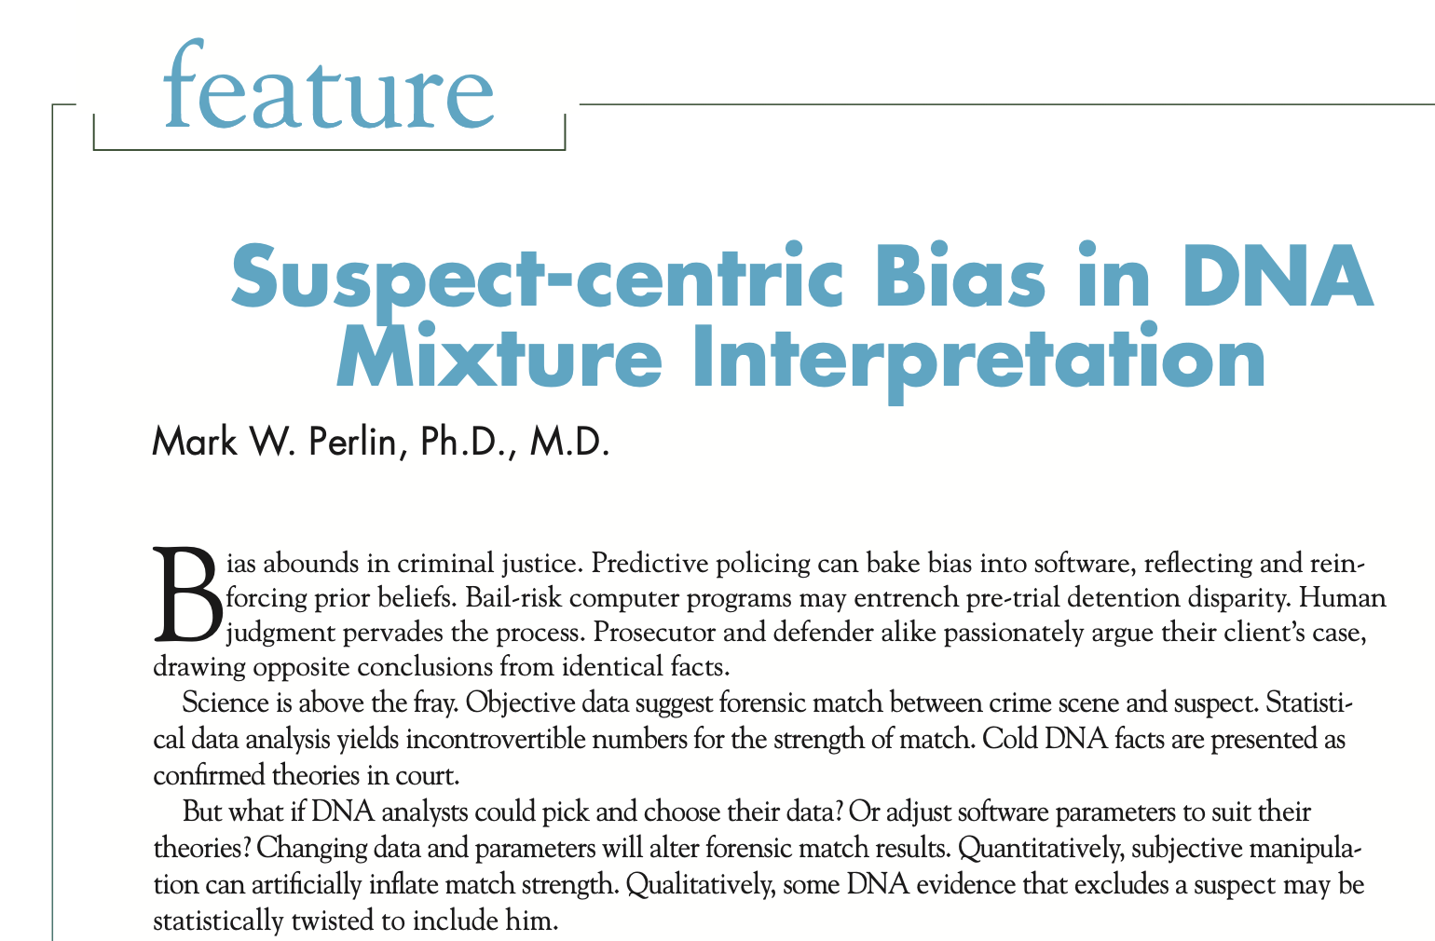

Slide 62
Subjective computer analysis
New York v. Oral “Nick” Hillary
New Zealand probabilistic genotyping software
Calibration
Modern Bayesian computing derives parameter probabilities directly from the data. However, limited DNA modeling may lack that math capability, and instead substitute historical data for case evidence. Crime labs usually develop calibration data to tune the foreign analysis software. However, no lab-specific calibration was done in the Hillary case. The foreign expert had to pick and choose calibration parameters in order to run his software on the NYSP lab data.

Slide 63
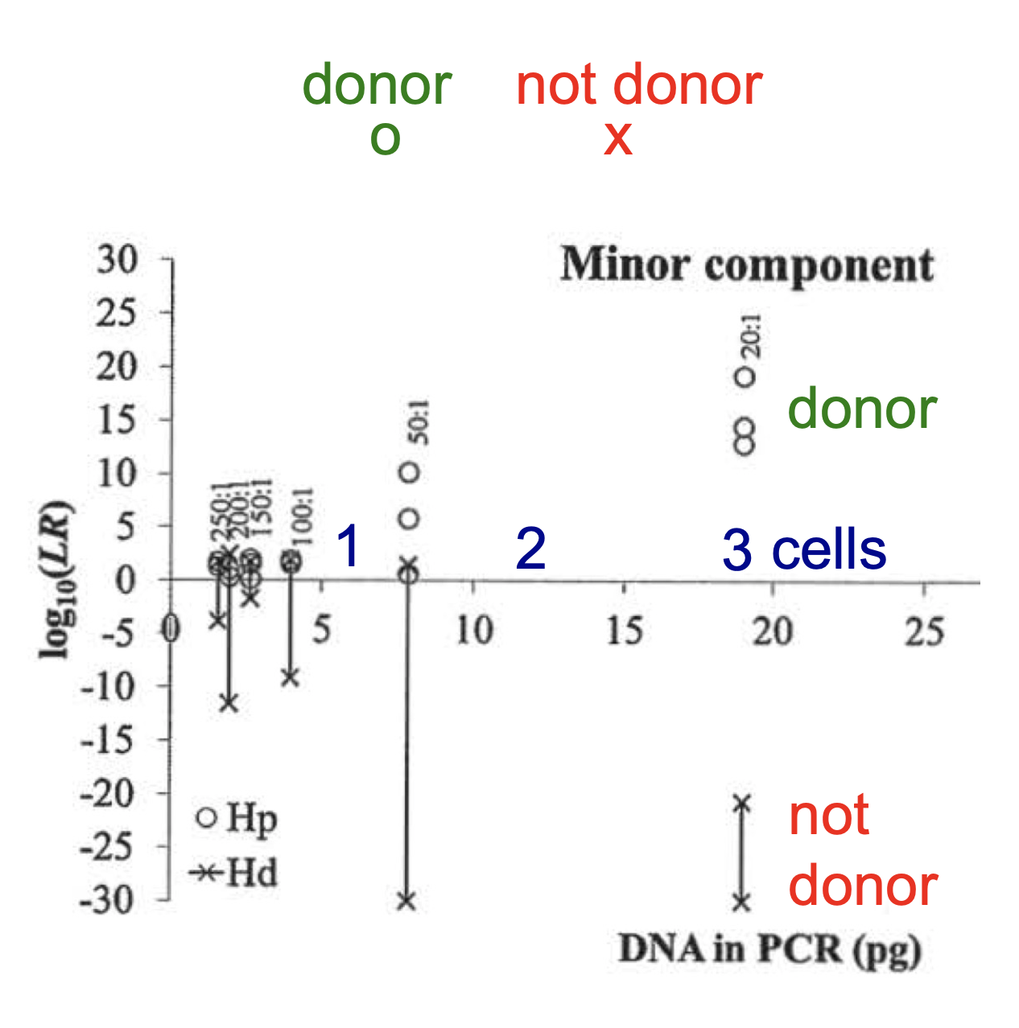
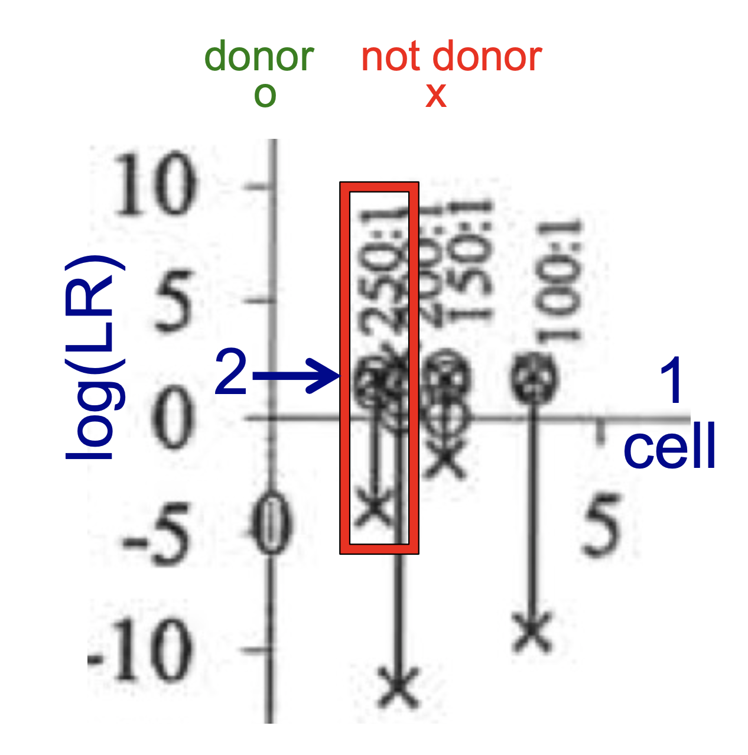
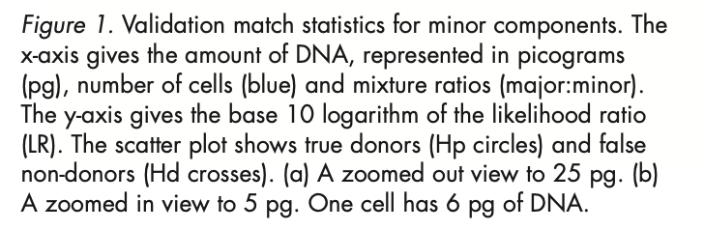
Validation study shows limits

Slide 64
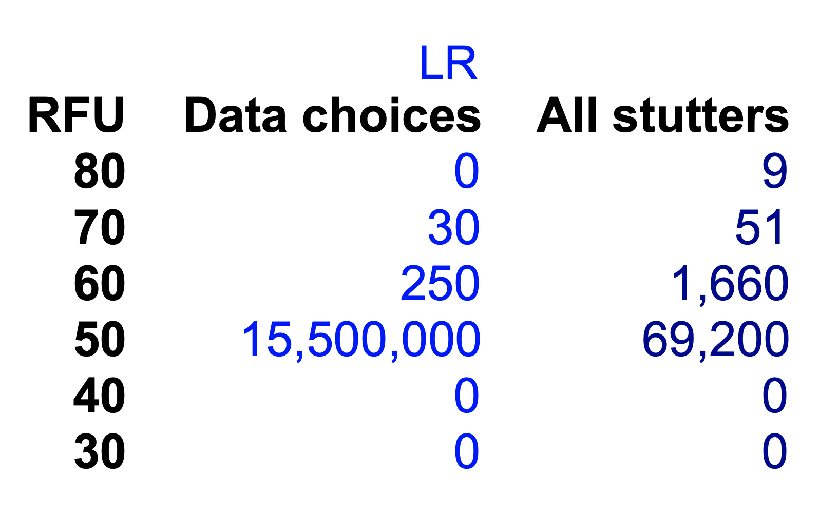
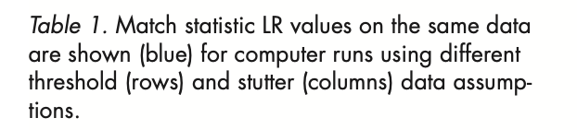
Picking & choosing parameters

Slide 65
Human limitations of other PGS
65
Feature | Description | Human | STRmix | TrueAllele
bias | Cognitive bias? | yes | yes | no
bias | Contextual bias? | yes | yes | no
prepare | People prepare input data? | yes | yes | no
filtering | People can discard input data? | yes | yes | no
intervention | People can adjust input data? | yes | yes | no
subjective | Human decision making? | yes | yes | no
limits | Follow human limitations? | yes | yes | no
time | Labor intensive process? | yes | yes | no
error | Human processing error? | yes | yes | no

Slide 66
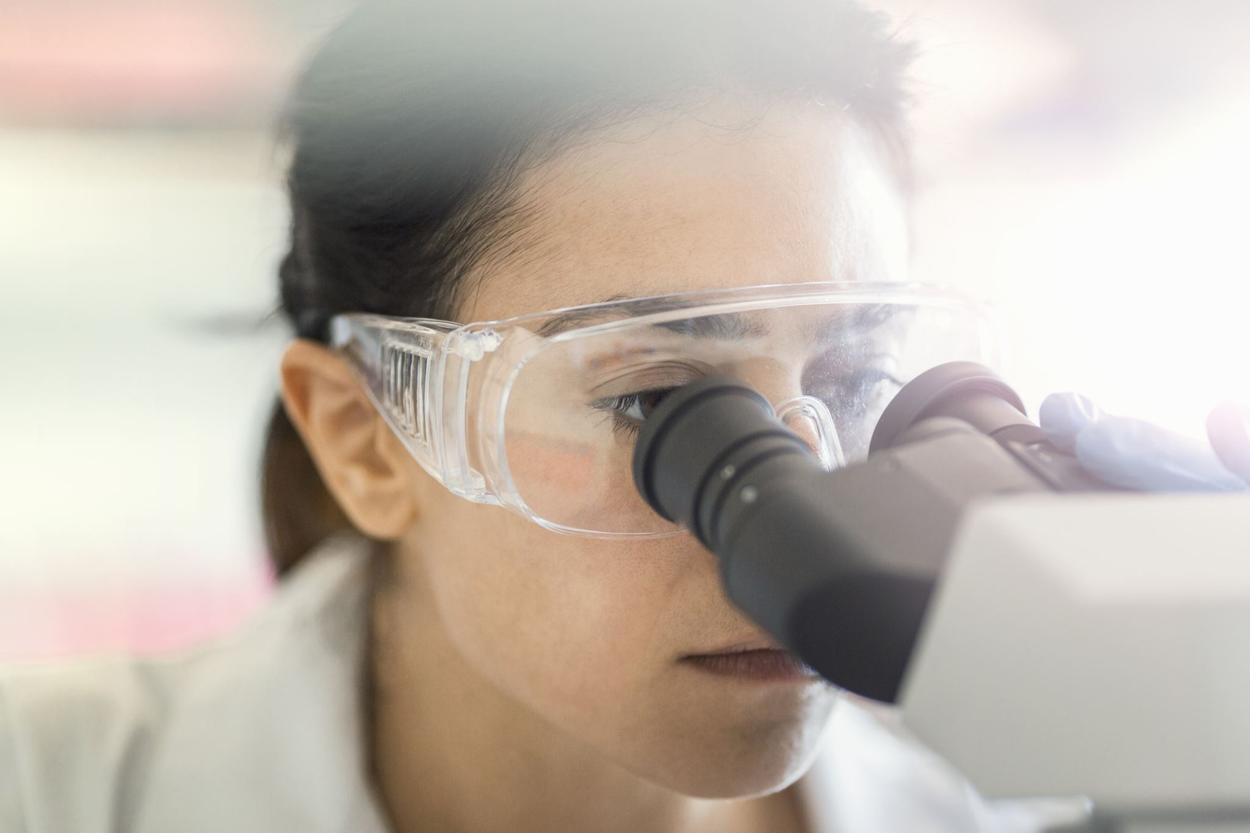
The weakest link
66
Nice try but no admissibility for New Zealand

Slide 67
Admissibility Rulings
Admissibility Rulings binder exhibit
Have there been admissibility challenges to TrueAllele reliability?
How many challenges?
In how many states?
How often has TrueAllele been admitted as reliable evidence?
What does this admissibility ruling binder contain?

Slide 68
Legal Commentary
Legal Commentary binder exhibit
Have legal scholars and practitioners written about TrueAllele?
What have they said?

Slide 69
Scientific Development
Scientific Development binder exhibit
When did Cybergenetics scientists first publish how to solve PCR stutter?
When did Cybergenetics first publish its mixture analysis methods?
Does Cybergenetics regularly publish articles about DNA mixture interpretation?

Slide 70
Other Papers
Other Papers binder exhibit
Is TrueAllele largely based on Bayesian probability modeling, Markov chain Monte Carlo computer methods, and the MATLAB programming language?
Are these three methods generally accepted as reliable in the scientific community?

Slide 71
Daniels trial court ruling (2018)
This Court finds that the TrueAllele DNA test results in this case meet the requirements of Frye. The scientific methodology used will assist the trier of fact. The methodology has been subjected to peer review and publication, there is a known rate of error and standards controlling the technique’s operation, the methodology is generally accepted in the scientific community and the scientific principle being challenged is not new or novel. All of the defense arguments in opposition to admission of the TrueAllele results are ripe for cross-examination.

Slide 72

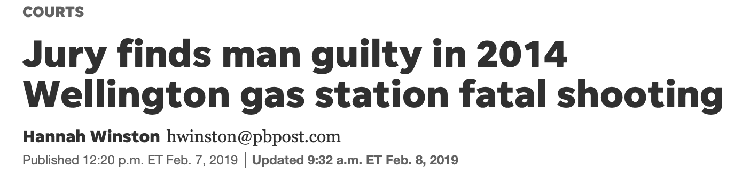
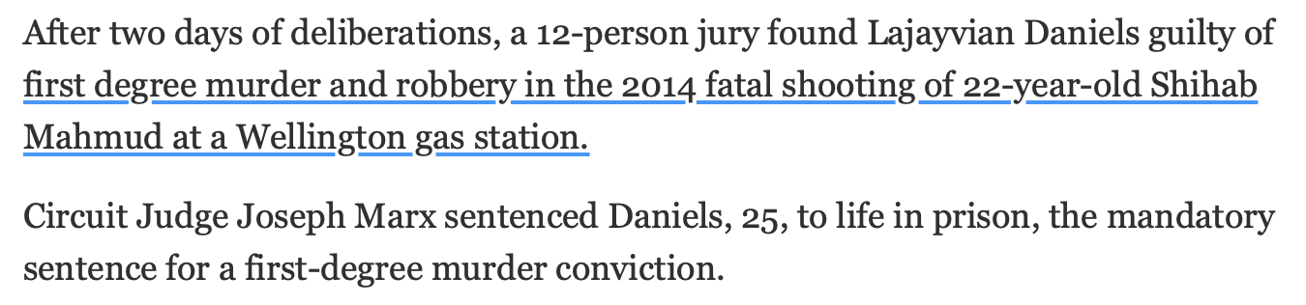

Slide 73
Appellate opinion (2021)
... we are satisfied that the trial court properly assessed and concluded that the DNA statistical interpretation performed by the TrueAllele software program was reliable after considering:
(1) the theory or technique has been tested;
(2) the theory or technique has been subjected to peer review and publication;
(3) the known or potential rate of error for the program; and
(4) the general acceptance of the program.
See Daubert, 509 U.S. at 593-94.

Slide 74
Appellate opinion (cont’d)
We are also satisfied that the trial court gave specific consideration to Appellant's argument regarding the lack of internal validation but concluded the argument and evidence did not merit excluding the TrueAllele evidence.
It is also particularly significant that the defense expert in this case was not sufficiently familiar with the TrueAllele software to effectively opine as to how the failure to internally validate the software using PBSO-generated test data compromised the reliability of the analysis of the DNA samples collected from clothing during the criminal investigation of this case.

Slide 75


More information
http://www.cybgen.com/information
• Courses
• Newsletters
• Newsroom
• Presentations
• Publications
• Webinars
http://www.youtube.com/user/TrueAllele
TrueAllele YouTube channel
perlin@cybgen.com

